Slide 1
Talking about what you and others prefer to do
Adverb lieber
Revisit [st-], [sp-], [sch]
Y8 German
Term 2.2- Week 3- Lesson 43
Author name(s): Inge Alferink/ Rachel Hawkes
Artwork: Steve Clarke
Date updated: 7 / 7 / 21
Notes:
Artwork by Steve Clarke. All additional pictures selected are available under a Creative Commons license, no attribution required.
Learning outcomes (lesson 1): Introduction of adverb lieber
Revisit [st], [sp], [sch]
Word frequency (1 is the most frequent word in German):
8.2.2.2 (introduce) was für [38/17] Art [260] Bild [253] Musik [509] Stimme [399] modern [747] traditionell [1555] besonders [270] lieber [459] statt [680] 8.2.1.5 (revisit) besser [201] billig [1738] gefährlich [1211] häufig [407] lang [97] mehr [52] sicher [265] teuer [950] noch3 [33] als² [22] 8.1.2.4 (revisit) erfahren [690] geblieben [113] geschwommen [1863] gestiegen [325] klettern [2601] küssen [2644] steigen [325] wandern [1803] Berg [934] die Erfahrung [619] Fahrt [1569] Luft [487] Wald [1028] frisch [1260] durch [55] ach [587] Source: Jones, R.L & Tschirner, E. (2019). A frequency dictionary of German: Core vocabulary for learners. London: Routledge.
The frequency rankings for words that occur in this PowerPoint which have been previously introduced in NCELP resources are given in the NCELP SOW and in the resources that first introduced and formally re-visited those words.
For any other words that occur incidentally in this PowerPoint, frequency rankings will be provided in the notes field wherever possible.

Slide 2
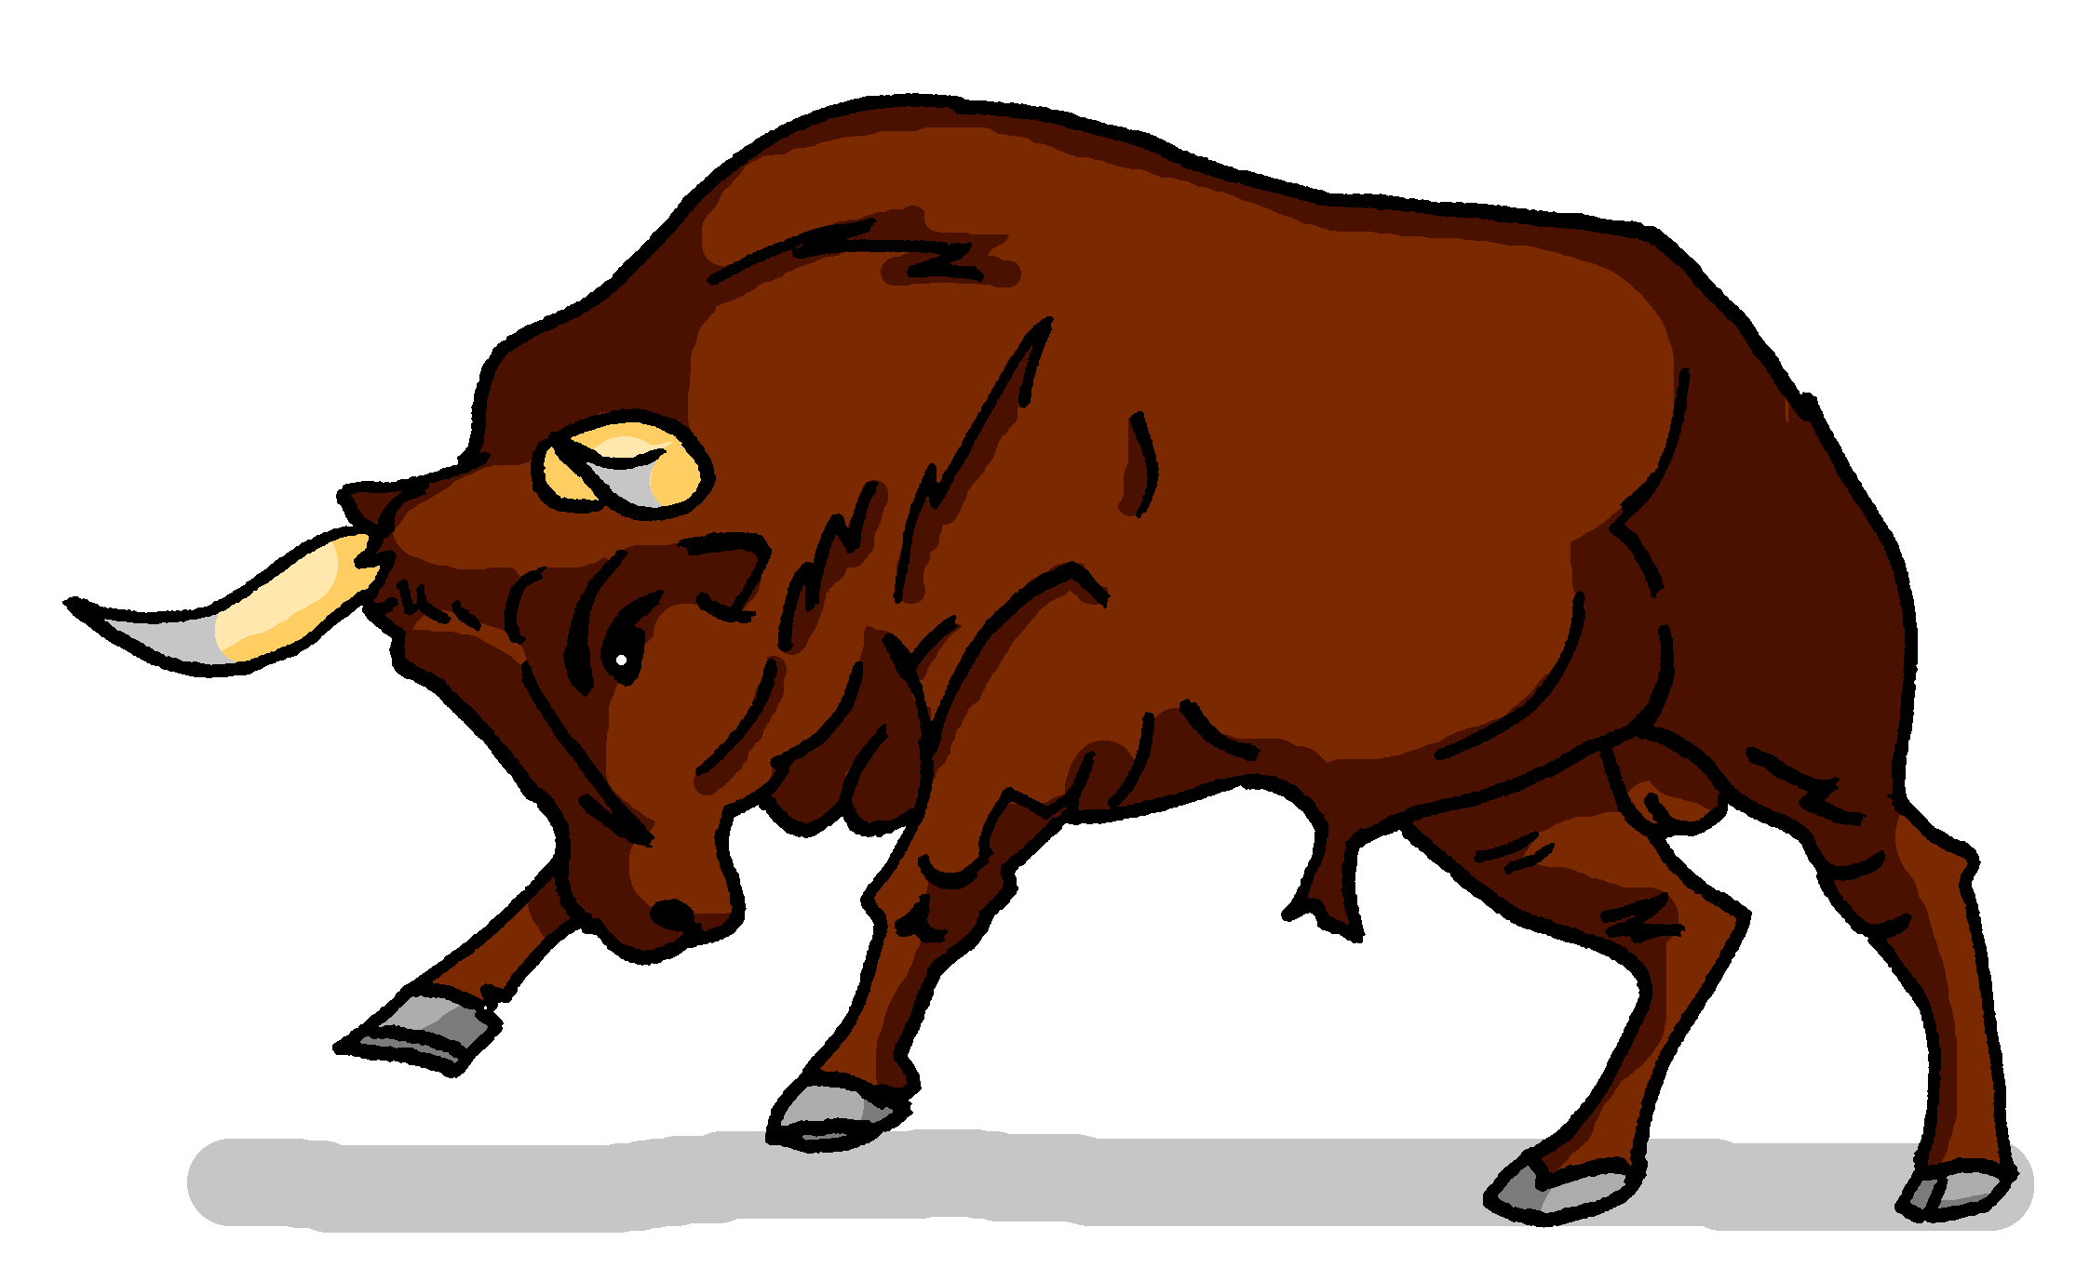
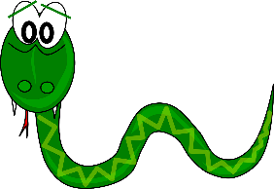
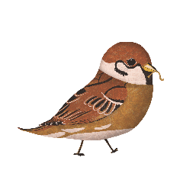
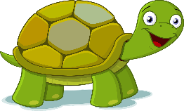
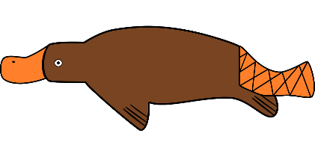
Phonetik
hören / schreiben
At the start of words, German [sp-] and [st-] are pronounced ‘schp-’ and ‘scht-’. [sch] is always pronounced ‘sh’.
Hör zu. Was fehlt? Schreib [sch], [sp-] oder [st-].
1 | 2 | 3
4 | 5 | 6
7 | 8 | 9
1
2
3
__
__
__
Schnecke
Stier
Schlange
4
5
6
__
__
__
Specht
Stinktier
Spatz
7
8
9
__
__
__
__
Schildkröte
Schnabeltier
Stachel sch wein
Notes:
Timing: 5 minutes Aim: To revisit and consolidate [sch], [sp], and [st]. Students listen out for and spell the SSCs Procedure: 1. Click the action buttons to play a word.
2. For each item write the sound that fills the gap.
3. Click to reveal and check answers.
Transcript: Schnecke, Stier, Schlange, Specht, Stinktier, Spatz , Schildkröte, Schnabeltier, Stachelschwein Word frequency (1 is the most frequent word in German): Schnecke [>5009] , Stier [>5009], Schlange [3601], Specht [4900], Stinktier [>5009], Spatz [>5009], Schildkröte [>5009], Schnabeltier [>5009], Stachelschwein [>5009]
Source: Jones, R.L. & Tschirner, E. (2019). A frequency dictionary of German: core vocabulary for learners. Routledge

Slide 3
Phonetik
When [sp] and [st] occur in the middle or end of a word, pronounce them as in English, except for compound nouns and separable verbs.
lesen / sprechen
savings bank
20
Sag diese deutschen Wörter.
stone
Sparkasse
snow
Stein
Schnee
cough
wasp
menu
Husten
Wespe
Speisekarte
Sekunden
stand up
crispy
capital
aufstehen
knusprig
Hauptstadt
fabric
cheque
funny
Stoff
0
Scheck
komisch
LOS!
Notes:
Timing: 2-3 minutes Aim: to practise pronouncing German unknown words, applying known SSC. Procedure: 1. Working individually, students have 20 seconds to pronounce all of the words.
2. Alternatively, they could work in pairs, conditions permitting.
3. Teacher to click to elicit the pronunciation of each word chorally from the class to check their SSC knowledge. Note: on successive clicks the German words are highlighted, to facilitate choral pronunciation of each. Then each English word is also highlighted to facilitate a further round of choral elicitation of the German words.
Word frequency (1 is the most frequent word in German):
Schnee [1760], Stein [1181], Sparkasse [>5009], Wespe [>5009], Speisekarte [>5009], Husten [>5009], knusprig [>5009], Hauptstadt [1694], aufstehen [966], Scheck [>5009], komisch [1875], Stoff [758]
Source: Jones, R.L. & Tschirner, E. (2019). A frequency dictionary of German: core vocabulary for learners. Routledge

Slide 4
Vokabeln
lesen / sprechen
 | Word | English meaning
1 | was für | what type of
2 | die Art | kind
3 | das Bild | picture
4 | die Musik | music
5 | die Stimme | voice
6 | modern | modern
7 | traditionell | traditional
8 | besonders | particularly
9 | lieber | rather
10 | statt | instead of
60
Sekunden
0
LOS!
Notes:
Vokabeln
Timing: 1-4 minutes Aim: To reactivate and strengthen vocabulary knowledge. Note: Students in Y8 pre-learn their vocabulary on Quizlet, additionally completing several tasks to build their knowledge. This task assists recall of the new vocabulary. Procedure: Round 1: Look at the German, recall the English meanings, saying them aloud. [1 minute] Round 2: Look at the English, recall the German meanings, saying them aloud. [1 minute] Repeat for two further minutes, to speed up recall. Word frequencies:
8.2.2.2 (introduce) was für [38/17] Art [260] Bild [253] Musik [509] Stimme [399] modern [747] traditionell [1555] besonders [270] lieber [459] statt [680]

Slide 5
eine Geschichte
hören / sprechen
Welcher Satz ist richtig?
 | I like walking through the woods because I need the fresh air. | I like walking on the mountain because I need the fresh air. | I like walking through the woods because I like the fresh air.
 | She frequently did long train rides because she loves them. | She often did long boat rides because she loves them. | She frequently did long boat rides because she loves them.
 | He likes to climb because it is more dangerous than hiking. | He likes to climb because it is more exciting than hiking. | He likes to climb because it is more dangerous than swimming.
 | The female pupils climbed the mountain because it was a good experience. | The male pupils climbed the mountain because it was a good experience. | The male pupils climbed the tree because it was a good experience.
 | The girl swam in the pool because the water was warmer. | The girl swam in the lake because the water was colder. | The girl swam in the lake because the water was warmer.
 | I stayed at school because I came too late for the bus. | I stayed at home because I came too late for the train. | I stayed at home because I came too late for the bus.
1
2
3
4
5
6
Notes:
Timing: 5 minutes Aim: To practise comprehension and production of most of this week’s revisited vocabulary in sentences. Procedure: 1. Encourage students to recall the vocabulary to predict what they will hear. In number one words that differentiate one sentence from another have been put in bold to facilitate task modelling.
2. Click the action buttons to play each sentence. Students pick which column (A, B or C) is correct.
3. Clicking reveals the answers. 4. Elicit the German for the other two answers each time, to practise productive recall of the vocabulary.
Transcript: 1. Ich wandere gern durch den Wald, weil ich die frische Luft brauche.
2. Sie hat häufig lange Bootsfahrten gemacht, weil sie sie liebt.Tho
3. Er klettert gern auf den Berg, denn das ist gefährlicher als Wandern.
4. Die Schüler sind auf den Berg gestiegen, denn das war eine gute Erfahrung.
5. Das Mädchen ist im See geschwommen, weil das Wasser wärmer war.
6. Ich bin zu Hause geblieben, denn ich bin zu spät für den Bus gekommen. Word frequency (1 is the most frequent word in German):
8.2.1.5 (revisit) gefährlich [1211] häufig [407] lang [97] teuer [950] als² [22] 8.1.2.4 (revisit) geblieben [113] geschwommen [1863] gestiegen [325] klettern [2601] wandern [1803] Berg [934] die Erfahrung [619] Fahrt [1569] Luft [487] Wald [1028] frisch [1260] durch [55]
Source: Jones, R.L. & Tschirner, E. (2006). A frequency dictionary of German: core vocabulary for learners. Routledge

Slide 6
Adverb lieber
Grammatik
Remember, the adverb of manner gern comes after a verb and before a noun:
Ich spiele gern.
Ich spiele gern Tennis.
The adverb lieber comes in exactly the same place:
Ich spiele gern Tennis, …
I like playing tennis, …
aber ich spiele lieber Golf.
…but I prefer playing golf.
Careful! The adverb lieber (rather) and the verb lieben (to love / loving) are two different words:
SUBJECT
VERB
NOUN
Ich
liebe
Tanzen.
I love dancing.
Tanzen starts with a capital letter here, because it is a noun.
SUBJECT
VERB
ADVERB
Mia
singt
lieber.
Mia prefers singing.
Notes:
Timing: 3 minutes Aim: To introduce the adverb lieber and to draw a parallel between the adverbs lieber and gern. Also highlight the difference between lieber (adverb) and lieben (verb).
Procedure: 1. Click on the mouse to animate the explanation.
2. Ensure student understanding at each stage.
Word frequency (1 is the most frequent word in German):
lieber [459] Source: Jones, R.L & Tschirner, E. (2019). A frequency dictionary of German: Core vocabulary for learners. London: Routledge.

Slide 7
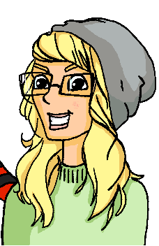
Was meinen sie?
lesen
Wolfgang und Heidi schreiben einander. –r oder --?
1
Wolfgang: Ich liebe Fußball spielen.
3
Wolfgang: Ich mache lieber Karate.
5
Wolfgang: Ja, das ist toll. Ich liebe Einkaufen.
_
_
_
2
Heidi: Ja? ich liebe Yoga machen.
4
Heidi: Ich besuche lieber Freunde.
6
Heidi: Na ja. Ich gehe lieber ins Kino.
_
_
_
Notes:
Timing: 3 minutes Aim: To practise using lieber / liebe in a sentence context in the written modality. Procedure: 1. Read Wolfgang and Heidi’s messages. What fits at the end of ‘liebe’? –r or --?
2. Click to reveal answers.
Word frequency (1 is the most frequent word in German):
lieber [459] Source: Jones, R.L & Tschirner, E. (2019). A frequency dictionary of German: Core vocabulary for learners. London: Routledge.

Slide 8
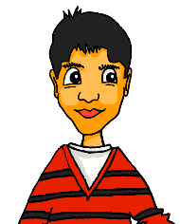
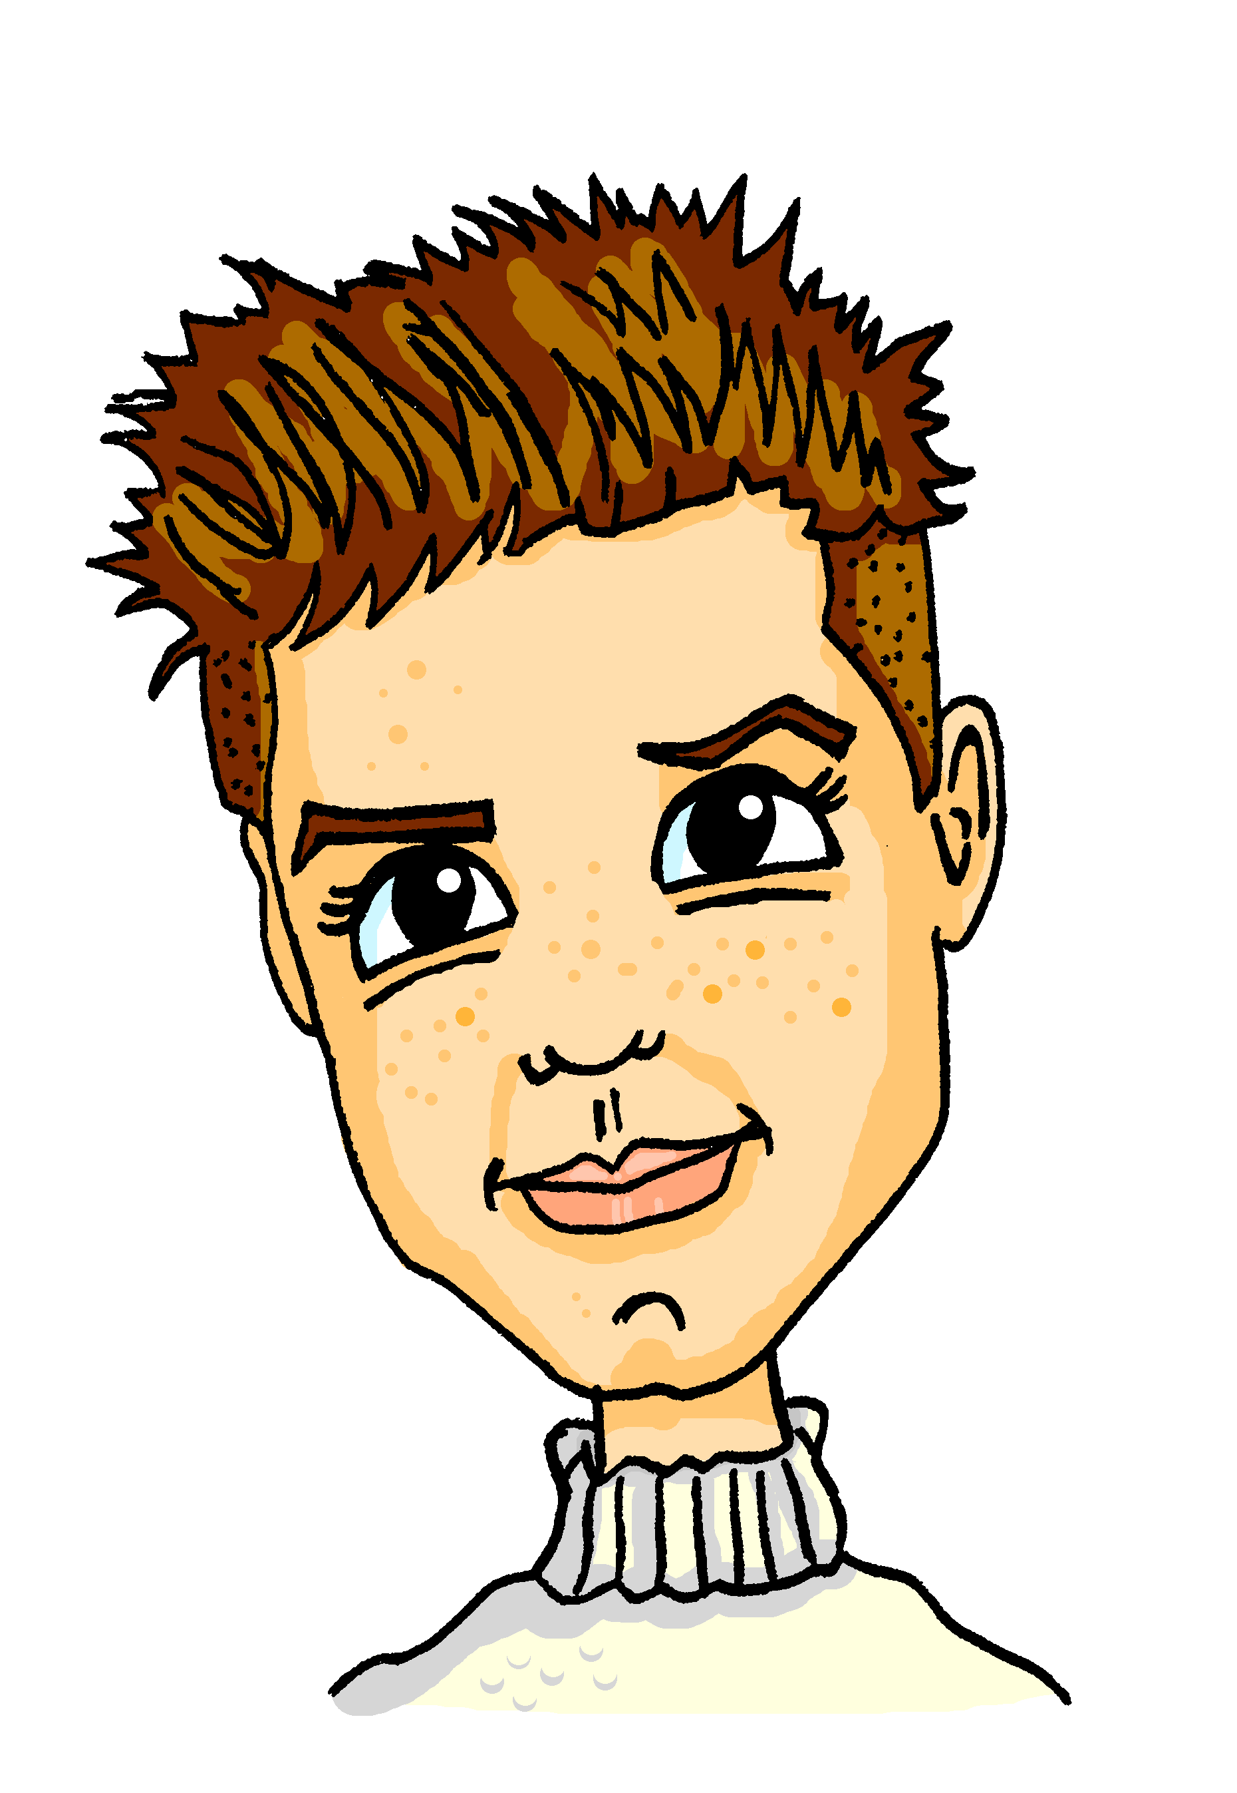
Meinungen
hören
Is s/he saying what s/he loves or what s/he prefers? Schreib 1-8 und ‘prefers’ oder ‘loves’.
1
3
 |  | prefers | loves
 | Ich liebe Tanzen.
 | Ich schwimme lieber.
 | Ich höre lieber Musik.
te | Ich liebe Lesen.
 | Ich liebe Laufen.
 | Ich sehe lieber Filme.
 | Ich liebe Radfahren.
 | Ich fahre lieber Skateboard.
2
1
2
3
4
4
5
5
6
8
7
6
7
8
Notes:
Timing: 5 minutes Aim: To practise using lieber / liebe in a sentence context in the oral modality. Procedure: 1. Click on an action button to hear as sentence.
2. Students check the prefers or loves column.
3. Click the mouse to reveal and check answers
Transcript: 1. Ich liebe Tanzen. (Wolfgang) 2. Ich schwimme lieber. (Mia) 3. Ich höre lieber Musik. (Mehmet) 4. Ich liebe Lesen. (Heidi) 5. Ich liebe Laufen. (Alistair) 6. Ich sehe lieber Filme. (Katja) 7. Ich liebe Radfahren. (Andrea) 8. Ich fahre lieber Skateboard. (Heidi) Word frequency (1 is the most frequent word in German): 8.2.2.2 (introduce) Musik [509] lieber [459]
Source: Jones, R.L. & Tschirner, E. (2019). A frequency dictionary of German: core vocabulary for learners. Routledge

Slide 9
Was meinen sie?
sprechen
Partner A
Partner B
Ich liebe…
…Uno spielen / …spiele Uno.
Ich liebe…
…Uno spielen.
Notes:
Timing: 5 minutes Aim: To practise liebe / lieber in a spoken sentence context. Procedure: 1. Students work in pairs.
2. Each writes down the list of sentence starters on the next slide.
3. In the first round, person A starts a sentence and person B finishes the sentence from their option (which are on the board)
4. Swap roles when all sentences have been completed.
Word frequency (1 is the most frequent word in German):
Musik [509] modern [747] lieber [459] teuer [950] klettern [2601] wandern [1803] Wald [1028] durch [55] Source: Jones, R.L & Tschirner, E. (2019). A frequency dictionary of German: Core vocabulary for learners. London: Routledge.

Slide 10
Was meinen sie?
*aufschreiben = to write down (separable verb)
sprechen
Schreib diese Satzbeginne auf*.
Partner A
Partner B
Ich fahre…
Ich liebe…
Du kochst…
Er spielt…
Wir lesen…
Sie liebt…
Sie geht…
Du liebst…
Wir kaufen…
Ich liebe…
Sie isst…
Sie lieben…

Slide 11
Was meinen sie?
sprechen
Runde 1
Partner B
1. …liebe Radfahren / …lieber Rad. 2. …höre Musik / …Musik hören.
3. … lieber Chinesisch / …liebst Chinesisch.
4. … liebt Basketball / lieber Basketball.
5. …lieber Bücher / … lieben Bücher.
6. … Wandern / … wandert.

Slide 12
Was meinen sie?
sprechen
Round 2
Partner A
1. …lieber ins Kino / …liebt ins Kino. 2. … Klettern / …kletterst.
3. …lieben Schokolade / lieber Schokolade.
4. …Musik spielen / … spiele Musik.
5. … liebt Nudeln / …lieber Nudeln.
6. … Einkaufen / … kaufen ein.

Slide 13
Bingo
schreiben
Kopier die Tabelle. Schreib einen Satz auf Deutsch in jedem Kästchen*.
She loves cooking.
I prefer listening to music.
He prefers climbing.
We prefer swimming.
They love cycling.
You love mountaineering.
She prefers shopping.
They prefer visiting friends.
I love hiking.
Sie liebt Kochen.
Ich höre lieber Musik.
Er klettert lieber.
Wir schwimmen lieber.
Sie lieben Radfahren.
Du liebst Bergsteigen.
Sie kauft lieber ein.
Sie besuchen lieber Freunde.
Ich liebe Wandern.
das Kästchen = box
Notes:
Timing: 8 -10 minutes Aim: written production of verb + lieber and lieben + noun using different persons of the verb in the present tense. Procedure: 1. Students draw a noughts and crosses grid.
2. In each box they write one of the German sentences 1-9. They can lay them out in any order (we are going to play noughts and crosses with them).
3. Teacher calls the sentences in any order, clicking to bring up the German sentence.
4. Student cross off (and correct, as necessary) sentences. They shout out Bingo when they have a line (horizontal, vertical or diagonal), and then play continues to full house.
Transcript: Answers appear in the following order, so it makes sense for the teacher to ‘call’ in this order: Sie lieben Radfahren. Wir schwimmen lieber. Sie liebt Kochen. Du liebst Bergsteigen. Sie besuchen lieber Freunde. Sie kauft lieber ein. Ich liebe Wandern. Er klettert lieber. Ich höre lieber Musik. Word frequency (1 is the most frequent word in German): Musik [509] lieber [459] klettern [2601] steigen [325] wandern [1803] Berg [934]
Source: Jones, R.L. & Tschirner, E. (2019). A frequency dictionary of German: core vocabulary for learners. Routledge

Slide 14
Talking about what you and others prefer to do
Two-verb clauses using statt
Revisit [st-], [sp-], [sch]
Y8 German
Term 2.2- Week 3- Lesson 44
Author name(s): Inge Alferink/ Rachel Hawkes
Artwork: Steve Clarke
Date updated: 7 / 7 / 21
Notes:
Artwork by Steve Clarke. All additional pictures selected are available under a Creative Commons license, no attribution required.
Learning outcomes (lesson 2): Consolidation of adverb lieber and use of other adverbs
2-verb clauses using statt Revisit [st], [sp], [sch]
Word frequency (1 is the most frequent word in German):
8.2.2.2 (introduce)] was für [38/17] Art [260] Bild [253] Musik [509] Stimme [399] modern [747] traditionell [1555] besonders [270] lieber [459] statt [680] 8.2.1.5 (revisit) besser [201] billig [1738] gefährlich [1211] häufig [407] lang [97] mehr [52] sicher [265] teuer [950] noch3 [33] als² [22] 8.1.2.4 (revisit) erfahren [690] geblieben [113] geschwommen [1863] gestiegen [325] klettern [2601] küssen [2644] steigen [325] wandern [1803] Berg [934] die Erfahrung [619] Fahrt [1569] Luft [487] Wald [1028] frisch [1260] durch [55] ach [587] Source: Jones, R.L & Tschirner, E. (2019). A frequency dictionary of German: Core vocabulary for learners. London: Routledge.
The frequency rankings for words that occur in this PowerPoint which have been previously introduced in NCELP resources are given in the NCELP SOW and in the resources that first introduced and formally re-visited those words.
For any other words that occur incidentally in this PowerPoint, frequency rankings will be provided in the notes field wherever possible.

Slide 15
Phonetik
lesen / hören
A
B
1. Er sieht viele Männchen.
1. Er sieht viele Menschen.
2. Ich habe das schon gemacht.
2. Ich habe das schön gemacht.
3. Sie hat die Kirsche fotografiert.
3. Sie hat die Kirche fotografiert.
4. Waschen ist schneller als Wachsen.
4. Wachsen ist schneller als Waschen.
5. Schälen oder schellen?
5. Schellen oder schälen?
6. Zeichnen ist besser als Zeigen.
6. Zeigen ist besser als Zeichnen.
das Männchen – little man die Kirsche – cherry
waschen – to wash wachsen – to grow
schälen – to peel schellen – to ring
zeichnen – to draw
Notes:
Timing: 5 minutes Aim: To practise this week’s SSCs in a sentence context. The format encourages attention to both pronunciation and listening. Procedure: 1. Students work in pairs.
2. Student says both versions of the sentence. 3. Their partner writes down in which order the sentences were said.
4. They take turns speaking and listening, so each student says three sentences. 5. Click each sentence to hear it pronounced.
Word frequency of unknown words (1 is the most frequent word in German):
Männchen [>5009] Kirsche [>5009] waschen [2315] wachsen [470] schälen [>5009] schellen [>5009] zeichnen [1259] Source: Jones, R.L & Tschirner, E. (2019). A frequency dictionary of German: Core vocabulary for learners. London: Routledge.

Slide 16
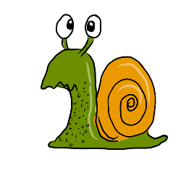
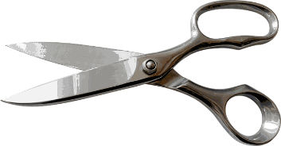
Phonetik
lesen / sprechen
20
Mein Spitzer spitzt Stifte spielend spitz.
1
My sharpener sharpens pencils effortlessly sharp.
Schnecken erschrecken, wenn sie an Schnecken schlecken.
2
Sekunden
Snails are startled, when they lick snails.
Schneiders Schere schneidet scharf –
scharf schneidet Schneiders Schere.
3
0
Schneider’s scissors cut sharply –
sharply (is how) Schneider’s scissors cut
LOS!
Notes:
Timing: 2 minutes Aim: To practise this week’s SSC in a sentences context. The time limit will help to speed up production of the words. Procedure: 1. Try to say the tongue twisters within the time available.
2. Click LOS! to start the timer.
3. Click the action buttons to hear the tongue twisters pronounced by a native speaker, first slowly, then at normal speed.

Slide 17
Vokabeln
schreiben
safe / secure
expensive
traditional
modern
more
long
better
rather
particularly
instead of
cheap
voice / vote
dangerous
picture
music
what type of
frequently
Notes:
Vokabeln Timing: 3 minutes
Aim: To practise recall of meaning of words in this week’s revisited sets in the written modality.
Procedure: 1. On click a word appears.
2. Write down the German translation before the word disappears.
Word frequency (1 is the most frequent word in German):
8.2.2.2 (introduce)] was für [38/17] Art [260] Bild [253] Musik [509] Stimme [399] modern [747] traditionell [1555] besonders [270] lieber [459] statt [680] 8.2.1.5 (revisit) besser [201] billig [1738] gefährlich [1211] häufig [407] lang [97] mehr [52] sicher [265] teuer [950]
Source: Jones, R.L & Tschirner, E. (2019). A frequency dictionary of German: Core vocabulary for learners. London: Routledge

Slide 18
Vokabeln
schreiben
sicher
teuer
safe / secure
traditionell
expensive
modern
traditional
mehr
modern
more
lang
besser
lieber
better
long
besonders
rather
billig
particularly
statt
die Stimme
cheap
gefährlich
instead of
voice / vote
dangerous
die Musik
was für
das Bild
häufig
music
picture
what type of
frequently
Notes:
Antworten
Click on an action button to make the German translation appear.

Slide 19
weil / denn + lieber
Grammatik
With WO3 (Word Order 3) the verb goes to the end of the clause.
With WO3 (Word Order 3) the verb goes at the end of the clause.
Remember, after weil use WO3:
Ich sehe keine Filme, weil ich lieber lese.
I don’t watch films because I prefer to read.
Ich gehe oft in die Bibliothek, weil ich Lesen liebe.
With WO1 (Word Order 1) the verb follows the subject, as in English.
I often go to the library because I love reading.
With WO3 (Word Order 3) the verb goes at the end of the clause.
After denn use WO1
Ich sehe keine Filme, denn ich lese lieber.
I don’t watch films because I prefer to read.
Ich gehe oft in die Bibliothek, denn ich liebe Lesen.
I often go to the library because I love reading.
Notes:
Timing: 2 minutes Aim: To revisit word order after denn and weil and illustrate use in combination with liebe / lieber. Procedure: 1. Click on the mouse to animate the explanation.
2. Ensure student understanding at each stage.
Word frequency (1 is the most frequent word in German):
lieber [459] Source: Jones, R.L & Tschirner, E. (2019). A frequency dictionary of German: Core vocabulary for learners. London: Routledge.

Slide 20
Virtueller Austausch*
der Austausch - exchange
lesen
Mias Klasse hilft Andreas Klasse online. Schreib 1-8 und ‘weil’ oder ‘denn’. Dann schreib die Gründe auf Englisch.
 | Reason
1
2
3
4
5
6
1) Ich fahre nicht oft Rad, ______ ich Laufen liebe! (weil/denn) DH
4) Ich esse nicht häufig Nudeln, ______ ich liebe Pizza! (weil/denn) MH
weil
denn
loves running
prefers visiting Berlin
2) Ich besuche nicht gern London, ____ ich lieber Berlin besuche. (weil/denn) JS
5) Ich spiele nicht gern Tennis, ____ ich lieber Volleyball spiele. (weil/denn) WH
weil
weil
prefers doing yoga
loves pizza
3) Ich mache nicht häufig Judo, _____ ich mache lieber Yoga. (weil/denn) SW
6) Ich fahre nicht oft Skateboard, _____ ich liebe Parkour. (weil/denn) H
prefers volleyball
denn
denn
loves Parkour
Notes:
Timing: 5 minutes Aim: To consolidate knowledge of lieber vs liebe, and in addition practise recognising the word order used in each sentence and inferring the use of weil or denn as appropriate. Procedure: 1. Write 1-6.
2. Students read sentences and write weil or denn for each as appropriate.
3. Click on the mouse to animate the correct answers. 4. Then students write the English reason. 5. Click to animate answers. Context: This is a padlet wall. Mia’s class is helping Andrea’s class with their German grammar by posting weil / denn sentences for them to practise. Initials are initials of Mia’s classmates.
Word frequency (1 is the most frequent word in German):
lieber [459] häufig [407]
Source: Jones, R.L & Tschirner, E. (2019). A frequency dictionary of German: Core vocabulary for learners. London: Routledge.

Slide 21
Mias Klasse hilft weiter…
hören
 |  |  | because she loves… | because she prefers | activity
 | …, weil ich lieber lese. | …, denn ich liebe Lesen.
 | …, weil ich klassische Musik liebe. | …, denn ich lieber klassische Musik höre.
 | …, weil ich lieber gewinne. | …, denn ich liebe Gewinnen.
 | …, weil ich lieber schwimme. | …, denn ich liebe Schwimmen.
 | …, weil ich Telefonieren liebe. | …, denn ich telefoniere lieber.
 | …, weil ich lieber Spanisch lerne. | …, denn ich liebe Spanisch.
1
reading
2
music
3
winning
4
swimming
5
phoning
6
Spanish
Notes:
Timing: 5 minutes Aim: To practise weil and denn constructions in combination with liebe / lieber. Procedure: 1. Click the action button to play the audio.
2. For each item students say whether Mia loves or prefers.
3. Students also write down the activity in English.
4. Click to reveal and check answers. 5. Click again to reveal the two possible answer options, then again to remove the incorrect option and leave the correct one.
6. Clicking the ticks plays the full sentence audio without beeps.
Transcript: 1. Ich sehe keine Filme, [weil] ich lieber lese. 2. Ich gehe oft ins Konzert, [weil] ich klassische Musik liebe.
3. Ich spiele häufig Spiele, [denn] ich liebe Gewinnen.
4. Ich laufe nicht, [weil] ich lieber schwimme.
5. Ich schreibe keine Emails, [denn] ich telefoniere lieber.
6. Ich lerne kein Türkisch, [denn] ich liebe Spanisch.
Word frequency (1 is the most frequent word in German):
Musik [509] häufig [407]
Source: Jones, R.L & Tschirner, E. (2019). A frequency dictionary of German: Core vocabulary for learners. London: Routledge.

Slide 22
Wer ist das?
sprechen
Markus
Person A stellt Fragen.
Fußball + | Sport (liebt)
Gitarre - | Klarinette (lieber)
Brüssel - | Spanien (lieber)
Englisch + | Sprachen (liebt)
Wandern - | klettern (lieber)
Lesen + | Bücher (liebt)
Person B antwortet (3,4 oder 5 Fragen)
Person A sagt den Namen.
You can use either denn (WO1) or weil (WO3) to give your reasons, but pay attention to the word order.
Beispiel
Person A spricht:
Wie oft spielt diese Person Fußball?
Person B ist Markus, und sagt:
Diese Person spielt sehr oft Fußball, denn er oder sie liebt Sport!
Nicht oft, weil er oder sie lieber Spanien besucht.
Wie oft besucht diese Person Brüssel?
Notes:
Timing: 4-5 minutes Aim: This is a productive speaking activity to practise using (understanding and producing) verb + lieber (prefers) or liebt (loves) Procedure: 1. Make sure students understand the task, using this example slide to model the activity. 2. Student B picks a character. Tell students that, at usual, there will be six characters on the board. Here, we just see one.
3. Student A asks ‘Wie oft xxx diese Person xxx.....?’ naming one of the things mentioned in the left-hand column for each character.
4. Student B answers sehr oft (marked with +) or nicht oft (marked with -)→ e.g. Diese Person spielt sehr oft (+) / nicht oft (-) Fußball, giving the reason corresponding to the thing mentioned by Student B in the right-hand column for their chosen character (using weil or denn, with correct word order). → e.g. denn er oder sie liebt Sport.
5. By spotting the reason given in the exact form specified, Student B attempts to guess the character chosen. It will take at least three questions before knowing the answer.
6. Partners swap roles.
2. Go on to the next slide.

Slide 23
Wer ist das?
?
sprechen
Stefanie
Dieter
Jörg
Fußball + | Sport (liebt)
Gitarre - | Klarinette (lieber)
Brüssel - | Spanien (lieber)
Englisch + | Sprachen (liebt)
Wandern - | klettern (lieber)
Lesen + | Bücher (liebt)
Wandern - | klettern (lieber)
Brüssel - | Spanien (lieber)
Englisch + | Sprachen (liebt)
Lesen - | Filme (lieber)
Gitarre - | Klarinette (lieber)
Fußball + | Sport (liebt)
Brüssel + | Belgien (liebt)
Gitarre - | Klarinette (lieber)
Lesen + | Bücher (liebt)
Wandern - | klettern(lieber)
Fußball + | Sport (liebt)
Englisch + | Sprachen (liebt)
Leah
Moritz
Sabine
Gitarre + | Musik (liebt)
Fußball + | Sport (liebt)
Lesen - | Filme (lieber)
Wandern + | frische Luft (liebt)
Englisch - | Deutsch (lieber)
Brüssel + | Belgien (liebt)
Englisch - | Deutsch (lieber)
Lesen - | Filme (lieber)
Brüssel - | Spanien (lieber)
Fußball - | laufen (lieber)
Wandern + | frische Luft (liebt)
Gitarre + | Musik (liebt)
Lesen - | Filme (lieber)
Wandern + | frische Luft (liebt)
Gitarre - | Klarinette (lieber)
Fußball - | laufen (lieber)
Brüssel + | Belgien (liebt)
Englisch - | Deutsch (lieber)
Notes:
Sprechen Timing: 8 minutes
Speaking activity: Wer ist das?
Aim: To practise lieben and lieber and giving answers with reasons using weil and denn. This is a variation on the ‘guess who’ game.
Procedure: 1. Student B picks a character.
2. Student A asks ‘Wie oft xxx diese Person xxx.....?’ naming one of the things mentioned in the left-hand column for each character.
3. Student B answers sehr oft (marked with +) or nicht oft (marked with -)→ e.g. Diese Person spielt sehr oft (+) / nicht oft (-) Fußball, giving the reason corresponding to the thing mentioned by Student B in the right-hand column for their chosen character (using weil or denn, with correct word order). → e.g. denn er oder sie liebt Sport.
4. By spotting the reason given in the exact form specified, Student B attempts to guess the character chosen. It will take at least three questions before knowing the answer.
5. Partners swap roles.
Note: The names include several SSC. Teachers may usefully ask students to pronounce their names before the activity starts: [St]efanie, D[ie]t[er], [J][ö]rg, L[e]ah, M[o][r]it[z], [S]ab[i]n[e] (pronounce the final ‘e’)
Word frequency (1 is the most frequent word in German):
Musik [509] lieber [459] klettern [2601] wandern [1803] Luft [487] frisch [1260] Source: Jones, R.L & Tschirner, E. (2019). A frequency dictionary of German: Core vocabulary for learners. London: Routledge.

Slide 24
Adverb statt
Note: you need a comma before the clause with zu.
Grammatik
The adverb statt means instead of.
You have seen this type of construction before:
Wir haben Lust, ins Kino zu gehen.
Use it in combination with zu and an infinitive:
Wir müssen heute Hausaufgaben machen, statt Fußball zu spielen.
We have to do homework today instead of playing football.
Compare:
Wir müssen heute Hausaufgaben machen und Fußball spielen.
We have to do homework and play football.
Notes:
Note: It would be perfectly possibly to omit the introduction of statt with ‘zu’ + infinitive clauses, and instead do further practice of lieber, e.g., by repeating the speaking task and then by completing slide 27 writing, without questions 5 & 6. There will be three further opportunities in Y8 to practise ‘zu’ + infinitive clauses.
Timing: 2 minutes Aim: To explain and illustrate the use of the adverb statt + zu + infinitive and draw comparisons with similar constructions already encountered. Procedure: 1. Click on the mouse to animate the explanation.
2. Ensure student understanding at each stage.
Word frequency (1 is the most frequent word in German):
statt [680] Source: Jones, R.L & Tschirner, E. (2019). A frequency dictionary of German: Core vocabulary for learners. London: Routledge.

Slide 25
In der Schule
*zuhören = to listen to (separable verb)
lesen
Katja und Mia schreiben einander. Statt oder und / oder?
?
1
Katja: Haben wir später eine Mathestunde, statt /oder das Kunstprojekt zu machen?
3
Katja: Ach so! Und dürfen wir das Projekt zusammen machen, statt / und das allein zu machen?
5
Katja: Ich kann nur an Essen denken! Soll ich Pizza essen , statt / oder Nudeln kaufen?
2
Mia: Wir haben eine Mathestunde und / , statt machen dann das Projekt.
4
Mia: Katja! Hast du geträumt oder /, statt Frau Schmitt zuzuhören*?
6
Mia: Oh, jetzt will ich auch Pizza kaufen und / , statt mein Butterbrot zu essen!
Notes:
Timing: 5 minutes Aim: To practise statt in a sentence context by attending to the absence or presence of zu in the written sentence. Procedure: 1. Read Mia’s and Katja’s messages.
2. Students say what fit in the gap, statt or oder / und.
3. Click to reveal and check answers. 4. Elicit English meanings orally.

Slide 26
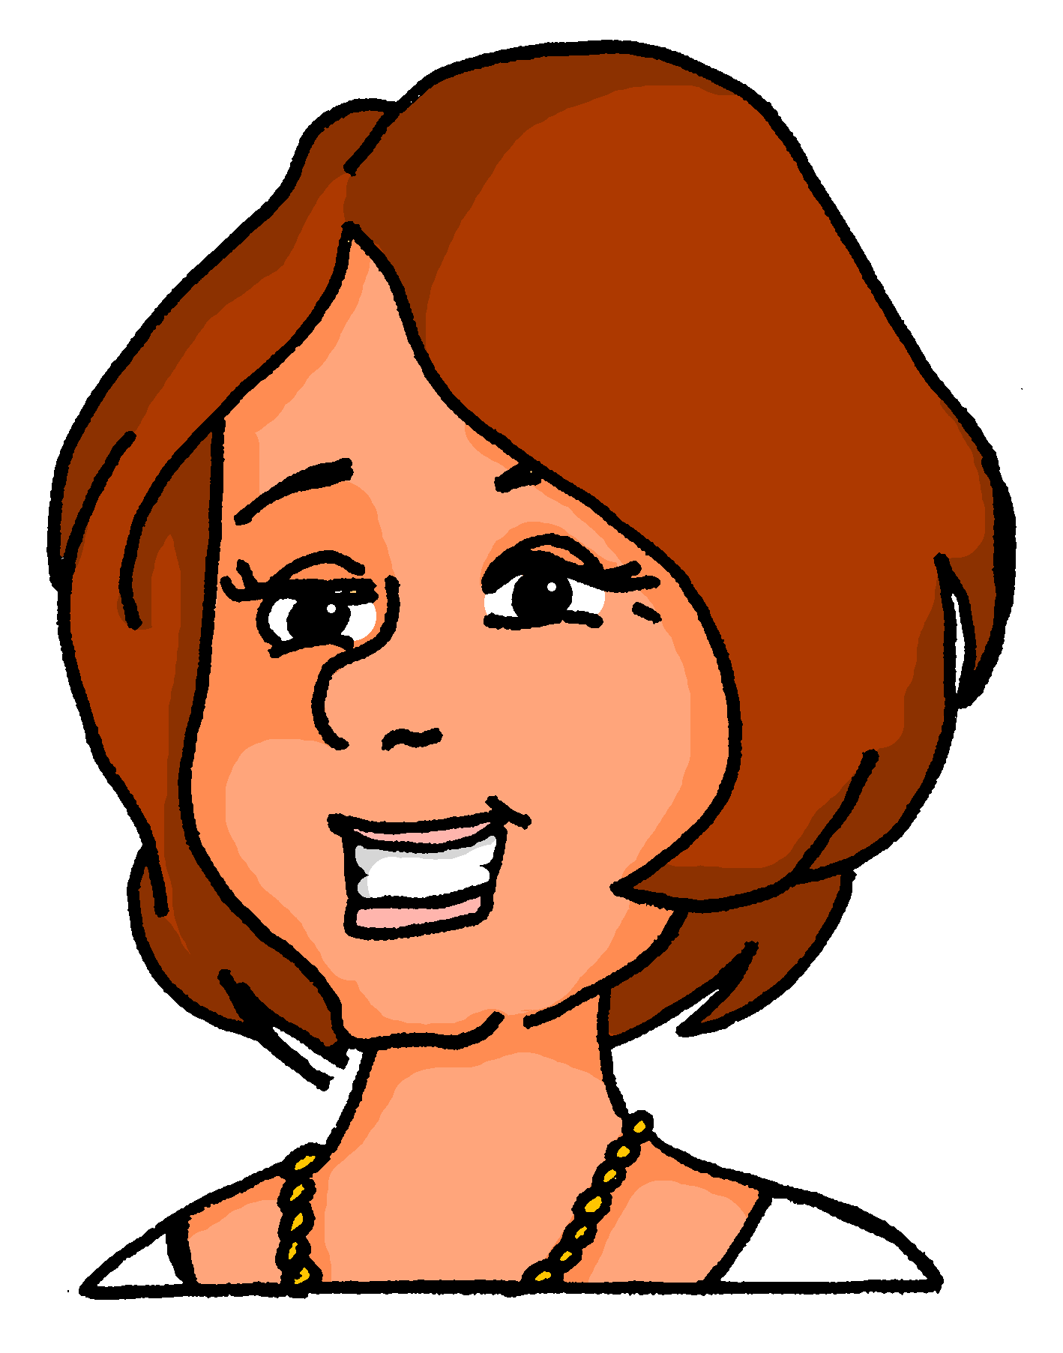
Zu Hause
hören
Statt oder und / oder? Schreib 1-6 und statt oder und/oder.
 |  | instead OR and/or
 | Wir müssen heute Abend Hausaufgaben machen und putzen. | und / statt
 | Wollen sie morgen Eis essen, statt Kaffee zu trinken? | statt / oder
 | Dürfen wir heute Videospiele spielen, statt ins Kino zu gehen? | statt / und
 | Aber, du musst morgen Abend babysitten, statt zur Party zu gehen. | oder / statt
 | Können wir am Sonntag Oma besuchen und ins Schwimmbad gehen? | statt / und
 | Wollen sie später Chinesisch kochen oder Pizza bestellen? | statt / oder
1
2
3
4
5
6
Notes:
Timing: 5 minutes Aim: To practise statt in a sentence context by attending to the absence or presence of zu in the spoken sentence. Procedure: 1. Click the action button to play the audio.
2. Students say what fit ins the gap, statt or oder / und.
3. Click to reveal and check answers. 4. Click the speech bubbles to hear the full sentence audio and elicit English meanings.
Transcript: 1. Mia: Wir müssen heute Abend Hausaufgaben machen [und] putzen.
2. Heidi: Wollen sie morgen Eis essen, [statt] Kaffee zu trinken?
3. Wolfgang: Dürfen wir heute Videospiele spielen, [statt] ins Kino zu gehen?
4. Mutti: Aber, du musst morgen Abend babysitten, [statt] zur Party zu gehen.
5. Katja: Können wir am Sonntag Oma besuchen [und] ins Schwimmbad gehen?
6. Frau Nowak: Wollen sie später Chinesisch kochen [oder] Pizza bestellen?
Word frequency (1 is the most frequent word in German):
statt [680] Source: Jones, R.L & Tschirner, E. (2019). A frequency dictionary of German: Core vocabulary for learners. London: Routledge.

Slide 27
Meinungen
schreiben
Schreib auf Deutsch.
1.
I like to visit Austria because I love mountains.
2.
She likes playing basketball but prefers playing hockey.
3.
Do you like reading books, or do you prefer watching films?
4.
We like to travel by car but prefer going by train.
5.
I prefer watching films at home instead of going to the cinema.
6.
I prefer drinking tea instead of drinking coffee.
Notes:
Timing: 5 minutes Aim: To practise the new grammar in a written sentence context. Procedure: 1. Translate the sentences into German.
2. Check answers on the next slide.
Word frequency (1 is the most frequent word in German):
lieber [459] statt [680] Berg [934] Source: Jones, R.L & Tschirner, E. (2019). A frequency dictionary of German: Core vocabulary for learners. London: Routledge.

Slide 28
Antworten
schreiben
1.
Ich besuche gern Österreich, weil ich Berge liebe.
2.
Sie spielt gern Basketball, aber sie spielt lieber Hockey.
3.
Liest du gern Bücher oder schaust du lieber Filme an?
4.
Wir reisen gern mit dem Auto, aber wir fahren lieber mit dem Zug.
5.
Ich schaue lieber Filme zu Hause an, statt ins Kino zu gehen.
6.
Ich trinke lieber Tee, statt Kaffee zu trinken.

Slide 29
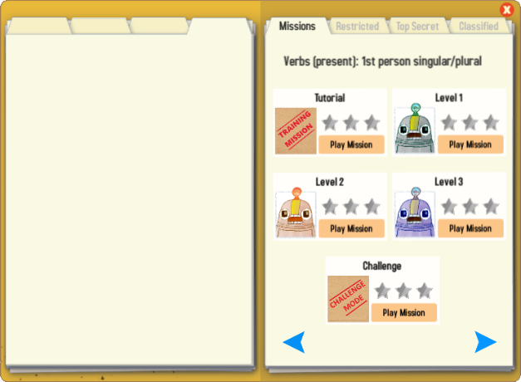
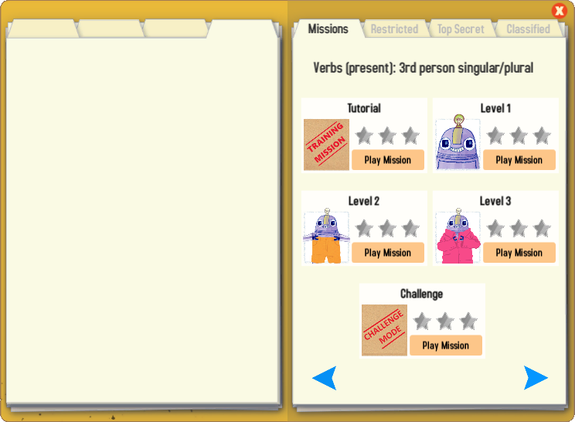
Gaming Grammar
Try the following Gaming Grammar missions to practise:
Notes:
Y8 T2.2 W3

Slide 30
Hausaufgaben
Pre-learning for lesson: Year 8 German Term 2.2 Week 4
Revisit 1: [Year 8 German Term 2.2 Week 1]
Revisit 2: [Year 8 German Term 1.2 Week 5]

Slide 31
Hausaufgaben
Vocabulary Learning Homework (Y8, Term 2.2, Week 4)
Audio file
Audio file QR code:
Student worksheet
Quizlet link
In addition, revisit: Year 8 Term 2.2 Week 1
Year 8 Term 1.2 Week 5
Notes:
Link to answers: https://resources.ncelp.org/concern/resources/b5644s280?locale=en

