Slide 1
An introduction to the key stage 4 scheme of work
Amanda Izquierdo
Louise Caruso
Notes:
Hello. This is the screencast for Key Stage 4.

Slide 2
This session…
Walk through of Key Stage 4 Spanish SoW document
Presentation of Key Stage 4 sample resources based on SoW
NCELP resource portal
Notes:
The session is going to be divided in three parts. First, I will talk about the excel file that contains the Spanish Scheme of Work and talk you through the different tabs and the information that these contain. Then, I’m going to showcase a selection of new styles of activity that we’ve introduced at Key Stage 4 and how these cater for different abilities and help to prepare students for the new GCSE exam. Finally, I will show you where you can find these resources on the NCELP resource portal and invite you to browse them at your leisure. If you’re interested in German or French then you can find similar presentations about those schemes of work on our portal.
Image: Steve Clarke / Katie Marsden

Slide 3
Tabs in the NCELP KS4 SOW
Y10 and Y11 Grammar Overviews
GCSE SOW
Phonics Tracker
GCSE Spanish Grammar tracker
GCSE list
KS3 Revisits
GCSE Revision Weeks
Notes:
The Excel file containing the Key Stage 4 Scheme of Work has a series of coloured tabs at the bottom. The first two yellow tabs are the Y10 and Y11 grammar week by week overviews of the new and revisited grammar points that provide the structure for that week’s teaching.

Slide 4
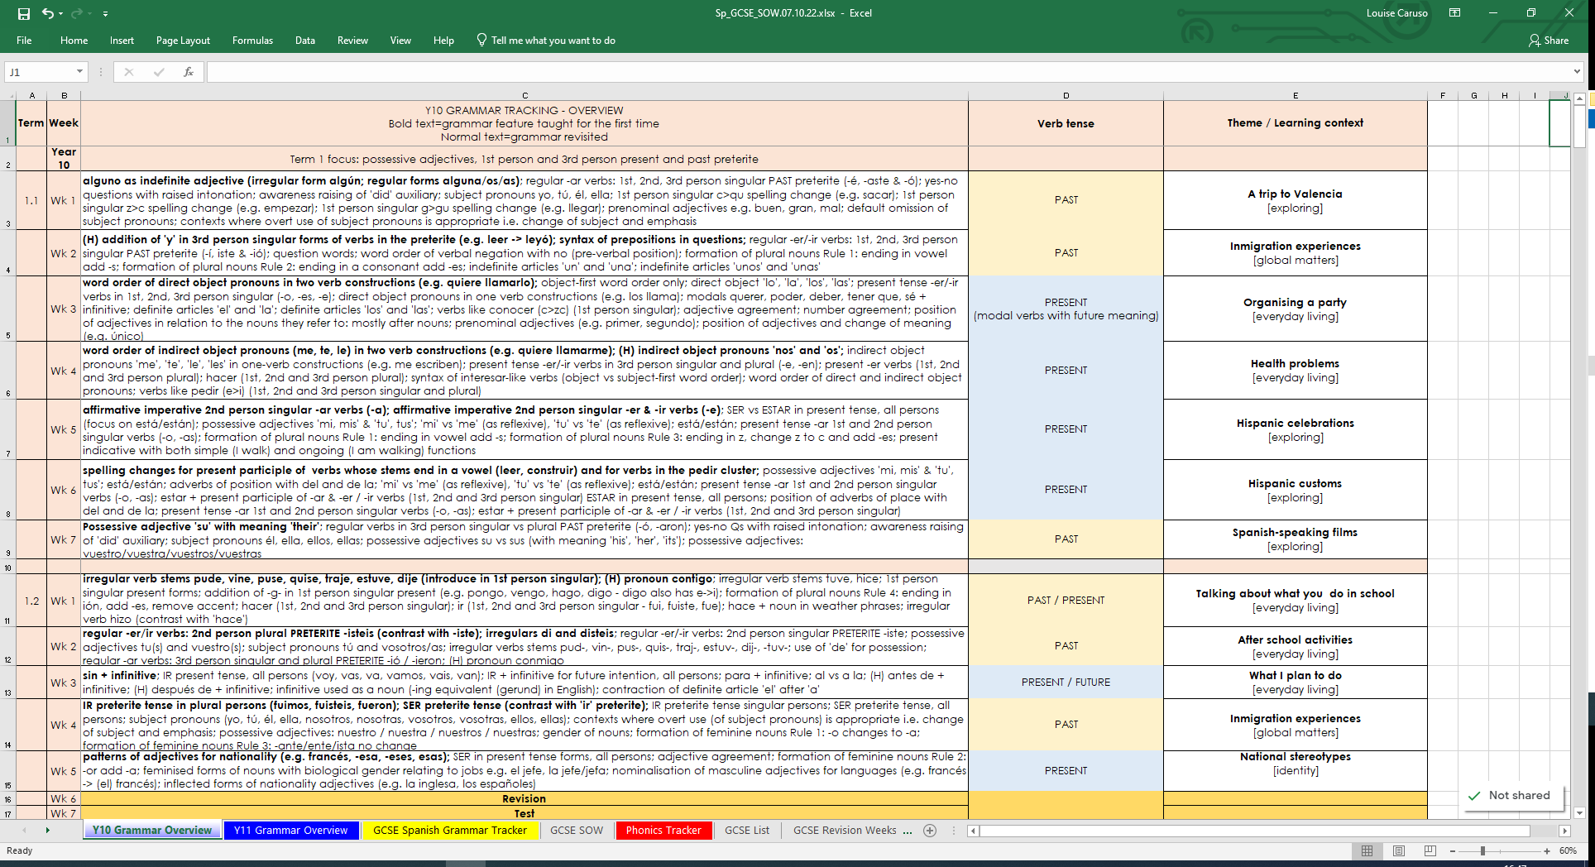
Y10 Grammar Overview
This column denotes the focus tense for that week.
This column gives the learning context.
New grammar features are in bold type.
It also gives a GCSE theme.
Higher only features are preceded by (H).
There are five themes in our SOW: Identity, Everyday living, My future, Exploring, Global matters.
There is continuity from KS3. All non-bold text shows previously-taught knowledge.
Revision and test weeks have been built into the SOW
Notes:
This is the Y10 Grammar Overview tab. [Click] There is continuity in the content from KS3. All non-bold text shows previously-taught knowledge.
[Click]
New grammar features are in bold type.
[Click]
Higher only features are preceded by H in brackets.
[Click]
This column denotes the focus tense for that week.
[Click]
This column gives the learning context.
[Click]
It also gives a GCSE theme.
[Click]
There are five themes in our SOW: Identity | Everyday living | My future | Exploring | Global matters.
[Click]
At the end of Term 1, there is a revision week followed by a test week. Revision and assessment weeks will aim to recap and assess knowledge of all the new grammar content, phonics and vocabulary covered since the start of the year or since the last assessment week. There are two further revision and assessment fortnights built into the scheme of work in Term 2.2 week 1 (just after the February half term) and Term 3.2 week 1 (just after May half term). Of course, teachers may wish to move these to align with school reporting deadlines or Y10 mock exams.
[Click]

Slide 5
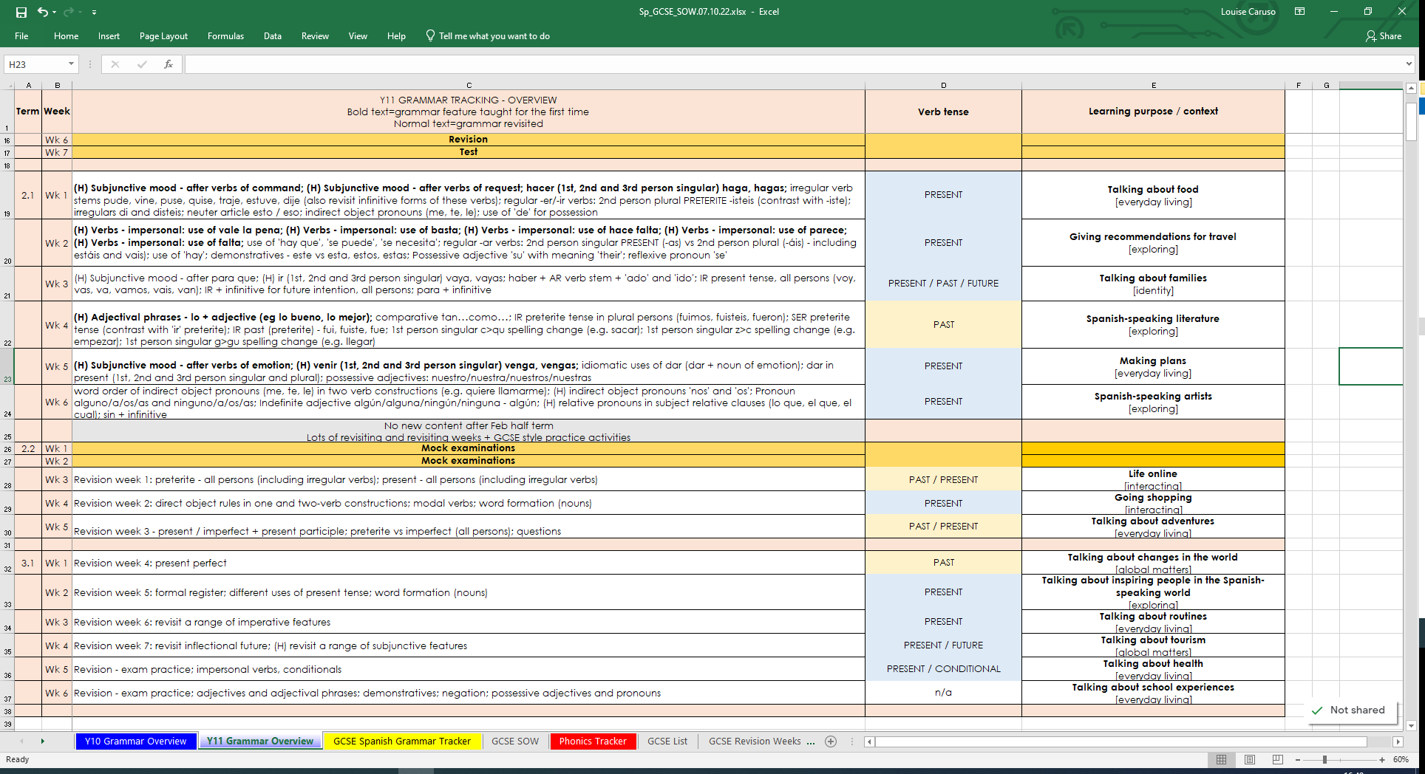
Y11 Grammar Overview
The Y11 week by week overview follows the same structure as the Y10 overview.
No new content is taught after February half term.
The GCSE content to be revised is divided up over the final 9 weeks, where the focus is exam practice.
Notes:
This is the Y11 Grammar Overview tab. [Click] The Y11 week by week overview follows the same structure as the Y10 one.
[Click]
No new content is taught after February half term.
[Click]
The GCSE content to be revised is divided up over the final 9 weeks, were the focus is exam practice.
[Click]

Slide 6
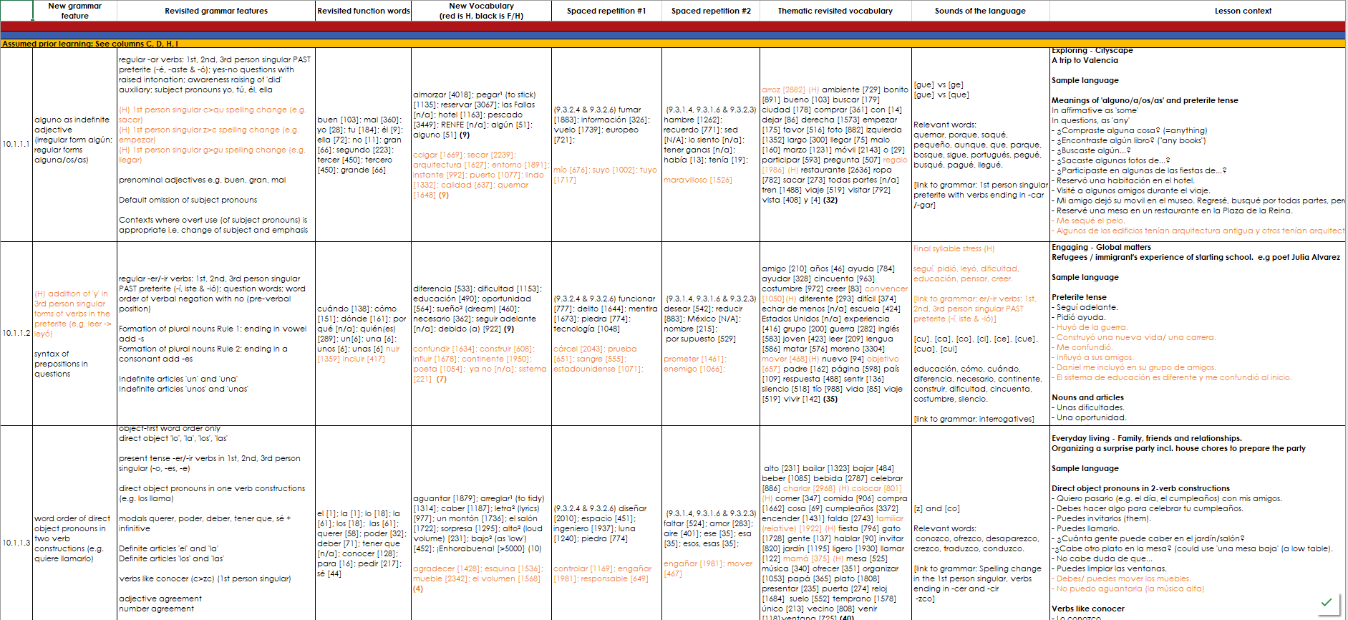
GCSE SOW
The new vocabulary column contains all new KS4 words.
1st and 2nd revisits of new KS4 words.
This column repeats the grammar information from the overview tab.
Superscript numbers for words with multiple meanings
Higher only vocabulary is in orange font.
Revisited thematic vocabulary from KS3.
This column lists all of the function words which were taught at KS3 and will be revisited at KS4.
Notes:
The GCSE SOW tab is, as you would expect, full and detailed. [Click]
This column repeats the grammar information from the overview. [Click] This column lists all of the function words (the words that are compulsory for all awarding bodies to include) which were taught at KS3 and will be revisited at KS4. They recur multiple times each and are listed every time, for transparency.
[Click]
The new vocabulary column contains all words that are new to KS4.
[Click]
Higher only vocabulary is in orange font.
[Click]
The next two columns show the spaced revisiting schedule for the new KS4 words, which are first revisited after three weeks, and revisited for a 2nd time after nine weeks. [Click]
The final vocabulary column sets out the words taught at KS3 that have been selected for revisiting in that particular week. All KS3 words are intentionally revisited three times each across KS4, twice as part of themed teaching weeks and again as part of the final nine-week revision schedule in the lead up to the exams. [Click]
Words followed by a superscript number show whether it is the first, second or even third definition of the word to be introduced.
[Click]

Slide 7
GCSE SOW continued…
Phonics, stress patterns and intonation
Weekly context
GCSE theme
Each row on the SOW represents one week of teaching, notionally 3 x 50 minute lessons.
Sample language – red denotes higher content
All lesson resources will be free and fully adaptable by teachers in their contexts.
Notes:
[Click]
Phonics are set out in the Sounds of the language column, which also includes other elements such as intonation, stress patterns in Spanish. This is largely revisiting sounds taught at Key Stage 3 as they appear in the grammar and vocabulary taught in that week. [Click x 2]
The Lesson context column repeats the final column on the Grammar Overview tabs with the weekly lesson context and the overarching GCSE theme it belongs to. We have also included examples of the language students might be expected to produce, bringing together the grammar, vocabulary, phonics and cultural context.
[Click]
Each row on the SOW represents one week of teaching, notionally 3 x 50 minute lessons.
[Click]
All lesson resources will be free and fully adaptable by teachers for us in their contexts.
[Click]

Slide 8
GCSE list
As the list is in excel it can be easy sorted by or filtered for:
part of speech,
F/H tier,
R (required), O (optional), C (culture), MWP (multiword phrase).
Colour shading denotes year of first teaching: pink = Y7
blue = Y8
green = Y9
Notes:
The GCSE List tab is a full word list for GCSE, and the word list that Eduqas will be using for its new suite of GCSE exams.
[Click]
As the list is in excel it can be easy sorted or filtered, making it easy to customise the display to show
[Click]
the different parts of speech,
[Click]
all the F or H words,
[Click]
all the ‘R’ (required words – these are the words that are 100% common to all awarding bodies),
the O (optional words) – these are the remaining words up to a total of 1200 F / 1700 H words, of which at least 85% items come from a list of the most common 2000 words, and up to 15% may be of any frequency.
You can also see the ‘C’ (20 cultural terms) and ‘MWP’ (30 Multiword phrases) that make up the final totals of 1250 and 1750.
[Click]
Pink words are higher only. Items shaded in blue, are an additional meaning of present tense verbs for higher students, which is taught with the phrase ‘desde hace’.
[Click]
These two columns give the year and the week when words were/are taught,
[Click]
and you can see that 2nd and 3rd meanings of words are taught and tracked separately.
Words shaded in orange are taught / revisited as part of the grammar feature for that week, not as a separate vocabulary item.
[Click]
The final two columns show where words from key stage 3 are to be revisited in key stage 4. Each word will be revisited at least twice.
[Click]

Slide 9
GCSE list
Note that words that are not in the top 5000 words, or multi-word phrases, do not have frequency value
Notes:
[Click]
Note that words that are not in the top 5000 words, this included the names of countries, or multi-word phrases, do not have frequency value. You will see that some words have been selected for their relevance to students rather than their frequency value, e.g. ‘bolígrafo’ / pen and ‘estresado’ / stressed.
[Click]

Slide 10
Phonics tracker
Here we have recorded when each SSC / stress pattern will be revisited and which grammar features it is relevant to in those weeks.
Notes:
Next is the phonics tracker.
[Click]
Here we have recorded when each SSC / stress pattern will be revisited and which grammar features it is relevant to in those weeks.
[Click]

Slide 11
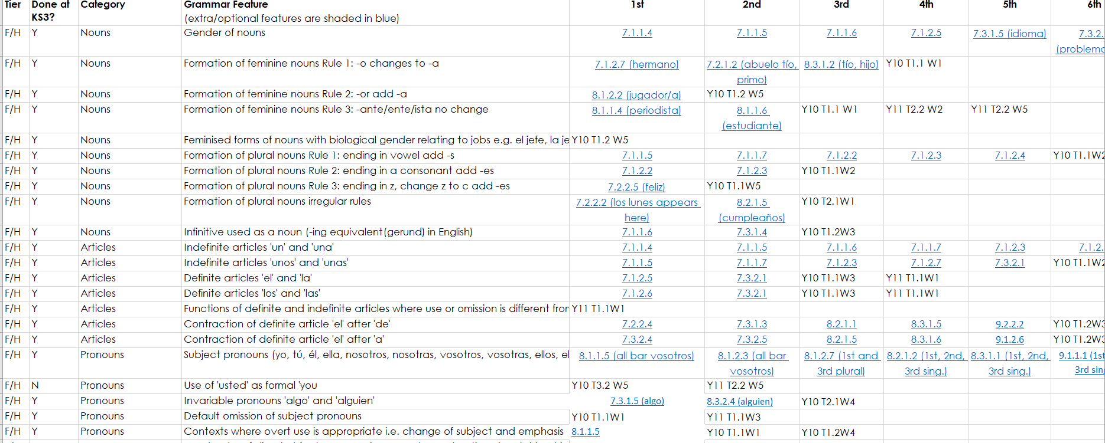
Grammar tracker
Details of when the grammar was introduced / revisited.
Hyperlinks to previous resources.
List of features included in the GCSE subject content.
Tier
Notes:
[Click]
The grammar tracker tab lists all of the grammar features included in the GCSE subject content, it details whether they are required knowledge for all students or higher only.
[Click]
and details when they are introduced and revisited.
[Click]
The document also contains hyperlinks to resources which taught and revisited the grammar, so the teacher can see to what depth the feature was covered and the context in which it was practised.
[Click]

Slide 12
GCSE revision weeks
The final tab on the spreadsheet shows which words are to be covered in each of the 9 revision weeks.
Notes:
[Click]
The GCSE revision weeks tab shows which words are to be covered in each of the 9 revision weeks.

Slide 13
Resources
Clicking on the hyperlink takes you directly to the resource on our resource portal.
Notes:
The final tab on the spreadsheet contains links to the lesson resource for each week and accompanying homeworks and answer sheets, Quizlet sets and Gaming Grammar activities.
[Click]
Clicking on the hyperlink takes you directly to the resource on our resource portal.
[Click]

Slide 14
This session…
Walk through of Key Stage 4 Spanish SoW document
Presentation of Key Stage 4 sample resources based on SoW
NCELP resource portal
Notes:
Having completed the walkthrough of the KS4 Scheme of Work document, I’m going to move on now to showcase some of the activities that you’ll find in the KS4 resources. I’ve chosen activities that really showcase the progress students have made since KS3 in the three strands of Phonics, Vocabulary and Grammar.
Image: Steve Clarke / Katie Marsden

Slide 15
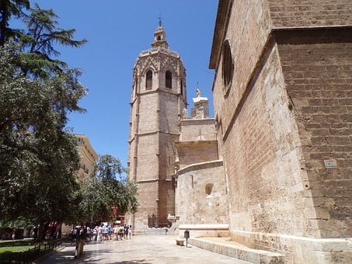
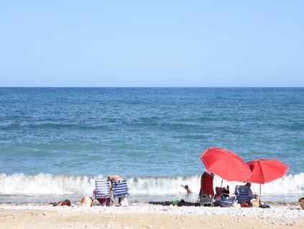
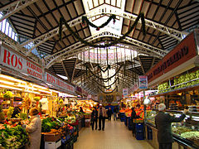
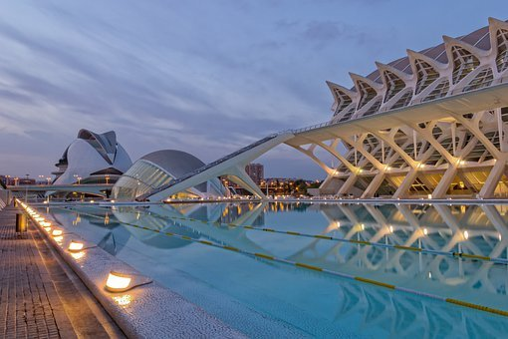
Recibiste una postal* de tu amigo. Lee la postal.
vocabulario
¡Hola!
Llegué a Valencia el lunes. Generalmente hace calor. Mi apartamento es genial. Tiene una vista bonita de la catedral y la torre Miguelete (la primera imagen). Ayer visité el museo de las ciencias (la última imagen) y luego jugué a fútbol en la playa Las Arenas. Había mucha gente. Probé la paella valenciana. Por la mañana fui a recoger naranjas con Jorge. Depués le pagué una horchata* en el Mercado Central.
¡Hasta pronto!
Valencia
*la postal = postcard
*la horchata = typical Valencian drink made with tiger nuts.
Notes:
First we have a phonics activity, where the sounds are practised as part of a longer text, in the context of the lesson. Students take it in turns to read a sentence from the text, taking care with their pronunciation, particularly of the words in bold. Students will need ample opportunity to practise reading aloud texts over the GCSE course. This year, phonics activities will focus on sounds that are relevant to the grammar / vocabulary taught in that week. This week’s grammar features are verbs ending in –car, -gar, and -car and algún / alguno. As students know already been taught the SSCs and stress patterns in Key Stage 3, phonics activities may practise a range of sounds, rather than one or two. At the end of the activity the teacher asks students to share anything they have learnt about Valencia from reading the text.
Photo by Nacho Pinotos from Barcelona, available at: https://commons.wikimedia.org/wiki/File:Horchata_(8508343768).jpg. License: Creative Commons Attribution 2.0 Generic

Slide 16
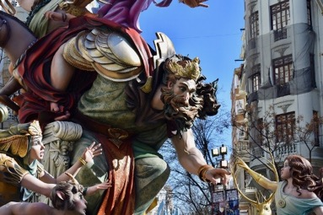
Las Fallas
*cartón = cardboard
vocabulario
Lee este artículo de una revista española y escribe las palabras correctas en cada espacio.
RENFE marzo
Fallas
pescado
algunas
almorzar
reservar
hoteles
La fiesta de las 1) [name] tiene lugar en Valencia cada año en 2) [March]. Las Fallas son figuras de cartón*. Pueden ser grandes o pequeñas y 3) [some] son bonitas y otras feas y representan a personas famosas de todo el mundo. Los ciudadanos las ponen en las calles […]. Hay premios para las mejores fallas de distintas categorías, por su diseño […] y su originalidad. El último día […] hay una gran fiesta a medianoche […]. También hay fuegos artificiales, y el cielo está lleno de luz y color […].
Para más información sobre cómo llegar, para 4) [book] 5) [hotels] y saber dónde 6) [to have for lunch] la mejor paella y el 7) [fish] fresco […] puedes vistar el sitio: www.visitvalencia.com
Para los billetes de tren, puedes visitar el sitio de 8) [name] : https://www.renfe.com/es/es
Fallas
marzo
algunas
f.
e.
Extension:
Suggest where these phrases could appear in the text.
… en restaurantes cerca del Puerto…
… y queman las fallas…
… en un instante…
… es muy lindo porque…
… su calidad…
… con la arquitectura valenciana en su entorno.
d.
b.
c.
reservar
hoteles
almorzar
pescado
a.
RENFE
Notes:
Following homework to pre-learn this week’s new vocabulary, this consolidation activity requires students read through the text and write the most appropriate word to fit in each gap. This activity has been differentiated to support mixed ability classes. The first click brings up a list of suitable words to fill the gaps to support students in step 1. The first task does not require knowledge of higher vocabulary. The second task asks students to suggest where a phrase could appear the text. Although this task focuses specifically on higher vocabulary, at this early stage, teachers may not have decided which tier students will be entered for, and so it is labelled simply as an ‘extension’ activity, available for all students to have a go at.

Slide 17
Talking about the past - Verb ending in ‘-car’, ‘-gar’ or ‘-zar’
gramática
Higher
Remember that the spelling of –ar verbs changes in the past.
This is due to their pronunciation!
For –ar verbs ending in ‘-car’, we remove –car and add –qué.
Ejemplos:
sacar
saqué
buscar
busqué
(to take out)
(I took out)
(to look for)
(I looked for)
For –ar verbs ending in ‘-gar’, we remove –gar and add –gué.
Ejemplos:
llegar
llegué
pegar
pegué
(to arrive)
(I arrived)
(to stick)
(I stuck)
For –ar verbs ending in ‘-zar’, we remove –gar and add –cé.
Ejemplos:
empezar
empecé
almorzar
almorcé
(to begin)
(I began)
(to have lunch)
(I had lunch)
Notes:
Grammar features, including higher only grammar, are introduced and revisited in the same way as in KS3 with a brief explanation followed by practice. Higher grammar are clearly labelled, so teachers can decided when planning the lesson, if they wish to include the slide as part of the presentation for the whole class.

Slide 18
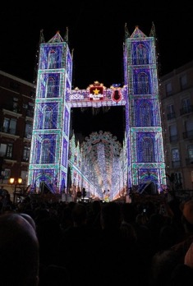
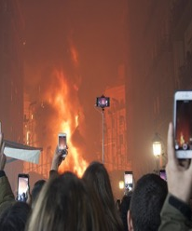
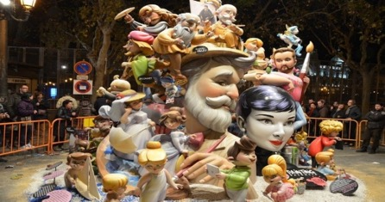
Un viaje para ver las Fallas (2)
leer/escuchar
*comprueba = check
Lee el texto y escribe ‘algunos’ o ‘algunas’ en los espacios.
Luego, escucha y comprueba* las respuestas. ¿Qué palabras tienen SSC [gu], [que] o [gué]?
¿La última vez que viajé en tren? Cuando visité Valencia en marzo. [Organizar] el viaje con mi hermano y 1) _________amigos. Yo [buscar] información sobre 2) _________ actividades interesantes y él reservó 3) _________ entradas. También intentó encontrar 4) _________ restaurantes buenos donde comer una paella tradicional. ¡El origen de este plato popular está en Valencia!
Higher:
Escribe la forma correcta del verbo para ‘yo’.
Organicé
algunos
busqué
algunas
algunas
algunos
Allí participé en Las Fallas y disfruté el ambiente de la ciudad. ¡En 5) _________ calles había tanta gente! Y en 6) _________ zonas había música muy fuerte y muchos fuegos artificiales*. Por la tarde llamé a mi madre ¡pero [colgar]* rápido por el ruido!
Además, encontré 7) _________ tiendas baratas. Compré
8) _________ recuerdos bonitos ¡y solo [pagar] veinte euros!
algunas
algunas
colgué*
*Colgar is used to say ‘hang up’.
algunas
algunos
pagué
*los fuegos artificiales = fireworks
Notes:
In this task, students work on the same task and fill in the correct form of ‘alguno’ in the gaps. There is a higher only task which requires students to write the first person singular form of the verbs in brackets, practising the higher grammar explained on the previous slide. There are follow up questions to check the understanding of the vocabulary and to discuss what students have understood about Las Fallas.

Slide 19
Un viaje a Valencia
escribir
Escribe las frases en español.
1. I visited the city of Valencia in March.
2. My mother reserved RENFE tickets.
3. My father found a hotel with a good restaurant.
4. It had some very pretty views
5. Did you look at some of my photos on Facebook?
6. Did you try any well-known dish from Valencia?
7. He ate for lunch the fish, but I tried the traditional paella.
Visité la ciudad de Valencia en marzo.
Mi madre reservó billetes de RENFE.
What happens to a prenominal adjective before a masculine noun?
Mi padre encontró un hotel con un buen restaurante
Tenía algunas vistas muy bonitas.
Remember, there’s no word for ‘did’ in Spanish.
¿Miraste algunas de mis fotos en Facebook?
¿Probaste algún plato conocido de Valencia?
Subject pronouns would be useful here!
Él almorzó el pescado, pero yo probé la paella tradicional.
Notes:
This is a translation task which deliberately targets words and grammar from this week, whilst including other previously taught language, which is not credited in the markscheme. Students should attempt full sentences, but they should also be clear which words are targeted. Each underlined section is worth 2 points, giving a total of 20 for the task. Markscheme: 2 points – message communicated accurately 1 point – message communicated 0 – message not communicated Note that item 3 repeats the same target structure as item 2. This is a 2nd chance for students to get the 2 points for this structure. If they get it right in both items, they still receive two points (i.e., they do not score 22/20).
Teachers may consider it useful to include summary tasks like this (either weekly or fortnightly), recording the scores and sharing them with students and parents (e.g., on the schools online data system). The tasks provide a very useful regular snapshot of student effort and progress over time.
Image attribution: Paul Lannuier from Sussex, NJ, USA, CC BY-SA 2.0 via Wikimedia Commons

Slide 20
Un viaje a Valencia
escribir
Escribe las frases en español.
1. I visited the city of Valencia in March.
2. I paid for the RENFE tickets.
3. My father found a hotel near the port with a good restaurant.
4. It had some lovely views of the architecture, so I took lots of photos.
5. Did you look at the photos that my mother hung on the wall? They are all mine!
6. Did you try any well-known dish from Valencia?
7. I ate for lunch the fish, but he tried the paella valenciana.
Visité la ciudad de Valencia en marzo.
What happens to a prenominal adjective before a masculine noun?
*Watch out for the spelling change*.
Pagué los billetes de RENFE.
Mi madre reservó un hotel cerca del puerto con un buen restaurante
*Watch out for the spelling change*.
Tenía algunas vistas lindas de la arquitectura, así que saqué muchas fotos.
¿Miraste las fotos que mi madre colgó en la pared? ¡son todas mías!
Remember, there’s no word for ‘did’ in Spanish.
*Watch out for the spelling change*.
¿Probaste algún plato conocido de Valencia?
Subject pronouns would be useful here!
Yo almorcé el pescado, pero él probó la paella valenciana.
Notes:
Note: this is a Higher version of the task. The animated callouts are presented as static tip boxes on the handouts.
Timing: 10-12 minutes Aim: to practise written production of language and structures from this week and prior learning. Procedure: 1. Students translate the seven sentences from English into Spanish. 2. Students can peer mark this task (at the start of next lesson, perhaps). Note: this task deliberately targets words and grammar from this week, whilst including other previously taught language, which is not credited in the markscheme. Students should attempt full sentences, but they should also be clear which words are targeted. Each underlined section is worth 2 points, giving a total of 20 for the task. Markscheme: 2 points – message communicated accurately 1 point – message communicated 0 – message not communicated Note that item 5 repeats the same target structure as item 3. This is a 2nd chance for students to get the 2 points for this structure. If they get it right in both items, they still receive two points (i.e., they do not score 22/20).
Similarly 5 and 6 repeat the same target structure.
Teachers may consider it useful to include summary tasks like this (either weekly or fortnightly), recording the scores and sharing them with students and parents (e.g., on the schools online data system). The tasks provide a very useful regular snapshot of student effort and progress over time. In our department, we have teacher-marked every 1/3 of these tasks, with peer marking for the rest. We have generally considered that 14+/20 is a benchmark for good progress, whilst regular scores of >12 are of concern.
Image attribution: Paul Lannuier from Sussex, NJ, USA, CC BY-SA 2.0 via Wikimedia Commons

Slide 21
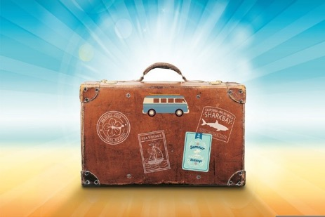
Habla con tu pareja: las vacaciones
hablar
Estudiante A hace la primera pregunta.
Estudiante B elige un verbo y termina la frase con palabras de la caja amarilla. Debe usar la forma correcta del verbo.
Estudiante A escribe la respuesta en inglés.
Ejemplo:
¿Visitaste alguna ciudad nueva ?
Viajé a Valencia.
Estudiante A
Estudiante B
1. Did you visit any new city?
1. visitar / viajar a | →el fútbol →bien →Valencia →Madrid
I travelled to Valencia.
Notes:
This activity practices spoken production of prepared questions, without reference to notes, but with English translations as support.

Slide 22
Habla con tu pareja
hablar
Habla con tu pareja: las vacaciones
Estudiante B elige el verbo y termina la frase.
Estudiante A hace las preguntas 6-1
1. Sí, [visitar / viajar] a | → el fútbol → bien → mal → una camiseta → las Fallas → Glastonbury → Madrid → nada → muchas → Valencia → la cámara → el verano → la playa
2. Sí, [pasar tiempo en/ disfrutar]
3. Sí, [practicar / jugar] a
4. Sí, [participar en / disfrutar]
5. Sí, [comprar / no, no encontrar]
6. Sí, [sacar / no, olvidar]
1 Did you visit any new city?
2 Did s/he spend a good summer?
3 Did s/he practise any sport?
4 Did you participate in a big festival?
5 Did you buy some souvenirs?
6 Did s/he take any photos?
Estudiante A, escribe las respuestas en inglés
Notes:
Student A faces away from the board and starts by asking their question in Spanish to Student B.
Student B listens out for the verb ending.
Student B looks at the yellow table and chooses a verb to answer with, taking care to use the correct verb ending according to if the question has been asked about you (with the –aste ending) or s/he (with the -ó ending).
Student B finishes their phrase with an appropriate option from the second column (option for Higher: students could be encouraged to think of their own appropriate ending).
Student A then writes the phrase in English.

Slide 23
This session…
Walk through of Key Stage 4 Spanish SoW document
Presentation of Key Stage 4 sample resources based on SoW
NCELP resource portal
Notes:
We will finish the session by looking at the NCELP resource portal.
Image: Steve Clarke / Katie Marsden

Slide 24
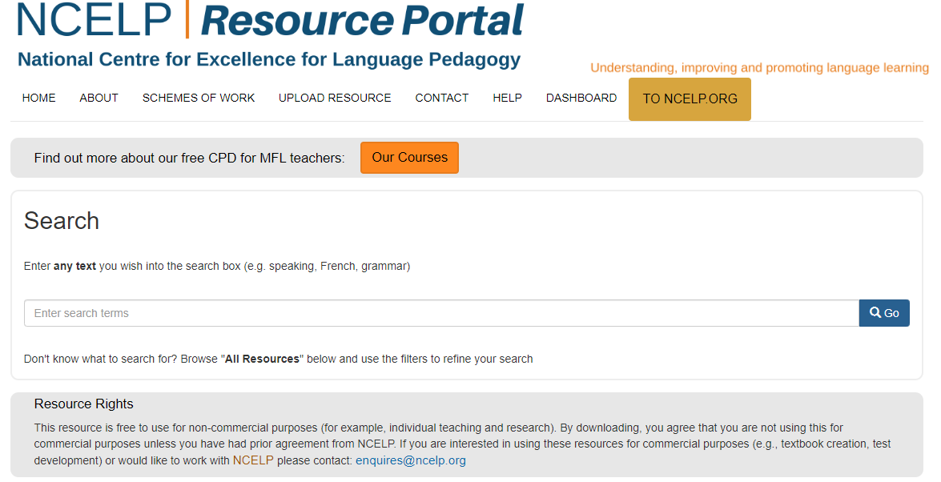
NCELP resource portal
https://resources.ncelp.org/
Notes:
Our resource portal contains schemes of work, lessons, homeworks, assessments, language guides and CPD materials. One option to find what you’re looking for is to type key words in to the search bar.

Slide 25
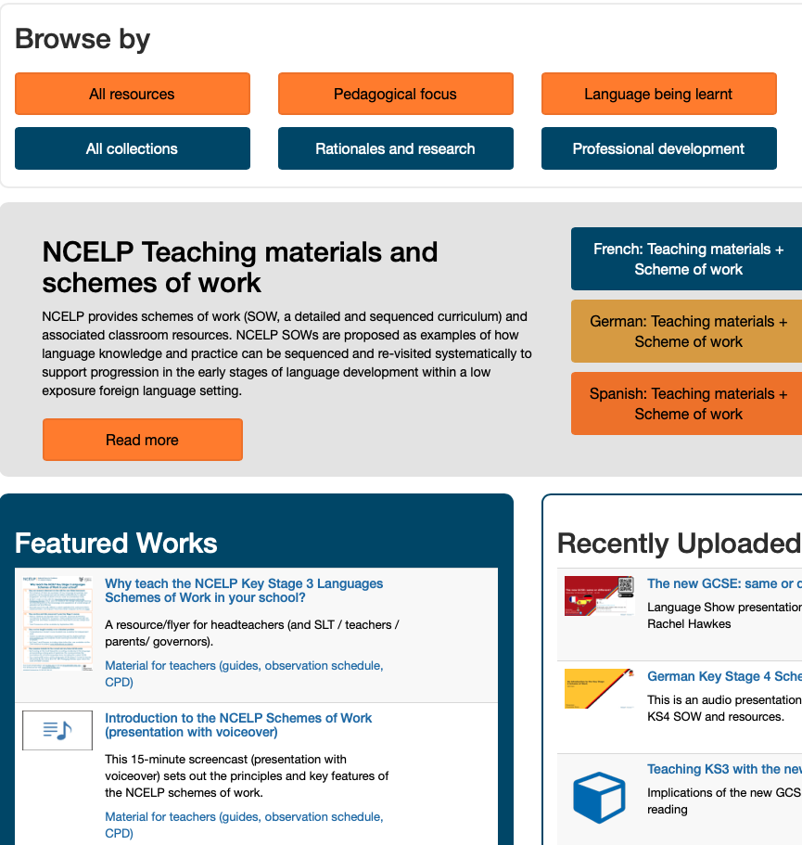
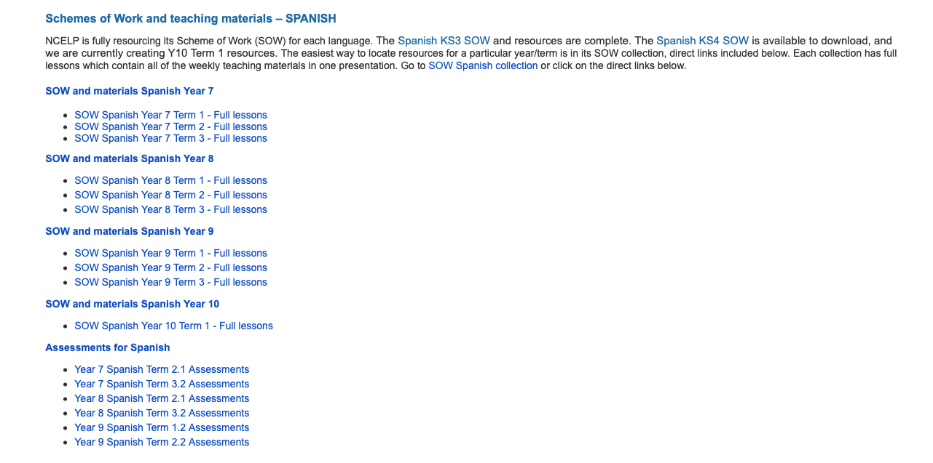
NCELP resource portal
https://resources.ncelp.org/
Click on the All collections tab and scroll to the bottom to see the SOW and all materials collections.
Scroll to the bottom of the page and click to download all.
Scroll to the bottom of the page and click to download all.
Click on a link to find all the resources for that term.
Notes:
However if you scroll down, you can see there are different methods of browsing including by collection.
[Click]
Click on the All collections tab and scroll to the bottom to see the SOW and all materials’ collections.
[Click]
Click on a link to find all the resources for that term.
[Click]
Then scroll to the bottom of the page and click to download all.

Slide 26
NCELP resource portal
https://resources.ncelp.org/
Notes:
You can see the Key Stage 4 scheme of work
[Click]
Click on the link to the full lessons for our list of resources for Year 10 Term 1.
[Click]

Slide 27
This session…
Walk through of Key Stage 4 Spanish SoW document
Presentation of Key Stage 4 sample resources based on SoW
NCELP resource portal
Notes:
That brings us to the end of this screencast presentation. I hope you’ve found it a useful starting point for using NCELP resources.
Image: Steve Clarke / Katie Marsden

