Slide 1
Principles of curriculum design in MFL: How to plan a scheme of work for KS3 and KS4
Presenters: Rachel Hawkes / Nick Avery
Date updated: 08/06/2021
Notes:
Images from www.pixabay.com – no attribution required.

Slide 2
Aims for the session
Part 1:
to understand the rationale for a new approach to curriculum design
identifying issues
setting out potential solutions
Part 2:
to explore one SOW design in detail
to understand individual lesson planning within this approach to curriculum design
Questions, discussion and next steps

Slide 3
Identifying issues
Step back to look at things differently
Notes:
As busy teachers, we make 1000s of decisions in one day, 100s in one lesson. The role is demanding. In each lesson our focus needs to be on the students moment-by-moment, to respond to what and how they are learning what we teach. Every lesson is different in that respect, and it requires all of our attention and skill. We rely on the planning of our SOW, our published lesson materials, and/or our individual lesson resources to be all there ready in advance. We buy published courses because we know that those producing them have had the time to plan the course in detail, that they have taken every care to ensure that it covers the national curriculum programmes of study, or at KS4, the requirements of the GCSE. Of course, we reserve the right to adapt and supplement (or sometimes ignore) material from a text book or other course, to meet the needs of our classes. We completely get the fact that a text book is just a tool, that there is not enough space on the pages to have all the practice steps that we need for our learners. Many of us like to innovate and create, too. We tend to put in additional vocabulary practice stages, more revisiting activities at the start and ends of lessons, or create scaffolded versions to tasks to support lower proficiency learners or additional tasks to increase the challenge for our higher proficiency learners. We also like to innovate and add in songs, more culture, or games etc..
But one thing we rarely have the opportunity to do is step back and look at things with different eyes. This is sometimes revealing so we’re going to start with that, here.

Slide 4
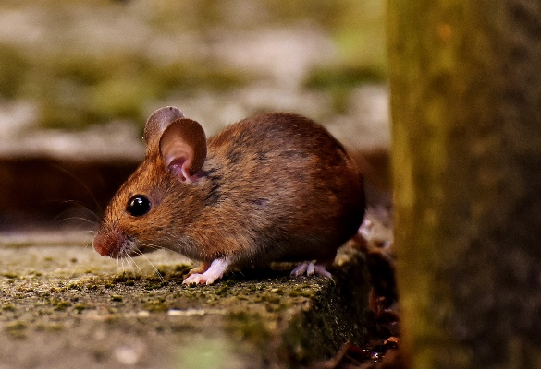
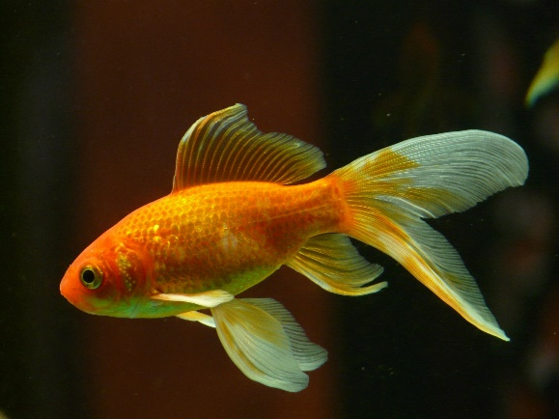
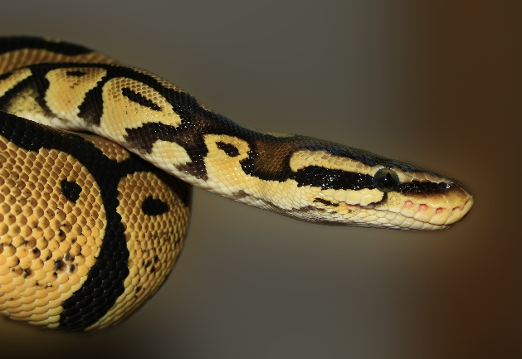
¿Tienes mascotas? Tengo…
un gato
un perro
un caballo
un ratón
no tengo mascotas
un pez
una serpiente
una cobaya
Notes:
So let’s take a unit from Y7 Spanish on pets, for example, as exists in many Y7 SOW and published resources. We might create a slide like this to give stronger visual support to what is in the text book.
What might we do with this slide? 1. Present the vocabulary (use animations to build up to independent oral recall of the vocabulary items for a few minutes) - 2. Typically we might then do a listening - e.g. listen and put the pets in order.
E.g
¿Tienes mascotas?
Sí. Tengo un gato.
¿Tienes mascotas?
Sí. Tengo una serpiente.
¿Tienes mascotas?
Sí. Tengo una cobaya.
Let’s pause for a moment to consider what content we are teaching here. What is the aim of the teaching?
Insert polling questions (multiple choice): Are we teaching knowledge of: a. individual vocabulary ítems? b. two parts of the verb tener? c. knowledge of gender through the singular indefinite article? 3. Which grammar is meant to be in the spotlight here? the indef articles and tener… So - if we keep the articles with the noun, the chances are that students will retain the noun word, but might forget the gender. Gender is non-salient for English speakers - we are not sensitive to it because we don’t have grammatical gender in English. 4. The use of tener (orally and in the listening) doesn’t vary - Tienes…? Tengo… Tengo… It’s not necessary for it to be in the listening at all, for students to do the task. Students will focus on what they need in order to do the task, i.e., the meaning of the noun. So, from this teaching so far, we are likely to be in the process of learning some vocabulary, but we are unlikely to retain the meaning of tienes / tengo this way. Most learners are not well-placed to learn the genders of these nouns this way. Other things make this selection of vocabulary tricky:
1. pez, serpiente and ratón do not fit the regular pattern so don’t help students establish the knowledge that nouns ending in -o/-a are generally masculine/feminine 2. caballo and cobaya sound very similar and tend to cause confusion in the early stages as students’ phonics knowledge is emergent and they can’t easily differentiate these two words in the oral modality.
3. word frequency - only gato [1728] and perro [888], caballo [907] are within 2000.
ratón [3415]; pez [3579]; serpiente [3662]; cobaya [>5000] mascota [>5000] Source: Davies, M. & Davies, K. (2018). A Frequency Dictionary of Spanish: Core vocabulary for learners (2nd ed.) London: Routledge

Slide 5
The indefinite article
In Spanish, the words for ‘a’ change according to whether the noun is masculine or feminine.
masculine | un perro | a dog
feminine | una tortuga | a tortoise
Copy the sentences and put in the correct word for ‘a’.
1 Tengo _______ gato. (m) | 4 ¿Tienes _____ pez? (m)
2 ¿Tienes _____ cobaya? (f) | 5 Tengo ____ hermanastro. (m)
3 Tengo _______ hermana. (f) | 6 Tiene _____ serpiente. (f)
Notes:
We might think that this is ok. We’re just focusing on the nouns themselves and then later we can focus on the grammar. How is this done in a text book? Or, how do we as teachers then ensure that students practise the grammar?
Often grammar is practised in written grammar exercises, and usually students have a model to follow and refer to. Sometimes the practice is oral, led by the class teacher, with moment-by-moment feedback. Do these sorts of practice tasks meet our criteria / expectations for meaningful practice?
meaning- and form-focused?
involving an element of struggle?
multi-modal?
1. Do we need to know the meaning of any of the words to do the task? 2. Do we need to remember that ‘a’ for masculine words = ‘un’ and for feminine words = ‘una’? 3. Do we have to listen and understand, read and understand, speak and understand or write and understand the meaning in these 6 sentences.
What are the chances that that this is the best way, in a time-poor classroom context, to:
practise the knowledge of indefinite articles
develop noun gender sensitivity/awareness
remember that every noun has gender in Spanish
know that the vast majority of nouns ending in ‘o’ are masculine and in ‘a’ are feminine (if the selection of nouns had only focused on those ending is -o/-a, then the gender information in brackets could have been omitted)
So, it’s quite likely that we might say, ‘yes, I don’t tend to do those sorts of mechanical practice tasks anyway’. We might say, ‘Instead, I…. do a lot of oral work to embed the grammar’, but that probably looks a lot like the previous oral practice slide, the design of which practises the vocabulary but not the grammar very effectively…

Slide 6
A Reading Example
Me llamo Mia y vivo en Arequipa, en Perú. Tengo catorce años. Tengo dos hermanos y una hermana.
Me llamo Daniel y vivo en Bogotá, en Colombia. Tengo trece años. Tengo dos hermanas y un hermanastro.
Me llamo Santi y vivo en Montevideo, en Uruguay. Tengo once años. No tengo hermanos. Soy hijo único.
1 _________ lives in Colombia.
2 Mia lives in _________.
3 _________ is eleven years old.
4 Mia has two _________ and one _______.
5 _________ has no brothers or sisters.
6 Daniel has two _________ and one_______.
Notes:
As we saw, the previous task had three forms of tener in it, but they were ‘incidental’ to the learning, and easily ignored. What about this reading example?
I haven’t been able to find a published resource that has listening, reading, speaking and writing practice tasks that focus on understanding and using TENER. It’s straightforward to find texts that feature TENER (alongside other features - e.g. reflexive verbs, ER-regular verbs, plural and singular nouns, definite and indefinite articles.
There are six examples of the verb tener in these texts. How many of them are task essential? Which questions require students to know that ‘tengo’ means ‘I have’? And what do we do about that fact that in three of these six examples, ‘tengo’ actually translates as ‘I am’.
In these texts we have a number of grammar features represented but none of them is task essential.
To what extent do reading (and listening) comprehension tasks like this support students’ learning of grammar? In this typical reading comprehension task, it is very easy to avoid any engagement beyond the lexis, i.e., avoid processing, therefore avoid learning, the grammar. Could we make more efficient use of limited lesson time (i.e. get more learning for our time!) if we could include listening and reading tasks that make the grammar essential.
Suggestions in the chat:
How might they look? How could we make parts of tener task essential? How could we make gender/article knowledge task essential?

Slide 7
The indefinite article
In Spanish, the words for ‘a’ change according to whether the noun is masculine or feminine.
This is grammatical, not biological gender! A house is not female, it is a feminine noun.
masculine | un perro | a dog
feminine | una casa | a house
Many Spanish masculine nouns end in -o, and many feminine nouns end in -a.
Mia writes what she has and what her friend Elena has. Her drink spills, smudging her list.
Write the correct words for ‘a’. Then write two lists in English, one for Mia, one for Elena.
1 Tiene _______ libro.
2 Tiene _______ cámara.
3 Tengo _______ gato.
4 Tiene _______ planta.
5 Tengo _______ bolsa.
6 Tengo _______ moneda.
Mia (I have …)
Elena (she has …)
un
una
a cat
a book
un
a bag
a camera
una
una
a coin
a plant
una
Notes:
So, how could we improve the task on the previous slide. Obviously, it’s always a bit false working in a vacuum, creating a one-off task, but it’s also helpful to go a step further than critiquing an existing task. So… Our context is that this is the introduction to gender of nouns and the indefinite article… We have to assume that students have already met at least two parts of the verb TENER, too.
Improvements could include:
1] Remove the gender information (m) / (f) from the task – to make the students have to notice the form of the noun. 2] Ensure that the nouns we use consolidate the pattern of a lot of nouns in Spanish (ends in ‘o’ = (m), ends in ‘a’ = (f) so, leave out ‘pez’ and ‘serpiente’ and instead use…. ‘libro’ / ‘casa’ 3) Consider the usefulness (i.e. frequency) of the words we include – ‘cobaya’ clearly fits the pattern for gender, but is it a useful word? Why not use grammar tasks to work with useful vocabulary, too? [This is a prompt again to think outside ‘topic’ lines – the original version of the task is topic-based – pets/family – we could keep the broad theme, potentially, but still include higher-frequency words] 4] Three parts of TENER are used but are completely superfluous to the task. If we’re not going to focus on them, we might as well get rid of them. OR, we make them a focus. It’s trickier to make a focus of three persons at once, so suggest we contrast I and s/he, and add a comprehension step.

Slide 8
Identifying issues [1/2]
many tasks may practise vocabulary only
listening and reading tasks that focus on processing grammar are typically missing (e.g. gender, verb endings)
grammar-focused tasks may be mechanical (i.e. it is possible to complete them without processing the language for meaning)
Notes:
So, the first main idea is that our current, very natural assumptions about published courses may need revising. As we’ve also just seen, we can adapt some text book tasks to make the grammar salient and increase the chances of students learning it. But this is only part of the issue.

Slide 9
Identifying issues [2/2]
If topics come first…
then learning the patterns will be secondary (and not as strong)
then students will learn some rare vocab that is not as useful
then learning is less secure and intrinsic motivation lower
Notes:
It is worth considering whether all the issues can be solved by re-designing the tasks to include a better grammar focus. One of the issues we saw (and then changed in the re-designed slide) was the choice of vocabulary. We swapped out some of the animals (those which didn’t have a helpful, regular pattern for students to grasp hold of and embed) for other items. These items – plant, book, coin were more suited to learning the dominant gender pattern - ends in –o = masculine, ends in –a = feminine. However, what has been de-emphasised is the topic of pets. This has taken a backseat, been backgrounded, if you like, in order for the regular pattern in the language to be foregrounded. Why? Because it makes the patterns more salient, easier to learn.
This one example is indicative of the wider issue. There is a tension between organising teaching (at the initial stages, at least) principally around topics (meaning the topics are king – they come first and other elements come after), and presenting students with the clearest, most learnable patterns that will give them maximum confidence in creating their own sentences. The fundamental issue : when topics are the main organising principle of curriculum design this leads to compromises in terms of progression and language development

Slide 10
Aims for the session
Part 1:
to understand the rationale for a new approach to curriculum design
identifying issues
setting out potential solutions
Part 2:
to explore one SOW design in detail
to understand individual lesson planning within this approach to curriculum design
Questions, discussion and next steps

Slide 11
Exploring alternatives
If we don’t foreground topics, what kind of SOW is possible?
A scheme of work driven by the language itself
More logical sequencing
Cohesion of different aspects of language (phonics, vocabulary, grammar)
Broader contexts for teaching
Notes:
So what’s the alternative? What could a SOW be like if topics didn’t come first? What would take their place as the ‘driver’ of the curriculum?
Without topics in the foreground, there is no need to make the language ‘fit’ a pre-selected topic. The language itself becomes the starting point for curriculum design. We can think about the structures and patterns that are likely to be most useful and learnable for our students.
This also allows us to sequence the teaching more logically. We can group grammar features that are naturally used together and bring them together for practice. For example, when we introduce forms of the verb ‘tener’, it seems logical to incorporate practice with indefinite articles (un/una), as people often use these features together to talk about possessions.
Without topics coming first, we can also think more about the cohesion between the different aspects of language that we plan to teach. For example, if our grammar focus is indefinite articles, which need to agree in gender with nouns, our selection of vocabulary might include nouns with regular gender marking patterns (-o for masculine, -a for feminine), and we can get students to make connections between vocabulary and grammar here.
The topics and contexts are still there, but with language taking precedence they can be made broader. For example, rather than a lesson on hobbies, we could have a lesson on ‘things that people do’ at different times and in different places.
Additional notes:
Re logical sequencing – in a topic-driven course reflexive pronouns are likely to be taught very early (je m’appelle, me llamo…). However, this is actually a complex grammar feature (word order is different from English, pronoun requires agreement with verb ending, and English often just omits it!). So if we think about the language itself, some traditional early topics probably aren’t optimal for a complete beginner in terms of language complexity.

Slide 12
Grammar
practice with ‘pairs’ of features (not whole paradigms)
compels thinking about form and meaning
brief explanation followed by input practice, then scaffolded production
revisiting leads to freer production activities
promotes true manipulation of language, where possible
Notes:
On the last slide I mentioned three language components: phonics, vocabulary and grammar.
There will be sessions on each of these as part of NCELP’s series of talks at Bath Spa, but I’d like to outline a few of principles for each of these :
The first is to plan a SOW where pairs of grammar features are practised. For example, two verb endings with contrasing meanings (or functions) can be juxtaposed. Practising a whole new set of features together, e.g., a full range of verb endings, is unlikely to be effective, as it is beyond what most learners can pay attention to at any one time.
The practice itself should require attention to form and meaning. We might need to strip out other language in order to make attention to the grammar essential for task completion.
After a brief explanation, students are given plenty of practice, initially in reading and listening, with the new features before scaffolded production.
When features are revisited, they can be used more freely.
There is an emphasis on true manipulation of language (as opposed to chunks) as this gives students the best chance of being able to communicate meaning themselves.

Slide 13
Vocabulary
using frequency to inform vocabulary selection
mixed word classes – allowing for sentence creation
word selection to support grammar practice
teaching one new meaning at a time (e.g., rico – rich, tasty)
systematic revisiting
Notes:
Up until now we’ve had to rely on intuition about which words might be useful to learn. However, there is now data available from corpora (large electronic collections of oral and written language) on the frequency with which words occur in the language. As high-frequency words can be used across contexts (rather than for a single topic), they are particularly useful in a time-limited teaching context.
The current GCSE proposals suggest teaching 90% of words that are among the 2000 most frequent in the language – on the next slide I will show a graph illustrating the potential implications of this for text comprehension.
Other principles for vocabulary teaching include:
combining different word classes in a each vocabulary set. This offers greater potential for sentence building than, say, a list of nouns used to fill a slot after a verb.
choosing words that are closely related to the grammar being practised – again, this is the cohesion between different language components that I mentioned on the last slide.
teaching each meaning of a word separately to avoid unnecessary difficulty. High-frequency words often have more than one meaning – e.g. rico for rich and tasty.
systematically revisiting previously taught words. This is the crucial factor leading to long-term retention.

Slide 14
Usefulness of words
The usefulness of the most frequent 1,000-1,300 words!
How many words in a text do you know if you know very high frequency words?
◆ General conversation  More formal speech – e.g. lectures  Written language
worked cited in Milton, J. (2009) Measuring second language vocabulary acquisition (p. 58). Multilingual Matters.
Notes:
To illustrate my first point about the usefulness of high-frequency words, here is a graph based on data about the English language.
The findings come from 100s of millions of words collected from a wide range of contexts.
You will see that the x axis along the bottom is ‘words by frequency’ – so, 1,000 means the most frequent 1000 words in a language.
The y axis is called ‘coverage’ – this is the amount of words in a text you will understand if you know the 1,000 or 2,000 most frequent words etc.
The top grey line is the estimation for general conversation – very high frequency vocabulary is the most important for this
The middle line is the estimation for more formal speech – the media, educational contexts,
The bottom line is the estimation for written language – you tend to get rarer words being used in written texts – though this massively varies according to context and genre (type of text)
I want to highlight three things about this visual:
First – you will see that knowing just the most frequent 200 words gives you a massive boost – you can see a really, really steep curve here – knowing these words gives you access to between 50% and 75% of any input you hear or read
Second – If you know somewhere around 1,700 of the most frequent words you can probably understand between 70% and 92% of things you read and hear.
Third - This very clear value of knowing really high frequency words tends to almost completely plateau after about the 1,700 to 2,000 most frequent words; but this plateauing starts even earlier, at between 1,000 and 1,500 most frequent words. So, after knowing about the 1,500 most frequent words, how much you understand depends on whether you happen to know those other, rarer words. We need to know A LOT of words to be able to be sure that we will understand any more of a text.

Slide 15
Common concerns
47.5% nouns
25.1% verbs
16.3% adjectives
1) Aren’t high-frequency words just the ‘function’ words?
How are they going to be able to talk about anything meaningful?
majority of words in top 2000 are nouns, verbs and adjectives
a much smaller proportion (<5% of the total) is made up of prepositions, conjunctions and articles
Source: Davies, M. & Davies, K. (2018). A frequency dictionary of Spanish: Core vocabulary for learners (2nd ed.). Routledge: London
Notes:
People have rightly asked questions about frequency data informing vocabulary selection.
One of these is whether learning the most frequent words actually allows you talk to about anything meaningful.
The answer is ‘yes’!
In the Spanish frequency dictionary published by Routledge, most words in the top 2000 are nouns, verbs and adjectives – typically the ‘content’ words – whereas fewer than 8% are prepositions, conjunctions and articles (usually considered the ‘function’ words).

Slide 16
Common concerns
2) Does this mean teaching completely different words to those typically taught now?
Some of our intuitions about ‘useful’ language seem right!
But there are also useful words that haven’t been regularly taught before (especially words that are not topic-specific)
Notes:
Another question is just how different vocabulary selection would be in a frequency-informed SOW compared to a traditional one.
Obviously this would depend on each individual SOW, but a look at texts and word lists being used by exam boards suggests that the words being used in assessments are a mix of both high- and low-frequency words. I’ll show a specific example on the next slide.

Slide 17
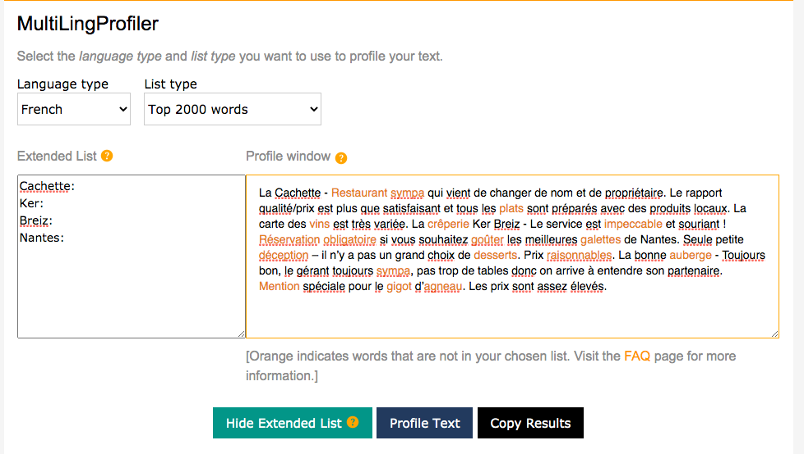
AQA French GCSE 2018 Reading Higher Tier
Percentage of words in most frequent 2,000 = 83%
Notes:
This screenshot shows the output from the MultiLingProfiler, a tool developed by NCELP that allows you to measure the percentage of words in a text that are within the 2000 most frequent words in the language. We profiled an AQA GCSE French reading paper from 2018.
All words that are orange are those that are outside of the 1-2000 range. NCELP profiled a number of texts and this was the one with the highest percentage of words not in the top 2000. Even so, coverage is 79% before proper nouns removed. When you add those to the list (because proper nouns are not included in the frequency dictionary), then the text has 83% already in the most frequent 2,000.
So we aren’t really looking at using such different vocabulary. It seems that quite a lot of the vocabulary already being taught and assessed is highly frequent, supporting our intuitions. It is just that we now have data to confirm it and can spot the examples of low-frequency vocabulary where we might reconsider the usefulness of a word.

Slide 18
Adapted text following profiling
With changes and glossing 91%
La Cachette - Restaurant sympa accueillant qui vient de changer de nom et de propriétaire. Le rapport qualité/prix est plus que satisfaisant et tous les plats sont préparés avec des produits locaux. La carte des vins est très variée. La crêperie Ker Breiz - Le service est impeccable excellent et souriant ! Réservation obligatoire Il faut réserver si vous souhaitez goûter manger les meilleures galettes de Nantes. Seule petite déception critique – il n’y a pas un grand choix de desserts. Prix raisonnables Pas trop cher. La bonne auberge - Toujours bon, le gérant toujours sympa heureux de vous voir, pas trop de tables donc on arrive à entendre son partenaire. Mention spéciale pour le gigot d’agneau. Les prix sont assez élevés.
Glossed: vins, galettes, gigot d’agneau, plats
Plus: desserts, restaurant, crêperie, mention (if no cognates can be added)
Notes:
With a few small changes to the text we can increase the proportion of words within the top 2000 to over 90% leading to a greater likelihood of text comprehension.

Slide 19
Common concerns
3) Don’t the most highly frequent words depend on which corpus you use?
comparisons of different corpora suggest significant overlap
E.g. German web 2013 (deTenTen13) shares 81% of the 2000 most frequent words in Jones & Tschirner (2019).
Notes:
Another question is whether the 2000 most frequent words vary according to the corpus used.
We have done some work at NCELP comparing corpora to explore this. We found a large overlap of 81% between the 2000 most frequent words in two general corpora of German (deTenTen13 and Jones & Tschirner). Similar comparisons have been done for English, French and Spanish, again pointing towards a considerable overlap, even when making comparisons with specialised corpora (like legal or political texts).

Slide 20
Common concerns
4) Are 1200 and 1700 enough words? Shouldn’t students be learning way more words than this?
Can pass a GCSE with…(receptive knowledge)
852 words by year 11 (Milton, 2006)
564 words by year 11 (David, 2008)
NCELP curriculum design suggests:
With systematic revisiting & active practice over 5 years (approx. 450 hours):
364 words per year * 5 years (minus one term in year 11)
= 1699 words, if all are retained and can be both understood and produced
Notes:
Another concern raised is whether the proposed 1200 at foundation tier and 1700 tier is enough, and whether students should actually be taught more words.
A couple of studies have been done on the average vocabulary size of a student at GCSE level, and have found that students can pass a GCSE with only 500-800 words known receptively (the number of words in their productive vocabulary would be smaller). So we do need to think about what is realistically possible to learn securely, given existing constraints on curriculum time, and also what would be fair to assess on that basis.
In our own schemes of work, we envisage that 364 words could be taught per year, with 1699 words that could be understood and produced, following a programme of systematic revisiting and active practice.

Slide 21
Phonics
explicit teaching of the key sound-spelling correspondences (SSCs)
improves ability to accurately sound out unknown words
positively associated with motivation and confidence in spoken and written production
supports errorless learning (accurate representation of the language from first exposure)
Notes:
The final component is phonics teaching: explicit teaching of the relationships between the letters of written words and their sounds.
Research has found that this improves students’ phonological decoding ability (their ability to sound out unknown words).
There are also many related benefits in terms of motivation and confidence in oral and written production.
And this also supports errorless learning – avoiding inaccurate representations regarding how the how new language sounds and is spelt.

Slide 22
Summing up
Full SOW evaluation doc here!
https://resources.ncelp.org/concern/resources/p2676v62m?locale=en
Five questions for SOW evaluation:
What is ‘driving’ the choice of the language and order of teaching?
When is each grammar feature taught and why then – what is the rationale for the sequencing?
Is the vocabulary highly frequent? How is the frequency known?
Is there explicit phonics teaching? Which SSC are taught and why?
How often is each language feature re-visited? Is it practised in both comprehension and production?
Notes:
In this part of the presentation I’ve spoken about potential solutions. We can’t claim to present all of them here, not least because there is no single one-size-fits-all scheme of work. Different
SOWs may be successful with different learners in different contexts. But to be confident in the planning, here are some key questions that we can ask:
Firstly, what is driving the choice of language and the order in which it is taught? Is it the usefulness of the language itself, or are we compromising (students’ ability to make progress in language learning) by making the language ‘fit’ a certain topic?
Secondly, when is each grammar feature taught? Why then? Here we might think about things like cross-linguistic complexity (does the feature exist in English? If so, does it work in the same way?).
Thirdly, how frequent is the vocabulary and what is our source? One published source of frequency data is the Routledge series of frequency dictionaries.
Fourthly, is there explicit phonics teaching – which SSC are taught and why?
Finally, how often do we revisit each language feature? And when we revisit them, do we give opportunities for that revisiting to happen in comprehension and production?

Slide 23
Aims for the session
Part 1:
to understand the rationale for a new approach to curriculum design
identifying issues
setting out potential solutions
Part 2:
to explore one SOW design in detail
to understand individual lesson planning within this approach to curriculum design
Questions, discussion and next steps

Slide 24
BREAK

Slide 25
Explore one SOW in detail
“an example of how language knowledge and practice can be sequenced and re-visited systematically to support progression in the early stages of language development within a low exposure foreign language setting.”
Teaching is carefully planned…
…to compel thinking,
thinking drives learning, and…
success in learning is motivational.
A teacher described the approach as ‘empowering.’
Notes:
NCELP has planned and fully resourced schemes of work for Y7 and Y8 French, German and Spanish driven by the principles that we explored in part 1. We are currently working on Y9. Years 10 and 11 will also be completed next year and by December 2022. It’s important to say that the SOW are an example of the principles in practice. It’s not an accident that the documents are fully editable, as are the resources. Teachers are of course adapting the SOW and resources for their classes, just like they have always done with textbooks. This is how we describe the SOW on the NCELP resource portal: “an example of how language knowledge and practice can be sequenced and re-visited systematically to support progression in the early stages of language development within a low exposure foreign language setting.”
The one thing I would say is that the depth of planning in these SOW is, in my experience, unique. I’ve written a lot of SOW over the past 25 years – as head of department and as a writer of textbooks. I’ve always felt that my planning was very detailed and thorough. And yet, this is something else. The overriding impression that I hope you take away from this walk through a SOW is the depth of thinking in its planning, and a sense of the implications this has for student progress and therefore their intrinsic motivation for language learning. One of the teachers involved in the project described the approach as empowering, and I can really echo that.

Slide 26
Explore one SOW in detail
Think of a SOW you are currently using
How is it laid out? in columns?
What headings does each column have?
What detail is included – about the language content?
Notes:
We are going to walk through the Y8 French Scheme of Work. All the SOW share the same design features. Before we start, it will be useful for us all to visualise a scheme of work, think about one that we know well. How is it laid out? In columns? What are the headings? What detail does it have? As you conjure up one of the SOW you are currently using, type the features that you see into the chat.

Slide 27
Tabs in the NCELP SOW
The grammar tracking tab is a week-by-week overview of the grammar spine, listing the new and revisited grammar features.
Notes:
NCELP SOW are written in excel. If you look at the bottom of the SOW Excel document you can see a number of useful tabs. We are going to explore the five main tabs:
Y8 Grammar tracking
Y8 SOW
Y8 Resources
Y8 Vocabulary List
Y8 multiple senses

Slide 28
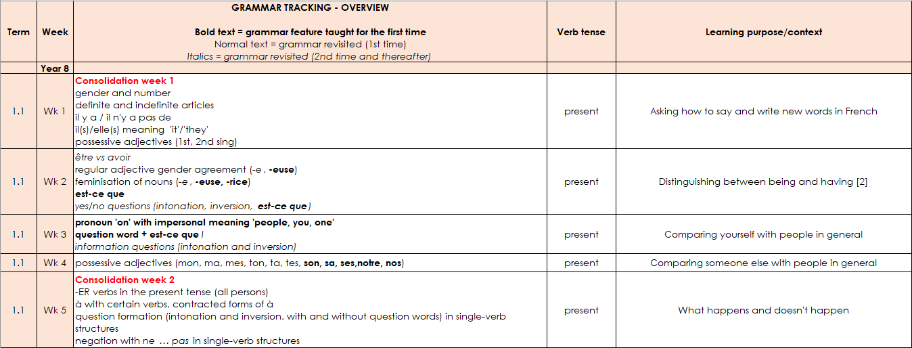
Grammar tracking tab
This columns denote the focus tense for that week.
This column gives the learning context.
A consolidation week revises vocabulary from Y7 and grammar features from either Y7 or Y8.
New grammar features are in bold type.
Features for 1st time revisiting are in normal type.
2nd and subsequent revisits are in italics.
Extended text exploitation weeks are in blue type.

Slide 29
Tabs in the NCELP SOW
The Y8 SOW tab is the detailed planning document for each week, with grammar, vocabulary, sounds of the language, and lesson overviews.

Slide 30
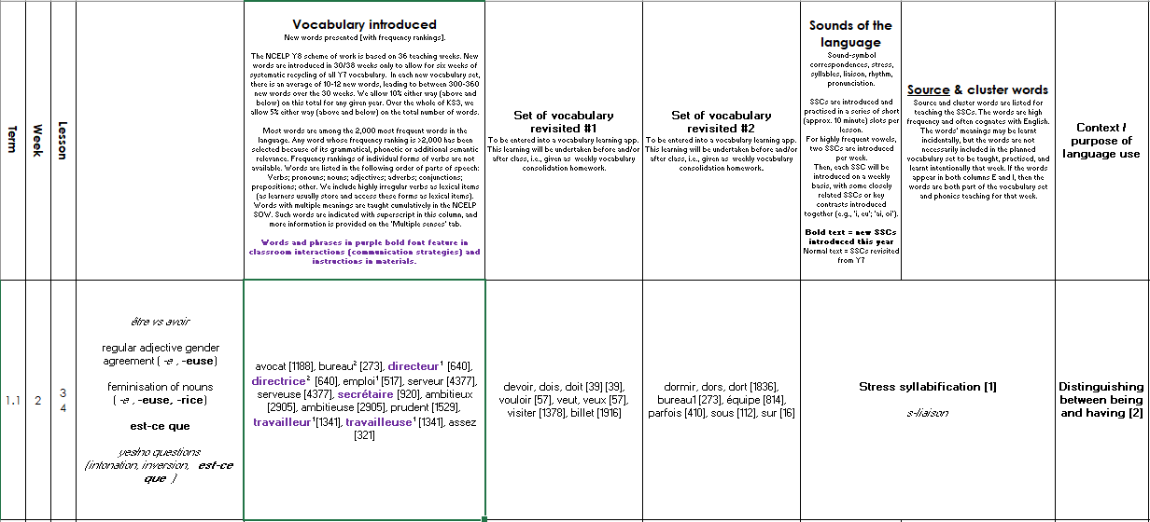
Y8 SOW
Sounds of the language practice in every lesson.
Systematic revisiting of vocabulary every 3 weeks and 9 weeks.
new | revisit | revisit
The grammar column reproduces the
information from the grammar tracking tab.
Additional notes detailing the content of each lesson.
Notes:
This is what the layout of the Y8 French SoW looks like – this is from week two of the first term.
Starts with grammar introduced – here est-ce que – in addition it references the grammar to be revisited, regular adjective gender agreement and the feminisation of nouns. Revisited for the second or subsequent time are yes/no and intonation questions (in italics).
Then we see new vocabulary introduced as well as vocabulary to be revisited – we revisit two sets of vocabulary every lesson from three and nine weeks ago - you can see that the sets differ a little in the number of words in each – the vocabulary is integrated as much as possible, but there are also stand-alone vocabulary tasks, where needed.
Then the sounds of the language - in this week we are doing stress syllabification and a 2nd revisiting of s-liaison.
There is still a context – no traditional topic but a context for language use, here it is ‘Distinguishing between being and having’. This particular week is a typical SOW week. In addition, at regular intervals there are weeks set aside for some revision and consolidation, assessment (in term 2 and 3) and also for work on “rich” texts or authentic text exploitation, as we saw on the grammar tracking tab.

Slide 31
Tabs in the NCELP SOW
The RESOURCES tab is a page of individual links to each SOW resource.

Slide 32
Resources
Notes:
Each hyperlink takes you to the resource on the portal. You can choose the full lessons or you can download the PVG elements separately – the quizlet links for vocabulary introduced and also the vocabulary learning homework sheets

Slide 33
Tabs in the NCELP SOW
The NCELP Y8 vocabulary list contains all French words taught in Y8, with English meanings, parts of speech and frequency information.

Slide 34
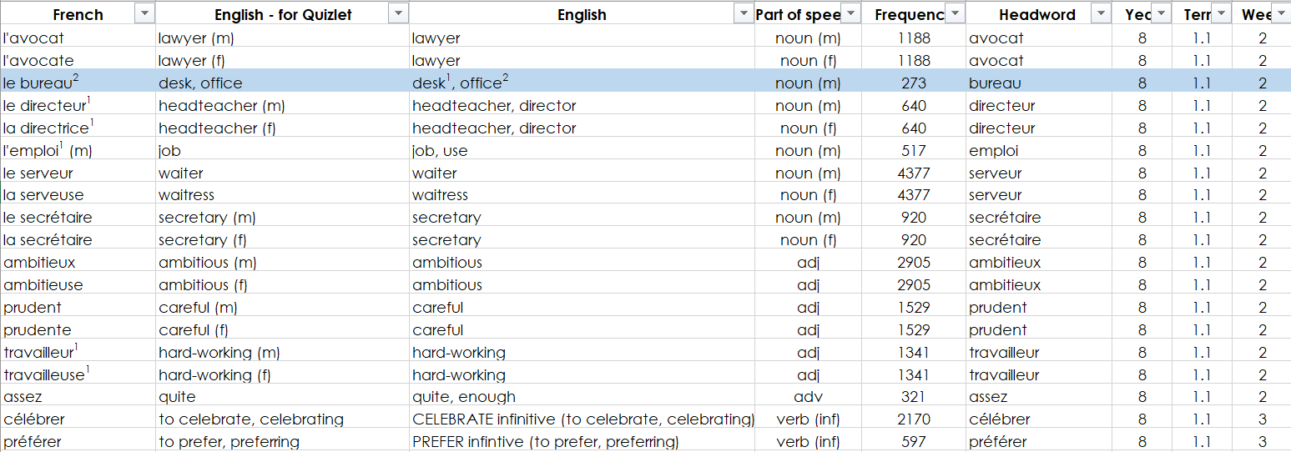
Y8 NCELP vocabulary list
Source of frequency information:
Londsale, D., & Le Bras, Y. (2009). A Frequency Dictionary of French: Core vocabulary for learners London: Routledge.
Frequency ranking of all words is provided, here.

Slide 35
Tabs in the NCELP SOW
The multiple senses tab lists all the Y8 words that have more than one meaning. These meanings are taught cumulatively.

Slide 36
Multiple senses
Notes:
Some words in the scheme of work are polysemous – they have multiple meanings. To indicate how this issue is covered in the SOW, the superscript number in each column header refers to the first, second, or third time that a word is introduced, each time with a different meaning or sense. Meanings/senses are introduced in a stepwise fashion and cumulatively, so previously taught meanings/senses are included in the English translations cumulatively. For example ‘bureau’ first taught as ‘desk’ (Y7 Term 3.1, Week 4) is then taught as ‘desk, office’ (Y8 Term 1.1, Week 2)
There are three categories of polysemous words shown here: those with different meaning that are the same part of speech, e.g. bureau (desk and office) or vous (you plural and polite); those with different meanings and different parts of speech (e.g. blanc (white, adjective, and gap/blank, noun) and those with the same meaning but different parts of speech.

Slide 37
Textploitation and cultural context
Weeks to focus on rich, more challenging texts
Secure, (and growing) vocabulary of high frequency words supports the understanding of longer texts
Inclusion of authentic, semi-adapted factual and literary texts
Readability checked using the Word Profiler
Notes:
In all of the KS3 SOW there are weeks set aside for work on rich, more challenging texts. Developing on from Y7, short and longer texts and spoken passages are integrated into lesson sequences more frequently, supported by students’ growing vocabulary base. It is this secure, and growing, vocabulary of high frequency words, together with grammar and phonics knowledge, that support the comprehension of longer texts, including authentic, semi-adapted factual and literary texts. Their readability is checked (using the Word Profiler) to ensure that texts are either 100% comprehensible or 90%+ with key language glossed and/or meanings carefully elicited through the activities in the lesson.

Slide 38
Assessment
Two Y8 assessment weeks
Achievement (two) and Applying your knowledge tests (one only)
Filmed assessment lessons work through two examples of each question type
More detail on assessment principles available here: Phonics, Vocabulary, Grammar
Notes:
For all years at KS3 there are two assessment weeks. There are two types of test which, between them, assess the full range of knowledge and skills students should have developed by the end of the first half of the summer term in Year 7 and 8.
The first is the ‘achievement’ test, which is designed to assess students' knowledge of a principled sample of phonics, vocabulary, and grammar (PVG) features. This ‘syllabus-based’ test is trying to find out to what extent students have actually learnt what we are trying to teach them up to the point of testing. The January test follows this model.
The second assessment type is the 'applying your knowledge' test, which brings together the PVG strands in a more holistic assessment of listening, reading, writing and speaking. This aims to assess students' ability to apply their knowledge in a fuller context through listening comprehension, oral picture description, and short translation tasks. There is one of these in the summer term of Y7 and Y8, in addition to another achievement test. Filmed assessment lessons work through two examples of each question type. These are on the Oak academy website.
If you would like more detail on the principles of assessment design, please access the following CPD screencast sessions. These contain voiceovers from NCELP specialists on: i) Phonics, ii) Vocabulary, iii) Grammar

Slide 39
Aims for the session
Part 1:
to understand the rationale for a new approach to curriculum design
identifying issues
setting out potential solutions
Part 2:
to explore one SOW design in detail
to understand individual lesson planning within this approach to curriculum design
Questions, discussion and next steps
Notes:
The final part of our input today is a detailed walk through one lesson resource. A session on curriculum design wouldn’t be complete without seeing how the principles that inform the SOW translate into a lesson resource.

Slide 40
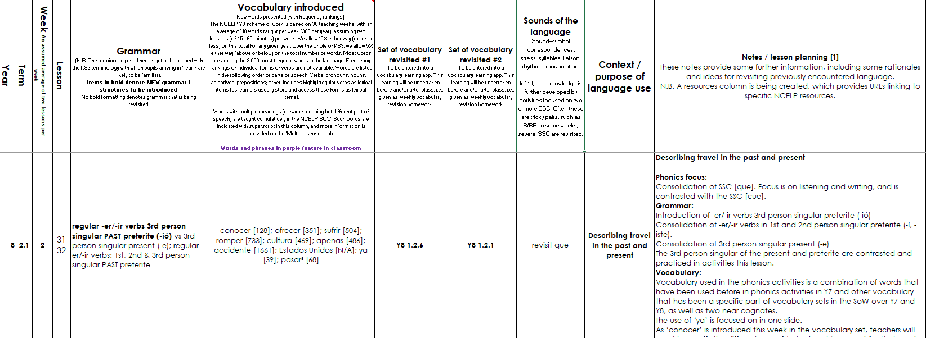
Walk through of a resource
Notes:
For this we have chosen a Y8 Spanish lesson from the second week of the spring term, so January of Y8. This screen shot shows the relevant week on the SOW document.

Slide 41
Describing travel in the past and present
–er & –ir verbs in 3rd person singular preterite (-ió)
SSC [que] [revisited]
Y8 Spanish
Term 2.1 - Week 2 – Lesson 31
Amanda Izquierdo / Nick Avery / Rachel Hawkes Artwork: Mark Davies
Date updated: 18/10/20
Notes:
RH: As with the SOW every lesson resource is editable. It is expected that teachers customise activities for their students, beyond the differentiation suggestions detailed in the under slide notes, as appropriate to their context. As you can see from the title slide, the context for the lesson is describing travel. That is to say, the language (both vocabulary and grammar) that students learn and practise in this lesson equips them to talk about travel in two tenses. You see also the specific grammar focus of the lesson – 3rd person preterite –er/-ir verbs, and the sound-symbol correspondence ‘que’ which has been learnt before and is revisited here.
Artwork by Mark Davies. All additional pictures selected are available under a Creative Commons license, no attribution required.
Native teacher feedback provided by Blanca Román.
Learning outcomes:
Introduction of -er/-ir verbs 3rd person singular preterite (-ió)
Consolidation of -er/-ir verbs in 1st and 2nd person singular preterite (-í, -iste).
Consolidation of 3rd person singular present (-e)
Consolidation of SSC [que]
Word frequency (1 is the most frequent word in Spanish):
New vocabulary (introduce in lesson 1): conocer [128]; ofrecer [351]; sufrir [504]; romper [733]; la cultura [469]; apenas [486]; el accidente [1661]; los Estados Unidos [N/A]; ya [39]; pasar³ [68]
Vocabulary to revisit:
Y8 1.2.6: paisaje [1685]; crecer [560]; desaparecer [655]; seco [1183]; lluvia [986]; clima [1675]; mejor [116]; frontera [1507]; ganar² [295]; mil [191]; altura [970]; suficiente [781]; dice [decir-31]; más [23]; vida [85]
Y8 1.2.1: elegir [561]; elijo [561]; describrir [1272]; compartir [579]; imprimir [2736]; diálogo [1466]; corto [1055]; largo [300]; finalmente [948]; mismo [55]; último [188]; primero [82]; segundo [223]; tercero [450]; propio [183];
The frequency rankings for words that occur in this PowerPoint which have been previously introduced in NCELP resources are given in the NCELP SOW and in the resources that first introduced and formally re-visited those words.
For any other words that occur incidentally in this PowerPoint, frequency rankings will be provided in the notes field wherever possible.
Source: Davies, M. & Davies, K. (2018). A frequency dictionary of Spanish: Core vocabulary for learners (2nd ed.). Routledge: London

Slide 42
escuchar / escribir
Escucha las frases. Escribe las palabras con [que] en la primera columna y las palabras con [cue] en la segunda columna. No siempre hay palabras en las dos columnas. Luego completa la frase en inglés.
[1/2]
[que]
[cue]
1
quedamos
escuela
school
We always __________ outside ___________.
meet up
2
frecuencia
frequency
Do you know the _____________ of the word? I do!
3
que
consecuencias
She ______ ____ the ________________ of the heat are important.
says
that
consequences
Notes:
RH: in early lessons in Y7 for example when students first learn an SSC or a grammar feature, the knowledge is usually isolated for practice. This prevents cognitive overload and allows students to focus all of their attention on one aspect. However, when revisiting, it is common to combine strands. Here, we combine phonics and vocabulary revisiting.
We focus on a pair of sound-symbol correspondences – que and cue. Que can cause confusion for students who may naturally pronounce ‘que’ as ‘cue’ because of the cross-linguistic difference from the English pronunciation of ‘que’, as in ‘question’, for example.
The task requires some sentence-level processing, the recognition of some previously taught words, such as quedamos and escuela, as well as the transcription of some lesser or unknown cognates, e.g. frecuencia or consecuencia. This is a level of phonics knowledge that is a significant step up from Y7. Remember that transcription is one of the ways in which the proposed Subject Content envisions the testing of phonics knowledge. Here, the activity could be adapted for higher proficiency learners by removing some or all of the scaffolding for the translations.
In the current GCSE examinations we have the style of listening question where students listen to a set of questions and have to write the English meaning for each. One possible way to build phonics knowledge into a similar task would be to require students to transcribe the question in the target language, and then write its English meaning.
Phonics and vocabulary [1/2] Timing: 7 minutes
Aim: to revisit the SSC [que] and focus on how it differs from [cue]; to consolidate understanding of vocabulary
Procedure: 1. Students copy 1-6 and the two-column grid into their books.
2. They listen to each sentence and write down any words with [que] in the first column and any words with [cue] in the second column.
3. They then listen again and write the missing words in the English translation. Some of the gaps to translate are the target words with [cue] and [que] that they students have just heard. Others are previously taught vocabulary items that also feature in the sentence.
Notes:
Vocabulary selection: the activity includes a mix of better known and lesser known words. Some words have appeared once before in a phonics activity (cincuenta, frecuencia, consecuencia, cuello). Two of these are near-cognates. The translation part of the activity aims to keep the meanings of these words in focus. Other words have been taught as vocabulary items (escuela, quedamos, que, querer, parque, porque, pequeño, qué, así que). As such, this is a hybrid phonics and vocabulary task.
It could be pointed out in feedback for item 5 that when talking about body parts, Spanish uses the definite article (“Es un animal con el cuello muy largo”), whereas English would use the indefinite article (“with a long neck”). This is an incidental point and an opportunity for awareness raising, if appropriate.
The activity could be adapted for a higher ability group by removing some or all of the scaffolding for the translations.
Transcript:
Siempre quedamos fuera de la escuela.
¿Tú sabes la frecuencia de la palabra? Yo sí.
Ella dice que las consecuencias del calor son importantes.
Es normal querer ir al parque en verano porque el clima es mejor.
Es un animal con el cuello muy largo. ¿Qué animal es?
No tengo cincuenta euros, así que no puedo comprar las entradas.

Slide 43
escuchar / escribir
[2/2]
[que]
[cue]
4
querer
parque
porque
to want
in
summer
It’s normal ________ to go to the park ___ ________ because the ________________ is better.
climate/weather
5
¿qué?
cuello
very
long
neck
It’s an animal with a ______ ______ ______. What animal is it?
6
así que
cincuenta
fifty
so
buy
I don’t have _______ euros, _____ I can’t _______ the ___________.
tickets
Notes:
[2/2]

Slide 44
Vocabulario
hablar
[1/2]
[to know, to get to know]
conocer
[to disappear, disappearing]
desaparecer
ofrecer
[hardly, barely]
apenas
[to offer]
romper
sufrir
[to break]
[to suffer]
Notes:
RH: this next activity practices the new vocabulary for this week. Students are always given homework to pre-learn the following week’s vocabulary. However, this does not mean it is expected that students arrive at the lesson with complete knowledge of the new words. Multiple encounters with words are needed for them to be successfully learnt and retained over time. This type of vocabulary activity, towards the start of the first lesson in the week, aims to reactivate learners’ emergent knowledge of the new words and strengthen it. The two slides can be used flexibly, but as they are they are designed first to elicit meaning recall, and then to prompt for spoken production. Students can work in pairs on further rounds of practice, as required.
Note that there is still a place for working at individual word level in these initial stages. Students need robust knowledge of individual, de-contextualized words, as all words can be re-combined with others to make new, unique utterances. If learners encounter new vocabulary too often in phrases, collocated with other words that they often co-occur with, they are less able to understand or use them outside of those set phrases or chunks. This has already proven to be problematic within the existing GCSE, where students are given prompts for the writing tasks, for example, and because they are not in a sentence, they are unable to recall their meaning. [Example: think back to the French foundation 40-word writing task in 2018 – four single word prompts – professeurs, matières, batiments, repas. Many students were not able to recall the meanings of batiments or repas, probably because they had not encountered them before in phrases about school. We aim to avoid creating these silos of word knowledge by developing secure individual word knowledge. This benefits students for the current as much as the proposed GCSE.]
Vocabulary practice slide [1/2]
Timing: 2 minutes
Procedure 1. Pupils either work by themselves or in pairs, reading out the words and recapping their English meaning (1 minute). 2. Then the teacher removes the English words or pictures (one by one) and they try to recall the English orally (chorally), looking at the Spanish (1 minute). 3. Then the Spanish meanings are removed (one by one) and they to recall them orally (again, chorally), looking at the English (1 minute) 4. Further rounds of learning can be facilitated by one pupil turning away from the board, and his/her partner asking him/her the meanings (‘Cómo se dice X en español?’). This activity can work from L2 → L1 or L1 → L2.
Note: one of this week’s revisited words, ‘desaparecer’, is included on this slide for further consolidation.

Slide 45
Vocabulario
hablar
[2/2]
You can use ‘ya’ in different tenses:
Miguel ya está aquí.
Miguel is already here. (present)
El concierto ya pasó.
The concert already happened. (preterite)
la cultura
el accidente
[accident]
[to pass, to spend (time), to happen]
los Estados Unidos
[United States]
pasar
[to choose, choosing]
elegir
ya
Notes:
RH: Note that whilst there are several –er/-ir verbs in the vocabulary set, as you’d expect in order to support the grammar objective, there are also words from other parts of speech – several nouns and adverbs. Remember we said that this was to facilitate independent sentence construction from the outset.
Back to Nick now to show how the lesson continues from here.
Vocabulary practice slide [2/2]
Timing: 2 minutes
Procedure 1. Pupils either work by themselves or in pairs, reading out the words and recapping their English meaning (1 minute). 2. Then the teacher removes the English words or pictures (one by one) and they try to recall the English orally (chorally), looking at the Spanish (1 minute). 3. Then the Spanish meanings are removed (one by one) and they to recall them orally (again, chorally), looking at the English (1 minute) 4. Further rounds of learning can be facilitated by one pupil turning away from the board, and his/her partner asking him/her the meanings (‘Cómo se dice X en español?’). This activity can work from L2 → L1 or L1 → L2.
Note: one of this week’s revisited words, ‘elegir’, is included on this slide for further consolidation.

Slide 46
Talking about ‘knowing’: using the verbs ‘saber’ and ‘conocer’
The verbs ‘saber’ and ‘conocer’ are both used to mean ‘know’, but there are some important differences.
Saber is used for facts and information.
¿Sabes mi número de teléfono?
Do you know my phone number?
¿Sabes qué hacer?
Do you know what to do?
Conocer refers to familiarity with a person, place or thing. This can also include becoming familiar with it (‘to get to know’).
¿Conoces España?
Do you know Spain?
Quiero conocer la cultura.
I want to get to know the culture.
Notes:
NA: In this lesson, we introduce the verb ‘conocer’. In Spanish there are two verbs for ‘to know’ (in a similar way to French), so we have a slide here that briefly explains the key difference in meaning. We’re imagining that after showing each Spanish example, the English meaning could be elicited, as these as animated separately.
Timing: 2 minutes
Aim: Slide to highlight the basic difference between ‘saber’ and ‘conocer’.
Procedure:
1. Go through the explanation, eliciting the English translations of the Spanish examples.

Slide 47
Talking about completed actions in the past: 3rd person singular (preterite)
gramática
Remember that in Spanish the verb ending changes depending on who the verb refers to.
Notice the position of the stress. In 3rd person singular present, it is on the penultimate syllable. In the 3rd person singular preterite, it is always on the final syllable.
Sufre = s/he or it suffers
Sufrió = s/he or it suffered
It also depends on when the action takes place.
To mean ‘s/he’ or ‘it’ in the present with an –er or –ir verb, remove –er or –ir and add _____.
–e
1
s/he or it offers
s/he or it knows, gets to know
Ofrece = _________________.
Conoce = _____________________________.
2
To mean ‘s/he’ or ‘it’ for a completed action in the past with an –er verb or –ir verb, remove –er or –ir and add –ió.
Romper
romp
rompió
(s/he or it broke)
Notes:
NA: This is the explanation slide for the new grammar feature: the –ió verb ending used to refer to 3rd person singular verbs in the preterite. As you can see, we focus here on a ‘pair’ of endings to try and keep the cognitive load manageable. We have left a gap to elicit the known verb ending (-e) and the meaning of the examples. Then we present the new ending (-ió), together with its function, which is to refer to completed events in the past. We also highlight the position of the stress, which differs between the two verb forms.
Timing: 2 minutes
Aim: to recap 3rd person singular form of present tense for –er/–ir verbs (-e) and introduce the 3rd person singular preterite (-ió)
Procedure:
Go through the grammar explanation with students, revealing each new sentence on a mouse click.

Slide 48
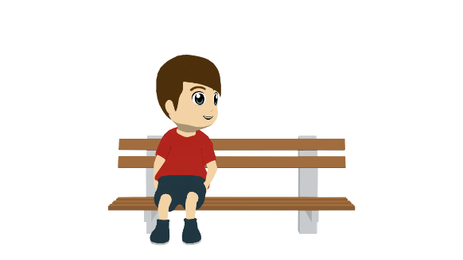
Daniel habla sobre las vacaciones de una amiga. Lee las frases. ¿Son las vacaciones de antes o son las vacaciones cada año? Elige la opción correcta y escribe la frase en inglés.
leer
 | Cada año | Antes
En inglés
She decided to go to the United States.
1. Decidió ir a los Estados Unidos.
2. Conoció los lugares famosos del país.
She got to know the famous places in the country.
3. Comparte una casa con unos amigos.
She shares a house with some friends.
4. Apenas aprendió inglés.
She hardly/barely learned English.
5. Imprime los billetes antes del viaje.
She prints the tickets before the trip.
6. Descubre partes del mundo en el extranjero.
She discovers parts of the world abroad.
Notes:
NA: This is a reading activity that we use to begin the receptive practice. We have Daniel, one of the characters, who’s talking about someone else’s holidays. Students have to read the sentences, which all use an –er/-ir verb in the 3rd person, and decide whether the verb ending refers to something that happens every year (cada ano) or something that happened before (antes). In each sentence an active decision is needed that connects the grammar to the meaning that it communicates. You’ll notice there are no time phrases that could give away the meaning – they have to pay attention to the grammar to understand the meaning that it conveys.
However, this isn’t all grammar-focused. We also anticipate that students will provide the English for the sentences that they read, either in writing or simply as an oral translation during feedback.
Timing: 7 minutes.
Aim: to consolidate understanding of the difference between 3rd person singular present (-e) and preterite (-ió) through reading. To consolidate understanding of vocabulary through translation.
Procedure:
Students read each sentence and decide whether it refers to the present or the past.
Students write each sentence in English.
Note: the use of ‘de’ for possession features in the first line of the instructions (‘Daniel habla sobre las vacaciones de una amiga’). This feature hasn’t yet been explicitly taught, but has appeared incidentally on occasions. If the meaning is unclear, it may be necessary to give this upfront.

Slide 49
Ahora Lucía habla de las vacaciones de un amigo, Enrique. Escucha las frases. ¿La acción pasa normalmente o ya pasó? También escribe el verbo en español y la actividad en inglés.
escuchar
Where is the stress? Does it need an accent?
 | Pasa normalmente | Ya pasó en el pasado
El verbo en español
La actividad en inglés
1
vivió
lived for a year in Mexico
2
conoce
knows the border with the United States
3
sufrió
suffered a car accident there
4
ofrece
offers gifts to friends after the holidays
5
decide
decides to visit old villages/towns
6
aprende
learns things about the culture of the cities
7
rompió
broke the camera near a mountain
8
salió
went out with a friend
Notes:
NA: In this activity, students are asked to listen to sentences that have the verb ending –e (for a habitual present action) or –ió (for a completed past action). They have to recognise the ending and then decide which meaning it corresponds to (‘happens normally’ or ‘happened last year’). The sentences that students hear do not have any time markers, so the only way to complete the task is to pay attention to the verb ending.
Incidentally, the task also gets the learner to transcribe the verb, after listening again, to practise use of the written accent, and also involves note taking to check comprehension of the vocabulary. This is an important thing to note again: grammar and vocabulary practice are closely connected, and happen as part of the same activities.
Timing: 8 minutes
Aim: 1) to consolidate understanding of the difference between 3rd person singular present (-e) and preterite (-ió) through listening; 2) to focus on the position of the stress and how this affects the use of the written accent.
Procedure:
Students listen to each recording.
They tick the correct column depending on whether the sentence refers to the present or to a completed action in the past.
Students listen again. This time, they write the verb in Spanish and the activity in English.
Note:
Some students may be able to complete the different parts in one go, rather than as separate steps.
Transcript
Vivió un año en México.
Conoce la frontera con Estados Unidos.
Sufrió un accidente de coche allí.
Ofrece regalos a los amigos después de las vacaciones .
Decide visitar pueblos antiguos.
Aprende cosas sobre la cultura de las ciudades.
Rompió la cámara cerca de una montaña.
Salió con un amigo.

Slide 50
Ahora escribe unas frases sobre los viajes de Enrique. ¿Son las vacaciones de antes o son las vacaciones cada año? Usa la forma correcta del verbo (‘–e’ o ‘–ió’), según la frase.
escribir
1. He got to know a famous church in Colombia.
Conoció una iglesias famosa en Colombia.
?
2. He always breaks something.
Siempre rompe algo.
?
3. He decided to travel up to/as far as the border with Ecuador.
Decidió viajar hasta la frontera con Ecuador.
?
4. He suffers many accidents during the holidays.
Sufre muchos accidentes durante las vacaciones.
?
5. He offers presents to some friends after the trips.
El Santuario de Las Lajas es una iglesia en el suroeste de Colombia. Está muy cerca de la frontera con Ecuador.
Ofrece regalos a unos amigos después de los viajes.
?
6. He barely learnt English in the United States.
Apenas aprendió inglés en los Estados Unidos.
?
Notes:
NA: This is the first chance to use some of the language in production. We start with a writing as it allows students a bit more time to reflect on the grammar and vocabulary needed. Here, the activity involves full sentence translation, but for some groups it might be more appropriate to do scaffolded practice (e.g. providing the sentence ending and asking students for the first half of the sentence only). It’s also a chance to bring in a bit of cultural content related to the topic of travel, in this case a church in a Spanish-speaking country.
Timing: 10 minutes
Aim: to produce the third person singular forms of –er/–ir verbs in present and preterite in writing; to produce vocabulary in writing
Procedure:
Students read the English sentences, paying particular attention to whether the verb refers to habitual present or to a completed action in the past.
They write the sentence in Spanish.
Notes:
Sentences 1 and 3 are based on real places in the Spanish-speaking world. A picture and caption are included as additional information about these.
The vast majority of the words in this activity have either been practised in the preceding activities or were taught in Y7 (e.g. iglesia). It may be worth recapping the word ‘hasta’ (taught in Year 8 Term 1) with students before the activity.

Slide 51
hablar / escuchar
Hablamos de las vacaciones.
Persona A lee cada tarjeta en inglés y habla en español.
Persona B mira las opciones con el mismo número y escucha: ¿es presente o pasado? Luego, escribe el nombre correcto, según el verbo.
Ejemplo:
Persona B escucha, mira las opciones y escribe el nombre correcto en una lista:
Persona A habla:
 | Nombres
1
2
3
4
5
6
7
8
Perdió una cámara.
Paula
1
loses a camera
[Marta]
lost a camera
[Paula]
1
Say: S/he lost a camera.
Después, Persona B habla y Persona A escucha.
Notes:
NA: This is a paired listening/speaking activity from the end of the same lesson. Person A is prompted to produce sentences that either have a verb with the ending –e or –ió, depending on the English prompt. The person listening has to decide who that sentence corresponds to, based on the verb ending they hear and the answer option that matches it (which juxtaposes ‘past’ and ‘present’). This isn’t all that different to the last activity, except that a student is now giving the ‘input’ that a native speaker was giving on the last slide.
Again, there are no time markers to give away the answer.
As well as making grammar essential to task completion, the activity also allows for productive and receptive practice of the vocabulary used in the lesson.
Timing: 10 min.
Aim: to practise producing and understanding the 1st person singular present and 3rd person singular preterite forms of –ar verbs in the oral modality; to practise producing and understanding vocabulary
Procedure:
1. Person A says the card number and reads the question aloud in Spanish. (Saying the card number will help the partner to follow the order.)
2. Person B looks at the card displayed on the interactive whiteboard with the same number that s/he just heard. Depending on what Person A says, Person B writes the name of the person that the sentence corresponds to (e.g. 1. Paula).
Notes:
The cards for the person speaking are on the next slide. These need to be printed.
The cards for the person listening are on the following slide. These can be displayed on the board during the activity (no need to print).

Slide 52
Prompt Cards
Persona A
Persona B
1
2
1
2
Say: S/he suffered accidents.
Say: S/he broke a mobile.
Say: S/he suffers accidents.
Say: S/he broke a mobile.
3
4
3
4
Say: S/he learns about the culture.
Say: S/he shares an ice cream.
Say: S/he learnt about the culture.
Say: S/he shared an ice cream.
5
6
5
6
Say: S/he offers drinks.
Say: S/he printed the tickets.
Say: S/he prints the tickets.
Say: S/he offers drinks.
7
8
7
8
Say: S/he lives in the United States.
Say: S/he got to know France.
Say: S/he lived in the United States.
Say: S/he got to know France.
Notes:
NA: These are the prompt cards. As you can see, half of the sentences that each person produces are in the present tense and half are in the past, and this cannot be known in advance, so there is no predictability. Every interaction requires the speaker and listener to actively choose between the two verb forms and the meanings that they convey. There is no other way to successfully complete the task, without cheating!
DO NOT DISPLAY DURING ACTIVITY
A printer-friendly version of these speaking cards is available with the resource.

Slide 53
hablar
1
2
3
suffers accidents
[Marta]
suffered accidents
[Paula]
breaks a mobile
[Pablo]
broke a mobile
[Quique]
learns about the culture
[Irene]
learnt about the culture
[David]
4
5
6
shares an ice cream
[Alba]
shared an ice cream
[Adrián]
prints the tickets
[Pablo]
printed the tickets
[Marta]
offers drinks
[Nerea]
offered drinks
[Álvaro]
7
8
lives in the United Stated
[Irene]
lived in the United Stated
[Adrián]
gets to know France
[Alba]
got to know France
[Álvaro]
Notes:
NA: While the other student reads his/her sentences aloud, the other student will be looking at these on the interactive whiteboard, and will decide which person is referred to for each item.
DISPLAY TO CLASS DURING ACTIVITY
While the other student reads his/her sentences aloud (see previous slide), the other student will be looking at these on the interactive whiteboard, and will decide which person is referred to for each item.

Slide 54
Solución – Persona A
1
2
3
suffers accidents
[Marta]
suffered accidents
[Paula]
breaks a mobile
[Pablo]
broke a mobile
[Quique]
learns about the culture
[Irene]
learnt about the culture
[David]
4
5
6
shares an ice cream
[Alba]
shared an ice cream
[Adrián]
prints the tickets
[Pablo]
printed the tickets
[Marta]
offers drinks
[Nerea]
offered drinks
[Álvaro]
7
8
lives in the United Stated
[Irene]
lived in the United Stated
[Adrián]
gets to know France
[Alba]
got to know France
[Álvaro]
Notes:
DO NOT DISPLAY DURING ACTIVITY

Slide 55
Solución – Persona B
1
2
3
suffers accidents
[Marta]
suffered accidents
[Paula]
breaks a mobile
[Pablo]
broke a mobile
[Quique]
learns about the culture
[Irene]
learnt about the culture
[David]
4
5
6
shares an ice cream
[Alba]
shared an ice cream
[Adrián]
prints the tickets
[Pablo]
printed the tickets
[Marta]
offers drinks
[Nerea]
offered drinks
[Álvaro]
7
8
lives in the United Stated
[Irene]
lived in the United States
[Adrián]
gets to know France
[Alba]
got to know France
[Álvaro]
Notes:
DO NOT DISPLAY DURING ACTIVITY

Slide 56
Aims for the session
Part 1:
to understand the rationale for a new approach to curriculum design
identifying issues
setting out potential solutions
Part 2:
to explore one SOW design in detail
to understand individual lesson planning within this approach to curriculum design
Questions, discussion and next steps

Slide 57
QUESTIONS?

Slide 58
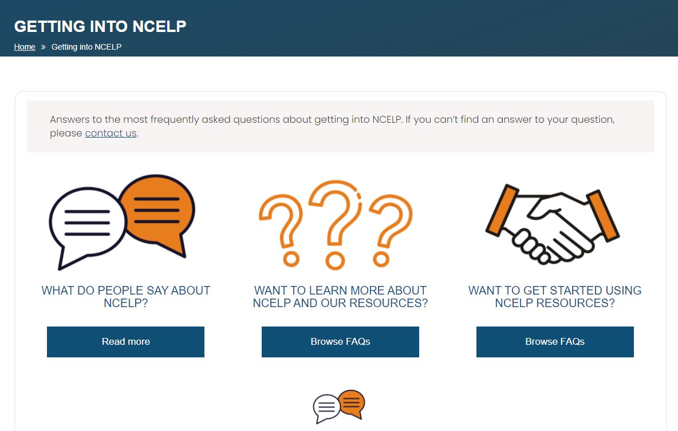
Next steps – further support
660 teachers outside the network on our regular mailing list
Some schools using and/or adapting the NCELP SOW and resources
New Getting into NCELP area of the website
Notes:
NCELP is a pilot project, set up to work intensively with 45 schools nationally, in the first phase. We have used the website, the resource portal, our mailing list and around 40 external presentations to date, to reach out to schools more widely.
So far, this has meant that… around 6000 teachers have attended one of our external events.

Slide 59
Further support [2]
NCELP alignment with wider policy (ECF, Ofsted) and pedagogy (Rosenshine)
Support for the GCSE Subject Content consultation
Notes:
Two further areas of support that are very recent additions to the website are a collection called NCELP alignment with wider policy, which brings together previous work on Ofsted framework with more recent work on the Early Career Framework and the Rosenshine principles. And at the same time we have put up a screencast and analysis documents as support to engage with the GCSE Subject Content consultation. There is a 60-minute screencast comparing the 2015 and the draft 2021 Subject Content that I would commend to you. I would strongly encourage people to get involved. There is still time!

