Slide 1
Vocabulario
Y7 Spanish
Term 2.1 - Week 1 - Lesson 29
Nick Avery / Rachel Hawkes
Date updated: 30/03/2019

Slide 2
Palabras importantes
la plaza | square
el balcón | balcony
la dama | lady
blanco | white
la flor | flower
torre | tower
el caballero | gentleman, knight
su | his/her/its
quién | who
saber | to know, knowing
pasar | to pass, passing
llevar | to carry, to wear
Notes:
Note: Students have been taught blanco, flor, quién, la plaza, and llevar. Revisiting them here within a new set of words will challenge their recall and deepen vocabulary knowledge. It’s encouraging for students to realise that a poem text contains words they have already learnt, as well as unfamiliar words.
Ask students to familiarise themselves with these words, using a usual routine (read aloud, ask and answer L2 → L1 meanings in pairs etc..)
Frequency rankings of key vocabulary:
plaza [806]; balcón [3133]; dama [2062]; blanco [372]; flor [739]; torre [2138]; caballero [2056]; su [12]; quién [132]; saber [44]; llevar [101]; pasar [68]
Source: Davies, M. & Davies, K. (2018). A frequency dictionary of Spanish: Core vocabulary for learners (2nd ed.). London: Routledge

Slide 3
En pareja. Lee el poema en alta voz.
hablar / escuchar
La plaza tiene una torre,
la torre tiene un balcón,
el balcón tiene una dama,
la dama una blanca flor.
Ha pasado un caballero
- ¡quién sabe por qué pasó! -,
y se ha llevado la plaza,
con su torre y su balcón,
con su balcón y su dama,
su dama y su blanca flor.
¿Cómo está el narrador / la narradora?
tonto/a
raro/a
alegre
nervioso/a
tranquilo/a
serio/a
Notes:
Check understanding of ‘pareja’ and ‘en alta voz’ in the instructions.
Students take turns to read the text to each other in pairs and the speaker decides how (i.e. with what tone) they will narrate the text. The partner listens and then asks the partner, e.g., ‘¿Estás serio?’. Remind students of the need to use ‘estás’ to speak directly to ‘you’ (singular).

Slide 4
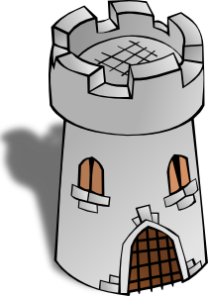
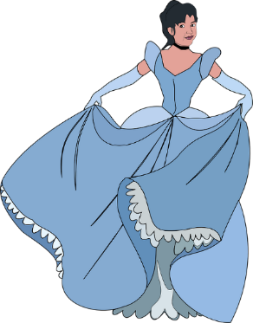
La dama describe una ciudad. ¿Qué hay?
un mercado
un m_ _ _ _ _ _
a market
un c_ _ _ _ _ de arte
un centro de arte
an art centre
laza
Hay una p_____ ,
un t_ _ _ _ _
a theatre
un teatro
una t____ y…
orre
un b_ _ _ _. Está c_ _ _ _.
a bank. It’s near.
un banco. Está cerca.
un m_ _ _ _
a museum
un museo
una tienda. Está lejos.
a shop. It’s far.
una t_ _ _ _ _. Está l_ _ _ _.
una iglesia
a church
una i_ _ _ _ _ _
una escuela. Está entre dos parques.
una e_ _ _ _ _ _. Está e_ _ _ _ dos parques.
a school. It’s between two parks.
Notes:
Vocabulary revision – all of the missing words are from Term 1.2, Week 5, which is revisited in the scheme of work this week.

Slide 5
Escucha y completa la frase.
escuchar / escribir
¿Cómo se dice en inglés?
1) Quiere _______ la _________.
saber
verdad
5) Da una bolsa a la señora en la tienda.
Es ___________ grande.
bastante
S/he wants to know the truth.
S/he gives a bag to the lady in the shop. It’s quite big.
2) Quiero __________ lejos de aquí.
celebrar
6) Doy películas a una amiga.
______ películas con ella es maravilloso!
I want to celebrate far from here.
Ver
I give films to a (female) friend.
Seeing / watching films with her is marvellous!
3) ¿Qué color quieres? ¿_______?
Verde
What colour do you want? Green?
abuela
4) ¿Das unas cosas a la _________?
Do you give some things to grandma?
Notes:
*AUDIO TO BE INSERTED*
This activity integrates grammar, vocabulary and phonics revision.
Phonics: Students first have to listen and write the missing word, which contains either the ‘b’ or ‘v’ SSC.
Grammar: After writing the missing words, students have to translate the sentence. Each one contains DAR and QUERER in 1st, 2nd or 3rd person singular.
Vocabulary is revisited from various earlier weeks. ‘Lejos’, ‘tienda’, ‘cosa’ and ‘bolsa’ are from the two vocabulary sets revisited this week (1.1.7 and 1.2.5) in the SoW.
Note: ‘ella’ has previously been encountered as a phonics word.

Slide 6
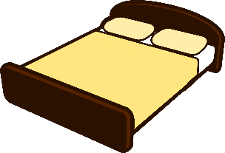
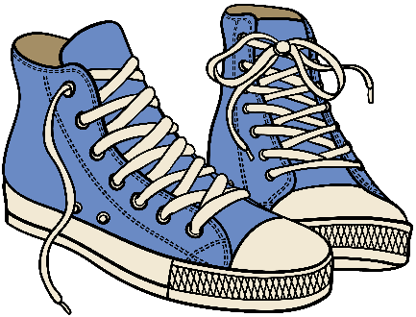
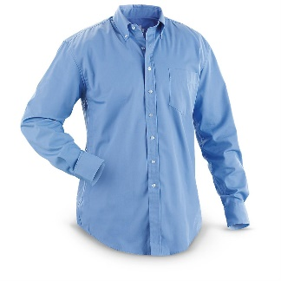
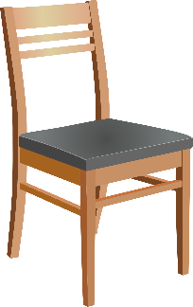
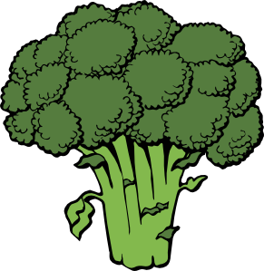
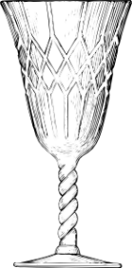
¿Qué es/son?
una cama
unos zapatos
dinero
un libro
una camisa
[product]
un producto
una silla
un plato de brocolí
un vaso
una bolsa
Notes:
Clicking each box triggers the appearance of the word.
Picture source: http://clipart-library.com/ (free to use)

