Slide 1
Vocabulary
Y7 German
Term 1.2 - Week 3
Natalie Finlayson / Rachel Hawkes

Slide 2
Vokabeln
F
o
s
die __ lasche
k__ chen
der Ti__ch
r
d
a
hie__
das Lieblingslie__
Mont__g
a
e
die T__fel
s__in
t
das Au__o
g
die Auf__abe
r
Z
leide__
das __immer
e
die L__hrerin
F
r
a
g
e
o
d
e
r
S
a
t
z
?
Notes:
Starter: This starter task revises 13 items of vocabulary (shown in bold below) drawn from 1.1.4, 1.1.7 (the two weeks students were set to revisit last week), as well as from the last two weeks 1.2.1 and 1.2.2. By working out which letters are missing and putting them in order into the spaces below, they create the question ‘Frage oder Satz?’, which is the grammatical focus for this lesson, so the activity does the task of ‘sharing the context learning objective’ with students. Elicit the English translation of this question from students to ensure that they are all clear about its meaning. Note: ‘Frage’ is a word students learnt in 1.1.6 but ‘Satz’ is a new, but highly frequent word, which we want to use from now on in classroom language/task instructions. Ensure that the meaning of Satz is clear. der Satz [582]
T1.1 Week 4
sein [3] ist [3] das Heft [3598] das Fenster [634] der Tisch [494] die Tafel [3660] die Flasche [1762] wo? [94] hier [71] da [35] der, die, das [1] T1.1 Week 7
Lieblings- [>4034] das Buch [295] der Film [524] der Sänger [3916] die Sängerin [3916] die Lehrerin [2696] das Lied [1726] die Band [<4034]; leider [642] T1.2 Week 1
wohnen [380] schreiben [245] spielen [197] reden [356] lernen [203] machen [49] Montag [794] die Aufgabe [317] im Klassenzimmer [609/619] im Unterricht [1107] in der Schule [208] mit Freunden [13/327]
T1.2 Week 2
arbeiten [200] putzen [2851] kochen [1005] sitzen [261] das Auto [490] zu Hause [6/159] der Garten [959] der Boden [445] die Liste [1975] das Zimmer [609]
Source: Jones, R.L. & Tschirner, E. (2006). A frequency dictionary of German: core vocabulary for learners. Routledge

Slide 3
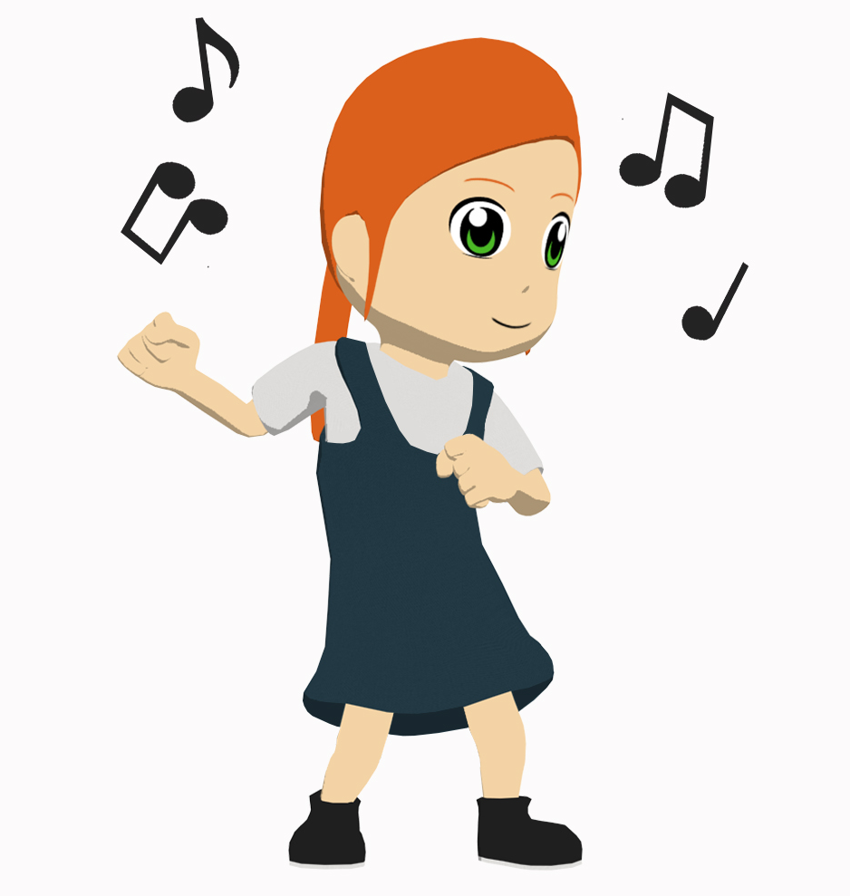
tanzen
[to dance | dancing]
tanzt
[dances | is dancing]
Notes:
Note: Students should know the meanings of the infinitives of these verbs already, as it was homework to learn them (audio and quizlet) but they are re-presented here in the infinitive and short form to deepen students’ knowledge and model the use of both forms in sentences.
Introducing the verb tanzen more explicitly. Tanzen is one of the NCELP 15 prototypical verbs in German. Prototypical verbs are common verbs that illustrate the typical characteristics of a class of verb – the German prototypical verbs contain examples of regular/weak verbs, but also common examples of each stem-change: e → i, a → äu, e → ie. All 15 prototypical verbs will be introduced early on using the same format. Both long form (infinitive) and short form (3rd person singular) are introduced in order to familiarise students with various forms of the same verb.
1. Bring up the word tanzen on its own, say it, students repeat it, and remind them of the phonics. 2. Try to elicit the meaning from the students. 3. Bring up the picture, and, if using gestures, a possible gesture would simply be to mime 1-2 seconds of dancing. 4. Then bring up the English translations. Emphasise the two meanings for the infinitive. 5. Bring up the short form tanzt, say it, students repeat it. 6. Try to elicit the meanings from the students. Emphasise the two meanings for the short form. Note: Students have had explicit teaching that the present tense in German communicates two different present tense meanings in English. This reinforces that learning.

Slide 4
tanzen
[to dance | dancing]
tanzt
[dances | is dancing]
Notes:
Cycle through the long and short form again.

Slide 5
tanzt
[dances | is dancing]
Laura tanzt oft.
[Laura often dances.]
Notes:
Introduce the short form in a sentence.
Oft [215] is part of the vocabulary set for this week, and it is expected that students have pre-learned this.

Slide 6
tanzen
[to dance | dancing]
Laura lernt tanzen.
[Laura learns| is learning to dance.]
Notes:
Introduce the long form in a sentence.
Lernen [203] was introduced in 1.2.1 and should be known.

Slide 7
tanzt
[dances | is dancing]
tanzt
Laura _____ oft.
[Laura often dances.]
Notes:
Cycle through the short form in context again.

Slide 8
tanzen
[to dance | dancing]
tanzen
Laura lernt ________ .
[Laura learns | is learning to dance.]
Notes:
Cycle through the long form in context again.

Slide 9
hören
[to listen to, hear | listening to, hearing]
hört
[listens to, hears | is listening to, hearing]
Notes:
Introducing the verb hören more explicitly. Hören is one of the NCELP 15 prototypical verbs in German. Prototypical verbs are common verbs that illustrate the typical characteristics of a class of verb – the German prototypical verbs contain examples of regular/weak verbs, but also common examples of each stem-change: e → i, a → äu, e → ie. All 15 prototypical verbs will be introduced early on using the same format. Both long form (infinitive) and short form (3rd person singular) are introduced in order to familiarise students with various forms of the same verb.
Students should recognise hören from the task bubbles on slides from previous weeks.
1. Bring up the word hören on its own, say it, students repeat it. Note: Students have not yet learnt ‘ö’ as an SSC and will therefore need some help/practice with this SSC. 2. Try to elicit the meaning from the students. 3. Bring up the picture, and if using gestures, a possible gesture would be to mime listening through headphones, putting a hand over each hear, and swaying as someone who is listening to music. 4. Then bring up the English translations. Emphasise the two meanings for the infinitive. 5. Bring up the short form hört, say it, students repeat it. 6. Try to elicit the meanings from the students. Emphasise the two meanings for the short form. Note: Students have had explicit teaching that the present tense in German communicates two different present tense meanings in English. This reinforces that learning.

Slide 10
hören
[to listen to, hear | listening to, hearing]
hört
[listens to, hears | is listening to, hearing]
Notes:
Cycle through the long and short form again.

Slide 11
hört
[listens to, hears | is listening to, hearing]
Laura hört Musik.
[Laura listens | is listening to music.]
Notes:
Introduce the short form in a sentence.
Musik (469) is not on the vocabulary list for this week, but is a highly frequent word. Out loud Musik sounds similar to English music which students will be able to use to infer the meaning.

Slide 12
hören
[to listen to, hear | listening to, hearing]
Laura kann Musik hören.
[Laura can listen to music.]
Notes:
Introduce the long form in a sentence.
Kann (23) is not on the vocabulary list for this week, but is a highly frequent word. Out loud kann sounds similar to English can which students might be able to use to infer the meaning.

Slide 13
hört
[listens to, hears | is listening to, hearing]
Laura ____ Musik.
hört
[Laura listens | is listening to music.]
Notes:
Cycle through the short form in context again.

Slide 14
hören
[to listen to, hear / listening to, hearing]
hören
Laura kann Musik ______.
[Laura can listen to music.]
Notes:
Cycle through the long form in context again.

Slide 15
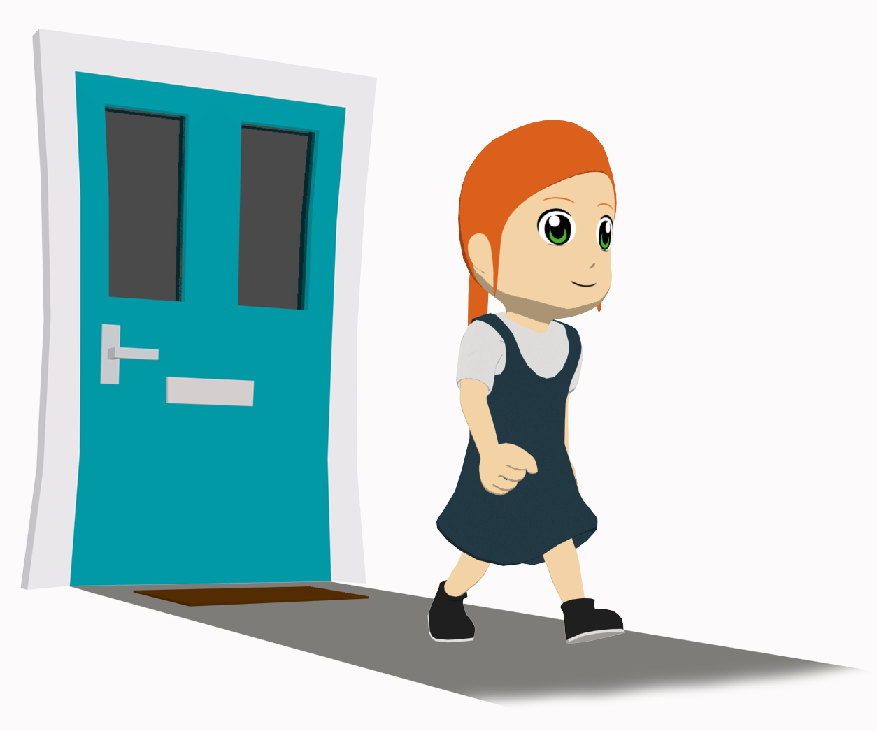
gehen
[to go | going]
geht
[goes | is going]
Notes:
Introducing the verb gehen more explicitly. Gehen is one of the 25 most frequently used verbs in German. All 25 most frequent verbs will be introduced early on using the same format. Both long form (infinitive) and short form (3rd person singular) are introduced in order to familiarise students with various forms of the same verb.
1. Bring up the word gehen on its own, say it, students repeat it, and remind them of the phonics. They have learnt the long ‘e’ sound.
2. Try to elicit the meaning from the students.
3. Bring up the picture, and if using gestures, a possible gesture would be to mime two legs walking, using two fingers on your right hand, going from right to left, in the air.
4. Bring up the short form geht, say it, students repeat it. Try to elicit the two meanings from the students.

Slide 16
gehen
[to go | going]
geht
[goes / is going]
Notes:
Cycle through the long and short form again.

Slide 17
geht
[goes / is going]
Laura geht in die Schule.
[Laura goes | is going to school.]
Notes:
Introduce the short form in a sentence.
Schule [208] was introduced in 1.1.6 and should be known.

Slide 18
gehen
[to go | going]
Laura kann in die Schule gehen.
[Laura can go to school.]

Slide 19
geht
[goes | is going]
geht
Luara ____ in die Schule.
[Laura goes | is going to school.]
Notes:
Cycle through the short form in context again.

Slide 20
gehen
[to go | going]
gehen
Laura kann in die Schule ________ .
[Laura can go to school.]

Slide 21
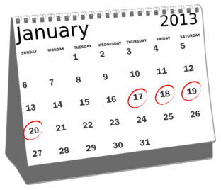
Wie oft?
Vokabeln
Put these adverbs of frequency in order, from most to least frequent.
manchmal
einmal die Woche
nie
jeden Tag
oft
sehr oft
kaum
Notes:
These adverbs are part of this week’s vocabulary and should be pre-learned.
This activity allows teacher to check meanings are known, and check pronunciation before the main task begins.
The teacher can use this opportunity to explain that adverbs are words that give more information about verbs – here, how often the verb happens.

Slide 22
Wie oft?
Vokabeln
Put the adverbs of frequency in order, from most to least frequent.
very often
sehr oft
jeden Tag
every day
often
einmal die Woche
oft
once a week
sometimes
manchmal
kaum
hardly
never
nie
Notes:
English translations revealed on clicks. With the English meanings displayed, try to elicit the German from students, to deepen their knowledge of this week’s vocabulary. This constant repetition of retrieval strengthens the memory of the words, whilst also giving the teacher valuable information as to how well the students know them. i.e. it’s a form of ongoing assessment.

Slide 23
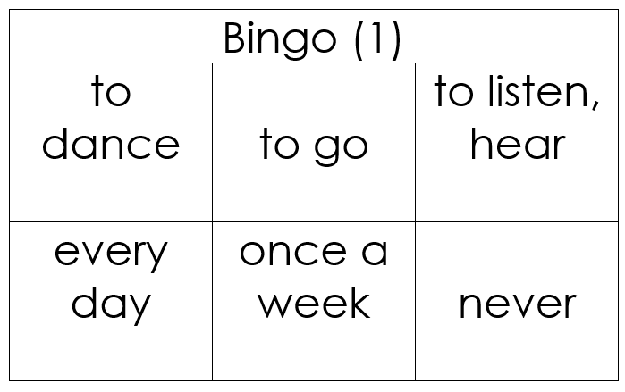
Vokabeln
hören und lesen
Ich gewinne!
Ich gewinne!
Notes:
Additional vocabulary practice.
This animated slide is an example only to explain the rules of the Bingo game.
Teacher distributes the Bingo cards included as supplementary materials this week. (The cards are double-sided, and there are three cards per page, so each printed sheet must be folded as instructed and cut into three). Note: If teachers prefer, they can give students scrap paper, they can draw three 3x2 tables (for 3 rounds of the game) and select their own words from the vocabulary set, writing the English on one side and replicate the 3 x 2 tables with German words on the reverse. Depending on the class ability, teachers may choose to display or not to display the German words in the list. (The final slide in this lesson gives a list of the vocabulary from this week with the option to obscure the German words).
Tell students to begin with the English side up. The teacher reads German words at random from this week’s vocabulary list. Students cross off the words they hear. When a student has crossed of all of his/her words, they use the German interjection ‘Ich gewinne!’ to indicate that they win. Gewinnen (infinitive) is a cluster word from 1.1.5, recycled here, in the first person singular. Ensure that students are clear about the meaning and that they can explain the verb ending change.
NB: As there are only 10 words on this week’s vocabulary list, the game will not last very long! It is highly like that one or more students will win after only 6 words have been called. For that reason, it is suggested that at least three rounds are played for additional practice.

Slide 24
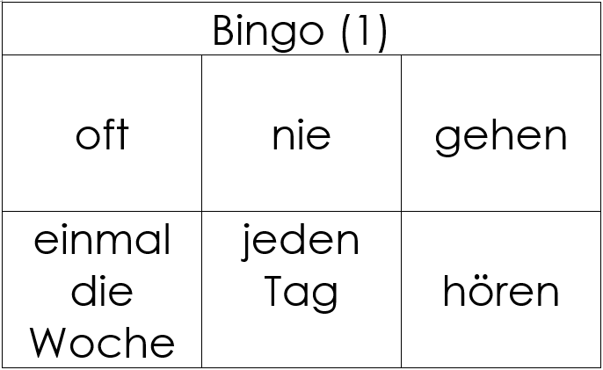
Vokabeln
hören und lesen
Ich gewinne!
Ich gewinne!
Notes:
This animated slide is an example only to explain the rules of the Bingo game.
Teacher distributes the Bingo cards included as supplementary materials this week. (The cards are double-sided, and there are three cards per page, so each printed sheet must be folded as instructed and cut into three).
Tell students to turn their cards German side up. The teacher reads English words at random from this week’s vocabulary list. Students cross off the words they hear. When a student has crossed of all of his/her words, they use the German interjection ‘Ich gewinne!’ to indicate that they win.
NB: As there are only 10 words on this week’s vocbulary list, the game will not last very long! It is highly like that one or more students will win after only 6 words have been called. It is suggested that at least three rounds are played for additional practice.

Slide 25
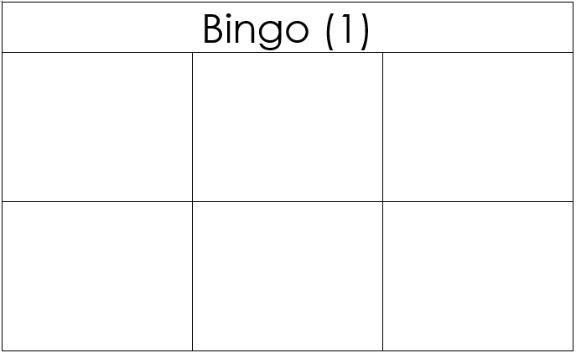
Du bist dran!
sprechen und schreiben
Schreib 6 Wörter auf Englisch.
Ich gewinne!
Ich gewinne!
Notes:
Additional group version of Bingo, time permitting.
Students have not yet met dran/daran [290] It is used idiomatically here in the sense of ‘you’re up/it’s your turn/you’re it/you’re on’. It’s literal meaning is often given as ‘on it’ Explain the meaning of ‘dran’ to students. Teachers can then use this in their classroom language, and encourage students to do the same.
Now, students play on their own in small groups (around 4 students). Students write six English words from the list. They then take it in turns to act as ‘gamemaster,’ and read German words from the list at random until one of their classmates shouts ‘Ich gewinne’

Slide 26
Du bist dran!
sprechen und schreiben
Schreib 6 Wörter auf Deutsch.
Ich gewinne!
Ich gewinne!
Notes:
This time, students write six German words from this week’s vocabulary (without referring to their notes/vocabulary list, ideally). They then take it in turns to act as ‘gamemaster,’ and read English words from the list at random until one of their classmates shouts ‘Ich gewinne’

Slide 27
 | Word | English meaning
1 | tanzen | to dance, dancing
2 | gehen | to go, going
3 | hören | to listen/hear
4 | jeden Tag | every day
5 | einmal die Woche | once a week
6 | nie | never
7 | kaum | seldom
8 | manchmal | sometimes
9 | sehr | very
10 | oft | often
Notes:
Vocabulary slide Frequency rankings (1 is the most common word in German):
tanzen [2011] gehen [69] hören [1557] jeden Tag [88/108] einmal die Woche [136 / 209] nie [196] kaum [259] manchmal [394] sehr [70] oft [215]
Source: Jones, R.L. & Tschirner, E. (2006). A frequency dictionary of German: core vocabulary for learners. Routledge

