Slide 1
Motivations and goals
aller + infinitive (future intention) (all persons)
two verb structures: negation, est-ce que questions
SSCs [en/an] and [on]
Y9 French
Term 1.1 - Week 3 - Lesson 5
Catherine Morris / Natalie Finlayson
Artwork by: Chloé Motard
Date updated: 21/07/21
Notes:
Artwork by Chloé Motard. All additional pictures selected are available under a Creative Commons license, no attribution required.
Native speaker feedback provided by Sarah Brichory.
With thanks to Rachel Hawkes for her input on the lesson material.
Learning outcomes (lesson 1):
Consolidation of SSCs [en/an] and [on]
Consolidation of:
aller + infinitive (future intention) (all persons)
two verb structures: negation
Introduction of:
- two verb structures: est-ce que questions, with and without question words Word frequency (1 is the most frequent word in French):
9.1.1.3 (revisit Y7 and Y8 vocabulary 3/13) aller, je vais, tu vas, il/elle va [53], boire [1879], changer [283], créer [332], devoir, je dois, tu dois, il/elle doit [39], dire [37], dormir [1836], emprunter [1123], étudier [960], faire [25], lire [278], partager [527], pouvoir, je peux, tu peux, il/elle peut [20], savoir, je sais, tu sais, il/elle sait [67], traduire [1125], vouloir, je veux, tu veux, il/elle veut [57], en [7], tout [24], ne [15], pas [18], annonce [1887], école [477], football [2602], frère [1043], histoire [263], mois [178], pont [1889], rêve [1313], sœur [1558], université [1192], dur [1029], plus [19], bien [47], très [66], d'abord [326], puis [320], ensuite [265], autre [28], général [147], jeune [152], meilleur [194], noir [572], petit [1385], rapide [672], seul [101], strict [1859], à l’avenir [4/1/471], absolument [1009], bien [47], bientôt [1208], demain [871], dur [1029], encore [513], facilement [1194], lentement [2637], maintenant [192], normalement [2018], parfois [410], plus [19], puis [230], rarement [2535], souvent [287], tôt [513]
Source: Londsale, D., & Le Bras, Y. (2009). A Frequency Dictionary of French: Core vocabulary for learners London: Routledge.
The frequency rankings for words that occur in this PowerPoint which have been previously introduced in NCELP resources are given in the NCELP SOW and in the resources that first introduced and formally re-visited those words.
For any other words that occur incidentally in this PowerPoint, frequency rankings will be provided in the notes field wherever possible.

Slide 2
Devoirs
Personne A lit sa version du texte.
Personne B écoute et prend des notes.
Quelles sont les différences ?
parler
amie
le mois prochain
rapide
emprunter
Ma sœur étudie l’anglais et l’histoire à l’école. Elle est plus jeune que tous les autres étudiants. Elle doit lire des livres en français et parfois en anglais. Demain, elle va faire du travail sur l’histoire du football. Son rêve est d’être une experte de l’histoire du football à l’avenir. Maintenant, elle ne dort pas beaucoup parce qu’elle étudie très dur. Par exemple, hier, elle a pris un petit café. Ensuite, elle a commencé les devoirs tôt.
bu
Mon amie
université.
meilleure
emprunter
souvent
Le mois prochain,
partager
partager
meilleure
Normalement
université
bu
café rapide
Puis,
normalement
seule.
puis
souvent
seule
Notes:
Timing: 10 minutes Aims: i) to review the homework task set last week (9.1.1.2).
ii) to develop fluency in decoding by reading aloud the student versions. iii) to listen attentively, noting differences in the original text. iv) to make judgements about the replacements made by a peer, and engage in peer feedback.
Procedure:
Student A reads his/her adapted homework text.
Student B follows along with the original and makes a note of any substituted words s/he hears (on his/her copy of the homework sheet)
Swap roles.
Compare and contrast the two versions. Scrutinise any differences and offer opinions about the correctness of the choices.
On successive clicks the bold words replaced with the appropriate substitute word.
Note that sometimes changes are needed to other words in the sentence. All of these changes revisit previously taught grammar, which teachers can elicit and/or explain as needed.
Note that alternative substitutions are possible. Teachers should make this clear and elicit students’ suggestions.
Note: the HW task set a time limit and asked students to try to replace at least ten of the words, so it’s to be expected that they might not have got them all.
Word frequency of cognates used (1 is the most frequent word in French):
version [1165]; différence [738]
Source: Londsale, D., & Le Bras, Y. (2009). A Frequency Dictionary of French: Core vocabulary for learners London: Routledge.

Slide 3
en/an
enfant
Notes:
Timing: 1 minute (2 slides)
Aim: To consolidate SSC [en/an]
Procedure: 1. Present the letter(s) and say the [en/an] sound first, on its own. Students repeat it with you. 2. Bring up the word ”enfant” on its own, say it, students repeat it, so that they have the opportunity to focus all of their attention on the connection between the written word and its sound.
3. A possible gesture for this would be to mime patting a child on the head/back 4. Roll back the animations and work through 1-3 again, but this time, dropping your voice completely to listen carefully to the students saying the [en/an] sound, pronouncing ”enfant” and, if using, doing the gesture.
Word frequency (1 is the most frequent word in French):
enfant [126]. Source: Londsale, D., & Le Bras, Y. (2009). A Frequency Dictionary of French: Core vocabulary for learners London: Routledge.

Slide 4
on
non!
Notes:
Aim: To consolidate SSC [on]
Procedure: 1. Present the letter(s) and say the [on] sound first, on its own. Students repeat it with you. 2. Bring up the word ”non” on its own, say it, students repeat it, so that they have the opportunity to focus all of their attention on the connection between the written word and its sound.
3. A possible gesture for this would be to shake ones head whilst waggling one’s index finger, to indicate ‘no!’ 4. Roll back the animations and work through 1-3 again, but this time, dropping your voice completely to listen carefully to the students saying the [on] sound, pronouncing ”non” and, if using, doing the gesture.
Word frequency (1 is the most frequent word in French):
onze [2447]
Source: Londsale, D., & Le Bras, Y. (2009). A Frequency Dictionary of French: Core vocabulary for learners London: Routledge.

Slide 5
‘mon’ ou ‘-ment’ ?
* répéter = to repeat
info
Écoute et répète.*
mon
il ment [he’s lying]
1
mon
normalement
3
mon
absolument
2
mon
rarement
4
mon
facilement
Notes:
Timing: 3 minutes
Aim: To distinguish aurally between SSCs [en/an] and accurately produce both sounds. This phonics focus prepares students to correctly pronounce -ment adverbs, which are this week’s word pattern feature.
Procedure:
1. Click to bring up the minima pair. Students listen to the pronunciation (click on the images to hear).
2. Explain that [on] and [en/an] are nasal vowels. [on] is a nasal [o], and [en/an] is a nasal [a]. Students practise saying [o] and [a], focusing on mouth position. The mouth should be wide in a square shape for [a], and almost closed like a kiss for [o].
3. Keeping the mouth position the same, students practise saying [on] and [en/an], and then [mon] and [il ment].
4. Click to bring up some known –ment adjectives juxtaposed with the word mon. Students listen and repeat.
Transcript:
mon – il ment
1. mon – normalement
2. mon – rarement
3. mon – absolument
4. mon – facilement

Slide 6
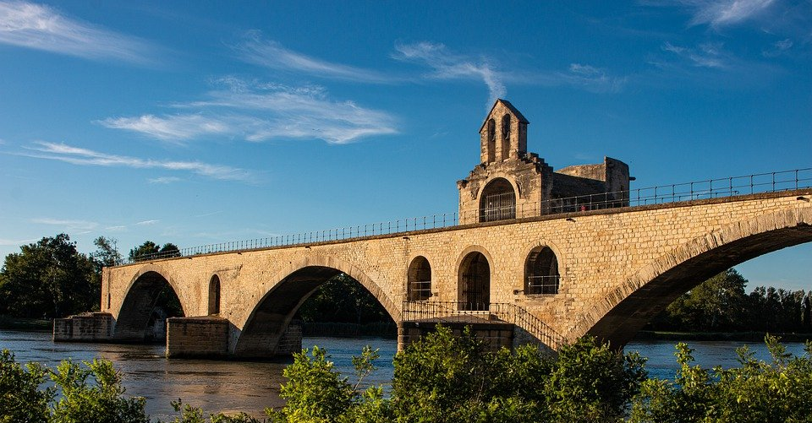
Une chanson populaire
*y = there
*le rond = circle
*les messieurs = gentlemen
écouter / écrire
C’est ‘on’ ou ‘en/an’ ?
Sur le pont d’Avignon
On y* danse, on y danse
Sur le pont d’Avignon
On y danse tous en rond*
Les beaux messieurs* font comme ça
Et puis encore comme ça …
On the Avignon bridge
People are dancing there (x2)
On the Avignon bridge
People are dancing round and round
The handsome gentlemen do this
And then do this again …
?
?
?
?
?
?
_
_
?
?
?
?
?
?
?
?
The lyrics say that people danced ‘sur le pont’, but the bridge was actually quite narrow. It is believed that people used to dance on the islands in the river under the bridge’s arches. But ‘sous le pont’ doesn’t sound quite so romantic!
Notes:
Timing: 6 minutes
Aim: Aural recognition of SSCs [on] and [en/an]; cultural awareness: folk song and geography
Procedure:
1. Tell students they are going to hear a traditional folk song about a famous French bridge. Point out that the end of the bridge is missing in the picture!
2. Explain that the rhyme scheme is based on SSCs [on] and [en/an]. As the two SSCs sound so similar to an English speaker, the students will have to listen very carefully!
3. Open video in a new tab – don’t let students see the video while they listen as it has the lyrics on screen: https://www.youtube.com/watch?v=uJKfxtYAt0s
4. Click to reveal the text with SSCs [on] and [en/an] missing. Play the first 45s of the video. On the first play, students simply listen and read along, focusing on the sounds covered by the question marks and listening for a difference.
5. Students listen to the audio again as many times as needed and fill the gaps in the text with either [on] or [en/an]. (NB: It may be easiest to let students copy out the text first, or to provide printed gapped versions).
6. Click to reveal answers one by one.
7. Click to reveal glosses. Students translate the text.
8. Click to reveal translation one line at a time.
9. Listen again, allowing students to read through/ watch video and sing along.
10. Click to bring up additional cultural information.
Transcript:
Sur le pont d’Avignon
On y* danse, on y danse
Sur le pont d’Avignon
On y danse tous en rond*
Les beaux messieurs* font comme ça
Et puis encore comme ça …
Word frequency of unknown words (1 is the most frequent word in French): y [36], rond [2268], messieurs [1549], populaire [1349]
Source: Londsale, D., & Le Bras, Y. (2009). A Frequency Dictionary of French: Core vocabulary for learners London: Routledge.
Word frequency of cognates (1 is the most frequent word in French): danser [2934],
Source: Londsale, D., & Le Bras, Y. (2009). A Frequency Dictionary of French: Core vocabulary for learners London: Routledge.
Video by Les Patapons available at https://www.youtube.com/channel/UCSpE7jrokfnEaVb7Ujf-hYQ

Slide 7
aller + infinitif
grammaire
aller – to go / going
je vais
tu vas
il/elle/on va
___
___
___
nous allons
vous allez
ils/elles vont
___
___
___
Use aller in the short form followed by a second verb in the long form (infinitive)
to talk about the future:
Je vais dormir tôt.
I am going to sleep early.
__ _____ ______
Tu vas aller en Espagne.
You (sing) are going to go to Spain.
__ _____ _____
Elle va faire le repas.
She is going to make the meal.
__ _____ _____
Nous allons boire de l’eau.
We are going to drink water.
_____ _____ ______
Vous allez emprunter le livre.
You (pl) are going to borrow the book.
_____ _____ __________
Ils vont traduire en français.
They are going to translate into French.
___ ____ ________
Notes:
Timing: 5 minutes
Aim: To recap all forms of aller in the present tense; to revise use of aller + infinitive to express future intention.
Procedure:
1. Click to bring up pronouns. Students produce the forms of aller (click to reveal one by one).
2. Click to bring up reminder about use of aller + infinitive to express future intention.
3. Click to bring up English sentences in the future, and partial French sentences. Students fill in the gaps with the missing verb phrase.
4. Click to reveal solutions.

Slide 8
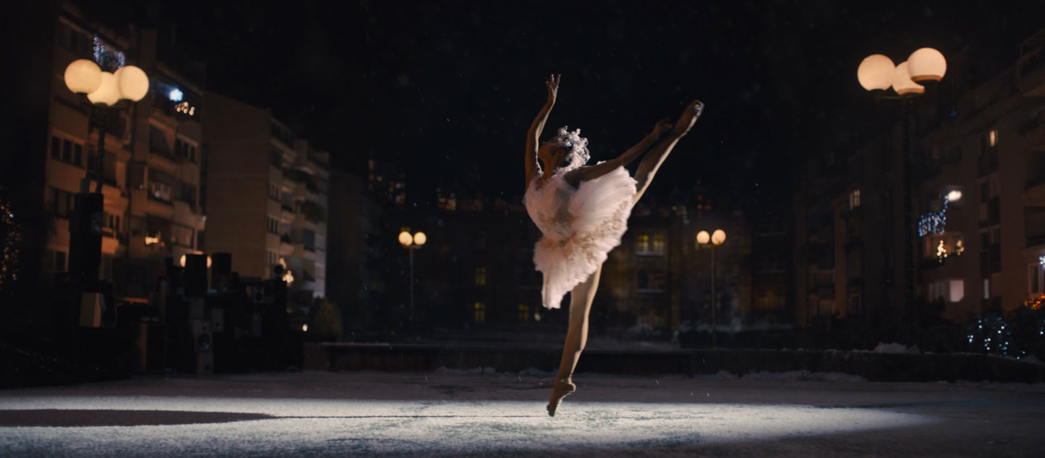
Taïs Vinolo (1/2)
Find the French for:
dreams are possible
lire
Find the French for:
Taïs wants to change the stereotypes
Find the French for: she wants to share a motivational message
Find the French for:
she is the star of the video
Find the French for:
Taïs lives in the United States now
Find the French for:
her dance school encourages diversity
Find the French for: the idea of the advert is to inspire other young ballerinas of colour
Find the French for:
the advert looks a lot like her life
*la danseuse = dancer (f) *l’an (m.) = year *la ballerine = ballerina
Taïs Vinolo est une jeune danseuse* de ballet française de 17 ans*. Elle est la star de la vidéo de Noël 2020 d'Amazon.
Dans les années 2000, il n'y avait pas beaucoup de filles noires dans le ballet. La jeune Taïs n’avait pas un vrai modèle. Taïs habite maintenant aux États-Unis et son école de danse encourage la diversité. L'idée de l'annonce est d'inspirer d'autres jeunes ballerines* noires. Taïs dit que l'histoire de l'annonce ressemble beaucoup à sa vie et elle veut partager un message de motivation : des rêves sont possibles.
À l'avenir, Taïs veut changer les stéréotypes
dans l'industrie du ballet. Elle veut partager son histoire avec des enfants plus jeunes pour créer une meilleure représentation des personnes noires dans les médias.
Notes:
Timing: 5 minutes
Aim: To demonstrate understanding of the text by picking out key information; reading comprehension.
Procedure:
1. Watch Amazon Advert video for context [30s version https://www.youtube.com/watch?v=rNgMqshvJsQ or 1min version https://www.youtube.com/watch?v=V_1sTW8jHDg]
2. Click to bring up an English sentence.
3. Students search for the translation in the French text.
4. Click to reveal the answer through an underline in the relevant sentence.
5. Click again to repeat steps 2-4 for a total of 8 sentences.
6. These 8 French sentences from the basis for the exercise on the next slide.
Word frequency of unknown words (1 is the most frequent word in French): danseuse [danseur 4309], an [76], ballerine [>5000]
Word frequency of cognates used (1 is the most frequent word in French): ballet [>5000], star [3322], vidéo [2611], admirer [2789], inspirer [1314], motivation [3522], stéréotype [>5000], industrie [692], représentation [1469], médias [1585], danse [2964], encourager [1434], diversité [2537]
Source: Londsale, D., & Le Bras, Y. (2009). A Frequency Dictionary of French: Core vocabulary for learners London: Routledge.
Image available at https://adobomagazine.com/campaign-spotlight/campaign-spotlight-the-show-must-go-on-ballet-dancer-shines-in-christmas-spot-for-amazon-by-prettybird-and-lucky-generals/

Slide 9
Taïs Vinolo (2/2)
écrire
Imagine this childhood conversation between Taïs and her ballet teacher.
Change the sentences using aller + infinitive to make them about the future.
E.g. Tu es une danseuse de ballet.
- Tu vas être une danseuse de ballet.
2nd person singular
+ infinitive
L’annonce inspire d’autres petites ballerines noires.
Nous partageons un message de motivation.
L’école encourage la diversité.
Les rêves sont possibles.
L’histoire ressemble beaucoup à ma vie.
Vous changez les stéréotypes.
Je suis la star de la vidéo.
Tu habites aux États-Unis.
Les rêves vont être possibles.
L’annonce va inspirer d’autres petites ballerines noires.
Vous allez changer les stéréotypes.
Nous allons partager un message de motivation.
L’école va encourager la diversité.
L’histoire va ressembler beaucoup à ma vie.
Je vais être la star de la vidéo.
Tu vas habiter aux États-Unis.
Notes:
Timing: 5 minutes
Aim: Tense substitution; written production of sentences with aller + infinitive to express future intention.
Procedure:
1. Click to go through example sentences and ensure understanding.
2. Students change sentences from present to future tense using aller + infinitive.
3. Click to bring up answers one by one.

Slide 10
ne…pas with two-verb structures
grammaire
Adding ne…pas around the verb turns a sentence negative.
Je vais à l’université.
Je ne vais pas à l’université.
In sentences with two verbs, ne…pas surrounds the first verb, which is in the short form. The second verb, in the long (infinitive) form, comes after pas.
Je vais aller à l’université.
Je ne vais pas aller à l’université.
Notes:
Timing: 2 minutes
Aim: To revise the placement of ne…pas to negate sentences with one and two verbs.
Procedure:
1. Click to bring up information.

Slide 11
On parle des objectifs
écrire
Réponds aux questions et justifie tes réponses.
e.g. Tu vas habiter en Angleterre?
Oui, je vais habiter en Angleterre.
Je vais habiter à Cambridge.
Non, je ne vais pas habiter en Angleterre. Je vais habiter en France.
Est-ce que ta famille va aller en France cet été ?
Est-ce que vous allez voyager en avion ?
Est-ce que tes amis vont étudier à l’université ?
Est-ce que tu vas bien apprendre une autre langue ?
Est-ce que tu vas avoir un chat à l’avenir ?
Est-ce que ton père va faire la cuisine aujourd’hui ?
Est-ce que tu vas travailler comme professeur ?
Est-ce que tes amis vont visiter d’autres pays ?
Notes:
Timing: 6 minutes
Aim: Written production of affirmative and negative sentences using aller + infinitive; reading comprehension.
Procedure:
1. Click through example on this slide to ensure students understand the activity.
2. Click to bring up questions for students to answer.
3. Students write their responses to the questions on the slide in full sentences with or without ne…pas and add a piece of qualifying information. Questions likely to elicit a range of affirmative and negatives responses.
Word frequency of cognates used (1 is the most frequent word in French):
justifier [884]
Source: Londsale, D., & Le Bras, Y. (2009). A Frequency Dictionary of French: Core vocabulary for learners London: Routledge.

Slide 12
Le voyant*
*le voyant = fortune teller
*prédire = to predict
parler
Parle avec un(e) partenaire.
Prédis ses réponses !
Ta famille ne va pas aller en France cet été. Elle va aller en Belgique!
Est-ce que ta famille va aller en France cet été ?
Est-ce que vous allez voyager en avion ?
Est-ce que tes amis vont étudier à l’université ?
Est-ce que tu vas apprendre bien une autre langue ?
Est-ce que tu vas avoir un chat à l'avenir ?
Est-ce que ton père va faire la cuisine aujourd’hui ?
Est-ce que tu vas travailler comme professeur ?
Est-ce que tes amis vont visiter d’autres pays ?
Notes:
Timing: 7 minutes
Aim: Oral production of affirmative and negative sentences with aller + infinitive to express future plans.
Procedure:
1. Click to bring up example.
2. Students work in pairs and predict each others’ answers.
3. The listening student corrects as necessary using their pre-prepared sentences to help them. At lower levels, the exercise can be carried out without the qualifying information (i.e., students answer to the yes/no question only).
Word frequency of unknown words (1 is the most frequent word in French): prédire [2869]

Slide 13
Motivations and goals
modal verbs (present) (je, tu, il/elle) two-verb structures: adverb positioning creating adverbs with -ment SSCs [en/an] and [on]
Y9 French
Term 1.1 - Week 3 - Lesson 6
Catherine Morris / Natalie Finlayson
Artwork by: Chloé Motard
Date updated: 21/07/21
Notes:
Artwork by Chloé Motard. All additional pictures selected are available under a Creative Commons license, no attribution required.
Native speaker feedback provided by Sarah Brichory.
With thanks to Rachel Hawkes and Emma Marsden for their input on the lesson material.
Learning outcomes (lesson 2):
Consolidation of SSCs [en/an] and [on] Consolidation of:
- modal verbs (present) (je, tu, il/elle)
- two-verb structures: adverb placement
Introduction of:
- creating adverbs with the –ment suffix
Word frequency (1 is the most frequent word in French):
9.1.1.3 (revisit Y7 and Y8 vocabulary 3/13) aller, je vais, tu vas, il/elle va [53], boire [1879], changer [283], créer [332], devoir, je dois, tu dois, il/elle doit [39], dire [37], dormir [1836], emprunter [1123], étudier [960], faire [25], lire [278], partager [527], pouvoir, je peux, tu peux, il/elle peut [20], savoir, je sais, tu sais, il/elle sait [67], traduire [1125], vouloir, je veux, tu veux, il/elle veut [57], en [7], tout [24], ne [15], pas [18], annonce [1887], école [477], football [2602], frère [1043], histoire [263], mois [178], pont [1889], rêve [1313], sœur [1558], université [1192], dur [1029], plus [19], bien [47], très [66], d'abord [326], puis [320], ensuite [265], autre [28], général [147], jeune [152], meilleur [194], noir [572], petit [1385], rapide [672], seul [101], strict [1859], à l’avenir [4/1/471], absolument [1009], bien [47], bientôt [1208], demain [871], dur [1029], encore [513], facilement [1194], lentement [2637], maintenant [192], normalement [2018], parfois [410], plus [19], puis [230], rarement [2535], souvent [287], tôt [513]
Source: Londsale, D., & Le Bras, Y. (2009). A Frequency Dictionary of French: Core vocabulary for learners London: Routledge.

Slide 14
en/an
grand
quand ?
?
enfant
penser
encore
prendre
[to take]
Notes:
Timing: 1 minute (2 slides)
Aim: To consolidate SSC [en/an]
Procedure:
1. Introduce and elicit the pronunciation of the individual SSC [en/an] and then the source word again ‘enfant’ (with gesture, if using). 2. Then present and elicit the pronunciation of the five cluster words.
The cluster words have been chosen for their high-frequency, from a range of word classes, with the SSC (where possible) positioned within a variety of syllables within the words (e.g. initial, 2nd, final etc.). Additionally, we have tried to use words that build cumulatively on previously taught SSCs (see the Phonics Teaching Sequence document) and do not include new SSCs. Where new SSCs are used, they are often consonants which have a similar symbol-sound correspondence in English.
Word frequency (1 is the most frequent word in French): grand [59]; quand [119] penser [116]; prendre [43]; encore [51]; enfant [126]. Source: Londsale, D., & Le Bras, Y. (2009). A Frequency Dictionary of French: Core vocabulary for learners London: Routledge.

Slide 15
on
onze
continuer
[to continue]
non!
monde
au fond
montrer
[at the back]
[to show]
Notes:
Aim: To consolidate SSC [on]
Procedure:
1. Introduce and elicit the pronunciation of the individual SSC [on] and then the source word again ‘non’ (with gesture, if using). 2. Then present and elicit the pronunciation of the five cluster words.
The cluster words have been chosen for their high-frequency, from a range of word classes, with the SSC (where possible) positioned within a variety of syllables within the words (e.g. initial, 2nd, final etc.). Additionally, we have tried to use words that build cumulatively on previously taught SSCs (see the Phonics Teaching Sequence document) and do not include new SSCs. Where new SSCs are used, they are often consonants which have a similar symbol-sound correspondence in English.
Word frequency (1 is the most frequent word in French): onze [2447]; continuer [113] monde [77]; montrer [108]; au fond [553]; non [72]. Source: Londsale, D., & Le Bras, Y. (2009). A Frequency Dictionary of French: Core vocabulary for learners London: Routledge.

Slide 16
Les adverbes en -ment
info
In English, we can add –ly to adjectives to turn them into adverbs.
This bus is dangerous! He is driving dangerously.
This word describes a noun.
This word describes a verb.
The French translation of –ly is –ment.
Ce bus est dangereux! Il conduit dangereusement.
SSC [en/an]
dangereux
dangerous (m)
dangereuse
dangerous (f)
This word describes a noun.
This word describes a verb.
–ment is normally added to the feminine form of adjectives:
dangereusement
dangerously
Notes:
Timing: 2 minutes
Aim: To introduce the ‘English '-ly' ➜ French '-ment’ suffix pattern; to introduce rule for turning French adjectives into –ment adeverbs (feminine form of adjective + –ment); to link the pronunciation of –ment adverbs with SSC [en/an]. NB: in this lesson, -ment adverbs are introduced for phonics practice only. As this derivational morphology pattern will be assessed, it will appear in systematic grammar activities in future lessons.
Procedure:
Click to bring up information and run through example.
Point out the cross linguistic similarity (adding a suffix to an adjective to make an adverb) and difference (the use of the feminine form of the adjective in French).
Draw attention to the pronunciation of the last syllable in dangereusement (SSC [en/an].)
Transcript:
dangereux
dangereuse
dangereusement
Word frequency of unknown words (1 is the most frequent word in French): dangereusement [>5000]
Word frequency of cognates (1 is the most frequent word in French): former [486], adverbe [>5000]
Source: Londsale, D., & Le Bras, Y. (2009). A Frequency Dictionary of French: Core vocabulary for learners London: Routledge.

Slide 17
Quel est l’adverbe ?
*sûr = safe
parler
Forme des adverbes en –ment.
Adjective base
Feminine form
Adverb
generally
sadly
lastly
surely
quickly
ambitiously
strictly
naturally
général
générale
généralement
1
general
sad
2
triste
triste
tristement
dernier
dernière
dernièrement
3
last
sure*
4
sûr
sûre
sûrement
rapide
rapide
rapidement
5
quick
ambitious
6
ambitieux
ambitieuse
ambitieusement
strict
stricte
strictement
7
strict
natural
8
naturel
naturelle
naturellement
Notes:
Timing: 4 minutes
Aim: Oral production of adverbs containing SSC [en/an]; applying word pattern knowledge (creating adverbs by adding –ment to feminine adjective form); vocabulary recall.
Procedure:
1. Students read the list of English words. Explain that although they don’t yet know these words in French, they have all the knowledge they need to produce them.
2. Guide students through the first example. First, ask them what the adjectival form of ‘generally’ is, and have them recall the French (all the adjectives needed to complete the activity have been taught previously).
3. Second, ask students to produce the feminine form of the adjective.
4. Third, ask them to add the –ment ending and say the word aloud.
5. Students repeat steps 2-4 for seven further examples.
6. Click to bring up answers one by one. Click on the audio button to hear the adverb said by a native speaker. Students repeat.
Transcript
généralement
tristement
dernièrement
sûrement
rapidement
ambitieusement
strictement
naturellement
Word frequency of unknown words (1 is the most frequent word in French): généralement [1710], dernièrement [>5000], tristement [>5000], sûrement [1750], rapidement [593], ambitieusement [>5000], strictement [2813], naturellement [2036]
Source: Londsale, D., & Le Bras, Y. (2009). A Frequency Dictionary of French: Core vocabulary for learners London: Routledge.
Word frequency of cognates (1 is the most frequent word in French): former [486], adverbe [>5000], sûr [270]
Source: Londsale, D., & Le Bras, Y. (2009). A Frequency Dictionary of French: Core vocabulary for learners London: Routledge.

Slide 18
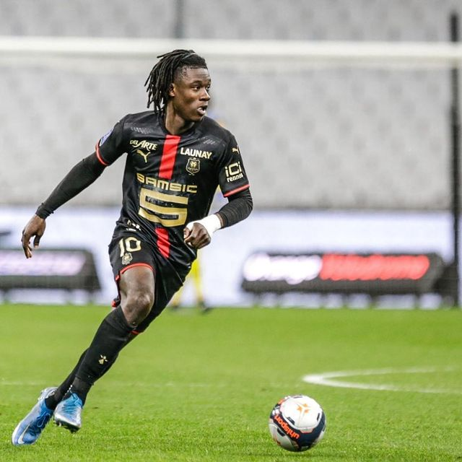
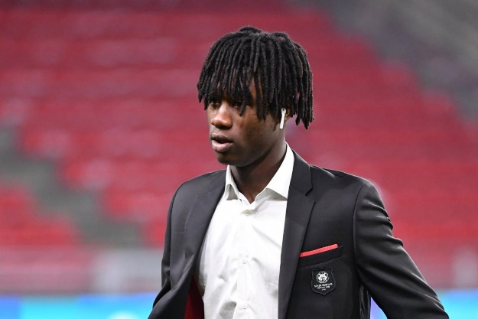
Eduardo Camavinga (1/2)
*né (m adj) = born
*l’an (m) = year
*perdu = lost
lire / écrire / parler
Lis le texte et prépare 4 questions avec est-ce que pour évaluer la compréhension de ton/ta partenaire !
Remember!
Add est-ce que to the start, either on its own or after a question word.
Est-ce qu’il a un frère ?
Combien de frères est-ce qu’il a ?
Eduardo Camavinga est né* dans un camp de réfugiés à Miconge, en Angola, en 2002. Il a deux frères et trois sœurs. Il arrive à Fougères en France à l'âge de deux ans* avec sa famille. Il joue au football à la maison et à l'école, puis en 2009 il entre en club. En 2013, il y a eu un feu de maison et la famille a tout perdu*. Eduardo dit que cet événement est sa motivation pour avoir une carrière dans le football aujourd’hui.
Il accepte son premier contrat professionnel avec le club de Rennes à l'âge de seize ans. Pour Eduardo, jouer pour l'équipe de France est "un rêve d'enfant, même si je suis encore enfant ! "
Notes:
Timing: 8 minutes
Aim: Reading comprehension; showing deep understanding of a text by using the information to produce comprehension questions using est-ce que.
Procedure:
1. Tell students they are going to create their own comprehension questions to test a partner’s understanding of the text.
2. Students read the text and note down 4 pieces of information. Students may need some help recognising which words are place names (Miconge, Angola, Fougères, Rennes). Remind them that a capital letter often indicates that a word is a name (of a person or place).
3. Click to reveal reminder about question formation with est-ce que.
4. Students turn their notes into questions. Encourage them to create two yes/no questions (using just est-ce que) and two information questions (using question words + est-ce que). Allow 5 minutes preparation time. NB: Optional English prompts are provided as role cards on the next slide.
5. Students work in pairs and take turns to ask and answer questions and provide feedback (in French) on their partner’s answers (e.g., Non, il n’a pas trois frères. Il a deux frères et trois sœurs.)
Word frequency of unknown words (1 is the most frequent word in French): né [pp naître 667], an [76], perdu [pp perdre 250]
Source: Londsale, D., & Le Bras, Y. (2009). A Frequency Dictionary of French: Core vocabulary for learners London: Routledge.
Word frequency of cognates used (1 is the most frequent word in French): évaluer [1544], compréhension [2827], camp [1084], réfugié [>5000], âge [502], club [1860], motivation [3522], carrière [1247], accepter [210], contrat [832], professionnel [1000], motivation [3522]
Source: Londsale, D., & Le Bras, Y. (2009). A Frequency Dictionary of French: Core vocabulary for learners London: Routledge.
Top image from Eduardo Camavinga’s Instagram page @Camavinga
Bottom image by P Lahalle for L’équipe available at https://www.lequipe.fr/Football/Actualites/Rennes-eduardo-camavinga-a-eu-son-bac/1150514

Slide 19
Eduardo Camavinga (2/2)
parler
Partner A Questions
Where was he born?
When does he move to France?
Did he move to France with his colleagues?
Does he play for Bordeaux?
Partner B Questions
Does he have brothers and sisters?
Where does Eduardo play football?
Does he have a professional contract?
What is his dream?
Partner A Questions
Où est-ce qu’il est né ?
Quand est-ce qu’il arrive en France ?
Est-ce qu’il arrive en France avec ses collègues ?
Est-ce qu’il joue pour Bordeaux ?
Partner B Questions
Est-ce qu’il a des frères et des sœurs ?
Où est-ce qu’il joue au football ?
Est-ce qu’il a un contrat professionnel ?
Quel est son rêve?
Notes:
Optional role cards

Slide 20
Modal verbs
grammaire
Use pouvoir to talk about abillity or permission
Use savoir to talk about skills/things you have learned to do
Modal verbs give more information about another verb. They tell us what someone has to, wants (to), is able to and knows how to do.
devoir must, to have to
vouloir to want (to)
pouvoir can, to be able to
savoir can, to know how to
je dois
je veux
je peux
je sais
tu dois
tu veux
tu peux
tu sais
il/elle/on doit
il/elle/on veut
il/elle/on peut
il/elle/on sait
Remember to use the modal verb in the short form. If there is a second verb it must be in the long form (infinitive).
Je veux du chocolat.
I want (some) chocolate.
Je veux manger du chocolat.
I want to eat (some)chocolate.
Notes:
Timing: 3 minutes
Aim: To recap meaning and singular forms of modal verbs; to revise structures with modal verbs and infinitives.
Procedure:
1. Click to bring up information and the modal verbs one by one. Students produce the singular forms of each.
2. Make sure students understand the difference between pouvoir (permission) and savoir (learned skills).
3. Click to bring up example sentences, drawing attention to the position of the infinitive in the two-verb structure, and drawing parallels with the aller + infinitive structure revised in the first lesson.
Word frequency (1 is the most frequent word in French): chocolat [4556]
Source: Londsale, D., & Le Bras, Y. (2009). A Frequency Dictionary of French: Core vocabulary for learners London: Routledge.

Slide 21
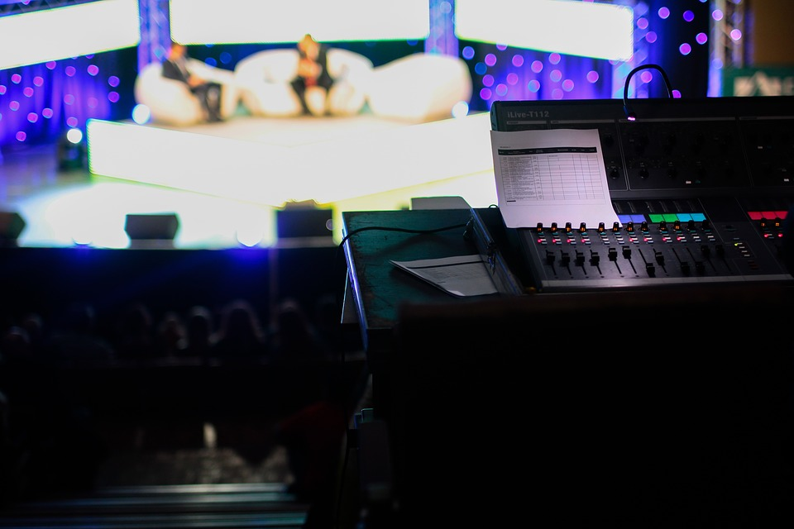
Missing modals?
*imaginer = to imagine
*la motivation = motivation
écouter
Deux journalistes sportives discutent de l’histoire de Camavinga à la radio. Écoute la conversation. Is a modal verb missing?
1
Eduardo Camavinga a cinq frères et sœurs. Est-ce que tu as une grande famille ?
2
Il vient d’Angola en Afrique, mais aujourd’hui il habite en France.
3
Un jour, il y a un accident et la maison prend feu.
4
Tu peux imaginer* être dans cette situation ?
?
5
Il dit que c’est sa motivation*. Il doit jouer au foot pour gagner de l’argent pour sa famille.
?
6
Il trouve vite son premier emploi.
7
Il sait travailler dur pour sa famille.
?
8
Tu veux jouer au football avec Eduardo Camavinga un jour ?
?
Notes:
Timing: 5 minutes
Aim: Identifying the presence or absence of modal verbs based on aural recognition of long and short verb forms.
Procedure:
Click audio buttons to hear sentences with a beep inserted before the verb.
Students decide, based on the verb form they hear after the beep, whether a modal verb is missing or not.
Click to reveal transcriptions of each sentence.
If there is a modal verb missing, students use the context to work out which one it might be (there are several justifiable answers).
Click to reveal.
Click on the transcripts to hear the full sentences read aloud.
Transcript:
1. Eduardo Camavinga a cinq frères et sœurs. Est-ce que tu [-] as une grande famille ?
2. Il vient d’Angola en Afrique, mais aujourd’hui il [-] habite en France.
3. Un jour, il y a un accident et la maison [-] prend feu.
4. Tu [peux] imaginer être dans cette situation ?
5. Il dit que c’est sa motivation. Il [doit] jouer au foot pour gagner de l’argent pour sa famille.
6. Il [-] trouve vite son premier emploi.
7. Il [sait] travailler dur pour sa famille.
8. Tu [veux] jouer au football avec Eduardo Camavinga un jour ?
Word frequency of cognates used (1 is the most frequent word in French): sportif [2670], journaliste [1337], discuter [737] imaginer [840], motivation [3522]
Source: Londsale, D., & Le Bras, Y. (2009). A Frequency Dictionary of French: Core vocabulary for learners London: Routledge.

Slide 22
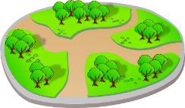
La position des adverbes
Exceptions !
Parfois sometimes comes at the beginning of a sentence:
Parfois, il parle à Sophie.
Aussi often comes at the end.
Je vais au magasin aussi.
grammaire
Adverbs and adverbial phrases give more information about a verb.
Adverbs that tell us when and where something happens normally come at the beginning or end of the sentence:
Demain, je vais aller au parc.
Je vais aller au parc demain.
I’m going to go to the park tomorrow.
Adverbs that tell us how and how often something happens normally come after the verb in short form:
Il parle souvent à Sophie.
He often speaks to Sophie.
So, in sentences with two verbs, these often come between the verbs:
Il veut souvent parler à Sophie.
He often wants to speak to Sophie.
Notes:
Timing: 2 minutes
Aim: To recap the function of adverbs and their position in single- and two-verb structures.
Procedure:
1. Click to bring up information, focusing on the positioning differences between a) adverbs of time/place and manner, and b) manner adverbs in single- and two-verb structures.
Word frequency of cognates used (1 is the most frequent word in French):
position [383]
Source: Londsale, D., & Le Bras, Y. (2009). A Frequency Dictionary of French: Core vocabulary for learners London: Routledge.

Slide 23
La position des adverbes
*joyeusement = happily
*vraiment = truly
*l’an (m) = year
lire
Une des journalistes veut publier le dialogue dans un magazine sportif.
Add more information by putting the adverbs in appropriate positions.
Sentence | Adverb
Est-ce que tu as une grande famille ? | aussi
Il arrive en France à l'âge de deux ans. | joyeusement*
Un grand feu de maison change la vie de la famille. | en 2013.
Tu peux imaginer être sans maison ? | vraiment*
Il doit jouer au foot pour gagner de l’argent. | absolument
Il trouve son premier emploi à Rennes. | à Rennes
Il sait travailler dur pour sa famille. | naturellement
Tu veux jouer au football avec Eduardo Camavinga? | à l’avenir
Est-ce que tu as une grande famille aussi ?
Il arrive joyeusement en France à l'âge de deux ans.
Un grand feu de maison change la vie de la famille en 2013.
En 2013, un grand feu de maison change la vie de la famille.
Tu peux vraiment imaginer être sans maison ?
Il doit absolument jouer au foot pour gagner de l’argent.
À Rennes, il trouve vite son premier emploi.
Il trouve vite son premier emploi à Rennes.
Il sait naturellement travailler dur pour sa famille.
À l’avenir, tu veux jouer au football avec Eduardo Camavinga?
Tu veux jouer au football avec Eduardo Camavinga un jour à l’avenir ?
Notes:
Timing: 5 minutes
Aim: To position adverbs in sentences with one or two verbs.
Procedure:
1. Tell students they are going to adapt the spoken dialogue they hear for publication by adding more detail for readers.
2. Ensure understanding of the meaning of the adverbs, and check that students know whether each is an adverb of time, place, manner or frequency.
3. Students re-write the sentences with the adverbs added.
4. Click to reveal answers.
5. Oral translation of sentences.
Word frequency of unknown words (1 is the most frequent word in French): vraiment [361], joyeusement [>5000], an [76]
Source: Londsale, D., & Le Bras, Y. (2009). A Frequency Dictionary of French: Core vocabulary for learners London: Routledge.
Word frequency of cognates used (1 is the most frequent word in French): motivation [3522], imaginer [840], publier [768], magazine [2033], dialogue [1719], journaliste [1337]
Source: Londsale, D., & Le Bras, Y. (2009). A Frequency Dictionary of French: Core vocabulary for learners London: Routledge.

Slide 24
À l’avenir …
*l’enquête (f.) = survey
parler
Imagine que tu es plus grand(e). Prépare des réponses à ces questions :
1. Tu veux faire quoi à l’avenir ?
Je veux être professeure.
2. On doit faire quoi pour être X ?
On doit étudier dur.
Remember!
être + no article + profession
Parle avec six autres personnes dans la classe. Fais une enquête !
Qui | vouloir être… | devoir …
Sophie | professeure | étudier dur
Notes:
Timing: 5 minutes
Aim: To revise use of être + no article to talk about professions; oral production of sentences with modal verbs to talk about future goals.
Procedure:
Students prepare their answers to the questions on the board for 1-2 minutes.
Click to bring up instructions for the oral part of the activity. Students sketch a 3x6 table.
Click again to add an example to the table.
Students conduct the survey in large groups.
Elicit some sentences from students in the 3rd person as examples (e.g. Sophie veut être professeure. Pour être professeure, on doit étudier dur.)
Word frequency of unknown words (1 is the most frequent word in French): enquête [866]
Source: Londsale, D., & Le Bras, Y. (2009). A Frequency Dictionary of French: Core vocabulary for learners London: Routledge.
Word frequency of cognates (1 is the most frequent word in French): enquête [866]
Source: Londsale, D., & Le Bras, Y. (2009). A Frequency Dictionary of French: Core vocabulary for learners London: Routledge.

Slide 25
Objectifs* et motivations 1/4
*un objectif = goal
écrire
Taïs Vinolo et Eduardo Camavinga ont parlé des motivations et des objectifs de chacun. Maintenant, tu écris sur tes motivations et tes objectifs.
Pour commencer, écris 4 choses que tu vas faire à l’avenir.
aller + infinitive
Je vais devenir journaliste.
Notes:
Timing: 15 minutes for four related activities. This is a four-part activity which guides students through the process of writing more complex sentences one stage at a time.
Part 1: 4 minutes
Aim: Written production of sentences with aller + infinitive in affirmative sentences to express future goals.
Procedure:
Click to bring up instructions.
Click again to bring up prompt (aller + infinitive) and example.
Students write four sentences about what they want to do in the future.
Word frequency of unknown words (1 is the most frequent word in French): objectif [518]
Source: Londsale, D., & Le Bras, Y. (2009). A Frequency Dictionary of French: Core vocabulary for learners London: Routledge.
Word frequency of cognates used (1 is the most frequent word in French): motivation [3522]
Source: Londsale, D., & Le Bras, Y. (2009). A Frequency Dictionary of French: Core vocabulary for learners London: Routledge.

Slide 26
Objectifs* et motivations 2/4
*un objectif = goal
écrire
Maintenant, écris 2 choses que tu ne vas pas faire à l’avenir.
aller + infinitive
ne … pas
Je ne vais pas habiter à Londres .
Notes:
Part 2: 2 minutes
Aim: Written production of sentences with aller + infinitive in negative sentences to express future goals.
Procedure:
Click to bring up instructions.
Click again to bring up prompt (aller + infinitive and ne…pas) and example.
Students write two sentences about what they do not want to do in the future.
Word frequency of unknown words (1 is the most frequent word in French): motivation [3522]
Source: Londsale, D., & Le Bras, Y. (2009). A Frequency Dictionary of French: Core vocabulary for learners London: Routledge

Slide 27
Objectifs* et motivations 3/4
*un objectif = goal
écrire
Pourquoi est-ce que tu vas faire ces choses ? Ou pourquoi pas ?
Écris des phrases plus longues avec ‘parce que.’ Utilise les verbes modaux pour expliquer tes motivations.
modal + infinitive
Je vais devenir journaliste parce que je sais bien écrire.
Je ne vais pas habiter à Londres parce que je veux habiter à l'étranger.
Notes:
Part 3: 6 minutes
Aim: Written production of two-clause sentences with parce que and modal verb + infinitive structures to express motivations.
Procedure:
Click to bring up instructions.
Click again to bring up prompt (modal + infinitive).
Students write six sentences about what they have to/must/want to/know how to do and link these to the ones they have already written using parce que.
Word frequency of unknown words (1 is the most frequent word in French): objectif [518]
Source: Londsale, D., & Le Bras, Y. (2009). A Frequency Dictionary of French: Core vocabulary for learners London: Routledge.
Word frequency of cognates used (1 is the most frequent word in French): motivation [3522], long [202]
Source: Londsale, D., & Le Bras, Y. (2009). A Frequency Dictionary of French: Core vocabulary for learners London: Routledge.

Slide 28
Objectifs* et motivations 4/4
*un objectif = goal
*ajouter = to add
écrire
Quand, où et comment est-ce que tu vas faire ces choses ?
Ajoute un adverbe à chaque phrase.
when/where = beginning or end of the sentence
how/how often
= after the verb in short form
Je vais absolument devenir journaliste parce que je sais bien écrire.
Je ne vais pas habiter à Londres parce que je veux habiter à l'étranger à l'avenir.
Notes:
Part 3: 3 minutes
Aim: Written production of complex sentences with adverbs.
Procedure:
Click to bring up instructions.
Click again to bring up prompt (adverb position).
Students insert adverbs to say when, where, how or for how long they are going to do these things. They need only add one adverb per sentence.
Point out to students that over the course of the last four slides students have produced a mini essay about their motivations and future goals.
Word frequency of unknown words (1 is the most frequent word in French): objectif [518], ajouter [359]
Source: Londsale, D., & Le Bras, Y. (2009). A Frequency Dictionary of French: Core vocabulary for learners London: Routledge.
Word frequency of cognates used (1 is the most frequent word in French): motivation [3522], adverbe [>5000]
Source: Londsale, D., & Le Bras, Y. (2009). A Frequency Dictionary of French: Core vocabulary for learners London: Routledge.

Slide 29
Gaming Grammar
Gaming Grammar
Relevant mini game(s):
Verbs (present): 1st person singular/plural (Verb agreement (present))
Verbs (present): 2nd person singular/plural (Verb agreement (present))
Verbs (present): 3rd person singular/plural (Verb agreement (present))
Notes:
This slide links to Gaming Grammar login screen. The appropriate mission can then be selected from the menu page.
Students will progress through the game at their own rate; teachers should use the teacher interface to check progress. This will help to inform future lesson planning.

Slide 30
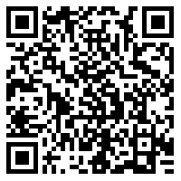
Devoirs
Vocabulary Learning Homework (Y9, Term 1.1, Week 4)
Audio file
Audio file QR code:
Student worksheet
Quizlet link
In addition, revisit: Year 8 Term 3.2 Week 4
Year 8 Term 3.1 Week 2
Notes:
The answer sheet for the 9.1.1.4 vocabulary learning homework is here: https://resources.ncelp.org/concern/resources/4x51hk12j?locale=en

