Slide 1
Introduction and Overview: Grammar Sequencing and Teaching
NCELP Hub Day
3rd July 2020
Victoria Hobson
Notes:
Hello, I’m Victoria Hobson. Welcome to the introduction and overview to Grammar Sequencing and Teaching, our last session of today’s Webinar.

Slide 2
Aims of the session
1. explore the key principles underpinning the development of the Schemes of Work, with a specific focus on the sequencing of grammar.
2. look at the grammar rationale and see a selection of resources exemplifying the principles in action which accompany the Y7 SoW.
3. look ahead to the plans for the grammar sequences for Y8.
Notes:
In this session we are going to consider the sequencing and teaching of grammar more closely. We will look at the general approach to the sequencing of grammar within our Y7 schemes of work, take a look at the types of teaching activities from our range of resources which supplement the Schemes of Work and take a look ahead to the plans for the sequences for Y8.

Slide 3
Key Principles Underpinning the Development of the SoW
Rate of progress
Content coverage: Knowledge and practice
Nature of the
explicit spine
Revisiting and
regular knowledge
and progress
checks
Notes:
Our Schemes of Work are proposed as principled examples of how language knowledge and practice can be sequenced and re-visited to support progression in the early stages of language development within a low exposure foreign language setting. Here we take a look at the specific approaches to the sequencing of grammar.
For a more detailed appreciation of these points, the full document ‘NCELP Schemes of Work KS3 Rationale and Principles’ can be found on the Resource Portal in the Rationales, research and guidance collection.
Let’s look specifically at how these key principles inform the sequencing and teaching of grammar within the NCELP Schemes of Work.
Principle 1: rate of progress.

Slide 4
Key Principles Underpinning the Development of the SoW
Our SoW aim to avoid introducing too much language too fast. For the majority of learners aged 11-13, introducing no more than one new main grammatical function every two weeks is likely to set sufficient amount of ‘desirable difficulty.’
Content coverage: Knowledge and practice
Nature of the
explicit spine
Revisiting and
regular knowledge
and progress
checks
Notes:
Our Schemes of Work aim to avoid introducing too much language too fast. For the majority of learners aged 11-13, introducing no more than one new main grammatical function every two weeks is likely to set sufficient amount of ‘desirable difficulty.’

Slide 5
Key Principles Underpinning the Development of the SoW
Rate of progress
Content coverage: Knowledge and practice
Nature of the
explicit spine
Revisiting and
regular knowledge
and progress
checks
Notes:
Principle 2: the nature of the ‘explicit spine’.

Slide 6
Key Principles Underpinning the Development of the SoW
Rate of progress
Content coverage: Knowledge and practice
NCELP proposes an explicit spine of grammar and high frequency vocabulary. It is not driven by a need to cover pre-determined topics or communicative functions via a holistic approach to sentences, but rather via a focus on the functions of grammar.
Revisiting and
regular knowledge
and progress
checks
Notes:
NCELP proposes an explicit spine of grammar and high frequency vocabulary. It is not driven by a need to cover pre-determined topics or communicative functions via a holistic approach to sentences, but rather via a focus on the functions of grammar.

Slide 7
Key Principles Underpinning the Development of the SoW
Rate of progress
Content coverage: Knowledge and practice
Nature of the
explicit spine
Revisiting and
regular knowledge
and progress
checks
Notes:
Principle 3: Content coverage: Knowledge and practice.

Slide 8
Key Principles Underpinning the Development of the SoW
Rate of progress
The grammar spine is not driven by traditional ‘paradigms’ (e.g., full sets of verb, article or adjectival agreements, all at once). However, in its totality the grammar spine will cover the full range of features for persons, subjects, tenses, and aspectual functions (‘complete’ versus ‘ongoing’), and a range of key syntax (word order and relations between words) over time.
Nature of the
explicit spine
Revisiting and
regular knowledge
and progress
checks
Notes:
The grammar spine is not driven by traditional ‘paradigms’ (e.g., full sets of verb, article or adjectival agreements, all at once). However, in its totality the grammar spine will cover the full range of features for persons, subjects, tenses, and aspectual functions (‘complete’ versus ‘ongoing’), and a range of key syntax (word order and relations between words) over time.

Slide 9
Key Principles Underpinning the Development of the SoW
Rate of progress
Content coverage: Knowledge and practice
Nature of the
explicit spine
Revisiting and
regular knowledge
and progress
checks
Notes:
Principle 4: Revisiting and regular knowledge and progress checks.

Slide 10
Key Principles Underpinning the Development of the SoW
Rate of progress
Content coverage: Knowledge and practice
Nature of the
explicit spine
NCELP has taken as guiding principles that revisiting must be: frequent enough to prevent forgetting; spaced enough so that recall is challenging; and systematically planned into the SoW so that it happens. Grammar features (and high-frequency vocabulary) are recycled in new semantic fields and different contexts, which strengthens the knowledge base.
Notes:
NCELP has taken as guiding principles that revisiting must be: frequent enough to prevent forgetting; spaced enough so that recall is challenging; and systematically planned into the SoW so that it happens. Grammar features (and high-frequency vocabulary) are recycled in new semantic fields and different contexts, which strengthens the knowledge base.

Slide 11
Grammar within the Scheme of Work
Our SoW aim to avoid introducing too much language too fast. For the majority of learners aged 11-13, introducing no more than one new main grammatical function every two weeks is likely to set sufficient amount of ‘desirable difficulty.’
NCELP proposes an explicit spine of grammar and high frequency vocabulary. It is not driven by a need to cover pre-determined topics or communicative functions via a holistic approach to sentences, but rather via a focus on the functions of grammar.
NCELP has taken as guiding principles that revisiting must be: frequent enough to prevent forgetting; spaced enough so that recall is challenging; and systematically planned into the SoW so that it happens. Grammar features (and high-frequency vocabulary) are recycled in new semantic fields and different contexts, which strengthens the knowledge base.
The grammar spine is not driven by traditional ‘paradigms’ (e.g., full sets of verb, article or adjectival agreements, all at once). However, in its totality the grammar spine will cover the full range of features for persons, subjects, tenses, and aspectual functions (‘complete’ versus ‘ongoing’), and a range of key syntax (word order and relations between words) over time.
Rate of progress
Content coverage: Knowledge and practice
Nature of the explicit spine
Revisiting and regular checks
Notes:
Now we have seen how these key principles inform the sequencing and teaching of grammar within the NCELP Schemes of Work, let’s take a closer look now at how these principles translate into sequences for teaching grammar in the NCELP Year 7 Schemes of Work.
We take a look at Term 1 for French, Term 2 for Spanish and Term 3 for German

Slide 12
Year 7 French: Term 1.1
Week
1 | être - je, tu, il/elle regular adjective gender agreement (as complement to verb only)
2 | être - je, tu, il/elle; regular adjective gender agreement (as complement to verb only); intonation questions
3 | avoir - je, il/elle indefinite articles & gender (un, une); c'est; intonation questions
4 | avoir - je, tu post-nominal position of adjectives (attributive, i.e. with noun) intonation questions
5 | être & avoir - je, tu, il/elle indefinite articles
6 | definite article (le, la, les, l') regular plural marking on nouns (-s) être & avoir; je, tu, il/elle
7 | faire for English equivalents 'do' and 'make' only followed by le/la/l' /les - je, tu, il/elle definite articles (le, la, les, l')
Notes:
Here is the grammar spine for Year 7 French Term 1.1.
As we have seen, we err on the side of slower progression and aim to give plenty of practice of the features introduced, and this really is, more than the explanations, the crucial factor leading to long-term learning.
At the beginning (first half of term one), we can see that highly frequent verbs form the basis of the scheme of work.

Slide 13
Year 7 French: Term 1.2
Week
1 | Text exploitation: Sept couleurs magiques
2 | faire with English equivalents other than 'do/make', e.g., 'go' revisit je, tu, il/elle
3 | -ER verbs (introduction using 'top 25' and 'prototypical' verb lists) - je, tu il/elle preposition à with certain verbs present simple used with its continuous meaning
4 | -ER verbs - je, tu, il/elle; preposition à with certain verbs intonation questions
5 | -ER verbs - il/elle; je; nous
6 | -ER verbs - il/elle; ils/elles
7 | tu and vous (plural) - with selection of common verbs
Notes:
Very soon after we also include regular verbs (second half of term one), and try to build the verb lexicon so that students can begin to actively manipulate verbs which they already know how to conjugate. So these are also taught in the early stages.

Slide 14
Year 7 Spanish: Term 2.1
Week
1 | Work with challenging text: La plaza tiene una torre (Antonio Machado); doy/das/da; quiero/quieres/quiere
2 | TENER - tengo, tienes, tiene; tenemos, tienen; es; son; adjective agreement; number agreement
3 | order of nouns and adjectives; tiene; tienen; soy; es; son; hay; está (+ location)
4 | HACER - hago/haces/hace; es; son; hay; question words: cuándo, cuánto(s), cuál(es), quién(es), adjective number agreement; adjective gender agreement
5 | revision week
6 | assessment week
Notes:
This the grammar spine for Y7 Spanish Term 2.
We aim for broad clarity across the 3 languages in terms of the features that we cover, with differences in sequencing owing to the internal grammar of each language.
So, there are these language specific characteristics, which we certainly cater for. So, for example, Spanish has two different verbs for 'to be', and we've built this into the early stages of Year 7. In the first term, singular persons are learnt and then revisited in Term 2.

Slide 15
Year 7 Spanish: Term 2.2
Week
1 | regular ar verbs: 1st person plural (-amos) PRESENT tense; -ar verbs 1st person singular (-o)
2 | PODER - puedo/puedes/puede + infinitive; yes/no questions with raised intonation versus 'flat' intonation for statements
3 | DEBER - debo/debes/debe + infinitive; PODER - puedo/puedes/puede; revisit QUERER quiero/quiere (+ infinitive); -ar verbs
4 | estamos, están for LOCATION; está, estoy
5 | somos, son, estamos, están for STATE/MOOD versus TRAITS, adjective agreement for gender and number
Notes:
Also In the second term, whilst revisiting singular persons we move on to embedding first and third person plural of both ser and estar.
Also, possessive adjectives are less complex in Spanish than in French, for example, as they don't require gender agreement, and so they come earlier in the Spanish scheme of work (in Term 1, compared to Term 2 in the French). So it's crucially the internal structure of the language that is driving the scheme of work.

Slide 16
Year 7 German: Term 3.1
Week
1 | Word Order 2 in statements, with adverbs of time
2 | Word Order 2; VSO questions with wann?
3 | Prepositions 'in' and 'auf' + R2 [acc] + movement, R3 [dat] + location
4 | Possessive adjectives: mein / dein / sein / ihr (R1); negation - kein; question words; question-forming
5 | possessives mein / dein / sein / ihr cont'd
6 | Word Order 2: with expressions of location; viel/viele; es gibt and numbers 1-12; more practice with in/auf+ R3 [dat] + location
Notes:
Here is the grammar spine for Y7 German Term 3.
When you look at the scheme of work, you'll see that the revisiting of grammar is incorporated into the grammar column, rather than in separate columns, and this should make progression easier to follow and see how new features are related to those which are previously taught. Grammar features in bold indicate that this is when the item is first introduced. Features not in bold are items revisited for the first time. Italics indicate grammar revisited for a second time and thereafter.
Just in case some of the abbreviations look a bit unfamiliar, we use WO for word order. WO1 is word order 1 – this is Subject Verb Object word order, the first pattern that students learn. Then they learn WO2 – word oder 2, which is subject-verb inversion after adverbs of time, initially, but we also ensure that we do full practice of word order 2 after locations, too. Word order 3 is saved for Y8 and this is obviously verb to the end of the clause after subordinating conjunctions, like weil, dass, wenn etc..
R1 stands for Row 1 on an articles table and is the nominative or subject case. Row 2 is the accusative, Row 3 dative. For any Germanists there, yes, we do know that Germans themselves typically have a different order for the rows but we are not teaching our students the genitive before the accusative or dative. Activities allow for differing levels of support, for example in the amount of vocabulary help offered, and for a variety of levels of outcome in the production tasks. Individual tasks, where appropriate, are differentiated either to support less able students or offer stretch and challenge.

Slide 17
Year 7 German: Term 3.2
Week
1 | Present tense - weak and strong, HABEN and SEIN (all persons except ihr); revisit present simple vs continuous, revisit question-forming
2 | Revision / Assessment week
3 | Modal verbs - müssen / dürfen / wollen; 2nd verb rule; man
4 | Modal verbs cont'd
5 | Future vs Present meaning using present tense; time adverbials plus R2 - nächsten Monat / nächste Woche /nächstes Jahr; nach (to for countries/cities); word order 2; wann
6 | Future meaning 1st person singular and plural; zu vs nach meaning 'to'; numbers 1-31; dates
7 | Text: Immer höher [revisits auf + R2 (Accusative) and R3 (Dative); extend to another preposition unter [85] or an [19]
Notes:
All verbs dealt with up to now have been in present tense. In the second half of term 3 , we contrast present with future tense. This is the same for Spanish and French as well.
Activities in all our Schemes of Work allow for differing levels of support, for example in the amount of vocabulary help offered, and for a variety of levels of outcome in the production tasks. Individual tasks, where appropriate, are differentiated either to support less able students or offer stretch and challenge.

Slide 18
Principles for teaching grammar in a foreign language.
A succinct, explicit description of the grammar feature and its meaning.
Initial practice to reinforce knowledge of the grammatical form and its meaning in the ‘input’(i.e. when reading
and listening), contrasting pairs
of features.
In order to complete the activity correctly, the learner needs to connect the grammar feature to its meaning.
(Task essential)
The grammar feature is made task-essential during practice by removing as many other clues from the sentence as possible.
Developing learners’ awareness of the relationship between English and the L2.
Pairs of meanings juxtaposed in different combinations, ensuring that features are revisited and reinforced.
After extensive initial practice of pairs of features, very gradually, activities may incorporate more than two features.
Grammar is encountered with a varied lexicon to consolidate learners’ knowledge of a grammatical system that works across multiple contexts.
Writing and speaking activities to help learners establish and practise accessing knowledge after the input practice.
Notes:
This slide summarises the key elements of teaching grammar from the ‘Principles for teaching grammar in a foreign language’ rationale document. If you wish to refer to the document in full, especially if you are new to NCELP, you will find it with the Rationales, research and guidance collection, here:
Grammar teaching: rationale - ‘Principles for teaching grammar in a foreign language’ (link to Resource Portal)
Take a minute to read these.
Now let’s look in more detail at these principles when it comes to introducing new grammar.

Slide 19
Saying what people have: nous and vous
A succinct, explicit description of the grammar feature and its meaning.
Saying what people have: nous and vous
grammaire
As you know, the verb avoir changes form to match the subject.
J’ai des chiens. Tu as des chiens. Il/elle a des chiens.
I have dogs. You have dogs. He/she has dogs.
To say ‘we’ + avoir (first person plural):
Nous avons des chiens. We have dogs.
To say ‘you’ (more than one person) + avoir (second person plural):
Vous avez des chiens. You (plural) have dogs.
Notes:
Year 7 French Term 2.1 week 3 - Introducing first and second person plural forms of avoir
Here we can see the new grammar feature being very briefly described ahead of plenty of practice. This is taken from a French resource on introducing first and second person plural forms of “avoir”.
Providing a succinct, explicit description of the grammar feature, before practice, can help learners to understand the meaning of the feature. We can see how importance has been given to describing the meaning of the grammar by explaining, ‘to say ‘we’…’ and ‘to say ‘you’ (more than one person)…’ rather than just giving information about forming the grammar structure.
There is a substantial amount of empirical evidence, of studies of language learning, that have shown that for most learners, for most of the time, and across a variety of different grammar features, providing an explanation upfront, before practice, is more beneficial than waiting for or asking learners to spot patterns.

Slide 20
Present simple or continuous?
Developing learners’ awareness of the relationship between English and the L2.
Grammatik
With an explanation and examples.
English has two present tense forms.
I play the drums every week. I am playing the drums right now.
German has one present tense only. The BE + -ing form does not exist.
Ich spiele jede Woche Schlagzeug. Ich spiele jetzt Schlagzeug.
Present simple - normally; routine
Ich spiele =
I play AND
I am playing
Present continuous (BE + -ing) - ongoing; current
Adverbs of time tell us which English tense to choose.
In German, the present simple is used with all adverbs referring to the present.
Notes:
Year 7 German Term 2.1 week 6 - Consolidation of present tense weak verbs in 1st person singular and 1st person plural.
This slide from a German resource is an example of how to develop learners’ awareness of the relationship between English and the L2. This is particularly beneficial for grammar features where the relationship is complex e.g., when the L2 grammar feature exists in English but works differently in some way. The brief explanation can include pointers. In this example, the useful pointer ‘Adverbs of time tell us which English tense to use’ is included.

Slide 21
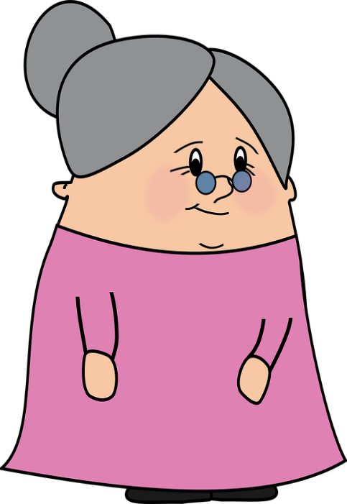
Present simple or continuous?
Developing learners’ awareness of the relationship between English and the L2.
Grammatik
Wolfgang and Mia are staying with Oma this week. She makes notes about their routine.
1.1 Choose the correct adverb.
With a task in L1.
A
Wolfgang is playing tennis at the moment/every week.
B
Mia wears a uniform at the moment/every week.
C
Mia is having lunch at the moment/every week.
D
Wolfgang is doing his homework at the moment/every week.
E
Mia goes for a walk at the moment/every week.
Notes:
Year 7 German Term 2.1 week 6 - Consolidation of present tense weak verbs in 1st person singular and 1st person plural.
In the previous slide we saw an example of how we can develop learners’ awareness of the relationship between English and the L2, with an explanation and examples. This time, to achieve the same aim, a task in the L1 is used. Here, students are asked to choose the correct adverb within a sentence in English, which serves to reinforce the pointer given in the previous slide.

Slide 22
Introducing new grammar
Contrasting “pairs of features” which have different meanings (or functions)
Introducing and practising full paradigms at one time is likely to overload learners’ attentional capacity and memory, and is likely to lead to false expectations about what has really been learnt.
Learners tend to pay attention to a limited number of new features at any one time (Robinson, 2003; VanPatten, 2004).
Introducing full paradigms can therefore be confusing and demotivating for learners, especially when all the components of the paradigm are not given sufficient practice. There is also very strong evidence that grammar systems, such as verb inflections, are not really learned linearly, in neat, holistic packages (such as “present tense ‘-ar’, ‘-er’ and ‘-ir’; then perfect tense; then imperfect tense) (Mitchell, Myles, & Marsden, 2019).
Notes:
Many existing resources tend to introduce full grammatical paradigms in one go (for example present tense verb endings for 1st, 2nd, 3rd person singular and plural, and sometimes in three different patterns (-er, -ir, -re) simultaneously or in close succession). However, introducing and practising full paradigms at one time is likely to overload learners’ attentional capacity and memory, and is likely to lead to false expectations about what has really been learned. Learners tend to pay attention to a limited number of new features at any one time (Robinson, 2003; VanPatten, 2004).
Introducing full paradigms can therefore be confusing and demotivating for learners, especially when all the components of the paradigm are not given sufficient practice. There is also very strong evidence that grammar systems, such as verb inflections, are not really learned linearly, in neat, holistic packages (such as “present tense ‘-ar’, ‘-er’ and ‘-ir’; then perfect tense; then imperfect tense) (Mitchell, Myles, & Marsden, 2019).

Slide 23
Introducing new grammar
Contrasting “pairs of features” which have different meanings (or functions)
It is likely to be most helpful for most learners to use activities that introduce and practise pairs of grammar features which have different meanings (or functions). For example, to describe events in the present, we contrast the use of a verb ending that ‘means’ 1st person singular with another feature that ‘means’ 1st person plural; or we juxtapose a word order that conveys the ‘function’ of a question with another word order that functions as a statement.
Notes:
It is likely to be most helpful for most learners to use activities that introduce and practise pairs of grammar features which have different meanings (or functions). For example, to describe events in the present, we contrast the use of a verb ending that ‘means’ 1st person singular with another feature that ‘means’ 1st person plural; or we juxtapose a word order that conveys the ‘function’ of a question with another word order that functions as a statement.
Let’s take a closer look now at this principle within our Year 7 resources.

Slide 24
Estar: I am & he/she is
In Spanish, the verb estar means to be when describing location.
Estoy
I am
Está
he / she is
Estoy en España.
I am in Spain.
Está en España.
He / she is in Spain.
Notes:
So here we see the verb ‘estar’ being explained, concentrating on the difference between ‘I am’ and ‘s/he is’.
This resources is taken from Year 7, Term 1, week 1, so it is one of the very first grammar activities that students encounter when following the NCELP Spanish SoW.
There then follow two activities to practise this pair of features: one reading and one listening activity.

Slide 25
Cartas postales
Read the postcards. Who is where? estoy (I am) or está (he/she is).
Write: 1. I am OR he/she is.
Notes:
These are the instructions to students for the reading task which follows. The rubrics here are in English, with this being a resource form the very first week of Year 7. Gradually, you will see the rubrics appear in the target language, as the resources progress through the weeks and terms.

Slide 26
leer
4)
1)
I am
I am
Está en el palacio
Miramar.
Estoy en el museo del
Prado.
he/she is
he/she is
2)
5)
I am
I am
Estoy en el museo
Guggenheim.
Estoy en el Bernabeu.
he/she is
he/she is
3)
I am
6)
I am
Está en La Alhambra.
Está en el Campo
Nou.
he/she is
he/she is
Notes:
Here we are making sure that students really notice the grammar in the ‘input’ and understand what meaning it conveys.
This is done in listening and reading activities, in the target language. They can’t guess, they can’t rely on words – JUST the grammar. Let’s move on to look at the listening.

Slide 27
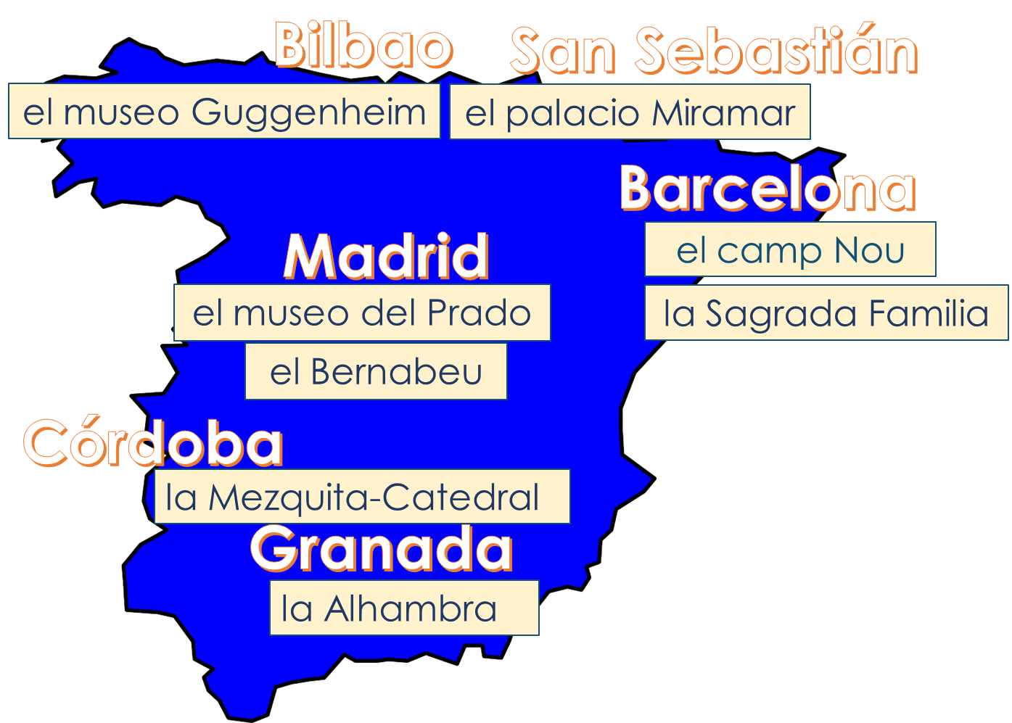
escuchar
I am | he is | City
1
Granada
2
Madrid
3
Barcelona
4
San Sebastián
5
Bilbao
6
Córdoba
7
Madrid
8
Barcelona
Sofia misses her boyfriend! She explains why - (estoy – I am), and (está - he is). Listen. Write ‘I’ or ‘he’ (and second time, the city.)
Notes:
Here the same features are being concentrated on, this time in a listening activity. Here, after listening to the audio, students are also asked to identify the city.

Slide 28
Regular –er verbs
To say ‘I’ + verb in French, the verb is in the short form, often ending in -e.
Je regarde.
I watch (or I am watching).
Je travaille.
I work (or I am working).
To say ‘we’ + verb, the verb ends with -ons.
Nous regardons.
We watch (or we are watching).
Nous travaillons.
We work (or we are working).
Stephen Owen
Notes:
Now let’s have a look at a French example where a pair of features is being contrasted here for number: 1st person singular and first person plural, from Term 1.2 week 5.

Slide 29
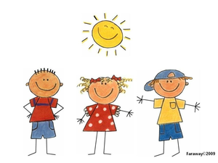
lire
nous
je
C’est qui? Pierre has written a short article about himself. Is he doing these activities by himself (‘I’) or with his friends (‘we’)?
1 | regardons la télé
2 | prépare le déjeuner
3 | restons à la maison
4 | travaillons à l’école
5 | marche dehors
6 | parle à un ami
7 | demandons la raison
8 | montre un exemple
Notes:
In these referential activities, the grammar feature is made task-essential. That is, in order to complete the activity correctly, the learner needs to connect the grammar feature to its meaning (or function). We make the grammar feature task-essential, during practice, by removing as many other cues from the sentence as possible. In this French example, this means obscuring the subject to make the verb ending for number task-essential, so that students cannot use any other clues within the sentence to arrive at the answer.

Slide 30
Listening activity
écouter
Nous ou je? Is the speaker talking about just themselves (‘I’) or themselves with other people (‘we’). You will not hear ‘je’ (I) or ‘nous’ (we). Écris l’ anglais.
 | I (je) | We (nous) | Activité – écris en anglais
1
find a present
2
like the dog
3
give the solution
4
wear a uniform
5
speak French
6
stay outside
7
work in the house
8
watch a film
Notes:
Now that students are becoming familiar with the verb endings, students are also asked to work out the activity, to not only reinforce the grammar but work on the vocabulary as well.
TRANSCRIPT
[beep] trouvons un cadeau
[beep] aimons le chien
[beep] donne la solution
[beep] porte un uniforme
[beep] parlons français
[beep] reste dehors
[beep] travaillons dans la maison
[beep] regarde un film

Slide 31
Asking questions
grammar explanation
Word order
To ask a ‘yes/no’ question in English, ‘do you..’ is followed by a verb.
Note that when you hear questions, you get an extra clue from the intonation, and when you read, you see the question mark.
Statement
You | have | a football.
Question
Do you | have | a football?
In German, just swap the verb and subject (e.g. ‘du’ (you), like this:
Statement
Du | hast | einen Fußball.
Question
Hast | du | einen Fußball?
→
Do you | have | a bottle?
Hast | du | eine Flasche?
Notes:
In this German example from Term 1.1 week 7, the two contrasting features are statements vs. questions.
Here the grammar feature is made task-essential by removing intonation cues, as we want to really focus attention on just the word order in questions vs statements.
Teachers are asked to tell students that they might find it tricky to remember this because a) the English construction is different, and b) additional clues are provided by intonation in spoken form, and punctuation in written form.

Slide 32
Ist das eine Frage?
ANTWORTEN
Frau Organisiert is texting Herr Organisiert to plan the shopping. He is confused as there is no punctuation!
Help Herr Organisiert. Write "?" after questions and "." after statements.
1. Hast du eine Flasche Cola __
4. Hast du ein Heft __
7. Du hast ein Lied __
?
?
.
2. Du hast einen Fußball __
5. Du hast eine Wasserflasche __
8. Hast du einen Film __
.
.
?
3. Hast du ein Buch __
6. Du hast einen Tisch __
9. Hast du eine Frage __
?
.
?
Notes:
In this reading activity, students do the task by writing numbers 1-9 and noting ? or . next to each.
The answers are revealed on individual clicks
The teacher elicits responses by asking ‘Ist das eine Frage?’ (Ja/nein) and pointing to the item. Students already know ‘Frage’, and the grammatical focus of this week is yes/no questions so the use of those here in the input serves to reinforce the pattern.

Slide 33
Ist das eine Frage?
hören
Zorg likes earth. He knows a lot of words but his voice is flat.
Is Zorg asking a question or making a statement? Write ? or .
?
.
C
?
A
B
?
?
.
D
E
F
.
?
?
G
H
I
Notes:
In this follow-on listening activity, students do the task by writing numbers 1-9 and noting ? or . next to each.
The audio is activated by clicking the individual letters.
The answers are revealed on clicking the gaps. The teacher elicits responses by asking ‘Ist A eine Frage?’ (Ja/nein)
Transcript
a) Hast du ein Haustier
b) Du hast einen Lehrer
c) Hast du eine Hand
d) Hast du einen Tisch
e) Hast du eine Tafel
f) Du hast ein Haus
g) Du hast ein Fenster
h) Hast du ein Heft
i) Hast du einen Freund

Slide 34
Principles for teaching grammar in a foreign language.
A succinct, explicit description of the grammar feature and its meaning.
Initial practice to reinforce knowledge of the grammatical form and its meaning in the ‘input’(i.e. when reading
and listening), contrasting pairs
of features.
In order to complete the activity correctly, the learner needs to connect the grammar feature to its meaning.
(Task essential)
The grammar feature is made task-essential during practice by removing as many other clues from the sentence as possible.
Developing learners’ awareness of the relationship between English and the L2.
Pairs of meanings juxtaposed in different combinations, ensuring that features are revisited and reinforced.
After extensive initial practice of pairs of features, very gradually, activities may incorporate more than two features.
Grammar is encountered with a varied lexicon to consolidate learners’ knowledge of a grammatical system that works across multiple contexts.
Writing and speaking activities to help learners establish and practise accessing knowledge after the input practice.
Notes:
We have just looked in detail at the principle for introducing new grammar using pairs of contrasting features. Now let’s take a look at a selection of resources which extend that basic idea.

Slide 35
Qui va où ? (je/elle)
écouter
Pairs of meanings juxtaposed in different combinations, ensuring that features are revisited and reinforced.
Léa is now talking about where she is going and where her friend Sophie is going. C’est qui? Léa (je) ou Sophie (elle)?
 | je | elle
 | je | elle
1
5
2
6
3
7
4
8
Notes:
Year 7 French Term 2.1 week 5 - Lesson 1 aller – je vais/ elle va
The next four slides are examples of activities from lessons one and two in a sequence where singular persons of the verb “aller” are being learnt. This allows for pairs of meanings to be juxtaposed in different combinations, ensuring that features are revisited and reinforced by being contrasted with different grammar features (e.g. comparing the previously taught 1st person singular with the new 3rd person singular verb ending).

Slide 36
Qui va où ? (je/elle, réponses)
écouter
Pairs of meanings juxtaposed in different combinations, ensuring that features are revisited and reinforced.
Léa is now talking about where she is going and where her friend Sophie is going. C’est qui? Léa (je) ou Sophie (elle)?
 |  | je | elle
 |  | je | elle
1
Elle va à Trouville.
5
Je vais à Strasbourg.
2
Elle va à Grenoble.
6
Elle va à Lille.
3
Je vais à Pau.
7
Elle va à Nantes.
4
Je vais à Nancy.
8
Je vais à Dijon.
Notes:
Year 7 French Term 2.1 week 5 - Lesson 1 aller – je vais/ elle va
In lesson one, first and third persons of the verb “aller” are the target features. In this listening we see “elle va” as the third person singular form. To note, if you are wondering – “il va” is also practised alongside “je vais” – in a reading activity within the lesson sequence.

Slide 37
Qui va où ? (je/tu)
écouter
Pairs of meanings juxtaposed in different combinations, ensuring that features are revisited and reinforced.
Je ou tu?
 | je | tu
 | je | tu
1
5
2
6
3
7
4
8
Notes:
Yr 7 French Term 2.1 week 5 - Lesson 2: aller – je vais/ tu vas
In lesson two, first and second persons of the verb “aller” are the target features.

Slide 38
Qui va où ? (je/tu, réponses)
écouter
Pairs of meanings juxtaposed in different combinations, ensuring that features are revisited and reinforced.
Je ou tu?
 |  | je | tu
 |  | je | tu
1
Tu vas à Paris.
5
Tu vas à Blois.
2
Je vais à Poitiers.
6
Tu vas à Lyon.
3
Je vais à Bordeaux.
7
Je vais à Deauville.
4
Je vais à Rouen.
8
Tu vas à Calais.
Notes:
Yr 7 French Term 2.1 week 5 - Lesson 2: aller – je vais/ tu vas
Across the two activities, consistent with the principle of making the grammar feature task-essential during practice, the subject has been removed from the sentence, to make the verb form for person task-essential. Particularly in French it’s important to select with care the two juxtaposed features for listening practice, as not all verb forms sound different, even when they are written differently i.e. vas and va.

Slide 39
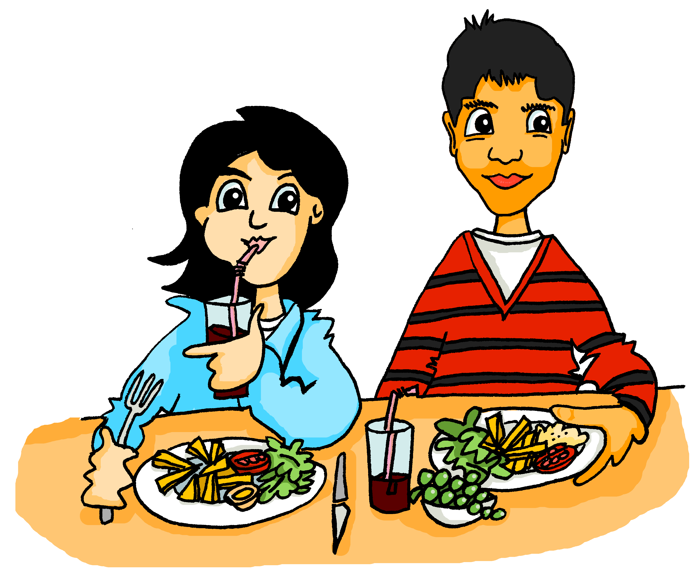
Ich, du oder Wolfgang?
After extensive initial practice of pairs of features, very gradually, activities may incorporate more than two features.
hören
Wie findest du das Essen?
Ich mag das Essen! ________ findet das Essen nicht lecker, aber ________ finde es gesund.
Wolfgang
ich
1
Antworten
Notes:
It is likely to be most helpful for most learners to use activities that introduce and practise pairs of grammar features which have different meanings (or functions) as we have seen in all of the examples up to now.
This German resource presents an example of an activity which, after extensive initial practice of pairs of features, very gradually, incorporates more than two features: specifically first, second and third persons singular of the verb “finden”. I particularly like the images on this one. The context is continued from the previous week and develops a storyline between the German characters Mehmet and Mia. Mehmet is a new arrival at Mia and Wolfgang’s school. Mia and Mehmet are getting to know each other and talking about their views of school, and referring also to Wolfgang’s views. We will now cycle through the six slides of this activity.
Year 7 German Term 2.1 week 4 – Introducing FINDEN: 1st, 2nd, 3rd person singular
Students listen to the audio, supported by the text and decide if the person of the verb refers to: ‘I,’ ‘you’ or ‘he’

Slide 40
Ich, du oder Wolfgang?
hören
Ich mag die Uniform. Und du?
______ findest die Uniform gut? ______ finde die Uniform hässlich.
Du
Ich
2
Antworten
Notes:
Slide 2 of 6.

Slide 41
Ich, du oder Wolfgang?
hören
Ich
______ finde Fremdsprachen ziemlich leicht, aber ________ findet Fremdsprachen nicht interessant.
Der Unterricht ist zu schwierig. Mia, wie findest ______ den Unterricht?
du
Wolfgang
3
Antworten
Notes:
Slide 3 of 6

Slide 42
Ich, du oder Wolfgang?
hören
______ finde die iPads ganz praktisch.
Ich mag die iPads nicht. ______ finde die iPads ein bisschen zu langsam.
Ich
Ich
4
Antworten
Notes:
Slide 4 of 6

Slide 43
Ich, du oder Wolfgang?
hören
Ach, ________ findet die Lehrer zu streng, aber ________ finde die Lehrer in Ordnung.
Wolfgang
Und wie findest ______ die Lehrer hier?
du
ich
5
Antworten
Notes:
Slide 5 of 6

Slide 44
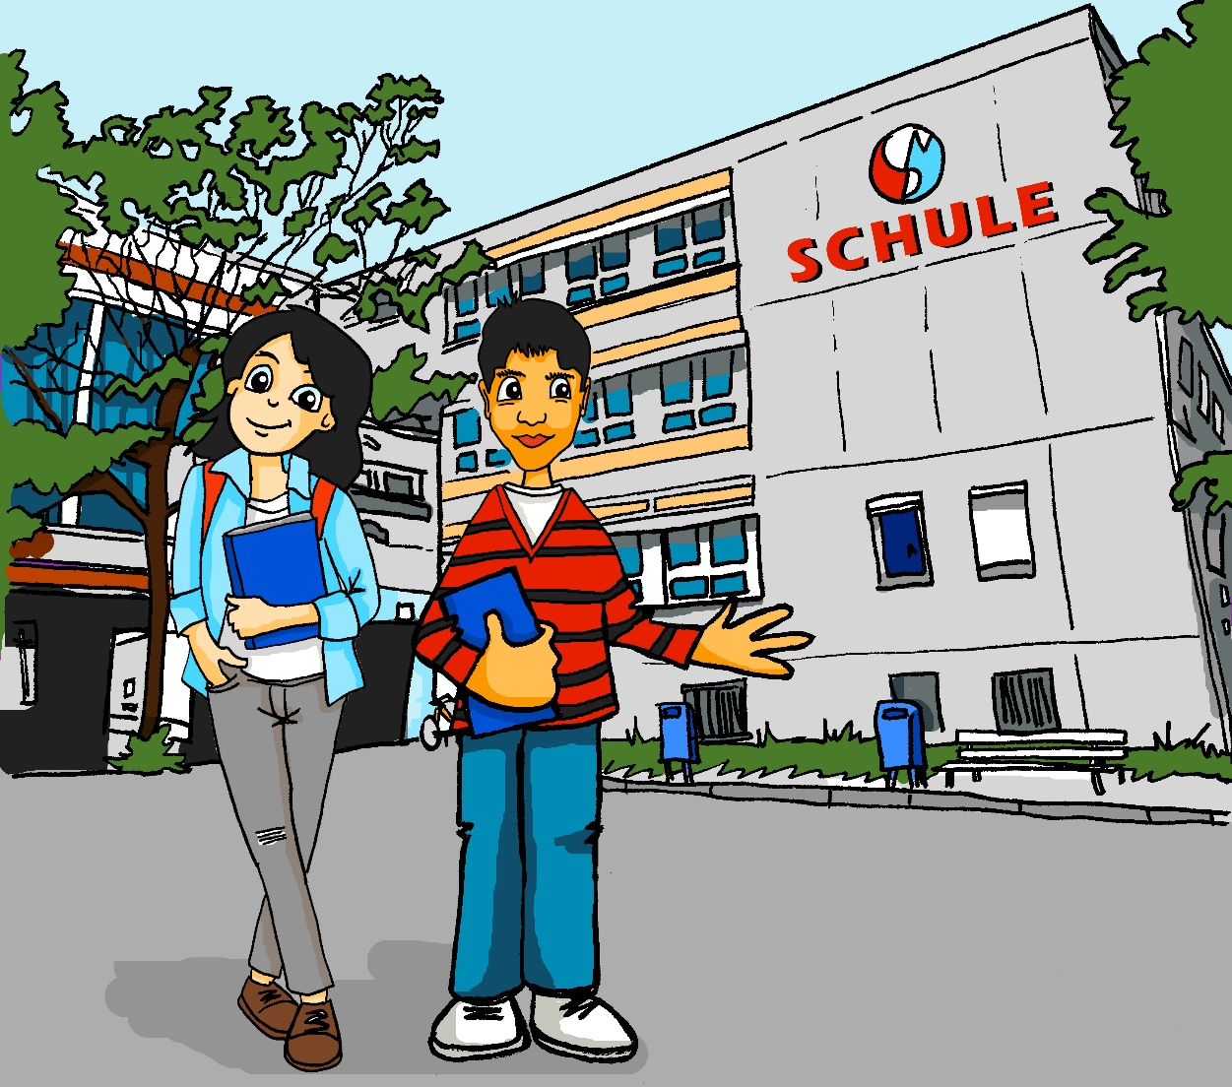
Ich, du oder Wolfgang?
hören
________ findet die Schule schlecht, aber Mehmet, _______ findest die Schule wichtig, nicht wahr?
Ja, aber ________ finde die Hausaufgaben schwierig.
Wolfgang
ich
du
6
Antworten
Notes:
Slide 6 of 6

Slide 45
Vocabulaire
Grammar encountered with a varied lexicon to consolidate learners’ knowledge of a grammatical system that works across multiple contexts.
lire
Trouve 16 verbes dans le texte.
Les professeurs de 6ème organisent un concert pour les enfants. Le concert est grand et important et les enfants sont très enthousiastes.
Les chanteurs sont drôles et très amusants. Ils chantent en anglais. Mais les professeurs ont un problème. Les chanteurs sont malades! La situation est très difficile.
Les professeurs ont une idée. Ils sont drôles et amusants, et ils parlent très bien anglais aussi …
Les professeurs portent des uniformes violets et ils chantent au concert. Ils sont des acteurs fantastiques!
Les enfants sont contents. La solution est super!
Varied lexicon - additional vocabulary incorporated from 1.1 week 1 (être)
1.1 week 3 (avoir) 1.2 week 6 (chanter)
1.2 week 4 (parler)
1.2 week 3 (porter)
Notes:
Year 7 French Term 2.1 week 3 - Introducing third person plural form of avoir & practising segmentation of a longer text
In this second of a series of scaffolded activities based on this text taken from a term 2 French resource, students are asked to identify all examples of verbs. All these verbs are recycled from previous contexts. It is an example of a resource which varies the lexicon around the grammar, specifically, seeing verb endings on a wide range of frequent verbs. All verbs included are regular in the present tense, with the exception of “être” and “avoir”. The teacher is asked to remind students of the “–ent” ending on regular verbs in the third person plural, and that forms of “être” and “avoir” are also verbs.
Other examples of varying the lexicon around the grammar includes: producing adjectival agreement on a wide range of adjectives; hearing questions with a wide range of subject-verb combinations. In doing so, grammar practice is not confined to one or two topics that seem to ‘lend themselves’ to one particular grammar feature, but is practised across a wide range of (preferably, high-frequency) vocabulary. This ‘diversity’ helps learners consolidate their knowledge of a grammatical system that works across multiple contexts.

Slide 46
Vocabulaire
Une situation d'urgence à l'école
Grammar encountered with a varied lexicon to consolidate learners’ knowledge of a grammatical system that works across multiple contexts.
lire
Trouve 16 verbes dans le texte.
Les professeurs de 6ème organisent un concert pour les enfants. Le concert est grand et important et les enfants sont très enthousiastes.
Les chanteurs sont drôles et très amusants. Ils chantent en anglais. Mais les professeurs ont un problème. Les chanteurs sont malades! La situation est très difficile.
Les professeurs ont une idée. Ils sont drôles et amusants, et ils parlent très bien anglais aussi …
Les professeurs portent des uniformes violets et ils chantent au concert. Ils sont des acteurs fantastiques!
Les enfants sont contents. La solution est super!
Varied lexicon - additional vocabulary incorporated from 1.1 week 1 (être)
1.1 week 3 (avoir) 1.2 week 6 (chanter)
1.2 week 4 (parler)
1.2 week 3 (porter)
Notes:
Year 7 French Term 2.1 week 3- Introducing first and second person plural forms of avoir
The answer slide to the previous activity is included here for reference, with the verbs highlighted. This is a resource from Year 7 Term 2.1 week 3. The varied lexicon is as follows: “organiser” (cognate); “être” Term 1.1 week 1; “avoir” Term 1.1 week 3; “chanter” Term 1.2 week 6; “parler” Term 1.2 week 4; “porter” Term 1.2 week 3.

Slide 47
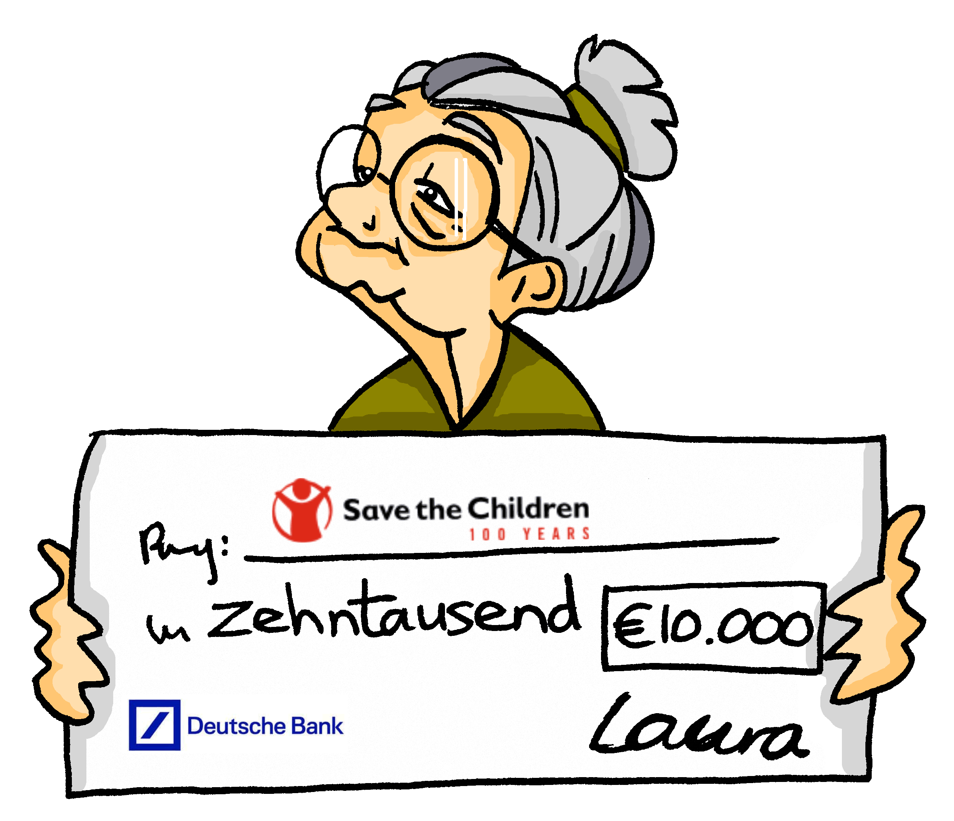
sprechen
PERSON A
Writing and speaking activities to help learners establish and practise accessing knowledge after the input practice.
vergessen
sprechen
fahren
laufen
geben
Notes:
Year 7 German Term 2.2 week 3 - Introduction of present tense strong verbs: 1st and 3rd person singular.
Now we move on to look at examples of embedding grammar in writing and speaking.
Grammatical knowledge can be skill-specific (or modality- and mode-specific) (DeKeyser, 2015). When we teach a grammar feature, we need to establish these different types of knowledge, via multiple routes (not just one route). For example, for some learners, practice in hearing the feature will probably have less benefit on written production than on listening; written production practice may have little observable benefit on speaking.
So, once a learner can connect a grammar feature to its meaning (or function) when reading and listening, they then need to establish and practise accessing knowledge they can use when writing and speaking.
Initially, writing and speaking practice can be through controlled, scaffolded, phrase- or sentence-level activities and that is what we have in this German example from Term 2.2 week 3 (using present tense strong verbs in first and third person singular). This is an activity which combines both speaking and writing and brings together the “ich” and “sie” from a selection of strong verbs.
Tante Laura defies expectations! She lives an active and busy life.
Work in pairs.
Person A and person B have a different set of pictures.
Person A describes one of their pictures (Tante Laura….).
Person B finds the corresponding picture for Mia and describes it from Mia’s perspective (Ich…).
Then person A starts with the next picture.
Repeat until all pictures have been described.
Activity could be repeated in different order with roles swapped, i.e. Person A has Mia’s pictures but describes Mia in 3rd person (Mia…) and Person B becomes Tante Laura (ich).

Slide 48
sprechen
PERSON B
vergessen
sprechen
schlafen
laufen
geben
Notes:
Year 7 German Term 2.2 week 3
Here are person B’s picture prompts for the speaking element.

Slide 49
Die perfekte Mia
schreiben
Mia
Die perfekte Mia
Ich spreche Chinesisch, aber kein Englisch
Sie spricht Chinesisch und Englisch
Notes:
Year 7 German Term 2.2 week 3 - Introduction of present tense strong verbs: 1st and 3rd person singular.
A follow-up writing activity now follows the speaking. This is the example slide.
After her stay with Tante Laura, Mia is inspired to make some changes in her life.
Take current Mia’s perspective
For each pair of pictures write a sentence about the current Mia (ich) and the perfect Mia (sie).
The first sentence will be first person singular, the second will be third person singular, as Mia imagines her perfect self! Example: Sentence 1 - Ich spreche Chinesisch, aber kein Englisch. Die perfekte Mia / Sie spricht (auch) Englisch.

Slide 50
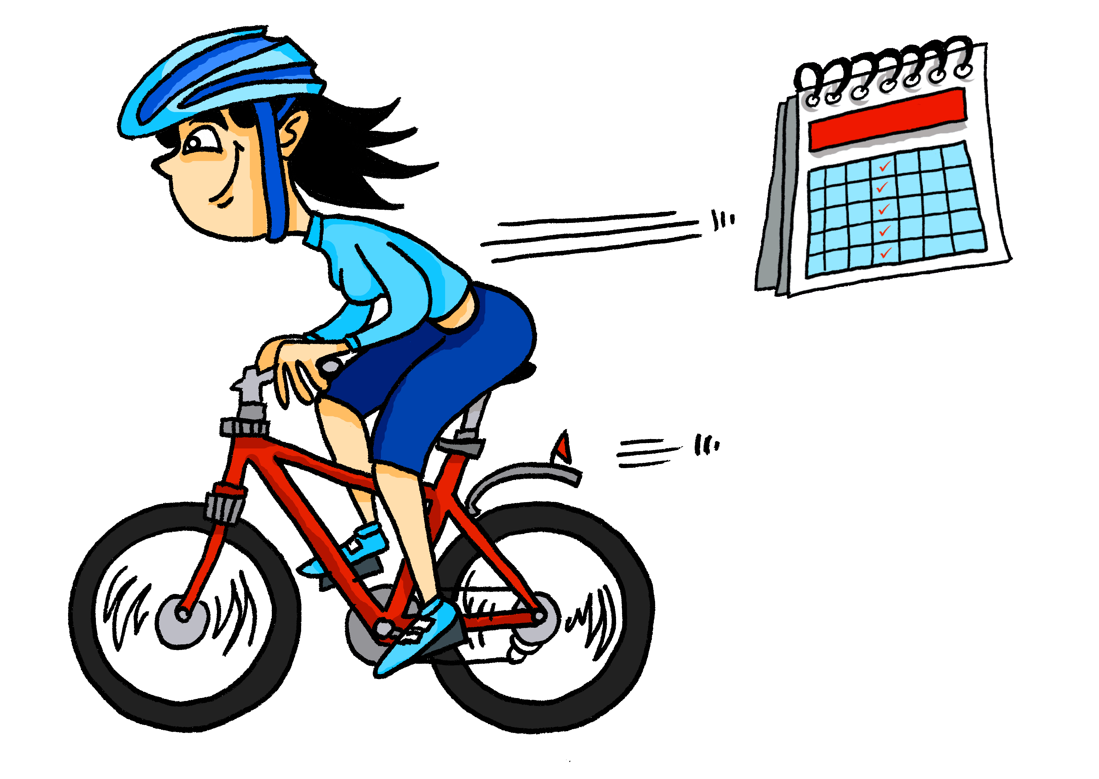
Die perfekte Mia
3
1
4
2
+
5
Notes:
Year 7 German Term 2.2 week 3
Here are the picture prompts for the writing follow-up activity where students now write five sentences practising first and third person singular.

Slide 51
hablar / escuchar
Persona A
Speaking activities to help learners establish and practise accessing knowledge after the input practice.
Say a sentence to your partner.
Escucha. Marca la opción correcta y escribe la frase en inglés.
Usa ‘Los/las……..+ ‘son’ / ‘están’.
dark-skinned | bored
acting crazy feeling nervous | calm brown
Hoy
[in general]
[today]
Hoy
En general
En general
The………………………………………..
The………………………………………..
[today]
[in general]
Hoy
Hoy
En general
En general
The………………………………………..
The………………………………………..
Notes:
Year 7 Spanish Term 2.2 week 5 using ser/estar to describe traits vs state/mood
Now a Spanish example. Here learners are establishing and practising their knowledge of the two different verbs for ‘to be’ in a speaking activity.
Wherever possible, such activities should make the grammar task-essential, i.e. the grammar is essential for communicating meaning and, critically, this meaning is a requirement of the way the task is set-up (e.g., someone else needs to understand the meaning being conveyed). This Spanish task has been set up to focus on comprehension and production of the correct verb for ‘to be’ with corresponding adjectives. Crucially the listener will have to pay careful attention to the verb to determine the correct translation of the adjective e.g. bored vs boring/tanned vs. dark-skinned.
This is partner A’s sheet. The pictures + adjectives are what partner A will translate into Spanish to say to their partner. The second half of the sheet (the blank grid) is for partner A to record in English the details partner B has told them.
Task instructions:
Give students a few minutes to think about their sentences. They then take it in turns to say their sentences in Spanish to their partner, who has to decide if the sentence is ‘today’ or ‘in general’ and write in English the noun and adjectives on the second half of the sheet. (This can be done anywhere - it does not matter if they are not mirrored in the same boxes). The listener will have to pay careful attention to the verb to determine the translation of the adjective. Teachers should circulate to check for accuracy of adjective agreement.
At the end of the task, students can compare sheets to see if they understood the sentences correctly – the English should match. The next slide also displays the English to facilitate feedback.

Slide 52
hablar / escuchar
Persona B
Say a sentence to your partner.
Escucha. Marca la opción correcta y escribe la frase en inglés.
Usa ‘Los/las……..+ ‘son’ / ‘están’.
quite serious | clear
tanned | active
Hoy
Hoy
[today]
[in general]
En general
En general
The………………………………………..
The………………………………………..
[today]
[in general]
Hoy
Hoy
En general
En general
The………………………………………..
The………………………………………..
Notes:
Partner B’s sheet.

Slide 53
hablar/escuchar
Persona A
Persona B
Hoy
Hoy
Hoy
Hoy
En general
En general
En general
En general
The boys/cousins (m) are being quite serious.
The rivers are clear.
The cousins (m/f) are dark-skinned.
The girls/cousins (f) are bored.
Hoy
Hoy
Hoy
Hoy
En general
En general
En general
En general
The grandparents are tanned.
The teachers (f) are active.
The boys (m) are acting crazy and feeling nervous.
The dogs are calm and brown.
Notes:
Here are the answers for students to be able to readily check their translations.

Slide 54
C’est quelle question?
Speaking activities to help learners establish and practise accessing knowledge after the input practice.
Grammar is encountered with a varied lexicon to consolidate learners’ knowledge of a grammatical system that works across multiple contexts.
parler
Look out for the word ‘Yes’;
this tells you what type of question is needed.
Marion
Pierre
Varied lexicon - additional vocabulary incorporated from across Terms 1/2/3.
Je comprends dix mots.
Combien de mots comprends-tu ?
Oui, je comprends le mot.
Comprends-tu
le mot ?
Notes:
Year 7 French Term 3.1 week 3 - Using question words with subject-verb inversion to form information questions (contrasting with yes/no questions)
Now, a French speaking activity from Term 3. We have seen examples of input activities where grammar is encountered with a varied lexicon, to consolidate learners’ knowledge of a grammatical system that works across multiple contexts. Here we can see this same principle applied to a production activity.
This activity brings together students’ prior learning on forming questions with subject-verb inversion with raised intonation plus the question words:
“Comment?”
“Combien?”
“Quel?”
“Que?”
Activity instructions:
Students construct questions that either:
require a yes/no answer i.e. subject-verb inversion
or:
require a question word+subject-verb inversion.
It is the answer that indicates which question type is required. The bold “Oui” indicates that a yes/no question type is required (i.e. subject-verb inversions). Where there is not the word “oui” – a question word plus subject-verb inversion will be needed.
Clicking on the answer text box reveals the question.

Slide 55
parler
Marc
Hélène
Clara
Philippe
Je comprends trois réponses.
Je sors le samedi.
Oui, je comprends les maths.
J’apprends dix mots.
Combien de réponses comprends-tu?
Quel jour sors-tu?
Comprends-tu les maths?
Combien de mots apprends-tu?
Maya
Rahul
Émile
Anya
Oui, je sors souvent.
Je fais question six.
Je fais des exercices au collège.
Fais-tu les devoirs?
Sors-tu souvent?
Quelle question fais-tu?
Que fais-tu au collège?
Oui, je fais les devoirs.
Chloë
Luca
Oscar
Ella
Oui, j’apprends une langue.
Oui, je viens à Londres chaque jour.
Prends-tu le train?
Comprends-tu la phrase?
Apprends-tu une langue?
Viens-tu à Londres chaque jour?
Oui, je prends le train.
Oui, je comprends la phrase.
Amir
Anna
Faiza
Félix
Oui, je dis la vérité.
Je prends le train de Nice à Marseille.
Je dis, ‘C’est strict!’
Je fais douze matières.
Dis-tu la vérité?
Quel train prends-tu?
Que dis-tu?
Combien de matières fais-tu?
Notes:
Year 7 French Term 3.1 week 3 - Using question words with subject-verb inversion to form information questions (contrasting with yes/no questions)
This is the master, displayed on the IWB whilst the speaking activity is taking place.
There are various ways this slide could be used:
1)the teacher puts the 16 names in a hat/bag (this can be done very roughly on scrap paper – only for teacher use), then pulls the names out of the bag one at a time. Students can all give the question in a choral response style or
2a) as above but in pairs – the teacher picks a name - partners take it in turns to give the question. The teacher gives the students time to form their questions and then reveals the answer before picking the next name. Students can award themselves a point if they get it correct.

Slide 56
C’est quelle question?
parler
Marion
Pierre
I’m doing number four.
Yes, I’m doing number four.
Quel numéro
fais-tu ?
Fais-tu numéro
quatre?
I’m doing number four.
Je fais numéro quatre.
Yes, I’m doing number four.
Oui, je fais numéro quatre.
Notes:
Year 7 French Term 3.1 week 3 - Using question words with subject-verb inversion to form information questions (contrasting with yes/no questions)
Teachers could use this slide to model the instructions for the speaking task – this time, the differentiated version of also putting the answer into French.
NB Click on the blue text box to reveal the questions in French.
On a mouse click, the English answer comes up to recap, followed by the answer in French – first for Marion and then for Pierre. This models the extension step of translating the answer into French (version 2 of the speaking – see next slide).

Slide 57
parler
Marc
Hélène
Clara
Philippe
I understand three answers.
I’m going out on Saturday.
Yes, I understand maths.
I’m learning ten words.
Combien de réponses comprends-tu?
Quel jour sors-tu?
Comprends-tu les maths?
Combien de mots apprends-tu?
Maya
Rahul
Émile
Anya
Yes, I go out often.
I’m doing question six.
I do exercises at school.
Fais-tu les devoirs?
Sors-tu souvent?
Quelle question fais-tu?
Que fais-tu au collège?
Yes, I’m doing homework.
Chloë
Luca
Oscar
Ella
Prends-tu le train?
Comprends-tu la phrase?
Yes, I’m learning a language.
Viens-tu à Londres chaque jour?
Yes I take the train.
Yes I understand the sentence.
Apprends-tu une langue?
Yes I come to London every day.
Amir
Anna
Faiza
Félix
Yes I tell the truth.
I take the train from Nice to Marseille.
I’m saying, ‘it’s strict!’
I do twelve subjects.
Dis-tu la vérité?
Quel train prends-tu?
Que dis-tu?
Combien de matières fais-tu?
Notes:
Year 7 French Term 3.1 week 3 - Using question words with subject-verb inversion to form information questions (contrasting with yes/no questions)
The differentiated version allows the extension opportunity as follows:
2b) in pairs – the teacher picks a name - partners take it in turns to give the question. The teacher gives the students time to form their questions and then reveals the answer before picking the next name.
Extension – the listening partner tries to give the response in French. Teachers could ask for hands up after thinking time, for volunteers to give their answer.

Slide 58
Year 8 French: Term 1.1
Week
1 | être vs avoir ; regular adjective gender agreement (-e, -euse); feminisation of job titles (-e, -euse -rice); est-ce que ; yes/no questions (intonation and inversion)
2 | pronoun 'on' with meaning everyone, you, one; construction rule for numbers 13-31 ; qu'est-ce que ; information; questions (intonation and inversion)
3 | possessive adjectives (mon, ma, mes, ton, ta, tes, son, sa, ses, notre); preposition de for possession
4 | Consolidation week 1; regular -ER verbs
5 | present vs perfect tense (with past simple equivalent in English); regular and irregular verbs (taking avoir) with no audible difference between present tense and past participle (je vs j'ai); regular -ER verbs (taking avoir) (je vs j'ai)
6 | present vs perfect tense (with past simple equivalent in English); regular -ER verbs (taking avoir) (je, tu); ce, cet, cette, ces; information questions (intonation, and qu'est-ce que only) in the present and perfect tense
7 | present vs perfect tense (with past simple equivalent in English); regular -ER verbs (taking avoir) (je, il/elle); il y a vs il y avait; yes/no questions (intonation and est-ce que only) in the present and perfect tense; negation: ne…pas (de) in the present and perfect tense
Notes:
Let’s now take a look ahead to Year 8.
This is the first half of Term 1 for French.
Year 8 is when students see past tense for the first time, specifically the perfect tense.

Slide 59
Year 8 Spanish: Term 1.1
Week
1 | past tense -ar verbs: 1st person singular (-é) Contrast with: 1st person singular present (-o); question words; negative 'no'
2 | past tense -ar verbs : 2nd person singular (-aste); 1st person singular (-é); 2nd person singular present (-as); question words; awareness raising of 'do' and 'did' in English questions
3 | revisit SER (for traits) vs ESTAR (for state/mood) in singular and plural persons; adjectival agreement for gender & number; awareness raising of 'be' in English questions
4 | present tense -er verbs only: 1st plural (-emos); tenemos; contrast with: 1st person sing (-o)
5 | HACER - hago hacemos; hace hacen; haces; revisit negatives; use of subject pronouns
6 | modals: PODER - puedo podemos; puede pueden; DEBER - debo debemos debe deben
7 | present tense -ir verbs only: 1st person plural (-imos); contrast with: 3rd person plural (-en); negatives
Notes:
In Spanish, it is the preterite tense

Slide 60
Year 8 German: Term 1.1
Week
1 | Present vs Past (perfect-weak verbs) 1st person singular; fronted time adverbials (past & present), word order ; preposition 'in'+R3(dat)+indefinite articles
2 | Past (perfect + haben) 1st person singular vs 3rd person singular (weak and some strong); Past (perfect + haben) 1st person singular vs 2nd person singular (weak and some strong), VSO questions (+W words)
3 | HABEN vs SEIN present (ich, du, er/sie/es, wir, sie (they)), include idioms Schmerz/Hunger/Lust haben; Present tense: Sie (you, formal) vs du, infinitive clauses with 'zu'
4 | Consolidation: Alphabet; wie sagt man das? wie schreibt man das? nouns - gender, def. & indef articles, R1 (nominative), R2 (accusative)
5 | Text: Vergnügungen - Brecht Pre-nominal adjectival agreement [1] - definite and indefinite articles R1 (nominative)
6 | Pre-nominal adjectival agreement [2] - indefinite article R2 (accusative) e.g. Er hat eine lange Nase. als meaning 'as' eg. Als Person ist er/sie… Plural Rule 5: Female person nouns ending in -in add -nen; preposition 'in'+'mit'+R3(dat)+indefinite articles; mit wem?
7 | Word order 3 - conjunctions weil vs denn; MÖGEN / ich mag / du magst, VSO questions (+W words)
Notes:
For Year 8 German Term 1.1, this is perfect tense – weak verbs and perfect with haben.

