Slide 1
Grammar
Regular plural forms of adjectives
Y7 French - Term 2.1 - Week 2 - Lesson 31
Stephen Owen / Emma Marsden
Date updated: 10/01/20
Notes:
Learning outcomes
SSC /e/
This week the first, second and third person plural forms of ‘être’ are introduced (the singular forms were introduced in Term 1.1, Weeks 1 & 2). Regular plural marking on adjectives is also introduced, following the introduction of regular plural noun forms the previous week.
Frequency rankings of vocabulary introduced this week (1 is the most common word in French):
2.1.2 - frère [1043], sœur [1558], parent [546], ouvert [897], prudent [1529], strict [1859], jeune [152]
N.B. This new vocabulary is not presented until the second lesson, owing to the amount of grammar covered in the first lesson. This lesson’s grammar is presented using previously-encountered vocabulary, which serves to reduce the cognitive load and is a useful way of revising this vocabulary.
Frequency rankings of vocabulary revisited this week (1 is the most common word in French):
1.2.6 - jouer [219], manger [1338], écouter [429], chanter [1820], étudier [960], ils, elles, fruit [896], radio [1526], histoire [263]
1.2.1 - ciel [1538], comme [32], couleur [1211], rêve [1313], sable [3263], vague [1493], bleu [1216], jaune [2585], rouge [987], vert [1060], violet [>5000]
Source: Londsale, D., & Le Bras, Y. (2009). A Frequency Dictionary of French: Core vocabulary for learners London: Routledge.
Teachers should conduct a spot check of the revisited vocabulary each week, to ensure that the required independent learning has been done. This could be in the form of an informal, oral ‘test’, and/or a more formal (but quick) written vocabulary test. Aim to test knowledge of all types: comprehension (L2-L1), production (L1-L2), oral (listening and speaking) and written (reading and writing) modalities.

Slide 2
Describing more than one: We are…
grammaire
“Nous” (we) is a plural pronoun – it refers to more than one person.
Remember: There must be agreement between the adjective and noun!
So, adjectives describing “nous” need to be in a plural form:
Nous sommes contents.
We are happy.
Don’t forget! The –s on the end of ‘sommes’ and the adjective are Silent Final Consonants.
Notes:
This slide points out that the adjective must agree with the plural pronoun as well as with the noun, as in the example on the previous slide.
N.B. The masculine plural form of the adjective having been introduced, the feminine plural is withheld for now, so that students may concentrate upon the new verb form (vous) to be introduced shortly, and also to avoid overcomplicating the treatment of the adjective (which would be a possibility, if we were to introduce all information at once). The feminine plural form of the adjective is dealt with as part of the next lesson.
Read this out to students so that they know exactly how to pronounce the French.
Remind them to not sound out the ‘s’ at the end of ‘sommes’, as well as that on the end of the adjectives.

Slide 3
“you (plural) are”: the verb être (to be)
grammaire
Earlier we learned:
s
Nous sommes content .
We are happy.
Here is the second person plural of être: you to more than one person:
Vous êtes content .
s
You(more than one) are happy.
Plural “YOU” (vous) also needs a plural adjective.
“êtes” does not end in –ez. This is different to the other ‘vous’ forms of verbs you have learned. This is because être – to be is an irregular verb.
Notes:
Having introduced and practised recognising the ‘nous’ form, the ‘vous’ form (plural) of ‘être’ is now introduced.
Students have met the ‘vous’ form ending in –ez previously, so the irregularity of être needs to be pointed out. You could explain that ‘to be’ in English is also very irregular: I am, You are, She is, We are… This helps learners develop cross-linguistic awareness.
Note we are introducing ‘vous’ as a polite form of ‘you’ in later lessons.
N.B. The feminine plural of adjectives is withheld for now, so that students may concentrate upon the new verb form (vous), and also to avoid overcomplicating the treatment of the adjective. The feminine plural form of the adjective is dealt with as part of the next lesson.

Slide 4
Grammar
Regular plural forms of adjectives
Y7 French - Term 2.1 - Week 2 - Lesson 32
Stephen Owen / Emma Marsden
Date updated: 10/01/20
Notes:
Learning outcomes
SSC /e/
This week the first, second and third person plural forms of ‘être’ are introduced (the singular forms were introduced in Term 1.1, Weeks 1 & 2). Regular plural marking on adjectives is also introduced, following the introduction of regular plural noun forms the previous week.
Frequency rankings of vocabulary introduced this week (1 is the most common word in French):
2.1.2 - frère [1043], sœur [1558], parent [546], ouvert [897], prudent [1529], strict [1859], jeune [152]
N.B. This new vocabulary is not presented until the second lesson, owing to the amount of grammar covered in the first lesson. This lesson’s grammar is presented using previously-encountered vocabulary, which serves to reduce the cognitive load and is a useful way of revising this vocabulary.
Frequency rankings of vocabulary revisited this week (1 is the most common word in French):
1.2.6 - jouer [219], manger [1338], écouter [429], chanter [1820], étudier [960], ils, elles, fruit [896], radio [1526], histoire [263]
1.2.1 - ciel [1538], comme [32], couleur [1211], rêve [1313], sable [3263], vague [1493], bleu [1216], jaune [2585], rouge [987], vert [1060], violet [>5000]
Source: Londsale, D., & Le Bras, Y. (2009). A Frequency Dictionary of French: Core vocabulary for learners London: Routledge.
Teachers should conduct a spot check of the revisited vocabulary each week, to ensure that the required independent learning has been done. This could be in the form of an informal, oral ‘test’, and/or a more formal (but quick) written vocabulary test. Aim to test knowledge of all types: comprehension (L2-L1), production (L1-L2), oral (listening and speaking) and written (reading and writing) modalities.

Slide 5
Describing others
grammaire
We have met the third person singular (s/he) form of the verb être (to be):
Il est content.
He is happy.
Remember: the feminine form of the adjective adds –e (agreement):
Elle est contente.
She is happy.
The –e is silent, but it makes you pronounce the ‘t’ before it!
Notes:
This slide reminds students of the third person singular form of ‘être’, which will be juxtaposed with the third person plural form (about to be introduced) over the next few slides. It also reminds them of the ‘e’ feminine adjective agreement (the feminine plural adjective agreement will be introduced on the next slide).
Read this out to students so that they know exactly how to pronounce the French.

Slide 6
Describing others – THEY are
grammaire
The –s on the end of ils and elles is silent!
To talk about about the third person plural form of the verb être (to be), they are:
Ils sont intelligents.
They (masc. pl) are intelligent.
Remember: in French the pronoun ‘they’ is different for masculine and feminine:
Elles sont intelligentes.
They (fem pl) are intelligent.
The –s on the end is silent, but again the –e makes you pronounce the ‘t’!
The feminine form of the adjective has –e and –s
Notes:
There is a lot of information here, but the following activities break it down and practise each part.
The first and second person plural forms of the verb ‘être’ having been presented last lesson, this slide introduces the third person plural form – ‘sont’. This verb form has other features that come with it: the ‘ils’ and ‘elles’ pronouns, and also another type of adjective agreement.
Read out the French, so that the students hear ‘sont’.
Explain ‘masc pl’ and ‘fem pl’ to students – ‘masculine plural’ and ‘feminine plural’ respectively. This will get shortened to mpl and fpl in the next slides and in the Quizlet homeworks.
Read this out to students, so that they know exactly how to pronounce the French.
Remind them to not sound out the ‘s’ at the end of ‘sont’.
N.B. Later, we will cover later the issue that if there is one male in a group, then the ‘ils’ pronoun is used. There is a lot of information here, so we hold this back until later.

Slide 7
Tick the correct form of the adjective.
lire
 | anglais
1 |  | intelligente | intelligentes
2 |  | contente | contentes
3 |  | drôle | drôles
4 |  | petit | petits
5 |  | sage | sages
6 |  | calme | calmes
7 |  | méchant | méchants
8 |  | amusant | amusants
Elles sont ......
Elle est ......
Il est ......
Ils sont ......
Elles sont ......
Elle est ......
Ils sont ......
Il est ......
Notes:
In this, second reading activity, students are required to attend to the subject pronoun and verb form to determine singular or plural, then select the correct form of the adjective.

Slide 8
C’est qui? il, elle, ils ou elles?. Écris l’anglais.
écouter
 | anglais | il (he) | elle (she) | ils (they – mpl) | elles (they – fpl)
1
(She) is happy.
2
(They – mpl) are intelligent.
3
(He) is happy.
4
(They - fpl) are interesting.
5
(They - mpl) are happy.
6
(He) is open.
7
(She) is tall.
8
(They - fpl) are small.
Notes:
This listening activity now juxtaposes the third person singular forms with the third person plural, requiring that students listen for both the verb form (to determine singular or plural) and the adjective agreement (to determine masculine or feminine).
To provide an additional challenge and check understanding of vocabulary (a mix of new and old, conducive to illustrating adjective agreement), learners are then asked to write the English in the space provided. The answers appear upon successive mouse clicks.
Transcript
... est contente.
... sont intelligents.
... est content.
... sont intéressantes.
... sont contentes.
... est ouvert.
... est grande.
... sont petites.

Slide 9
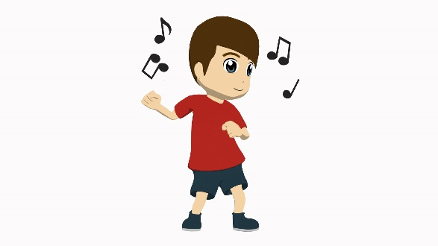
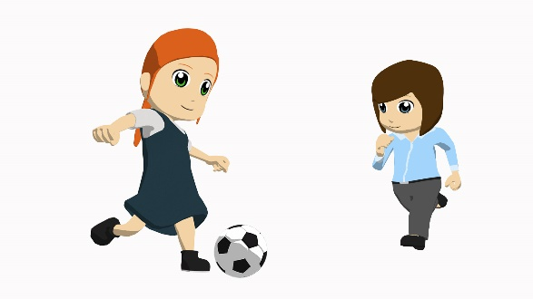
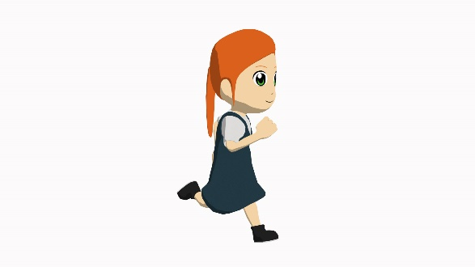
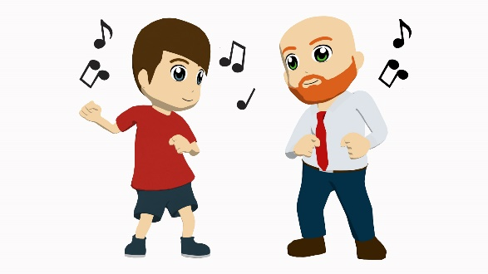
Partenaire A (Task 1):
Exemple
parler
Tell your partner about each person/pair of people pictured below.
Say ‘She is ...’, ‘He is...’, ‘They are...’, plus the adjective given, in French.
happy
XXXX
XXXX
XXXX
XXXX
XXXX
XXXX
XXXX
XXXX
XXXX
XXXX
XXXX
Notes:
Speaking task - example for teachers to model with learners.
On this example slide, only one adjective is given (happy). The rest are shown as XXXX to indicate that there will be three adjectives per person/pair of people, to talk about.
Partner A Teachers can elicit the full sentence from learners ‘il est content’ and then show the next slide, the example slide for Partner B, to model what partner B has to do.

Slide 10
Partenaire B (Task 1): Example
parler
Listen to what your partner tells you about each person/pair of people shown.
Write three adjectives in English on the lines next to their picture.
happy
_____________________
_____________________
_____________________
_____________________
_____________________
_____________________
_____________________
_____________________
_____________________
_____________________
_____________________
_____________________
Notes:
Speaking task - example for teachers to model with learners.
Partner B has to write down the description (adjectives only) in English in the spaces provided on this slide. This tests understanding of the grammar (subject pronoun, verb and adjective agreement where audible) as well as of the (adjective) vocabulary.
Note: Teachers should encourage students NOT to say their three sentences in order; i.e., they should mix up their 12 sentences so that students have to listen out carefully for the pronoun, verb and adjective agreement and understand all in order to know where to write their English adjectives.

Slide 11
TASK 1 Réponses (Partner B)
parler
Tell your partner about each person/pair of people pictured below.
Say ‘She is ...’, ‘He is...’, ‘They are...’, plus the adjective, in French.
naughty
open
intelligent
happy
interesting
pleasant, nice
small
well-behaved
strict
tall
young
amusing, fun
Notes:
Task 1 answers check what Partner B.

Slide 12
Task 2 Réponses (Partner A)
parler
Tell your partner about each person/pair of people pictured below.
Say ‘She is ...’, ‘He is...’, ‘They are...’, plus the adjective, in French.
small
intelligent
strict
naughty
young
open
well-behaved
tall
interesting
happy
amusing, fun
pleasant, nice
Notes:
Task 2 responses check what Partner A wrote.

Slide 13
écrire
Now write three sentences in French about each person/pair of people below.
Don’t forget the adjective agreement if required!
e.g. Elle est grande. Ils sont contents.
small
intelligent
strict
naughty
young
open
well-behaved
tall
interesting
happy
amusing, fun
pleasant, nice
Notes:
Students are now challenged to write complete sentences like the ones they have just produced for the speaking task – they need to select the correct subject pronoun, verb form, adjective (and agree the adjective where necessary), fulfilling the context of this week’s language: describing people.

Slide 14
réponses
Now write three sentences in French about each person/pair of people below.
1. il est petit.
2. il est intelligent.
3. il est jeune.
1. elle est grande.
2. elle est intéressante.
3. elle est amusante.
Notes:
ANSWERS

Slide 15
réponses
Now write three sentences in French about each person/pair of people below.
1. elles sont strictes.
2. elles sont méchantes.
3. elles sont ouvertes.
1. ils sont sages.
2. ils sont contents.
3. ils sont aimables.
Notes:
ANSWERS

Slide 16
C’est qui? nous, ils ou elles?
lire
 |  | nous (we) | ils (they - mpl) | elles (they - fpl)
1 | ... sommes contentes.
2 | ... sont intelligentes.
3 | ... sont intéressants.
4 | ... sommes calmes.
5 | ... sommes stricts.
6 | ... sont ouverts.
7 | ... sommes jeunes.
8 | ... sont contentes.
Notes:
ADDITIONAL TASK This task might be used for some additional homework, or saved for revision work (for example, in Week 2.2.1).
Here we bring in the other plural verb form, learnt last lesson – ‘nous sommes.’
This reading activity asks students to distinguish between the first person plural (as recently introduced) and third person plural forms of ‘être’, by noticing the verb form in the first instance and the adjective agreement in the case of the ‘elles’ form. The subject pronoun is missing from each sentence, to force attention upon these aspects of grammar.

