Slide 1
Saying what people have
avoir (je, il/elle)
SSC [e]
Y7 French
Term 1.1 - Week 3 - Lesson 5
Stephen Owen / Rachel Hawkes / Ciarán Morris
Artwork by: Chloé Motard
Date updated: 04/08/2022
Notes:
Learning outcomes (lesson 1):
Introduction of SSC [e]
Introduction of first, second and third person plural forms of avoir
Introduction of ce + est contraction c’est
Word frequency (1 is the most frequent word in French):
1.1.3 (introduce) a [8], ai [8], avoir [8], ce (c') [12], animal [1002], chambre [633], chien [1744], chose [125], idée [239], portable [4002], règle¹ [488], bon [94], un¹ [3], une [3], qui [14]
Source: Londsale, D., & Le Bras, Y. (2009). A Frequency Dictionary of French: Core vocabulary for learners London: Routledge.
The additional English meanings of the following words have been added to Quizlet since the creation of this resource: chambre: bedroom, (hotel) room

Slide 2
e
je
Notes:
Timing: 1 minute
Aim: To introduce SSC [e]
Procedure: 1. Present the letter(s) and say the [e] sound first, on its own. Students repeat it with you. 2. Bring up the word ”je” on its own, say it, students repeat it, so that they have the opportunity to focus all of their attention on the connection between the written word and its sound.
3. A possible gesture for this would be to point to oneself. 4. Roll back the animations and work through 1-3 again, but this time, dropping your voice completely to listen carefully to the students saying the [e] sound, pronouncing ”je” and, if using, doing the gesture.
Word frequency (1 is the most frequent word in French):
je [22]. Source: Londsale, D., & Le Bras, Y. (2009). A Frequency Dictionary of French: Core vocabulary for learners London: Routledge.

Slide 3
e
je
Notes:
With sound and no pictures to focus all attention on the sound-symbol correspondence.

Slide 4
e
je
Notes:
Without sound to elicit pronunciation (without first hearing the teacher).
Teacher to elicit pronunciation by asking “Comment dit-on …"

Slide 5
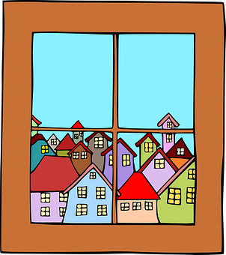
e
fenêtre
cela
[that]
je
second
cheval
devoir
[to have to]
Notes:
Timing: 2 minutes
Aim: To introduce SSC [e]
Procedure:
1. Introduce and elicit the pronunciation of the individual SSC [e] and then the source word again ‘je’ (with gesture, if using). 2. Then present and elicit the pronunciation of the five cluster words.
The cluster words have been chosen for their high-frequency, from a range of word classes, with the SSC (where possible) positioned within a variety of syllables within the words (e.g. initial, 2nd, final etc.). Additionally, we have tried to use words that build cumulatively on previously taught SSCs (see the Phonics Teaching Sequence document) and do not include new SSCs. Where new SSCs are used, they are often consonants which have a similar symbol-sound correspondence in English.
Word frequency (1 is the most frequent word in French): fenêtre [1604]; cela [54] second [379]; devoir [39]; cheval [2220]; je [22]. Source: Londsale, D., & Le Bras, Y. (2009). A Frequency Dictionary of French: Core vocabulary for learners London: Routledge.

Slide 6
e
fenêtre
cela
je
second
cheval
devoir
Notes:
With sound and no pictures to focus all attention on the sound-symbol correspondence.

Slide 7
e
fenêtre
cela
je
second
cheval
devoir
Notes:
Without sound to elicit pronunciation (without first hearing the teacher).
Teacher to elicit pronunciation by asking “Comment dit-on …"

Slide 8
Phonétique
écouter
Which word has the SSC [e] ?
ou
au revoir
chanter
Notes:
Timing: 5 minutes for 5 slides
Aim: Aural recognition of SSC [e]
Procedure: 1. For the next five slides, click on the pictures to hear the words.
2. Decide which word contains SSC [e]. Remember that the [e] sound might not be obvious at first – it won’t be ‘stressed’ like some of the other vowels, so you might have to listen carefully to pick it up. For this reason, we are providing the beginning of the word so students know where to start listening!
3. Click to check.
4. Clarify the meaning of unknown vocabulary.
Transcript
au revoir, chanter
Word frequency of unknown vocabulary used (1 is the most frequent word in French):
chanter [1820] Source: Londsale, D., & Le Bras, Y. (2009). A Frequency Dictionary of French: Core vocabulary for learners London: Routledge.

Slide 9
Phonétique
écouter
Which word has the SSC [e] ?
[this, that]
ou
ce
chien
Notes:
Transcript
ce, chien

Slide 10
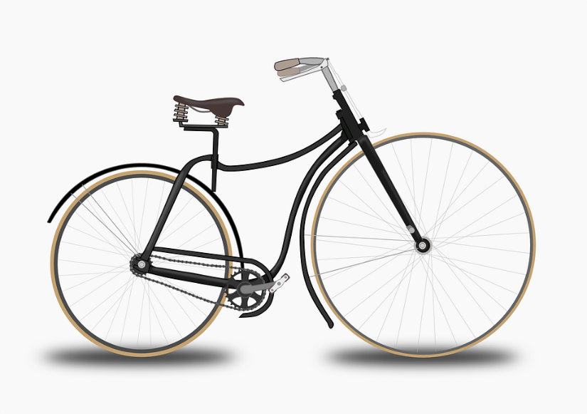
Phonétique
écouter
Which word has the SSC [e] ?
ou
the (m.)
vélo
le
Notes:
Transcript
vélo, le
Word frequency of unknown vocabulary used (1 is the most frequent word in French):
vélo [4594], le [1] Source: Londsale, D., & Le Bras, Y. (2009). A Frequency Dictionary of French: Core vocabulary for learners London: Routledge.

Slide 11
Phonétique
écouter
Which word has the SSC [e] ?
[partner]
ou
partenaire
personne
Notes:
Transcript
partenaire, personne
Word frequency of unknown vocabulary used (1 is the most frequent word in French):
partenaire [1077], personne [84] Source: Londsale, D., & Le Bras, Y. (2009). A Frequency Dictionary of French: Core vocabulary for learners London: Routledge.

Slide 12
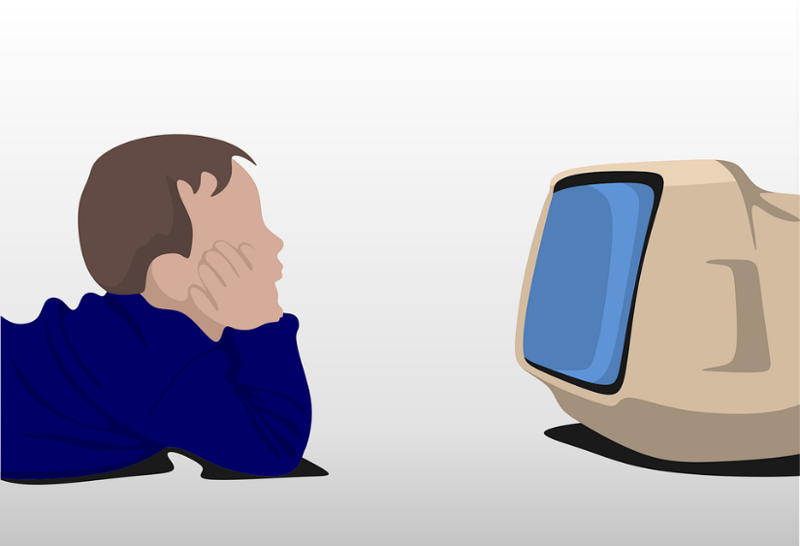
Phonétique
écouter
Which word has the SSC [e] ?
ou
regarder
télé
Notes:
Transcript
regarder, télé
Word frequency of unknown vocabulary used (1 is the most frequent word in French):
regarder [425], télé [2746] Source: Londsale, D., & Le Bras, Y. (2009). A Frequency Dictionary of French: Core vocabulary for learners London: Routledge.

Slide 13
Phonétique
SFC
parler
facile
de
45
le
[of]
[the (m)]
secret
[secret]
regard
dehors
[a glance]
rebelle
Secondes
[outside]
[rebel]
fenêtre
mercredi
[window]
[Wednesday]
promenade
0
difficile
[a walk]
DÉBUT
Notes:
Timing: 3 minutes for 3 slides.
Aim: Oral production of SSC [e] in words of varying degrees of complexity in decreasing amounts of time.
Procedure:
Students pair up.
Explain that students are going to work their way down the ‘ladder’ by correctly pronouncing words containing [e], starting with simple words and building up to more complex words. Using their knowledge of English, students should be able to work out the meanings of facile and difficile form context – clarify. Explain that only the letters in bold are examples of [e] – the others are the ‘e’ sound they know from English.
Start the timer. Starting with de, Partner A works their way down the ladder. Partner B listens for correct pronunciation of [e]. If Partner A makes a mistake, they must go back to de and start again!
Students swap roles. Re-start the timer.
Whoever is furthest down the ladder when the timer stops is the winner!
Click on the words to hear them said aloud by a native speaker. Students repeat.
Move on to the next slide.
Transcript and word frequency (1 is the most frequent word in French):
de [2], le [1], secret [796], regard [1209], dehors [1217], rebelle [2621], fenêtre [1604], mercredi [1168], promenade [>5000]
Word frequencies of unknown words used in task instructions (1 is the most frequent word in French): facile [822], difficile [296]
Source: Londsale, D., & Le Bras, Y. (2009). A Frequency Dictionary of French: Core vocabulary for learners London: Routledge.

Slide 14
Phonétique
SFC
parler
facile
de
30
le
[of]
[the (m)]
secret
[secret]
regard
dehors
[a glance]
rebelle
Secondes
[outside]
[rebel]
fenêtre
mercredi
[window]
[Wednesday]
promenade
0
difficile
[a walk]
DÉBUT
Notes:
As previous but with 15 fewer seconds on the timer.

Slide 15
Phonétique
SFC
parler
facile
de
15
le
[of]
[the (m)]
secret
[secret]
regard
dehors
[a glance]
rebelle
Secondes
[outside]
[rebel]
fenêtre
mercredi
[window]
[Wednesday]
promenade
0
difficile
[a walk]
DÉBUT
Notes:
As previous but with 15 fewer seconds on the timer still.

Slide 16
Vocabulaire
lire / parler
un animal
an animal / a pet
un chien
a dog
un portable
a mobile phone
une chambre
a bedroom / (hotel) room
une chose
a thing
une idée
an idea
une règle
a ruler
qui?
who
bon
good
ce, c’
this/that
Notes:
Timing: 5 minutes
Aim: Recognition and recall of the words in this week’s set (other than the parts of the verb avoir, which will be introduced separately on the slides that follow). Though the masculine and feminine nouns respectively are grouped (to indicate a pattern in the use of the article rather than a totally random situation), the emphasis is on the meaning of the nouns, rather than on the indefinite article and gender, for now.
Procedure:
French words appear one by one on clicks.
Teacher says the French word. Students repeat.
Students say the English.
Answers appear on clicks.
Once all words have appeared, click to trigger the disappearance of a French word (it will reappear on a second click). Students say the French.

Slide 17
C’est
grammaire
As you know, est (is) is the third person singular form of être (to be).
Ce means ‘this, that’. Used together with est, it means ‘this is’, ‘that’s’ or ‘its’.
ce + est =
c’est
C’est excellent!
Before a vowel, ce changes to ‘c’.
C’est bon!
“C’est une chose?”
“Non, c’est un animal!”
Notes:
Timing: 2 minutes
Aim: to explain construction of c’est, which will be featured in task instructions going forward, and give examples of usage.
NB: students have not yet encountered the word non [75], which will be formally introduced next week. However, they should be able to work out its meaning from context.

Slide 18
Liaison
écouter
C’est bon! That’s good!
The final –t in c’est is a Silent Final Consonant.
But …
C’est un chien. It’s a dog.
This time, the final consonant in c’est is not an SFC!
Because the -t is followed by a vowel, it is pronounced.
This pronunciation change is known as liaison.
Notes:
Timing: 2 minutes
Aim: Introduction to the –t liaison.

Slide 19
Liaison
écouter
c’est
it's, that’s
Notes:
Timing: 3 minutes for 6 slides
Aim: to introduce the concept of t-liaison before a vowel with c’est.
Procedure:
1. Listen and repeat.

Slide 20
Liaison
écouter
c’est un
it’s a, that’s a
Notes:
Timing: 3 minutes for 6 slides
Aim: to introduce the concept of t-liaison before a vowel with c’est.
Procedure:
Listen and repeat.
Highlight that this sounds like one word, rather than two

Slide 21
Liaison
écouter
C’est bon !
It’s good!
Notes:
Procedure:
1/ Listen and repeat.
2/ Ask students to translate the sentence.
3/ Reveal picture on a click, ask students to check their translations.
4/ Reveal English translation on click.

Slide 22
Liaison
écouter
C’est un chien !
It’s a dog!
Notes:
Procedure:
1/ Listen and repeat.
2/ Ask students to translate the sentence.
3/ Reveal picture on a click, ask students to check their translations.
4/ Reveal English translation on click.

Slide 23
Liaison
écouter
C’est triste.
It’s sad.
Notes:
Procedure:
1/ Listen and repeat.
2/ Ask students to translate the sentence.
3/ Reveal picture on a click, ask students to check their translations.
4/ Reveal English translation on click.

Slide 24
Liaison
écouter
C’est une règle.
It’s a ruler.
Notes:
Procedure:
1/ Listen and repeat.
2/ Ask students to translate the sentence.
3/ Reveal picture on a click, ask students to check their translations.
4/ Reveal English translation on click.

Slide 25
Liaison
écouter
C’est calme.
It’s quiet.
Notes:
Procedure:
1/ Listen and repeat.
2/ Ask students to translate the sentence.
3/ Reveal picture on a click, ask students to check their translations.
4/ Reveal English translation on click.

Slide 26
Liaison
écouter
C’est un portable.
It’s a mobile phone.
Notes:
Procedure:
1/ Listen and repeat.
2/ Ask students to translate the sentence.
3/ Reveal picture on a click, ask students to check their translations.
4/ Reveal English translation on click.

Slide 27
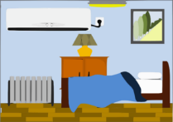
Liaison
écouter
1
C’est … grand / un pentagone !
What is Léa saying about these things?
Écoute!
2
C’est … calme / une chambre !
3
C’est … petit / un hexagone !
4
C’est … bon / un portable !
5
C’est … petite / une chose !
6
C’est … triste / un visage !
Notes:
Timing: 5 minutes
Aim: To detect the presence or absence of a t-liaison with c’est, and connect this with meaning.
Procedure:
Check students understand the task instructions. They have not encountered écoute before. Explain that this is the short form of écouter, which they met in week 1, and that they will encounter this in task instructions in the weeks to come.
Students write 1-6.
Click on a button to hear a form of ‘c’est’, followed by a beep.
Based on the presence or absence of a liaison, students decide what comes next. Remind them it is the presence or absence of a -t- sound that will give them this information – they won’t be able to tell the answer from the picture!
Click to check.
Full audio can be found on the next slide.
Transcript
1. C’est [grand].
2. C’est [une chambre].
3. C’est [petit].
4. C’est [un portable].
5. C’est [une chose].
6. C’est [triste].
Word frequency (1 is the most frequent word in French): pentagone [>5000], hexagone [>5000]
Source: Londsale, D., & Le Bras, Y. (2009). A Frequency Dictionary of French: Core vocabulary for learners London: Routledge.

Slide 28
Liaison
écouter
1
C’est … grand / un pentagone !
What is Léa saying about these things?
Écoute!
2
C’est … calme / une chambre !
3
C’est … petit / un hexagone !
4
C’est … bon / un portable !
5
C’est … petite / une chose !
6
C’est … triste / un visage !
Notes:
Full audio for the exercise on the previous slide.
Transcript
1. C’est grand.
2. C’est une chambre.
3. C’est petit.
4. C’est un portable.
5. C’est une chose.
6. C’est triste.

Slide 29
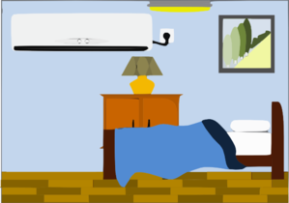
C’est … ? (1/2)
parler
1
2
3
4
5
6
Say what each item is,
e.g.,1) C’est une règle.
Notes:
Timing: 5 minutes for two slides.
Aim: Spoken production of sentences with c’est, to practise presence and absence of a liaison.
Procedure.
Working in pairs, students take turns to say what they see.
For numbers 1-6 on this slide, students say C’est + un(e) + noun. Remind students of the liaison.
Click to move to the next slide.
Students take turns to say what they see using an adjective. Remind students that no liaison is needed.
Answers (slide 1/2)
C’est une règle.
C’est une chambre.
C’est une idée.
C’est un portable.
C’est un chien.
C’est un animal.

Slide 30
C’est … ? (2/2)
parler
7
8
9
10
11
Say what each item is, e.g.,
1) C’est une règle.
Now say what each item is like,
e.g.,1) C’est grand.
Notes:
Answers (slide 2/2)
C’est français.
C’est amusant.
C’est petit.
C’est anglaise.
C’est bon.

Slide 31
avoir
[to have | having]
a
[has | is having]
Notes:
Timing: 3 minutes for sequence of six verbs
Aim: to introduce the verb avoir more explicitly. Avoir is one of the 25 most frequently used verbs in French. All 25 most frequent verbs will be introduced early on using the same format. Both long form (infinitive) and short form (3rd person singular) are introduced in order to familiarise students with various forms of the same verb.
Procedure
Bring up the word avoir on its own, say it, students repeat it, and remind them of the phonics. Draw attention to SSC [a].
Try to elicit the meaning from the students. Students have had explicit teaching that the present tense in French communicates two different present tense meanings in English. This reinforces that learning. Emphasise the two meanings for the short form, reminding students that French only has one form and does not have a direct equivalent of the grammar for ‘is + ing’, the continuous form (as covered in previous weeks).
Then bring up the English translations. Emphasise the two meanings for the infinitive.
Bring up the short form [a], say it, students repeat it.
Try to elicit the meaning from the students. Emphasise the two meanings for the short form.

Slide 32
avoir
[to have | having]
a
[has | is having]
Notes:
Cycle through the long and short form again.

Slide 33
a
[has]
Il a un animal.
[He has a pet.]
Notes:
Introduce the short form in a sentence.

Slide 34
avoir
[to have | having]
Il aime avoir un animal.
.
[He likes having a pet.]
Notes:
Introduce the long form in a sentence.

Slide 35
a
[has]
Il un animal.
a
[He has a pet.]
Notes:
Cycle through the short form in context again.

Slide 36
avoir
[to have | having]
Il aime un animal.
avoir
[He likes having a pet.]
Notes:
Cycle through the long form in context again.

Slide 37
Using the verb avoir
grammaire
To talk in French about what you have, use the verb avoir.
The pronoun je is j’ before a vowel.
avoir to have|having
j’ai I have
il a he has
elle a she has
These are all part of the verb avoir.
J’ai un animal. I have an animal (i.e., pet).
Il a un chien. He has a dog.
Elle a une idée. She has an idea.
Notes:
Timing: 2 minutes

Slide 38
Léa a un message !
lire
Léa wrote a message to tell us what she has, and what Amir has. The app has a bug! It deleted all the pronouns. Write the items, in English, in the appropriate column of the response grid shown on the following slide. C’est qui – Léa ou Amir ?
1 | ai un animal. | 5 | ai une idée.
2 | a un poster. | 6 | a une chose.
3 | a une chambre. | 7 | a un chien.
4 | ai une règle. | 8 | a un portable.
Notes:
Timing: 5 minutes
Aim: to connect the written form of the first and third person singular forms of avoir with their meanings.
Procedure:
Explain, if necessary, that Léa is writing about herself in the first person, whereas she is talking about Amir using the third person.
Students sketch a grid in their books with the column headers ‘Léa’ and ‘Amir’.
Students complete their tables by writing English nouns in the appropriate columns. Remind students that it is the form of the verb that will give them the necessary information. NB: masculine and feminine nouns are equally distributed between Léa and Amir to avoid any potential for the incorrect supposition at any point on the part of the student that the indefinite article is the key to the answer here.
Answers on the next slide.
N.B. Response grid on following slide.
Word frequency of unknown cognates used (1 is the most frequent word in French): poster [3011], message [792]
Source: Londsale, D., & Le Bras, Y. (2009). A Frequency Dictionary of French: Core vocabulary for learners London: Routledge.

Slide 39
Léa a un message !
lire
 | Léa a... | Amir a...
1
2
3
4
5
6
7
8
an animal
a poster
a bedroom
a ruler
an idea
a thing
a dog
a phone
Notes:
Answers appear on clicks.

Slide 40
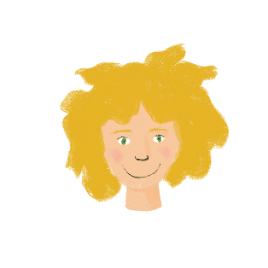
C’est qui ?
écouter
Léa tries phoning instead! Now she is talking about what she has and what her friend Sophie has. But the line is bad! Écoute. C’est qui – Léa (I) ou Sophie (she) ?
Léa (I)
Sophie (she)
Léa (I)
Sophie (she)
1
thing
5
pet
2
dog
6
thing
3
mobile phone
7
ruler
4
bedroom
8
idea
Notes:
Timing: 5 minutes
Aim: to connect the spoken form of the first and third person singular forms of avoir with their meanings.
Click on a button to hear the audio with the pronoun obscured.
Students listen to the verb and decide to whom the thing belongs.
They write the name of the thing in the appropriate column.
Answers appear on clicks, one by one.
For full audio, including pronouns, see the next slide.
Transcript
[beep] ai une chose.
[beep] a un chien.
[beep] ai un portable.
[beep] ai une chambre.
[beep] a un animal.
[beep] a une chose.
[beep] ai une règle.
[beep] a une idée.

Slide 41
C’est qui ?
écouter
Léa tries phoning instead! Now she is talking about what she has and what her friend Sophie has. But the line is bad! Écoute. C’est qui – Léa (I) ou Sophie (she) ?
Léa (I)
Sophie (she)
Léa (I)
Sophie (she)
1
thing
5
pet
2
dog
6
thing
3
mobile phone
7
ruler
4
bedroom
8
idea
Notes:
Answers for the activity on the previous slide. Full audio (including pronouns) plays on clicks.
Transcript
J’ai une chose.
Elle a un chien.
J’ai un portable.
J’ai une chambre.
Elle a un animal.
Elle a une chose.
J’ai une règle.
Elle a une idée.

Slide 42
Challenge
écrire
Écris une liste !
Can you remember what Léa told you about what she and Sophie have? Translate your list into French. Use the correct word for ‘a’ / ‘an’ Remember to distinguish between ‘I have’ and ‘she has’. When you have finished, check the wordlist.
Notes:
OPTIONAL EXTENSION
Timing: 8 minutes
Aim: Written recall of this week’s vocabulary.
Procedure:
Students write sentences beginning with Léa a … and Sophie a …
Use the previous slide to check!

Slide 43
Saying what people have
Indefinite articles and gender
SSC [eau/au/o]
Y7 French
Term 1.1 - Week 3 - Lesson 6
Stephen Owen / Rachel Hawkes / Ciarán Morris
Artwork by: Chloé Motard
Date updated: 12/10/2022
Notes:
Learning outcomes (lesson 1):
Introduction of SSC [e]
Consolidation of first, second and third person plural forms of avoir
Introduction of indefinite articles and gender
Word frequency (1 is the most frequent word in French):
1.1.3 (introduce) a [8], ai [8], avoir [8], ce (c') [12], animal [1002], chambre [633], chien [1744], chose [125], idée [239], portable [4002], règle¹ [488], bon [94], un¹ [3], une [3], qui [14]
Source: Londsale, D., & Le Bras, Y. (2009). A Frequency Dictionary of French: Core vocabulary for learners London: Routledge.
The additional English meanings of the following words have been added to Quizlet since the creation of this resource: chambre: bedroom, (hotel) room

Slide 44
au
[au/eau]
gauche
Notes:
Timing: 1 minute
Aim: To introduce SSC [au]
Procedure: 1. Present the letter(s) and say the [au] sound first, on its own. Students repeat it with you. 2. Bring up the word ”gauche” on its own, say it, students repeat it, so that they have the opportunity to focus all of their attention on the connection between the written word and its sound.
3. A possible gesture for this would be to point to the students’ left (teacher’s right!) to indicate this direction. 4. Roll back the animations and work through 1-3 again, but this time, dropping your voice completely to listen carefully to the students saying the [au] sound, pronouncing ”gauche” and, if using, doing the gesture.
Word frequency (1 is the most frequent word in French):
gauche [607].
Source: Londsale, D., & Le Bras, Y. (2009). A Frequency Dictionary of French: Core vocabulary for learners London: Routledge.

Slide 45
au
[au/eau]
gauche
Notes:
With sound and no pictures to focus all attention on the sound-symbol correspondence.

Slide 46
au
[au/eau]
gauche
Notes:
Without sound to elicit pronunciation (without first hearing the teacher).
Teacher to elicit pronunciation by asking “Comment dit-on …"

Slide 47
au
faux
bateau
[au/eau]
beau
eau
gauche
aussi
[also]
Notes:
Timing: 2 minutes
Aim: To introduce SSC [au]
Procedure:
1. Introduce and elicit the pronunciation of the individual SSC [au] and then the source word again ‘gauche’ (with gesture, if using). 2. Then present and elicit the pronunciation of the five cluster words.
The cluster words have been chosen for their high-frequency, from a range of word classes, with the SSC (where possible) positioned within a variety of syllables within the words (e.g. initial, 2nd, final etc.). Additionally, we have tried to use words that build cumulatively on previously taught SSCs (see the Phonics Teaching Sequence document) and do not include new SSCs. Where new SSCs are used, they are often consonants which have a similar symbol-sound correspondence in English.
Word frequency (1 is the most frequent word in French): gauche [607]; aussi [44]; faux [555] bateau [1278]; beau [393]; eau [475] Source: Londsale, D., & Le Bras, Y. (2009). A Frequency Dictionary of French: Core vocabulary for learners London: Routledge.

Slide 48
au
faux
bateau
[au/eau]
beau
eau
gauche
aussi
Notes:
With sound and no pictures to focus all attention on the sound-symbol correspondence.

Slide 49
au
faux
bateau
[au/eau]
beau
eau
gauche
aussi
Notes:
Without sound to elicit pronunciation (without first hearing the teacher).
Teacher to elicit pronunciation by asking “Comment dit-on …"

Slide 50
Phonétique – c’est [au] ?
écouter / parler
restaurant
uniforme
piano
docteur
radio
poste
intéressant
professeur
[(e)au / o]
personne
[other sounds]
Notes:
Timing: 5 minutes
Aim: Aural recognition and production of SSC [au].
Procedure:
Click on a word to hear it said out loud.
Students allocate each word to either the left bucket, if they think the SCE in bold is [au] or the right bucket, if not. Tell students that even though these words look like English, English will not help them. Sometimes the SSCs sound the same as English, sometimes not.
Click to check and clarify the meaning of the words.
Once all the words have been assigned, reset the slide.
Students now try saying the words.
Click to check.
Transcript and word frequency (1 is the most frequent word in French):
restaurant [2336], uniforme [1801], piano [4967], docteur [2176], radio [1526], poste [489], intéressant [1244], professeur [1150], personne [84]

Slide 51
Phonétique – c’est [au] ?
écouter
Les faux animaux sont à gauche.
1
The fake animals are on the left.
Le bateau est sur l’eau.
2
The boat is on the water.
Ce nouveau tableau montre le problème.
3
This new chart shows the problem.
Il porte le cadeau jaune au bureau.
4
He is carrying the yellow present to the office.
Notes:
Timing: 3 minutes
Aim: Aural identification of SSC [au] in sentences.
Procedure:
Click on the numbers to play audio. Tel students they won’t understand the meaning of the sentences, they just need to listen out for the sound.
Students tally the number of times they hear the SSC [au].
On clicks, transcriptions of the sentences appear. Students use these to check their answers.
On a second round of clicks, the answers appear one by one.
On a final round of clicks, English translations appear.
Word frequency of unknown target words (1 is the most frequent word in French):
faux [555], animal [1002], gauche [607], bateau [1287], eau [475], nouveau [52], tableau [1456], cadeau [2298], jaune [2585], au [4, 1], bureau [273]

Slide 52
Vocabulaire
écrire
A
B
C
D
[good]
[this, that]
E
F
G
H
[animal]
[to have, having]
[thing]
I
J
K
L
[early]
[a, an]
[who?]
Notes:
Timing: 5 minutes
Aim: Written recall of 12 items of vocabulary, within a limited time frame.
Procedure:
1. Write A-L in books, in a grid format as pictured.
2. Click / press enter to flash a picture or English word. It will disappear after 3 seconds.
3. Students write down the French word before the picture has faded away. Ensure that indefinite articles are included for nouns.
4. Check answers against the grid on the next slide.
ANSWERS
A. bon
B. ce
C. un portable
D. une règle
E. un chien
F. une chose
G. un animal
H. avoir
I. une chambre
J. une idée
K. un, une
L. qui

Slide 53
Vocabulaire: réponses
écrire
[bon]
[un portable]
[une règle]
[ce]
[un chien]
[une chose]
[un animal]
[avoir]
[une chambre]
[une idée]
[un, une]
[qui?]
Notes:
Answers to previous slide

Slide 54
Grammatical gender
grammaire
Nouns are words for things and people. Every noun has a gender in French.
This means that nouns are either masculine or feminine:
Masculine
Feminine
animal
chambre
chien
chose
livre
idée
portable
règle
You cannot usually guess the gender from the meaning of the noun, or from how it looks or sounds. You have to learn the gender with the noun!
Stephen Owen
Notes:
Timing: 2 minutes

Slide 55
The indefinite article
grammaire
To say a (or an) in French before a noun, you use un or une, depending on whether the noun is masculine or feminine:
Masculine
Feminine
un animal
une chambre
When we learn nouns, we must learn them with the article, to make sure that we know their gender.
un chien
une chose
un poster
une idée
un portable
une règle
Un and une are known as indefinite articles.
Stephen Owen
Notes:
Timing: 2 minutes

Slide 56
C’est ‘un’ ou ‘une’ ?
lire
You message Léa to check you understood what she said. Now your app has a bug! It has eaten the indefinite articles. Use the correct word for ‘a’: ‘un’ or ‘une’. When you have finished, check the wordlist.
1 | J’ai animal. |  |  | 5 | J’ai idée.
2 | Elle a chose. |  |  | 6 | J’ai chien.
3 | Elle a chambre. |  |  | 7 | Elle a portable.
4 | J’ai règle.
un
une
un
une
Notes:
Timing: 5 minutes
Aim: A test (and demonstration) of the rote learning involved, rather than a referential activity. Remind students that they must take the trouble to check and learn gender, rather than guessing.
Procedure:
Students write 1-7 in their books, and un or une.
Answers appear on clicks.

Slide 57
Vocabulary introduction
Vocabulaire – un ou une?
lire
chose
portable
animal
chambre
idée
règle
chien
un
une
Notes:
Timing: 5 minutes for two slides.
Aim: Recognition and recall of the nouns from this week’s vocabulary set and their genders,.
Procedure
1. Students should predict to which word for ‘a/an’ each item will fly to – un or une, pronouncing the words in French (with the article) as they go. 2. Click to check. Note: Students can volunteer answers in any order. Pictures are triggered. Click the word and it flies to un/une.

Slide 58
Vocabulaire – un ou une?
parler
un
une
Notes:
As previous. However, this slide has the nouns as pictures, to stimulate recall of the words themselves, as well as their gender.

Slide 59
Je ou elle? Partenaire A (1)
parler
You play Léa. Tell your partner what you have, and what Amir has.
Use the pronoun il (he) to talk about Amir.
Léa (I…)
Amir (he…)
Notes:
Timing: 10 minutes
Aim: Oal consolidation of vocabulary and grammar learned this week.
Procedure:
Partner A faces the board. Partner B turns away from the board and sketches a 2x3 grid with column headings ‘Léa (I…)’ and ‘Amir’ (he…) (alternatively, the role card on the next slide may be printed).
Partner A reads 6 sentences using the prompts. Partner B adds ticks to their grid.
Partner B turns back to the board and corrects using this slide.
Partners swap roles (see slides 48-49).

Slide 60
Je ou elle? Partenaire B (1)
parler
Léa calls you. She tells you what she has, and what Amir has.
Tick who has each item. N.B. The pictures are not in order.
Léa (I…)
Amir (he…)
Léa (I…)
Amir (he…)
Notes:
Partner B is challenged to spot the correct vocabulary item, as well as to listen out for whether it belongs to Alex or to his/her sister, as revealed by Partner A’s use of either ‘j’ai’ or ‘elle a’.
Vocabulary (phonics cluster word inclusions in bold
un [3], une [3], chien [1744], cheval [2220], livre [358], portable [4002], chambre [633], photo [1412], idée [239], règle [488]
Source: Londsale, D., & Le Bras, Y. (2009). A Frequency Dictionary of French: Core vocabulary for learners London: Routledge.

Slide 61
Je ou elle? Partenaire A (1)
parler
You play Amir. Tell your partner what you have, and what Léa has.
Use the pronoun elle (she) to talk about Léa.
Amir (I…)
Léa (she…)
Notes:
Speaking role card for partner A.

Slide 62
Je ou elle? Partenaire B (1)
parler
Amir calls you. He tells you what he has, and what Léa has.
Tick who has each item. N.B. The pictures are not in order.
Amir (I…)
Léa (she…)
Amir (I…)
Léa (he…)
Notes:
Speaking role card for partner B.

Slide 63
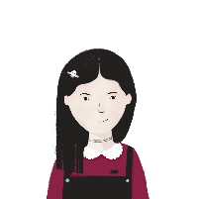
Je ou elle ?
écrire
You are Léa. You write to another friend. Write a sentence for each thing, using the information below. E.g., J’ai une règle. Elle a un animal. Écris !
Léa (I…)
Sophie (‘she’)
Léa (I…)
Amir (he…)
1 |  |  | 2
3 |  |  | 4
5 |  |  | 6
Notes:
Timing: 10 minutes
Aim: Written production of the ‘je’ and ‘il/elle’ forms of ‘avoir’ and this vocabulary.
Procedure:
1. Students write 1-6 in their books.
2. Students write sentences using the appropriate pronouns, nouns, indefinite articles and forms of avoir.
3. Check answers on the next slide.

Slide 64
Réponses correctes
écrire
1 |  | 2
3 |  | 4
5 |  | 6
J’ai une règle.
J’ai une idée.
J’ai un chien.
Il a un portable.
Elle a un animal.
Elle a une chambre.
Notes:
These are the answers to the activity on the previous slide.

Slide 65
Gaming Grammar
Gaming Grammar
Relevant mini game(s):
Indefinite articles: Gender (Article Agreement)
To have and to be: 1st person and 3rd person singular
Notes:
This slide links to Gaming Grammar login screen. The appropriate mission can then be selected from the menu page.
Students will progress through the game at their own rate; teachers should use the teacher interface to check progress. This will help to inform future lesson planning.

Slide 66
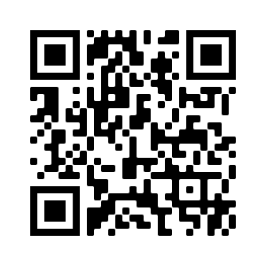
Devoirs
Vocabulary Learning Homework (Term 1.1, Week 4)
Audio file
Audio file QR code:
Student worksheet
Quizlet link
In addition, revisit: Term 1.1 Week 1

