Slide 1
Describing what people can, must and want to do
Using ‘poder’, ‘deber’ and ‘querer’
Possessive adjectives ‘mi’ and ‘tu’ [revisited]
Y7 Spanish
Term 3.2 - Week 7 - Lesson 71
Victoria Hobson / Nick Avery / Rachel Hawkes Artwork: Mark Davies
Date updated: 19/04/21
Notes:
Artwork by Mark Davies. All additional pictures selected are available under a Creative Commons license, no attribution required.
Learning outcomes (lesson 1):
Consolidation of a range of SSCs
Consolidation of possessive adjectives mi/mis and tu/tus
Consolidation of ‘quiere’, ‘debe’ and ‘puede’
Introduction of ‘quieren’, ‘deben’ and ‘pueden’
Note: although the 3rd person plural forms of QUERER, DEBER and PODER are listed as ‘new’ language, they in fact tie in very closely with earlier Y7 grammar teaching. The 3rd person plural –en verb ending was already taught in 3.1.6 and revisited in 3.2.3 with these verbs. Furthermore, students will already be familiar with the verb stems used in the 3rd person plural (i.e. ‘quier-’, ‘pued-’ and ‘deb-’), having learnt the 3rd person singular forms in term 2. The lesson is therefore carefully planned to consolidate and extend learning without overburdening students with new grammatical concepts and forms just before the summer break.
Word frequency (1 is the most frequent word in Spanish):
No new vocabulary introduced. A range of vocabulary to be revisited. Vocabulary to be revisited has been drawn from 1.1.5, 1.1.7, 1.2.5, 2.1.2, 2.2.1, 3.1.1, 3.1.5, 3.1.6.
Source for subsequent slides: Davies, M. & Davies, K. (2018). A frequency dictionary of Spanish: Core vocabulary for learners (2nd ed.). Routledge: London
The frequency rankings for words that occur in this PowerPoint which have been previously introduced in NCELP resources are given in the NCELP SOW and in the resources that first introduced and formally re-visited those words.
For any other words that occur incidentally in this PowerPoint, frequency rankings will be provided in the notes field wherever possible.

Slide 2
İPracticamos!
hablar
1. Voy a comer carne roja y otra comida rica en un restaurante de La Rioja.
2. Vamos a bailar y beber limonada en los bares de Valencia.
3. En marzo va a visitar Zaragoza otra vez . İVa a estar muy feliz en la plaza y en otras zonas de la ciudad!
4. Vas a descansar, caminar y jugar en la playa en Málaga.
5. Voy a llegar a Sevilla a caballo y luego hacer llamadas a los abuelos en Léon.
6. Vamos a elegir imágenes de gente argentina en Girona.
7. Voy a ganar algo el domingo con mis amigos de Galicia. ¡Estoy seguro!
Notes:
Tongue twisters
Timing: 5 minutes
Aim: to revisit a number of SSCs from throughout the year and build students’ confidence in oral production.
Revisited SSCs include [co], word-initial [r], [z], [ci], [a], [l], [ll], [ge], [gi], [ga], [go], [gu], [j].
Procedure:
Teachers ask students to read these sentences aloud in pairs. As them to focus especially on pronouncing the bold words.
Teachers can elicit meanings of the sentences in English to check comprehension. Focus in particular on understanding of ir + infinitive as this construction will be revisited in the second lesson this week.
Notes:
All vocabulary apart from place names has been taught in the Y7 scheme of work or used for earlier phonics practice.

Slide 3
Vocabulario
ir
de vacaciones
sin amigos
en tren
las vistas
en la playa
de vacaciones
sin amigos
en tren
Francia
a la playa
montar a caballo
al parque
la basura
a la playa
al parque
los deberes
con la familia
los museos
trabajo
fruta
con la familia
la naturaleza
deporte
una bolsa
deporte
comida rica
por el país
zapatos
ejercicio
por el país
Notes:
Timing: 10 minutes (for slides 3-14)
Aim: to refresh students’ knowledge of infinitives and vocabulary items that collocate with them. These constructions will all be used in the input and production activities over the course of this lesson.
Procedure:
Students should volunteer/write down any items of vocabulary that can be used after each of the 13 infinitives.
Teachers should elicit the English with each slide.
Notes:
An alternative way to conduct this activity would be for students to work in groups of four using one print out (consider A3) of one of the slides with the infinitive removed. Students would have to supply all of the possible infinitives that match with at least one vocabulary item. They could simply record their answers in lists with each infinitive and the accompanying vocab items or create a spider diagram with the infinitive in the middle and the correct accompanying items around each infinitive. Students could also record the English as they go as part of this activity.

Slide 4
Vocabulario
visitar
sin amigos
Francia
de vacaciones
sin amigos
en tren
las vistas
en la playa
Francia
a la playa
montar a caballo
al parque
la basura
los deberes
con la familia
trabajo
fruta
con la familia
la naturaleza
deporte
los museos
la naturaleza
los museos
una bolsa
deporte
comida rica
ejercicio
por el país
zapatos
Notes:
‘Visitar’ may be used as an intransitive verb (Collins Spanish Dictionary, 2005, 5th ed.)

Slide 5
Vocabulario
comprar
de vacaciones
sin amigos
en tren
las vistas
en la playa
Francia
a la playa
montar a caballo
al parque
la basura
los deberes
fruta
con la familia
los museos
trabajo
la naturaleza
deporte
fruta
una bolsa
deporte
una bolsa
comida rica
zapatos
comida rica
ejercicio
por el país
zapatos
Notes:
‘Comprar los museos’ is also grammatically possible, though not highlighted as it is an unlikely scenario. However, you may wish to explore this with your class:
Comprar algo EN los museos (buy something in the museums)
Comprar los museos (buy the museums)
Although ‘comprar’ may be used intransitively, this use hasn’t appeared in the scheme of work and so ‘con amigos’ and ‘con la familia’ aren’t highlighted.

Slide 6
Vocabulario
buscar
de vacaciones
sin amigos
en tren
las vistas
en la playa
Francia
Francia
la basura
a la playa
montar a caballo
al parque
la basura
los deberes
los deberes
trabajo
fruta
con la familia
los museos
trabajo
la naturaleza
deporte
fruta
los museos
la naturaleza
una bolsa
deporte
una bolsa
comida rica
zapatos
comida rica
ejercicio
por el país
zapatos

Slide 7
Vocabulario
disfrutar
las vistas
en la playa
de vacaciones
sin amigos
en tren
las vistas
Francia
a la playa
montar a caballo
al parque
la basura
los deberes
los deberes
los museos
trabajo
fruta
con la familia
los museos
la naturaleza
deporte
la naturaleza
una bolsa
deporte
comida rica
zapatos
comida rica
ejercicio
por el país

Slide 8
Vocabulario
sacar
de vacaciones
sin amigos
en tren
las vistas
en la playa
Francia
la basura
a la playa
montar a caballo
al parque
la basura
los deberes
los deberes
los museos
trabajo
fruta
con la familia
trabajo
deporte
fruta
la naturaleza
una bolsa
deporte
comida rica
zapatos
comida rica
ejercicio
por el país

Slide 9
Vocabulario
viajar
de vacaciones
sin amigos
las vistas
en la playa
sin amigos
en tren
en tren
Francia
a la playa
montar a caballo
al parque
la basura
a la playa
al parque
los deberes
con la familia
los museos
trabajo
fruta
con la familia
la naturaleza
deporte
una bolsa
deporte
comida rica
por el país
zapatos
ejercicio
por el país

Slide 10
Vocabulario
pasar tiempo
de vacaciones
sin amigos
las vistas
en la playa
de vacaciones
sin amigos
en tren
en la playa
en tren
Francia
a la playa
montar a caballo
al parque
la basura
al parque
los deberes
con la familia
los museos
trabajo
fruta
con la familia
la naturaleza
deporte
una bolsa
deporte
comida rica
ejercicio
por el país
zapatos

Slide 11
Vocabulario
aprender a
de vacaciones
sin amigos
en tren
las vistas
en la playa
Francia
montar a caballo
la basura
a la playa
montar a caballo
al parque
los deberes
fruta
con la familia
los museos
trabajo
la naturaleza
deporte
una bolsa
deporte
comida rica
ejercicio
por el país
zapatos

Slide 12
Vocabulario
descansar
sin amigos
en la playa
de vacaciones
sin amigos
en tren
las vistas
en la playa
Francia
a la playa
montar a caballo
al parque
la basura
los deberes
con la familia
los museos
trabajo
fruta
con la familia
la naturaleza
deporte
una bolsa
deporte
comida rica
ejercicio
por el país
zapatos

Slide 13
Vocabulario
llevar
de vacaciones
sin amigos
en tren
las vistas
en la playa
Francia
la basura
los deberes
a la playa
montar a caballo
al parque
la basura
los deberes
fruta
los museos
trabajo
fruta
con la familia
trabajo
la naturaleza
deporte
una bolsa
deporte
comida rica
zapatos
una bolsa
comida rica
ejercicio
por el país
zapatos

Slide 14
Vocabulario
‘To do’ or ‘to make’?
hacer
1. hacer una bolsa
to make
2. hacer ejercicio
to do
3. hacer zapatos
to make
4. hacer los deberes
to do
de vacaciones
sin amigos
en tren
las vistas
en la playa
Francia
a la playa
montar a caballo
al parque
la basura
los deberes
los deberes
los museos
trabajo
fruta
con la familia
trabajo
la naturaleza
deporte
una bolsa
deporte
ejercicio
zapatos
una bolsa
comida rica
ejercicio
por el país
zapatos

Slide 15
Talking about possessions
Possessive adjectives (mi/mis & tu/tus)
To say ‘my’ before a singular or uncountable noun, use mi.
To say ‘my’ before a plural noun, use mis.
Mi perro quiere correr en el parque.
My dog wants to run in the park.
Mis padres quieren descansar en la playa.
My parents want to relax at the beach.
Notice how ‘-en’ is the verb ending when ‘they’ are doing the action.
The same happens with ‘poder’.
Puede – s/he, it can.
Pueden – they can.
To say ‘your’ before a singular or uncountable noun, use tu.
To say ‘your’ before a plural, use tus.
Tu hermano debe lavar el coche.
Your brother must wash the car.
Tus profesores deben trabajar mucho.
Your teachers must work a lot.
Stephen Owen
Notes:
Grammar revision slide – possessive adjectives and 3rd person plural ending (-en)
Timing: 2 minutes
Aims:
to refresh students’ knowledge of possessive adjectives ahead of the subsequent comprehension and production activities
to draw attention to the –en verb ending for 3rd person plural (taught in 3.1.6) and how PODER, QUERER and DEBER have this.
Procedure:
1. Each click reveals the next part of the explanation. Teachers should elicit the previously taught forms and translations of sentences from students.

Slide 16
puede
[s/he, it can | is able to]
pueden
[they can|are able to]
Notes:
Timing: 2 minutes (for slides 16-18)
Aim: to introduce ‘pueden’ more explicitly
Here is an opportunity to refresh students’ memories of the meanings of puede/quiere/debe in 3rd person singular and also learn 3rd person plural form which has not been covered in the SoW up to now. However, students have seen –er verbs in 3rd person plural so teachers could draw on students’ prior learning to reinforce that the same pattern is followed here.

Slide 17
quiere
[s/he, it wants]
quieren
[they want]

Slide 18
debe
[s/he, it must]
deben
[they must]

Slide 19
leer
Daniel escribe sobre las vacaciones. Lee las frases y marca cada opción correcta. Luego escribe las frases en inglés.
leer
[1/2]
1 | Mis | profesores | quiere | ir de vacaciones al extranjero.
 |  | madre | quieren
2 | Mis | hermana | debe | aprender el vocabulario español.
 |  | amigos | deben
3 | Mi | perro | pueden | descansar en el barco.
 |  | amigos | puede
4 | Mi | padre | quieren | visitar los museos de Barcelona.
 |  | hermanos | quiere
5 | Mis | primos | puede | comprar mucha fruta en el mercado.
 |  | abuela | pueden
My teachers want to go on holiday abroad.
My friends must learn Spanish vocabulary.
My dog can relax on the boat.
My dad wants to visit the museums of Barcelona.
My cousins can buy a lot of fruit in the market.
Notes:
Timing: 10 minutes (for slides 19-20)
Aim:
1. to practise making connections between singular / plural forms of possessive adjective ‘mi’ and the noun to which it refers.
2. to practise connecting third person singular and plural forms of modal verbs DEBER, QUERER and PODER with the correct subject (i.e. a singular or plural noun).
Procedure:
For question items 1-5 (this slide), students write the two correct answers in their books.
They then write the sentence in their books in English.
For question items 6-10 (next slide), students do the same, but this time have to write the verb in Spanish (this adds progression/increases task difficulty).
Notes:
In addition to vocabulary revisited at the start of this lesson, this activity allows for a recap of people/family members. Consider allowing students recourse to reference materials if they are unlikely to readily recall these items.

Slide 20
leer / escribir
Daniel escribe sobre las vacaciones. Lee las frases y marca
cada opción correcta. Luego escribe el verbo y las frases en inglés.
leer / escribir
[2/2]
1 | Tus | profesor | quieren | caminar por las calles antiguas de Salamanca.
 |  | padres
2 | Tu | hermano | debe | buscar trabajo.
 |  | padres
3 | Tu | amiga | puede | aprender a montar a caballo.
 |  | profesores
4 | Tus | madre | deben | hacer muchos deberes.
 |  | primas
5 | Tus | abuelos | pueden | disfrutar las vistas bonitas.
 |  | gato
want
Your parents want to walk around the old streets of Salamanca.
must
Your brother must look for work.
can
Your friend can learn how to horse ride.
must
Your cousins must do a lot of homework.
can
Your grandparents can enjoy the pretty views.

Slide 21
Saying what I and others don’t do
Using the negative ‘no’
In Spanish, to say what you or others don’t, can’t or mustn’t do, put no before the verb. This makes it negative.
Compare:
S/he can go abroad.
S/he can’t go abroad.
→ Puede ir al extranjero.
→ No puede ir al extranjero.
This works for any verb and any person (e.g., I, you, s/he, they).
They must do sport.
They mustn't do sport.
→ Deben hacer deporte.
→ No deben hacer deporte.
Notes:
Grammar revision slide - negation
Timing: 2 minutes
Aim: to refresh students’ knowledge of negation ahead of the subsequent comprehension and production activities
Procedure:
1. Each click reveals the next part of the explanation. Teachers elicit the previously taught forms and translations of sentences from students.

Slide 22
escuchar / escribir
[1/2]
Hablan Ana y Diego, los padres de Lucía.
¿Qué puede/no puede hacer Lucía durante las vacaciones?
Marca la opción correcta y escribe la información en español.
escuchar / escribir
 | Actividad (en español) | Información adicional
She can She can’t
She doesn’t want to She wants to
She must She mustn’t
She can’t She can
She wants to She doesn’t want to
(porque) debe pasar tiempo con la abuela
1
ir a la playa
hacer deporte
(aunque) no puede
2
sacar la basura
(pero) no quiere
3
correr (sola)
por el parque
4
pasar tiempo con los amigos
5
(pero) debe estudiar
Notes:
Timing: 10 minutes (slides 22-23)
Aims:
to practise listening for affirmative vs negative meaning with Spanish modal verbs
to accurately write the Spanish that is heard (drawing on knowledge of previously taught SSCs, e.g., [rr], [qui], [que])
Procedure:
Students listen first and decide which English sentence starter is correct.
They listen again and write down the Spanish.
Note: some students may be able to do steps 1 and 2 together.
Transcript:
No puede ir a la playa porque debe pasar tiempo con la abuela.
Quiere hacer deporte, aunque no puede.
Debe sacar la basura pero no quiere.
No puede correr sola por el parque.
Quiere pasar tiempo con los amigos, pero debe estudiar.

Slide 23
escuchar / escribir
Ahora, ¡Lucía habla sobre los padres!
Marca la opción correcta y escribe la información
en español.
escuchar / escribir
[2/2]
 | Actividad (en español) | Información adicional
They mustn’t They must
They can They can’t
They must They mustn’t
They can’t They can
They don’t want to They want to
(pero) quieren visitar Francia
6
trabajar en julio
7
hacer ejercicio
por las tardes
8
viajar a otro lugar
si es caro
9
ir de vacaciones
durante agosto
pasar tiempo con la familia
(porque) es divertido
10
Notes:
Listening/writing activity (cont.)
Transcript (items 6-10)
6) Deben trabajar en julio pero quieren visitar Francia.
7) Pueden hacer ejercicio por las tardes.
8) No deben viajar a otro lugar si es caro.
9) No pueden ir de vacaciones durante agosto.
10) Quieren pasar tiempo con la familia porque es divertido.

Slide 24
Hablamos de las vacaciones
hablar / escuchar
La familia López habla de las vacaciones.
En parejas, habla y escucha.
Persona A
Persona B
Eres Lucía.
Eres Daniel.
You are talking to a friend.
Say what your sister (‘she’)
and parents (‘they’) can / want / must do in the holidays!
You are talking to a friend. Say what your brother (‘he’) and parents (‘they’) can / want / must do in the holidays!
Notes:
Timing: 15 minutes
Aim: to practise the 3rd person singular and plural forms of PODER, DEBER and QUERER in oral production and listening comprehension. To also practise negatives.
Procedure:
After going through the instructions (this slide) and worked example (next slide), Student A speaks and Student B listens and completes the grid.
Students then swap roles (Student B speaks, Student A listens)
Teacher gives feedback (see slides 29-30).

Slide 25
hablar / escuchar
Persona A
hablar / escuchar
[ [to visit the museums every day] | [read famous books]
Pueden leer libros famosos.
No quiere visitar los museos todos los días.
She doesn’t want
They can
Persona B
Los padres (‘they’) |  | Actividad (en inglés) | Lucía (‘she’) |  | Actividad (en inglés)
must | mustn’t |  | must | mustn’t
can | can’t |  | can | can’t
want | don’t want |  | wants | doesn’t want
read famous books
to visit museums every day
Notes:
Example slide
Aim: to provide a model of a worked example to illustrate how the activity works.
Notes:
Teacher should make clear to students here that they will be completing both sides of the grid – they need to listen out first for the verb ending to know if it’s ‘they’ or ‘she’.
Then they choose the correct verb and write the activity in English. Teachers can explain that, for each sentence heard, the correct verb on the grid could be any one of the six provided. Students therefore have to scan the options and decide which is correct.

Slide 26
hablar
1
2
[to do homework] | [visit the museums on an evening] | [go to the park every day]
[to travel around Spain by train] | [learn how to horse ride] | [do exercise in the afternoon]
3
hablar
She doesn’t want
They can
She mustn’t
4
5
6
They want
She can’t
They must
Notes:
Student A’s speaking prompt cards
Target sentences will be as follows:
No quiere hacer los deberes.
Pueden visitar los museos por la tarde.
No debe ir al parque cada día.
Quieren viajar por España en tren.
No puede aprender a montar a caballo.
Deben hacer ejercicio por la tarde.

Slide 27
hablar
[to go to France] | [work in July and August] | [go to the beach alone]
[to go abroad] | [learn how to horse ride] | [run in the morning]
1
2
3
hablar
He wants
They must
He mustn’t
4
5
6
They don’t want
They can’t
He can
Notes:
Student B’s speaking prompt cards.
Target sentences will be as follows:
Quiere ir a Francia.
Deben trabajar en julio y agosto.
No debe ir solo a la playa.
No quieren ir al extranjero.
Puede aprender a montar a caballo.
No pueden correr por la manaña.

Slide 28
hablar / escuchar
Persona A
hablar / escuchar
Los padres (‘they’) |  | Actividad | Lucía (‘she’) |  | Actividad
must | mustn’t |  | must | mustn’t
can | can’t |  | can | can’t
want | don’t want |  | wants | doesn’t want
Persona B
Los padres (‘they’) |  | Actividad | Daniel (‘he’) |  | Actividad
must | mustn’t |  | must | mustn’t
can | can’t |  | can | can’t
want | don’t want |  | wants | doesn’t want
Notes:
Blank example grid

Slide 29
hablar / escuchar
Respuestas
hablar / escuchar
Persona A
Los padres (‘they’) |  | Actividad | Lucía (‘she’) |  | Actividad
must | mustn’t | do exercise in the afternoon/evening | must | mustn’t | go to the park every day
can | can’t | visit museums in afternoon/evening | can | can’t | learn how to horse ride
want | don’t want | travel around Spain by train | wants | doesn’t want | to do homework
Persona B
Los padres (‘they’) |  | Actividad | Daniel (‘he’) |  | Actividad
must | mustn’t | work in July and August | must | mustn’t | go to the beach alone
can | can’t | run in the morning | can | can’t | learn how to horse ride
want | don’t want | to go abroad | wants | doesn’t want | to go to France
Notes:
Teachers could display this slide to bring the activity to a close and give feedback.
Student A - Daniel
No quiere hacer los deberes.
Pueden visitar los museos por la tarde.
No debe ir al parque todos los días.
Quieren viajar por España en tren.
No puede aprender a montar a caballo.
Deben hacer ejercicio por la tarde.
Student B- Lucía
Quiere ir a Francia.
Deben trabajar en julio y agosto.
No debe ir solo a la playa.
No quieren ir al extranjero.
Puede aprender a montar a caballo.
No pueden corer por la manaña.

Slide 30
Describing future plans
IR for habitual actions [revisited]
IR + infinitive to express future [revisited]
Y7 Spanish
Term 3.2 - Week 7 - Lesson 72
Victoria Hobson / Nick Avery / Rachel Hawkes Artwork: Mark Davies
Date updated: 19.04.21
Notes:
Artwork by Mark Davies. All additional pictures selected are available under a Creative Commons license, no attribution required.
Learning outcomes (lesson 2):
Consolidation of SSCs [ce], [ci] & [z]
Consolidation of voy / vas / va / vamos + a + infinitive
Word frequency (1 is the most frequent word in Spanish):
No new vocabulary introduced. A range of vocabulary to be revisited. Vocabulary to be revisited has been drawn from 1.1.5, 1.1.7, 1.2.5, 2.1.2, 2.2.1, 3.1.1, 3.1.5, 3.1.6.
Source for subsequent slides: Davies, M. & Davies, K. (2018). A frequency dictionary of Spanish: Core vocabulary for learners (2nd ed.). Routledge: London
The frequency rankings for words that occur in this PowerPoint which have been previously introduced in NCELP resources are given in the NCELP SOW and in the resources that first introduced and formally re-visited those words.
For any other words that occur incidentally in this PowerPoint, frequency rankings will be provided in the notes field wherever possible.

Slide 31
SSCs [CE], [CI] y [Z]
escuchar
Remember, there are different ways to pronounce CE and CI.
In most of Spain, the ‘c’ before ‘e’ or ‘i’ is pronounced
like th in English. The same is true of ‘z’ before a vowel.
In the Canary Islands and Latin America, this ‘c’ is often pronounced like an s. The same is true of ‘z’ before a vowel.
Escucha. Es ¿España o Canarias / Latinoamérica?
ciencias
España
1
________________________________
ciencias
Canarias / Latinoamérica
2
________________________________
cabeza
Canarias / Latinoamérica
3
________________________________
cabeza
España
4
________________________________
Notes:
Phonics recap slide
Timing: 3 minutes
Aim: to revisit the SSCs [CE], [CI] and [Z] and raise awareness of the different ways in which they are pronounced in the Spanish-speaking world.
Procedure:
Read the explanation, eliciting the answers from students where prompted by gaps.
Play the audio and ask where the person is from (‘¿La persona es de…?’).
Ask students which other words they can recall from Y7 which have [ce], [ci] and [z]. This will help to prepare them for the next activity.
Anticipate, for [Z], voz, cabeza, empezar, zapato, zona, diez, naturaleza,
Anticipate, for [CI], cine, diciembre, decir, cierto
Anticipate, for [CE], ciudad, centro, necesitar, cerca
Notes:
Individual teachers may also find it useful to consider the information from exam board specifications below:
AQA : “The [listening] test will be studio recorded using native speakers speaking Castilian in clearly articulated, standard speech at near normal speed. Different types of spoken language will be used, using familiar language across a range of contemporary and cultural themes. (p. 82)
EdExcel : “For listening and reading assessments, the majority of contexts are based on the culture and countries where the assessed language is spoken. […] It is, therefore, important that students are exposed to materials relating to Spanish-speaking countries throughout the course.” (p. 7)
WJEC : “This GCSE specification in Spanish for use in Wales is based on a conviction that learners studying a modern foreign language will develop their desire and ability to communicate with and understand speakers of Spanish in a variety of contexts and for a variety of purposes.” (p. 3)
Image attribution:
Image with creative commons public domain licence
https://mycsres.com/freesheet/spanish-speaking-world-map-18.html.html

Slide 32
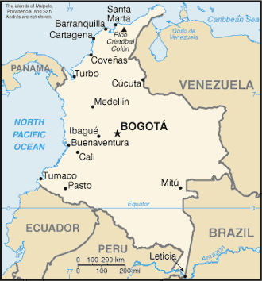
¿De dónde son las personas?
escuchar
Latin America / Canaries | Mainland Spain
Estás de vacaciones en Colombia. Hay mucha gente en la plaza en Bogotá, la capital.
1
cine
2
plaza
Escucha las voces diferentes. Decide si la persona (probablemente) es de España o Latinoamérica.
3
empezar
4
ciudad
5
centro
Marca la opción correcta y escribe las palabras con [ce], [ci] y [z] en español.
6
necesito
naturaleza
7
zona
cerca
8
cierto
Notes:
Phonics practice activity
Timing: 6 minutes
Aim: to raise awareness of the different ways in which the SSCs [CE, [CI] and [Z] and are pronounced in the Spanish-speaking world.
Procedure:
Play the audio and ask students to tick the right column and write the word(s) with the target SSCs.
Check answers, including spelling, and give feedback.
Note:
Some students may be able to write the entire sentence.
Ensure understanding of ‘de dónde’. Both words have been taught, but separately, and the word order is different here from English (‘where….from’).
Transcript:
¿Dónde está el cine?
La plaza es muy antigua.
¿Cuándo va a empezar la clase de baile?
En la ciudad hay muchos restaurantes muy buenos.
Las tiendas en el centro son muy caras.
Necesito comprar un regalo barato.
La naturaleza aquí en esta zona es hermosa.
El teatro famoso está cerca, ¿cierto?

Slide 33
Talking about routine actions and future plans
[1/2]
In English we use different forms of the verb ‘go’ to say where we normally go and what we are going to do in the future.
I go to the shop.
Routine action.
I am going to visit Madrid.
Future plan.
In Spanish, the same form of ‘ir’ is used for both:
Voy a la tienda.
Routine action.
Voy a visitar Madrid.
Future plan.
Notes:
Grammar recap
Timing: 6 minutes (slides 33-35)
Aim: to refresh students’ knowledge of ‘ir’ to describe future intention vs habitual events ahead of the activities in this lesson.
Notes:
1. ‘am/is/are going’ is also used in English to refer to ongoing (unfinished) actions in the present. The use of the Spanish present simple to convey the same meaning (e.g. ¿Dónde vas? to mean ‘Where are you going?’) is not the focus of the current lesson. This will be a focus of resources in Year 8, Term 1.1, Week 5. Thus far in Year 7, the Spanish present simple has only been used to express habitual events or states (e.g. estar, tener, querer).
2. The Spanish present simple, in addition to expressing habitual actions, is also frequently used to express future intentions/plans. For example, one can say ‘Mañana vamos a California’. We’re going to California tomorrow.’ (Butt & Benjamin, 2004). This is an additional use of the present simple that will be taught later. Here we are focusing on the new feature (ir + a + infinitive) alongside the previously taught use of ‘ir’ for habitual events.

Slide 34
IR + a + infinitive
[2/2]
To talk about what someone is going to do (future plans), use part of the verb ir + a + infinitive.
We are going to visit the square.
Vamos
a
visitar
la plaza.
I am going to discover the world.
Voy
a
descubrir
el mundo.
Choose the part of the verb ‘ir’ to say who is going.
Use ‘a’ plus an infinitive to make this a sentence about the future.
Notes:
Grammar recap slide
Procedure:
Click to make each part of the explanation appear, in order.
Elicit the target forms in gaps and the Spanish translations of the English sentences.

Slide 35
IR + a + infinitive
As you know, in Spanish, the same word order is used for both statements and questions:
Vamos a visitar Francia en marzo.
1
We are going to visit France in March.
¿Vamos a visitar Francia en marzo?
2
Are we
going to visit France in March?
In English, we swap round the subject and the verb.
Notes:
OPTIONAL
Cross-linguistic awareness raising: although in this lesson students won’t be required to produce yes-no questions with ‘ir’ themselves, this slide highlights how English question formation requires subject-verb inversion when using ‘going to’. Regular awareness raising is important for students in the early stages of L2 acquisition to avoid direct translation of English questions.
Teachers Click on the orange action button to hear each sentence.

Slide 36
escuchar
Ana es de Colombia. La familia viaja mucho allí. Escucha. ¿Ana habla de Agosto (el futuro) o cada año? Luego, escucha otra vez. ¿Es una pregunta o una afirmación?
escuchar
Cada año | En agosto (futuro) | Pregunta o afirmación?
Escucha y completa las frases 1, 2, 4 y 8.
Are we going
?
1
pregunta
____ ____ _______ to travel all around the country
2
afirmación
We are going
.
____ ____ ______ to discover (the) old cities
3
afirmación
4
pregunta
Are you going
?
____ ____ _______ to take a lot of money
5
pregunta
6
afirmación
7
pregunta
8
afirmación
I am going
.
___ ___ ______ to rest/relax on the beach every day
Notes:
Timing: 10 minutes
Aim: to practise distinguishing between ‘ir’ for future plans and habitual actions in listening. To also practice listening for question vs statement intonation and the meaning that this conveys in English.
Procedure:
Ask students to listen and tick the correct column (first two columns)
Ask students to listen again and decide if they heard a question or statement (third column). Some students might be able to do this on the first time they listen.
Finally, and playing the audio for 1,2,4 and 8 a final time, teachers ask students to complete the words and punctuation in the four sentences in English that translate with ‘going to + infinitive’. The focus on the L1-L2 difference in question formation here is likely to help in the final activity.
Note:
To avoid overload, we only ask for the four English sentences using ‘going to + verb’ to be completed. The other four sentences use other constructions in English (e.g. auxiliary ‘do’). which are likely to be too much to process when translating directly from spoken Spanish to written English.
Transcript
¿Vamos a viajar por todo el país?
Vamos a descubrir las ciudades antiguas.
Voy a los museos porque disfruto la cultura.
¿Vas a llevar mucho dinero?
¿Vas con tu familia?
Voy a la capital mucho porque mis primos viven allí.
¿Tu amiga va a la capital también?
Voy a descansar en la playa todos los días.

Slide 37
leer
Ana escribe sobre los viajes a Colombia. ¿Quién es, Ana (‘I’) o Ana y los primos (‘we’)? Decide si es cada año o en agosto (el futuro).
leer
Disfruto las vacaciones en Colombia porque es un país hermoso. Como soy de allí, voy a la casa de mis primos. Viven en la capital, Bogotá. Vamos juntos a las tiendas en el centro. İEs super divertido! Tambien, voy a viajar allí con mi familia en verano.
Los museos de Bogotá, como el Museo del Oro*, son increíbles. Voy porque quiero descubrir la historia, pero no voy a ir con mi familia (para Lucía, ¡es aburrido!).
La costa es espectacular. Mis primos y yo vamos a ir a la playa - ¡estoy segura!
Además, vamos a montar a caballo en las montañas. ¡Los viajes activos son geniales!
Ana (‘I’)
Ana y las primos (‘we’)
Cada año
Cada año
goes to cousins’ house
go together to the shops in the centre (it’s really fun).
goes to the gold museum (because she wants to discover the history)
En agosto (futuro)
En agosto (futuro)
are going to go to the beach (Ana is sure)
is going to travel there with all the family
is not going to go to gold museum with the family
are going to go horse riding in the mountains
*el oro = gold
*además = in addition
Notes:
Timing: 10 minutes
Aim: to practise distinguishing between ‘ir’ for future plans and habitual actions in reading.
NB A secondary aim to encourage reflection about whether the verb refers to Ana (‘voy’) or Ana and cousins (‘vamos’). For this reason, we have divided the responses into columns for ‘I’ and ‘we’. As this is an extended text, however, the task is not intended to be strictly referential (i.e. it doesn’t always require attending to the verb to decide who is referred to).
Procedure:
Ask students, working individually or in pairs, to complete the two boxes for ‘Ana’ and ‘Ana y los primos’ in English.
Check answers.
Notes:
Although there is use of a time indicator (‘en verano’) within this text to signal a future tense, it has not yet been taught to students and therefore they will need to rely on the verbs which are the target features to arrive at the answers.
All language has been previously taught apart from ‘además’ (which will be taught in Year 8, Term 1) and ‘oro’ [863].

Slide 38
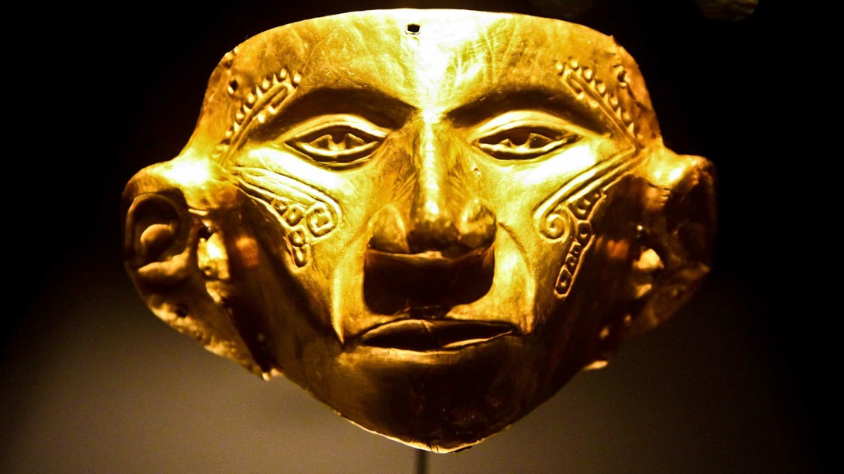
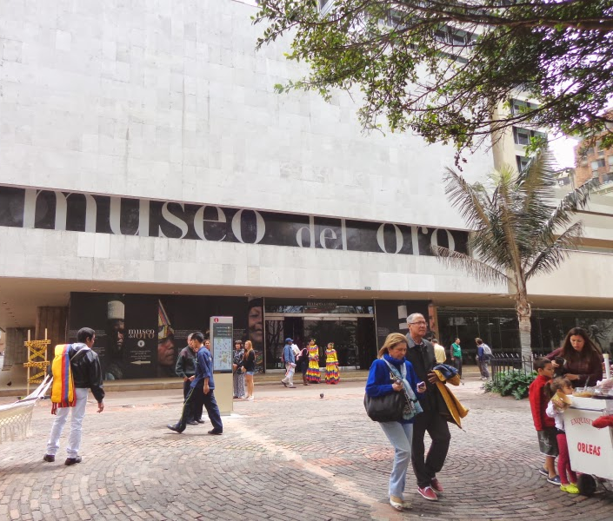
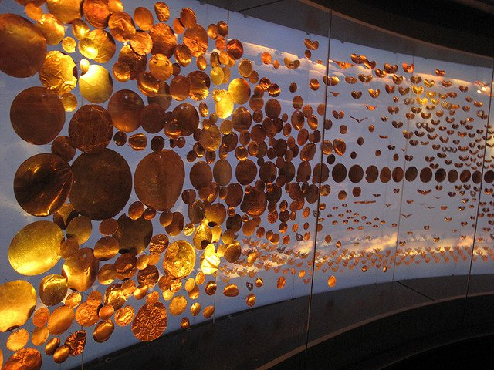
El museo del oro, Bogotá
El museo está en el centro de Bogotá.
Recibe muchos visitantes cada año.
Notes:
Cultural information slide

Slide 39
İUn viaje a Colombia!
hablar / escuchar
hablar / escuchar
Ana va a Colombia cada año.
En agosto, ¡va a viajar allí otra vez!
¿Qué hace allí normalmente? ¿Y qué va a hacer en agosto?
Person A: Ask your partner (Ana) where s/he normally goes and where s/he is going to go on the next trip to Colombia.
Person B: you are Ana. Is your partner asking about where you usually go or where you are going to go next time? Answer using the speaking cards.
Remember:
for where someone usually goes, use ir + a + noun/place
for where someone is going to go, use: ir + a + infinitive
Then swap roles. You have different sets of cards.
Notes:
Timing: 15 minutes
Aim: to practise listening to and producing (orally) the two constructions ‘ir a’ (habitual present tense) and ‘ir a + infinitive’ (future plans), in the affirmative and negative. To also revisit ‘al’ vs ‘a la’ (though this is a secondary focus).
Procedure:
Person A uses their prompt cards to ask a question that either starts with ‘Vas a’ or ‘Vas a ir a’.
Student B listens and says ‘sí voy / sí voy a ir’ if the action has a tick on their card or ‘no, no voy’ / ‘no, no voy a ir’ if not. Encourage full sentences in responses, if possible.
Student A then completes their card accordingly, adding a tick or cross after each question.
Swap roles.
Notes:
1. An active choice will be needed between these two verb forms in each interaction, both by the speaker and listener. This makes the choice of verb essential to completion of the task.
2. Other features revisited here include: al vs a la (monitor to check accuracy), question intonation, negative ‘no’ and vocabulary.

Slide 40
hablar / escuchar
Un ejemplo
hablar / escuchar
Say “Sí voy/voy a ir…” or “No, no voy/no voy a ir…”, depending on what you can see on your card.
¿Vas al museo?
Sí, voy al museo.
Persona A (pregunta):
Persona B (contesta):

Slide 41
Persona A
Ask your partner these questions.
Persona A: Is your partner asking about where you go normally or where you are going to go?
Say whether you normally go / are going to go ( ) or not ( ) :
Tick ( ) if your partner goes / is going to go and cross out ( ) if not.
normally
next time
1. Do you go to the museum?
[to the mountains]
2. Are you going to go to the centre?
[to the shops]
3. Do you go to the shops?
[to the market]
4. Do you go to the market?
[to the beach]
5. Are you going to go to the beach?
[to the centre]
6. Are you going to go to the mountains?
[to the museum]
Notes:
DO NOT DISPLAY DURING ACTIVITY
See accompanying Word doc for printable version.
Target answers for Person A during speaking, based on Person B’s questions:
Sí, voy a ir a las montañas.
Sí, voy a las tiendas.
No, no voy a ir al mercado.
Sí, voy a la playa.
No, no voy al centro.
No, no voy a ir al museo.

Slide 42
Persona B
Ask your partner these questions.
Persona B: Is your partner asking about where you go normally or where you are going to go?
Say whether you normally go / are going to go ( ) or not ( ) :
Tick ( ) if that person does it and cross out ( ) if that person doesn’t.
normally
next time
1. Are you going to go to the mountains?
[to the museum]
2. Do you go to the shops?
[to the centre]
3. Are you going to go to the market?
[to the shops]
4. Do you go to the beach?
[to the market]
5. Do you go to the centre?
[to the beach]
6. Are you going to go to the museum?
[to the mountains]
Notes:
DO NOT DISPLAY DURING ACTIVITY
See accompanying Word doc for printable version.
Target answers for Person B during speaking, based on Person A’s questions:
Sí, voy al museo.
No, no voy a ir al centro.
No, no voy a las tiendas.
Sí, voy al mercado.
No, no voy a ir a la playa.
Sí, voy a ir a las montañas.

Slide 43
Respuestas
Persona A
Persona B
Ask your partner these questions.
Ask your partner these questions.
Tick ( ) if that person goes / is going to go and cross out ( ) if not.
Tick ( ) if that person does it and cross out ( ) if that person doesn’t.
1. Do you go to the museum?
1. Are you going to go to the mountains?
2. Are you going to go to the centre?
2. Do you go to the shops?
3. Do you go to the shops?
3. Are you going to go to the market?
4. Do you go to the market?
4. Do you go to the beach?
5. Are you going to go to the beach?
5. Are you going to go to the centre?
6. Are you going to go to the mountains?
6. Do you go to the museum?
Notes:
DO NOT DISPLAY DURING ACTIVITY

Slide 44
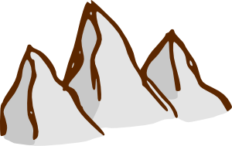
İEscribimos!
escribir
Preguntas
Respuestas
M
1 | [Do you go] | [Normally I go with my]
 | ¿Vas al museo normalmente? | Sí, normalmente voy con mi abuela.
2 | [Are you going to go]
 | ¿Vas a ir a la playa en agosto? | No, no voy a ir a la playa, pero voy a ir a las tiendas con mis primos.
3 | [Are you going to eat] [tasty] | [eat tasty food in the centre]
 | ¿Vas a comer comida rica? | Sí, voy a comer comida rica en el centro.
4 | [Do you go] | [every July] [I learn to
 | ¿Vas a las montañas cada julio? | Sí, voy a las montañas cada julio. Aprendo a montar a caballo allí.
[normally]
[in August]
[but]
[with my cousins]
[every July]
there.
Notes:
OPTIONAL
Timing: 8 minutes
Aim: to practise producing (in writing) the two constructions ‘ir a’ (habitual present tense) and ‘ir a + infinitive’ (future plans), in the affirmative and negative.
Procedure:
1. Ask students to write 4 pairs of questions and answers with the verb ‘ir’ (in 1st and 2nd person singular), using the word and picture prompts.
2. Check answers by clicking on the orange boxes.
Notes:
Teachers can use this to reinforce a number of different grammatical features (as well as immediate future and the range of recycled vocabulary):
al vs a a la
mi / mis
negative ‘no’
adjective agreement – comida rica
Encourage students to use raised intonation when volunteering the questions as part of the feedback.

Slide 45
Deberes
İFelices vacaciones!

