Slide 1
Les vacances de printemps
Revision of grammar from terms 9.2.1. and 9.2.2 for assessment
SSCs ill-/-ille. -ail-/aille, -eil/-eille, -euil/-euille, ouil/ouille
Y9 French
Term 2.2 - Week 4 - Lesson 45
Author name(s): Catherine Salkeld / Mary Richardson
Artwork by: Chloé Motard
Date updated: 12/02/22
Notes:
Artwork by Chloé Motard. All additional pictures selected are available under a Creative Commons license, no attribution required.
Native teacher feedback provided by Sarah Brichory.
Learning outcomes (lesson 1):
Consolidation of SSCs [ill-/-ille], [-ail/aille], [-eil/-eille], [-euil/-euille], [ouil/ouille]
Revision of grammar from terms 9.2.1 and 9.2.2 for assessment
Word frequency (1 is the most frequent word in French):
Revisit Y7 and Y8 vocabulary (8/13)
attendre [155], il/elle boit [1879], conduire [487], demander [80], gagner2 [258], habiter [1186], inscrire [1004], répondre [200], ressembler à [1398], réussir [279], je sors [309], sortir [309], venir [88], actrice [1552], animal [1002], avocate [1188], café1 [1886], cahier [4001], chapeau [2908], chat [3138], courses [1289], cuisine2 [2618], la date [660], directeur1 [640], enfant [126], eau [475], facteur [1264], film [848], fromage [4475], heure [99], journaux [520], lait [2507], liste [924], main [418], médecin [827], ménage [2326], partenaire [1077], portable [4002], rue [598], secrétaire [920], tâche [887], anglais1 [784], à côté de [4/123/2], à droite [4/1293], à gauche [4/607], plusieurs [213], tous [24], deux [41], pour1 [10], quatre [253]
Source: Lonsdale, D., & Le Bras, Y. (2009). A Frequency Dictionary of French: Core vocabulary for learners London: Routledge.
The frequency rankings for words that occur in this PowerPoint which have been previously introduced in NCELP resources are given in the NCELP SOW and in the resources that first introduced and formally re-visited those words.
For any other words that occur incidentally in this PowerPoint, frequency rankings will be provided in the notes field wherever possible.

Slide 2
-ill-/-ille
fille
Notes:
Timing: 1 minute
Aim: To consolidate SSC [-ill-/-ille]
Procedure: 1. Present the letter(s) and say the [-ill-/ille] sound first, on its own. Students repeat it with you. 2. Bring up the word ”fille” on its own, say it, students repeat it, so that they have the opportunity to focus all of their attention on the connection between the written word and its sound.
3. A possible gesture for this would be to gesture at some of the girls in the class. 4. Roll back the animations and work through 1-3 again, but this time, dropping your voice completely to listen carefully to the students saying the [-ill-/-ille] sound, pronouncing ”fille” and, if using, doing the gesture.
Word frequency (1 is the most frequent word in French):
fille [629]
Source: Lonsdale, D., & Le Bras, Y. (2009). A Frequency Dictionary of French: Core vocabulary for learners London: Routledge.

Slide 3
-aill-/-ail
taille
Notes:
Timing: 1 minute
Aim: To consolidate SSC [-aill-/-ail]
Procedure: 1. Present the letter(s) and say the [-aill-/-ail] sound first, on its own. Students repeat it with you. 2. Bring up the word ”taille” on its own, say it, students repeat it, so that they have the opportunity to focus all of their attention on the connection between the written word and its sound.
3. A possible gesture for this would be to start with hands together and move them apart, representing varying size. 4. Roll back the animations and work through 1-3 again, but this time, dropping your voice completely to listen carefully to the students saying the [-aill-/-ail] sound, pronouncing ”taille” and, if using, doing the gesture.
Word frequency (1 is the most frequent word in French):
taille [1500]
Source: Lonsdale, D., & Le Bras, Y. (2009). A Frequency Dictionary of French: Core vocabulary for learners London: Routledge.

Slide 4
-eill-/-eil
oreille
Notes:
Timing: 1 minute
Aim: To consolidate SSC [-eill-/-eil]
Procedure: 1. Present the letter(s) and say the [-eill-/-eil] sound first, on its own. Students repeat it with you. 2. Bring up the word ”oreille” on its own, say it, students repeat it, so that they have the opportunity to focus all of their attention on the connection between the written word and its sound.
3. A possible gesture for this would be to point to your ear. 4. Roll back the animations and work through 1-3 again, but this time, dropping your voice completely to listen carefully to the students saying the [-eill-/-eil] sound, pronouncing ”oreille” and, if using, doing the gesture.
Word frequency (1 is the most frequent word in French):
oreille [1884]
Source: Lonsdale, D., & Le Bras, Y. (2009). A Frequency Dictionary of French: Core vocabulary for learners London: Routledge.

Slide 5
-euill-/-euil
[-ueill-/-ueill, -œill-/-œil]
feuille
Notes:
Timing: 1 minute
Aim: To consolidate SSC [-euill-/-euil]
Procedure: 1. Present the letter(s) and say the [-euill-/-euil] sound first, on its own. Students repeat it with you. 2. Bring up the word ”feuille” on its own, say it, students repeat it, so that they have the opportunity to focus all of their attention on the connection between the written word and its sound.
3. A possible gesture for this would be [to stroke the back of one hand]. 4. Roll back the animations and work through 1-3 again, but this time, dropping your voice completely to listen carefully to the students saying the [-euill-/-euil] sound, pronouncing ”feuille” and, if using, doing the gesture.
Word frequency (1 is the most frequent word in French):
feuille [2440]
Source: Lonsdale, D., & Le Bras, Y. (2009). A Frequency Dictionary of French: Core vocabulary for learners London: Routledge.

Slide 6
-ouill-/-ouil
brouillard
Notes:
Timing: 1 minute
Aim: To consolidate SSC [-ouill-/-ouil]
Procedure: 1. Present the letter(s) and say the [-ouill-/-ouil] sound first, on its own. Students repeat it with you. 2. Bring up the word ”brouillard” on its own, say it, students repeat it, so that they have the opportunity to focus all of their attention on the connection between the written word and its sound.
3. A possible gesture for this would be [to squint and wiggle fingers in front of face miming being unable to see through fog]. 4. Roll back the animations and work through 1-3 again, but this time, dropping your voice completely to listen carefully to the students saying the [-ouill-/-ouil] sound, pronouncing ”brouillard” and, if using, doing the gesture.
Word frequency (1 is the most frequent word in French):
brouillard [4452]
Source: Lonsdale, D., & Le Bras, Y. (2009). A Frequency Dictionary of French: Core vocabulary for learners London: Routledge.
Word frequency (1 is the most frequent word in French):
brouiller [4682]
Source: Lonsdale, D., & Le Bras, Y. (2009). A Frequency Dictionary of French: Core vocabulary for learners London: Routledge.

Slide 7
Phonétique
phonétique
As you know, [-ill/ille] and [-ail/aill] sound like a vowel + ‘yih’:
[-ill/ille]
= i + ‘yih’
[-ail/aill]
= a + ‘yih’
Using this pattern, we have also learned how these SSCs sound:
[-eil/eill]
= è + ‘yih’
e.g. oreille
[-ouil/ouill]
= ou + ‘yih’
e.g. brouillard
[-euil/euill]
= long eu/œ + ‘yih’
e.g. feuille
Notes:
Timing: 2 minutes
Aim: Consolidation of SSCs [-eil/eill], [-euil/euill], and [-ouil/ouill] and the idea of vowel + [-il/ill] to help students break down these less frequent SSCs.
Procedure:
1. Click to remind students of SSCs [-ill/ille] and [-ail/aill], drawing attention to the fact that they can be broken down into SSCs [i]/[a] + yih.
2. Click to bring up further SSC consolidation. Students say SSC [-eil/eill] following the pronunciation tips given.
3. Click to reveal ‘decoded’ pronunciation and example word (click picture to hear pronunciation).
4. Repeat for [-ouil/ouill] and [-euil/euill].
Word frequency of unknown words (1 is the most frequent word in French):
oreille [1884], feuille [2440], brouillard [4452]
Source: Lonsdale, D., & Le Bras, Y. (2009). A Frequency Dictionary of French: Core vocabulary for learners London: Routledge.

Slide 8
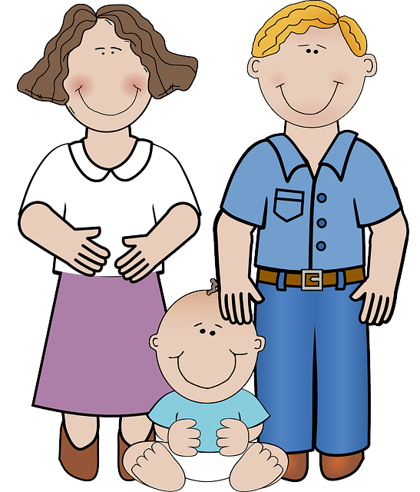
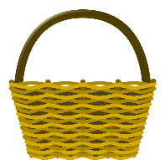
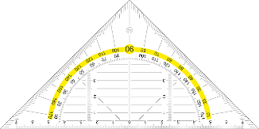
ill-/-ille, -ail/-aille, -eil/-eille, -ouil/-ouille
parler
brouillard
30
Marseille
famille
lentille
bouteille
médaille
oreille
travail
vitrail
paille
corbeille
SECONDES
éventail
chandail
soleil
feuille
cheville
grenouille
0
appareil
écureuil
fauteuil
détail
DÉBUT
Notes:
Timing: 3 minutes
Aim: Speaking practice of SSCs
Procedure:
1. Students work in pairs.
2. One at a time they have to say as many [ill-/-ille. -ail-/-aille, -eil/-eille, -euil/-euille, ouil/ouille.] words as possible in 30s.
3. The partner listens to make sure pronunciation is correct.
4. If they get one wrong, start again.
5. Swap roles.
6. Click on words to hear native pronunciation.
Transcript:
lentille
brouillard
Marseille
famille
travail
bouteille
vitrail
médaille
oreille
paille
corbeille
éventail
chandail
soleil
feuille
cheville
grenouille
appareil
écureuil
fauteuil
détail
Word frequency of cognates (1 is the most frequent word in French): lentille [>5000], brouillard [4452], famille [172], travail [153], bouteille [2979], vitrail [>5000], médaille [3361], oreille [1884], paille [>5000], ville [260], corbeille [>5000], éventail [4621], chandail [>5000], soleil [1713], feuille [2440], cheville [>5000], grenouille [>5000], appareil [1420], écureuil [>5000], fauteuil [2743], détail [318]
Source: Lonsdale, D., & Le Bras, Y. (2009). A Frequency Dictionary of French: Core vocabulary for learners London: Routledge.

Slide 9
Connect quatre
vocabulaire
In pairs, take it in turns to pick a word, translate into French on the grid.
If your partner disagrees with your translation, they can correct it and steal that box.
The first to get four in a row wins.
to come, coming | actor (f) | Several | street | task, chore | to drive, driving
four | English | I go out | hat | to pass (an exam) | milk
housework | hand | all, the whole (pl) | animal | cooking, kitchen | exercise book
food shopping | to go out, going out | list | two | hour, time, o’clock | postman
film | child | on the right | for, in order to | date | to look like
to live, living | to answer, answering | to win, to earn | cheese | water | on the left
mobile phone | to wait, waiting | he/she drinks | cat | manager, headteacher | to ask, asking
venir
l’actrice
plusieurs
la rue
la tâche
conduire
quatre
anglais
je sors
le chapeau
réussir
le lait
le ménage
la main
tous
l’animal
la cuisine
le cahier
les courses
sortir
la liste
deux
l’heure
le facteur
le film
l’enfant
à droite
pour
la date
ressembler à
habiter
répondre
gagner
le fromage
l’eau
à gauche
le portable
attendre
il/elle boit
le chat
le directeur
demander
Notes:
Timing: 4 minutes
Aim: Game to consolidate vocabulary from year 7 and 8: seasons, months, days, weather and numbers
Procedure:
Print grid to distribute to class (one between two).
In pairs, pupils take it in turns to pick a word and translate it into French, writing the word on the grid, each student using a different colour pen.
If the other player disagrees with the translation, they can correct it and steal the box on the grid.
The first to get four correct in a row wins.
The game can be repeated until all the boxes have been filled.
Teacher to elicit answers from individual pupils and click to reveal them.

Slide 10
Connect quatre
vocabulaire
to come, coming | actor (f) | several | street | task, chore | to drive, driving
four | English | I go out | hat | to pass (an exam) | milk
housework | hand | all, the whole (pl) | animal | cooking, kitchen | exercise book
food shopping | to go out | list | two | hour, time, o’clock | postman
film | child | on the right | for, in order to | date | to look like
to live, living | to answer, answering | to win, to earn | cheese | water | on the left
mobile phone | to wait, waiting | he/she drinks | cat | manager, headteacher | to ask, asking
Notes:
Grid for printing – reduce to A5 and distribute one between two

Slide 11
Perfect tense with être
Remember, we add –e to the past participle when the subject of the verb is feminine.
grammaire
Remember, some verbs take être instead of avoir in the perfect tense:
I went, have gone
je suis allé(e)
you _{[sing.]} stay, have stayed
tu es resté(e)
No –s when on means ‘one’ or ‘people in general’.
he arrived, has arrived
il est arrivé
she went up, has gone up
elle est montée
one entered, has entered
on est entré
Add –s when on means ‘we’.
we arrived, have arrived
on est arrivé(e)s
we fell, have fallen
nous sommes tombé(e)s
No –s when vous means ‘you [sing fml]’.
you _{[pl./fml]} returned, have returned
vous êtes retourné(e)(s)
they (m.) went, have gone
ils sont allés
they (f.) stayed, have stayed
elles sont restées
Notes:
Timing: 2 minutes
Aim: Recap perfect tense of –er verbs taking être
Procedure:
1. Click to reveal explanations and examples.
2. Elicit French where possible.
3. Draw attention to feminine and plural agreement of past participles.
4. Ensure understanding.

Slide 12
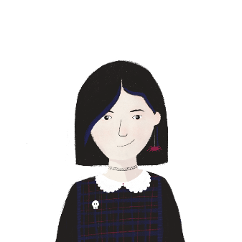
Les vacances de printemps
Sophie parle des vacances. Elle parle de qui ?
écouter
Q | je | tu | nous | anglais | R
 |  |  |  | never went into town without me
 |  |  |  | went to the cinema
 |  |  |  | entered the cinema before you
 |  |  |  | fell in the street
 |  |  |  | stayed with you to help
 |  |  |  | got on the bus
 |  |  |  | went back to your house
 |  |  |  | stayed at your house for several hours
 |  |  |  | went to your bedroom at 11pm
 |  |  |  | arrived home at midnight
1
1
2
2
3
3
4
4
5
5
6
6
7
7
8
8
9
9
10
10
Notes:
Timing: 10 minutes
Aim: Aural recognition of –er verbs taking être in the perfect tense and connecting these with meaning
Procedure:
1. Click buttons on the left to play audio.
2. Use the first sentence as an example to model the task. For groups who may need extra support, this could be read by the teacher to exaggerate the delivery, or the sentence could be displayed with the beeped word hidden so they can read along while they listen.
3. Students listen and tick je, tu, or nous according to the part of être they hear.
4. Click to reveal answers.
5. Students listen again and note the activity in English.
6. Click to reveal answers.
7. Click buttons on the right to play full audio.
Transcript:
Pendant les dernières vacances de printemps, [tu] n’es jamais allée en ville sans moi.
Un jour, [nous] sommes allées au cinéma.
[Je] suis entrée dans le cinéma avant toi pour acheter les billets.
[Tu] es tombée dans la rue.
[Je] suis restée avec toi pour aider.
[Nous] sommes montées dans le bus.
[Nous] sommes retournées chez toi.
[Je] suis restée plusieurs heures chez toi.
[Tu] es allée dans ta chambre pour dormir à onze heures.
[Je] suis arrivée chez moi à minuit.

Slide 13
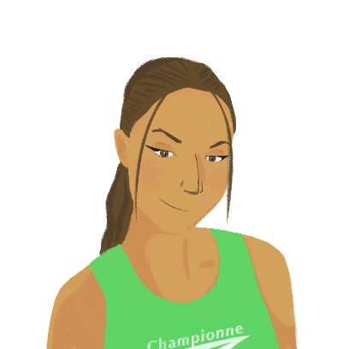
Les vacances d’Amir et Océane
lire
1. je suis
Océane écrit un message sur les dernières vacances de printemps. Choisis je suis, il est, ou on est.
2. il est
3. Il est
Salut Léa ! Je pense aux vacances de printemps avec Amir. L’année dernière [1] allée à une fête sur la plage, mais [2] resté à la maison pour faire des tâches dans la cuisine. [3] arrivé en retard et [4] allés au café. [5] entré dans le café pour acheter des glaces et [6] restée dehors. [7] retournés à la plage pour manger les glaces. [8] allée dans l’eau mais [9] resté avec nos sacs. Après la fête, [10] monté dans le bus mais [11] retournée à la maison à vélo. [12] arrivée chez moi à huit heures.
À bientôt !
Océane
4. on est
5. Il est
6. je suis
7. On est
8. Je suis
9. il est
10. il est
11. je suis
12. Je suis
Notes:
Timing: 6 minutes
Aim: Written recognition of feminine and plural past participle agreement and production of je/tu/on forms of être used as an auxiliary
Procedure:
1. Students read the text and choose je suis, il est, or on est according to whether the past participles are masculine, feminine, or masculine/mixed gender plural.
2. Click to reveal answers.
3. Oral translation of text.

Slide 14
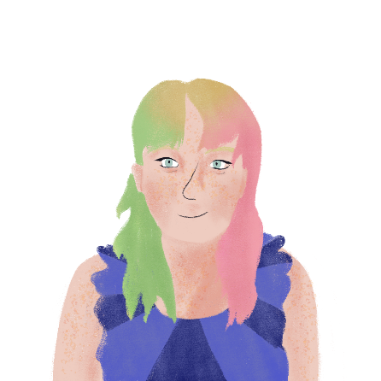
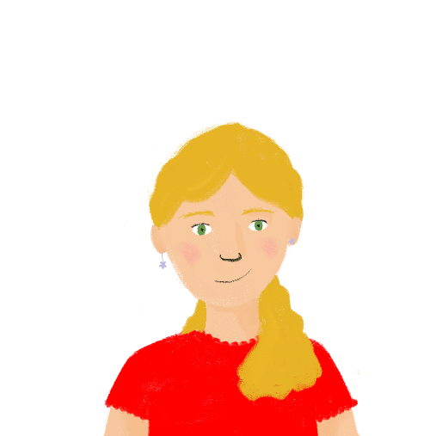
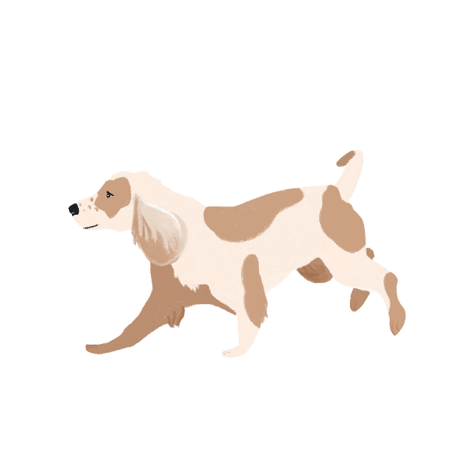
Emphatic pronouns: moi and toi
grammaire
Remember, we use the emphatic pronouns moi and toi after a preposition.
Veux-tu chanter avec moi ?
Do you want to sing with me?
Le chien est derrière toi.
The dog is behind you.
Notes:
Timing: 2 minutes
Aim: Recap emphatic pronouns moi and toi
Procedure:
1. Click to reveal explanation and examples.
2. Elicit English.
3. Ensure understanding.

Slide 15
Relative pronoun “qui”
grammaire
Remember, qui can be used to introduce more information about a noun. It translates into English as who, which, or that.
Le garçon qui habite ici.
The boy who/that lives here.
L’actrice qui porte un chapeau.
The actress who/that wears a hat.
Le magasin qui est près de l’école.
The shop which/that is near the school.
In English, we use who or that for people and animals, and we use which or that for things.
Notes:
Timing: 2 minutes
Aim: Recap use of relative pronoun qui
Procedure:
1. Click to reveal explanations and examples.
2. Elicit English.
3. Ensure understanding.

Slide 16
Une queue
Il y a un homme qui porte de vieux vêtements après moi.
lire
Qui pense ces choses ? Écris les numéros.
Il y a une personne qui porte un chapeau noir après moi.
Il y a une femme qui ressemble à un animal avant moi.
Il y a un homme qui aime l’histoire avant moi.
Il y a un homme qui porte de vieux vêtements après moi.
Il y a quatre personnes qui attendent un rendez-vous* avec moi.
Il y a quatre personnes qui attendent un rendez-vous* avec moi.
Il y a un homme qui aime l’histoire avant moi.
Il y a une personne qui porte un chapeau noir après moi.
Il y a une femme qui ressemble à un animal avant moi.
*le rendez-vous = appointment
1
2
3
4
5
Notes:
Timing: 4 minutes
Aim: Written recognition of relative pronoun qui and emphatic pronoun moi.
Procedure:
1. Students read the think bubbles and match them with the people in the queue.
2. Click to check answers.
3. Oral translation of texts.
Word frequency of unknown words used (1 is the most frequent word in French): rendez-vous [1873]
Source: Lonsdale, D., & Le Bras, Y. (2009). A Frequency Dictionary of French: Core vocabulary for learners London: Routledge.

Slide 17
Qui habite dans ta rue ?
parler
Qui habite où ? Pose des questions à ton/ta partenaire et trouve la maison de chaque personne.
Où habite la fille qui joue au foot ?
La fille qui joue au foot habite au numéro quatre.
[the girl who plays football]
The girl who plays football lives at number four.
1
2
3
4
Notes:
Timing: 10 minutes
Aim: Oral production of relative pronoun qui in context
Procedure:
1. Print rolecards from slide 18 and distribute.
2. Students work in pairs.
3. Model task with the example on this slide.
4. Partner A asks questions to find out who lives where.
5. Partner B translates the clues on their card to answer the questions.
6. Partner A makes notes, then works out who lives in which house.
7. Students swap roles.
8. Suggested answers on slide 19.
Transcript:
Word frequency (1 is the most frequent word in French):
Source: Londsale, D., & Le Bras, Y. (2009). A Frequency Dictionary of French: Core vocabulary for learners London: Routledge.

Slide 18
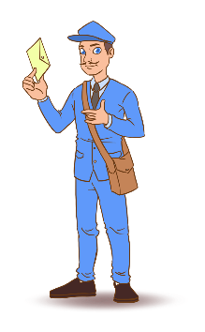
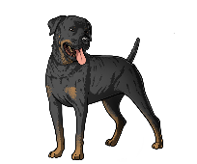
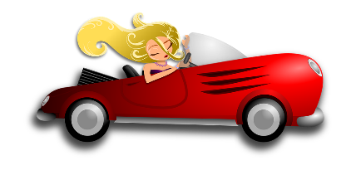
Qui habite dans ta rue ?
Qui habite où ?
parler
Partenaire A – répond aux questions de ton/ta partenaire.
The doctor (m) who does the housework lives at number eight.
The lawyer (f) who has two dogs lives next to the postman who is doing the shopping.
The secretary (f) who speaks English lives on the left of the lawyer (f).
Pose des questions pour trouver les maisons de ces personnes:
the child who is drinking milk
the cat who eats cheese
the manager who writes lists
the actress who drives a red car
5
6
7
8
Pose des questions pour trouver les maisons de ces personnes.
The doctor (m) who does the housework
The lawyer (f) who has two dogs
The postman who is doing the shopping
The secretary (f) who speaks English
Partenaire B – répond aux questions de ton/ta partenaire.
The child lives at number three.
The manager who writes lists lives on the right of the child who is drinking milk.
The cat who eats cheese lives on the right of the actress who drives a red car.
1
2
3
4
Notes:
ROLECARDS FOR PRINTING – DO NOT DISPLAY DURING ACTIVITY

Slide 19
Qui habite dans ta rue ?
Qui habite où ?
parler
Le médecin qui fait le ménage habite au numéro huit.
L’avocate qui a deux chiens habite à côte du facteur qui fait les courses.
La secrétaire qui parle anglais habite à gauche de l’avocate.
L’enfant habite au numéro trois.
Le directeur qui écrit des listes habite à droite de l’enfant qui boit du lait.
Le chat qui mange du fromage habite à droite de l’actrice qui conduit une voiture rouge.
1
2
3
4
5
6
7
8
Notes:
SUGGESTED ANSWERS

Slide 20
Les vacances de printemps
Revision of grammar from terms 9.2.1. and 9.2.2 for assessment
SSCs ill-/-ille. -ail-/aille, -eil/-eille, -euil/-euille, ouil/ouille
Y9 French
Term 2.2 - Week 4 - Lesson 46
Author name(s): Catherine Salkeld / Mary Richardson
Artwork by: Chloé Motard
Date updated: 12/02/22
Notes:
Artwork by Chloé Motard. All additional pictures selected are available under a Creative Commons license, no attribution required.
Native teacher feedback provided by Sarah Brichory.
Learning outcomes (lesson 2):
Consolidation of SSCs [ill-/-ille], [-ail/aille], [-eil/-eille], [-euil/-euille], [ouil/ouille]
Revision of grammar from terms 9.2.1 and 9.2.2 for assessment
Word frequency (1 is the most frequent word in French):
Revisit Y7 and Y8 vocabulary (8/13)
attendre [155], il/elle boit [1879], conduire [487], demander [80], gagner2 [258], habiter [1186], inscrire [1004], répondre [200], ressembler à [1398], réussir [279], je sors [309], sortir [309], venir [88], actrice [1552], animal [1002], avocate [1188], café1 [1886], cahier [4001], chapeau [2908], chat [3138], courses [1289], cuisine2 [2618], la date [660], directeur1 [640], enfant [126], eau [475], facteur [1264], film [848], fromage [4475], heure [99], journaux [520], lait [2507], liste [924], main [418], médecin [827], ménage [2326], partenaire [1077], portable [4002], rue [598], secrétaire [920], tâche [887], anglais1 [784], à côté de [4/123/2], à droite [4/1293], à gauche [4/607], plusieurs [213], tous [24], deux [41], pour1 [10], quatre [253]
Source: Lonsdale, D., & Le Bras, Y. (2009). A Frequency Dictionary of French: Core vocabulary for learners London: Routledge.
The frequency rankings for words that occur in this PowerPoint which have been previously introduced in NCELP resources are given in the NCELP SOW and in the resources that first introduced and formally re-visited those words.
For any other words that occur incidentally in this PowerPoint, frequency rankings will be provided in the notes field wherever possible.

Slide 21
-ill-/-ille
brillant
juillet
[shiny]
habiller
fille
pavillon
[to dress]
famille
[family]
Notes:
Timing: 1 minute
Aim: To consolidate SSC [-ill-/-ille]
Procedure:
Introduce and elicit the pronunciation of the individual SSC [-ill-/-ille] and then the source word again ‘fille’ (with gesture, if using). Then present and elicit the pronunciation of the five cluster words. The cluster words have been chosen for their high-frequency, from a range of word classes, with the SSC (where possible) positioned within a variety of syllables within the words (e.g. initial, 2nd, final etc.). Additionally, we have tried to use words that build cumulatively on previously taught SSCs (see the Phonics Teaching Sequence document) and do not include new SSCs. Where new SSCs are used, they are often consonants which have a similar symbol-sound correspondence in English.
Word frequency (1 is the most frequent word in French): brillant [2569]; juillet [1326]; habiller [3576]; famille [172]; pavillon [3412]. Source: Lonsdale, D., & Le Bras, Y. (2009). A Frequency Dictionary of French: Core vocabulary for learners London: Routledge.

Slide 22
-aill-/-ail
[garlic]
détail
ail
[detail]
taille
medaille
ailleurs
travailler
[elsewhere]
[to work]
Notes:
Timing: 1 minute
Aim: To consolidate SSC [-aill-/-ail]
Procedure:
Introduce and elicit the pronunciation of the individual SSC [-aill-/-ail] and then the source word again ‘taille’ (with gesture, if using). Then present and elicit the pronunciation of the five cluster words. The cluster words have been chosen for their high-frequency, from a range of word classes, with the SSC (where possible) positioned within a variety of syllables within the words (e.g. initial, 2nd, final etc.). Additionally, we have tried to use words that build cumulatively on previously taught SSCs (see the Phonics Teaching Sequence document) and do not include new SSCs. Where new SSCs are used, they are often consonants which have a similar symbol-sound correspondence in English.
Word frequency (1 is the most frequent word in French): taille [1500]; ail [>5000]; détail[318]; médaille [3361] travailler [290]; ailleurs [360]. Source: Lonsdale, D., & Le Bras, Y. (2009). A Frequency Dictionary of French: Core vocabulary for learners London: Routledge.

Slide 23
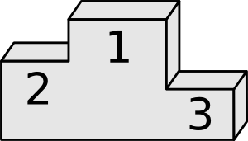
-eill-/-eil
soleil
bouteille
oreille
meilleur
appareil
[best]
merveilleux
[device]
[marvellous]
Notes:
Timing: 1 minute
Aim: To consolidate SSC [-eill-/-eil]
Procedure:
Introduce and elicit the pronunciation of the individual SSC [-eill-/-eil] and then the source word again ‘oreille’ (with gesture, if using). Then present and elicit the pronunciation of the five cluster words. The cluster words have been chosen for their high-frequency, from a range of word classes, with the SSC (where possible) positioned within a variety of syllables within the words (e.g. initial, 2nd, final etc.). Additionally, we have tried to use words that build cumulatively on previously taught SSCs (see the Phonics Teaching Sequence document) and do not include new SSCs. Where new SSCs are used, they are often consonants which have a similar symbol-sound correspondence in English.
Word frequency (1 is the most frequent word in French): oreille [1844], meilleur [194], soleil [1713], bouteille [2979], merveilleux [2209], appareil [1420] Source: Lonsdale, D., & Le Bras, Y. (2009). A Frequency Dictionary of French: Core vocabulary for learners London: Routledge.

Slide 24
-euill-/-euil
fauteuil
[-ueill-/-ueill, -œill-/-œil]
recueillir
[to collect]
feuille
accueil
[welcome]
œil
écureuil
Notes:
Timing: 1 minute
Aim: To consolidate SSC [-euill-/-euil]
Procedure:
1. Introduce and elicit the pronunciation of the individual SSC [-euill-/-euil] and then the source word again ‘feuille’ (with gesture, if using). 2. Then present and elicit the pronunciation of the four cluster words.
The cluster words have been chosen for their high-frequency, from a range of word classes, with the SSC (where possible) positioned within a variety of syllables within the words (e.g. initial, 2nd, final etc.). Additionally, we have tried to use words that build cumulatively on previously taught SSCs (see the Phonics Teaching Sequence document) and do not include new SSCs. Where new SSCs are used, they are often consonants which have a similar symbol-sound correspondence in English.
Word frequency (1 is the most frequent word in French): fauteuil [2743]; feuille [2440] recueillir [1230]; accueil [2541], écureuil [>5000], oeil [474] Source: Lonsdale, D., & Le Bras, Y. (2009). A Frequency Dictionary of French: Core vocabulary for learners London: Routledge.

Slide 25
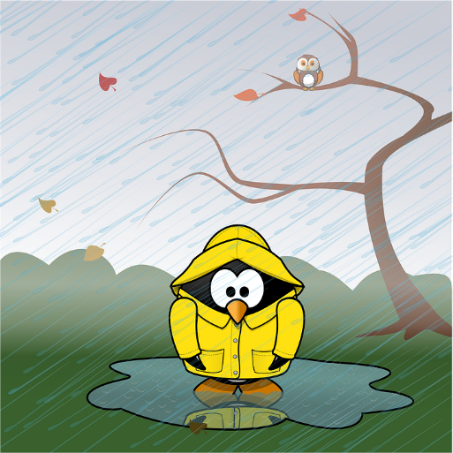
-ouill-/-ouil
fouiller
grenouille
[to rummage]
brouillard
débrouiller
[wet]
brouiller
mouillé
[disentangle]
[to scramble]
Notes:
Timing: 1 minute
Aim: To consolidate SSC [-ouill-/-ouil]
Procedure:
1. Introduce and elicit the pronunciation of the individual SSC [-ouill-/-ouil] and then the source word again ‘brouiller’ (with gesture, if using). 2. Then present and elicit the pronunciation of the four cluster words.
The cluster words have been chosen for their high-frequency, from a range of word classes, with the SSC (where possible) positioned within a variety of syllables within the words (e.g. initial, 2nd, final etc.). Additionally, we have tried to use words that build cumulatively on previously taught SSCs (see the Phonics Teaching Sequence document) and do not include new SSCs. Where new SSCs are used, they are often consonants which have a similar symbol-sound correspondence in English.
Word frequency (1 is the most frequent word in French): fouiller [3431]; brouiller [4682] débrouiller [3618]; grenouille [>5000], mouillé [>5000] Source: Lonsdale, D., & Le Bras, Y. (2009). A Frequency Dictionary of French: Core vocabulary for learners London: Routledge.

Slide 26
Phonétique
écouter / écrire
Écoute et complète les mots avec le bon SSC
 |  | [-ill-/-ille] | [-ail-/aille] | [-eil/-eille] | [-euil/-euille] | [ouil/ouille]
 | bouillon
 | portefeuille
 | cons eil
 | pastille
 | acc ueill ir
 | orteil
 | trouvaille
 | bille s
1
___
[broth]
2
_____
[wallet]
3
___
[advice]
4
__
[tablet]
5
___
[to welcome]
6
__
[toe]
7
____
[discovery]
8
__
[marbles]
Notes:
Timing: 7 minutes
Aim: aural recognition of SSCs [ill-/-ille. -ail-/aille, -eil/-eille, -euil/-euille, ouil/ouille]
Procedure:
1. Click the numbers to play the audio.
2. Students write 1-12 and choose which SSC they think is missing.
3. Click to reveal the answers.
Transcript:
1. bouillon
2. portefeuille
3. conseil
4. pastille
5. accueilir
6. orteil
7. trouvaille
8. billes
Word frequency (1 is the most frequent word in French): bouillon [>5000],portefeuille [>5000], conseil [577], pastille [>5000], accueillir [1189], orteil [>5000], trouvaille [>5000], billes [>5000]
Source: Lonsdale, D., & Le Bras, Y. (2009). A Frequency Dictionary of French: Core vocabulary for learners London: Routledge.

Slide 27
Imperfect tense
Je jouais au foot tous les jours. I used to play football every day.
grammaire
We use the imperfect tense to talk about events and actions that used to happen regularly in the past.
To form the imperfect tense for je:
je + stem of present tense ‘nous’ form + -ais
e.g. aller → nous → j’
allons
allais
I used to go
e.g. empêcher → nous → j’
empêchais
empêchons
I used to prevent
To form the imperfect tense for il/elle/on, you need:
il/elle/on + stem of present tense ‘nous’ form + -ait
e.g. voyager → nous → il/elle/on
he/she used to travel
voyageons
voyageait
cochons
he/she used to tick
e.g. cocher → nous → il/elle/on
cochait
Notes:
Timing: 2 minutes
Aim: Recap of imperfect tense of –er verbs
Procedure:
1. Click to reveal explanations and examples.
2. Elicit English.
3. Ensure understanding.

Slide 28
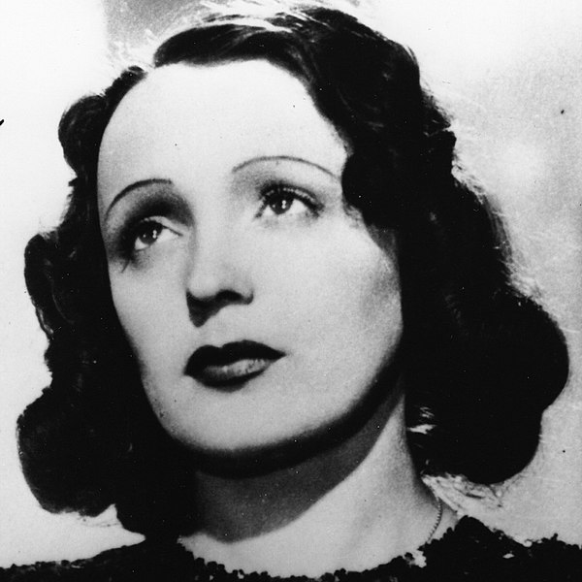
Édith Piaf
Choisis le bon mot.
lire
j’
j’
J’ habitais à Paris, mais pas avec ma mère. Elle travaillait dans le théâtre. Elle voyageait souvent pour le travail. J’ habitais avec la mère de mon père. Je chantais dans la rue avec ma sœur et on gagnait de l’argent ensemble. Je travaillais parfois avec Django Reinhardt. Il jouait de la guitare. J’ aidais de nouveaux artistes, comme Charles Aznavour. Il partageait la scène avec moi. Les gens ont dit que je travaillais avec les Allemands pendant la guerre, mais selon mon secrétaire et moi, j’ aidais les Français.
j’
j’
1
2
3
4
je
je
5
je
on
6
7
il
il
8
9
elle
elle
10
11
12
Notes:
Timing: 5 minutes
Aim: Written recognition of –er verbs in the imperfect tense
Procedure:
1. Students read the text and choose the correct pronoun according to the verb ending.
2. Click to reveal answers.
3. Oral translation of text if time allow.
Word frequency of cognates used (1 is the most frequent word in French): théâtre [1701]
Source: Lonsdale, D., & Le Bras, Y. (2009). A Frequency Dictionary of French: Core vocabulary for learners London: Routledge.
Édith Piaf is licensed under CC BY-SA 4.0

Slide 29
Verbs like prendre
grammaire
Verbs like prendre (apprendre, comprendre):
I take
you _{[sing.]} learn
he/she understands
je prends
tu apprends
il/elle comprend
we take
you _{[pl./fml]} learn
they understand
nous prenons
vous apprenez
ils/elles comprennent
Notes:
Timing: 1 minute
Aim: Recap of verbs like prendre
Procedure:
1. Click to reveal examples.
2. Elicit French where possible.
3. Ensure understanding.

Slide 30
Verbs like venir
grammaire
Verbs like venir (devenir, revenir, appartenir, soutenir, contenir):
I come
you _{[sing.]} become
he/she comes back
je viens
tu deviens
il/elle revient
we belong
you _{[pl./fml]} support
they contain
nous appartenons
vous soutenez
ils/elles contiennent
Notes:
Timing: 1 minute
Aim: Recap of verbs like venir
Procedure:
1. Click to reveal examples.
2. Elicit French where possible.
3. Ensure understanding.

Slide 31
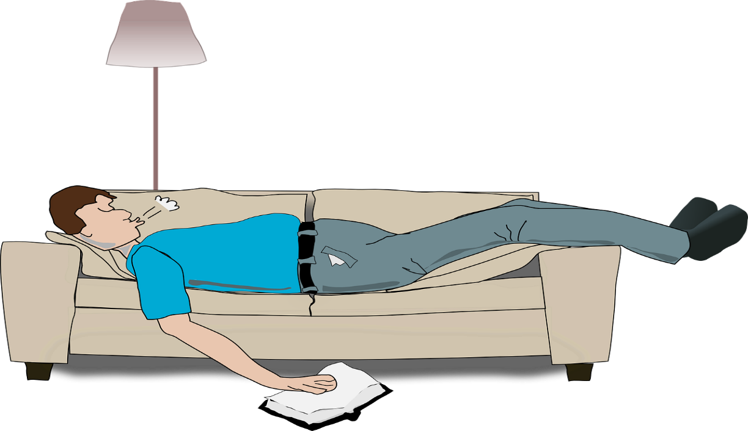
Verbs like sortir
grammaire
Verbs like sortir (partir, dormir):
I go out
you _{[sing.]} leave
he/she sleeps
je sors
tu pars
il/elle dort
we go out
you _{[pl/fml]} leave
they sleep
nous sortons
vous partez
ils/elles dorment
Notes:
Timing: 1 minute
Aim: Recap of verbs like sortir
Procedure:
1. Click to reveal examples.
2. Elicit French where possible.
3. Ensure understanding.

Slide 32
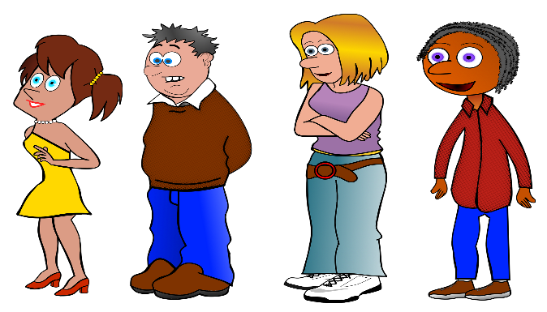
Verbs like entendre
grammaire
Verbs like entendre (attendre, répondre, perdre, dépendre, descendre, mettre, remettre):
I wait
you _{[sing.]} hear
he/she answers
j’attends
tu entends
il/elle répond
we lose
you _{[pl./fml]} depend
they go down
nous perdons
vous dépendez
ils/elles descendent
Notes:
Timing: 1 minute
Aim: Recap of verbs like entendre
Procedure:
1. Click to reveal examples.
2. Elicit French where possible.
3. Ensure understanding.

Slide 33
Verbs like lire
grammaire
Verbs like lire (dire, conduire, interdire, construire, traduire):
I read
you _{[sing.]} say
he/she drives
je lis
tu dis
il/elle conduit
we ban
you _{[pl./fml]} build
they translate
nous interdisons
vous construisez
ils/elles traduisent
Notes:
Timing: 1 minute
Aim: Recap of verbs like lire
Procedure:
1. Click to reveal examples.
2. Elicit French where possible.
3. Ensure understanding.

Slide 34
Verbs like écrire
grammaire
Verbs like écrire (inscrire, décrire):
I write
you _{[sing.]} write down
he/she describes
j’écris
tu inscris
il/elle décrit
we write
you _{[pl/fml]} write down
they describe
nous écrivons
vous inscrivez
ils/elles décrivent
Notes:
Timing: 1 minute
Aim: Recap of verbs like écrire
Procedure:
1. Click to reveal examples.
2. Elicit French where possible.
3. Ensure understanding.

Slide 35
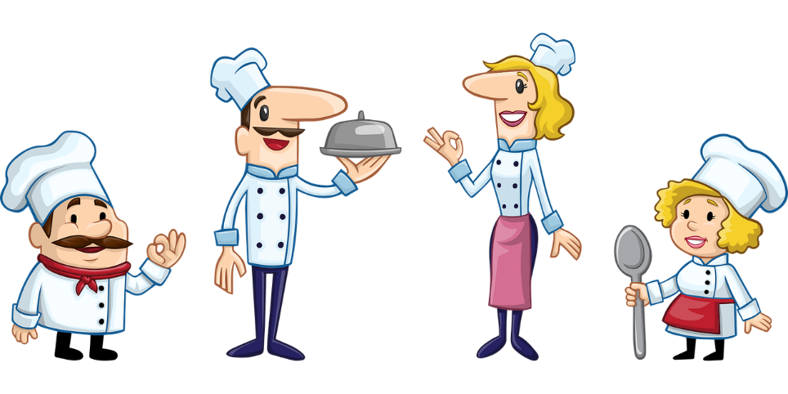
Verbs like choisir
grammaire
Verbs like choisir (réussir, finir, remplir, définir, réagir, réfléchir, nourrir):
I choose
you _{[sing.]} finish
he/she fills
je choisis
tu finis
il/elle remplit
we define
you _{[pl/fml]} react
they feed
nous définissons
vous réagissez
ils/elles nourrissent
Notes:
Timing: 1 minute
Aim: Recap of verbs like choisir
Procedure:
1. Click to reveal examples.
2. Elicit French where possible.
3. Ensure understanding.

Slide 36
La vie à l’université
Abdel parle de l’université ou du lycée ?
écouter
Q | lycée | université | anglais
 |  |  | choose all my subjects
 |  |  | used to write messages on my phone in class
 |  |  | never used to read newspapers
 |  |  | used to write important dates on my hand
 |  |  | go out on Wednesdays
 |  |  | used to go out on Saturdays
 |  |  | answer messages after lessons
 |  |  | write a lot in my exercise books
 |  |  | am becoming more responsible
 |  |  | didn’t use to finish all my homework
 |  |  | used to understand my work easily
 |  |  | pass all my exams
1
2
3
4
5
6
7
8
9
10
11
12
Notes:
Timing: 10 minutes
Aim: Aural recognition of present and imperfect tenses and connecting these with meaning
Procedure:
1. Click audio buttons to play audio.
2. Students listen and tick lycée or université according to whether they hear the imperfect or the present tense.
3. Click to reveal answers.
4. Students listen again and write the English of each activity.
5. Click to reveal answers.
Transcript:
Je choisis toutes mes matières.
J’écrivais des messages sur mon portable en classe.
Je ne lisais jamais de journaux.
J’inscrivais les dates importantes sur la main.
Je sors les mercredis.
Je sortais les samedis.
Je réponds aux messages après les cours.
J’écris beaucoup dans mes cahiers.
Je deviens plus responsable.
Je ne finissais pas tous mes devoirs.
Je comprenais mon travail facilement.
Je réussis tous mes examens.

Slide 37
Perfect and imperfect tenses
grammaire
Remember, you need present tense of avoir + past participle to form the perfect tense:
avoir: j’ai tu as il/elle/on a
nous avons vous avez ils/elles ont
e.g. visiter
→ J’ai visité
I visited
past participles:
-ER verbs: stem + é
We use the perfect tense to talk about specific or one-off events and actions that happened in the past.
You also know how to form the imperfect tense:
Stem of present tense ‘nous’ form + -ais (je form) or + -ait (il/elle/on form)
e.g. regarder → nous
regardons →
je regardais
I used to watch
tu regardais
You _{[sing.]} used to watch
We use the imperfect tense to talk about events and actions that used to happen regularly in the past.
elle regardait
She used to watch
Notes:
Timing: 2 minutes
Aim: Recap perfect vs imperfect tenses
Procedure:
Click to reveal explanations and examples.
2. Ensure understanding.

Slide 38
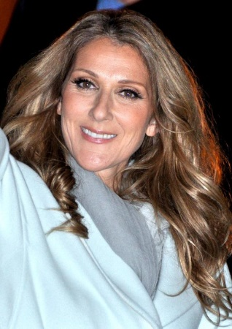
Céline Dion
Traduis les verbes en français.
écrire
I arrived
I used to live
we used to sing
I used to write
helped
I made
sent
used to work
he listened to
he sent
I went
changed
I used to sing
I learnt
I entered
I sang
I used to go up
I returned
I have started
Le trente mars 1968, je suis arrivée. J’habitais près de Montréal avec ma mère, mon père, et mes treize frères et sœurs.
On chantait toujours à la maison. À l’âge de douze ans, j’écrivais déjà mes propres chansons ! Ma mère et mon frère
ont aidé avec la première chanson. J’ai fait une cassette de ma première chanson. Ma mère a envoyé la cassette à René Angélil, un homme qui travaillait avec la chanteuse québécoise Ginette Reno. Quand il a écouté la chanson, il a envoyé une lettre à ma famille. Je suis allée au bureau de René pour chanter. Ce moment a changé ma vie ! Je chantais toujours en français, mais j’ai appris l’anglais et je suis entrée dans le marché américain il y a trente ans. En 1997, j’ai chanté une chanson pour le film Titanic, et entre 2003 et 2007 je montais sur scène à Las Vegas tous les soirs. Je suis retournée à Las Vegas pour huit ans en 2011. Maintenant j’ai commencé une nouvelle tournée mondiale*.
1
2
3
4
*la tournée mondiale = world tour
5
6
7
8
9
10
11
12
13
14
15
16
17
18
19
Notes:
Timing: 12 minutes
Aim: Written production of perfect and imperfect tense in context
Procedure:
1. Students translate the verbs into French in the appropriate tense.
2. Click to reveal answers.
3. Ensure understanding of choice of tenses.
4. Oral translation of text.
Differentiation: For more support, provide either the verb forms (jumbled) on the board, OR the infinitive verbs. To reduce the overall load within the time, cut the text in half, stopping after item 10. The remainder of the task could be given for homework.
Word frequency of unknown words (1 is the most frequent word in French): tournée [2691], mondial [549]
Word frequency of cognates used (1 is the most frequent word in French):
âge [502], cassette [4925], américain [374]
Source: Lonsdale, D., & Le Bras, Y. (2009). A Frequency Dictionary of French: Core vocabulary for learners London: Routledge.
Céline Dion is licensed under CC BY-SA 3.0

Slide 39
Devoirs
Vocabulary Learning Homework
Audio file
Audio file QR code:
Quizlet link
In addition, revisit:
Notes:
Resources pending release

