Slide 1
Vocabulary
Y7 French
Term 3.1 - Week 5
Kirsten Somerville / St James’ Hub / Natalie Finlayson
Date updated: 07/05/20
Notes:
Frequency rankings of vocabulary introduced this week (1 is the most common word in French):
3.1.5 - sais [67], sait [67], savoir [67], café [1886], cinéma [1623], plage [2693], rue [598], devant [198], derrière [805], entre [55]
Frequency rankings of vocabulary revisited this week (1 is the most common word in French):
3.1.2 - dire [37], dis [37], dit [37], sors [309], sort [309], sortir [309], venir [88], viens [88], vient [88], vérité [907], de [2], important [215]
2.2.2 - aéroport [2113], l'étranger [305], hôtel [1774], île [1245], université [1192], États-Unis [n/a], rarement [2535], souvent [287]
Source: Londsale, D., & Le Bras, Y. (2009). A Frequency Dictionary of French: Core vocabulary for learners London: Routledge.

Slide 2
Trouve le trésor !
0
écrire
+5
+10
+15
+ 25
 | 1 | 2 | 3 | 4 | 5 | 6
A
B
C
D
E
to say /
to tell
dire
to learn
venir
sortir
apprendre
to understand
to come
to go out
prendre
comprendre
to take
tu apprends
she is coming
you learn
je sors
elle vient
I am going out
tu prends
je comprends
he tells
you take
I understand
il dit
you say
tu dis
elle comprend
she understands
I come
I am taking
je viens
je prends
il apprend
you go out
he is learning
tu sors
elle prend
I am saying
you are coming
she takes
tu comprends
je dis
tu viens
you understand
I learn
il sort
j’apprends
he goes out
I come from Paris.
Je sors avec des amis.
I’m taking the train.
Je prends le train.
I’m learning an important language.
Je viens de Paris.
I’m telling the truth.
J’apprends une langue importante.
Je dis la vérité.
I go out with friends.
Je comprends le français.
I understand French.
Notes:
This ‘treasure hunt’ activity reviews the three irregular verbs in this week’s first revisited set, as well as three irregular verbs revisited the previous week, which follow a similar pattern. As well as meaning, the focus is on form and spelling – this will prime for the introduction of savoir in the slides that follow.
Students can work individually, in pairs or in small groups. Each row (A-E) represents one round. Students write 1-6 in exercise books or mini whiteboards, and write the French for each number. Click the blue box to reveal the answers – students tick or cross accordingly. Click the yellow box to reveal the points for each correct answer (these are randomly allocated for an element of chance) – students tally up their totals.
NB: as this activity is simply for revision, teachers may consider cutting it down a little to ensure enough time is available to progress through the main grammar focus of the lesson.
Frequency rankings of vocabulary revisited this week (1 is the most common word in French):
3.1.2 - dire [37], dis [37], dit [37], sors [309], sort [309], sortir [309], venir [88], viens [88], vient [88], vérité [907], de [2], important [215]

Slide 3
savoir
[to know how to | knowing how to]
sait
[knows how to]
Notes:
Students should know the meaning of this verb already, as it was set as (audio and quizlet) homework. It is re-presented here in the infinitive and short form to deepen students’ knowledge and model the use of both forms in sentences.
Introducing the verb savoir more explicitly. Savoir is one of the 25 most frequently used verbs in French. All 25 most frequent verbs will be introduced early on using the same format. Both long form (infinitive) and short form (3rd person singular) are introduced in order to familiarise students with various forms of the same verb.
Note that only the meaning ‘to know how to’ is introduced at this stage – the meaning ‘to know’ will be introduced in Y8, along with connaître.
Bring up the word savoir on its own, say it, students repeat it, and remind them of the phonics. Draw attention to the SSC [a].
Try to elicit the meaning from the students.
Bring up the picture, and, if using gestures, a possible gesture would be to point at your head.
Then bring up the English translations. Emphasise the two meanings for the infinitive.
Bring up the short form sait, say it, students repeat it. . Draw attention to the SSC [ai].
Try to elicit the meaning from the students. Emphasise the two meanings for the short form.
Note: Students have had explicit teaching that the present tense in French communicates two different present tense meanings in English. This reinforces that learning. Emphasise the two meanings for the short form, reminding students that French only has one form and does not have a direct equivalent of the grammar for ‘is + ing’, the continuous form (as covered in previous weeks).

Slide 4
savoir
[to know how to | knowing how to]
sait
[knows how to]
Notes:
Cycle through the long and short form again.

Slide 5
sait
[knows how to]
Elle sait faire l’exercice.
[She knows how to do the exercise.]
Notes:
Introduce the short form in a sentence. Note that this verb describes a state, and so is unlikely to be translated in the continuous.

Slide 6
savoir
[to know how to | knowing how to]
Savoir parler français est important.
[Knowing how to speak French is important.]
Notes:
Introduce the long form in a sentence.

Slide 7
sait
[knows how to]
sait
Elle faire l’exercice.
[She knows how to do the exercise.]
Notes:
Cycle through the short form in context again.

Slide 8
savoir
[to know how to | knowing how to]
Savoir
parler français est important.
[Knowing how to speak French is important.]
Notes:
Cycle through the long form in context again.

Slide 9
Using the verb ‘savoir’ – to know
You have seen this pattern of –s, -s, -t, -t endings before:
dire, sortir and venir also follow this pattern.
grammaire
This is the pattern of endings for the first, second and third person singular forms of savoir:
We can’t say to know in the present continuous. To ‘know how to’ do something is something that is generally true, not an action you do at a particular time.
je sais
I know how to
tu sais
you know how to
il sait
he knows how to
These verb forms all sound the same!
The –s on the je and tu forms is a silent final consonant (SFC)
elle sait
she knows how to
Notes:
The first three persons singular of the verb savoir are now presented. Make students aware of the fact that, like the verbs practised in the previous exercise, the three forms here all sound the same in French.

Slide 10
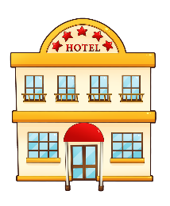
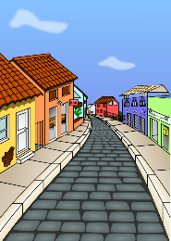
Vocabulaire
écrire
1
2
C’est masculin ou féminin ? Écris en français.
masculin
féminin
3
4
café
cinéma
aéroport
hôtel
université
plage
île
rue
5
6
un
une
7
8
Notes:
This slide practises the form of the nouns in this week’s new and revisited vocabulary sets.
Students to draw two boxes in books/on whiteboard. Students to categorise nouns by gender and write them from memory. Teacher to ask which article is needed in front of each one.
The indefinite article is used to show the gender of nouns beginning with a vowel, and to prepare for use with ‘il y a / il n’y a pas’ later in the lesson.

Slide 11
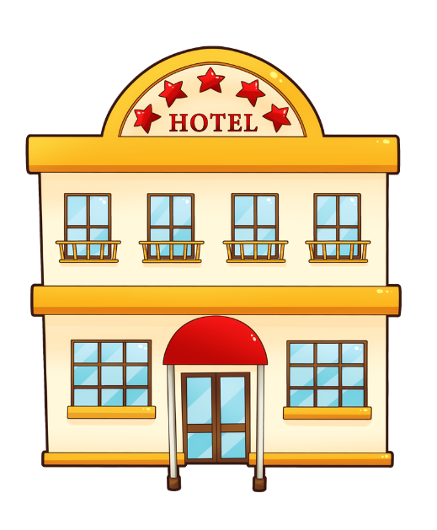
Vocabulaire
parler
un cinéma
un café
un hôtel
un aéroport
Notes:
This slide practises the meaning of the masculine nouns.
First, students see the French and say the French, in order from left to right. Then, the French words disappear randomly one by one and students say the French again. Since these words are near-cognates, teacher to listen carefully to ensure that words are being pronounced according to French SSCs.
Frequency rankings of vocabulary introduced this week (1 is the most common word in French):
3.1.5 - sais [67], sait [67], savoir [67], café [1886], cinéma [1623], plage [2693], rue [598], devant [198], derrière [805], entre [55]
Frequency rankings of vocabulary revisited this week (1 is the most common word in French):
2.2.2 - aéroport [2113], l'étranger [305], hôtel [1774], île [1245], université [1192], États-Unis [n/a], rarement [2535], souvent [287]
Source: Londsale, D., & Le Bras, Y. (2009). A Frequency Dictionary of French: Core vocabulary for learners London: Routledge

Slide 12
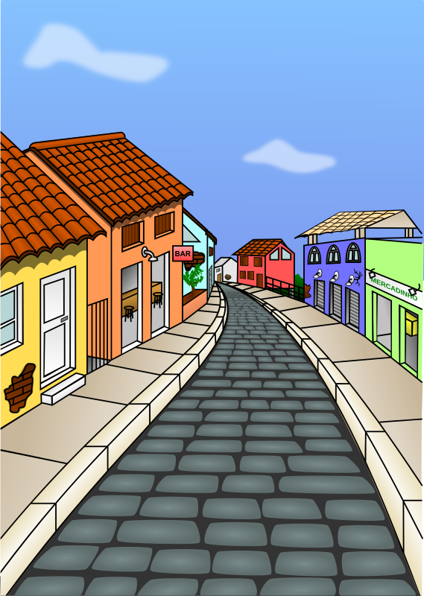
Vocabulaire
parler
une plage
une rue
une île
une université
Notes:
This slide practises the meaning of the feminine nouns.
First, students see the French and say the French, in order from left to right. Then, the French words disappear randomly one by one and students say the French, again.
Frequency rankings of vocabulary introduced this week (1 is the most common word in French):
3.1.5 - sais [67], sait [67], savoir [67], café [1886], cinéma [1623], plage [2693], rue [598], devant [198], derrière [805], entre [55]
Frequency rankings of vocabulary revisited this week (1 is the most common word in French):
2.2.2 - aéroport [2113], l'étranger [305], hôtel [1774], île [1245], université [1192], États-Unis [n/a], rarement [2535], souvent [287]
Source: Londsale, D., & Le Bras, Y. (2009). A Frequency Dictionary of French: Core vocabulary for learners London: Routledge

Slide 13
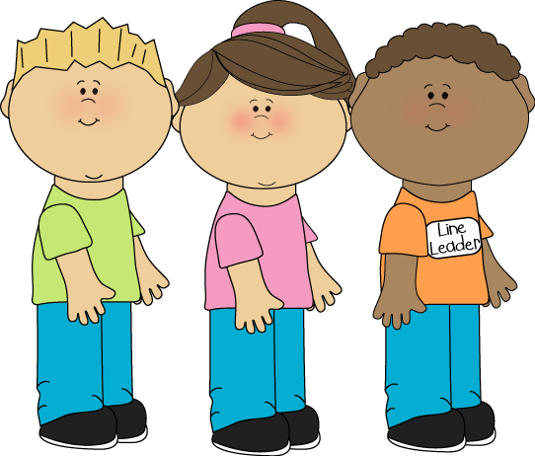
Vocabulaire
parler
devant
Charles
Charlotte
Michel
Notes:
This and the following two slides introduce the prepositions from this week’s vocabulary.
Teacher elicits the answer by asking e.g. ‘Où est Michel?’
NB: The names have been carefully chosen to offer further practice of this week’s SSC [ch].
Frequency rankings of vocabulary introduced this week (1 is the most common word in French):
3.1.5 - sais [67], sait [67], savoir [67], café [1886], cinéma [1623], plage [2693], rue [598], devant [198], derrière [805], entre [55]
Source: Londsale, D., & Le Bras, Y. (2009). A Frequency Dictionary of French: Core vocabulary for learners London: Routledge

Slide 14
Vocabulaire
parler
derrière
Charles
Charlotte
Michel

Slide 15
Vocabulaire
parler
entre
Charles
Charlotte
Michel

Slide 16
Faire la queue !
écrire
Complète les phrases:
Charles est ____________ Charlotte.
Charlotte est ____________ Charles et Michel.
Michel est __________ Charlotte.
devant
derrière
entre
Charles
Charlotte
Michel
Notes:
Students write the preposition which completes the sentence.
Frequency rankings of vocabulary introduced this week (1 is the most common word in French):
3.1.5 - sais [67], sait [67], savoir [67], café [1886], cinéma [1623], plage [2693], rue [598], devant [198], derrière [805], entre [55]

