Slide 1
Talking about your day
Numbers 32-69, telling the time
SSCs [en/an], [ain/in]
Y9 French
Term 1.2 - Week 6 - Lesson 23
Catherine Salkeld / Natalie Finlayson / Cath Morris
Artwork by: Chloé Motard
Date updated: 03/08/21
Notes:
Artwork by Chloé Motard. All additional pictures selected are available under a Creative Commons license, no attribution required.
Native speaker feedback provided by Sarah Brichory.
With thanks to Rachel Hawkes for her input on the lesson material.
Learning outcomes (lesson 1):
Revision of SSCs [en/an], [ain/in]
Introduction of numbers 32-69, telling the time
Word frequency (1 is the most frequent word in French):
9.1.2.6 (introduce) faim [1986], heure^{2,3} [99], midi [2483], minuit [3453], soif [4689], peur [755], tort [1652], quarante [2436], cinquante [2273], soixante [3151], donc [145], raison² [72]
9.1.2.1 (revisit) empêcher [306], pratiquer [1268], respecter [673], risquer [322], château [3510], région [241], essentiel [675], fantastique [4107], historique [902], utile [1003]
8.3.2.6 (revisit) bu [boire - 1879], eu [avoir - 8], pris [prendre - 43], accident [1227], bras [1253], jambe [2472], mal² [277], maladie [793], petit-déjeuner [>5000], photo [1412], déjà² [58], pas encore [18/51], ensuite [265]
Source: Lonsdale, D., & Le Bras, Y. (2009). A Frequency Dictionary of French: Core vocabulary for learners London: Routledge.
The frequency rankings for words that occur in this PowerPoint which have been previously introduced in NCELP resources are given in the NCELP SOW and in the resources that first introduced and formally re-visited those words.
For any other words that occur incidentally in this PowerPoint, frequency rankings will be provided in the notes field wherever possible.

Slide 2
en/an
enfant
Notes:
Timing: 1 minute [2 slides]
Aim: To consolidate SSC [en/an]
Procedure: 1. Present the letter(s) and say the [en/an] sound first, on its own. Students repeat it with you. 2. Bring up the word ”enfant” on its own, say it, students repeat it, so that they have the opportunity to focus all of their attention on the connection between the written word and its sound.
3. A possible gesture for this would be to mime patting a child on the head/back 4. Roll back the animations and work through 1-3 again, but this time, dropping your voice completely to listen carefully to the students saying the [en/an] sound, pronouncing ”enfant” and, if using, doing the gesture.
Word frequency (1 is the most frequent word in French):
enfant [126]. Source: Londsale, D., & Le Bras, Y. (2009). A Frequency Dictionary of French: Core vocabulary for learners London: Routledge.

Slide 3
ain/in
train
Notes:
Aim: To consolidate SSC [ain/in]
Procedure: 1. Present the letter(s) and say the [ain/in] sound first, on its own. Students repeat it with you. 2. Bring up the word ”train” on its own, say it, students repeat it, so that they have the opportunity to focus all of their attention on the connection between the written word and its sound.
3. A possible gesture for this would be to move both arms simultaneously forwards and back in a circular motion, simulating the motion of train wheel connecting rods.
4. Roll back the animations and work through 1-3 again, but this time, dropping your voice completely to listen carefully to the students saying the [ain/in] sound, pronouncing ”train” and, if using, doing the gesture.
Word frequency (1 is the most frequent word in French):
train [232]. Source: Londsale, D., & Le Bras, Y. (2009). A Frequency Dictionary of French: Core vocabulary for learners London: Routledge.

Slide 4
Phonétique
[ain/in] comes from the middle of the mouth. Smile when you say it!
écouter
Vingt contains SSC [ain/in].
[en/an] comes from the back of the mouth near the throat. It can feel a bit like swallowing!
Practise saying it:
vingt
vingt
vingt
Trente contains SSC [en/an].
Practise saying it:
trente
trente
trente
Now practise both together:
vingt
trente
vingt
trente
trente
vingt
trente
vingt
vingt
trente
Cinquante has both of these SSCs! Practise saying it.
Notes:
Timing: 3 minutes
Aim: Revision of SSCs [ain/in] and [en/an]. This challenging contrast prepares students to correctly pronounce numbers 20-60, which is one of the themes of this lesson.
Procedure:
1. Click to reveal examples together with native speaker pronunciation.
2. Click to reveal pronunciation tips. Explain that [ain/in] and [en/an] are both nasal vowels, but they are produced in different parts of the mouth.
3. Elicit pronunciation to practise contrast as a class.
[en/an] comes from the back of the mouth near the throat – it can feel a bit like you are about to swallow it!

Slide 5
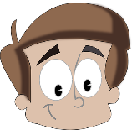
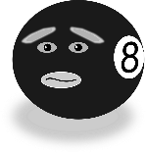
Phonétique
écouter / écrire
Ce sont quelles SSCs ? Écoute et coche.
Q | [en/an] x2 | [ain/in] x2 | [en/an] + [ain/in] | mot | English
 |  |  |  | tendance | tendency, trend
 |  |  |  | Quentin | a boy’s name
 |  |  |  | enfin | at last
 |  |  |  | instance | authority
 |  |  |  | instinct | instinct
 |  |  |  | pansement | bandage
 |  |  |  | incertain | uncertain
 |  |  |  | intense | intense
1
__
__
2
__
__
3
__
__
4
__
__
5
__
__
6
__
__
7
__
__
8
__
__
Notes:
Timing: 5 minutes
Aim: Aural recognition of SSCs [en/an] and [ain/in] in words containing either both sounds, or the same sound twice.
Procedure:
1. Click the buttons on the left to play audio.
2. Students tick to indicate whether they heard [en/an] twice, [ain/in] twice, or one of each (either way round). At higher levels, the full French word may be covered and transcribed.
3. Click to reveal answers.
4. Click to reveal English translations.
Transcript:
tendance
Quentin
enfin
instance
instinct
pansement
incertain
intense
Word frequency (1 is the most frequent word in French): tendance [1158], Quentin [n/a], enfin [349], instance [2278], instinct [4482], pansement [>5000], incertain [3135], intense [2270]
Source: Lonsdale, D., & Le Bras, Y. (2009). A Frequency Dictionary of French: Core vocabulary for learners London: Routledge.

Slide 6
Les numéros 32-69
grammaire
You already know how to say the numbers 1-31 in French.
Remember, the numbers 17-31 are made up of a combination of numbers in French:
The –ante ending in these numbers has SSC [en/an] and SFE. The - t- is pronounced.
vingt-deux
twenty-two
trente et un
thirty-one
Add a hyphen between the numbers.
Add et before un.
The numbers 32-69 follow the same pattern:
trente-trois
thirty-three
cinquante-sept
fifty-seven
quarante et un
forty-one
soixante-deux
sixty-two
Notes:
Timing: 2 minutes
Aim: Revision of construction rules for numbers 1-31 and introducing the construction rule for numbers 32-69.
Procedure:
Click through the explanation and examples, eliciting the French for the later examples (note the animation order changes to allow for this).
Ensure understanding.
Draw attention to SSCs [an/en] and SFE in the –ante suffix.

Slide 7
Les numéros
écouter / écrire
a
34
trente-quatre
i
42
quarante-deux
b
52
cinquante-deux
j
59
cinquante-neuf
c
63
soixante-trois
k
44
quarante-quatre
d
39
trente-neuf
l
38
trente-huit
e
45
quarante-cinq
m
51
cinquante et un
f
67
soixante-sept
n
48
quarante-huit
g
56
cinquante-six
o
61
soixante et un
h
37
trente-sept
p
65
soixante-cinq
Notes:
Timing: 5 minutes [depending on needs of class – teacher can choose to use all or just some examples]
Aim: Aural recognition and spelling of numbers 32-69.
Procedure:
1. Click on a letter to hear a number said aloud.
2. Students write down numbers in digits.
3. Click to reveal answer.
4. Students write the French number in full.
5. Click to reveal answer.
6. Repeat steps 1-5 for each number.
Transcript:
a. trente-quatre
b. cinquante-deux
c. soixante-trois
d. trente-neuf
e. quarante-cinq
f. soixante-sept
g. cinquante-six
h. trente-sept
i. quarante-deux
j. cinquante-neuf
k. quarante-quatre
l. trente-huit
m. cinquante et un
n. quarante-huit
o. soixante et un
p. soixante-cinq
Word frequency of near-cognates used (1 is the most frequent word in French):
nombre [249]
Source: Lonsdale, D., & Le Bras, Y. (2009). A Frequency Dictionary of French: Core vocabulary for learners London: Routledge.

Slide 8
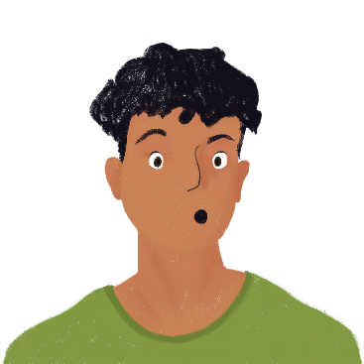
L’hôpital local en chiffres* !
écrire
Amir lit le journal local. Réécris les numéros en lettres. Puis, traduis les phrases en anglais.
*le chiffre = figure
*la sécurité = safety
Sixty-four people have already had an accident in this region today. We mustn’t risk accidents!
Soixante-quatre personnes ont déjà eu un accident dans cette région aujourd’hui. Il ne faut pas risquer des accidents !
64 personnes ont déjà eu un accident dans cette région aujourd’hui. Il ne faut pas risquer des accidents !
43 personnes sont à l’hôpital avec une maladie. Le médecin n’a pas encore parlé avec tous ces gens.
32 personnes ont mal à la tête. Elles n’ont pas bu assez d’eau. Empêcher ce problème, c’est essentiel !
55 personnes ont mal aux bras et aux jambes parce qu’elles ont pris des photos dans le château sans respecter les règles de sécurité*. La grande porte historique du château ferme vite !
Quarante-trois personnes sont à l’hôpital avec une maladie. Le médecin n’a pas encore parlé avec tous ces gens.
Forty-three people are at the hospital with an illness. The doctor hasn’t spoken to all these people yet.
Thirty-two people have a headache. They haven’t drunk enough water. Preventing this problem is essential !
Trente-deux personnes ont mal à la tête. Elles n’ont pas bu assez d’eau. Empêcher ce problème, c’est essentiel !
Cinquante-cinq personnes ont mal aux bras et aux jambes parce qu’elles ont pris des photos dans le château sans respecter les règles de sécurité*. La grande porte historique du château ferme vite !
Fifty-five people have sore arms and legs because they took photos in the castle without respecting the safety rules. The big historic door of the castle closes quickly!
Notes:
Timing: 5 minutes
Aim: Written production of French numbers; written recognition of new and revisited vocabulary in a longer context.
Procedure:
1. Students read sentences and re-write them with numbers in full.
2. Click to reveal.
3. Students translate sentences into English to check understanding.
4. Click to reveal translations.
Word frequency of unknown words used (1 is the most frequent word in French):
chiffre [749], sécurité [478]
Source: Lonsdale, D., & Le Bras, Y. (2009). A Frequency Dictionary of French: Core vocabulary for learners London: Routledge.

Slide 9
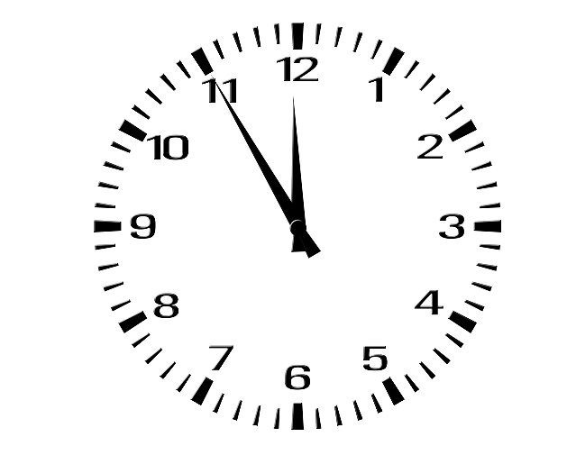
Telling the time
info
The question word is different! Quelle ? (which) in French, what? in English.
You already know one meaning of heure (hour). Here is another meaning (time of day).
To ask what time it is in French, we say:
Quelle heure est-il ?
What time is it?
In casual conversation, you might also hear: À quelle heure tu manges ? Unusually, the verb and subject are not inverted.
To ask what time something happens, we use the phrase:
à quelle heure… ?
(at) what time…?
À quelle heure manges-tu ?
Tu manges à quelle heure ?
À quelle heure va-t-il au collège ? Il va au collège à quelle heure ?
(At) what time do you eat?
(At) what time does he go to school?
Notes:
Timing: 4 mins [slide 1/2]
Aim: Introduction to telling and asking about the time.
Procedure:
1. Click through explanations and examples.
2. Ensure understanding.

Slide 10
Telling the time
info
The ‘s’ isn’t needed when it’s one o’clock.
Il est une heure.
To say what time it is in French, we use:
The hours and minutes are sometime separated by ‘h’ to represent heures.
Il est + [number] + heure(s) + [minutes]
Il est dix heures cinquante. Il est 10h50.
It’s ten fifty. It’s 10:50.
Some exceptions:
Il est midi. It’s midday.
Il est minuit. It’s midnight.
To say at what time something happens, we use à.
In French, the 24-hour clock is used a lot more than in English. In English, we use the 12-hour clock with ‘am’ and ‘pm’ instead,
Je mange à 18h15. Je mange à dix-huit heures quinze.
I eat at 6.15 pm. I eat at six fifteen pm.
Notes:
[slide 2/2]
Procedure:
1. Draw attention to the cross-linguistic difference between use of the 24 hours clock in French and use of a.m. / p.m. in English. Ensure students are aware that times from 00:00-11.59 are equivalent to a.m., and 12:00-23:59 to p.m.

Slide 11
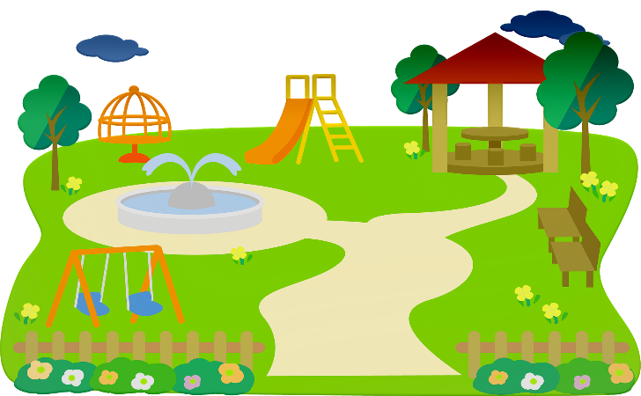
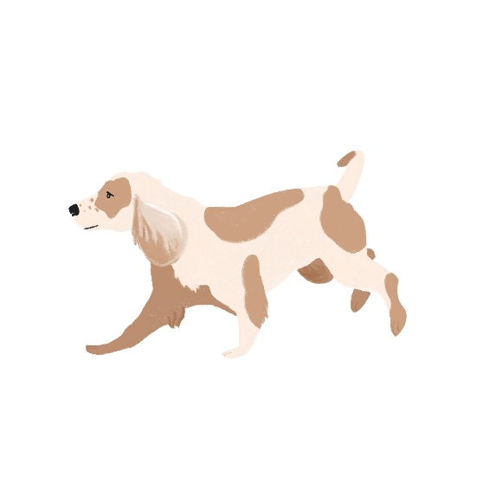
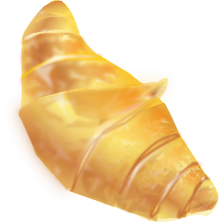
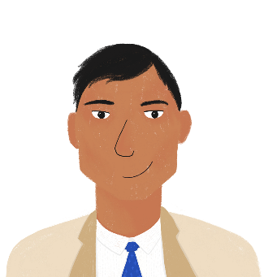
Le samedi d’Amir
lire
Écris les heures en numéros.
Now write the times in 12-hour time, using am or pm.
10:30am
13h45
10h30
1:45pm
À dix heures trente, Amir prend le petit-déjeuner.
À treize heures quarante-cinq, il va au parc avec Apollon.
4:35pm
16h35
16h35
19h15
7:15pm
À seize heures trente-cinq, il fait ses devoirs d’anglais.
À dix-neuf heures quinze, il mange avec sa famille.
Notes:
Timing: 3 minutes
Aim: Written comprehension of French times.
Procedure:
1. Students rewrite the times in bold in numbers.
2. Click to reveal the answers.
3. Students read the sentences aloud.
4. Click to reveal instruction for a follow-up task.
5. Students write the times using the 12-hour clock with am or pm.
6. Answers revealed on clicks.

Slide 12
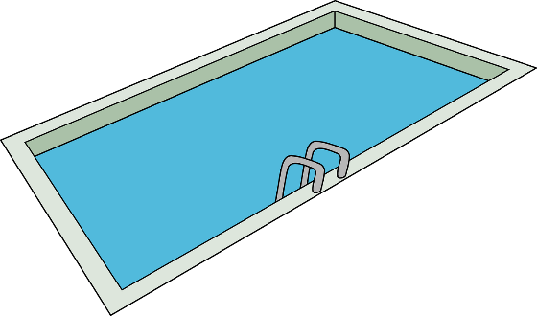
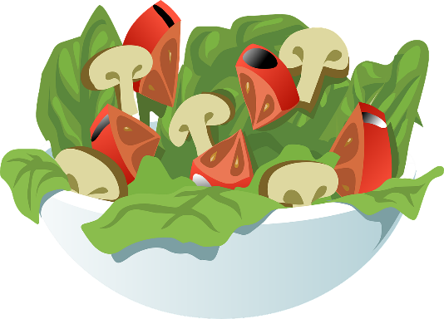
Le samedi d’Océane
écrire
Écris les heures en mots.
Now write the times in 12-hour time, using am or pm.
huit heures trente
8:30am
11:20am
onze heures vingt
À 8h30, Océane fait de la natation.
À 11h20, elle joue au basket.
treize heures quarante
treize heures quarante
quatorze heures quarante-cinq
quatorze heures quarante-cinq
À 13h40, elle prend le déjeuner.
À 14h45, elle étudie.
Notes:
Timing: 3 minutes
Aim: Written production of French times.
Procedure:
1. Students rewrite the times in bold in words.
2. Click to reveal the answers.
3. Students read the sentences aloud.
4. Click to reveal instruction for a follow-up task.
5. Students write the times using the 12-hour clock with am or pm.
6. Answers revealed on clicks.
Word frequency of unknown words used (1 is the most frequent word in French):
basket [>5000]
Source: Lonsdale, D., & Le Bras, Y. (2009). A Frequency Dictionary of French: Core vocabulary for learners London: Routledge.

Slide 13
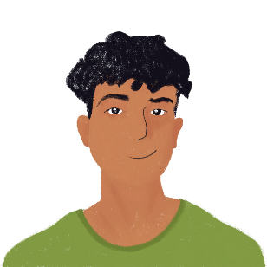
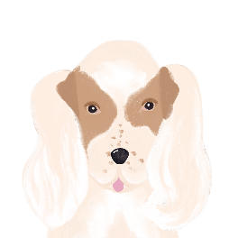
La vie d’Apollon
lire
Apollon va chez Océane ce weekend. Océane a des questions sur sa vie. Choisis les bonnes expressions et écris ‘?’ ou ‘?/.’
Here, the intonation tells us whether the sentence is a statement or a question.
1. À quelle heure / À 8h10 prend-il le petit déjeuner
1. À quelle heure prend-il le petit déjeuner ?
5. À quelle heure / À 12h45 préfère-t-il jouer au foot
5. À quelle heure préfère-t-il jouer au foot ?
2. Il boit de l’eau à quelle heure ?
2. Il boit de l’eau à quelle heure / à 8h30
2. Il boit de l’eau à 8h30 ./?
6. À quelle heure / À 1540 regarde-t-il la télé
6. À quelle heure regarde-t-il la télé ?
3. Il va au parc à quelle heure ?
7. Il mange à quelle heure ?
3. Il va au parc à 10h10 ./?
3. Il va au parc à quelle heure / à 10h10
7. Il mange à quelle heure / à 18h15
7. Il mange à 18h15 ./.?
4. Il joue dans le jardin à midi ./?
4. Il joue dans le jardin à quelle heure / à midi
8. À quelle heure/À 21h30 dort-il
4. Il joue dans le jardin à quelle heure ?
8. À quelle heure dort-il ?
Notes:
Timing: 5 minutes
Aim: Written recognition of phrases for asking and telling the time; word order practice.
Procedure:
1. Students choose the correct phrase to complete each message.
2. Students choose whether each message must end a question mark, or whether it could be either a statement or an intonation question.
3. Click to reveal answers. Where the answer could be either, discuss and practice flat/rising intonation to distinguish between questions and statements.
4. Click on answers to hear audio
Transcript:
À quelle heure prend-il le petit déjeuner ?
Il boit de l’eau à 8h30. Il boit de l’eau à 8h30 ? Il boit de l’eau à quelle heure ?
Il va au parc à 10h10. Il va au parc à 10h10 ?
Il va au parc à quelle heure ?
Il joue dans le jardin à midi. Il joue dans le jardin à midi ?
Il joue dans le jardin à quelle heure ?
À quelle heure préfère-t-il jouer au foot ?
À quelle heure regarde-t-il la télé ?
Il mange à 18h15. Il mange à 18h15 ?
Il mange à quelle heure ?
À quelle heure dort-il ?
Word frequency of cognates used (1 is the most frequent word in French):
expression [952]
Source: Lonsdale, D., & Le Bras, Y. (2009). A Frequency Dictionary of French: Core vocabulary for learners London: Routledge.

Slide 14
À quelle heure … ?
parler
Shy’m commence à vingt heures trente.
Shy’m commence à quelle heure ?
À quelle heure prend-on le déjeuner ?
On prend le déjeuner à treize heures quinze.
8.30pm Shy’m (commencer) 13h15 prendre le déjeuner
20h30 Shy’m
1.15pm prendre le déjeuner
_______
______
Notes:
Timing: 6 minutes. Slide 1/2.
Aim: Oral production of times in questions and statements.
Procedure:
1. Tell students they are going to work together to find out at what time things are happening. One student will ask about events at a music festival, and the other will ask about evening plans.
2. Work through the example on this slide. Students suggest a question Océane might ask to find the information to fill the gap on her card.
3. Click to reveal suggested answer.
4. Students suggest what Amir’s response might be.
5. Click to reveal suggested answer.
6. Repeat steps 2-5 for Amir’s card.
7. Print and distribute rolecards.
8. Students ask each other questions to find out what time things are happening. Encourage students to ask two intonation questions and two inversion questions.
9. Students look at each other’s rolecards to check answers.
Word frequency of cognates used (1 is the most frequent word in French): festival [3858]
Source: Lonsdale, D., & Le Bras, Y. (2009). A Frequency Dictionary of French: Core vocabulary for learners London: Routledge.

Slide 15
À quelle heure… ?
parler
Partenaire A
Tu veux aller au festival de musique. Réponds aux questions de ton/ta partenaire.
19h20 Daft Punk
19h40 Alpha Wann
20h00 Stromae
21h30 Christine and the Queens
Ton/ta partenaire fait beaucoup de choses aujourd’hui ! Trouve les heures.
_____ jouer au foot
_____ manger au restaurant
_____ aller au magasin
_____ finir les devoirs
Partenaire B
Tu veux aller au festival de musique. Trouve les heures des shows.
_____ Daft Punk (jouer)
_____ Alpha Wann (arriver)
_____ Stromae (chanter)
_____ Christine and the Queens (commencer)
Tu fais beaucoup de choses aujourd’hui ! Réponds aux questions de ton/ta partenaire.
16h10 jouer au foot
17h45 aller au magasin
18h30 finir les devoirs
19h15 manger au restaurant
Notes:
Slide 2/2

Slide 16
Au cinéma
écrire
Maman, j’ai raté l’avion ! commence à quatorze heures cinq.
[Home Alone – literally ‘Mum, I’ve missed the plane!’]
Amir est au cinéma. Il regarde la liste des films de Noël et il écrit un message à Océane. Finis le message. Écris les heures en mots.
Le Pôle Express commence à treize heures vingt-cinq.
[The Polar Express]
L’étrange Noël de Monsieur Jack commence à quatorze heures cinquante-cinq.
[The Nightmare Before Christmas – literally ‘Mr Jack’s Strange Christmas’]
Le Pôle Express 13h25
Maman, j’ai raté l’avion ! 14h05
L’étrange Noël de Monsieur Jack 14h55
Le Miracle de la 34e Rue 15h20
La Reine des Neiges 15h45
Les Chroniques de Noël 16h10
Mission : Noël : Les aventures de la famille Noël 16h40
Noël blanc 17h15
Mission : Noël : Les aventures de la famille Noël commence à seize heures quarante.
[Arthur Christmas – literally ‘Mission: Christmas – The Adventures of the Christmas Family’]
Le Miracle de la 34e Rue commence à quinze heures vingt.
[Miracle on 34th Street]
La Reine des Neiges commence à quinze heures quarante-cinq.
[Frozen – literally ‘The Snow Queen’]
Tu veux venir au cinéma aujourd’hui ? Tu peux choisir le film.
Le Pôle Express commence à __________.
Maman, j’ai raté l’avion commence à…
Les Chroniques de Noël commence à seize heures dix.
[The Christmas Chronicles]
Noël blanc commence à dix-sept heures quinze.
[White Christmas]
Notes:
Timing: 8 minutes
Aim: Written production of times in longer contexts.
Procedure:
1. Students write sentences to say what time each film starts.
2. Click to reveal answers.
3. Students use their vocabulary knowledge to infer the English titles of the films if time allows.
English film titles:
Le Pôle Express – The Polar Express
Maman, j’ai rate l’avion – Home Alone
L’étrange Noël de Monsieur Jack – The Nightmare Before Christmas
Le Miracle de la 34e Rue – Miracle on 34th Street
La Reine des Neiges – Frozen
Les Chroniques de Noël –The Christmas Chronicles
Mission : Noël : Les aventures de la famille Noël – Arthur Christmas
Noël blanc – White Christmas
Word frequency of unknown words used (1 is the most frequent word in French):
raté (rater) [2553], étranger [2159], reine [2809], chronique [3078]
Word frequency of cognates used (1 is the most frequent word in French):
pole [3165], express [>5000], miracle [2638], mission [627], aventure [2090]
Source: Lonsdale, D., & Le Bras, Y. (2009). A Frequency Dictionary of French: Core vocabulary for learners London: Routledge.

Slide 17
Talking about your day
Uses of avoir and être to talk about feelings and states
SSCs [en/an], [ain/in]
Y9 French
Term 1.2 - Week 6 - Lesson 26
Catherine Salkeld / Natalie Finlayson / Cath Morris
Artwork by: Chloé Motard
Date updated: 06/11/21
Notes:
Artwork by Chloé Motard. All additional pictures selected are available under a Creative Commons license, no attribution required.
Native speaker feedback provided by Sarah Brichory.
With thanks to Rachel Hawkes for her input on the lesson material.
Learning outcomes (lesson 2):
Revision of SSCs [en/an], [ain/in]
Introduction of uses of avoir and être to talk about feelings and states
Word frequency (1 is the most frequent word in French):
9.1.2.6 (introduce) faim [1986], heure^{2, 3} [99], midi [2483], minuit [3453], soif [4689], peur [755], tort [1652], quarante [2436], cinquante [2273], soixante [3151], donc [145], raison² [72]
9.1.2.1 (revisit) empêcher [306], pratiquer [1268], respecter [673], risquer [322], château [3510], région [241], essentiel [675], fantastique [4107], historique [902], utile [1003]
8.3.2.6 (revisit) bu [boire - 1879], eu [avoir - 8], pris [prendre - 43], accident [1227], bras [1253], jambe [2472], mal² [277], maladie [793], petit-déjeuner [>5000], photo [1412], déjà² [58], pas encore [18/51], ensuite [265]
Source: Lonsdale, D., & Le Bras, Y. (2009). A Frequency Dictionary of French: Core vocabulary for learners London: Routledge.
The frequency rankings for words that occur in this PowerPoint which have been previously introduced in NCELP resources are given in the NCELP SOW and in the resources that first introduced and formally re-visited those words.
For any other words that occur incidentally in this PowerPoint, frequency rankings will be provided in the notes field wherever possible.

Slide 18
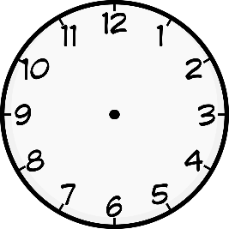
en/an
grand
quand ?
?
enfant
penser
encore
prendre
[to take]
Notes:
Timing: 1 minute [2 slides]
Aim: To consolidate SSC [en/an]
Procedure:
1. Introduce and elicit the pronunciation of the individual SSC [en/an] and then the source word again ‘enfant’ (with gesture, if using). 2. Then present and elicit the pronunciation of the five cluster words.
The cluster words have been chosen for their high-frequency, from a range of word classes, with the SSC (where possible) positioned within a variety of syllables within the words (e.g. initial, 2nd, final etc.). Additionally, we have tried to use words that build cumulatively on previously taught SSCs (see the Phonics Teaching Sequence document) and do not include new SSCs. Where new SSCs are used, they are often consonants which have a similar symbol-sound correspondence in English.
Word frequency (1 is the most frequent word in French): grand [59]; quand [119] penser [116]; prendre[43]; encore [51]; enfant [126]. Source: Londsale, D., & Le Bras, Y. (2009). A Frequency Dictionary of French: Core vocabulary for learners London: Routledge.

Slide 19
ain/in
fin
matin
[end]
vingt
train
main
maintenant
[now]
Notes:
Aim: To consolidate SSC [ain/in]
Procedure:
1. Introduce and elicit the pronunciation of the individual SSC [ain/in] and then the source word again ‘train’ (with gesture, if using). 2. Then present and elicit the pronunciation of the five cluster words.
The cluster words have been chosen for their high-frequency, from a range of word classes, with the SSC (where possible) positioned within a variety of syllables within the words (e.g. initial, 2nd, final etc.). Additionally, we have tried to use words that build cumulatively on previously taught SSCs (see the Phonics Teaching Sequence document) and do not include new SSCs. Where new SSCs are used, they are often consonants which have a similar symbol-sound correspondence in English.
Word frequency (1 is the most frequent word in French): fin [111]; matin [442] vingt[1273]; maintenant [192]; main [418]; train [232]. Source: Londsale, D., & Le Bras, Y. (2009). A Frequency Dictionary of French: Core vocabulary for learners London: Routledge.

Slide 20
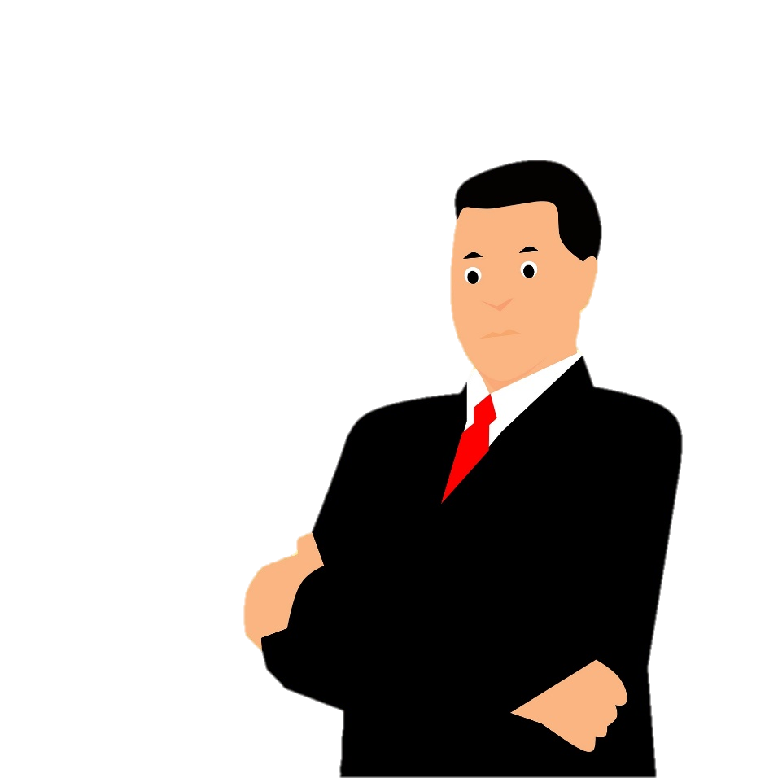
Virelangues
lire / parler
Romain Leblanc se plaint : il y a de grands sapins dans le bain !
(Romain Leblanc is complaining: there are big fir trees in the bath!)
a
b
c
Notes:
Timing: 5 minutes [slide 1/5]
Aim: Oral production of SSCs [en/an] and [ain/in] in senences.
Procedure:
1. Read the tongue twister.
2. Click to hear example pronunciation (a = slow; b = fast; c = very fast).
3. Click to reveal English translations.
4. Repeat on next slides (5 tongue twisters in total).
Transcript:
Romain Leblanc se plaint : il y a de grands sapins dans le bain !
Word frequency of unknown words used (1 is the most frequent word in French): se plaint (se plaindre), sapin, bain, Roumain, soudain, tente (tenter), dent, sain
Word frequency of cognates used (1 is the most frequent word in French):
danser, romancière (romancier), craint (craindre), vendre, dentist, patient
Source: Lonsdale, D., & Le Bras, Y. (2009). A Frequency Dictionary of French: Core vocabulary for learners London: Routledge.

Slide 21
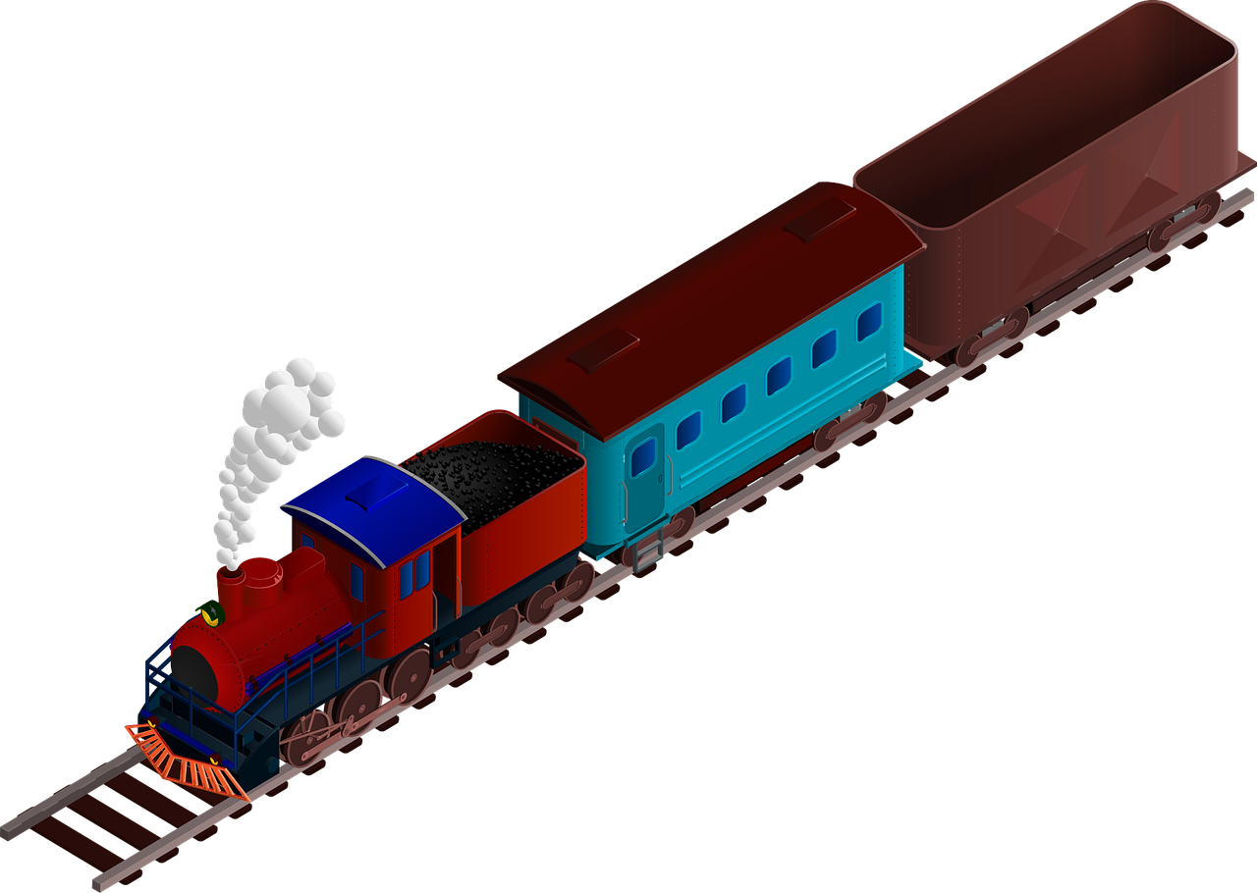
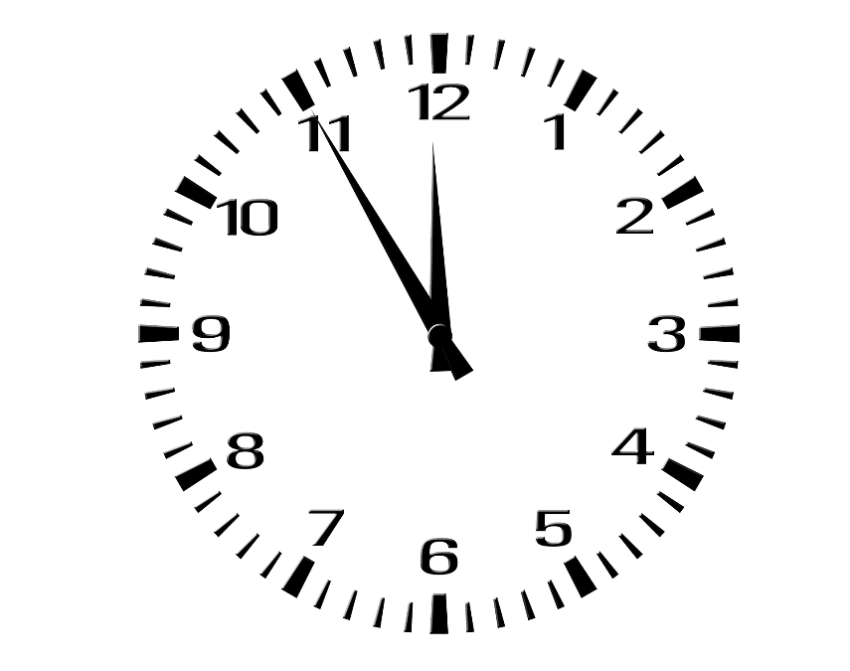
Virelangues
lire / parler
Le prochain train lent pour Romorantin, c’est quand ?
(When is the next slow train to Romorantin?)
a
b
c
Notes:
Slide 2/5
Transcript:
Le prochain train lent pour Romarantin, c’est quand ?

Slide 22
Virelangues
lire / parler
Alain l’Anglais danse lentement maintenant.
(Alain the Englishman dances slowly now.)
a
b
c
Notes:
Slide 3/5
Transcript:
Alain l’Anglais danse lentement maintenant.

Slide 23
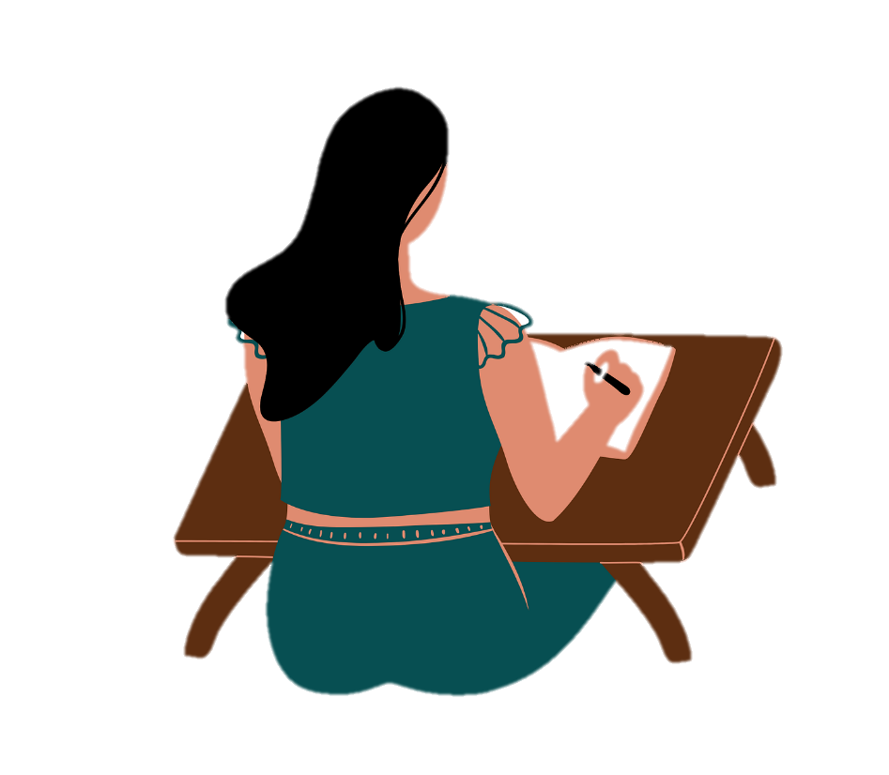
Virelangues
lire / parler
Françoise Sagan, grande romancière française, craint de ne pas vendre de romans aux Roumains.
(The great French novelist Françoise Sagan is scared she won’t sell novels to Romanians.)
a
b
c
Notes:
Slide 4/5
Transcript:
Françoise Sagan, grand romancière française, craint de ne pas vendre de romans aux Roumains.

Slide 24
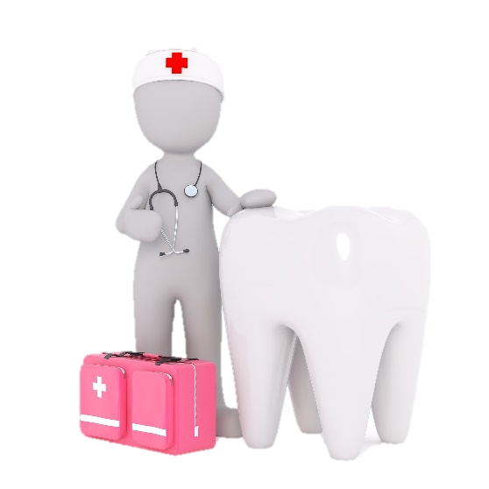
Virelangues
lire / parler
Soudain, demain, dimanche, trente-cinq dentistes tentent de vendre les dents des patients sains !
(Suddenly, tomorrow, on Sunday, thirty-five dentists are trying to sell healthy patients’ teeth!)
a
b
c
Notes:
Slide 5/5
Transcript:
Soudain, demain, dimanche, trente-cinq dentistes tentent de vendre les dents des patients sains !

Slide 25
Avoir ou être ?
grammaire
As you know, avoir means ‘to have, having’
J’ai un chien.
I have a dog.
As you know, we sometimes talk about having things in French that we can’t have in English:
Elle a mal.
She is in pain.
J’ai chaud. Tu as froid.
I am warm. You are cold.
Here are some more examples:
J’ai faim.
I am hungry.
We are thirsty.
Nous avons soif.
Attention!
When we use these expressions there is no article after avoir.
Ils ont raison.
They (m.) are right.
Il a tort.
He is wrong.
Tu as peur.
You are scared.
Notes:
Timing: 5 minutes
Aim: To revise use of avoir mal (part of this week’s revisited vocabulary) and avoir chaud/froid; to extend the use of avoir + noun to talk five other feelings and states.
Procedure:
1. Click to reveal examples and explanations.
2. Ensure understanding.

Slide 26
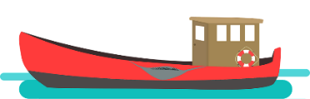
Cause à effet
Remplis les blancs avec tort, faim, soif, peur, chaud, froid, mal, ou raison.
lire
Pourquoi font-ils ça ? Pourquoi non ?
‘Donc’ means ‘so, therefore’. It connects two short, related sentences to make a longer sentence explaining why something happens.
Antoine a __________, donc il porte un manteau.
Nous avons __________, donc nous mangeons.
J’ai __________, donc je veux un verre d’eau.
Ce n’est pas la réponse ! Tu as __________ !
J’ai __________ à la jambe, donc je ne joue pas au foot aujourd’hui.
Elle a __________ de l’eau, donc elle ne voyage pas en bateau.
Il a __________ , donc il mange une glace.
Tu as toujours __________ , donc j’apprends beaucoup quand on parle.
froid
faim
soif
tort
mal
peur
chaud
raison
Notes:
Timing: 8 minutes
Aim: Written recognition of nouns in sentences with avoir to express feelings and states; introducing donc to express the relationship between sentences expressing cause and effect.
Procedure:
1. Students fill in the gaps using the words provided.
2. Click to reveal answers.
3. Oral translation of sentences into English, drawing attention to the use of avoir in French and to be in English.
4. Draw attention to the sentence with donc, highlighting that these could be two separate, shorter sentences. Students read the sentences aloud, first as two shorter sentences, then as a longer sentence with donc.

Slide 27
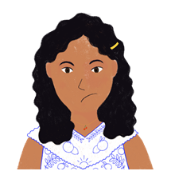
Noura ne va pas à l’école !
lire
Choisis le bon mot.
Noura est malade/mal, donc elle reste à la maison.
Elle a triste/soif, donc elle boit un thé.
Elle a froid/prudente, donc elle porte un chapeau.
Elle n’est pas heureuse/faim, donc elle veut dormir.
How is Noura feeling? Write a summary in English.
Noura is feeling ill, thirsty, cold, and not happy.
Notes:
Timing: 5 minutes
Aim: Written recognition of nouns in sentences with avoir and être to express feelings and states.
Procedure:
1. Students read the sentences and choose between the noun and the adjective to complete the sentence, depending whether it is used with avoir or être.
2. Click to reveal answers.
3. Students write a summary in English of how Noura is feeling.
4. Click to check summary.

Slide 28
Des rêves bizarres (1/2)
écouter
Noura parle quand elle dort ! Écoute et coche le bon mot.
Write a summary in English of how Noura is feeling and what she has.
J’ai un… chien/soif.
J’ai … manteau/faim.
J’ai un… chapeau/tort.
J’ai … livre/froid.
J’ai un… frère/peur.
J’ai une… maison/chaud.
J’ai… chemise/raison.
J’ai un… vélo/mal.
1
1
5
5
2
2
6
6
3
3
7
7
4
8
4
8
Noura is feeling hungry, cold, and that she is right.
Noura has a dog, a hat, a brother, a house, and a bike.
Notes:
Timing: 8 minutes
Aim: Aural recognition of idiomatic expressions with avoir, contrasted with avoir + article + noun.
Procedure:
1. Click on the blue buttons to hear the start of the sentence. Students listen and choose the correct sentence end depending on whether or not they hear an article.
2. Click to reveal answers, and orange buttons with full answer audio attached.
3. Students write lists in English of what Noura has and how she is feeling.
4. Click to reveal answer.
Word frequency of cognates used (1 is the most frequent word in French):
bizarre [2756]
Source: Lonsdale, D., & Le Bras, Y. (2009). A Frequency Dictionary of French: Core vocabulary for learners London: Routledge.
Transcript:
J’ai un [chien].
J’ai [faim].
J’ai un [chapeau].
J’ai [froid].
J’ai un [frère].
J’ai une [maison].
J’ai [raison].
J’ai un [vélo].

Slide 29
Des rêves bizarres (2/2)
écrire
Écris la bonne forme de avoir ou être.
Tu __________ chaud.
Nous __________ heureux.
Mon frère __________ ambitieux.
Vous __________ faim ?
Les filles __________ allemandes.
Nous __________ froid.
Le chien __________ soif.
Les avocats __________ raison.
as
sommes
est
avez
sont
avons
a
ont
Notes:
Timing: 6 minutes
Aim: Written production of forms of avoir and être to complete sentences with nouns about feelings and states.
Procedure:
1. Students write the correct form of avoir or être to complete the sentence.
2. Click to check answers.

Slide 30
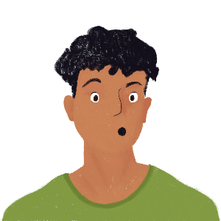
Partenaire A
parler
1. Il est 8h10 et Amir est __________, donc il mange du chocolat. | 2. Il est 9h30 et Amir a __________, donc il boit de l’eau. | 3. Il est 11h15 et Amir est __________ parce qu’il a un cours d’anglais. | 4. Il est midi et Amir est __________. C’est l’heure du déjeuner !
5. Il est __________ et Amir a chaud, parce qu’il y a du soleil. | 6. Il est __________ et il a peur. Il a un examen demain, donc il étudie beaucoup. | 7. Il est __________ et Amir est calme. Il sait tout pour l’examen ! | 8. Il est __________ et Amir a tort. Il n’a pas appris le vocabulaire !
Notes:
Timing: 12 minutes [slide 1/3]
Aim: Oral production of times and expressions with avoir + noun in context.
Procedure:
1. Print rolecards.
2. Partner A reads out sentences 1-4, stopping at the gap.
3. Partner B reads out the rest of each sentence. Partner A listens and fills in the gap.
4. Students swop roles for sentences 5-8.
5. Students look at each other’s rolecards to check answers.

Slide 31
Partenaire B
parler
1. Il est __________ et Amir est triste, donc il mange du chocolat. | 2. Il est __________ et Amir a soif, donc il boit de l’eau. | 3. Il est __________ et Amir est heureux parce qu’il a un cours d’anglais. | 4. Il est _________ et Amir est content. C’est l’heure du déjeuner !
5. Il est 14h30 et Amir a __________, parce qu’il y a du soleil. | 6. Il est 16h30 et il a __________. Il a un examen demain, donc il étudie beaucoup. | 7. Il est 19h20 et Amir est __________. Il sait tout pour l’examen ! | 8. Il est 21h30 et Amir a __________. Il n’a pas appris le vocabulaire !
Notes:
[slide 2/3]

Slide 32
Réponses
parler
1. Il est 8h10 et Amir est triste, donc il mange du chocolat. | 2. Il est 9h30 et Amir a soif, donc il boit de l’eau. | 3. Il est 11h15 et Amir est heureux parce qu’il a un cours d’anglais. | 4. Il est midi et Amir est content. C’est l’heure du déjeuner !
5. Il est 14h30 et Amir a chaud, parce qu’il y a du soleil. | 6. Il est 16h30 et il a peur. Il a un examen demain, donc il étudie beaucoup. | 7. Il est 19h20 et Amir est calme. Il sait tout pour l’examen ! | 8. Il est 21h30 et Amir a tort. Il n’a pas appris le vocabulaire !
Notes:
[slide 3/3]

Slide 33
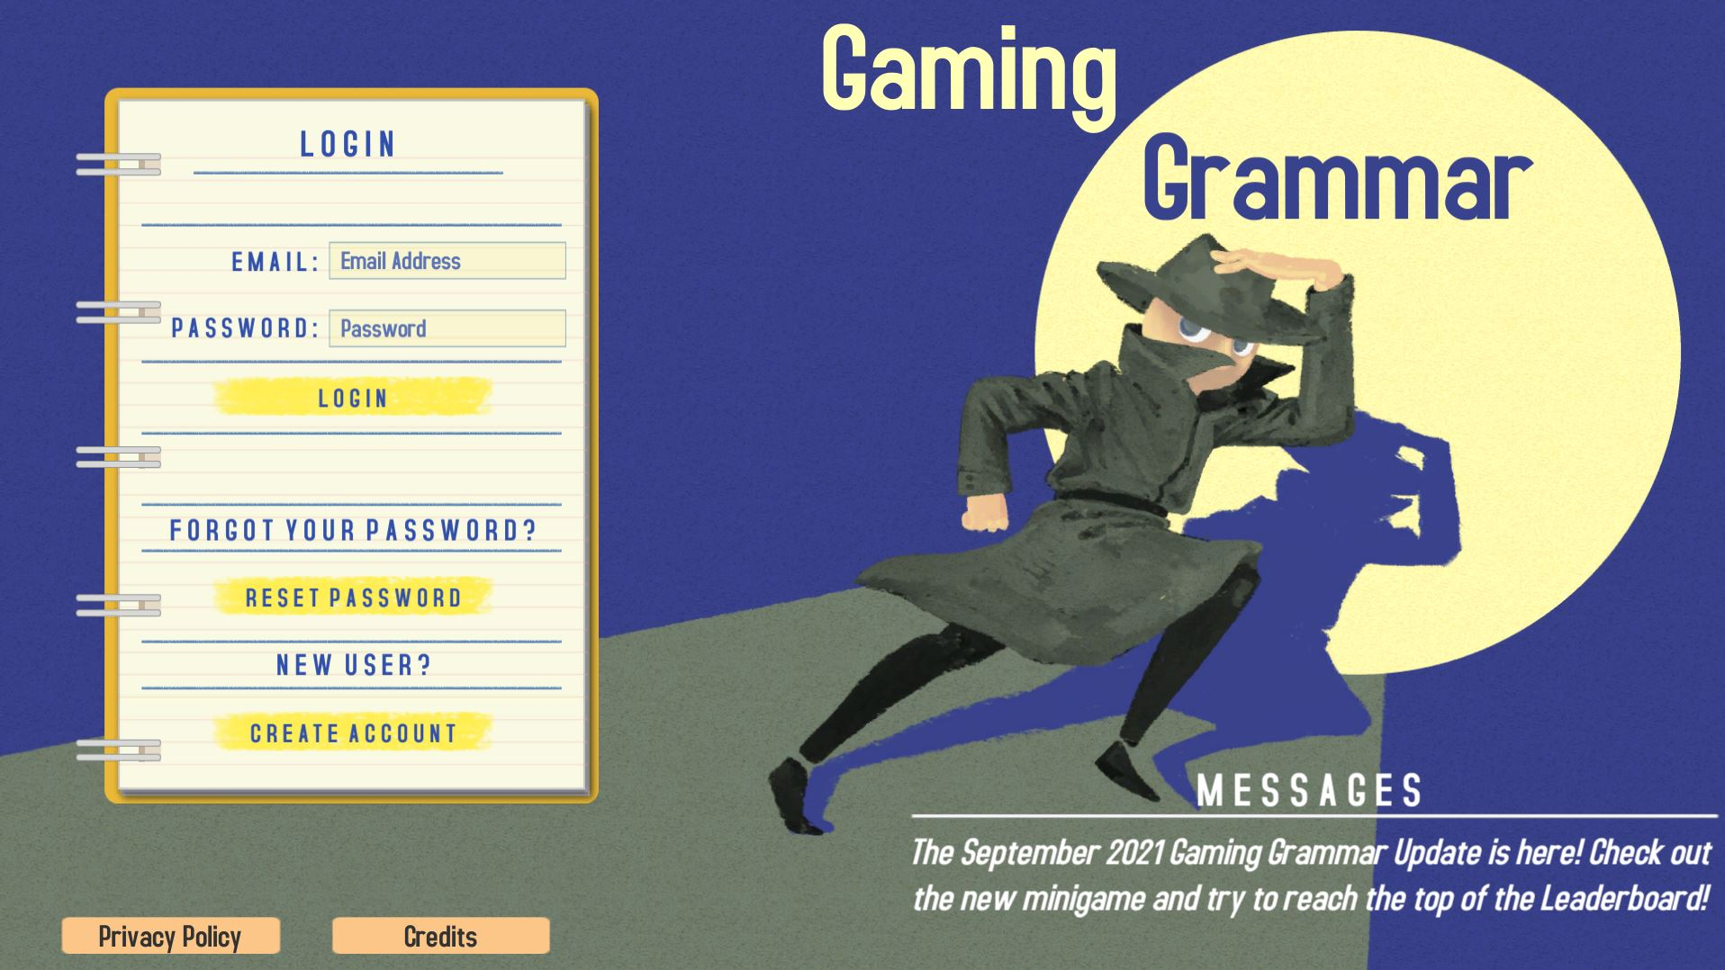
Gaming Grammar
Gaming Grammar
Relevant mini game(s):
Questions: Subject-verb inversion
To have and to be: 1st person and 3rd person singular
Notes:
This slide links to Gaming Grammar login screen. The appropriate mission can then be selected from the menu page.
Students will progress through the game at their own rate; teachers should use the teacher interface to check progress. This will help to inform future lesson planning.

Slide 34
Devoirs
Vocabulary Learning Homework (Y9, Term 1.2, Week 7)
Audio file
Audio file QR code:
Student worksheet
Quizlet link
In addition, revisit: Year 9 Term 1.2 Week 1
Year 8 Term 3.2 Week 6
Notes:
The answer sheet for the 9.1.2.7 vocabulary learning homework is here:
https://resources.ncelp.org/concern/resources/hd76s125x?locale=en

