Slide 1
Asking questions about what people did
-ar, -er and -ir verbs in 1st and 2nd person singular preterite [revisited]
penultimate syllable stress [revisited]
Y8 Spanish
Term 3.2 – Week 1 – Lesson 61
Pete Watson / Mollie Bentley-Smith / Nick Avery Artwork: Mark Davies
Date updated: 30/06/21
Notes:
Artwork by Mark Davies. All additional pictures selected are available under a Creative Commons license, no attribution required.
Learning outcomes (lesson 1):
Consolidation of –ar, –er and –ir verbs in 1st and 2nd person singular (preterite)
Consolidation of penultimate syllable stress
Consolidation of a subset of Y7 vocabulary
Word frequency (1 is the most frequent word in Spanish):
Revisted Y7 Vocabulary subset
norte [624]; sur [661]; España [>5000]; casa [106]; música [340]; teatro [605]; banco [728]; pueblo [244]; río [496]; oeste [2416]; este [>5000]; día [65]; noche [164]; mañana [402]; tarde [392]; número [324]; enero [1173]; marzo [1231]; abril [1064]; julio [659]; agosto [931]; mar [480]; isla [810]; montaña [1464]; estudiar [281]; es [ser, 7]; serio [856]; loco [846]; mucho [41]; feliz [908]; nunca [158]; temprano [1578]; tarde [392]; no [11]; o [29]; algo [110]; ¿cómo? [151]; ¿qué? [50]; ¿quién? [289]; ¿cuándo? [57];¿cuál? [445]; ¿por qué?; ¿dónde? [161]; uno [425]; dos [64]; tres [134]; cuatro [241]; cinco [284]; seis [438]; siete [603]; ocho [641]; nueve [991]; diez [449]; once [1700]; doce [1138]
Source: Davies, M. & Davies, K. (2018). A frequency dictionary of Spanish: Core vocabulary for learners (2nd ed.). Routledge: London
The frequency rankings for words that occur in this PowerPoint which have been previously introduced in NCELP resources are given in the NCELP SOW and in the resources that first introduced and formally re-visited those words.
For any other words that occur incidentally in this PowerPoint, frequency rankings will be provided in the notes field wherever possible.

Slide 2
Vocabulario
hablar
[1/4]
3
Segundos
el sur
el norte
el este
0
INICIO
Notes:
Timing: 2 minutes (for slides 2-5)
Aim: to practise productive (oral) recall of twelve words from this week’s vocabulary revision subset of Y7 vocabulary, within a given time. This is slide 1/4.
Procedure:
1. Students need to say all three words before three seconds elapse.
2. Teachers click to reveal answers.
3. Repeat if additional practice needed.

Slide 3
Vocabulario
hablar
[2/4]
3
Segundos
[sea]
[river]
el oeste
el mar
el río
0
INICIO
Notes:
[2/4]

Slide 4
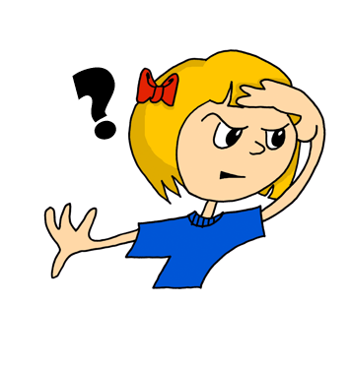
Vocabulario
hablar
[3/4]
3
Segundos
[where?]
[when?]
[who?]
¿dónde?
¿cuándo?
¿quién?
0
INICIO
Notes:
[3/4]

Slide 5
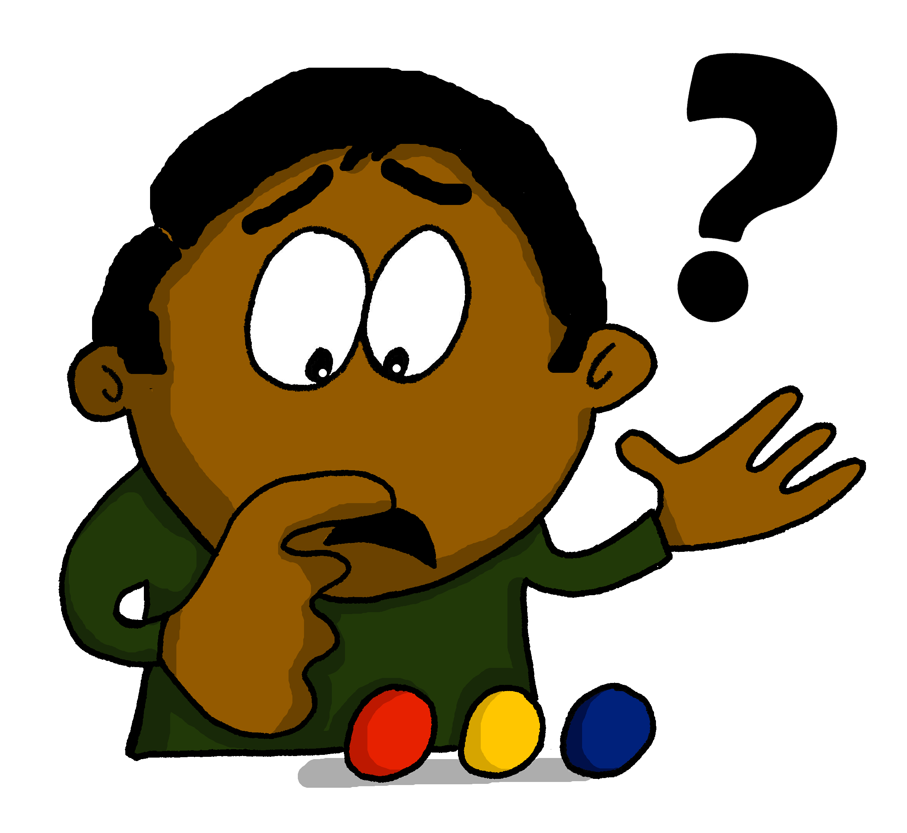
Vocabulario
hablar
[4/4]
3
Segundos
[which?]
[how?]
[what?]
¿cuál?
¿cómo?
¿qué?
0
INICIO
Notes:
[4/4]

Slide 6
escuchar
Escucha y decide. Is the stress on the penultimate syllable or on the final syllable?
 | Penultimate syllable, like ‘playa’ | Final syllable, like ‘igual’ | Meaning in English
1
island
2
theatre
3
coffee
4
bank
5
besides, as well
6
April
7
to study
8
night
Notes:
Timing: 5 minutes
Aim: to practise identifying final-syllable stress and penultimate syllable stress.
Procedure:
Teacher plays the audio for each word.
Students listen to each word and decide if they hear the stress on the penultimate syllable or the final syllable.
Students also write the meaning of the word in English. They may need to hear the words again to do this.
For each question item, the teacher reveals answers for syllable stress position and then the English meaning.
Extension suggestion: to revisit the vocabulary productively, teachers call out a random question number and students have to translate the English into Spanish and answer in choral fashion. For example, the teacher calls out ‘siete’ and students would say ‘estudiar’. Alternatively, this could be a short pairs activity.
Notes: All words in this activity are previously taught. Most are taken from this week’s Y7 revision subset (isla, teatro, banco, abril, estudiar, noche). Words taught are in Year 8 are café (week 8.1.2.5) and además (week 8.1.1.2). Pictures could be removed from the right hand side for a greater challenge.
Transcript:
isla
teatro
café
banco
además
abril
estudiar
noche

Slide 7
Talking about ‘I’ in the past: 1st person singular in the preterite [revisited]
gramática
completed
The preterite tense is used for ____________ actions in the ______.
past
ar
é
To mean ‘I’ with an ‘-ar’ verb in the preterite, remove ____ and add ___.
to study
estudiar
to cry
llorar
Remember! To ask a yes/no question in Spanish, use the same verb with raised intonation:
I studied
estudié
I cried
lloré
er/ir
í
To mean ‘I’ with an –er or –ir verb in the preterite, remove _____ and add ___ .
to offer
ofrecer
to suffer
sufrir
¿Estudié bastante? Did I study enough? ¿Sufrí demasiado? Did I suffer too much?
I offered
ofrecí
I suffered
sufrí
Notes:
Timing: 2 minutes
Aim: to briefly recap 1st person singular endings of -ar, -er and -ir verbs in the preterite.
Procedure:
Teachers click to go through the slide. Animations are left for teachers to elicit answers from the students about formation of the verbs.
Notes:
These verb endings were first introduced in Year 8 Term 1.
‘Bastante’ is used here with the meaning ‘enough’. It may be useful to point this out, since the word was previously introduced with the meaning ‘quite’.

Slide 8
Memorias de un viaje a Gijón. Escucha. ¿Es una afirmación o una pregunta? Escribe la frase en español.
escuchar
 | Afirmación | Pregunta
Frase en español
Gijón
1
¿Viajé a Gijón en julio?
2
Salí por la tarde.
3
¿Monté a caballo?
4
¿Caminé al pueblo para ir al teatro?
5
Canté mucho después del concierto.
6
Volví a la casa.
7
Decidí ir a las montañas.
8
¿Corrí al banco?
Notes:
Timing: 8 minutes
Aim: to practise recognising statement and question intonation using the 1st person singular of the preterite of ‘-ar’, ‘-er’, ’-ir’ verbs; to accurately transcribe the question mark punctuation (¿) and the accents on the verbs.
Procedure:
1. Teachers click on the number buttons to play the recordings. Students need to listen and decide if the sentence is a statement or a question. Students should pay attention, in particular, to whether intonation is rising or falling at the end of the sentence.
2. Students should then listen to the sentences again and transcribe them. Teachers should remind students of the need for correct punctuation (¿) and accents on the final vowel (all verbs have final syllable stress).
3. Answers are shown by clicking. These appear by row (statement vs question, then the transcription). The meaning of each Spanish sentence should be elicited via oral translation into English. This will help to support students’ comprehension of the text on the next slide. Students’ attention can be drawn here to the translation of yes-no questions (Did I…?).
Notes:
These eight sentences are taken from the next reading activity.
Transcript:
¿Viajé a Gijón en julio?
Salí por la tarde.
¿Monté a caballo?
¿Caminé al pueblo para ir al teatro?
Canté mucho después del concierto.
Volví a la casa.
Decidí ir a las montañas.
¿Corrí al banco?

Slide 9
Talking about ‘you’ in the past: 2nd person singular preterite [revisited]
gramática
aste
To mean ‘you’ with an ‘-ar’ verb in the preterite, remove ____ and add _____.
ar
you studied
estudiaste
you cried
lloraste
er/ir
To mean ‘you’ with an ‘–er’ or ‘–ir’ verb in the preterite, remove _____ and add ____.
iste
you offered
ofreciste
you suffered
sufriste
Notes:
Timing: 2 minutes
Aim: to recap 1st and 2nd person singular endings of ‘-ar’, ‘-er’ and ‘-ir’ verbs in the preterite.
Procedure:
Teachers click to go through the slide. Animations are left for teachers to elicit answers from the students about formation of the verbs

Slide 10
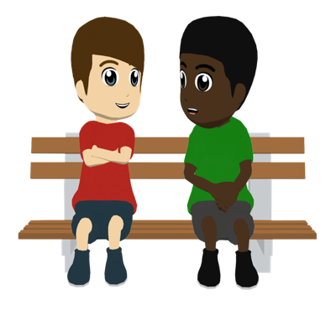
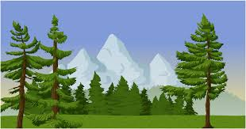
Daniel tiene mala memoria. No sabe qué hizo durante una visita a Gijón. Lee el texto.
Ahora busca todos los ejemplos de verbos en segunda persona (‘you’) en el pretérito.
leer
Daniel: ¿Viajé Gijón en julio, *verdad?
Hugo: Sí, tienes razón. Llegaste el siete de julio, muy temprano, a las cinco de la mañana. Desayunaste en un café después de llegar.
Daniel: ¡Ay, tengo muy mala memoria! *¡Qué vergüenza! Pues, creo que salí por la tarde. ¿Monté a caballo al lado de un río el mismo día?
Hugo: No, montaste a caballo el día después, el ocho de julio. Y luego, caminaste al pueblo para visitar el teatro.
Daniel: ¿Caminé al pueblo para ir al teatro? ¡Parece raro! ¿Por qué?
Hugo: Escuchaste un concierto de música tradicional por la noche.
Daniel: ¡Uy, sí! Siempre me alegra la música española. Canté mucho
después del concierto cuando volví a la casa a las once.
Hugo: *Bueno, intentaste cantar. ¡En realidad hiciste ruido!
Daniel: ¡Ja, ja, ja! Vale. El día después, el nueve, decidí ir a las montañas al oeste del pueblo.
Hugo: Sí, y además jugaste al fútbol también con unos chicos cerca del mar.
Corriste al banco más tarde.
Daniel: ¿Corrí al banco? ¿Por qué? ¿Perdí algo?
Hugo: Perdiste tu bolsa con todo tu dinero. ¡Parece que perdiste tu memoria también!
Want to write ‘haha’?
Use ‘ja, ja, ja’! ☺
*¿verdad? = right?
*¡Qué vergüenza! = How embarrassing!
* bueno = well
Notes:
Timing: 8 minutes
Aim: to understand key information in the text; to raise awareness of 2nd person singular preterite forms of ‘-ar’, ’-er’ and ’-ir’ verbs and their meanings.
Procedure:
1. First, teachers ask students to read the text, telling them that they will be asked some questions afterwards. To ensure understanding of the information in the text, teachers can opt to do one of the following or use another preferred task: i. whole class oral English translation, phrase by phrase ii. Individual summary of the text, with the instruction – Note five activities that were done, note five places that were visited.
iii. Ask direct questions to elicit the key information. Here are some suggestions: 1. Which city in Spain did Daniel visit? 2. When exactly did he arrive? 3. When did Daniel go out horse riding? 4. What did Daniel do in the evening after horse riding? 5. What does Hugo think of Daniel’s singing and how do we know? 6. Where are the mountains? 7. Who did Daniel play football with, and where? 8. Why did Daniel run to the bank?
2. Then, a second instruction appears, prompting students to search the text for all examples of verbs referring to ‘you’ in the preterite. This includes both –ar and –er/-ir verb forms. Students skim the text and try to identify as many as they can.
3. Correct answers appear one by one and are circled. Students can be asked for these in the order of the text. The translation can be elicited after each one is given. It is worth reminding students that ‘hiciste’ is slightly irregular in its stem, but does share the ‘iste’ ending of –er/-ir verbs.
Note: see the following page from the RAE regarding the Spanish equivalent of ‘haha’. https://www.rae.es/duda-linguistica/es-valido-escribir-la-risa-jajaja#:~:text=Lo%20indicado%20es%20escribir%20ja,todos%20los%20elementos%20son%20t%C3%B3nicos.

Slide 11
Saying dates in Spanish
gramática
These are called ‘ordinal numbers’.
To say the date in English, we say, for example, the second of December or the twenty third of June.
These are called ‘cardinal numbers’.
To say the date in Spanish, we use numbers such as uno, dos, tres...
Ejemplos:
el tres de enero
the third of January
(literally, ‘the three of January’)
el seis de abril
the sixth of April
(literally, ‘the six of April’)
The only exception is the first of the month. There are two possibilities:
el primero de enero
‘El primero’ is more common in
Latin America.
’El uno’ is more common in Spain.
the first of January
el uno de enero
Notes:
Timing: 2 minutes
Aim: to teach students how to say dates in Spanish; to raise awareness of cross-linguistic differences between English and Spanish
Procedure:
Teachers click to go through the slide. Gaps are left to allow teachers to elicit answers from students.
Teachers could go back to the previous slide to show the examples of dates used in the text.
Notes:
1. Teachers could also highlight how the English say ‘on the 7th July’, but Spanish doesn’t have a word for ‘on’ in this context.
2. Teachers could draw attention to the fact that months do not have capitals.
3. Months and numbers are part of the vocabulary set to be revisited this week, which coincides with the introduction of this new feature.

Slide 12
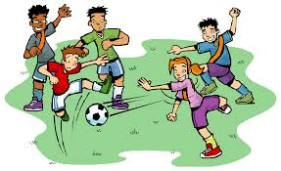
Ahora escucha y lee al mismo tiempo. Después de escuchar cada parte del texto, ¿puedes dar una palabra alternativa?
escuchar y leer
Daniel: ¿Viajé a Gijón en julio, verdad?
Hugo: Sí, tienes razón. Llegaste el siete de julio, muy temprano, a las cinco de la mañana. Desayunaste en un café después de llegar.
Daniel: ¡Ay, tengo muy mala memoria! ¡Qué vergüenza! Pues, creo que salí por la tarde. ¿Monté a caballo al lado de un río el mismo día?
Hugo: No, montaste a caballo el día después, el ocho de julio. Y luego, caminaste al pueblo para visitar el teatro.
Daniel: ¿Caminé al pueblo para ir al teatro? ¡Parece raro! ¿Por qué?
Hugo: Escuchaste un concierto de música tradicional por la noche.
Daniel: ¡Uy, sí! Siempre me alegra la música española. Canté mucho después del concierto cuando volví a la casa a las once.
Hugo: Bueno, intentaste cantar. ¡En realidad hiciste ruido!
Daniel: ¡Ja, ja, ja! Vale. El día después, el nueve, decidí ir a las montañas al oeste del pueblo.
Hugo: Sí, y además jugaste al fútbol también con unos chicos cerca del mar. Corriste al banco más tarde.
Daniel: ¿Corrí al banco? ¿Por qué? ¿Perdí algo?
Hugo: Perdiste tu bolsa con todo tu dinero. ¡Parece que perdiste tu memoria también!
1
4
2
5
3
6
7
Notes:
Timing: 8 minutes
Aim: to help students to connect the spoken and written forms of the language more securely; to consolidate vocabulary and grammar knowledge by eliciting suggested changes to the text.
Procedure:
1. Teachers click on the audio button to play the text. Read and listen.
Note: There is a full version of the audio top right with a player. Alternatively, the audio is in 7 sections with a pause just before the words in bold in the text on the slide below, to facilitate easy stop/start.
2.To support segmentation, stop the audio and ask students to say: a) the next word b) the previous word
3. In addition, to develop understanding, vocabulary and grammar knowledge, pause at the key points and ask students to suggest an alternative word.
The recordings are divided up into 7 parts. The audio stops after each extract below.
1. Daniel: ¿Viajé a Gijón en julio, verdad?
Hugo: Sí, tienes razón. Llegaste el…. (students suggest an alternative day or date)
2. Hugo: el siete de julio, muy temprano, a las cinco de la mañana. Desayunaste en un café después de… (students suggest an infinitive).
3. Hugo: No, montaste a caballo el día después, el ocho de julio. Y luego… (students suggest another verb in 2nd person singular preterite or a change in person and another clause)
4. Daniel: ¡Ja, ja, ja! Vale. El día después, el... (students suggest an alternative day or date)
5. Hugo: Sí, y además … (students suggest an alternative verb in 2nd person singular preterite)
6. ...jugaste al fútbol también con unos chicos españoles cerca del mar. Corriste al… (students suggest a singular masculine noun)
7. Students hear the rest of the text
Note:
One idea for extensión could be to explore how changes to one part of the text affect other parts of it (i.e. beyond the same phrase or sentence). Suggested changes may sound natural in one place, but might not always make sense when reading another section of the text. This is to be expected, and is not an issue; students are likely to be focusing on a single word or phrase in one place at a time. However, students could be asked to consider the effects of word changes beyond the sentence level. For example, they may be replace ‘caminaste’ with another verb (the third change above) and then find that in the sentence below that Daniel says ‘caminé al pueblo’. Students could be asked for the same verb that they previously suggested, but now in the ‘I’ form.
Transcript:
Daniel: ¿Viajé al norte de España en julio, verdad?
Hugo: Sí, tienes razón. Llegaste el siete de julio, muy temprano, a las cinco de la mañana. Desayunaste en un café después de llegar.
Daniel: ¡Qué memoria tan mala tengo! ¡Qué vergüenza! Pues, creo que salí por la tarde. ¿Monté a caballo al lado de un río el mismo día?
Hugo: No, montaste a caballo el día después, el ocho de julio. Y luego, caminaste al pueblo para visitar el teatro.
Daniel: ¿Caminé al pueblo para ir al teatro? ¡Parece raro! ¿Por qué?
Hugo: Escuchaste un concierto de música tradicional por la noche.
Daniel: ¡Uy, sí! Siempre me alegra la música española. Canté mucho después del concierto cuando volví a la casa a las once.
Hugo: Bueno, intentaste cantar. ¡En realidad hiciste ruido!
Daniel: ¡Ja, ja, ja! Vale. El día después, el nueve, decidí ir a las montañas que están al oeste del pueblo.
Hugo: Sí, y además jugaste al fútbol también con unos chicos cerca del mar. Corriste al banco más tarde.
Daniel: ¿Corrí al banco? ¿Por qué? ¿Perdí algo?
Hugo: Perdiste tu bolsa con todo tu dinero. ¡Parece que perdiste tu memoria también!

Slide 13
Asking questions in Spanish Question intonation and verb use
Remember that to ask a question in Spanish, you use the same verb, but with raised intonation. Listen and compare:
1
Olvidé los billetes.
I forgot the tickets.
2
¿Olvidé los billetes?
Did I forget the tickets?
3
Viajaste a un pueblo.
You travelled to a town.
4
¿Viajaste a un pueblo?
Did you travel to a town?
In English we use the verb ‘did’ to ask these questions in the past.
Notes:
Timing: 1 minute
Aim: to remind students of question formation differences between English and Spanish, in particular the use of the auxiliary ‘do’ (which becomes ‘did’ in past), as this is a feature of the next activity.
Procedure: teachers click to go through the slide. Teachers can elicit translations of the Spanish example sentences before revealing them.

Slide 14
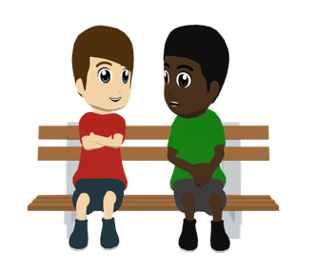
hablar / escuchar
Daniel y Hugo hablan más del viaje a Gijón y preguntan otras cosas.
hablar / escuchar
El estudiante A hace preguntas en el pasado, según la tarjeta (‘Did you...’ o ‘Did I...’).
El estudiante B contesta con la información de la tarjeta.
Say “Sí …” or “No …” depending on what you can see on your card. Try to give a full sentence.
¿Prestaste la cámara a Lucía?
Un ejemplo:
Sí, presté la cámara a Lucía.
Estudiante A (pregunta):
Estudiante B
(contesta):
Ask your partner these questions.
Estudiante B
Is your partner asking ‘Did I…’ or ‘Did you…’ ?
Say if that person did it ( ) or not ( ) :
Tick ( ) if that person did it and cross out ( ) if that person didn’t.
my partner
me
1. Did you lend the camera to Lucía?
[lend the camera to Lucía]
Notes:
Timing: 12 minutes
Aim: to practise 1st and 2nd person singular endings in the preterite with a range of regular verbs (see notes on the pairings of verbs)
Procedure:
Person A uses their prompt cards to ask a question that either starts with ‘did I’ or ‘did you’.
Student B listens and says ‘sí’ or ‘no’, depending on whether the person referenced by their partner did the action. Teachers should encourage full sentences in students’ responses here, as modelled by the example.
Student A then completes their card accordingly, adding a tick or cross after each question.
Students then swap roles.
Notes
In the first interaction (Person A speaking, person B listening), –ar verbs are used, in order to practise the endings –é and –aste. Then, in the second interaction (Person B speaking, Person A listening) –er and –ir verbs are used, in order to practise –í and –iste. This ensures that all verb types are revisited in the activity, but in a controlled way that maintains focus on one pair of endings at a time.
Higher-ability students could even try to respond in the negative using subject pronouns for comparison. E.g. ‘Yo no. Tú prestaste una cámara a Lucía.’ or ‘No, yo no presté la cámara a Lucía. Tú sí‘. However, a shorter response is still ok – students are also having to listen carefully for the right verb form, which is the key for task completion. They will still have the chance to produce full sentences orally when they swap roles.

Slide 15
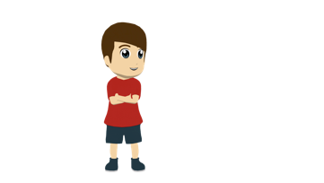
hablar / escuchar
hablar / escuchar
Estudiante A - Daniel
Estudiante A
Is your partner asking ‘Did I…’ or ‘Did you…’ ?
Say if that person did it ( ) or not ( ) :
Ask your partner these questions.
Tick ( ) if that person did it and cross out ( ) if that person didn’t.
1. Did I forget the tickets for the train?
my partner
me
[write a letter to some friends]
2. Did you celebrate a birthday?
[lose the trousers]
3. Did you have breakfast at home?
[return by boat]
4. Did I lend a book to Juan?
[drink something at the party]
5. Did I buy a present?
[get to know a musician (m)]
6. Did you arrive early?
[go up the mountain]
Notes:
DO NOT DISPLAY DURING ACTIVITY
See accompanying Word doc for printable version.
Target answers for Student A during speaking, based on Student B’s questions:
No, no escribiste una carta a unos amigos.
Sí, perdiste los pantalones.
No, no volví en barco.
Sí, bebí algo en la fiesta.
Sí, conociste a un músico.
Sí, subí la montaña.

Slide 16
hablar / escuchar
hablar / escuchar
Estudiante B – Hugo
Ask your partner these questions.
Estudiante B
Is your partner asking ‘Did I…’ or ‘Did you…’ ?
Say if that person did it ( ) or not ( ) :
Tick ( ) if that person did it and cross out ( ) if that person didn’t.
my partner
me
1. Did I write a letter to some friends?
[forget the tickets for the train]
2. Did I lose the trousers?
[celebrate a birthday]
3. Did you return by boat?
[have breakfast at home]
4. Did you drink something at the party?
[lend a book to Juan]
5. Did I get to know a musician (m)?
[buy a present]
6. Did you go up the mountain?
[arrive early]
Notes:
DO NOT DISPLAY DURING ACTIVITY
See accompanying Word doc for printable version.
Target answers for Student B during speaking, based on Student A’s questions:
Sí, olvidaste los billetes para el tren.
No, no celebré un cumpleaños.
Sí, desayuné en casa.
No, no prestaste un libro a Juan.
Sí, compraste un regalo.
No, no llegué temprano.

Slide 17
hablar / escuchar
Respuestas
hablar / escuchar
Estudiante A
Estudiante B
Ask your partner these questions.
Ask your partner these questions.
Tick ( ) if that person did it and cross out ( ) if that person didn’t.
Tick ( ) if that person did it and cross out ( ) if that person didn’t.
1. Did I forget the tickets for the train?
1. Did I write a letter to some friends?
2. Did you celebrate a birthday?
2. Did I lose the trousers?
3. Did you have breakfast at home?
3. Did you return by boat?
4. Did I lend a book to Juan?
4. Did you drink something at the party?
5. Did I buy a present?
5. Did I get to know a musician?
6. Did you arrive early?
6. Did you go up the mountain?
Notes:
DO NOT DISPLAY DURING ACTIVITY

Slide 18
Learning about a famous Spanish-speaking person
regular verbs in 3rd person singular preterite [revisited]
‘ir’ and ‘hacer’ in the preterite [revisited]
Y8 Spanish
Term 3.2 – Week 1 – Lesson 62
Pete Watson / Mollie Bentley-Smith / Nick Avery Artwork: Mark Davies
Date updated: 30/06/21
Notes:
Artwork by Mark Davies. All additional pictures selected are available under a Creative Commons license, no attribution required.
Learning outcomes (lesson 2):
Consolidation of –ar, –er and –ir verbs in 3rd person singular preterite (3rd person singular -ó and –ió endings)
Consolidation of ‘ir’ and ‘hacer’ in 3rd person singular preterite (‘fue’ and ‘hizo’)
Consolidation of penultimate syllable stress and spelling rules
Consolidation of a subset of Y7 vocabulary
Word frequency (1 is the most frequent word in Spanish):
Revisted Y7 Vocabulary subset
norte [624]; sur [661]; España [>5000]; casa [106]; música [340]; teatro [605]; banco [728]; pueblo [244]; río [496]; oeste [2416] ; este [>5000]; día [65]; noche [164]; mañana [402]; tarde [392]; número [324]; enero [1173]; marzo [1231]; abril [1064]; julio [659]; agosto [931]; mar [480]; isla [810]; montaña [1464]; estudiar [281]; ser [7]; soy [ser, 7]; eres [ser, 7]; es [ser, 7]; son [ser, 7]; serio [856]; loco [846]; mucho [41]; feliz [908]; nunca [158]; temprano [1578]; tarde [392]; no [11]; o [29]; algo [110]; ¿cómo? [151]; ¿qué? [50]; ¿quién? [289]; ¿cuándo? [57];¿cuál? [445]; ¿por qué?; ¿dónde? [161]; uno [425]; dos [64]; tres [134]; cuatro [241]; cinco [284]; seis [438]; siete [603]; ocho [641]; nueve [991]; diez [449]; once [1700]; doce [1138
Source: Davies, M. & Davies, K. (2018). A frequency dictionary of Spanish: Core vocabulary for learners (2nd ed.). Routledge: London

Slide 19
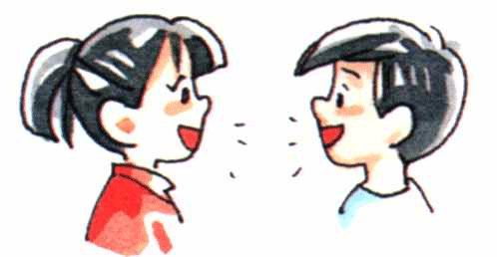
Fonética
hablar / escuchar / escribir
Remember, if the stress is on the second-last syllable and the word ends in a _______ or the consonants ___ or ___, then there will be no accent on the stressed vowel. For any other consonants, an accent is needed.
vowel
‘n’
‘s’
Estudiante A lee cada frase en español.
Estudiante B completa la tabla.
Ejemplo:
Estudiante A habla.
Estudiante B escucha y completa la tabla.
Say these sentences
1. Yo hablo español.
Fill in the gaps. If necessary, include an accent to keep the stress on the penultimate syllable. | Missing words in English
1. Yo __________ español.
hablo
I speak
Notes:
Timing: 6 minutes
Aim: speaking, listening and writing exercise focusing on spelling and the penultimate syllable stress in Spanish.
Procedure:
1. Students A reads out each sentence in Spanish.
2. Student B listens and completes the grid. They must fill in the missing words in Spanish, all of which are stressed on the penultimate syllable, and decide whether they need to add an accent. They should also write the English for known missing words. English translations for unknown words are given.
3. Students swap roles.
4. Teachers can offer feedback using the answer slides.
Note: Half of the missing words are known and half are unknown. Frequency rankings for unknown words are below.
Word frequency (1 is the most frequent word in Spanish):
moderno [861], cáncer [1983], cuidar [751], enfermo [1092], carácter [813], líder [1155], escritor [864], merecer [1216], enorme [631], ángel [1300], dólar [677], inútil [1753]

Slide 20
hablar / escuchar / escribir
Estudiante A
Say these sentences
1. Tú sales por la noche todos los viernes en marzo.
2. Me gusta jugar al fútbol . Es fácil porque soy activo.
3. Pedro conoce a muchos escritores famosos.
4. Mis padres merecen una fiesta loca.
5. Su perro se llama Ángel y es muy débil.
6. Tengo un dólar pero es inútil en Inglaterra.
Fill in the gaps. If necessary, include an accent to keep the stress on the penultimate syllable. | Missing words in English
1. Mi abuela no usa un __________ porque es __________.
2. Tú __________ mucho tiempo en los ____________________.
3. Mis primas __________ ropa __________ en el mercado.
4. El gato ________ sube el __________ porque tiene __________.
5. El padre __________ a su hijo cuando está __________.
6. María, tienes el __________ de una buena __________. Eres ________ .
modern
cancer
personality
leader
Notes:
Student A speaking cards and answer grid
DO NOT DISPLAY DURING ACTIVITY

Slide 21
hablar / escuchar / escribir
Estudiante B
Say these sentences
1. Mi abuela no usa un móvil porque es difícil.
2. Tú pasas mucho tiempo en los Estados Unidos.
3. Mis primas venden ropa moderna en el mercado.
4. El gato nunca sube el árbol porque tiene cáncer.
5. El padre cuida a su hijo cuando está enfermo.
6. María, tienes el carácter de una buena líder. Eres seria.
Fill in the gaps. If necessary, include an accent to keep the stress on the penultimate syllable. | Missing words in English
1. Tú __________ por la __________ todos los viernes en ________.
2. Me gusta jugar al __________ . Es __________ porque soy activo.
3. Pedro __________ a muchos __________ famosos.
4. Mis padres __________ una fiesta __________.
5. Su perro se llama __________ y es muy __________.
6. Tengo un __________ pero es __________ en Inglaterra.
writers
they deserve
loca
Angel
dollar
useless
Notes:
Student B speaking cards and answer grid
DO NOT DISPLAY DURING ACTIVITY

Slide 22
hablar / escuchar / escribir
Solución – Estudiante A
Fill in the gaps. If necessary, include an accent to keep the stress on the penultimate syllable. | Missing words in English
1. Mi abuela no usa un __________ porque es __________.
2. Tú __________ mucho tiempo en los ____________________.
3. Mis primas __________ ropa __________ en el mercado.
4. El gato _______ sube el __________ porque tiene __________.
5. El padre __________ a su hijo cuando está __________.
6. María tienes el __________ de una buena __________. Eres _________.
móvil
mobile (phone)
difícil
difficult
pasas
you spend
Estados Unidos
United States
venden
moderna
they sell
modern
nunca
árbol
never
tree
cáncer
cancer
cuida
takes care of
enfermo
ill, sick
carácter
personality
líder
seria
leader
serious
Notes:
ANSWERS
Notes: Words appear one at a time, first missing words and then English translations.

Slide 23
hablar / escuchar / escribir
Solución – Estudiante B
Fill in the gaps. If necessary, include an accent to keep the stress on the penultimate syllable. | Missing words in English
1. Tú __________ por la __________ todos los viernes en ________.
2. Me gusta jugar al __________ . Es __________ porque soy activo.
3. Pedro __________ a muchos __________ famosos.
4. Mis padres __________ una fiesta __________.
5. Su perro se llama __________ y es muy __________.
6. Tengo un __________ pero es __________ en Inglaterra.
sales
noche
you go out
marzo
night
March
fútbol
fácil
football
easy
conoce
escritores
he knows
writers
they deserve
merecen
loca
crazy
Ángel
Angel
débil
weak
dólar
inútil
dollar
useless
Notes:
ANSWERS
Notes: Words appear one at a time, first missing words and then English translations.

Slide 24
Saying the date [revisited]
gramática
To give the date in Spanish, which do we use?
a) an ordinal number (such as second, third etc.)
b) cardinal numbers (such as two, three, etc.)
Ejemplos:
the sixth of July
el seis de julio
the eleventh of May
el once de mayo
uno
The only exception is the first of the month. In Spanish we can use el _____ or el ________ .
primero
Remember, there is no word in Spanish for ‘on’ a day.
Ejemplos:
His birthday is on the first of August.
Su cumpleaños es el uno / el primero de agosto.
She arrived on the first of June.
Llegó el uno / el primero de junio.
Notes:
Timing: 2 minutes
Aim: to recap how to say the date in Spanish.
Procedure:
Teachers click to go through the slide and examples. Gaps are left for students to provide answers.

Slide 25
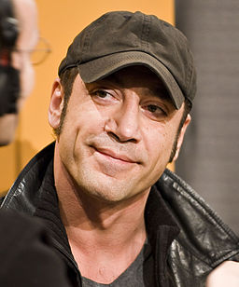
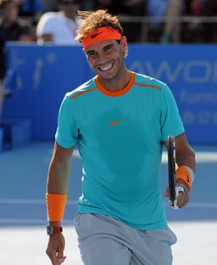
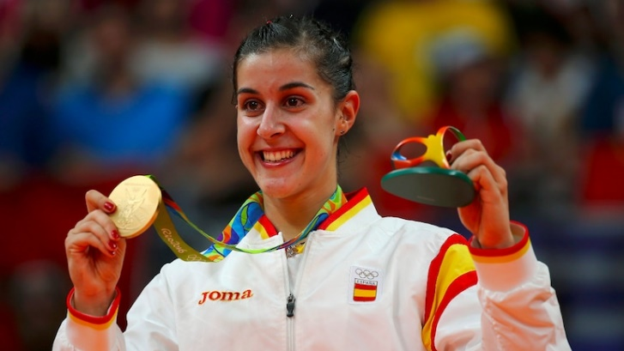
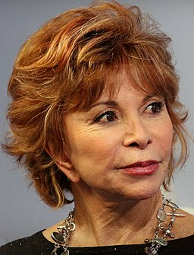
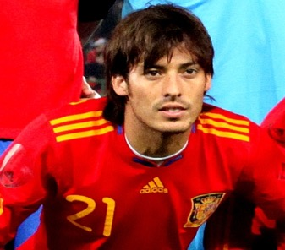
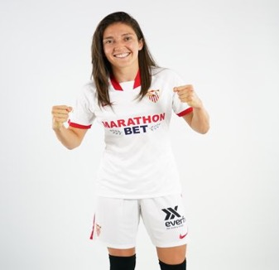
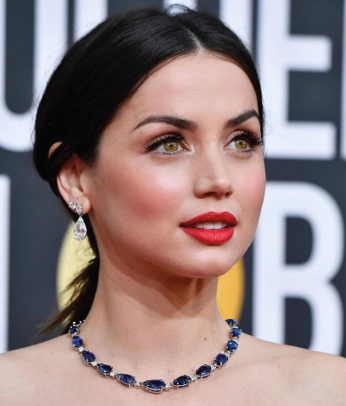
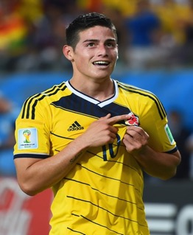
¿Cuándo es el cumpleaños de cada persona famosa? Escucha y escribe la letra correcta.
escuchar
Las opciones
A: 2nd of August
B: 12th of July
C: 3rd of June
D: 30th of April
E: 9th of August
F: 8th of January
G: 3rd of March
H: 15th of June
1
E
2
C
3
H
4
A
5
F
6
G
7
D
8
B
Notes:
Timing: 5 minutes
Aim: to practise aural recognition of dates.
Procedure:
1. Students will need to write the correct letter for each person’s birthday. They can write 1-8 in their exercise books. The potential answers are in English on the right hand side.
2. Teachers click the number buttons to hear the recording.
3. Click again to see the answers.
Idea for extension: Teachers could ask students to listen again and write down the names that they hear. Teachers could then ask, for example, ‘¿Quién es la persona 1?’ after hearing the audio again (or alternatively, ¿Cómo se llama la persona 1?) to see whether students are have noted these down accurately, and are able to reproduce them orally. All the names will appear on the next slide, so this could be used to give feedback on spelling.
Transcript:
El cumpleaños de Javier Bardem es el nueve de agosto.
El cumpleaños de Rafael Nadal es el tres de junio.
El cumpleaños de Carolina Marín es el quince de junio.
El cumpleaños de Isabel Allende es el dos de agosto.
El cumpleaños de David Silva es el ocho de enero.
El cumpleaños de Natalia Gaitán es el tres de marzo.
El cumpleaños de Ana de Armas es el treinta de abril.
El cumpleaños de James Rodríguez es el doce de julio.
Photo of Javier Bardem free from Siebbi from https://commons.wikimedia.org/wiki/File:Javier_Bardem_(Berlin_Film_Festival_2007).jpg. The file is licensed under the Creative Commons Attribution 3.0 Unported license.
Photo of Rafael Nadal free from Tatiana from https://commons.wikimedia.org/wiki/File:Rafael_Nadal_(16207904747).jpg. The file is licensed under the Creative Commons Attribution-Share Alike 2.0 Generic license.
Photo of Isabel Allende from Lesekreis from https://commons.wikimedia.org/wiki/File:Isabel_Allende_Frankfurter_Buchmesse_2015_(cropped).JPG. This file is licensed under the Creative Commons Attribution-Share Alike 4.0 International license
Photo of David Silva from Steindy from https://commons.wikimedia.org/wiki/File:David_Silva_cropped_02.jpg. This file is licensed under the Creative Commons Attribution-Share Alike 3.0 Unported, 2.5 generic, 2.0 Generic and 1.0 Generic license.
Picture of Natalia Gaitán from her Twitter profile pic @NataliaGaitan3
Photo of James Rodríguez from Hasebemakoto from https://commons.wikimedia.org/wiki/File:Jamesrodriguez.jpg. The file is licensed under the Creative Commons Attribution-Share Alike 4.0 International license

Slide 26
¿Quiénes son? ¿De dónde son?
*el/la futbolista – football player (m/f)
leer
*la actriz – actress
Carolina Marín es una jugadora de bádminton española.
Se llama Javier Bardem.
Es un actor español.
Se llama Rafael Nadal.
Es un tenista español.
Isabel Allende es una autora chilena.
David Silva es un futbolista* español.
Natalia Gaitán es una futbolista colombiana.
Ana de Armas es una actriz* cubana.
James Rodríguez es un futbolista colombiano.
Notes:
Timing: 1 minute
Aim: to present some factual information about some of the celebrities mentioned in the previous activity.
Procedure:
Teachers could ask who each person is with ‘¿Quién es? and ¿De dónde es?, in case any students know, before clicking to reveal the short information (left to right, top row then bottom row).
Note: a number of the adjectives of nationality are near-cognates (chilena, colombiano, cubana). The meanings of these words may need to be given to students.
Frequency of unknown words/cognates:
actor [1533]; actriz [3567]; futbolista [4897]; colombiano [1611]; cubano [703]; actriz [3567]; chileno [1887]
Photo of Javier Bardem free from Siebbi from https://commons.wikimedia.org/wiki/File:Javier_Bardem_(Berlin_Film_Festival_2007).jpg. The file is licensed under the Creative Commons Attribution 3.0 Unported license.
Photo of Rafael Nadal free from Tatiana from https://commons.wikimedia.org/wiki/File:Rafael_Nadal_(16207904747).jpg. The file is licensed under the Creative Commons Attribution-Share Alike 2.0 Generic license.
Photo of Sergio García free from Usien from https://commons.wikimedia.org/wiki/File:BMW_Open_Sergio_Garcia_nxjc.jpg. This file is licensed under the Creative Commons Attribution-Share Alike 3.0 Unported, 2.5 Generic, 2.0 Generic and 1.0 Generic license.
Photo of Isabel Allende from Lesekreis from https://commons.wikimedia.org/wiki/File:Isabel_Allende_Frankfurter_Buchmesse_2015_(cropped).JPG. This file is licensed under the Creative Commons Attribution-Share Alike 4.0 International license
Photo of David Silva from Steindy from https://commons.wikimedia.org/wiki/File:David_Silva_cropped_02.jpg. This file is licensed under the Creative Commons Attribution-Share Alike 3.0 Unported, 2.5 generic, 2.0 Generic and 1.0 Generic license.
Picture of Natalia Gaitán from her Twitter profile pic @NataliaGaitan3
Photo of Manu Tenorio from Teodoromix from https://commons.wikimedia.org/wiki/File:Manu_Tenorio_-_Concierto_OT_Sant_Jordi.jpg. This file is licensed under the Creative Commons Attribution-Share Alike 4.0 International license.
Photo of James Rodríguez from Hasebemakoto from https://commons.wikimedia.org/wiki/File:Jamesrodriguez.jpg. The file is licensed under the Creative Commons Attribution-Share Alike 4.0 International license

Slide 27
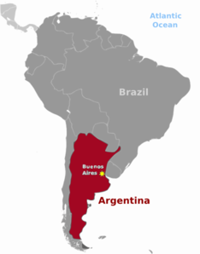
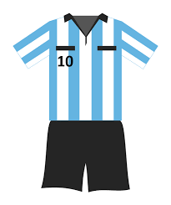
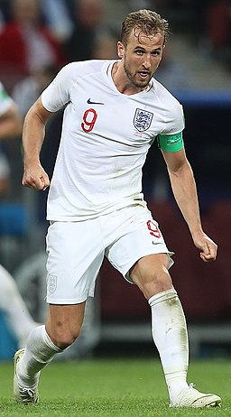
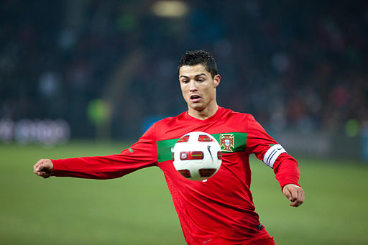
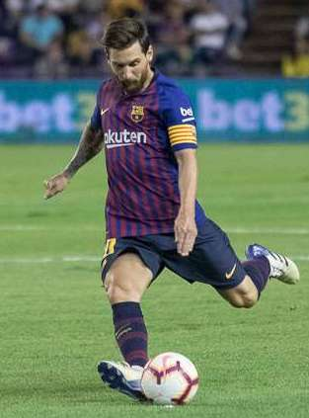
Hoy vamos a leer un texto sobre un hombre muy famoso. ¿Quién es?
leer
Es bastante bajo y es moreno.
Vive en España y habla español, pero no es español.
Es de la ciudad de Rosario en este país (en rojo).
Le encanta el fútbol.
Tiene muchos premios.
Lleva la camiseta* número diez. A veces lleva esta camiseta:
*camiseta = t-shirt
¿Es Harry Kane?
¿Es Cristiano Ronaldo?
¿Es Lionel Messi?
Notes:
Timing: 3 minutes
Aim: to build anticipation about the identity of the person described in the text and to reveal who this person is.
Procedure:
Teachers click to reveal the clues one by one.
Students are not expected to know the answer, but if they do, they should write it down (to avoid saying the correct answer aloud before the options appear!) Then, once all of the prompts have been shown, the teacher can ask for the answer.
Teachers can ask students why it is not Kane or Ronaldo (¿Por qué no es…?). Students could say short sentences about their nationalities (e.g., Kane es inglés, Ronaldo no es de Argentina), what shirt colours / numbers they wear (Normalmente Kane lleva una camiseta blanca; Harry Kane lleva el número nueve, Ronaldo lleva el número siete etc), or other things that contradict the information on the previous slide (Ronaldo es alto, Kane no habla español, Ronaldo no vive en España, etc.)
Frequency of unknown words/cognates:
camiseta [4130]
Harry Kane image Source: https://www.soccer.ru/galery/1057623/photo/736078, author: Антон Зайцев. https://commons.wikimedia.org/wiki/File:Harry_Kane_2018.jpg Permission is granted to copy, distribute and/or modify this document under the terms of the GNU Free Documentation License, Version 1.2 or any later version published by the Free Software Foundation; with no Invariant Sections, no Front-Cover Texts, and no Back-Cover Texts
Cristiano Ronaldo image source: Author Ludovic Péron, https://commons.wikimedia.org/wiki/File:Argentine_-_Portugal_-_Cristiano_Ronaldo.jpg Permission is granted to copy, distribute and/or modify this document under the terms of the GNU Free Documentation License, Version 1.2 or any later version published by the Free Software Foundation; with no Invariant Sections, no Front-Cover Texts, and no Back-Cover Texts.
Lionel Messi image source: www.realvalladolid.es,, https://commons.wikimedia.org/wiki/File:Lionel_Messi_vs_Valladolid_3.jpg, This file is licensed under the Creative Commons Attribution-Share Alike 4.0 International license.

Slide 28
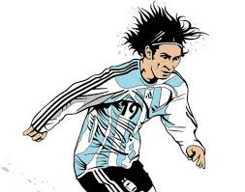
Lee unas frases sobre la vida de Lionel Messi. Debes poner la información en el orden correcto (1 = earliest event; 7 = latest event):
leer
 | Información
A | Hizo su debut para Barcelona a los dieciséis años.
B | A los seis años, empezó a jugar para Newell’s Old Boys.
C | En 2009 *marcó un gol y ganó la copa de la Champions League.
D | Recibió el premio del Balón de Oro en 2010.
E | Lionel *nació en la ciudad de Rosario en Argentina.
F | A los catorce años fue con su familia a España.
G | En 2014 jugó con Argentina en la final de la Copa del Mundo, pero perdió.
*nacer = to be born
*marcar = to score
*mejor = better, best
El Balón de Oro es un premio para el *mejor futbolista cada año.
 | Orden correcto
1
2
3
4
5
6
7
E
B
F
A
C
D
G
Notes:
Timing: 6 minutes
Aim: to correctly order the biographical information about Lionel Messi.
Procedure:
1. Students write 1-7 and will need to sort the facts by chronological order, and write the letters of the answers.
2. There is a call out shown by clicking to explain what the Balón de Oro is (mejor is used here in the superlative context ‘best’, which teachers will need to provide). It is removed by clicking again.
3. When students are finished, teachers click to show the answer table, and then the answers one by one.
4. Teachers can ask students to translate the sentences.
Note: This could be a good moment for teachers to explain how to say years in Spanish. No years before 2000 are included in this text (and subsequent activities) due to the SOW not having taught above 30 yet, but ‘mil’ has been taught, as have numbers 1-30. So 2009, 2010 and 2014 can be explained. In Spanish, you simply say years as cardinal numbers: 2010 → dos mil diez. The small difference from English is the English addition of ‘and’.
Word frequency (1 is the most frequent word in Spanish): ‘nacer’ [426] and ‘marcar’ [994] have not yet been taught, so are provided here as a gloss on the slide.
Other words ‘début’ [>5000], ‘gol’ [2069] and ‘final’ [366] have also not been taught but are cognates or near cognates.

Slide 29
Talking about the past: 3rd person singular in the preterite [revisited]
gramática
With –ar verbs, use the verb ending ____ to mean ‘s/he’ or ‘it’ for a completed past event.
ó
Ejemplo:
to win
ganar
s/he (or it) won
ganó
ió
With –er / –ir verbs, use the verb ending ____ to mean ‘s/he’ or ‘it’ for a completed past event.
Ejemplo:
to grow up
crecer
s/he (or it) grew up
creció
fue
hizo
The verbs ______ (s/he or it went) and _____ (s/he or it made, did) are irregular.
These verbs have a different pattern of endings.
Notes:
Timing: 2 minutes
Aim: to recap 3rd person singular verb endings in the preterite for ‘-ar’, ’-er’ and ‘-ir’verbs
Procedure:
1. Teachers click to go through this recap slide. Gaps are left with the animation for teachers to elicit answers from the students about verb endings.

Slide 30
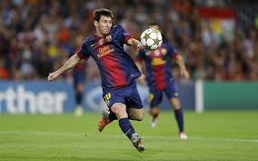
Lee el texto sobre la vida de Messi y completa el texto. Después, escucha. ¿Cuántos verbos regulares ‘-ar’ y ‘-er/ir’ en el pretérito hay en el texto?
leer / escuchar
Lionel Messi nació en la ciudad de Rosario en Argentina. 1)________ en esta ciudad y a los seis años, 2) _________ a jugar para un club local. A los catorce años 3) ____ con su familia a España. Poco después, su madre 4) ______a Argentina con sus hermanos y Lionel vivió con su padre. 5) _______ unos años no muy felices.
Hizo su debut para Barcelona a los dieciséis años y 6) _____ con futbolistas muy conocidos como Ronaldinho. Muy pronto 7) ______ el segundo equipo y después hizo historia con sus goles para el primer equipo. En 2009 8) _____ un gol y ganó la copa de la Champions League. Jugó para Argentina en la Copa del Mundo en 2010 pero Argentina no 9) ______ a la final. Sin embargo, Messi 10) ________ su primer Balón de Oro, un premio para el mejor futbolista. En 2014 participó con Argentina en la final de la Copa del Mundo pero
11) _______ contra *Alemania 1-0. 12) _______ con Argentina otra vez para jugar en la Copa del Mundo en 2018 aunque sin mucho éxito. Messi siempre da alegría a muchas personas con sus goles hermosos.
Creció
Verbos en pasado
jugó perdió volvió fue marcó recibió | viajó pasó llegó empezó creció dejó
empezó
fue
volvió
Pasó
jugó
dejó
marcó
llegó
recibió
AR | ER / IR
perdió
Viajó
*Alemania = Germany
Notes:
Timing: 12 minutes
Aim: to learn more about the life of Lionel Messi; to practise recognition and spelling of 3rd person singular ‘-ar’, ’-er’ and ’-ir’ verbs. Two known irregular verbs, ‘fue’ and ‘hizo’ are also included in the text.
Procedure:
Students look at the list of verbs in past tense on the right hand side and try to fit them in the most appropriate space, depending on the meaning and the context.
To check their answers, students listen to the recording, which the teacher plays by clicking on the play button in the top right. The recording can be paused if necessary to give students time to write down their answers.
Then students should look through the texts and their answers and tally how many 3rd person regular verbs there are for ‘-ar’ and ‘er/’ir’, respectively. ‘Fue’ and ‘hizo’ should not be counted. The text can be listened to again if needed.
Teachers reveal the missing verbs first by clicking. Then the answers are shown to the tally exercise. Teachers can ask students to say which the ‘-ar’ verbs and ‘-er/-ir’ verbs are. Teachers click to show the ‘-ar’ verbs first (one by one), and then to show the ‘er/ir’ verbs.
Teachers can go through this text with students as an L2->L1 oral translation exercise as well, either by translating with the class or potentially asking some questions of the class to demonstrate comprehension. Questions could include: i) Where did Messi grow up? ii) Who did Messi live with in Spain? iii) Why is Ronaldinho mentioned? iv) What happened in 2010? v) Why does Messi make people happy?
Notes
As mentioned on the previous slide, students may need some help with years in Spanish. As ‘mil’ has been taught, years such as ‘dos mil nueve’ (2009) should be understandable in the context.
There are several cognates or near cognates in the text, which appeared on the previous slide. In addition ‘Alemania’ [>5000] is a new word but as ‘alemán’ has been taught, students may be able to work this out.
Frequency of unknown words/cognates (1 is the most frequent word in Spanish): Alemania [>5000]; final [366]; debut [>5000]
Transcript:
Lionel Messi nació en la ciudad de Rosario en Argentina. Creció en esta ciudad y a los seis años, empezó a jugar para un club local. A los catorce años fue con su familia a España. Poco después, su madre volvió a Argentina con sus hermanos y Lionel vivió con su padre. Pasó unos años no muy felices.
Hizo su debut para Barcelona a los dieciséis años y jugó con futbolistas muy conocidos como Ronaldinho. Muy pronto dejó el segundo equipo y después hizo historia con sus goles para el primer equipo. En 2009 marcó un gol y ganó la copa de la Champions League. Jugó para Argentina en la Copa del Mundo en 2010 pero Argentina no llegó a la final. Sin embargo, Messi recibió su primer Balón de Oro, un premio para el mejor futbolista. En 2014 participó con Argentina en la final de la Copa del Mundo pero perdió contra Alemania 1-0. Viajó con Argentina otra vez para jugar en la Copa del Mundo en 2018 aunque sin mucho éxito. Todavía hoy Messi da mucha alegría a muchas personas con sus goles hermosos.

Slide 31
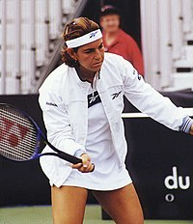
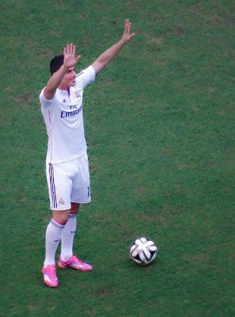
Escribe una biografía de una persona famosa de España o de otro país donde hablan español. Debes utilizar verbos que terminan en ‘-ó’, ‘-ió’, ‘hizo’ y ‘fue’.
escribir
Puede ser un futbolista o un/a jugador/a de otro deporte, un/a músico/a, un/a autor/a etc.
Algunas ideas de España: Rafael Nadal, Penelope Cruz, Antonio Banderas, Pablo Picasso, Arantxa Sánchez Vicario, Cesc Fábregas.
De América Latina: Shakira, Sergio Agüero, Frida Kahlo, James Rodríguez, Isabel Allende, Christiane Endler.
Puedes usar estos verbos:
-ar: viajar, visitar, participar, jugar, organizar, ganar, aprovechar, estudiar, celebrar, pintar, cantar, empezar, terminar, publicar.
-er/ir: nacer, crecer, perder, volver, conocer, romper, vivir, recibir, escribir, decidir, descubrir.
Otras frases que puedes utilizar:
a los [15] años
luego
dos años más tarde
el año después
en [agosto] de 2001
después
cuatro años después
en el mismo año
Notes:
Creative writing exercise
Timing: 12 minutes
Aim: creative writing activity to practise using 3rd person singular verbs and encourage some research into famous Spanish-speaking people.
Procedure:
1. Teachers can set up the creative writing activity by going through this slide. Teachers can either ask students to select from the names on this slide or encourage students to find other famous Spanish-speaking people to write about.
2. It is worth going through the suggested verbs and time phrases provided on this slide and suggesting students model their writing by using verbs from this list, as well as ‘fue’ and ‘hizo’. This will avoid the chance of students using verbs with irregular preterite endings.
Photo of Frida by @jpdc from https://unsplash.com/photos/wPO-BKq96sc
Photo of James Rodríguez from https://pixabay.com/es/photos/james-rodr%C3%ADguez-futbolista-399817/
Photo of Arantxa Sánchez Vicario from https://es.wikipedia.org/wiki/Arantxa_S%C3%A1nchez_Vicario

Slide 32
Hablamos sobre Lionel Messi en parejas.
leer / escuchar
El estudiante A: traduce la frase al español.
El estudiante B: escucha y elige la opción correcta para completar la frase.
Luego, escribe la frase en inglés.
Ejemplo:
“Lionel Messi nació…”
Estudiante A
Estudiante B
1 | [Lionel Messi was born]…
 | en una ciudad en Argentina
Lionel Messi was born in a city in Argentina.
Notes:
OPTIONAL
Aim: to correctly match the sentence halves, working in pairs; to then accurately translate the sentences into English. This task involves producing 3rd person singular verbs in the preterite
Procedure:
Students A and B are given their prompt cards.
The first time round, Student A reads the start of the sentence to translate. On both cards there are 4 sentences needing a preterite, and one needing a present tense verb. Student B listens and searches for and then says the correct sentence ending form the five options
The students then work together to translate the sentence into English.
Students repeat for the rest of items 1-5, then swap roles. This time, Student B will repeat the sentence starter and Student A will listen and complete it.
The answers are shown on the following slides.

Slide 33
cards
Estudiante A
Estudiante A respuestas
1. [He is]…
el Balón de Oro en 2010.
2. [He grew up]…
a jugar a fútbol para un club local.
3. [His mother did not live]…
con futbolistas muy conocidos en su debut.
4. [He made]…
momentos felices a mucha gente.
5. [He lost]…
ir a España.
Estudiante B
Estudiante B respuestas
6. [His family decided]…
en la final de la Copa del Mundo en 2014.
7. [He started]…
un futbolista muy famoso de Argentina.
8. [He played]…
historia para el primer equipo de Barcelona.
9. [He received]…
con la familia en España.
10. [He gives]…
en Rosario, una ciudad en Argentina.
Notes:
DO NOT DISPLAY DURING ACTIVITY
Read aloud cards

Slide 34
Solución
[1/2]
1. Es un futbolista muy famoso de Argentina.
He is a famous footballer from Argentina.
2. Creció en Rosario, una ciudad argentina.
He grew up in Rosario, an Argentinian city .
3. Su madre no vivió con la familia en España.
His mother did not live with the family in Spain.
4.Hizo historia para el primer equipo de Barcelona.
He made history for the Barcelona first team.
5. Perdió en la final de la Copa del Mundo en 2014.
He lost in the World Cup final in 2014.
Notes:
The next two slides can be used to give feedback on students answers.
The correct Spanish sentence appears first, and then the English translation.

Slide 35
Solución
[2/2]
6. Su familia decidió ir a España.
His family decided to go to Spain.
7. Empezó a jugar a fútbol para un club local.
He started to play football for a local club.
8. Jugó con futbolistas muy conocidos en su debut.
He played with very well-known footballers on his debut.
9. Recibió el Balón de Oro en 2010.
He received the Golden Ball (Balón de Oro) in 2010.
10. Da momentos felices a mucha gente.
He gives happy moments to many people.

Slide 36
Gaming Grammar
Gaming Grammar
Gaming Grammar mini-game Verbs: 1st and 3rd person past tense in the ‘Verb agreement (past)’ menu practices aspects of this week’s lessons.
Notes:
This slide links to Gaming Grammar login screen. The appropriate mission can then be selected from the menu page.
Students will progress through the game at their own rate; teachers should use the teacher interface to check progress. This will help to inform future lesson planning.

Slide 37
Deberes
Vocabulary Learning Homework (Y8, Term 3.2, Week 2)
Audio file
Audio file QR code:
Student worksheet
Quizlet link: Term 3.2 Week 2 Y7 Vocabulary Mashup 6

