Slide 1
Tell me more: describing in more detail
Adjective endings with definite and indefinite articles (R3) dative
SSC [f] and [v]
Y8 German
Term 3.1- Week 6 - Lesson 59
Author name(s): Stephen Owen / Rachel Hawkes
Artwork: Steve Clarke
Date updated: 21/7/21
Notes:
Artwork by Steve Clarke. All additional pictures selected are available under a Creative Commons license, no attribution required.
Native speaker teacher feedback provided by Stephanie Cross.
Learning outcomes (lesson 1):
Consolidation of SSC [v] and [f]
Introduction of adjective endings with indefinite articles (R3) dative
Consolidation of adjective endings with indefinite articles (R1/R2) and definite articles (R1/R2/R3)
Word frequency (1 is the most frequent word in German):
8.3.1.6 (introduce) Baum [1013] Feld [834] Gebäude [1316] Teil [198] Universität [415] bekannt [319] aus¹ [37] hinter [269] neben [266] vor² [50]
8.3.1.3 (revisit) sollen [60] ich soll du sollst er/sie/es soll kosten [903] lachen [444] teilen [906] verstecken [1575] versuchen [247] Fehler [861] Gefühl [462] Glas [885] Kosten [564] Stunde² [262] etwa [181]
8.2.2.1 (revisit) alles [36] alle [36] Rock [3551] Kleid [1780] alt [138] arm [1475] einfach [131] eng [59] genau [167] hell [1411] jung [199] kurz [176] reich [1568]
Source: Jones, R.L & Tschirner, E. (2019). A frequency dictionary of German: Core vocabulary for learners. London: Routledge.
The frequency rankings for words that occur in this PowerPoint which have been previously introduced in NCELP resources are given in the NCELP SOW and in the resources that first introduced and formally re-visited those words.
For any other words that occur incidentally in this PowerPoint, frequency rankings will be provided in the notes field wherever possible.

Slide 2
v
vor
Notes:
Timing: 1 minute
Aim: To introduce/consolidate SSC [v]
Procedure: 1. Present the letter(s) and say the [v] sound first, on its own. Students repeat it with you. 2. Bring up the word ”vor” on its own, say it, students repeat it, so that they have the opportunity to focus all of their attention on the connection between the written word and its sound.
3. A possible gesture for this would be to hold your hands, left in front of right, in front of your body, palms facing inward. Quickly move the right hand over the top of the left, as you say ‘vor’, to mime ‘in front’.
4. Roll back the animations and work through 1-3 again, but this time, dropping your voice completely to listen carefully to the students saying the [v] sound, pronouncing ”vor” and, if using, doing the gesture. Word frequency (1 is the most frequent word in German): vor [55] Source: Jones, R.L. & Tschirner, E. (2006). A frequency dictionary of German: core vocabulary for learners. Routledge

Slide 3
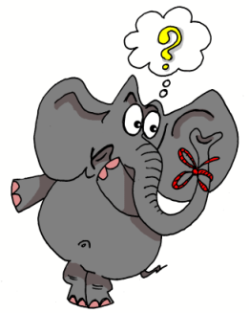
v
positiv
voll
vor
bevor
Vater
vergessen
Notes:
Timing: 2 minutes
Aim: To introduce/consolidate SSC [v]
Procedure:
Introduce and elicit the pronunciation of the individual SSC [v] and then the source word again ‘vor’ (with gesture, if using).
Then present and elicit the pronunciation of the five cluster words.
The cluster words have been chosen for their high-frequency, from a range of word classes, with the SSC (where possible) positioned within a variety of syllables within the words (e.g. initial, 2nd, final etc.). Additionally, we have tried to use words that build cumulatively on previously taught SSCs (see the Phonics Teaching Sequence document) and do not include new SSCs. Where new SSCs are used, they are often consonants which have a similar symbol-sound correspondence in English.
Word frequency (1 is the most frequent word in German): vor [55]; positiv [690] voll [357]; bevor[541]; vergessen [595]; Vater [216]. Source: Jones, R.L. & Tschirner, E. (2006). A frequency dictionary of German: core vocabulary for learners. Routledge

Slide 4
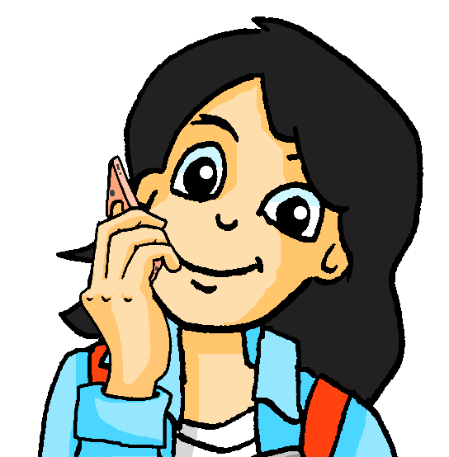
Phonetik / Vokabeln
lesen / sprechen / hören
Mia hilft Andrea mit den Hausaufgaben. Andrea hört Mia zu. Welches Wort hat die SSC [v]?
Vierzehn beginnt mit [v], nicht wahr?
Und wie sagt man den Satz auf Englisch, Mia?
Beispiel: FranzifängtvierzehnFischeamFreitag.
Ja, richtig!
Franzi catches fourteen fish on Friday?
Notes:
Timing: 7 minutes (including answers)
Aim: to practise reading aloud familiar words in novel combinations to practise decoding at sentence level, and to differentiate words that start with the SSC [v] by drawing on previous vocabulary knowledge (as the SSC [f] is the same). This activity includes 13 of the words from this week’s vocabulary sets.
Procedure: 1. Model the task, using the example on this slide.
2. Then student B turns away from the board. 2. Student A reads the first sentence aloud. 3. Student B listens and identifies any words that start with the SSC [v]. There is usually just one, though number 3 has two. S/he writes the word down. 4. Student A continues with sentences 2-4. 5. The students swap roles for sentences 5-8. 6. Then the teacher elicits the answers from students, including an oral translation of each sentence into English, and prompts them to re-read the German sentences as quickly as possible.

Slide 5
Partner(in) A
lesen / sprechen / hören
1. FelixfindetvieleeinfacheFehlerimText. 2. DasFeldhatvierzigfantastischeBäume. 3. IhrVaterversuchtFranzösischzulernen. 4. WirsollenunsereGefühleversteckenundnichtlachen.
Notes:
DO NOT CLICK TO BRING UP THE TEXT UNTIL STUDENT B HAS TURNED AWAY FROM THE BOARD

Slide 6
Partner(in) B
lesen / sprechen / hören
1. DievierFreundefindenihreFahrräderhinterdemGebäude. 2. ElefantenvergessennieihreFamilie. 3. FrankfurthateineBevölkerungvonetwasiebenhundert
fünzigtausendPersonen. 4. VielleichtfindestdueinpaarFotosvomHausfürmich?
Notes:
DO NOT CLICK TO BRING UP THE TEXT UNTIL STUDENT A HAS TURNED AWAY FROM THE BOARD

Slide 7
Phonetik / Vokabeln
lesen / sprechen / hören
1. FelixfindetvieleeinfacheFehlerimText.
1
Felix is finding a lot of simple mistakes in the text.
Notes:
Answers

Slide 8
Phonetik / Vokabeln
lesen / sprechen / hören
2. DasFeldhatvierzigfantastischeBäume.
2
The field has forty fantastic trees.
Notes:
Answers

Slide 9
Phonetik / Vokabeln
lesen / sprechen / hören
3. IhrVaterversuchtFranzösischzulernen.
3
Her/their father is trying to learn French.
Notes:
Answers

Slide 10
Phonetik / Vokabeln
lesen / sprechen / hören
4. WirsollenunsereGefühleversteckenundnichtlachen.
4
We should hide our feelings and not laugh.
Notes:
Answers

Slide 11
Phonetik / Vokabeln
lesen / sprechen / hören
5. DievierFreundefindenihreFahrräderhinterdemGebäude.
5
The four friends find their bikes behind the building.
Notes:
Answers

Slide 12
Phonetik / Vokabeln
lesen / sprechen / hören
6. ElefantenvergessennieihreFamilie.
6
Elephants never forget their family.
Notes:
Answers

Slide 13
Phonetik / Vokabeln
lesen / sprechen / hören
7. FrankfurthateineBevölkerungvonetwasiebenhundert
fünzigtausendPersonen.
7
Frankfurt has a population of about seven hundred and fifty thousand people.
Notes:
Answers

Slide 14
Phonetik / Vokabeln
lesen / sprechen / hören
8. VielleichtfindestdueinpaarFotosvomHausfürmich?
8
Perhaps you’ll find a few photos of the house for me?
Notes:
Answers

Slide 15
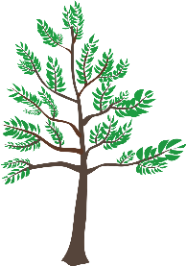
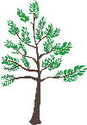
Adjektivendungen – R1 und R2
Grammatik
As you know, adjectives add endings when they come in front of a noun.
After sein, use R1 endings because the noun is the subject of the sentence:
R1:
Links ist…
ein junger Baum
eine kurze Hose
_
_
ein volles Glas
_
Only the masculine ending is different in R2!
R2:
Es gibt…
einen jungen Baum
eine kurze Hose
ein volles Glas
_
_
_
After most other verbs use R2 endings because the noun is the object of the sentence:
In R1 and R2 the plural ending is always –en after an article. Without an article, it is –e.
R1/R2 plural:
keine jungen Bäume
junge Bäume
_
_
Notes:
Timing: 2 minutes Aim: To recap prenominal adjective agreement in R1(nominative) and R2 (accusative) with indefinite articles. Procedure: 1. Click and present the knowledge in small steps as per animation.
2. Elicit the key understanding that after the verb sein R1 endings are needed, and after most other verbs R2 endings are needed. Note: R1 is also used after werden and heißen but this knowledge will be taught later.

Slide 16
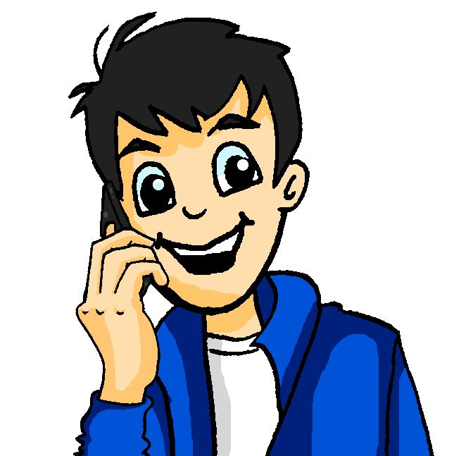
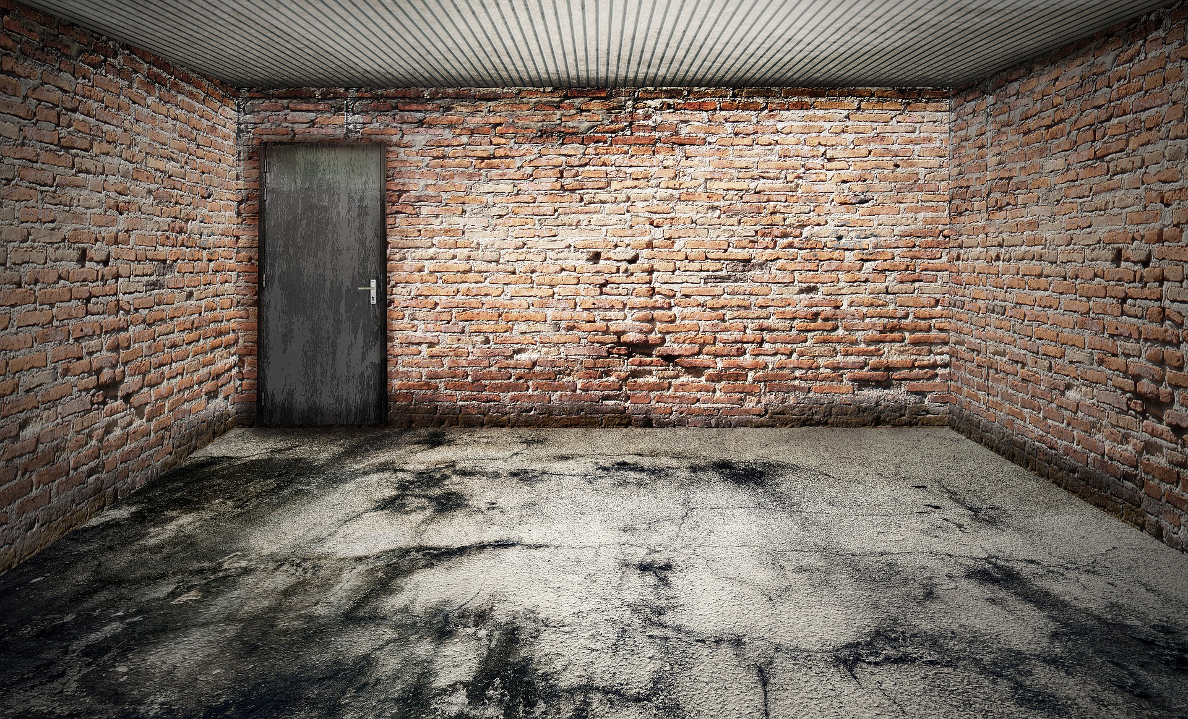
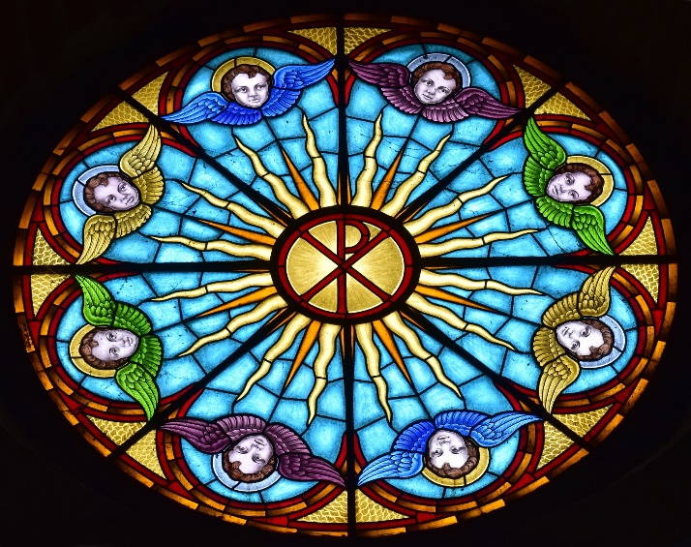
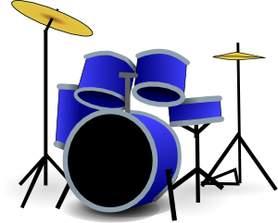
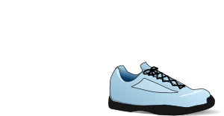
In der Garage
hören
Wolfgang telefoniert mit Mehmet über die neue
Garage. Hör zu. Is he saying what there is (es gibt) or where it is (ist)?
bunt - colourful
 |  | Adjective | Object
 | ist | brown | hat
 | es gibt | old | computer
 | es gibt | small | table
 | ist | bright | skirt
 | ist/es gibt | modern | drum kit
 | es gibt | white | shoe
 | ist/es gibt | colourful | window
 | es gibt | small | teddy
1
2
3
4
5
6
7
8
Notes:
Timing: 5 minutes Aim: To practise distinguishing between sentences including prepositions saying where things are and those saying merely what there is (listening). Procedure: 1. Click on the numbered audio buttons to play the sentences.
2. Students fill in the grid (or simply note three things per line), indicating ‘ist’ or ‘es gibt’ in the first column, then the details as specified in English.
3. Click to reveal the answers item by item.
Transcript:
1. [Links ist] ein brauner Hut.
2. [Es gibt] einen alten Computer. 3. [Es gibt] einen kleinen Tisch. 4. [Auf dem Boden ist] ein heller Rock. 5. [Rechts ist] ein modernes Schlagzeug. 6. [Es gibt] einen weißen Schuh. 7. [An der Wand ist] ein buntes Glasfenster. 8. [Es gibt] einen kleinen Teddy. Word frequency (1 is the most frequent word in German): Teddy [>5000], Computer [1252] braun [2320] bunt [1817] Source: Jones, R.L. & Tschirner, E. (2019). A frequency dictionary of German: core vocabulary for learners. Routledge

Slide 17
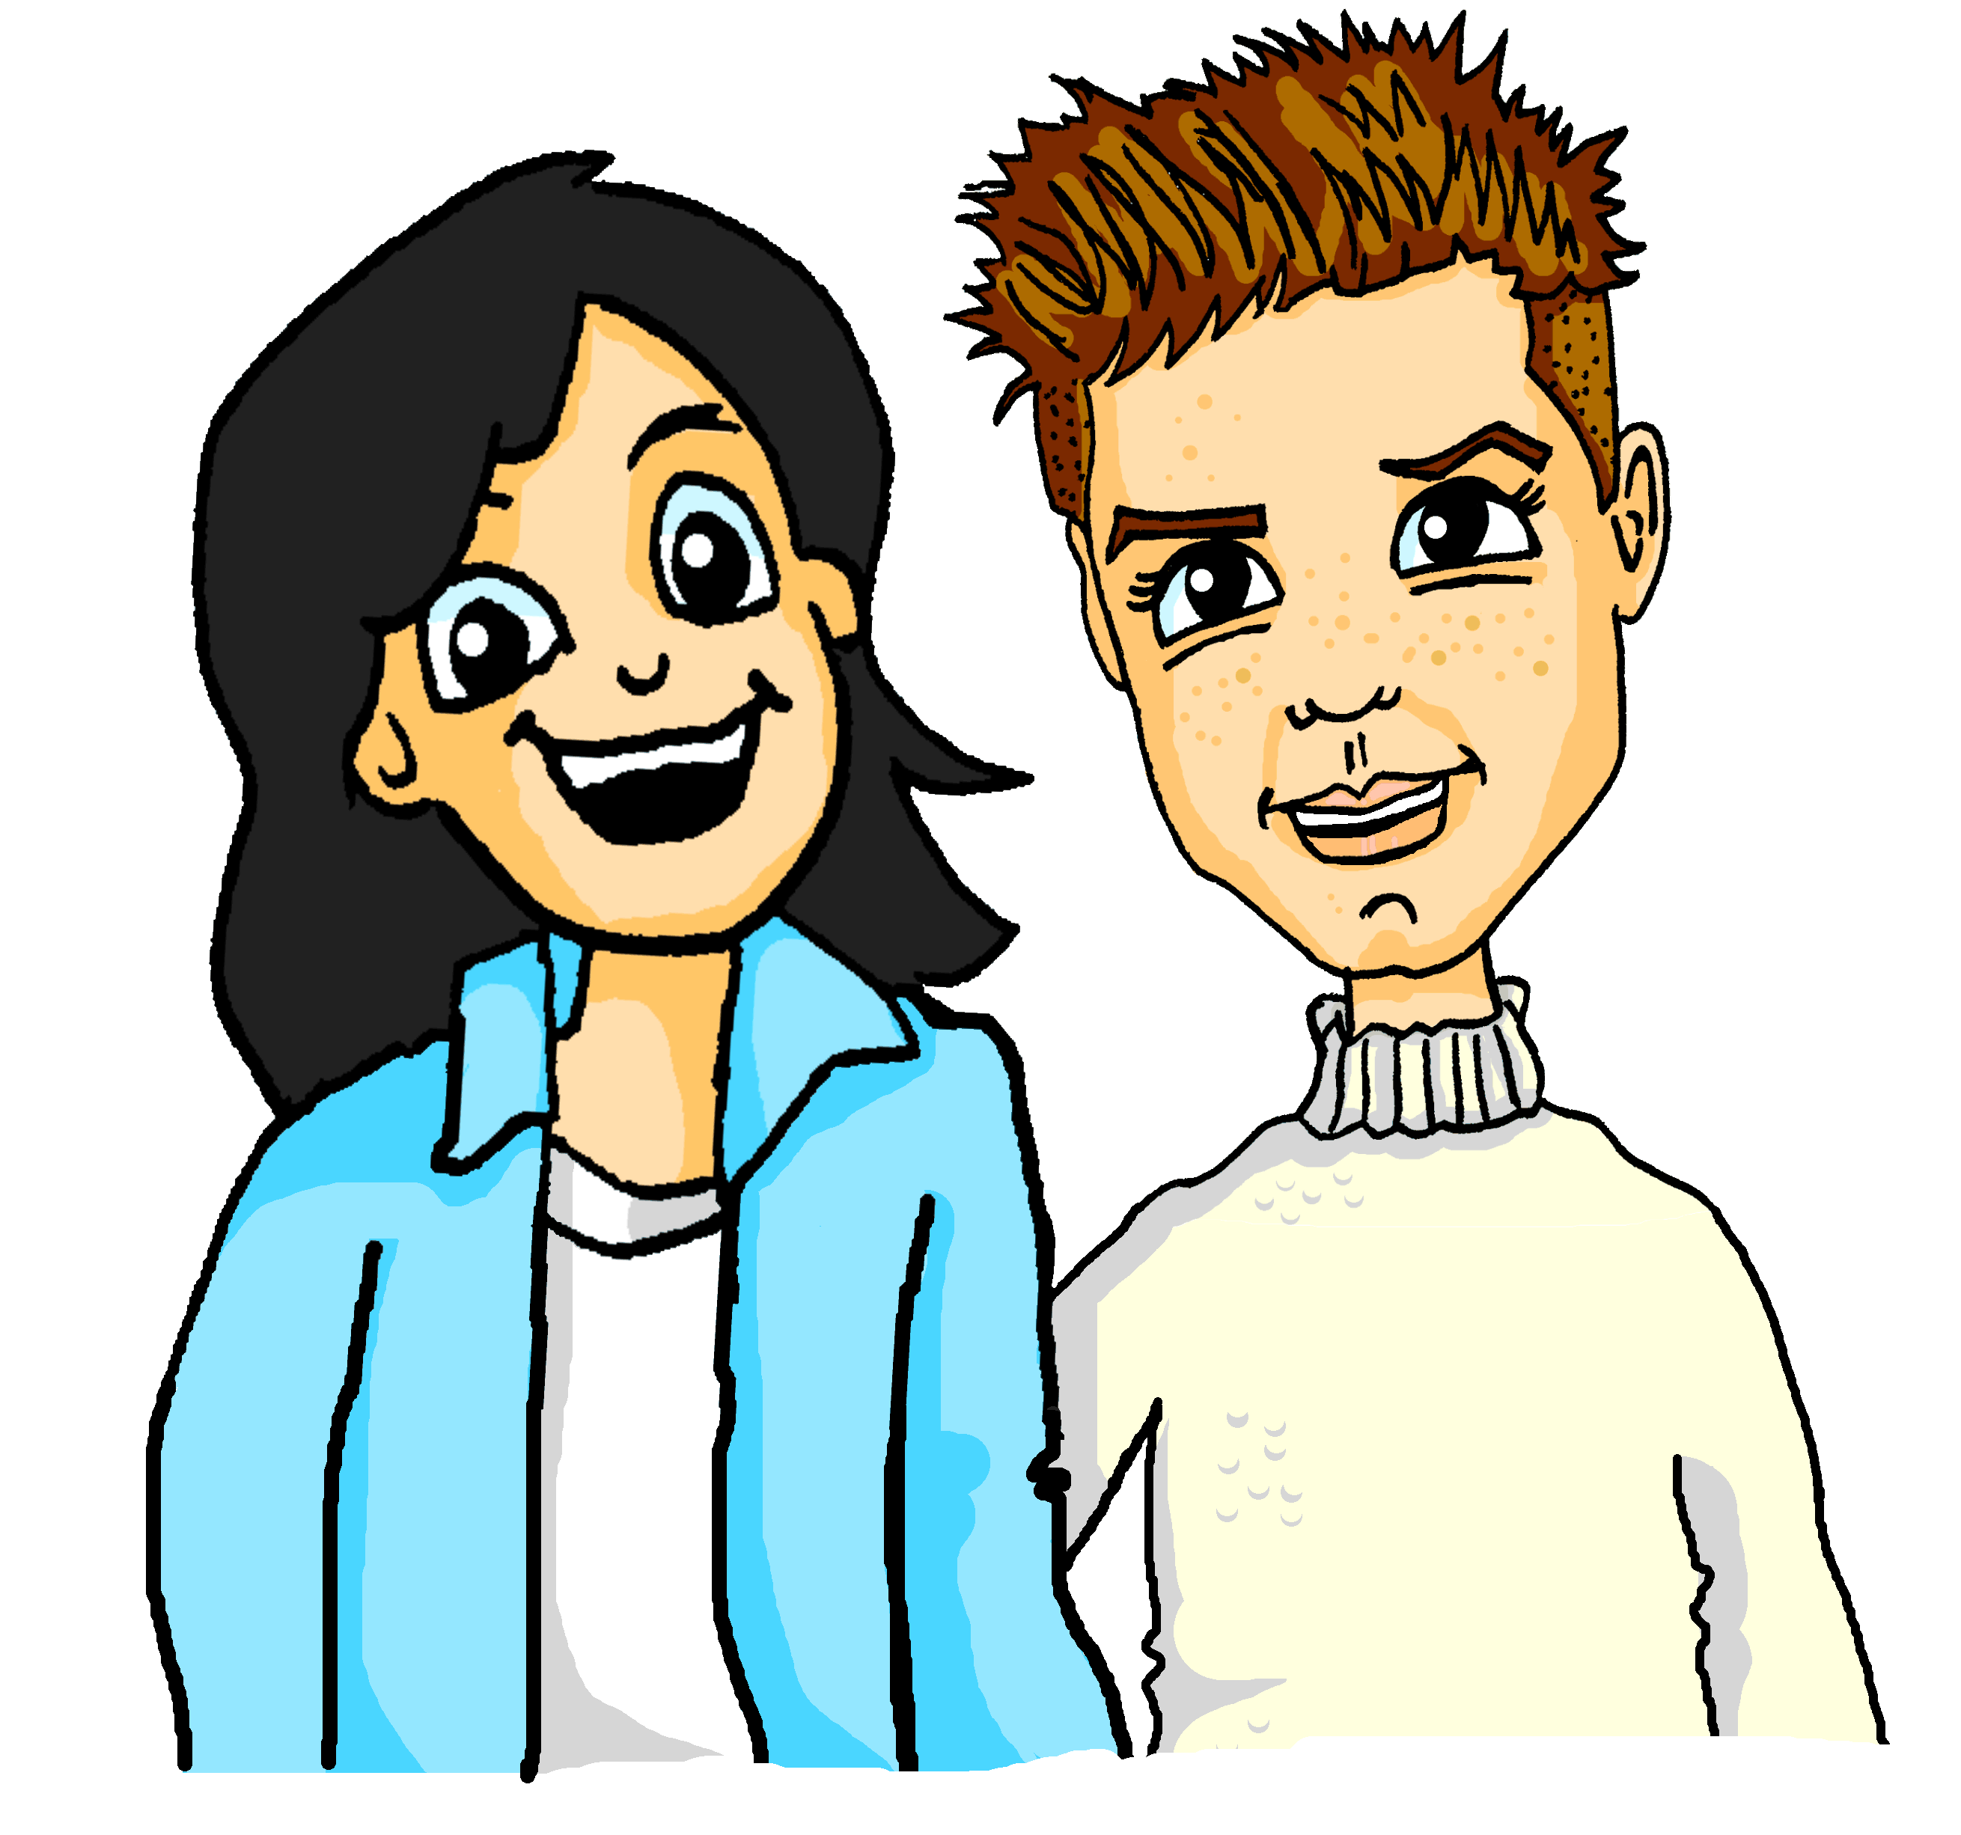
In der Garage
lesen / schreiben
Mia schreibt mit Alastair über die neue Garage.
*das Holz – wood
*darin
– in it
Schreib 1-6, das Objekt, den Artikel und das Adjektiv mit der richtigen Endung. Wie heißen die Sachen auf Englisch?
1
3
5
Mia: Unsere neue Garage ist wie ein Museum! Dort gibt es ein kaputtes Auto…
Links ist eine traditionelle Holztür* (für mein Zimmer, vielleicht?!).
Dort ist auch eine große Stofftasche und…
_
_
_
_
_
_
2
4
6
darin* habe ich auch einen alten Liebesbrief gefunden. Ich habe ihn noch nicht gelesen…!
Es gibt auch einen weißen Fußball,
ein schönes Kleid, und eine blaue Polizeiuniform.
Rechts gibt es ein gefährliches Rad – das werde ich nie benutzen!
_
_
_
_
_
_
_
_
_
_
Notes:
Timing: 5 minutes Aim: To practise production of appropriate R1 and R2 articles and adjective endings (writing). Procedure: 1. Students read the texts and write out the articles, adjectives and nouns, putting the appropriate endings on the articles and adjectives.
2. Click to reveal the answers one by one.

Slide 18
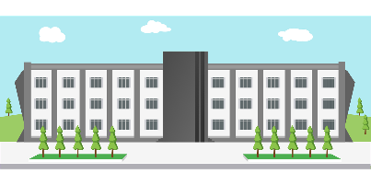
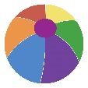
Vokabeln [1/2]
lesen / sprechen
die Universität
vor
[in front of]
reich
der Baum
[rich]
hinter
eng
[narrow]
[behind]
exact, exactly
genau
neben
[next to, beside]
Notes:
Timing: 3 minutes (two slides)
Aim: to practise the words from this week’s new vocabulary set and six from the revisited sets.
Procedure 1. Students either work by themselves or in pairs, reading out the words and recapping their English meaning (1 minute). 2. Then the teacher removes the English words or pictures (one by one) and students try to recall the English orally (chorally), looking at the German (1 minute). 3. Then the German meanings are removed (one by one) and they need to recall them orally (again, chorally), looking at the English (1 minute) 4. Further rounds of learning can be facilitated by one student turning away from the board, and his/her partner asking him/her about the meanings (‘Wie sagt man X auf Deutsch?’). This activity can work from L2 → L1 or L1 → L2.

Slide 19
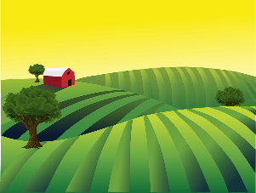
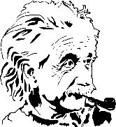
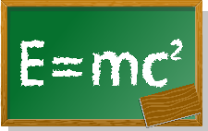
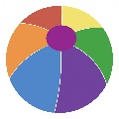
Vokabeln [2/2]
lesen / sprechen
everything
alles
das Feld
der Teil
bekannt
[part]
[well-known, famous]
das Gebäude
aus
[out, out of]
60 Min.
die Stunde
teilen
lesson
[to share]
Notes:
This is the continuation of the activity on the previous slide.

Slide 20
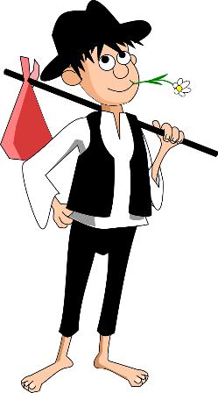
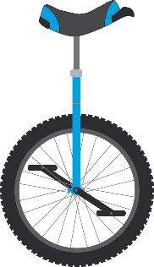
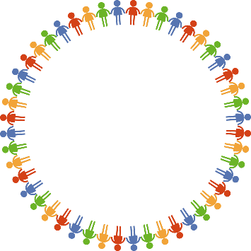
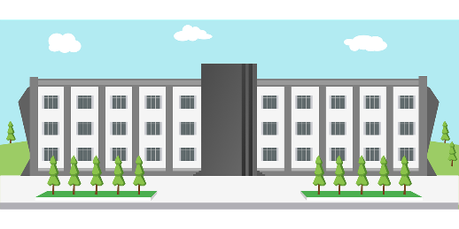
Falsche Freunde
lesen
Falscher Freund oder Kognat?
die Kosten
arm
der Rock
B
C
A
€500
But note:
der Arm = arm
€375
Kognat
falscher Freund
Kognat
falscher Freund
Kognat
falscher Freund
die Universität
hell
alle
E
F
G
all
everyone
Kognat
falscher Freund
Kognat
falscher Freund
Kognat
falscher Freund
Notes:
Timing: 3 minutes
Aim: To recall meanings of a set of known vocabulary items from this week’s vocabulary sets and categorise them as cognates or false friends. Procedure: 1. Students match the word to one of the pictures, thereby classing it as either a cognate or a false friend.
2. Click to reveal answer.
3. Where a false friend is identified, clarify the English translation.

Slide 21
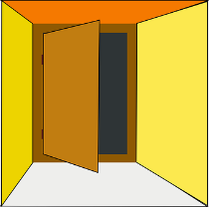
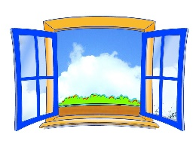
Adjektivendungen R3 (Dativ)
Grammatik
As you know, adjectives add endings when they come in front of a noun.
After sein, use R1 (subject) endings. After most other verbs, use R2 (object) endings.
__
__
After certain prepositions, always use R3 endings:
R3:
aus
einem roten Apfel
einer kleinen Tür
einem blauen Fenster
zu
mit
nach
_
_
_
bei
von
seit
_
_
_
After durch and für always use R2.
After other prepositions, use R3 endings when talking about location in:
But use R2 endings when talking about movement to.
in
an
auf
vor
neben
hinter
_
_
_
_
____
____
Notes:
Timing: 3 minutes Aim: To explain pronominal adjective agreement in R3 (dative) after certain prepositions with indefinite articles. Procedure: 1. Click and present the knowledge in small steps as per animation.
2. Elicit the key understanding about when to use R1 and R2 endings. 3. Elicit the English for the examples: out of a red apple, out of a small door, out of a blue window.
4. Elicit the prepositions that students already know that also always take R3, and the Wechselpräpositionen that take either R2 or R3. 5. Finally remind them of the two prepositions that they know that are always followed by R2. This primes for the next exercise.
Word frequency of unknown words (1 is the most frequent word in German): Apfel [3490] Source: Jones, R.L. & Tschirner, E. (2019). A frequency dictionary of German: core vocabulary for learners. Routledge

Slide 22
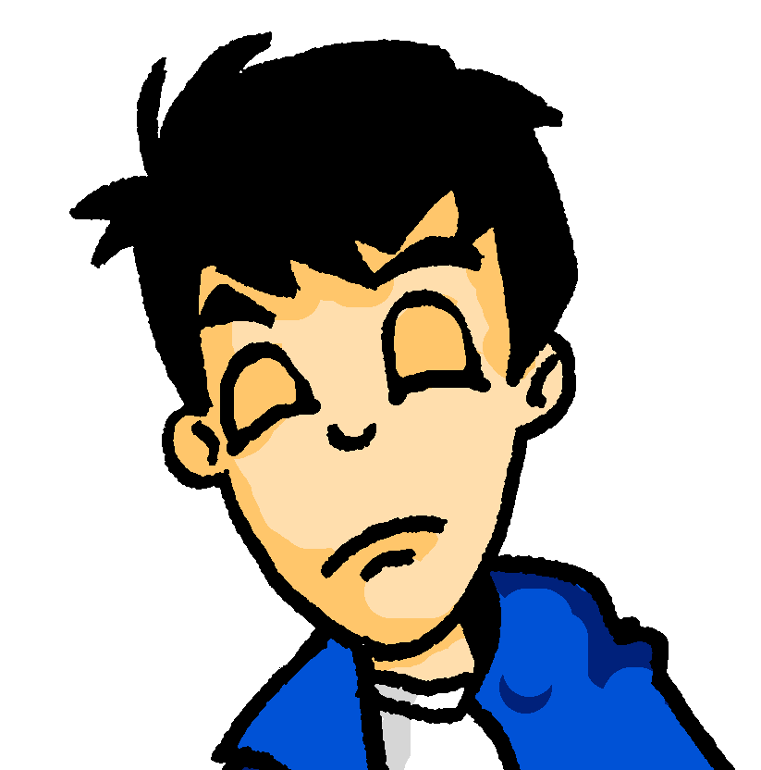
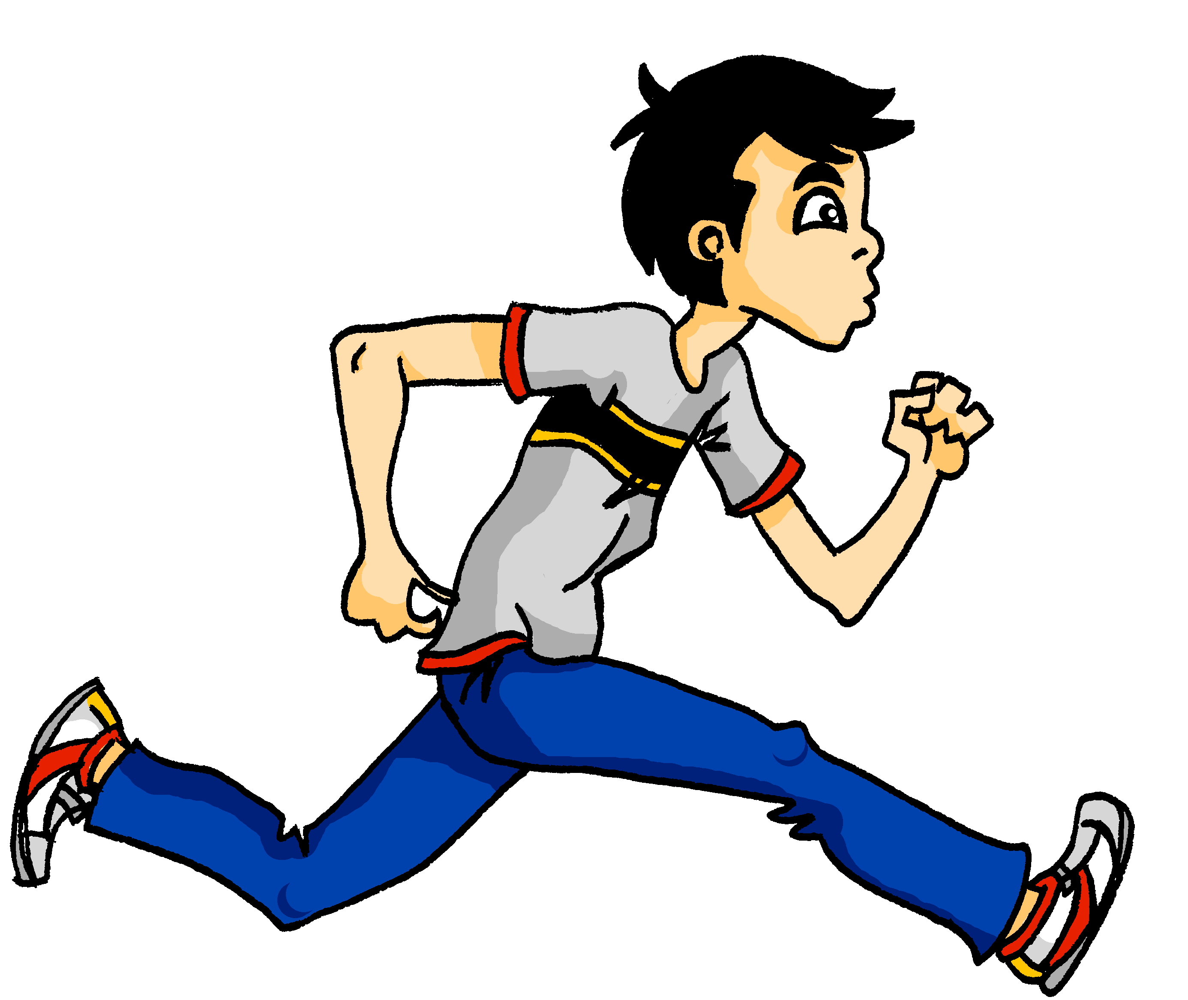
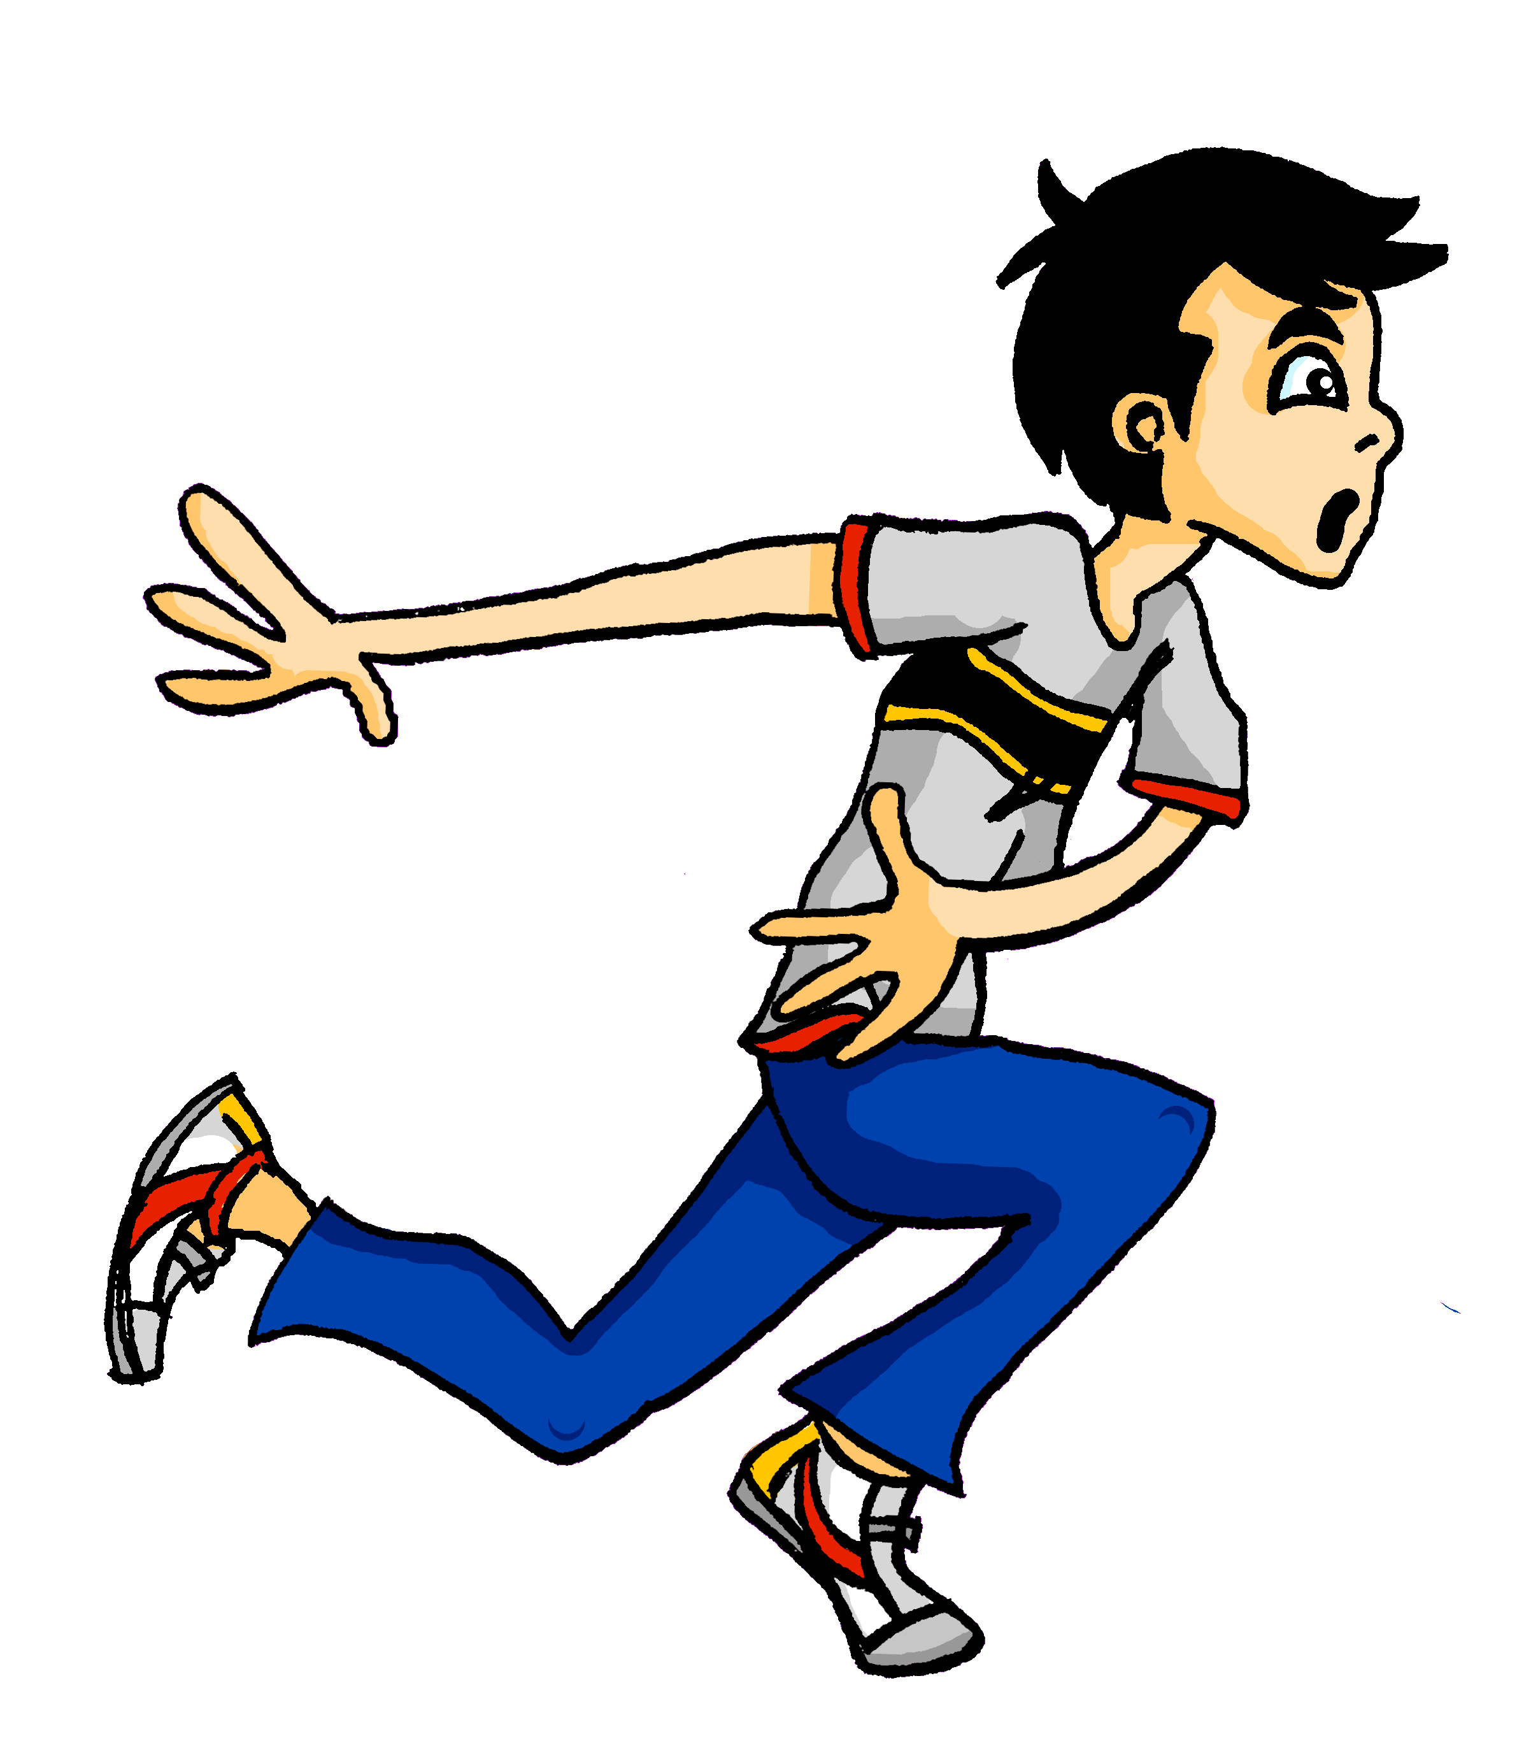
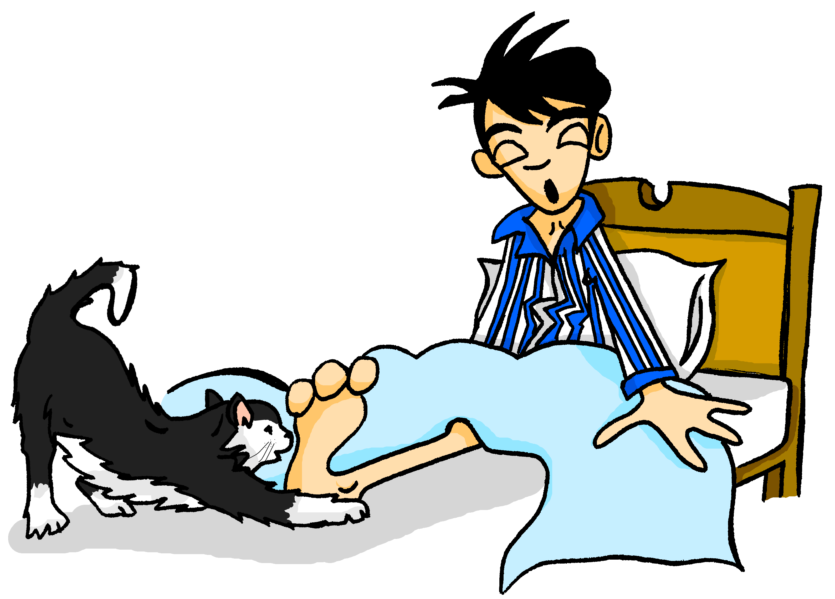
ein Traum*
Die erste Nacht im neuen Haus. Wolfgang träumt*…
lesen
Was träumt er? Schreib 1-8 und durch oder aus und den Artikel (ein, eine oder einem, einer).
z z z
1
2
3
____ ____
Er sieht durch ein kleines Fenster.
Er kommt aus einer roten Tür.
____ ____
____ ____
Er läuft aus einem großen Haus.
5
der Traum – dream träumen – to dream die Wolke – cloud
4
____ ____
Er geht durch eine neue Welt.
____ ____
Er springt durch eine weiße Wand.
8
6
7
____ ____
Er läuft durch ein anderes Gebäude.
____ ____
____ ____
Er springt aus einer kalten Wolke*.
Er fliegt aus einem alten Schloss.
Notes:
Timing: 5 minutes Aim: to practise written recognition of R3 (dative) and R2 (accusative) adjective endings in a sentence context. Procedure: 1. Ensure that students know this is a dream narrative, and that they need to fill in the missing preposition durch or aus dependent on the form of the adjective that follows. Make sure they remember the importance of knowing the gender of the noun in each sentence.
2. Students write 1-8 and the missing preposition and article.
3. Click to reveal answers.
4. Elicit sentence meanings in English. Word frequency of unknown words (1 is the most frequent word in German): Traum [992] träumen [1793] Wolke [2114] Source: Jones, R.L. & Tschirner, E. (2019). A frequency dictionary of German: core vocabulary for learners. Routledge

Slide 23
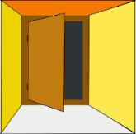
Adjektivendungen R3 (Dativ)
Grammatik
You have practised R3 adjective endings after the indefinite article:
R3:
aus
einem roten Apfel
einer kleinen Tür
einem blauen Fenster
_
_
_
dem roten Apfel
der kleinen Tür
dem blauen Fenster
_
_
_
They are the same after the definite article:
Plural R3 endings are also always - en. Remember: R3 plural nouns also add -n or -en.
aus
(den) großen Gebäuden
Note: after these prepositions, use R3 endings when talking about location in:
in
an
auf
vor
neben
hinter
_
_
_
_
____
____
Notes:
Timing: 3 minutes Aim: To explain pronominal adjective agreement in R3 (dative) after certain prepositions with definite articles. Procedure: 1. Click and present the knowledge in small steps as per animation.
2. Recap the use of R3 endings with indefinite articles by eliciting translations of the examples: out of a red apple, out of a small door, out of a blue window.
3. Explain that the endings are the same after the definite articles. Elicit the missing endings in the examples: dem roten Apfel, der kleinen Tür, dem blauen Fenster. Make sure students are clear about the translations of these.
4. Explain that R3 plural endings are also –en. 5. Finally, remind students and elicit the R3 prepositions, as a precursor for the activity on slide 25.
Word frequency of unknown words (1 is the most frequent word in German): Apfel [3490] Source: Jones, R.L. & Tschirner, E. (2019). A frequency dictionary of German: core vocabulary for learners. Routledge

Slide 24
Katrin mag ihr Zimmer!
Remember to use the dative to talk about current location.
schreiben
Wo ist:
1. der Teddy – blau – Bett
Der Teddy sitzt auf dem blauen Bett.
2. das Fenster – klein – Teddy
Das Fenster ist hinter dem kleinen Teddy.
3. der Tisch – weiß – Boden
Der Tisch steht auf dem weißen Boden.
4. die Tasche – neu – Wand
Die Tasche ist vor der neuen Wand.
5. das Bett – schön – Tisch
Das Bett steht neben dem schönen Tisch.
6. die Pflanze – groß – Fenster
Die Pflanze steht am großen Fenster.
7. der Computer – braun – Tisch
Der Computer steht auf dem braunen Tisch.
8. das Foto – modern – Computer
Das Foto hängt hinter dem modernen Computer.
an
auf
vor
neben
hinter
Notes:
Timing: 5 minutes Aim: Written production of sentences describing where things are using auf/hinter/vor/neben/an with dative. Procedure: 1. Students should describe where the items are in Katrin’s new bedroom (unknown words are glossed or are cognates), using the prompts provided and the prepositions at the bottom right.
2. Click to reveal possible answers one by one.
Word frequency (1 is the most frequent word in German): Teddy [>5000], Bett [659], Computer [1252] braun [2320] Source: Jones, R.L. & Tschirner, E. (2019). A frequency dictionary of German: core vocabulary for learners. Routledge

Slide 25
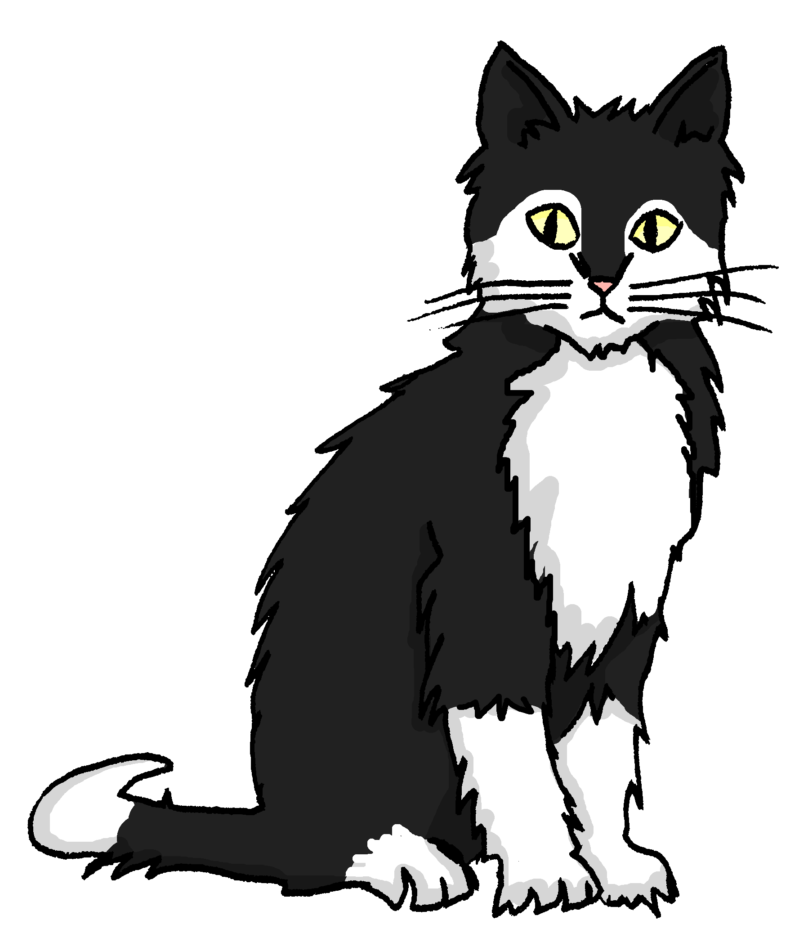
Wo ist Mieze? Wo ist Einstein? Finde Paare
sprechen
Mia und Wolfgang suchen Mieze und Einstein. Wo sind sie?
Partner / Partnerin A
Partner / Partnerin B
Ja, sie ist vor einem großen Baum.
Ist Mieze vor einem großen Baum?
Nein, sie ist vor einer kleinen Tür.
Notes:
Timing: 6 minutes (this slide models the activity) Aim: Oral production of prepositions and R3 adjective endings with indefinite articles. This is a spot the difference task (information gap). Students work in pairs with another pair. Each pair has a sheet with eight cards. Speakers exchange information to find the differences together.
Procedure: 1. Use this slide to model the task (click to reveal pictures and model questions/answers).
2. Distribute the sheets on the next two slides. The pairwork sheets are downloadable in a separate file with this sequence on the NCELP Resource Portal.
3. Student A asks a question about one of the cards.
4. Student B checks if the information on his/her card is the same and responds accordingly. 5. Then Student B asks a question and student A responds accordingly; they keep taking it in turns until all the cards have been discussed and the differences found.
Note: This task focuses primarily on the R3 (dative) articles and adjective endings, rather than the prepositions. A variety of prepositions are used in the task, but they are the same for each pair of cards. The noun varies to compel students to choose the correct article. It is worth reminding students once again that all R3 (dative) adjective endings are –en, so it will be the article and the adjective themselves that may need to change.

Slide 26
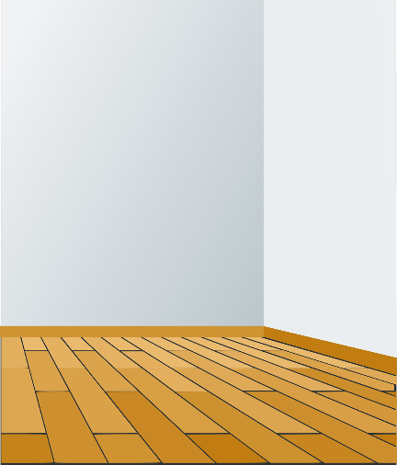
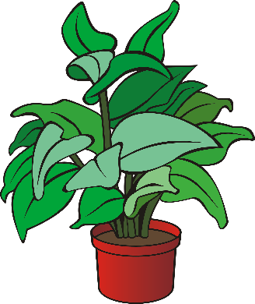
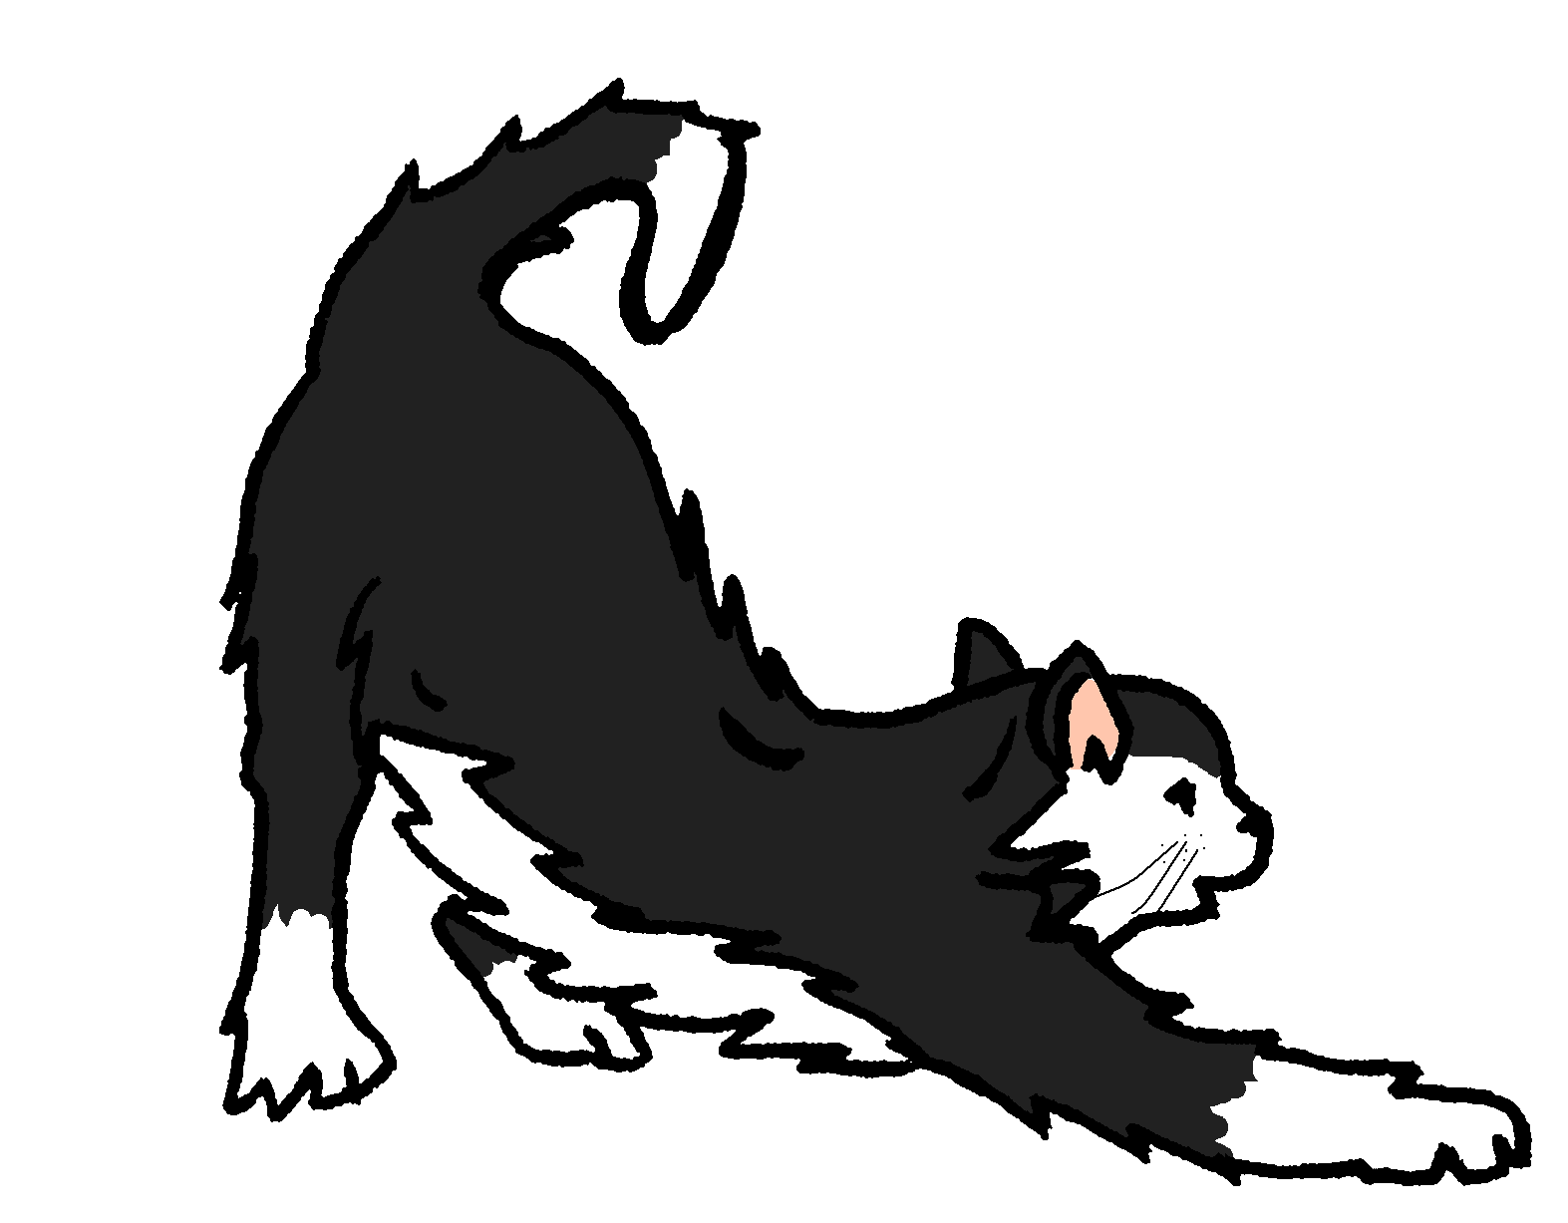
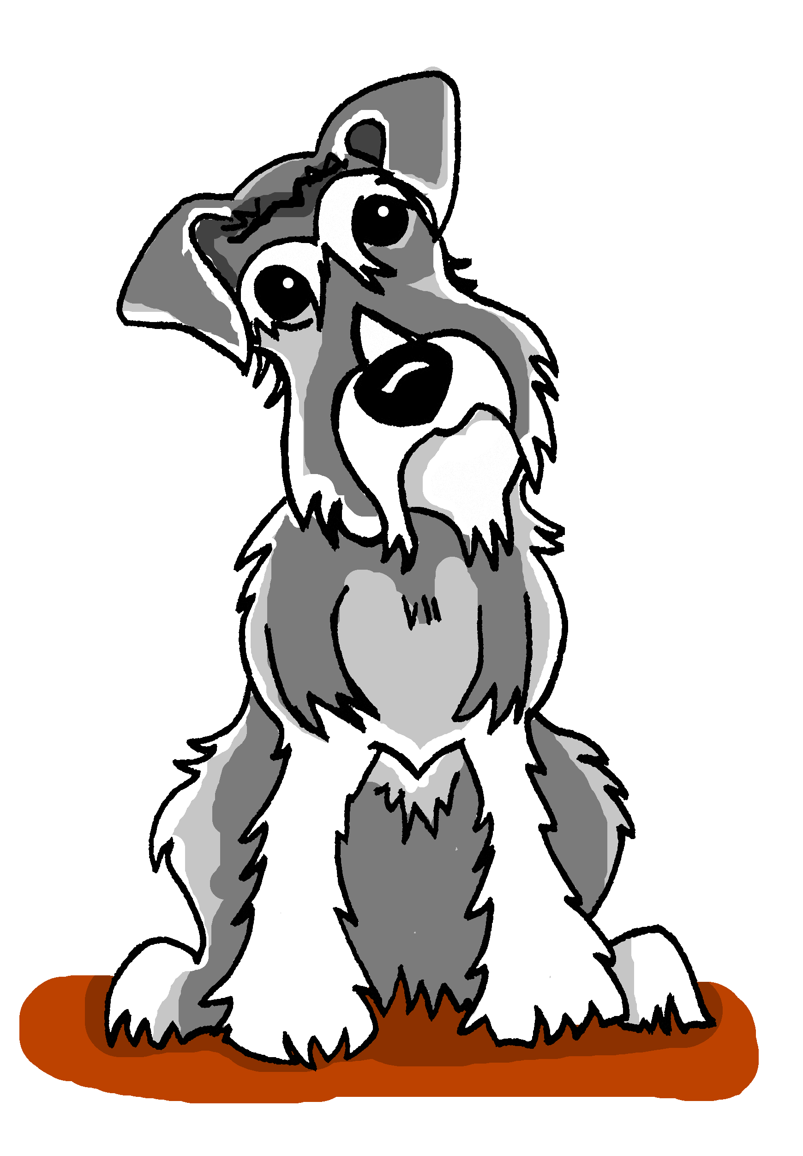
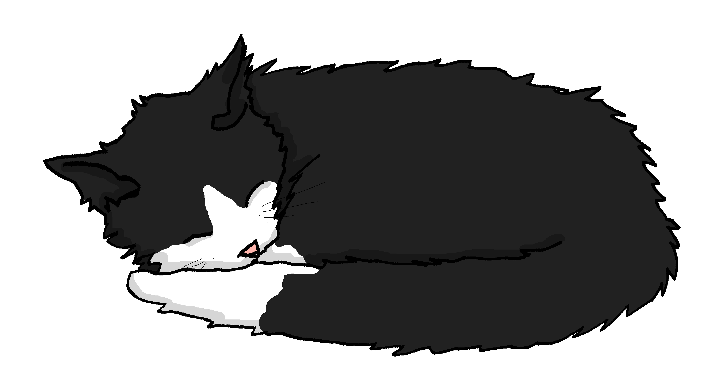
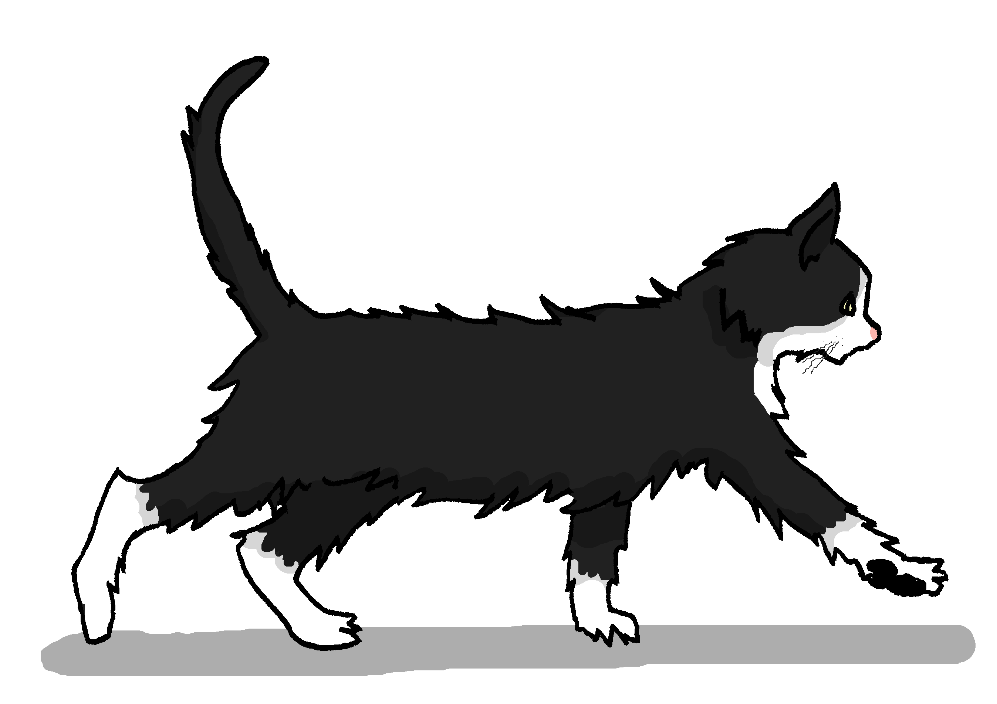
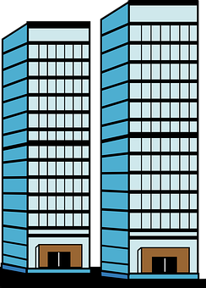
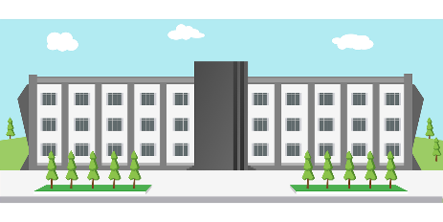
Partner(in) A
sprechen
Notes:
NOT FOR DISPLAY DURING THE ACTIVITY

Slide 27
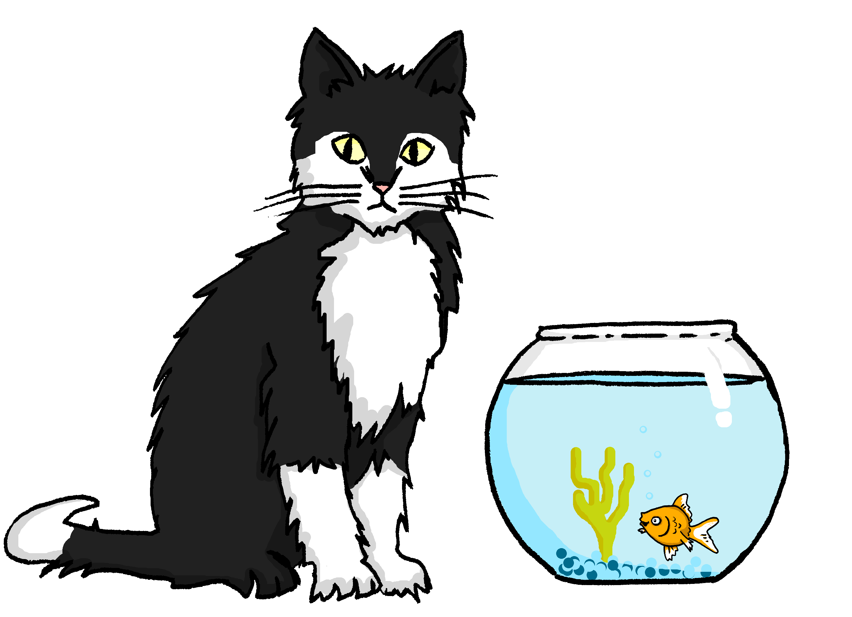
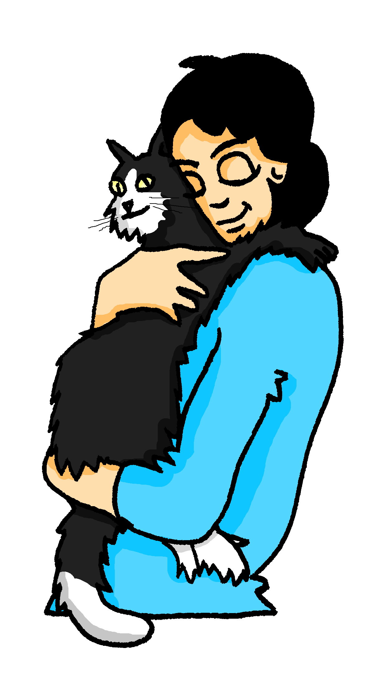
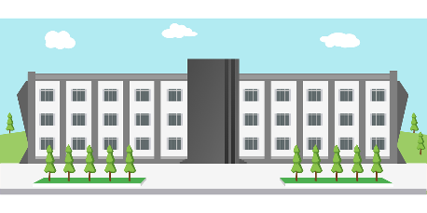
Partner(in) B
sprechen
Notes:
NOT FOR DISPLAY DURING THE ACTIVITY

Slide 28
Antworten
sprechen
Partner(in) A
Partner(in) B
Sie ist neben einem braunen Tisch. | Sie ist neben einem braunen Tisch.
Er ist hinter einem großen Baum. | Er ist hinter einem großen Baum.
Sie ist vor einer blauen Tür. | Sie ist vor einer blauen Tür.
Sie ist hinter einer roten Tasche. | Sie ist hinter einer weißen Tasche.
Sie ist neben einer grünen Pflanze. | Sie ist neben einem kleinen Fisch.
Er ist vor einer alten Universität. | Er ist vor einem großen Fenster.
Sie ist auf einem kleinen Gebäude. | Sie ist auf einer großen Universität.
Er ist neben einem hohen Gebäude. | Er ist neben einem kleinen Feld.
Notes:
Answers
Note: As there was no numbering on the task, the answers are presented as the three similarities, followed by the five differences. Word frequency of cognates (1 is the most frequent word in German): Fisch [1959] braun [2320] Source: Jones, R.L. & Tschirner, E. (2019). A frequency dictionary of German: core vocabulary for learners. Routledge

Slide 29
Tell me more: describing in more detail
Adjective endings with definite and indefinite articles (R3) dative
SSC [v] and [w]
Y8 German
Term 3.1- Week 6 - Lesson 60
Author name(s): Stephen Owen / Rachel Hawkes
Artwork: Steve Clarke
Date updated: 21/7/21
Notes:
Artwork by Steve Clarke. All additional pictures selected are available under a Creative Commons license, no attribution required.
Native speaker teacher feedback provided by Stephanie Cross.
Learning outcomes (lesson 1):
Consolidation of SSC [v] and [w]
Consolidation of adjective endings with definite and indefinite articles (R2) accusative and (R3) dative
Word frequency (1 is the most frequent word in German):
8.3.1.6 (introduce) Baum [1013] Feld [834] Gebäude [1316] Teil [198] Universität [415] bekannt [319] aus¹ [37] hinter [269] neben [266] vor² [50]
8.3.1.3 (revisit) sollen [60] ich soll du sollst er/sie/es soll kosten [903] lachen [444] teilen [906] verstecken [1575] versuchen [247] Fehler [861] Gefühl [462] Glas [885] Kosten [564] Stunde² [262] etwa [181]
8.2.2.1 (revisit) alles [36] alle [36] Rock [3551] Kleid [1780] alt [138] arm [1475] einfach [131] eng [59] genau [167] hell [1411] jung [199] kurz [176] reich [1568]
Source: Jones, R.L & Tschirner, E. (2019). A frequency dictionary of German: Core vocabulary for learners. London: Routledge.
The frequency rankings for words that occur in this PowerPoint which have been previously introduced in NCELP resources are given in the NCELP SOW and in the resources that first introduced and formally re-visited those words.
For any other words that occur incidentally in this PowerPoint, frequency rankings will be provided in the notes field wherever possible.

Slide 30
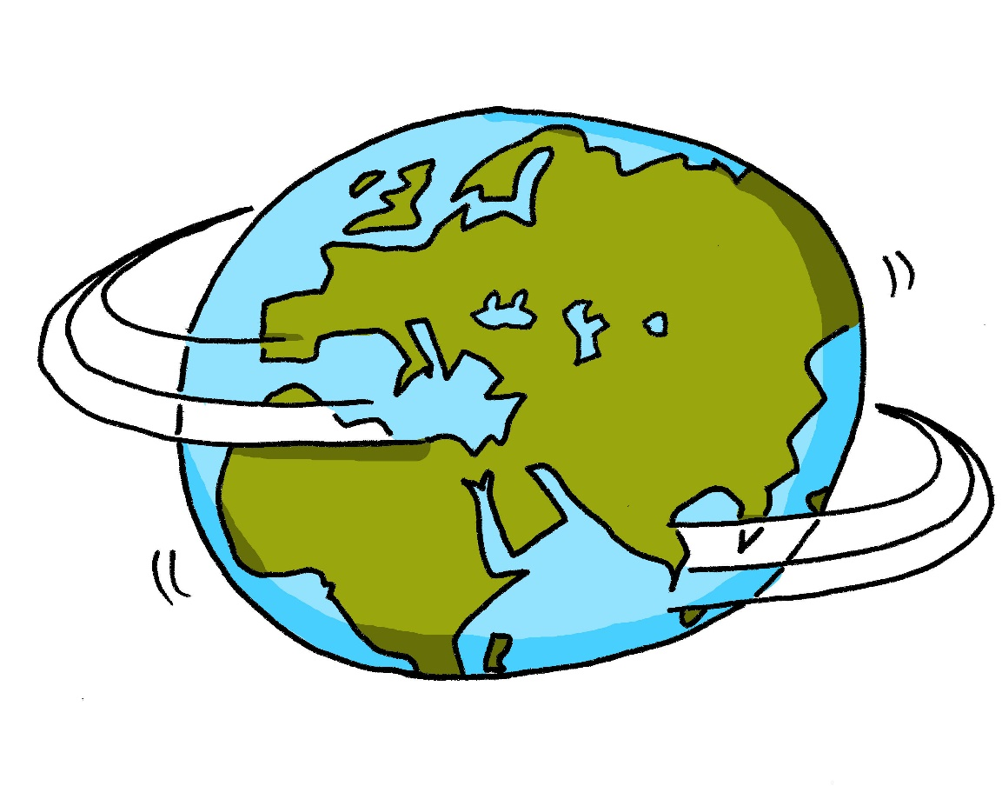
w
Welt
Notes:
Timing: 1 minute
Aim: To introduce/consolidate SSC [w]
Procedure: 1. Present the letter(s) and say the [w] sound first, on its own. Students repeat it with you. 2. Bring up the word ”Welt” on its own, say it, students repeat it, so that they have the opportunity to focus all of their attention on the connection between the written word and its sound.
3. A possible gesture for this would be to start with your hands above your head and draw them down, out and then back into the body, tracing the shape of the world.
4. Roll back the animations and work through 1-3 again, but this time, dropping your voice completely to listen carefully to the students saying the [w] sound, pronouncing ”Welt” and, if using, doing the gesture. Word frequency (1 is the most frequent word in German): Welt [190] Source: Jones, R.L. & Tschirner, E. (2006). A frequency dictionary of German: core vocabulary for learners. Routledge

Slide 31
w
Wasser
wahr
Welt
Was?
gewinnen
antworten
Notes:
Timing: 2 minutes
Aim: To introduce/consolidate SSC [w]
Procedure:
Introduce and elicit the pronunciation of the individual SSC [w] and then the source word again ‘Welt’ (with gesture, if using).
Then present and elicit the pronunciation of the five cluster words.
The cluster words have been chosen for their high-frequency, from a range of word classes, with the SSC (where possible) positioned within a variety of syllables within the words (e.g. initial, 2nd, final etc.). Additionally, we have tried to use words that build cumulatively on previously taught SSCs (see the Phonics Teaching Sequence document) and do not include new SSCs. Where new SSCs are used, they are often consonants which have a similar symbol-sound correspondence in English.
Word frequency (1 is the most frequent word in German): Welt [190]; Wasser [297] wahr [662]; Was? [39]; antworten [804]; gewinnen [410]. Source: Jones, R.L. & Tschirner, E. (2006). A frequency dictionary of German: core vocabulary for learners. Routledge

Slide 32
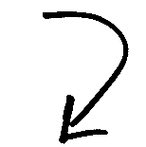
Phonetik: [v] oder [w]?
hören / schreiben
Partner(in) A
Partner(in) B
A
Vetter
Wetter
[male cousin]
[weather]
B
Wehlen
Velen
[German town names]
C
wir
vier
[we]
[four]
D
wogt
Vogt
[undulates]
[bailiff]
Notes:
Timing: 5 minutes Aim: to apply SSC knowledge of [v] and [w] to unknown words in transcription [Slide 1 of 2]. Procedure: 1. Partner B turns away from the board.
2. Click to reveal four pairs of words, which Partner A reads aloud.
3. Partner B transcribes all words.
4. Then turns back to check answers.
5. Next slide, repeat the task with roles reversed.
Transcript: Vetter - Wetter Wehlen - Velen wir – vier
wogt – Vogt
Word frequency (1 is the most frequent word in German): Vetter [>5000] Wetter [1881] wogen [>5000] Vogt [>5000]
Source: Jones, R.L. & Tschirner, E. (2019). A frequency dictionary of German: core vocabulary for learners. Routledge

Slide 33
Phonetik: [v] oder [w]?
hören / schreiben
Partner(in) B
Partner(in) A
A
wie
Vieh
[how]
[cattle]
B
Weilchen
Veilchen
[little while]
[violet flower]
C
Veste
Weste
[festival]
[waistcoat]
D
voran
woran
[ahead]
[about which]
Notes:
Timing: 5 minutes Aim: to apply SSC knowledge of [v] and [w] to unknown words in transcription [Slide 2 of 2]. Procedure: 1. Partner A now turns away from the board.
2. Click to reveal four pairs of words, which Partner B reads aloud.
3. Partner A transcribes all words.
4. Then turns back to check answers.
Transcript: wie - Vieh Weilchen - Veilchen
Veste – Weste
voran - woran Word frequency (1 is the most frequent word in German): Vieh [>5000] Weilchen [>5000] Veilchen [>5000] Veste [>5000] Weste [>5000] voran [n/a] woran [3545]
Source: Jones, R.L. & Tschirner, E. (2019). A frequency dictionary of German: core vocabulary for learners. Routledge

Slide 34
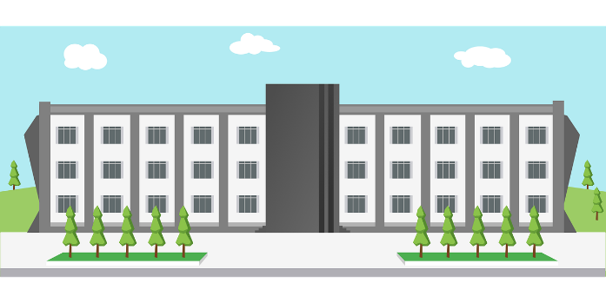
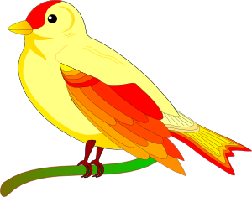
Phonetik: [v] oder [w]?
sprechen
Deutsches [w] ist wie englisches [v].
Deutsches [v] ist wie englisches [f].
However, in German words of foreign origin, [v] is usually like English [v].
5
Sekunden
[Universität]
[Vogel]
[November]
0
LOS!
Notes:
Timing: 2 minutes (for 3 slides) Aim: to apply SSC knowledge of both variants of [v] to unknown words in pronunciation. Procedure: 1. Teacher clicks and all 3 words appear.
2. Then, s/he quickly clicks the timer.
3. Students try to say all three words within the 5 seconds, chorally, differentiating the two ‘v’ pronunciations. Note: Teacher to reinforce that it will be the cognates that are likely to have English-sounding [v]. 4. Click on each word to hear the pronunciations, as desired.
Word frequency (1 is the most frequent word in German):
Vogel [1701]
Source: Jones, R.L & Tschirner, E. (2019). A frequency dictionary of German: Core vocabulary for learners. London: Routledge.

Slide 35
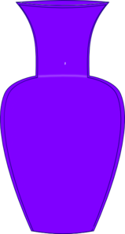
Phonetik: [v] oder [w]?
sprechen
5
Sekunden
[Wolke]
[Vase]
[Aktivität]
0
LOS!
Notes:
As for previous slide.
Word frequency (1 is the most frequent word in German):
Wolke [2114] Vase [>5000] Aktivität [1422]
Source: Jones, R.L & Tschirner, E. (2019). A frequency dictionary of German: Core vocabulary for learners. London: Routledge.

Slide 36
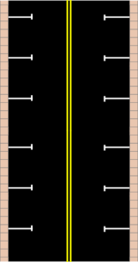
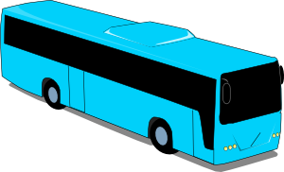
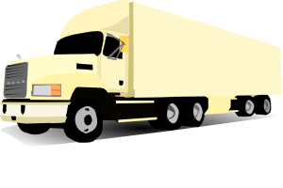
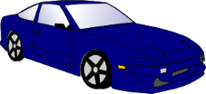
Phonetik: [v] oder [w]?
sprechen
5
Sekunden
[vage]
[Verkehr]
[vierzig]
0
LOS!
Notes:
As for previous slide.
Word frequency (1 is the most frequent word in German):
vage [>5000] Verkehr [2131]
Source: Jones, R.L & Tschirner, E. (2019). A frequency dictionary of German: Core vocabulary for learners. London: Routledge.

Slide 37
Vokabeln
 | 43 | 34 | 56 | 65 | 78 | 87
f
v
w |  | [about/ approx.] |  |  |  | [to try]
r
k |  |  |  |  |  | [simple]
a |  |  |  |  | [feeling]
sprechen
60 Min.
to cost
lesson
[to hide]
every-thing
all
everyone
€500
exact, exactly
€375
Notes:
Timing: 5 minutes Aim: To practise orally the new and revisited vocabulary for this week, also revisiting some letters and numbers learnt previously. Procedure: 1. Teacher calls co-ordinates.
2. Students have to recall vocabulary at those coordinates.

Slide 38
English → German → English
Some German adverbs have -(er)weise, where English adverbs often have -ly.
die Weise means way, manner.
That is possibly true!
Das ist möglicherweise wahr!
Translate these sentences.
1. Das ist nur teilweise korrekt.
2. Luckily (happily) he has no problems.
What would the following be in German?
sadly normally/usually logically Choose one and write a sentence in German.
Notes:
Timing: 3 minutes Aim: To explain the use of –(er)weise to form adverbs in German, comparing this to the English -ly.
Procedure: 1. Cycle through the information on the slide using the animation sequence.
2. The answers are on the next slide.
Word frequency: Weise [468] teilweise [1122] möglicherweise [1428], normalerweise [2062] glücklicherweise [>5009, glücklich - 1070], traurigerweise [>5009, traurig - 1752], logischerweise [>5009, logisch - 2782], beispielsweise [672] natürlicherweise [>5009, natürlich-137] freundlicherweise [>5009, freundlich - 1566]
Source: Jones, R.L. & Tschirner, E. (2019). A frequency dictionary of German: core vocabulary for learners. Routledge

Slide 39
ANTWORTEN
Das ist nur teilweise korrekt.
Luckily (happily) he has no problems.
sadly
normally, usually
logically
That is only partly/partially correct.
Glücklicherweise hat er keine Probleme.
traurigerweise
normalerweise
logischerweise
Remember: Word Order 2 when you start your sentence with an adverb.
Don’t forget to pronounce the words!
Notes:
Answers

Slide 40
Wo ist das genau?
Vokabeln
You know to use R3 (dative) to describe location.
Here are a few useful ways to say where things are:
Remember: von + dem → vom vom Bahnhof vom Museum
die Nähe
nearby area, vicinity
R3:
in der Nähe
von
dem Bahnhof
der Kirche
dem Museum
near to
Note: these are R3 (dative) adjective endings.
die Seite
rechts
links
page, side
(on the) right
(on the) left
R3:
auf der
rechten
Seite
auf der
linken
Seite
on the
right (hand)
side
on the
left (hand)
side
Notes:
Timing: 3 minutes Aim: To explain the use of the dative (R3) after prepositions to describe location. Procedure: 1. Cycle through the information on the slide using the animation sequence.

Slide 41
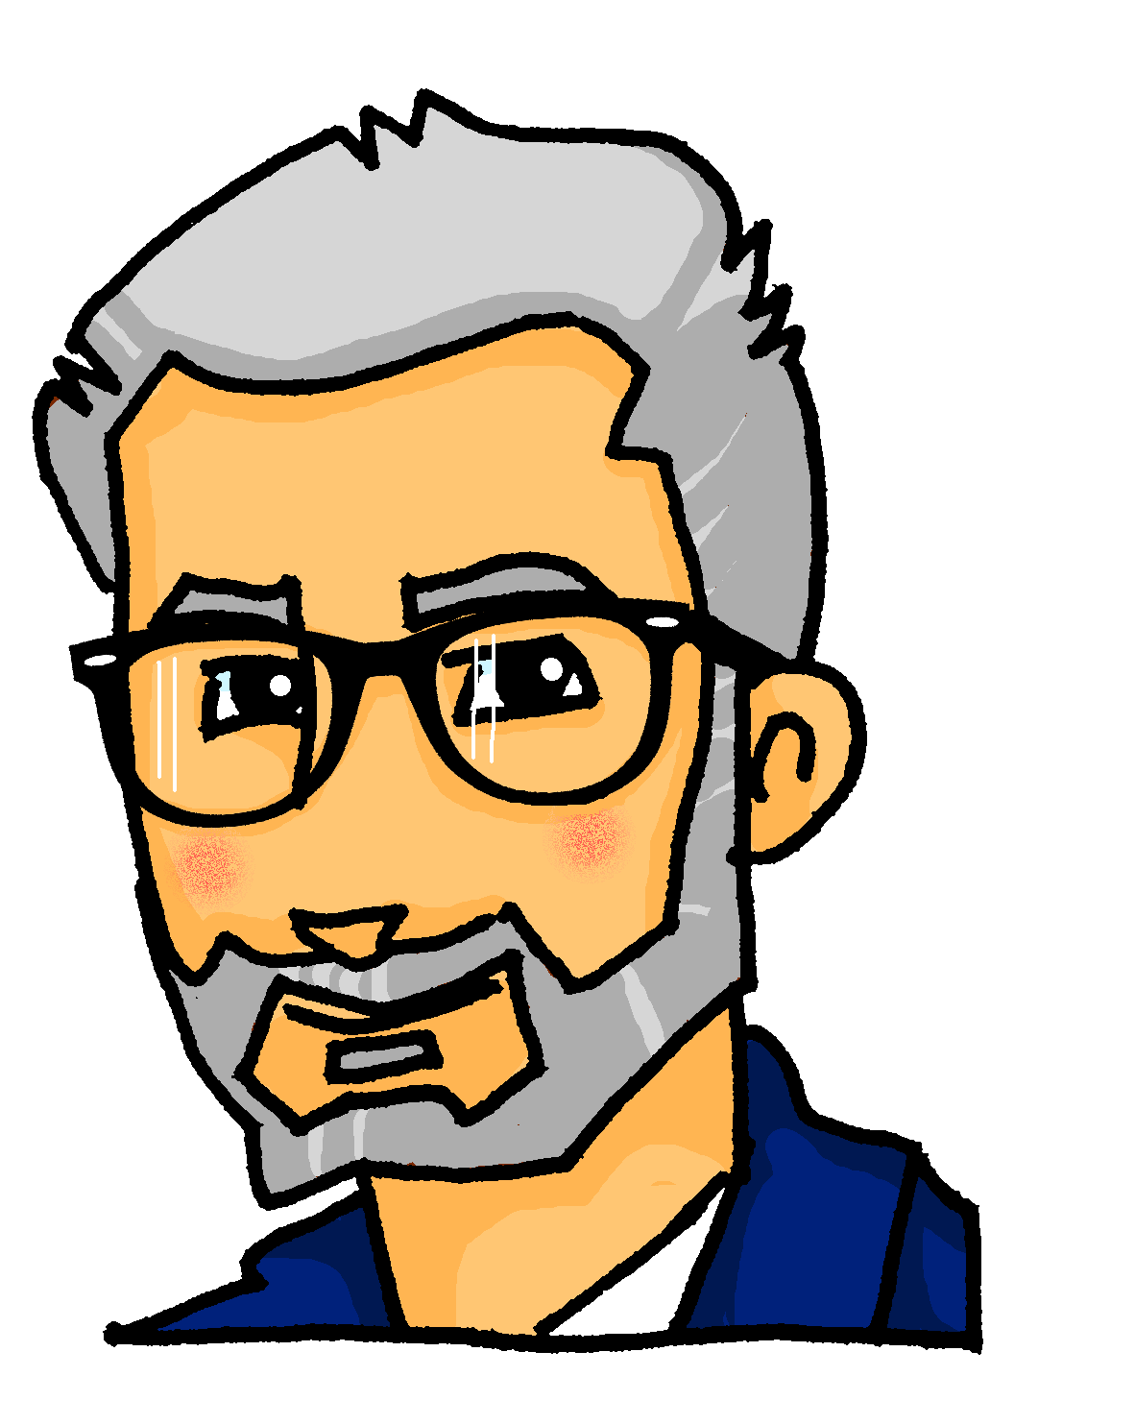
Ein Berlinbesuch
Katjas Onkel Antoni und Tante Lena kommen nach Berlin zu Besuch.
hören
Katja plant einen Tag für sie.
Schreib 1-8 und den richtigen Satzbeginn.
1
2
3
4
Sie gehen hinter…
Sie kommen aus…
Sie gehen direkt…
und sehen…
Sie sehen hinter…
Dort finden Sie…
Sie sind direkt…
mit…
5
6
7
8
Dann stehen Sie vor ..
Sie sind im…
Sie sollen …
Sie gehen in …
Sie gehen in …
Sie sehen das…
Sie sollen mit …
Sie stehen vor…
U
Notes:
Timing: 6 minutes Aim: Aural comprehension of articles and adjectives in R2 (accusative) and R3 (dative). Ability to connect these with meaning. Procedure: 1. Click the number to hear the gapped sentence.
2. Based on the article and adjective they hear, students decide whether the sentence is R2 (acc) or R3 (dative).
3. Click to reveal the answer.
4. Click on the green arrow to hear the full sentence.
Transcript: 1 [Sie kommen aus] dem Bahnhof. 2 [Sie gehen direkt] auf den großen Alexanderplatz. 3 [mit] der bekannten Uhr. Das ist die Weltzeituhr. 4 [Sie gehen hinter] die große Uhr und sehen den hohen Fernsehrturm. 5 [Dann stehen Sie vor] der schönen Marienkirche. 6 [Sie sehen das] interessante Menschen Museum. 7 [Sie sollen] die schnelle U-Bahn nehmen. 8 [Sie stehen vor] dem bekannten Bode Museum und machen ein Foto.
Word frequency (1 is the most frequent word in German): U-bahn [>5000] Source: Jones, R.L. & Tschirner, E. (2019). A frequency dictionary of German: core vocabulary for learners. Routledge

Slide 42
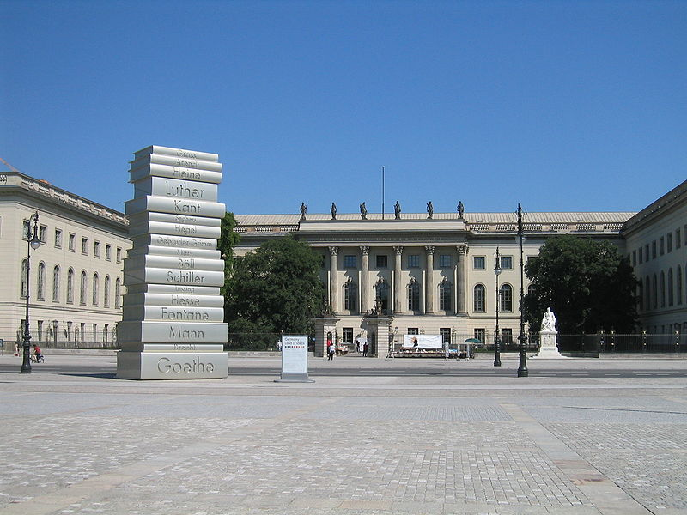
Katja sucht weitere Infos im Internet
der Wolkenkratzer - skyscraper
lesen
Was weißt du über Berlin? Schreib sechs Sätze!
Auf der bekannten Straße ‚Unter den Linden‘ gibt es eine wichtige Universität – die Humboldt-Universität. Jedes Jahr lernen über 6.000 junge Studenten hier. | Neben dem grünen Tiergarten gibt es ein großes Geschäft: KaDeWe (Kaufhaus des Westens). Hier kann man billige oder teuere Kleidung kaufen. | Der schöne Volkspark Friedrichshain, in der Nähe vom wunderbaren Velodrom, hat viele alte Bäume. Man kann eine glückliche Stunde in diesem großen Park verbringen.
Die modernen Wolkenkratzer* von Berlin – zum Beispiel der tolle Berliner Fernsehturm – sind sehr interessante Gebäude. Von diesem großen Wolkenkratzer hat man einen tollen Ausblick** auf die ganze Stadt! | Jeden Mittwoch um 18 Uhr findet in einem Café in Berlin die World Language Party statt. Neue Menschen aus der ganzen Welt kommen. Das ist immer ein tolles Event. | Sie dürfen nicht vergessen, eine ruhige Bootstour auf der Spree zu machen. Auf der rechten Seite, das schöne Schloss Bellevue! Auf der linken Seite, die Grüne Meile (grüne Felder)!
Notes:
Timing: 8 minutes Aim: To provide extended reading practice featuring R1, R2 and R3 article and adjective endings, as well as some cultural background. Procedure: 1. Clicking removes the photos one by one to reveal a short text behind each about the Berlin location pictured.
2. Students read the texts and then write six sentences about what they have learnt from the texts, one sentence for each.
3. Use backspace to have another look at the photo, if desired, after reading each text, before advancing again.
Texts:
1. Auf der bekannten Straße Unter den Linden gibt es eine wichtige Universität – die Humboldt-Universität. Jedes Jahr lernen über 6.000 junge Studenten hier.
2. Neben dem grünen Tiergarten gibt es ein großes Geschäft: KaDeWe (Kaufhaus des Westens). Hier kann man billige oder teuere Kleidung kaufen.
3. Der schöne Volkspark Friedrichshain, in der Nähe vom wunderbaren Velodrom, hat viele alte Bäume. Man kann eine glückliche Stunde in diesem großen Park verbringen.
4. Die modernen Wolkenkratzer* von Berlin – zum Beispiel der tolle Berliner Fernsehturm – sind sehr interessante Gebäude. Von diesem großen Wolkenkratzer hat man einen tollen Ausblick** auf die ganze Stadt!
5. Jeden Mittwoch um 18 Uhr findet in einem Café in Berlin die World Language Party statt. Neue Menschen aus der ganzen Welt kommen. Das ist immer ein tolles Event.
6. Sie dürfen nicht vergessen, eine ruhige Bootstour auf der Spree zu machen. Auf der rechten Seite, das schöne Schloss Bellevue! Auf der linken Seite, die Grüne Meile (grüne Felder)!
Word frequency (1 is the most frequent word in German): Wolkenkratzer [>5000] Ausblick [4959] Velodrom [>5000] Event [>5000] Bootstour [>5000] Meile [>5000] Park [2141]
Source: Jones, R.L. & Tschirner, E. (2019). A frequency dictionary of German: core vocabulary for learners. Routledge
Pictures:
1. Ryan Hadley from Seattle, USA (https://commons.wikimedia.org/wiki/File:Humboldt_University_And_Bebelplatz.jpg), „Humboldt University And Bebelplatz“, https://creativecommons.org/licenses/by-sa/2.0/legalcode
2. Dieter Brügmann (https://commons.wikimedia.org/wiki/File:Berlin_kadewe.jpg), „Berlin kadewe“, https://creativecommons.org/licenses/by-sa/3.0/legalcode
3. Manfred Brückels (https://commons.wikimedia.org/wiki/File:Maerchenbrunnen_Berlin_Friedrichshain_Zugang_2.jpg), „Maerchenbrunnen Berlin Friedrichshain Zugang 2“, https://creativecommons.org/licenses/by-sa/3.0/legalcode
4. Jörg Blobelt creator QS:P170,Q28598952 (https://commons.wikimedia.org/wiki/File:19860930290NR_Berlin-Mitte_Berliner_Fernsehturm_Marienkirche.jpg), https://creativecommons.org/licenses/by-sa/4.0/legalcode
5. CC0 Public Domain. Free for personal and commercial use. No attribution required.
6. Biberbaer (https://commons.wikimedia.org/wiki/File:Tagesausflugsschiff_Alexander_in_Berlin_auf_der_Spree.JPG), „Tagesausflugsschiff Alexander in Berlin auf der Spree“, https://creativecommons.org/licenses/by-sa/3.0/legalcode

Slide 43
Die neue Universität
schreiben
Schreib die Sätze auf Deutsch!
1. The new university has many beautiful buildings.
2. Behind this building you see the famous part.
3. In the green field there is a big tree.
4. Next to the tree there is a small plant.
5. In front of the university you see many people.
6. These young people come from France and Spain.
Die neue Universität hat viele schöne Gebäude.
Hinter diesem Gebäude sieht man/siehst du den bekannten Teil.
Im grünen Feld gibt es einen großen Baum.
Neben dem Baum gibt es eine kleine Pflanze.
Vor der Universität sieht man viele Personen/Leute.
Diese jungen Personen kommen aus Frankreich und Spanien.
Notes:
Timing: 10 minutes Aim: To consolidate knowledge of articles and adjective endings, associating them with known vocabulary. Procedure: 1. Students translate the sentences into German.
2. Click to reveal suggested answers one by one.
Suggested answers:.
Die neue Universität hat viele schöne Gebäude.
Hinter diesem Gebäude sieht man/siehst du den bekannten Teil.
Im grünen Feld gibt es einen großen Baum.
Neben dem Baum gibt es eine kleine Pflanze.
Vor der Universität gibt es viele Personen/Leute.
Diese jungen Personen kommen aus Frankreich und Spanien.
Word frequency (1 is the most frequent word in German):
8.3.1.6 (introduce) Baum [1013] Feld [834] Gebäude [1316] Teil [198] Universität [415] bekannt [319] aus¹ [37] hinter [269] neben [266] vor² [50]
Source: Jones, R.L & Tschirner, E. (2019). A frequency dictionary of German: Core vocabulary for learners. London: Routledge.

Slide 44
Gaming Grammar
Try the following Gaming Grammar missions to practise:

Slide 45
Hausaufgaben
Pre-learning for lesson: Year 8 German Term 3.2 Week 1
Revisit 1: [Year 8 German Term 3.1 Week 4]
Revisit 2: [Year 8 German Term 2.2 Week 2]
Notes:
This is the HW slide for the Oak Academy videoed lesson. Don’t upload to the portal with this slide, but do save a separate version on the Google drive and send link to RH, when complete.

Slide 46
Hausaufgaben
Vocabulary Learning Homework (Y7, Term 3.2, Week 1)
Audio file
Audio file QR code:
Quizlet link
In addition, revisit: Term 3.1 Week 4
Term 2.2 Week 2
Notes:
Link to student homework worksheet answers: https://resources.ncelp.org/concern/resources/0r9674611?locale=en

