Slide 1
Christmas Talking about presents you wish for
SEIN ist / sind; Plural Rule 3 - die --> +(e)n
Plural article = 'die'
Y7 German
Term 1.2 – Week 7 - Lesson 27
Inge Alferink / Rachel Hawkes
Artwork: Steve Clarke
Date updated: 15/12/21
Notes:
Artwork by Steve Clarke. All additional pictures selected are available under a Creative Commons license; no attribution required.
Learning outcomes (lesson 1):
Introduction of third person plural form of SEIN (ist / sind)
Introduction of plurals Rule 3 - die --> +(e)n; plural article = 'die'
Word frequency (1 is the most frequent word in German):
7.1.2.7 (introduce) bekommen [212] sind [4] Familie [329] Hund [825] Idee [451] Katze [2235] Kirche [892] Woche [219] früh [366] schön [188] spät [169] ich wünsche mir [n/a]
7.1.2.4 (revisit) lesen [305] sprechen [161] wiederholen [988] zeigen [136] zuhören [1629] Antwort [522] freiwillig [1652] (Antworten) zeigen! Zuhören! Sprechen! Lesen! Schreiben! Wiederholen!
7.1.1.5 (revisit) haben, hat [6] er1 [15] sie1 [7] wer? [149] Freund [273] Fußball [1277] Haus [159] Haustier [>5009] Lehrer [695] Wasser [245] Welt [164] Wort [194] wahr [737] nicht wahr? [n/a] Ist es warm/kalt heute?
Source: Jones, R.L. & Tschirner, E. (2019). A frequency dictionary of German: core vocabulary for learners. Routledge

Slide 2
bekommen
[to get / receive | getting / receiving]
bekommt
[gets / receives | is getting / receiving]
Notes:
Timing: 3 minutes for sequence of six verbs
Aim: To introduce the verb bekommen more explicitly.
Note: Though bekommen is not one of the 25 most frequent verbs in German, kommen is on that list, so bekommen is both useful in the Christmans context of this lesson and as a precursor to kommen, which students will meet later.
Procedure:
Bring up the word bekommen on its own, say it, students repeat it, and remind them of the phonics.
Try to elicit the meaning from the students. Students have had explicit teaching that the present tense in German communicates two different present tense meanings in English. This reinforces that learning. Emphasise the two meanings for the short form, reminding students that German only has one form and does not have a direct equivalent of the grammar for ‘is + ing’, the continuous form (as covered in previous weeks).
Bring up the picture, and, if using gestures, a possible gesture would be mime receiving something in one’s hands from another.
Then bring up the English translations. Emphasise the two meanings for the infinitive.
Bring up the short form bekommt, say it, students repeat it.
Try to elicit the meaning from the students. Emphasise the two meanings for the short form.

Slide 3
bekommen
[to get / receive | getting / receiving]
bekommt
[gets / receives | is getting / receiving]
Notes:
Cycle through the long and short form again.

Slide 4
bekommt
[gets / receives | is getting / receiving]
Die Frau bekommt das Buch.
[The woman gets | is getting the book.]
Notes:
Introduce the short form in a sentence.

Slide 5
bekommen
[to get / receive | getting / receiving]
Die Frau kann das Buch bekommen.
[The woman can get the book.]
Notes:
Introduce the long form in a sentence.

Slide 6
bekommt
[gets / receives | is getting / receiving]
bekommt
Die Frau __________ das Buch.
[The woman gets | is getting the book.]
Notes:
Cycle through the short form in context again.

Slide 7
bekommen
[to get / receive | getting / receiving]
bekommen
Die Frau kann das Buch ___________.
[The woman can get the book.]
Notes:
Cycle through the long form in context again.

Slide 8
Vokabeln
lesen / sprechen
schön
Notes:
Timing: 1 minute (all 3 slides) Aim: To present words from this week’s vocabulary set.
Procedure: 1. The vocab has been pre-learnt, so the pictures appear first, to elicit responses, if known, using standard ‘Was ist das?’ prompt. 2. The text appears on the 2nd click, and can be practised by all, as necessary.

Slide 9
Vokabeln
lesen / sprechen
früh
05:30!!!
Notes:
Timing: 1 minute (all 3 slides) Aim: To present words from this week’s vocabulary set
Procedure: 1. The vocab has been pre-learnt, so the pictures appear first, to elicit responses, if known, using standard ‘Was ist das?’ prompt. 2. The text appears on the 2nd click, and can be practised by all, as necessary.

Slide 10
Vokabeln
lesen / sprechen
spät
Notes:
Timing: 1 minute (all 3 slides) Aim: To present words from this week’s vocabulary set.
Procedure: 1. The vocab has been pre-learnt, so the pictures appear first, to elicit responses, if known, using standard ‘Was ist das?’ prompt. 2. The text appears on the 2nd click, and can be practised by all, as necessary.

Slide 11
sein (to be): ist (is), sind (are)
Grammatik
(he /she) is
(er / sie) ist
(they) are
(sie) sind
Der Lehrer ist zu spät.
Die Lehrer sind zu spät.
Das Wort ist lang.
Die Wörter sind lang.
Der Stern ist schön.
Die Sterne sind schön.
Notes:
Timing: 2 minutes Aim: To introduce the third person plural form of SEIN: ‘sind’.
Procedure: 1. Click to animate the explanation.
2. Ensure students’ understanding at each stage.
Note: Remind / elicit from students that ist/sind are both part of sein. This is something that is hard to understand and retain, so needs regular reinforcement.

Slide 12
Singular oder Plural? Schreib 1-10 und ‘ist’ oder ‘sind’.
lesen
ist | sind
ist
1. Der Marktplatz _____ groß.
ist
2. Der Arzt _____ klein.
sind
3. Die Weihnachtsmärkte _____ schön.
ist
4. Der Kopf _____ groß.
sind
5. Die Züge _____ kurz.
sind
6. Die Bäume _____ grün.
sind
7. Die Sterne _____ gelb.
ist
8. Der Schnee _____ kalt
9. Die Stiefel _____ braun.
ist/sind
10. Der Engel _____ weiß.
ist/sind
Notes:
Timing: 2 minutes Aim: To practise distinguishing between the third person singular and plural forms of SEIN: ‘ist’ v. ‘sind’.
Procedure: 1. Number one is worked through as a modelled example, three clicks taking students through the procedure. 2. Click again to bring up the remaining questions. Students predict whether the verb form will be ‘ist’ or ‘sind’, according to whether the noun is singular or plural. Articles are obscured to force students to pay attention to the form.
3. Click to bring up the correct verb form, and again to uncover the definite articile (of particular importance for the last two questions – see step 5 below). Elicit both from students.
5. Stiefel and Engel could be both singular and plural. Teacher can emphasise that the article is a crucial piece of information here.

Slide 13
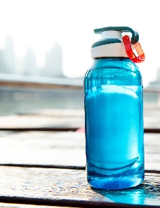
Plurale – weiblich (feminine)
Most feminine words make a plural by adding an –n or –en:
Remember! The plural word for ‘the’ is die for all genders!
die Flasche
die Frau
die Tür
die Flaschen
die Frauen
die Türen
Notes:
Timing: 2 minutes Aim: To introduce Plural Rule 3 - die --> +(e)n.
Procedure: 1. Click to animate the explanation.
2. Ensure students’ understanding at each stage.
Note: The word ‘weiblich’ is in the title [2491]. It’s equivalent ‘männlich’ [3326] hasn’t yet been used with students, but they know ‘Mann’ and the ‘ä’ SSC, so it can be expected that these two adjectives could be consistently used in tasks focused on gender, from now on.

Slide 14
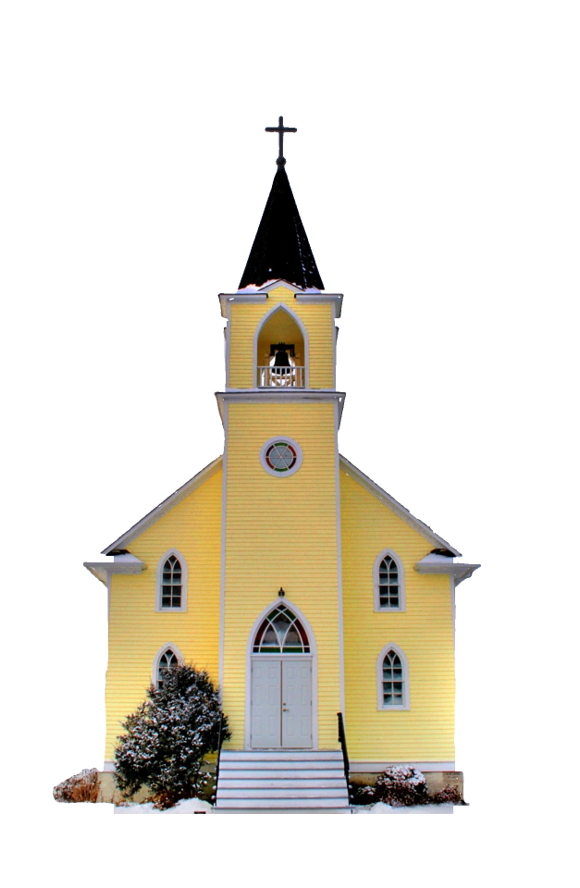
Grammatik
die _______
die Kirche
Notes:
Timing: 10 minutes (all slides in sequence) Aim: To practise forming noun plurals.
Procedure: 1. Successive clicks bring up the following: the singular picture; the singular noun form; the plural pictures; the plural definite article and blank for plural noun (which students will supply).
2. Introduce the singular noun (elicit from students with just picture, then confirm, showing word).
3. Ask students to supply the plural using the rules they have just learnt. Show just picture at first to elicit (students could write this down), then show plural definite article to underline this change. The answers to the exercise follow after the remaining question slides.
Note: Kirche / Idee / Woche / Familie are on the vocabulary list for this week. The other words are broadly Christmas-themed words or other high frequency words from the phonics clusters that we are not expecting students to learn, at this time. However, depending on the level of the class, it might work well to do this activity as a written activity, relying on students’ working memory from having briefly seen the singular written form.
Word frequency (1 is the most frequent word in German):
Kirche / Kirchen [519] Familie / Familien [310]
Idee / Ideen [641]
Woche / Wochen [209]
Liste / Listen [1975]
Million / Millionen [206]
Kerze / Kerzen [3985]
Glocke / Glocken [>5000]
Kugel / Kugeln [3618]
Source: Jones, R.L. & Tschirner, E. (2011). A frequency dictionary of German: core vocabulary for learners. Routledge

Slide 15
Grammatik
die Familie
die _______
Notes:
As for previous slide.

Slide 16
Grammatik
die Idee
die _______
Notes:
As for previous slide.

Slide 17
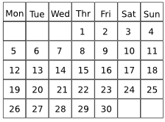
Grammatik
X
X
X
die Woche
die _______
Notes:
As for previous slide.

Slide 18
Grammatik
_________
_________
_________
_________
_________
_________
_________
_________
_________
_________
_________
_________
_________
_________
_________
_________
_________
_________
die _______
die Liste
Notes:
As for previous slide.

Slide 19
Grammatik
die Million
die _______
Notes:
As for previous slide.

Slide 20
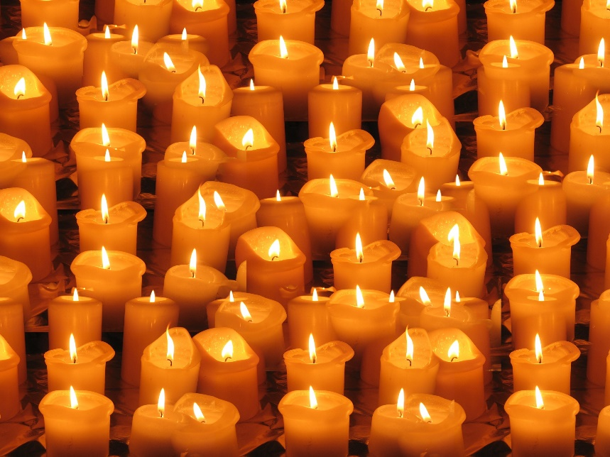
Grammatik
die _______
die Kerze
Notes:
As for previous slide.

Slide 21
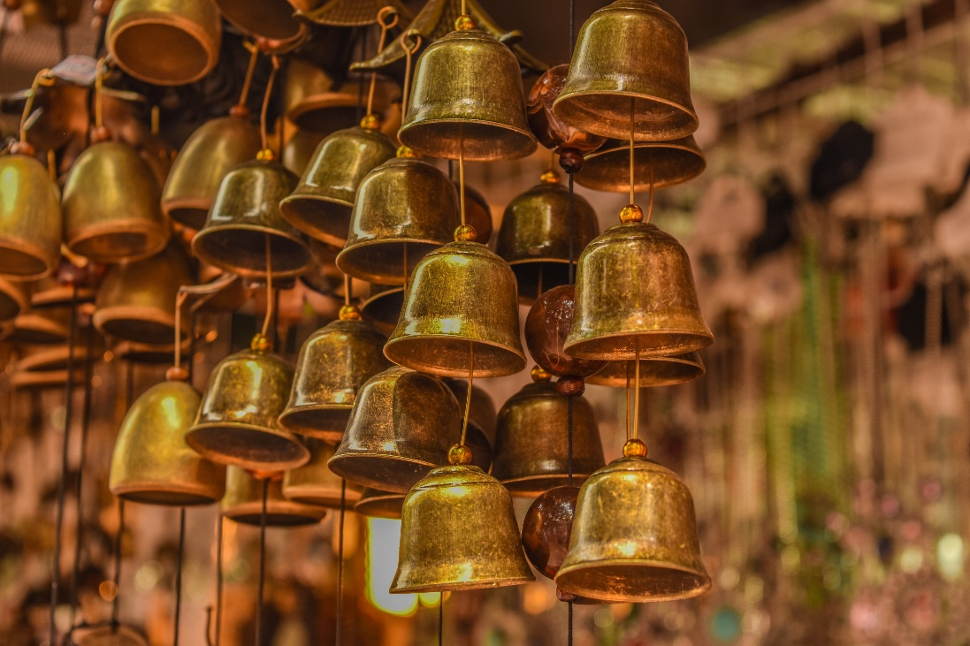
Grammatik
die Glocke
die _______
Notes:
As for previous slide.

Slide 22
Grammatik
die _______
die Kugel
Notes:
As for previous slide.

Slide 23
Grammatik
Antworten
die _______
die Kirchen
Notes:
Timing: 6 minutes (all slides in answer sequence) Aim: To provide the answers to the activity on the preceding slides.
Procedure: 1. Click to bring up the plural picture and plural definite article, with blank space for noun.
2. Elicit plural noun from students.
3. Click to confirm answer.

Slide 24
Grammatik
die _______
die Familien
Notes:
As for previous slide.

Slide 25
Grammatik
die Ideen
die _______
Notes:
As for previous slide.

Slide 26
Grammatik
X
X
X
die Wochen
die _______
Notes:
As for previous slide.

Slide 27
Grammatik
_________
_________
_________
_________
_________
_________
_________
_________
_________
_________
_________
_________
die Listen
die _______
Notes:
As for previous slide.

Slide 28
Grammatik
die _______
die Millionen
Notes:
As for previous slide.

Slide 29
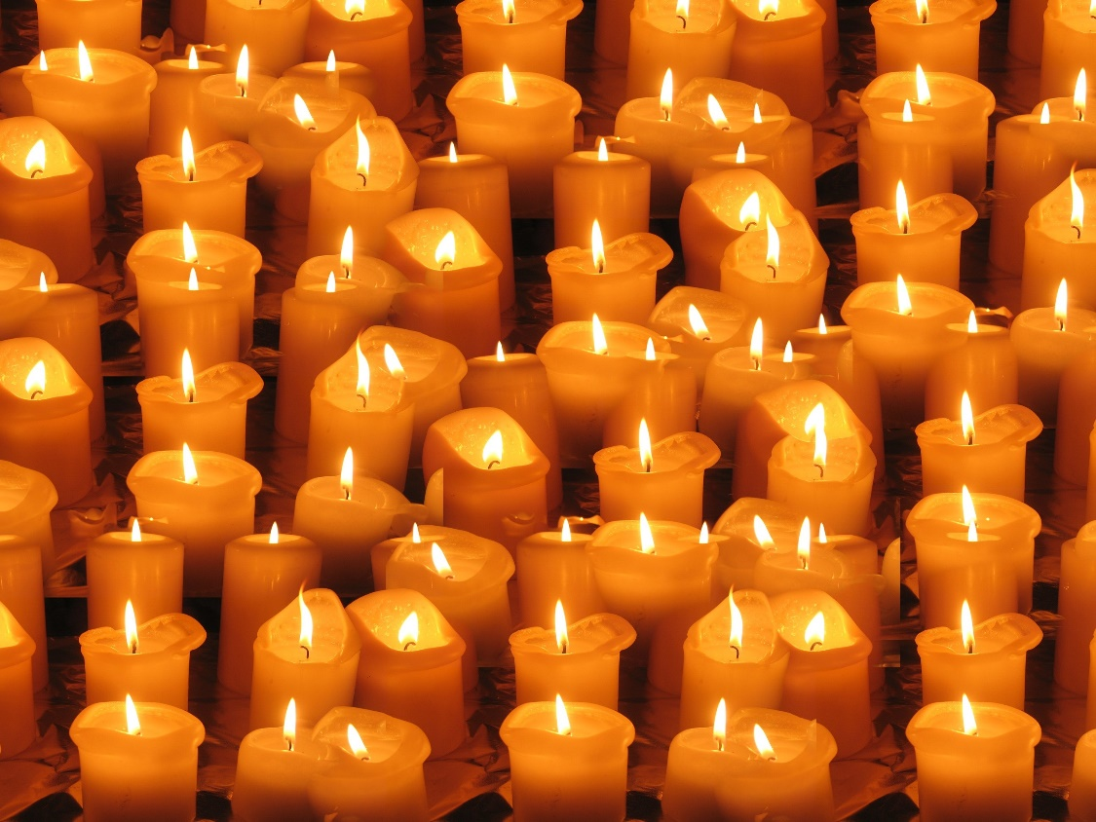
Grammatik
VokabelnVokabeln
die Kerzen
die _______
Notes:
As for previous slide.

Slide 30
Grammatik
die Glocken
die _______
Notes:
As for previous slide.

Slide 31
Vokabeln
die _______
die Kugeln
Notes:
As for previous slide.

Slide 32
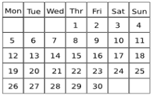
hören
hören
1
6
2
7
3
8
Vokabeln
4
X
X
X
9
5
10
Notes:
Timing: 6 minutes Aim: To practise producing third person singular and plural forms of SEIN as appropriate (listening).
Note: A variation of this activity, using the same audio but requiring full sentence transcription, is to be found on the next slide. Teachers may choose to skip straight to the more demanding activity.
Procedure: 1. Click to bring up the questions one at a time.
2. Click to the numbered button to play the audio. The verb (SEIN) is obscured (with a festive jingle!).
3. Students listen to the sentences and write ‘ist’ or ‘sind’ as appropriate, considering the form of the noun heard.
4. Once all questions have been displayed and heard, successive clicks display the correct answers.
Note: All nouns are feminine, i.e. the article does not supply any additional information. It is worth reminding students of this. The only way they can distinguish between singular and plural here is the ending on the noun.
Transcript:
1. Die Kirchen [sind] offen.
2. Die Glocke [ist] laut.
3. Die Kugeln [sind] rot.
4. Die Wochen [sind] kurz.
5. Die Idee [ist] gut.
6. Die Millionen [sind] falsch.
7. Die Familie [ist] zu früh.
8. Die Kerzen [sind] schön.
9. Die Liste [ist] lang.
10. Die Frauen [sind] zu spät.

Slide 33
hören
hören
1
Die Kirchen sind offen.
6
Die Millionen sind falsch.
2
Die Glocke ist laut.
7
Die Familie ist zu früh.
3
Die Kugeln sind rot.
8
Die Kerzen sind schön.
4
Die Wochen sind kurz.
9
Die Liste ist lang.
5
Die Idee ist gut.
10
Die Frauen sind zu spät.
Notes:
Timing: 6 minutes Aim: To practise transcription skills.
Note: This is a variation of this activity on the previous slide, using the same audio but requiring full sentence transcription.
Procedure: 1. Click to bring up the question numbers one at a time.
2. Click to the numbered button to play the audio. The verb (SEIN) is obscured (with a festive jingle!).
3. Students listen to the sentences and transcribe them, writing ‘ist’ or ‘sind’ as appropriate, considering the form of the noun heard.
4. Once all questions have been displayed and heard, successive clicks display the sentences as heard.
Note: All nouns are feminine, i.e. the article does not supply any additional information. It is worth reminding students of this. The only way they can distinguish between singular and plural here is the ending on the noun.
Transcript:
1. Die Kirchen [sind] offen.
2. Die Glocke [ist] laut.
3. Die Kugeln [sind] rot.
4. Die Wochen [sind] kurz.
5. Die Idee [ist] gut.
6. Die Millionen [sind] falsch.
7. Die Familie [ist] zu früh.
8. Die Kerzen [sind] schön.
9. Die Liste [ist] lang.
10. Die Frauen [sind] zu spät.

Slide 34
übersetzen
hören / lesen
1
Die Kirchen sind offen.
6
Die Millionen sind falsch.
The churches are open.
The millions are fake.
2
Die Glocke ist laut.
7
Die Familie ist zu früh.
The bell is loud.
The family is too late.
3
Die Kugeln sind rot.
8
Die Kerzen sind schön.
The baubles are red.
The candles are lovely, beautiful.
4
Die Wochen sind kurz.
9
Die Liste ist lang.
The weeks are short.
The list is long.
5
Die Idee ist gut.
10
Die Frauen sind zu spät.
The idea is good.
The women are too early.
Notes:
Timing: 6 minutes Aim: To practise translation skills.
Note: This uses the same sentences as the previous activity, but with full audio this time (i.e. verbs left in). Students are asked to translate the full sentences into English.
Procedure: 1. Click to bring up the question numbers and German sentences one at a time.
2. Click to the numbered button to play the audio. The verb (SEIN) is is left in this time.
3. Students read and listen to the sentences, and translate them into English in writing.
4. Once all questions have been displayed and heard, successive clicks display the suggested translation for each sentence.
Transcript:
1. Die Kirchen sind offen.
2. Die Glocke ist laut.
3. Die Kugeln sind rot.
4. Die Wochen sind kurz.
5. Die Idee ist gut.
6. Die Millionen sind falsch.
7. Die Familie ist zu früh.
8. Die Kerzen sind schön.
9. Die Liste ist ang.
10. Die Frauen sind zu spät.

Slide 35
Vokabeln
Antworten
Welt
Wort
Freunde
Fußball
Haus
1
VIELE
Lehrer
Lehrer
Haustiere
Familie
Ideen
Notes:
Timing: 6 minutes
Aim: To practise recognising singular and plural forms of nouns.
Procedure: 1. Click to bring up the nouns, one at a time.
2. Students say whether each noun is singular or plural.
3. Click to make the noun ‘fly’ to the appropriate ‘sack’ on the screen.

Slide 36
Christmas Talking about presents you wish for
Weihnachtsliste
Using singular and plural nouns
SSC [ä]
Y7 German
Term 1.2 – Week 6 - Lesson 28
Inge Alferink / Rachel Hawkes
Artwork: Steve Clarke
Date updated: 15/12/21
Notes:
Artwork by Steve Clarke. All additional pictures selected are available under a Creative Commons license; no attribution required.
Learning outcomes (lesson 2):
Introduction of SSC [ä]
Consolidation of third person plural form of SEIN (ist / sind)
Consolidation of plurals Rule 3 - die --> +(e)n; plural article = 'die'
Word frequency (1 is the most frequent word in German):
7.1.2.7 (introduce) bekommen [212] sind [4] Familie [329] Hund [825] Idee [451] Katze [2235] Kirche [892] Woche [219] früh [366] schön [188] spät [169] ich wünsche mir [n/a]
7.1.2.4 (revisit) lesen [305] sprechen [161] wiederholen [988] zeigen [136] zuhören [1629] Antwort [522] freiwillig [1652] (Antworten) zeigen! Zuhören! Sprechen! Lesen! Schreiben! Wiederholen!
7.1.1.5 (revisit) haben, hat [6] er1 [15] sie1 [7] wer? [149] Freund [273] Fußball [1277] Haus [159] Haustier [>5009] Lehrer [695] Wasser [245] Welt [164] Wort [194] wahr [737] nicht wahr? [n/a] Ist es warm/kalt heute?
Source: Jones, R.L. & Tschirner, E. (2019). A frequency dictionary of German: core vocabulary for learners. Routledge

Slide 37
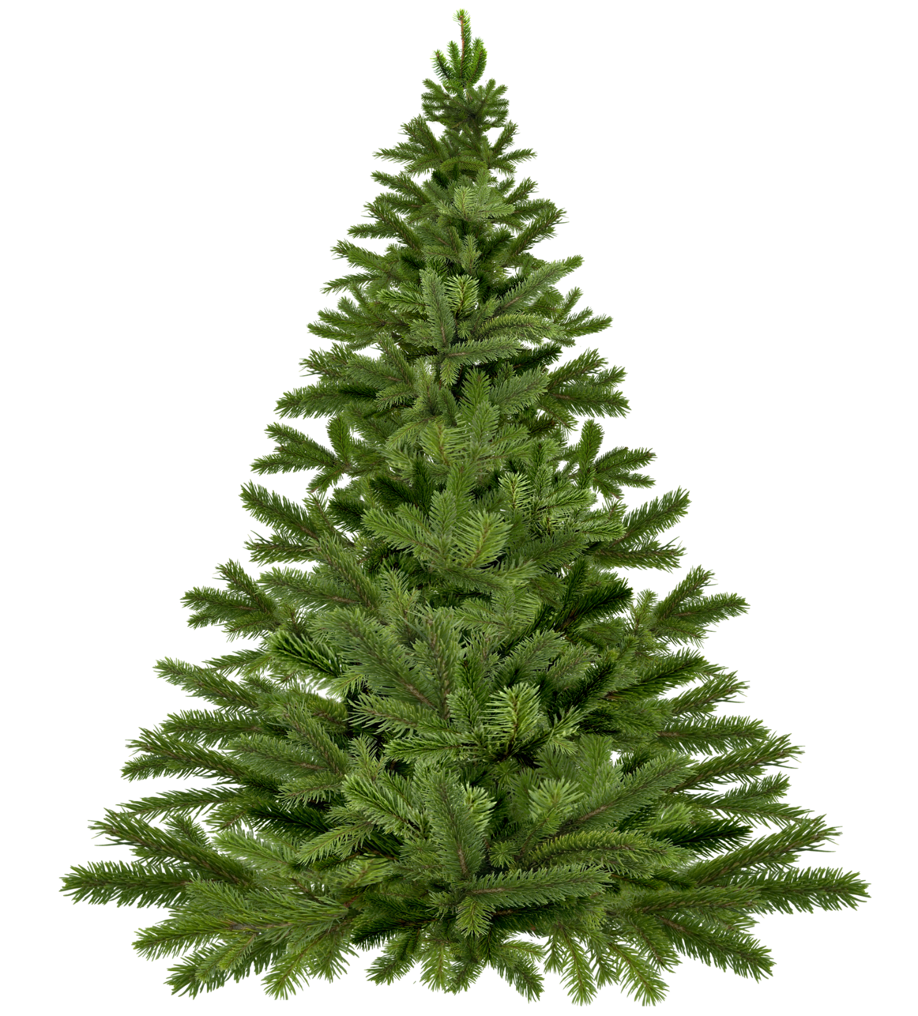
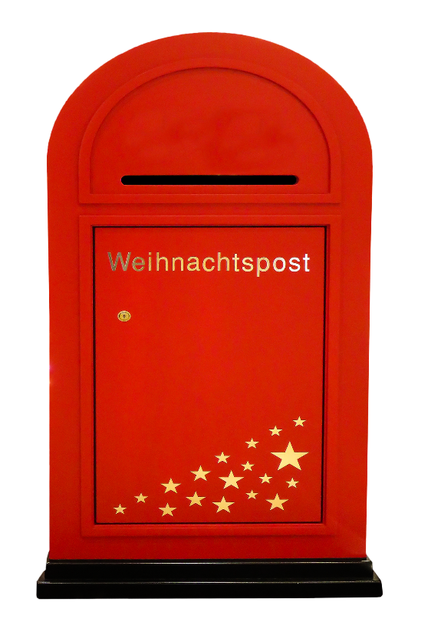
Vokabeln
A
B
A
B
C
C
i
h
3
c
3
D
3
E
F
D
E
F
G
H
I
J
G
J
w
ü
n
h
e
1
3
5
s
c
7
2
1
10
H
I
K
L
M
K
M
L
m
i
r
6
3
3
Notes:
Timing: 10 minutes
Aim: To revisit vocabulary that is not included in the lesson otherwise (includes some items from week 6).
Procedure: 1. Ask students to write down A to M in their notebooks.
2. Click on a bauble to hear the word twice. Repeat if necessary.
3. Students write down the German words they hear.
4. The number on the bauble that appears next to the tree upon subsequent clicks will tell you which letter you need from the word.
5. When all the baubles have appeared, the next sequence of clicks reveals the letters. All the letters together spell ‘ich wünsche mir’, which introduces the theme for the lesson, which we’ll come back to after the phonics introduction.
Transcript/[answers]:
zeigen [→ ich (3)]
nicht wahr [→ ich (3)]
zuhören [→ ich (3)]
wiederholen [→ wünsche (1)]
früh [→ wünsche (3)]
haben [→ wünsche (5)]
hat [→ wünsche (1)]
ich weiß nicht [→ wünsche (10)]
das Wasser [→ wünsche (7)]
wer? [→ wünsche (2)]
manchmal [→ mir (6)]
kein [→ mir (3)]
freiwillig [→ mir (3)]

Slide 38
ä
spät
Notes:
Timing: 1 minute
Aim: To introduce/consolidate SSC [ä]
Procedure: 1. Present the letter(s) and say the [ä] sound first, on its own. Students repeat it with you. 2. Bring up the word ”spät” on its own, say it, students repeat it, so that they have the opportunity to focus all of their attention on the connection between the written word and its sound.
3. A possible gesture for this would be to bring your left arm up to mime suddenly looking at your watch.
4. Roll back the animations and work through 1-3 again, but this time, dropping your voice completely to listen carefully to the students saying the [ä] sound, pronouncing ”spät’” and, if using, doing the gesture. Word frequency (1 is the most frequent word in German): spät [171]
Source: Jones, R.L. & Tschirner, E. (2006). A frequency dictionary of German: core vocabulary for learners. Routledge

Slide 39
ä
spät
Notes:
With sound and no pictures to focus all attention on the sound-symbol correspondence.

Slide 40
ä
spät
Notes:
Without sound to elicit pronunciation (without first hearing the teacher).
Teacher to elicit pronunciation by asking “Wie sagt man…”

Slide 41
ä
zählen
ähnlich
1, 2, 3, …100
spät
Nähe
wählen
Berlin 1KM
erklären
[to explain]
Notes:
Timing: 1 minute
Aim: To introduce/consolidate SSC [ä]
Procedure:
Introduce and elicit the pronunciation of the individual SSC [ä] and then the source word again ‘spät’ (with gesture, if using).
Then present and elicit the pronunciation of the five cluster words.
The cluster words have been chosen for their high-frequency, from a range of word classes, with the SSC (where possible) positioned within a variety of syllables within the words (e.g. initial, 2nd, final etc.). Additionally, we have tried to use words that build cumulatively on previously taught SSCs (see the Phonics Teaching Sequence document) and do not include new SSCs. Where new SSCs are used, they are often consonants which have a similar symbol-sound correspondence in English.
Word frequency (1 is the most frequent word in German): spät [171]; zählen [680] ähnlich [429]; Nähe [795]; erklären [250]; wählen [64]. Source: Jones, R.L. & Tschirner, E. (2006). A frequency dictionary of German: core vocabulary for learners. Routledge

Slide 42
ä
zählen
ähnlich
spät
Nähe
wählen
erklären
Notes:
With sound and no pictures to focus all attention on the sound-symbol correspondence.

Slide 43
ä
zählen
ähnlich
spät
Nähe
wählen
erklären
Notes:
Without sound to elicit pronunciation (without first hearing the teacher).
Teacher to elicit pronunciation by asking “Wie sagt man…”

Slide 44
ä
lächeln
Notes:
Timing: 1 minute
Aim: To introduce/consolidate SSC [ä]
Procedure: 1. Present the letter(s) and say the [ä] sound first, on its own. Students repeat it with you. 2. Bring up the word ”lächeln” on its own, say it, students repeat it, so that they have the opportunity to focus all of their attention on the connection between the written word and its sound.
3. A possible gesture for this would be to trace a broad smile on your own face, drawing your index fingers away from the middle of your mouth to the outer edges.
4. Roll back the animations and work through 1-3 again, but this time, dropping your voice completely to listen carefully to the students saying the [ä] sound, pronouncing “lächeln” and, if using, doing the gesture. Word frequency (1 is the most frequent word in German): lächeln [793]
Source: Jones, R.L. & Tschirner, E. (2006). A frequency dictionary of German: core vocabulary for learners. Routledge

Slide 45
ä
lächeln
Notes:
With sound and no pictures to focus all attention on the sound-symbol correspondence.

Slide 46
ä
lächeln
Notes:
Without sound to elicit pronunciation (without first hearing the teacher).
Teacher to elicit pronunciation by asking “Wie sagt man…”

Slide 47
ä
Verhältnis
Mädchen
[relationship]
lächeln
Hälfte
ändern
ständig
[constant(ly)]
Notes:
Timing: 2 minutes
Aim: To introduce/consolidate SSC [ä]
Procedure:
Introduce and elicit the pronunciation of the individual SSC [ä] and then the source word again ‘lächeln’ (with gesture, if using).
Then present and elicit the pronunciation of the five cluster words.
The cluster words have been chosen for their high-frequency, from a range of word classes, with the SSC (where possible) positioned within a variety of syllables within the words (e.g. initial, 2nd, final etc.). Additionally, we have tried to use words that build cumulatively on previously taught SSCs (see the Phonics Teaching Sequence document) and do not include new SSCs. Where new SSCs are used, they are often consonants which have a similar symbol-sound correspondence in English.
Word frequency (1 is the most frequent word in German): lächeln [793]; Verhältnis [517] Mädchen [537]; Hälfte [972]; ständig [612]; ändern [476].
Source: Jones, R.L. & Tschirner, E. (2006). A frequency dictionary of German: core vocabulary for learners. Routledge

Slide 48
ä
Verhältnis
Mädchen
lächeln
Hälfte
ändern
ständig
Notes:
With sound and no pictures to focus all attention on the sound-symbol correspondence.

Slide 49
ä
Verhältnis
Mädchen
lächeln
Hälfte
ändern
ständig
Notes:
Without sound to elicit pronunciation (without first hearing the teacher).
Teacher to elicit pronunciation by asking “Wie sagt man…”

Slide 50
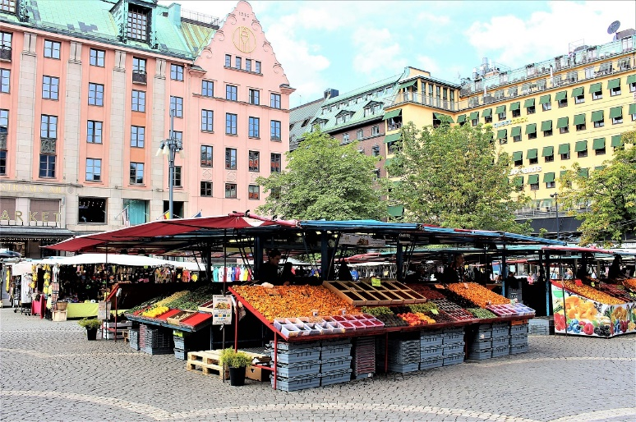
Sag es!
hören und sprechen
die Marktplätze
der Marktplatz
Notes:
Timing: 5 minutes (all phonics practice slides)
Aim: To provide phonics practice [ä].
Procedure: 1. Click to bring up the singular picture, then again to bring up the singular form of the noun. (These are all nouns containing [a] which goes to [ä] for the plural). Students repeat aloud.
2. Click again to bring up the plural picture, then again to bring up the plural form of the noun. Students repeat aloud.

Slide 51
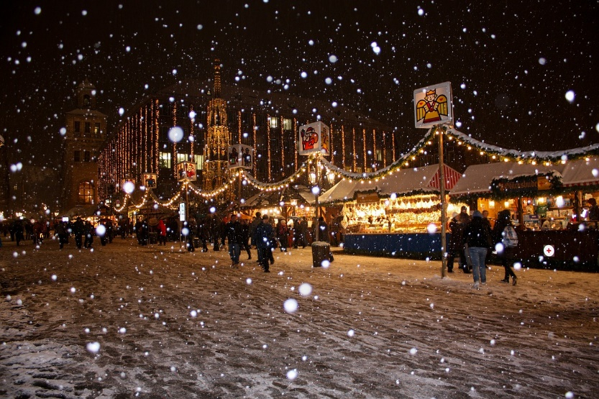
Sag es!
hören und sprechen
der Weihnachtsmarkt
die Weihnachtsmärkte
Notes:
As for previous slide.

Slide 52
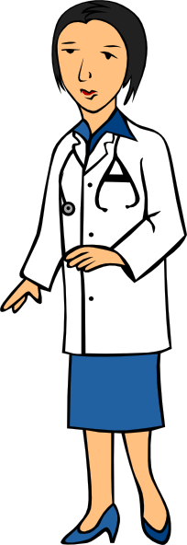
Sag es!
hören und sprechen
der Arzt
die Ärzte
Notes:
As for previous slide.

Slide 53
Sag es!
hören und sprechen
die Männer
der Mann
Notes:
As for previous slide.

Slide 54
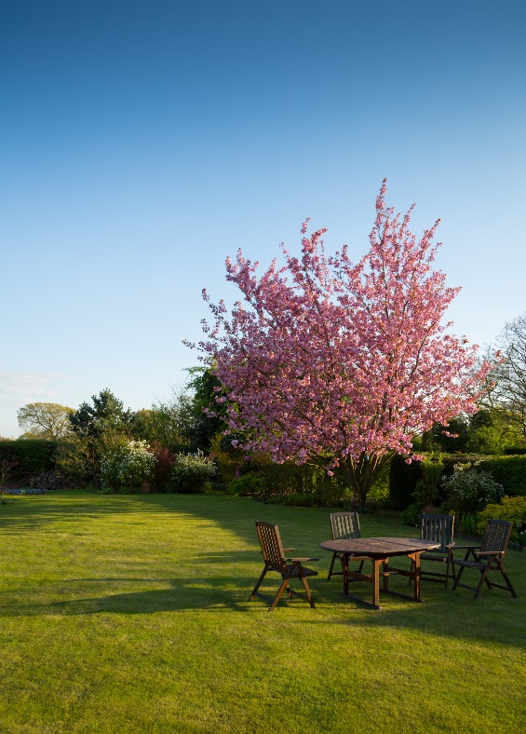
Sag es!
hören und sprechen
der Garten
die Gärten
Notes:
As for previous slide.

Slide 55
Sag es!
hören und sprechen
die Nacht
die Nächte
Notes:
As for previous slide.

Slide 56
Sag es und schreib es!
hören / sprechen / schreiben
PERSON A
1. Mann
2. Plätze
3. Gärten
4. Nächte
5. Arzt
6. Markt
PERSON B
1. Märkte
2. Männer
3. Arzt
4. Plätze
5. Gärten
6. Nacht
Notes:
Timing: 5 minutes
Aim: To provide phonics practice (speaking) [ä].
Procedure: 1. Pair work: 1 person reads out loud and the other person writes down the word paying particular attention to the vowel.
2. Students swap roles.

Slide 57
Sag es!
sprechen
Wir wünschen dir frohe Weihnacht,
wir wünschen dir frohe Weihnacht,
wir wünschen dir frohe Weihnacht
und ein glücklich’ Neujahr!
Notes:
Timing: 7 minutes
Aim: To provide phonics practice (read aloud task).
Procedure: 1. Students read out loud line by line.
Note: Neu is a new sound and needs to be modelled.
2. Alternatively or additionally, sing to the tune of ‘We wish you a merry Christmas’. Note: versions of the carol can be found on YouTube. Singing along in time to a song is a useful way to speed up spoken production.

Slide 58
Ich wünsche mir…
… einen Fußball
1. ______________
2. ______________
3. ______________
4. ______________
5. ______________
6. ______________
… ein Haustier
… eine Kerze
Notes:
Timing: 15 minutes
Note: Timing is generous on this slide to allow additional space in the final lesson of term.
Aim: To practise dictionary work with Weihnachtsliste - Ich wünsche mir + Row 2 nouns indefinite article (revisiting previous grammar with new lexis).
Procedure: 1. Explain ‘Ich wünsche mir’ (I wish (for myself)). At this point we will not explain the grammar behind mir, but treat it as a chunk.
2. Go through the examples on the slide to remind the students of the accusative form with indefinite articles. Ask them which indefinite article goes with which gender.
3. Ask students to look up in the dictionary 6 things in they wish to put on their Weihnachtslist.
4. Students write the items on their list with the correct indefinite article in the correct form.

Slide 59
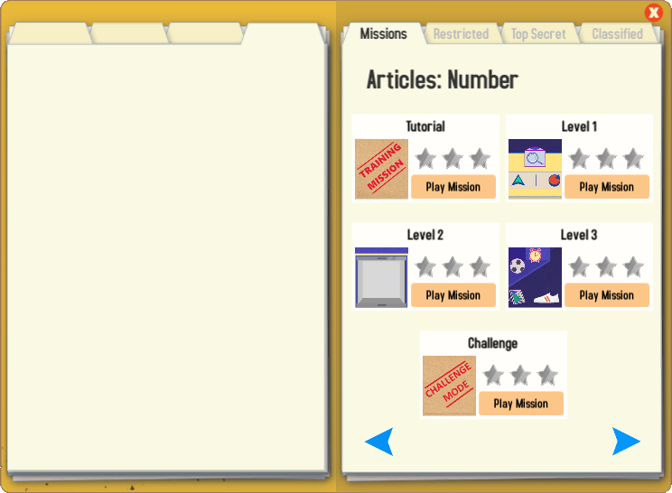
Gaming Grammar
Try the following Gaming Grammar missions to practise:

Slide 60
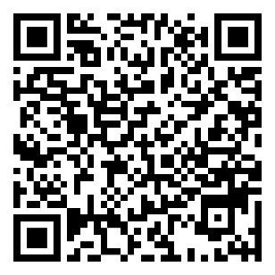
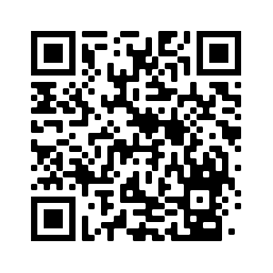
Hausaufgaben
Vocabulary Learning Homework (Term 2.1, Week 1)
Audio file: audio homework file
Audio file QR code:
Student worksheet: student worksheet link
Quizlet link
In addition, revisit: Term 1.2 Week 5
Term 1.1 Week 6
Notes:
Timing: 2 minutes Use this slide to set the homework.

