Slide 1
German definite articles: the words for ‘the’
Explanation and tasks
Leigh McClelland

Slide 2
Grammar explanation
German nouns are divided up into three groups.
Each group has a grammatical gender and a different word for the.
These words for the are called definite articles.
masculine | der | e.g. der Zug (the train)
feminine | die | e.g. die Familie (the family)
neuter | das | e.g. das Haus (the house)
When you learn a German noun, you must learn its grammatical gender.
Leigh McClelland, / Rachel Hawkes
Notes:
Teacher notes: Read this short explanation out. Remember, that these explanations by themselves do not make a huge impact on learning – it is practice that really has the biggest benefits. So it is not worth spending too much time on these explanations. Also, they are always ‘partial’ – we can’t communicate all the complexity at once.
Word frequency ratings: Haus [159], Familie [310], Zug [613] Source: Jones, R.L & Tschirner, E. (2011). A frequency dictionary of German: Core vocabulary for learners. London: Routledge.

Slide 3
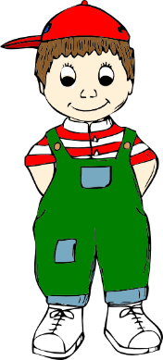
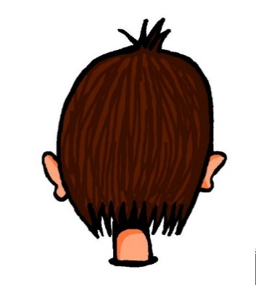
Vocabulary introduction
Masculine nouns (der …)
der
Mann
der
Vater
der
Junge
Why?
der
Fußball
der
Kopf
der
Grund
Leigh McClelland, / Rachel Hawkes,/ Emma Marsden
Notes:
Presentation/introduction to the active nouns from the tasks that follow.
Here, all the masculine nouns are introduced.
You may need to explain the image for “Grund” = reason or cause. Please just give the English word (in case learners think that Grund means question or why, even if they have met it before!).
You could explain to pupils why ‘gender of nouns’ exists in languages, as they often wonder why and it can help them to understand why it is important to learn it. Some thoughts: It is common in many languages other than English that ALL nouns have a gender (not just nouns that refer to biologically male or female things). It speeds up our understanding of language as we listen to it and read it – even two year olds use gender to understand language faster! Gender also helps ‘gel’ or ‘glue’ sentences together. For example, it helps us to link words like ‘the’ with the noun they belong to (as they don’t always appear next to each other!). In some languages, gender can make it clear which adjective describes which noun – as the adjective often changes to match the gender of the noun. Also, because the word for ‘the’ expresses gender, it can even help us to understand “who is doing what to who”. You will get a chance to practise all these important things later. For now, you just need to learn the gender of nouns.
Word frequency ratings: Mann [131], Vater [216], Junge [630] Fußball [1497]; Kopf [279]; Grund [230]

Slide 4
Vocabulary introduction
Feminine nouns (die …)
die
Hand
die
Mutter
die
Familie
die
Nacht
die
Tür
Leigh McClelland
Notes:
Presentation/introduction to the active nouns from the tasks that follow.
Here, all the feminine nouns are introduced.
Word frequency ratings: Hand [179]; Mutter [227], Familie [310] Nacht [335]; Tür [400];

Slide 5
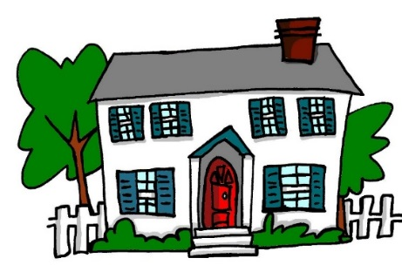
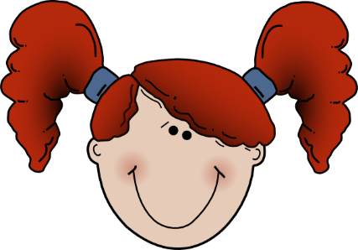
Vocabulary introduction
Neuter nouns (das …)
das
Buch
das
Haus
das
Monster
das
Programm
das
Wasser
das
Mädchen
Leigh McClelland
Notes:
Presentation/introduction to the active nouns from the tasks that follow.
Here, all the neuter nouns are introduced.
You could point out that, yes, the noun ‘girl’ has a neuter gender. This just shows that ALL nouns have gender, and in German this is not always in ways that you expect. Gender on nouns is very ‘abstract’!! It has to be learnt, and can’t really be guessed or worked out in German.
Word frequency ratings: Buch [295]; Haus [159], Monster [>5000] Programm [464]; Wasser [297]; Mädchen [537]

Slide 6
Vocabulary introduction
der, die, oder das?
Mann
Familie
Monster
Fußball
Haus
Tür
Buch
Hand
Nacht
Programm
Wasser
Junge
Grund
Kopf
Mädchen
Mutter
Vater
der
die
das
Leigh McClelland
Notes:
Presentation/introduction to the active nouns from the tasks that follow.
Here, pupils should predict to which word for ‘the’ each noun will fly – der, die or das? This slide has the words as text. The next slide has the nouns as pictures to stimulate recall of the words themselves as well as their gender.
It is anticipated that the meaning of many/most of these nouns will be known as many are included as phonics source/cluster words and will have been encountered and practised for pronunciation, but not with a focus on their gender / matching word for ‘the’.

Slide 7
Vocabulary introduction
Why?
der, die, oder das?
der
die
das
Leigh McClelland
Notes:
Presentation/introduction to the active nouns from the tasks that follow.
Here, pupils should predict to which word for ‘the’ each noun will fly – der, die or das? and try to recall the German for each noun at the same time.

Slide 8
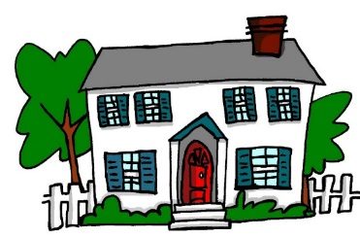
Vocabulary introduction
Was passt nicht in die Reihe?
1.
4.
die
die
das
der
die
die
2.
5.
das
die
das
der
das
das
Why?
3.
6.
der
der
der
das
der
der
die
Leigh McClelland
Notes:
Presentation/introduction to the active nouns from the tasks that follow.
Here, pupils find the odd one out by identifying the gender of each noun.

Slide 9
Reading exercise
Your German friend has a film project homework but has ripped up her notes in frustration. You rescue the scraps of paper and try to reconstruct her ideas for the opening scene.
Familie
Mädchen
Vater
1. Die / / macht ein Picknick im Garten.
Mädchen
Junge
Mutter
2. Die / / sitzt auf dem Gras.
Mutter
Vater
Mädchen
3. Der / / hat ein Buch.
Junge
Mädchen
Mutter
4. Die / / trinkt Wasser.
Mädchen
Junge
Familie
5. Das / / spielt Fußball mit einem Freund.
Leigh McClelland
Notes:
Familie [cluster 310], Fußball [cluster 1497], Vater [cluster 216], machen [cluster 49], Picknick [cognate ˃2000], Garten [959]
Junge [cluster 630], Eltern [cluster 351], sitzen [cluster 261], Gras [cognate ˃2000]
Mutter [cluster 227], Mädchen [cluster 537], haben [cluster 7], Buch [source 295]
trinken [608], Wasser [cluster 297]
spielen [source 197], mit [cluster 13], Freund [cluster 327]

Slide 10
Reading exercise
Your German friend has a film project homework but has ripped up her notes in frustration. You rescue the scraps of paper and try to reconstruct her ideas for the opening scene.
Haus
Fußball
Mädchen
6. Der / / ist klein.
Mädchen
Mutter
Junge
7. Der / / geht ins Haus.
Vater
Fußball
Haus
8. Das / / ist groß.
Mutter
Junge
Eltern
9. Der / / kommt wieder aus dem Haus.
Familie
Fußball
Haus
10. Das / / explodiert!
Leigh McClelland
Notes:
Haus [source 159], sein [2], klein [cluster 114], und [source 2], rund [cluster 316]
gehen [69]
groß [source 74], neu [cluster 80]
kommen [61] wieder [cluster 75]
explodieren [cognate ˃2000]

Slide 11
Listening exercise
Your German friend is on the phone describing a rather tense episode of her favourite TV programme. You are struggling to hear because your dad keeps using the blender in the kitchen. Can you make sense of it all?
1
der/die/das | Mann / Nacht / Monster | ist sehr dunkel.
der/die/das | Mann / Familie / Monster | steht in der Kirche.
der/die/das | Programm / Nacht / Grund | ist nicht klar.
der/die/das | Familie / Mann / Monster | findet einen Körper! Was?!
der/die/das | Kopf / Monster / Hand | ist rot und blutig.
2
3
4
5
Leigh McClelland
Notes:
Transcript: Recordings have blender noises inserted instead of the words in square brackets.
1. Die [Nacht] ist sehr dunkel.
2. Der [Mann] steht in einer Kirche.
3. Der [Grund] ist nicht klar.
4. Der [Mann] findet einen Körper! Was?!
5. Der [Kopf] ist rot und blutig.
6. Die[ Hand] hat keine Finger.
7. Der [Mann] sieht jetzt ein Monster. Hilfe!
8. Die [Tür] ist da.
9. Das [Monster] kommt plötzlich in die Kirche.
10. Das [Programm] endet! O nein!
die Nacht [cluster 335], sehr [70], dunkel [cluster 819]
der Mann [cluster 131], stehen [cluster 210], Kirche [cluster 519]
der Grund [cluster 230], nicht [cluster 12], klar [cluster 255]
finden [source 110], der Körper [cluster 617], was [cluster 39]
der Kopf [source 279], sein [cluster 3], rot [cluster 381], blutig [cognate ˃2000]
die Hand [cluster 179], haben [7], keine [50], Finger [cognate 1034]
sehen [81], das Monster [cognate ˃2000], jetzt [62], Hilfe [cluster 737]
die Tür [source 400], offen [cluster 382]
das Monster [cognate ˃2000], kommen [cluster 61], plötzlich [source 459], Kirche [cluster 519]
das Programm [cognate 464], enden [cognate 1846]

Slide 12
Listening exercise
You keep listening to your friend, and start to make notes in English to try to make sense of the story.
article | noun | notes
 | Monster / Hand / Mann
 | Familie / Mädchen / Mann
 | Programm / Mann / Tür
 | Familie / Mann / Monster
 | Nacht / Programm / Familie
6
7
8
9
10
Leigh McClelland
Notes:
Transcript: Recordings have blender noises inserted instead of the words in square brackets.
6. Die[ Hand] hat keine Finger.
7. Der [Mann] sieht jetzt ein Monster. Hilfe!
8. Die [Tür] ist da.
9. Das [Monster] kommt plötzlich in die Kirche.
10. Das [Programm] endet! O nein!
die Nacht [cluster 335], sehr [70], dunkel [cluster 819]
der Mann [cluster 131], stehen [cluster 210], Kirche [cluster 519]
der Grund [cluster 230], nicht [cluster 12], klar [cluster 255]
finden [source 110], der Körper [cluster 617], was [cluster 39]
der Kopf [source 279], sein [cluster 3], rot [cluster 381], blutig [cognate ˃2000]
die Hand [cluster 179], haben [7], keine [50], Finger [cognate 1034]
sehen [81], das Monster [cognate ˃2000], jetzt [62], Hilfe [cluster 737]
die Tür [source 400], offen [cluster 382]
das Monster [cognate ˃2000], kommen [cluster 61], plötzlich [source 459], Kirche [cluster 519]
das Programm [cognate 464], enden [cognate 1846]

Slide 13
Listening exercise
You keep listening to your friend, and start to make notes in English to try to make sense of the story.
article | noun | notes
 | Monster / Hand / Mann
 | Familie / Mädchen / Mann
 | Programm / Mann / Tür
 | Familie / Mann / Monster
 | Nacht / Programm / Familie
6
die
Hand – no fingers
7
der
Man sees monster
8
die
Door is there
9
das
Monster comes into the church
10
das
Programme ends
Leigh McClelland
Notes:
ANSWERS
6. Die[ Hand] hat keine Finger.
7. Der [Mann] sieht jetzt ein Monster. Hilfe!
8. Die [Tür] ist da.
9. Das [Monster] kommt plötzlich in die Kirche.
10. Das [Programm] endet! O nein!
die Nacht [cluster 335], sehr [70], dunkel [cluster 819]
der Mann [cluster 131], stehen [cluster 210], Kirche [cluster 519]
der Grund [cluster 230], nicht [cluster 12], klar [cluster 255]
finden [source 110], der Körper [cluster 617], was [cluster 39]
der Kopf [source 279], sein [cluster 3], rot [cluster 381], blutig [cognate ˃2000]
die Hand [cluster 179], haben [7], keine [50], Finger [cognate 1034]
sehen [81], das Monster [cognate ˃2000], jetzt [62], Hilfe [cluster 737]
die Tür [source 400], offen [cluster 382]
das Monster [cognate ˃2000], kommen [cluster 61], plötzlich [source 459], Kirche [cluster 519]
das Programm [cognate 464], enden [cognate 1846]

Slide 14
Speaking exercise
Partner A
Read each sentence out to your partner in German, but do not say out loud the word that is crossed out. You must decide which German word for ‘the’ should be used (before the noun that you will not say!). This way your partner has to listen to the word for the and work out which word you missed out. They will choose between two pictures they have in front of them. They will then write out the whole sentence in German – so give them a moment to do this.
Partner B
Listen to your partner reading out 5 sentences. For each, tick the noun that matches the word for the that your partner says. They will not read the German noun but you will be able to tell which noun is missing by the gender of the word for the. Then try to write the spelling of each whole sentence that your partner has read out.
Leigh McClelland

Slide 15
Speaking exercise
Partner A
[The girl] spielt Fußball.
[The mother] trinkt Wasser.
[The door] ist offen.
[The monster] ist groß.
[The man] lächelt schön.
Das Mädchen spielt Fußball.
Die Mutter trinkt Wasser.
Die Tür ist offen.
Das Monster ist groß.
Der Mann lächelt schön.
Leigh McClelland
Notes:
lächeln [source 793], schön [source 164]
kosten [894], Million [cluster 206], Euro [cluster 333]
kalt [875]
The German support (on right) can be provided for pupils as necessary.

Slide 16
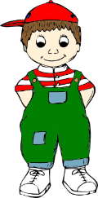
Speaking exercise
Partner B
1.
2.
3.
4.
5.
Leigh McClelland
Notes:
Das Mädchen spielt Fußball.
Die Mutter trinkt Wasser.
Die Tür ist offen.
Das Monster ist groß.
Der Mann lächelt schön.

Slide 17
Speaking exercise
Partner B
1.
Das
Mädchen
spielt
Fußball.
2.
Die
Mutter
trinkt
Wasser.
3.
Die
Tür
ist
offen.
4.
Das
Monster
ist
groß.
5.
Der
Mann
lächelt
schön.
Leigh McClelland
Notes:
Das Mädchen spielt Fußball.
Die Mutter trinkt Wasser.
Die Tür ist offen.
Das Monster ist groß.
Der Mann lächelt schön.

Slide 18
Speaking exercise
Now swap roles!
Partner B
Now read each sentence out to your partner in German, but do not say out loud the word that is crossed out. You must decide which German word for ‘the’ should be used (before the noun that you will not say!). This way your partner has to listen to the word for the and work out which word you missed out. They will choose between two pictures they have in front of them. They will then write out the whole sentence in German – so give them a moment to do this.
Partner A
Listen to your partner reading out 5 sentences. For each, tick the noun that matches the word for the that your partner says. They will not read the German noun but you will be able to tell which noun is missing by the gender of the word for the. Then try to write the spelling of each whole sentence that your partner has read out.
Leigh McClelland

Slide 19
Speaking exercise
Partner B
[The book] ist nicht lang.
[The head] explodiert plötzlich.
[The family] macht ein Picknick.
[The house] kostet eine Million Euro.
[The hand] ist kalt.
Das Buch ist nicht lang.
Der Kopf explodiert plötzlich.
Die Familie macht ein Picknick.
Das Haus kostet eine Million Euro.
Die Hand ist kalt.
Notes:
lächeln [source 793], schön [source 164]
kosten [894], Million [cluster 206], Euro [cluster 333]
kalt [875]
The German support (on right) can be provided for pupils as necessary.

Slide 20
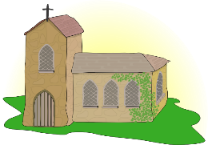
Speaking exercise
Partner A
1.
2.
3.
4.
5.
Leigh McClelland
Notes:
Das Buch ist nicht lang.
Der Kopf explodiert plötzlich.
Die Familie macht ein Picknick.
Das Haus kostet eine Million Euro.
Die Hand ist kalt.

Slide 21
Speaking exercise
Partner A
1.
Das
Buch
ist
nicht
lang.
2.
Der
Kopf
explodiert
plötzlich.
3.
Die
Familie
macht
ein
Picknick.
4.
Das
Haus
kostet
eine
Million
Euro.
5.
Die
Hand
ist
kalt.
Leigh McClelland
Notes:
Das Buch ist nicht lang.
Der Kopf explodiert plötzlich.
Die Familie macht ein Picknick.
Das Haus kostet eine Million Euro.
Die Hand ist kalt.

Slide 22
Writing exercise
Write sentences in German based on these words. You may add other words. Choose the words for the carefully.
Mann/trinkt
Haus/ist
Mädchen/spielt
Nacht/ist
Junge/liest
Mutter/spielt
Der Mann trinkt Wasser.
Das Haus ist klein/groß/neu/offen/schön.
Das Mädchen spielt Fußball (mit einem Freund).
Die Nacht ist lang und dunkel.
Der Junge liest ein Buch.
Die Mutter spielt Tennis.
Leigh McClelland
Notes:
The sentences listed are examples.
e.g.
1. Der Mann trinkt Wasser.
2. Die Nacht ist lang/dunkel.
3. Das Mädchen spielt Fußball/mit einem Freund.
4. Das Haus ist groß/klein und neu.
5. Der Junge liest ein Buch.
6. Die Mutter spielt Tennis.
Pupils should add source or cluster words if they want to add more detail.

