Slide 1
Talking about life experiences
-er & -ir verbs in the preterite tense:
1st person singular (-í)
2nd person singular (-iste)
Y9 Spanish
Term 3.2 – Week 5 – Lesson 69
Nick Avery / Louise Caruso / Amanda Izquierdo Artwork: Mark Davies
Date updated: 13/05/22
Notes:
Artwork by Mark Davies. All additional pictures selected are available under a Creative Commons license, no attribution required.
With thanks to Rachel Hawkes for her input on the lesson material.
Learning outcomes (lesson 1):
Consolidation of –er and –ir verbs in 1st person singular preterite tense (-í)
Consolidation of –er and –ir verbs in 2nd person singular preterite tense (-iste)
Consoldiation of preterite tense verbs with irregular stems: fui, fuiste, hiciste, tuviste
Consolidation of [r] and [rr]
Word frequency (1 is the most frequent word in Spanish):
revision 14/14 (64 words used, 36 from Y7, 28 from Y8): tener [19]; tengo [19]; tienes [19]; tiene [19]; lee [209]; escuchar [281]; da [42]; trabajar [174]; marca [993]; puede [32]; pedir [217]; debe [71]; leer [209]; visitar [792]; dormir [403]; tomar [133]; creer [83]; entender [229]; dividir [1385]; traer [341]; poner [91]; dirigir [1385]; traducir [2037]; octubre [1242]; colegio [628]; mano [135]; ruso [1645]; actor [1533]; actriz [3567]; personaje [595]; euro [2435]; precio [557]; pagar [377]; veintiún [>5000]; treinta [830]; entrar [207]; su [12]; dinero [127]; solo [95]; respuesta [488]; escuela [424]; once [1700]; director [592]; número [324]; arte [208]; grupo [200]; palabra [192]; letra [977]; frase [1036]; opción [1175]; correcto [1467]; correcta [1467]; pared [778]; que [3]; sobre [62]; página [598]; minuto [598]; razón [360]; sueño [450]; apoyo [866]; risa [1101]; ánimo [1855]; ¿Cómo se dice? {n/a]; ¿Cómo se escribe? [N/a]
Source: Davies, M. & Davies, K. (2018). A frequency dictionary of Spanish: Core vocabulary for learners (2nd ed.). Routledge: London
The frequency rankings for words that occur in this PowerPoint which have been previously introduced in NCELP resources are given in the NCELP SOW and in the resources that first introduced and formally re-visited those words.
For any other words that occur incidentally in this PowerPoint, frequency rankings will be provided in the notes field wherever possible.

Slide 2
¿Cómo se dice en español?
escribir
+5
+10
+15
+ 25
 | 1 | 2 | 3 | 4 | 5 | 6
A
B
C
D
E
to have, having
answer
to translate, translating
to take, taking
s/he must,
it must
la respuesta
alone
tomar
debe
tener
solo
traducir
eleven
I have
reason
correct
to visit, visiting
to believe, believing
once
tengo
razón
correcto, correcta
visitar
creer
dividir
da
tienes
option
la pared
to divide
s/he gives,
it gives
to enter, entering
you have
la opción
wall
entrar
Russian
s/he has,
it has
group
to bring, bringing
to work, working
to ask for, asking for
traer
trabajar
pedir
ruso, rusa
tiene
el grupo
brand
s/he can,
it can
hand
minute
s/he reads,
it reads
to put, putting
marca
puede
la mano
el minuto
lee
poner
Notes:
Vocabulario Timing: 8 minutes Aim: This ‘treasure hunt’ activity revisits key vocabulary to consolidate knowledge (in the written modality). As well as meaning, the focus is on form and spelling. Procedure:
1. Work individually, in pairs or in small groups. Each row (A-E) represents one round. 2. Write A-E in exercise books or mini whiteboards, chose 3 numbers for each line and write the Spanish for these three only. 3. Teacher elicits answers chorally for each item in Round 1 (A), clicking the blue box to reveal and check answers. 4. Teacher then clicks the yellow box to reveal the points for each correct answer (these are randomly allocated for an element of chance) – students tally their total.
5. Repeat steps 3-4 for Rounds 2-5 (B-E). Establish the winning indivudal, pair or group.

Slide 3
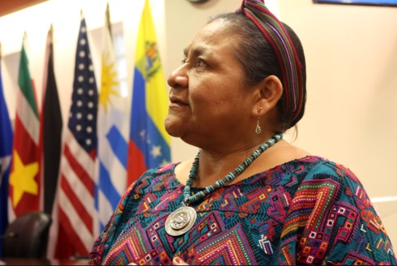
Hoy vamos a conocer a una persona de Guatemala, un país en Centroamérica. Se llama Rigoberta Menchú. ¿Cuáles son sus intereses?
leer / hablar
1
la pobreza
[poverty]
2
la corrupción
9
la memoria de la guerra
3
la igualdad de géneros
8
la religión
[gender equality]
7
el papel* de las mujeres en la sociedad
*papel = paper, role
4
el liderazgo
[leadership]
6
el respeto de los indígenas
5
los derechos humanos
Notes:
Timing: 3 minutes
Aims:
i) to introduce students to an influential person from the Spanish-speaking world
ii) to consolidate SSCs [r] and [rr] in oral production, including word-initial [r]
Procedure:
Go through the introductory information with students and ensure their understanding.
Click to make each word or phrase appear.
Students say the word in chorus.
Click on the orange action button to listen and check.
For further practice, click again to make the words spin in random order (this aims to keep students on their toes).
Note: the activity could also be done with initial listening transcription instead, given that audio is included. To facilitate this, the orange action buttons are not animated.
Picture source: https://upload.wikimedia.org/wikipedia/commons/8/85/Premio_Nobel_de_la_Paz_%281992%29%2C_Rigoberta_Mench%C3%BA_%2839368937735%29.jpg
This file is licensed under the Creative Commons Attribution-Share Alike 2.0 Generic license.
Note:
Note that some of the unknown words are not glossed as they are cognates. Cognates are words in which the substantial majority of letters are the same in English and the assessed language; they have the same meaning in both languages and any difference in spelling should not impede understanding.
Frequency of unknown words and cognates:
memoria [827]; religión [1338]; respeto [1098]; liderazgo [3310]; igualdad [2865]; género [1238]; corrupción [2163]; pobreza [1937]

Slide 4
Describing completed events in the past -er and -ir verbs in the preterite
gramática
Remember, some Spanish infinitives end in –er, some in –ir.
The verb ending changes depending on who the verb refers to.
To mean ‘I’ for a completed event in the past, remove –er or –ir and add _____.
–í
I read about his/her life.
Leí sobre su vida. = ________________________
To mean ‘you’ for a completed event in the past, remove –er or –ir and add _____.
–iste
You directed a support group.
Dirigiste un grupo de apoyo. = _______________________________
Notes:
Timing: 1 minute
Aim: to recap the 1st and 2nd person singular form of –er and –ir verbs in the preterite tense (-í and -iste).
Procedure:
Go through the grammar explanation with students, revealing each new sentence on a mouse click.
Elicit the English meaning for the Spanish examples.

Slide 5
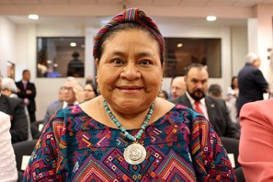
Lee los extractos de una entrevista con Rigoberta Menchú. ¿Quién habla? ¿Habla Rigoberta (‘I’) o la entrevistadora* (‘you’)?
leer
1
 | ‘I’ | ‘you’
Nací en el campo en Guatemala en 1959.
2
3
Creciste en una comunidad indígena.
Sufriste mucho por la violencia del ejército*.
1
2
4
5
3
Decidí huir a México porque la situación era peligrosa.
Escribiste un libro sobre la experiencia de vivir una guerra.
4
6
5
Recibí el Premio Nobel de la Paz en 1992.
6
7
Volví a Guatemala varias veces.
7
8
8
Aprendiste a hablar español.
*el ejército = army
*entrevistador/a = interviewer
Notes:
Timing: 6 minutes
Aim: to practise differentiation between first and second person singular in preterite (–í and –iste).
Procedure:
Students read each sentence and decide if the person speaking is Rigoberta (‘I’) or the interviewer (‘you’).
Click to show the answers.
Elicit an oral translation of each sentence.
Notes:
i. In an interview context, the ‘you’ statements might more commonly be questions. To facilitate practice of ‘-í’ vs ‘-iste’, any question punctuation has been removed.
ii. Some students may be unfamiliar with the Nobel Peace Prize. Explain that it’s given to people who in the past year have done remarkable work to unite nations and to promote peace.
Frequency of unknown words and cognates:
ejército [905]; entrevistador [>5000]
Picture source: https://commons.wikimedia.org/wiki/File:Premio_Nobel_de_la_Paz_(1992)_Do%C3%B1a_Rigoberta_Menchu_(39368934675).jpg

Slide 6
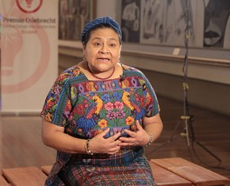
Una entrevista con Rigoberta Menchú Escucha y elige ‘I’ o ‘you’. Después escucha y completa la frase en inglés.
escuchar
 | ‘I’ | ‘you’
recognised
You _____________ the problem and decided to do ____________.
1
something
went
war
2
I ______ to another country to escape from the ______.
3
lost
relatives / family members
You ______ several ___________________________.
4
made
effort
support
You _______ an ________ to _________ the indigenous communities.
shared
5
I ________ a lot of experiences in the book ‘I, Rigoberta Menchú’.
fulfil / achieve
I didn’t _______________ the objective of becoming __________.
6
president
7
had
to
You _____ ___ live in exile several times.
8
felt
happiness / joy
You _____ ________________ when you received the Nobel Peace Prize.
Notes:
Timing: 8 minutes
Aim:
to practise aural recognition of the –er/–ir verb endings ‘-í’ and ‘-iste’.
to show understanding of key vocabulary in the sentences
Procedure:
Students write 1-8 and copy the two-column grid into their books.
Click the number button to play the recording.
Students listen carefully and tick the column with the meaning that matches what they hear in the audio. This will be based on whether they hear ‘-í’ (‘I) or ‘-iste’ (you).
Click to reveal the sentence scaffolding for the English translations.
Students listen again and complete the missing parts of the translation. They need only write the missing words.
The answers are revealed by clicking.
Notes: the verbs ‘fui’ and ‘tuviste’ are included as their endings follow the pattern of –í and –iste. It may be helpful to remind students that fui doesn’t take an accent in written form, unlike the other 1st person verbs.
Transcript:
Reconociste el problema y decidiste hacer algo.
Fui a otro país para escapar de la guerra.
Perdiste varios familiares.
Hiciste un esfuerzo para apoyar a las comunidades indígenas.
Compartí muchas experiencias en el libro ‘Me llamo Rigoberta Menchú’.
No cumplí el objetivo de ser presidenta.
Tuviste que vivir en el exilio varias veces.
Sentiste alegría cuando recibiste el Premio Nobel de la Paz.
Notes:
i. In an interview context, the ‘you’ statements might more commonly be questions. To facilitate practice of ‘-í’ vs ‘-iste’, any question intonation and punctuation has been removed.
ii. The full name of the book is ‘Me llamo Rigoberta Menchú y así me nació la conciencia’.
Images are in the public domain and free to use:
https://commons.wikimedia.org/wiki/File:RIGOBERTA_MENCHU_PREMIO_ODENBRECHT_(15846118842).jpg
Frequency of unknown words and cognates:
exilio [3600]

Slide 7
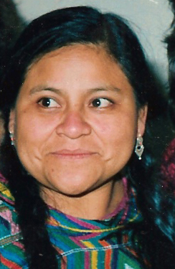
Lee la entrevista completa. Debes poner las seis frases en orden, según la información en el texto.
leer
Una entrevista con Rigoberta Menchú
[1/2]
Part A: Number these events in the order that they happened.
Write the correct number (1= happened first, 6 = happened last).
1
a. Describes working in the countryside.
b. Mentions an unsuccessful attempt to do something.
c. Talks about the environment in her place of origin.
d. Mentions winning something.
e. Talks about losing relatives.
f. Mentions having to leave her country.
6
2
5
3
4
Rigoberta Menchú
Notes:
Timing: 10 minutes (slides 7-8)
Aim: to show broad understanding of the main events in the text
Procedure:
Hand out a copy of the text to students and ask them to read it.
After reading the text, they try to put these events (displayed on the board throughout the activity) in chronological order.
Click to reveal the answers one by one. These appear in chronological order.
Note: this could also be done as a listening activity with higher-achieving groups. Click on the audio icon to hear the interview.
The text has been written by NCELP but is based on factual information from interviews given by Rigoberta Menchú.
Image sources:
Photo of Rigoberta Menchú from Wikipedia: https://upload.wikimedia.org/wikipedia/commons/4/45/Rigoberta_Mench%C3%BA_%281992%29_cropped.jpg
https://commons.wikimedia.org/wiki/File:Map_of_Central_America.png
Information in the text:
‘La fuerza maya’ by Juan Camilo Maldonado Tovar /Revista Bocas in El Tiempo at https://www.eltiempo.com/bocas/entrevista-con-la-nobel-de-paz-rigoberta-menchu-para-la-revista-bocas-70264 (accessed 27/04/22)
Rigoberta Menchú, https://www.britannica.com/biography/Rigoberta-Menchu (accessed 28/04/22)

Slide 8
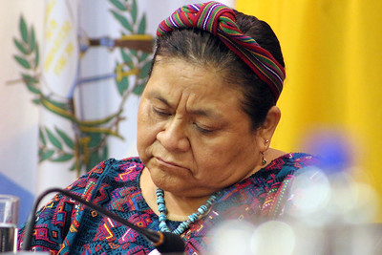
Ahora decide si estas frases son verdaderas (‘V’), falsas (‘F’) o si no se mencionan (‘NM’).
leer
Una entrevista con Rigoberta Menchú
[2/2]
 | V | F | NM
a. Rigoberta didn’t have any shoes when she was a child.
b. She was born in a dry area.
c. Her father was killed in a protest.
d. Her mother was also killed in a protest.
e. She used the money from a prize to found an organization.
f. She won the elections.
Rigoberta Menchú
Notes:
Timing: 6 minutes
Aim: to show understanding of specific details within the text
Procedure:
1. Students can read the text again and decide whether these statements are true, false or not mentioned.
2. Click to reveal the answers.
Note: passive ‘se’ is used in the instructions. Students are not yet familiar with this construction, so it is advisable to give the English meaning upfront.
Source:
Photo of Rigoberta Menchú from Flickr: https://www.flickr.com/photos/corteidh/39677581854. Attribution-ShareAlike 2.0 Generic (CC BY-SA 2.0)

Slide 9
¿Cuál es tu opinión sobre la vida de Rigoberta Menchú?
escribir
Grr..
me da pena/tristeza
me da rabia
me da vergüenza
me da alegría
me da miedo
Puedes dar tu opinión sobre estas partes:
1. Crecí sin zapatos y no tenía mucha ropa.
2. Sufrí mucho cuando perdí a mi padre. Murió durante una manifestación no violenta. Lo mataron y un año después mataron a mi madre.
3. Huí a México donde aprendí mejor el español y escribí mi primer libro.
4. Cuando recibí el ‘Nobel de la Paz’ en 1992, con el dinero abrí una organización para promover los derechos humanos de la gente indígena.
5. En 2011 me presenté como candidata en las elecciones. Perdí, pero no es el fin de nuestra historia.
Notes:
Timing: 3 minutes
Aim: to allow students to give an affective response to the text.
Procedure:
Click to bring up the picture and Spanish phrase. It may be possible to elicit the Spanish.
Ask students for the English meaning of each phrase.
Either in whole-class format, or working in pairs, ask students to give their response to the text.
To provide some structure, several extracts from the text are also provided. Students could also be asked to give their opinion to teach of these, individually. They could also justify their opinion using a conjunction like ‘porque’. If so, it may be worth giving them a little extra time to consider their ideas and write notes, rather than expecting unprompted oral production.

Slide 10
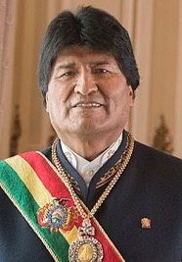
¡Ahora tú!
escribir
Elige a una persona de las opciones de la derecha. Imagina que tú eres esa persona. Estás hablando en una entrevista sobre las experiencias de tu vida. Debes buscar información. Lee y contesta estas preguntas.
Nemonte Nenquimo
Yalitza Aparicio
Evo Morales
¿Dónde naciste? Y, ¿cuándo?
¿Creciste en el mismo lugar?
¿Fuiste a vivir en otro país?
¿Qué aprendiste en la vida?
¿Cumpliste tu(s) objetivo(s)?
¿Hiciste cambios en tu vida?
¿Qué experiencias tuviste?
¿Qué decidiste hacer en momentos difíciles?
Puedes usar estas palabras :
Conecta tus ideas con estas palabras:
un día
entonces
durante varios años/meses
aunque
además
así que
y
antes de
antes / después de (+ infinitive)
pero
sin embargo
porque
Notes:
Timing: 10 minutes (to start the task, which can then be continued for homework)
Aim:
to practise writing more freely with the 1st person singular form of –er and –ir verbs (-í)
to understand a range of questions using –er and –ir verbs in the 2nd person singular preterite (-iste)
Procedure:
Teachers can set up the creative writing activity by going through this slide. Explain that they’ll be writing about someone’s life experiences. They must choose one of the Spanish-speaking indigenous people on the right and do some research.
They can use the suggested vocabulary, or they can use any other known vocabulary.

Slide 11
Talking about life experiences [2]
-ar verbs in the preterite tense:
1st person singular (-é)
2nd person singular (-aste)
Y9 Spanish
Term 3.2 – Week 5 – Lesson 70
Louise Caruso / Amanda Izquierdo / Nick Avery Artwork: Mark Davies
Date updated: 21/06/22
Notes:
Artwork by Mark Davies. All additional pictures selected are available under a Creative Commons license, no attribution required.
With thanks to Rachel Hawkes for her input on the lesson material.
Learning outcomes (lesson 2)
Consolidation of question words
Consolidation of verb endings –é and –aste (-ar verbs in 1st and 2nd person singular, preterite tense)
Consolidation of irregulars ‘tuve’ and ‘hice’
Word frequency (1 is the most frequent word in Spanish):
revision 14/14 (64 words used, 36 from Y7, 28 from Y8): tener [19]; tengo [19]; tienes [19]; tiene [19]; lee [209]; escuchar [281]; da [42]; trabajar [174]; marca [993]; puede [32]; pedir [217]; debe [71]; leer [209]; visitar [792]; dormir [403]; tomar [133]; creer [83]; entender [229]; dividir [1385]; traer [341]; poner [91]; dirigir [1385]; traducir [2037]; octubre [1242]; colegio [628]; mano [135]; ruso [1645]; actor [1533]; actriz [3567]; personaje [595]; euro [2435]; precio [557]; pagar [377]; veintiún [>5000]; treinta [830]; entrar [207]; su [12]; dinero [127]; solo [95]; respuesta [488]; escuela [424]; once [1700]; director [592]; número [324]; arte [208]; grupo [200]; palabra [192]; letra [977]; frase [1036]; opción [1175]; correcto [1467]; correcta [1467]; pared [778]; que [3]; sobre [62]; página [598]; minuto [598]; razón [360]; sueño [450]; apoyo [866]; risa [1101]; ánimo [1855]; ¿Cómo se dice? {n/a]; ¿Cómo se escribe? [N/a]
Source: Davies, M. & Davies, K. (2018). A frequency dictionary of Spanish: Core vocabulary for learners (2nd ed.). Routledge: London
The frequency rankings for words that occur in this PowerPoint which have been previously introduced in NCELP resources are given in the NCELP SOW and in the resources that first introduced and formally re-visited those words.
For any other words that occur incidentally in this PowerPoint, frequency rankings will be provided in the notes field wherever possible.

Slide 12
Mi colegio
Persona A lee su versión del texto. Persona B escucha y toma apuntes*. ¿Cuáles son las diferencias?
*apuntes = notes
hablar
palabra
respuesta
marca
coger
comprar
Which other words did you need to change?
Hoy es treinta de octubre y es el último día de colegio antes de las vacaciones. Mi colegio es muy bonito. Cuando alguien entra, puede ver muchos ejemplos del arte de los estudiantes en la pared. Los profesores me dan apoyo y tengo amigos que me dan mucha risa. Hoy tenemos un examen de ciencias. Debe ser fácil: solo tenemos que escoger la letra correcta para once preguntas.
Por la tarde tengo una clase de ruso. Tenemos que escuchar frases y preguntar “¿cómo se dice?” en ruso. El profesor dice “Lee la opción correcta” y entonces podemos traducir la actividad en la página. Es muy útil porque en el futuro quiero ser actor, trabajar en otros países y también dirigir películas en otras lenguas. Me gusta mucho una actriz española pero no me acuerdo de su nombre. Quiero ganar mucho dinero.
A veces voy al cine después del colegio y mi hermana viene conmigo. Hoy dice que no quiere pagar entradas caras. ¡Tiene sueño! Prefiere dormir. Así que voy a tomar el autobús para ir al mercado y traer algo de comer. Vamos a dividir el costo.
escuela
trabajo
ánimo
el
alegría
idioma
visitar
veintiún
entender
francés
precios
milliones de
razón
leer
director
euros
escribe
Notes:
Timing: 10 minutes Aims: i) to review the homework task set last week (9.3.2.4).
ii) to develop fluency in decoding by reading aloud the student versions. iii) to listen attentively, noting differences in the original text. iv) to make judgements about the replacements made by a peer, and engage in peer feedback. Procedure: 1. Student A reads his/her adapted HW text. 2. Student B follows along with the original and makes a note of any substituted words s/he hears (on his/her copy of the HW sheet)
3. Swap roles.
4. Compare and contrast the two versions. Scrutinise any differences and offer opinions about the correctness of the choices.
5. Move to the next slide, which has a possible answer version, using all of the viable words. Note: the HW task set a time limit and asked students to try to replace at least ten of the words, so it’s to be expected that they might not have got them all.
Frequency of unknown language:
apunte [4865]

Slide 13
Mi colegio
Persona A lee su versión del texto. Persona B escucha y toma apuntes*. ¿Cuáles son las diferencias?
*apuntes = notes
hablar
palabras
respuesta
marca
Which other words did you need to change?
palabra
marca
coger
comprar
respuesta
coger
comprar
Hoy es treinta de octubre y es el último día de colegio antes de las vacaciones. Mi colegio es muy bonito. Cuando alguien entra, puede ver muchos ejemplos del arte de los estudiantes en la pared. Los profesores me dan apoyo y tengo amigos que me dan mucha risa. Hoy tenemos un examen de ciencias. Debe ser fácil: solo tenemos que escoger la letra correcta para once preguntas.
Por la tarde tengo una clase de ruso. Tenemos que escuchar frases y preguntar “¿cómo se dice?” en ruso. El profesor dice “Lee la opción correcta” y entonces podemos traducir la actividad en la página. Es muy útil porque en el futuro quiero ser actor, trabajar en otros países y también dirigir películas en otras lenguas. Me gusta mucho una actriz española pero no me acuerdo de su nombre. Quiero ganar mucho dinero.
A veces voy al cine después del colegio y mi hermana viene conmigo. Hoy dice que no quiere pagar entradas caras. ¡Tiene sueño! Prefiere dormir. Así que voy a tomar el autobús para ir al mercado y traer algo de comer. Vamos a dividir el costo.
escuela
escuela
trabajo
trabajo
del
el
ánimo
ánimo
alegría
alegría
otros idiomas
idioma
visitar
visitar
veintiuna
veintiún
entender
entender
francés
francés
precios caros
precios
milliones de
milliones de
razón
razón
leer
director
euros
escribe
leer
director
euros
escribe
Notes:
Procedure: 1. On successive clicks the bold words are underlined and the appropriate substitute word is highlighted. If a change is needed to its form, or an article is needed, this is highlighted in bold. 2. Note that sometimes changes are needed to other words in the sentence. All of these changes revisit previously taught grammar, which teachers can elicit and/or explain as needed.
3. When concluded, students see that 22 replacements were possible.
4. Note that alternative substitutions are possible. Teachers should make this clear and elicit students’ suggestions.

Slide 14
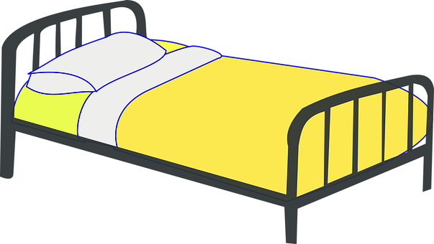
Vocabulario
escuchar / leer
Escucha y elige una palabra relacionada* con las palabras en el audio.
los números | los amigos | dormir | las palabras
el dinero | el cine | los libros | la escuela
1
el cine
5
risa, apoyo, entender
los amigos
dirigir, actor, actriz
2
sueño, cama, cansado
6
leer, página, personaje
los libros
dormir
3
pagar, precio, euro
7
letra, frase, ¿cómo se escribe?
el dinero
las palabras
4
los números
8
once, treinta, veintiún
arte, director, colegio
la escuela
relacionado/a = related, associated
Notes:
Timing: 5 minutes
Aim: to revise a significant number of words in the oral modality. Time is constrained (as a result of the aural input) to compel learners to comprehend words more quickly, a valuable component in vocabulary practice that speeds up the process of recall.
Procedure:
1. Write 1-8 in books. 2. Listen to each set of three words and write the most appropriate category word. Note: It may be useful to write all the words down to have more time to review them and select the most appropriate category word. 3. Answers (including a written version of the three words in each set) appear on mouse clicks. 4. Check all meanings are known.
Transcript:
dirigir, actor, actriz
sueño, cama, cansado
pagar, precio, euro
once, treinta, veintiún
risa, apoyo, entender
leer, página, personaje
letra, frase, ¿cómo se escribe?
arte, director, colegio
Frequency of unknown words:
relacionar [1224]

Slide 15
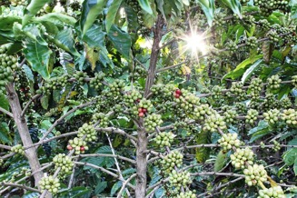
Lee unas frases sobre Rigoberta Menchú y la gente indígena de Guatemala. ¿Qué piensas? ¿Son verdaderas o falsas?
leer
1. La familia de Rigoberta recogía café.
2. La gente indígena de Guatemala solo habla español.
3. Cuando era pequeña, Rigoberta y su familia vivían en una zona pobre de una ciudad.
4. El clima en el norte de Guatemala es muy seco.
5. Durante la guerra civil de Guatemala, Rigoberta perdió a unos familiares.
6. Rigoberta quiere ser presidenta de su país.
Notes:
Timing: 3 minutes
Aim: to recap some information from lesson 1 about the life of Rigoberta Menchú and the indigenous people of Guatemala.
Procedure:
Students read each statement and decide whether the answer is true or false. They could base their suppositions on what they have learned so far in the first lesson. This is a low stakes activity and isn’t intended to be a test.
Teacher shows the correct answers one by one.
Extra information about each statement (includes quotes from original sources):
1. “De niña trabajé en las fincas y lo que hoy recuerdo es el aroma del café.” https://www.eltiempo.com/bocas/entrevista-con-la-nobel-de-paz-rigoberta-menchu-para-la-revista-bocas-70264
2. “The Mayan family of languages consists of about thirty extant languages, plus at least two (Chicomuceltec and Ch’olti’) that have died since European contact. They are spoken in a relatively compact area in Guatemala, Mexico, Belize, and Honduras and have been the most studied of all Mesoamerican language families.” https://www.oxfordbibliographies.com/view/document/obo-9780199772810/obo-9780199772810-0147.xml?rskey=r2qXwH&result=2&q=quich%C3%A9#firstMatch
3 and 4. “Nací a la orilla de un bosque nuboso, crecí recorriendo los cerros y las montañas como venada. Conocí los nacimientos de los ríos y la brisa de la neblina, porque en mi tierra llueve mucho, día y noche. Chimel es una cuna mágica, donde las piedras cambian de rostro de acuerdo con la claridad de las nubes.”
5. “In January 1980, students and CUC activists, including Menchú’s father, occupied the Spanish embassy in Guatemala City to call attention to state terror. State forces firebombed the building, and the protestors and others burned to death. The army had murdered Menchú’s brother the year before, and tortured, raped, and killed her mother a few months after the embassy massacre.” https://www.oxfordbibliographies.com/view/document/obo-9780199766581/obo-9780199766581-0254.xml
6. “Menchú created the Indian-led political movement Winaq (Mayan: “The Wholeness of the Human Being”) in February 2007. That September, as the candidate of a coalition between Winaq and the left-wing Encounter for Guatemala party, she ran for president of Guatemala but earned less than 3 percent of the vote. Her 2011 presidential bid was also unsuccessful.” https://www.britannica.com/biography/Rigoberta-Menchu
Image of Rigoberta Menchú available at: https://commons.wikimedia.org/wiki/File:Premio_Nobel_de_la_Paz_(1992),_Rigoberta_Mench%C3%BA_(39368937735).jpg free to use - licensed under the Creative Commons Attribution-Share Alike 2.0 Generic license.

Slide 16
Describing completed events in the past -ar verbs in the preterite
gramática
As you know, many verbs in Spanish end in –ar.
When talking about completed events in the past, the verb ending changes.
é
To mean ‘I’, remove the ‘ar’ and add __.
I found the camera.
Encontré la cámara.
aste
To mean ‘you’, remove the ‘ar’ and add _____.
You travelled to the mountains in October.
Viajaste a las montañas en octubre.
To mean ‘s/he’ or ‘it’, remove the ‘ar’ and add __.
ó
He walked to the museum.
Caminó al museo.
Notes:
Timing: 2 minutes
Aim: to recap the 1st, 2nd and 3rd person singular endings for –ar verbs in the preterite tense.
Procedure:
1. Click to go through the rules for each verb ending. Gaps are left for teachers to elicit answers from students for the endings and translated sentences.

Slide 17
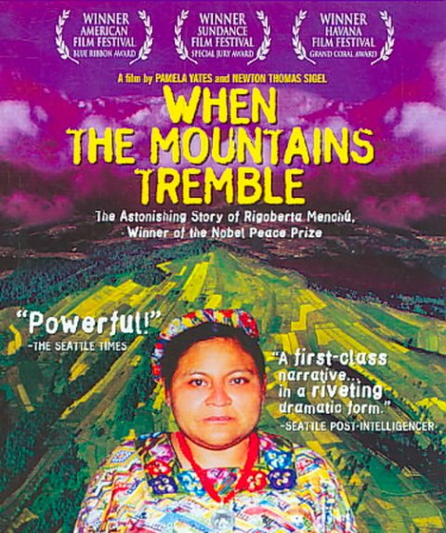
Una entrevista con Rigoberta Menchú Lee las frases. La traducción ¿está bien? Escribe sí ( ) o no ( ).
leer
1
4
Llegué a México en 1981.
Escapaste de Guatemala.
2
Participaste en una película sobre las experiencias de los indígenas.
5
Viajé por todo el mundo para compartir un mensaje.
3
6
Ayudó a escribir el libro.
Regresó a Guatemala en 1988.
Las traducciones de las frases son correctas o incorrectas?
1. I arrived in Mexico in 1981.
4. S/he escaped from Guatemala.
2. I took part in a film […]
5. I travelled around the world […]
3. S/he helped to write the book.
6. You returned to Guatemala [...]
Notes:
Timing: 6 minutes
Aim: to consolidate understanding of the verb endings ‘-é’ , ‘-aste’ and ’-ó’.
Procedure:
Go through instructions with students.
Explain that this is essentially a true/false activity. Students will be comparing the English sentences with the Spanish ones to see if the translations are correct or incorrect. This will depend on the person that the verb refers to (‘I’ , ‘you’ or ‘s/he’).
Click to reveal each answer.
Picture source: https://www.imdb.com/title/tt0421089/mediaviewer/rm3350699264/ (included on the basis of fair use for educational, non-commercial purposes)

Slide 18
How to ask questions in Spanish Using verbs in questions
gramática
When asking questions in English, we often use ‘do’ (or ‘did’) before the subject.
Example:
Did you work in the countryside?
Spanish doesn’t have a word for ‘do’ or ‘did’ in questions. Only the main verb is used.
Ejemplos:
1
¿Viajaste a otro país?
2
¿Participó en una película?
Did you travel to another country?
Did s/he participate in a film?
Notes:
Timing: 1 minute
Aim: to help students prepare for later tasks by recapping Spanish question formation. Students often find it difficult to construct questions by translating from English prompts, as the translation is often not literal.
Procedure:
Click to go through this slide’s explanation and examples.
Audio is provided to model the intonation (see note below).
Note: the teacher could also highlight the fact that Spanish questions have raised intonation at the end. This distinguishes them from statements.

Slide 19
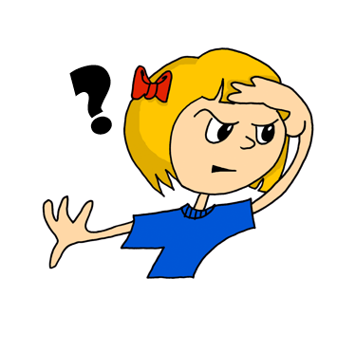
dónde
hablar
¿dónde?
where?
Dónde
¿ _______ estudiaste español?
[Where did you study Spanish?]
Notes:
Timing: 5 minutes (slides 19-26)
Aim:
to revise question words
to give students further practice in understanding the verb endings –aste and –ó.
Procedure:
Bring up the English prompt in the centre of the screen.
Elicit the Spanish from students.
Bring up the sentence in English at the bottom of the screen.
Then either elicit the full sentence OR click again and elicit the missing question word only, depending on the ability of the students.
Follow the same procedure for all slides.

Slide 20
cuándo
hablar
¿cuándo?
when?
¿ ________ regresaste a tu país?
Cuándo
[When did you return to your country?]
Notes:
Procedure as described in slide 19 notes.
Students could be reminded here of how Spanish uses ‘llegar a’ for ‘arrive at’.

Slide 21
qué
hablar
¿qué?
what?
Qué
¿ ____ tipo de premio ganó?
[What type of prize did s/he win?]
Notes:
Procedure as described in slide 19 notes.

Slide 22
quién
hablar
¿quién?
Remember, use the ‘s/he’ form of the verb (e.g., ‘-ó’) with ‘quién’.
who?
¿ ______ te ayudó?
Quién
[Who helped you?]
Notes:
Procedure as described in slide 19 notes.

Slide 23
Por qué
hablar
¿por qué?
why?
¿ ___ ____ viajaste a México?
Por qué
[Why did you travel to Mexico?]
Notes:
Procedure as described in slide 19 notes.

Slide 24
cuál
Remember to use cuáles if you are referring to more than one thing.
Ejemplo: ¿Cuáles eran las ciudades?
Which were the cities?
hablar
¿cuál?
which?
¿ _____ era mejor?
Cuál
[Which was better?]
Notes:
Procedure as described in slide 19 notes.

Slide 25
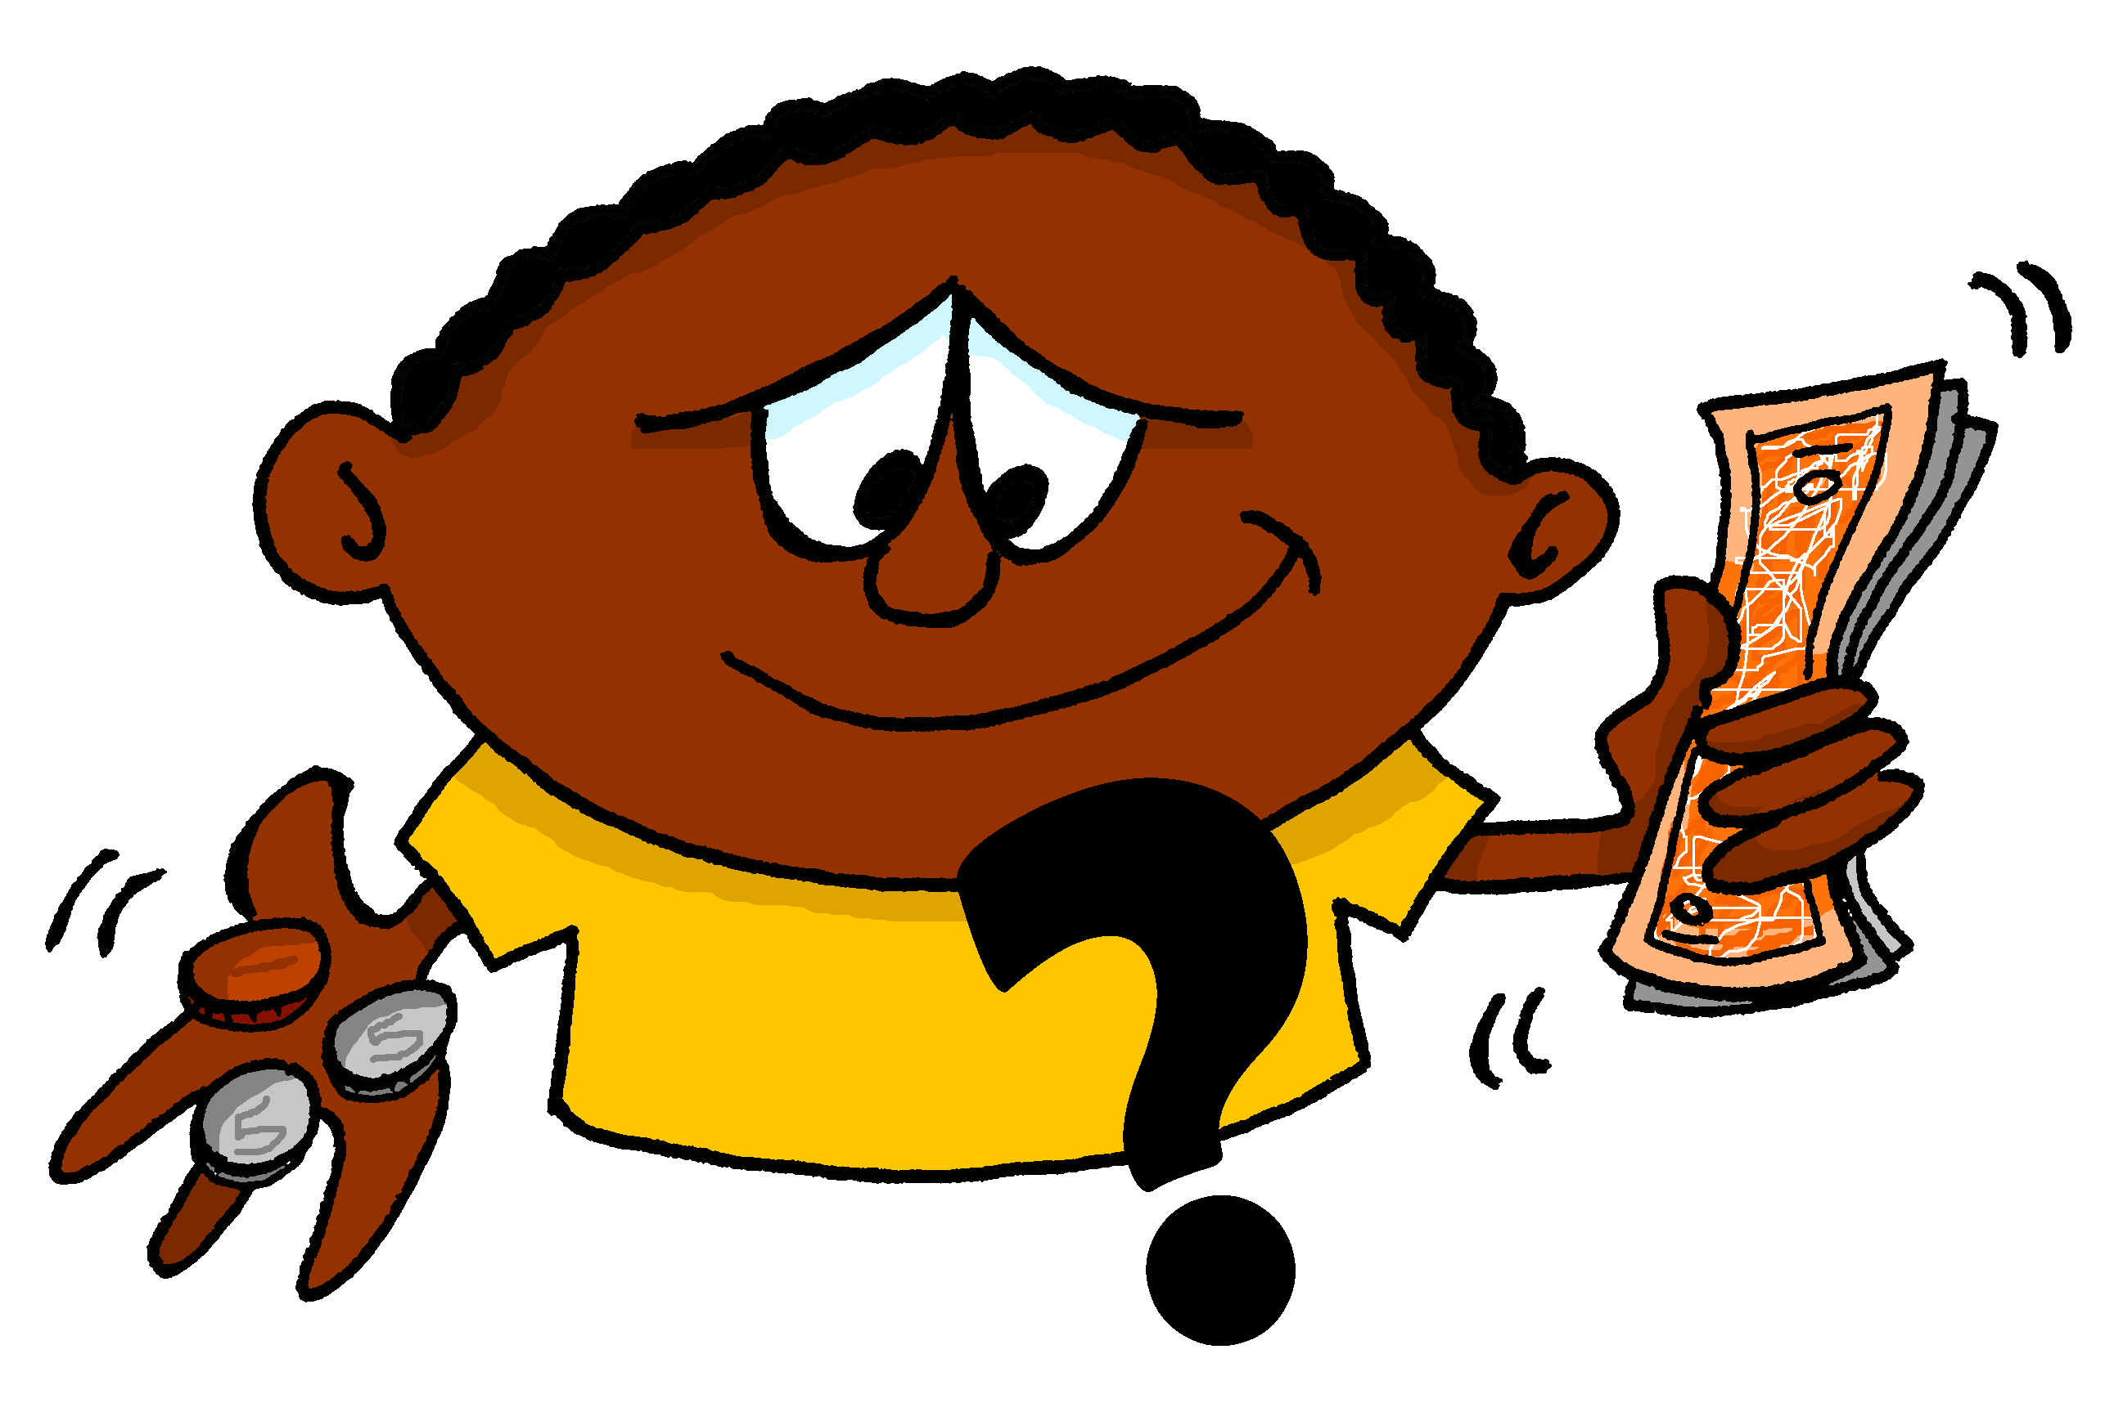
cuánto
hablar
¿cuánto?
how much?
Cuánto
¿ _______ pagaste?
[How much did you pay?]
Notes:
Procedure as described in slide 19 notes.
On the next slide, students will also be given a reminder about gender agreement. Because ‘cuánto’ is used as a pronoun here, gender agreement rules do not apply.

Slide 26
cuántos
Remember that ‘cuánto’ also needs to agree with the gender of the noun.
Use ‘cuántos’ for nouns that are plural and ____________.
Use ‘cuántas’ for nouns that are plural and ____________.
hablar
¿cuántos/as?
masculine
feminine
how many?
Cuántas
¿ ________ entrevistas realizó?
[How many interviews did s/he carry out?]
Notes:
Procedure as described in slide 19 notes.
Teachers may wish to remind students here that this also applies to the singular form (cuánto, cuánta) when it refers directly to a noun (e.g., ¿Cuánta ropa compró?, ¿Cuánto dinero pagaste?)

Slide 27
cómo
hablar
¿cómo?
how?
Cómo
¿ ______ celebraste el éxito?
[How did you celebrate the success?]
Notes:
Procedure as described in slide 19 notes.

Slide 28
cómo
¿Cómo…?
hablar
What … like?
¿ ______ ____ ¿Muy peligroso ?
Cómo era?
[What was it like? Very dangerous?]
Notes:
Procedure as described in slide 19 notes.

Slide 29
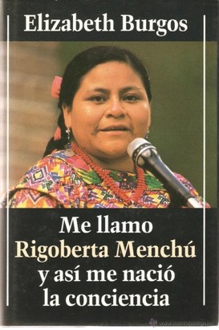
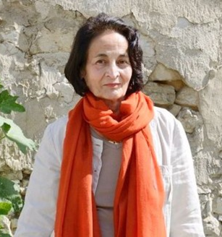
Ahora Rigoberta y la entrevistadora hablan sobre otra persona: Elisabeth Burgos. Las dos mujeres escribieron un libro juntas. Escucha las frases. Escribe el interrogativo. También elige la opción correcta.
escuchar
 | el interrogativo (en inglés) | ‘did you’ | ‘did she’ | el resto de la frase (en inglés)
1
How?
escape from Guatemala
2
When?
think about writing the story
3
Why?
consider the idea of writing a book
4
How much (time)?
spend in Guatemala
5
Where?
organise the interviews
6
What (issues)?
deal with at the beginning
7
How many (books)?
publish
Elizabeth Burgos-Debray
8
How
manage to sell so many books
Notes:
Timing: 8 minutes
Aim:
to consolidate understanding of interrogatives.
to practise differantiation between singular verb endings in preterite –aste and –ó.
Procedure:
Students listen to each recording.
They tick the correct column depending on whether the sentence refers to ‘you’ in the past (-aste) or ’s/he’ in the past (-ó).
Students listen again. This time, they write the action in English.
Give feedback on students’ responses.
Note: Some students may be able to complete the different parts in one go, rather than as separate steps.
Transcript
¿Cómo escapaste de Guatemala?
¿Cuándo pensaste en escribir la historia?
¿Por qué consideró la idea de escribir un libro?
¿Cuánto tiempo pasó en Guatemala?
¿Dónde organizaste las entrevistas?
¿Qué temas trató al principio?
¿Cuántos libros publicaste?
¿Cómo lograste vender tantos libros?
Sources:
Image of Elisabeth Burgos-Debray: http://clasarchive.berkeley.edu/Events/fall2000/10-10-00-burgos/index.html
Image of the book: https://www.abebooks.co.uk/9788422645177/llamo-rigoberta-menchu-asi-menacio-8422645173/plp

Slide 30
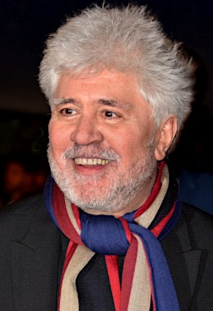
hablar / escuchar
Experencias de la vida
Eres una persona famosa. ¡El/la profesor(a) te va a decir quién eres!
Debes hacer dos cosas:
Hacer preguntas a tus compañeros. Escribe información sobre cada persona famosa en tu tarjeta. En total debes escribir información sobre tres personas diferentes.
Contesta las preguntas de tus compañeros.
Un ejemplo:
¿Quién eres?
Soy Pedro Almodóvar.
Persona A
(pregunta):
¿Dónde pasaste tu infancia?
En Cáceres porque mi familia compró una casa allí.
Persona B
(contesta):
Pedro Almodóvar
Pedro Almodóvar (director de cine)
1. Where did you spend your childhood?
I spent my childhood in Cáceres because my family bought a house there.
In Cáceres. His family bought a house there.
Notes:
Timing: 10 minutes
Aims:
i) to practise using question words
ii) to practise asking questions with –ar verbs in the 2nd person singular (-aste)
iii) to understand questions and give answers using known (or glossed) language
Procedure:
Go through the worked example with students. Check understanding.
Then give each student one A4 piece of paper. Each piece of paper will have information already complete for one of the four people. This is the person that the student is role-playing (i.e. they will respond to questions from classmates imagining that they were this person and using the information on the card). There will be three people left on the A4 piece of paper whose information needs to be added. Students will have to go around the classroom asking their peers who they are and then asking further questions to get the information needed to complete the card in full. The prompts for these questions are displayed on the next slide. To avoid making the activity too predictable, the information is not listed on the cards in order, so students will need to listen carefully to the questions and answer accordingly.
Give students feedback after the activity using the answer slide.
Note: it is important to have approximately the same number of person A, B, C and D for the activity to work effectively. Before the lesson, order the sheets in a pile with roughly equal numbers of cards A-D in random order. This way, when the cards are given out, all four individuals will be represented within the class (so students will be able to complete their cards in full).

Slide 31
hablar
Experiencias de la vida
Preguntas para vuestros compañeros
1. Where did you spend your childhood*?
Hint: use ‘tener’ (not ‘ser’ or ‘estar’)
2. What did you study?
3. When did you start your career?
4. How did you manage to be successful?
5. Why did you change job?
Hint: use ‘cambiar de’ + noun
*childhood = la infancia
Notes:
DISPLAY DURING THE ACTIVITY
The hints are for language previously covered in resources that may be useful to recap before starting.

Slide 32
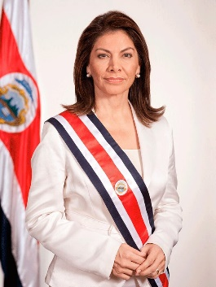
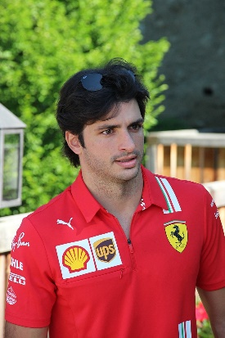
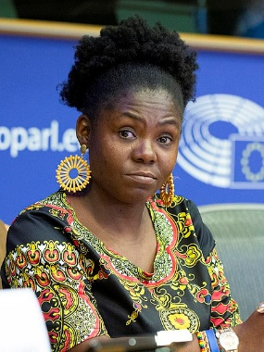
Pedro Almodóvar (director de cine)
Laura Chinchilla (presidenta de Costa Rica, 2010-2014)
I tried to study cinema in Madrid, but they closed the school.
I studied politics*
I made* my first film 40 years ago.
In order to work in the USA
I spent my childhood in the city of Cáceres, Spain.
After university I started my career.
My films are unique.
I am calm and I try to help many people.
I left my first job to make more films
I spent my childhood* in San José
childhood = la infancia
to make = realizar
politics = la política
childhood = la infancia
Carlos Sainz Junior (piloto de Fórmula 1)
Francia Márquez (abogada y activista)
I spent my childhood* in Madrid.
I spent my childhood* near Cali, Colombia.
In 2021 I changed team in order to drive a better car.
I didn’t change job
childhood = la infancia
I started to take part in demonstrations when I was 13
I didn’t need to study at university.
childhood = la infancia
I always do everything to protect my community
I worked hard!
law = el derecho
When I was 7 I started to drive.
I studied law* at university
Notes:
Picture cards (Do not show during the activity – students will have a separate handout)
Sources of pictures and facts:
Pedro Almodóvar
https://commons.wikimedia.org/wiki/File:Pedro_Almodovar_C%C3%A9sars_2017.jpg
https://www.imdb.com/name/nm0000264/awards
https://www.imdb.com/name/nm0000264/
Carlos Sainz
By XaviYuahanda - File:Formel12021-SchlossGabelhofen(15).jpg, CC BY-SA 4.0, https://commons.wikimedia.org/w/index.php?curid=107650937
https://childhoodbiography.com/carlos-sainz-childhood-biography/
Laura Chinchilla
https://commons.wikimedia.org/wiki/File:Laura_4.jpg
Francia Marquez
https://en.wikipedia.org/wiki/Francia_M%C3%A1rquez#/media/File:(Francia_M%C3%A1rquez)_F70A6326_(49199213312)_(cropped).jpg
https://www.huffingtonpost.co.uk/patrick-kane/colombia-women_b_6255064.html
https://www.goldmanprize.org/recipient/francia-marquez/

Slide 33
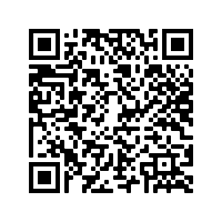
Deberes
Vocabulary Learning Homework (Y9, Term 3.2, Week 6)
Audio file
Audio file QR code:
Student worksheet
Quizlet link

Slide 34
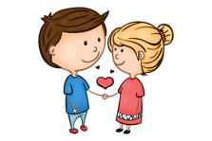
Ricardo de Puerto Rico
escuchar
Puerto Rico es una isla en el Caribe. Es parte de los Estados Unidos. La mayoría de la población habla español.
Remember, when a Spanish word begins with [r], the [r] is pronounced like [rr]!
Escucha y completa las frases con r y rr.
R
r
r
rr
r
r
r
__ica__do __eco__e las pa__tes __u__ales de Pue__to __ico.
1
r
R
Ricardo travels around the rural parts of Puerto Rico.
R
r
rr
Vio a __osa__io en el pa__que mient__as paseaba* al pe__o y se enamo__ó* a p__ime__a vista.
2
r
r
r
r
r
He saw Rosario whilst he was walking the dog in the park and it was love at first sight.
rr
r
r
r
r
r
3
En la gue__a __evolucion__ia suf__ió una he__ida* en la pie__na.
In the revolutionary war, he suffered an injury to the leg.
*enamorarse = to fall in love
*pasear = to walk (a dog)
*la herida = injury, wound
Notes:
OPTIONAL EXTRA ACTIVITY – PHONICS CONSOLIDATION
Timing: 5 minutes
Aim: to consolidate recognition of SSCs [r], including in word-initial position, and [rr]
Procedure:
Click to reveal the recap regarding [r] and [rr] and then the instructions.
Click the audio button for item 1.
Students listen and write the words that are missing letters. Alternatively, give students a printed version of the slide and ask them to simply write the missing letters in the gaps.
Ask students ‘¿Qué significa?’ to elicit the English meaning of the sentence.
Click to reveal the English.
Repeat steps 2-5 for the remaining items.
Then ask students to practice saying the sentences to each other in pairs.
Word frequency (1 is the most frequent word in Spanish) of unknown words:
revolucionario [1727]; herida [>5000]; enamorar [1783]; pasear [1741]
Picture source: https://commons.wikimedia.org/wiki/File:Puerto_rican_Flag.png

