Slide 1
Phonics
SSC [u] [re-visited]
Y7 French
Term 2.1 - Week 4
Natalie Finlayson / Emma Marsden / Rachel Hawkes
Date updated: 24/01/20

Slide 2
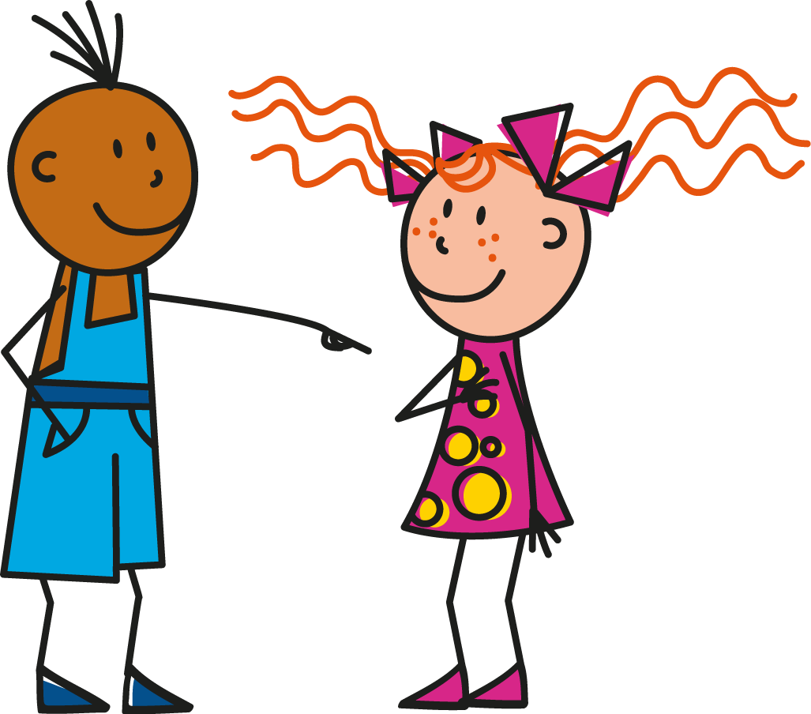
u
tu
Notes:
Source word: tu [112]
1. Present the letter and say the [u] sound first, on its own. Students repeat it with you. 2. Bring up the word ‘‘tu” on its own, say it, students repeat it, so that they have the opportunity to focus all of their attention on the connection between the written word and its sound.
3. A possible gesture for this would be to point to someone else as though addressing him/her ‘you’.
4. Roll back the animations and work through 1-3 again, but this time, dropping your voice completely to listen carefully to the students saying the [u] sound, pronouncing ”tu” and, if using, doing the gesture.

Slide 3
u
tu
Notes:
Source word: tu [112]
With sound and no pictures to focus all attention on the sound-symbol correspondence.

Slide 4
u
tu
Notes:
Source word: tu [112]
Without sound to elicit pronunciation (without first hearing the teacher).
Teacher can elicit pronunciation by asking ‘Comment dit-on ‘you (sing)’?’

Slide 5
u
Salut !
vue
amusant
tu
utiliser
[to use]
sur
[on]
Notes:
Introduce and elicit the pronunciation of the individual SSC [u] and then the source word again (with gesture, if using). Then present and elicit the pronunciation of the five cluster words. The cluster words have been chosen for their high-frequency, from a range of word classes, with the SSC (where possible) positioned within a variety of syllables within the words (e.g. initial, 2nd, final etc.) and additionally, we have tried to use words that build cumulatively on previously taught SSCs (see the Phonics Teaching Sequence document) and do not include new SSCs. Where new SSCs are used, they are often consonants which have a similar symbol-sound correspondence in English. Word frequency rankings (1 is the most common word in French): tu [112]; salut ! [2205] vue [191]; sur [16]; amusant [4695]; utiliser [345]. Source: Londsale, D., & Le Bras, Y. (2009). A Frequency Dictionary of French: Core vocabulary for learners London: Routledge.

Slide 6
u
Salut !
vue
amusant
tu
utiliser
sur
Notes:
With sound and no pictures to focus all attention on the sound-symbol correspondence. Word frequency rankings (1 is the most common word in French): tu [112]; salut ! [2205] vue [191]; sur [16]; amusant [4695]; utiliser [345]. Source: Londsale, D., & Le Bras, Y. (2009). A Frequency Dictionary of French: Core vocabulary for learners London: Routledge.

Slide 7
u
Salut !
vue
amusant
tu
utiliser
[to use]
sur
[on]
Notes:
Without sound to elicit pronunciation (without first hearing the teacher).
Teacher can elicit pronunciation by asking “Comment dit-on view, to use etc.? Word frequency rankings (1 is the most common word in French): tu [112]; salut ! [2205] vue [191]; sur [16]; amusant [4695]; utiliser [345]. Source: Londsale, D., & Le Bras, Y. (2009). A Frequency Dictionary of French: Core vocabulary for learners London: Routledge.

Slide 8
Saying what people have: nous and vous
Prononciation
lire
Trouve les mots qui ont la SSC [u].
boutique
pollution
routine
retourner
musée
plus
révolution
journaliste
usage
culture
université
budget
tourisme
température
couple
troupe
cousin
multiple
Notes:
The aim of this awareness-raising exercise, composed entirely of cognates from within the top 5000 which students have not yet encountered, is to make students aware of a) differences in pronunciation between French and English cognates, and b) the consistency of the French spelling rules which account for these.
Before beginning the task, the teacher should make students aware that their knowledge of English will not help them here. They must look for words in which the letter ‘u’ stands alone as a vowel, (i.e. is not combined with another vowel as in routine, couple) etc. The presence of a single letter ‘u’ in French normally indicates that SSC [u] is needed (NB: there are a few exceptions to this when letter ‘u’ is combined with a nasal –n, as in un, lundi etc which are avoided here).
Using this information, students should be able to locate the 10 words containing SSC [u] (shown on the next slide).

Slide 9
Saying what people have: nous and vous
Prononciation
parler
Prononce les mots qui ont la SSC [u].
boutique
pollution
routine
retourner
musée
plus
révolution
journaliste
usage
culture
université
budget
tourisme
température
couple
troupe
cousin
multiple
Notes:
On revealing the answers, teachers should draw attention to the following points:
1/ Four sounds are represented by the letter ‘u’ in English: plus/budget/multiple; museum/university/usage; pollution/revolution; temperature/culture. In the French cognates, the ‘u’ is pronounced the same way in each case.
2/ Several of the words in blue, which contain SSC [u] in English, do not in French (routine, boutique, tourisme, troupe). Teachers to highlight the fact that students must therefore look at the spelling, rather than English pronunciation, to work out the correct sound. (NB: SSC [ou] is revisited in next week’s sequence).
3/ Teacher elicits pronunciation by pointing at a word, and asking Comment dit-on? Students answer chorally.
4/ Students check their pronunciation by listening to recordings, played on clicking individual words.
5/ Students repeat.

