Slide 1
Talking about nouns you can't count
irregular verb boire (je, tu, il/elle)
partitive article with uncountable nouns
partitive articles in the negative
SSC [-ill-, -ille], [i] revisited
Y8 French
Term 2.1 - Week 1 - Lesson 29
Kirsten Somerville / Catherine Morris / Natalie Finlayson
Artwork by: Chloé Motard
Date updated: 09/07/21
Notes:
Learning outcomes (lesson 1):
Introduction of SSC [-ill-, -ille], [i] revisited
Consolidation of partitive articles
Introduction of irregular –RE verb boire in the 1st, 2nd and 3rd person singular
Introduction of uncountable nouns used with partitive articles
Introduction of partitive articles in the negative
Word frequency (1 is the most frequent word in French):
8.2.1.1 (introduce) boire [1879], bois [1879], boit [1879], gagner² [258], argent [472], chance [438], lait [2507], café² [1886], thé [3517], viande [2625], peu [91], verre [2174], beaucoup [150]
8.1.2.5 (revisit) gérer [1354], espace [870], goût [1829], langue², [712], plat [2167], recette [1709], repas [2948] d'abord [326], puis [230], par [21], puisque [528], Noël [>5000], réveillon [>5000]
8.1.1.4 (revisit) célébrer [2170], préférer [597], on¹ [29], date [660], juin [931], mars [868], mai [943], tradition [1371], avril [1022], événement [573], février [1136], janvier [939], premier [56], première [56], quatorze [1472], quinze [3359], seize [3285], trente [1646], treize [3245], vingt [1273]
construction rule for numbers 13-31
Source: Londsale, D., & Le Bras, Y. (2009). A Frequency Dictionary of French: Core vocabulary for learners London: Routledge.

Slide 2
i
midi
Notes:
Timing: 1 minute
Aim: To consolidate SSC [i]
Procedure: 1. Present the letter(s) and say the [i] sound first, on its own. Students repeat it with you. 2. Bring up the word ”midi” on its own, say it, students repeat it, so that they have the opportunity to focus all of their attention on the connection between the written word and its sound.
3. A possible gesture for this would be to draw a circle representing a clock face with one hand, with the other arm and hand pointing straight up (representing the hands on 12) within the circle. 4. Roll back the animations and work through 1-3 again, but this time, dropping your voice completely to listen carefully to the students saying the [i] sound, pronouncing ”midi” and, if using, doing the gesture.
Word frequency (1 is the most frequent word in French):
midi [2483].
Source: Londsale, D., & Le Bras, Y. (2009). A Frequency Dictionary of French: Core vocabulary for learners London: Routledge.

Slide 3
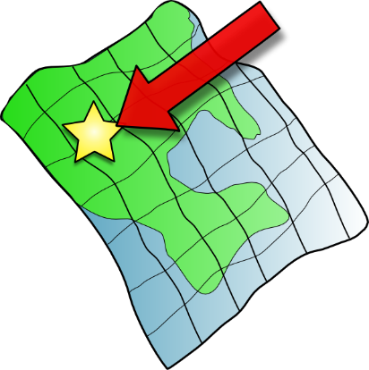
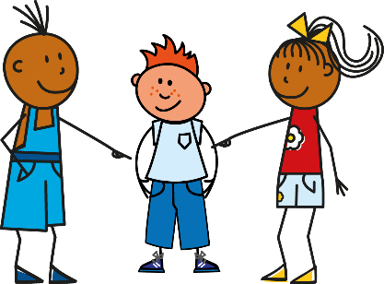
i
petit
lit
midi
ici
qui ?
il
?
Notes:
Timing: 1 minute
Aim: To consolidate SSC [i]
Procedure:
1. Introduce and elicit the pronunciation of the individual SSC [i] and then the source word again ‘midi’ (with gesture, if using). 2. Then present and elicit the pronunciation of the five cluster words.
The cluster words have been chosen for their high-frequency, from a range of word classes, with the SSC (where possible) positioned within a variety of syllables within the words (e.g. initial, 2nd, final etc.). Additionally, we have tried to use words that build cumulatively on previously taught SSCs (see the Phonics Teaching Sequence document) and do not include new SSCs. Where new SSCs are used, they are often consonants which have a similar symbol-sound correspondence in English.
Word frequency (1 is the most frequent word in French): midi [2483]; petit [138]; lit [1837] ici [167]; il[13]; qui [14]. Source: Londsale, D., & Le Bras, Y. (2009). A Frequency Dictionary of French: Core vocabulary for learners London: Routledge.

Slide 4
-ill-/-ille
fille
Notes:
Timing: 1 minute
Aim: To introduce SSC [-ill-/-ille]
Procedure: 1. Present the letter(s) and say the [-ill-/ille] sound first, on its own. Students repeat it with you. 2. Bring up the word ”fille” on its own, say it, students repeat it, so that they have the opportunity to focus all of their attention on the connection between the written word and its sound.
3. A possible gesture for this would be to gesture at some of the girls in the class. 4. Roll back the animations and work through 1-3 again, but this time, dropping your voice completely to listen carefully to the students saying the [-ill-/-ille] sound, pronouncing ”fille” and, if using, doing the gesture.
Word frequency (1 is the most frequent word in French):
fille [629]
Source: Londsale, D., & Le Bras, Y. (2009). A Frequency Dictionary of French: Core vocabulary for learners London: Routledge.

Slide 5
-ill-/-ille
fille
Notes:
With sound and no pictures to focus all attention on the sound-symbol correspondence.

Slide 6
-ill-/ille
fille
Notes:
Without sound to elicit pronunciation (without first hearing the teacher).
Teacher to elicit pronunciation by asking “Comment dit-on …”

Slide 7
-ill-/-ille
brillant
juillet
[shiny]
habiller
fille
pavillon
[to dress]
famille
[family]
Notes:
Timing: 2 minutes
Aim: To introduce SSC [-ill-/-ille]
Procedure:
Introduce and elicit the pronunciation of the individual SSC [-ill-/-ille] and then the source word again ‘fille’ (with gesture, if using). Then present and elicit the pronunciation of the five cluster words. The cluster words have been chosen for their high-frequency, from a range of word classes, with the SSC (where possible) positioned within a variety of syllables within the words (e.g. initial, 2nd, final etc.). Additionally, we have tried to use words that build cumulatively on previously taught SSCs (see the Phonics Teaching Sequence document) and do not include new SSCs. Where new SSCs are used, they are often consonants which have a similar symbol-sound correspondence in English.
Word frequency (1 is the most frequent word in French): brillant [2569]; juillet [1326]; habiller [3576]; famille [172]; pavillon [3412]. Source: Londsale, D., & Le Bras, Y. (2009). A Frequency Dictionary of French: Core vocabulary for learners London: Routledge.

Slide 8
-ill-/ille
brillant
juillet
habiller
fille
pavillon
famille
Notes:
With sound and no pictures to focus all attention on the sound-symbol correspondence.

Slide 9
-ill-/ille
brillant
juillet
habiller
fille
pavillon
famille
Notes:
Without sound to elicit pronunciation (without first hearing the teacher).
Teacher to elicit pronunciation by asking “Comment dit-on …”

Slide 10
Phonétique
écouter / écrire
Say these words:
 |  | SSC [-ill-/ille] | SSC [i]
 | gentil
 | briller
 | grille
 | fils
 | billet
 | fillette
 | outil
 | subtil
fi !
[yuck]
fille
[girl]
1
[nice]
2
[to shine]
Attention!
The last letters of gentil and outil are SFCs. These are exceptions to the CRFL rule.
3
_
[railings]
4
[son]
Hint
SSC [-ill-/ille] sounds like SSC [i] followed by a ‘yih’ sound.
5
[ticket]
6
_
[little girl]
7
[tool]
8
[subtle]
Notes:
Timing: 5 minutes
Aim: aural recognition of SSCs [-ill-/ille] and [i]
Procedure:
1. Students try to say the words in the minimal pair, fi and fille. Click to hear the words said by a native speaker. Students repeat.
2. Click to bring up the hint.
3. Click the numbers to play the audio.
4. Students write 1-8 and choose [-ill-] or [i] for each.
5. Click to reveal the answers.
6. Click to highlight exceptions to the CRLF rule.
Transcript:
1. gentil
2. briller
3. grille
4. fils
5. billet
6. fillette
7. outil
8. subtil
Word frequency (1 is the most frequent word in French): gentil [2832] fils [735] outil [1725] briller [2904], billard [>5000], fillette [4737] grille [3341] subtil [4345]
Source: Londsale, D., & Le Bras, Y. (2009). A Frequency Dictionary of French: Core vocabulary for learners London: Routledge.

Slide 11
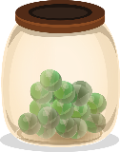
Phonétique
Quels mots sont différents ?
écouter / écrire
Il y a mille villes tranquilles comme Lille.
 |  | différent ?
 | famille [family]
 | ville [town]
 | coquillage [shell]
 | mille [thousand]
 | billes [marbles]
 | tranquille [quiet]
 | Lille [a French city]
 | camomille
1
These four words are different – the letter ‘l’ in [ille] is pronounced as normal.
There are not many of these exceptions, but some are important, high-frequency words.
You just have to learn them by heart!
2
3
4
5
6
7
8
Notes:
Timing: 5 minutes
Aim: To raise awareness of exceptions to the [-ill-/-ille] pronunciation rule
Procedure:
1. Explain to students that there are four important exceptions to the pronunciation rule they have practiced, and they are going to spot them in this exercise.
2. Click on the audio buttons to play the words.
3. Students tick in the column for the words in which they hear the difference.
4. Click to animate the answers (the words which are not exceptions disappear following the fifth click of the mouse).
5. Click once more to bring up the speech bubble explanation and the mnemonic. Students try to say the mnemonic. Teacher demonstrates, students repeat.
Transcript:
1. famille
2. ville
3. coquillage
4. mille
5. bille
6. tranquille
7. Lille
8. camomille
Word frequency (1 is the most frequent word in French): famille [172], ville [260], coquillage [>5000], mille [1008], bille [>5000], tranquille [2555], Lille [n/a], camomille [>5000]
Source: Londsale, D., & Le Bras, Y. (2009). A Frequency Dictionary of French: Core vocabulary for learners London: Routledge.

Slide 12
Vocabulaire
écouter
1
a lot
beaucoup
2
to win, to earn
gagner
3
money
l'argent (m)
4
luck
la chance
5
milk
le lait
6
coffee, café
le café
7
tea
le thé
8
meat
la viande
9
a little (bit)
un peu
10
glass
le verre
Notes:
Timing: 3 minutes
Aim: Aural recognition of new vocabulary.
Procedure:
1. Clicking the action buttons plays the audio for the vocabulary. Students write the English.
2. Clicking reveals the English word.
3. Optional extension for advanced levels: write the French word. Click to check.
Transcript: [articles missing: re-recording in progress]
beaucoup
gagner
l'argent
la chance
le lait
le café
le thé
la viande
un peu
le verre

Slide 13
boire
[to drink | drinking]
boit
[drinks | is drinking]
Notes:
Timing: 3 minutes for sequence of six verbs
Procedure
Bring up the word boire on its own, say it, students repeat it, and remind them of the phonics. Draw attention to SSC [oi].
Try to elicit the meaning from the students. Students have had explicit teaching that the present tense in French communicates two different present tense meanings in English. This reinforces that learning. Emphasise the two meanings for the short form, reminding students that French only has one form and does not have a direct equivalent of the grammar for ‘is + ing’, the continuous form (as covered in previous weeks).
Bring up the picture, and, if using gestures, a possible gesture would be to mime drinking tea.
Then bring up the English translations. Emphasise the two meanings for the infinitive.
Bring up the short form boit, say it, students repeat it. Draw attention to SSCs [oi] and SFC.
Try to elicit the meaning from the students. Emphasise the two meanings for the short form.

Slide 14
boire
[to drink | drinking]
boit
[drinks | is drinking]
Notes:
Cycle through the long and short form again.

Slide 15
boit
[drinks | is drinking]
Elle boit du thé.
[She drinks | is drinking tea.]
Notes:
Introduce the short form in a sentence.

Slide 16
boire
[to drink | drinking]
Elle aime boire du thé.
[She likes drinking tea.]
Notes:
Introduce the long form in a sentence.

Slide 17
boit
[drinks | is drinking]
Elle boit du thé.
[She drinks | is drinking tea.]
Notes:
Cycle through the short form in context again.

Slide 18
boire
[to drink | drinking]
Elle aime boire du thé.
[She likes drinking tea.]
Notes:
Cycle through the long form in context again.

Slide 19
Using the verb ‘boire’
You have seen this pattern of –s, -s, -t, -t endings before:
dire, sortir, partir, dormir and venir also follow this pattern.
grammaire
This is the pattern of endings for the first, second and third person singular forms of boire:
je bois
I drink / I am drinking
tu bois
you drink / you are drinking
These verb forms all sound the same!
The –s and the –t are silent final consonants (SFC).
il boit
he drinks / he is drinking
elle boit
she drinks / she is drinking
Notes:
Timing: 1 minute
The first three persons singular of the verb boire is now presented. Highlight that all forms sound the same due to the SFC.

Slide 20
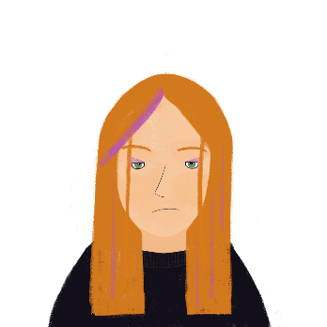
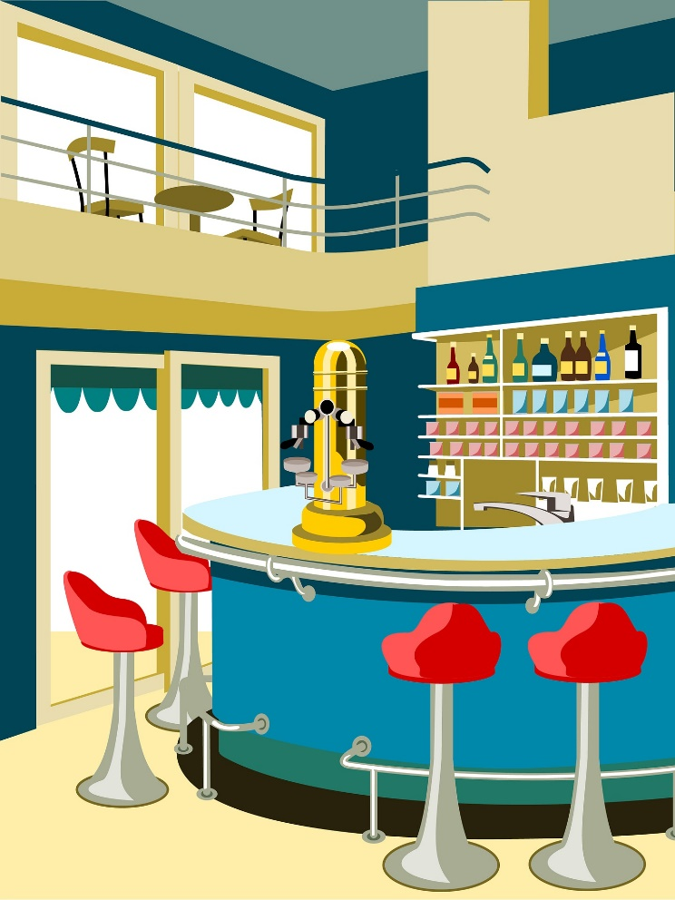
Qui boit quoi ?
* alors = right, so
* le vin = wine
lire
Élodie est serveuse dans un café. Elle trouve ça un peu difficile ! Elle prend la commande d’une femme. Qui boit quoi ?
1. Alors*… tu bois du thé et il boit du Coca-Cola.
[tu/il]
[tu/il]
2. Bah non, il boit du thé et je bois de l’eau.
[je/il]
[je/il]
3. D’accord, il boit du thé et tu bois du lait.
[tu/il]
[tu/il]
4. Je bois un verre de vin* et tu bois un grand café !
[je/il]
[tu/il]
Notes:
Timing: 5 minutes
Aim: Written recognition of forms of boire, and connecting these with meaning.
Procedure:
1. Students write 1-4 and two pronouns for each, using their knowledge of forms of boire to make the choice.
2. Click to reveal answers.
3. Oral translation of the full text.
Word frequency of cognates used (1 is the most frequent word in French): commande [2123]
Source: Londsale, D., & Le Bras, Y. (2009). A Frequency Dictionary of French: Core vocabulary for learners London: Routledge.
Word frequency of unknown words used (1 is the most frequent word in French): alors [81], vin [2309]
Source: Londsale, D., & Le Bras, Y. (2009). A Frequency Dictionary of French: Core vocabulary for learners London: Routledge.

Slide 21
Uncountable nouns
grammaire
As you know, we use un/une (the indefinite article) to talk about ‘whole’ things, and du/de la/de l’ (the partitive article) to talk about ‘parts’ of things in French:
J’achète… un poisson du poisson
I’m buying… a fish some fish
These nouns are countable – you can put ‘a’ or a number in front of them (one fish, three ice creams, seven loaves of bread).
But what about nouns you can’t count? We can’t say ‘a flour’ or ‘two rice,’ we can only say ‘some’. These uncountable nouns take the partitive article only:
J’achète… du riz de la farine
I’m buying… some rice some flour
Notes:
Timing: 3 minutes
Aim: Introducing the concept of uncountable nouns, and the use of the partitive article with these.
Word frequency of unknown words used (1 is the most frequent word in French): riz [>5000], farine [>5000]
Source: Londsale, D., & Le Bras, Y. (2009). A Frequency Dictionary of French: Core vocabulary for learners London: Routledge.

Slide 22
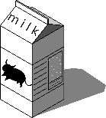
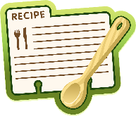
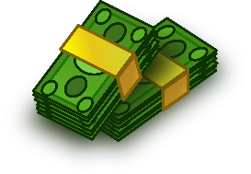
Uncountable nouns
lire
Hint
To check whether a noun is countable or uncountable, try putting a number in front of the English word.
Chance means ‘luck’ here, which is uncountable
(She has a lot of luck).
Chance can also mean ‘chance’, which is countable
(She has three chances).
J’ai …
glace
du/de la (uncountable) | un/une (countable)
lait
chance
recette
langue
argent
viande
Notes:
Timing: 3 minutes
Aim: To connect article types (partitive and indefinite) with noun types (countable and uncountable)
Procedure:
1. Students sketch the table and assign the items to the appropriate columns, based on whether they think they are countable or uncountable nouns.
2. Click to see each noun move to the appropriate column.

Slide 23
Le week-end d’Élodie
* le prix = prize
* après tout = after all
* le riz = rice
* l’huile (f) = oil
lire
avoir de la chance
= to be lucky
Qu’est-ce qu’elle a fait ?
C’est samedi et Élodie a de la [1] surprise / chance. Elle a gagné un [2] prix* / argent au travail. C’est €50 ! Pour célébrer, elle décide de cuisiner un [3] bœuf / repas magnifique pour sa famille. Après tout*, elle a de l’ [4] argent / idée et elle a une [5] temps / recette aussi. Elle va au marché et elle achète un [6] poisson / riz*. Pour la sauce, elle prend de l’ [7] oignon / huile* d’olive. Elle revient chez elle pour préparer le dîner. Mais il y a un problème. Elle n’a pas acheté de boissons. On doit boire du [8] lait / verre d’eau. Quelle catastrophe !
Notes:
Timing: 5 minutes
Aim: Written recognition of indefinite and partitive articles and connecting these with countable and uncountable nouns.
Procedure:
Students write 1-8.
They read the text and use their knowledge of indefinite and partitive articles to decide which noun is needed.
Answers revealed on clicks.
On a final click, the info bubble explaining the avoir de la chance appears. Other adverbial expressions with avoir (faim/mal/peur) are taught in 8.1.2.2.
Oral translation of text, or short summary in English if time permits. Check students understand the meaning of boisson, which is not glossed as it is anticipated that students will infer the meaning using a combination of their knowledge of boire and the surrounding context.
Word frequency of (near) cognates used (1 is the most frequent word in French): week-end [2475], surprise [1815], bœuf [3914], magnifique [2136], sauce [>5000], oignon [>5000], olive [>5000], dîner [2365], catastrophe [1832]
Source: Londsale, D., & Le Bras, Y. (2009). A Frequency Dictionary of French: Core vocabulary for learners London: Routledge.
Word frequency of unknown words used (1 is the most frequent word in French): prix [310], decider [165], cuisiner [>5000], après [82], tout [24], riz [>5000], huile [2340], boisson [3614]
Source: Londsale, D., & Le Bras, Y. (2009). A Frequency Dictionary of French: Core vocabulary for learners London: Routledge.

Slide 24
Negating partitive articles
grammaire
Remember, un/une (the indefinite article) changes to de in negative sentences:
Il y a un café ici. Il n’y a pas de café ici.
There’s a café here. There isn’t a café here.
Du/de la/de l’ (the partitive article) also changes to de in negative sentences:
Il y a du lait dans le thé. Il n’y a pas de lait dans le thé.
There’s (some) milk in the tea. There isn’t any milk in the tea.
Il y a de la viande dans la recette. Il n’y a pas de viande dans la recette.
There’s (some) meat in the recipe. There isn’t any meat in the recipe.
Notes:
Timing: 2 minutes
Aim: Introducing negation with partitive articles

Slide 25
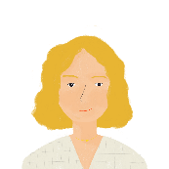
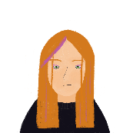
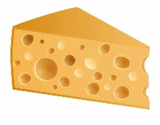
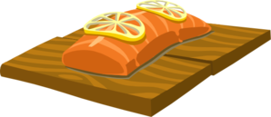
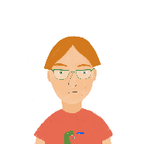
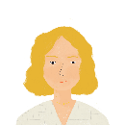
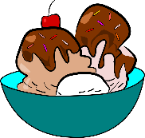
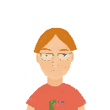
Qui aime quoi ?
écouter
La famille et les amis de Léa ont des goûts particuliers !
Écoute Léa. La personne mange / boit ça, ou pas ?
 |  |  | /
 |  |  | /
1
5
2
6
3
7
4
8
Notes:
Timing: 5 minutes for 2 slides
Aim: Practising aural recognition of negation of partitive articles with de.
Procedure:
1. Click the numbers to play the audio. The verb structures are obscured by beeps.
2. Students write 1-8 and a tick or cross for each item.
3. Click to reveal the answers.
4. The full audio (without beeps) is provided on the next slide.
Transcript:
Mes parents […] de viande.
Mon père […] du poisson.
Ma mère […] du thé.
Nous […] du pain.
Élodie […] de fromage.
Antoine […] de fruit.
Je […] du lait.
Sophie […] de glace.
Word frequency of cognates used (1 is the most frequent word in French): particulier [381]
Source: Londsale, D., & Le Bras, Y. (2009). A Frequency Dictionary of French: Core vocabulary for learners London: Routledge.

Slide 26
Qui aime quoi ?
Réponses
écouter
La famille et les amis de Léa ont des goûts particuliers !
Écoute Léa. La personne mange / boit ça, ou pas ?
 |  |  | /
 |  |  | /
1
5
2
6
3
7
4
8
Notes:
Procedure:
1. Click the numbers to play the full audio without beeps.
2. English translations can also be elicited.
Transcript:
Mes parents ne mangent pas de viande.
Mon père mange du poisson.
Ma mère boit du thé.
Nous mangeons du pain.
Élodie ne mange pas de fromage.
Antoine ne mange pas de fruit.
Je bois du lait.
Sophie ne mange pas de glace.

Slide 27
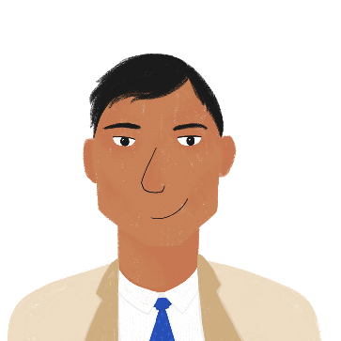
Un pique-nique
* pendant ce temps-là = in the meantime
lire
Bilal prépare un pique-nique. C’est un peu compliqué !
Qui fait/a fait quoi ? Qui ne fait pas / n’a pas fait quoi ?
 |  | oui | non
1. | Noura n’a pas préparé de sandwichs.
2. | Il n’y a pas de poisson.
3. | Il y a de la viande.
4. | Bilal cuisine un couscous.
5. | Amir fait du jus d'orange.
6. | Amandine n’a pas acheté de verres.
7. | Bilal va au magasin. Il ne trouve pas de choses.
8. | Pendant ce temps-là*, le chien a mangé du couscous.
9. | La famille prend une pizza à emporter.
Notes:
Timing: 5 minutes
Aim: Written recognition of use of de to negate both indefinite and partitive articles in present and perfect tense.
Procedure:
1. Students write 1-9, read the sentence and decide, based on the article, whether it the action happened or not.
2. They indicate their answers by writing oui/non, and adding, where required, ‘ne’ and ‘pas’ in the correct places.
3. Click to reveal answers.
4. Elicit oral translations.
Word frequency of (near) cognates used (1 is the most frequent word in French): pique-nique [>5000], compliqué [3324], sandwich [>5000], couscous [>5000], jus [>5000], orange [3912], pizza [>5000]
Source: Londsale, D., & Le Bras, Y. (2009). A Frequency Dictionary of French: Core vocabulary for learners London: Routledge.

Slide 28
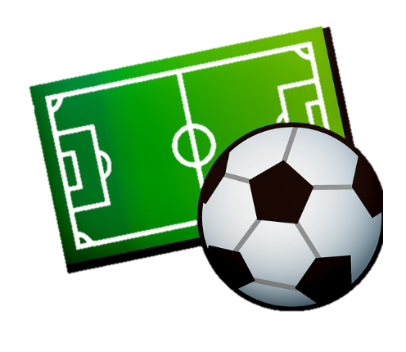
Qui fait quoi ? (A)
parler
 | Start these sentences (don’t say the word in brackets!) |  | Finish your partner’s sentences with a word that fits
A. | Il mange une ( ) | A. | /
B. | Je n’achète pas ( / ) | B. | /
C. | Nous cherchons un ( ) | C. | de la / de
D. | Elle ne boit pas ( / ) | D. | du / d’
E. | Tu a gagné un ( ) | E. | /
[?]
[?]
[?]
Notes:
Timing: 7 minutes
Aim: Aural recognition of indefinite, partitive and negative articles, and connecting these with appropriate vocabulary items.
Procedure:
1. Students take it in turns to read the beginning of a sentence. In the affirmative sentences, student should use the article they think is correct in place of the question mark. In the negative sentences, it is up to the listener to decide which article must follow ‘ne’.
2. The listening partner completes the sentence with an appropriate noun, based on the presence of an indefinite, partitive or negative article. Note that in the negative, either answer is possible – you may wish to inform students of this possibility before beginning the exercise.
3. Answers revealed on clicks (left-hand column answers appear first).
4. Elicit from students the article that is would be needed to create sentences with the unused items.

Slide 29
Qui fait quoi ? (B)
parler
 | Start these sentences (don’t say the word in brackets!) |  | Finish your partner’s sentences with a word that fits
A. | Il a de la ( ) | A. | /
B. | Elles gagnent de l’ ( ) | B. | de / du
C. | Je ne prépare pas ( / ) | C. | /
D. | Elle n’a pas trouvé ( / ) | D. | du / de
E. | Tu as acheté une ( ) | E. | /
[?]
[?]
[?]

Slide 30
Talking about nouns you can't count
partitive article with specified and unspecified quantities
SSC [-ill-, -ille], [i] revisited
Y8 French
Term 2.1 - Week 1 - Lesson 30
Kirsten Somerville / Catherine Morris / Natalie Finlayson
Artwork by: Chloé Motard
Date updated: 09/07/21
Notes:
Learning outcomes (lesson 1):
Consolidation of SSC [-ill-, -ille], [i] revisited
Consolidation of partitive articles
Introduction of specified quantities with partitive articles
Introduction of unspecified quantities with partitive articles
Word frequency (1 is the most frequent word in French):
8.2.1.1 (introduce) boire [1879], bois [1879], boit [1879], gagner² [258], argent [472], chance [438], lait [2507], café² [1886], thé [3517], viande [2625], peu [91], verre [2174], beaucoup [150]
8.1.2.5 (revisit) gérer [1354], espace [870], goût [1829], langue², [712], plat [2167], recette [1709], repas [2948] d'abord [326], puis [230], par [21], puisque [528], Noël [>5000], réveillon [>5000]
8.1.1.4 (revisit) célébrer [2170], préférer [597], on¹ [29], date [660], juin [931], mars [868], mai [943], tradition [1371], avril [1022], événement [573], février [1136], janvier [939], premier [56], première [56], quatorze [1472], quinze [3359], seize [3285], trente [1646], treize [3245], vingt [1273]
construction rule for numbers 13-31
Source: Londsale, D., & Le Bras, Y. (2009). A Frequency Dictionary of French: Core vocabulary for learners London: Routledge.

Slide 31
LL
écouter / écrire
You have learned that ll is pronounced like the English ‘y’ when it follows the letter i (famille, juillet, travailler).
Remember there are a handful of exceptions to this rule (ville, tranquille, mille, Lille). In these words, ll is pronounced like the English L.
After other vowels, ll is always pronounced like English L, (salle, belle, collège).
Challenge: on the next slide you will see a set of words in French containing ll.
Can you read them out to your partner before the timer runs out?
Notes:
Timing: 2 minutes
Aim: To introduce spelling rules governing the pronunciation of ‘ll’ and cross-linguistic comparison with English.

Slide 32
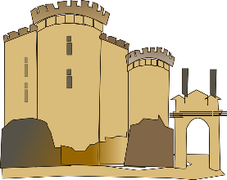
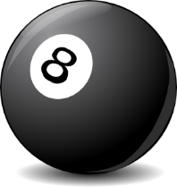
LL
parler
milllion
Lille
cédille
tellement
60
folle
[cedilla]
cheville
[so much]
[crazy]
vanille
collectif
actuellement
elle
[collective]
[at the moment]
[she]
secondes
syllabe
la Bastille
collègue
pull
[colleague]
[syllable]
installer
excellent
[to install]
dollar
vallée
0
salle
[valley]
DÉBUT
balle
Notes:
Timing: 5 minutes for 3 slides
Aim: Oral production (speaking) practice with the ‘ll’ sound after various vowels
Procedure:
1. Click to start the timer.
2. Students have one minute to try to say all the words correctly to a partner.
3. If the LL sound is pronounced incorrectly, the listening students stops the speaker and has them pronounce the word correctly three times before moving on (any pronunciation errors noticed in other parts of the word should not be penalised, but noted by the listener and given as feedback once the timer stops.
4. The student who pronounces the most words correctly in 30 seconds is the winner.
5. Move on to the following slides to repeat the task in fewer seconds, helping automisation.
Word frequency (1 is the most frequent word in French): dollar [432], collègue [1099], collectif [1224], salle [812], installer [821], actuellement [728], vallée [2856], folle [fou 1357], syllabe [>5000], elle [38], cédille [>5000], tellement [869], excellent [1225], vanille [>5000], la Bastille [n/a], cheville [>5000], pull [>5000], balle [2311], Lille [n/a], million [307]
Source: Londsale, D., & Le Bras, Y. (2009). A Frequency Dictionary of French: Core vocabulary for learners London: Routledge.

Slide 33
LL
parler
milllion
Lille
cédille
tellement
45
folle
[cedilla]
cheville
[so much]
[crazy]
vanille
collectif
actuellement
elle
[collective]
[at the moment]
[she]
secondes
syllabe
la Bastille
collègue
pull
[colleague]
[syllable]
installer
excellent
[to install]
dollar
vallée
0
salle
[valley]
DÉBUT
balle
Notes:
As previous with 15 fewer seconds on the timer.

Slide 34
LL
parler
milllion
Lille
cédille
tellement
30
folle
[cedilla]
cheville
[so much]
[crazy]
vanille
collectif
actuellement
elle
[collective]
[at the moment]
[she]
secondes
syllabe
la Bastille
collègue
pull
[colleague]
[syllable]
installer
excellent
[to install]
dollar
vallée
0
salle
[valley]
DÉBUT
balle
Notes:
As previous with 15 fewer seconds on the timer still.

Slide 35
Vocabulaire
parler 1/8
parler 1/2
4.5
[to earn, to win]
l’argent
gagner
le verre
Secondes
[a little (bit)]
le thé
un peu
0
DÉBUT
Notes:
Timing: 2 minutes for two slides Aim: Oral recall of three words within a given time. This is slide 1/2.
Procedure:
1. Say all three words before three seconds elapse.
2. Click to reveal answers.
3. Repeat if additional practice needed.

Slide 36
Vocabulaire
parler 1/8
parler 2/2
5
[a lot]
[to drink]
beaucoup
boire
Secondes
le lait
[luck]
la viande
la chance
le café
0
DÉBUT
Notes:
This is slide 2/2.

Slide 37
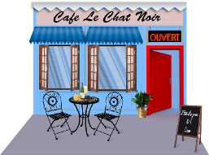
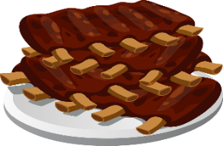
Vocabulaire
lire / écrire
Amir is choosing what to get at the café. C’est quel mot?
Je vais au café. Je veux manger de la viande.
Je veux boire du thé ou du café, mais c’est un peu cher. Je n’ai pas beaucoup d’argent. Je dois travailler et gagner. Mais j’ai de la chance !
Le serveur est sympa. Je bois un verre de lait.
.
[a little bit]
[a lot]
[to earn]
.
Notes:
Timing: 5 minutes
Aim: Written recall of this week’s new vocabulary.
Procedure:
Students fill the gaps using the images or words provided. NB due to the use of partitives in the surrounding text, students are not asked to provide the noun articles here (they are, however, asked to recall these in the speaking exercise on the previous slide).
Answers revealed on clicks.

Slide 38
Associations
lire
Write 1-4. Select the word (a-d) which best goes together with the word in bold.
1. le directeur | a) le goût
 | b) gérer
 | c) la recette
 | d) le repas
3. la tradition | a) d’abord
 | b) la première
 | c) l’espace
 | d) le réveillon de Noël
2. le premier | janvier
 | b) puis
 | c) préférer
 | d) l’événement
4. la recette | a) la langue
 | b) le plat
 | c) la date
 | d) célébrer
Notes:
Timing: 3 minutes
Aim: Written recognition of revisited vocabulary in an activity which strengthens semantic associations between words.
Procedure:
Students select the word they think best goes together with the word in bold and write 1b etc..
Answers revealed on clicks

Slide 39
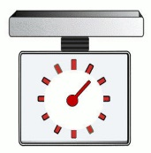
Specified quantities
grammaire
Uncountable nouns cannot be counted, but they can be measured.
We can do this using expressions of quantity, eg.:
beaucoup a lot un kilo a kilo un litre a litre
un peu a little un gramme a gram un verre a glass
The partitive article changes to de after an expression of quantity:
un peu de lait un kilo de viande un verre d’eau
a little milk a kilo of meat a glass of water
De → d’ before a vowel / h.
Notes:
Timing: 2 minutes
Aim: Introducing expressions of quantity with uncountable nouns

Slide 40
Que dit Amir ?
écouter
Amir dit des choses que sa famille mange et boit.
La phrase est complète, ou il y a une expression de quantité ? Écris a ou b.
 |  | a | b
 |  | [ - ] | un litre
 |  | [ - ] | un verre
 |  | [ - ] | un peu
 |  | [ - ] | beaucoup
 |  | a | b
 |  | [ - ] | trente grammes
 |  | [ - ] | beaucoup
 |  | [ - ] | un peu
 |  | [ - ] | des kilos
1
5
2
6
3
7
4
8
Notes:
Timing: 5 minutes for 2 slides
Aim: Practising aural recognition of expressions of quantity with de
Procedure:
1. Click the numbers to play the audio. There is a beep after each verb.
2. Students write 1-8 and choose ‘a’ if the sentence is already complete, or ‘b’ if the beep hides an expression of quantity.
3. Click to reveal the answers.
4. The full audio (without beeps) is provided on the next slide.
Transcript:
Chaque jour, mes parents partagent […] de café.
Noura préfère […] de lait.
Parfois, ma mère prépare […] du thé.
Normalement, je bois […] de l’eau.
Au déjeuner, l’école donne […] du fromage aux enfants.
À Nice, on mange […] de poisson.
Ma famille achète […] de viande aussi.
En été, nous emportons […] de la glace à la plage.
Word frequency of cognates used (1 is the most frequent word in French): complet [965], expression [952], quantité [1680], litre [3972], gramme [>5000], kilo [3894]
Source: Londsale, D., & Le Bras, Y. (2009). A Frequency Dictionary of French: Core vocabulary for learners London: Routledge.

Slide 41
Que dit Amir ?
Réponses
écouter
Amir dit des choses que sa famille mange et boit.
La phrase est complète, ou il y a une expression de quantité ? Écris a ou b.
 |  | a | b
 |  | [ - ] | un litre
 |  | [ - ] | un verre
 |  | [ - ] | un peu
 |  | [ - ] | beaucoup
 |  | a | b
 |  | [ - ] | trente grammes
 |  | [ - ] | beaucoup
 |  | [ - ] | un peu
 |  | [ - ] | des kilos
1
5
2
6
3
7
4
8
Notes:
Procedure:
1. Click the numbers to play the full audio without beeps.
2. English translations can also be elicited.
Transcript:
Chaque jour, mes parents partagent un litre de café.
Noura préfère un verre de lait.
Parfois, ma mère prépare du thé.
Normalement, je bois de l’eau.
Au déjeuner, l’école donne du fromage aux enfants.
À Nice, on mange beaucoup de poisson.
Ma famille achète un peu de viande aussi.
En été, nous emportons de la glace à la plage.

Slide 42
Unspecified quantities
In French, we use the definite article to make general statements and give our opinions about things.
grammaire
To talk about things in general, we use the definite article.
Le/la/l’ is necessary in French, but, we don’t always say ‘the’ in English:
Tu aimes le fromage ? Do you like the cheese? (a specific cheese)
OR Do you like cheese? (cheese in general)
Similarly, du/de la/de l’ (the partitive article) is not always translated as ‘some’:
Tu as acheté du fromage ? Did you buy some cheese?
OR Did you buy cheese?
It is not possible to drop the article in French. The type of article tells us whether we are talking about something in general (le/la/l’), or referring to an unspecified amount of it.
Notes:
Timing: 2 minutes
Aim: introducing differences in article use between English and French

Slide 43
Unspecified quantities
Try the word ‘some’ in front of ketchup / mayonnaise to see if it implies an ‘amount’ .
lire
 |  | making a general statement | talking about an amount
1. | My favourite sauce is ketchup.
2. | I eat ketchup with every meal.
3. | You like mayonnaise.
4. | You often buy mayonnaise.
In English, we use context to work this out:
 |  | making a general statement | talking about an amount
1. | Tu aimes la mayonnaise.
2. | Ma sauce préférée est le ketchup.
3. | Tu achètes souvent de la mayonnaise.
4. | Je mange du ketchup à chaque repas.
In French, the article tells us this information:
Notes:
Timing: 5 minutes
Aim: Raising awareness of differences in article use and meaning between English and French
Procedure:
1. Students write 1-4 and choose if each sentence is talking about the noun in bold in general, or about an unspecified amount of it
2. Click to reveal the answers.
3. Repeat steps 1-2 for the French sentences. Emphasise that the article is essential in French, even if it isn’t used in English.
Word frequency of cognates used (1 is the most frequent word in French): sauce [>5000], ketchup [>5000], mayonnaise [>5000]
Source: Londsale, D., & Le Bras, Y. (2009). A Frequency Dictionary of French: Core vocabulary for learners London: Routledge.

Slide 44
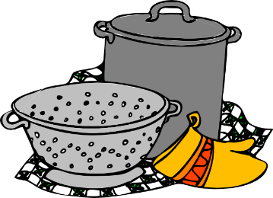
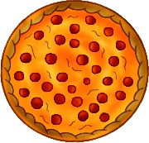
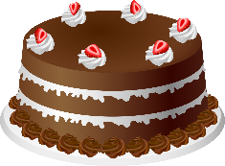
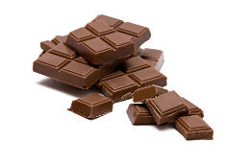
Le repas idéal
écouter
Amir veut préparer un repas pour Océane.
Il demande si elle aime ça, ou si elle mange ça ?
 |  | tu aimes…? | tu manges…?
 |  | tu aimes… ? | tu manges… ?
1
5
2
6
3
7
4
8
Notes:
Timing: 5 minutes for 2 slides
Aim: Practising aural recognition of the partitive article to indicate an unspecified amount
Procedure:
1. Click the numbers to play the audio. The verbs are obscured by beeps.
2. Students write 1-8 and choose ‘aimer’ (indicating something in general) or ‘manger’ (indicating an amount of something) for each.
3. Click to reveal the answers.
4. The full audio (without beeps) is provided on the next slide.
Transcript:
Tu […] du pain ?
Tu […] le poisson ?
Tu […] de la pizza ?
Tu […] le fromage ?
Tu […] du fruit ?
Tu […] la glace ?
Tu […] du gâteau ?
Tu […] le chocolat ?
Word frequency of cognates used (1 is the most frequent word in French): pizza [>5000], gâteau [4845], chocolat [4556]
Source: Londsale, D., & Le Bras, Y. (2009). A Frequency Dictionary of French: Core vocabulary for learners London: Routledge.

Slide 45
Le repas idéal
Réponses
écouter
Amir veut préparer un repas pour Océane.
Il demande si elle aime ça, ou si elle mange ça ?
 |  | tu aimes…? | tu manges…?
 |  | tu aimes… ? | tu manges… ?
1
5
2
6
3
7
4
8
Notes:
Procedure:
1. Click the numbers to play the full audio without beeps.
2. English translations can also be elicited.
Transcript:
Tu manges du pain ?
Tu aimes le poisson ?
Tu manges de la pizza ?
Tu aimes le fromage ?
Tu manges du fruit ?
Tu aimes la glace ?
Tu manges du gâteau ?
Tu aimes le chocolat ?
Word frequency of cognates used (1 is the most frequent word in French): pizza [>5000], gâteau [4845], chocolat [4556]
Source: Londsale, D., & Le Bras, Y. (2009). A Frequency Dictionary of French: Core vocabulary for learners London: Routledge.

Slide 46
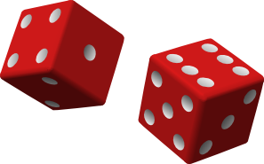
Grammaire
parler
j’aime | il y a un peu
il y a un kilo | je mange / bois
je ne mange / bois pas | il y a beaucoup
1
2
1
2
3
4
3
4
5
6
5
6
Notes:
Timing: 5 minutes
Aim: To practise article use with or without specified / unspecified quantities.
Procedure:
1. Students take it in turns to roll two dice. The numbers on the dice correspond to the numbers in the two grids (the die on the left pertains to the left-hand grid, the die on the right to the right-hand grid).
2. Students say the beginning of the sentence indicated by their left-hand die and finish it with the name of the food or drink item indicated by their right-hand die. NB: where the noun can be countable, both the definite and indefinite article are correct after je mange/bois … just ensure students are aware of the difference in meaning!

Slide 47
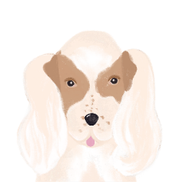
Noura et Apollon
* le chat
= cat
* maman
= mum
lire / écrire
Fill in the gaps. Do you need a definite article, an indefinite article or a partitive article?
A. Noura at Apollon font de l’exercice au parc. Apollon a de la chance. Il est heureux parce qu’il a trouvé un peu de viande dans la rue !
B. Noura trouve ça drôle. Normalement elle ne mange pas de viande. Elle préfère le poisson. Elle va au marché et elle achète un poisson entier.
C. Noura veut partager son déjeuner. Elle donne du poisson à Apollon. Mais Apollon est un chien. Les chiens préfèrent la viande.
D. Noura boit un verre de lait. Elle demande à Apollon s’il veut boire du lait aussi. Mais les chiens n’aiment pas le lait. Apollon boit seulement de l’eau.
E. Noura téléphone à sa mère qui fait du sport. Elle dit “Maman! Je veux un chat* !”
[1]
[2]
[3]
[4]
[5]
[6]
[7]
[8]
[9]
[10]
[11]
[12]
[13]
[14]
[15]
[16]
[17]
Notes:
Timing: 8 minutes
Aim: Written production of articles, consolidating the various uses of definite, indefinite and partitive articles encountered so far.
Procedure:
NB: As the task is quite complex, it is broken down into sections A-E. We recommend working through these a section at a time, correcting and discussing each before moving onto another.
Begin by recapping the uses of definite, indefinite and partitive articles encountered so far.
Students write the numbers and decide, based on article knowledge and gender, which article is needed.
Answers revealed on clicks. For each answer revealed, give a detailed explanation for the use of the article.
As such a range of article uses are exemplified here, it is strongly recommended that students translate the story if time permits, thinking carefully about English translations of the various articles. A suggested translation is provided on the following slide.
Word frequency of cognates used (1 is the most frequent word in French): entier [455], téléphoner [2448]
Source: Londsale, D., & Le Bras, Y. (2009). A Frequency Dictionary of French: Core vocabulary for learners London: Routledge.
Word frequency of unknown words used (1 is the most frequent word in French): chat [3138], maman [2168]
Source: Londsale, D., & Le Bras, Y. (2009). A Frequency Dictionary of French: Core vocabulary for learners London: Routledge.

Slide 48
Noura et Apollon
Look how often the article can be dropped in English! This cannot happen in French.
* le chat
= cat
* maman
= mum
écrire
Fill in the gaps. Do you need a definite article, an indefinite article or a partitive article?
A. Noura and Apollon are taking (some) exercise at the park. Apollon is lucky! He is happy because he has found a bit of meat on the street.
B. Noura finds this funny. She doesn’t normally eat (any) meat. She prefers fish. She goes to the market and (she) buys a whole fish.
C. Noura wants to share her lunch. She gives some fish to Apollon. But Apollon is a dog. Dogs prefer meat.
D. Noura is drinking a glass of milk. She asks Apollon if he wants to drink (some) milk as well. But dogs don’t like milk. Apollon only drinks water.
E. Noura calls her mother who is doing (some/a bit of) sport. She says: ‘Mum! I want a cat!”
Notes:
Suggested translation for the exercise on the following slide.
The noun phrases in orange highlight the wide range of cross-linguistic differences in article usage. Note especially how often the article can be dropped in English, whereas it cannot in French.

Slide 49
Les nombres de 1 à 31
parler
Numbers 1 - 31
1
2
3
4
5
6
7
8
9
10
11
12
13
14
15
16
17
18
19
20
21
22
23
24
25
26
27
28
29
30
31
Say up to three consecutive numbers
One number -> next person
Two numbers -> change direction
Three numbers -> skip the next person
Notes:
Optional extra
Timing: 5 minutes
Aim: to revise numbers 1-31 (whole class or small group activity)
Procedure:
1. Like the number game 21 – but 31!
2. One by one students start counting out loud. They can say up to three consecutive numbers each.
3. If the student says one number, continue to the next student. If the student says two numbers, the game changes directions and goes back to the previous student. If the student says three numbers, the next student is skipped.
4. The goal is not to be the person who has to say 31

Slide 50
Gaming Grammar
Gaming Grammar
Relevant mini game(s):
Verbs (present): 1st person singular/plural (Verb agreement (present))
Verbs (present): 2nd person singular/plural (Verb agreement (present))
Verbs (present): 3rd person singular/plural (Verb agreement (present))
Notes:
This slide links to Gaming Grammar login screen. The appropriate mission can then be selected from the menu page.
Students will progress through the game at their own rate; teachers should use the teacher interface to check progress. This will help to inform future lesson planning.

Slide 51
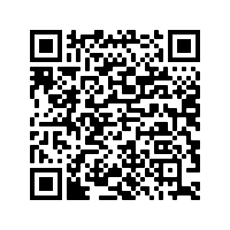
Devoirs
Vocabulary Learning Homework (Y8, Term 2.1, Week 2)
Quizlet link: Y8 Term 2.1 Week 2 (Y7 Mashup 3)
Quizlet QR code:

