Slide 1
Grammar
ER verbs: il/elle & ils/elles
(s/he & they)
Lesson 1
Y7 French
Term 1.2 - Week 6
Victoria Hobson / Emma Marsden / Rachel Hawkes
Date updated: 24/02/20

Slide 2
Regular –er verbs
To say ‘s/he’ + verb in French, the verb is in the short form, often ending in -e.
Il joue.
He plays.
NB! These endings are all silent – they all sound the same!
Elle joue.
She plays.
NB! These endings are all silent – so all these words sound the same!
To say ‘they’ + verb, the verb ends with -ent.
For either a group of boys or a mixed group.
Ils jouent.
They play.
For a group of girls only.
Elles jouent.
They play.
Stephen Owen
Notes:
Model the sound of ‘joue’ and ‘jouent’.
Say ‘il joue’ and ‘ils jouent’, then ask the students if they can tell whether you are talking about one person or more than one. The answer is ‘no’!
Explain to the students that a lot of the activities in this set are going to be reading and writing. This is because you can often only tell the difference between singular and plural ‘he and they’ in writing

Slide 3
Reading exercise
lire
Qui? You are reading an article about your favourite band. The band members (they) and the lead singer (he) have given information about themselves. Some words are missing. Identify ‘who’ each time. |  | ils (they) | il (he)
1 | ….joue de la guitare
2 | ….chantent
3 | ….écoutent la radio
4 | ….parle anglais
5 | ….mange un fruit
6 | ….étudient l’histoire et l’anglais
7 | …..regardent les films
8 | ….aime les voyages
Notes:
As suggested in the scheme of work, a cognate is used with jouer in this activity: de la guitare

Slide 4
Regular –er verbs
To say ‘s/he’ + verb in French, the verb is in the short form, often ending in -e.
Il joue.
He plays.
Elle joue.
She plays.
NB! These endings all sound the same!
To say ‘they’ + verb, the verb ends with -ent.
For either a group of boys or a mixed group.
Ils jouent.
They play.
For a group of girls only.
Elles jouent.
They play.
Stephen Owen
Notes:
Ahead of the listening activity, use this slide as an opportunity to recap that 3rd person singular and plural both sound the same, and likewise for the subject pronoun (NB unless there is a liaison needed – although none of this type are practised in the listening – so this teaching point may be saved until a more appropriate time).

Slide 5
mangent
écoutent
elles
ils
étudient
chantent
jouent
Notes:
Teachers could use this slide to reinforce the specific pronunciation of third person plural, along with the subject pronouns ils and elles.
Step one – ask students how to say ‘ils’ – which is the first text box seen on the ppt
Step two – teacher-led listen and repeat to reinforce pronunciation of 3rd person plural
Step three – use custom animation to elicit choral responses from students
Step four – practise with ils + verb
Step five – practise with elles + verb
NB – liaison between the ‘s’ on the end of ’ils’ and the initial vowel of the next word is not addressed here. Therefore students are not asked to produces ils + étudient / écoutent and elles + étudient / écoutent in this round of practice.

Slide 6
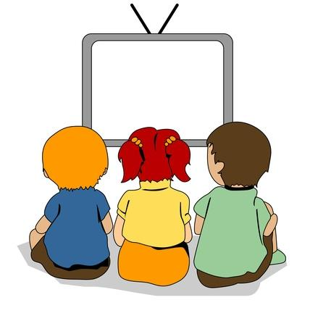
écouter / écrire
C’est qui? ………..
il ou ils?
elle ou elles?
Écoute, regarde et écris en français.
Exemple
ils regardent
Notes:
Use this slide to help explain the next task. Students will hear a verb (e.g., ils regardent) at the same time a circle will appear around the picture to indicate whether it is 3rd person singular or 3rd person plural. This is an example of a bimodal task which connects the spoken form with the written form simultaneously, as in this case listening alone does not indicate singular or plural. Once they have heard the audio and seen whether it is singular or plural, then they can WRITE the correct form. Then, click again so that they see the correct written form that they should have written down.
It is useful to practise bimodal tasks in this case because learners practise the idea that you can only tell which verb ending to use in writing when you know whether the person is singular or plural – so, here the learners get a visual cue (the picture) and this tells them what the written verb ending would be (the oral verb ending doesn’t help!). This teaches students about ‘ambiguity’ in language, and how sentences fit together. In this case, to know ‘who did the verb’ for 3rd person verbs (il and ils), you usually need other prompts to know whether singular or plural is being referred to.
NB Teachers need to mouse click on the ‘Exemple’ box, which triggers the audio to play the word ‘exemple’
If this step is missed, the first verb will not play in full.

Slide 7
écouter / écrire
ils chantent

Slide 8
écouter / écrire
il joue

Slide 9
écouter / écrire
il trouve

Slide 10
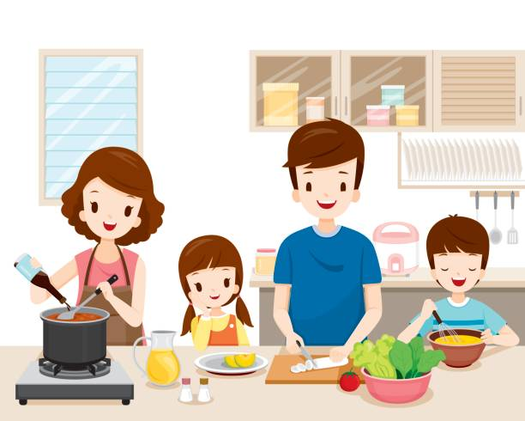
écouter / écrire
ils préparent

Slide 11
écouter / écrire
elle mange

Slide 12
écouter / écrire
elle écoute

Slide 13
écrire / parler
Partenaire A
Partenaire B
Translate these sentences. Then say them to your partner. Your partner must understand what you say, so take care.
He studies __________________________
They (m) play _______________________
They (m) sing _______________________
She listens __________________________
They (f) eat ________________________
He wears __________________________
She gives _______________________
They (f) walk ________________________
Translate these sentences. Then say them to your partner. Your partner must understand what you say, so take care.
They (f) sing __________________________
He listens _______________________
They (m) eat _______________________
They (f) play _________________________
She studies ________________________
She wears __________________________
They (m) give _______________________
He walks __________________________
Notes:
This slide is to be used with the next SEVEN slides, which shows the partners’ response sheets and models for doing the activity, to show how carefully the students will really need to think here.
Students should take around 5 minutes to write their respective sentences. At this point, in-class teacher circulation for checking of accuracy is really important.
Once each pair have written their sentences, they then take it in turns to say their sentences to their partner. At the oral stage, of course there is no audible difference between singular and plural. The activity is designed to reinforce this point to both the speaker and the listener and as such represents valuable practice. For example, when a student hears ‘elles portent’ the pictures are set up so that to get the answer correct the student has to tick an image that represents more that one person wearing (in this case, all girls). This reinforces the connection between pronunciation and meaning. In addition, the listener must write the correct verb form and in doing so connects pronunciation to meaning plus written form. Again, teacher circulation to check pronunciation is important here.
For the response sheets (next slide), the listener should write the French for what they hear immediately after ticking the picture to strengthen the link between pronunciation, verb form and meaning. If partners also compare immediately after each item, rather than waiting until the end of the whole activity (students would have to find a way of keeping their forthcoming answers covered up, with an ex. book, sheet of paper etc.), this would make the feedback immediate to help further strengthen the learning.

Slide 14
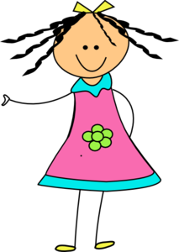
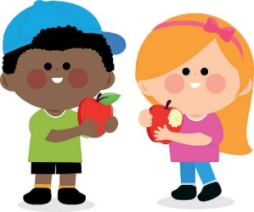
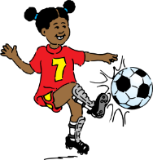
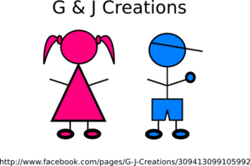
écouter / écrire
Partenaire B
Listen to your partner, tick the correct picture, write the French then compare answers:
1) 5)
2) 6)
3) 7)
4) 8)
Notes:
Student copy.
To minimise printing, print these as ‘handouts’ selecting ‘two to a page’ (slides 22&23).

Slide 15
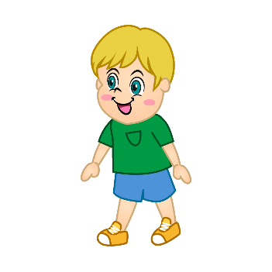
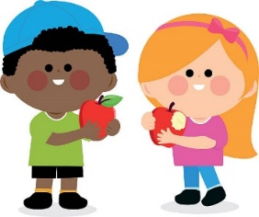
écouter / écrire
Partenaire A
Listen to your partner, tick the correct picture, write the French then compare answers:
1) 5)
2) 6)
3) 7)
4) 8)
Notes:
Student copy

Slide 16
écrire / parler
Partenaire A
Partenaire B
eg)
1)
She listens
______________
__Elle écoute__
elle écoute
Notes:
Teachers could use this slide to model the instructions to the class.

Slide 17
écrire / parler
Partenaire A
Partenaire B
eg)
1)
They (m) sing
______________
__ils chantent__
ils chantent
Notes:
Again, this could be used to model the instruction, this time with 3rd person plural. This is a valuable step to illustrate how the listener will need to think really carefully about singular and plural.

Slide 18
écouter / écrire
Partenaire B
Listen to your partner, tick the correct picture, write the French then compare answers:
1) 5)
2) 6)
3) 7)
4) 8)
Notes:
Answers
Teachers could elicit the spoken form from the students, then the animated circle appears to show the correct answer.
He studies / il étudie
They (m) play / ils jouent
They (m) sing / ils chantent
She listens / elle écoute
They (f) eat / elles mangent
He wears / il porte
She gives / elle donne
They (f) walk / elles marchent

Slide 19
écouter / écrire
Partenaire A
Listen to your partner, tick the correct picture, write the French then compare answers:
1) 5)
2) 6)
3) 7)
4) 8)
Notes:
Answers
They (f) sing / elles chantent
He listens / il écoute
They (m) eat / ils mangent
They (f) play / elles jouent
She studies / elle étudie
She wears / elle porte
They (m) give / ils donnent
He walks / il marche

Slide 20
écrire / parler
Partenaire A
Partenaire B
He studies __________________________
They (m) play _______________________
They (m) sing _______________________
She listens __________________________
They (f) eat ________________________
He wears __________________________
She gives _______________________
They (f) walk ________________________
elles chantent
il écoute
ils mangent
elles jouent
elle étudie
elle porte
ils donnent
il marche
il étudie
ils jouent
ils chantent
elle écoute
elles mangent
il porte
elle donne
elles marchent
They (f) sing __________________________
He listens _______________________
They (m) eat _______________________
They (f) play _________________________
She studies ________________________
She wears __________________________
They (m) give _______________________
He walks __________________________
Notes:
It may prove useful at the end of the activity to show the written answers to the class to address any errors students may have made during the course of the activity. They could ‘mark’ their written responses and give themselves a score out of 16, one point each for the first eight (their own translations) then one point each for the eight verbs that they heard. This slide could be used in conjunction with the images slides with the correct images circled – so that there is an opportunity to feedback on the speaking and listening element, then the written form.

Slide 21
lire / écrire
Read the sentence, choose the correct first verb and complete the sentence with a correct part. Then write the English for each sentence.
1 | Les filles | aime | le français | et | parle français.
 |  | aiment
2 | Les hommes | étudient | l’anglais | et | étudie aussi l’anglais.
 |  | étudie
3 | La femme | parlent | français | et | trouvent l’histoire intéressante aussi.
 |  | parle
4 | Le médecin | travaillent | en France | et | parlent espagnol.
 |  | travaille
trouvent l’histoire intéressante aussi.
parlent espagnol.
The girls like French and find history interesting as well.
The girls like French and speak Spanish.
parlent espagnol.
trouvent l’histoire intéressante aussi.
The men study English and speak Spanish.
The men study English and find history interesting as well.
The woman speaks French and also studies English.
étudie l’anglais aussi.
The doctor works in France and speaks French.
parle français.
Notes:
This reading acts as a lead-in to the more challenging listening task ahead. Here, students focus on verb form by having to choose between 3rd person singular or plural, depending on the subject of the verb but by using full nouns, rather than the subject pronoun (il/ils elle/elles) as in the previous lesson. Students then have to choose the correct accompanying verb to form the second part of the sentence successfully. (This is broken down even further in the next listening activity when students have to write the correct subject pronoun and then conjugate the verb accordingly.) The context for all four sentences is similar which reduces the reliance on vocabulary to work out the answers; students will have to look carefully at verb form.
NB There are two possible versions for the plural forms, but not for the singular. This adds a level of complexity to the task, in that students will not only have to focus on verb form but meaning as well. You could let the students realise that there is more than one correct answer, or you could tell them up front.
Some regular –er verbs from previous weeks are revisted here (parler/aimer/trouver/travailler).

Slide 22
écouter et écrire
Exemple
Listen to the sentence. Use the start of the sentence to work out how to complete the end of the sentence.
Tick the correct one
Write the correct ending
Write the correct subject pronoun
Write the correct verb
E.G.
 | Le garçon | aim_____ | le sport; |  |  | au foot.
 | Les garçons
e
il
joue
E.G.
 | La fille | rest_____ | à la maison; |  |  | la télé.
 | Les filles
ent
elles
regardent
Notes:
Use this slide to model the requirements of the task. Really emphasise the importance of listening carefully to the subject of the verb – is it singular or plural? Elicit from students what will be heard when the subject is singular and what is heard when it is plural – the subtle difference between ’le’ and ‘les’ (or ‘la’ and ‘les’) really makes a difference to meaning! This is key to students succeeding in the task. The two part nature of the task sets up differentiation. All students should be able to complete the first part of the sentence at least – hearing the difference between ‘le’ and ‘les’; and the difference between ‘la’ and ‘les’ and then writing the verb ending accordingly: ‘e’ or ‘ent’.
The second part offers a greater level of challenge.
Teachers could consider asking students to mark their work in two sets, to allow students to feel successful and give the teacher an indication of how students did with the two aspects of the task.
TRANSCRIPT
E.G
Le garçon aime le sport; il joue au foot.
E.G
Les filles restent à la maison; elles regardent la télé.

Slide 23
écouter et écrire
Tick the correct one
Write the correct ending
Write the correct subject pronoun
Write the correct verb
1 | Le garçon | aim_____ | la télé; |  |  | des films.
 | Les garçons
2 | La fille | aim_____ | la musique; |  |  | avec la radio.
 | Les filles
3 | Les médecins | travaill____ | en Angleterre; |  |  | anglais.
 | Le médecin
4 | Le chanteur | aim_____ | la musique; |  |  | la radio.
 | Les chanteurs
e
il
regarde
ent
elles
chantent
ent
ils
parlent
e
il
écoute
Notes:
There is no need to print the grid, simply have students write their responses in their exercise books. Teachers will need to allow students time to write, give enough time for this between each play of the sentences. Playing each sentence twice should suffice, given that they have had two worked examples, one singular and one plural.
Remind students to listen for the difference between ‘le’ and ‘les’ and connect ‘le’ to singular and ‘les’ to plural.
And, similarly, listen for the difference between ‘la’ and ‘les’ – connect ‘la’ to singular, and ‘les’ to plural.
IDEA FOR EXTENSION: Rather than allowing the whole sentence to play on the audio, stop it after the first verb and do not reveal the second part of the sentence. Then, ask the students to PREDICT what will come next. ‘Can you work out what will come next?’ They will use the first part of the sentence and the final words to work it out. They could tell the teacher orally, in whole class format. Or they could write down what they think will come next.
THEN, continue the audio and the students read their own work to check whether they predicted the subject pronoun and verb correctly. Check how they spelled the verb (-ent or –e).
(Teachers could choose to play the first four without the pause and then the second four (on the next slide) using the idea for extension once students are confident with the nature of the task. This will depend on the level of the group.)
TRANSCRIPT
1) Le garçon aime la télé; il regarde des films.
2) Les filles aiment la musique; elles chantent avec la radio.
3) Les médecins travaillent en Angleterre; ils parlent anglais.
4) Le chanteur aime la musique; il écoute la radio.

Slide 24
écouter et écrire
Tick the correct one
Write the correct ending
Write the correct subject pronoun
Write the correct verb
5 | Le professeur | travaill____ | dans la salle de classe; |  |  | les devoirs.
 | Les professeurs
6 | Les chiens | march____ | dehors; |  |  | dans le sable.
 | Le chien
7 | Les mères | prépar____ | le déjeuner; |  |  | du fruit.
 | La mère
8 | Le garçon | écout____ | le professeur; |  |  | un uniforme.
 | Les garçons
ent
ils
préparent
e
il
joue
ent
elles
mangent
e
il
porte
Notes:
TRANSCRIPT
5) Les professeurs travaillent dans la salle de classe; ils préparent les devoirs.
6) Le chien marche dehors; il joue dans le sable.
7) Les mères préparent le déjeuner; elles mangent du fruit.
8) Le garçon écoute le professeur; il porte un uniforme.
(Teachers could choose to play the first four without the pause and then the second four (on the next slide) using the idea for extension once students are confident with the nature of the task. This will depend on the level of the group.)
IDEA FOR EXTENSION: Rather than allowing the whole sentence to play on the audio, stop it after the first verb and do not reveal the second part of the sentence. Then, ask the students to PREDICT what will come next. ‘Can you work out what will come next?’ They will use the first part of the sentence and the final words to work it out. They could tell the teacher orally, in whole class format. Or they could write down what they think will come next.
THEN, continue the audio and the students read their own work to check whether they predicted the subject pronoun and verb correctly. Check how they spelled the verb (-ent or –e).
On completion of the task, teachers could take the opportunity to do some further sentence level comprehension by asking students to give the meanings in English of the complete sentences.

Slide 25
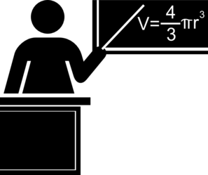
parler et écrire
Partenaire A
Partenaire B
The dog plays outside.
The teachers speak English.
The girls eat at school.
The dogs play in the sand.
The girl eats lunch.
The teacher speaks French.
Notes:
Instructions for the pair work: Partner B translates their sentences 1- 6 into French whilst Partner A also translates his/her sentences into French (see next slide). They take it in turns to say these French sentences to their partner. The partner must listen and write down in English what their partner has told them, next to the correct image. At the end of the activity, partners translate the sentences by writing the French underneath each picture in a full sentence, say them in French back to their partner and then compare written versions in French to see if they are correct, so third person singular and plural can be checked.
E.g
Partner B says: ‘Le chien joue dehors.’
Partner A finds the picture of one dog (singular) and writes in English next to the picture ‘plays outside’.
Partners then swap roles completing this step for all 6 pictures.
At the end of the activity:
Partner A then writes the French for the full sentence underneath the picture: ‘Le chien joue dehors,’ says it back to their partner in French to practise pronunciation and checks his/her written French version against the original written French version that his/her partner wrote at the start to check if the verb endings match.
Partners swap roles completing this step for all 6 sentences.

Slide 26
parler et écrire
Partenaire B
Partenaire A
The boy studies History.
The doctors listen to the radio.
The boys study at home.
The mums prepare lunch.
The doctor listens to the girl.
The mum prepares the fruit.
Notes:
Instructions for the pair work : Partner A translates their sentences 1- 6 into French whilst Partner B also translates his/her sentences into French (see previous slide). They take it in turns to say these French sentences to their partner. The partner must listen and write down in English what their partner has told them, next to the correct image. At the end of the activity, partners translate the sentences by writing the French underneath each picture in a full sentence, say them in French back to their partner and then compare written versions in French to see if they are correct, so third person singular and plural can be checked.
E.g
Partner A says: ‘Le garçon étudie l’histoire.’
Partner B finds the picture of one boy (singular) and writes in English next to the picture ‘studies History’.
Partners then swap roles completing this step for all 6 pictures.
At the end of the activity:
Partner B then writes the French for the full sentence underneath the picture: ‘Le garçon étudie l’histoire,’ says it back to their partner in French to practise pronunciation and checks his/her written French version against the original written French version that his/her partner wrote at the start to check if the verb endings match.
Partners swap roles completing this step for all 6 sentences.

Slide 27
Speaking cards
Partenaire A
Partenaire B
plays outside
play in the sand
studies History
study at home
Le chien joue dehors.
Les chiens jouent dans le sable.
Le garçon étudie l’histoire.
Les garçons étudient à la masion.
eat at school
eat at home
prepares the fruit
prepare lunch
Les filles mangent à l’école.
La fille mange à la maison.
Les mères préparent le déjeuner.
La mère prépare le fruit.
speaks French
speak English
listen to the radio
listens to the girl
Le professeur parle français.
Les professeurs parlent anglais.
Les médecins écoutent la radio.
Le médecin écoute la fille.
Notes:
Final slide with French and English of all 12 sentences for checking.
This is what students’ sheets will look like on completion of the activity.

Slide 28
écrire et parler
Now write two sentences about what your friend does - use ‘he’ or ‘she’ and write two sentences about what you think your teachers do – use ‘they’ (it doesn’t have to be true!).
E.G.
L’amie
Les professeurs
Elle écoute le chanteur.
Ils préparent le déjeuner.
Elle étudie l’histoire.
Ils chantent avec la radio.
Say your sentences to your partner who will translate them into English.
Notes:
Final extension activity
This offers an opportunity to try to get students to write and say something creative that actually applies to their own lives e.g., write (then say) 2 sentences describing what one friend does (it doesn't have to be true!) 'use she or he'; write (then say) 2 sentences that you think all your teachers do (it doesn't have to be true!) - use 'they'.
Throughout this sequence and generally we are (for very good reasons) not allowing students to produce their own language really to express their own meanings - but now, they might have enough to be able to produce 4 sentences that express the meaning they want to (rather than translations etc.)

