Slide 1
Grammar
Strong verbs in the present tense:
‘he/she’ or ‘they’
Y7 German
Term 2.2 - Week 5
Author name(s):
Jenny Hopper / Rachel Hawkes / Stephen Owen
Date updated: 30/03/20

Slide 2
Reminder Strong verbs: I, you, he/she/it
For strong verbs, you change the vowel for the du and er/sie/es forms:
schlafen
to sleep/sleeping
ich schlafe
I sleep/am sleeping
du schläfst
you sleep/are sleeping
er/sie schläft
he/she sleeps/is sleeping
Notes:
This slide recaps the grammar taught and practised previously, concerning the stem change and endings for singular strong verb forms in German, prior to the introduction of the third person plural form later in this sequence.

Slide 3
nehmen
[to take | taking]
nimmt
[takes | is taking]
Notes:
Three highly frequent strong verbs are now featured in more detail, in their long and short forms, over the next few slides: nehmen, lassen and halten (irregular).
Bring up the word [nehmen] on its own, say it, students repeat it, and remind them of the phonics (long ‘e’ in in first syllable of infinitive).
Try to elicit the meaning from the students.
If using gestures, a possible gesture would be to mime grabbing something.
Then bring up the English translations. Emphasise the two meanings for the infinitive.
Bring up the short form [nimmt], say it, students repeat it. Emphasise the short ‘I’ sound.
Try to elicit the meaning from the students. Emphasise the two meanings for the short form.
Note: Students have had explicit teaching that the present tense in German communicates two different present tense meanings in English. This reinforces that learning. Emphasise the two meanings for the short form, reminding students that German only has one form and does not have a direct equivalent of the grammar for ‘is + ing’, the continuous form (as covered in previous weeks).

Slide 4
nehmen
[to take | taking]
nimmt
[takes | is taking]
Notes:
Cycle through the long and short form again, eliciting the English meanings again, chorally.

Slide 5
nimmt
[takes | is taking]
Sie nimmt den Bus.
[She takes | is taking the bus.]
Notes:
Introduce the short form in a sentence. Elicit the English before providing the translation.

Slide 6
nimmt
[takes | is taking]
Sie _________ den Bus.
nimmt
[She takes | is taking the bus.]
Notes:
Cycle through the short form in context again. This time, the English appears, with the gapped German translation. Teachers can elicit the 3rd person form in the full sentence from students, chorally, before providing the audio on the next click.

Slide 7
lassen
[to leave |leaving]
lässt
[leaves | is leaving]
Notes:
Bring up the word [lassen] on its own, say it, students repeat it, and remind them of the phonics, short ‘a’.
Try to elicit the meaning from the students.
If using gestures, a possible gesture would be to mime pushing something away, as if leaving it.
Then bring up the English translations. Emphasise the two meanings for the infinitive.
Bring up the short form [lässt], say it, students repeat it. Draw attention to the vowel change. ä but still short.
Try to elicit the meaning from the students. Emphasise the two meanings for the short form.
Note: Students have had explicit teaching that the present tense in German communicates two different present tense meanings in English. This reinforces that learning. Emphasise the two meanings for the short form, reminding students that German only has one form and does not have a direct equivalent of the grammar for ‘is + ing’, the continuous form (as covered in previous weeks).
Note: There are other meanings of lassen which of course account for its high-frequency. They will be introduced subsequently, and links made back to this meaning.

Slide 8
lassen
[to leave | leaving]
lässt
[leaves | is leaving]
Notes:
Cycle through the long and short form again, eliciting the English meanings again, chorally.

Slide 9
lässt
[leaves | is leaving]
Sie lässt das Handy zu Hause.
[She leaves| is leaving her mobile at home.]
Notes:
Introduce the short form in a sentence. Elicit the English before providing the translation.

Slide 10
lässt
[leaves | is leaving]
lässt
Sie _________ das Handy zu Hause.
[She leaves | is leaving her mobile at home.]
Notes:
Cycle through the short form in context again. This time, the English appears, with the gapped German translation. Teachers can elicit the 3rd person form in the full sentence from students, chorally, before providing the audio on the next click.

Slide 11
halten
[to stop | stopping ]
hält
[stops | is stopping]
Notes:
Bring up the word [halten] on its own, say it, students repeat it, and remind them of the phonics.
Try to elicit the meaning from the students.
If using gestures, a possible gesture would be to mime coming to a stop from a walking motion.
Then bring up the English translations. Emphasise the two meanings for the infinitive.
Bring up the short form [hält], say it, students repeat it. Draw attention to the vowel change, plus the shortened form in the case of this verb (i.e. not ‘hältet’).
Try to elicit the meaning from the students. Emphasise the two meanings for the short form.
Note: Students have had explicit teaching that the present tense in German communicates two different present tense meanings in English. This reinforces that learning. Emphasise the two meanings for the short form, reminding students that German only has one form and does not have a direct equivalent of the grammar for ‘is + ing’, the continuous form (as covered in previous weeks).

Slide 12
halten
[to stop |stopping]
hält
[stops | is stopping]
Notes:
Cycle through the long and short form again, eliciting the English meanings again, chorally.

Slide 13
hält
[stops | is stopping]
Der Bus hält.
[The bus stops| is stopping.]
Notes:
Introduce the short form in a sentence. Elicit the English before providing the translation.

Slide 14
hält
[stops| is stopping]
hält
Der Bus _________.
[The bus stops | is stopping.]
Notes:
Cycle through the short form in context again. This time, the English appears, with the gapped German translation. Teachers can elicit the 3rd person form in the full sentence from students, chorally, before providing the audio on the next click.

Slide 15
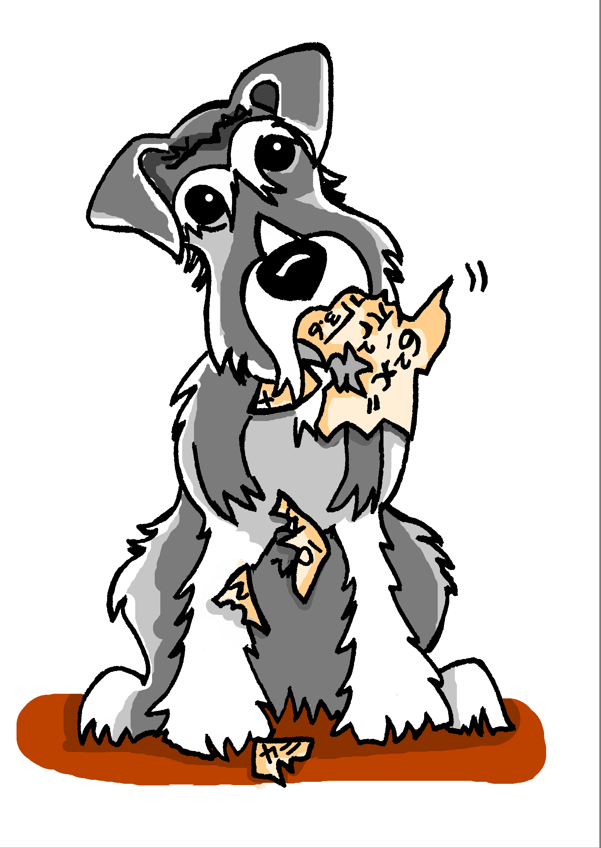
Es ist Montag. Wolfgang redet über Mias Schultag. Was sagt er?
lesen
1
Sie _______ in die Schule.
Sie _______ Matheunterricht aber sie __________ die Hausaufgaben!
Sie _______ nach Hause und _______ die Hausaufgaben!
Sie _______ spät ins Bett und _______.
Mias Hund ______ die Hausaufgaben!
2
3
4
5
essen | schlafen | fahren | haben | laufen | vergessen | machen | gehen
Notes:
This gapped reading exercise challenges students to insert the correct form of the verb into each gap. It is not an input processing task, as students have, in previous lessons, had practice in differentiating between 1st and 3rd singular person strong forms, and 1st and 2nd person singular strong forms. Here, students need to understand the language in the whole sentence, recognise which verb they need, and recall from memory the 3rd person singular forms. Note: verb prompts are given, in a jumbled order, in the infinitive form. Optional: They can hear the text with the gaps bleeped out on this slide; the following slide displays the answers with the complete audio sentences.
Transcript
Sie [fährt] in die Schule.
Sie [hat] Matheunterricht aber sie [vergisst] die Hausaufgaben!
Sie [läuft] nach Hause und [macht] die Hausaufgaben!
Sie [geht] spät ins Bett und [schläft].
Mias Hund [isst] die Hausaufgaben.

Slide 16
Es ist Montag. Wolfgang redet über Mias Schultag. Was sagt er?
Antworten
Sie _______ in die Schule.
Sie _______ Matheunterricht aber sie __________ die Hausaufgaben!
Sie _______ nach Hause und _______ die Hausaufgaben!
Sie _______ spät ins Bett und _______.
Mias Hund ______ die Hausaufgaben!
1
fährt
hat
vergisst
2
3
läuft
macht
4
geht
schläft
5
isst
essen | schlafen | fahren | haben | laufen | vergessen | machen | gehen
Notes:
ANSWERS This slide has the written answers and audio recordings of the complete sentences. Students can be asked to state the full sentence before hearing the audio, for increased challenge. Transcript
Sie fährt in die Schule.
Sie hat Matheunterricht aber sie vergisst die Hausaufgaben!
Sie läuft nach Hause und macht die Hausaufgaben!
Sie geht spät ins Bett und schläft.
Mias Hund isst die Hausaufgaben.

Slide 17
Sprechen: Was macht Wolfgang/Mia?
Er/Sie
zu Hause
nach Hause
das Auto
im Bett
das Handy
den Bus
im Garten
das Buch
laufen
helfen
fahren
vergessen
lassen
nehmen
schlafen
halten
Notes:
Pairwork: One student asks a question and the other responds with the correct pronoun and a combination that makes sense! Beispiel: Student A: Was macht Mia? Student B: Sie lässt das Handy im Garten! Was macht Wolfgang? Student A: Er hilft zu Hause.

Slide 18
Strong and weak verbs: ‘s/he’ versus ‘they’
For weak verbs:
For strong verbs:
For ‘they’, simply add back the ‘en’
No vowel change for ‘they’ form
sie / er singt
s/he sings
sie / er läuft
s/he runs
sie singen
they sing
sie laufen
they run
The ‘they’ form of haben is formed in the same way:
sie haben = they have
The ‘they’ form is identical to the infinitive!
Notes:
The third person plural form of the verb is now introduced, for both weak and strong verbs..

Slide 19
hören und lesen
Wer macht was im Osterlaub? Nur Mia, oder Mia und Wolfgang?
Remember: sie means both ‘she’ and ‘they’!
 |  | nur Mia | M & W
1
Sie bleiben nicht zu Hause.
2
Sie spielen in einer Band.
3
Sie schreibt die Musik.
4
Sie fahren nach Österreich.
5
Sie geben ein Konzert in Wien.
6
Sie nehmen den Zug.
7
Sie schläft im Zug.
8
Sie lässt die Noten* zu Hause!
*die Noten - written music
Notes:
Students are now challenged to listen and use the form of the verb to determine whether the subject of the German sentence (sie) refers to Mia alone (‘she’) or Mia and Wolfgang together (‘they’). They tick the appropriate column. The answers are animated and appear upon successive mouse clicks. The sentences also appear in written form – students could translate these into English.
Transcript
1. Sie bleiben nicht zu Hause.
2. Sie spielen in einer Band.
3. Sie schreibt die Musik.
4. Sie fahren nach Österreich.
5. Sie geben ein Konzert in Wien.
6. Sie nehmen den Zug.
7. Sie schläft im Zug.
8. Sie lässt die Noten zu Hause.
Frequency rankings:
2.2.5 lassen [82] nehmen [141] 2.2.3 fahren [169] geben [57] schlafen [787] vergessen [595] der Urlaub [1192] Recycled from previous learning: die Musik [469] bleiben [112] spielen [197] Band [>4037] nach [38] Österreich [n/a] Zug [613] zu Hause [6/159] Note: Konzert [1721] is used here as a near cognate but will be taught explicitly next week.
Note: Numbers are also to be revisited this week. Teachers can use this task to elicit numbers explicitly from students. For example: Teacher - Sie fahren nach Österreich. Welche Nummer ist das? 2.1.2 null [2847] eins [1372] zwei [77] drei [101] vier [195] fünf [272] sechs [468] sieben [570] acht [458] neun [934] zehn [312] elf [1417] zwölf [882]

Slide 20
eine Musiktournee
hören und lesen
Listen to the text and make notes in German. Then try to write what you heard in sentences.
Wolfgang und Mia haben fast zwei Wochen frei und machen zusammen eine Musiktournee. Wolfgang fährt mit Freunden. Er hat kein Geld. Mia nimmt allein den Bus und liest Zeitung.
Wolfgang und Mia spielen beide in einer Band. Wolfgang spielt Gitarre, aber es gibt ein Problem! Wolfgang lässt die Gitarre leider zu Hause. Deshalb kann er nicht im Konzert spielen! Mia findet das schlecht! Sie hat Angst! Was können sie jetzt machen? Sie müssen das Konzert geben. Ohne Gitarre! Eins, zwei, drei, vier...! Es sind viele Leute dort aber sie finden das Konzert nicht gut! Mia und Wolfgang laufen danach zum Hotel. Mia ist sehr müde und hat dann Kopfschmerzen. Sie schläft.
Sie fahren schließlich beide nach Hause. Der Bus hält plötzlich und was sehen sie da? Ach, die Gitarre!
(eine Musiktournee = a concert tour) (zum Hotel = to the hotel)
Notes:
This is a dictogloss activity. Students listen to the text and make notes in German. Then try to reconstruct it in sentences. The first mouse click displays this simple instruction; the second displays the German text, for verification of students’ versions.
Students can then read the text whilst listening to the audio recording. This helps to develop their segmentation skills, improving their ability to listen and understand when there is no text to support them.
Transcript
Wolfgang und Mia haben fast zwei Wochen frei und machen zusammen eine Musiktournee. Wolfgang fährt mit Freunden. Er hat kein Geld. Mia nimmt allein den Bus und liest Zeitung.
Wolfgang und Mia spielen beide in einer Band. Wolfgang spielt Gitarre, aber es gibt ein Problem! Wolfgang lässt die Gitarre leider zu Hause. Deshalb kann er nicht im Konzert spielen! Mia findet das schlecht! Sie hat Angst! Was können sie jetzt machen? Sie müssen das Konzert geben. Ohne Gitarre! Eins, zwei, drei, vier...! Es sind viele Leute dort aber sie finden das Konzert nicht gut! Mia und Wolfgang laufen danach zum Hotel. Mia ist sehr müde und hat dann Kopfschmerzen. Sie schläft.
Sie fahren schließlich beide nach Hause. Der Bus hält plötzlich und was sehen sie da? Ach, die Gitarre!
Frequency rankings of vocabulary introduced this week (1 is the most common word in German):
2.2.5: lassen [82] nehmen [141] halten [144] dann [33] zuerst [726] spät(er) [171] danach [437] schließlich [307] deshalb [264] Additional known vocabulary or cognates to recycle: plötzlich [459] die Leute [163] es gibt leider [642]
2.2.3: fahren [169] geben [57] helfen [406] mir [64] vergessen [595] laufen [248] schlafen [787] die Zeitung [572] das Geld [249] der Urlaub [1192] fast [223]
2.1.2 null [2847] eins [1372] zwei [77] drei [101] vier [195] fünf [272] sechs [468] sieben [570] acht [458] neun [934] zehn [312] elf [1417] zwölf [882]

