Slide 1
Deutsch - SSC revisit
A – E – EI – W - Z
Notes:
Learning aims for Week 6:
Indefinite articles – accusative (Row 2)
Recap SSCs so far (a / e / ei / z / w)
The vs a
Source: Jones, R.L. & Tschirner, E. (2006). A frequency dictionary of German: core vocabulary for learners. Routledge
Frequency rankings (1 is the most common word in German):
ich habe [8/7] du hast [52/7] das Beispiel [89] die Frau [103] die Hand [179] die Frage [152] das Problem [189] die Schule [208] der Herr [187] der/die/das Erste [91]

Slide 2
sagen
geben
Welt
Zug
frei
kalt
denken
Inge Alferink / Rachel Hawkes
Notes:
Structural revision and repetition are essential aspects of the NCELP approach. Here we revise all the SSCs introduced so far: long and short a, long and short e, ei, W, Z.
The target SSC in each of the source words is obscured. Click on the word to play the audio. Repeat if necessary. Students write the whole word with the obscured sound in their exercise books.

Slide 3
sagen
geben
Welt
Zug
frei
kalt
denken
Inge Alferink / Rachel Hawkes
Notes:
Antworten
The words used here are all source words. When discussing the answers the teacher might ask if students can remember other words with the same SSC, either cluster words or other vocabulary items they have encountered.
Target language: Students have started to learn the word ‘Beispiel’. Here the teacher could say: Ein Beispiel mit ‘a’… noch ein Beispiel mit ‘a’ etc.. to provide additional input of this word.

Slide 4
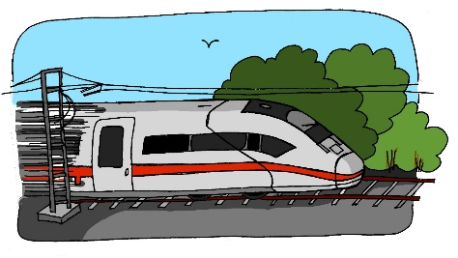
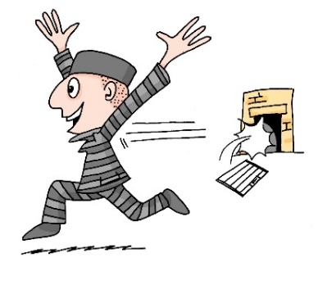
A
zehn
antworten
D
Zug
H
allein
C
E
Welt
klein
[alone]
Wasser
I
F
G
frei
B
Arzt
Inge Alferink / Rachel Hawkes
Notes:
Was passt zusammen?
Which pictures go together (based on the obscured SSC)? There are three groups of three: Z (Zimmer, zehn, Arzt), ei (frei, klein, allein), and w (Welt, antworten, Wasser). Each group includes the source word, which they have been reminded of in the previous slide.
Ask students to write down which ones they think go together.
The teacher can remind them of the source words they have just seen.
Clicking on the pictures will play the word if the students need an extra prompt.
Clicking on the paw prints will remove them.

Slide 5
antworten
zehn
Zug
allein
Welt
frei
Sekunden
klein
Wasser
Arzt
ANFANG
Inge Alferink / Rachel Hawkes
Notes:
Alphabetical read aloud: Individually (but all at once) pupils read out the words but in alphabetical order. They keep going for one minute.
Teacher can circulate to listen into their SSC knowledge.

Slide 6
ei
Der Mann sit_t all__n. ☹
1
z
e
a
2
Der Arzt d_nkt ’W_s?!’
ei
i
3
Der Gast hat __n Z_mmer.
4
Der Freund ge_ innt __n B_tt.
w
ei
e
ei
a
Die Frau h_t __nen G_st.
5
a
6
a
Der Lehrer s_gt ‘Hurr_’. ☺
a
Notes:
ADDITIONAL SSC transcription task. This activity includes all the SSCs that have been introduced so far.
Play the sound by clicking on the number. Repeat if necessary.
Students fill in the gaps.
Transcript
1. Der Mann sitzt allein.
2. Der Arzt denkt ‘was?!’
3. Der Gast hat ein Zimmer.
4. Der Freund gewinnt ein Bett.
5. Die Frau hat einen Gast.
6. Der Lehrer sagt ‘ Hurrah’.

Slide 7
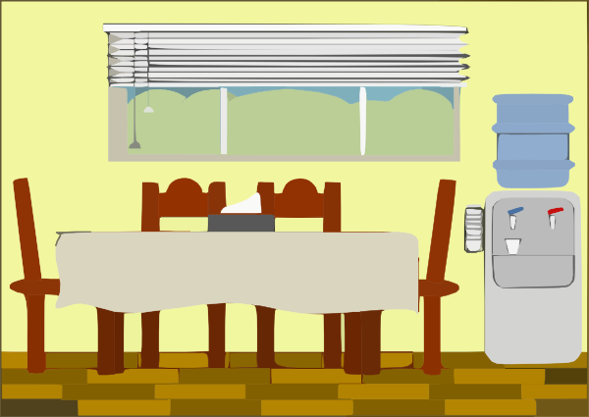
1
Der Mann sitzt allein. ☹
2
Der Arzt denkt ’Was?!’
3
Der Gast hat ein Zimmer.
4
Der Freund gewinnt ein Bett.
5
Die Frau hat einen Gast.
6
Der Lehrer sagt ‘Hurra’. ☺
Notes:
It’s important to see the source and cluster words as vocabulary, as well. Knowing that most are in the top 500 most high frequency German words means we can be confident that the time learning them will be well spent.
1) Read aloud task. As a whole-class activity or in pairs.
2) Translation task.
3) Paired vocabulary tennis task (with gestures for the verbs)
Note: Zimmer and Arzt are cluster words only. The pictures have been included to help access their meanings. Bett is a near cognate and should be transparent enough for students to guess.

Slide 8
Eine kleine Meise geigt allein eine leise Weise, eine zweite schweigt leider.
Notes:
OPTIONAL Zungenbrecher
Teacher reads out the whole sentence slowly and then takes the students through it word by word. Teacher models word; students respond with word.
The target SSC is ei, but some of the others are covered too: W in Weise, Z in zweite, a in allein. Most of the other sounds that have not been covered so far are similar to English with the exception of sch, which should be pointed out and modelled more carefully.
Discuss the meaning of the sentence. Words they know or might be able to guess:
Eine
kleine (in SOW vocab)
allein (cluster word just repeated)
Meise (they might be able to guess that it’s a type of bird based on the picture and the fact that it’s a noun as it’s capitalized)
However, vocabulary is not the focus here and shouldn’t be dwelt on too long.
Students practise saying the sentence individually. They could then do a competition to see who can say it the fastest without tripping up.

