Slide 1
Phonics
SSC [EI vs IE - revisited]
Y7 German
Term 3.1 - Week 4
Stuart Williams / Stephen Owen / Rachel Hawkes
Date updated: 04/05/20
Notes:
Revision of SSC EI and IE

Slide 2
ie
Liebe
Notes:
Introduce and elicit the pronunciation of the individual SSC ‘ie’ and then present and practise the pronunciation of the source word ‘liebe’.
A possible gesture for this would be to fold both hands over your heart, and smile!

Slide 3
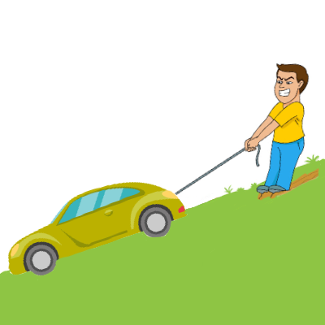
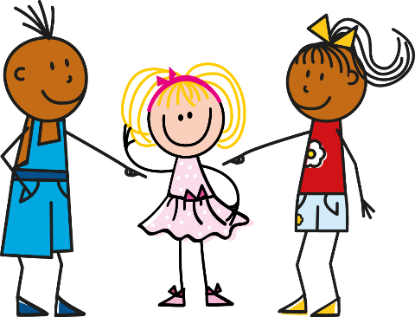
ie
ziehen
sie
Liebe
tief
Brief
liegen
2000 Kilometer
Notes:
Introduce and elicit the pronunciation of the individual SSC ‘ie’ and then the source word again (with gesture, if using). Then present and elicit the pronunciation of the five cluster words.
The cluster words have been chosen for their high-frequency, from a range of word classes, with the SSC (where possible) positioned within a variety of syllables within the words (e.g. initial, 2nd, final etc.). Additionally, we have tried to use words that build cumulatively on previously taught SSCs (see the Phonics Teaching Sequence document) and do not include new SSCs. Where new SSCs are used, they are often consonants which have a similar symbol-sound correspondence in English.
Word frequency rankings (1 is the most common word in German): Liebe [843]; ziehen[266] sie [10]; tief [506]; liegen [118]; Brief [813]. Source: Jones, R.L. & Tschirner, E. (2006). A frequency dictionary of German: core vocabulary for learners. Routledge

Slide 4
ie
ziehen
sie
Liebe
tief
Brief
liegen
Notes:
Without pictures to focus on the SSC alone.
Word frequency rankings (1 is the most common word in German): Liebe [843]; ziehen[266] sie [10]; tief [506]; liegen [118]; Brief [813]. Source: Jones, R.L. & Tschirner, E. (2006). A frequency dictionary of German: core vocabulary for learners. Routledge

Slide 5
ie
ziehen
sie
Liebe
tief
Brief
liegen
2000 Kilometer
Notes:
Without sound to elicit the pronunciation.
Word frequency rankings (1 is the most common word in German): Liebe [843]; ziehen[266] sie [10]; tief [506]; liegen [118]; Brief [813]. Source: Jones, R.L. & Tschirner, E. (2006). A frequency dictionary of German: core vocabulary for learners. Routledge

Slide 6
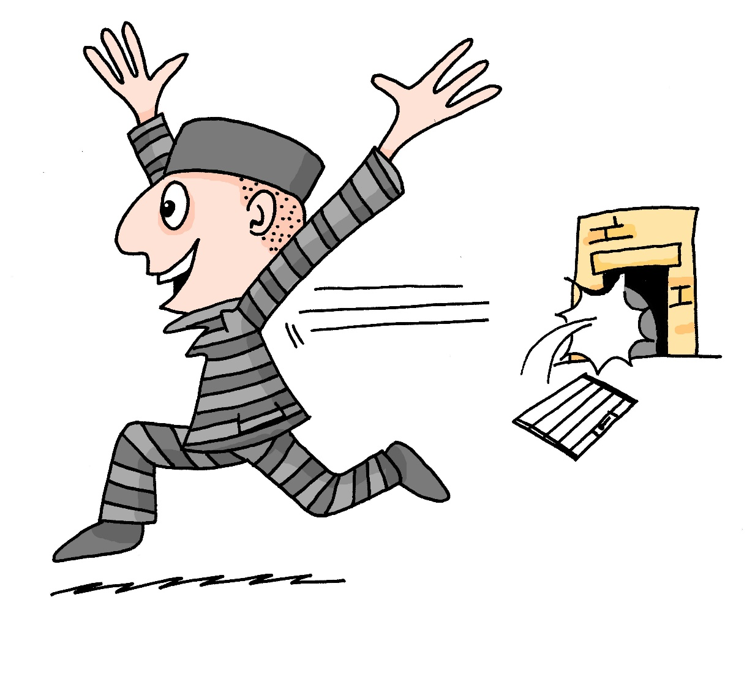
ei
frei
Notes:
NOTE: This SSC has been previously introduced in T.1.1_W3/ The ei and ie SSCs are brought together here for practice as minimal pairs in the exercises that follow.
Introduce and elicit the pronunciation of the individual SSC ‘ei’ and then present and practise the pronunciation of the source word ‘frei’.
A possible gesture for this would be stretch both arms up in the air (pointing outwards slightly to make a Y shape with your body), and smile!

Slide 7
ei
leider
ein
[unfortunately]
/a
frei
klein
allein
sein
[alone]
[to be]
Notes:
Introduce and elicit the pronunciation of the individual SSC ‘ei’ and then the source word again (with gesture, if using). Then present and elicit the pronunciation of the five cluster words. The cluster words have been chosen for their high-frequency, from a range of word classes, with the SSC (where possible) positioned within a variety of syllables within the words (e.g. initial, 2nd, final etc.). Additionally, we have tried to use words that build cumulatively on previously taught SSCs (see the Phonics Teaching Sequence document) and do not include new SSCs. Where new SSCs are used, they are often consonants which have a similar symbol-sound correspondence in English.
Word frequency rankings (1 is the most common word in German): frei [318]; leider [642] ein [5]; klein [114]; sein [3]; allein [258]. Source: Jones, R.L. & Tschirner, E. (2006). A frequency dictionary of German: core vocabulary for learners. Routledge
Note: ein is introduced to mean ‘a’ and ‘1’. This is reinforced in the grammar explanation slide, too.

Slide 8
ei
leider
ein
frei
klein
allein
sein
Notes:
Without pictures to focus on the SSC alone.

Slide 9
ei
leider
ein
[unfortunately]
/a
frei
klein
allein
sein
[to be]
Notes:
Without sound to elicit the pronunciation.

Slide 10
ei
ie
leicht
Ziel
kein
wie
schwierig
dein
heißen
Schauspieler
erreichen
ziemlich
sie
leider
schließlich
mein
sein
Lied
langweilig
ziehen
Schweiz
Computerspiel
Notes:
Phonics revision.
This is a paired read aloud task. The students use different colours to play. Pupil A says one of the words/phrases and pupil B has 3 seconds to locate it and cross it off with their colour. If the pupil takes longer than 3 seconds pupil A can steal the point. Clearly, the classroom conditions need to be right with the individual class for friendly competition.
Alternatively, they can do it more slowly and carefully, scrutinising each other’s pronunciation. If one makes a mistake (quite common with ei/ie), then the other pupil corrects and crosses off in his/her colour.
Note: Not all of these words have been taught before, so there is the opportunity for some genuine decoding.

Slide 11
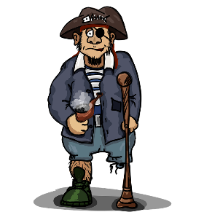
Pirates!
1
c
w
Riese
leider
Riese
One of the chests contains buried treasure. All the others contain poison!
Listen carefully to the secret code and follow the arrows to find the treasure.
Reise
Lieder
Reise
h
z
Wien
Biene
Feile
v
Wein
Beine
viele
Riese
k
Riese
Biene
Feile
leider
i
Reise
Beine
viele
Lieder
Reise
Riese
leider
Feile
leider
Riese
r
Reise
Lieder
viele
Lieder
Reise
Riese
y
j
q
Reise
Notes:
This slide and the two that follow are three versions of the activity with different solutions.
The game makes use of minimal pairs of unknown words (unknown words are used so that pupils focus on the sound. Definitions are given on a later slide).
Starting on the red square, pupils listen to the words and decide whether they hear /ei/ or /ei/. They follow the arrows indicated by their choice to finish at one of the chests. There is only one correct route per slide, so pupils must correctly identify all words to find the treasure. The order or /ei/ and /ie/ changes (i.e. sometimes /ei/ is on the white square and sometimes on the blue) so the pupils must read the spellings.
Pupils can follow the slide on the projector, or the slide can be printed so they can trace the route with a pen/finger.
Teacher asks ‘Wo bist du?’ Pupils respond ‘Z, W’ etc. to practise the alphabet. Teacher clicks on the chests they say to reveal treasure (or not!)
Audio plays on clicking play. Pupils will probably need to hear the audio at least three times.
Note: Each treasure chest is triggered to reveal what is underneath. You see a hand icon appear when you mouse over it – click and the chest disappears. Each slide only has one treasure chest – the rest reveal skulls.
Transcript:
Wein, Biene, Feile, Lieder, Riese
Treasure is located in chest r

Slide 12
Pirates!
2
c
w
Riese
leider
Riese
Reise
Lieder
Reise
One of the chests contains buried treasure. All the others contain poison!
Listen carefully to the secret code and follow the arrows to find the treasure.
h
z
Wien
Biene
Feile
v
Wein
Beine
viele
Riese
k
Riese
Biene
Feile
leider
i
Reise
Beine
viele
Lieder
Reise
Riese
leider
Feile
leider
Riese
r
Reise
Lieder
viele
Lieder
Reise
Riese
y
j
q
Reise
Notes:
Alternative: Give pupils a copy of the transcript below on a slip of paper and ask them to read to a partner.
The game makes use of minimal pairs of unknown words (unknown words are used so that pupils focus on the sound. Definitions are given on a later slide).
Starting on the red square, pupils listen to the words and decide whether they hear /ei/ or /ei/. They follow the arrows indicated by their choice to finish at one of the chests. There is only one correct route, so pupils must correctly identify all words to find the treasure. The order or /ei/ and /ie/ changes (i.e. sometimes /ei/ is on the white square and sometimes on the blue) so the pupils must read the spellings.
Pupils can follow the slide on the projector, or the slide can be printed so they can trace the route with a pen/finger.
Teacher asks ‘Wo bist du?’ Pupils respond ‘Z, W’ etc. to practice the alphabet. Teacher clicks on the chests they say to reveal treasure (or not!)
Audio plays on clicking play. Pupils will probably need to hear the audio at least three times.
Transcript:
Wien, Beine, viele, Lieder, Reise
Treasure is located in chest q

Slide 13
Pirates!
3
c
w
Riese
leider
Riese
Reise
Lieder
Reise
One of the chests contains buried treasure. All the others contain poison!
Listen carefully to the secret code and follow the arrows to find the treasure.
h
z
Wien
Biene
Feile
v
Wein
Beine
viele
Riese
k
Riese
Biene
Feile
leider
i
Reise
Beine
viele
Lieder
Reise
Riese
leider
Feile
leider
Riese
r
Reise
Lieder
viele
Lieder
Reise
Riese
y
j
q
Reise
Notes:
Alternative: Give pupils a copy of the transcript below on a slip of paper and ask them to read to a partner.
The game makes use of minimal pairs of unknown words (unknown words are used so that pupils focus on the sound. Definitions are given on a later slide).
Starting on the red square, pupils listen to the words and decide whether they hear /ei/ or /ei/. They follow the arrows indicated by their choice to finish at one of the chests. There is only one correct route, so pupils must correctly identify all words to find the treasure. The order or /ei/ and /ie/ changes (i.e. sometimes /ei/ is on the white square and sometimes on the blue) so the pupils must read the spellings.
Pupils can follow the slide on the projector, or the slide can be printed so they can trace the route with a pen/finger.
Teacher asks ‘Wo bist du?’ Pupils respond ‘Z, W’ etc. to practice the alphabet. Teacher clicks on the chests they say to reveal treasure (or not!)
Audio plays on clicking play. Pupils will probably need to hear the audio at least three times.
Transcript:
Wein, Beine, viele, Lieder, Reise
Treasure is located in chest y

