Slide 1
¡A pronunciar!
l
l
libro
Nick Avery / Juan Pedro Herrera
Notes:
The audio appears with the letter/image. If preferred, teachers can mute the audio and use their own voice to model the SSC and source/cluster words.
Introduce and elicit the pronunciation of the individual SSC ‘L’ and then present and practise the pronunciation of the source word ‘libro’. A possible gesture for this source word would be to mime opening a book with both hands.

Slide 2
l
salir
palabra
lista
libro
luz
luego
[later; then]
Nick Avery
Notes:
Recap individual SSC ‘L’ and then the source word again (with gesture, if using). Then present and elicit the pronunciation of the five cluster words. The cluster words have been chosen for their high-frequency, from a range of word classes, with the SSC (where possible) positioned within a variety of syllables within the words(e.g. initial, 2nd, final etc..) and additionally, we have tried to use words that build cumulatively on previously taught SSCs (see the Phonics Teaching Sequence document) and do not include new SSCs. Where new SSCs are used, they are often consonants which have a similar symbol-sound correspondence in English. Word frequency rankings: libro [230]; salir [114]; lista [1189]; luego [150]; palabra [192]; luz [278] Source: Davies, M. & Davies, K. (2018). A Frequency Dictionary of Spanish: Core vocabulary for learners (2nd ed.) London: Routledge.

Slide 3
l
salir
palabra
lista
libro
luz
luego
Nick Avery / Juan Pedro Herrera
Notes:
Picture-free version
Word frequency rankings: libro [230]; salir [114]; lista [1189]; luego [150]; palabra [192]; luz [278] Source: Davies, M. & Davies, K. (2018). A Frequency Dictionary of Spanish: Core vocabulary for learners (2nd ed.) London: Routledge.

Slide 4
¡A pronunciar!
ll
ll
llamar
Nick Avery / Juan Pedro Herrera
Notes:
The audio appears with the letter/image. If preferred, teachers can mute the audio and use their own voice to model the SSC and source/cluster words.
Introduce and elicit the pronunciation of the individual SSC ‘LL’ and then present and practise the pronunciation of the source word ‘llamar’. A possible gesture for this source word would be to bring an imaginary phone to your ear.

Slide 5
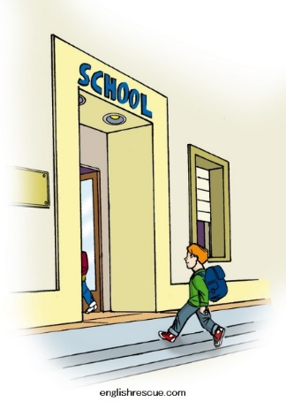
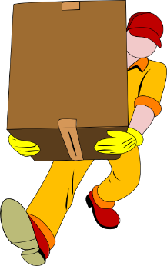
ll
llegar
llave
© www.englishrescue.com
llamar
llevar
amarillo
ella
Nick Avery
Notes:
Recap individual SSC ‘LL’ and then the source word again (with gesture, if using). Then present and elicit the pronunciation of the five cluster words. The cluster words have been chosen for their high-frequency, from a range of word classes, with the SSC (where possible) positioned within a variety of syllables within the words(e.g. initial, 2nd, final etc..) and additionally, we have tried to use words that build cumulatively on previously taught SSCs (see the Phonics Teaching Sequence document) and do not include new SSCs. Where new SSCs are used, they are often consonants which have a similar symbol-sound correspondence in English. Word frequency rankings: llamar [122]; llegar [75]; llevar [101]; ella [72]; llave [1853]; amarillo [1381] Source: Davies, M. & Davies, K. (2018). A Frequency Dictionary of Spanish: Core vocabulary for learners (2nd ed.) London: Routledge.

Slide 6
ll
llegar
llave
llamar
llevar
amarillo
ella
Nick Avery / Juan Pedro Herrera
Notes:
Picture-free version
Word frequency rankings: llamar [122]; llegar [75]; llevar [101]; ella [72]; llave [1853]; amarillo [1381] Source: Davies, M. & Davies, K. (2018). A Frequency Dictionary of Spanish: Core vocabulary for learners (2nd ed.) London: Routledge.

Slide 7
ella
60
salir
llamar
Segundos
llevar
lista
amarillo
luz
palabra
0
EMPEZAR
Nick Avery / Juan Pedro Herrera
Notes:
Slides 7-9 have three further practice activities for L / LL. It may be best to choose one and consider the other two as optional extras.
Pairwork ‘tennis’ – pupils say the words alternately out loud with a partner, building up speed, over 1 minute’s intensive practice. They call in any order they like, pupils are not allowed to repeat the one they said in their last turn. Teacher can circulate to listen into their SSC knowledge. Click on EMPEZAR to start a one minute timer on the screen.

Slide 8
ella
60
salir
llamar
Segundos
llevar
lista
amarillo
luz
palabra
0
EMPEZAR
Nick Avery / Juan Pedro Herrera
Notes:
Alphabetical read aloud: Individually (but all at once) pupils read out the words but in alphabetical order. They keep going for one minute.
Teacher can circulate to listen into their SSC knowledge.

Slide 9
lista
palabra
llave
libro
llamar
© www.englishrescue.com
llegar
Nick Avery / Juan Pedro Herrera
Notes:
Whole class: the target SSC (L/ LL) is obscured. The teacher can say the word and ask students to write the missing letter(s) (L or LL). To challenge students more, ask students to try to remember which source/cluster words with L and LL don’t appear here (e.g. amarillo, llevar, ella, luz, salir, luego), making sure to check their spelling and to also have students say them aloud.

