Slide 1
Talking about movement into and location in places
Prepositions in and auf R2 (acc) + movement R3(dat) + location
SSC [st]
Y7 German
Term 3.1 - Week 3 - Lesson 53
Mel Yates / Stephen Owen / Rachel Hawkes
Artwork: Steve Clarke
Date updated: 20/12/21
Notes:
Artwork by Steve Clarke. All additional pictures selected are available under a Creative Commons license, no attribution required.
Learning outcomes (lesson 1):
Introduction of SSC [st]
Introduction of prepositions in and auf + R2 (acc) + movement, R3(dat) + location
Word frequency (1 is the most frequent word in German):
7.3.1.3 (introduce) fallen [332] springen [1431] Geschäft [765] Kino [2020] Konzert [2350] Markt [476] Museum [1078] Party [2809] Stadt [204] Straße [391] angenehm [2214] auf¹ ² [16] in [3]
7.2.2.4 (revisit) Fahrrad/Rad fahren [n/a] Abend [342] Eis [1874] Fleisch [1790] Gemüse [3650] Nachmittag [1464] Wochenende [1243] heute [116] am Abend [n/a] am Nachmittag [n/a] am Wochenende [n/a] mit wem? [n/a]
7.2.1.3 (revisit) mögen, mag, magst [168] ihn [92] sie [7] Deutsch [112] Fach [1731] Fremdsprache [3770] Kunst [554] Mathematik [1636] Naturwissenschaft [4425]
Additional known vocabulary or cognates to recycle:
kommen [62] stehen [85] sitzen [231] Café [2492] Bibliothek [2366] Boden [536] Klassenzimmer [>5009] Markt [476] Park [2141] Schule [359] Theater [1086] still [1301]
Source: Jones, R.L & Tschirner, E. (2019). A frequency dictionary of German: Core vocabulary for learners. London: Routledge.
The frequency rankings for words that occur in this PowerPoint which have been previously introduced in NCELP resources are given in the NCELP SOW and in the resources that first introduced and formally re-visited those words. For any other words that occur incidentally in this PowerPoint, frequency rankings will be provided in the notes field wherever possible.

Slide 2
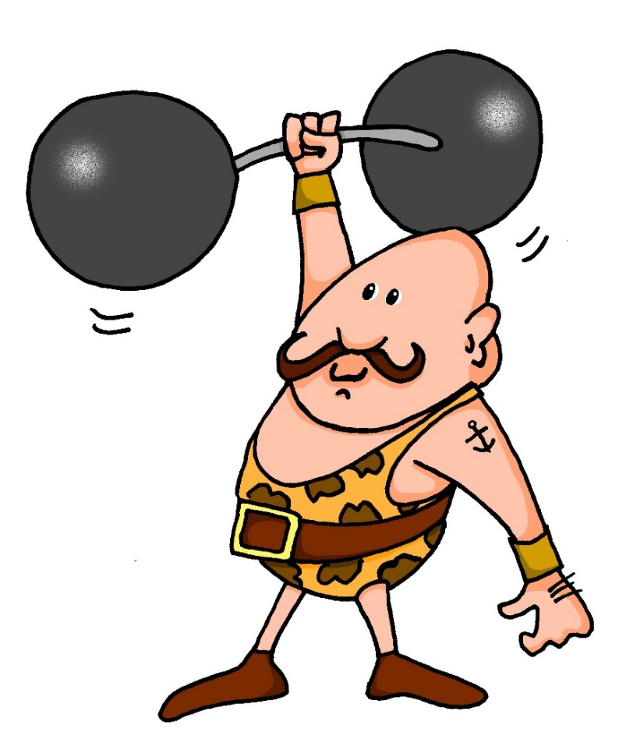
st-
stark
Notes:
Timing: 1 minute
Aim: To introduce/consolidate SSC [st-]
Procedure: 1. Present the letter(s) and say the [st-] sound first, on its own. Students repeat it with you. 2. Bring up the word ”stark” on its own, say it, students repeat it, so that they have the opportunity to focus all of their attention on the connection between the written word and its sound.
3. A possible gesture for this would be to mime lifting dumbells by clenching your fists and raising them above your head.
4. Roll back the animations and work through 1-3 again, but this time, dropping your voice completely to listen carefully to the students saying the [st-] sound, pronouncing ”stark” and, if using, doing the gesture. Word frequency (1 is the most frequent word in German): stark [207] Source: Jones, R.L. & Tschirner, E. (2006). A frequency dictionary of German: core vocabulary for learners. Routledge

Slide 3
st-
stark
Notes:
With sound and no pictures to focus all attention on the sound-symbol correspondence.

Slide 4
st-
stark
Notes:
Without sound to elicit pronunciation (without first hearing the teacher).
Teacher to elicit pronunciation by asking “Wie sagt man…”

Slide 5
st-
Straße
stehen
stark
Stadt
verstehen
bestimmt
[to understand]
[certain/special/specific]
Notes:
Timing: 2 minutes
Aim: To introduce/consolidate SSC [st-]
Procedure:
Introduce and elicit the pronunciation of the individual SSC [st-] and then the source word again ‘stark’ (with gesture, if using).
Then present and elicit the pronunciation of the five cluster words.
The cluster words have been chosen for their high-frequency, from a range of word classes, with the SSC (where possible) positioned within a variety of syllables within the words (e.g. initial, 2nd, final etc.). Additionally, we have tried to use words that build cumulatively on previously taught SSCs (see the Phonics Teaching Sequence document) and do not include new SSCs. Where new SSCs are used, they are often consonants which have a similar symbol-sound correspondence in English.
Word frequency (1 is the most frequent word in German): stark [207]; Straße [355] stehen [87]; verstehen [222]; bestimmt [226]; Stadt [186]. Source: Jones, R.L. & Tschirner, E. (2006). A frequency dictionary of German: core vocabulary for learners. Routledge

Slide 6
st-
Straße
stehen
stark
Stadt
verstehen
bestimmt
Notes:
With sound and no pictures to focus all attention on the sound-symbol correspondence.

Slide 7
st-
Straße
stehen
stark
Stadt
verstehen
bestimmt
Notes:
Without sound to elicit pronunciation (without first hearing the teacher).
Teacher to elicit pronunciation by asking “Wie sagt man…”

Slide 8
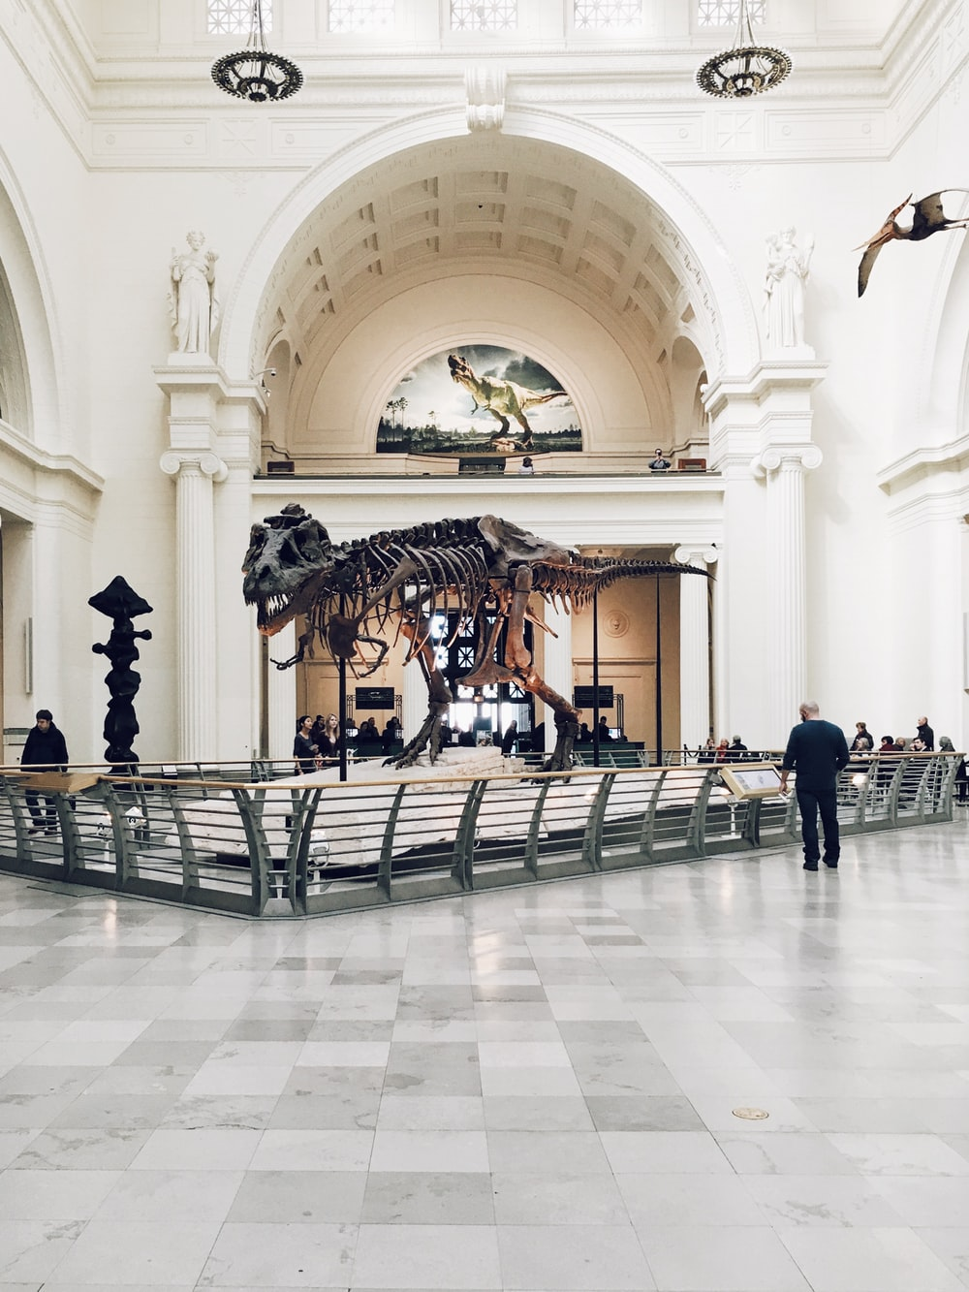
Vokabeln
lesen
das Museum
d_ _ M _ _ _ _ _ !
Ich mag Kunst.
Notes:
Slide 1/6
Timing: 3 minutes (six slides)
Aim: This vocabulary starter activity revisits the following vocabulary from this, and previous, weeks. The words in bold type are revisited in this task.
Procedure: 1. Students read the sentence, then suggest the name of the place where it applies.
2. Click to confirm the name of the place.

Slide 9
Vokabeln
lesen
das Kino!
d _ _ K _ _ _!
Ich mag Naturwissenschaften.
Wir essen dort Eis!
Notes:
Slide 2/6

Slide 10
Vokabeln
lesen
die Stadt!
d_ _ S _ _ _ _ !
Wir fahren am
Wochenende dort Rad.
Notes:
Slide 3/6

Slide 11
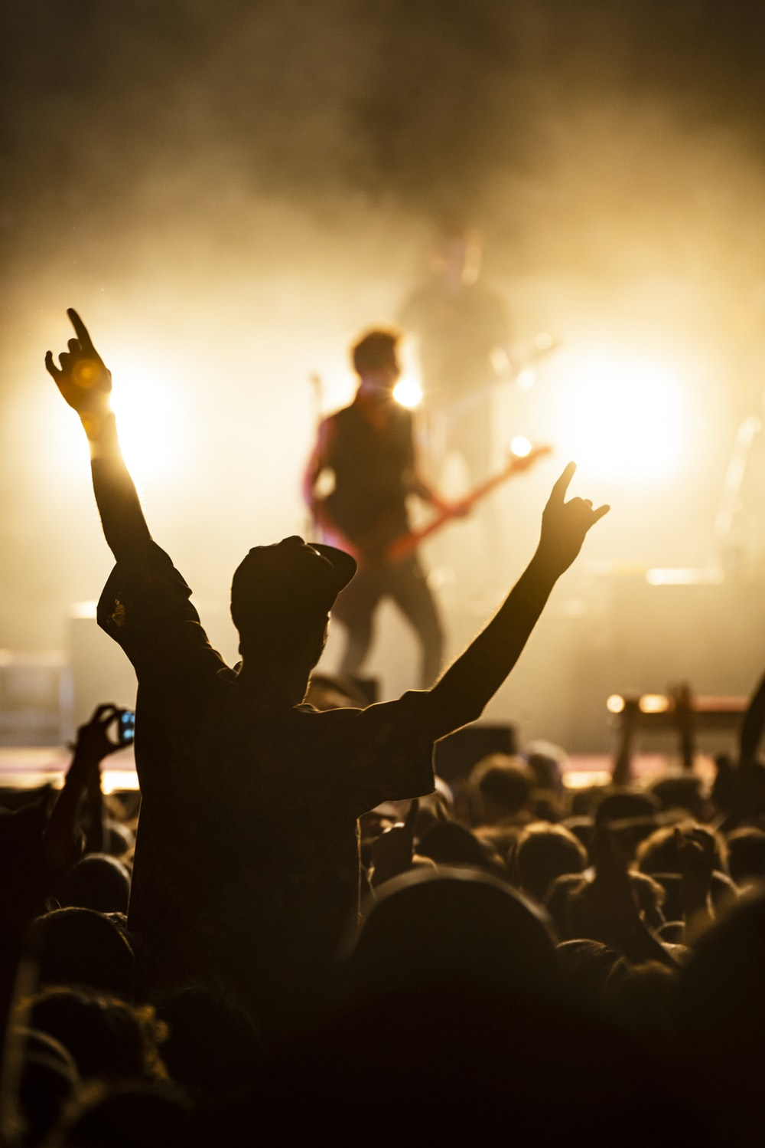
Vokabeln
lesen
das Konzert!
d _ _ K _ _ _ _ _ _ _ !
Ich mag Naturwissenschaften.
Ich spiele am Abend Klarinette
Notes:
Slide 4/6

Slide 12
Vokabeln
lesen
die Schule!
d_ _ S_ _ _ _ _ !
Wir mögen Naturwissenschaften.
Notes:
Slide 5/6

Slide 13
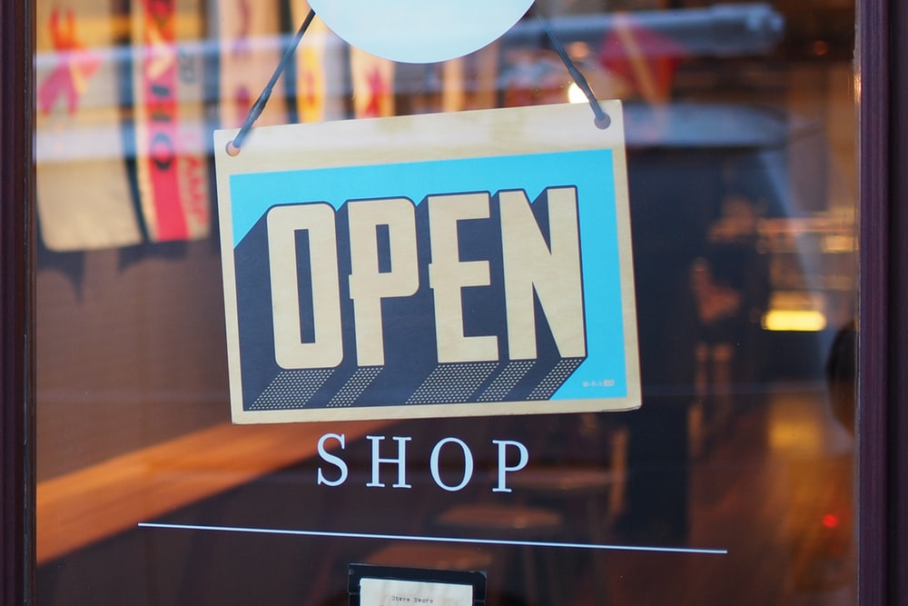
Vokabeln
lesen
das Geschäft!
d _ _ G _ _ _ _ _ _ _ !
Ich brauche eine Tasche.
Notes:
Slide 6/6

Slide 14
Vokabeln
Eine Person oder zwei?
lesen
1. Ich mag Naturwissenschaften. 2. Ich brauche eine Tasche.
3. Wir essen Eis. 4. Ich spiele am Abend Klarinette. 5. Wir fahren am Wochenende Rad. 6. Wir mögen Mathematik.
1. Ich mag Naturwissenschaften. 2. Ich brauche eine Tasche.
3. Wir essen Eis. 4. Ich spiele am Abend Klarinette. 5. Wir fahren am Wochenende Rad. 6. Wir mögen Mathematik.
3, 5 und 6 sind ‘we’.
Remember! The ‘wir’ form of the verb is always the same as the infinitive.
Notes:
Timing: 2 minutes
Aim: To draw attention to the use of the ‘wir’ form and associated verb endings.
Procedure:
1. Cycle through the information on the slide using the animation sequence.
2. Draw students’ attention to the ‘we’ forms in sentences 3,5 and 6; it is useful to take every opportunity to compel learners to notice different verb inflections (endings) and connect them to their meanings.

Slide 15
Vokabeln
der
das
der
die
__________
Geschäft
Notes:
Timing: 3 minutes (13 slides)
Aim: Set of revision slides for all new vocabulary from this week’s sequence. Focus as above for gender to make it as salient as possible.
Procedure: 1. Students name the place shown in the picture and choose the correct form f the definite article according to its gender.
2. Click to reveal the name and correct form of the definite article.

Slide 16
Vokabeln
der
die
das
__________
Kino
Notes:
(2/13)

Slide 17
Vokabeln
der
die
das
__________
Stadt
Notes:
(3/13)

Slide 18
Vokabeln
der
die
das
__________
Konzert
Notes:
(4/13)

Slide 19
Vokabeln
der
die
das
__________
Museum
Notes:
(5/13)

Slide 20
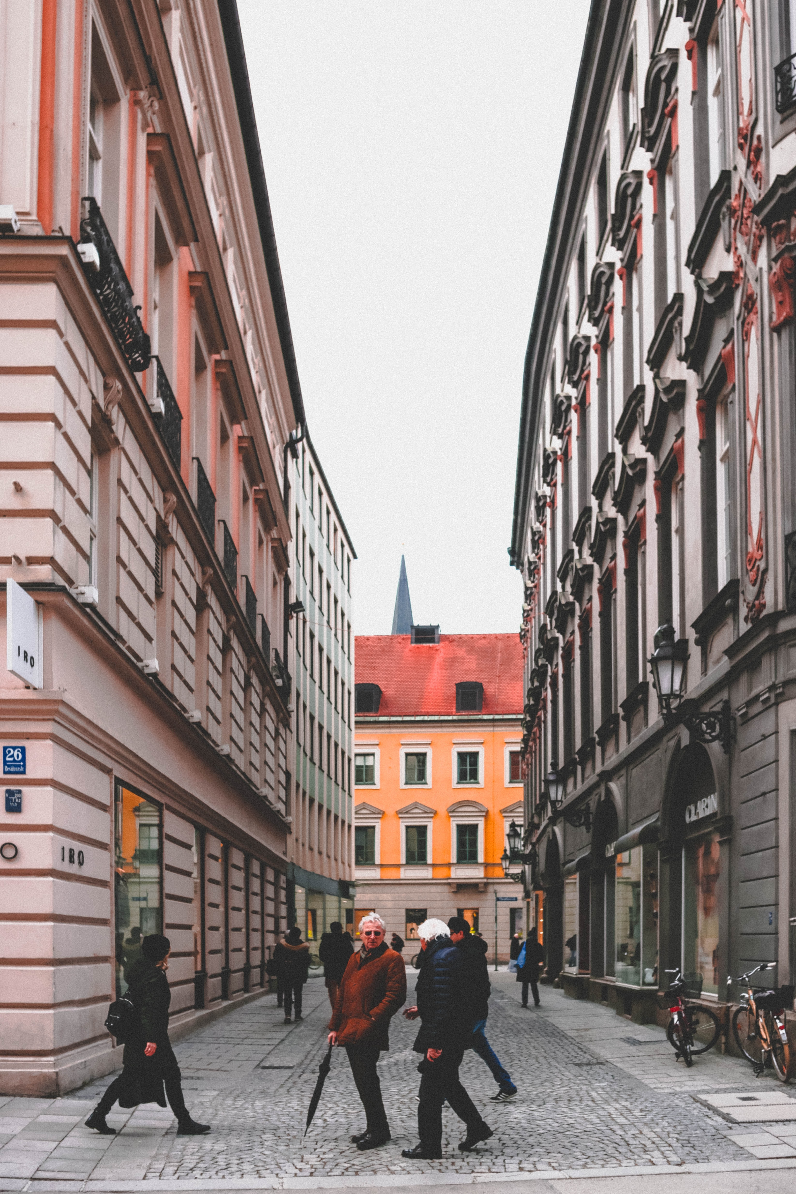
Vokabeln
der
die
das
__________
Straße
Notes:
(6/13)

Slide 21
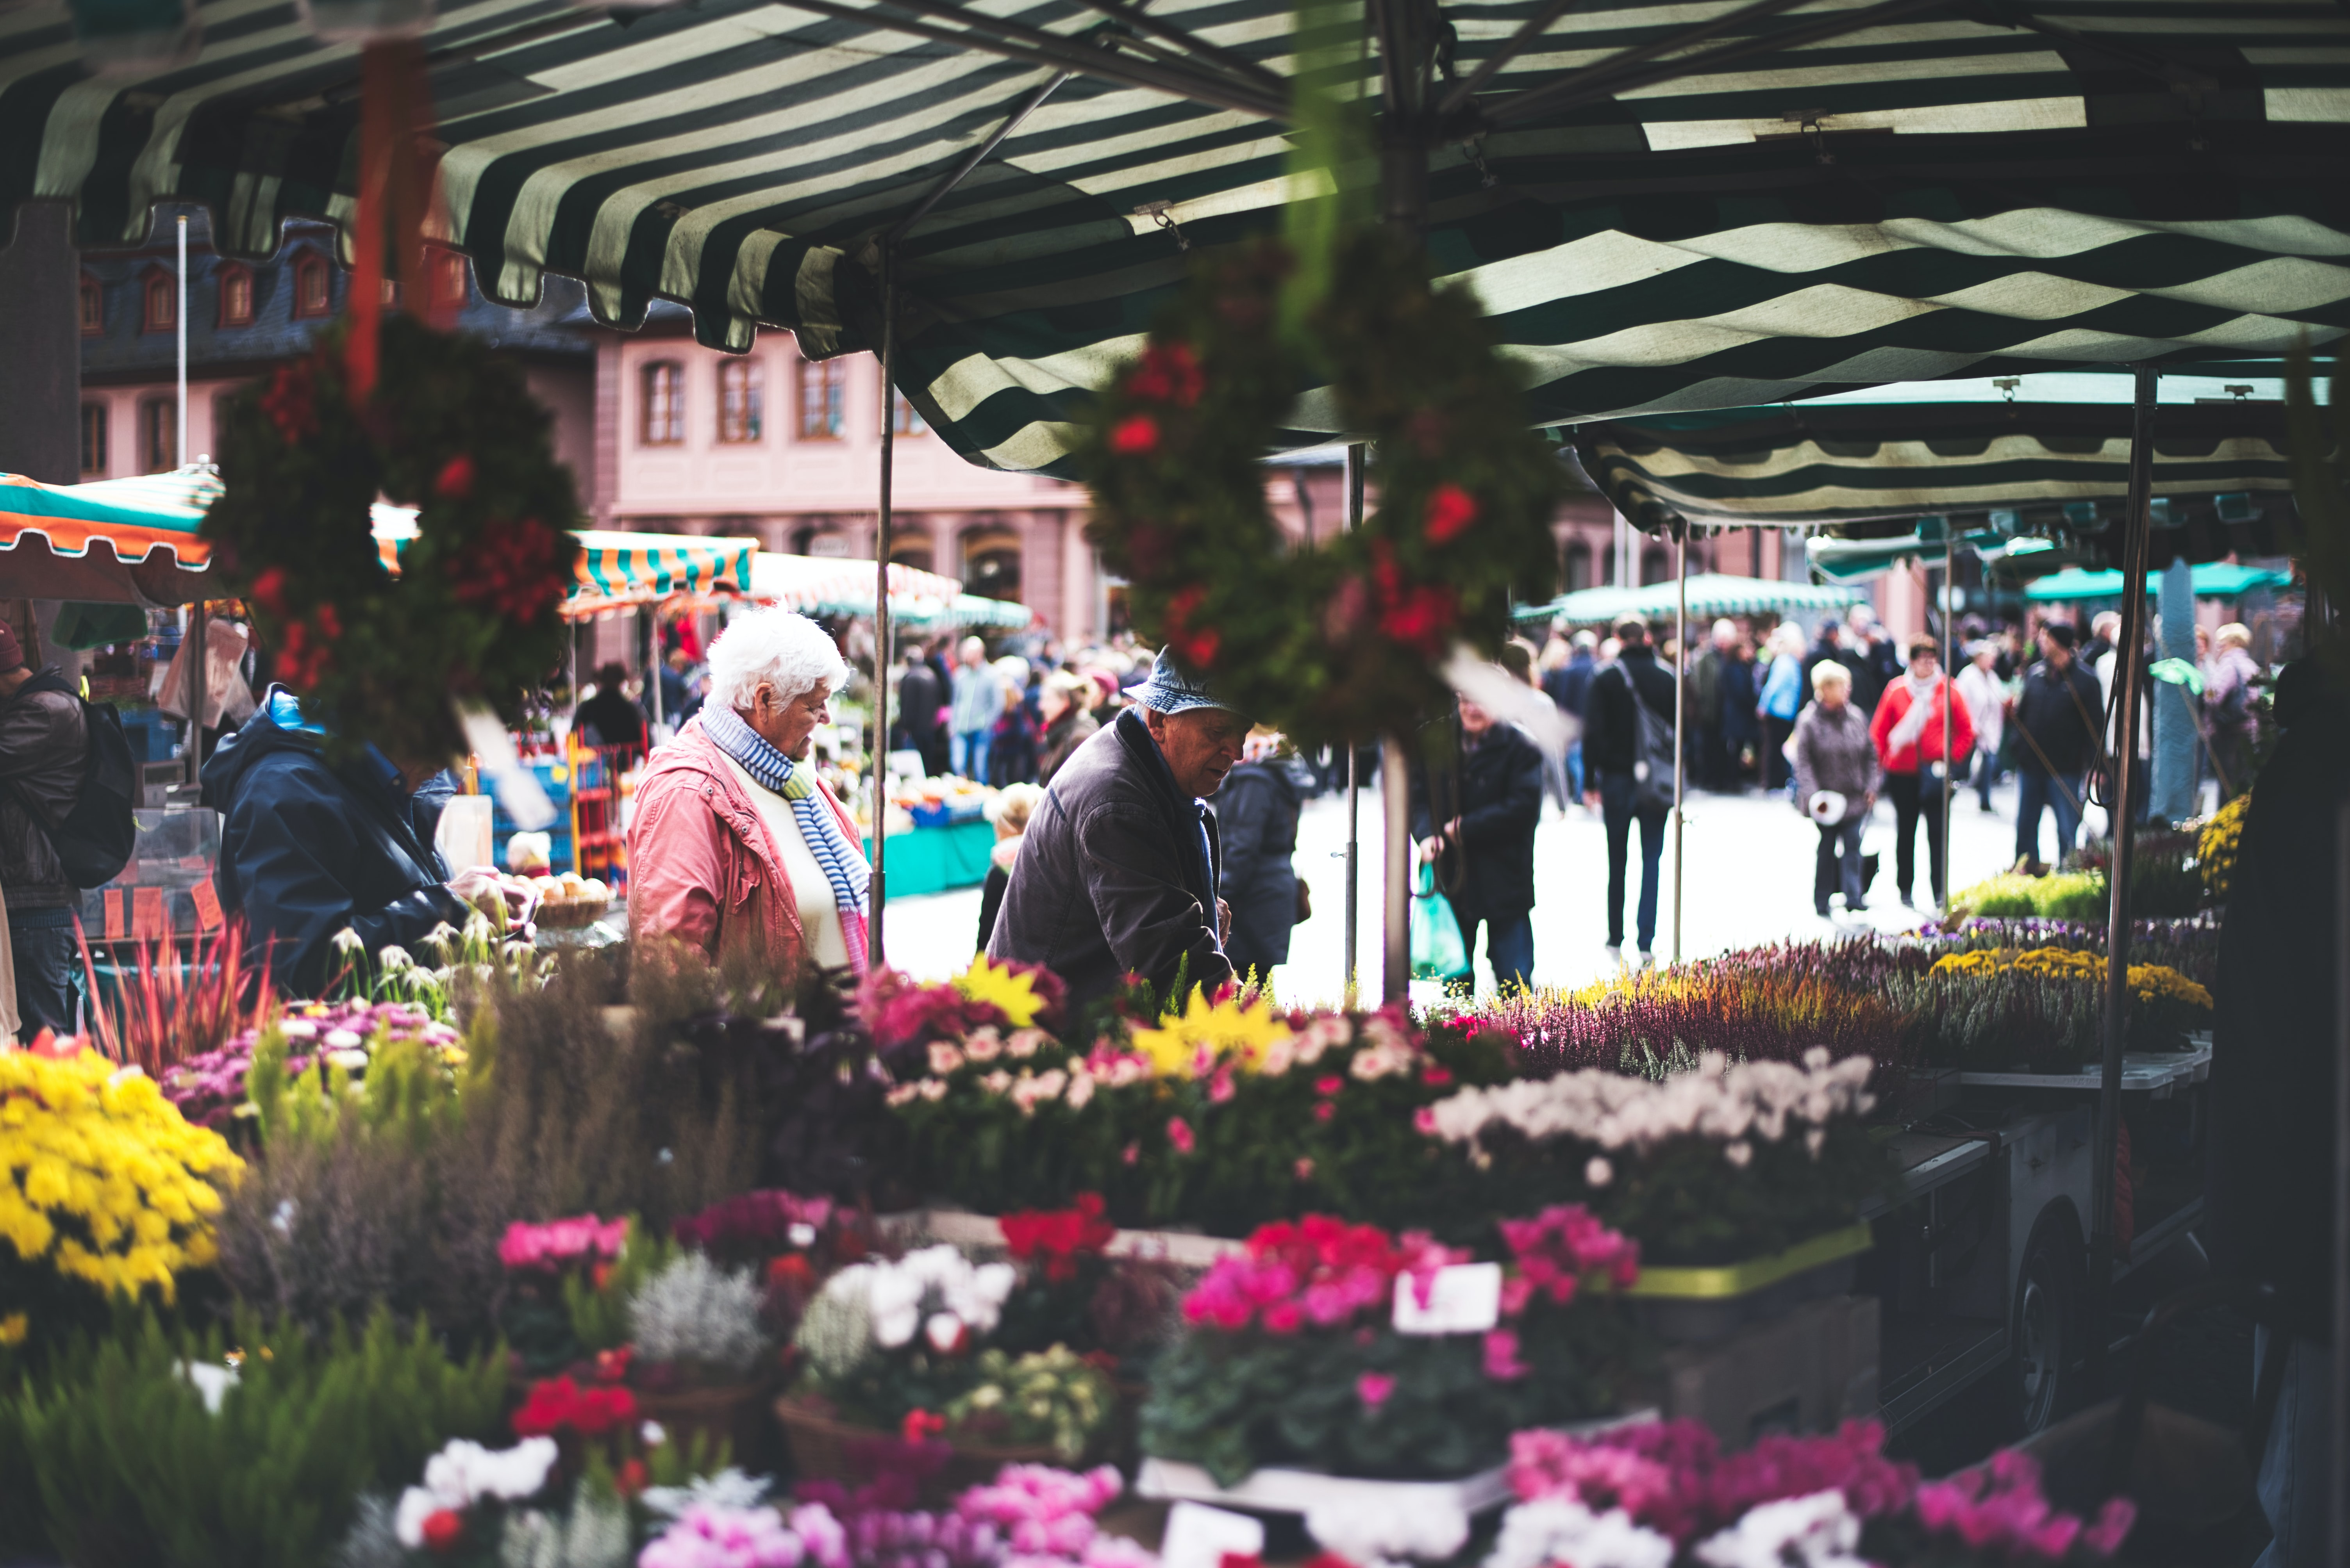
Vokabeln
der
die
das
__________
Markt
Notes:
(7/13)

Slide 22
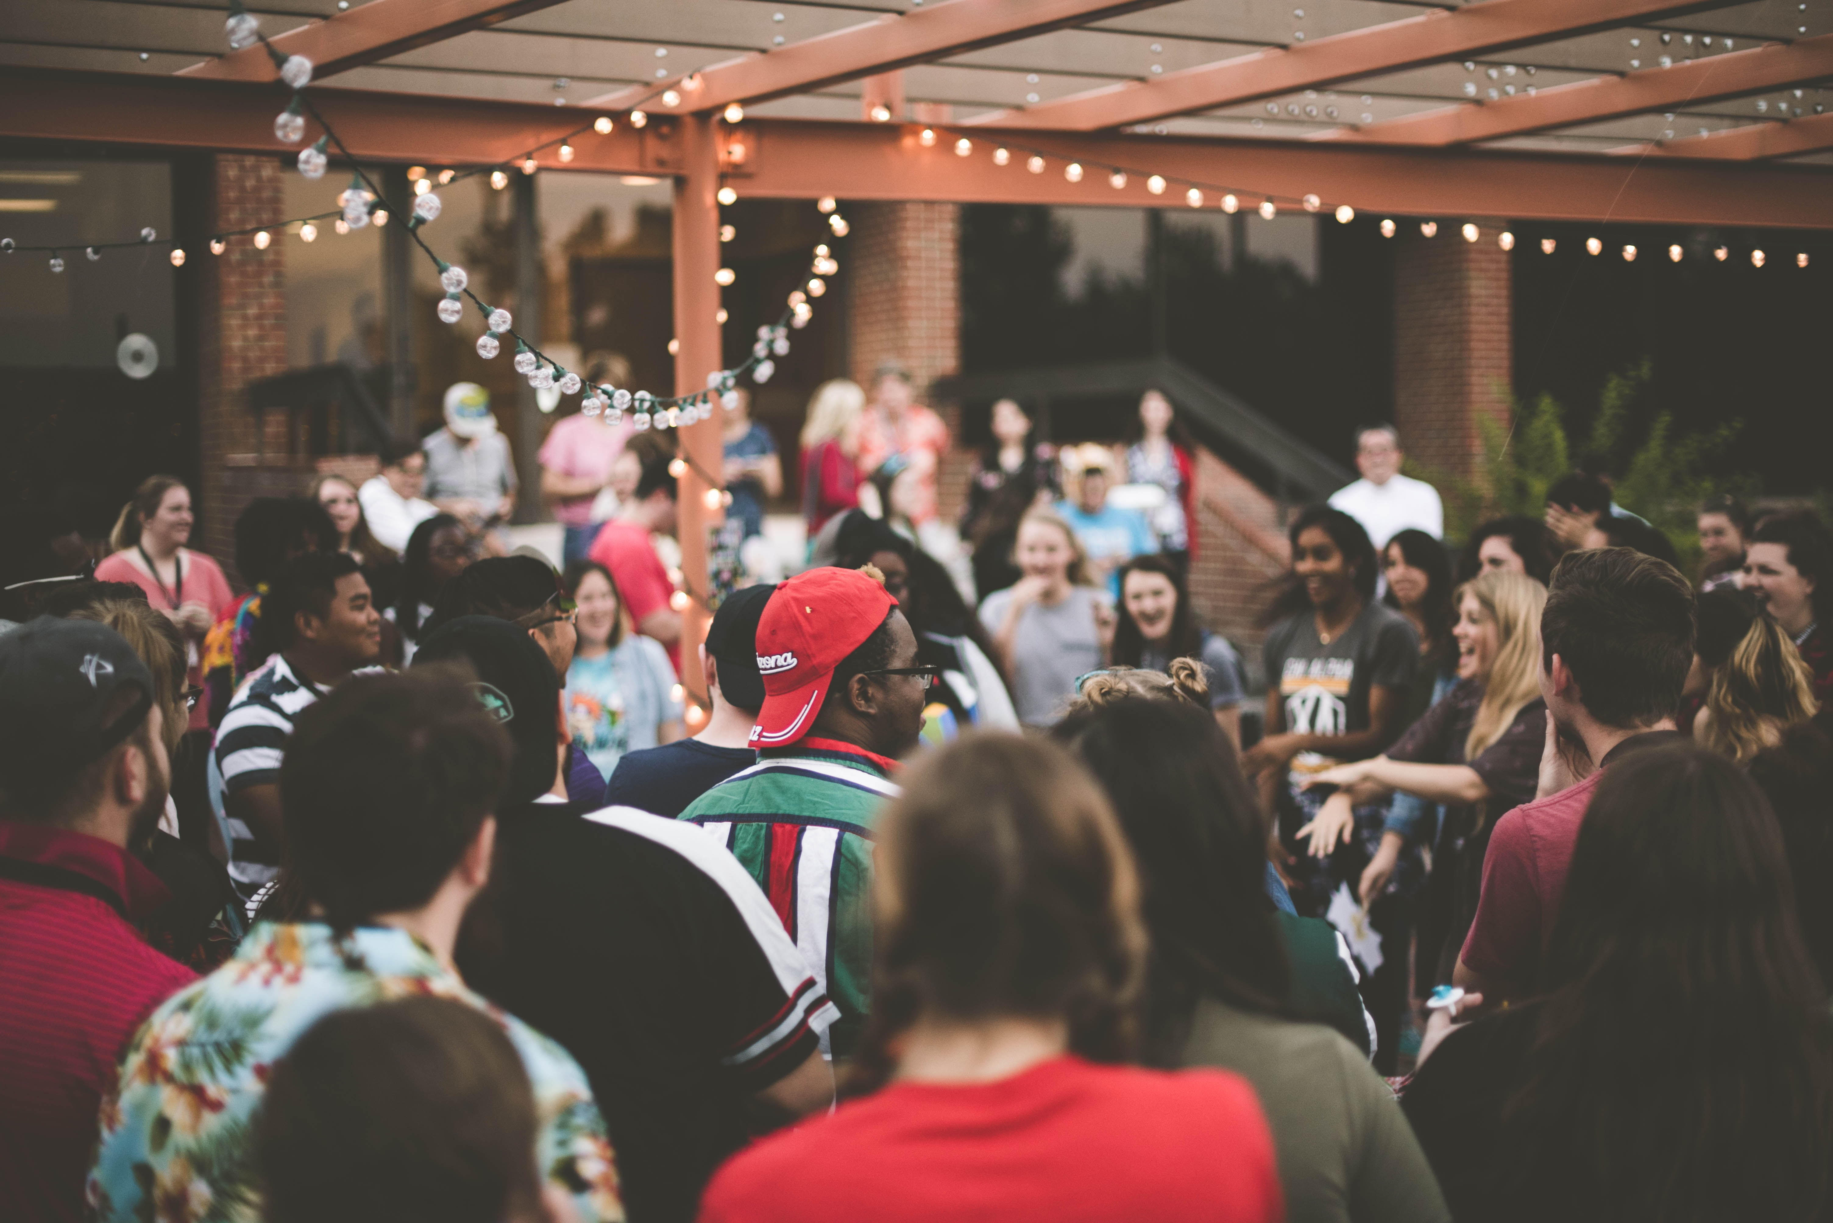
Vokabeln
der
die
das
__________
Party
Notes:
(8/13)

Slide 23
Vokabeln
__________
angenehm
[pleasant]
Notes:
(9/13) Slides 9-13 give the English meaning first to support the picture prompt, and elicit student responses.

Slide 24
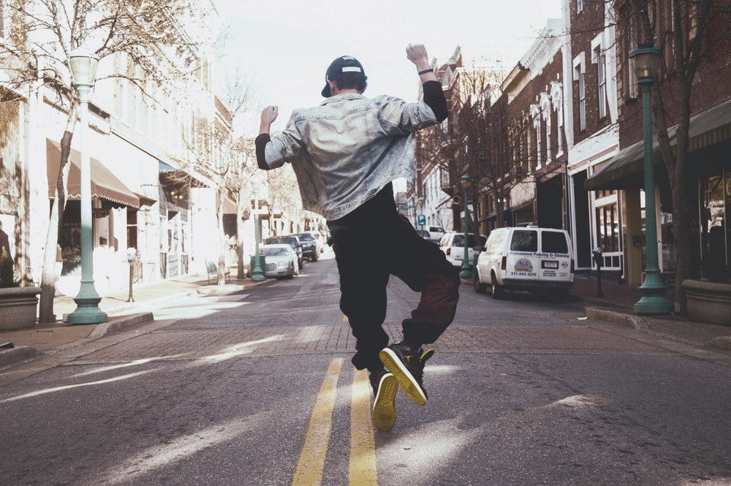
Vokabeln
__________
springen
[to jump, jumping]
Notes:
(10/13)

Slide 25
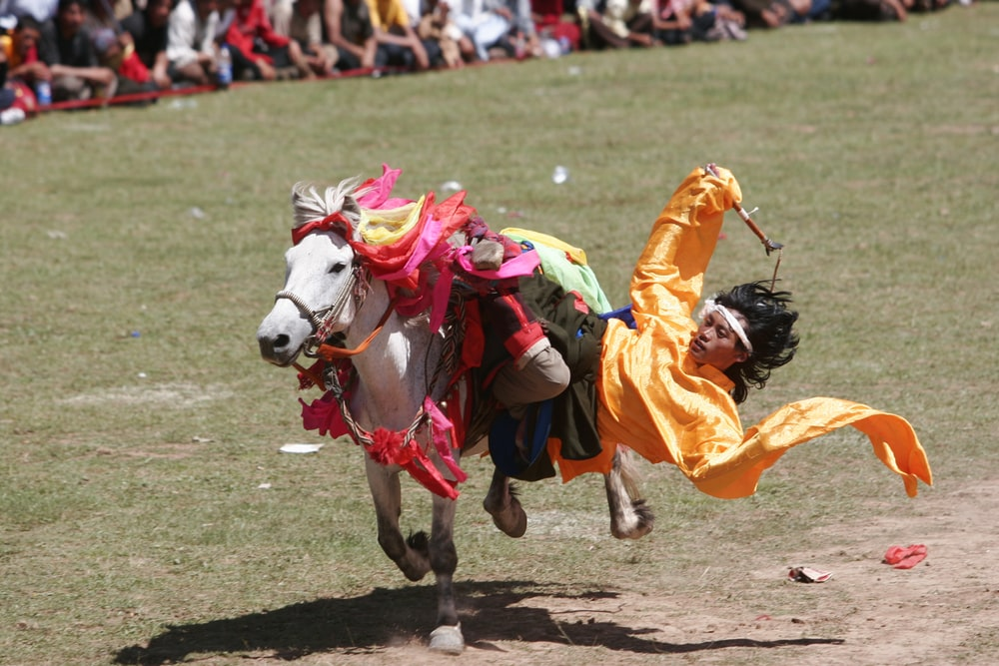
Vokabeln
__________
fallen
[to fall, falling]
Notes:
(11/13)

Slide 26
Vokabeln
__________
in
[in | into]
Notes:
(12/13)

Slide 27
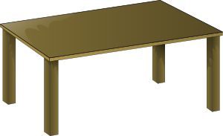
Vokabeln
__________
auf
[on | onto]
Notes:
(13/13)

Slide 28
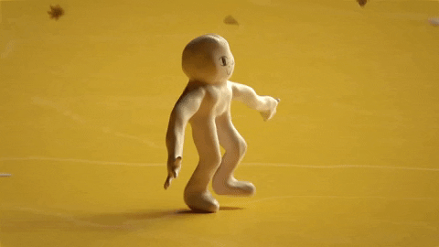
Talking about where something or someone is moving to
‘in das ‘ is often shortened to ‘ins’:
→ ich gehe ins Kino.
Note: the masculine word for the (definite article) changes:
Grammatik
To say where something or someone is moving to, use the prepositions ‘in’ (into) and ‘auf’ (onto):
der Park
die Stadt
das Kino
Ich gehe…
in den Park
in die Stadt
in das Kino
der Tisch
die Zeitung
das Heft
Die Katze springt...
auf den Tisch
auf die Zeitung
auf das Heft
These are the Row 2 (or accusative case) forms of the definite article.
Notes:
Timing: 2 minutes
Aim: This explanation expands the students’ knowledge of the Row 2 (accusative) definite article to their use following these two high-frequency prepositions. A listening and reading activity to practise this will follow.
Note: Students have been taught definite (and indefinite) article in Row 2 (accusative) in Term 1.1 Weeks 5 & 6.
Procedure:
1. Cycle through the information on the slide using the animation sequence.
2. Teachers should elicit the English meanings of each sentence from students, stressing the directional movement involved: ‘I go / I’m going’ and ‘The cat jumps / is jumping’.

Slide 29
Talking about where something is
Grammatik
To say where something or someone is located, use the same prepositions ‘in’ (in) and ‘auf’ (on), but change the word for the (definite article):
der Park
die Stadt
das Kino
Ich bin…
in dem Park
in der Stadt
in dem Kino
‘in dem ‘ is often shortened to ‘im’:
→ ich bin im Park. → ich bin im Kino.
der Tisch
die Zeitung
das Heft
Das Buch ist…
auf dem Tisch
auf der Zeitung
auf dem Heft
These are the Row 3 (dative case) forms of the definite article.
Notes:
Timing: 2 minutes
Aim: This explanation expands the students knowledge of the definite article to the dative (Row 3). A listening and reading activity to practise this will follow.
Note: Students have been taught definite (and indefinite) article in Row 2 (accusative) in Term 1.1 Weeks 5 & 6.
Procedure:
1. Cycle through the information on the slide using the animation sequence.
2. Teachers should elicit the English meanings of each sentence from students, stressing the static position implicated by ‘I am’ and ‘The book is’, as well as the difference in prepositional meaning between ‘into’ and ‘in’, ‘onto’ and ‘on’.

Slide 30
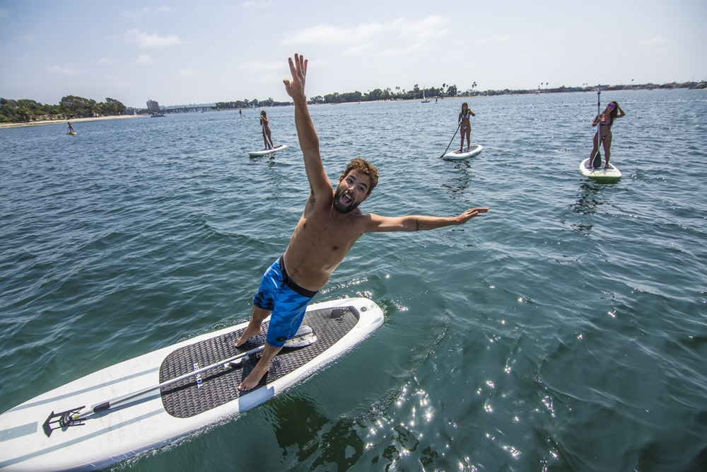
R2 and R3: summary
Grammatik
Row 2 is used when describing motion into/onto something
Changes to the definite article:
Row 1:
der Park
die Stadt
das Kino
ins Kino
Row 2:
Ich gehe…
in den Park
in die Stadt
in das Kino
im Park
in dem Park
in der Stadt
im Kino
Row 3:
Ich bin…
in dem Kino
Row 3 is used when describing location in or on something
fallen is a strong verb
Which row is this? Why?
Er fällt ins Wasser!
What gender is ‘Wasser’?
Notes:
Timing: 1 minute
Aim: This slide summarises the changes to the article for Row 2 and Row 3, reiterating when to use each.
Procedure:
1. Cycle through the information on the slide using the animation sequence.

Slide 31
Mia sendet Katja eine SMS*
*die SMS - text message (stands for ‘Short Message Service’)
lesen
...aber keine Fotos! ☹ Es gibt ein Problem mit dem Handy.
Welches Verb ist richtig?
Mia: Hier sind einige Fotos. Mieze sitzt / springt auf den Boden!
Hier ist Wolfgang im Urlaub! Er fällt / steht ins Wasser!
Hier geht / ist Mehmet in den Garten…
Hier ist / geht Wolfgang auf dem Markt…
1
3
5
7
…und Einstein sitzt / springt auf dem Tisch!
und Mehmet steht / fällt im Wasser.
Auf diesem Foto bist / gehst du in der Schule.
…und ich gehe / bin in die Stadt.
2
4
6
8
Notes:
Timing: 3 minutes
Aim: This reading activity requires students to pay attention to the case used for the definite article, in order to choose the correct verb – location or motion.
Procedure:
1. Students read the sentences and indicate the correct verb fr each.
2. The answers are animated and appear upon successive clicks of the mouse.
Word frequency of unknown words (1 is the most frequent word in German):
SMS [>5009]
Source: Jones, R.L & Tschirner, E. (2011). A frequency dictionary of German: Core vocabulary for learners. London: Routledge.

Slide 32
Ich gehe oder ich bin?
hören
ich gehe
ich bin
ich gehe
ich bin
1
7
2
8
3
9
4
10
5
11
6
12
Notes:
Timing: 5 minutes
Aim: This listening activity requires students to pay attention to the case used for the definite article, in order to choose the correct verb – location or motion.
Procedure:
1. Click on the numbered buttons to play the audio (the verb is omitted).
2. Students need only write 1-8 and either gehe or bin.
3. The answers are animated and appear upon successive clicks of the mouse.
Transcript:
1. Ich [gehe] ins Kino.
2. Ich [bin] im Konzert.
3. Ich [gehe] in die Bibliothek.
4. Ich [gehe] in den Park.
5. Ich [bin] im Museum.
6. Ich [gehe] in die Stadt.
7. Ich [gehe] in den Garten.
8. Ich [bin] im Theater.
9. Ich [gehe] ins Café.
10. Ich [gehe] in die Schule.
11. Ich [bin] im Klassenzimmer.
12. Ich [gehe] ins Geschäft.

Slide 33
Using prepositions 'in' and 'auf'
Prepositions in and auf R2 (acc) + movement R3(dat) + location
SSC [st]
Y7 German
Term 3.1 - Week 3 - Lesson 54
Mel Yates / Stephen Owen / Rachel Hawkes
Artwork: Steve Clarke
Date updated: 20/12/21
Notes:
Artwork by Steve Clarke. All additional pictures selected are available under a Creative Commons license, no attribution required.
Learning outcomes (lesson 2):
Consolidation of SSC [st]
Consolidation of prepositions in and auf + R2 (acc) + movement, R3(dat) + location
Word frequency (1 is the most frequent word in German):
7.3.1.3 (introduce) fallen [332] springen [1431] Geschäft [765] Kino [2020] Konzert [2350] Markt [476] Museum [1078] Party [2809] Stadt [204] Straße [391] angenehm [2214] auf¹ ² [16] in [3]
7.2.2.4 (revisit) Fahrrad/Rad fahren [n/a] Abend [342] Eis [1874] Fleisch [1790] Gemüse [3650] Nachmittag [1464] Wochenende [1243] heute [116] am Abend [n/a] am Nachmittag [n/a] am Wochenende [n/a] mit wem? [n/a]
7.2.1.3 (revisit) mögen, mag, magst [168] ihn [92] sie [7] Deutsch [112] Fach [1731] Fremdsprache [3770] Kunst [554] Mathematik [1636] Naturwissenschaft [4425]
Additional known vocabulary or cognates to recycle:
kommen [62] stehen [85] sitzen [231] Café [2492] Bibliothek [2366] Boden [536] Klassenzimmer [>5009] Markt [476] Park [2141] Schule [359] Theater [1086] still [1301]
Source: Jones, R.L & Tschirner, E. (2019). A frequency dictionary of German: Core vocabulary for learners. London: Routledge.
The frequency rankings for words that occur in this PowerPoint which have been previously introduced in NCELP resources are given in the NCELP SOW and in the resources that first introduced and formally re-visited those words. For any other words that occur incidentally in this PowerPoint, frequency rankings will be provided in the notes field wherever possible.

Slide 34
SCH oder ST?
hören / schreiben
Schulfach
streng
1
6
stehen
Geschenk
2
7
Stück
Deutsch
3
8
schreiben
Gutschein
4
9
Fleisch
Kunst
5
10
Notes:
Timing: 5 minutes
Aim: To practise distinguishing aurally between [sch] and [st].
Note: A more challenging version of this task, in which the answers appear as a whole word, rather than just the target graphemes, is one the next slide.
Procedure:
1. Click on the numbered buttons to play the audio.
2. Students determine the correct SSC in each case.
3. Click to reveal the answer.
4. Teachers should elicit meanings to confirm vocabulary knowledge. NB: Also point out that the –st in Kunst is pronounced as in English, to reinforce the fact that it is only a ‘sht’ sound at the beginning of a word.
5. To challenge students further, ask them to turn away from the board to complete the task and write the whole word independently. This allows for differentiation through more/less support. If the whole class is high attaining, then the prompts can be removed from the slide, of course (a more challenging version of the activity is on the next slide).

Slide 35
SCH oder ST?
hören / schreiben
Schulfach
streng
1
6
stehen
Geschenk
2
7
Stück
Deutsch
3
8
schreiben
Gutschein
4
9
Fleisch
Kunst
5
10
Notes:
Timing: 5 minutes
Aim: To practise distinguishing aurally between [sch] and [st], and in addition to practise transcription of whole words.
Note: This is the same task as on the previous slide, but answers appear as a whole word, rather than just the target graphemes.
Procedure:
1. Click on the numbered buttons to play the audio.
2. Students determine the word featuring the correct SSC in each case.
3. Click to reveal the answer.
4. Teachers should elicit meanings to confirm vocabulary knowledge. NB: Also point out that the –st in Kunst is pronounced as in English, to reinforce the fact that it is only a ‘sht’ sound at the beginning of a word.

Slide 36
Vokabeln
am Nachmittag
mögen
die Kunst
mit wem?
ihn
das Deutsch
sie
heute
sie
kommen
das Fleisch
die Fremdsprache
still
das Gemüse
1. Ich sehe [her].
Ich sehe sie.
Notes:
Timing: 10 minutes (8 slides)
Aim: This task revises all of the vocabulary items not yet incorporated into the sequence from the sets to be revisited
Procedure:
1. Students choose a word/words from those displayed to write the full sentence, replacing the English word(s) of the same meaning.
2. The answers appear upon clicking the mouse, and the correct option is highlighted from the list.

Slide 37
Vokabeln
am Nachmittag
mögen
die Kunst
mit wem?
ihn
das Deutsch
ihn
heute
sie
kommen
das Fleisch
die Fremdsprache
still
das Gemüse
2. Ich mag [him].
Ich mag ihn.
Notes:
(2/8)

Slide 38
Vokabeln
am Nachmittag
mögen
die Kunst
mögen
Deutsch
mit wem?
ihn
das Deutsch
heute
sie
kommen
das Fleisch
die Fremdsprache
still
das Gemüse
3. Wir [like German].
Wir mögen Deutsch.
Notes:
(3/8)

Slide 39
Vokabeln
am Nachmittag
mögen
die Kunst
mit wem?
ihn
das Deutsch
heute
sie
kommen
das Fleisch
die Fremdsprache
still
Fremdsprache
das Gemüse
4. Wir lernen eine
[foreign language].
Wir lernen eine
Fremdsprache.
Notes:
(4/8)

Slide 40
Vokabeln
am Nachmittag
mögen
die Kunst
mit wem?
ihn
das Deutsch
heute
sie
kommen
heute
das Fleisch
die Fremdsprache
still
still
das Gemüse
5. Es ist [quiet today].
Es ist heute still.
Notes:
(5/8)

Slide 41
Vokabeln
am Nachmittag
mögen
die Kunst
mit wem?
ihn
das Deutsch
heute
sie
kommen
Fleisch
das Fleisch
die Fremdsprache
still
Gemüse
das Gemüse
6. Wir essen
[meat] und [vegetables].
Wir essen
Fleisch und Gemüse.
Notes:
(6/8)

Slide 42
Vokabeln
am Nachmittag
mögen
die Kunst
am Nachmittag
Mit wem?
das Deutsch
mit wem?
ihn
heute
sie
kommen
das Fleisch
die Fremdsprache
still
das Gemüse
7. [With whom?] gehst du
[in the afternoon]?
Mit wem gehst du
am Nachmittag?
Notes:
(7/8)

Slide 43
Vokabeln
die Kunst
am Nachmittag
mögen
Kunst
mit wem?
ihn
das Deutsch
heute
sie
kommen
kommen
das Fleisch
die Fremdsprache
still
das Gemüse
Wir haben Kunst.
- Wir kommen!
8. Wir haben [art].
- Wir [are coming]!
Notes:
(8/8)

Slide 44
Using auf to mean ‘at’ or ‘to’
Grammatik
We use the preposition ‘auf’ to mean ‘on’ or ‘onto’, e.g.:
Der Hund sitzt auf dem Tisch.
Die Katze springt auf den Boden.
(location)
(motion)
Often, as in these examples, the use of auf is for open spaces or events. For example, also use auf for an open air or pop concert.
But ‘auf’ can also sometimes mean ‘at’ or ‘to’:
Ich bin…
auf dem Markt
(location)
auf der Party
auf dem Festival
Ich gehe…
auf den Markt
auf die Party
(motion)
auf das → aufs
auf das Festival
aufs Festival
Notes:
Timing: 2 minutes
Aim: This slide explains the use of auf to mean ‘at’ or ‘to’ (we have previously seen it meaning ‘on’ or ‘onto’).
Procedure:
1. Cycle through the information on the slide using the animation sequence.

Slide 45
Saying ‘to’ and ‘in’ in French
lesen
The different meanings of auf
Remember! The translation of auf is ‘onto’ or ‘to’ with verbs of movement Row 2 article) and ‘on’ or ‘at’ with verbs of location (Row 3 article).
What is the correct translation in each case below?
 |  | ‘on’ | ‘onto’ | ‘at’ | ‘to’
1. | Ich gehe auf die Party.
2. | Ich bin auf dem Festival.
3. | Das Buch is auf dem Tisch.
4. | Die Katze springt auf den Tisch.
Notes:
Timing: 5 minutes (both slides)
Aim: This reading activity practises the different translation of the preposition auf with verbs of movement and location. Attention should be drawn to the fact that the same preposition can be translated differently depending on the context.
Procedure:
1. Students choose the correct translation of the preposition for each sentence.
2. The answers appear upon clicking the mouse.
3. The activity is continued on the next slide.

Slide 46
Saying ‘to’ and ‘in’ in French
lesen
The different meanings of auf [2]
Remember! The translation of auf is ‘onto’ or ‘to’ with verbs of movement Row 2 article) and ‘on’ or ‘at’ with verbs of location (Row 3 article).
What is the correct translation in each case below?
 |  | ‘on’ | ‘onto’ | ‘at’ | ‘to’
5. | Ich bin auf der Party.
6. | Ich gehe auf den Markt.
7. | Ich springe auf den Boden.
8. | Der Hund sitzt auf dem Boden.

Slide 47
Wolfgang und Mia gehen shoppen
normal
langsam
lesen / hören / schreiben
Am Samstagnachmittag gehen Wolfgang und Mia in die Stadt. Sie brauchen Gemüse. Wolfgang isst Fleisch aber Heidi ist Vegetarierin. Am Sonntagabend kocht Wolfgang für sie zu Hause. Mia braucht auch eine Tasche.
Zuerst gehen sie ins Geschäft. Dort gibt es sehr viel Gemüse! Dann gehen sie auf den Markt. Mia sieht eine Tasche. Sie mag sie sehr!
Sie gehen danach ins Café, und dann in den Park. Heidi ist im Park! Wolfgang findet das toll! Sie reden über die Schule. Mias Lieblingsfach ist Deutsch, aber Wolfgang und Heidi mögen Naturwissenschaften und Kunst. Sie finden Mathematik beide schwierig.
Sie gehen gemeinsam ins Kino. Mehmet sitzt auch im Kino! Er isst ein Eis – mmm, lecker! Die vier Freunde finden den Film sehr lustig. Mehmets Lieblingsschauspieler spielt im Film mit! Danach springt Mehmet auf sein Rad und fährt nach Hause. Mia, Wolfgang und Heidi gehen auch nach Hause. Am Abend gibt Mia in der Schule ein Konzert.
die Vegetarierin – vegetarian (f); für – for; sein – his; der Schauspieler - actor
Notes:
Timing: 8 minutes
Aim: This segmentation exercise, which consists of known words and cognates, with a small number of (glossed) exceptions, can be treated as a reading exercise, a listening exercise, or a multimodal exercise, as described below.
Note: The word Schauspieler features in next week’s vocabulary list. Teachers should flag the compounds for times of day – e.g. Samstagnachmittag, Sonntagabend, reminding students to try to break down longer words into more familiar single words.
Procedure:
1. Teacher presses play. Students listen to the audio and read along. Alternatively the teacher can read the text him/herself.
2. Teacher pauses the audio before the gaps.
3. Students and teacher summarise the meaning of what has come before as a class.
4. Students are then given 10 seconds to propose a sensible word (or phrase) which could come next, and to write it down.
5. Teacher elicits suggestions from the class. Multiple suggestions are possible. Students should be encouraged to be creative, and recap vocabulary from previous learning.
6. Teacher reveals the written solution by clicking on the gap, and presses play to continue.
Note: If time permits, students can write a summary from audio only, or work with the written text to produce a summary or full translation.
Word frequency (1 is the most frequent word in German):
Vegetarier [>5009] Schauspieler [1704]
Source: Jones, R.L & Tschirner, E. (2011). A frequency dictionary of German: Core vocabulary for learners. London: Routledge.

Slide 48
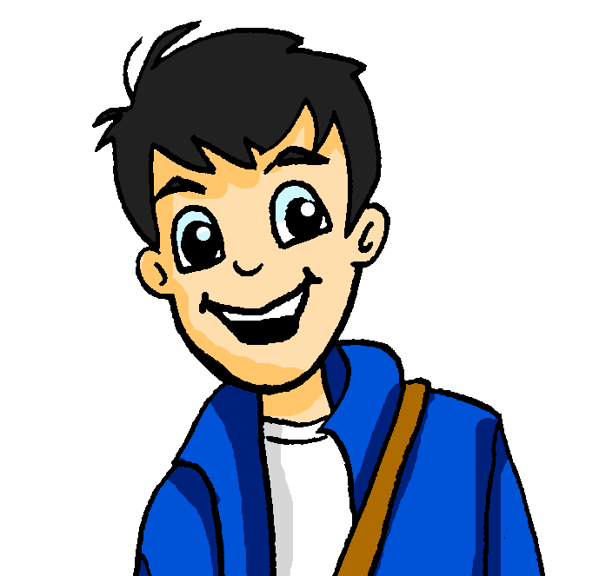
Wo ist er/sie? Wohin geht er/sie?
sprechen / hören / schreiben
Er geht…
Beispiel:
Partner A
Person | is going / is | where?
is going
(in)to the park
…in den Park.
Partner B
 | Wer? | Wohin? | Wo?
1
Wolfgang
(in)to the park
in the park
Notes:
Timing: 12 minutes (five slides)
Speaking task modelling slide
Aim: To practise spoken production of sentences using prepositions ‘in’ and ‘auf’ with R2(acc.) and R3(dat.) to talk about movement to and location in.
This activity requires partners to listen to the information from each other about where Wolfgang and Mia (a) are going, and (b) are already situated. Partners have complementary information, making this a genuine information-gap exercise.
Note: Partners note their answers in English on the printed version of the exercise (which shows the different information for each partner) – this is available to download as a Word file from the NCELP Resource Portal.
Procedure:
1. Click through the slide animation, which highlights each stage of the process below in sequence.
2. Person A is compelled to use the correct verb – gehen or sein – together with the appropriate subject pronoun (er or sie) to produce the first part of the sentence, as shown in the first speech bubble.
2. Person B processes the verb infomation to select the correct case of the definite article with the preposition, adding the destination specified to produce the second part of the sentence, as shown in the second speech bubble. Person B also notes whether it is Wolfgang or Mia to whom the sentence refers (based on the subject pronoun information).
3. Person A processes the preposition and noun meaning of the destination specified, noting this down in English.
4. Partners swap roles halfway through the exercise.
5. Advance to the next slide to show the answers.

Slide 49
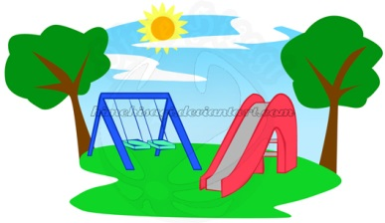
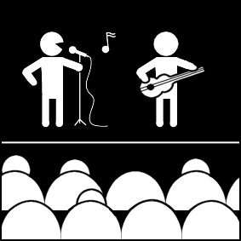
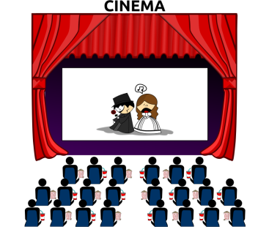
Wo ist er/sie? Wohin geht er/sie?
sprechen
A:
B:
3. Sie ist…
3. im Kino.
2. Sie geht..
1. Er geht…
2. ins Café.
1. ins Geschäft.
Antworten 1-3:
A | who | is going / is | where?
1 | Wolfgang | is going
2 | Mia | is going
3 | Mia | is
(in)to the shop
(in)to the café
in the cinema
B | wer? | wohin? | wo?
1 |  | (in)to the shop | in the shop
2 |  | (in)to the café | in the café
3 |  | (in)to the cinema | in the cinema
Wolfgang
Mia
Mia
Notes:
ROUND 1: ANSWERS 1-3 Partner A
1. Er geht ... 2. Sie geht ...
3. Sie ist ... 4. ... im Theater. 5. ... im Museum. 6. ... in die Schule.
Partner B
1. ... ins Geschäft. 2. ... ins Café. 3. ... im Kino.
4. Er ist ...
5. Er ist ...
6. Sie geht ...
Possible Round 2 (change prompt cards accordingly):
Partner A
1. Er ist ... 2. Sie geht ...
3. Er geht ... 4. ... in den Park. 5. ... in der Bibliothek. 6. ... im Klassenzimmer.
Partner B
1. ... auf dem Konzert. 2. ... auf den Markt. 3. ... in die Stadt. 4. Sie geht ...
5. Er ist ...
6. Sie ist ...

Slide 50
Wo ist er/sie? Wohin geht er/sie?
sprechen
A:
3. in die Schule.
B:
3. Sie geht..
2. im Museum.
2. Er ist...
1. Er ist…
1. im Theater.
Antworten 4-6:
B | who | is going / is | where?
4 | Wolfgang | is
5 | Wolfgang | is
6 | Mia | is going
in the theatre
in the museum
(in)to (the) school
A | wer? | wohin? | wo?
4 |  | (in)to the theatre | in the theatre
5 |  | (in)to the museum | in the museum
6 |  | (in)to the school | in the school
Wolfgang
Wolfgang
Mia
Notes:
ROUND 1: ANSWERS 4-6
Partner A
1. Er geht ... 2. Sie geht ...
3. Sie ist ... 4. ... im Theater. 5. ... im Museum. 6. ... in die Schule.
Partner B
1. ... ins Geschäft. 2. ... ins Café. 3. ... im Kino.
4. Er ist ...
5. Er ist ...
6. Sie geht ...
Possible Round 2 (change prompt cards accordingly):
Partner A
1. Er ist ... 2. Sie geht ...
3. Er geht ... 4. ... in den Park. 5. ... in der Bibliothek. 6. ... im Klassenzimmer.
Partner B
1. ... auf dem Konzert. 2. ... auf den Markt. 3. ... in die Stadt. 4. Sie geht ...
5. Er ist ...
6. Sie ist ...

Slide 51
Wo ist er/sie? Wohin geht er/sie?
sprechen
A:
3. in die Stadt.
B:
3. Er geht…
2. Sie geht..
1. Er ist…
1. auf dem Konzert.
2. auf den Markt.
Antworten 1-3:
A | who | is going / is | where?
1 | Wolfgang | is
2 | Mia | is going
3 | Wolfgang | is going
at the concert
to the market
in(to) the town
B | wer? | wohin? | wo?
1 |  | to the concert | at the concert
2 |  | to the market | at the market
3 |  | (in)to the town | in the town
Wolfgang
Mia
Wolfgang
Notes:
ROUND 2: ANSWERS 1-3 Round 2 (change prompt cards accordingly):
Partner A
1. Er ist ... 2. Sie geht ...
3. Er geht ... 4. ... in den Park. 5. ... in der Bibliothek. 6. ... im Klassenzimmer.
Partner B
1. ... auf dem Konzert. 2. ... auf den Markt. 3. ... in die Stadt. 4. Sie geht ...
5. Er ist ...
6. Sie ist ...

Slide 52
Wo ist er/sie? Wohin geht er/sie?
sprechen
A:
3. im Klassenzimmer.
B:
3. Sie ist..
2. in der Bibliothek.
1. Sie geht..
2. Er ist...
1. in den Park.
Antworten 4-6:
B | who | is going / is already | where?
4 | Mia | is going
5 | Wolfgang | is already
6 | Mia | is already
(in)to the park
in the library
in the classroom
A | wer? | wohin? | wo?
4 |  | (in)to the park | in the park
5 |  | (in)to the library | in the library
6 |  | (in)to the classroom | in the classroom
Mia
Wolfgang
Mia
Notes:
ROUND 2: ANSWERS 4-6 Round 2 (change prompt cards accordingly):
Partner A
1. Er ist ... 2. Sie geht ...
3. Er geht ... 4. ... in den Park. 5. ... in der Bibliothek. 6. ... im Klassenzimmer.
Partner B
1. ... auf dem Konzert. 2. ... auf den Markt. 3. ... in die Stadt. 4. Sie geht ...
5. Er ist ...
6. Sie ist ...

Slide 53
Wo bist du? Wohin gehst du?
schreiben
Wolfgang and Heidi are trying to meet up, but they are so busy! Sie schreiben SMS: “Ich bin... aber ich gehe jetzt…”Schreib drei SMS für Wolfgang oder Heidi.
“Ich bin... aber ich gehe jetzt…”
Wohin? – Where (to)?
Notes:
Timing: 8 minutes
Aim: To practise written production of sentences with gehen and sein with the correct preposition and case of the definite article to talk about where you are going/are.
Procedure:
1. Students write the sentences implied by the pictures in each thought bubble, taking care to use the Row 2 and Row 3 articles correctly.
2. Each student writes three extended sentences, choosing to be either Wolfgang OR Heidi.
Note: they won’t all be the same sentences as students can choose which combination of places to talk about in each sentence.
3. Students can be encouraged to share their texts with each other. They can orally translate these into English, and peer check answers for meaning.
4. Clearly, teachers will want to circulate as students are writing to check accuracy of Row 2/Row 3 articles.

Slide 54
Hausaufgaben
Vocabulary Learning Homework (Term 3.1, Week 4)
Audio file
Audio file QR code:
Student worksheet
Quizlet link
In addition, revisit: Term 2.2 Week 4
Term 2.1 Week 3
Notes:
Use this slide to set the homework.

