Slide 1
Saying what you do with other people
Saying what you do with others
-ER verbs (je, tu, il/elle & nous)
Present simple used with its continuous meaning
SFC revisited
Y7 French
Term 1.2 - Week 5 - Lesson 23
Victoria Hobson / Emma Marsden / Catherine Morris
Artwork by: Chloé Motard
Date updated: 02/08/2021
Notes:
Artwork by Chloé Motard. All additional pictures selected are available under a Creative Commons license, no attribution required.
Learning outcomes (lesson 1):
Consolidation of SFC
Consolidation of -ER verbs in first three persons singular
Introduction of -ER verbs in first person plural
Word frequency (1 is the most frequent word in French):
7.1.2.5 (introduce) marcher [1532], manger [1338], préparer [368], regarder¹ [425], travailler [290], nous¹ [31], déjeuner [2724], film [848], maison [325], partenaire [1077], télé [2746], dehors [1217], préféré [préférer 597]
7.1.2.2 (revisit) bateau [1287], magasin [1736], numéro [766], promenade [>5000], question [144], réponse [456], visite [1072], voyage [904], beau [393], mauvais¹ [274], de¹ [2], en² [7], Paris [n/a], Londres [n/a]
7.1.1.4 (revisit) as [8], livre [358], ordinateur [2201], vélo [4594], voiture [881], cher [803], chère [803], moderne [1239], rapide [672], voici [1103], oui [284], non [75], comment ça s'écrit?
Source: Londsale, D., & Le Bras, Y. (2009). A Frequency Dictionary of French: Core vocabulary for learners London: Routledge.

Slide 2


SFC
Silent final consonant
dans
X
Notes:
Timing: 1 minute
Aim: To consolidate SSC [SFC]
Explanation in English, if desired: Something that makes French sounds very different from English is that some consonants at the ends of words are silent. This means you don’t pronounce/sound them out at all. As in the word ‘dans’ in French.
Procedure:
1. Present the letter(s) and say the [SFC] sound first, on its own. Students repeat it with you.
2. Bring up the word ”dans” on its own, say it, students repeat it, so that they have the opportunity to focus all of their attention on the connection between the written word and its sound.
3. A possible gesture for this would be to hold ones finger to ones lips to indicate ‘Shhhh!’.
4. Roll back the animations and work through 1-3 again, but this time, dropping your voice completely to listen carefully to the students saying the [SFC] sound, pronouncing ”dans” and, if using, doing the gesture.
Word frequency (1 is the most frequent word in French):
dans [11]
Source: Londsale, D., & Le Bras, Y. (2009). A Frequency Dictionary of French: Core vocabulary for learners London: Routledge.

Slide 3
SFC
Silent final consonant
dans
X
Notes:
With sound and no pictures to focus all attention on the sound-symbol correspondence.

Slide 4
SFC
Silent final consonant
dans
X
Notes:
Without sound to elicit pronunciation (without first hearing the teacher).
Teacher to elicit pronunciation by asking “Comment dit-on …"

Slide 5




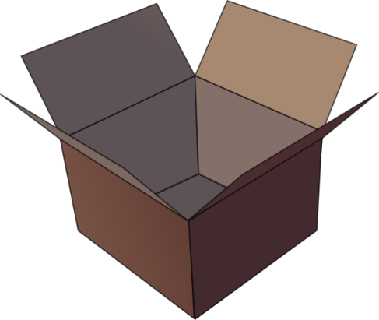


SFC
petit
prix
€15.95
grand
mot
dans
X
mais
[but]
Notes:
Timing: 2 minutes
Aim: To consolidate SSC [SFC]
Procedure:
1. Introduce and elicit the pronunciation of the individual SSC [SFC] (in this case is SFC – silent final consonant so nothing to pronounce as an individual sound!) and then the source word again ‘dans’ (with gesture, if using).
2. Then present and elicit the pronunciation of the five cluster words.
The cluster words have been chosen for their high-frequency, from a range of word classes, with the SSC (where possible) positioned within a variety of syllables within the words (e.g. initial, 2nd, final etc.). Additionally, we have tried to use words that build cumulatively on previously taught SSCs (see the Phonics Teaching Sequence document) and do not include new SSCs. Where new SSCs are used, they are often consonants which have a similar symbol-sound correspondence in English.
Word frequency (1 is the most frequent word in French):
dans [11]; petit [138] prix [310]; mot [220]; mais [30]; grand [59].
Source: Londsale, D., & Le Bras, Y. (2009). A Frequency Dictionary of French: Core vocabulary for learners London: Routledge.

Slide 6
SFC
petit
prix
grand
mot
dans
X
mais
Notes:
With sound and no pictures to focus all attention on the sound-symbol correspondence.

Slide 7
SFC
petit
prix
grand
mot
dans
X
mais
Notes:
Without sound to elicit pronunciation (without first hearing the teacher).
Teacher to elicit pronunciation by asking “Comment dit-on …"

Slide 8
… except for
c r f l
Be c a r e f u l with these!

Slide 9


Phonétique
écouter
[SFe] ou [SFC] ?
[lawn]
pelouse
Notes:
Timing: 4 minutes for 12 slides
Aim: aural recognition of SSC [SFe] and [SFC]
Procedure:
1. Click the word to play the audio.
2. Students choose if the word ends in SFe or SFC.
Word frequency (1 is the most frequent word in French):
pelouse [>5000]
Source: Londsale, D., & Le Bras, Y. (2009). A Frequency Dictionary of French: Core vocabulary for learners London: Routledge.

Slide 10

Phonétique
écouter
[SFe] ou [SFC] ?
[bridge]
pont
Notes:
Word frequency (1 is the most frequent word in French):
pont [1889]
Source: Londsale, D., & Le Bras, Y. (2009). A Frequency Dictionary of French: Core vocabulary for learners London: Routledge.

Slide 11

Phonétique
écouter
[SFe] ou [SFC] ?
[wolf]
loup
Notes:
Word frequency (1 is the most frequent word in French):
loup [3927]
Source: Londsale, D., & Le Bras, Y. (2009). A Frequency Dictionary of French: Core vocabulary for learners London: Routledge.

Slide 12

Phonétique
écouter
[SFe] ou [SFC] ?
froid
[cold]
Notes:
Word frequency (1 is the most frequent word in French):
froid [1307]
Source: Londsale, D., & Le Bras, Y. (2009). A Frequency Dictionary of French: Core vocabulary for learners London: Routledge.

Slide 13

Phonétique
écouter
[SFe] ou [SFC] ?
trente
Notes:
Word frequency (1 is the most frequent word in French):
trente [1646]
Source: Londsale, D., & Le Bras, Y. (2009). A Frequency Dictionary of French: Core vocabulary for learners London: Routledge.

Slide 14

Phonétique
écouter
[SFe] ou [SFC] ?
[hand]
main
Notes:
Word frequency (1 is the most frequent word in French):
main [418]
Source: Londsale, D., & Le Bras, Y. (2009). A Frequency Dictionary of French: Core vocabulary for learners London: Routledge.

Slide 15

Phonétique
écouter
[SFe] ou [SFC] ?
[shy]
timide
Notes:
Word frequency (1 is the most frequent word in French):
timide [3835]
Source: Londsale, D., & Le Bras, Y. (2009). A Frequency Dictionary of French: Core vocabulary for learners London: Routledge.

Slide 16
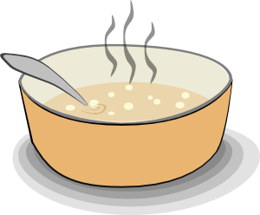
Phonétique
écouter
[SFe] ou [SFC] ?
soupe
Notes:
Word frequency (1 is the most frequent word in French):
soupe [4563]
Source: Londsale, D., & Le Bras, Y. (2009). A Frequency Dictionary of French: Core vocabulary for learners London: Routledge.

Slide 17

Phonétique
écouter
[SFe] ou [SFC] ?
riz
Notes:
Word frequency (1 is the most frequent word in French):
riz [>5000]
Source: Londsale, D., & Le Bras, Y. (2009). A Frequency Dictionary of French: Core vocabulary for learners London: Routledge.

Slide 18

Phonétique
écouter
[SFe] ou [SFC] ?
[prize]
prix
Notes:
Word frequency (1 is the most frequent word in French):
prix [310]
Source: Londsale, D., & Le Bras, Y. (2009). A Frequency Dictionary of French: Core vocabulary for learners London: Routledge.

Slide 19
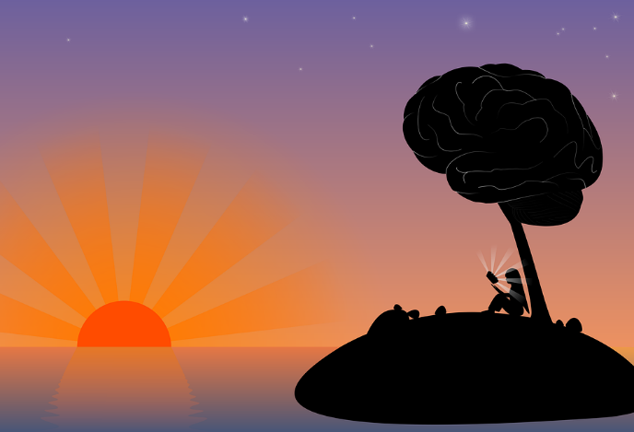
Phonétique
écouter
[SFe] ou [SFC] ?
[dawn]
aube
Notes:
Word frequency (1 is the most frequent word in French):
aube [2728]
Source: Londsale, D., & Le Bras, Y. (2009). A Frequency Dictionary of French: Core vocabulary for learners London: Routledge.

Slide 20
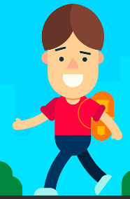

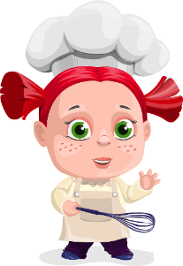



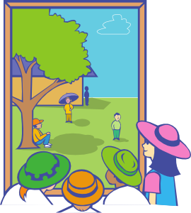









Vocabulaire
Vocabulaire
1
2
3
4
5
6
écouter
7
8
9
10
11
12
13
b
d
c
travailler
a
marcher
regarder
préparer
g
dehors
manger
le déjeuner
f
e
préféré
le film
j
h
i
nous
m
k
la télé
l
la maison
le/la partenaire
Notes:
Timing: 3 minutes
Aim: Aural recognition of words in this week’s vocabulary set in isolation.
Procedure:
1. Students write 1-12 in their books.
2. Click on a number to hear a word said aloud.
3. Students decide which of the pictures a-l the words best represent and write the letter in their books.
4. On clicks, the words appear next to the letters in the order they were said. At more advanced levels, teacher may wish to elicit responses in French by asking e.g. ‘c’est quoi, A?’
Transcript (audio missing – recording in progress)
1. regarder
2. nous
3. marcher
4. la télé
5. la maison
6. préparer
7. le film
8. travailler
9. dehors
10. préféré
11. manger
12. le déjeuner
13. le partenaire

Slide 21
Vocabulaire
Vocabulaire
lire
Elle aime travailler avec un partenaire.
Il aime travailler dehors.
Il aime manger à la maison.
Elle aime marcher dehors.
C’est le film préféré de Léa.
Il aime la maison chère.
Elle aime regarder la télé.
Il aime préparer le déjeuner.
He likes to eat at home.
She likes to walk outside.
It’s Léa’s favourite film.
She likes to work with a partner.
She likes to watch TV.
He likes the expensive house.
He likes to work outside.
He likes to prepare lunch.
Notes:
Timing: 5 minutes (for eight sentences)
Aim: Written recognition of words in this week’s vocabulary set in context.
Procedure:
1. Click to reveal sentences constructed from words in this week’s vocabulary set and known vocabulary. Sentences containing new verbs begin with il/elle aime so that the verbs are seen in the familiar infinitive form.
2. Students translate the sentences orally or in writing.
3. Click to reveal an answer.
4. Click again to reveal a new sentence.

Slide 22
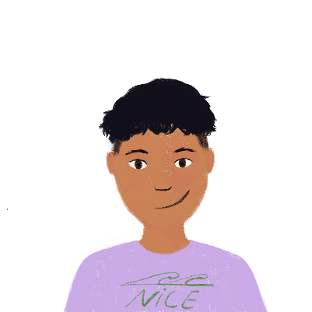
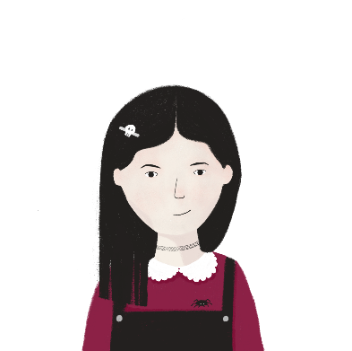
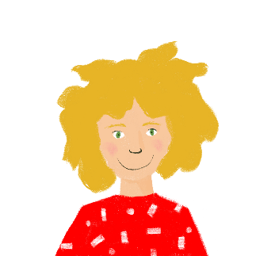
Le préféré
lire
Amir pense à Léa et Sophie. Il demande quoi ?
a. C’est quoi, la chose préférée de Sophie ?
a. C’est quoi, [le voyage / la chose] préférée de Sophie ?
b. C’est quoi, l’activité préférée de Léa ?
b. C’est quoi, [le numéro / l’animal] préférée de Léa ?
c. C’est qui, [l’acteur / l’actrice] préféré de Sophie?
c. C’est qui, l’acteur préférée de Sophie ?
d. C’est qui, [le professeur / la professeure] préféré de Léa ?
d. C’est qui, la professeure préférée de Léa ?
e. C’est quoi, [la couleur / le livre] préférée de Sophie ?
e. C’est quoi, la couleur préférée de Sophie ?
f. C’est quoi, [la voiture / le film] préféré de Léa ?
f. C’est quoi, le film préféré de Léa ?
Notes:
Timing: 5 minutes
Aim: Written recognition of préféré and préférée and connecting these with meaning.
Procedure:
1. Students write a-f and the correct form of préféré, using their knowledge of noun gender to help them.
2. Answers revealed on clicks.
3. If time permits, students should read the sentences aloud, thereby practising pronunciation of SSC [é] and drawing attention to the fact that the two forms of préféré sound identical.

Slide 23
Regular –er verbs
grammaire
To say ‘I’ + verb in French, the verb is in the short form, often ending in -e.
Je regarde.
I watch (or I am watching).
Je travaille.
I work (or I am working).
To say ‘we’ + verb, the verb ends with -ons.
Nous regardons.
We watch (or we are watching).
Nous travaillons.
We work (or we are working).
Stephen Owen
Notes:
Timing: 2 minutes
Aim: to introduce the first person plural form of regular –ER verbs.

Slide 24

manger
[to eat | eating]
mange
[eats | is eating]
We keep the ‘e’ in the nous form so that the [g] is still soft.
mangeons
[eat | are eating]
Notes:
Timing: 4 minutes for eight slides
Aim: to introduce the verb manger more explicitly. Both long form (infinitive) and short form (3rd person singular) are introduced in order to familiarise students with various forms of the same verb.
Procedure
Bring up the word manger on its own, say it, students repeat it, and remind them of the phonics.
Try to elicit the meaning from the students. Students have had explicit teaching that the present tense in French communicates two different present tense meanings in English. This reinforces that learning. Emphasise the two meanings for the short form, reminding students that French only has one form and does not have a direct equivalent of the grammar for ‘is + ing’, the continuous form (as covered in previous weeks).
Bring up the picture, and, if using gestures, a possible gesture would be to mime eating a sandwich.
Then bring up the English translations. Emphasise the two meanings for the infinitive.
Bring up the first short form mange, say it, students repeat it.
Bring up the second short form mangeons, say it, students repeat it. Draw attention to spelling with [e] added onto the stem. As students how the word would be pronounced if conjugated as normal, i.e. no ‘e’ added (‘mangons’ – hard [g])
Try to elicit the meaning from the students. Emphasise the two meanings for the short forms.
Bring up the info bubble to introduce the stem-change. NB: This is not a grammar point that students are expected to produce at this stage and will not feature in any NCELP tests. It is showcased here for awareness and passive understanding only.

Slide 25
manger
[to eat | eating]
mange
[eats | is eating]
mangeons
[eat | are eating]
Notes:
Cycle through the long and short forms again.

Slide 26
mange
[eats | is eating]
Elle mange des fruits.
[She eats | is eating fruit.]
Notes:
Introduce the first short form in a sentence.

Slide 27
mangeons
[eat | are eating]
Nous mangeons des fruits.
[We eat | are eating fruit.]
Notes:
Introduce the second short form in a sentence.

Slide 28
manger
[to eat | eating]
Elle aime manger des fruits.
[She likes eating fruit.]
Notes:
Introduce the long form in a sentence.

Slide 29
mange
[eats | is eating]
mange
Elle des fruits.
[She eats | is eating fruit.]
Notes:
Cycle through the first short form in context again.

Slide 30
mangeons
[eat | are eating]
mangeons
Nous des fruits.
[We eat | are eating fruit.]
Notes:
Cycle through the second short form in context again.

Slide 31
manger
[to eat | eating]
manger
Elle aime des fruits.
[She likes eating fruit.]
Notes:
Cycle through the long form in context again.

Slide 32



C’est qui?
Grammaire
lire
nous
je
C’est qui? Pierre has written a short article about himself. Is he doing these activities by himself (‘I’) or with his friends (‘we’)?
1 | regardons le bateau cher.
2 | prépare le déjeuner.
3 | restons à la maison.
4 | travaillons avec un ordinateur.
5 | marche dehors mais il fait mauvais.
6 | parle à un ami.
7 | demandons un vélo rapide.
8 | montre un exemple à la professeure.
Notes:
Timing: 5 minutes
Aim: Students identify first person singular and plural forms of verbs
Procedure:
This vocabulary should be known to students and so teachers could also choose to ask students the meanings of the sentence as vocabulary practice after the initial task.
There is no need to print the table, students can write the answers in their exercise books.
Students read the sentences and choose whether they think it refers to first person singular or plural
Answers revealed on clicks

Slide 33
Listening exercise
Grammaire
écouter
Nous ou je?
Is the speaker talking
about just themselves (‘I’)
or themselves with other
people (‘we’).
You will not hear ‘je’ (I)
or ‘nous’ (we).
Écris l’ anglais.
I (je) | We (nous) | activité – écris en anglais
1
find a present
2
like the dog
3
give the solution
4
wear a uniform
5
speak French
6
stay outside
7
work in the house
8
watch a film
Notes:
Timing: 8 minutes
Aim: Now that students are becoming familiar with the verb endings, students are also asked to work out the activity to not only reinforce the grammar but work on the vocabulary as well.
Procedure:
Students listen to the audio and write answers in their exercise books
The sequencing of the answers is such that the verb is addressed first (as this is the element all students should be able to access) allowing teachers to take feedback on scores out of 8
Then the comprehension of the vocabulary is checked. (Teachers could re-order the custom animation if they wish the activity to follow immediately after the tick. )
To note: the vocabulary chosen for this activity has all been previously seen by students (either as identified vocab for a particular week or as source/cluster words).
Transcript:
[beep] trouvons un cadeau
[beep] aimons le chien
[beep] donne la solution
[beep] porte un uniforme
[beep] parlons français
[beep] reste dehors
[beep] travaillons dans la maison
[beep] regarde un film

Slide 34


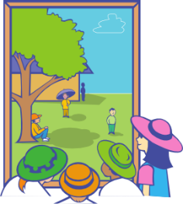
Grammaire Chut
Grammaire
écrire / parler
Chut !
Partner A
Partner B
(walk outside)
_____________________
Chut
Nous marchons dehors.
Je
Nous
Notes:
Timing: 10 minutes
Aim: Introduce the game – (partners’ cards are on the following slides.)
Procedure:
1. This slide could be used to model what the students need to do.
This is a game of ‘chut’ (=shhhhh!) – don’t give away the pronoun.
Partners must listen carefully to the verb and tick under the correct picture whether ‘Je’ or ‘Nous’ is needed to complete their partner’s sentence.
2. Full instructions for reference which also appear on the next slide:
Partner A writes these sentences in French following the English prompts. At the same time Partner B also writes their sentences (see next slide).
3. When both students have completed their sentences, they take it in turns to say one sentence at a time to their partner without using the subject pronoun.
Make this the game element: this is a game of ‘chut’ (=shhhhh!) – don’t give away the pronoun.
Partners must listen carefully to the verb and tick under the correct picture whether ‘Je’ or ‘Nous’ is needed to complete their partner’s sentence.
Example:
Partner A writes: Je regarde un film
Partner A says to B: chut regarde un film
Partner B finds the correct pair of images and ticks ‘Je’ underneath.
Once they have said all 6 sentences to their partner, students then recreate, in speaking, the sentences that their partners must have written. They use their pictures on their sheet, and the box they have ticked (je or nous) to re-create their partner’s sentence and read out this sentence. The partner who wrote the sentences confirms if they are correct – the sentence read out loud should be exactly the same as the sentence they themselves had written earlier.

Slide 35











Chut
Partner A
Partner B
écrire / parler
1) (watch a film)
___________________________
2) (speak French)
___________________________
3) (work in the house)
___________________________
4) (prepare lunch)
___________________________
5) (walk outside)
___________________________
6) (like the dog)
___________________________
Je Je
Nous Nous
Je Je
Nous Nous
Je Je
Nous Nous
Notes:
Partner A writes these sentences in French following the English prompts. At the same time Partner B also writes their sentences (see next slide).
When both students have completed their sentences, they take it in turns to say one sentence at a time to their partner without using the subject pronoun.
Make this the game element: this is a game of ‘chut’ (=shhhhh!) – don’t give away the pronoun.
Partners must listen carefully to the verb and tick under the correct picture whether ‘Je’ or ‘Nous’ is needed to complete their partner’s sentence.
EG
Partner A writes: Je regarde un film
Partner A says to B: chut regarde un film
Partner B find the correct pair of images and ticks ‘Je’ underneath.
STEP 2
Once they have said all 6 sentences to their partner, students then recreate, in speaking, the sentences that their partners must have written. They use their pictures on their sheet, and the box they have ticked (je or nous) to re-create their partner’s sentence and read out this sentence. The partner who wrote the sentences confirms if they are correct – the sentence read out loud should be exactly the same as the sentence they themselves had written earlier.

Slide 36

Chut
Partner B
Partner A
écrire / parler
1) (work outside)
___________________________
2) (watch tv)
___________________________
3) (prepare lunch)
___________________________
4) (like the film )
___________________________
5) (speak English )
___________________________
6) (walk in the house )
___________________________
Je Je
Nous Nous
Je Je
Nous Nous
Je Je
Nous Nous

Slide 37
Saying what you do with other people
Saying what you do with others
-ER verbs (je, tu, il/elle & nous)
Present simple used with its continuous meaning
SFC [revisted]
Y7 French
Term 1.2 - Week 5 - Lesson 24
Victoria Hobson / Emma Marsden / Catherine Morris
Artwork by: Chloé Motard
Date updated: 09/07/2021
Notes:
Artwork by Chloé Motard. All additional pictures selected are available under a Creative Commons license, no attribution required.
Learning outcomes (lesson 2):
Consolidation of SFC
Consolidation of -ER verbs in first three persons singular
Consolidation of -ER verbs in first person plural
Word frequency (1 is the most frequent word in French):
7.1.2.5 (introduce) marcher [1532], manger [1338], préparer [368], regarder¹ [425], travailler [290], nous¹ [31], déjeuner [2724], film [848], maison [325], partenaire [1077], télé [2746], dehors [1217], préféré [préférer 597]
7.1.2.2 (revisit) bateau [1287], magasin [1736], numéro [766], promenade [>5000], question [144], réponse [456], visite [1072], voyage [904], beau [393], mauvais¹ [274], de¹ [2], en² [7], Paris [n/a], Londres [n/a]
7.1.1.4 (revisit) as [8], livre [358], ordinateur [2201], vélo [4594], voiture [881], cher [803], chère [803], moderne [1239], rapide [672], voici [1103], oui [284], non [75], comment ça s'écrit?
Source: Londsale, D., & Le Bras, Y. (2009). A Frequency Dictionary of French: Core vocabulary for learners London: Routledge.

Slide 38

Phonétique
Phonétique
*le chat = cat
*dans = in
*retourner = to return
lire / parler
1
Le chat* est méchant.
2
Nous trouvons le professeur amusant.
3
Je suis petit mais Nicolas, mon frère, est grand.
4
Il fait les courses et je fais les magasins.
5
Gaspard fait du sport et Clément regarde les films.
6
Nous restons à Paris mais dans* deux semaines
nous retournons* à Londres.
Notes:
Timing: 5 minutes
Aim: Oral production of SFC.
Procedure:
1. Students read sentences aloud to practice SFC
2. Including a few words that are unfamiliar, is the way to assess if pupils are applying their SSC knowledge, as opposed to recalling the pronunciations of whole words that they already know. A way to include unknown words without affecting pupils’ ability to understand the language is to use proper nouns, place or people names, as done here.
3. Sentence six offers an opportunity to stretch students with a sentence that includes a verb they have not previously met [retourner 999]. Teachers should use their judgement as to whether they wish to include this in the SFC practice here.
Word frequency of unknown words and cognates used (1 is the most frequent word in French):
chat [3138], retourner [999], sport [2011], dans [11],
Source: Londsale, D., & Le Bras, Y. (2009). A Frequency Dictionary of French: Core vocabulary for learners London: Routledge.

Slide 39
Vocabulaire
Vocabulaire
Écris en français !
écrire
b
d
c
travailler
a
marcher
regarder
préparer
g
dehors
manger
le déjeuner
f
e
préféré
le film
j
h
i
nous
m
k
la télé
l
la maison
le/la partenaire
Notes:
Timing: 3 minutes
Aim: Aural recognition of words in this week’s vocabulary set in isolation.
Procedure:
1. Students write 1-12 in their books.
2. Click on a number to hear a word said aloud.
3. Students decide which of the pictures a-l the words best represent and write the letter in their books.
4. On clicks, the words appear next to the letters in the order they were said. At more advanced levels, teacher may wish to elicit responses in French by asking e.g. ‘c’est quoi, A?’
Timing: 1 minute
Procedure:
In pairs students have a minute to give the French for the images (either written in books/mini-whiteboards or orally to each other, depending on what the teacher wishes the focus to be).

Slide 40
Vocabulaire
Vocabulaire
parler
Français | Anglais
Il aime la maison moderne. | He likes the modern house.
Elle aime travailler avec un partenaire. | She likes to work with a partner.
Il aime manger dehors. | He likes to eat outside.
C’est le film préféré de Noura. | It’s Noura’s favourite film.
Elle aime regarder la télé. | She likes to watch TV.
Il aime préparer le déjeuner. | He likes to prepare lunch.
Elle aime marcher dehors. | She likes to walk outside.
Voici la chose préférée de Léa. | Here is Léa’s favourite thing.
60
secondes
0
DÉBUT
Notes:
Timing: 8 minutes
Aim: Written recognition of words in this week’s vocabulary set in context.
Procedure:
Pairs could compete against each other.
Partner B sits with their back to the board. Partner A says the English. If partner B translates the sentence successfully they get the point, if not partner A gives the translation and keeps the point. Pairs can ask in any order.
After a minute pairs swap round.

Slide 41
Vocabulaire
parler
Discuss your favourite things with your partner.
Here are some example questions to get you started.
Tu as un livre préféré ?
Tu as un professeur préféré ou une professeure préférée ?
Tu as une couleur préférée ?
Tu as un chanteur préféré ou une chanteuse préférée ?
Tu as un film préféré ?
Les réponses :
Non / oui, c’est … Comment ça s'écrit ?
Notes:
Timing: 8 minutes
Aim: Students use cues on slide to ask and answer questions about their favourite things.
Procedure:
1. Allow up to 3 minutes’ preparation time. The questions suggested use known vocabulary and are designed to elicit answers that take the form of names or titles. However, at advanced levels, students could be encouraged to use dictionaries to ask about other things (animals, food, sports …)
2. Students use cues on slide to ask and answer questions about their favourite things. Draw attention to the fact that the masculine and feminine forms of préféré are identical in the oral form.
3. Encourage students to use Comment ça s'écrit ? to request clarification and spell answers. Students should be encouraged not to respond with non more than once!

Slide 42
Regular –er verbs
grammaire
To say ‘s/he’ + verb in French, the verb is in the short form, often ending in -e.
Il regarde.
He watches (or he is watching).
Elle regarde.
She watches (or he is watching).
To say ‘we’ + verb, the verb ends with -ons.
Nous regardons.
We watch (or we are watching).
Stephen Owen
Notes:
Timing: 2 minutes
Aim: to revise regular –RE verb forms in the third person singular, and contrast these with the first person plural forms introduced this week.
Procedure:
Here, first person singular and plural plus third person singular are recapped ahead of the production activities to follow.
Now that students are familiar with the pair ‘je’ and ‘nous’, we add third person singular which was learnt in the previous week to offer a greater level of challenge and extend students’ competency with these regular –ERverbs.

Slide 43
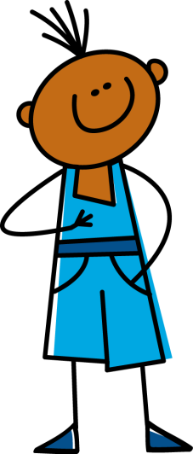
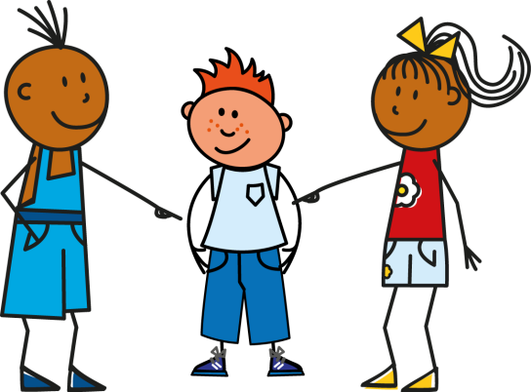

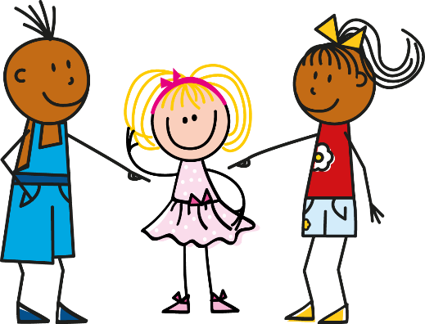


Grammaire
Grammaire
écrire / parler
Notes:
Timing: 6 minutes
Aim: written or oral production of first person singular, third person singular and first person plural forms of regular -ER verbs. The activity could be done as a mini-whiteboard / exercise book activity, as a paired oral activity or as a choral response.
Procedure:
1. Click to reveal a pair of circles. The circle in the top line represents who is doing the action, the second line represents the verb that should be used.
2. Students say or write pronoun/verb pairs.
3. Repeat for 12 total combinations.
Sequence:
1. il travaille
2. nous marchons
3. je prépare
4. elle regarde
5. nous regardons
6. il prépare
7. je marche
8. nous travaillons
9. elle marche
10. il regarde
11. je prépare
12. nous préparons

Slide 44



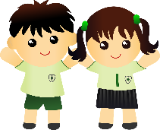

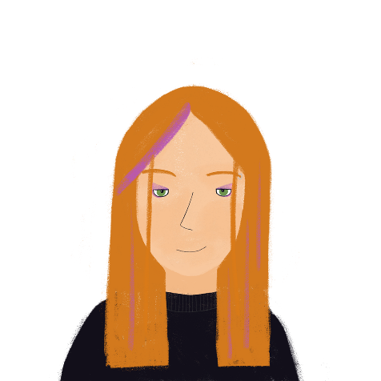


Grammaire
Grammaire
écrire
Élodie fait un échange scolaire à Londres. Elle parle de la visite. Écris le français.
 | Élodie (I) | Peter (he)
1)
2)
3)
4)
5)
6)
Nous aimons le français.
Il marche à l’école.
Nous portons un uniforme.
Nous parlons anglais.
Il aime le cadeau.
J’aime Londres.
Notes:
Timing: 5 minutes
Aim: Written production of verbs in the 1st/3rd person singular and 1st person plural at sentence level. Revision of regular –ER verbs introduced in previous weeks.
Procedure:
1. Check students understand the context. Encourage them to use their knowledge of English to interpret the meaning of échange scolaire.
2. Explain to students that Élodie will require a ‘je’ sentence to talk about what she does, Peter an ‘il’ sentence to talk about what he does, and both a ‘nous’ sentence to talk about what they do.
3. Students may make some error relating to structures others than the verb form; e.g. students may miss the definite article in nous aimons français. Correct this but do not penalise.
4. NB. Use the opportunity to remind students of the contraction in j’aime. Ask where else they have seen this before (students should say j’ai!) You may wish to exemplify further with other verbs such as adorer, étudier, admirer etc. These verbs will not be known to students but teachers can write them up on the board and ask students how they would say ‘I…’
5. Use the opportunity to highlight the cultural difference –wearing a uniform will be new to Élodie!
Word frequency of cognates used (1 is the most frequent word in French):
échange [785], scolaire [1993]
Source: Londsale, D., & Le Bras, Y. (2009). A Frequency Dictionary of French: Core vocabulary for learners London: Routledge.

Slide 45

Dictogloss
écouter / écrire
You are going to hear Élodie talking about her exchange trip to London. Make notes in French (or English if you need to). It will be too fast for you to write every word!
Then, work with a partner to write it up in good French, as if you were Élodie. Keep the meaning the same as what you heard.
Stephen Owen
Notes:
Timing: 5 minutes
Aim: Reformulate auditory information into a text. The focus is regular verbs in 1st person singular and plural. All verbs and associated items of vocab are taken from the SoW and as such, should be known by the students. This activity does, however, represent a greater level of challenge and teachers may wish to scaffold this with the help tool (provided on the next slide). This then doubles as a scaffold for the write-up.
Procedure:
1. Click audio button to play passage.
2. Students listen to the passage and write notes in French/English.
3. They should then pair up to write a text that matches the information they heard.
Transcript:
Je passe une semaine à Londres. Je reste avec un ami, Peter. À la maison nous parlons français. C’est intéressant ! Nous regardons la télé, nous aimons les films. À l’école, je parle anglais. Nous portons un uniforme. C’est drôle ! Aujourd’hui, je prépare le déjeuner. Il fait beau et je fais une promenade dehors. Je donne un cadeau à Peter.

Slide 46
Dictogloss
lire / écrire
 |  | I | We | Additional info (in French or English)
to spend a week | passer une semaine
to stay with a friend | rester avec un ami
to speak French | parler français
to watch tv | regarder la télé
to like films | aimer les films
to speak English | parler anglais
to wear a uniform | porter un uniforme
to prepare lunch | préparer le déjeuner
to give a present to | donner un cadeau à
Stephen Owen
Notes:
Teachers could use this as a scaffold.
During the listening, students tick whether it is je or nous they hear associated with the activity, plus write any additional information that they hear such as ‘in the house’ or ‘at school’. This then helps students with the write up, as a record of which person to put the infinitive into.
Or it could be used as a stand alone vocab list if the teachers remove the final three columns.

Slide 47


Dictogloss
écouter / écrire
Je passe une semaine à Londres. Je reste avec un ami, Peter. À la maison nous parlons français. C’est intéressant ! Nous regardons la télé, nous aimons les films. À l’école, je parle anglais. Nous portons un uniforme. C’est drôle ! Aujourd’hui, je prépare le déjeuner. Il fait beau et je fais une promenade dehors. Je donne un cadeau à Peter.
Stephen Owen
Notes:
Here is the transcript. This can either be read by the teacher, or teachers can use the audio recording.

Slide 48
Dictogloss
Dictogloss
écrire / parler
I’m spending a week in London.
Je passe une semaine à Londres.
Je reste avec un ami, Peter.
À la maison nous parlons français.
C’est intéressant !
Nous regardons la télé,
nous aimons les films.
À l’école, je parle anglaise.
Nous portons un uniforme. C’est drôle!
Aujourd’hui, je prépare le déjeuner.
Il fait beau et je fais une promenade
dehors.
Je donne un cadeau à Peter.
I’m staying with a friend, Peter.
In the house we speak French.
It’s interesting!
We watch tv,
we like films.
At school I speak English.
We wear a uniform. It’s funny!
Today, I’m preparing lunch.
The weather is nice and I’m going for a walk outside.
I’m giving a present to Peter.
Notes:
Timing: 8 minutes
Aim: L2 – L1 translation activity that allows teachers to check students’ understanding of the whole text.
Procedure:
1. Students could attempt this is pairs or groups of four. Remind students of the two English present tenses and encourage them to think about which they are using in their translations and why.
2. Suggested translations are provided, but appropriate alternatives should be encouraged and praised (e.g. at home rather than in the house, translations in the present simple rather than continuous, etc)

Slide 49
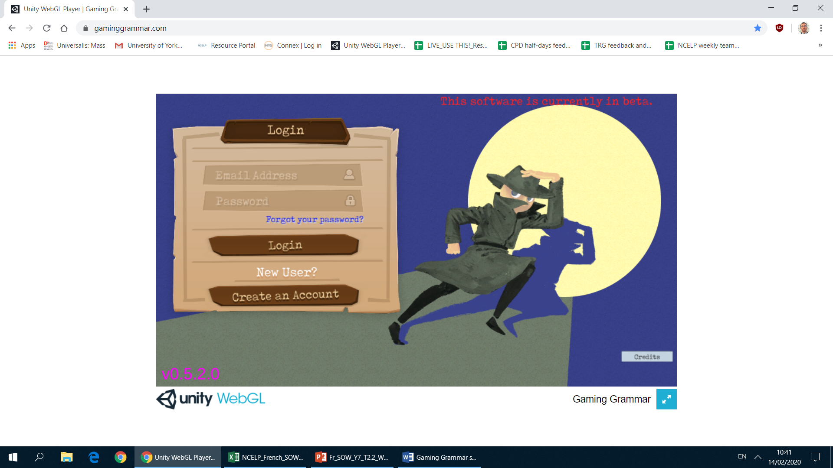
Gaming Grammar
Gaming Grammar
Relevant mini game(s):
Verbs (present): 1st person singular/plural (Verb agreement (present))
Verbs (present): 2nd person singular/plural (Verb agreement (present))
Verbs (present): 3rd person singular/plural (Verb agreement (present))
Notes:
This slide links to Gaming Grammar login screen. The appropriate mission can then be selected from the menu page.
Students will progress through the game at their own rate; teachers should use the teacher interface to check progress. This will help to inform future lesson planning.

Slide 50

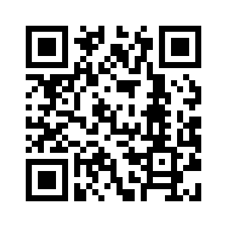

Devoirs
Vocabulary Learning Homework (Term 1.2, Week 6)
Audio file
Audio file QR code:
Student worksheet
Quizlet link
In addition, revisit: Term 1.2 Week 2
Term 1.1 Week 4

