Slide 1
KS2 Grammar knowledge
NCELP Residential 3
Rowena Kasprowicz
Date updated: 02/03/20

Slide 2
Aims of the session
Explore KS2 grammar teaching in terms of:
a) the foreign language curriculum
b) the English curriculum
Consider the role of metalanguage and terminology we can build on from KS2
Discuss the benefits of developing learners’ knowledge about language
Explore the role of language analysis and cross-linguistic analysis in L2 learning
Introduce some examples of activities to promote cross-linguistic comparisons
Rowena Kasprowicz

Slide 3
MFL Pedagogy Review
When new starters arrive in Year 7, what information do you have in terms of:
What the children have learnt so far about grammar in English?
What the children have learnt so far about other languages?
Rowena Kasprowicz
Notes:
Aim of this slide is to get a sense of teachers’ current level of awareness of what is taught in primary school. What information do they receive from their primary schools? What kind of knowledge have they observed that children start Year 7 with?
Thinking in particular about grammar / knowledge about English and/or FL they were learning in primary school.

Slide 4
Grammar teaching in KS2
In the foreign language curriculum…
Also the (archived) KS2 framework for languages…
Focus on developing learners’ knowledge about language
“When learning a new language, children reinforce and reinterpret knowledge and
understanding gained in learning their first language(s). […] They compare the new language with English or another language […] They become aware of rules or patterns in language and begin to apply their knowledge when creating new language.”
“understand basic grammar relevant to the language being studied, including (where relevant): feminine, masculine and neuter forms and the conjugation of high-frequency verbs; key features and patterns of the language; how to apply these, for instance to build sentences; and how these differ from or are similar to English”
(DfE, 2013a)
Rowena Kasprowicz
Notes:
Developing learners’ awareness about language is a key part of the KS2 languages curriculum (current PoS as well as the (now archived) framework for languages, which is still widely used at KS2).
Note the focus in the KS2 Languages curriculum. Also the archived (but still quite widely used) KS2 Framework for languages emphasises the importance of developing learners’ knowledge about language.
3 core strands – oracy, literacy, intercultural understanding and two cross-cutting strands, language learning strategies and knowledge about language.
Not going to focus too much on foreign language curriculum today, since provision can vary so drastically between different schools and contexts (also going to be discussed further in the transition section – coming up next at Residential).
However, it is important to acknowledge the intention set out in the curriculum for primary foreign languages. As we’ve discussed before, often children’s motivation is tied to their sense of progression, so it is important to keep in mind what children (may) have covered prior to arriving in Year 7.
In addition, even if the children begin learning a new foreign language in Year 7 (which is different to the language learnt in primary school), we can still draw on that prior learning to support their future language learning – more on this later.

Slide 5
Grammar teaching in KS2
In the English curriculum…
Driven by the Spelling Punctuation and Grammar (SPaG) component of the SATs tests
Developing pupils’ explicit knowledge about English to enable “more conscious control and choice” in their language use (DfE, 2013a)
In tandem with developing literacy skills: exploring how new grammatical concepts are used by others (e.g. in their reading) and how to apply these concepts (e.g. in their writing)
Focus on:
Small units of syntactic analysis
Definitions of grammatical terms
Functions of word classes
Based on ‘Standard English’
Rowena Kasprowicz
Notes:
Language analysis and grammar teaching driven by the SPaG component of the SATs tests. Strong washback effect of the test on teaching (determining what is covered when and how), as you might expect.
The national curriculum explicitly focusses on developing learners’ explicit knowledge about English.
Often language pupils use in speech in far more complex than the language they are able to use when writing. SPaG component aims to help pupils become more sophisticated writers.

Slide 6
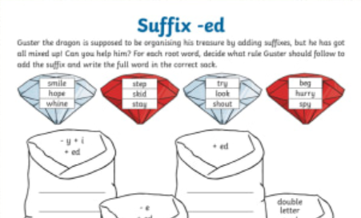
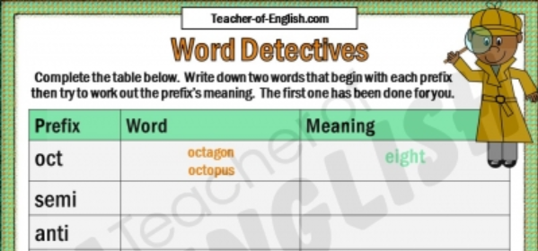
Grammar teaching in KS2
What does (English) grammar teaching look like in KS2?
Explicit, decontextualized practice (e.g. prefix bingo)
Frequent repetition and revisiting (e.g. “grammar starter” to every literacy lesson)
Highlighting and discussing structures when they arise in guided reading, shared and guided writing, and in other subject work (e.g. history)
Repeated exposure to and reinforcement of metalanguage (in line with curriculum)
Proof-reading own work, identifying errors, making improvements
(Safford, 2016, pg. 10)
Rowena Kasprowicz
Notes:
Note of explanation of Safford study: gathered teachers’ views on SPaG via questionnaires and interviews.
Often very explicit, focussed, systematic. Often, this often takes the form of decontextualized explicit practice of particular grammatical structures(e.g. see worksheet excerpts at the top).
Lots of repetition and revisiting. Likely to be part of primary school pupils’ daily ‘diet’.
Safford study – teachers reported that grammar teaching is very much embedded throughout the school curriculum. Any opportunity to draw attention to grammar / structures / metalanguage is utilised.
Making use of more contextualised practice too. (although in contrast with how tested in SATs / SPaG – follow this point up on next slide). Emphasis also on how grammar is used to convey meaning / different style of language use etc.
Not just providing input to pupils about what key terms mean, but also encouraging students to notice, discuss, correct grammar in their own writing.

Slide 7
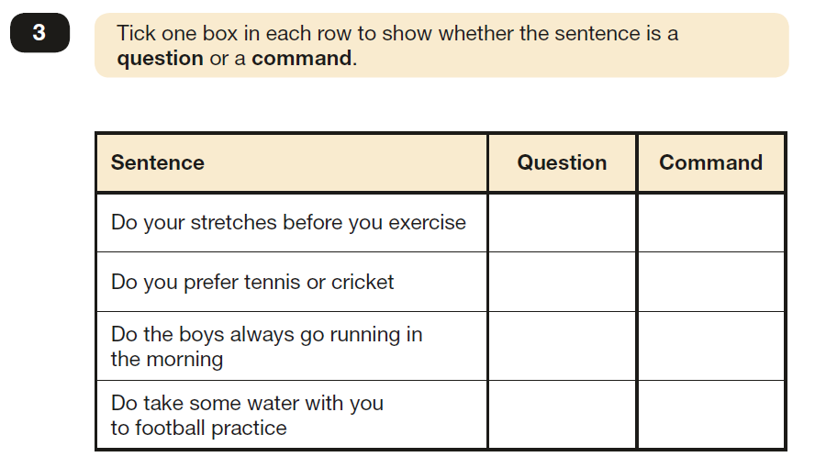
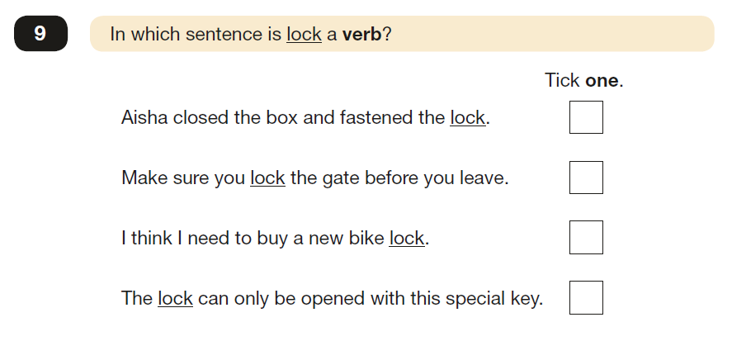
Grammar teaching in KS2
(Examples taken from 2019 test paper)
What does (English) grammar assessment look like in KS2?
Rowena Kasprowicz
Notes:
SPaG: Often discrete decontextualized measure of grammatical knowledge. Labelling parts of speech, identifying types of sentences (E.g. question / command – syntax / word order). Transforming words from one tense to another.
In many ways the focus is on pupils’ understanding of the terminology itself (although note some questions can be completed just by intuition rather than really understanding and applying the target terms). Less emphasis on the why (e.g. first example – don’t really need to understand why one sentence is a question and the other a command – can complete just based on intuition). Question whether this test demonstrates that pupils have awareness at the level of understanding (Schmitt’s conceptualisation), and whether this sort of knowledge reflects transferable declarative knowledge (DeKeyser work discussed in Meaningful practice session).
Note that there are issues with the SPaG test (e.g. emphasis on identification of grammar features rather than testing understanding of their meaning). Not going to focus on the issues, but just using these as a demonstration of the way in which children are interacting with and talking about language in KS2 and what they are expected to be able to do.

Slide 8
Grammar teaching in KS2
Pupils’ perceptions of grammar teaching at KS2:
Often contrary to teachers’ view of grammar teaching…
Viewed positively and enjoyed by pupils
Appreciate having a clearly defined set of rules (at least within context of SPaG)
Boosts confidence of weaker readers and writers
Embedding grammar practice in wider literacy work helps to deepen pupils’ understanding of the concepts (although this isn’t reflected in the content of the test)
Notably, SPaG is one area in which EAL learners perform at a similar level (or indeed outperform) L1 English learners (DfE, 2019)
(Safford, 2016)
Rowena Kasprowicz
Notes:
Note of explanation of Safford study: gathered teachers’ views on SPaG via questionnaires and interviews.
These points reflect the teachers’ observations of how pupils respond to SPaG teaching.
Teachers often express fairly negative views of the amount of grammar teaching that is happening/required. But interestingly in the Safford study they also observed that students actually seem to express quite positive views about their grammar learning.
SPaG test & defined set of rules – more of a right/wrong (less subjective than creative writing for example), e.g. know what preposition is or not etc.
Grammar teachers felt that the grammar teaching was equipping learners with the tools to analyse their own learning and own language use. Empowering & builds their confidence. Similar potential in L2 learning – usefulness of drawing connections with language / structures that pupils already know / have encountered in English.

Slide 9
Using metalanguage
MFL Pedagogy Review recommends making use of standard grammatical terminology
The KS1 and KS2 (English) curriculums also require children to recognise and use grammatical terminology.
This knowledge is tested in the SPaG (Spelling Punctuation and Grammar) test at the end of KS2.
Why is this useful?
Equips children with language they can use to talk about their knowledge and learning
Provides clarity through shared understanding of a clearly defined set of terms and definitions
Boosts children’s confidence, including lower ability learners
To some extent, facilitates application of these concepts to different contexts and languages (Safford, 2016; TSC, 2016)
Rowena Kasprowicz
Notes:
Point 3: Acknowledge (as noted on earlier slide) that whether or not the SPaG test does a good job of testing pupils’ grammatical knowledge is open for debate, but in theory this is the purpose of the test.
Final point: to some extent noted here. At KS2, students are developing knowledge of terminology and different grammatical concepts. But the SPaG test really just seems to focus on labelling grammar features / matching terminology to grammatical features. Also, for many of the SpaG test questions, pupils can answer just on intuition (without the terminology). So, its not clear how transferable this knowledge is, and whether pupils are really understanding how and why these are used.

Slide 10
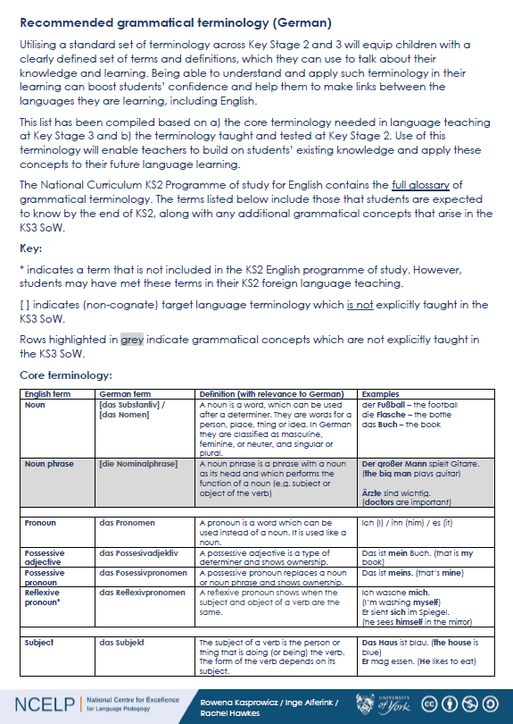
Using metalanguage
Handouts 1 to 3: List of recommended terminology
Based on terminology taught in KS1 & KS2 English curriculum and core grammatical concepts introduced in SoW
How closely do the terms match with those you currently use in your teaching?
Are there any terms that are surprising or potentially problematic?
Is there anything missing?
Rowena Kasprowicz
Notes:
10 minutes to look over the three versions and consider the three questions on the board.
2-3 minutes to gather in a few responses.
NCELP have been developing a list of recommended grammatical terminology, based on a) what structures students will be encountering in the KS3 SoW and b) based on the terminology and concepts that children have covered in primary school.
A bespoke version for each language, with definitions and examples tailored to that specific language.
Included the equivalent target language terminology, although see key on page 1
– Terms in [ ] are not expected to be explicitly taught, just provided for reference.
– Rows highlighted in grey are grammatical concepts that will not be introduced in KS3 SoW in that language (but they might come up in one of the other languages).

Slide 11
Using metalanguage – English first
Introduce new grammatical concepts using terminology in English first.
Why?
Building on learning from KS2
Ensuring understanding is firmly established in English
Avoiding cognitive overload
Once understanding is firmly established, introduce equivalent TL terms in subsequent practice
In NCELP SOW, TL terms in year 7 if they are COGNATES (e.g., adjectif)
Other terms (non-cognates) might be introduced in year 8 or 9 (or beyond)
Ensure that meaning of term is clear in English
Ensure that examples are clear in both English and TL
Rowena Kasprowicz
Notes:
Important to ensure understanding is established using L1 (English terms) first, before introducing new terminology in the L2. Builds on pupils’ learning from KS2 – reinforce their understanding of these concepts and how they apply in the L2.
Avoiding cognitive overload – so that the pupils are not having to deal with various levels of new learning / knowledge all at the same time (e.g. understanding the meaning of the new L2 terminology, whilst also getting to grips with the new TL structure and it’s meaning and use)

Slide 12
Developing learners’ knowledge about language
A substantial body of research explores the benefits of developing learners’ awareness of and knowledge about language (in their first language and in other languages) and the impact this can have on language learning.
metalinguistic ability / awareness
ability to look at language as an object
ability to describe linguistic phenomena and (where known) using technical language
(Han & Ellis, 1998; White & Ranta, 2002)
metalinguistic knowledge
→ knowledge of the rules governing a language
knowledge of the technical language used to describe
patterns and linguistic phenomena
language analytical ability
ability to spot patterns in language
ability to make generalizations and extrapolate rules
(Roehr-Brackin & Tellier, 2019)
Such knowledge, skills, and abilities are developing during middle childhood (around 7 to 11 years old).
This coincides with biological maturation, the onset of literacy, and (where present) exposure to other languages.
Rowena Kasprowicz
Notes:
When we are considering learners’ awareness of language / knowledge about language, there are a number of different terms that are used.
Term metalinguistic (knowledge / ability / awareness) is applied to / used to define tasks that require learners to look at language as an object
We can talk about a learners’ metalinguistic ability / awareness, and this is generally used to refer to learners’ ability to look at language as an object etc (points on slide)
The term metalinguistic knowledge is used to refer to learners’ knowledge of rule / technical languages (points above)
We can also talk about a learners’ language analytic ability – this is learners’ ability to analyse language, spot patterns, and to make generalisations / extrapolate rules based on those patterns.
These analytical skills / abilities are developing rapidly during middle childhood, which is generally defined as around 7 to 11 years old. This coincides with / is triggered by the biological changes happening in children at this age, as well as the development of their literacy skills once they start school, and any exposure they might have to other languages.
By the time pupils reach KS3 / secondary school, have a much greater propensity to be able to look at language in an abstract way.
Different terms used across different studies – all essentially talking about learners’ ability to look at language as an object, pick out patterns, apply rules, and talk about the language. In the following slides, when talking about specific studies, I will use the terminology that was used within the study.

Slide 13
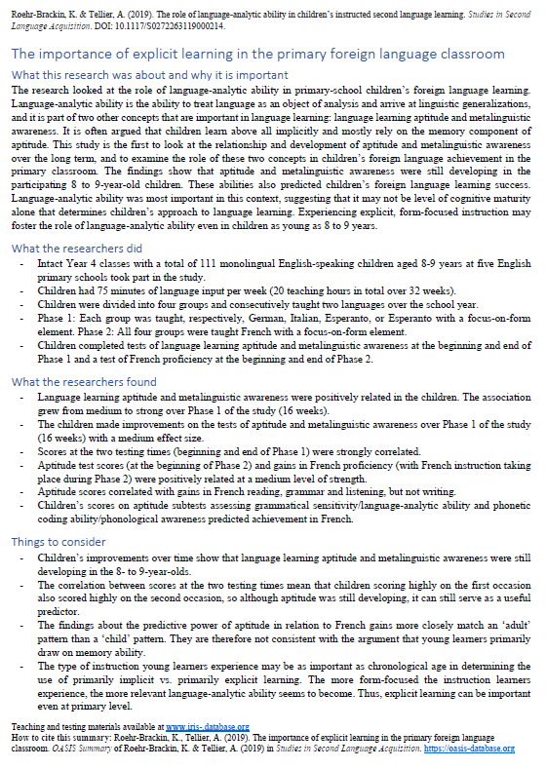
Developing learners’ knowledge about language
Developing learners’ knowledge about language and their ability to analyse language can be beneficial for language learning.
Language analytic ability (LAA) has been found to predict foreign language proficiency in young learners
Handout 4: Summary of Roehr-Brackin & Tellier (2019)
N = 111 8-9 year olds from 5 primary schools
Observed a strong relationship between LAA and the learners’ L2 French proficiency after 16 weeks of French learning
LAA seems to be particularly important in instructed settings where learners are more likely to be relying on explicit learning (e.g. through focus-on-form activities to practise grammar)
Similarly, Kasprowicz, Marsden & Sephton (2019) found LAA was related to performance on Gaming Grammar (N = 113 learners aged 8-11)
Rowena Kasprowicz
Notes:
What evidence is there to demonstrate?
Relationship between language learning and analytic ability already fairly accepted for older learners / adults. Strong relationship between analytical skills and success in language learning. However, less clear for younger learners, because analytical skills are still developing.. Earlier research suggested that younger learners rely primarily on memory abilities in learning. However, more recent research in an instructed context, where learners are more likely to be using more explicit learning, focussing on form, indicates that language analytic ability is also important for younger learners.
Although LAA is still developing throughout childhood, a number of studies have shown that language analytic ability seems to be predictive of learners’ foreign language proficiency.
Handout 4 – allow time to read (see how time is doing)
Example of Roehr-Brackin & Tellier (2019) study: found that LAA (rather than memory abilities) was the strongest predictor of proficiency (i.e. those learners with higher LAA were more likely to be doing well in their French learning). Measured over a period of 16 weeks. French proficiency measured using a paper and pen test, examining listening, reading, writing, grammar.
In our recent research with GG, we found a similar pattern, where learners’ LAA predicted how well they would do on the game, and how quickly they would pick up the grammatical patterns being introduced.
Page 17: In other words, the more form-focused the instruction learners experience, the more relevant language-analytic ability becomes, and the greater its role in children’s L2 success.
Summary of Kasprowicz et al (2019) also available as follow-up reading.

Slide 14
Developing learners’ knowledge about language
Studies have also observed a relationship between learners’ metalinguistic knowledge and their ability to use the foreign language
Summary of White & Ranta (2002)
Two classes of French children (N = 59) in intensive English programme (Quebec)
Both classes engaged in communicative language lessons.
One class also received metalinguistic instruction about use of his/her in English vs. French
Picture description task
Both classes improved their use of possessive adjectives
BUT
Higher proportion of learners who received metalinguistic instruction demonstrated mastery of agreement rule for his/her than in other group.
Without metalinguistic instruction, learners had to rely more on own ability: those learners with higher LAA were more likely to improve use of his/her, compared to learners with lower LAA.
his? her?
Rowena Kasprowicz
Notes:
Another benefit to providing some instruction that develops learners’ metalinguistic knowledge, is that there is evidence of the relationship between…
(Note: summary not available yet, but will share once it is available.)
Give a brief overview of this study.
Final point: For the Comparison group (who did not receive any metalinguistic instruction), learners with higher levels of LAA able to impose structure (analyse / work out the rules) in the input unaided. However, learners with lower LAA were not. Whereas in the class who did receive the metalinguistic instruction, this helped to ‘level out’ these differences, meaning a higher proportion of learners demonstrated mastery of this feature.
Important take-away here: if we don't teach it, then it is, arguably, less equitable - learners who are naturally good at analysing language could perhaps do it anyway, but those who can't are less likely to 'get it‘
Learning success is less reliant on individual variation between learners.

Slide 15
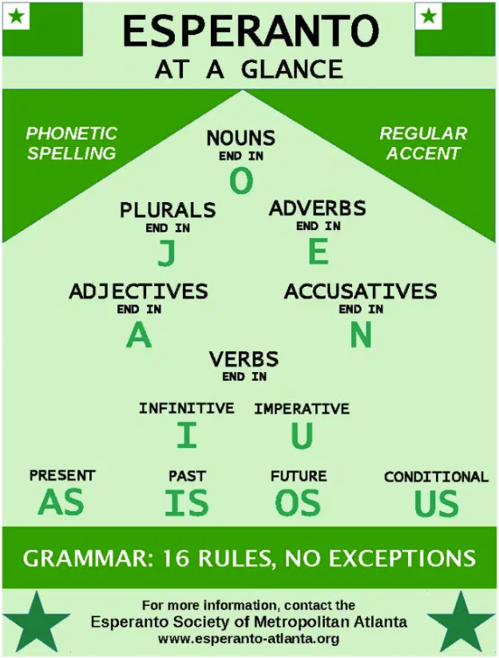
Developing learners’ knowledge about language
Training pupils in language analysis seems to lead to more consistent outcomes amongst pupils
White & Ranta (2002) observed less variation in outcomes for their metalinguistic instruction group
Handout 5: Summary of Roehr-Brackin & Tellier (2018)
Three studies investigated whether metalinguistic ability can be improved by learning Esperanto
Form-focused activities improved metalinguistic ability, regardless of language (real language or Esperanto)
Learning Esperanto did not confer special benefits for metalinguistic ability or language proficiency
BUT
Across all three studies there was less variation in L2 performance among children who learnt Esperanto
Fewer learners did poorly
Artificial language governed by transparent, systematic, unambiguous rules
Rowena Kasprowicz
Notes:
(Link to previous slide) – this seems to suggest that training pupils in language analysis seems to lead to more consistent outcomes.
This was demonstrated in the previous study (White & Ranta) where there was less variation in performance within the group who had received metalinguistic instruction – overall a higher proportion of learners had mastered the target grammar feature, compared to the comparison group.
Similarly, Handout 5 gives an overview of a second study by R-B & T that also observed this finding.
Read this summary if time
Brief overview:
Series of studies looking at the benefits of teaching Esperanto (an artificial language, which has transparent, systematic, unambiguous grammatical rules) → can this improve learners’ metalinguistic ability?
Idea is that Esperanto is a good ‘test bed’ for developing learners’ metalinguistic and language analytic ability, because it is very systematic and unambiguous, with no exceptions to the rules.
Esperanto / German / Italian → all then went onto learn French for half of the year..
Looked at: Improvement in metalinguistic ability & subsequent benefits for learning French.
Brief summary of the main points:
Engaging learners with grammar teaching (form-focused activities) seemed to have a beneficial impact on learners’ metalinguistic ability (regardless of whether they were learning Esperanto or French)
Esperanto itself didn’t seem to have any greater benefits than other languages, in terms of learners’ overall metalinguistic ability and language proficiency.
But: there was less variation in L2 performance among the children who had learnt Esperanto. So having that period of of form-focussed instruction which focussed on developing learners’ metalinguistic ability was beneficial.
So the important take-home from this study is that: these findings suggest that metalinguistic ability is trainable. This can help to ‘level the playing field’ by helping learners who are less naturally analytical in languages. Success in language learning is therefore less reliant on individual differences and learners’ natural propensity for analysis etc.
Also link back to earlier point about EAL pupils performing just as well (or indeed better than) pupils with English as an L1 in SPaG test (learners of all abilities / backgrounds able to engage in and do well at language analysis - indeed EAL children may be particularly well suited to these kinds of activities given their wider experience of language)

Slide 16
Engaging in language analysis
… can facilitate a deeper understanding of language by encouraging learners to
“spot patterns in language and to identify variables”
… can include any and all languages,
i.e. first language, home language(s), foreign language(s)
… can develop learners’ understanding of both language and culture
(how languages are used in similar and different ways to convey meaning)
… is in line with the move towards more explicit and direct teaching of language
… can lead to greater interest and enjoyment in language study
… can prepare learners for further language learning later in life
(Eric Hawkins’ “language apprenticeship”)
(CLiE Manifesto https://clie.org.uk/laser/#manifesto)
Rowena Kasprowicz
Notes:
Bringing together the findings from those studies, we can conclude that engaging in language analysis can be beneficial for language learning for the following reasons. (Note, these points are taken from the CLiE – Committee for Linguistics in Education - manifesto)
Point 2 – also useful as a way to incorporate learners’ home languages in the classroom discourse.
Point 3 – Drawing comparisons between L1 (e.g. English or home language) and foreign language. Exploring how language is used to covey meaning.
Point 5 - Probably the most important benefit of LA in FL teaching is to present the target language as a source of interest, or even wonder.
Point 6 – as L1 English speakers, there is not one obvious language that we will need later in life. Developing learners’ ability to analyse and talk about language will help to equip learners to tackle any language they may choose / need to learn in the future.
Indeed the 2014 National Curriculum for languages notes that ‘language teaching should provide the foundation for learning further languages, equipping pupils to study and work in other countries.’

Slide 17
Practising in language analysis
Yodaspeak
Activity
Exploring word order
Rachel Hawkes / UKLO
Notes:
Look now at an example of an activity designed to encourage learners to analyse language.
This activity was kindly shared by Rachel, originally adapted from UKLO battery.

Slide 18
Practising language analysis
Adapted from UKLO activity
(see Slide 24)
Example:
Yodaspeak activity
Practise identifying subject / verb / object in English sentences to consolidate understanding of these terms
Practise identifying and describing word order patterns
Practise manipulating word order in English sentences
Precursor to introduction of word order changes in German
Rachel Hawkes / UKLO

Slide 19
Practising language analysis: Example
Yodaspeak
In the Star Wars movies, the character Yoda was heard to speak English with a distinctive word order, apparently a deliberate device to make him seem different and special.
We are going to look at some examples of Yoda’s English, all genuine examples from the Star Wars movies.
In the examples:
Circle the verbs, box the subjects, and underline the objects.
Rachel Hawkes / UKLO
Notes:
An activity looking at word order .
Pre-cursor to introducing word order changes in German.
Because based on sentences that use English words, but in an unfamiliar / different structure to sentences (WO). Means learners aren’t preoccupied with understanding the meaning of the individual words or lexical items, but can really focus in on the grammatical function on the words in each sentence.

Slide 20
Examples of questions
Look at the examples. Circle the verbs, box the subjects, and underline the objects.
1. Take you to him I will.
2. A domain of evil it is.
3. Help them you could.
4. Chewbacca and Tarfful, miss you I will.
5. Truly wonderful the mind of a child is.
6. Much to learn you still have.
7. When nine hundred years old you reach, look as good you will not.
8. Lost a planet Master Obi-Wan has.
9. Begun the Clone Wars have.
10. Your father he is.
Rachel Hawkes / UKLO
Notes:
Note that there is a worksheet to accompany this activity.
Maybe do this bit as an interactive activity – ask teachers to have a look at the sentences and spot patterns.
Why might this be useful practice for pupils?
EM Comment: point out the issue of auxiliary and modal verbs - yes, we are to count those as verbs! would be useful to go to next level of identifying these kinds of verbs with more than one word in them!

Slide 21
Practising in language analysis
Look at the examples. Circle the verbs, box the subjects, and underline the objects.
1. Take you to him I will.
2. A domain of evil it is.
3. Help them you could.
4. Chewbacca and Tarfful, miss you I will .
5. Truly wonderful the mind of a child is.
6. Much to learn you still have .
7. When nine hundred years old you reach , look as good you will not.
8. Lost a planet Master Obi-Wan has .
9. Begun the Clone Wars have .
10. Your father he is .
Rachel Hawkes / UKLO
Notes:
Introducing idea of word order moving away from strict SVO that we have in English.
Here students are identifying the different parts of speech (focussing on key elements – subject, object, and verb) and looking for patterns. Leading into next activity where they are then practising applying these rules.
Introducing ideas of verbs appearing at the end of the sentence and also sometimes at the start (modals).

Slide 22
Yoda’s sentences
Q. What does the position of the subject and verb tell us about how Yoda forms his sentences?
The subject moves to the end of the sentence just before the verb.
VERBS move!
If there is just one main verb, it moves to the end of the sentence.
If there are two verbs (e.g. modal verb + main verb), the modal verb moves to the end of the sentence and the main verb moves to the start of the sentence.
If there is an object, it moves to the start of the sentence. If there are two verbs, the object comes just after the main verb at the start of the sentence.
Q. How are Yoda’s sentences different from regular English sentences?
Rachel Hawkes / UKLO
Notes:
Gather ideas from the pupils about patterns they have spotted.
Then encourage the pupils to compare Yoda’s sentences to regular English sentences and explain the differences.

Slide 23
Practising in language analysis
Now, take the following genuine but ‘incorrect’ examples (a-j) and rewrite them in ‘pure’ Yoda-speak.
Incorrect sentences | Correct ‘Yodaspeak’
The boy has no patience. | No patience the boy has.
I cannot teach him. | Teach him I cannot.
A Jedi’s strength flows from the Force. | From the force a Jedi’s strength flows.
The fear of loss is a path to the dark side. | A path to the dark side the fear of loss is.
Great care we must take. | Take great care we must.
Disturbing is this move by Chancellor Palpatine. | Disturbing this move by Chancellor Palpatine is.
The capture of General Grievous will end this war. | End this war the capture of General Grievous will.
A little more knowledge might light our way. | Light our way a little more knowledge might.
Sick have I become. | Become sick I have.
Rachel Hawkes / UKLO
Notes:
Answers revealed on click.
Actively having to manipulate word order / apply the rules that were identified on the previous slide

Slide 24
Practising language analysis
UK Linguistics Olympiad
Aim to develop learners’ understanding of language
Lots of example problem sets available via the website
Wide range of languages (including Fr / Ge / Sp)
Wide range of language features / structures / patterns explored
Rowena Kasprowicz
Notes:
1 min
Flag as a useful source of resources.
UK Linguistics Olympiad has a huge set of example problem sets, drawing on a wide range of languages – useful database to explore, for inspiration for these sorts of activities.

Slide 25
Comparing different languages
Although there is often a concern about using the L1 in the foreign language classroom, strategic, systematic use and discussion of the L1 (and other languages) and comparison with the L2 can have distinct benefits for both L1 and L2 learning.
(Cook, 2001; Horst, White, Bell, 2010; Macaro, 2002; Turnbull, 2001)
Making L1/L2 comparisons can have a positive effect on L2 learning. Some evidence…
Earlier study by White & Ranta (2002)
Study by Ammar, Lightbown, Spada (2010): positive relationship between learners’ awareness of L1-L2 differences and ability to accurately form questions
Series of studies by McManus & Marsden demonstrating the benefit of L1 grammar explanation and practice on L2 learning (see summaries from Grammar & Meaningful Practice)
Cross-linguistic awareness (awareness of the similarities and differences between languages) is part of a learners’ metalinguistic awareness
Rowena Kasprowicz
Notes:
As noted earlier – another very effective method for developing learners’ analytical abilities and metalinguistic awareness is through activities that encourage comparisons between different languages.
As discussed in the previous CPD session on the use of the TL, strategically and systematically using the L1 (and other languages) in comparison with the L2, can be beneficial for both L1 and L2 learning.
This cross-linguistic awareness is an important part of learners’ wider metalinguistic awareness.
In previous sessions (grammar, meaningful practice, use of TL), and earlier in this session, we’ve seen a range of evidence that explicitly drawing comparisons between the L1 (i.e. English) and L2 can be beneficial for learners’ developing knowledge of the L2.
We saw this in the earlier study by W&R where we saw that metalinguistic instruction about possessive adjectives in French versus English had a positive impact of learners’ mastery of possessive adjectives in the L2 (English).
Also, A, L, and S (2010) – study looking at the benefits of instruction which focussed on drawing learners’ attention to the differences in question formation in English vs. French. Found that this instruction had a positive impact on learners’ ability to accurately form questions.
In addition, we’ve encountered the studies by McManus and Marsden in previous sessions, which demonstrated that providing the grammar explanation and practice in the L1 English (about how habitual vs. ongoing meaning is conveyed in the past tense) as well as the L2 French, was beneficial for learning the Imparfait in French, and led to better learning than just the L2 Explanation and practice alone. Note: McManus and Marsden (2018) demonstrated that the combination of L1 explanation + L1 practice was important (the L1 practice without L1 explanation did not lead to the same benefits).
Also McManus 2019 study in Language Awareness which also demonstrated that awareness of form-meaning mappings in the L1 can benefit L2 learning of crosslinguistically complex features (i.e. those that exist but behave differently in the two languages)
Important take away here: teaching, comparing, switching between languages can be helpful for L2 learning for certain features (see next slide).

Slide 26
Comparing different languages
“regardless of the extent to which the language teacher avoids using the L1 in class,
it is still always there in the minds of the learner”
(Horst et al., 2010, p. 333)
We know that the L1 can positively and negatively influence L2 learning
Learners try to apply patterns from their L1 when interpreting and using the L2
Learners view the L2 through the “lens” of their L1, especially in earlier stages of learning (and across all areas of language learning, including phonics, vocabulary & grammar)
(N. Ellis, 2006)
Cross-linguistic comparisons can help to reinforce correct L2 form-meaning connections
particularly for features which behave differently in the L1 versus the L2
Rowena Kasprowicz
Notes:
We know, of course, that learners’ knowledge about the L1 is always there – even if the L1 is not explicitly mentioned in the classroom.
In addition, learners are making use of this knowledge, in the process of trying to breakdown, understand, and use the L2 – with potentially positive and negative consequences.
For instance, (particularly in the early stages of language learning), learners try to apply patterns from their L1 in the L2 – for example, transferring the canonical S-V-O word order from English. This can lead to difficulties when learning languages such as German where word order behaves quite differently to English.
Learners are viewing L2 through the lens of their L1.
Important take-away: Given that learner’s knowledge about L1 is always there and that learners do make use of this (regardless of whether its explicitly mentioned or not), the important question becomes “how can we harness what pupils have been learning about English, to help them develop their knowledge and understanding of the L2”? As mentioned on the previous slide, this is where drawing cross-linguistic caomprisons (i.e. comparing L2 nad L1) can be useful.
Note: this is not necessarily a blanket approach for all aspects of the L2. This sort of comparison is particularly useful for features that have a complex relationship between the L1 and L2.

Slide 27
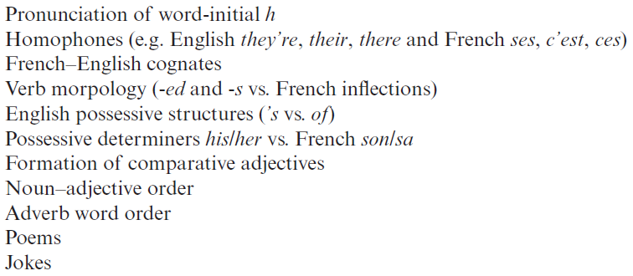
Comparing different languages
Features Horst et al (2010) identified for the (L1 French) learners of English in their study
Handout 6: Summary of Horst, White & Bell (2010)
In both the L1 and L2 classroom, observed minimal, sporadic comparisons with the other language.
Developed cross-linguistic awareness activities for L1 French learners of English.
Learners able to clearly compare the languages and note useful points of similarity and difference.
In your own teaching, where do you think it might be useful to draw comparisons between English and the target language?
Are there particular language structures that it would be useful to explore with your pupils?
Rowena Kasprowicz
Notes:
Handout 6: 10 minutes to read through + 10 minutes for discussion of questions (ideas on post-it notes, see below)
Acknowledge this is a pilot study, that was looking at the feasibility of using cross-linguistic comparison activities in the classroom. Therefore, this study does not provide evidence about the impact of these activities.
Briefly summarise the main take-away:
Unprompted use of L1/L2 comparisons was rare in the classrooms observed → suggests that when/where/how to draw on these comparisons and sorts of activities needs to be considered and planned systematically.
These sorts of activities did not lead to overuse of the L1 (the students know when it was time to talk about/use the L1)
Positive response to the language comparison activities from both the teacher and students
Students’ learning diaries suggested that they were able to draw thoughtful, detailed comparisons between the two languages and reflect on similarities and differences.
Follow-up questions as post-it note activity – capture ideas of what grammar features cause particular difficulty (different colour post-its for the three languages). Useful for NCELP to consider when developing the scheme of work and points at which we can build in some cross-linguistic comparison work.

Slide 28
Practising in language analysis
Asking questions
Explanation and activity
Rachel Hawkes / UKLO
Notes:
Note that syntax – word order, question formation etc – is one particular area where cross-linguistic comparisons can be particularly useful. Often the L2 behaves quite differently to English for these sorts of structures.

Slide 29
Asking questions
grammar explanation
Word order
To ask a ‘yes/no’ question in English, ‘do you..’ is followed by a verb.
Note that when you hear questions, you get an extra clue from the intonation, and when you read, you see the question mark.
Statement
You | have | a football.
Question
Do you | have | a football?
In German, just swap the verb and subject (e.g. ‘du’ (you), like this:
Statement
Du | hast | einen Fußball.
Question
Hast | du | einen Fußball?
→
Do you | have | a bottle?
Hast | du | eine Flasche?
Notes:
In the explanations provided for grammar activities – drawing attention to the similarities / differences to English. Important, because students are bringing these expectations from Eng (e.g. need a word for ‘do’ at the start of a question). Vs. German where we see a WO order change.
SOW Week 1.1.7
Note: the verb is in orange to highlight the change in word order that happens in German, but not in English.
Tell students that they might find it tricky to remember this because a) the English construction is different, and b) additional clues are provided by intonation in spoken form, and punctuation in written form.
Note in German there is the added complication of the homophony between ‘do’ and ‘du’ – useful to ensure pupils understand that this German ‘du’ is the English ‘do’!

Slide 30
Ist das eine Frage?
lesen
Frau Organisiert is texting Herr Organisiert to plan the shopping. He is confused as there is no punctuation!
Help Herr Organisiert. Write "?" after questions and "." after statements.
1. Hast du eine Flasche Cola __
4. Hast du ein Heft __
7. Du hast ein Lied __
2. Du hast einen Fußball __
5. Du hast eine Wasserflasche __
8. Hast du einen Film __
3. Hast du ein Buch __
6. Du hast einen Tisch __
9. Hast du eine Frage __
Notes:
TASK SLIDE
Students can do the task by writing numbers 1-9 and noting ? or . next to each. Alternatively, if needed for particular students, this slide could be printed.

Slide 31
Ist das eine Frage?
ANTWORTEN
Frau Organisiert is texting Herr Organisiert to plan the shopping. He is confused as there is no punctuation!
Help Herr Organisiert. Write "?" after questions and "." after statements.
1. Hast du eine Flasche Cola __
4. Hast du ein Heft __
7. Du hast ein Lied __
?
?
.
2. Du hast einen Fußball __
5. Du hast eine Wasserflasche __
8. Hast du einen Film __
.
.
?
3. Hast du ein Buch __
6. Du hast einen Tisch __
9. Hast du eine Frage __
?
.
?
Notes:
Answers revealed on individual clicks
Teacher elicits responses by asking ‘Ist das eine Frage?’ (Ja/nein) and pointing to the item. Students already know ‘Frage’, and the grammatical focus of this week is yes/no questions so the use of those here in input serves to reinforce the pattern. The word for sentence ‘Satz’ [582] is also a high-frequency word, and some teachers might find themselves naturally introducing it here.
Note: Students have not yet been taught numbers in the SOW so at this point there is not direction to use them. Depending on the class, some teachers may feel that they can begin to use them in tasks receptively, priming for subsequent teaching.

Slide 32
Frage oder Satz?
Grammatik
Closed (yes/no) questions
As you know, closed questions are formed by swapping the verb and subject:
Note that when you hear questions, you get an extra clue from the intonation, and when you read, you see the question mark.
Statement
Du | spielst | oft Tennis.
You often play Tennis.
Question
Spielst | du | oft Tennis?
Do you often play Tennis?
Statement
Du | schreibst | ein Buch.
You are writing a book.
Question
Schreibst | du | ein Buch?
Are you writing a book?
This is how you ask ‘do’ or ‘are’ questions in German.
Notes:
Revisit to this rule a few weeks later – this time focussing in on German WO but important remind pupils that German does not have a word for do/does.
SOW Week 1.2.3
This explanation revisits knowledge that students were taught in 1.1.7.
Teacher to highlight that German does not have a word for do/does, or the continuous equivalent are/is, and that inversion must be used to translate these.

Slide 33
Frage oder Satz?
hören
Zorg is making observations about Wolfgang. He can produce a lot of words, but lacks intonation (and manners!)
Is Zorg asking a question or making a statement? Write ? or .
?
.
C
A
B
D
E
F
G
H
I
Notes:
Listening This task revisits the VSO syntax of questions vs SVO of statements. It is important to revisit essential grammar with different lexis for students to deepen their understanding of the grammar feature. Here vocabulary is recycled from 1.2.1 and 1.2.2 and integrated with the frequency adverbs from this week.
Example slide
This slide is an example to do first with students and correct. It has audio inserted for A and B and the corresponding answers.
Then go to the next slide for the full exercise. The next slide has the audio and the answers.
NB: If it seems strange to students that we have so many appearances from Zorg, the robot, explain that it is important that we remove the audible clues (i.e. raised intonation) that come with questions, so that they only focus on the syntax.
Transcript
a) Hörst du jeden Tag das Leid
b) Du arbeitest kaum im Garten
c) Putzt du manchmal das Auto
d) Du tanzt nicht so gut
e) Du sitzt oft zu Hause am Computer
f) Gehst du nie in den Garten
g) Du redest sehr oft im Unterricht
h) Lernst du manchmal in der Schule
i) Spielst du nie mit Freunden Fußball

Slide 34
Frage oder Satz?
hören
Zorg is making observations about Wolfgang. He can produce a lot of words, but lacks intonation (and manners!)
Is Zorg asking a question or making a statement? Write ? or .
?
.
C
?
A
B
.
.
?
D
E
F
.
?
I
?
G
H
Notes:
Task slide
Students can do the task by writing letters A-I and noting ? or . next to each.
Audio is activated by clicking the individual letters.
Answers revealed on individual clicks. Teacher elicits responses by asking ‘Ist A eine Frage oder ein Satz?’ (‘A ist eine Frage … B ist ein Satz …’)
Transcript
a) Hörst du jeden Tag das Leid
b) Du arbeitest kaum im Garten
c) Putzt du manchmal das Auto
d) Du tanzt nicht so gut
e) Du sitzt oft zu Hause am Computer
f) Gehst du nie in den Garten
g) Du redest sehr oft im Unterricht
h) Lernst du manchmal in der Schule
i) Spielst du nie mit Freunden Fußball

Slide 35
Open (wh-) questions
Grammatik
Open (wh-) questions
To ask an open question, place a question word directly in front of the verb:
Closed
Schreibst | du | ein Buch?
Are you writing a book?
Open
Wer
Who is writing a book?
Wo
schreibst | du | ein Buch?
Where are you writing a book?
schreibt |  | ein Buch?
Beispiel:
Was hast du am Montag?
What do you have on Monday?
Wo spielst du Tennis?
Where do you play tennis?
Wie oft putzt du dein Zimmer?
How often do you clean your room?
Wer ist dein Lieblingslehrer?
Who is your favourite (male) teacher?
Notes:
Explanation of open (wh-) questions
Teacher to draw attention to word order: VSO for closed questions, Question word + VSO or VO for open questions.
Several examples using previously taught question words are given in German. Teacher elicits the meaning in English.
This primes for the question generation task later this lesson.

Slide 36
Order of words in a question
Grammatik
Sentences are turned into questions by swapping the verb and subject.
Du spielst zu Hause Gitarre.
Spielst du zu Hause Gitarre?
You play/are playing guitar at home.
Do you play / Are you playing guitar at home?
To ask an open question, place a question word in front of the verb.
Only the verb and subject swap places. The adverb and noun stay in the same position.
Wann spielst du zu Hause Gitarre?
When do you play / are you playing guitar at home?
Wer spielt zu Hause Gitarre?
Who plays / is playing guitar at home?
Notes:
SOW Week 1.2.4
This is an animated slide reminding students of the order and formation of questions
Animations allow teachers to elicit the du and er/sie forms of the sentences, as well as the English translations.
Teacher to pay special attention to the word order with adverbs, highlighting that a word-for-word translation from English will result in incorrect word order.

Slide 37
Saying what people do [1]
Present simple and continuous
Year 7 French
Term 1.2 - Week 3 - Lesson 19
Natalie Finlayson / Emma Marsden /
Stephen Owen
Notes:
SOW Week 1.2.3
Learning aims for Week 3:
SSC ‘j/soft g’ and ‘qu’
present tense used with its simple and continuous meanings
introduction to -ER verbs with je, tu, il/elle;
verbs with à (donner)

Slide 38
Le verbe
grammaire
Verbs tell you how two nouns relate to each other.
Verbs are not just action words! They can mean things that we can’t see or hear:
In English, you can add ‘-ed’ or ‘-ing’ to the end of verbs and put ‘to’ in front of them.
Verbs can have other verbs in front of them, like ‘do’, ‘was’, ‘is’, or ‘has’.
studies
hates
The girl ??? French.
loves
speaks
be
have
want
get
become
happen
Notes:
Robust knowledge of verb vocabulary is absolutely critical for learning a language. That is, the meaning of verbs – ‘go’, ‘eat’, ‘be’, ‘play’, ‘love’ – not the grammar of verbs in their different tenses and forms. It would be useful to explain this to students. It is something that we take for granted in our own language.
Students in year 7 should all know what a verb is, from their primary school lessons. It might, however, be worth checking this in the initial stages.
Before showing this slide, ask students to define a verb and give some examples.
Note (2nd to last point): important to emphasise here that we’re trying to move away from the reliance of ‘verb is an action word’. What is demonstrated here is the importance of the DISTRIBUTION in the language - this is how we know whether something is a verb - not by its meaning, but by what words come around it. It is not taught like this generally. Generally people focus on the semantics (e.g. adj is a describing word - but to be an adjective t needs to be describing a noun). Another example is that nouns often have 'the' or 'a' in front of them → you can't define a noun by 'it's a thing or a person' as it can be an activity, and then children are stumped.

Slide 39
Le verbe
grammaire
Circle the verb/verbs in the following sentences.
1. George plays computer games for three hours every day. 2. Helen loves detective stories. 3. Everyone thinks that it is great. 4. He never really liked fizzy drinks. 5. The climate is getting warmer.
6. If the match had been more exciting, the players would have been happier. 7. Are you becoming a bore? 8. What kind of taste do you detect? 9. The fish was eaten by the shark. 10. Making myself do sport is my ambition this year!
1. George plays computer games for three hours every day. [to play]
2. Helen loves detective stories. [to love]
3. Everyone thinks that it is great. [to think, to be]
4. He never really liked fizzy drinks. [to like]
5. The climate is getting warmer. [to get]
6. If the match had been more exciting, the players would have been happier. [to be, to be]
7. Are you becoming a bore? [to become]
8. What kind of taste do you detect? [to do, to detect]
9. The fish was eaten by the shark. [to eat]
10. Making myself do sport is my ambition this year! [to make, to do, to be]
Notes:
Awareness-raising exercise in English to teach students to recognise different forms of verbs. This is in preparation for a lot of work with verbs and, in particular, the two forms of the present in English with the one equivalent form in French.
Answers revealed on clicks.
To go further you could ask students to:
tell you what the ‘infinitive’, the dictionary form, of each verb is in English (shown in square brackets above)
- change the ‘dictionary’ form into as many different versions of the same VERB as they can, without turning it into a different word class (part of speech)! e.g. think, thinks, thinking, thought are all forms of the same verb; BUT…. thoughtful, thoughtless, thinker are NOT verbs, but they come from the same word family.
- give you some words that can be both a noun and a verb (e.g., head; captain; chair; cook).

Slide 40
Present simple or continuous?
grammaire
English has two present tense forms.
I make the bed every week. I am making the bed at the moment.
French has one present tense only. The BE + -ing form does not exist.
Je fais le lit chaque semaine. Je fais le lit en ce moment.
Present simple - normally; routine
Je fais = I make AND
I’m making
Present continuous (BE + -ing) - ongoing; current
Adverbs of time tell us which English tense to choose.
In French, the present simple is used with all adverbs.
Notes:
Here, the metalanguage (present simple, present continuous and adverbs) used to talk about verbs in this and subsequent sequences is described and explained.
Teacher to highlight the distinction between present simple for routine actions and present continuous for current/ongoing actions.
Teacher to stress the fact that the BE + -ing form is an English construction only. Être cannot be used with a verb this way.

Slide 41
Adverbs of time
chaque semaine
[every week]
[at the moment]
en ce moment
Notes:
The majority of this week’s vocabulary items will be formally introduced in lesson 2, but these phrases are used in the activities that follow.
Teacher to elicit pronunciation and English meaning from students.
To prepare for the listening exercise that follows, the teacher writes ‘chaque semaine and ‘en ce moment’ on the board, and asks students which form of the English present tense is indicated by each.

Slide 42
Present simple or continuous?
lire (1/2)
Nick is babysitting for the Petit family. He makes notes about the children, Jaques and Géraldine.
1.1 Choose the correct adverb.
A
Jaques is playing tennis at the moment/every week.
B
Géraldine wears a uniform at the moment/every week.
C
Géraldine is having lunch at the moment/every week.
D
Jaques is doing his homework at the moment/every week.
E
Jaques goes for a walk at the moment/every week.
Notes:
Awareness-raising exercise in English to teach students to connect temporal adverbs with tense. Note choice of French names incorporates this week’s SSCs: Jaques and Géraldine.

Slide 43
Present simple or continuous?
lire (2/2)
Nick is babysitting for the Petit family. She makes notes about the children, Jaques and Géraldine.
1.2 Choose present simple (normally; routine) or continuous (ongoing; current).
F
Jaques washes/is washing up at the moment.
G
Géraldine learns/is learning English every week.
H
Géraldine plays/is playing with her friends at the moment.
I
Jaques reads/is reading a book at the moment.
J
Géraldine sings/is singing every week.
Notes:
Awareness-raising exercise in English to teach pupils to connect temporal adverbs with tense.

Slide 44
Present simple or continuous?
écouter
Madame Petit calls Nick with more information about her children. Help Nick take notes. Choose present simple or continuous.
A
Jaques does/is doing his homework.
B
Jaques has/is having an idea.
C
Géraldine does/is doing the housework.
D
Géraldine is/is being naughty.
E
Géraldine cooks/is cooking.
Notes:
Basic translation exercise to introduce present tenses and revise vocabulary from Term 1 weeks 2 and 7.
Teacher explains that the temporal adverbs are not given in the English translation because the verb tense provides information about whether things happen routinely, or are ongoing right now.
Teacher draws attention to fact that French tense is the same throughout, and that students will have to listen out for the adverb in French to find out this information.
No new verbs are introduced at this point; all sentences contain the previously introduced être, avoir and faire.
Students will be familiar with all vocabulary from this week and previous weeks, with the exception of madame [294] which is a highly frequent word.
Audio plays on clicking the letters.
Transcript
Audio plays on individual letter clicks.
A. Jaques fait les devoirs en ce moment.
B. Jaques a une idée chaque semaine.
C. Géraldine fait le ménage en ce moment.
D. Géraldine est méchante chaque semaine.
E. Géraldine fait la cuisine chaque semaine.

Slide 45
Present simple or continuous?
écouter
Madame Petit calls Nick with more information about her children. Help Nick take notes. Choose present simple or continuous.
A
Jaques does/is doing his homework.
B
Jaques has/is having an idea.
C
Géraldine does/is doing the housework
D
Géraldine is/is being naughty.
E
Géraldine cooks/is cooking.
Notes:
Answers revealed on clicks.
Transcript
A. Jaques fait les devoirs en ce moment.
B. Jaques a une idée chaque semaine.
C. Géraldine fait le ménage en ce moment.
D. Géraldine est méchante chaque semaine.
E. Géraldine fait la cuisine chaque semaine.

Slide 46
Present simple or continuous?
lire
Nick is talking about the Petit family in English. Decide whether to translate what he says with ‘en ce moment’ or ‘chaque semaine’.
A
Madame Petit fait le tour [en ce moment / chaque semaine] mais elle fait la cuisine [en ce moment / chaque semaine].
B
Monsieur Petit fait le lit [en ce moment / chaque semaine] et fait le ménage [en ce moment / chaque semaine].
C
Géraldine fait le modèle [en ce moment / chaque semaine] et fait une promenade [en ce moment / chaque semaine].
D
Jaques est méchant en [en ce moment / chaque semaine] mais il fait les devoirs [en ce moment / chaque semaine].
Notes:
Basic translation exercise to introduce present tenses and revise vocabulary from Term 1 weeks 2 and 7.
Students hear Nick’s English voice. The adverbs are obscured by noises. Students must work out from the present tense form alone whether these things happen every week, or are happening at the moment.
Two equally plausible events are connected by mais in each case so that students cannot guess from context.
No new verbs are introduced at this point; all sentences contain the previously introduced être, avoir and faire.
Students will be familiar with all vocabulary from this week and previous weeks, with the exception of madame [294] which is a highly frequent word.
Audio plays on clicking individual letters.
Transcript
A. Mrs Petit goes on a tour [noise] but is cooking [noise].
B. Mr Petit is making the bed [noise] and does the housework [noise].
C. Géraldine is making a model [noise] and goes for a walk [noise].
D. Jaques is being naughty [noise] but does his homework [noise].

Slide 47
Present simple or continuous?
lire
Nick is talking about the Petit family in English. Decide whether to translate what he says with ‘en ce moment’ or ‘chaque semaine’.
A
Madame Petit fait le tour [en ce moment / chaque semaine] mais elle fait la cuisine [en ce moment / chaque semaine].
B
Monsieur Petit fait le lit [en ce moment / chaque semaine] et fait le ménage [en ce moment / chaque semaine].
C
Géraldine fait le modèle [en ce moment / chaque semaine] et fait une promenade [en ce moment / chaque semaine].
D
Jaques est méchant en [en ce moment / chaque semaine] mais il fait les devoirs [en ce moment / chaque semaine].
Notes:
Answers revealed on clicks. Full recordings including adverbs play on clicking individual letters.
Transcript
A. Mrs Petit goes on a tour every week but is cooking at the moment.
B. Mr Petit is making the bed at the moment and does the housework every week.
C. Géraldine is making a model at the moment and goes for a walk every week.
D. Jaques is being naughty at the moment but does his homework every week.

Slide 48
Present simple / continuous
We have already seen that the French present tense
has two English meanings:
Elle porte un uniforme
She wears a uniform
She is wearing a uniform
Notes:
SOW Week 1.2.4
This animated slide reminds learners that the present tense in French can be translated two ways in English: either the simple present (“does”) or the present continuous (“is doing”).
Learners were formally introduced to the present continuous usage in the previous week’s resources.

Slide 49
Circle the translations of the verbs that sound best to you (the most likely meaning).
Present simple / continuous
lire
 |  | en ce moment | normalement
1 | Claude aime le football. | is liking | likes
2 | Michel passe une semaine à faire le ménage. | is spending | spends
3 | Paul fait la cuisine chaque semaine. | is doing | does
4 | Natalie a une voiture moderne. | is having | has
5 | Sarah est grande et intelligente. | is being | is
6 | Zoë parle à une amie. | is talking | talks
7 | Jean donne un cadeau à un ami. | is giving | gives
8 | Gaëlle reste à l’école. | is staying | stays
9 | Philippe fait les devoirs chaque semaine. | is doing | does
10 | Claire fait un voyage. | is going on | goes on
Notes:
This is meta-linguistic activity to raise students awareness about the ambiguity of the French present tense. This activity should give rise to lots of talk about the two English forms.
This reading task asks learners to consider whether they would translate the French present tense verb in each sentence with the simple present or the present continuous meaning.
Whilst both answers are possible, in some cases more so than in others, there will be a sense of which is the “best fit”. This should be discussed with learners. As long as learners can justify their choice, they cannot really be “wrong”, but the real aim of this exercise is simply to force them to engage with both possible meanings in the English, whilst appreciating the fact that both are rendered by the present tense in French.
Note: this is teaching pupils to use grammar to get meaning, and that this involves subtle decisions!
The sentences consist entirely of vocabulary already presented, either this week or in previous weeks.
Suggested answers are provided via animated ovals which appear upon clicking the mouse. N.B. Where both answers would be a good fit, given the time expressions ‘en ce moment’ and ‘normalement’, both are indicated with the animated oval.
Please explain to students that that the ‘à’ in ‘à faire le ménage’ (sentence 2 on the slide) is used with the infinitive after ‘passer’ to mean ‘doing’ that verb.

Slide 50
Possessive adjectives

Slide 51
Possessive adjectives
Compare these French and English sentences.
What do you notice about the possessive adjectives?
Elle adore son livre.
She loves her book.
Il adore son livre.
He loves his book.
Elle adore sa voiture.
She loves her car.
Il adore sa voiture.
He loves his car.
Rowena Kasprowicz
Notes:
This slide encourages pupils to consider the differences between possessive adjectives in English and French.
Invite ideas from pupils.
Click reveal arrows to draw attention to these differences.

Slide 52
Possessive adjectives
“agree” means it needs to match the noun’s gender (masculine or feminine) and number (singular or plural)
In English, the possessive adjective (his / her) has to agree with the subject of the sentence
She loves her book.
He loves his car.
In French, the possessive adjective (his / her) has to agree with the noun it belongs to.
Elle adore son livre.
Il adore sa voiture.
Rowena Kasprowicz
Notes:
Explanation of the differences between possessive adjectives in English and French.

Slide 53
Possessive adjectives
Choose which possessive adjective is needed to complete the French sentences. Don’t be tricked by the English sentences!
English | French
She loves her brother. | Elle adore son / sa frère.
He likes his sister. | Il aime son / sa sœur.
He reads his book. | Il lit son / sa livre.
She finds her mobile phone. | Elle trouve son / sa portable.
She writes her letter. | Elle écrit son / sa lettre.
He wears his shirt. | Il porte son / sa chemise.
Rowena Kasprowicz
Notes:
Receptive activity – choosing the correct possessive adjective to complete the French sentences.
Note: this could of course also be practised using referential style / prediction style activities: son..... which word follows frère v sœur etc. so that pupils are provided with the grammar that is hard, and have to use it to choose what this then means for the language and meaning.

Slide 54
Summary
Students have encountered quite a wide range of grammatical metalanguage and concepts during KS2, through the English curriculum.
Use of metalanguage can provide clarity, boost students’ confidence, and enable students’ to talk about the language.
Developing learners’ language analytic ability can have a ‘levelling’ effect.
Activities which promote crosslinguistic comparison are useful, particularly for grammatical concepts which work differently in the L2 (compared to English).
Rowena Kasprowicz
Notes:
Note: the slides at the end provide more examples of opportunities to draw comparisons between English / target language (which are already embedded in NCELP resources)

Slide 55
References
Ammar, A., Lightbown, P., & Spada, N. (2010). Awareness of L1/L2 differences: Does it matter? Language Awareness 19(2), 129-146.
DfE (2013a). English programmes of study: Key Stages 1 and 2. London: Crown Copyright.
DfE (2013b). Languages programme of study: Key Stage 2. London: Crown Copyright.
DfE (2019). National curriculum assessments at Key Stage 2 in England, 2019: Revised. London: Crown Copyright.
Ellis, N. (2006). Selective attention, and transfer phenomena in L2 acquisition: Contingency, cue competition, salience, interference, overshadowing, blocking, and perceptual learning. Applied Linguistics, 27(2), 164-194.
Han, Y. & Ellis, R. (1998). Implicit knowledge, explicit knowledge and general language proficiency. Language Teaching Research, 2, 1-23.
Horst, M., White, J., & Bell, P. (2010). First and second language knowledge in the language classroom. International Journal of Bilingualism, 14(3), 331-349.
McManus, K. & Marsden, E. (2017). L1 explicit instruction can improve L2 online and offline comprehension. Studies in Second Language Acquisition, 39, 459-492.
McManus, K. & Marsden, E. (2018). Online and offline effects of L1 practice in L2 grammar learning: A partial replication. Studies in Second Language Acquisition, 40, 459-475.
Roehr-Brackin, K. & Tellier, A. (2019). The role of language analytic ability in children’s instructed second language learning. Studies in Second Language Acquisition, 45(5), 1111-1131.
Safford, K. (2016). Teaching grammar and testing grammar in the English primary school: The impact on teachers and their teaching of the grammar element of the statutory test in spelling punctuation and grammar (SPaG). Changing English, 23(1), 3-21.
White, J. & Ranta, L. (2002). Examining the interface between metalinguistic task performance and oral production in a second language. Language Awareness, 11(4), 259-290.
Rowena Kasprowicz

Slide 56
Other resources
Englicious: a free online library of original English language teaching resources
Rowena Kasprowicz

Slide 57
Asking questions
Stephen Owen / Emma Marsden
Notes:
SOW Week 1.2.3
Learning aims for Week 3:
SSC ‘j/soft g’ and ‘qu’
present tense used with its simple and continuous meanings
introduction to -ER verbs with je, tu, il/elle;
verbs with à (donner)

Slide 58
Asking questions
Remember, to ask a question in French,
raise the pitch of your voice at the end of a sentence:
Tu as un animal. You have a pet.
Tu as un animal ? Do you have a pet?
Do not say the final ‘s’.
SILENT FINAL CONSONANT
Stephen Owen & Emma Marsden
Notes:
SOW Week 1.1.4
This slide also revises the sound of ‘as’. Remind the learners not to sound out the ‘s’.
Very quick listening and oral rehearsal to remind them about the raised intonation and to increase confidence. Provide a model for the students by reading out the French with a ‘flat intonation’ then with the raised intonation. Ask the whole class to say this then ask individuals to to simply repeat it to their partner, then a few individuals to repeat it out loud to the class.
Remind the students – ‘do you’ is the way we ask questions in English - there is no way of saying ‘do you’ in French.

Slide 59
Questions with où
Remember, in French we use intonation to form questions.
Tu as un animal ?
Do you have a pet?
Literally: You have an animal?
“Do” is not used in French!
We can add the question word où ? – where?
Je vais où ?
Where am I going?
Tu vas où ?
Where are you going?
The question word goes to the end of the French sentence.
Notes:
SOW Week 2.1.5 Forming intonation questions with où is now explained. N.B. Intonation questions were introduced in 1.1.2.

Slide 60
Introducing verbs

Slide 61
aller
[ to go | going ]
Notes:
SOW Week 2.1.5
Note:

Slide 62
aller
[to go | going]
va
[goes | is going]
Notes:
Teacher note for 25 most frequent verbs:
Students should know the meaning of this verb already, as it was set as (audio and quizlet) homework. It is re-presented here in the infinitive and short form to deepen students’ knowledge and model the use of both forms in sentences.
Introducing the verb aller more explicitly. Aller is one of the 25 most frequently used verbs in French. All 25 most frequent verbs will be introduced early on using the same format. Both long form (infinitive) and short form (3rd person singular) are introduced in order to familiarise students with various forms of the same verb.
Bring up the word aller on its own, say it, students repeat it, and remind them of the phonics. Draw attention to SSC ’a’ and ‘é/er/et/ez’
Try to elicit the meaning from the students.
Then bring up the English translations. Emphasise the two meanings for the infinitive.
Bring up the short form va, say it, students repeat it. . Draw attention to SSC ‘a’.
Try to elicit the meaning from the students. Emphasise the two meanings for the short form.
Note: Students have had explicit teaching that the present tense in French communicates two different present tense meanings in English. This reinforces that learning. Emphasise the two meanings for the short form, reminding students that French only has one form and does not have a direct equivalent of the grammar for ‘is + ing’, the continuous form (as covered in previous weeks).

Slide 63
aller
[to go| going]
va
[goes | is going]
Notes:
Cycle through the long and short form again.

Slide 64
va
[goes | is going]
Elle va au parc.
[She goes | is going to the park.]
Notes:
Introduce the short form in a sentence.

Slide 65
aller
[to go | going]
Elle aime aller au parc.
[She likes going to the park.]
Notes:
Introduce the long form in a sentence.

Slide 66
va
[goes | is going]
va
Elle au parc.
[She goes | is going to the park.]
Notes:
Cycle through the short form in context again.

Slide 67
aller
[to go | going]
aller
Elle aime au parc.
[She likes going to the park.]
Notes:
Cycle through the long form in context again.

Slide 68
3rd person singular
Explanation and activity

Slide 69
Dictionary verb Vs he/she form
Only the infinitive form of a verb appears in the dictionary.
e.g. wohnen (to live / living), lernen (to learn / learning)
To say what he/she does or is doing, use er (he), sie (she)
and change the ending from -en to -t:
There is only one present tense in German!
wohnen – Er wohnt in Berlin.
(He lives in Berlin / He is living in Berlin.)
lernen – Sie lernt Gitarre.
(She learns guitar / She is learning guitar.)
How many are there in English?
Notes:
SOW Week 1.2.1

Slide 70
Hören: Infinitiv oder er/sie?
Noch einmal, bitte!
Infinitiv | Er/Sie
1
to learn / learning
2
plays / is playing
3
has
4
to talk / talking
5
to say / saying
6
lives / is living
7
learns / is learning
8
to write / writing
9
does/makes
10
to come / coming
Notes:
Here, students listen to the verb, decide first if it is infinitive or s/he form, then write the English translation (e.g. 1. to learn, 2. plays)
It is worth doing the first two with students as examples, and give feedback before doing the remainder. Each audio is activated by clicking the numbered button.
Students can be encouraged to ask for a repeat, if they need to hear it again. ‘Noch einmal, bitte’. They have just met ‘noch’ meaning ‘still’. Here the phrase means ‘one time more/again, please’ or literally, ‘still one time, please’. This recycles ‘bitte’, which they encountered a few weeks ago, and of course they know ‘ein’.
A prompt is on the slide to teach this phrase, with an image to remind them what it means.
Note: This listening repeats some of the verbs from the previous reading, but in their opposite forms (i.e. infinitive or 3rd person singular). In addition, verbs are recycled from previous learning (hat, sagen) and one is included from the phonics from this week (kommen).
Transcript [with numbers]
1. lernen 2. spielt
3. hat 4. reden
5. sagen
6. wohnt
7. lernt
8. schreiben
9. macht
10. kommen

