Slide 1
Vocabulary
Author name(s): Victoria Hobson, Rachel Hawkes
Date updated: 10.01.2020

Slide 2
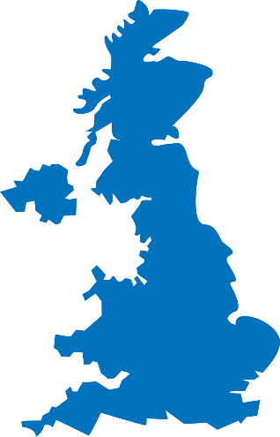
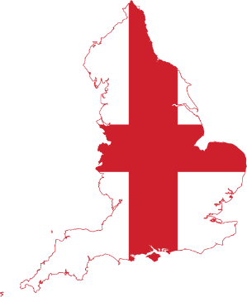
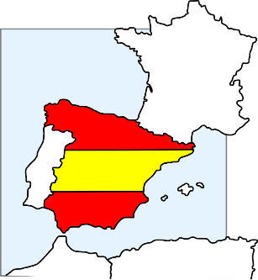
Está en Inglaterra.
¿Dónde está Granada?
Está en España.
hablar
Notes:
In this series of slides we extend practice of phonics to names of cities (with lots of 'a' and not too many other tricky SSCs) - and ask ¿Dónde está? - answers will be Inglaterra / España. Ask students to pronounce the English towns in a Spanish way - see what they come up with (a good way to assess some prior knowledge of phonics/Spanish).
We need to deal explicitly with the fact that 'está' stands for two words in English, here - it and is.
In the verb slides, we translate 'está' as 'is' and then show it with subjects Madrid and Pablo. Here we see it for the first time meaning 'it is'
As Inglaterra and España are key vocabulary from week 1, these slides at this point ask about the location of different cities (which are either in England or Spain) - just a few but to practise chorally - teacher-fronted. This will provide another useful practice opportunity for both está and the two countries. A couple of the places aren't obvious, so there is genuinely new/surprising info added in here. Note that ‘rr’ and ‘ñ’ are new SSC. Some brief attention will need to be given to RR in Inglaterra and Ñ in España, before they are more formally introduced and practised. It can be quite fun for students to practise rolling the RR! And if students can say ‘lasagne’ they can say ‘España’.

Slide 3
¿Dónde está Córdoba?
Está en Inglaterra.
Está en España.
hablar

Slide 4
Está en Inglaterra.
¿Dónde está Camborne?
Está en España.
hablar
Notes:
After revealing the answer, ask students to pronounce Camborne in a Spanish way - see what they come up with (a good way to assess some prior knowledge of phonics/Spanish).

Slide 5
Está en Inglaterra.
¿Dónde está Pamplona?
Está en España.
hablar

Slide 6
Está en Inglaterra.
¿Dónde está Kendal?
Está en España.
hablar

Slide 7
Está en Inglaterra.
¿Dónde está Salamanca?
Está en España.
hablar

Slide 8
Está en Inglaterra.
¿Dónde está Aspatria?
Está en España.
hablar

Slide 9
Está en Inglaterra.
¿Dónde está Maldon?
Está en España.
hablar

Slide 10
Está en Inglaterra.
¿Dónde está Soria?
Está en España.
hablar

Slide 11
Está en Inglaterra.
¿Dónde está Cantabria?
Está en España.
hablar

Slide 12
Vocabulary [2]
Author name(s): Victoria Hobson, Rachel Hawkes
Date updated: 10.01.2020

Slide 13
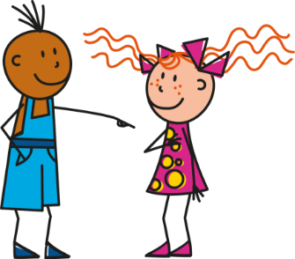
¡A escribir!
1
Estás en España.
Victoria Hobson
Notes:
This writing activity practises both the vocabulary and grammar for Week 1.
NB Since estoy, estás and está appear in the same activity, this is intended for use once students have already done plenty of practice of these forms in pairs (see the full weekly lesson resource).
Students use mini whiteboards to write the sentences generated by the images.
Vocabulary: dónde [161]; estar [21]; estoy; estás; está; en [5]; Inglaterra [proper noun - N/A]; España [proper noun - N/A]; norte [624]; sur [661]
Source: Davies, M. & Davies, K. (2018). A Frequency Dictionary of Spanish: Core vocabulary for learners (2nd ed.) London: Routledge.

Slide 14
¡A escribir!
2
Estás en el norte.
Victoria Hobson
Notes:
Students use mini whiteboards to write the sentences generated by the images.

Slide 15
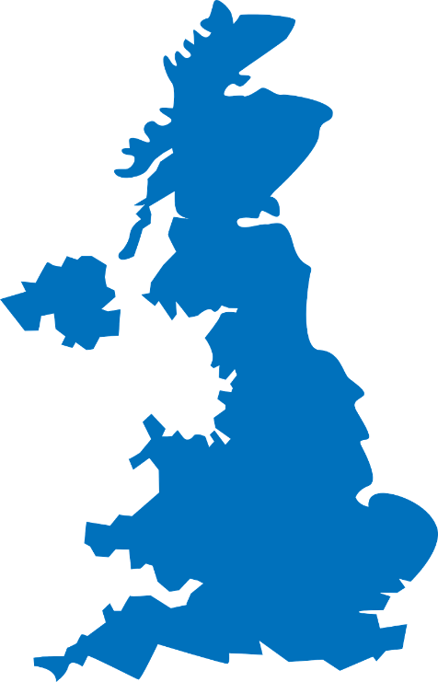
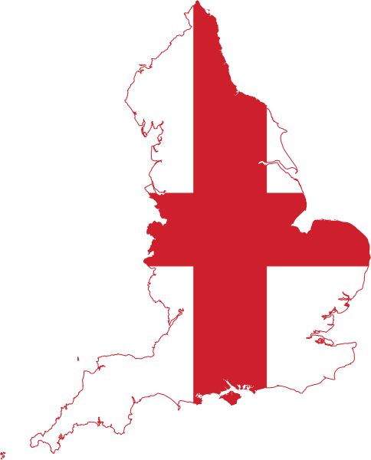
İA escribir!
3
Estoy en Inglaterra.
Victoria Hobson
Notes:
Students write the sentences generated by the images in exercise books/mini-whiteboards.

Slide 16
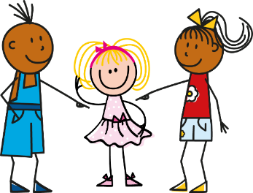
¡A escribir!
4
Madrid
Está en Madrid.
Victoria Hobson

Slide 17
¡A escribir!
5
S
Estoy en el sur.
Victoria Hobson
Notes:
Students use mini whiteboards to write the sentences generated by the images.

Slide 18
¡A escribir!
6
Granada
Estoy en Granada.
Victoria Hobson
Notes:
Students use mini whiteboards to write the sentences generated by the images.

Slide 19
¡A escribir!
7
Estás en Inglaterra.
Victoria Hobson
Notes:
Students use mini whiteboards to write the sentences generated by the images.

Slide 20
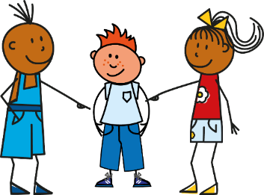
¡A escribir!
8
Está en España.
Victoria Hobson
Notes:
Students write the sentences generated by the images in exercise books/mini-whiteboards.

