Slide 1
Vocabulary
Y7 French
Term 1.2 - Week 2
Stephen Owen / Emma Marsden
Date updated: 27/04/20

Slide 2
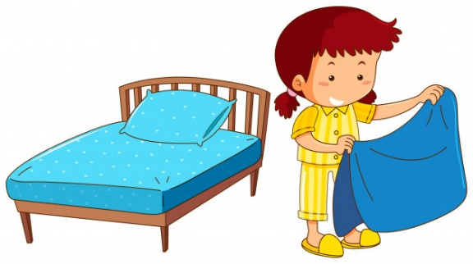
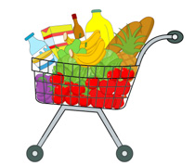
Exercise-faire
faire le lit
faire le modèle
faire le ménage
faire la cuisine
faire l’activité
faire les courses
faire les devoirs
Victoria Hobson & Stephen Owen
Notes:
These images remind students of the two previously-learnt translations of faire as ‘make’ and ‘do’.
Teachers can use this slide to revise the previously-presented vocabulary in a listen and repeat style.

Slide 3
The verb ‘faire’ – other meanings
However, faire is used with many other meanings in French:
faire un voyage
to go on a journey
faire une promenade
to go for a walk/ride
faire un tour
to go on a tour
faire les magasins
to go shopping
faire beau
to be nice weather
faire mauvais
to be bad weather
Victoria Hobson & Stephen Owen
Stephen Owen
Notes:
Some alternative meanings of ‘faire’ are now introduced. It is important to point out that the verb can variously be rendered as ‘go (on/for)’ and ‘be’ across these examples, the verb ‘faire’ in French covering all of these different meanings in these common collocations. The weather terms are covered with the infinitive for now, as they can of course be encountered in this form in natural language: e.g., ‘il va faire beau’. The impersonal use of ‘faire’ in these expressions will be discussed later. Instead of blanking out each term in turn to challenge learners to recall them (as has been done at times previously), a different set of activities designed to practise this vocabulary follows on the next sequence of slides.
As with all vocabulary sets in this scheme of work, ideally these terms will have been learned prior to the lesson with the aid of Quizlet, or similar.
Vocabulary
voyage [904], promenade [>5000], tour [523], magasin [1736], bateau [1287], beau [393], mauvais [274]
Source: Londsale, D., & Le Bras, Y. (2009). A Frequency Dictionary of French: Core vocabulary for learners London: Routledge.

Slide 4
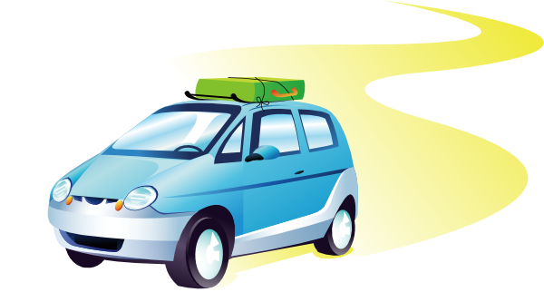
Exercise-faire
faire un voyage
faire une promenade
faire beau
faire les magasins
faire mauvais
faire un tour
faire une promenade en bateau
Victoria Hobson & Stephen Owen
Notes:
This slide presents the new and alternative uses of ‘faire’.
Teachers can use this slide to practise this vocabulary in a listen and repeat style.

Slide 5
faire un tour
Victoria Hobson & Stephen Owen
Notes:
Further vocabulary practice. This slide, along with the six slides which follow it, slowly reveal the image of one of the items of vocabulary just introduced. Learners can be challenged to guess the item (in French) at the earliest opportunity, gaining more ‘points’, for example, the earlier they do so.
The notes for each slide state the vocabulary item sought, e.g. (for this slide):
Faire un tour.

Slide 6
faire un voyage
Victoria Hobson & Stephen Owen
Notes:
Faire un voyage.

Slide 7
faire une promenade
Victoria Hobson & Stephen Owen
Notes:
Faire une promenade.

Slide 8
faire beau
Victoria Hobson & Stephen Owen
Notes:
Faire beau.

Slide 9
faire mauvais
Victoria Hobson & Stephen Owen
Notes:
Faire mauvais.

Slide 10
faire une promenade en bateau
Victoria Hobson & Stephen Owen
Notes:
Faire une promenade en bateau.

Slide 11
faire les magasins
Victoria Hobson & Stephen Owen
Notes:
Faire les magasins.

