Slide 1
Where people go [on holiday]
forms of 'à' with 'to' English equivalent meaning (à l'/aux)
SFe [revisited]
x-liaison
Y7 French
Term 2.2 - Week 2 - Lesson 41
Victoria Hobson / Stephen Owen / Natalie Finlayson
Artwork by: Chloé Motard
Date updated: 10/08/21
Notes:
Artwork by Chloé Motard. All additional pictures selected are available under a Creative Commons license, no attribution required.
Learning outcomes (lesson 1):
Introduction of forms of 'à' with 'to' English equivalent meaning (à la/au/à l'/aux)
Consolidation of SFe
Word frequency (1 is the most frequent word in French):
7.2.1.2 (introduce) aéroport [2113], étranger¹ [305], hôtel [1774], île [1245], université [1192], États-Unis [n/a], rarement [2535], souvent [287]
7.2.1.3 (revisit) avons [8], avez [8], ont [8], enfant [126], famille [172], problème [188], difficile [296], ici [167], très [66], aussi [44], pour¹ [10], dans [11]
7.1.2.5 (revisit) marcher [1532], manger [1338], préparer [368], regarder¹ [425], travailler [290], nous¹ [31], déjeuner [2724], film [848], maison [325], partenaire [1077], télé [2746], dehors [1217], préféré [préférer 597]
Source: Londsale, D., & Le Bras, Y. (2009). A Frequency Dictionary of French: Core vocabulary for learners London: Routledge.
The frequency rankings for words that occur in this PowerPoint which have been previously introduced in NCELP resources are given in the NCELP SOW and in the resources that first introduced and formally re-visited those words.
For any other words that occur incidentally in this PowerPoint, frequency rankings will be provided in the notes field wherever possible.

Slide 2
SFE
Silent final -e
[shy]
timide
Notes:
Timing: 1 minute
Aim: To consolidate SSC [SFE]
Procedure: 1. Present the letter(s) and say the [SFE] sound first, on its own. Students repeat it with you. 2. Bring up the word ”timide” on its own, say it, students repeat it, so that they have the opportunity to focus all of their attention on the connection between the written word and its sound.
3. A possible gesture for this would be to cower and cover one’s face slightly, simulating shyness. 4. Roll back the animations and work through 1-3 again, but this time, dropping your voice completely to listen carefully to the students saying the [SFE] sound, pronouncing ”timide” and, if using, doing the gesture.
Word frequency (1 is the most frequent word in French):
timide [3835]
Source: Londsale, D., & Le Bras, Y. (2009). A Frequency Dictionary of French: Core vocabulary for learners London: Routledge.

Slide 3
SFE
Silent final -e
timide
Notes:
With sound and no pictures to focus all attention on the sound-symbol correspondence.

Slide 4
SFE
Silent final -e
[shy]
timide
Notes:
Without sound to elicit pronunciation (without first hearing the teacher).
Teacher to elicit pronunciation by asking “Comment dit-on …"

Slide 5
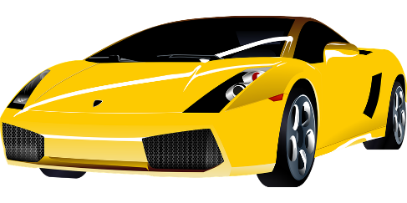
SFE
monde
moderne
[silent final –e]
[shy]
centre
timide
douze
vie
[life]
Notes:
Timing: 2 minutes
Aim: To consolidate SSC [SFE]
Procedure:
1. Introduce and elicit the pronunciation of the individual SSC [SFE] and then the source word again ‘timide’ (with gesture, if using). 2. Then present and elicit the pronunciation of the five cluster words.
The cluster words have been chosen for their high-frequency, from a range of word classes, with the SSC (where possible) positioned within a variety of syllables within the words (e.g. initial, 2nd, final etc.). Additionally, we have tried to use words that build cumulatively on previously taught SSCs (see the Phonics Teaching Sequence document) and do not include new SSCs. Where new SSCs are used, they are often consonants which have a similar symbol-sound correspondence in English.
Word frequency (1 is the most frequent word in French): monde [77]; moderne [1239] centre [491]; vie [132]; douze [1664]; timide [3835]. Source: Londsale, D., & Le Bras, Y. (2009). A Frequency Dictionary of French: Core vocabulary for learners London: Routledge.

Slide 6
SFE
monde
moderne
[silent final –e]
[shy]
centre
timide
douze
vie
Notes:
With sound and no pictures to focus all attention on the sound-symbol correspondence.

Slide 7
SFE
monde
moderne
[silent final –e]
[shy]
centre
timide
douze
vie
Notes:
Without sound to elicit pronunciation (without first hearing the teacher).
Teacher to elicit pronunciation by asking “Comment dit-on …"

Slide 8
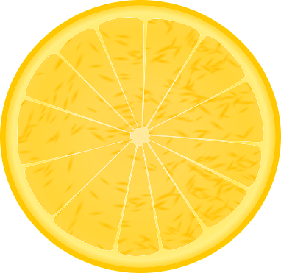
Phonétique
écouter
Phonétique
The ends of these words are hidden.
C’est la SSC [SFe] ?
[sour]
[degree]
aigre
degré
Notes:
Timing: 4 minutes for 6 slides
Aim: Aural recognition of SSC [SFe]
Procedure:
1. Click the images to play the audio.
2. Students choose which word has an SFe.
Word frequency (1 is the most frequent word in French):
aigre [>5000], degré [1311] Source: Londsale, D., & Le Bras, Y. (2009). A Frequency Dictionary of French: Core vocabulary for learners London: Routledge.

Slide 9
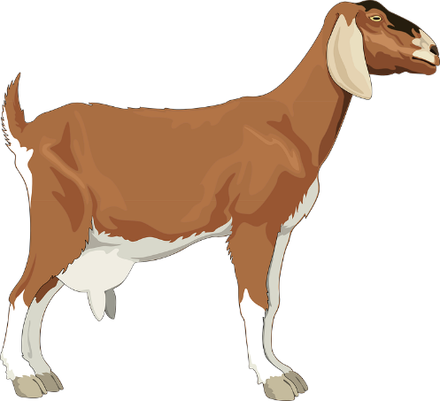
Phonétique
écouter
The ends of these words are hidden.
C’est la SSC [SFe] ?
[billy goat]
[sweet (f)]
bouc
douce
Notes:
Word frequency (1 is the most frequent word in French):
bouc [>5000], douce [>5000] Source: Londsale, D., & Le Bras, Y. (2009). A Frequency Dictionary of French: Core vocabulary for learners London: Routledge.

Slide 10
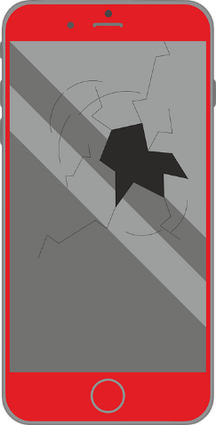
Phonétique
écouter
The ends of these words are hidden.
C’est la SSC [SFe] ?
[defect]
[jumps]
défaut
il saute
Notes:
Word frequency (1 is the most frequent word in French):
défaut [1276], sauter [2114] Source: Londsale, D., & Le Bras, Y. (2009). A Frequency Dictionary of French: Core vocabulary for learners London: Routledge.

Slide 11
Phonétique
écouter
The ends of these words are hidden.
C’est la SSC [SFe] ?
[besides]
[outraged]
outré
outre
Notes:
Word frequency (1 is the most frequent word in French):
outré [>5000], outre [974] Source: Londsale, D., & Le Bras, Y. (2009). A Frequency Dictionary of French: Core vocabulary for learners London: Routledge.

Slide 12
Phonétique
écouter
The ends of these words are hidden.
C’est la SSC [SFe] ?
[ink]
[to anchor]
encre
ancrer
Notes:
Word frequency (1 is the most frequent word in French):
encre [>5000], ancrer [4951] Source: Londsale, D., & Le Bras, Y. (2009). A Frequency Dictionary of French: Core vocabulary for learners London: Routledge.

Slide 13
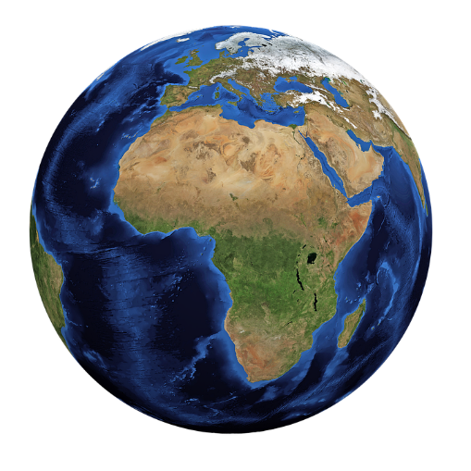
Phonétique
écouter
The ends of these words are hidden.
C’est la SSC [SFe] ?
[global]
[likable]
global
aimable
Notes:
Word frequency (1 is the most frequent word in French):
global [1155], aimable [4668] Source: Londsale, D., & Le Bras, Y. (2009). A Frequency Dictionary of French: Core vocabulary for learners London: Routledge.

Slide 14
Phonétique
écouter
The ends of these words are hidden.
C’est la SSC [SFe] ?
[useful]
[tool]
utile
outil
Notes:
Word frequency (1 is the most frequent word in French):
outil [1725], utile [1003] Source: Londsale, D., & Le Bras, Y. (2009). A Frequency Dictionary of French: Core vocabulary for learners London: Routledge.

Slide 15
Phonétique
parler
adulte
45
brise
ancêtre
breeze
aigle
ancestor
Secondes
viable
prendre
eagle
to take
cible
attendre
0
DÉBUT
target
to wait for
Notes:
Timing: 5 minutes for 3 slides.
Aim: Oral production of SSC [SFe] in a limited time.
Procedure:
1. In pairs, pupils read out the words to one another in alphabetical order. They keep going for one minute.
2. The listening student pays close attention to their partner’s pronunciation of the last sound in each word. If they hear ‘-e’, they must ask their partner to repeat the word three times.
3. Click on words to check pronunciation. Students repeat.
4. Clarify meanings of cognate words.
5. Move on to the follow slide to repeat the activity in a shorter space of time, increasing automisation.
Word frequency (1 is the most frequent word in French):
brise [>5000], adulte [1580], ancêtre [3067], aigle [>5000], prendre [43], viable [4946], attendre [155], cible [2740] Source: Londsale, D., & Le Bras, Y. (2009). A Frequency Dictionary of French: Core vocabulary for learners London: Routledge.

Slide 16
Phonétique
parler
adulte
30
brise
ancêtre
breeze
aigle
ancestor
Secondes
viable
prendre
eagle
to take
cible
attendre
0
DÉBUT
target
to wait for
Notes:
As previous, but with 15 fewer seconds on the timer.

Slide 17
Phonétique
parler
adulte
15
brise
ancêtre
breeze
aigle
ancestor
Secondes
viable
prendre
eagle
to take
cible
attendre
0
DÉBUT
target
to wait for
Notes:
As previous, but with 15 fewer seconds on the timer still.

Slide 18
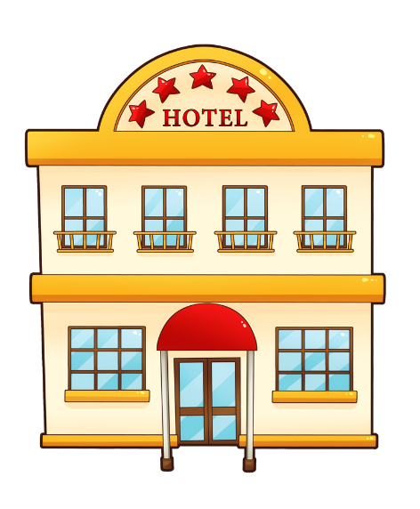
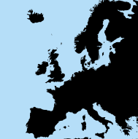
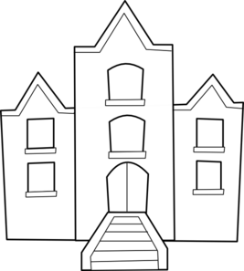
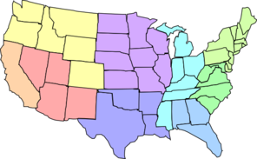
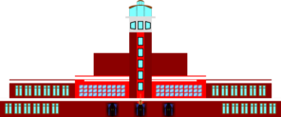
Vocabulaire
Souvent and rarement are adverbs. They come after the verb:
Je mange souvent à l’aéroport.
This is different from English:
I often eat at the airport.
lire
Je vais souvent aux États-Unis.
souvent
rarement
Il va rarement à l’étranger.
Je vais rarement à l’île.
Tu vas très rarement à l’hôtel.
Je mange très souvent à l’aéroport.
Je vais souvent à l’université.
l’hôtel (m)
l’île (f)
l'université (f)
l’étranger (m)
l'aéroport (m)
les États-Unis
Notes:
Timing: 8 minutes
Aim: Written recognition of words in this week’s vocabulary set at sentence level.
Procedure:
1. Begin by revising the nouns in this week’s set. Elicit oral translations of the English, and teacher-led pronunciation practice.
2. Click to bring up example sentences for students to translate orally or by using mini-whiteboards/ books to embed comprehension and illustrate the word order. Each time souvent and rarement appear, draw attention to the position of the adverb in the sentence.
3. Click to bring up the bubble with word order information/cross-linguistic comparison with English.

Slide 19
Saying ‘to (the)...’ in French
Saying ‘to (the)…’
grammaire
To say ‘to (the)... + noun’ in French, we use au or à la, according to whether the noun is masculine (au) or feminine (à la).
au parc
___
___
to the park
à la caisse
to the checkout
Because the -x in aux is followed by a vowel, it is pronounced like the English ‘z’.
This is a liaison.
If the noun begins with a vowel or h, we use à l’ for masculine and feminine:
___
à l’ île
to the island
___
à l’ aéroport
to the airport
___
à l’ hôtel
to the hotel
à l’ université
to the university
___
If the noun is plural, we use aux for both masculine and feminine nouns:
aux îles
___
to the islands
aux États-Unis
to the USA
___
Stephen Owen
Notes:
Timing: 3 minutes
Aim: To recap au/à la and introduce à l’/aux
Procedure:
Teacher to draw attention to the liaison in ‘aux États-Unis’ and ‘aux îles.’ This is practised further in the slides that follow.
Explain that because ‘États’ (states) is plural, the name of the country needs ‘aux’.

Slide 20
La liaison avec ‘aux’
La liaison avec ‘aux’
parler
La liaison avec ‘aux’
Il va aux hôtels.
He goes/is going to the hotels.
Notes:
Timing: 2 minutes for 4 slides.
Aim: Pronunciation practice with ‘aux’ + liaison.
Procedure:
1. Listen and repeat.
2. Ask students to translate the sentence.
3. Reveal picture on a click, ask students to check their translations.
4. Reveal English translation on click.

Slide 21
La liaison avec ‘aux’
La liaison avec ‘aux’
parler
La liaison avec ‘aux’
Je vais aux États-Unis.
I go/am going to the USA.

Slide 22
La liaison avec ‘aux’
La liaison avec ‘aux’
parler
La liaison avec ‘aux’
Elle va aux aéroports
She goes/is going to the airports.

Slide 23
La liaison avec ‘aux’
La liaison avec ‘aux’
parler
La liaison avec ‘aux’
Tu vas aux universités.
You go/are going to the universities.

Slide 24
Qui va où ?
lire
Qui va où ?
Qui va où?
Lis les phrases. Coche la réponse correcte.
1 | Je vais aux | hôtels
 |  | aéroport
2 | Il va à l’ | étranger
 |  | universités
3 | Elle va à l’ | États-Unis
 |  | hôtel
4 | Tu vas aux | îles
 |  | étranger
5 | Je vais aux | parcs
 |  | île
6 | Tu vas aux | hôtel
 |  | collèges
7 | Il va à l’ | aéroport
 |  | États-Unis
8 | Elle va à l’ | île
 |  | poste
Notes:
Timing: 5 minutes
Aim: Written recognition of à l’ and aux and connecting this with meaning.
Procedure:
Students write 1-8 and the appropriate noun, using their knowledge of à l’ and aux to guide them.
Teacher to elicit responses by asking e.g. Je vais où ? to elicit the response Je vais aux hôtels. This way, students practise pronunciation of ‘aux + liaison’.
During the feedback, teachers should check understanding by eliciting the meanings of the different persons indicated by the verb aller, which were learned in the previous sequence of lessons.
Word frequency of cognates used (1 is the most frequent word in French): correct [2617]
Source: Londsale, D., & Le Bras, Y. (2009). A Frequency Dictionary of French: Core vocabulary for learners London: Routledge.

Slide 25
Qui va quand, où, comment ?
Qui va quand, où et comment?
lire
The definite article ‘le’ before days of the week means ‘on’ or ‘at’
le samedi – on Saturday
le week-end – at the weekend
Lis les phrases et les réponses. C’est quoi la question? Écris ‘quand’, ‘où’ ou ‘comment’.
 | Réponse | Quand / où / comment? | Réponse
1 | Je vais aux hôtels. |  | À Paris.
2 | Il va à l’étranger. |  | En train.
3 | Elle va à l’hôtel. |  | Le samedi.
4 | Tu vas aux îles. |  | En bateau.
5 | Je vais aux parcs. |  | Dehors.
6 | Tu vas aux collèges. |  | Dans une semaine.
7 | Il va à l’aéroport. |  | En voiture.
8 | Elle va à l’île. |  | Le week-end.
Où ?
Comment ?
Quand ?
Comment ?
Où ?
Quand ?
Comment ?
Quand ?
Notes:
Timing: 5 minutes
Aim: Written recognition of question words où, quand and comment in appropriate contexts.
Procedure:
Students read the questions and answers and decide which question word bridges the gap.
Answers revealed on clicks.
Click once more to bring up a bubble drawing attention to the use of the definite article with days of the week (this point will be explored further in Year 8).

Slide 26
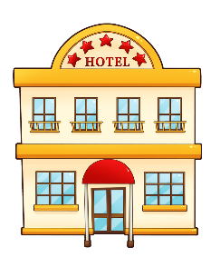
Qui va où ?
Qui va où?
écouter / écrire
Qui va où ?
1
5
2
6
3
7
4
8
Notes:
Timing: 5 minutes
Aim: Aural recognition of à la and aux and connecting this with meaning.
Procedure:
Audio (with the noun obscured) plays on clicking individual numbers.
Teacher to remind students that aux/à l’ tell us the meaning – singular or plural. Students decide based on this which noun is missing.
Answers revealed on clicks. The full audio (including nouns) may be found on the next slide.
Optional extension: To add complexity to the activity, the teacher may wish to ask students to write down the verb forms they hear. Answer slides with and without this additional element are provided in the slides that follow.
Transcript:
1) Tu vas à l’ [aéroport]
2) Il va aux [îles]
3) Je vais aux [États-Unis]
4) Elle va à l’ [hôtel]
5) Je vais aux [universités]
6) Tu vas aux [hôtels]
7) Il va à l [étranger]
8) Elle va à l’ [’île]

Slide 27
Qui va où ? (réponses)
Qui va où? Réponses
écouter / écrire
Qui va où ? (réponses)
1
5
2
6
3
7
4
8
Notes:
Answers to the activity on the previous slide. Full audio (including the noun) plays on clicking individual numbers.
TRANSCRIPT
1) Tu vas à l’aéroport.
2) Il va aux îles.
3) Je vais aux États-Unis.
4) Elle va à l’hotel.
5) Je vais aux universités.
6) Tu vas aux hotels.
7) Il va à l’étranger.
8) Elle va à l’île.

Slide 28
Qui va où ? (réponses)
Qui va où? Réponses
écouter / écrire
Qui va où ? (réponses)
1
tu vas
5
je vais
2
il va
6
tu vas
3
je vais
7
il va
4
8
elle va
elle va
Notes:
Answers to the optional extension on slide 22. Full audio (including the noun) plays on clicking individual numbers.
Transcript
1) Tu vas à l’aéroport.
2) Il va aux îles.
3) Je vais aux États-Unis.
4) Elle va à l’hotel.
5) Je vais aux universités.
6) Tu vas aux hotels.
7) Il va à l’étranger.
8) Elle va à l’île.

Slide 29
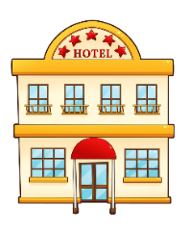
Qui fait un voyage ? (partenaire A)
Qui fait un voyage?
écouter / écrire / parler
Qui fait un voyage ?
Partenaire A
1) I go to the hotel …………………………………………………
2) He goes to the USA …………………………………………………
3) You go to the islands …………………………………………………
4) She goes to the airport …………………………………………………
5) I go to the universities …………………………………………………
6) You go abroad …………………………………………………
1)………………………. | 2)………………………..
3)……………………….. | 4)………………………..
5)………………………… | 6)………………………..
Notes:
Timing: 10 minutes for 4 slides
Aim: Oral and written production of forms of aller and à.
Partner A’s sheet.
Procedure:
Students translate their six sentences into French. NB Explain to students clearly that the set of pictures on their sheet does not match up to their own sentences, these are to record answers when listening to their partner.
Students take it in turns to say one sentence at a time to their partner BUT they must not say the subject pronoun or the place in French, ONLY the correct part of the verb aller and the à l’ or aux. (E.g. partner A would say 1) vais à l’)
The partner who is listening writes the correct subject pronoun in French, dependent on the verb they have heard, and plus ticks the correct place, depending on the form of ‘to the’ they have heard. (E.g. partner B would write ‘je’ and tick the picture of the hotel, not the universities.)
(Note the aux will trigger a liaison in all of these sentences, as per the input activities. Pronunciation practice of aux without liaison is featured in the following lesson.)

Slide 30
Qui fait un voyage ? (partenaire B)
Qui fait un voyage?
écouter / écrire / parler
Qui fait un voyage ?
Partenaire B
1) He goes to the island ………………………………………………….
2) You go to the airports ………………………………………………….
3) I go to the hotels ………………………………………………….
4) You go to the USA ………………………………………………….
5) I go abroad ………………………………………………….
6) She goes to the university ………………………………………………….
1)………………………. | 2)………………………..
3)……………………….. | 4)………………………..
5)………………………… | 6)………………………..
Notes:
Partner B’s sheet.

Slide 31
Qui fait un voyage ?
Qui fait un voyage? Réponses
écouter / écrire / parler
Qui fait un voyage ?
Partenaire A
Partenaire B
1) I go to the hotel ………………………………………
2) He goes to the USA ………………………………………
3) You go to the islands ………………………………………
4) She goes to the airport ………………………………………
5) I go to the universities ………………………………………
6) You go abroad ………………………………………
1) He goes to the island …………………………………………
2) You go to the airports …………………………………………
3) I go to the hotels ………………………………………
4) You go to the USA …………………………………………
5) I go abroad …………………………………………
6) She goes to the university …………………………………………
(Je) vais à l’ (hôtel).
(Il) va à l’ (île).
(Il) va aux (États-Unis).
(Tu) vas aux (aéroports).
(Tu) vas aux (îles).
(Je) vais aux (hôtels).
(Elle) va à l’ (aéroport).
(Tu) vas aux (États-Unis).
(Je) vais aux (universités).
(Je) vais à l’ (étranger).
(Tu) vas à l’ (étranger).
(Elle) va à l’ (université).
Notes:
Teachers can show this slide for students to check the accuracy of their written sentences to close the activity.

Slide 32
Qui fait un voyage ?
écouter / écrire / parler
Qui fait un voyage ?
Partenaire A
Partenaire B
tu
je
il
1)………………………. | 2)………………………..
3)……………………….. | 4)………………………..
5)………………………… | 6)………………………..
1)………………………. | 2)………………………..
3)……………………….. | 4)………………………..
5)………………………… | 6)………………………..
il
je
tu
tu
elle
je
tu
je
elle
Notes:
Answers
Then teachers can use this slide to show correct versions of the students’ response grids as a quick way for students to see if they succeeded in the pairwork task.

Slide 33
Where people go [on holiday]
forms of 'à' with 'to' English equivalent meaning (à la/au/à l'/aux)
SFe [revisited]
x-liaison
Y7 French
Term 2.2 - Week 2 - Lesson 42
Victoria Hobson / Stephen Owen / Natalie Finlayson
Artwork by: Chloé Motard
Date updated: 09/07/21
Notes:
Artwork by Chloé Motard. All additional pictures selected are available under a Creative Commons license, no attribution required.
Learning outcomes (lesson 1):
Introduction of forms of 'à' with 'to' English equivalent meaning (à la/au/à l'/aux)
Consolidation of SFe
Word frequency (1 is the most frequent word in French):
7.2.1.2 (introduce) aéroport [2113], étranger¹ [305], hôtel [1774], île [1245], université [1192], États-Unis [n/a], rarement [2535], souvent [287]
7.2.1.3 (revisit) avons [8], avez [8], ont [8], enfant [126], famille [172], problème [188], difficile [296], ici [167], très [66], aussi [44], pour¹ [10], dans [11]
7.1.2.5 (revisit) marcher [1532], manger [1338], préparer [368], regarder¹ [425], travailler [290], nous¹ [31], déjeuner [2724], film [848], maison [325], partenaire [1077], télé [2746], dehors [1217], préféré [préférer 597]
Source: Londsale, D., & Le Bras, Y. (2009). A Frequency Dictionary of French: Core vocabulary for learners London: Routledge.
The frequency rankings for words that occur in this PowerPoint which have been previously introduced in NCELP resources are given in the NCELP SOW and in the resources that first introduced and formally re-visited those words.
For any other words that occur incidentally in this PowerPoint, frequency rankings will be provided in the notes field wherever possible.

Slide 34
On écoute
Elle fait quoi ?
écouter / écrire
Écoute et écris les phrases.
Salut!
La femme
L’amie
1
Elle parle à l’homme.
3
Elle porte une chemise bleue.
Elle étudie l’histoire.
4
Elle aime l’uniforme moderne.
2
Notes:
Timing: 5 minutes
Aim: Transcription of known vocabulary containing SFe in short sentences.
Procedure:
1. Students listen to the sentences and transcribe what they hear. This activity moves students on from the cluster words, asking them to recall previously taught vocabulary which illustrates the SFe. Though they should, in theory, know the spellings of these words, the short time frame in addition to lack of an aural hint poses challenges.
2. The answers are revealed on clicks.
3. Teachers should ask students for meanings in English to reinforce vocabulary knowledge.
Transcript
Elle parle à l’homme.
Elle étudie l’histoire.
Elle porte une chemise bleue.
Elle aime l’uniforme moderne.

Slide 35
On parle !
On parle !
parler
Partenaire A
drôle | intéressante | timide
grande | la femme | sage
stricte | calme | triste
 | l’amie
Rachel Hawkes
Notes:
Timing: 5 minutes for 3 slides
Aim: Oral production of known words containing SFe.
Procedure:
1. Students take it in turns to say full sentences to their partner, starting with the adjective in the top left. E.g. partner A says to partner B: ‘La femme est drôle’
2. Partner B then writes down the adjective in the top left box. The order should then go round clockwise. This will allow students to easily check their answers against the master which will be displayed during the feedback.
3. Point out to students that all the adjectives are in the feminine form. This will can be further explored at the end of the activity, should teachers find it helpful.

Slide 36
On parle !
On parle !
parler
Partenaire B
 | la femme
petite | méchante | amusante
intelligente | l’amie | malade
excellente | contente | drôle
Notes:
Partner B’s sheet.

Slide 37
On parle !
On parle !
parler
drôle | intéressante | timide
grande | la femme | sage
stricte | calme | triste
petite | méchante | amusante
intelligente | l’amie | malade
excellente | contente | drôle
funny
interesting
shy
big
well-behaved
strict
calm
sad
Rachel Hawkes
Notes:
Answers to the activity on the previous slide.
Procedure:
1. The teacher can display this slide to close the activity as a way for students to check their answers.
2. The teacher could also choose to elicit meanings in English from students to maximise vocabulary consolidation. (English translations appear on clicks.)
3. Finally: a circle appears on a final click around the adjectives where the feminine version has changed spelling. Ask students what these adjectives have in common. This is a way to make quick reference to the pronunciation change in the feminine form which illustrates the Sfe, while reminding students that these adjectives also have a masculine form and the loss of the –e will change the pronunciation to SFC. If teachers want to practise this particular SSC at a future date to revise the differences between pronunciations of masculine and feminine forms, then the activity could be repeated with: l’homme and l’ami as the middle words.
Note:
Differentiation option (for lower ability levels): teachers could use this slide as a student worksheet. Partner A gives sentences (in a random order) starting ‘La femme est…’ / Partner B gives sentences starting ‘L’amie est…’
The partner listening would highlight/tick off/number the adjectives as they are heard (and translate into English). Partner A could keep a record of the order so as not to repeat a word and have something to compare with their partner at the end of the activity. Partner A could write the English as they go.

Slide 38
Vocabulaire
Vocabulaire
parler / écrire
l'hôtel (m)
l’île (f)
l'université (f)
l’étranger (m)
l'aéroport (m)
les États-Unis
Notes:
Timing: 3 minutes
Aim: Written and oral production of pre-learnt vocabulary pertaining to highly frequent places.
Procedure:
1. Three items disappear three at a time on clicks.
2. Students are challenged to name the missing three each time.
3. Students write down the missing words down in their exercise books or on mini-whiteboards.
4. The spoken form is elicited. This activity could be done as whole class choral response or in pairs. Teachers/students point to a picture and ask ‘C’est quoi?’
5. In the final round, all six items disappear to challenge students to recall all this week’s nouns. This takes place after four sets of three.

Slide 39
Vocabulaire
problème
avez
partenaire
regardons
difficile
avons
marchons
famille
ont
avec
maison
préparons
travaillons
travaillons
Nous préparons le déjeuner pour la famille.
Ici à la maison nous regardons des films à la télé.
Nous travaillons avec un partenaire.
C’est un problème difficile.
Nous marchons dehors; nous travaillons dehors aussi.
Ils ont une maison très moderne.
Vous avez un problème avec la famille.
Nous avons des fruits dans la salle de classe pour les enfants.
We prepare/are preparing lunch for the family.
Here at home we watch/are watching films on the tv.
We work/are working with a partner.
It’s a difficult problem.
We walk/are walking outside; we also work/are working outside.
They have a very modern house.
You have a problem with the family.
We have some fruit in the classroom for the children.
Notes:
Timing: 10 minutes
Aim: Written recognition of revisited vocabulary
Procedure:
1. Students should fill in vocabulary gaps and try to translate the sentences.
2. The boxes disappear on a click to reveal the missing word.
3. Once all words are revealed, translations appear on clicks.
4. When completing the translation exercise, the teacher should draw attention to the English tense – both present simple and continuous are possible. (one tense in French = two in English).

Slide 40
Saying ‘to (the)...’ in French
Saying ‘to (the)…’
grammaire
We have learned that aux means ‘to the’ for both masculine and feminine plural nouns:
aux États-Unis
to the USA
aux îles
to the islands
If the noun does not begin with h- or a vowel, we do not make a liaison, so aux sounds the same as au:
Remember!
This is not the case for feminine nouns.
In the singular you need à la. In the plural you need aux
(these do sound different).
à la caisse – to the checkout
aux caisses – to the checkouts
aux parcs
to the parks
aux caisses
to the checkouts
This means that it is not possible to tell the difference when listening to masculine singular and masculine plural:
au parc
to the park
aux parcs
to the parks
Stephen Owen
Notes:
Timing: 3 minutes
Aim: To highlight the fact that while aux is used for all plural nouns, its pronunciation changes depending on whether the noun begins with a vowel, an h-, or a consonant.

Slide 41
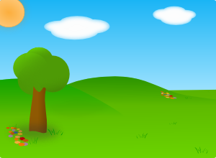
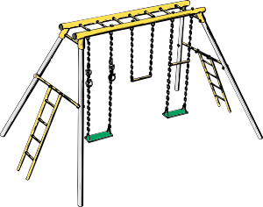
Au ou aux ?
Au ou aux ?
écouter / écrire
Au ou aux ?
aux parcs
Notes:
Timing: 5 minutes for 8 slides
Aim: To connect the spoken and written forms of au and aux, raising awareness of the fact that they sometimes sound the same.
Procedure:
1. Students hear the word ‘to the’ (e.g., aux).
2. At the same time, a circle appears around the picture to indicate whether it indicates singular or plural.
3. Students now write the correct form. Then, click again so that they see the correct written form that they should have written down.
4. Now ask students to write the other form. Emphasise that the pronunciation is the same for both.
5. Emphasise to students that this is only the case with masculine nouns beginning with a consonant other than h, and remind them of à la for feminine singular.

Slide 42
Au ou aux ?
écouter / écrire
Au ou aux ?
Au ou aux ?
collège
collège
collège
au collège

Slide 43
Au ou aux ?
Au ou aux ?
écouter / écrire
Au ou aux ?
magasin
magasin
magasin
magasin
aux magasins

Slide 44
Au ou aux ?
écouter / écrire
Au ou aux ?
Au ou aux ?
Café
Café
Café
aux cafés

Slide 45
Au ou aux ?
écouter / écrire
Au ou aux ?
Au ou aux ?
Bar
Bar
Bar
au bar

Slide 46
Au ou aux ?
Au ou aux ?
écouter / écrire
Au ou aux ?
aux cinémas

Slide 47
Au ou aux ?
Au ou aux ?
écouter / écrire
Au ou aux ?
au monde

Slide 48
Au ou aux ?
Au ou aux ?
écouter / écrire
Au ou aux ?
au centre

Slide 49
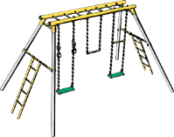
Attention! Two pronunciations:
Attention! Prononciation
grammaire
aux
aux
(before a plural noun,
beginning with a vowel or h-)
(before a plural noun,
beginning with a consonant)
Stephen Owen
Notes:
Timing: 3 minutes
Aim: Juxtaposition of aux in structures with and without liaison.
Procedure:
1. On clicking the large play buttons, the indicated version of ‘to the’ is heard.
2. On clicking the smaller play buttons, the name of a place is heard. Tell students these are examples of nouns they will hear after a particular pronunciation of aux. This recaps the grammar point in aural format ahead of the next listening.
3. Now explain to students you are going to practise hearing the difference between to the for plural nouns: before a vowel/h and before a consonant.
4. This grammar point can only be practised though listening.
Word frequency of cognates used (1 is the most frequent word in French): pronunciation [>5000]
Source: Londsale, D., & Le Bras, Y. (2009). A Frequency Dictionary of French: Core vocabulary for learners London: Routledge.

Slide 50
On va où ?
écouter
Qui va où ?
Coche la bonne réponse.
1
5
2
6
Bar
Bar
3
7
Café
Café
4
8
Notes:
Timing: 5 minutes
Aim: Oral recognition of aux with and without an SSC, and connecting these spoken forms with meaning.
Procedure:
1. Click on a number to hear a sentence with the noun obscured.
2. Students listen to the pronunciation of aux and use their knowledge of liaison patterns to determine the noun that follows.
Optional extension: at more advanced levels, invite students to also indicated how often the people visit these places, drawing their attention to the adverbs of frequency.
3. Answers revealed on clicks.
4. Full audio, with the noun included, can be found on the slides that follow.
Transcript
Je vais souvent aux [îles]
Il va rarement aux [collèges]
Elle va très souvent aux [magasins]
Tu vas très rarement aux [hotels]
Je vais souvent aux [parcs]
Tu vas très souvent aux [caisses]
Elle va rarement aux [aéroports]
Il va souvent aux [universités]

Slide 51
On va où ?
écouter
Qui va où ?
Coche la bonne réponse.
écouter
1
5
2
6
Bar
Bar
3
7
Café
Café
4
8
Notes:
Answers to the activity on the previous slide.
Click on the number to play the sentence in full.
Transcript
je vais souvent aux îles.
il va rarement aux collèges.
elle va très souvent aux magasins.
tu vas très rarement aux hotels.
je vais souvent aux parcs.
tu vas très souvent aux caisses.
elle va rarement aux aéroports.
il va souvent aux universités.

Slide 52
On va où ?
écouter
Coche la bonne réponse.
Aussi, c’est souvent ou rarement ?
Qui va où ?
écouter
often
often
1
5
very often
2
rarely
6
very often
Bar
Bar
3
7
rarely
very rarely
Café
Café
4
8
often
Notes:
Differentiated version of the answers to the activity on slide 50 which also gives the adverbs of frequency.
Click on the number to play the sentence in full.

Slide 53
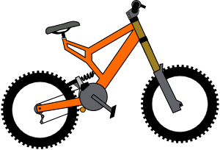
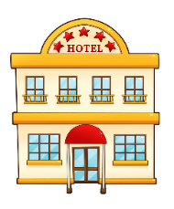
On parle !
On parle !
écouter / écrire / parler
Example – partenaire A
Qui ?
1. Où ?
2. Comment ?
3. Quand ?
en vélo
aux -----
rarement
tu
rarely
Example – partenaire B
Tu vas quand ?
Tu vas où ?
Tu vas comment ?
rarely
tu
by bike
Tu vas rarement aux États-Unis en vélo.
Notes:
Timing: 10 minutes for 4 slides
Aim: Oral production of questions with où ?, comment ? and quand ? and answers with aux/à l’ and adverbs of frequency/time.
Procedure:
1. Partner A asks Partner B the following questions (allowing Partner B to answer each time): Il va où ? Il va comment ? Il va quand ?
2. Partner A then writes down Partner B’s answers to each question in turn, in note form in English, in the spaces provided in the table (see Partner B’s information on the next slide).
3. Partner A then does the same with the second row of the table, asking Elle va où ? (etc.)
4. Partner B then asks the same questions about the third and fourth lines of the table, saying Je vais où ? and Tu vas où ?, for example.
5. Partner A gives the relevant information as shown on this slide, which Partner B writes down.
NB To force students to think very carefully in their production and listening, the student must not say the place name – just the word for ‘to the.’ It is up to the person listening to then determine which the correct place must be. This is modelled in this example slide.
As a culmination to the learning, when students’ grids are complete, they must then write the four sentences. This will embed not only the vocabulary (including the singular forms of the verb aller), the aux/ à l’ but also the position of the adverb. The answers are displayed on the subsequent feedback slide.

Slide 54
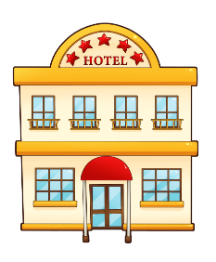
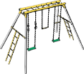
On parle !
On parle !
écouter / écrire / parler
Partenaire A
Qui ?
1. Où ?
2. Comment ?
3. Quand ?
il
elle
je
rarely
tu
often
Notes:
Partner A’s grid.
Instructions explained on the example slide.

Slide 55
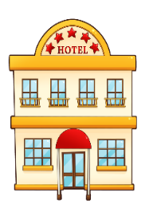
On parle !
On parle !
écouter / écrire / parler
Partenaire B
Qui ?
1. Où ?
2. Comment ?
3. Quand ?
il
often
elle
rarely
je
tu
Notes:
Partner B’s grid.
Instructions explained on the example slide.

Slide 56
On écrit !
On écrit !
écrire
il va souvent à l’étranger en bateau.
il
often
elle va rarement aux îles en train.
elle
rarely
je vais rarement à l’aéroport en train.
je
rarely
tu vas souvent aux hôtels en voiture.
often
tu
Notes:
Answers for the activity on slides 53-55.
Procedure:
Teachers can use this slide to check students’ written responses.
Also, teachers will be able to have some interesting dialogues about the places – why it had to be the picture ticked – to further explore the learning around: aux (with the two different pronunciations) / à l’.
E.g. how did students know which plural picture to choose in numbers 2&4?

Slide 57
Écris en français !
Écris en français !
écrire
Questions
Write 3 different questions in French for your partner, using the words below:
où – comment – quand - à l’étranger – aux magasins – au collège - à la maison
E.g. Tu vas aux magasins quand ?
1.
E.g. Tu vas à la maison comment ?
E.g. Tu vas où ?
2.
E.g. How do you go (get) home?
E.g. Where are you going?
E.g. When do you go to the shops?
3.
Réponses
Answer in French (in full sentences) the 3 questions which your partner has prepared for you!
Here are some other words you may find useful:
souvent – rarement – chaque semaine – aujourd’hui – le week-end
E.g. Je vais aux magasins chaque semaine.
1.
E.g. Je vais à la maison en vélo.
E.g. Je vais au collège.
2.
E.g. I go (get) home by bike.
E.g. I go to the shops every week.
E.g. I am going to school.
3.
Notes:
Optional extension activity.
Timing: 5 minutes
Aim: Written production of questions with où ?, comment ? and quand ? and answers with aux/à l’ and adverbs of frequency/time.
Procedure:
Teachers could choose to add a speaking element to this activity for higher ability pupils. After preparing the questions, students take turns to ask each other the questions. The student listening has to say their response in a full sentence, striving for grammatical accuracy. Partner A would write down partner B’s response in English on their sheet. A back translation task could follow whereby the sentence in English is translated back into French by the listener.
Students will need to be reminded of the position of the adverbs: rarement/souvent after the verb; le week-end / aujourd’hui / chaque semaine at the end of the sentence.
This also offers the teacher the chance to remind students of the two different translations into English of the present tense: I go / am going; you go/are going.

Slide 58
Écris en français !
Écris en français !
écrire
Questions
Write 3 different questions in French for your partner, using the words below:
où – comment – quand - à l’étranger – aux magasins – au collège - à la maison
1.
2.
3.
Réponses
Answer in French (in full sentences) the 3 questions which your partner has prepared for you!
Here are some other words you may find useful:
souvent – rarement – chaque semaine – aujourd’hui – le week-end
1.
2.
3.
Notes:
Student worksheet

Slide 59
Gaming Grammar
Gaming Grammar
Relevant mini game(s):
Verbs (present): 1st person singular/plural (Verb agreement (present))
Verbs (present): 2nd person singular/plural (Verb agreement (present))
Verbs (present): 3rd person singular/plural (Verb agreement (present))
Prepositions (to the): Gender (Prepositions)
Notes:
This slide links to Gaming Grammar login screen. The appropriate mission can then be selected from the menu page.
Students will progress through the game at their own rate; teachers should use the teacher interface to check progress. This will help to inform future lesson planning.

Slide 60
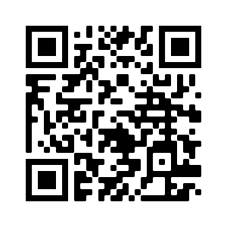
Devoirs
Vocabulary Learning Homework (Term 2.2, Week 3)
Audio file
Audio file QR code:
Student worksheet
Quizlet link
In addition, revisit: Term 2.1 Week 4
Term 1.2 Week 6

