Slide 1
Grammar
SAVOIR in the 1st, 2nd, 3rd persons singular
Y7 French
Term 3.1 - Week 5
Kirsten Somerville / St James’ Hub / Natalie Finlayson
Date updated: 07/05/20
Notes:
Learning outcomes (lesson 1)
Introducing the first, second and third person singular forms of savoir meaning ‘to know how to’

Slide 2
Using the verb ‘savoir’ – to know
You have seen this pattern of –s, -s, -t, -t endings before:
dire, sortir and venir also follow this pattern.
grammaire
This is the pattern of endings for the first, second and third person singular forms of savoir:
We can’t say to know in the present continuous. To ‘know how to’ do something is something that is generally true, not an action you do at a particular time.
je sais
I know how to
tu sais
you know how to
il sait
he knows how to
These verb forms all sound the same!
The –s on the je and tu forms is a silent final consonant (SFC)
elle sait
she knows how to
Notes:
The first three persons singular of the verb savoir are now presented. Make students aware of the fact that, like the verbs practised in the previous exercise, the three forms here all sound the same in French.

Slide 3
Using the verb ‘savoir’ – to know
grammaire
Remember! The infinitive comes after the subject pronoun in inversion questions.
As you know, when there are two verbs in a French sentence, the second verb is in infinitive:
Il aime parler français.
He likes to speak French.
He likes speaking French.
With aimer, we can translate the infinitive with to or –ing. With savoir, an –ing translation is not possible.
Aimes-tu parler français ?
Do you like to speak French?
Do you like speaking French?
This is also the case for savoir:
These verb forms all sound the same!
The –s on the je and tu forms is a silent final consonant (SFC)
Il sait parler français.
He knows how to speak French.
Sais-tu parler français ?
Do you know how to speak French?

Slide 4
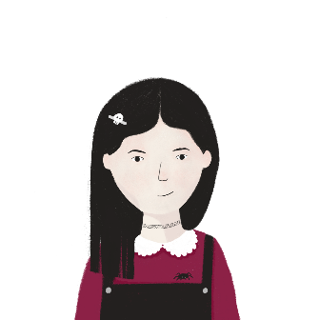
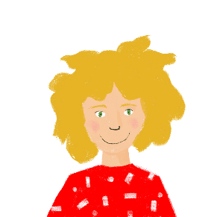
Léa et Sophie au collège
The je and elle forms of aimer are the same.
The je and elle forms of savoir are different!
lire
Léa écrit les matières qu’elle et Sophie aiment au collège.
Qui sait faire quoi ? Coche Léa (je) ou Sophie (elle).
 |  | Léa (je) | Sophie (elle)
 | Elle aime l’anglais ! Elle sait parler la langue.
 | Elle aime la technologie ! Elle sait faire le modèle.
 | J’ aime la géographie ! Je sais donner la réponse.
 | J’ aime la musique ! Je sais chanter.
 | Elle aime les maths ! Elle sait trouver la solution.
 | J’ aime le français ! Je sais écrire les mots.
 | J’ aime l’histoire ! Je sais apprendre les dates.
 | Elle aime les sciences ! Elle sait faire les devoirs.
1
2
3
4
5
These verb forms all sound the same!
The –s on the je and tu forms is a silent final consonant (SFC)
6
7
8
Notes:
In this reading activity, students identify the subject pronoun from the verb form.
Students write 1-8 and either Léa or Sophie. Translations can also be elicited. Highlight that a present continuous translation of savoir is not appropriate, as it describes a state.
The exercise includes previously taught vocabulary and two cognates, géographie [>5000] and technologie [1388].

