Slide 1
Phonics
SSC /ü/
Y7 German
Term 1.2 - Week 6
Inge Alferink / Rachel Hawkes

Slide 2
ü
[y:]
Tür
Notes:
Introduce and elicit the pronunciation of the individual SSC ‘ü’ and then present and practise the pronunciation of the source word ‘Tür’.
A possible gesture for this would be to hold both hands touching in front of your body, palms facing inward, thumbs to the ceiling. Then, with the right hand, mime a door opening by drawing it away from the left so that it finishes at a right angle, like a fully open door.

Slide 3
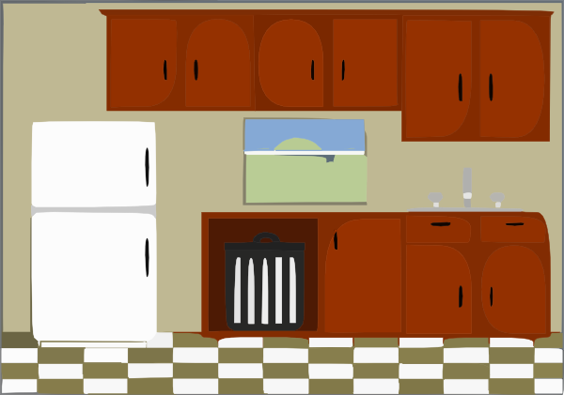
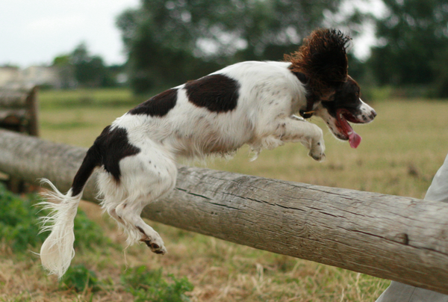
ü
fühlen
grün
Tür
Küche
über
früh
05:30!!!
Notes:
Introduce and elicit the pronunciation of the individual SSC ‘ü’ and then the source word again (with gesture, if using). Then present and elicit the pronunciation of the five cluster words. The cluster words have been chosen for their high-frequency, from a range of word classes, with the SSC (where possible) positioned within a variety of syllables within the words(e.g. initial, 2nd, final etc..) and additionally, we have tried to use words that build cumulatively on previously taught SSCs (see the Phonics Teaching Sequence document) and do not include new SSCs. Where new SSCs are used, they are often consonants which have a similar symbol-sound correspondence in English.
Word frequency rankings (1 is the most common word in German): Tür [400]; fühlen [419] grün [556]; Küche [960]; früh [322]; über [48]. Source: Jones, R.L. & Tschirner, E. (2006). A frequency dictionary of German: core vocabulary for learners. Routledge

Slide 4
ü
fühlen
grün
Tür
Küche
über
früh
Notes:
Audio but no pictures to focus on the sound-symbol relationship.

Slide 5
ü
fühlen
grün
Tür
Küche
über
früh
Notes:
No audio to elicit pronunciation from students.

Slide 6
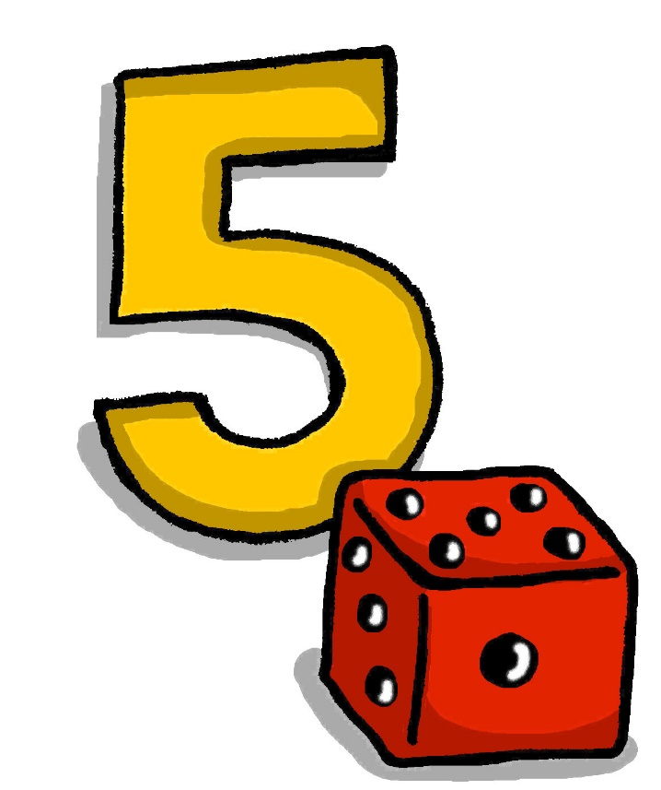
ü
[Y]
fünf
Notes:
Introduce and elicit the pronunciation of the individual SSC ‘ü’ and then present and practise the pronunciation of the source word ‘fünf’.
A possible gesture for this would be to hold up your right hand, five digits spread apart.

Slide 7
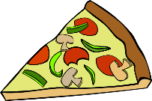
ü
Rücken
wünschen
[to wish]
fünf
Stück
Glück
[luck/happiness]
müssen
[to have to/must]
Notes:
Introduce and elicit the pronunciation of the individual SSC ‘ü’ and then the source word again (with gesture, if using). Then present and elicit the pronunciation of the five cluster words. The cluster words have been chosen for their high-frequency, from a range of word classes, with the SSC (where possible) positioned within a variety of syllables within the words(e.g. initial, 2nd, final etc..) and additionally, we have tried to use words that build cumulatively on previously taught SSCs (see the Phonics Teaching Sequence document) and do not include new SSCs. Where new SSCs are used, they are often consonants which have a similar symbol-sound correspondence in English.
Word frequency rankings (1 is the most common word in German): fünf [272]; Rücken [914] wünschen [684]; Glück [763]; müssen [45]; Stück [417]. Source: Jones, R.L. & Tschirner, E. (2006). A frequency dictionary of German: core vocabulary for learners. Routledge

Slide 8
ü
Rücken
wünschen
fünf
Stück
Glück
müssen
Notes:
Audio with text only to focus more closely on the sound-symbol relationship.

Slide 9
ü
Rücken
wünschen
fünf
Stück
Glück
müssen
Notes:
No audio to elicit responses from students.

Slide 10
U oder Ü?
hören
 | U | Ü
1
2
3
4
5
6
1
2
3
4
5
6
Notes:
Phonics contrast activity
Click on the number to play the audio
1. der Zug
2. die Nummer
3. die Tür
4. grün
5. putzen
6. wünschen

Slide 11
Schmückt den Saal mit grünen Zweigen! Fa-la-la-la-la-la-la-la-la!
Tretet an zum bunten Reigen!
Fa-la-la-la-la-la-la-la-la!
Auf und nieder, immer wieder!
Fa-la-la-la-la-la-la-la-la!
Singt die alten Weihnachtslieder!
Fa-la-la-la-la-la-la-la-la!
Notes:
Practising phonics in a real text. Note: lesson two includes a more detailed Christmas song covering the same SSCs. Depending on available time and how the students are getting on with these particular SSCs this activity could be left out.
Phonics ü sound. Speak the first two lines out loud drawing attention to the ü introduced earlier in the lesson. Students repeat out loud. In case students are curious about the meaning of the words to this song, find English translations below).
Schmückt den Saal mit grünen Zweigen! (Decorate the room with green boughs/branches) Fa-la-la-la-la-la-la-la-la!
Tretet an zum bunten Reigen! (Step up to the varied melodies - i.e. an invitation to dance)
Fa-la-la-la-la-la-la-la-la!
Auf und nieder, immer wieder! (Up and down, over and over again)
Fa-la-la-la-la-la-la-la-la!
Singt die alten Weihnachtslieder! (Sing the old Christmas carols)
Fa-la-la-la-la-la-la-la-la!

Slide 12
Schmückt den Saal mit grünen Zweigen! Fa-la-la-la-la-la-la-la-la!
Tretet an zum bunten Reigen!
Fa-la-la-la-la-la-la-la-la!
Auf und nieder, immer wieder!
Fa-la-la-la-la-la-la-la-la!
Singt die alten Weihnachtslieder!
Fa-la-la-la-la-la-la-la-la!
Notes:
Highlight the 'ei’ / 'ie’ SSCs in the text lines by line.
Students repeat each line out loud. Repeat if necessary.
Now sing the song together (Melody is Deck the Halls).
Schmückt den Saal mit grünen Zweigen! Fa-la-la-la-la-la-la-la-la!
Tretet an zum bunten Reigen!
Fa-la-la-la-la-la-la-la-la!
Auf und nieder, immer wieder!
Fa-la-la-la-la-la-la-la-la!
Singt die alten Weihnachtslieder!
Fa-la-la-la-la-la-la-la-la!

