Slide 1
Work on a challenging text
La plaza tiene una torre
(Antonio Machado)
Y7 Spanish
Term 2.1 - Week 1 - Lesson 29
Nick Avery / Rachel Hawkes
Date updated: 16/08/2021
Notes:
All pictures selected are available under a Creative Commons license, no attribution required.
Learning outcomes (lesson 1):
Work with a challenging text
Introduction of SSCs [v] and [b]
Consolidation of ‘ser’ for traits and ‘estar’ for state
Word frequency (1 is the most frequent word in Spanish):
7.2.1.1 (introduce) vocab set: saber [44]; pasar [68]; torre [2138]; su [12]
7.1.2.5 (revisit) museo [1114]; banco [728]; teatro [605]; centro [316]; mercado [487]; tienda [1515]; plaza [806]; iglesia [437]; escuela [424]; ciudad [178]; entre [63]; el, la [1]; lejos [833]; cerca [1042]; respuesta [488]
7.1.1.7 (revisit) necesitar [276]; usar [317]; llevar¹ [75]; zapato [1477]; vaso [1609]; producto [394]; bolsa [1581]; camisa [1873]; cosa [69]; ayuda [784]; voluntario¹ [2732]; gracias [275]; de nada [nada-87]; luego¹ [150]
Source: Davies, M. & Davies, K. (2018). A frequency dictionary of Spanish: Core vocabulary for learners (2nd ed.). Routledge: London
The frequency rankings for words that occur in this PowerPoint which have been previously introduced in NCELP resources are given in the NCELP SOW and in the resources that first introduced and formally re-visited those words.
For any other words that occur incidentally in this PowerPoint, frequency rankings will be provided in the notes field wherever possible.

Slide 2
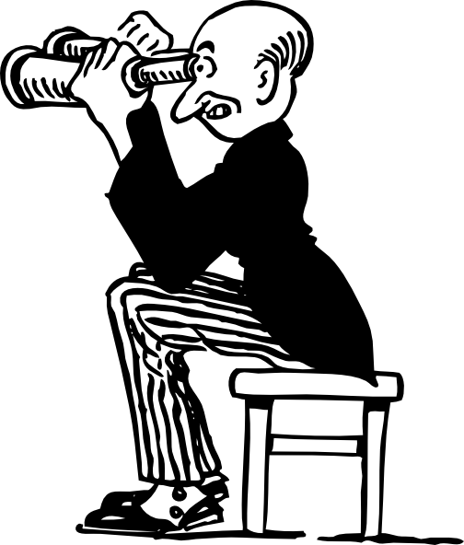
v
ver
Notes:
Introduce and elicit the pronunciation of the individual SSC ‘V’ and then present and practise the pronunciation of the source word ‘ver’.
A possible gesture for this source word would be to pretend to look through binoculars, as in the picture above

Slide 3
v
ver
Notes:
Repeat the sound and elicit the source word.

Slide 4
v
ver
Notes:
Repeat the sound and elicit the source word.

Slide 5
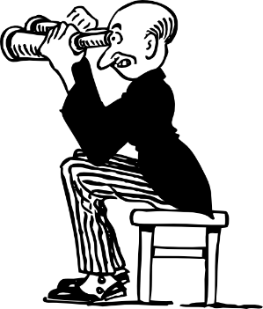
v
verdad
verano
verde
joven
ver
vivir
[to live]
Notes:
Introduce and elicit the pronunciation of the individual SSC ‘gi’ and then the source word again (with gesture, if using). Then present and elicit the pronunciation of the five cluster words.
The cluster words have been chosen for their high-frequency, from a range of word classes, with the SSC (where possible) positioned within a variety of syllables within the words (e.g. initial, 2nd, final etc.). Additionally, we have tried to use words that build cumulatively on previously taught SSCs (see the Phonics Teaching Sequence document) and do not include new SSCs. Where new SSCs are used, they are often consonants which have a similar symbol-sound correspondence in English.

Slide 6
v
verdad
verano
verde
joven
ver
vivir
Notes:
Without the images, students focus this time again closely on the SSC and the cluster words.

Slide 7
v
verdad
verano
verde
joven
ver
vivir
Notes:
Without the images or sound, students have to pronounce the words themselves.

Slide 8
b
celebrar
Notes:
Introduce and elicit the pronunciation of the individual SSC ‘b’ and then present and practise the pronunciation of the source word ‘celebrar’.
A possible gesture for this source word would be to put your hands above your ahead and dance/jump

Slide 9
b
celebrar
Notes:
Repeat the sound and elicit the source word.

Slide 10
b
celebrar
Notes:
Repeat the sound and elicit the source word.

Slide 11
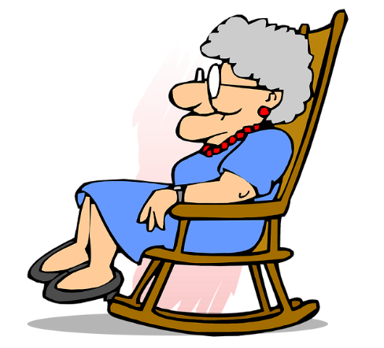
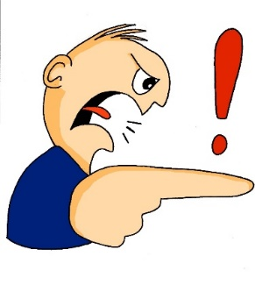
b
abuela
bonito
[pretty]
saber
deber
celebrar
[to know]
bastante
[quite]
Notes:
Introduce and elicit the pronunciation of the individual SSC ‘b’ and then the source word again (with gesture, if using). Then present and elicit the pronunciation of the five cluster words.
The cluster words have been chosen for their high-frequency, from a range of word classes, with the SSC (where possible) positioned within a variety of syllables within the words (e.g. initial, 2nd, final etc.). Additionally, we have tried to use words that build cumulatively on previously taught SSCs (see the Phonics Teaching Sequence document) and do not include new SSCs. Where new SSCs are used, they are often consonants which have a similar symbol-sound correspondence in English.

Slide 12
b
abuela
bonito
saber
deber
celebrar
bastante
Notes:
Without the images, students focus this time again closely on the SSC and the cluster words.

Slide 13
b
abuela
bonito
saber
deber
celebrar
bastante
Notes:
Without the images or sound, students have to pronounce the words themselves.

Slide 14
Escucha y lee. Es ¿‘v’ o ‘b’?
escuchar
A
B
C
jo__en
v
v
cele__rar
__erdad
b
D
E
F
__erde
b
b
v
__astante
de__er
G
H
I
b
a__uela
v
sa__er
_i_ir
b
v
Notes:
Timing: 3 minutes
Aim: Listening activity to provide input to help establish the sound-spelling connection.
Note that the audio will not help students to distinguish ‘b’ from ‘v’; the audio is simply provided for reinforcement. Students need to recall the spelling of each word.
Procedure:
Teachers click the letter button to play the recording of the word.
Students write the missing letter.
See next slide for a variation of this activity (where students have to write full word).

Slide 15
¿‘v’ o ‘b’?
escuchar
celebrar
verdad
joven
A
B
C
bastante
deber
verde
D
E
F
abuela
vivir
saber
G
H
I
Notes:
Variation activity to the previous slide
Timing: 3 minutes
Aim: Listening activity to provide input to help establish the sound-spelling connection.
Note that the audio will not help students to distinguish ‘b’ from ‘v’; the audio is simply provided for reinforcement. Students need to recall the spelling of each word.
Procedure
1. Teachers click the letter button to play the recording. Students listen and write the full word.

Slide 16
Identifica la palabra correcta.
deber
hablar
vivir
verde
[to know]
1
2
3
4
[young]
5
6
[to live]
joven
verdad
7
8
[quite]
9
[must]
saber
bastante
celebrar
abuela
Notes:
Timing: 3 minutes
Aim: Having focused on the sound-spelling correspondence, students now focus on the meaning of the words used for practice.
Procedure:
1. The teacher says the number (either in numerical or random order, to challenge students more). Students have to search the options around the edge of the box to decide which is the corresponding word. Teachers should pause for several seconds to allow students to search, then elicit the Spanish word from students in chorus.
Notes:
To allow for flexibility in the order of numbers, the answers have not been animated.

Slide 17
leer
Lee el texto. ¿Qué tipo de texto es?
leer
La plaza tiene una torre,
la torre tiene un balcón,
¿Un artículo?
¿Una novela?
¿Un poema?
El balcón tiene una dama,
La dama una blanca flor…
Notes:
Timing: 1 minute
Aim: Introductory slide to challenging text that is the focus of this lesson for students to anticipate what they might be about to work on.
Procedure:
Ask students to read aloud the first four lines of the text and then identify its type. ‘Artículo’, ‘novela’ and ‘poema’ haven’t been taught in the scheme of work but should be recognisable as cognates.
Teachers could prompt certain reasons why they may suggest a poem: frases cortas, repetición

Slide 18
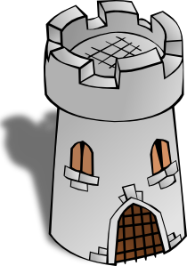
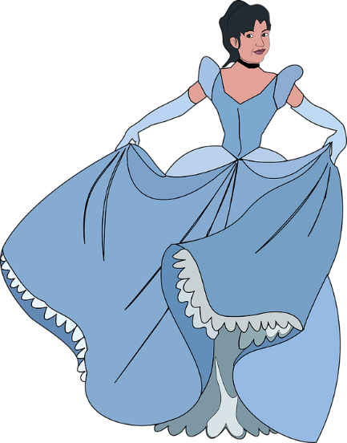
La plaza tiene una torre,
la torre tiene un balcón,
El balcón tiene una dama,
La dama una blanca flor…
Notes:
Timing: 1 minute
Aim: slide to remind students of the use of ‘tiene’ . This begins to foster an approach to challenging texts of searching for words that are familiar.
Procedure:
1. Teachers elicit from students the meaning of ‘tiene’, which they first learnt in term 1.1 week 4. Since it was introduced, there have been several opportunities to revisit parts of ‘TENER’ in the scheme of work.
2. Teachers ask students why they think ‘tiene’ is missing from line 4 of the poem (i.e. to maintain the rhythm/flow), and where it would have gone, if the writer had included it.
Notes Images are animated to support the meaning.

Slide 19
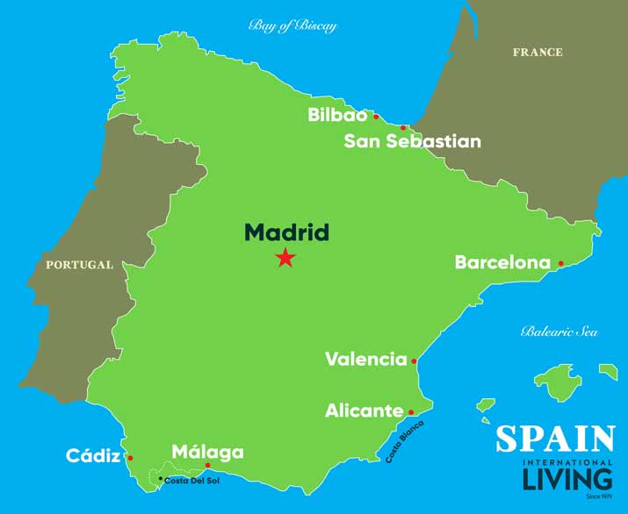
El autor: Antonio Machado (1875-1913)
Biografía
Nace en Valencia.
Estudia en Madrid.
Viaja mucho a Francia.
Habla francés.
viajar = to travel
Intereses
La memoria
La reflexión
El romance
Notes:
Timing: 3 minutes
Aim: Introductory details of the author of the poem, using familiar language and some cognates.
Procedure:
Teachers click to go through the slide. We can give details of his life in the present tense. Students can read aloud (whole class) to practise SSC knowledge.
Students could be asked to guess what ‘nace’ means. In the context of ‘biografía’, they may be able to guess this.
Students could also be asked:
1/ where Valencia and Madrid are (‘¿Dónde está…?) to elicit ‘Está en el sur’ or ‘Está en el centro’. Note: ‘centro’ has been taught as a phonics word.
2/ yes-no questions with raised intonation (e.g. ‘¿Valencia está en el norte?’). Encourage full answers here (‘No, está en el sur’).
Frequency of unknown words/cognates:
nacer [426]; viajar [902]; memoria [827]; reflexión [1909]; romance [4541]

Slide 20
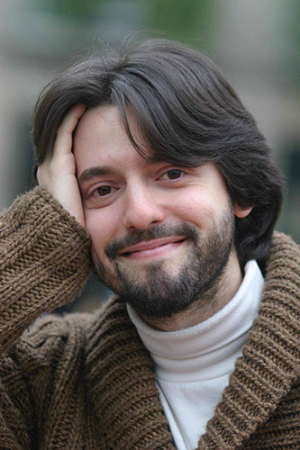
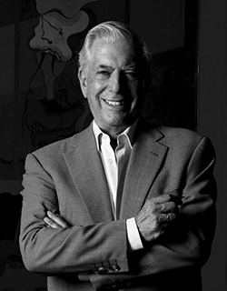
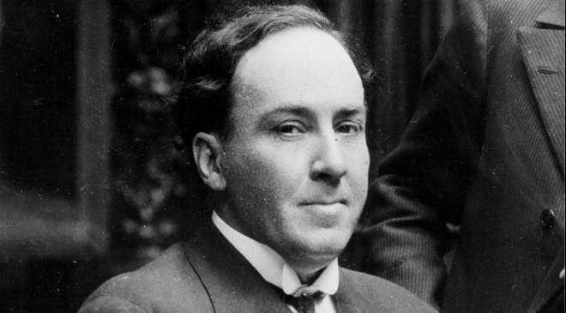
¿Quién es Antonio Machado?
A
C
B
Notes:
Timing: 1 minute
Aim: another short activity to whet the interest of the students in the text
Procedure:
Ask students, e.g., ‘Es la persona en A?’. Elicit the correct answer (B).
Photo A too young, too recent (colour photo!). Photo B and C both black and white, so might be options. Students might look at their clothes to guess this.
In B (the correct photo) he also seems calm and composed, which is in tune with the interests mentioned on the last slide.
Image sources:
A: Photo by Luis Angelis licensed under CC BY-SA 4.0 and retrieved from https://www.worldliteraturetoday.org/blog/news-and-events/award-winning-argentinean-spanish-writer-speak-ou
B: Photo by EFE, is licensed under CC BY-SA 4.0 and retrieved from http://www.spainisculture.com/en/artistas_creadores/antonio_machado.html
C: Photo by US library of Congress is licensed under CC BY-SA 4.0 and retrieved from https://www.loc.gov/item/n79079153/mario-vargas-llosa-peru-1936/

Slide 21
¿Cómo está en la foto?
Está serio.
Está alegre.
Está raro.
Notes:
Timing: 1 minute
Aim: to revisit some adjectives with ‘estar’ for temporary state.
Procedure:
Ask students to translate the 3 phrases. Ask for other potential descriptions of how he looks, or doesn’t look.
Other adjectives previously taught in the Spanish scheme of work could be revisited here: guapo [4192]; feo [2373]; bonito [891]; tranquilo [1073]; tonto [2379]; nervioso [1521].
Photo by EFE, is licensed under CC BY-SA 4.0 and retrieved from http://www.spainisculture.com/en/artistas_creadores/antonio_machado.html

Slide 22
Palabras importantes
la plaza | square
el balcón | balcony
la dama | lady
blanco | white
la flor | flower
torre | tower
el caballero | gentleman, knight
su | his/her/its
quién | who
saber | to know, knowing
pasar | to pass, passing
llevar | to carry, to wear
Notes:
Timing: 4 minutes
Aim: Introduce (and recap) vocabulary involved with the poem.
Procedure:
Teachers click to reveal the English meanings of the words. First you could ask students what the words mean.
Ask students to familiarise themselves with these words, using a usual routine (read aloud, ask and answer L2 → L1 meanings in pairs etc..)
Notes: Students have been taught blanco, flor, quién, la plaza, and llevar. Revisiting them here within a new set of words will challenge their recall and deepen vocabulary knowledge. It’s encouraging for students to realise that a poem text contains words they have already learnt, as well as unfamiliar words.

Slide 23
Escucha el poema.
escuchar
¿Cómo está la narradora?
tonta
rara
alegre
nerviosa
tranquila
seria
Notes:
Timing: 3 minutes
Aim: First listen of the poem (in two tones), potential dictogloss activity
Procedure:
There are two versions here – one in a happy-sounding voice (alegre) and one in a serious voice (seria).
Students could be encouraged to write down any words they hear and understand in the poem to practise their SSC knowledge.
Note: Later in the lesson, after students have had more receptive practice (reading and listening to the poem), they could listen to again and see if they can reform any full lines from the poem (in a dictogloss style task).
Alternative, additional version:
https://www.youtube.com/watch?v=fgcyPadvZjA

Slide 24
Escucha. Organiza las 5 partes del poema.
escuchar
La plaza tiene una torre, la torre tiene un balcón,
A
Order
Part
el balcón tiene una dama, la dama una blanca flor.
B
#1
C
ha pasado un caballero -¡ quién sabe por qué pasó !-,
#2
E
C
#3
A
y se ha llevado la plaza, con su torre y su balcón,
D
#4
D
con su balcón y su dama,
su dama y su blanca flor.
#5
B
E
Notes:
Timing: 4 minutes
Aim: listening activity to help students recognise SSCs and words.
Procedure:
Students have just heard the poem in full on the previous slide. This time, teachers click on the number buttons to play fragments of the poem. Students listen and write down the letter that the fragment corresponds to
The answers can be checked item by item by clicking. This makes it less difficult than listening to all 5 parts and then checking answers.
Frequency of unknown words/cognates: Organizar [1053] is a cognate that usefully includes the SSC ‘z’, which students practised in Term 1.2 Week 1.

Slide 25
Lee el poema. Completa la tabla con la letra correcta.
leer
La plaza tiene una torre, la torre tiene un balcón,
A
What the pair of lines describes
el balcón tiene una dama, la dama una blanca flor.
B
Tells us that a man goes past
C
Tells us who is on the balcony
B
ha pasado un caballero -¡ quién sabe por qué pasó !-,
C
Tells us what happens as the man goes past.
D, E
y se ha llevado la plaza, con su torre y su balcón,
Tells us what the square has.
A
D
con su balcón y su dama, su dama y su blanca flor.
E
leer
Notes:
Timing: 3 minutes
Aim: reading activity to begin to think more closely about the meaning of each couplet of the poem
Procedure:
Teachers click to reveal a couplet of the poem out of order. Students fill in the table with the letters of the couplet.
Answers are shown by clicking.
Notes:
The poem appears out of order so that students think more carefully about the meaning of different parts of the poem. This way, they can’t simply rely on a predictable order of events to complete the task.

Slide 26
Los sonidos
 | plaza, una, blanca, dama, ha, pasado, sabe, caballero
A
A
 | con, blanca, balcón, caballero
CA/CO
CA/CO
Notes:
Timing: 4 minutes
Aim: activity to revisit SSCs [A], [CA] and [CO]
Procedure:
Go back to the previous slide and ask students to find words with the listed SSCs.
Once done, return to this slide and click on the boxes to reveal the words with the appropriate SSC.
Ask them to find examples of other SSCs. For example, you could also ask them to find an example of RR (torre). What other words can they think of that have this SSC? (Inglaterra, correcto – which they’ve seen before in target language instructions). SSC ‘r’ and ‘rr’ will be the phonics focus next week.
Notes:
Learners will be most familiar with [A], having seen it in Term 1.1, Week 1.
They have also seen [CA]/[CO]/[CU] in Term 1.1, Week 5.

Slide 27
En parejas. Lee el poema en alta voz.
hablar / escuchar
La plaza tiene una torre,
la torre tiene un balcón,
el balcón tiene una dama,
la dama una blanca flor.
Ha pasado un caballero
- ¡quién sabe por qué pasó! -,
y se ha llevado la plaza,
con su torre y su balcón,
con su balcón y su dama,
su dama y su blanca flor.
¿Cómo está el narrador / la narradora?
tonto/a
raro/a
alegre
nervioso/a
tranquilo/a
serio/a
Notes:
Timing: 5 minutes
Aim: Speaking and pronunciation practice, involving some ‘acting’ of tones
Procedure:
Check understanding of ‘pareja’ and ‘en alta voz’ in the instructions.
Students take turns to read the text to each other in pairs and the speaker decides how (i.e. with what tone) they will narrate the text. The partner listens and then asks the partner, e.g., ‘¿Estás serio?’. Remind students of the need to use ‘estás’ to speak directly to ‘you’ (singular).

Slide 28
La plaza tiene una torre
Notes:
https://www.youtube.com/watch?v=Z6jD2xUiea4
Alternative version on YouTube (includes audio and text).

Slide 29
La plaza tiene una torre [2]
Antonio Machado
Y7 Spanish
Term 2.1 - Week 1 - Lesson 30
Nick Avery / Rachel Hawkes
Date updated: 16/08/2021
Notes:
Artwork by Mark Davies. All additional pictures selected are available under a Creative Commons license, no attribution required.
Learning outcomes (lesson 2):
Work with a challenging text
Consolidation of definite vs indefinite articles
Consolidation of SSCs [v] and [b]
Word frequency (1 is the most frequent word in Spanish):
7.2.1.1 (introduce) vocab set: saber [44]; pasar [68]; torre [2138]; su [12]
7.1.2.5 (revisit) museo [1114]; banco [728]; teatro [605]; centro [316]; mercado [487]; tienda [1515]; plaza [806]; iglesia [437]; escuela [424]; ciudad [178]; entre [63]; el, la [1]; lejos [833]; cerca [1042]; respuesta [488]
7.1.1.7 (revisit) necesitar [276]; usar [317]; llevar¹ [75]; zapato [1477]; vaso [1609]; producto [394]; bolsa [1581]; camisa [1873]; cosa [69]; ayuda [784]; voluntario¹ [2732]; gracias [275]; de nada [nada-87]; luego¹ [150]
Source: Davies, M. & Davies, K. (2018). A frequency dictionary of Spanish: Core vocabulary for learners (2nd ed.). Routledge: London
The frequency rankings for words that occur in this PowerPoint which have been previously introduced in NCELP resources are given in the NCELP SOW and in the resources that first introduced and formally re-visited those words.
For any other words that occur incidentally in this PowerPoint, frequency rankings will be provided in the notes field wherever possible.

Slide 30
Completa la frase con LA o UNA.
escribir
La plaza tiene ____ torre, ____ torre tiene un balcón,
una
La
Notes:
Timing: 3 minutes (for slides 24-26)
Aim: Recap of meaning of definite and indefinite articles.
Procedure:
Teachers draw out and make explicit the difference in meaning between the definite and indefinite article ‘la’ and ‘una’, eliciting an English translation of each of the lines from this and the next two slides. Answers are revealed by clicking.
Repeat the procedure on slides 25 and 26.
An active choice between the definite and indefinite articles is needed in each instance. We have separated parts of the poem to ask for a choice between definite and indefinite (rather than between masculine and feminine) so that students only have to focus on article usage.

Slide 31
Completa la frase con LA o UNA.
escribir
La torre tiene ___ balcón, ___ balcón tiene una dama,
un
El

Slide 32
Completa la frase con LA o UNA.
escribir
el balcón tiene ____ dama, ____ dama una blanca flor.
una
La

Slide 33
La dama describe una ciudad. ¿Qué hay?
un mercado
un m_ _ _ _ _ _
a market
un c_ _ _ _ _ de arte
un centro de arte
an art centre
laza
Hay una p_____ ,
un t_ _ _ _ _
a theatre
un teatro
una t____ y…
orre
un b_ _ _ _. Está c_ _ _ _.
a bank. It’s near.
un banco. Está cerca.
un m_ _ _ _
a museum
un museo
una tienda. Está lejos.
a shop. It’s far.
una t_ _ _ _ _. Está l_ _ _ _.
una iglesia
a church
una i_ _ _ _ _ _
una escuela. Está entre dos parques.
una e_ _ _ _ _ _. Está e_ _ _ _ dos parques.
a school. It’s between two parks.
Notes:
Timing: 3 minutes
Aim: vocabulary revision activity for vocabulary set 7.1.2.5.
Procedure:
Teachers ask students for the missing words. A choral response can be sought, or teachers could ask students to work in pairs first to remember the vocabulary.
Teachers click to reveal the answers.

Slide 34
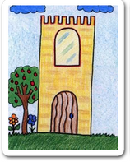
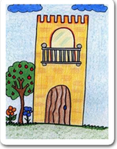
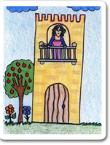
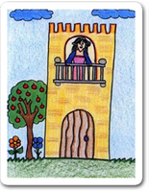
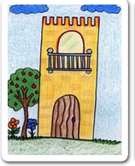
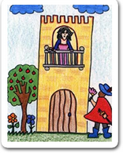
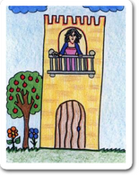
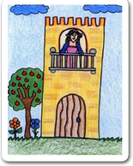
escribir/hablar
__ _______ tiene ___ ______, __ ______ tiene __ ______, __ ______ tiene ___ ____, __ ____ ___ blanca ____. ha pasado un caballero -¡ quién sabe por qué pasó !-, y se ha llevado __ _____, con su _____ y su ______, con su _____ y su ____
su ____ y su _____ ____.
Notes:
Timing: 8 minutes
Aim: Writing / speaking exercise using pictures to practice articles and nouns
Procedure:
Two possible tasks: (1) Writing: students have to complete the text with both definite and indefinite articles, plus the nouns or (2) Speaking: students do a read aloud, aided by the picture prompts
The next slide shows the answers
Image attribution: Images by Colegio de Educación Infantil y Primaria Vista Alegre
Licensed under CC BY-SA 4.0
http://literaturalunalunera.blogspot.com/2014/03/la-plaza-tiene-una-torre.html

Slide 35
Answers
__ ______ tiene ____ ____, __ _____ tiene ___ _______, __ ______ tiene ____ ______, __ _____ ____ blanca ____. ha pasado un caballero -¡ quién sabe por qué pasó !-, y se ha llevado __ _____, con su _____ y su ________, con su _______ y su _______
su _______ y su _______ ___.
La plaza
una torre
la torre
un balcón
el balcón
una dama
La dama una
flor
la plaza
torre
balcón
balcón
dama
dama
blanca flor

Slide 36
Escucha y completa la frase.
escuchar / escribir
Luego escribe la frase en inglés.
Quiere _______ la _________.
1
saber
verdad
5
Da una bolsa a la señora en la tienda.
Es ___________ grande.
bastante
S/he wants to know the truth.
S/he gives a bag to the lady in the shop. It’s quite big.
celebrar
2
Quiero __________ mi cumpleaños lejos de aquí.
6
Doy películas a una amiga, Sara.
¡______ películas con Sara es maravilloso!
I want to celebrate my birthday far (away) from here.
Ver
I give films to a friend, Sara.
Seeing / watching films with Sara is marvellous!
Verde
3
¿Qué color quieres? ¿_______?
What colour do you want? Green?
4
abuela
¿Das unas cosas a la _________?
mi = my
cumpleaños = birthday
Do you give some things to grandma?
Notes:
Timing: 8 minutes
Aim: This activity integrates grammar, vocabulary and phonics revision.
Procedure:
Phonics: Students first have to listen and write the missing word, which contains either the ‘b’ or ‘v’ SSC. The 7 missing words were used for phonics practice in lesson 1.
Grammar and vocabulary: After writing the missing words, students have to translate the sentence. Each one contains DAR and QUERER in 1st, 2nd or 3rd person singular. These two verbs are revisited in the current lesson, both for receptive and then productive practice. Vocabulary is also revisited from various earlier weeks. ‘Lejos’, ‘tienda’, ‘cosa’ and ‘bolsa’ are from the two vocabulary sets revisited this week (1.1.7 and 1.2.5) in the SoW.

Slide 37
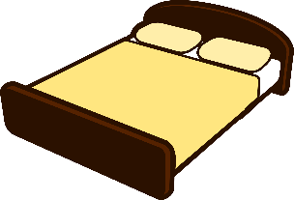
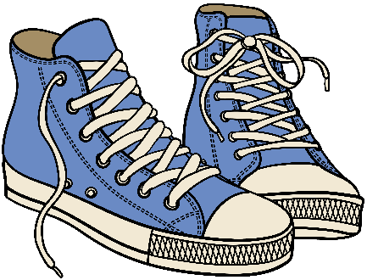
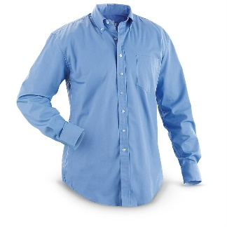
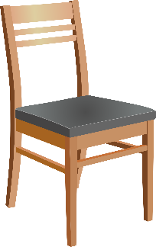
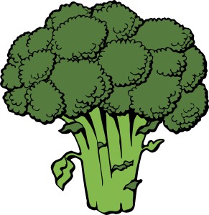
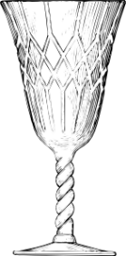
¿Qué es/son?
una cama
unos zapatos
dinero
un libro
una camisa
[product]
un producto
una silla
un plato de brócoli
un vaso
una bolsa
Notes:
Timing: 3 minutes
Aim: recap of vocabulary used in forthcoming activities
Procedure:
1. This help slide can be looked at before the speaking/listening activity on slides 32-37 to give students a quick reminder of the vocabulary that will be needed.
2. Clicking each box triggers the appearance of the word.
Notes:
We recommend not displaying the words during the activity, as we want to encourage students to retrieve previously taught words.
The SoW hasn’t yet taught the names of specific foods in Spanish, so ‘brócoli’ was chosen as a cognate.
Picture source: http://clipart-library.com/ (free to use)

Slide 38
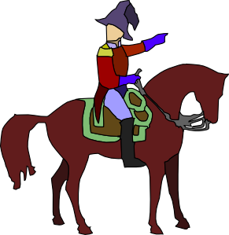
El caballero y su caballo
hablar / escuchar
Persona A: eres el caballero.
Use the prompt cards to say
what you want.
what your horse wants.
Importante!
‘Quiero’ es ‘I want’.
‘Quiere’ es ‘it wants’.
Persona B: escucha y completa la tabla.
¿Quién es, el caballero o el caballo?
Notes:
Timing: 6 minutes (for slides 32-34)
Aim: This is a two-part speaking/listening activity to practise spoken production of DAR and QUERER in 1st and 3rd person singular.
Procedure
Teachers click to go through the instructions. Teachers should elicit the meaning of ‘eres’ in the instructions.
One student uses the speaking cards to say sentences, while the other completes the grid. Students will swap roles half-way through.
Picture source: http://clipart-library.com/ (free to use)

Slide 39
Persona A
1
2
3
4
[I want]
[I want]
[it wants]
[I want]
a glass of Coca-Cola
a chair
some products
a shirt
5
6
7
8
[it wants]
[I want]
[it wants]
[it wants]
a plate a broccoli
a glass of
Fanta
some shoes
a bed
Notes:
DO NOT SHOW DURING THE ACTIVITY
Student A speaking card
‘Vaso’, ‘camisa’, ‘zapato’, ‘producto’ are words from the Term 1.1, Week 7 vocabulary set, which is revisited this week.

Slide 40
Persona B
Answers
El caballero (‘I want’)
El caballo (‘it wants’)
un vaso de Coca-Cola
unos productos
una silla
un plato de brócoli
una camisa
un vaso de Fanta
unos zapatos
una cama
Notes:
Students can copy the grid into their books.
Ask students if it’s normal for a horse to want those things (!)

Slide 41
La dama y su hermano
hablar / escuchar
Importante!
‘Doy’ es ‘I give’.
‘Da’ es ‘s/he gives’.
Persona B: eres la dama.
Use the prompt cards to say
what you give to someone in the square.
what your brother gives to someone in the square.
Persona A: escucha y completa la tabla.
¿Quién es, la dama o el hermano?
Notes:
Timing: 6 minutes (slides 35-37)
Aim: This is a two-part speaking/listening activity to practice spoken production of dar and querer in 1st and 3rd person singular.
Procedure:
1. Students B and A now swap roles. Student B speaks, while Student A listens and completes the grid.
Image attribution: http://www.clker.com/and http://clipart-library.com/

Slide 42
Persona B
1
2
3
4
[I give]
[he gives]
[I give]
[I give]
a book
money
a shirt
some shoes
5
6
7
8
[he gives]
[I give]
[he gives]
[he gives]
a glass of Coca-Cola
a plate of broccoli
a bag
some products
Notes:
DO NOT SHOW DURING THE ACTIVITY
Student B speaking cards
‘Vaso’, ‘camisa’, ‘zapato’, ‘producto’ are words from the Term 1.1, Week 7 vocabulary set, which is revisited this week.

Slide 43
Persona A
Answers
La dama (‘I give’)
El hermano (‘he gives’)
un libro
dinero
unos zapatos
una bolsa
una camisa
un vaso de Coca-Cola
unos productos
un plato de brócoli
Notes:
Students can copy the grid into their books.

Slide 44
una versión adaptada
Notes:
https://www.youtube.com/watch?v=VpvQxBlKDRc
Additional material that teachers could exploit to work with ‘La plaza tiene una torre’.

Slide 45
dos posibilidades
una adaptación oral del poema en grupo
una versión moderna (escrita) del poema
Notes:
Two more ideas for production activities based on ‘La plaza tiene una torre’.

Slide 46
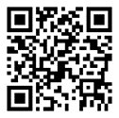
Deberes
Vocabulary Learning Homework (Term 2.1, Week 2)
Audio file
Audio file QR code:
Student worksheet
Quizlet link
In addition, revisit: Term 1.2 Week 6
Term 1.2 Week 1

