Slide 1
Describing how things are and used to be: French school system
-ER verbs in the imperfect tense (habitual events with 'used to' equivalent in English) (je)
hard and soft (-s-)
Y9 French
Term 2.2 - Week 1 - Lesson 39
Catherine Morris / Louise Bibbey / Natalie Finlayson
Artwork by: Chloé Motard
Date updated: 08/08/2022
Notes:
Artwork by Chloé Motard. All additional pictures selected are available under a Creative Commons license, no attribution required.
Native speaker feedback provided by Sarah Brichory.
With thanks to Rachel Hawkes for her input on the lesson material.
Learning outcomes (lesson 1): Consolidation of SSC [s]
Consolidation of hard and soft [-s-]
Introduction of –ER verbs in the imperfect (habitual events with 'used to' equivalent in English) (je)
9.2.2.1 (introduce) corriger [1639], durer [605], poser [218], compétence [1757], connaissance [806], contrôle [662], système [289], cinquième [2030], deuxième [427], quatrième [1603], primaire [2527], sixième [3124], troisième [506], [13/36/8], longtemps [312]
9.2.1.3 (revisit) entrer [337], monter [853], rentrer [295], retourner [990], tomber [547], après-midi [596], attente [936], corps [561], doigt [1938], dos [1672], médicament [1954], pied [626], santé [641], situation [223], soir [397], urgence [1199], faible [723], seulement [130], trop [195]
9.1.2.1 (revisit) empêcher [306], pratiquer [1268], respecter [673], risquer [322], château [3510], région [241], essentiel [675], fantastique [4107], historique [902], utile [1003]
Source: Londsale, D., & Le Bras, Y. (2009). A Frequency Dictionary of French: Core vocabulary for learners London: Routledge.
The frequency rankings for words that occur in this PowerPoint which have been previously introduced in NCELP resources are given in the NCELP SOW and in the resources that first introduced and formally re-visited those words.
For any other words that occur incidentally in this PowerPoint, frequency rankings will be provided in the notes field wherever possible.
The additional English meanings of the following words have been added to Quizlet since the creation of this resource:
longtemps – a long time, a long while
corriger – to correct, to mark
competence – skill, competence

Slide 2
-s-
maison
Notes:
Timing: 1 minute [2 slides]
Aim: To consolidate SSC [-s-]
Procedure: 1. Present the letter(s) and say the [-s-] sound first, on its own. Students repeat it with you. 2. Bring up the word ”maison” on its own, say it, students repeat it, so that they have the opportunity to focus all of their attention on the connection between the written word and its sound.
3. A possible gesture for this would be to trace the outline of a house in the air with two fingers. 4. Roll back the animations and work through 1-3 again, but this time, dropping your voice completely to listen carefully to the students saying the [-s- between vowels] sound, pronouncing ”maison” and, if using, doing the gesture.
Word frequency (1 is the most frequent word in French):
maison [325]
Source: Londsale, D., & Le Bras, Y. (2009). A Frequency Dictionary of French: Core vocabulary for learners London: Routledge.

Slide 3
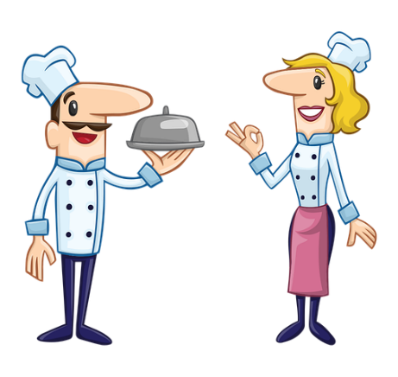
-s-
magasin
église
désolé
maison
cuisine
[sorry]
chose
[thing]
Notes:
Aim: To consolidate SSC [-s-]
Procedure:
Introduce and elicit the pronunciation of the individual SSC [-s-] and then the source word again ‘maison’ (with gesture, if using). Then present and elicit the pronunciation of the five cluster words. The cluster words have been chosen for their high-frequency, from a range of word classes, with the SSC (where possible) positioned within a variety of syllables within the words (e.g. initial, 2nd, final etc.). Additionally, we have tried to use words that build cumulatively on previously taught SSCs (see the Phonics Teaching Sequence document) and do not include new SSCs. Where new SSCs are used, they are often consonants which have a similar symbol-sound correspondence in English.
Word frequency (1 is the most frequent word in French): maison [325]; chose [125]; magasin [1736]; église [1782]; désolé [2081]; cuisine [2618]. Source: Londsale, D., & Le Bras, Y. (2009). A Frequency Dictionary of French: Core vocabulary for learners London: Routledge.

Slide 4
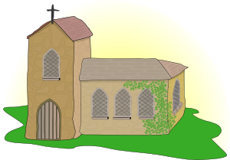
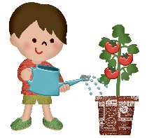
Les mots hard [-s] en français
parler
30
magasin
chaise
réviser
désolé
saisons
maison
cuisine
musique
usine
visiter
SECONDES
maîtrise
plaisir
analyse
église
arroser
0
écraser
déguisement
valise
rose
pelouse
DÉBUT
Notes:
Timing: 3 minutes
Aim: Speaking practice of SSC hard [-s]
Procedure:
1. Students work in pairs.
2. One at a time they have to say as many hard [-s] words as possible in 30s.
3. The partner listens to make sure pronunciation is correct.
4. If they get one wrong, start again.
5. Swap roles.
6. Click on words to hear native pronunciation.
Transcript:
magasin
chaise
réviser
désolé
saisons
maison
cuisine
musique
usine
visiter
maîtrise
plaisir
analyse
église
arroser
écraser
déguisement
valise
rose
pelouse
Word frequency of cognates (1 is the most frequent word in French): magasin [1736], chaise [3419], réviser [2551], désolé [>5000], saisons [1667], maison [325], cuisine [2618], musique [1139], usine [1482], visiter [1378], maîtrise [3442], plaisir [797], analyse [1204], église [1782], arroser [>5000], écraser [2334], déguisement [>5000], valise [4308], rose [2671], pelouse [>5000]
Source: Lonsdale, D., & Le Bras, Y. (2009). A Frequency Dictionary of French: Core vocabulary for learners London: Routledge.

Slide 5
Vocabulaire
écouter
Écoute et écris la bonne lettre.
1
2
3
4
5
6
7
8
9
10
11
12
13
14
F
I
A
N
D
J
L
B
H
C
E
M
G
K
[to correct, correcting] |  |  | [test]
A
B
C
D
E
F
G
th
to ask (a question)
th
skill/
competence
primary
corriger
sixième
poser
le contrôle
quatrième
la compétence
primaire
H
I
J
K
L
M
N
to last/
lasting
a long time/while
knowledge
nd
system
th
rd
la connaissance
deuxième
le système
cinquième
durer
longtemps
troisième
Notes:
Timing: 4 minutes
Aim: Aural recognition of new vocabulary.
Procedure:
1. Click on each number in turn (1-14).
2. Students decide which image, word, or letter corresponds to what they hear.
3. The answer appears on the click (underneath the number and picture)
4. Students can practise pronunciation of each word by listening again to the native speaker/teacher and repeating.
Transcript:
la compétence
deuxième
corriger
troisième
le contrôle
le système
durer
sixième
la connaissance
poser
quatrième
longtemps
primaire
cinquième

Slide 6
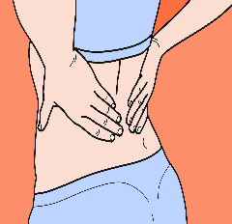
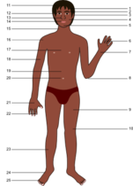
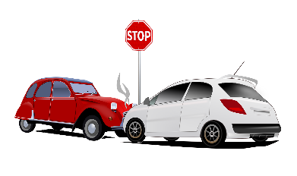
Vocabulaire
Trouve les paires
écrire
A
C
E
B
weak
D
to enter
1
C
faible
7
J
le corps
wait
8
I
le doigt
foot
2
K
tomber
F
G
medicine
le pied
H
9
B
3
D
le médicament
I
10
H
la santé
l’urgence
emergency
finger
4
F
11
M
la situation
back
J
health
5
E
entrer
M
12
G
le dos
K
L
situation
6
A
l’attente
13
L
trop
too (much)
body
to fall
Notes:
Timing: 3 minutes
Aim: To revisit vocabulary relating to emergency medical situations
Procedure:
Explain that pupils need to match the French words to the English words and images
Click on numbers to hear the words spoken by a native speaker
Ask pupils to match the correct letter
Click to reveal answers

Slide 7
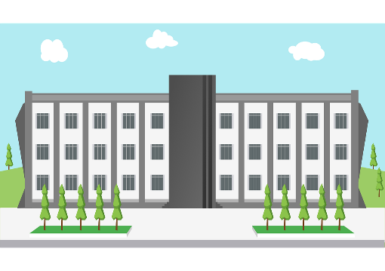
Le système scolaire en France
Tu es en quelle année scolaire ? Et tes frères/soeurs et ami(e)s, ils sont en quelles années scolaires? Parle avec un(e) partenaire!
info / parler
Adding an article to these forms of numbers gives you the names of French secondary school years. Notice that we count down - the lower the number, the older the pupils!
l’école maternelle
[nursery]
3 – 5 ans
l’école primaire
[primary school]
6 – 10 ans
le collège
[secondary school]
la sixième: 11 – 12 ans [Year 7]
la cinquième: 12 – 13 ans [Year 8]
la quatrième: 13 – 14 ans [Year 9]
la troisième: 14 – 15 ans [Year 10]
le lycée
[sixth form college]
16 – 18 ans
[Years 11, 12, 13]
A pupil in France would say, for example: Je suis en cinquième – (I am in Year 8)
Notes:
Timing: 3 minutes
Aim: To explain the structure of the French school system, highlighting the differences between English and French schools. To explain how ordinal numbers are used as the names of French secondary school years.
Procedure:
1. Click to show each school type in French and English, and the ages of children attending each school.
2. Click to highlight the ordinal numbers which are used for school years.
3. Click to bring up the speaking prompt. Have students engage in a quick discussion in French in which they tell a partner what year they are in, and also what years (or schools) their family members and friends are in.

Slide 8
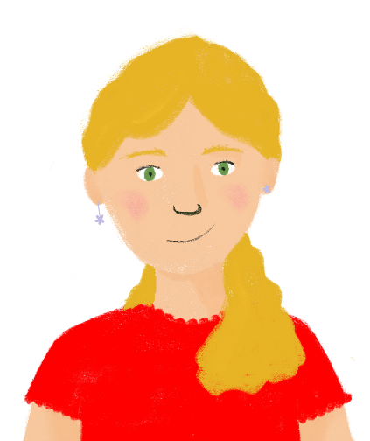
Léa parle du système scolaire
Réponds aux questions en anglais.
lire
Le système scolaire en France est très différent du système anglais. Dans le passé, j’ai étudié à l’école primaire, mais maintenant je suis au collège, en quatrième. L’année prochaine je vais être en troisième. Les deux premières années du collège sont la sixième et la cinquième. On fait beaucoup de contrôles au collège. Aujourd’hui le deuxième contrôle va durer une heure ! Il faut avoir de bonnes connaissances et compétences pour faire les contrôles! Sinon*, on risque des problèmes: il faut beaucoup corriger !
*sinon = if not
You may have noticed…
In English, the word ‘knowledge’ is both singular and plural. To talk about having lots of knowledge, in French, we add an ‘s’ to make the plural form: ‘les connaissances’.You need more than one item of knowledge to succeed in tests!
in the past
How long ago was I still studying at primary school?
What year am I in now?
What year will I be in next year?
What are the first two years of secondary school?
What do we do a lot of at secondary school?
How long is today’s second test going to last?
What two things do you need to succeed in tests?
What will happen if I don’t have knowledge and skills?
4th (Year 9)
3rd (Year 10)
6th & 5th (Years 7 & 8)
a lot of tests
one hour
good knowledge & skills
lots of correcting!
Notes:
Timing: 5 minutes
Aim: Reading comprehension exercise to further consolidate new vocabulary in context.
Procedure:
Students to work individually, writing down answers.
Teacher elicits answers from students before revealing the answers.
Click to reveal the note on the cross-linguistic difference in countability between ‘knowledge’ and ‘connaissance(s)’.

Slide 9
L’imparfait* [1/2]
*imparfait = imperfect
grammaire
Je jouais au foot tous les jours. Maintenant, je joue au foot les samedis.
I used to play football every day. Now, I play football on Saturdays.
We use the imperfect tense to talk about events and actions that used to happen regularly in the past.
We use the present tense to talk about something that happens regularly now.
imparfait
présent
You can translate the imperfect to English
using the phrases ‘used to’ and ‘kept (on) …ing’
Notes:
Timing: 3 minutes [slide 1 of 2]
Aim: To introduce the used of the imperfect tense with regular, repeated actions (with English translations ‘used to’).
Procedure:
1. Click to bring up information.
2. Check students’ understanding at each stage.
3. Move to the next slide for an explanation of forms.
Word frequency of cognates used (1 is the most frequent word in French): imparfait [>5000]
Source: Lonsdale, D., & Le Bras, Y. (2009). A Frequency Dictionary of French: Core vocabulary for learners London: Routledge.
Notes:
The new GCSE subject content specifies that, both at foundation and higher tier, the imperfect (as used for regular verbs) is only to be used when the English equivalent is ‘used to’ (not when the English equivalent is the preterite, e.g., ‘I sent’). In English, the preterite and ‘used to’ are often used interchangeably, which can cause difficulty for learners translating from English into French. For example, it may be difficult for these learners to know whether ‘I played football’ should be translated as j’ai joué au foot or je jouais au foot. It might only be possible to know this from context or surrounding discourse. In English, we might also use ‘would’ when describing past habituality (e.g., ‘I would send emails everyday’). We avoid this translation of the imperfect in NCELP resources to avoid confusion with conditional translations, but if a student suggests it it should be accepted as correct.
There are several highly frequent verbs in the new GCSE where an additional translation is used for the imperfect. Students will study these in Year 9 Term 3.For example, étais is translated both was ‘was’ and as ‘used to be’. For this reason, in the resource we tell students that they will ‘usually’ meet the imperfect as ‘used to’ (rather than ‘always’).

Slide 10
L’imparfait* [2/2]
*imparfait = imperfect
grammaire
You already know one past tense; the perfect tense is made up of two verbs, an auxiliary verb and a past participle. The imperfect is made up of one word.
To form the imperfect tense:
je + stem of present tense ‘nous’ form + -ais
regardons
regardais
e.g. regarder → nous → je
allons
allais
e.g. aller → nous → j’
empêchons
empêchais
e.g. empêcher → nous → j’
Notes:
[slide 2 of 2]
Procedure:
1. Click to bring up information. 2. Ask students to predict the imperfect forms of the verbs given as examples. Note especially the regular behavior of aller in this tense.
3. Continue to exercises on following slides
Word frequency of cognates used (1 is the most frequent word in French): imparfait [>5000]
Source: Londsale, D., & Le Bras, Y. (2009). A Frequency Dictionary of French: Core vocabulary for learners London: Routledge.

Slide 11
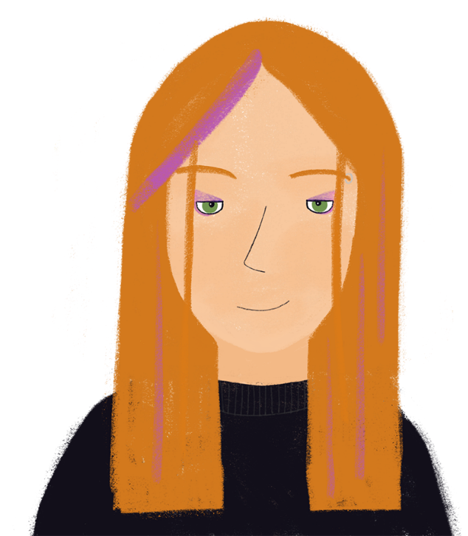
Que pense Élodie ?
*poser = to ask (a question)
lire
Je suis Élodie ! J’étudie dix matières. J’écoutais bien en maths mais c’est plus difficile dans les grandes classes. Je pratiquais beaucoup l’anglais au café de la ville. Je respecte les professeurs et je pose beaucoup de questions pour comprendre mes cours. J’aimais aller au château historique de la région avec mes amis.
Élodie is comparing her experiences at secondary school and sixth form college.
Write down the verbs you find in the text in the present and imperfect tense.
Notes:
Timing: 8 minutes [slide 1 of 2]
Aim: Written recognition of first person singular –ER verbs in the present and imperfect tenses and connecting these with meaning (ongoing actions in the present vs the past).
Procedure:
1. Students read text.
2. Click to bring up first task.
3. Give students three minutes to identify the verbs in the text, and to mark them as either ‘P’ (present) or ‘I’ (imperfect).
4. Click to bring up answers – elicit answers from students before revealing.
5. Move to the comprehension questions on the next slide.

Slide 12
Que pense Élodie ?
*poser = to ask (a question)
lire
Je suis Élodie ! J’étudie dix matières. J’écoutais bien en maths mais c’est plus difficile dans les grandes classes. Je pratiquais beaucoup l’anglais au café de la ville. Je respecte les professeurs et je pose beaucoup de questions pour comprendre mes cours. J’aimais aller au château historique de la région avec mes amis.
What does Élodie do now?
study ten subjects
respect the teachers
ask a lot of questions
What did Élodie use to do?
listen well in maths
practise English a lot in the café in town
like going to the region’s historic castle with her friends
You already know:
j’aime aller = I like to go
so you can work out:
j’aimais aller = I used to like to go
Notes:
[slide 2 of 2]
Procedure:
Click to bring up comprehension questions.
Allow 3 minutes for students to note their answers in English.
Click to bring up answers one by one (first present tense, then imperfect tense) – elicit answers from students before revealing answers each time.

Slide 13
Que pense Léa ?
écouter
Que dit-elle ?
Léa parle de l’école primaire
(imparfait) ou du collège (présent) ?
1
le collège (présent)
Je ne porte pas d’uniforme.
I don’t wear uniform.
2
l’école primaire (imparfait)
Je mangeais toujours un fruit.
I always ate fruit.
3
le collège (présent)
Je parle avec les professeurs.
I speak with the teachers.
4
Je coche les bonnes réponses
dans les contrôles.
I tick the right answers
in the tests.
le collège (présent)
5
l’école primaire (imparfait)
I used to like going to the cinema.
J’aimais aller au cinéma.
6
l’école primaire (imparfait)
Je regardais beaucoup la télé.
I used to watch a lot of TV.
7
J’écoute quand les autres parlent.
le collège (présent)
I listen when the others talk.
8
l’école primaire (imparfait)
J’achetais des livres.
I used to buy books.
Notes:
Timing: 8 minutes
Aim: Aural recognition of first person singular –ER verbs in the present and imperfect tenses and connecting these with meaning (ongoing actions in the present vs the past).
Procedure:
1. Click on audio buttons to hear sentences in the present and imperfect tense.
2. Students decide whether Léa is talking about her experiences at primary or secondary school.
3. Click to bring up answers one by one.
4. Listen to each sentence again.
5. Students transcribe and translate each sentence.
6. Click to bring up answers one by one (French and English for each sentence).
Transcript:
1. Je ne porte pas d’uniforme.
2. Je mangeais toujours un fruit.
3. Je parle avec les professeurs.
4. Je coche les bonnes réponses dans les contrôles.
5. J’aimais aller au cinéma.
6. Je regardais beaucoup la télé.
7. J’écoute quand les autres parlent.
8. J’achetais des livres.

Slide 14
Présent ou imparfait ?
lire / écrire
Some students of different ages are talking about what they used to do and what they do now. Put the verbs in brackets in the correct tense.
Jean : En cinquième, j’_________ l’anglais. (to learn)
En troisième, j’ _________ l’espagnol. (to study)
Jacques : En cinquième, je _________ avec mes amis. (to speak)
En sixième, j’ _________ le professeur. (to listen)
Loïs : En quatrième, je _________ du fromage le soir. (to eat)
En troisième, j’ _________ un livre essentiel. (to borrow)
Clément : En troisième, je _________ au foot l’après-midi. (to play)
En cinquième, j’ _________ aux magasins. (to go)
En cinquième, j’apprenais l’anglais.
En troisième, je pose des questions utiles en espagnol.
En cinquième, je parle avec mes amis.
En sixième, j’écoutais le professeur
En quatrième, je mangeais du fromage le soir.
En troisième, j’emprunte un livre essentiel.
En troisième, je joue au foot l’après-midi.
En cinquième, j’allais aux magasins.
Notes:
Timing: 5 minutes
Aim: Written production of first person singular –ER verbs in the present and imperfect tenses; written comprehension of French secondary school years.
Procedure:
1. Explain to students that these people are comparing their past school experiences with their school experiences now. Ensure students understand that in order to complete the task, they will have to work out which of the activities in each pair happened first by looking at the school year. Remind them of the English equivalents of the French school years (le sixième 11 – 12 ans (Y7), le cinquième 12 – 13 ans (Y8), le quatrième 13 – 14 ans (Y9), le troisième 14 – 15 ans (Y10)) and, if necessary, add a hint reminding them that the higher the number, the younger the pupil.
2. Students fill the gaps with the verb in the relevant tense.
3. Click to reveal answers one by one.
4. Oral translation of full sentences.

Slide 15
Les activités scolaires
parler
Partenaire A
J’écoutais mes amis.
Je voyage au collège en autobus.
Partenaire B
Activity | When?
travel by bus to secondary school | do now
listen to my friends | used to do
Activity | When?
travel by bus to secondary school
present
listen to my friends
past
Notes:
Timing: 5 minutes
Aim: Oral production and written recognition of first person singular –ER verbs in the present and imperfect tenses.
Procedure:
Divide students into pairs. Print and distribute the role cards on slide 19.
Click to go through example.
Student A says the activity on their rolecard in either present or imperfect tense as indicated.
Student B writes notes in their book – what is the activity and when is it done? (to reduce complexity for lower level classes, remove the part where partner B writes down the activity and keep the focus just on verb forms)
Swap roles
Check answers on slide 19.

Slide 16
Les activités scolaires
parler
Partenaire A
Activity | When?
go up to the library | do now
study German | used to do
listen to the teacher (m) | used to do
go back early | do now
buy fantastic books | used to do
ask questions | used to do
Partenaire B
Activity | When?
respect the headteacher (f) | used to do
work hard | do now
walk to primary school | used to do
help my friends | used to do
share my lunch | do now
prefer French | do now
Notes:
Role cards do not display

Slide 17
Les activités scolaires
parler
Réponses
Partenaire A
Je monte à la bibliothèque.
J’étudiais l’allemand.
J’écoutais le professeur.
Je rentre tôt.
J’achetais des livres fantastiques
Je posais des questions.
Partenaire B
Je respectais la directrice.
Je travaille dur.
Je marchais à l’école primaire.
J’aidais mes amis.
Je partage mon déjeuner.
Je préfère le français.
Notes:
Answers

Slide 18
Describing how things are and used to be: French school system
-ER verbs in the imperfect tense (habitual events with 'used to' equivalent in English) (il/elle/on)
ordinal numbers
liaison (x-, s-)
Y9 French
Term 2.2 - Week 1 - Lesson 40
Catherine Morris / Louise Bibbey / Natalie Finlayson
Artwork by: Chloé Motard
Date updated: 08/08/2022
Notes:
Artwork by Chloé Motard. All additional pictures selected are available under a Creative Commons license, no attribution required.
Native speaker feedback provided by Sarah Brichory.
With thanks to Rachel Hawkes for her input on the lesson material.
Learning outcomes (lesson 2): Consolidation of (x-, s-) liaison
Introduction of ordinal number formation
Introduction of –ER verbs in the imperfect tense (habitual events with 'used to' equivalent in English) (il/elle/on)
9.2.2.1 (introduce) corriger [1639], durer [605], poser [218], compétence [1757], connaissance [806], contrôle [662], système [289], cinquième [2030], deuxième [427], quatrième [1603], primaire [2527], sixième [3124], troisième [506], longtemps [312]
9.2.1.3 (revisit) entrer [337], monter [853], rentrer [295], retourner [990], tomber [547], après-midi [596], attente [936], corps [561], doigt [1938], dos [1672], médicament [1954], pied [626], santé [641], situation [223], soir [397], urgence [1199], faible [723], seulement [130], trop [195]9.1.2.1 (revisit) empêcher [306], pratiquer [1268], respecter [673], risquer [322], château [3510], région [241], essentiel [675], fantastique [4107], historique [902], utile [1003]
The frequency rankings for words that occur in this PowerPoint which have been previously introduced in NCELP resources are given in the NCELP SOW and in the resources that first introduced and formally re-visited those words.
For any other words that occur incidentally in this PowerPoint, frequency rankings will be provided in the notes field wherever possible.
The additional English meanings of the following words have been added to Quizlet since the creation of this resource:
longtemps – a long time, a long while
corriger – to correct, to mark
competence – skill, competence

Slide 19
Les nombres ordinaux*
*ordinal (masc. sing.) = ordinal
info
Ordinal numbers are used to describe the order in which things happen.
For example, the fourth year, the sixth lesson, the tenth test!.
In English, we normally add -th to numbers to make them ordinal. In French, we add –ième:
Translating the English ordinal number first into French is different:
First becomes premier or première (depending on whether the subject is masculine or feminine).
However, twenty-first follows the normal pattern, becoming le vingt-et-unième.
number
Ordinal number
SSC [i] + [ê/è]
second
deux
le deuxième
Exception: for cardinal numbers ending with ‘e’ such as quatre, remove the ‘e’ before adding the suffix –ième
For cinq, add ‘u’ before the suffix –ième
third
trois
le troisième
fourth
quatre
le quatrième
fifth
cinq
le cinquième
sixth
six
le sixième
Notes:
Timing: 3 minutes
Aim: To introduce the formation of ordinal numbers in French using the -ième suffix; to link the pronunciation of –ième with SSC [ê/è].
Procedure:
Click to bring up information and run through examples.
Point out the cross linguistic similarity (adding a suffix to a cardinal number to make an ordinal number).
Point out the link to SSCs [i] and [ê/è]. Practise saying the suffix with the two vowels
Click on the ordinal numbers to hear the native speaker pronounce them.
Draw attention to the exceptions for cardinal numbers ending with ‘e’, such as quatre (the ‘e’ is removed before adding the suffix), and to add ‘u’ after cinq.
Draw attention to how the English ordinal number ‘first’ into French is slightly different: First becomes premier or première (depending on whether the subject is masculine or feminine). However, twenty-first follows the normal pattern, becoming le vingt-et-unième.
Transcript:
1. le deuxième
2. le troisième
3. le quatrième
4. le cinquième
5. le sixième
Word frequency of cognates used (1 is the most frequent word in French): nombre [249], ordinal [>5000]
Source: Londsale, D., & Le Bras, Y. (2009). A Frequency Dictionary of French: Core vocabulary for learners London: Routledge.

Slide 20
Comprendre les nombres
*classé = classed/ranked
lire / écouter
1. Change these ordinal numbers into numbers, e.g. le huitième → huit
1
le soixantième
soixante
2
le trente-et-unième
trente-et-un
The -f in neuf changes to -v- in the ordinal form
3
le douzième
douze
4
le neuvième
neuf
2. Listen first, then read and translate the sentences into English.
1
J’habite dans la première maison à gauche.
I live in the first house on the left.
2
Joe Biden est le quarante-sixième président des États-Unis.
Joe Biden is the forty-sixth president of the United States.
3
Les Misérables est le septième roman de Victor Hugo.
Les Misérables is Victor Hugo’s seventh novel.
4
En tennis, Gaël Monfils est classé* vingt-deuxième au monde.
In tennis, Gaël Monfils is ranked twenty-second in the world.
Notes:
Timing: 5 minutes
Aim: To consolidate understanding and use of ordinal numbers; reading comprehension.
Procedure:
Click to reveal instructions and ordinal numbers 1-4.
Click on numbers to hear each ordinal number said aloud.
Students to produce the corresponding cardinal numbers (oral or written).
Click to reveal each answer in turn.
Draw attention to the spelling change from neuf to neuvième.
Click to reveal the instructions for the second task.
Click the number to hear each sentence before clicking again to reveal the transcript.
For number four, point out to students the meaning of the unknown word [classé], and ask them to practise saying the word.
Students to translate each French sentence into English (oral or writing).
Elicit answers from students before revealing each.
Transcript:
J’habite dans la première maison à gauche.
Joe Biden est le quarante-sixième président des États-Unis.
Les Misérables est le septième roman de Victor Hugo.
En tennis, Gaël Monfils est classé vingt-deuxième au monde.
Word frequency of cognates used (1 is the most frequent word in French): président [268], tennis [3867], classer [2070]
Source: Londsale, D., & Le Bras, Y. (2009). A Frequency Dictionary of French: Core vocabulary for learners London: Routledge.

Slide 21
[s-]/[x-] before a vowel
info
As you have already learned, an -x or -s at the end of a word is a silent final consonant (SFC), e.g. deux, trois.
However, when these numbers become ordinal numbers the [x] and [s] are no longer the last letter.
Instead, they are between two vowels, which changes SFC to [-s-].
deux >
deuxième
trois >
troisième
SFC >
[-s-]
SFC >
[-s-]
Notes:
Timing: 1 minute
Aim: To draw attention to the change from SFC to [-s-] when converting numbers ending in -s- or -x- into ordinal numbers.
Procedure:
1. Talk through the change from SFC to [-s-], giving deux and trois as example.
2. Click on text to play audio.
Transcript:
deux, deuxième
trois, troisième

Slide 22
Les nombres ordinaux
parler
Change to ordinal numbers.
Remember the liaison if needed!
cinquante
quarante-deux
cinquantième
[50th]
quarante-deuxième
[42nd]
dix-neuf
dix-neuvième
[19th]
quarante-et-un
treize
cinquante-trois
quarante-et-unième [41st]
treizième
[13th]
cinquante-troisième
[53rd]
vingt-sept
trente-trois
un
vingt-septième
[27th]
trente-troisième
[33rd]
premier/première
[1st]
Notes:
Timing: 5 minutes (Option 1 for higher-proficiency students – no digits provided. See next slide for a version for lower-proficiency students with digits provided).
Aim: To orally convert cardinal numbers into ordinal numbers, taking pronunciation changes into account.
Procedure:
Working in pairs, students take it in turns to say the cardinal numbers aloud, followed by the ordinal numbers, paying close attention to any pronunciation changes to –x and –s.
Click to reveal answers (answers appear left to right, top to bottom).
Teacher says the numbers aloud. Students repeat.

Slide 23
Les nombres ordinaux
parler
Change to ordinal numbers.
Remember the liaison if needed!
cinquante
[50]
quarante-deux
[42]
cinquantième
[50th]
quarante-deuxième
[42nd]
dix-neuf
[19]
dix-neuvième
[19th]
quarante-et-un
[41]
treize
[13]
cinquante-trois
[53]
quarante-et-unième [41st]
treizième
[13th]
cinquante-troisième
[53rd]
vingt-sept
[27]
trente-trois
[33]
un
[1]
vingt-septième
[27th]
trente-troisième
[33rd]
premier/première
[1st]
Notes:
(Option 2 for lower-proficiency students - digits provided to help).
Aim: To orally convert cardinal numbers into ordinal numbers, taking on board the spelling and phonics rules
Procedure:
Choose students to convert the cardinal numbers into ordinal numbers, and say them to the class
Pay particular attention to the SSC [s]
Click to reveal answers (answers appear left to right, top to bottom)

Slide 24
On va au collège!
parler
primaire
primary
deuxième
second
troisième
third
quatrième
fourth
fifth
cinquième
sixième
sixth
to correct, mark
test
to last, lasting
system
a long time/while
to ask (a question)
knowledge, skills/
competences
corriger
le contrôle
durer
le système
longtemps
poser
connaissances/ compétences
Notes:
Timing: 3 minutes
Aim: Oral production of new vocabulary, working at speed to increase fluency.
Procedure:
Students work in pairs. The aim is to travel to school (bottom right) by translating the new vocabulary correctly.
One student is the speaker, and one the listener.
The speaker starts at the top left and translates each word into French as fast as possible.
If the listener decides the speaker has made a mistake, they correct the mistake and take over as the speaker from the beginning.
This continues until one student succeeds in translating to the end without making a mistake.
The teacher clicks on the boxes to reveal the correct answers.

Slide 25
Le contrôle!
Copy the sentences in French, filling in the blanks
écrire
Cette semaine, j’ai fait un contrôle.
This week, I did a test.
?
Le contrôle a duré deux heures.
The test lasted two hours.
?
?
Le professeur a corrigé le contrôle.
The teacher marked the test.
?
?
J’ai été classé* seulement vingt-sixième.
I was only classed twenty-sixth.
?
Je n’ai pas étudié longtemps pour le contrôle.
I didn’t study a long time for the test.
?
?
Je n’ai pas de compétences et connaissances.
I don’t have skills and knowledge.
?
?
La prochaine fois, je vais étudier plus et je vais poser plus de questions.
Next time, I am going to study more and I am going to ask more questions.
?
?
?
Je préfère l’école primaire !
I prefer the primary school!
?
*classé = classed/ranked
Notes:
Timing: 5 minutes
Aim: Written production of new vocabulary items in longer contexts.
Procedure:
Students independently complete the French translations, filling in the blanks.
The teacher points out that the bold words in English correspond to the blanks, drawing attention to French word order with il y a and adjective. NB: If a shorter version is required, students can be asked only to write the missing words in the order they appear.
The teacher draws attention to the fact that the verbs ‘to last’ and ‘to correct’ must be in the perfect tense (and not the imperfect tense as these are not repeated actions). Remind students of the rule for creating past participles of –ER verbs if necessary.
The teacher asks individual students for answers, then clicks to reveal them.

Slide 26
L’imparfait* (il/elle/on)
*imparfait = imperfect
grammaire
To form the imperfect tense for il/elle/on, you need:
il/elle/on + stem of present tense ‘nous’ form + -ait
You have seen this before in the phrase
il y avait = there was, there were
travaillons
travaillait
e.g. travailler → nous → il/elle/on
voyageons
voyageait
e.g. voyager → nous → il/elle/on
cochons
cochait
e.g. cocher → nous → il/elle/on
Il mangeait dans le jardin.
He used to eat in the garden.
Notes:
Timing: 2 minutes
Aim: To introduce further forms of the imperfect tense (il/elle/on)
Procedure:
1. Click to bring up information.
2. Optional: get students to predict example verb forms.
3. Animate example sentence.
4. Continue to exercises on following slides.
Word frequency of cognates used (1 is the most frequent word in French): imparfait [>5000]
Source: Londsale, D., & Le Bras, Y. (2009). A Frequency Dictionary of French: Core vocabulary for learners London: Routledge.

Slide 27
Amir parle de qui ?
Is Amir talking about what he used to do (je) or about what Noura used to do (elle)? Traduis !
lire
Je suis plus vieux que ma sœur Noura. À l’école maternelle, je jouais avec les autres enfants tous les jours. À l’école primaire, j’ étudiais plus.
Elle restait à la maison comme bébé*. Je travaillais pour les contrôles et elle rampait* sous la table ! Elle empruntait des livres et
elle commençait à* lire. J’aidais avec le ménage.
1
2
3
4
5
6
7
8
I am older than my sister Noura. At nursery school, I used to play with other children every day. At primary school, I used to study more.
She used to stay at home as a baby. I used to work for tests and she used to crawl under the table! She used to borrow books and used to start to read. I used to help with the housework.
*le bébé = baby
*ramper = to crawl
*commencer à = to start to
Notes:
Timing: 5 minutes
Aim: Written recognition of first and third person singular –ER verbs in the present and imperfect tenses and connecting these with meaning (who used to do what).
Procedure:
1. Students read the text and decide who used to do what, using the verb ending to help them.
2. Click to reveal answers one by one – elicit answers from students each time.
3. Students summarise who did what, or translate the full text into English, taking care to translate the imperfect tense correctly using used to.
4. Click to reveal suggested translations one sentence at a time.
Word frequency of unknown words (1 is the most frequent word in French): bébé [2271], ramper [>5000]
Source: Londsale, D., & Le Bras, Y. (2009). A Frequency Dictionary of French: Core vocabulary for learners London: Routledge.

Slide 28
Que dit Noura ?
Noura parle de l’école maternelle (imparfait) ou de l’école primaire (présent) ?
écouter
1
l’école primaire (présent)
On travaille dur.
We work hard.
2
l’école primaire (présent)
On étudie beaucoup pour les contrôles.
We study a lot for tests.
3
l’école maternelle (imparfait)
On jouait plus.
We used to play more.
4
l’école maternelle (imparfait)
On lisait ensemble.
We used to read together.
5
l’école maternelle (imparfait)
On dormait le midi.
We used to sleep at midday.
6
l’école primaire (présent)
On comprend que c’est important d’apprendre.
We understand that it is important to learn.
7
l’école primaire (présent)
On emprunte des livres
de la bibliothèque.
We borrow books from
the library.
8
l’école maternelle (imparfait)
On gagnait les jeux.
We used to win the games.
Notes:
Timing: 8 minutes
Aim: Aural recognition of third person singular –ER verbs in the present and imperfect tenses and connecting these with meaning (ongoing actions in the present vs the past).
Procedure:
1. Click on audio buttons to hear sentences in the present and imperfect tense.
2. Students decide whether Noura is talking about her experiences at primary school or nursery.
3. Click to bring up answers one by one.
4. Listen to each sentence again.
5. Students transcribe and translate each sentence.
6. Click to bring up answers one by one (French and English for each sentence).
Transcript:
On travaille dur.
On étudie beaucoup pour les contrôles.
On jouait plus.
On lisait ensemble.
On dormait le midi.
On comprend que c’est important d’apprendre.
On emprunte des livres de la bibliothèque.
On gagnait les jeux.

Slide 29
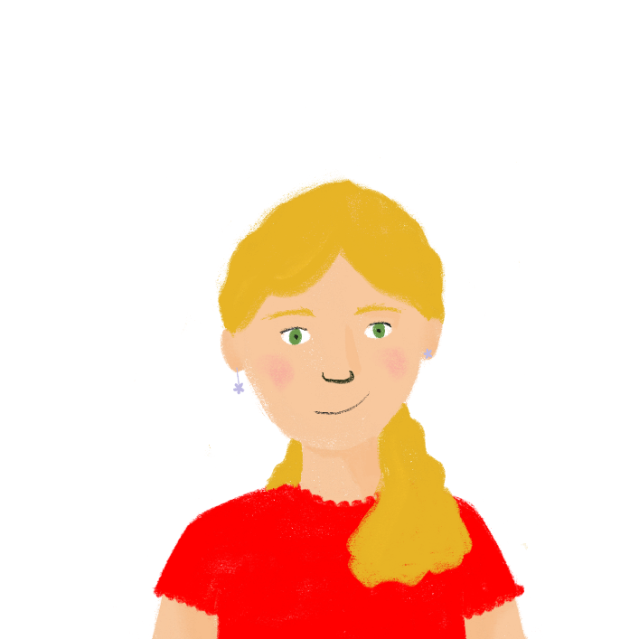
C’est qui et quand ? [1/2]
parler/écrire
Talk about how you have changed
Au collège aujourd’hui …
J’aime …
Il/elle regarde …
À l’école primaire …
Je respectais…
Il/elle jouait…
Je jouais au foot tous les jours.
Il écrit beaucoup.
J’aime étudier.
Elle respectait
les règles.
Je jouais au foot tous les jours.
Il écrit beaucoup.
J’aime étudier.
Elle respectait les règles.
Notes:
Timing: 10 minutes [slide 1 of 2]
Aim: Oral and written production of sentences in the first and third person singular, present and imperfect tense; scaffolded free speaking and writing.
Procedure:
1. Students work in pairs.
2. One student speaks about what they do at school now vs in primary (using the present and imperfect tense), using the prompts on the next slide to help. They should talk about themselves and a classmate (using je and il/elle/on verb forms)
3. The other student transcribes – paying attention to verb endings that sound the same
4. Students swap roles
5. Click through model on this slide
5. Some sentence starters to help on the next slide (these may be deleted for higher ability students)

Slide 30
C’est qui et quand ? [2/2]
parler/écrire
Talk about how you have changed
Il/elle fait …
Il/elle regarde …
Il/elle gagne …
Il/elle étudie…
Au collège aujourd’hui …
Je mange …
J’aime …
Je voyage …
Je retourne…
Il/elle jouait …
Il/elle étudiait …
Il/elle pensait …
Il/elle entrait…
À l’école primaire …
Je respectais …
Je quittais …
J’achetais …
Je tombais…
Notes:
[slide 2 of 2] Prompts

Slide 31
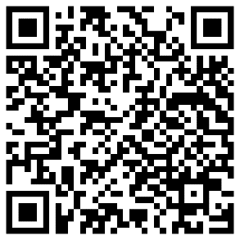
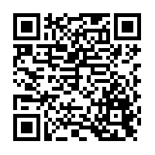
Devoirs
Vocabulary Learning Homework (Y9, Term 2.2, Week 2)
Audio file
Audio file QR code:
Student worksheet
Quizlet QR:
Quizlet link
In addition, revisit: Year 9 Term 2.1 Week 4
Year 9 Term 1.2 Week 2
Notes:
The answer sheet for the 9.2.2.2 vocabulary learning homework is here: Resource | French SOW Y9 Term 2.2 Week 2 - vocabulary learning homework answers | ID: 6395w895q | NCELP

