Slide 1
How does explicit phonics teaching make a difference?
Robert Woore / Rachel Hawkes
Date updated: 8/3/2020
Notes:
Session 3
Thursday 23rd January 2020
How does Explicit Phonics Teaching
make a Difference?
Dr Rachel Hawkes
Director MFL, CAM Academy Trust / Co-Director NCELP
The MFL Pedagogy Review recommendations include (amongst others) principles for teaching phonics, vocabulary, grammar and their combination in meaningful practice. In this workshop we focus on research-informed practice for explicitly teaching, consolidating and applying the sound-writing relationship in secondary language learning. The session includes (freely available) resources for teaching phonics in French, German and Spanish.
Rachel Hawkes is co-director of the NCELP managing the Centre together with Emma Marsden. She works across the six schools in The CAM Academy Trust, where she is Director of International Education and Research and SLE for languages. She is also a former President of ALL, co-author of the new Pearson textbook for GCSE Spanish (¡Viva!). She also has a PhD from the University of Cambridge, focusing on teacher and learner interaction in the secondary languages classroom.
Note: Robert Woore is Lecturer at Oxford University and has conducted research into phonics, most recently he led the FLEUR project.

Slide 2

NCELP website
Notes:
A brief introduction to NCELP – fusing research and practice more closely than has previously been possible.
The importance of both practitioner knowledge and research – one is no substitute for the other, both are necessary and complementary.
Quite a few people I’m meeting now have come across the website, but there’s that awkwardness when you encounter something in print that you’ve never heard said!
People who then want to refer to it say– N – C – E – L – P or NKELP or even worse, try to avoid the acronym altogether and say the whole long name!
Importance of prepositions: FOR not OF!
In November 2016, the Teaching Schools Council published the Report of the MFL Pedagogy Review .
The report noted that only a third of pupils achieves a languages GCSE at grade 4 or above and that less than a half of pupils even takes a language GCSE.
Research has shown that poor motivation in studying a language is partly due to pupils feeling that they do not know the language and feeling that they are not making progress.
The National Centre for Excellence for Language Pedagogy (NCELP)’ s approach to FL pedagogy is both research- and practice-informed, taking into account the time-poor context of curriculum FL learning in English classrooms.
Anon. 2016. Modern Foreign Languages Pedagogy Review. A review of modern foreign languages teaching practice in key stage 3 and key stage 4. (Chair: Ian Bauckham). Teaching Schools Council

Slide 3
NCELP team
Research and CPD specialists
Prof Suzanne Graham (University of Reading)
KS2-3 transition, literature, meaningful practice
Dr Rowena Kasprowicz (University of Reading)
KS2 knowledge about language, grammar
Prof René Koglbauer (University of Newcastle)
School FL policy, leadership training, CALL
David Shanks (Harris Federation)
School FL policy, CALL, differentiation
Dr Robert Woore (University of Oxford)
Teaching and learning phonics, reading, vocabulary
Director: Prof Emma Marsden (University of York)
Co-Director: Dr Rachel Hawkes (Cam Academy Trust)
Resource developers
Dr Inge Alferink
Nick Avery
Natalie Finlayson
CPD providers
Victoria Hobson
Stephen Owen
Management and administration
Ann Mannion, Heather Bradley, Wendy Burns
Tech team for Gaming Grammar
Andy Wood
Dr Nick Sephton
Tech team,
Resource Portal
Dr Frank Feng
Dr Sebastian Pelucha
Notes:
An even quicker introduction to the NCELP team, both in York and around the country.

Slide 4
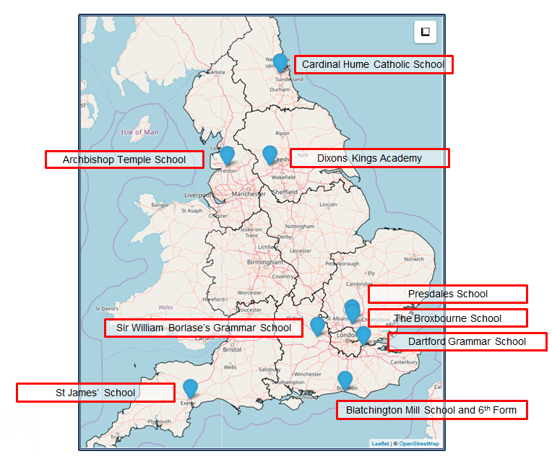
The Nine Lead Schools
Working with 9 Hubs:
9 Lead Schools each with 4 hub schools
Dartford Grammar School, Dartford
Dixons Kings Academy, Bradford
Presdales School, Ware, Hertfordshire
Sir William Borlase’s Grammar School, Marlow
St James’ School, Exeter
The Broxbourne School, Broxbourne, Hertfordshire
Archbishop Temple School, Preston
Blatchington Mill School and Sixth Form, Hove
Cardinal Hume Catholic School, Gateshead

Slide 5

Essential language knowledge
(for beginner language learners)
Pupils need to gain systematic knowledge of the vocabulary, grammar, and sound and spelling systems (phonics) of their new language, and how these are used by speakers of the language. They need to reinforce this knowledge with extensive planned practice and use it in order to build the skills needed for communication. (MFL Pedagogy Review, p.3)
Notes:
So, question 1: What is the subject content that we teach in languages?
We teach three core strands of essential knowledge: phonics, which is the set of sound-symbol correspondences that represent the relationship between how the language sounds and how it is written.
We teach vocabulary, a chosen set of words in the language, and we teach grammar – a set of features that are the essential building blocks needed to put language together to make meaningful sentences.
The metaphor of the braid indicates that:
the knowledge is stronger because of the interconnections between the strands.
The fact that they are closely intertwined suggests that
each strand is important and affects the other.
The loose ends recognise that
the language learning process is always unfinished, and
the knowledge is vulnerable to decay, just as the braid is prone to unravelling.
Braid image:
By Chris 73 / Wikimedia Commons, CC BY-SA 3.0, https://commons.wikimedia.org/w/index.php?curid=10484

Slide 6
FAQ in schools this year
What is the essential knowledge in your subject?
Why are you teaching it in this order?
Is teaching clear and do learners understand?
Do they remember more, know more and can they do more? (And how do you know?)

Slide 7

Session aims
Develop an understanding of the rationale for teaching phonics in a foreign language and the research evidence underpinning this
Explore the NCELP phonics resources
Consider how phonics teaching might be put into practice in your school context

Slide 8
Session overview
Presentation and discussion: Research evidence relating to the teaching of phonics in MFL
Possible concerns
NCELP Symbol-Sound Correspondences (SSC) and how we chose them
A range of teaching approaches and resources
Assessing students’ SSC knowledge

Slide 9
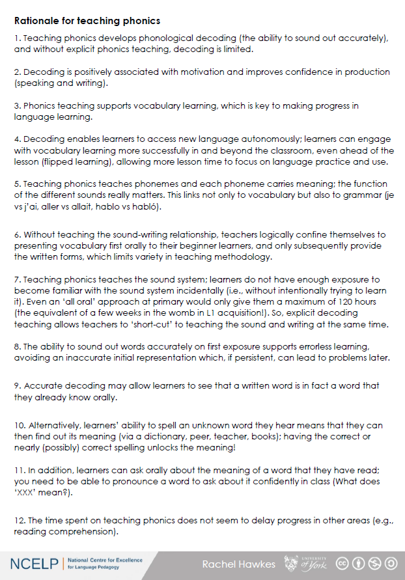
Rationale for teaching phonics
Read through ‘Handout 6: Rationale for teaching phonics’
Any comments or questions on any of this?

Slide 10
Concerns?
At this stage, do you have any concerns about teaching phonics in MFL? Do you have any worries or foresee any problems?
Here are some possible objections that we envisaged. How do you feel about these points?
I think it will confuse my lower attaining learners.
There’s no point teaching phonics. They will pick it up on their own.
Ideally, I would like to teach this, but there is no time in the Scheme of Work.
I can see the point in Spanish and German, but in French it is too complicated.
My students would find this boring or babyish
This is not my priority – my students are already OK at reading. The other skills are more important to focus on.

Slide 11
PHONICS
selection & sequencing of sound-symbol correspondences (SSCs)
high-frequency ‘source’ words
Erler, L. and Macaro, E. (2012) ‘Decoding Ability in French as a Foreign Language and Language Learning Motivation’. The Modern Language Journal, 95(4): 496-518.
Woore, R. (2007) ‘“Weisse Maus in Meinem Haus”: Using Poems and Learner Strategies to Help Learners Decode the Sounds of the L2’. Language Learning Journal, vol. 35, no. 2, pp. 175-188.
Woore, R. (2009) ‘Beginners’ progress in decoding L2 French: some longitudinal evidence from English Modern Foreign Languages classrooms’. Language Learning Journal, vol. 37, no. 1, pp. 3-18.
Woore, R. (2010) ‘Thinking aloud about L2 decoding: an exploration into the strategies used by beginner learners when pronouncing unfamiliar French words’. Language Learning Journal, vol. 38, no. 1, pp. 3-17.
Woore, R. (2011) Investigating and developing beginner learners’ decoding proficiency in second language French: an evaluation of two programmes of instruction. Unpublished PhD thesis, University of Oxford.
Woore, R. (2014) ‘Beginner learners’ progress in decoding L2 French: transfer effects in typologically similar L1-L2 writing systems’. Writing Systems Research, volume 4(2): 167-189.
Woore, R (2018) ‘Learners’ pronunciations of familiar and unfamiliar French words: what can they tell us about phonological decoding in an L2?’ The Language Learning Journal, 46(4):456-69.
Woore, R., Graham, S., Porter, A., Courtney, L. and Savory, C. (2018) Foreign Language Education: Unlocking Reading (FLEUR) - A study into the teaching of reading to beginner learners of French in secondary school. https://ora.ox.ac.uk/objects/uuid:4b0cb239-72f0-49e4-8f32-3672625884f0
Notes:
The frequency principle is uppermost in all three strands (PVG).
Let’s look briefly at phonics.

Slide 12
FAQ in schools this year
What is the essential knowledge in your subject?
Why are you teaching it in this order?
Is teaching clear and do learners understand?
Do they remember more, know more and can they do more? (And how do you know?)

Slide 13
Choice of target SSC
We lack clear research evidence on which SSC are the most important to teach, and in what order
We have based our selection on a ‘bang for buck’ principle, drawing on evidence concerning:
Difficulty – how hard it is for students to decode the SSC accurately
Frequency – how often the SSC occur in the language
Teacher expertise and judgment
We have also adopted a ‘cumulative’ principle in ordering sounds and their ‘source words’
We have made a ‘working selection’ – this may be refined over time (with help from your feedback!)

Slide 14
SSC difficulty
In your experience, which are the most difficult French SSC for students to pronounce (i.e. which do they get wrong most often)?
How do your intuitions match the following empirical data?

Slide 15
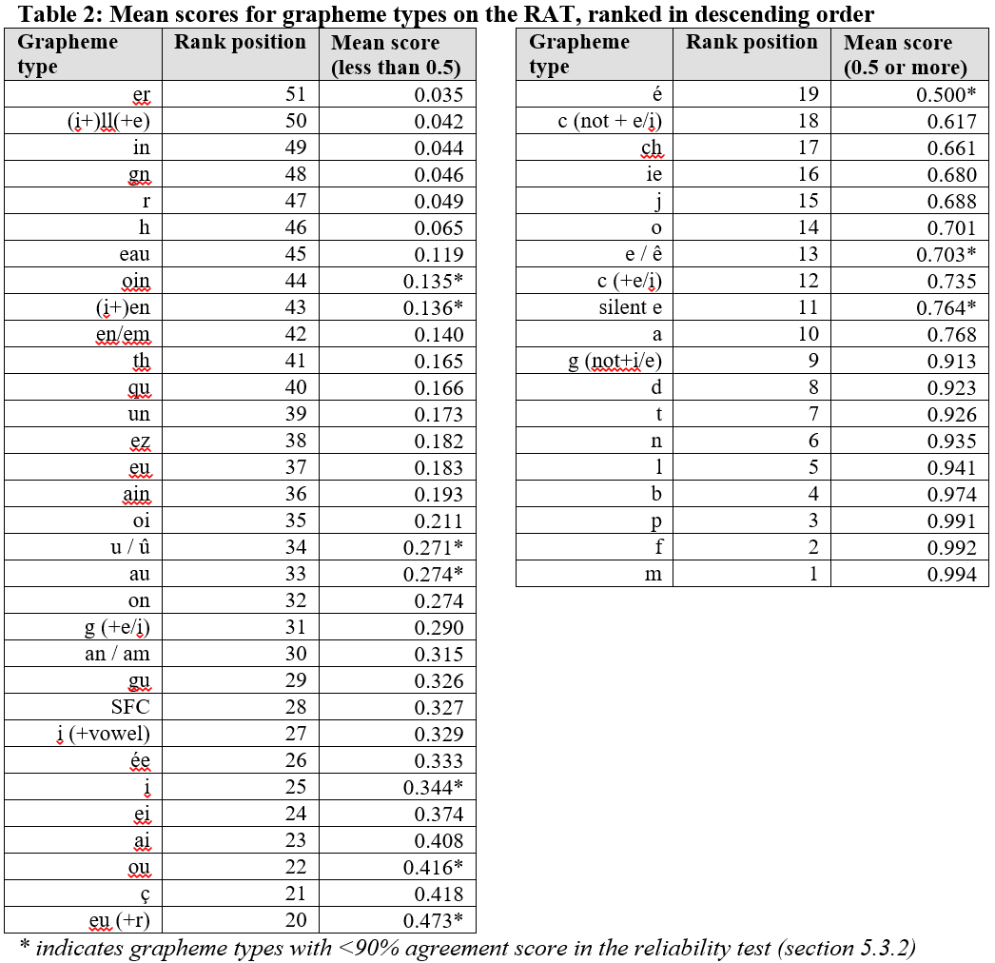
Data from Woore (2006)
Data from Woore (2006)
N=188 Year 7 and Year 9
One comprehensive school
English L1
Robert Woore

Slide 16
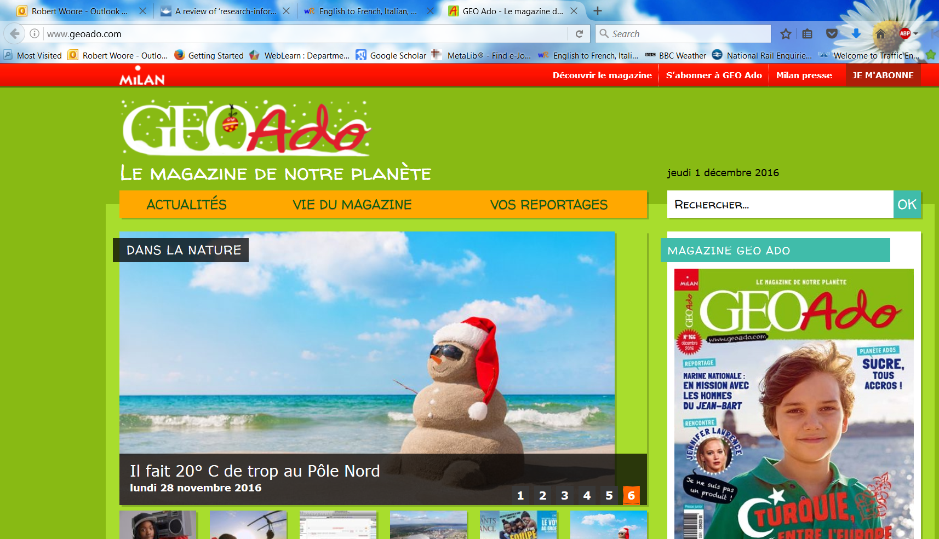
SSC frequency
Analysis of two small corpora:
first 200 words of six ‘featured texts’ from an on-line magazine for French young people (www.geoado.com)
Analysis of words in Dynamo 1 Module 1

Slide 17
graphemes
SFC(all) | 339 | SFCt | 76 | tion | 24 | o[O] | 12 | ph | 4 | aî | 1
r | 302 | en | 73 | ll[L] | 22 | h | 11 | x[KS] | 4 | aill | 1
a | 245 | c[+i/e] | 61 | est | 19 | mm | 11 | e[e] | 3 | am | 1
d | 240 | ou | 60 | in | 19 | om | 11 | eau | 3 | aon | 1
SFCs | 235 | an | 59 | oi | 19 | em | 10 | ei | 3 | cc[+i/e] | 1
l | 228 | e[O] | 58 | è | 18 | SFCd | 10 | gu | 3 | eil | 1
i | 221 | es | 58 | nn | 17 | ent[3PV] | 9 | SFCp | 3 | œu | 1
SFe | 219 | on | 57 | ss | 17 | j | 9 | x[GZ] | 3 | oy | 1
t | 167 | f | 43 | à | 16 | tt | 9 | z | 3 | s[finalSOUNDED] | 1
p | 164 | qu | 43 | ch | 16 | ê | 7 | eill | 2 | SFCc | 1
e[SCHWA] | 143 | SMe | 40 | u[G] | 16 | rr | 7 | ein | 2 | th | 1
m | 117 | i[G] | 39 | un | 16 | ain | 6 | ez | 2 | tielle | 1
s | 117 | b | 38 | ée | 15 | ç | 5 | im | 2 | tien | 1
o[C] | 114 | s[IV] | 38 | eur | 15 | ff | 5 | ô | 2 | y[CONS] | 1
é | 113 | ai | 35 | g | 15 | ien | 5 | oin | 2
u | 96 | et | 30 | y | 15 | ay | 4 | pp | 2
n | 94 | g[+i/e] | 29 | eu | 14 | cc | 4 | tio | 2 | 4393 graphemes
c | 86 | au | 27 | SFCx | 14 | gn | 4 | um[NN] | 2
v | 79 | er | 24 | ie | 13 | ill[Y] | 4 | â | 1

Slide 18
SSC table
 | Totals Dynamo | Total Géoado | Dynamo ranking | Géoado ranking
SFC | 60 | 339 | 1 | 1
a / à / â / as | 51 | 262 | 2 | 2
i / ie / y | 42 | 249 | 4 | 3
SFe | 45 | 219 | 3 | 4
e / eu / oeu | 34 | 179 | 6 | 5
é/ et / ez / er / les | 37 | 152 | 5 | 6
en / em / an | 25 | 151 | 7 | 7
o /eau(x) / au(x) | 20 | 141 | 8 | 8
u | 20 | 112 | 8 | 9
on | 9 | 57 | 11 | 11
ou | 7 | 60 | 15 | 10
-in / -ain / ym | 9 | 27 | 11 | 14
è / ê | 9 | 25 | 11 | 15
qu / q | 7 | 43 | 15 | 12
oi | 9 | 21 | 11 | 17
un /um | 10 | 18 | 10 | 18
j / g (soft) | 4 | 38 | 17 | 13
-tion | 0 | 24 | 21 | 16
ch | 3 | 16 | 18 | 19
ç | 3 | 5 | 18 | 20
-ien | 1 | 5 | 20 | 20

Slide 19
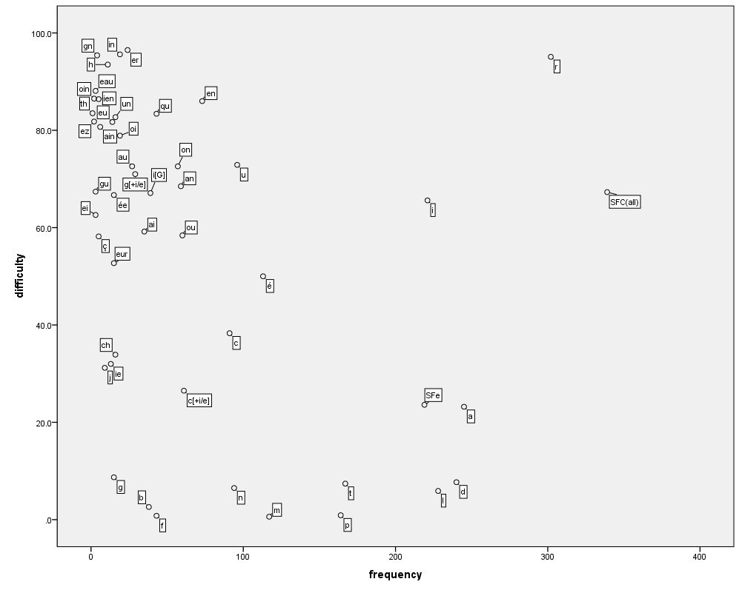
Graph

Slide 20
Target SSC in French
Teaching order | Frequency order | SSC | Teaching order | Frequency order | SSC
1 | 1 | SFC | 13 | 12 | -in / -ain
2 | 2 | a | 14 | 13 | è / ê
3 | 3 | i | 15 | 13 | ai (ais / ait)
4 | 5 | eu | 16 | 15 | oi
5 | 5 | e | 17 | 19 | ch
6 | 8 | o /eau / au | 18 | 20 | ç (and soft -c)
7 | 9 | u | 19 | 14 | qu
8 | 11 | ou | 20 | 17 | j
9 | 4 | SFe | 21 | 18 | -tion
10 | 6 | é | 22 | 21 | -ien
11 | 7 | en / an | 23 | 16 | un
12 | 10 | on

Slide 21
Target SSC In German
Teaching order | SSC | IPA
Group 1 | a (long), a (short) e (long), e (short) ei w z | /a:/ /a/ /e:/ /ɛ/ /ai/ /v/ /ts/
Group 2 | i (long), i (short) ie ch sch | /i:/ /ɪ/ /i:/ /ç/ /x/ /ʃ/
Group 3 | o (long), o (short) u (long), u (short) | /o:/ /ɔ/ /u:/ /ʊ/
Group 4 | er (stressed) er (unstressed) r (vocalic), r (consonantal) v | /eːɐ/ /ɐ/ /ɐ/ /r/ /f/
Teaching order | SSC | IPA
Group 5 | s (start/middle) ss / ß / -s | /z/ /s/
Group 6 | ü (long), ü (short) ö (long), ö (short) ä (long), ä (short) | /y:/ /ʏ/ /ø:/ /ø/ /ɛ:/ /ɛ/
Group 7 | au eu äu | /au/ /ɔɪ/ /ɔɪ/
Group 8 | -d -ig st-, sp- j th | /t/ /ç/ /ʃt/ /ʃp/ /j/ /t/
1) The long vowels a,e,i,o,u in German are less straightforward than the short vowels. They are presented together for contrast purposes. Later they can be contrasted with the trickier ä, ö, ü.
2) Likewise the ‘er’ unstressed sound is very similar to the –er at the end of ‘mother’, but the ‘er’ stressed is a rather different sound, so the two are presented together.
3) A tentative, suggested time frame might be to spend 10-12 minutes each lesson on phonics. So, for example, a / e would be lesson 1, ei/w/z in lesson 2. The following week would revisit all of these, before starting in Week 3 with Group 2. This would put the initial introduction and practice phase at 16 weeks, just over one term. After that, specific contrasts would be practised regularly: u/ü, o/ö, a,ä, ei/ie, z/s-, sch/st/sp, v/w and sch/ch, as well as other tasks that combine several SSCs. This would run over the spring term. The summer term of Y1 would continue to develop and apply SSC knowledge, including through the use of more extended, authentic texts.
4) Diagnostic assessment of pupils’ development would also inform the re-visiting of specifically challenging SSCs.

Slide 22
Target SSC in Spanish
Teaching order | SSC
Group 1 vocales | a e i o u
Group 2 LL/L * | ll vs l
Group 3 C/Z *** | ca, co, cu vs ce, ci, z
Group 4 | que, qui
Teaching order | SSC
Group 5 | ga, go, gu vs j, ge, gi (gue, gui)
Group 6* | n vs ñ
Group 7** | v, b
Group 8* | rr vs r
Group 9 | h
1) Spanish is clearly a much shallower language, phonetically. The pace of introduction and practice is likely to be somewhat quicker than in French, as a result.
2) * Note that some straightforward SSCs are introduced, predominantly to contrast with other less straightforward ones (ll/l, n/ñ, r/rr).
3) ** B is presented with V because these are the same sound – different spelling pair.
4) A tentative, suggested time frame for teaching might be to spend 10-12 minutes each lesson on phonics. So, for example, each group would be introduced and practised in lesson 1, and further practised in lesson 2. In week 2, we would present and practise group 2. After that, specific contrasts would be practised regularly, as well as other tasks that combine several SSCs. This fairly controlled introduction/practice would probably run until the end of the spring term. The summer term of Y1 would continue to develop and apply SSC knowledge, including through the use of more extended and richer texts.
5) Diagnostic assessment of pupils’ development would also inform the re-visiting of specifically challenging SSCs.
6) Seseo / ceceo. Whether the ce / ci/ z are pronounced seseo (e.g., as in Latin America/the Canary Islands) or ceceo (e.g., as in most parts of Spain) does not make a difference to meaning or to the SSCs, but learners should be exposed to and understand both versions at later stages. Given GCSE requirements, ‘ceceo’ is probably the most sensible starting point.

Slide 23
Order of teaching
frequency (phonics, vocabulary and grammar)
age-appropriateness / context-appropriateness
learner choice
awarding body vocabulary list
Notes:
Q2: Why are you teaching it (the knowledge, Phonics, Vocabulary, Grammar) in this order?
The most important principle is frequency.
High frequency – so, the most likely to be the most useful

Slide 24

























Chart of French phonics
SFC
X
a
i
eu
e
au
dans
 |  |  |  |  | Francophoniques
animal
midi
deux
je
gauche
u
ou
a
en/an
on
SFE
Non!
tu
nous
X
écrire
enfant
timide
ain/in
ê/è
ai
oi
ch
c
train
tête
vrai
voir
ici
chercher
qu
j
tion
ien
un
question
jour
bien
un
Attention!
X
Stephen Owen / Rachel Hawkes
Notes:
Phonics
1. Choice of SSC (Sound-symbol correspondences) was based on frequency of occurrence in the language (hence Silent-Final-Consonant first).
A ‘bang for buck’ principle was implemented to achieve the maximum improvement in decoding within a time-limited teaching context.
The SSC were chosen based on their difficulty for L1 English speakers, their frequency of occurrence in the language and teacher knowledge.
The notion is that one SSC would be the focus each week in Y7, with time also built in for revisiting/recycling.
10-12 minutes per lesson might be spent on introducing the new SSC and recapping one or more previously learnt SSC.
Phonics work is likely to continue in Y8, too.

Slide 25
Source words in French
Teaching order | SSC | Source word | Frequency | Teaching order | SSC | Source word | Frequency
1 | SFC | dans | 11 | 13 | -in / -ain | train | 232
2 | a | animal | 1002 | 14 | è / ê | tête | 343
3 | i | midi | 2483 | 15 | ai (ais / ait) | vrai | 292
4 | eu | deux | 41 | 16 | oi | voir | 69
5 | e | je | 22 | 17 | ch | chercher | 336
6 | o /eau / au | gauche | 607 | 18 | ç (and soft -c) | ici | 167
7 | u | tu | 112 | 19 | qu | question | 144
8 | ou | nous | 31 | 20 | j | jour | 78
9 | SFe | timide | 3835 | 21 | -tion | Attention! | 482
10 | é | écrire | 382 | 22 | -ien | bien | 47
11 | en / an | enfant | 126 | 23 | un | un | 3
12 | on | non! | 72
Stephen Owen / Robert Woore
Notes:
2. Source words were chosen for frequency, but also for their simplicity in terms of the pronunciation of the word in terms of the other phonemes apart from the target SSC.
We use a cumulative principle too, to ensure that later SSCs are not used before they have been learnt.
This was more important than whether the word could be easily depicted in an image or linked to a gesture, although we wanted also to achieve these things.
This table includes the frequency so people can see the rationale for the selection of the words

Slide 26


















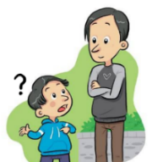
















Spanish SSC
a
e
i
o
u
ll
libro
alto
elefante
idea
yo
universo
llamar
l
ca
co
cu
ce
ci
z
MADRID 1KM
casa
comer
cuerpo
cerca
cierto
zona
ga
go
gu
ge
gi
j
ganar
gol
preguntar
gente
imaginar
ojo
ñ
mano
v
celebrar
rr
pero
h
porque
qui
guerra
gui
español
n
ver
b
perro
r
hablar
que
quiero
gue
guitarra
Notes:
Click on the letter(s) to hear the SSC sound alone, and then either the picture or the word to hear the SOURCE word itself.
Suggestions for gestures to accompany each source word can be found in the Spanish_SSC_Source_Words PPT, in the notes under each slide.

Slide 27



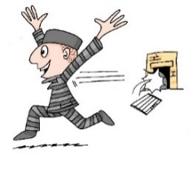

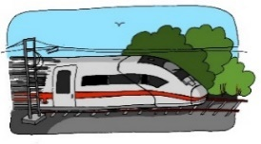









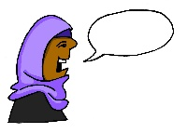








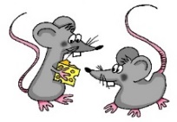




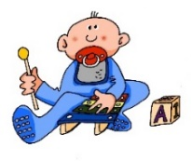

German SSC
a
e
ei
w
z
sagen
geben
frei
Welt
Zug
i
ie
ch
ch
sch
wir
Liebe
ich
Buch
schreiben
o
u
er
r
v
s
ß
wo?
du
er
reden
vor
sollen
groß
ü
ö
ä
au
eu
äu
Tür
schön
spät
Haus
Deutschland
Mäuse
-d
-ig
st-
sp-
j
th
und
richtig
stark
spielen
ja
Theater
Steve Clarke/ Rachel Hawkes
Notes:
This version has the short versions of all vowels removed, as these correspond more closely with English short vowels. In addition, the lesser or unvocalised ‘er’ and ‘r’ SSCs have been omitted, so as to achieve maximum clarity in the poster version. A full version with all SSCs is on slide 2.

Slide 28




























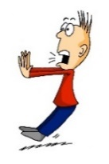









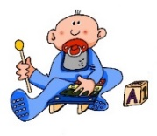

All German SSC
a
a
e
e
ei
w
z
sagen
kalt
geben
denken
frei
Welt
Zug
i
i
ie
ch
ch
sch
wir
finden
Liebe
ich
Buch
schreiben
o
o
u
u
er
er
r
r
v
s
ß
wo?
Kopf
du
Punkt
er
wieder
reden
Uhr
vor
sollen
groß
ü
ü
ö
ö
ä
ä
au
eu
äu
Tür
fünf
schön
plötzlich
spät
lächeln
Haus
Deutschland
Mäuse
-d
-ig
st-
sp-
j
th
und
richtig
stark
spielen
ja
Theater
Steve Clarke/ Rachel Hawkes
Notes:
ALL German SSCs

Slide 29
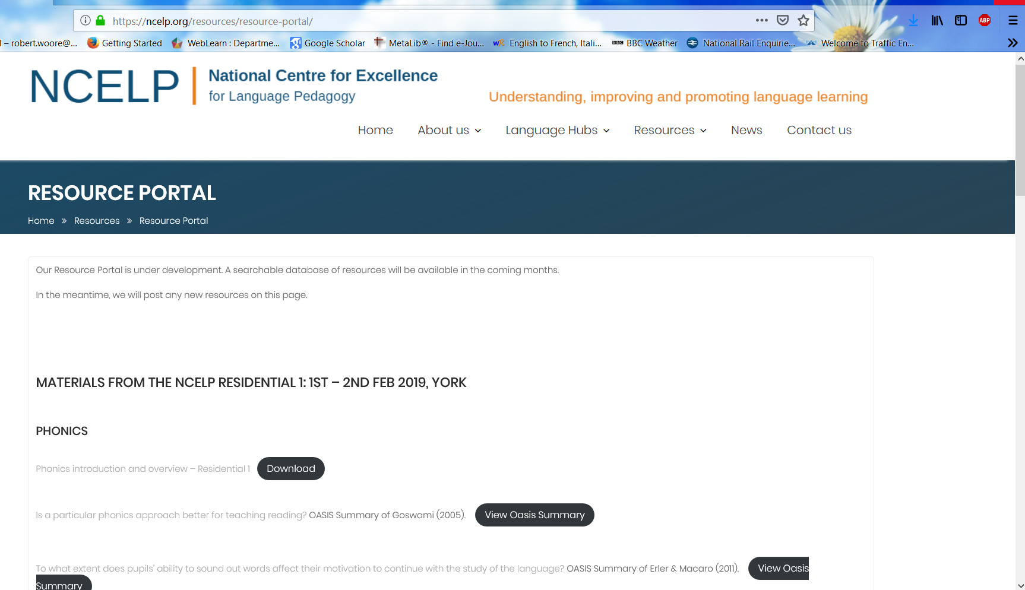
Teaching approaches & resources
Introducing new SSC
Consolidating SSC knowledge
Applying SSC knowledge
Notes:
Handout 2: Summary suggested ideas for teaching phonics

Slide 30
Phonics introduction of new SSC
SSC presentation
Source word presentation (gesture and picture)
Cluster word presentation and practice

Slide 31

Silent final consonant
dans
X
Notes:
AUDIO x 2: on appearance of X and of the visual for ‘in’.
Explanation in English, if desired: Something that makes French sounds very different from English is that some consonants at the ends of words are silent.
This means you don’t pronounce/sound them out at all.
As in the word ‘dans’ in French.
Say and repeat the word.
Ensure pupils know the meaning (use usual routine for this – e.g. C’est quoi en anglais ‘dans’? ‘In’, oui, c’est ça.
A possible gesture to accompany this SSC would be to hold ones finger to ones lips to indicate ‘Shhhh!’

Slide 32
Silence!
prix
petit
dans
X
mot
grand
mais
Notes:
Elicit pronunciation of ‘dans’ again before clicking to animate the ‘X’
Possible explanation, in English, if desired: Let’s see which other final consonants are silent in French.
Lead class repetition of the five CLUSTER words.
Word frequency rankings (1 is the most common word in French):
dans [11]; petit [138]; prix[310] mot [220]; grand [59]; mais [30]
Source: Londsale, D., & Le Bras, Y. (2009). A Frequency Dictionary of French: Core vocabulary for learners London: Routledge.

Slide 33




French SFC exercise
petit
prix
grand
€15.95
mot
mais
Notes:
With this round of repetition, ensure that pupils are clear about the meaning of each of these high-frequency words.
NB: pictures can, at best, only suggest meaning. Many high-frequency words less concrete than other words, and less easy to communicate unequivocally in pictures.
Therefore, teachers should not shy away from giving the English meaning to students, to prevent any erroneous representations taking root in memory.
With these words, however, it is expected that pupils will know several of them already.
Lead class repetition of the five CLUSTER words.

Slide 34

Vowels
German vowels can be short or long.
Vowels are short when followed by more than one consonant, e.g., Mann, Gast.
Vowels are long when:
  there is a double vowel, e.g. Paar,
  or when followed by the letter ‘h’, e.g., fahren,
  or by a single consonant, e.g., sagen.
NB: German final ‘e’is not silent, but very short, e.g. danke, Klasse.
Notes:
Note: It is important to give this explanation, but in the same way as with explicit grammar explanation, it is the practice that counts most. The idea here is not to write out the explanation, but to put it into practice with the phonics source words, and then relate the long and short ‘a’ sounds to two new nouns, ‘die Tafel’ and ‘die Flasche’.
It may be helpful to ensure that ‘vowel’ is 100% understood, eliciting an example in English from students.
Note: There are, of course, exceptions to these rules – ‘mit’ has a short vowel sound, and so does ‘das’ which they have just met.
It may be helpful to draw attention to the trickiness of English vowel/letter strings and show that there are many exceptions here, too – e.g. the pronunciation of ‘o’ in ‘love’ and ‘move’ and ‘cove’ – different in all three.

Slide 35

a
[a:]
sagen
Notes:
Source word: sagen [46]
1. Present the letter and say the long ‘a’ sound first, on its own. Students repeat it with you.
2. Bring up the word ‘sagen’ on its own, say it, students repeat it, so that they have the opportunity to focus all of their attention on the connection between the written word and its sound.
3. Bring up the picture, and if using gestures, a possible gesture for this would be to mime speech coming out of your mouth, opening your mouth and drawing your hand away quickly away from you. Establish the meaning of the word in English, clearly, i.e., ‘to say, tell’.
It is also worth asking them (this probably in English!) what type of word it is, to see if they can identify it as a verb.
4. Roll back the animations and work through 1-3 again, but this time, dropping your voice completely to listen carefully to the students saying the ‘a’ sound, pronouncing ‘sagen’ and, if using, doing the gesture.
Note: Whilst these two words are not in the vocabulary set for this week’s learning, the idea is that elaborating the first encounter with these high-frequency phonics words will prime students for learning them later. The verb ‘sagen’ for example will soon be met again in the communication strategy language ‘Wie sagt man… (auf Deutsch/Englisch)?

Slide 36
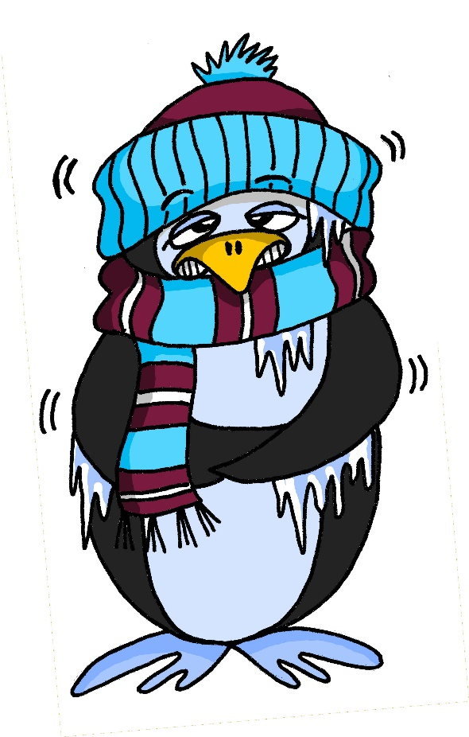
a
[a]
kalt
Notes:
Source word: kalt [875]
1. Present the letter and say the short ‘a’ sound first, on its own. Students repeat it with you.
2. Bring up the word ‘kalt’ on its own, say it, students repeat it, so that they have the opportunity to focus all of their attention on the connection between the written word and its sound.
3. Bring up the picture, and if using gestures, a possible gesture for this would be to mime a shiver, crossing your arms in front of your body. Establish the meaning of the word in English, clearly, i.e., ‘cold’. It is also worth asking them what type of word it is, to see if they can identify it as an adjective.
4. Roll back the animations and work through 1-3 again, but this time, dropping your voice completely to listen carefully to the students saying the ‘a’ sound, pronouncing ‘kalt’ and, if using, doing the gesture.

Slide 37
a
a
sagen
[a:]
Notes:
Repeat the first two stages from Slide 9; i.e., elicit ‘a’ and then ‘sagen’ from students. They should produce these now, chorally, without first hearing the teacher.
(A possible gesture for this would be to mime speech coming out of your mouth, opening your mouth and drawing your hand away quickly away from you).
Elicitation can be accomplished by pointing. Some teachers may use a very straightforward prompt like ‘Was ist das?’. Students already know ‘Wo ist das?’ Was ist das primes for the next question word students will know. Word order is straightforward here (1:1 equivalent with English in this question structure) and words are cognate-like – was/what – ist/is – das/that.
Check that they remember the meaning of the verb.

Slide 38










a
Paar
haben
sagen
fahren
Tag
klar
Notes:
Introduce and elicit the pronunciation of the individual SSC ‘a’ and then the source word again (with gesture, if using).
Then present and elicit the pronunciation of the five cluster words.
The cluster words have been chosen for their high-frequency, from a range of word classes, with the SSC (where possible) positioned within a variety of syllables within the words(e.g. initial, 2nd, final etc..) and additionally, we have tried to use words that build cumulatively on previously taught SSCs (see the Phonics Teaching Sequence document) and do not include new SSCs. Where new SSCs are used, they are often consonants which have a similar symbol-sound correspondence in English.
Word frequency rankings (1 is the most common word in German):
sagen [46]; Paar [284] haben [7]; fahren [169]; klar [255]; Tag [108].
Source: Jones, R.L. & Tschirner, E. (2006). A frequency dictionary of German: core vocabulary for learners. Routledge

Slide 39
a
Paar
haben
sagen
fahren
Tag
klar
Notes:
With sound and no pictures to focus all attention on the sound-symbol correspondence.
Word frequency rankings (1 is the most common word in German):
sagen [46]; Paar [284] haben [7]; fahren [169]; klar [255]; Tag [108].
Source: Jones, R.L. & Tschirner, E. (2006). A frequency dictionary of German: core vocabulary for learners. Routledge

Slide 40
a
Paar
haben
sagen
fahren
Tag
klar
Notes:
Without sound to elicit production from students.
Word frequency rankings (1 is the most common word in German):
sagen [46]; Paar [284] haben [7]; fahren [169]; klar [255]; Tag [108].
Source: Jones, R.L. & Tschirner, E. (2006). A frequency dictionary of German: core vocabulary for learners. Routledge

Slide 41


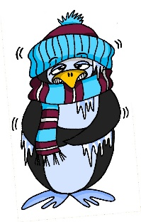


a
lang
Mann
6 Meter
kalt
Klasse
danke
Gast
[guest]
Notes:
Introduce and elicit the pronunciation of the individual SSC ‘a’ and then the source word again (with gesture, if using).
Then present and elicit the pronunciation of the five cluster words.
The cluster words have been chosen for their high-frequency, from a range of word classes, with the SSC (where possible) positioned within a variety of syllables within the words(e.g. initial, 2nd, final etc..) and additionally, we have tried to use words that build cumulatively on previously taught SSCs (see the Phonics Teaching Sequence document) and do not include new SSCs. Where new SSCs are used, they are often consonants which have a similar symbol-sound correspondence in English.
Word frequency rankings (1 is the most common word in German):
kalt [875]; lang [95] Mann [131]; Klasse [619]; Gast [675]; danke [778].
Source: Jones, R.L. & Tschirner, E. (2006). A frequency dictionary of German: core vocabulary for learners. Routledge

Slide 42
a
lang
Mann
6 Meter
kalt
Klasse
danke
Gast
[guest]
Notes:
With sound and no pictures to focus all attention on the sound-symbol correspondence.
Word frequency rankings (1 is the most common word in German):
kalt [875]; lang [95] Mann [131]; Klasse [619]; Gast [675]; danke [778].
Source: Jones, R.L. & Tschirner, E. (2006). A frequency dictionary of German: core vocabulary for learners. Routledge

Slide 43
a
lang
Mann
kalt
Klasse
danke
Gast
Notes:
Without pictures to focus all attention on the SSC.
Word frequency rankings (1 is the most common word in German):
kalt [875]; lang [95] Mann [131]; Klasse [619]; Gast [675]; danke [778].
Source: Jones, R.L. & Tschirner, E. (2006). A frequency dictionary of German: core vocabulary for learners. Routledge

Slide 44








a
¡A pronunciar!
a
nada
amar
∅
casa
alto
agosto
cama
Notes:
First phonic practice ‘a’ – source and cluster words.
1. Introduce and elicit the pronunciation of the individual SSC ‘a’ and then present and practise the pronunciation of the source word ‘alto’.
A possible gesture for this source word would be to stretch up one hand high above your head, fingers bent at right angle to show act of ‘measuring’
2. Say and repeat the word.
3. Ensure pupils know the meaning (use usual routine for this – e.g. ¿Qué significa’? ‘tall’, sí, es correcto.
4. Then present and elicit the pronunciation of the five cluster words.
The cluster words have been chosen for their high-frequency, from a range of word classes, with the SSC (where possible) positioned within a variety of syllables within the words(e.g. initial, 2nd, final etc..) and additionally, we have tried to use words that build cumulatively on previously taught SSCs (see the Phonics Teaching Sequence document) and do not include new SSCs. Where new SSCs are used, they are often consonants which have a similar symbol-sound correspondence in English.
Note: the cluster words are not necessarily being taught as vocabulary items for active use - their oral and written forms are being used to teach SSCs, and their meanings could be learned incidentally. If they are included as lexical items to be learned, they will also appear in the 'Vocabulary' column on the SOW.
Word frequency rankings:
alto [231]; nada [87]; casa [106] cama [609]; amar [700]; agosto [931]
Source: Davies, M. & Davies, K. (2018). A Frequency Dictionary of Spanish: Core vocabulary for learners (2nd ed.) London: Routledge.
A note on L1:L2 word translations: these are supported in the research literature on vocabulary learning, and should only be avoided where meanings are transparent. If at any point in teaching, pupils are not clear about a meaning, teachers should not hesitate in giving the English meaning.

Slide 45
a
¡A pronunciar!
a
nada
amar
casa
alto
agosto
cama
Notes:
Without the images and sound, students have to pronounce the words themselves.

Slide 46
Phonics consolidation
A-Z in pairs
Pairwork tennis
Dictation/transcription – individual SSC or whole words

Slide 47

Alphabetical read aloud exercise
a
alto
60
agosto
nada
amar
Segundos
casa
cama
0
EMPEZAR
Notes:
Alphabetical read aloud
Individually (but all at once) pupils read out the words but in alphabetical order. They keep going for one minute.
Teacher can circulate to listen into their SSC knowledge.

Slide 48
Alphabetical read aloud exercise
60
petit
prix
Secondes
grand
mot
mais
0
DÉBUT
Notes:
Alphabetical read aloud
Individually (but all at once) pupils read out the words but in alphabetical order. They keep going for one minute.
Teacher can circulate to listen into their SSC knowledge.

Slide 49


pairwork
donner
60
écrire
bébé
Secondes
et
aller
0
parler
DÉBUT
Notes:
Pairwork ‘tennis’ – pupils say the words alternately out loud with a partner, building up speed, over 1 minute’s intensive practice.
They call in any order they like, pupils are not allowed to repeat the one they said in their last turn.
Teacher can circulate to listen into their SSC knowledge.
Click on Début to start a one minute timer on the screen.

Slide 50




SSC spanish
¡A pronunciar!
a
e
i
o
u
alto
elefante
idea
yo
universo
Notes:
Revisit the SSC learnt so far: las vocales – a - I – o – u
Choral responses
1. Students say the SSC as they appear on each click.
2. Students say the source words as they appear on each click. (Teacher to monitor carefully, particularly ‘idea’)
3. Words disappear. Students say the source words in response to picture prompts.

Slide 51





French dictation task
faux
1
aussi
2
[also]
gauche
3
4
photo
5
eau
beau
6
Notes:
Optional dictation task 1-6.
Teacher reads words aloud and students write them, then check. As this is the first session with this SSC, it makes sense to check the spelling after each one, and encourage students to correct any errors as they go. It’s helpful to present this as an activity, not as a test!
Transcript:
faux
aussi
gauche
photo
eau
beau

Slide 52
Lang oder kurz?
 | sagen | kalt
1
2
3
4
5
Notes:
Hör zu. Ist es ‘aaaa’ wie ‘sagen’ oder ‘a’ wie kalt?
Mann
Paar
fahren
Klasse
danke

Slide 53
Antworten
 | sagen | kalt
1
2
3
4
5
Mann
Paar
fahren
Klasse
danke
Notes:
Antworten
Mann
Paar
fahren
Klasse
danke

Slide 54

SSC revision
sagen
geben
Welt
Zug
frei
kalt
denken
Notes:
Structural revision and repetition are essential aspects of the NCELP approach. Here we revise all the SSCs introduced so far: long and short a, long and short e, ei, W, Z.
The target SSC in each of the source words is obscured. Click on the word to play the audio. Repeat if necessary. Students write the whole word with the obscured sound in their exercise books.

Slide 55
SSC revision
sagen
geben
Welt
Zug
frei
kalt
denken
Notes:
Antworten
The words used here are all source words. When discussing the answers the teacher might ask if students can remember other words with the same SSC, either cluster words or other vocabulary items they have encountered.
Target language: Students have started to learn the word ‘Beispiel’. Here the teacher could say: Ein Beispiel mit ‘a’… noch ein Beispiel mit ‘a’ etc.. to provide additional input of this word.

Slide 56
Alphabetical read aloud
antworten
zehn
Zug
allein
Welt
frei
Sekunden
klein
Wasser
Arzt
ANFANG
Notes:
Alphabetical read aloud: Individually (but all at once) pupils read out the words but in alphabetical order. They keep going for one minute.
Teacher can circulate to listen into their SSC knowledge.

Slide 57
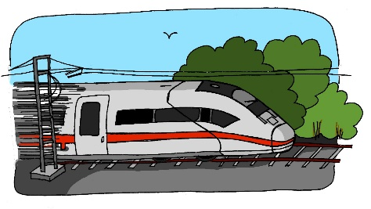











German SSC
A
zehn
antworten
D
Zug
H
allein
C
E
Welt
klein
[alone]
Wasser
I
F
G
B
frei
Arzt
Notes:
Was passt zusammen?
Which pictures go together (based on the obscured SSC)? There are three groups of three: Z (Zimmer, zehn, Arzt), ei (frei, klein, allein), and w (Welt, antworten, Wasser). Each group includes the source word, which they have been reminded of in the previous slide.
Ask students to write down which ones they think go together.
The teacher can remind them of the source words they have just seen.
Clicking on the pictures will play the word if the students need an extra prompt.
Clicking on the paw prints will remove them.

Slide 58
Make a word.
Translate it!
cui
hablar / escuchar
cui
¡Hola! Soy CUI.
Soy CUE.
Soy CUA.
tro
dar
rpo
dro
es ____ la
cue
dado
cua
cue
cua
Notes:
Starter task to recap this week’s SSCs.
The 3 SSCs lost the rest of their words! Students work in pairs to put the words back together.
Student A chooses an SSC and says it aloud to their partner CUE, CUA or CUI. Student B has to listen and write that SSC, then complete it with a fragment in the middle.
Students then swap roles.
Then ask students to translate the words that they wrote (together each pair should be able to produce the six words in English)
NB to make cuerpo – two word fragments are needed. Exclamation marks were not included with ‘cui’ and ‘dado’ to avoid giving away the answer.

Slide 59
Escucha y escribe las letras.
¿CE o CI?
ci
__udad
ce
do__
1
6
___ntro
ce
ne___sario
ce
2
7
ci
ci
de__r
di__embre
3
8
ce
ne___sitar
4
__en__as
ci
ci
5
Notes:
AUDIO TO BE ADDED
To challenge students further, ask them to turn away from the board to complete the task and write the whole word independently. This allows for differentiation through more/less support. If the whole class is high attaining, then the prompts can be removed from the slide, of course, as per the following slide.

Slide 60
Escucha y escribe la palabra.
¿CE o CI?
ciudad
doce
1
6
centro
necesario
2
7
decir
diciembre
3
8
necesitar
4
ciencias
5
Notes:
AUDIO TO BE ADDED
Same task, but answers appear as a whole word, rather than just the target graphemes.

Slide 61
Phonics application SSC knowledge
Odd one out (read aloud)
Dictation/transcription – words and/or sentences
Tongue twisters (read aloud)
Re-visiting two or more SSC

Slide 62
escuchar
Tally how many times you hear CE, CI and ZA in the text.
CE
CI
ZA
¿Qué palabras escuchas?
CE
CI
ZA
centro
cerca
necesita
ciudad
bicicleta
ciencias
empezar
zapatos
Notes:
Phoneme monitoring task – students copy the tally grids into their books for this. All words are pronounced with Castilian ‘distinción’. Click on the ‘play’ button (top right) to listen.
Part 1: The first (and second) time they listen, they just tally how many times they hear the SSCs.
Part 2: Students listen again. Ask them to write which words they hear with these SSCs. It may be necessary to replay the audio multiple times to give students the chance to complete all three boxes. There isn’t a problem with this – it is more likely to support errorless learning (see NCELP phonics rationale document (https://resources.ncelp.org/concern/parent/kd17cs85f/file_sets/sn009x76k).
The fully readable text (i.e., a text that includes 100% or near to 100% previously taught language) could also be used for a dictation. Only one word is new (‘catedral’). This is a near-cognate (in both its spoken and written form), so shouldn’t cause great difficulty. All other words have previously been encountered as vocabulary items or phonics practice words (escuela, ciudad, ciencias, cerca, centro, empezar).
Text (57 words): Madrid es una ciudad en España. Natalia está en el centro. ¡La catedral está cerca! En la escuela, Natalia estudia ciencias. Es importante empezar a estudiar inglés también. En casa, tiene unas cosas : una cama, una revista, una planta, y unos zapatos, pero no tiene un caballo. No necesita un coche - tiene una bicicleta y ¡es nueva!

Slide 63
hablar
cerca
centro
necesitar
doce
necesario
cierto
decir
ciudad
ciencias
diciembre
zona
cabeza
diez
empezar
zapato
Notes:
Printer-friendly version of these cards available in Word document. These contain all the phonics practice words for this and last week in NCELP SoW, with the addition of ‘diciembre’ and ‘necesario’, included as near cognates to provide additional decoding practice and provide 5 cards with each SSC.
A game in pairs: Start with all cards face down. Student A and B take turns to turn over one card at time. The student turning over says the word aloud each time they turn one over. S/he then puts the card into one of three piles:
CE
CI
Z (Z here includes ZA, ZO and word-final Z).
There is only one pile for each SSC (it is a shared pile). The student who adds the 4th card in any category wins!

Slide 64

Hören und schreiben
1
Wo ist das Fenster?
Das ist richtig.
2
Was denkst du?
3
Das ist falsch.
4
Die Flasche ist da.
5
Ist die Tafel hier oder da?
6
Notes:
Transcription exercise
Play the audio recording of the sentences. Click the number to repeat the sentence as many times as needed.
Students write the sentences down.
Discuss the answers. For each item ask a student to read what they have written. Play the recording again and then show the written version.
A lot of the activities so far have used isolated words. This activity puts the vocabulary they have learnt in context. It also focuses the students’ attention on spelling of the words. This leads into the next activity where we discuss the various aspects of ‘knowing a word’.

Slide 65


SSC transcription task
ei
Der Mann sit_t all__n. ☹
1
z
e
a
2
Der Arzt d_nkt ’W_s?!’
ei
i
3
Der Gast hat __n Z_mmer.
4
Der Freund ge_ innt __n B_tt.
w
ei
e
ei
a
Die Frau h_t __nen G_st.
5
a
6
a
Der Lehrer s_gt ‘Hurr_’. ☺
a
Notes:
ADDITIONAL SSC transcription task. This activity includes all the SSCs that have been introduced so far.
Play the sound by clicking on the number. Repeat if necessary.
Students fill in the gaps.
Transcript
1. Der Mann sitzt allein.
2. Der Arzt denkt ‘was?!’
3. Der Gast hat ein Zimmer.
4. Der Freund gewinnt ein Bett.
5. Die Frau hat einen Gast.
6. Der Lehrer sagt ‘ Hurrah’.

Slide 66

SSC transcription task
1
Der Mann sitzt allein. ☹
2
Der Arzt denkt ’Was?!’
3
Der Gast hat ein Zimmer.
4
Der Freund gewinnt ein Bett.
5
Die Frau hat einen Gast.
6
Der Lehrer sagt ‘Hurra’. ☺
Notes:
It’s important to see the source and cluster words as vocabulary, as well.
Knowing that most are in the top 500 most high frequency German words means we can be confident that the time learning them will be well spent.
1) Read aloud task. As a whole-class activity or in pairs.
2) Translation task.
3) Paired vocabulary tennis task (with gestures for the verbs)
Note: Zimmer and Arzt are cluster words only. The pictures have been included to help access their meanings. Bett is a near cognate and should be transparent enough for students to guess.

Slide 67



Optional exercise
Eine kleine Meise geigt allein eine leise Weise, eine zweite schweigt leider.
Notes:
OPTIONAL Zungenbrecher
Teacher reads out the whole sentence slowly and then takes the students through it word by word. Teacher models word; students respond with word.
The target SSC is ei, but some of the others are covered too: W in Weise, Z in zweite, a in allein. Most of the other sounds that have not been covered so far are similar to English with the exception of sch, which should be pointed out and modelled more carefully.
Discuss the meaning of the sentence. Words they know or might be able to guess:
Eine
kleine (in SOW vocab)
allein (cluster word just repeated)
Meise (they might be able to guess that it’s a type of bird based on the picture and the fact that it’s a noun as it’s capitalized)
However, vocabulary is not the focus here and shouldn’t be dwelt on too long.
Students practise saying the sentence individually. They could then do a competition to see who can say it the fastest without tripping up.

Slide 68









Minimal pairs
Wien
[Vienna]
Wein
[wine]
Beine
[legs]
Biene
[bee]
viele
[many]
Feile
[file]
Lieder
[songs]
leider
[unfortunately]
Riese
[giant]
Reise
[journey]
Notes:
Teacher introduces students to the concept of minimal pairs and the importance of connecting sound to meaning.
Teacher-led pronunciation practice.

Slide 69
Phonics revision
ei
Frankreich
ie
Liebe
kein
weiß
die
Brief
ich heiβe
Lieblings-
Wie schreibt man das?
sie
Haustier
leider
ein
wie sagt man …
hier
klein
ziehen
die Schweiz
Lied
Polizei
tief
Notes:
Phonics revision.
This is a paired read aloud task. The students use different colours to play. Pupil A says one of the words/phrases and pupil B has 3 seconds to locate it and cross it off with their colour. If the pupil takes longer than 3 seconds pupil A can steal the point. Clearly, the classroom conditions need to be right with the individual class for friendly competition.
Alternatively, they can do it more slowly and carefully, scrutinising each other’s pronunciation. If one makes a mistake (quite common with ei/ie), then the other pupil corrects and crosses off in his/her colour.
Note: Not all of these words have been taught before, so there is the opportunity for some genuine decoding.

Slide 70





Pirates!
1
c
w
Riese
leider
Riese
One of the chests contains buried treasure. All the others contain poison!
Listen carefully to the secret code and follow the arrows to find the treasure.
Reise
Lieder
Reise
h
z
Wien
Biene
Feile
v
Wein
Beine
viele
Riese
k
Riese
Biene
Feile
leider
i
Reise
Beine
viele
Lieder
Reise
Riese
leider
Feile
leider
Riese
r
Reise
Lieder
viele
Lieder
Reise
Riese
y
j
q
Reise
Notes:
This slide and the two that follow are three versions of the activity with different solutions.
The game makes use of minimal pairs of unknown words (unknown words are used so that pupils focus on the sound. Definitions are given on a later slide).
Starting on the red square, pupils listen to the words and decide whether they hear /ei/ or /ei/. They follow the arrows indicated by their choice to finish at one of the chests. There is only one correct route per slide, so pupils must correctly identify all words to find the treasure. The order or /ei/ and /ie/ changes (i.e. sometimes /ei/ is on the white square and sometimes on the blue) so the pupils must read the spellings.
Pupils can follow the slide on the projector, or the slide can be printed so they can trace the route with a pen/finger.
Teacher asks ‘Wo bist du?’ Pupils respond ‘Z, W’ etc. to practise the alphabet. Teacher clicks on the chests they say to reveal treasure (or not!)
Audio plays on clicking play. Pupils will probably need to hear the audio at least three times.
Note: Each treasure chest is triggered to reveal what is underneath. You see a hand icon appear when you mouse over it – click and the chest disappears. Each slide only has one treasure chest – the rest reveal skulls.
Transcript:
Wien, Biene, Feile, Lieder, Reise
Treasure is located in chest W.

Slide 71
Pirates!
2
c
w
Riese
leider
Riese
Reise
Lieder
Reise
One of the chests contains buried treasure. All the others contain poison!
Listen carefully to the secret code and follow the arrows to find the treasure.
h
z
Wien
Biene
Feile
v
Wein
Beine
viele
Riese
k
Riese
Biene
Feile
leider
i
Reise
Beine
viele
Lieder
Reise
Riese
leider
Feile
leider
Riese
r
Reise
Lieder
viele
Lieder
Reise
Riese
y
j
q
Reise
Notes:
Alternative: Give pupils a copy of the transcript below on a slip of paper and ask them to read to a partner.
The game makes use of minimal pairs of unknown words (unknown words are used so that pupils focus on the sound. Definitions are given on a later slide).
Starting on the red square, pupils listen to the words and decide whether they hear /ei/ or /ei/. They follow the arrows indicated by their choice to finish at one of the chests. There is only one correct route, so pupils must correctly identify all words to find the treasure. The order or /ei/ and /ie/ changes (i.e. sometimes /ei/ is on the white square and sometimes on the blue) so the pupils must read the spellings.
Pupils can follow the slide on the projector, or the slide can be printed so they can trace the route with a pen/finger.
Teacher asks ‘Wo bist du?’ Pupils respond ‘Z, W’ etc. to practice the alphabet. Teacher clicks on the chests they say to reveal treasure (or not!)
Audio plays on clicking play. Pupils will probably need to hear the audio at least three times.
Transcript:
Wein, Beine, viele, Lieder, Reise
Treasure is located in chest Y.

Slide 72
Pirates!
3
c
w
Riese
leider
Riese
Reise
Lieder
Reise
One of the chests contains buried treasure. All the others contain poison!
Listen carefully to the secret code and follow the arrows to find the treasure.
h
z
Wien
Biene
Feile
v
Wein
Beine
viele
Riese
k
Riese
Biene
Feile
leider
i
Reise
Beine
viele
Lieder
Reise
Riese
leider
Feile
leider
Riese
r
Reise
Lieder
viele
Lieder
Reise
Riese
y
j
q
Reise
Notes:
Alternative: Give pupils a copy of the transcript below on a slip of paper and ask them to read to a partner.
The game makes use of minimal pairs of unknown words (unknown words are used so that pupils focus on the sound. Definitions are given on a later slide).
Starting on the red square, pupils listen to the words and decide whether they hear /ei/ or /ei/. They follow the arrows indicated by their choice to finish at one of the chests. There is only one correct route, so pupils must correctly identify all words to find the treasure. The order or /ei/ and /ie/ changes (i.e. sometimes /ei/ is on the white square and sometimes on the blue) so the pupils must read the spellings.
Pupils can follow the slide on the projector, or the slide can be printed so they can trace the route with a pen/finger.
Teacher asks ‘Wo bist du?’ Pupils respond ‘Z, W’ etc. to practice the alphabet. Teacher clicks on the chests they say to reveal treasure (or not!)
Audio plays on clicking play. Pupils will probably need to hear the audio at least three times.
Transcript:
Wein, Biene, Feile, leider, Riese
Treasure is located in chest K.

Slide 73

escuchar
Escucha.
Marca ‘GA’, ‘GA’ o ‘GU’.
Escucha otra vez.
Escribe la palabra.
 | GA | GO | GU
¿Cómo se dice en inglés?
go
1
conmi___
with me
se___ro
gu
sure, safe
2
go
3
___l
goal
ga
4
__to
cat
pre___ntar
5
gu
to ask
se___ndo
second
6
gu
ami__
7
ga
(female) friend
__nar
8
ga
to win
go
9
lar__
long
lu___r
10
ga
place
Notes:
These are high-frequency words that some students will acquire incidentally. They are not counted within the core expected learning of 400 words in Y7, so the additional challenge of translating into English shouldn’t be seen as a test, but as an additional opportunity.
See the next slide for a variation of this activity.

Slide 74
escuchar
Escucha.
Marca ‘GA’, ‘GA’ o ‘GU’.
Escucha otra vez.
Escribe la palabra.
 | GA | GO | GU
¿Cómo se dice en inglés?
1
conmigo
with me
seguro
sure
2
3
gol
goal
4
gato
cat
5
preguntar
to ask
6
segundo
second
7
amiga
(female) friend
8
ganar
to win
9
largo
long
10
lugar
place
Notes:
Variation: students have to write the whole word.
These are high-frequency words that some students will acquire incidentally. They are not counted within the core expected learning of 400 words in Y7, so the additional challenge of translating into English shouldn’t be seen as a test, but as an additional opportunity.

Slide 75

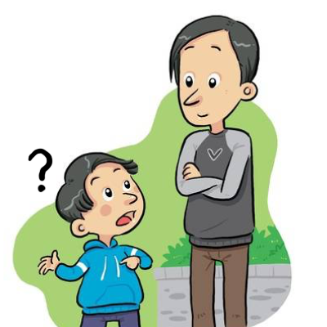


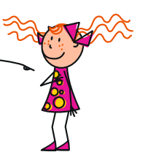


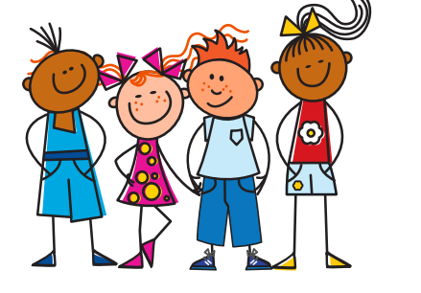


Spanish exercise
Identifica la imagen y escribe la letra correcta.
2019
planta
E
A
B
C
pequeño
F
[to put]
mano
H
español
I
D
E
F
G
señora
D
poner
C
nosotros
J
H
I
J
año
A
pregunta
B
niña
G
Notes:
OPTIONAL
Having focused on the sound-spelling correspondence(s), students now focus on the meaning of the words used for practice.
They will already have written these in their books, so can simply write the letter next to the word, as above.
Elicit the letter in Spanish to practise letters of the alphabet.

Slide 76








Minimalpaare
hören und sprechen
das Vieh
wie?
der Vetter
das Wetter
das Veilchen
das Weilchen
volle
die Wolle
Notes:
Teacher-led pronunciation practice which draws attention to the importance of individual sounds in creating meaning.

Slide 77




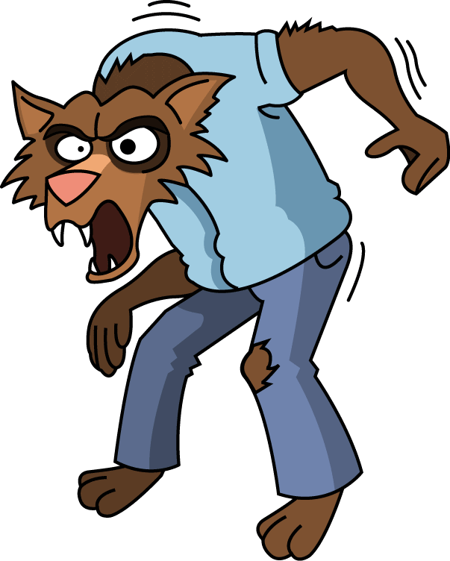





Wie sagt man das?
hören und schreiben
1
d e r W i k i n g e r
6
d e r V a t e r
__
__
2
S c h w e d e n
7
d e r W e r w o l f
__
__
__
3
d e r V o g e l
8
w i e v i e l e ?
__
__
__
4
d i e K r a w a t t e
9
v i e r u n d z w a n z i g
__
__
__
5
d a s V i e r e c k
10
w a r m
__
__
Notes:
This listening exercise both helps students strengthen the association with German SSC [v], and lose the interfering association with the English SSC [v].
Words have been chosen which may have a surprising pronunciation in German (e.g. ‘Sweden vs Schweden’) or because they are pronounced similarly in German to English (e.g. Viking / Wikinger) which may throw students in terms of spelling. Teacher to remind students to resist the temptation to write ‘v’ straight away for words they recognise from English. They must first listen, and focus on the sound.
Audio plays on clicking individual letters. Answers revealed on individual clicks.
Teacher can elicit responses by asking ‘Wie schreibt man das? Mit v oder mit w?’

Slide 78
Wie sagt man das?
sprechen
10
d e r W i k i n g e r
d e r V a t e r
S c h w e d e n
d e r W e r w o l f
d e r V o g e l
w i e v i e l e ?
d i e K r a w a t t e
v i e r u n d z w a n z i g
0
d a s V i e r e c k
w a r m
LOS
Notes:
Now, students work in pairs to practise saying the words they have just learned in turn.
Once they have practised a couple of times, the teacher can set the timer to see how many words students can pronounce correctly within ten seconds. Students act as jurors for one another. If a student pronounces a word incorrectly, they must start again! Teacher may wish to run the times several times, depending on the needs of the class.

Slide 79

Zungenbrecher!
Phonetik
Sieben spanische Spinnen schauen ein spanisches Fußballspiel an!
1
2
3
4
Notes:
This tongue twister offers practice of this week’s SSCs in a full sentence. It consists of previously encountered vocabulary with the exception of schauen [470] to look (at), which will need to be translated for students.
Recordings of the tongue twister said at various speeds play on clicking numbers 1 (slow) to 4 (very fast). All students should start by listening and repeating recording 1. Higher level students may enjoy the challenge of trying the faster versions.
English translation: Seven Spanish spiders are watching a Spanish football match.
sieben [570], spanisch [1865], Spinne [>4037] anschauen [1271], schauen [470], Fußball [1497], Spiel [500].

Slide 80


Zungenbrecher!
Phonetik
Ein Stachelschwein, ein Stachelschwein,
das muss ein Schwein mit Stacheln sein!
1
2
3
4
Notes:
Recordings of the tongue twister said at various speeds play on clicking numbers 1 (slow) to 4 (very fast). All students should start by listening and repeating recording 1. Higher level students may enjoy the challenge of trying the faster versions.
English translation: a porcupine, a porcupine, that must be a pig with spines!
Schwein [4009], Stachel [>4037], müssen [45], mit [13], sein [3]

Slide 81

-tion
population
situation
attention!
action
solution
international
Notes:
Quick recap of first SSC from previous lesson’s phonics work:
Elicit again the pronunciation of the individual SSC ‘-tion’ and then the source word ‘attention’ again (with gesture, if using).
Then present and elicit the pronunciation of the five cluster words.
The cluster words have been chosen for their high-frequency, from a range of word classes, with the SSC (where possible) positioned within a variety of syllables within the words (e.g. middle, final, etc.), and additionally we have tried to use words that build cumulatively on previously taught SSCs (see the Phonics Teaching Sequence document). Where new SSCs are used, they are often consonants which have a similar symbol-sound correspondence in English.
Word frequency rankings (1 is the most common word in French):
population [509]; action [355] situation [223]; international [282]; solution [608]; attention [482].
Source: Londsale, D., & Le Bras, Y. (2009). A Frequency Dictionary of French: Core vocabulary for learners London: Routledge.

Slide 82




ien
chien
ancien
bien
rien
combien ?
[nothing]
bientôt
€ ?
[soon]
Notes:
Quick recap of second SSC from previous lesson’s phonics work:
Elicit again the pronunciation of the individual SSC ‘IEN’ and then the source word again ‘bien’ (with gesture, if using).
Then present and elicit the pronunciation of the five cluster words.
The cluster words have been chosen for their high-frequency, from a range of word classes, with the SSC (where possible) positioned within a variety of syllables within the words (e.g. middle, final, etc.), and additionally we have tried to use words that build cumulatively on previously taught SSCs (see the Phonics Teaching Sequence document). Where new SSCs are used, they are often consonants which have a similar symbol-sound correspondence in English.
Word frequency rankings (1 is the most common word in French):
chien [1744]; rien [168] bientôt [1208]; ancien [392]; combien? [800]; bien [47].
Source: Londsale, D., & Le Bras, Y. (2009). A Frequency Dictionary of French: Core vocabulary for learners London: Routledge.

Slide 83
écouter
Écoute. C’est ‘-tion’ ou ‘-ien’ ? Coche p.
-tion | -ien
1
2
3
4
5
Notes:
Learners listen to the words and tick the column of the appropriate SSC.
Animated answers are provided on the following slide.
Transcript: 1: bientôt / 2: action / 3: international / 4: ancien / 4: attention

Slide 84

écouter
Réponses
-tion | -ien
1
bientôt
action
2
international
3
4
ancien
attention
5
Notes:
As well as an opportunity to check answers, this slide offers a further chance to elicit some of the cluster words from students.
Transcript: 1: bientôt / 2: action / 3: international / 4: ancien / 4: attention

Slide 85
écouter et écrire
Complete the words you hear below, using either –tion or -ien
ien
comb___
tion
1
5
interna___ al
ac___
ien
2
tion
6
b___tôt
atten___ !
ien
tion
3
anc___
7
r___
tion
ien
4
solu____
8
Notes:
This activity seeks to practise this week’s phonics work further, by getting learners to complete the partially-shown words in writing, after hearing them pronounced. The featured SSCs are what is needed to complete the word in each case. The solutions are animated upon successive clicks of the mouse.
Transcript
combien
action
ancien
solution
international
bientôt
attention
rien

Slide 86

parler
ancien
action
60
combien ?
international
rien
bien
attention
situation
chien
solution
0
bientôt
DÉBUT
population
Notes:
Pair tennis
Learners say the words alternately out loud with a partner, building up speed, over 1 minute’s intensive practice.
Students need to call out words with alternate SSCs each time so that the key sound varies, e.g. action – ancien – international –bien.
The teacher can circulate during this activity to listen into learners’ SSC knowledge.
Word frequency rankings (1 is the most common word in French):
population [509]; action [355] situation [223]; international [282]; solution [608]; attention [482]; chien [1744]; rien [168] bientôt [1208]; ancien [392]; combien? [800]; bien [47]
Source: Londsale, D., & Le Bras, Y. (2009). A Frequency Dictionary of French: Core vocabulary for learners London: Routledge.

Slide 87
Assessing & monitoring progress
What approaches / resources are you currently using to assess your students’ phonics knowledge (phonological decoding) in MFL?
What do you consider to be their strengths / limitations?

Slide 88
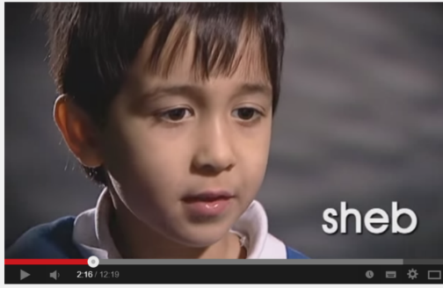
Assessing & monitoring progress
Two main approaches:
Reading aloud
Pen-and-paper test
Greater validity: direct measure of the construct we are interested in
Time consuming to administer and mark
Quicker and easier to administer and mark
Difficult to create valid tests of this kind (and impossible for Spanish & German!)
Cf. Year 1 Phonics Screening Check in English primary schools
Beware pitfalls of reading aloud. How can this be handled sensitively?
E.g. individual work with teacher; paired reading; self-recording (homework)

Slide 89
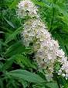
Assessing & monitoring progress
Two main classes of item:
Familiar real words
Pseudowords
Unfamiliar real words
< chat >
< ulmaire >
Familiar words: students may have pre-stored phonological forms which they can access as wholes.
Unfamiliar words / pseudowords: students have to generate the phonological forms by applying SSC knowledge.
To test SSC knowledge, tests need to include unfamiliar items
Decontextualized (isolated) words: this prevents the use of context to identify words, and therefore isolate decoding skills
Phonological decoding (reading aloud) of flowing text is also important!

Slide 90
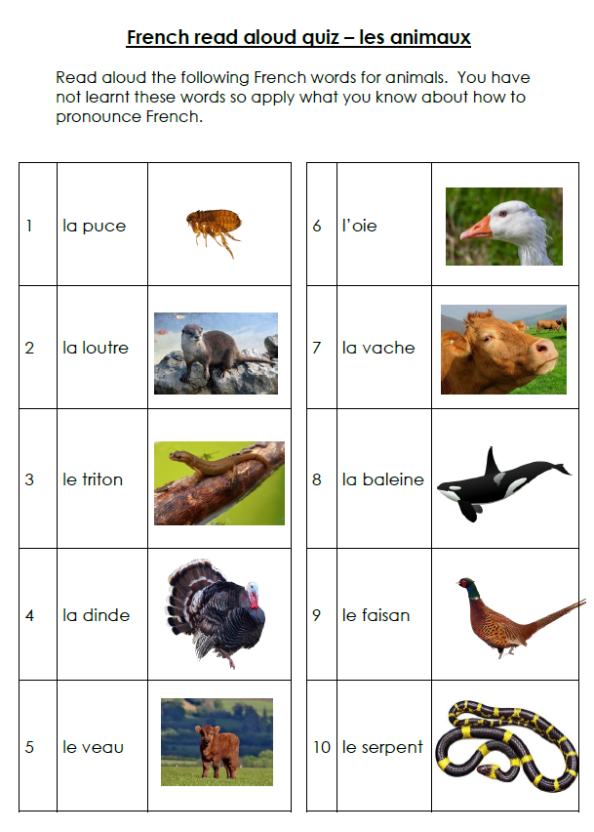
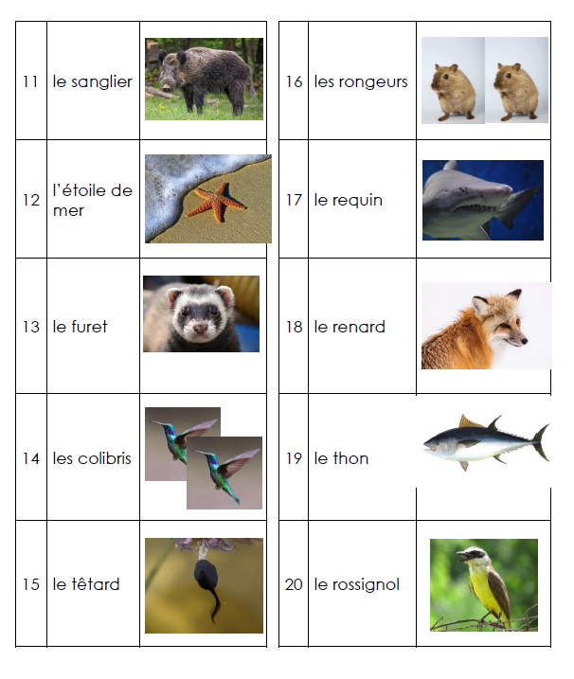
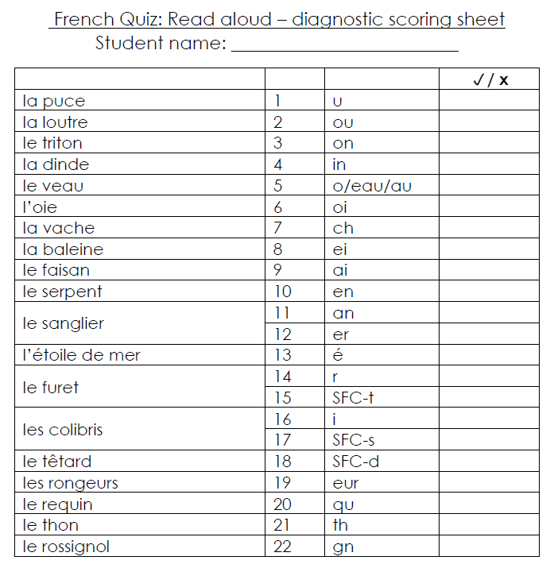
Assessing & monitoring progress
NCELP Resource Portal

Slide 91




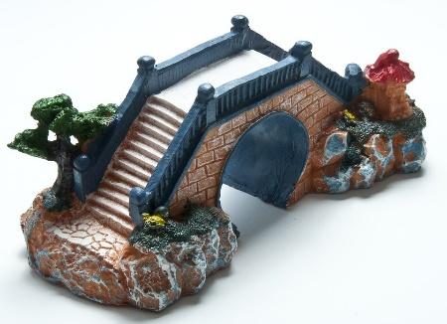




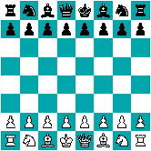
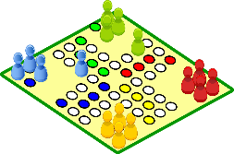

French Noel exercise
Ballou
x
x
trois poires
x
Nicolas
Mattieu
x
x
un rat
un pont
Manon
x
x
x
x
Benoit
un loup
deux jeux

Slide 92
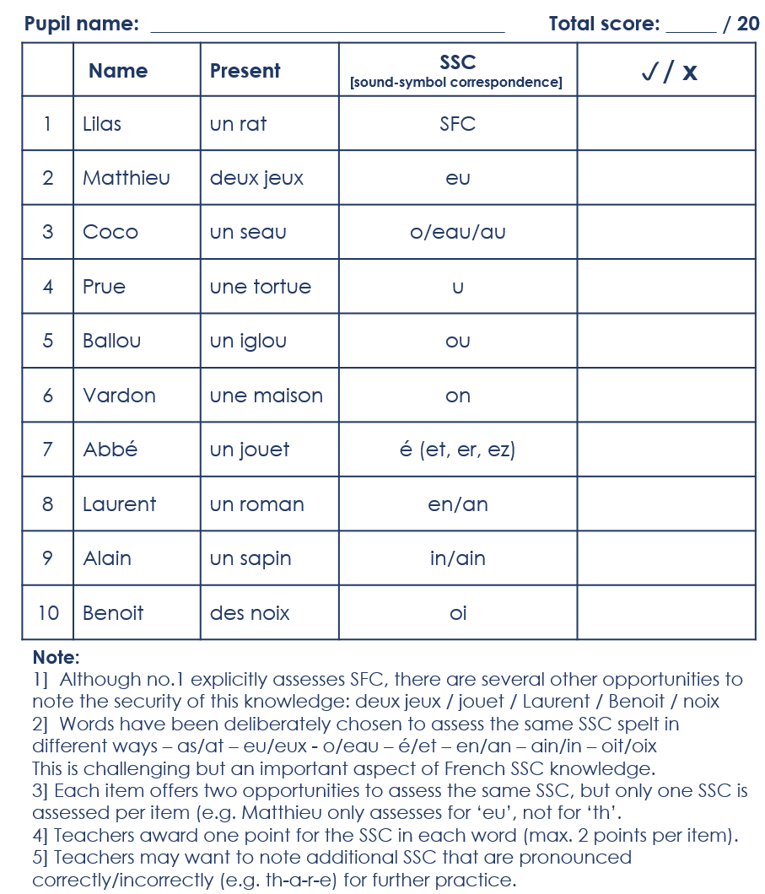
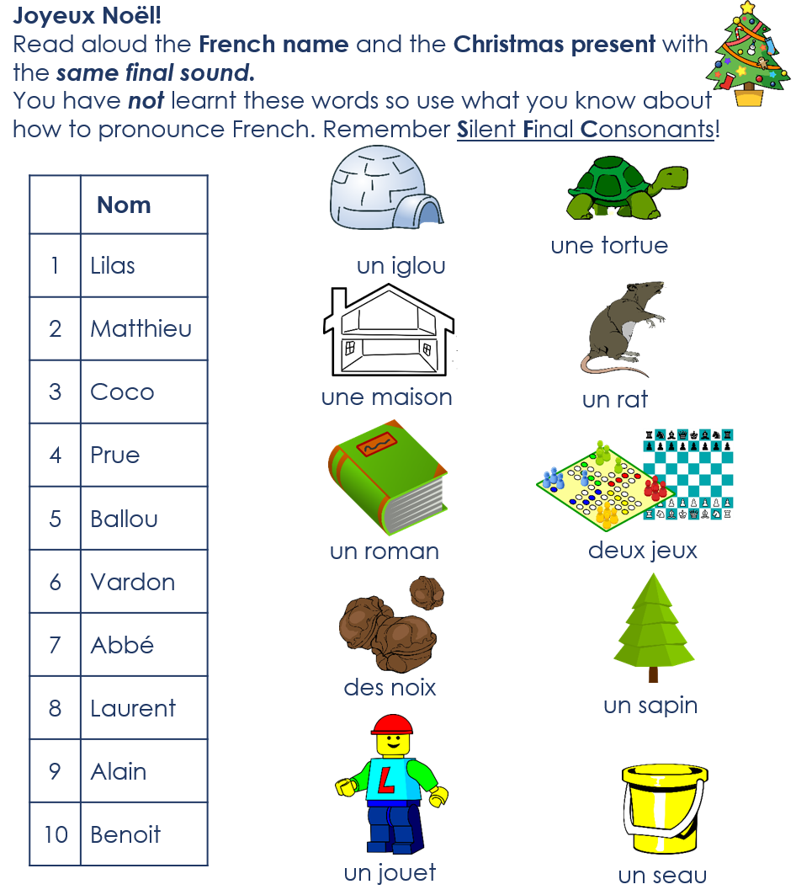
French Noel exercise

Slide 93
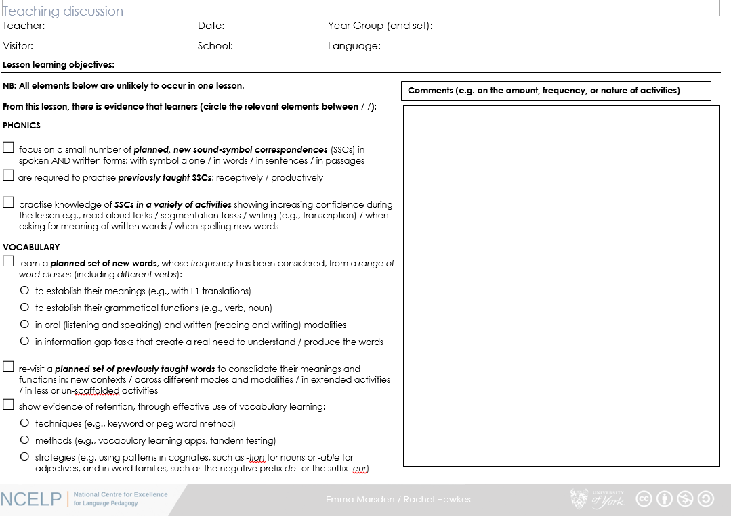
Developing good practice in school
Teaching discussion proforma: principles and use
Teaching discussion proforma on the NCELP Resource Portal

Slide 94
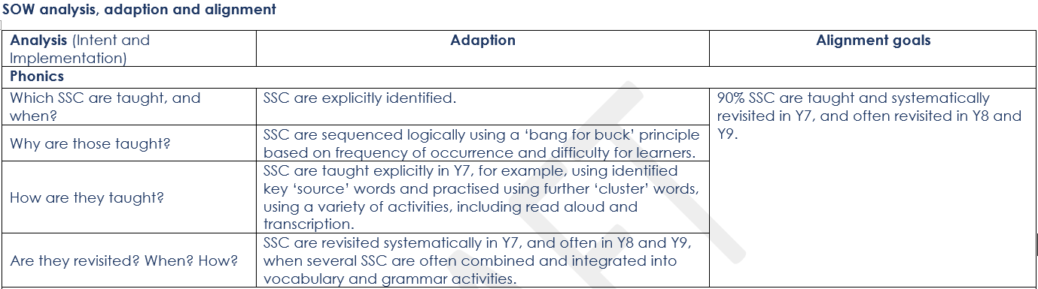
Summary and next steps
Questions?
Next steps?
Thank you for coming ☺
Safe journey home.

