Slide 1
On target for unprepared speaking
ALL Sheffield Tuesday 6 December 2022
Presenter: Rachel Hawkes

Slide 2
Session overview
Part 1: research, policy and practice
Ofsted research review
New GCSE
Current practice
Ways forward
Part 2: TL case study
Part 3: Teacher and student TL use (practical activities for tomorrow)
Part 4: Next steps
Notes:
Let’s have a quick look at our session overview.
[click x 2]
I will start with a bit of context, in particular looking at what the Ofsted research review has to say about teacher and student us of TL
[click]
and also the implications of the new GCSE for the ways in which we practise speaking. [click x 2] I’ll briefly give a bit more context to what we typically see in classrooms at the moment and some suggested ways forward.
[click]
And then I will hand on to Claire, and this is the part where you’ll all get excited! She will share with you the experience of the past couple of years as she and her colleagues have devised and embedded a target language strand in their KS3 curriculum. [click]
Part 3 is back to me to look at a few examples of resources that I think show how a planned approach to TL use (both student and teachers’) can work really well.
[click]
Claire will conclude with some suggested next steps and we will then have some time for discussion and questions. Let’s get started.

Slide 3
Ofsted research review: languages
Teacher use of the new language…
should not make things more difficult to understand
needs very careful planning
should build systematically on pupils’ prior knowledge
can grow incrementally with learners’ progress
Student use of the new language…
is essential and there is strong evidence that it correlates with learning
requires competence and the motivation to create meaning
benefits from a conducive classroom climate
will often be less fluent, less accurate and slower when it is unrehearsed
Ofsted research review
Notes:
The Ofsted languages research review makes the following points about teacher use of the target language. [click x 2]
It should not be a barrier to learning – the example given is explaining a tricky grammar concept in the target language but this is just an example – it doesn’t mean that grammar can’t be explained in the target language – it means that the teacher needs to be sure that the language s/he uses in the classroom for all teaching – explanations, instructions, interactions – needs to be readily understood, otherwise it can overwhelm and demotivate students.
[click]
The way to have the best chance of ensuring that students understand readily is to plan our use of language very carefully
[click]
and deliberately re-use the language that students have already been taught.
[click]
This obviously means that our use of the target language can increase in line with learner’s progress. The golden thread here is plan, plan, plan. Deliberate, careful planning. The level of detail that we can have in our schemes of work that sets out clearly what pupils have been taught when is what can inform our decisions about which language to use with students each week.
[click]
In terms of student use of the new language, the Ofsted research review proposes that it
[click]
is an essential part of practice (and use here means both comprehension and production) and cites strong evidence that it correlates with learning
[click]
We also read that students, in order to create the meaning they want (rather than relying on formulaic routines), need both the linguistic competence (i.e., a major component of which is linguistic knowledge, so the knowledge of words, how they sound and how to physically produce them, and knowledge of grammar, how to put them together) and also the motivation for ‘real speech’. A powerful motivator is the feeling of success, of being able to do something. This tends to come from retaining and being able to recall, with increasing ease in unplanned interactions, the language sounds, words and structures that have been taught.
[click]
We don’t want to underestimate the value of creating a classroom climate where appropriately planned target language use (by the teacher) leading to successful, unplanned use by the students is the norm.
[click]
And the value of everyone – teacher and students – embracing the likelihood that with beginner to intermediate learners (KS2-KS4) unplanned (or spontaneous) speaking will naturally be less fluent, less accurate and slower than rehearsed or memorised language would be, but that the struggle to retrieve language in the moment of communication is an essential step along the way, it is desirable difficulty, and it is best not to spend too much time (if any) on activities that bestow an illusion of fluency. This is not to say that memorisation activities don’t have their place (learning lines for a play, giving a prepared speech, performing a song for an assembly) – these can be of value, they nourish aspirations of fluency, enjoying the feeling of mastery of a small amount of language, developing the articulatory musculature of the new language sounds, working together with others towards a joint performance. However, the core speaking practice in the classroom will optimally require students to retrieve language from memory, using their own linguistic resources to create sentences, selecting the right structures, words and sounds.

Slide 4
Towards the new GCSE
Using a defined word list supports planned target language use
Most of the new speaking exam will be unprepared interaction
Hearing and responding to teacher questions and instructions can be part of normal classroom routines
Using the new language between tasks as well as within them is central not tangential practice
‘Clear and comprehensible’ should be the aim for teachers and students
Notes:
Let’s look at this from the perspective of the new GCSE.
[click]
First, the fact that students can achieve the highest grade in the new exam by using (understanding and producing words from the word list means that we can plan our TL use and that of the students to use/recycle words from the defined word list. This principle can apply at KS2, KS3 and KS4.
[click]
We know that most of the new speaking exam will be unprepared– there will be some planning time for the role play and the visual stimulus, but there will be two follow up interactions after the read aloud and the visual stimulus that are described as ‘unprepared conversation’ and ‘unprepared interaction’.
[click]
And we recognise the huge change that this represents. Many of you may have seen (or contributed to) the hilarious thread on twitter earlier this year about the current GCSE speaking exams, kicked off by this tweet. The spirit of the new GCSE Subject Content takes us a long way from this scenario. Knowing this makes it important that
[click]
hearing and responding to teacher talk in the classroom becomes part of what students normally do
[click]
As long as the language of these interactions is planned and based on prior learning of language from the wordlist, using the target language in the moments between tasks as well as in the tasks themselves is a central part of practice, not an add-on. [click]
And we know from the GCSE Subject Content that the expectation is that students’ language production should be ‘clear and comprehensible’ – this is not the same as ‘fluent, accurate, fast, complex’. It is important to remember that speed and accuracy often decrease when speech is produced spontaneously.
This is important because it is the crucial complement to introducing the requirement for speaking to be unplanned and unrehearsed. We can have confidence that expectations for spoken proficiency are appropriately matched to the increased requirement for interactions to be unplanned. So, in the classroom, the sort of speaking we need to be practising is unplanned sentence creation, building from individual words in unrehearsed situations, and the sort of output we are aiming for is ‘clear and comprehensible’.

Slide 5
Current practice
Limited TL use by teachers and students
Substantial unplanned teacher use of the TL
Variable approaches within the same lesson
Notes:
The use of the TL in language teaching in this country has been a source of constant debate for longer than I can remember. We have had several pendulum swings and national initiatives that have steered one way or the other.
The result is some wildly variable practice in different schools, and in some cases, between different colleagues in the same department. The sorts of practice we might see include: [click] not very much target language use at all – teachers preferring English in all situations, perhaps for classroom management reasons, or a lack of own confidence orally (many teachers end up teaching a 2nd or 3rd language that they might not feel secure in), believing that students don’t understand so it takes a lot longer, or
[click] we might see substantial unplanned teacher use of the TL, which expects students to understand the gist, grasp what they are meant to do, without necessarily recognising or understanding the individual words they’re hearing. [click]
we can also see both of these within one lesson; a scenario where the teacher begins the lesson in the TL, apparently intending to give instructions, explanations etc. in the new language, and prompting students to interact with him/her in the target language, but as the lesson progresses (sometimes, but not always, as attention reduces and behaviour slips) we then see the teacher resorting to English to reestablish the pace or momentum of the lesson.
All of these scenarios are suboptimal.
Too much unguarded, incautious, unplanned use of teacher TL can overwhelm many students, not just the ones that kick up a fuss and less us know about it. Some students react particularly vociferously (e.g., often Aspergers and other neuro-diverse learners experience the sense of overwhelm particularly keenly) but there are often students who suffer inwardly and it takes some robust student voice to draw out their discomfort. In a time-limited lesson scenario many students will expect and want to understand readily what it is they need to know and do. Processing aural language input with quantities of unknown words puts students under cognitive pressure – relying on attributes for inferencing, speedy processing, world knowledge, and common sense, that by no means all students (or the majority) in a class typically have. Just as our approach to planning to teach phonics, vocabulary, and grammar explicitly is underpinned by the aim of levelling the playing field, so too should be our approach to using the target language.

Slide 6
Ways forward
plan it carefully, using your SOW
pare back teacher use of TL to ensure it is clear and comprehensible to our learners
deliberately use words and structures to recycle previously taught language
build TL use incrementally in step with the SOW
plan our own and students’ use of TL to develop speed of understanding and production over time
use English when there would otherwise be a barrier to learning
Notes:
To make teacher and student use of the new language count, we can:
[click] plan it carefully, using your SOW
[click]
pare back teacher use of TL to ensure it is clear and comprehensible to our learners
[click]
deliberately use words and structures to recycle previously taught language
[click]
build TL use incrementally in step with the SOW
[click]
plan our own and students’ use of TL to develop speed of understanding and production over time
[click]
use English when there would otherwise be a barrier to learning

Slide 7
Session overview
Part 1: research, policy and practice
Ofsted research review
New GCSE
Current practice
Ways forward
Part 2: TL case study
Part 3: Teacher and student TL use
Part 4: Next steps
Notes:
What might this look this like? I’m going to describe a case study from a former colleague from my trust – Claire Jones – who is now Head of Languages at The Orchard School in Bristol. She has started to set out a target language strand with the rest of her department – their work is the cohesive effort of a whole department to introduce a target language strand to their curriculum.

Slide 8
‘Vision without implementation is hallucination.’
Thomas Eddison
Why focus on target language?
Previous practice
Pandemic → poorer speaking
Why create a discrete TL strand?
Practice → proceduralisation → automaticity
Prompt production of previously taught language
Provide support for all learners – level the playing field
Notes:
To mix up two quotations…They had a dream. As language teachers, our goal is for students to use the language we are teaching them, to understand and communicate, allowing them to meaningfully and usefully interact with others. Of course, we want them to take this beyond school. But it starts in the classroom. Claire was clear that having this dream wasn’t enough. They also needed a considered approach as to what and how they could go about moving themselves and our students towards using more of the new language in the classroom. [click]
Claire’s motivation to focus on teacher and student use of the target language in the classroom with her new department was
[click]
Prompted by her previous practice – she worked for several years in our trust and we had a strong focus on teacher and student use of the target language (part of which she had been instrumental in developing with colleagues there)
[click]
And also the pandemic – most of us noted that there was a particular deficit in spoken confidence following lock down, for obvious reasons
[click]
So why create a discrete TL strand in their SOW?
[click]
This ties into learning theory – and is underpinned by a broadly defined ‘skill acquisition’ (information processing) account of learning (DeKeyser, 2017), cognitive-interactionist perspectives on second language learning (Collins & Marsden, 2016) and classroom learning more generally (Horvath, Lodge, & Hattie, 2016). These perspectives, taken in the round, foreground the need to plan, sequence and practise language thoroughly to give learners time to establish, consolidate and automatize their knowledge of it. These theories seem more likely to hold together as an account of language learning within a very time-limited learning classroom context in which most learning is likely to be intentional, rather than incidental.
[click]
It also offers an ideal way to intentionally prompt practice of previously taught language – in the communicatively relevant scenario of classroom communication.
[click]
And additionally, as does all explicit teaching, it offers a way to level the playing field for all learners. I.e., if we just use the target language indiscriminately and require learners to infer the meaning of the input stream, which contains unfamiliar language, supported by some gestures or pictures, then the most linguistically analytical learners will manage but others will get left behind. Claire’s current school has 40% disadvantaged and 25% EAL. She was very determined to ensure that the gap was closed not widened by any departmental innovation that they introduced.
References: Collins, L., & Marsden, E. (2016). Cognitive perspectives on classroom language learning. In G.Hall (Ed.), The Routledge Handbook of English Language Teaching [Chapter 21] (Routledge Handbooks in Applied Linguistics). Routledge.
DeKeyser, R. M. (2017). Knowledge and skill in ISLA. In S. Loewen & M. Sato (Eds.), The Routledge handbook of instructed second language acquisition (pp. 15–32). New York, NY: Routledge.
Horvath, J. C., Lodge, J. M., & Hattie, J. (2016). From the laboratory to the classroom: Translating science of learning for teachers. New York, NY: Routledge.

Slide 9
The process of designing a TL strand to KS3 SOW
Identify communicative functions
Greetings and the register
Politeness
Obligation / prohibition
Permission
Desire
Need / Possession
Opinions
Repair strategies
Sequence the teaching (using the SOW)
Limit the quantity (3-4 items of new language)
Plan explicit teaching and practice slots of 5 minutes
Notes:
Claire worked with her brilliant 2nd in dept – they brainstormed what they and students might need to say and understand in the classroom. To put some structure to it, they identified some broad functional categories and then started to think how to put new language to these. [click]
Greetings – for different times of day, beginning and end of lesson, responding to the register
[click]
Being polite – transactional e.g. please, thank you, asking how people are, bless you
[click]
Obligation – for giving and understanding instructions
[click]
Permission – asking and giving
[click]
Need – saying what you have, don’t have, need
[click]
Opinions – initially feedback on what is happening in the lesson, later more spontaneous interaction
[click]
Repair strategies. Troubleshooting – e.g asking for repetition, clarification, change of speed
[click]
When it came to devising the order or sequence of teaching, they cross-referenced the SOW to identify where students would be meeting some of the key verbs that we wanted to use e.g. je suis, j’ai, je peux, and sought to align them / and/or introduce them in TL after their point of first introduction in the SOW so as to minimise cognitive load and maximise potential for long-term learning through the additional practice opportunities these TL slots provide. [click] Limiting the quantity – they wanted to ensure this was both manageable within lesson time and for students to work with. So the aim was for no more than 3/4 bits of new language in each section, always anchored around something the students already know.
[click]
The intention is for an explicit TL teaching slot within the lesson time of about 5 mins.

Slide 10
Key considerations
Deliberate recycling of high frequency verbs from the SOW
Focus on asking questions
Re-use grammar features in classroom contexts (enfermo/a, absent(e))
Introduction of new, high frequency verbs ahead of the SOW (il faut, hay que)
Paring the language down
Having patience
Notes:
[click]
Key implications and considerations for them were:
[click]
Deliberate recycling of high-frequency key verbs from SOW – j’ai, je suis, tengo, estoy
[click]
A focus on asking questions (in French this meant using the question types they had been taught at that point in the SOW – e.g., intonation questions, intonation questions + question words, inversion – but leaving out est-ce que until they had been taught this)
[click]
Opportunity to practise grammar elements introduced alongside these in a different context e.g adjective agreement: il est absent/elle est absente, está enfermo/a
[click]
Identifying new, high surrender value verbs that can be easily and usefully introduced alongside known language e.g. il faut, hay que ahead of their teaching on the SOW
[click]
Having some flexibility in our approach – at the planning stage. Looking at where they could streamline verbs used and maximally exploit those key verbs, and pare the language down, even where there might be a range of ways to express and idea and pick the one they are going to go with that will get the most bang for your buck.
[click]
Having some patience – you can’t teach everything all at once, so there will be a TL/English compromise in the first place.
Having a bit more patience – ensuring explicit teaching and breaking it down into manageable chunks means that for them this is a 3-year programme. They have taken advantage of this to spiral the language functions in the TL SOW and increase complexity each time they are re-visited.

Slide 11
Time | 1 | 2 | 3 | 4 | 5 | 6 | 7
Register and greetings | bonjour, au revoir, salut, à demain, à bientôt | je suis là, où est, il est, elle est, absent, malade | bon après-midi, bonne soirée, bonne journée, bon week-end, bonnes vacances | je suis là, où est, il est, elle est, malade, en retard, absent | bonjour, au revoir, salut, à demain, à bientôt, bon après-midi, bonne soirée, bonne journée, bon week-end | je suis là, où est, il est, elle est, n’est pas, malade, en retard, absent, aux toilettes, avec monsieur/ madame… | à tout à l’heure !
Saying how you are | Ça va/ bien mal/ je suis malade, content, triste, fatigué, calme, motivé | Je suis content, fatigué, calme, triste, inquiet motivé | Ça va/ bien mal/ je suis malade, content, triste, fatigué, calme, motivé | Je suis/ je ne suis pas [content, fatigué, calme, triste, inquiet motivé] | J’ai [des soucis, des problèmes] | Je suis heureux, malheureux, dangereux, sérieux [+ feminine] | J’ai chaud, soif, peur, faim, froid
Giving opinions | C’est très bien, génial, chouette, c’est comment? | C’est vrai, faux, facile, difficile, c’est comment? | Je pense que, tu penses que (?), Qui pense que ? +c’est+adj | C’est une bonne idée, c’est dommage, c’est nul, c’est formidable | A mon avis, selon moi +: C’est vrai, faux, facile, difficile | J’aime, je déteste, j’adore | embêtant, ennuyeux terrible passionnant excellent intéressant
Notes:
Here is an example of how some of the identified functions grow when they are revisited. Here you can see that sometimes, when they are revisited, more language is added. In other cases, the language is simply revisited.
[click]
The vast majority of these words appear on the new GCSE word lists (Eduqas/NCELP and/or AQA) – the exceptions are ‘chouette’ and ‘motivé’ though the latter is a cognate.
[click]
So even if the words are learnt ahead of their planned introduction in the SOW, we still know that we are using words in everyday classroom use that are supporting students’ overall learning journey towards the new GCSE.

Slide 12
Talk time
Objective: To understand and use more Spanish in lessons!
Notes:
Make expectations clear to students – we are doing this so we can communicate, therefore that’s what we expect!

Slide 13
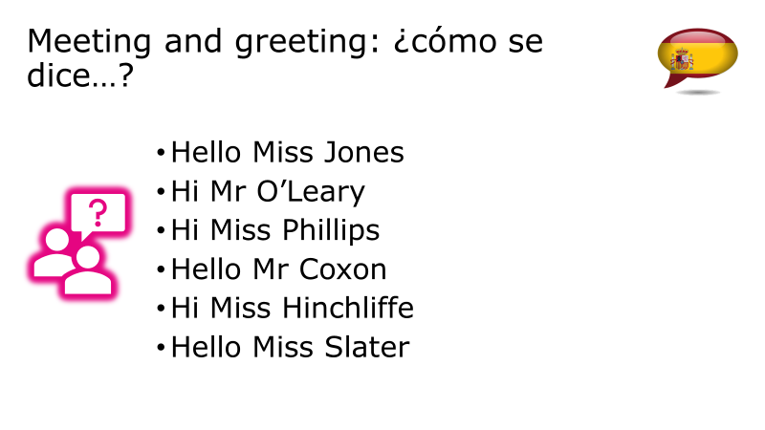
Notes:
What does it look like in lessons?
Principles are in line with vocab and grammar teaching across NCELP and similar to the phonics delivery – explicit, direct instruction, a chance to hear, see, say the new words.
Then using them in practice when called for. Celebrate this!
Two lessons a week means we introduce the language in lesson 1 and practise in lessons 1 and 2, giving LOTS of opportunities to say it.

Slide 14
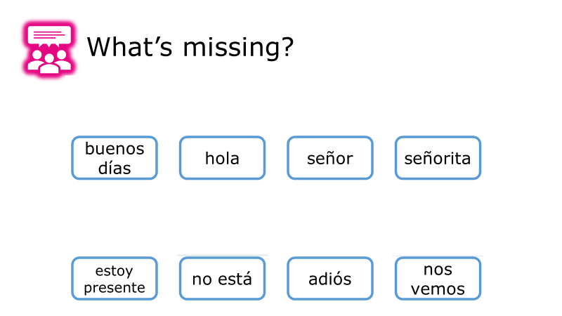
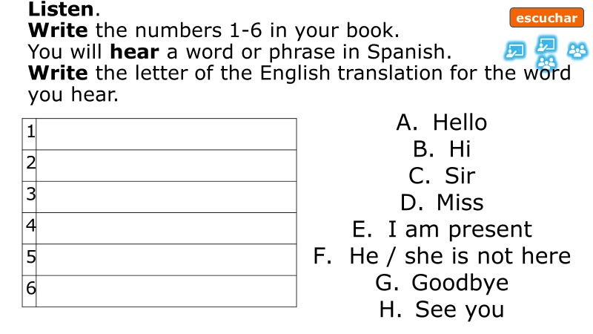
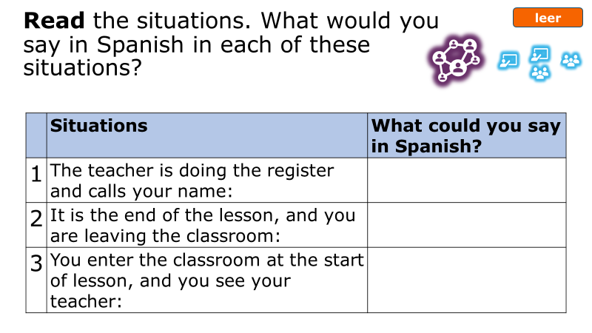
\
Notes:
Explicit translations – no guessing what words mean
Receptive practice and productive – give students opportunities across all modes / modalities
Practise applying new learning and situate in classroom context to reinforce that this is what we do

Slide 15
1 | Hello
2 | Hi
3 | Sir
4 | Miss
5 | I am present
6 | He/she is not here
7 | Goodbye
8 | See you
9 | Please
10 | Thank you
11 | Yes
12 | No
Notes:
Activities that allow for retrieval in the way that we would plan the same with ‘content’ vocabulary

Slide 16
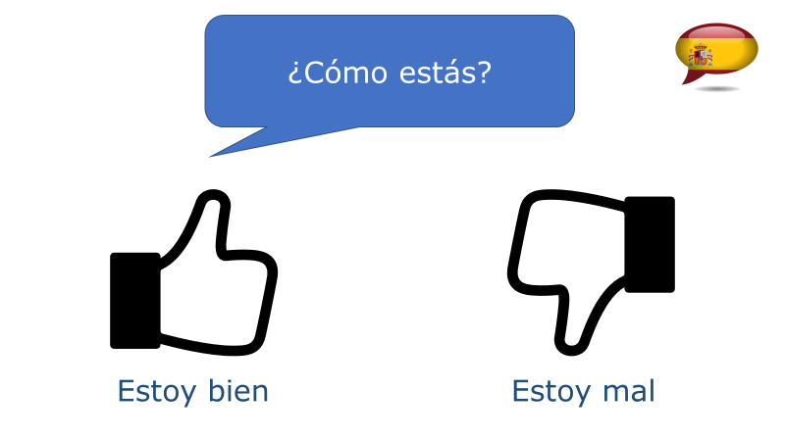
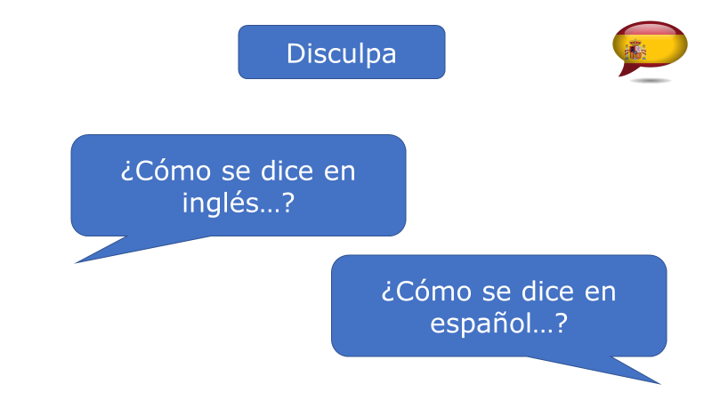
Notes:
Quick recap at the beginning of a lesson and 10 sec conversation
Direct instruction
Vocab recap
Then apply in a conversation

Slide 17
Our lessons learned (so far)
Make it clear
Make it manageable
Be insistent
Monitor it
Review/critique regularly
Remember! It’s a process, not an event
Notes:
Claire reports that this is what she and her colleagues have learnt so far: [click] To maximise consistency across and between colleagues, be very clear about what is to be taught when. Share your vision so there is a clear, shared purpose.
[click]
Break it down into small steps that feel manageable for learners and teachers. Include opportunities to revise and consolidate. Share the rationale behind the way it is broken down.
[click]
Be insistent – at all levels. With yourself – if you’ve taught it, use it. With learners – if you’ve taught it, they use it. With your team – if you’ve taught it, they use it. Be insistent too in terms of fidelity – you and your colleagues may need to adapt your usual classroom scripts to initially ensure that you are using only what you have taught.
[click]
Monitor your use and that of colleagues – is it consistent. Invite colleagues to observe you as a critical friend. Are there missed opportunities? Monitor student use – is movement happening?
[click]
Review, reflect and critique – what is changing in your classroom as a result of your work on TL. How? Why? What still needs to move forwards?
[click]
Our intention is that TL teaching will spiral over three years, each time language structures are revisited there will be added complexity to tie in with prior learning. Embedding learning and –hopefully - developing automaticity with these language functions over time. Forgetting opportunities are built in. This is something we need to stay aware of and maintain momentum.

Slide 18
Next steps
Notice and recognize – celebrate!
Checking
Maintaining expectations – it’s a process!
Notes:
[click]
That’s pupils and teachers! Recognising when an effort is being made to communicate, and celebrating it.
[click]
Considering how we check for this learning with those ‘under the radar’ students
[click]
Keep the focus – use a peer coaching approach, drop ins, learning walks, student voice

Slide 19
Session overview
Part 1: research, policy and practice
Ofsted research review
New GCSE
Current practice
Ways forward
Part 2: TL case study
Part 3: Teacher and student TL use
Part 4: Next steps
Notes:
What might this look this like? I’m going to describe a case study from a former colleague from my trust – Claire Jones – who is now Head of Languages at The Orchard School in Bristol. She has started to set out a target language strand with the rest of her department – their work is the cohesive effort of a whole department to introduce a target language strand to their curriculum.

Slide 20
Ways forward
plan it carefully, using your SOW
pare back teacher use of TL to ensure it is clear and comprehensible to our learners
deliberately use words and structures to recycle previously taught language
build TL use incrementally in step with the SOW
plan our own and students’ use of TL to develop speed of understanding and production over time
use English when there would otherwise be a barrier to learning
Notes:
To make teacher and student use of the new language count, we can:
[click] plan it carefully, using your SOW
[click]
pare back teacher use of TL to ensure it is clear and comprehensible to our learners
[click]
deliberately use words and structures to recycle previously taught language
[click]
build TL use incrementally in step with the SOW
[click]
plan our own and students’ use of TL to develop speed of understanding and production over time
[click]
use English when there would otherwise be a barrier to learning

Slide 21
Estar: I am & he/she is
Y7 Week 1 Lesson 1
In Spanish, the verb estar means to be when describing location.
Estoy
I am
Está
he / she is
Estoy en España
I am in Spain
Está en España
He / she is in Spain
Notes:
In the next few slides, I just give a snapshot of planned teacher TL use – and how it develops incrementally, taking account of what students know. In these examples we have written TL in instructions and explanation, but we can extrapolate the same planning principle to build up TL use over time also to what teachers say in the classroom.
Example 3: Use of English in grammar explanations

Slide 22
Lire
Y7, T1.1, Week 3
Michel’s message tells us what he has, and what his sister Sophie has. The app has a bug! It deleted all the pronouns. Write the nouns (e.g. un animal) in English, in two columns: Michel / Sophie.
1 | ai un animal. | 5 | ai une idée.
2 | a un livre. | 6 | a une chose.
3 | a une chambre. | 7 | ai un chien.
4 | ai une règle. | 8 | a un portable.
Notes:
Example 4: Use of English in task rubrics
Note: This is Year 7, first half-term, week 3 of learning. At this stage, students do not have a lot of target language knowledge. The rubric is given in English. Next two slides show progression and increased use of TL for task instructions.
Vocabulary frequencies
un [3], une [3], animal [1002], chien [1744], livre [358], portable [4002], chambre [633], chose [125], idée [239], règle [488]

Slide 23
Ich oder du?
Y7, T1.2, Week 3
lesen
Wolfgang and Mia want to help more often, but they can’t agree!
Wer macht was? Schreib ich (I) oder du (you).
Ich
Du
a) @mia2008: ___ koche einmal die Woche und ___ arbeitest im Garten.
b) @der_wolf: Nein! ___ putzt jeden Tag den Boden und ___ koche manchmal.
c) @mia2008: Was?! ___ putze manchmal den Boden und ___ machst das Bett.
d) @der_wolf: Das ist unfair! ___ machst das Bett und ___ putze das Fenster.
e) @mia2008: Okay. ___ schreibe eine Liste.
f) @der_wolf: Nein! ___ schreibe die Liste und ___ machst die Arbeit. @mia2008: …
du
ich
Du
Ich
ich
Ich
Ich
du
du
Notes:
Example 5: Use of English in task rubrics
This German task is half a term later on in learning. Student have learnt the verbs ‘machen’ and ‘schreiben’, the question words ‘wer’ (who) and ‘was’ (what), the pronouns ‘ich’ and ‘du’ and the conjunction ‘oder’. All of those are recycled here in the task instruction. However the very brief ‘scenario’ is given in English.

Slide 24
leer
Amanda está en España.
Describe diez ciudades.
Lee la segunda frase.
Marca la opción correcta.
Marca la opción correcta.
1
2
3
4
5
Es muy antiguo.
Son muy antiguos.
No son muy bonitos.
No es muy bonito.
Son muy pequeñas.
Es muy pequeña.
Es bueno.
Son buenos.
Es cara.
Son caras.
Madrid
En Madrid
hay un monumento.
León
En León
tiene unos parques.
En Mallorca
Mallorca
hay una escuela.
En Málaga
Málaga
hay unos coches.
San Sebastián
En San Sebastián
tiene unas casas.
Y7, T1.2, Week 4
Notes:
Example 6: Use of English in task rubrics
In this example from November of Y7, you can see that the task scenario and the instructions are given in Spanish. Students have learnt ‘estar’ and ‘ciudades’. The remainder of the instructions use cognates. The slide is animated to allow for item-by-item feedback, so that the teacher can work through a model with students first, too.

Slide 25
Session overview
Part 1: research, policy and practice
Ofsted research review
New GCSE
Current practice
Ways forward
Part 2: TL case study
Part 3: Teacher and student TL use
Part 4: Next steps
Notes:
Let’s look now at student use of the new language in different speaking activities.

Slide 26
Task analysis questions
Which language knowledge is being practised in the activity?
Are students compelled to focus on both form and meaning throughout?
If it is an interaction task, are both students involved in processing the language (i.e., thinking about the form and meaning of the words), whether listening or speaking
Is there an element of struggle – i.e., retrieval of vocabulary, choices between grammar features to create meaning

Slide 27
1
6
On four pieces of paper, write any four numbers between 1 and 12. You have five minutes to go around the room, reading a sentence aloud from the board. If your partner has that number on one of their cards, you can take the card. The winner has the most cards at the end of the five minutes.
9
7
1 | C’est un message ?
2 | C’est une affiche.
3 | Il a un chat.
4 | Elle a un cheval.
5 | J’ai un dessin ?
6 | C’est un crayon.
7 | Tu as une chaise.
8 | Elle a un bureau.
9 | C’est une chaise ?
10 | J’ai un chien.
11 | Tu as un animal ?
12 | C’est un chat.
Notes:
Let’s do this first activity – it’s time for a bit of participation.
OK – let’s reflect on the questions from the previous slide. What are we practising? Are we practising the language on the board? In what way? Are we engaged in focusing on form and meaning at the same time? Is it an interaction task? Is there an element of struggle? Some language choices to be made to create meanings? Perhaps it’s easier to ask a question the other way around – Could learners do this task without knowing or thinking about what any of this means?
Timing: 5 minutes
Aim: to practise ???
Procedure:
Students write down four numbers on four different small pieces of paper.
They circulate around the room reading a sentence aloud from the board to different students within the class.
If they student they speak to has that number on one of their cards, they win that card.
After five minutes, the student with the most cards wins.

Slide 28
Parle en français.
Écris cinq phrases en anglais. Utilise les mots ici.
Ton/ta partenaire dit tes phrases en français.
parler
30
Est-ce que/qu’ | je/j’ tu il elle | bois boit fais fait mange manges achète achètes | un une du de la de l’ des | poisson café pain glace tomate(s) eau gâteau(x) sandwich(s)
S
0
DÉBUT
Notes:
Timing: 5 minutes Aim: to practise written comprehension and spoken production using vocabulary and grammar from this week to communicate a range of messages about food and drink.
Procedure:
Both pupils write 5 sentences (in English) made up of words from the table.
They swap sentences.
Partner A tries to say all B’s sentences in French within 30 seconds (without or without using the support).
Then Partner B tries to say all A’s sentences in French within 30 seconds.

Slide 29
En parejas
Persona A
Persona B
hablar
Persona C
Persona D
Notes:
Timing: 5 minutes (two slides, if desired)
Aim: to practise oral production of ‘tienes, unos, unas and plural forms of familiar nouns’ connecting them to meaning.
The aim of both activities is to identify a character (Persona A, B, C, D), but with slight differences.
Pupil B chooses one of the Personas but doesn’t tell his/her partner which one.
Pupil A asks questions to determine which person B has chosen. E.g. ¿Tienes unos gatos?
Pupil A makes notes and after several questions can ask ¿Eres persona X?
When A has correctly identified the person, they swap roles.
Notes:
Students A and B will both see this set of cards (so the slide can be projected for the whole group, so no printing needed).
There is a 2nd set of cards for a further round of activity, if time allows.

Slide 30
En parejas
Persona A
Persona B
hablar
Persona C
Persona D
Notes:
[2/2]

Slide 31
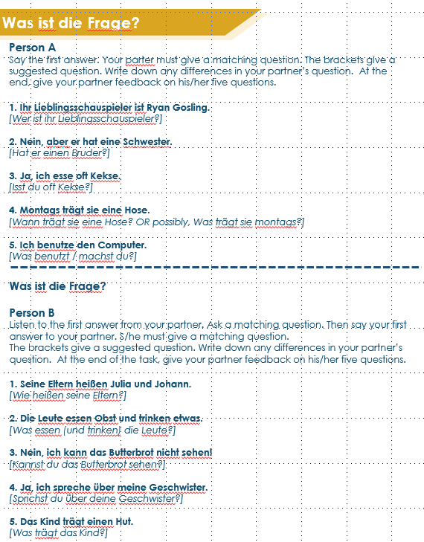
Was ist die Frage?
sprechen
Jede Person hat fünf Antworten auf der Karte.
Person A sagt die erste Antwort.
Person B muss eine Frage stellen.
Person B sagt die erste Antwort.
Person A muss eine Frage stellen….
Notes:
7.3.2.4
Timing: 6 minutes
Aim: To practise oral production of questions and revisit vocabulary from the two revisited sets for this week.
Note: This task requires the separate speaking worksheet downloadable from the NCELP Resource Portal. A/B roles are on one A4 sheet, to be cut in half. Instructions for the task are in English.
Procedure: 1. Person A and B both have five answers on a card.
Note: they have completely different answers from each other.
2. Person A gives person B one of the answers. Person B then comes up with a suitable question that would generate that answer.
3. Then person B gives person A an answer and s/he generates a suitable question.
4. They continue taking turns until all answers have been used, and ten questions generated.
5. Teachers will want to circulate to give support where necessary.
Examples:
Man mischt blau und gelb. Wie macht man grün?
Das kommt aus 1907. Wie alt ist Mensch, ärgere dich nicht!?

Slide 32
Puissance 4! (Connect 4)
parler
porter une
chemise
manger à
l’école
bien travailler en classe
jouer à l'ordinateur
A: Tu portes une chemise normalement ?
B: Oui, je porte une chemise normalement.
OU:
A: Portes-tu une chemise en ce moment ?
B: Non, je ne porte pas une chemise en ce moment.
parler avec mes amis
étudier l’allemand
arriver en retard
aimer les chiens
préparer mon déjeuner
chanter dans une chorale
habiter à [name of town]
écouter la radio
regarder la télé
ressembler à ton ami(e)
gagner des matchs
rester à la maison le week-end
Notes:
8.1.1.7
Timing: 8 minutes
Aim: To practise spoken question production (intonation alone or subject-verb inversion) and answering in either the affirmative or negative, as appropriate
Procedure:
1. The aim of the game is to cross off four adjacent squares in a row. Each student picks his/her own colour to do this.
2. Student A picks a square, and asks a question as suggested by the verb phrase in the square – see animated example on slide, which should be played through for students before starting.
3. The question should contain either normalement or en ce moment, at the choice of Student A, who is trying to elicit both affirmative and negative responses.
4. Upon production of a valid question in correct French, Student A crosses off the relevant square in his/her own colour.
5. Student B responds to the question honestly, in either the affirmative or the negative as required, as per the examples on the slide.
6. Upon production of a valid answer in correct French, Student B crosses off the relevant square in his/her own colour
7. The winner is the first student to cross off four boxes in a row, either vertically, horizontally or diagonally.
8. If all questions and answers are produced correctly in a given round, then obviously Student A will win, having started first. When partners swap roles, this advantage will be reversed. Clearly, any mistake gives the advantage to the opposing side.
9. Partners swap roles after four questions have been asked. If the previous round resulted in a win, they start again; if not, they play on until there is a winner.

Slide 33
hablar / escuchar / escribir
hablar / escuchar / escribir
Sevilla
There are some parks and some towers.
The parks are small.
¿Qué hay en Sevilla?
Hay unos parques y unas torres. Los parques son pequeños.
Notes:
7.3.2.1
Timing: 7 minutes
Aim: to brings together all the revision from the lesson into a final production activity.
Procedure:
1. Teachers could use this slide to model the requirements of the task.
2. Here students work in groups of three. The person writing starts the dialogue off by asking ¿Qué hay en….?
3. The other two people speaking take it in turns to say alternate words of the answer in Spanish. Sentences are then compared at the end as a whole class (or after each city if preferred).
4. The words for this example’s answers are revealed by clicking on each box.
5. Suggested order: Málaga: Persons A&B speak (A says the first word of the response) and person C writes down the Spanish.
Madrid: Persons C&A speak (C says the first word of the response) and person B writes down the Spanish.
Granada: Persons B&C speak (B says the first word of the response) and person A writes down the Spanish.
(Teachers can be less prescriptive if students can work out for themselves how to take turns!)
Notes:
The person writing cannot interrupt if s/he spots a mistake. However, teachers should allow one minute for reflection on the sentences as a group of three, before the answers are revealed. Teachers could consider asking students to undertake the speaking without reference to their exercise books/vocab books and then in the reflection time allowing access to reference materials to allow for successful edits.

Slide 34
hablar / escuchar / escribir
¿Qué hay en….?
hablar / escuchar / escribir
Málaga
There are some shops and some markets.
The markets are outside.
Madrid
There are some museums and some churches.
The churches are big.
Granada
There are some buildings and some squares.
The buildings are beautiful.
Málaga: Hay unas tiendas y unos mercados. Los mercados están fuera.
Madrid: Hay unos museos y unas iglesias. Las iglesias son grandes.
Granada: Hay unos edificios y unas plazas. Los edificios son hermosos.
Notes:
The three speaking cards are available in a printer-friendly Word document.
Procedure:
1. Students use this slide to conduct the activity.
2. Suggested order: Málaga: Persons A&B speak (A says the first word of the response) and person C writes down the Spanish.
Madrid: Persons C&A speak (C says the first word of the response) and person B writes down the Spanish.
Granada: Persons B&C speak (B says the first word of the response) and person A writes down the Spanish.
(Teachers can be less prescriptive if students can work out for themselves how to take turns!)
3. The answers are shown by clicking to reveal the full sentences in turn.

Slide 35
Quartett
die Familie
das Essen
die Kleidung
Bruder
Schwester
Obst
Butterbrot
Hose
Jacke
Eltern
Kind
Keks
Gemüse
Hut
T-Shirt
die Jobs
die Fahrzeuge
die Orte
Schauspielerin
Arzt
Fahrrad
Auto
Theater
Kino
Sängerin
Lehrer
Zug
Bus
Bibliothek
Markt
Notes:
Timing: 15 minutes
Aim: To practise (in a game of Quartett – Happy Families) spoken production and comprehension of questions, grammatical gender and most of the nouns in this week’s vocabulary sets.
Note: This slide shows one card for each of the categories. The full set of cards is available on the NCELP Resource Portal as a printable pdf (3 A4 pages = one set of cards for 3-4 players).
Procedure:
1. Before starting the game, use the next slide to practise additional language to use in the game.
2. Elicit translations for the category titles. Most are known, the exceptions being Fahrzeuge [1721] and Kleidung [2820]. The cards in each set should give students a clue as to what the category is
3. Check that students know what Quartett is and explain the rules if necessary.
4. Elicit language about asking questions (Hast du X? Darf ich X haben?)
5. Remind students that they will need to pay attention to the gender of the word, and elicit from them that they will use Row 2 (accusative) articles.
6. Practise using the items on this slide: Hast du den Bruder? Hast du das Obst? Hast du die Hose? Hast du die Sängerin? Hast du das Auto? Hast du den Markt? Ideally students will be prompted to use Darf ich den Bruder haben, bitte? to provide additional spoken practice of one of the modal verbs.
7. Students play in groups of three or four. A player wins when s/he has no cards left, i.e. all his/her cards are in families/sets of four.
Word frequency (1 is the most frequent word in German):
Fahrzeug [1721] and Kleidung [2820]
Source: Jones, R.L & Tschirner, E. (2011). A frequency dictionary of German: Core vocabulary for learners. London: Routledge.

Slide 36
Jetzt bist du dran! [Now you’re on! / Now it’s your turn!]
hören
How many cards have you got?
2
Wie viele Karten hast du?
So, you start.
Also, du beginnst.
It’s my turn!
Ich bin dran.
Minuten
Do you have (the father)?
Hast du (den Vater)?
May I have (the father), (please)?
Darf ich (bitte) (den Vater) haben?
Oh no! You are so mean!
Ach, nein! Du bist so gemein!
0
I’m winning!
Ich gewinne!
LOS!
Mensch, ärgere dich nicht! Man, don’t be mad!
Notes:
Timing: 3 minutes
Aim: To practise additional language to use in the Quartett game.
Procedure:
Before starting the game give students two minutes to come up with language that might be useful when playing the game, using the English prompts on the slide.
Review suggestions together.
Then play Quartett [Happy Families] in groups of three or four.
Word frequency (1 is the most frequent word in German):
gemein [>5009]
Source: Jones, R.L & Tschirner, E. (2011). A frequency dictionary of German: Core vocabulary for learners. London: Routledge.

Slide 37
Quartett cards
die Familie
die Familie
die Familie
die Familie
Bruder
Eltern
Bruder
Eltern
Bruder
Eltern
Bruder
Eltern
Schwester
Kind
Schwester
Kind
Schwester
Kind
Schwester
Kind
das Essen
das Essen
das Essen
das Essen
Obst
Keks
Obst
Keks
Obst
Keks
Obst
Keks
Butterbrot
Gemüse
Butterbrot
Gemüse
Butterbrot
Gemüse
Butterbrot
Gemüse
Notes:
Template

Slide 38
Quartett cards
die Kleidung
die Kleidung
die Kleidung
die Kleidung
Hose
Jacke
Hose
Jacke
Hose
Jacke
Hose
Jacke
Hut
T-Shirt
Hut
T-Shirt
Hut
T-Shirt
Hut
T-Shirt
die Jobs
die Jobs
die Jobs
die Jobs
Schauspielerin
Arzt
Schauspielerin
Arzt
Schauspielerin
Arzt
Schauspielerin
Arzt
Sängerin
Lehrer
Sängerin
Lehrer
Sängerin
Lehrer
Sängerin
Lehrer
Notes:
Template

Slide 39
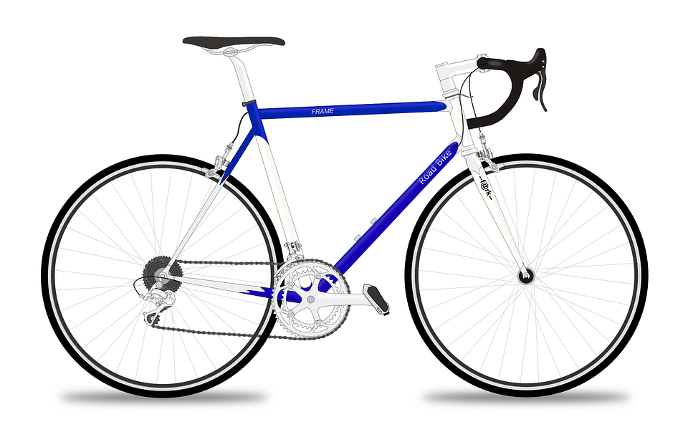
Quartett cards
die Fahrzeuge
die Fahrzeuge
die Fahrzeuge
die Fahrzeuge
Fahrrad
Auto
Fahrrad
Auto
Fahrrad
Auto
Fahrrad
Auto
Zug
Bus
Zug
Bus
Zug
Bus
Zug
Bus
die Orte
die Orte
die Orte
die Orte
Markt
Theater
Markt
Theater
Markt
Theater
Markt
Theater
Bibliothek
Kino
Bibliothek
Kino
Bibliothek
Kino
Bibliothek
Kino
Notes:
Template

Slide 40
L’école au Sénégal
Unscripted Speaking
parler
Partenaire A
Ask your partner about their life at school. Use you plural.
What is your school like?
What are your French lessons like?
Are your maths exercises easy?
What is your favourite sport?
Answer your partner’s questions about your life at school. Use the we form in full sentences.
yellow
strict but funny
science and maths
Wolof
Partenaire B
Answer your partner’s questions about your life at school. Use the we form in full sentences.
small
useful
difficult
football
Ask your partner about their life at school. Use you plural.
What are your uniforms like?
Is your teacher strict?
What are your favourite subjects?
What is your first language?
Notes:
Timing: 5 minutes [slide 1/2]
Aim: Oral production of inversion questions and possessive adjectives
Procedure:
1. Pupils take the roles of Senegalese pupils and ask and answer each other questions.
2. Suggested answers are on the next slide.
Word frequency of cognates used (1 is the most frequent word in French): wolof [>5000]
Source: Lonsdale, D., & Le Bras, Y. (2009). A Frequency Dictionary of French: Core vocabulary for learners London: Routledge.

Slide 41
hablar / escuchar
¿Quién es? – QUIZ QUIZ TRADE
Elige un personaje. Escribe tres pistas* para describir la persona en español. La primera pista no debe ser obvia*. Después escribe otras dos frases más fáciles. Debes esconder tu trabajo - ¡es secreto!
Estudiante A lee las pistas* a Estudiante B.
Después de cada pista* Persona B puede intentar decir quién es el personaje.
Ejemplo:
Estudiante A :
Estudiante B :
Es joven.
¿María?
No, es moreno.
Es joven.
Es moreno.
Tiene el pelo negro.
[Quique]
¿Adrián?
No, tiene el pelo negro.
¿Quique?
¡Sí!
la pista = clue
Notes:
Note the use of target language instructions here – these have been built up cumulatively over 2-3 years. It looks like a look to read and digest and yet, all the words except ‘pista’ have been previously taught and practised over time, such that now we can expect students to process these. In the earlier examples we saw some English being used in instructions, then also some much shorter, simple sentences. At every point, the explanations for the activities (which the teacher would say and students would also read) are made up of words from the SOW (and therefore also words from the GCSE content) that have already been taught. This is planned recycling, additional practice opportunities that slot neatly into the fabric of the lesson. Powerful stuff.
OPTIONAL – ALTERNATIVE FINAL ACTIVITY
This alternative final activity gives the option for students to be more creative with their language.
Timing: 10 min.
Aim:
i) to practise producing and understanding sentences describing a person’s appearance, personality and/or mood
ii) to practise producing and understanding vocabulary
Procedure:
After going through this instruction slide, display the following slide. Students choose a character and write down 3 clues on a piece of paper which will describe the character they have chosen. They should write the clues in order of difficulty, i.e., with the least obvious clue first and the most obvious clue last. They should also write the character’s name. They should not show their work their classmates.
Students then move around the room with their clues and find somebody to speak to.
Student A reads their clues to Student B.
After each clue, the student B can guess which character they think is being described.
Students then swap roles.
Once both students have read out their clues, they swap their pieces of paper and then move on to another student in the class and repeat steps 3-6.
Notes:
Alternatively, rather than using the characters on the following slide, students could describe another member of their class.
Slide 16 is an optional support slide that gives students ideas of what clues they could give and slide 17 gives the answers to those clues.
Students can challenge themselves to refer less to their written notes as they go through the activity.
Slide 18 has an alternative version of the activity using characters from the film ‘Encanto’.
Frequency of unknown words:
pista [2150]

Slide 42
hablar
1
2
3
4
5
6
[Marta]
[Enrique]
[Pablo]
[Quique]
[Irene]
[David]
7
8
9
10
11
12
[Alba]
[Adrián]
[Nerea]
[Pepa]
[Pablo]
[Marta]
*rubio/a = blonde
Notes:
DISPLAY THIS SLIDE DURING THE ACTIVITY
See previous slide for task instructions
Word frequency (1 is the most frequent word in Spanish):
rubio [2861]; gafas [>5000]

Slide 43
hablar
1
2
3
4
5
6
She is excited.
She is young.
She is blond.
[Marta]
He is calm.
He is old.
He doesn’t have much hair.
[Enrique]
He is sad.
He is tired.
He is bored.
[Pablo]
He’s young.
He’s happy.
He has black hair.
[Quique]
She’s thinking.
She has long hair.
She’s sad.
[Irene]
He’s dark-skinned.
He wears glasses.
He is proud.
[David]
7
8
9
10
11
12
She has blue eyes.
She is serious.
She is blond.
[Alba]
He has brown hair.
He is calm.
He’s greeting somebody.
[Adrián]
She has long hair.
She is strange.
She’s angry.
[Nerea]
She is calm.
She wears glasses.
She has grey hair.
[Pepa]
He is old.
He has glasses.
He is angry.
[Pablo]
She is calm.
She is beautiful.
She is not sad.
[Marta]
*rubio/a = blonde
Notes:
OPTIONAL SUPPORT SLIDE
This slide can be used to give students ideas for the descriptions that they could give in Spanish.
Word frequency (1 is the most frequent word in Spanish):
rubio [2861]; gafas [>5000]

Slide 44
Jetzt oder früher?
sprechen
aktiv sein jemanden fragen
eine Blume haben
gucken beliebt sein beobachten
Wissenschaftler sein wachsen
eine Person unterstützen
Chemie studieren einen Gegenstand kaufen
Forscher sein Tourist sein
keinen Zahn verlieren
wach bleiben in Bewegung sein immer einschlafen viel entdecken
im November anfangen
 |  |  | odd = imperfect even = present
1 | I | 1 | wollen
2 | you | 2 | müssen
3 | s/he | 3 | können
4 | I | 4 | wollen
5 | you | 5 | müssen
6 | s/he | 6 | können
Notes:
Note: to keep track during the activity, it may be helpful for each pair to have one print out of this slide between them.
Timing: 8 minutes
Aim: to practise oral productions of first, second and third person singular forms of present and imperfect tense modal verbs.
Procedure:
1. Ensure that students notice that odd numbers = imperfect modal, even numbers = present modals. Player A rolls the dice twice to generate: 1) a pronoun and 2) a verb.
2. S/he changes the infinitive to produce a conjugated verb, e.g. 1+6 = Ich kann
3. S/he then chooses a word or phrase from the square to finish their sentence. Partners write down the sentence in English.
4. Partners take it in turns thereafter.
Each word from the square can only be used once. Once a word is used it can be crossed out. As the number of possible words decreases, players may have to ‘knock’ if there is no appropriate word to finish their sentence. In this case, play passes to their partner. All modals work with all verb phrases. The player who is able to make the most sentences within the time or until all the words run out is the winner.
5. To bring the learning to a close, students should translate orally into German the English sentences that their partner made (which they have noted in English in their books).

Slide 45
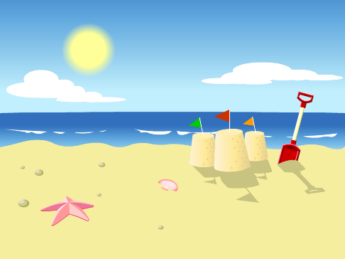
Escribir un poema nuevo
hablar / escuchar / escribir
hablar / escuchar / escribir
Vamos a usar verbos en –ar y escribir un poema nuevo.
Persona A: Lee el poema. ¡Debes interpretar las imágenes!
Ejemplo:
Persona B: Escucha y escribe el poema. Luego, compara.
Luego, Persona B habla y Persona A escucha y escribe.
Jugamos en la playa en verano.
[We play] en la en verano.
De la obra "El príncipe Zeta" de Juan Guinea Díaz, A Fortiori Editoria, 2010.
Notes:
Read aloud, speaking, listening and writing (in the form of dictation) all in one activity.
7.3.2.6
There are two options for the final activity. We recommend doing ONE of the these. The two options are summarised below.
First 3 slides: Paired speaking/listening/writing, using an scaffolded text that allows for a new, alternative version of the poem in Spanish to be written. This poem is designed to elicit –ar verbs in 1st person plural and 3rd person plural, plus vocabulary items from the poem.
OR
Second 4 slides: Paired speaking/listening/writing, using speaking cards. This activity focuses on the same grammar features and also allows for productive practice of vocabulary from the poem.

Slide 46
Persona A
Persona B
1 [We walk] en la en verano 2 [They look at] las del mar 3 [We listen to] la brisa, [we take out] un
4 [They jump] y [they swim] 5 [We prepare] en el patio 6 [They carry] melón y 7 [They listen to] la 8 [We need] una siesta al mediodía 9 [They buy] un cubo y una pala 10 [We play] con enormes castillos
11 [They enjoy] un paseo por la 12 [We look at] el amarillo 13 [They have] el enredado 14 [They rest] en la y la sal 15 [We play] con los arrugados 16 [We have dinner] en el bar 17 [They sing] con la ventana abierta 18 [We speak] con la 19 [They dance] en la playa desierta 20 en el cielo todas las
[sky]
[sand]
Notes:
Timing: 10-12mins
Aim: for students to a) produce the target grammar features (-ar verbs with –amos and –an) and vocabulary in oral production; b) write the Spanish they hear accurately.
Procedure:
Person A first reads out his/her 10 lines of the poem, using the English words and images as prompts to say the Spanish. These include –ar verbs in the 1st person and 3rd person plural. Person B listens and writes.
The two students swap roles. Person B reads out lines 11-20. Person A listens and writes.
Check against the answers on slide 48.
Notes:
In this task students can see the English so it works to consolidate their understanding of the sound of the word and its meaning. This prepares students for the more challenging listening and speaking task that follows (if these are both done). However, should teachers want to increase the challenge for students, they could print and cut this slide, so that students additionally have to translate into English (orally, back to their partner) the lines they have written down.

Slide 47
Persona A
El poema completo
Persona B
1 Caminamos en la playa en verano 2 Miran las olas del mar 3 Escuchamos la brisa, sacamos un helado
4 Saltan y nadan
5 Preparamos comida en el patio 6 Llevan melón y sandía 7 Escuchan la radio 8 Necesitamos una siesta al mediodía 9 Compran un cubo y una pala 10 Jugamos con enormes castillos
11 Disfrutan un paseo por la playa 12 Miramos el cielo amarillo 13 Tienen el pelo enredado 14 Descansan en la arena y la sal 15 Jugamos con los dedos arrugados 16 Cenamos en el bar 17 Cantan con la ventana abierta 18 Hablamos con la abuela 19 Bailan en la playa desierta 20 en el cielo todas las estrellas
Notes:
ANSWERS

Slide 48
Vas a Francia cada julio. Habla con tu compañero sobre un día en la playa allí.
hablar / escuchar / escribir
Persona A: Describe el día en la playa.
Usa las cartas.
Student B: Escucha y completa la tabla.
¿El verbo es con –amos (‘we’) o con –an (‘they’)?
Escribe la acción en la columna correcta.
Después, Persona B habla y Persona A escucha y escribe. Persona B tiene otras cartas.
Notes:
Timing: 10-12mins
Aim: for students to produce the target grammar features (-ar verbs with –amos and –an) and vocabulary in oral production and understand them in listening
Procedure:
Student A speaks; Student B listens and writes down notes in English in the correct column of the speaking grid (see slide 47)
Students A and B swap roles.
See slide 47 to do this activity individually from home (remote learning).
Revisited vocabulary from 3.2, Week 3: mi [37]; tu [53]; Francia [N/A], cada [107], julio [659]

Slide 49
Persona A
A
They arrive at the patio.
B
C
D
We play in the
They buy a
We listen to my
E
F
They look at the
G
We jump in the
H
They take
out the
We need an
[beach]
Notes:
DO NOT DISPLAY Student A speaking cards Note: Cards are labelled with letters for additional alphabet practice.
Transcript:
Llegan al patio.
Jugamos en las olas.
Compran una sandía.
Escuchamos mi radio.
Sacan el melón.
Miran la playa.
Saltamos en el mar.
Necesitamos un helado.

Slide 50
Persona B
A
B
C
They need an
D
We look at the
They take
out the
We play in the
[beach]
E
We arrive at the patio.
F
G
They listen to my
H
They jump in the
We buy a
Notes:
DO NOT DISPLAY Student B speaking cards Note: Cards are labelled with letters for additional alphabet practice.
Transcript:
Miramos la playa.
Sacan el melón.
Necesitan un helado.
Jugamos en las olas.
Llegamos al patio.
Compramos una sandía
Escuchan mi radio.
Saltan en el mar.

Slide 51
Eduqas French SAMS

Slide 52
Finding ideas

Slide 53
Session overview
Part 1: research, policy and practice
Ofsted research review
New GCSE
Current practice
Ways forward
Part 2: TL case study
Part 3: Teacher and student TL use
Part 4: Next steps

Slide 54
Next steps
Plan teacher use of the new language to go step-in-step with your KS3 SOW
Consider developing a target language talk strand for your KS3 SOW
Get some ideas for speaking activities which:
Compel students to focus on form and meaning
Contain an element of desirable difficulty (i.e., retrieval of vocabulary, choices between grammar features to create meaning)

Slide 55
Task
Take a lesson you have in mind for next week’s teaching and plan a speaking task for it.

Slide 56
On target for unprepared speaking
ALL Sheffield Tuesday 6 December 2022
Presenter: Rachel Hawkes

