Slide 1
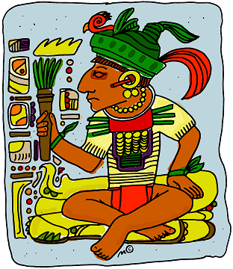
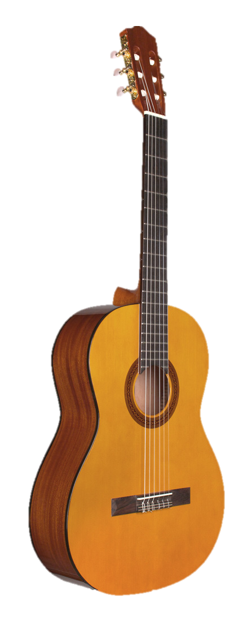
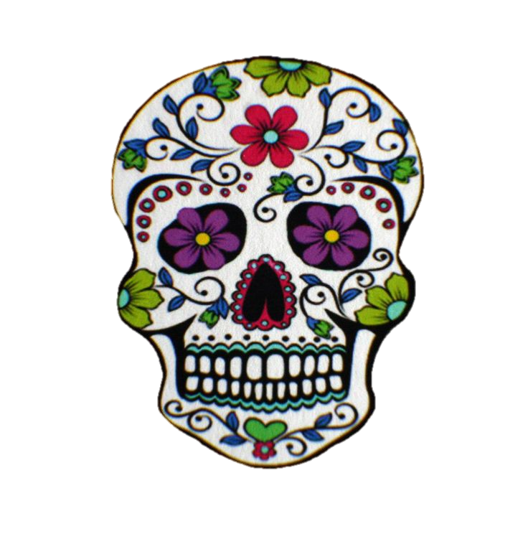
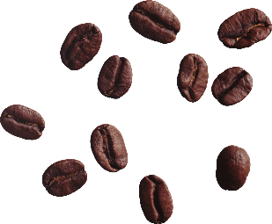
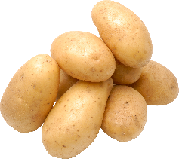
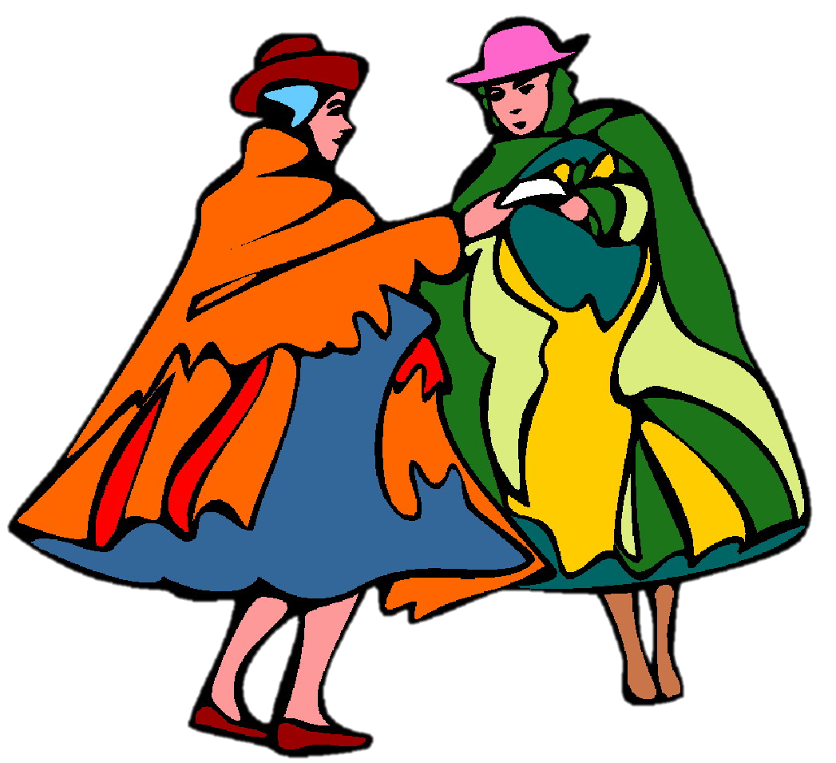
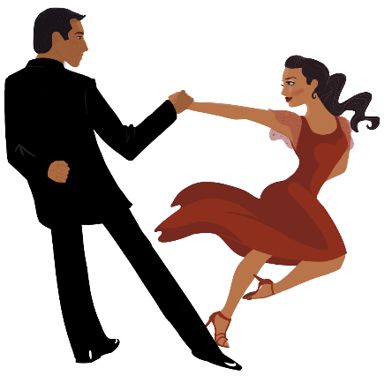
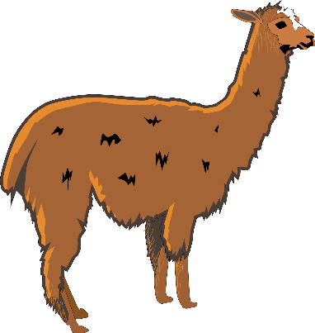
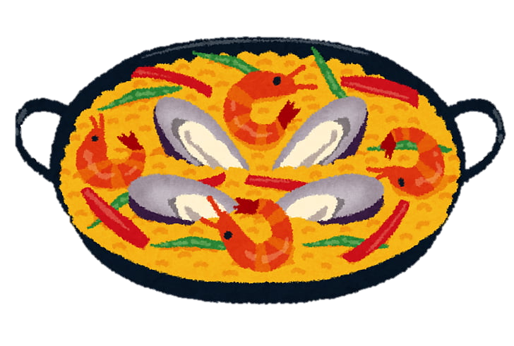
Español
la historia
la naturaleza
la música
la cultura
la comida
Year 9 Language Guide
Nombre: ………………………………………
Profesor/a: ……………………………………
Last updated: 01.07.22

Slide 2
Contents
Past tense (preterite) –ar verbs Describing past events (holidays) | 7 | –ar/–er/–ir verbs in preterite A school event | 31
Past tense (preterite) –er/–ir verbs Asking questions about past events | 8 | ‘Tener que’ & tuve/tuviste/tuvo Making a film | 32-33
Possessives ‘mi’ and ‘tu’; ESTAR Describing the location of things | 9 | ESTAR in the imperfect tense Comparing how you feel vs felt | 34-5
Reflexive pronoun ‘se’ A Mexican tradition | 10-11 | Imperfect continuous Describing events in the past | 36-7
Direct object pronouns ‘los’ & ‘las’ Talking about food and culture | 12-13 | Imperfect continuous (cont.) Reporting the news | 38
Spanish OVS word order A trip to a Spanish-speaking city | 14 | AR verbs in the imperfect tense What people used to do | 39-40
Using the pronoun ‘les’ Looking after people | 15 | ER/IR verbs in the imperfect tense Family celebrations in the past | 41-2
–ar verbs in 2nd person plural (–áis) Sport and exercise | 16-17 | SER in the present vs imperfect Comparing jobs in past vs present | 43-4
‘Estáis’ and ‘sois’ Health | 18-19 | Tenía vs había Text exploitation: Don Quijote | 45
SER vs ESTAR [revisited] How people feel | 20 | -AR verbs in 2nd person Talking about jobs | 46
Revision and test practice week Weekend activities | 21 | -ER/-IR verbs in 2nd person Advice and instructions at school | 47-8
IR in present and past Where people go (and went) | 22 | Gustar-type verbs Spending time with friends | 49-50
IR in future Future plans | 23 | Use of SER [revisited] Saying where people are from | 51
HACER in preterite Talking about the weather | 24-25 | Demonstrative adjectives A trip to a theme park | 52
–ar verbs in the preterite A charity event | 26 | Possessive adjectives Describing a crime scene | 53
–ar verbs in the preterite Talking about history | 27 | Verbs in preterite (1st & 2nd person) Talking about life experiences | 54-5
–er and –ir verbs in preterite Lives of Spanish speakers in the US | 28 | Verbs in the preterite (3rd person) Text exploitation: Diana Trujillo | 56
–er and –ir verbs in preterite Climate change | 29-30 | Use of ‘ir + a + infinitive’ Talking about plans for holidays | 57

Slide 3
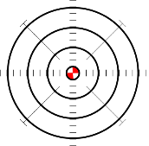
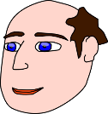
Sounds of the language
In Year 9, we continue to practise sound-spelling correspondences (SSC) in activities focused on two or more SSC. Often these are tricky pairs, such as [r] vs [rr]. Here are some of the SSC that we will revisit, with their source and cluster words.
Double ll, as in calle, is very different to a single l. In most parts of Spain, it sounds like the letter “y” in English.
[to arrive]
[then]
llegar
llave
amarillo
palabra
luego
luz
[she]
[list; ready (f)]
llevar
ella
lista
salir
The SSCs [ce], [ci] and [z] are pronounced differently in different parts of the Spanish-speaking world. In most of mainland Spain, this ‘c’ and ‘z’ is pronounced like “th” in English. In the Canary Islands and Latin America, they are pronounced like an “s”.
It doesn’t matter which way you say it – you will be understood!
[to need]
[to seem; appear]
[necessary]
centro
necesitar
doce
parecer
necesario
[to say; tell]
[city]
decir
ciencias
ciudad
cine
diciembre
[to start]
cabeza
voz
empezar
zapato
diez
2

Slide 4
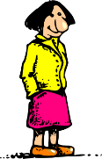
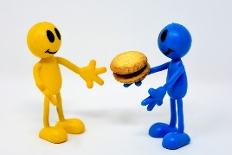
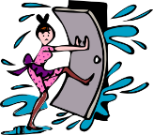
Sounds of the language (con’t)
[Argentinian]
[gesture]
[generally]
imagen
gesto
recoger
argentino
generalmente
47
48
[to choose, choosing]
Versión original
página
elegir
religión
original
colegio
[red]
[better]
[to leave]
julio
rojo
dejar
mujer
mejor
[to do;
to make]
H is silent in Spanish. Imagine it’s not there.
hospital
hacer
helado
Ñ is a separate letter in Spanish. It is pronounced like the ne in lasagne.
2020
[night]
[we]
año
señora
noche
nosotros
[about]
correr
cerrar
sobre
dar
Remember that if a word starts with R, this will be pronounced just like RR.
rico

Slide 5
Sounds of the language (con’t)
In Year 8, we focus in particular on stress (the part of a word that is given most emphasis) and the use of the written accent to indicate which part of the word is stressed.
Syllables in Spanish and English
In Spanish, syllables often come in single consonant-vowel pairs.
Spanish
English
Four clear, separate syllables:
cho-co-la-te
Each part is always pronounced.
Three syllables if speaking slowly.
(‘cho-co-lat’).
Often two syllables (‘choc–lat’)!
‘Strong’ vowels
When they appear next to each other, the Spanish vowels [a], [e] and [o] are pronounced separately (as two syllables).
idea
oeste
leer
aeropuerto
feo
These vowels are often short, open and crisp!
‘Weak’ vowels
The vowels [i] and [u] merge with [a], [e] and [o] to make a single syllable.
igual
antiguo
bien
puerta
sucio
Because the [u] sound ‘glides’ into the next vowel, it sounds like a [w]!
In Y7, we saw the SSC [cu] + vowel. This is an example of how a weak vowel, [u], merges with a following vowel:
cuerpo
escuela
cuidar
cuatro
cuarenta

Slide 6
Sounds of the language (con’t)
Final-syllable stress
The part of a word that is ‘stressed’ is the part given most emphasis.
The position of the stress is sometimes marked by a written accent.
opción
op-CIÓN
Rule #1: If the final syllable is stressed, and the word ends in the consonants ‘n’ or ‘s’, write an accent above the stressed vowel.
según
quizás
también
después
autobús
(‘se-GÚN’)
(‘qui-ZÁS’)
(‘tam-BIÉN’)
(‘des-PUÉS’)
(‘auto-BÚS’)
Rule #2: If the final syllable is stressed and the word ends in a vowel, write an accent above the stressed vowel.
café
decidí
Panamá
escuché
papá
(‘ca-FÉ’)
(‘de-ci-DÍ’)
(‘pa-na-MÁ’)
(‘es-cu-CHÉ’)
(‘pa-PÁ’)
Now try saying the words aloud! Emphasise the final syllable.
Penultimate (second-last) syllable stress
Rule #1: if the second-last syllable is stressed and the word ends in any vowel OR ‘n’ or ‘s’, there is no accent on the stressed vowel.
minuto
triste
martes
ejemplo
(‘mi-NU-to’)
(‘TRIS-te’)
(‘MAR-tes’)
(‘e-JEM-plo’)
Rule #2: if the second-last syllable is stressed and the word ends in any consonant except ‘n’ or ‘s’, write an accent above the stressed vowel.
fútbol
fácil
difícil
líder
(‘FÚT-bol)
(‘FÁ-cil’)
(‘di-Fí-cil’)
(‘LÍ-der’)
Now say them aloud! Emphasise the second-last syllable.

Slide 7
Sounds of the language (con’t)
Ante-penultimate (third-last) syllable stress
Words with stress on the third-last syllable always have an accent on the stressed vowel.
cámara
página
teléfono
sábado
(‘CÁ-ma-ra’)
(‘PÁ-gi-na’)
(‘te-LÉ-fo-no’)
(‘SÁ-ba-do’)
Now say them aloud! Emphasise the third-last syllable.
Stress position on common verb endings and suffixes
Spanish verb endings change when talking about completed actions in the past (this is called the ‘preterite’ tense).
For –ar/–er/–ir verbs in 1st person singular (talking about ‘I’), this can change the position of the stress.
present tense
past tense (preterite)
-AR verbs
(e.g. escuchar):
escucho - I listen
escuché - I listened
(‘es-CU-cho’)
(‘es-cu-CHÉ’)
-ER/-IR verbs
(e.g. abrir):
abro - I open
abrí - I opened
(‘A-bro’)
(‘a-BRÍ’)
This is final-syllable stress.
The suffix ‘–tion’ at the end of an English word (e.g. option) often changes to ‘–ción’ in Spanish (e.g. opción). The singular and plural forms follow two of the rules mentioned on the last page:
opción
(the final syllable is stressed and word ends in ‘n’, so an accent is needed)
opciones
(the second-last syllable is stressed and word ends in ‘s’, so there is no accent)

Slide 8
T1.1 Semana 1
Gramática
Past tense (preterite) –ar verbs [revisited]
Viajar Viajé
Viajé a la costa. I travelled to the coast.
Llegar llegaste
¿Llegaste por la mañana? Did you arrive in the morning?
Celebrar Celebró
Celebró su compleaños. She celebrated her birthday.
Ella caminó, mientras que yo monté a caballo.
She walked, whereas I went horse-riding (‘rode a horse’).
Yo descansé en (la) casa, pero tú pasaste tiempo con tus amigos.
I rested at home but you spent time with your friends.
To talk about ‘I’ with an action completed in the past, remove –ar and add an –é.
To talk about ‘you’ remove –ar and add an –aste.
Spanish doesn’t have a word for ‘do’ or ‘did’ in questions. Only the main verb is used.
To talk about ‘s/he’ or ‘it’ remove –ar and add an –ó.
Remember to use subject pronouns (e.g. ‘yo’) when comparing what different people do or did, and to add emphasis.
Vocabulario
This week we revisit vocabulary from Year 7 and Year 8. Write the English next to each Spanish word.
cantar | ____________ | agosto | _____________
bailar | ____________ | la fiesta | _____________
el mar | ____________ | el lugar | _____________
Now cover up the Spanish words. Look at the English words and write the Spanish on a piece of paper. Then check your answers.

Slide 9
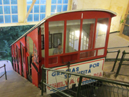
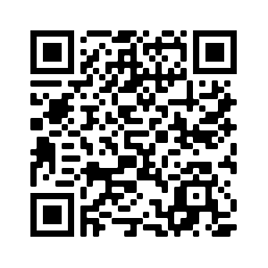
T1.1 Semana 2
Gramática
Past tense (preterite) –er and ir verbs [revisited]
Salir Salí
Salí todas las tardes. I went out every afternoon.
Coger cogiste
Cogiste el autobús. Yesterday you caught the bus.
Subir Subió
Subió a la montaña. She went up the mountain.
hablar (ha-BLAR) estación (es-ta-CIÓN)
actividad (ac-ti-vi-DAD) después (des-PUÉS)
To talk about ‘I’ with an action completed in the past, remove -er or -ir and add an –í.
To talk about ‘you’ remove -er or -ir and add an –iste.
To talk about ‘s/he’ or ‘it’ remove -er or -ir and add an –ió.
If the stress falls on the final syllable, and the word ends in any consonant except ‘n’ or ‘s’, there is no written accent.
San Sebastián es una ciudad genial. Hay unas playas y un río hermosos. Puedes comer la comida tradicional en la parte vieja, coger un barco y visitar una isla pequeña, Santa Clara, o subir a la montaña en el funicular para disfrutar de unas vistas preciosas. Es un lugar con mucha cultura y arte, con muchos monumentos, edificios antiguos y festivales de cine y música. Además, si te gusta el fútbol puedes ver un partido del equipo de la zona: La Real Sociedad de Fútbol.
Santa Clara
Funicular
Vocabulario
This week we revisit vocabulary from Year 7 and Year 8. Follow the QR code to the Quizlet Mashup.

Slide 10
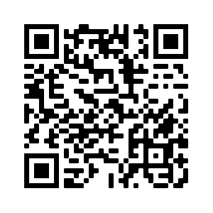
T1.1 Semana 3
Gramática
Possessive adjectives [revisited]
to say ‘my’ before a singular or uncountable noun, use ’mi’.
My sister is at home.
Mi hermana está en casa.
to say ‘my’ before a plural noun, use ’mis’.
I left my things at school.
Dejé mis cosas en la escuela.
To say ‘your’ before a singular or uncountable noun, use ’tu’.
Your bottle is on the table.
Tu botella está en la mesa.
To say ‘your’ before a plural noun, use ’tus’.
Your friends are in class.
Tus amigos están en clase.
You can use ‘mi(s)’ and ‘tu(s)’ with masculine and feminine nouns.
Understanding the difference between ‘mi’ and ‘me’
Remember, ‘me’ (myself, to me) and ‘mi’ (my) look similar but ‘me’ is followed by a verb and ‘mi(s)’ is followed by a noun.
I wash (myself).
Me lavo.
My book is new.
Mi libro es nuevo.
Using ‘del’ and ‘de la’ with adverbs of position [revisited]
For a singular masculine noun change de + el to ‘del’.
My school is behind the cinema.
Mi escuela está detrás del cine.
For a singular feminine noun, use‘de la’.
Your house is near the station.
Tu casa está cerca de la estación.
Vocabulario
This week we revisit vocabulary from Year 7 and Year 8. Follow the QR code to the Quizlet Mashup.

Slide 11
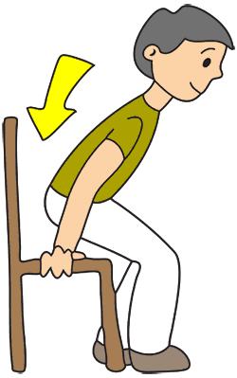
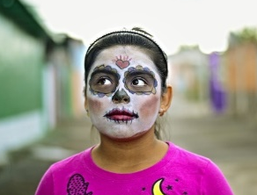
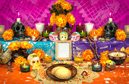
T1.1 Semana 4
Gramática
Possessive adjectives [revisited]
to say ‘his’, ‘her’ or ‘its’ before a singular or uncountable noun, use ’su’.
His / her / its community is special.
Su comunidad es especial.
to say ‘his’, ‘her’ or ‘its’ before a plural noun, use ’mis’.
His / her / its customs are unique.
Sus costumbres son únicas.
You can use ‘su(s)’ with masculine and feminine nouns.
Personal ‘a’ [revisited]
When the ’doer’ (subject) and ‘receiver’ (object) of the verb are not the same person, we use an ‘a’ after the verb.
Sienta al niño.
S/he sits the child down.
Using the reflexive pronoun ‘se’
We use reflexive pronouns (e.g. myself) when the ‘doer’ and ‘receiver’ are the same. To mean ‘herself’ or ‘himself’ in Spanish, use ‘se’ before a verb.
S/he sits (himself/herself) down.
Se sienta.
Some Spanish verbs have a very different meaning when used reflexively.
Quedar =
to meet up
to remain, to stay
Quedarse =
El Día de Muertos es una costumbre muy importante para la comunidad mexicana porque es una forma de pensar en los muertos. Los mexicanos creen que los muertos vienen a la tierra este día. Preparan un altar con dulces, fruta y fotos de personas de la familia que están muertas.

Slide 12
Describing people and places in Mexico
Vocabulario
The stem of sentar changes in the present tense (e->ie) for the following:
‘I’ (siento)
‘you’ (sientas)
‘s/he’ (sienta)
‘they’ (sientan)
vb
vb
vb
vb
vb
nf
nf
nf
acordarse | to remember, remembering
quedarse | to stay, staying
sentar | to sit (down), sitting (down)
venir | to come, coming
la comunidad | community
la costumbre | custom
la forma | way
la hora | hour, time
The stem of venir changes in the present tense for the following:
‘I’ (vengo)
‘you’ (vienes)
‘s/he’ (viene)
‘they’ (vienen)
nf
nf
nm
nf
adj
adj
adj
adj
la luz | light
la muerte | death
el nivel | level
la tierra | earth
especial | special
mexicano/a | Mexican
muerto/a | dead (m)
único/a | unique (m)
Revisit vocab 8.3.2.4 & 8.3.1.4

Slide 13
T1.1 Semana 5
Gramática
Direct object pronouns ‘lo’ & ‘la’ [revisited]
Use ‘lo’ to mean ‘him’ or ‘it’ for a masculine object:
→ Daniel collects the bread.
Daniel recoge el pan.
Daniel recoge a un amigo.
→ Daniel collects a friend.
Daniel lo recoge.
→ Daniel picks him / it (m) up.
¡Ojo! Object pronouns often go before the verb.
Use ‘la’ to mean ‘her’ or ‘it’ for a feminine object:
Lucía busca la verdura.
→ Lucía looks for the vegetable.
Lucía busca a una amiga.
→ Lucía looks for a friend.
Lucía la busca.
→ Lucía looks for her / it (f).
This can be tricky because ‘la’ also means ‘the’ when it comes before a noun.
Direct object pronouns ‘los’ & ‘las’
Use ‘los’ to mean ‘them’ for plural masculine objects.
→ You mix the eggs.
Mezclas los huevos.
→ You mix them.
Los mezclas.
Use ‘las’ to mean ‘them’ for plural feminine objects.
Cortas las verduras.
→ You cut (up) the vegetables.
→ You cut them (up).
Las cortas.

Slide 14
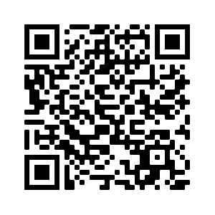
T1.1 Semana 5
Vocabulario
vb
vb
vb
vb
vb
vb
vb
nm
colocar | to place, placing
cortar | to cut, cutting
costar | to cost, costing
mezclar | to mix, mixing
preferir | to prefer, preferring
probar | to taste, to try
soler | to usually do something
el huevo | egg
Using stem changing verbs
In the following verbs, the first ’o’ changes to ‘ue’ for ‘I’, ‘you’, ‘s/he’ and ‘they’ in the present tense.
Probar →
Pruebas la leche.
You try/taste the milk.
Costar →
El pan cuesta un euro.
The bread costs one euro.
I usually eat early.
Soler →
Suelo comer temprano.
‘Soler’ is a modal verb, so it is followed by an infinitive.
nf
nm
nf
nm
adj
adj
adj
adj
la leche | milk
el pan | bread
la verdura | vegetable
el vino | wine
caliente | hot
dulce | sweet
fresco | fresh
tradicional | traditional
Revisit vocab 8.3.2.5 & 8.3.1.5

Slide 15
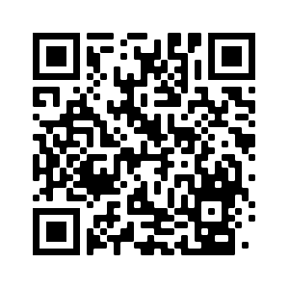
T1.1 Semana 6
Gramática
Spanish object-verb-subject word order [revisited]
The object is the person or thing that ‘receives’ an action or is affected by it. In English, it goes after the verb.
In Spanish, the object can go before OR after the verb.
This doesn’t change the meaning of the sentence.
SUBJECT
VERB
OBJECT
The student (m)
calls
the teacher.
El estudiante
llama
a la profesora.
OBJECT
VERB
SUBJECT
Going on a school trip
el estudiante.
A la profesora
la llama
Remember, ‘a’ is used before the object if it is a living thing.
Object-first sentences use lo or la between the object and verb. There is no translation in English for this.
Object pronouns ‘me’ and ‘te’ [revisited]
If the person affected by the verb is ‘me’, use ‘me’.
The teacher listens to me.
La profesora me escucha.
If the person affected by the verb is ‘you’, use ‘te’.
Los chicos te envían correos.
The boys send you emails.
Vocabulario
This week we revisit vocabulary from Year 7 and Year 8. Follow the QR code to the Quizlet Mashup.

Slide 16
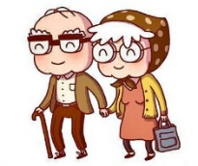
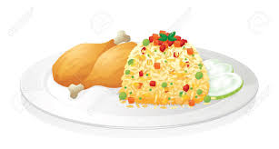
T1.1 Semana 7
Gramática
Indirect object pronouns ‘le’ and ‘les’
Pronouns are used to avoid repeating nouns.
For one person or thing indirectly affected by an action, use le.
Le manda un regalo.
He/she/it sends him/her/it a present.
If more than one person or thing is indirectly affected, use les.
Les manda un regalo.
He/she/it sends them a present.
-ar/-er/-ir verbs in 3rd person singular present tense
For ‘s/he’ with a present tense –ar verb, remove –ar and add -a.
Les ofrece ayuda en la casa.
S/he offers them help in the house.
For ‘s/he’ –er or -ir verb, remove –er or -ir and add -e.
Les cocina pollo con arroz.
S/he cooks them chicken with rice.
pron.
vb
vb
vb
nm
nm
nm
nm
nf
nf
adj
adj
adj
les | to them
cocinar | to cook, cooking
mandar | to send, sending
contar | to tell, telling
el arroz | rice
el dolor | pain
el invierno | winter
el pollo | chicken
la camiseta | t-shirt
las gafas | glasses
gris | grey
naranja | orange
tanto | so much, so many
Vocabulario
Revisit vocab 8.3.2.6 & 8.3.1.6
‘Naranja’ is an adjective but its ending only changes in the plural (naranjas).
‘Tanto’, an adjective, agrees in gender and number with the noun: eg. tantas camisetas, tantos pollos.

Slide 17
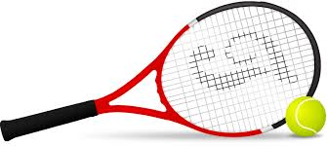
T1.2 Semana 1
Gramática
-ar verbs in 2nd person singular & plural
To refer to ‘you’ for one person with a present-tense –ar verb, use the verb ending -as.
You fight a lot with your brother →
Peleas mucho con tu hermano.
To refer to ‘you’ for two or more people with a present-tense –ar verb, use the verb ending -áis.
If you (plural) practise, you play well →
Si practicáis, jugáis bien.
Some verbs follow the pattern (u->ue) for ‘I’, ‘you’, ‘s/he’ and ‘they’ in the present tense.
juego
I play, I am playing
Otros ejemplos:
juegas
you play, you are playing
1. acordar(se) -> acuerdo
2. encontrar -> encuentro
To say what people play, use ‘a’ before the sport. This is often ‘al’ because many sports are masculine.
3. probar -> pruebo
Juegan al tenis.
They play tennis.
‘Estar’
‘Estar’ means ‘to be’ and is used to express a state or a location
To say ‘you are’ for one person, use ‘estás’ .
Estás emocionado/a.
You are excited.
To say ‘you are’ for two or more people, use ‘estáis’.
Estáis jugando al tenis.
You (plural) are playing tennis.
Use the –ando ending with an –ar verb to refer to an ongoing event (something in progress).

Slide 18
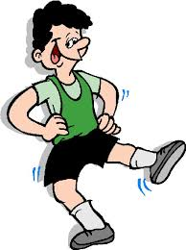
Talking about sport and exercise
Vocabulario
vb
vb
vb
vb
vb
vb
nm
nmj
nf
nm
prep
adj
adj
adj
adj
cruzar | to cross, crossing
invitar | to invite, inviting
mejorar | to improve, improving
pelear | to fight, fighting
practicar | to practise, practising
sé | I know
el consejo | advice
el riesgo | risk
la pelota | ball
el tenis | tennis
contra | against
duro | hard, difficult (m)
dura | hard, difficult (f)
varios | several, various (m)
varias | several, various (f)
Revisit vocab 9.1.1.4 & 8.3.2.4
From the verb ’saber’ - to know
inglés | español
1. You are playing
2. You are crossing
3. You are inviting
4. You lot are fighting
5. You lot are practising
Escribe las frases en español.

Slide 19
T1.2 Semana 2
Gramática
How to say ‘your’
For one person before a singular or uncountable noun, use ‘tu’.
Tu cuerpo es fuerte.
Your body is strong. →
For two or more people before a singular or uncountable noun use ‘vuestro’ or ‘vuestra’.
Vuestro peso es sano.
Your weight is healthy. →
Your skin is beautiful. → Vuestra piel es bonita.
‘Piel’ is a feminine noun.
SER vs ESTAR second person plural
Use ‘estáis’ for location and for state or mood.
You (all) are tired [state] → Estáis cansados.
Adjectives usually need a plural –s to refer to more than one ‘you’.
You (all) are healthy [state] → Estáis sanas.
You (all look young [state] → Estáis jóvenes.
Use ’sois’ for traits.
Some adjectives don’t end in –o or –a. The ending is the same for masculine and feminine nouns.
You (all) are kind [trait] → Sois amables.
You (all) are healthy [trait] → Sois sanas.
You (all) are young [trait] → Sois jóvenes.
To say ‘we’ in Spanish we say ‘nosotros’ for male and mixed groups and ‘nosotras’ for all female groups.
To say ‘you (all)’ in Spanish we say, ‘vosotros’ or ‘vosotras’.
We look/are looking fat but you (all) look/are looking slim. →
Nosotros estamos gordos pero vosotras estáis delgadas.

Slide 20
Talking about health
Vocabulario
pron
vb
nm
nm
nm
nf
nm
nm
nf
adj
adj
adj
adj
adj
adj
num
num
num
num
vosotros, vosotras | you (all) (m, f)
aumentar | to increase
el beneficio | benefit
el corazón | heart
el cuerpo | body
la edad | age
el ojo | eye
el peso | weight
la piel | skin
delgado/a | thin
gordo/a | fat
joven | young
pálido/a | pale
sano/a | healthy
vuestro, vuestra | your (m, f)
cuarenta | forty
cincuenta | fifty
sesenta | sixty
setenta | seventy
Revisit vocab 9.1.1.5 & 8.3.2.5

Slide 21
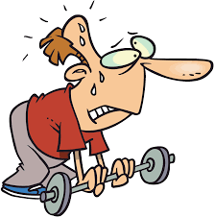
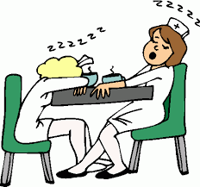
T1.2 Semana 3
Gramática
Ser vs Estar in 1st person singular and plural [revisited]
In Spanish, there are two ways to say ‘I am’: ’estoy’ and ‘soy’.
Use ‘estoy’, ‘estás’ and ‘estamos’ for location, state or mood.
Use ‘soy’, ‘eres’ and ‘somos’ for traits.
Estoy feliz.
I am happy (state). →
I am happy (trait). →
Soy feliz.
There are two ways to say ‘you are’: ’estás’ and ‘eres’.
You are tanned (state). →
Estás moreno/a.
You are dark-skinned (trait). →
Eres moreno/a.
There are two ways to say ‘we are’: ’estamos’ and ‘somos’.
We are weak (state). →
Estamos débiles.
We are weak (trait). →
Somos débiles.
Comparative adjectives
To say ‘more … than’ in Spanish, use ‘más’ + adjective + que’.
Yo estoy más nervioso que Quique.
I am more nervous than Quique. →
To say ‘less … than’ in Spanish, use ‘menos’ + adjective + que’.
We are less tired than the girls. →
Estamos menos cansados que las chicas.
Vocabulario
This week we revisit vocabulary from Year 7 and Year 8. Follow the QR code to the Quizlet Mashup.

Slide 22
T1.2 Semana 4
Gramática
What’s happening now – present continuous [revisited]
For an ongoing event in the present, you can use ’estar’ with an –ar verb ending in ‘–ando’.
You are speaking Chinese. → Estás hablando chino.
You (plural) are studying history. → Estáis estudiando historia.
The ‘-ando ending (and –ing in English) is called the present participle)
For –er or –ir verbs, add ‘–iendo’ to the stem.
You are driving. → Estás conduciendo.
You (plural) are returning by car. → Estáis volviendo en coche.
How to say ‘them’ [revisited]
For a plural feminine object, use ‘las’ to mean ‘them’.
I want these skirts. → Quiero estas faldas.
I want them (f). → Las quiero.
For a plural masculine object, use ‘los’ to mean ‘them’.
S/he cleans the cars. → Limpia los coches.
S/he cleans them (m). → Los limpia.
Using ‘gustar’ + verb [revisited]
When an infinitive (e.g. bailar) is used as a subject, we refer to it as ‘it’, so must use the (-a) ending for –ar verbs in the present.
Me gusta bailar.
Dancing pleases me (I like dancing).
Bailar me gusta.

Slide 23
T1.2 Semana 6
Gramática
IR in present tense [revisited]
Remember, to mean ‘to the’, use ‘a la’ for singular feminine nouns and ‘al’ for singular masculine nouns.
I go, am going = voy
you go, are going = vas
s/he or it goes, is going = va
To talk about what someone is going to do (future plans), use part of the verb ‘ir’ + a + infinitive:
I am going to eat tapas. →
Voy a comer tapas.
You are going to go to the countryside. →
Vas a ir al campo.
S/he is going to go to the church. →
Va a ir a la iglesia.
For completed actions in the past:
I went = fui (I went to the centre → fui a la tienda)
You went = fuiste (you went by train→ fuiste en tren.)
S/he went or it went = fue (he went in April → fue en abril)
Somos débiles.
Vocabulario
Suffixes
-ly at the end of an English word often changes to –mente .
-tion at the end of an English word often changes to –ción .
inglés | español
1. totally
2. personally
3. construction
4. imagination
Escribe las frases en español.
This week we revisit vocabulary from Year 7 and Year 8. Follow the QR code to the Quizlet Mashup.

Slide 24
T1.2 Semana 7
Gramática
IR in the 2nd person plural, present tense (‘vais’)
There are two ways to say ‘you go’:
you go, you are going (one ‘you’) = vas
you go, you are going (more than one ‘you’) = vais
¿Vais a la playa? →
Do you (plural) go to the beach?
Are you (plural) going to the beach?
IR for future plans [revisited]
To talk about what someone is going to do (future plans), use the verb ‘ir’ + a + infinitive:
Vamos a tocar la guitarra. →
We are going to play the guitar.
Remember, the word ‘para’ can be used before an infinitive to express a purpose.
Van a ir a España para pasar tiempo con la familia. →
They are going to go to Spain (in order) to spend time with the family.
Vocabulario
vb
vb
vb
vb
nf
nf
nf
nm
gastar | to spend, spending
tener que | to have to
tocar | to touch, to play (instrument)
vais | you (plural) go, are going
la estrella | star
la guitarra | guitar
la Navidad | Christmas
el programa | programme
nf
nf
nf
adj
prep
num
num
num
num
la television | television
la medianoche | midnight
la tradición | tradition
siguiente | next, following
desde | from
hasta | as far as, up to, until
ochenta | eighty
noventa | ninety
cien | one hundred
ciento uno | one hundred and one

Slide 25
T2.1 Semana 1
Gramática
Hacer in singular forms [revisited]
PRESENT
To say ‘I do’ or ‘I make’ in Spanish, use hago.
Hago ejercicio.
I do exercise.
To say ‘you do’ or ‘you make’ in Spanish, use haces.
Haces un plan.
You make a plan.
To say ‘s/he does/makes’ or ‘it does/make’, use hace.
Hace muchas entrevistas.
S/he does a lot of interviews.
PAST
To say ‘I did’ or ‘I made’ in Spanish, use hice.
Hice la traducción.
I did the translation.
To say ‘you did’ or ‘you made’ in Spanish, use hiciste.
Hiciste un comentario.
You made a comment.
To say ‘s/he did/made’ or ‘it did/made’, use hizo.
Hizo una entrevista.
She did an interview.
Talking about the weather
In English, we use the verb ‘to be’ to talk about the weather (e.g., it is cold). In Spanish the verb ‘hacer’ is used.
To say ‘it is’ + weather (present tense), we say: ________
hace
It is 20 degrees.
Hace veinte grados.
20ºC
It is sunny.
Hace sol.
In English, we often use an adjective (sunny). Spanish may use a noun instead (e.g., sol – sun).

Slide 26
T2.1 Semana 1
Gramática
To say ‘it was’ + weather (preterite tense), we say: hizo.
It was hot.
Hizo calor.
It was bad weather.
Hizo mal tiempo.
Remember, the preterite is used for completed events in the past.
‘Hacer’ normally means ‘to do’ or ‘to make’. How many words can you think of that can be used with ‘hacer’? In which cases would hacer mean ‘to do’ or ‘to make’?
TO DO
e.g., ‘hacer los deberes’
(to do the homework)
TO MAKE
e.g., ‘hacer un esfuerzo’
(to make an effort)
Vocabulario
This week we revisit vocabulary from Year 7 and Year 8. Follow the QR code to the Quizlet Mashup.
Write the meanings of the question words.
español | inglés
¿Cuántos?
¿Cuándo?
¿Qué?
¿Cuál?
¿Cuánto?
¿Por qué?

Slide 27
T2.1 Semana 2
.
Gramática
Past tense –ar verbs ending in ‘–qué’ and ‘–gué’
Normally, we just add‘-é’ to a stem to refer to ‘I’ in the (preterite).
For –ar verbs ending in ‘-car’, we remove –car and add –qué.
sacar
(to take out)
saqué
(I took out)
For –ar verbs ending in ‘-gar’, we remove –gar and add –gué
llegar
(to arrive)
llegué
(I arrived)
1st person plural verbs in the past and present
For ‘we’ for events completed in the past remove the ‘-ar’ and add -amos. The same verb ending is used for ‘we’ for events that happen (or are happening) in the present!
Time markers (e.g. normalmente, ayer) will help you to know when the event takes place.
Normalmente soportamos el calor.
Normally we put up with the heat.
Ayer soportamos el calor.
Yesterday we put up with the heat.
Vocabulario
vb
vb
vb
vb
vb
vb
nf
nf nm
aceptar | to accept
dedicar | to dedicate
echar de menos | to miss
lograr | to manage to
nadar | to swim
soportar | to put up with, to stand (something)
Alemania | Germany
la aventura | adventure
el desafío | challenge
nm
nm
nf
nm
adj
el sol | sun
el humano | human
la organización | organization
el tiempo | time, weather
diferente | different
peligrosa | dangerous (f)
peligroso | dangerous (m)
pobre | poor
todavía | still
a través de | through, across
adj
adj
adj
adv
adv

Slide 28
T2.1 Semana 3
Gramática
-ar verbs: 1st person singular (present), 3rd person singular (preterite) and 3rd person plural (preterite)
To mean ‘I’ in the present, remove –ar and add –o
I escape
I consider
Escapo = _______________
Considero = __________
_____.
To mean ‘s/he’ or ‘it’ for a completed action in the past, remove –ar and add –ó
–ó
s/he, it killed
Don’t forget the written accent!
Mató = _______________
To mean ‘they’, remove –ar and add –aron
they increased
Aumentaron = _______________.
Atacaron = _______________
they attacked
En 1526 Francisco Pizarro organizó un viaje a Perú y encontró el imperio de los incas. Pizarro llamó al rey de los incas para quedar en un lugar y hablar. Atahualpa aceptó y llegó con miles de hombres. Los españoles atacaron a los incas por un problema de comunicación y ganaron.
Vocabulario
nm
nm/f
nf
nm
nm
nm
nm
adj
adj
adv
el imperio | empire
el /la indígena | indigenous, native
la lengua | language
el oro | gold
Perú | Peru
el rey | king
el siglo | century
peruano | Peruvian (m)
peruana | Peruvian (f)
entonces² | so, then
vb
vb
vb
vb
vb
nm
nm nf
amenazar | to threaten, threatening
atacar | to attack, attacking
considerar | to consider, considering
escapar | to escape, escaping
matar | to kill, killing
el camino | path, way
el dios | God
la batalla | battle

Slide 29
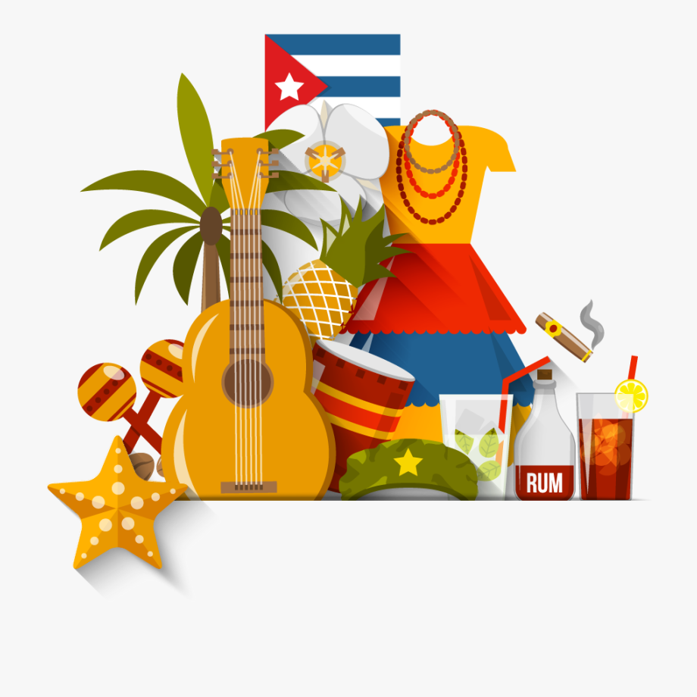
T2.1 Semana 4
Gramática
-er & -ir verbs in 1st person plural – present
To mean ‘we’ with an –er verb, remove –er and add -emos.
we offer
we know, we are familiar with
Ofrecemos =
Conocemos =
For ‘we’ with an –ir verb, remove –ir and add –imos.
we feel
we attend, go to
Sentimos =
Asistimos =
-er & -ir verbs in 1st person plural – past
For ‘we’ with an –er or –ir verb, remove –er/–ir and add -imos.
we drank
Beber bebimos = _______________
we allow, we allowed
Permitir permitimos = ________________________
For –ir verbs, –imos is used for ‘we’ in the present AND the past tense.
Vocabulario
nm
nf
nm
nm
nf
nf
nf
nm
nf
nf
adj
adj
adj
el extranjero | abroad, foreigner (m)
la extranjera | foreigner (f)
el gobierno | government
el marido | husband
la mujer | woman, wife
la población | population
la raíz | root
el derecho | right
la duda | doubt
la relación | relationship
actual | current
cubano | cuban (m)
cubana | cuban (f)
vb
vb
vb
vb
vb
vb
nm
asistir | to attend, attending
cumplir | to fulfill, fulfilling
huir | to run away, running away
nacer | to be born
oír | to hear, hearing
reconocer | to recognise, recognising
sentir | to feel, feeling
el derecho | right
la duda | doubt
la esperanza | hope
la experiencia | experience
nf
nf
nf

Slide 30
T2.1 Semana 5
Gramática
-er & -ir verbs in 1st and 3rd person plural (present)
To mean ‘s/he’ or ‘it’, remove –er/ir and add -e.
S/he or it resolves difficult problems.
Resuelve problemas difíciles.
To mean ‘they’, remove –er/ir and add -en.
_____.
-en
Promueven los productos naturales.
They promote natural products.
These verbs also have a spelling change in the stem o -> ue (e.g., resolver -> resuelve)
-er & -ir verbs in 1st and 3rd person plural (past)
For ‘s/he’ or ‘it’ for a completed action in the past with an –er or –ir verb, remove –er or –ir and add -ió.
prohibió =
s/he or it forbade / banned
s/he or it survived
prohibió =
sobrevivió =
To mean ‘they’ for a completed action in the past with an –er verb or –ir verb, remove –er or –ir and add –ieron.
(they protected)
Proteger
proteg
protegieron
Possessive adjective ‘nuestros/as’
To say ‘our’ before a masculine noun in singular, use nuestro.
nuestro futuro
our future
To say ‘our’ in before a feminine noun in singular, use nuestra.
nuestra ayuda
our help
To say ‘our’ before a feminine noun in plural, use nuestras.
nuestras ciudades
our cities
To say ‘our’ before a masculine noun in plural, use nuestros.
nuestros recursos
our resources

Slide 31
T2.1 Semana 5
Vocabulario
vb
vb
vb
vb
vb
vb
vb
encender | to turn on, turning on
morir | to die, dying
producir | to produce, producing
prohibir | to prohibit, to forbid
promover | to promote, promoting
proteger | to protect, protecting
resolver | to resolve, resolving
sobrevivir | to survive, surviving
Morir has a change (o>u) in the stem (the beginning of the verb) for ‘he/she’ or ‘it’ and ‘they’ in the past: murió (s/he died), murieron (they died).
vb
nm
nm
nm
nm
nm
nm
nm
nm
nf
nm
nm
adj
adj
adj
el bosque | forest
el consumo | consumption
el efecto | effect
el future | future
el medio ambiente | environment
el planeta | planet
el plástico | plastic
el recurso | resource
la situación | situation
el uso | use
el vidrio | glass
esencial | esencial
grave | serious
terrible | terrible

Slide 32
T2.1 Semana 6
Gramática
-ar verbs in 1st and 3rd person plural (past) [revisited]
To mean ‘we’ with an –ar verb, remove –ar and add -amos.
Organizamos juegos divertidos.
We organise fun games.
We organised fun games.
For ‘they’ with an –ar verb, remove –ar and add –aron.
Prepararon comida tradicional.
They prepared traditional food.
-er & -ir verbs in 1st and 3rd person plural (past) [revisited]
For ‘we’ with an –er or –ir verb, remove –er/–ir and add -imos.
we sold
vender vendimos = _______________
we write, we wrote
escribir escribimos = ________________________
To mean ‘they’ for a completed action in the past with an –er verb or –ir verb, remove –er or –ir and add –ieron.
(they learnt)
Aprender
aprend-
aprendieron
Possessive adjectives ‘su’ and ‘sus’
To say ‘his’, ‘her’ or ‘its’ before a singular or uncountable noun use ‘su’
Su mujer es rica.
His / her wife is rich.
To say ‘his’, ‘her’ or ‘its’ before a plural noun use ‘sus’
Sus poemas hablan del amor.
His / her poems talk about love.
Chile tiene una longitud* de 4270 kilómetros. Una gran parte de su población vive en el centro. El desierto en el norte y la tierra seca y fría en el sur son inhabitables.
*la longitud = length

Slide 33
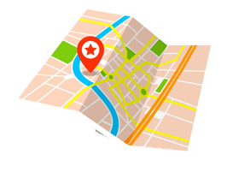
T2.2 Semana 1
Gramática
Using ‘tener que’ [revisited]
As you know, ‘tener que’ can be used to express obligation (what people have to do). Use ‘tener que’ with an infinitive.
Tienes que incluir más ideas.
You have to include more ideas.
Tiene que conseguir un plano.
S/he has to get a map.
Demonstrative adjectives [revisited]
To say, ‘this’ for a singular masculine noun, use ‘este’.
Este diálogo trata un tema difícil.
This dialogue deals with a difficult issue/subject.
To say, ‘this’ for a singular feminine noun, use ‘esta’.
Esta escena tiene efectos especiales.
This scene has special effects.
Using ‘tener’ in the preterite
To say, ‘I had’, use ‘tuve’.
Tuve la ayuda de una autora.
I had the help of an author.
To say, ‘you had’, use ‘tuve’.
Tuviste varias opciones.
You had several/various options.
To say, ‘s/he had’ or ‘it had’, use ‘tuvo’.
Tuvo un problema con las escenas de la manifestación.
S/he had or it had a problem with the scenes of the protest.

Slide 34
Idiomatic expressions with ‘tener’
Gramática
Remember that the verb ‘tener’ does not always mean ‘to have’.
In English you use ‘to be’ + adjective in expressions such as
‘to be scared’. In Spanish, use ‘tener’ + noun (e.g. ‘tener miedo’).
I was sleepy.
Tuve sueño.
You were right.
Tuviste razón.
S/he was successful.
Tuvo éxito.
Vocabulario
vb
vb
vb
vb
vb
vb
vb
tuve | I had
comprender | to understand, understading
incluir | to include, including
realizar | to carry out, carrying out
respetar | to respect, respecting
tratar | to deal with
conseguir | to get, to obtain
la acción | action
el final | end
la ley | law
nm
nm
nf
nm
nm/f
nf
nm
un millón | million
el plano | map
la manifestación | protest
el principio | beginning
el, la protagonista | main character
la idea | idea
el público | audience
nf
nm
nf

Slide 35
T2.2 Semana 2
Gramática
Using ‘estar’ in the imperfect tense
To say ‘I was’, ‘s/he was’ or ‘it was’ for a state or location at a particular past time, use ‘estaba’.
Estaba emocionado durante el partido.
I was OR s/he was excited during the match.
To say ‘you were’ for a state or location at a particular past time, use ‘estabas’.
Estabas orgullosa de tu prima.
You were proud of your cousin.
Comparatives [revisited]
When comparing things in Spanish, use ‘más’ + adjective + que to mean ‘more … than’.
Mi amiga está más contenta que tu prima.
My friend is happier than your cousin.
To say something is ‘less … than’, use ‘menos + adjective + que’
Estabas menos asustada que Ana.
You were less scared than Ana.
Using ‘del’ and ‘de la’ for places and locations [revisited]
You can give locations in Spanish by using adverbs like ‘cerca’. Use ‘del’ afterwards to refer to a singular masculine noun.
Mi habitación está al lado del baño.
My bedroom is next to the bathroom.
Use ‘de la’ to refer to a singular feminine noun.
Tu marido está fuera de la sala.
Your husband is outside the living room.

Slide 36
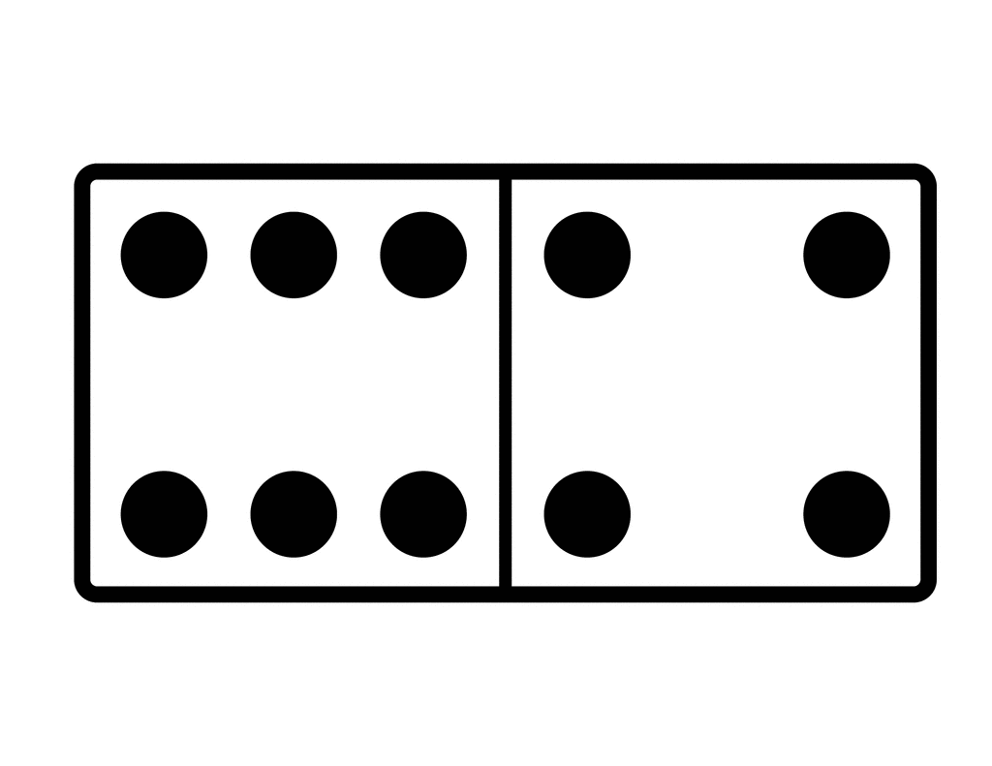
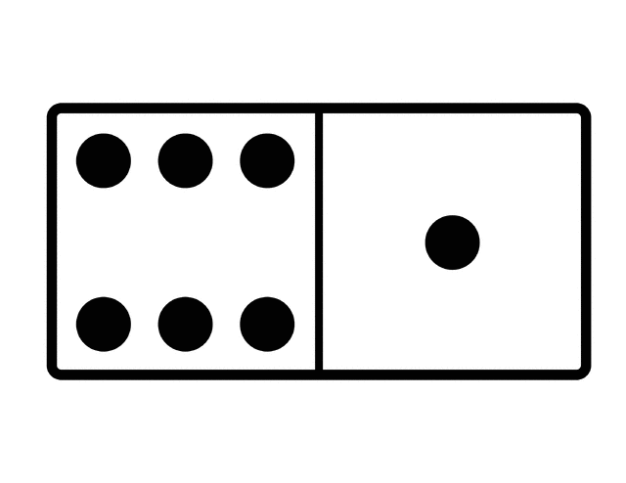
Using the relative pronoun ‘que’
Gramática
In Spanish, you can use the word ‘que’ to mean both ‘who’. You can also use it to mean ‘that’ or ‘which’.
Carlos es el estudiante que vive en la colina.
Carlos is the student who / that lives on the hill.
Florida es un estado que tiene una gran población cubana.
Florida is a state which / that has a big Cuban population.
La Habana es un puerto* grande en la costa de Cuba. La ciudad está en unas colinas y también hay un bosque pequeño cerca del centro. Es famoso por sus edificios y coches antiguos, el café, el ron* y los puros*.
*el puerto = port
*el ron = rum
*el puro = cigar
Vocabulario
vb
vb
nm
nm
nf
nm
nm
estaba | I, s/he, it was (state, location)
estabas | you were (state, location)
el baño | bathroom
el castillo | castle
la carretera | road
el patio | courtyard
el piso | flat
la región | region
la sala | living room
la colina | hill
asustado | scared (m)
adj
adj
adj
adj
adj
adj
adj
asustada | scared (f)
orgulloso | proud (m)
orgullosa | proud (f)
satisfecho | satisfied (m)
satisfecha | satisfied (f)
vivo | alive (m)
viva | alive (f)
alrededor (de) | around
a pesar de | despite
por eso | that’s why
adv
conj
conj
nf
nf
nf
adj
e.g. Las sillas están alrededor de la mesa. = The chairs are around the table.

Slide 37
T2.2 Semana 3
T2.2 Semana 3
Gramática
Using the present continuous [revisited]
Remember, we can use ‘estar’ with a present participle to talk about ongoing events (things in progress).
For –ar verbs, remove –ar and add –ando.
Estoy animando a Hugo a hacer su trabajo.
I’m encouraging Hugo to do his work.
For –er and –ir verbs, remove –er/-ir and add –iendo.
¿Está lloviendo en el norte?
Is it raining in the north?
Demonstrative adjectives [revisited]
To say ‘these’ for a plural masculine noun, we use ‘estos’
Estos chicos son serios.
These boys are serious.
To say ‘these’ for a plural feminine noun, we use ‘estas’
Estas chicas son cubanas.
These girls are Cuban.
Dónde vs donde, cuándo vs cuando
‘Dónde’ (where) and ‘cuándo’ (where) are used to ask questions. Used in this way, they always have an accent.
¿Dónde vives?
Where do you live?
‘Donde’ and ‘cuando’ (with no accent) are used to add more information to a sentence.
Sevilla es una ciudad donde hace mucho calor.
Sevilla is a city where it’s very hot.
Estaba comiendo cuando Obama entró.
I was (or ‘s/he was’) eating when Obama walked in.

Slide 38
T2.2 Semana 3
Gramática
Suffix -idad
We can create nouns in Spanish by adding –idad to singular adjectives ending in a consonant. These words end in –ity in English.
All –idad words have final syllable stress.
real
idad
realidad
personal
idad
personalidad
We can also create nouns ending in –idad by removing the final vowel.
All –idad words are feminine.
curioso
idad
curiosidad
seguro
idad
seguridad
vb
vb
vb
vb
vb
vb
animar | to cheer up, encourage
anunciar | to announce, announcing
cerrar | to close, closing
llover | to rain, raining
charlar | to chat, chatting
notar | to notice, noticing
regresar | to return, returning
la llegada | arrival
la atención | attention
prestar atención | to pay attention
Vocabulario
nm
nf
nm
nm
nm
adv
adj
el sabor | taste
la boda | wedding
el espectáculo | show
el golpe | hit, strike
el olor | smell
enseguida | straight away
mundial | worldwide
en este momento | at the moment
de repente | suddenly
vb
nf
nf
other
adv
adv

Slide 39
T2.2 Semana 4
T2.2 Semana 4
Gramática
Using the imperfect continuous [revisited]
We can talk about what was happening at a particular time by using ‘estaba’ (‘I was’) or ‘estabas’ (you were) + present participle.
For –ar verbs, remove –ar and add –ando.
Estaba jugando en el parque.
I was playing in the park.
For –er and –ir verbs, remove –er/-ir and add –iendo.
Estabas corriendo por la playa.
You were running along the beach.
Using ‘cuando’ for interruptions [revisited]
Sometimes an action interrupts what someone was doing. To express this interruption, in Spanish we use the word ‘cuando’ and then a verb in the preterite tense.
No accent!
Estaba jugando en el parque cuando oí un ruido.
I was playing in the park when I heard a noise.
Estabas corriendo cuando la policía llegó.
You were running when the police arrived.
Using ‘de’ between two nouns [revisited]
In Spanish, it is common to use ‘de’ between these two nouns to describe a particular type of something (e.g. bus ticket).
accidente de coche = car accident
escena de película = film scene

Slide 40
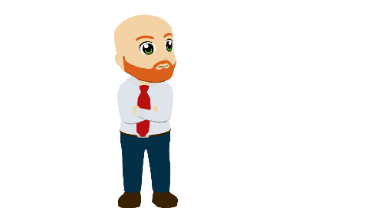
T3.1 Semana 1
Gramática
Talking about what people used to do
Imperfect tense – AR verbs
To talk about something that used to happen repeatedly in the past, we use a tense called the ‘imperfect’.
Add ‘-aba’ to the verb stem to talk about ‘I’ in this tense.
Mandaba correos todos los días.
I used to send emails everyday.
You will usually meet this tense when it means ‘used to’ in English.
To talk about ‘you’ in this tense, add ‘-abas’ to the verb stem.
¿Organizabas reuniones?
I had the help of an author.
To talk about ‘s/he’ or ‘it’, add ‘-aba’ to the verb stem.
Trabajaba en el una oficina.
He/she worked in an office.
This is the same ending as for ‘I’!
In context, the person that the verb refers to is normally clear. If not, we can use subject pronouns (e.g. ‘yo’ – ‘I’).
To talk about ‘I’, use yo
Cuando la jefa estaba en una reunión, yo contestaba el teléfono.
When the boss was in a meeting,
I used to answer the phone.
To talk about ‘he’, use él, and for ‘she’ use ella.
Él mandaba fotos por correo, pero ella no las miraba.
He used to send photos by post, but she didn’t (use to) look at them.

Slide 41
Idiomatic expressions with ‘dar’
Gramática
Remember that the verb ‘dar’ does not always translate as ‘to give’.
For example, ‘dar’ is often used to describe how something makes people feel. Compare these sentences:
The films are sad.
(literally, ‘the films give sadness’)
Las películas dan tristeza.
Las películas me dan tristeza.
The films make me sad.
(lit, ‘the films give me sadness’)
La película me da risa.
The film makes me laugh.
(lit. ‘the film gives me laughter’)
Un negocio = ‘a business’ (i.e., a company)
Los negocios =‘business’ in general (i.e., trade, deals).
Vocabulario
vb
vb
vb
vb
nf
nf
nm
contestar | to answer, to reply
entregar | to deliver, delivering
firmar | to sign, signing
hace | ago
la carrera¹ | degree, course
la empresa | company
el jefe | boss (m)
la jefa | boss (f)
nm
nf
nm
nf
nf
nf
adj
prep
el negocio | business
la oficina | office
el proyecto | proyect
la reunión | meeting
la universidad | university
la vez | time, occasion (specific)
útil | useful
por³ | around, because of, by
nf

Slide 42
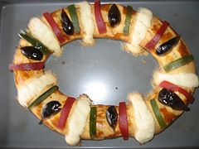
T3.1 Semana 2
Gramática
Talking about what people used to do
Imperfect tense with ER and IR verbs
With these verbs, add –ías to the verb stem to talk about ‘you’.
Recorrías la ciudad.
You used to travel around the city.
To talk about ‘I’ in this tense with –er and –ir verbs, add ‘-ía’.
I used to turn up late often.
Aparecía tarde a menudo.
To talk about ‘s/he’ or ‘it’ in with –er and –ir verbs, also add ‘-ía’.
S/he used to serve tasty dishes.
Servía platos ricos.
La rosca de Reyes
Los tamales.
Modal verbs [revisited]
‘querer’, ‘poder’ and ‘deber’ are often followed by the infinitive.
To talk about what someone wants to do, we use querer.
Note that ‘querer’ has a e>ie spelling change.
Quiero cumplir mi sueño.
I want to achieve/fulfil my dream.
To talk about what someone can do, we use poder.
Note that ‘poder’ has a u>ue spelling change.
Puedo ver la carretera
I can see the road.
To talk about what someone must (or has to) do, we use deber.
Debo asistir a la clase.
I must attend/go to the class.

Slide 43
Suffix -ía
Gramática
-y at the end of an English word often changes to –ía or –ia in Spanish.
These words have stress on the second-last syllable. No accent is needed.
history
ia
historia
All –ía or –ia words in Spanish are feminine, so use ‘la’ for ‘the’ and ‘una’ for ‘a, an’.
These words have stress on the final syllable.
An accent is needed on the final vowel.
energy
energía
ía
To say, ‘consist of’ in Spanish, we say, ‘consistir en’, e.g. Mi trabajo consiste en limpiar el edificio- My job consists of cleaning the building.
Vocabulario
aparecer | to appear, to turn up
consistir | to consist, consisting
existir | to exist, existing
ocurrir | to happen, happening
recorrer | to travel around, to cover (distance)
reunir | to bring together, to gather
servir | to serve, serving
nm/f
nm/f
nf
el/la bebé | baby
el/la familiar | relative, family member
la fecha | date
rato | time, while
vecina | neighbour (m)
vecino | neighbour (f)
visita | visit
cercano | close, nearby (m)
cercana | close, nearby (f)
mayor¹ | older
menor¹ | younger
a menudo | often
vb
vb
vb
vb
vb
vb
vb
nm
nf
nm
nf
adj
adj
adj
adj
adv

Slide 44
T3.1 Semana 3
Gramática
Comparing traits
SER in the present and imperfect
In Spanish, we use SER (to be) to talk about traits.
We use ‘soy’ for ‘I am’ and ‘eres’ for ‘you are’
Soy jugador de fútbol.
I am a football player.
Eres escritor.
You are a writer (m).
We use ‘era’ to mean ‘I was’ or ‘I used to be’.
I was / used to be quite tall (f).
Era bastante alta.
We also use ‘era’ to mean ‘s/he was’ or ‘s/he used to be’.
Nadia era triste pero ahora es feliz.
Nadia was/used to be very sad, but now s/he it is happy.
Medellín es una ciudad en Colombia que hace veinte años era muy peligrosa. […] Hoy en día Medellín es mucho más seguro.
‘Era’ can also be used to mean ‘it was’ or ‘it used to be’.
Medellín
We use ‘eras’ to mean ‘you were’ or ‘you used to be’.
You were / used to be a bit strange.
Eras un poco raro.
Try not to confuse ‘eras’ (‘you were’) with ‘eres’ (‘you are’).
El metrocable

Slide 45
Prenominal adjectives
Gramática
As you know, most masculine adjectives end in –o.
However, some lose this ‘o’ before a singular masculine noun.
bueno
buen
e.g. un buen amigo
primero
primer
e.g. el primer mes del año
malo
mal
e.g. un mal olor
The adjective ‘grande’ shortens to ‘gran’ before any singular noun.
Look at how this changes this usual meaning:
Una caja grande
A big box
Una gran persona
A great, remarkable person
Vocabulario
el transporte | transport
cierto | certain, true (m)
cierta | certain, true (f)
moderno | modern (m)
moderna | modern (f)
normal | normal
optimista | optimistic
posible | possible
popular | popular
buen | good (before singular masculine noun)
mal | bad (before singular masculine noun)
gran | big, great (before singular noun)
único² | unique (after noun), only (before noun)
era | I, s/he, it was (trait) | I, s/he, it used to be (trait)
eras | you were (trait) | you used to be (trait)
el dueño | owner (m)
la dueña | owner (f)
el/la artista | artist
el escritor | writer (m)
la escritora | writer (f)
el conductor | driver (m)
la conductora | driver (f)
enfermero | nurse (m)
enfermera | nurse (f)
el/la dependiente | shop assistant
el metro¹ | underground train, metro
nm
adj
adj
adj
adj
adj
adj
adj
adj
vb
vb
nm
nf
nm/f
nm
nf
nm
nf
nm
nf
nm/f
nm
adj
adj
adj
adj

Slide 46
T3.1 Semana 4
Gramática
Tenía vs había
To say ‘there was’, ‘there were’ or ‘there used to be’, Spanish uses the word ‘había’.
Había un caballero.
There was / used to be a knight.
Había dos hombres.
There were / used to be two men.
Sentences with ‘había’ often start with ‘en’.
En la casa había un arma.
In the house there was a weapon.
Use ‘tenía’ to mean ‘I or s/he had / used to have’.
El caballero tenía muchos libros de historia.
The knight used to have / had many history books.
Miguel de Cervantes era un autor de novelas, poemas y teatro […] Su protagonista Don Quijote, era un señor que vivía en la región de La Mancha. Tenía muchos libros y creía que cada historia era verdad y deseaba ser un caballero.
Vocabulario
nm
nm/f
nf
nm
nm
nm
adj
prometer | to promise, promising
el amor | love
el arma | weapon
el caballero | knight, gentleman
el enemigo | enemy
el nombre | name
increíble | incredible
estar a punto de + infinitive | to be about to + verb
sobre todo | especially, above all
vb
vb
vb
vb
vb
nm
nm nf
había | there was, there were
tenía | I, s/he had | I, s/he used to have
continuar | to continue, continuing
convencer | to convince, convincing
desear | to desire, to wish for
imaginar | to imagine, imagining
mwp
adv

Slide 47
T3.1 Semana 5
Gramática
Talking about ‘you’ – 2nd person singular and plural
In Spanish, we use ’ser’ to talk about traits.
‘Eres’ means you are, ‘sois’ means you all are.
Eres simpático.
You are kind.
Sois músicos.
You are all musicians.
To refer to ‘you’ for one person with a present-tense –ar verb, use the verb ending ‘-as’.
Buscas un trabajo.
.
You look for job.
To refer to ‘you’ for two or more people with a present-tense –ar verb, use the verb ending ‘-áis’.
You (all) work late.
Trabajáis tarde.
To say ‘you go’ or you are going we use ‘vas’.
To say you all go’ or ‘you are all going use ‘vais’.
Vas a la oficina.
You go / you are going to the office.
Vais al extranjero.
You (all) go / you are (all) going abroad.
El *fundador de Chupa Chups, Enrico Berat, abrió el negocio hace más de sesenta años. El logo lo creó un *pintor muy conocido: Salvador Dalí.
*el/la fundador/a = founder
*el/la pintor/a = painter
Vocabulario
Can you find any examples of penultimate or final syllable stress?
This week we revisit vocabulary from Year 7 and Year 8. Follow the QR code to the Quizlet Mashup.

Slide 48
T3.1 Semana 6
Gramática
Talking about ‘you’ – 2nd person singular and plural
(-ER and -IR verbs)
To refer to ‘you’ for one person with a present-tense –er or -ir verb, use the verb ending ‘-es’
¿Comprendes la tarea?
Do you understand the task?
To refer to ‘you (all)’ for two or more people with a
present-tense –er verb, use the verb ending -éis.
¿Por qué movéis las mesas?
Why do you (all) move the tables?
Why are you (all) moving the tables?
The final syllable (-éis) is stressed, so there is an accent on the ‘e’.
To refer to ‘you (all)’ for two or more people with a
present-tense –ir verb, use the verb ending -ís.
Do you (all) write the phrases/sentences in Spanish?
¿Escribís las frases en español?
The final syllable (-ís) is stressed, so there is an accent on the ‘i’.
Are you (all) writing the phrases/sentences in Spanish?
How to say ‘your’ for two or more people
For singular or uncountable nouns, we use ‘vuestro’ or ‘vuestra’. For plural nouns use ‘vuestros’ or ‘vuestras’.
Vuestros exámenes son en marzo. →
Your exams are in March.
Your grades are very high.
Vuestras notas son muy altas. →

Slide 49
T3.1 Semana 6
Vocabulario
‘Aprobar’ has a stem change (o→ue) for ‘I’, ‘you’, ‘s/he’ and ‘they’ in the present tense.
Ejemplo: Apruebo los exámenes.
(I pass the exams.)
PASS
To talk about a person moving, use ‘mover’ with a reflexive pronoun (e.g. me, te).
Ejemplo: iSiempre te mueves cuando saco una foto!
(You always move when I take a photo!)
vb
vb
vb
vb
vb
nf
nf
nm
aprobar | to pass (exam), passing (exam)
explicar | to explain, explaining
mover | to move, moving
reducir | to reduce, reducing
tener ganas de + infinitive | to feel like (+ -ing), to want to (+ verb)
la fecha límite | deadline
la hoja | sheet
Ejemplo: Tengo ganas de salir.
I feel like going out.
I want to go out.
el examen | exam
la imagen | image
la nota | mark, grade
el objetivo | objective
de acuerdo | ok, in agreement
conmigo | with me
lo siento | sorry
nf
nf
nm
nm
pron
int
To say “to get a mark/grade”, use the verb ‘sacar’.
Ejemplo: Siempre saco buenas notas en inglés.
I always get good grades in English.
You already know the word ‘perdón’ for ‘sorry’. You might say this if you accidentally bump into someone. If you want to give a more formal, sincere apology, use ‘lo siento’.

Slide 50
T3.2 Semana 1
Gramática
Verbs commonly used with indirect object pronouns
Some verbs are often used with an indirect object pronoun to show an effect on someone/something.
Le
molesta
la música.
literally:
to him/her/it
(it) annoys / bothers
the music.
The music annoys him/her/it.
Sentences in English often begin with a subject (e.g. the music).
‘Les’ can refer to all male, all female or mixed groups.
Les
anima
la historia.
literally:
to them
(it) is encouraging
the story.
The story encourages them.
Subject-verb agreement with present-tense –ar verbs
The verb needs to agree with the subject (singular or plural).
Use the ending –a for a singular subject (‘s/he’ or ‘it’).
Les encanta el juego.
The game is delightful to them. (They love the game.)
Use the ending –an for a plural subject (‘they’).
The games are delightful to him/her/it.
(S/he or it loves (the) games.)
Le encantan los juegos.

Slide 51
Gramática
T3.2 Semana 1
Hola, ¿Cómo estás?
An infinitive can be used as the subject in a sentence.
Hablar español es divertido.
Speaking Spanish is fun.
Hablar español les alegra.
Speaking Spanish makes them happy.
Les alegra hablar español.
Verbs ending in –cir and –cer
To talk about ‘I’ in the present tense for these verbs, remove ‘-cir’ or ‘-cer’ and add –zco.
conducir
conducir
condu
-zco
conduzco
to drive, driving
I drive, am driving
Other verbs that work like this:
Crecer (to grow, growing)
Have a go at changing the verbs to mean ‘I’ in the present tense
(e.g. I translate)!
Producir (to produce, producing)
Traducir (to translate, translating)
Ofrecer (to offer, offering)
Conocer (to know, to be familiar with)
Parecer (to seem, seeming)
Vocabulario
This week we revisit vocabulary from Year 7 and Year 8. Follow the QR code to the Quizlet Mashup.
50

Slide 52
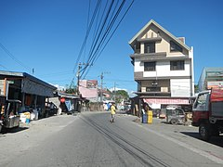
T3.2 Semana 2
Gramática
Saying where someone is from using the verb ‘ser’
To say ‘I am’ for a trait, use ‘soy’
I’m from Iquique, a city on the coast of Chile.
Soy de Iquique, una ciudad en la costa de Chile.
To say ‘we are’ for a trait, use ‘somos’
We’re from Ibagué, a city in the mountains of Colombia.
Somos de Ibagué, una ciudad en las montañas de Colombia.
To say ‘they are’ for a trait, use ‘son’
They’re from San Miguel, a city in El Salvador with a famous carnaval.
Son de San Miguel, una ciudad en El Salvador con un carnaval famoso.
Asking questions
To ask ‘are you…?’ to one person, use ‘¿Eres…?’.
¿Eres de Guinea Ecuatorial?
Are you from Equatorial Guinea?
To ask ‘are you…?’, to more than one person, use ‘¿Sois…?’
¿Sois de San Guillermo?
Are you (all) from San Guillermo?
Remember to add the ‘¿’ at the start of a question, too!
Guinea Ecuatorial en el este de
Africa era parte del imperio español hasta 1968.
San Guillermo es un pueblo en las Filipinas. El país era parte del imperio español hasta 1898.
Vocabulario
This week we revisit vocabulary from Year 7 and Year 8. Follow the QR code to the Quizlet Mashup.

Slide 53
T3.2 Semana 3
Gramática
Demonstrative adjectives (e.g. ‘this’ and ‘that’)
These are used to distinguish one thing from another.
In Spanish, to say ‘that’ for a singular masculine noun, use ‘ese’.
¿Eras el dueño de ese coche?
Were you the owner of that car?
In Spanish, to say ‘that’ for a singular feminine noun, use ‘esa’.
Esa guitarra está rota.
That guitar is broken.
To say ‘those’ for a plural masculine noun, use ‘esos’.
Esos sitios son muy buenos.
Those places are very good.
To say ‘those’ for a plural feminine noun, use ‘esas’.
Esas tallas son demasiado pequeñas.
Those sizes are too small.
Vocabulario
In English, we say ‘to be thirsty’.
In Spanish, they use ‘tener’ (to have).
I’m thirsty = Tengo sed
(literally ‘I have thirst’)
Used in 3rd person only
e.g. Falta pan =
There isn’t any bread.
nf
adj
adj
adj
adj
adj
adj
adj
adj
adj
oth.
la talla | size
ese | that (m)
esa | that (f)
esos | those (m)
esas | those (f)
gratis | free
maravilloso | wonderful, marvellous (m)
maravillosa | wonderful, marvellous (f)
roto | broken (m)
rota | broken (f)
por supuesto | of course
vb
nm
nf
nf
nm
nm
nm
nf
nm
faltar | to be missing, being missing
el aire (al aire libre) | air (outdoor)
la sed | thirst
el hambre | hunger
el restaurante | restaurant
México | Mexico
el recuerdo | souvenir
la cola | queue
el sitio | place

Slide 54
T3.2 Semana 4
Gramática
Possessive adjectives
To say ’mine’ after a singular masculine noun, use ‘mío’.
Ese libro es mío.
That book is mine.
To say ’mine’ after a singular feminine noun, use ‘mía’.
Esa bolsa es mía.
That bag is mine.
To say ’yours’ after a singular masculine noun, use ‘tuyo’.
Ese reloj es tuyo.
That watch is yours.
To say ‘yours’ after a singular feminine noun, use ‘tuya’.
Esa camiseta es tuya.
That t-shirt is yours.
To say ‘hers’ or ‘his’ after a singular masculine noun, use ‘suyo’.
Ese billete de avión es suyo.
That plane ticket is his/hers.
To say ‘hers’ or ‘his’ after a singular feminine noun, use ‘suya’.
Esa planta seca es suya.
That dry plant is his/hers.
Vocabulario
nf
adj
adj
adj
adj
adj
adj
adj
adj
adj
mentira | lie
mío | mine (m)
mía | mine (f)
tuyo | yours (m)
tuya | yours (f)
suyo | his/hers (m)
suya | his/hers (f)
estadounidense | from the USA
europeo | European (m)
europea | European (f)
engañar | to trick, tricking
fumar | to smoke, smoking
la cárcel | prison
el cigarrillo | cigarette
el delito | crime
el documento | document
el rincón | corner
la sangre | blood
la prueba | proof
vb
vb
nf
nf
nm
nm
nm
nf
nf

Slide 55
T3.2 Semana 5
Gramática
-AR verbs in 1st and 2nd person preterite [REVISITED]
To talk about ‘I’ with an action completed in the past, remove –ar and add an –é.
Participar → Participé
Participé en una película.
I took part in a film.
To talk about ‘you’, remove –ar and add –aste.
Llegar→ llegaste ¿Cuando llegaste a Mexico?
When did you arrive in Mexico?
-ER/-IR verbs in 1st and 2nd person preterite [REVISITED]
To talk about ‘I’ with an action completed in the past, remove -er or -ir and add an –í.
Crecer → crecí Crecí en Guatamala.
I grew up in Guatamala.
To talk about ‘you’ remove -er or -ir and add an –iste.
Recibir → recibiste Recibiste el Premio Nobel de la Paz. You received the Nobel Peace Prize.
Rigoberta Menchú
Cuando era niña trabajaba con mi familia en el
campo. Aprendí mucho sobre la naturaleza y el efecto del sol y el clima. Nuestra comunidad tenía sus propias costumbres y su propia lengua, el Quiché. Mi padre dirigió el movimiento de los campesinos*. Murió durante una manifestación no violenta. Un año después mataron a mi madre. Huí a México donde aprendí mejor el español y escribí mi primer libro. Recibí el ‘Nobel de la Paz’ en 1992 y en 2011 decidí presentarme como candidata en las elecciones. Perdí, pero no es el fin de nuestra historia.
*el/la campesino/a = rural worker

Slide 56
T3.2 Semana 5
Gramática
Completed actions – 1st and 2nd person preterite forms of IR, HACER and TENER [REVISITED]
Remember, Spanish doesn’t have a word for ‘do’ or ‘did’ in questions. Only the main verb is used.
IR
I went = fui
I went to Mexico. → Fui a Mexico.
You went = fuiste
Where did you go? → ¿Dónde fuiste?
HACER
I did, I made = hice
I did an interview. → Hice una entrevista.
You did, you made = hiciste
What did you do? →¿Qué hiciste?
TENER
I had = tuve
I had a bad experience. → Tuve una mala experiencia.
You had = tuviste
You had to learn Spanish. → Tuviste que aprender español.
Vocabulario
Remember, ‘tener que’ + infinitive means ‘to have to + verb’
This week we revisit vocabulary from Year 7 and Year 8. Follow the QR code to the Quizlet Mashup. What do these useful questions mean?
¿Cómo se dice? _____________________________
¿Cómo se escribe? __________________________

Slide 57
T3.2 Semana 6
Gramática
-AR verbs in past and present
In Spanish the –ar verb endings change depending on when the action takes place and who the verb refers to.
To mean ‘they’ in the present, remove –ar and add –an.
analizan = they analyse
diseñan = they design
To mean ‘they’ for a completed action in the past, remove –ar and add -aron.
aprobaron = they passed
explicaron = they explained
Cuando Diana Trujillo tenía 17 años, fue a
Estados Unidos con solo 300 dólares. Al
principio tuvo que trabajar limpiando
casas. No hablaba inglés, así que hizo un
cambio y empezó a aprender el idioma. Soñaba con ser ingeniera, por eso fue a la universidad. Tuvo mucha suerte y logró ser jefa de misiones diferentes para NASA.
Do you know the meaning of the past tense verbs in bold in this text?
Vocabulario
nm
nf
nf
nf
nf
nm
adj
adj
adj
el desarollo | development
la misión | mission
la luna | moon
la piedra | stone, rock
la tecnología | technology
el vuelo | flight
ingeniero | engineer (m)
ingeniera | engineer (f)
responsable | responsible
vb
vb
vb
vb
vb
nm
nf
analizar | to analyse, analysing
diseñar | to design, designing
funcionar | to work, to function
controlar | to control, controlling
destacar | to stand out, standing out
el espacio | space
la información | information

Slide 58
T3.2 Semana 7
Gramática
-er verbs in 1st person plural – present and past [REVISITED]
To mean ‘we’ with an –er verb in the present, remove –er and add -emos.
vendemos =
we sell
corremos =
we run
To mean ‘we’ with an –er verb for a completed past action, remove –er and add –imos.
vendimos =
we ran
we sold
corrimos =
Present simple for future events
Sometimes, in Spanish, we use the present simple to talk about an event in the future.
Mañana cenamos en un restaurante.
Tomorrow we are having dinner at a restaurant.
In English, the present continuous is often used for future plans.
Using ‘para’ in different ways
Remember that the word ‘para’ can mean ‘for’:
=
The ball is for those children.
La pelota es para esos niños.
However, ‘para’ + infinitive means ‘in order to + verb’.
Vas a ir al campo para caminar en el bosque.
I am going to go to the countryside (in order) to walk in the forest.
Vocabulario
This week we revisit vocabulary from Year 7,8 and Year 9. Follow the QR code to the Quizlet Mashup.

