Slide 1
Talking about what you can, must, will and want to do
Consolidation of a selection of Y7 grammar and vocabulary
SSC [aim/in], [ain/in] [revisited]
Y8 French
Term 2.2 - Week 5 - Lesson 47
Victoria Hobson / Natalie Finlayson
Artwork by: Chloé Motard
Date updated: 09/07/21
Notes:
Artwork by Chloé Motard. All additional pictures selected are available under a Creative Commons license, no attribution required.
Native speaker feedback provided by Sarah Brichory.
With thanks to Rachel Hawkes for her input on the lesson material.
Learning outcomes (lesson 1):
Consolidation of SSC [aim/im], [ain/in]
Consolidation of modal verbs; aller + infinitive (future intention); question formation, adverb placement and negation in two-verb structures; prepositions: uses of ‘en’, ‘à’ and ‘chez’ (to vs in)
Word frequency (1 is the most frequent word in French):
(Revisit 5/6) aimer [242], aller, allez, allons, va, vais, vas, vont [53], devoir, dois, doit [39], peut, peux, pouvoir [20], sais, sait, savoir [67], visiter [1378], en [7], aéroport [2113], Alger [n/a], Algérie [n/a], Allemagne [n/a], allemand [844], anglais [784], Angleterre [n/a], avenir [471], avion [1409], bateau [1287], café [1886], caisse [1881], cinéma [1623], Écosse [n/a], église [1782], États-Unis [n/a], étranger [305], français [251], France [n/a], hôtel [1774], jardin [2284], Londres [n/a], magasin [1736], parc [1240], Paris [n/a], pays [114], plage [2693], pont [1889], poste [489], samedi [1355], train [232], ville [260], visite [1072], différent [350], prochain [380], bientôt [1208], demain [871], à [4], avec [23], chez [206]
Source: Londsale, D., & Le Bras, Y. (2009). A Frequency Dictionary of French: Core vocabulary for learners London: Routledge.
The frequency rankings for words that occur in this PowerPoint which have been previously introduced in NCELP resources are given in the NCELP SOW and in the resources that first introduced and formally re-visited those words.
For any other words that occur incidentally in this PowerPoint, frequency rankings will be provided in the notes field wherever possible.

Slide 2
aim/im
faim
Notes:
Timing: 1 minute
Aim: To consolidate SSC [aim/im]
Procedure: 1. Present the letter(s) and say the [aim/im] sound first, on its own. Students repeat it with you. 2. Bring up the word ”faim” on its own, say it, students repeat it, so that they have the opportunity to focus all of their attention on the connection between the written word and its sound.
3. A possible gesture for this would be to rub your tummy as if hungry. 4. Roll back the animations and work through 1-3 again, but this time, dropping your voice completely to listen carefully to the students saying the [-(a)im] sound, pronouncing ”faim” and, if using, doing the gesture.
Word frequency (1 is the most frequent word in French):
faim [1986]
Source: Londsale, D., & Le Bras, Y. (2009). A Frequency Dictionary of French: Core vocabulary for learners London: Routledge.

Slide 3
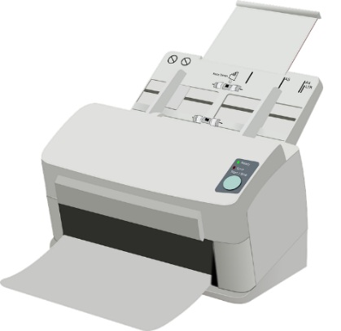
aim/im
grimper
imprimer
faim
simple
impossible
[simple]
[impossible]
important
[important]
Notes:
Timing: 1 minute
Aim: To consolidate SSC [aim/im]
Procedure:
Introduce and elicit the pronunciation of the individual SSC [aim/im] and then the source word again ‘faim’ (with gesture, if using). Then present and elicit the pronunciation of the five cluster words. The cluster words have been chosen for their high-frequency, from a range of word classes, with the SSC (where possible) positioned within a variety of syllables within the words (e.g. initial, 2nd, final etc.). Additionally, we have tried to use words that build cumulatively on previously taught SSCs (see the Phonics Teaching Sequence document) and do not include new SSCs. Where new SSCs are used, they are often consonants which have a similar symbol-sound correspondence in English.
Word frequency (1 is the most frequent word in French): faim [1986]; simple [212]; important [215]; grimper [2646]; imprimer [3092]; impossible [3092]. Source: Londsale, D., & Le Bras, Y. (2009). A Frequency Dictionary of French: Core vocabulary for learners London: Routledge.

Slide 4
ain/in
train
Notes:
Timing: 1 minute
Aim: To consolidate SSC [ain/in]
Procedure: 1. Present the letter(s) and say the [ain/in] sound first, on its own. Students repeat it with you. 2. Bring up the word ”train” on its own, say it, students repeat it, so that they have the opportunity to focus all of their attention on the connection between the written word and its sound.
3. A possible gesture for this would be to move both arms simultaneously forwards and back in a circular motion, simulating the motion of train wheel connecting rods.
4. Roll back the animations and work through 1-3 again, but this time, dropping your voice completely to listen carefully to the students saying the [ain/in] sound, pronouncing ”train” and, if using, doing the gesture.
Word frequency (1 is the most frequent word in French):
train [232]. Source: Londsale, D., & Le Bras, Y. (2009). A Frequency Dictionary of French: Core vocabulary for learners London: Routledge.

Slide 5
ain/in
fin
matin
[end]
vingt
train
main
maintenant
[now]
Notes:
Timing: 1 minute
Aim: To consolidate SSC [ain/in]
Procedure:
1. Introduce and elicit the pronunciation of the individual SSC [ain/in] and then the source word again ‘train’ (with gesture, if using). 2. Then present and elicit the pronunciation of the five cluster words.
The cluster words have been chosen for their high-frequency, from a range of word classes, with the SSC (where possible) positioned within a variety of syllables within the words (e.g. initial, 2nd, final etc.). Additionally, we have tried to use words that build cumulatively on previously taught SSCs (see the Phonics Teaching Sequence document) and do not include new SSCs. Where new SSCs are used, they are often consonants which have a similar symbol-sound correspondence in English.
Word frequency (1 is the most frequent word in French): fin [111]; matin [442] vingt[1273]; maintenant [192]; main [418]; train [232]. Source: Londsale, D., & Le Bras, Y. (2009). A Frequency Dictionary of French: Core vocabulary for learners London: Routledge.

Slide 6
Nasal or oral vowels?
écouter
 |  | nasal | oral + m/n
 | diminuer [decrease]
 | interroger [to interrogate]
 | grimper [to climb]
 | aimable [likeable]
 | contraindre [to force]
 | chimique [chemical]
 | minorité [minority]
 | crainte [fear]
 | vraiment [really]
 | centaine [hundred]
1
2
3
4
5
Remember!
[aim/im] and [ain/in] are nasal sounds before a consonant, and oral sounds before a vowel.
6
7
8
9
10
Notes:
Timing: 6 minutes
Aim: Aural recognition of nasal and non-nasal vowels [aim/im], [ain/in], [ai] and [i] in unknown words.
Procedure:
1. Practise saying SSCs [aim/im], [ain/in], [ai] and [i] aloud, in isolation. Students should notice a vibration in the nose when they produce the nasal sounds, but not when they produce the oral sounds.
2. Click the numbers to play the audio.
3. Students write 1-8 and decide if the letters in bold represent a ‘nasal’ or ‘non-nasal’ vowel sound.
4. Click to reveal the answers. The word appears first, followed by the ticks in the appropriate columns.
5. Click to bring up the reminder about spelling rules introduced last week (8.2.2.3) and demonstrate its applicability here.
Procedure:
1. Students listen to the words and tick the appropriate column.
2. Click to reveal the words one by one, together with the correct tick for each.
Transcript:
1. diminuer
2. interroger
3. grimper
4. aimable
5. contraindre
6. chimique
7. minorité
8. crainte
9. vraiment
10. centaine
Word frequency (1 is the most frequent word in French): diminuer [1507], interroger [1093], grimper [2646], aimable [4668], plaindre [137], chimique [2650,] minorité [>5000], crainte [1195], vraiment [361], centaine [1417]
Source: Londsale, D., & Le Bras, Y. (2009). A Frequency Dictionary of French: Core vocabulary for learners London: Routledge.

Slide 7
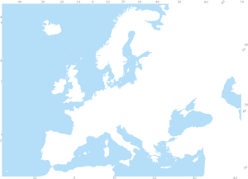
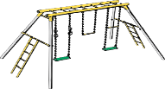
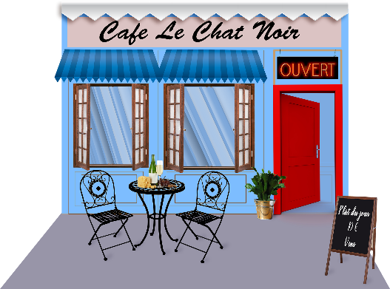
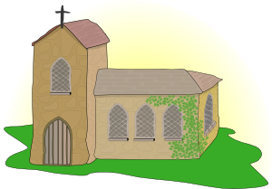
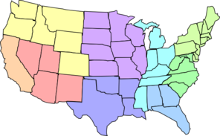
Vocabulaire
A
B
écouter
Écoute. Écris la bonne lettre.
1
C
9
O
C
Post Office
D
E
F
2
H
10
G
3
F
11
E
4
L
12
J
5
M
13
I
G
H
I
J
6
B
14
A
7
K
15
N
8
D
K
L
M
N
O
Notes:
Timing: 5 minutes
Aim: Aural recognition of nouns in this vocabulary revision set.
Procedure:
1. Click the number trigger to play the audio.
2. Students write 1-15 and the correct letter for each vocabulary item heard.
3. Click to bring up the answers.
Transcript:
1. la poste
2. le parc
3. le magasin
4. les États-Unis
5. l’hotel
6. le jardin
7. l’église
8. le cinéma
9. le café
10. l'aéroport
11. la caisse
12. le pont
13. la plage
14. l’étranger
15. le pays
Word frequency of cognates used (1 is the most frequent word in French): lettre [480]
Source: Londsale, D., & Le Bras, Y. (2009). A Frequency Dictionary of French: Core vocabulary for learners London: Routledge.

Slide 8
Vocabulaire
lire
masculin féminin
parc
aéroport
États-Unis
plage
hôtel
étranger
poste
café
caisse
jardin
cinéma
pont
église
magasin
pays
Notes:
Timing: 3 minutes
Aim: Written recognition of nouns in this week’s vocabulary revision set. Revision of noun genders.
Procedure:
1. Students write two columns in their exercise books.
2. Individually or in pairs, they categorise the words by writing them in the correct column alongside their English translations.
3. Click to reveal the answers, starting with ‘parc’ (L→R). Draw attention to the fact that États-Unis is a masculine plural noun and that the singular noun l’État is masculine.
4. Elicit meanings in English as part of the feedback.
Word frequency of cognates used (1 is the most frequent word in French): masculin [3741], féminin [2381]
Source: Londsale, D., & Le Bras, Y. (2009). A Frequency Dictionary of French: Core vocabulary for learners London: Routledge.

Slide 9
The verb ‘aller’
grammaire
____________
The verb ‘aller’ means ‘to go/going’.
___________
___________
I go, am going = je vais
You go, are going = tu vas
S/he goes, is going = il/elle va
We go, are going = nous allons
You (pl.) go, are going = vous allez
They go, are going = ils/elles vont
___________
___________
___________
____________
Remember, we can use the verb ‘aller’ with an infinitive to talk about future plans.
Je vais aller à l’étranger.
I am going to go abroad.
Nous allons visiter Londres.
We are going to visit London.
Notes:
Timing: 2 minutes
Aim: To recap all forms of aller and its use with an infinitive to express future intention.
Procedure:
1. Begin by eliciting the meaning of aller from students.
2. Click to bring up the French form.
3. Click to bring up the full set of English forms.
4. Give students a minute in pairs to produce as many of the French forms as they can.
5. Take feedback from the class, revealing the French by clicking.
6. Click to bring up the reminder of its use to express future intentions.

Slide 10
Une amie de Léa va visiter Paris !
lire
Julie (I) | Léa (she) | we
Lis et écris en anglais. Qui, quoi et quand ?
… am
going to
France to stay with my friend Léa.
… isn’t
going to go
to the churches.
… are going to visit the city by boat.
Je vais en France pour rester chez mon amie Léa.
Je vais à Paris en avion.
Léa ne va pas
à l’école le samedi.
1
4
7
… am going to Paris by plane.
… doesn’t go to school on Saturdays.
… aren’t going to go to the beach.
Nous n’allons pas aller à la plage. C’est trop loin.
Nous allons visiter la ville en bateau.
5
Je vais aimer Paris. On dit que c’est une belle ville.
2
8
Léa ne va pas aller aux églises. Elle doit travailler.
Léa va aller chez ma famille aux États-Unis!
… am going to like Paris. They say it is a beautiful city.
… is going to go to Julie' family’s place in the USA.
… are going to the ‘Alexandre III’ bridge.
Nous allons aller au pont ‘Alexandre III’ aussi.
3
6
9
Notes:
Timing: 8 minutes (for 3 slides)
Aim: Written recognition of forms of aller in the present and future and connecting these with meaning (sentence subject/point in time). Written recognition of a range of target vocabulary including prepositions en, à and chez with meaning ‘to’. Written recognition of two-verb structures in the negative.
Procedure:
1. Students read the texts and complete the table in English, using the pronoun which matches the verb form and using an appropriate English tense. Remind students to choose between present simple and continuous where translating in the present.
2. Click to bring up the answers in the table.
3. Click on the flag triggers to reveal the French pronoun.
4. Look more closely at the grammar points featured using the slides that follow.
Word frequency of glossed word (1 is the most frequent word in French): célèbre [1689]
Source: Londsale, D., & Le Bras, Y. (2009). A Frequency Dictionary of French: Core vocabulary for learners London: Routledge.

Slide 11
Using negatives
grammaire
Remember:
To make a sentence with two (or more) verbs negative, add ‘ne...pas’ around the first verb in short form.
Je vais en France pour rester chez mon amie Léa.
Je vais à Paris en avion.
Léa ne va pas
à l’école le samedi.
1
4
7
Je vais aller
→
Nous n’allons pas aller à la plage. C’est trop loin.
Nous allons visiter la ville en bateau.
5
Je vais aimer Paris. On dit que c’est une ville belle.
2
Je ne vais pas aller
8
Elle va aller
→
Léa ne va pas aller aux églises. Elle doit travailler.
Elle ne va pas aller
Léa va aller chez ma famille aux États-Unis!
Nous allons aller au pont ‘Alexandre III’ aussi.
→
Nous allons aller
3
6
Nous n’allons pas aller
9
Notes:
Use this slide to revise the rules for negating two-verb structures. This prepares students for the production tasks that follow.

Slide 12
Saying ‘to’ with the verb ‘aller’
Remember:
grammaire
‘En’ means ‘to’ with feminine countries and ‘by’ with transport.
Je vais en France pour rester chez mon amie Léa.
Je vais à Paris en avion.
Léa ne va pas
à l’école le samedi.
‘Aux’ means ‘to the’ with plural nouns.
1
4
‘À’ means ‘to’ with cities.
7
‘À la’ means ‘to the’ with feminine nouns.
Nous n’allons pas aller à la plage. C’est trop loin.
Nous allons visiter la ville en bateau.
5
Je vais aimer Paris. On dit que c’est une ville belle.
2
‘Au’ means ‘to the’ with masculine nouns.
8
‘À l’ means ‘to the’ before nouns beginning with h- /vowel.
Léa ne va pas aller aux églises. Elle doit travailler.
Léa va aller chez ma famille aux États-Unis!
‘Chez’ means ‘to’ or ‘to the’ with people’s homes/workplaces.
Nous allons aller au pont ‘Alexandre III’ aussi.
3
‘Aux’ means ‘to the’ with plural countries.
6
9
Notes:
Procedure:
1. Click to highlight a preposition.
2. With higher-level classes, ask ‘why is the word for ‘to’/’to the’ translated this way?’ If more prompting is needed, invite students to consider the noun that follows. With lower-level classes, skip this stage and move to step 3.
3. Click to bring up the grammar explanation. This information prepares students for the task on the following slides.

Slide 13
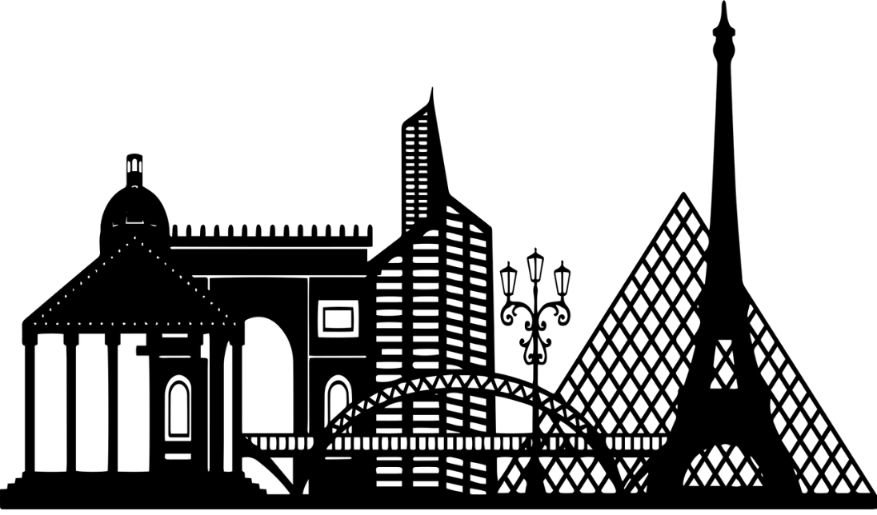
Où vont-ils aller ?
écouter / écrire
La mère de Julie est au téléphone. Elle parle à qui ? Elle demande quoi ?
Écoute et choisis les bonnes réponses. Écris des réponses complètes en français.
 | Qui ? |  | Où ? |  | Réponses
 | Tu | Vous
 | Tu | Vous
EG
Oui, nous allons aller au cinéma.
Post Office
Non, je ne vais pas aller à la poste.
EG
Notes:
Timing: 8 minutes for 3 slides.
Aim: Aural recognition of forms of à + definite article and connecting these with meaning (nouns). Scaffolded writing. Written production of the je and nous forms of aller.
Procedure:
1. Ask students to read the explanation and check their understanding.
2. Use this slide to model the task. Click on the first example trigger to play audio with the noun obscured. Students note two things: 1) whether Julie’s mother is asking about both girls or just Julie; 2) the location she is asking about, based on the form of à + definite article they hear.
3. Click to reveal the answers. Click on the orange outline around the picture of the place to hear the full audio, including the noun.
4. In the Réponses column, prompts indicate whether students need to write an affirmative or a negative response is required. Clarify which pronoun is required here (i.e vous → nous / tu → je).
5. Students write an answer in a full sentence.
6. A suggested answer appears on a click.
7. Click on the second example trigger. This time a negative response is required.
8. Click to reveal the answers.
Transcript:
E.g. Allez-vous aller au [cinéma] ?
E.g. Vas-tu aller à la [poste] ?
Word frequency of cognates used (1 is the most frequent word in French): téléphone [1366], complet [935]
Source: Londsale, D., & Le Bras, Y. (2009). A Frequency Dictionary of French: Core vocabulary for learners London: Routledge.

Slide 14
Où vont-elles aller ? [1/2]
écouter / écrire
La mère de Julie est au téléphone. Elle parle à qui ? Elle demande quoi ?
Écoute et choisis les bonnes réponses. Écris les réponses complètes en français.
 | Qui? |  | Où? |  | Réponses
 | Tu | Vous
 | Tu | Vous
 | Tu | Vous
 | Tu | Vous
1
Oui, je vais aller au pont.
Post Office
2
Oui, nous allons aller au magasin.
Non, je ne vais pas aller à la caisse.
3
Non, nous n’allons pas aller à la plage.
4
Notes:
Procedure:
1. Proceed as per the worked examples on the previous slide.
Transcript:
1. Vas-tu aller au [pont] ?
2. Allez-vous aller au [magasin] ?
3. Vas-tu aller à la [caisse] ?
4. Allez-vous aller à la [plage] ?

Slide 15
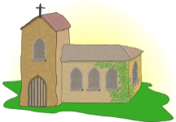
Où vont-elles aller ? [2/2]
écouter / écrire
La mère de Julie est au téléphone. Elle parle à qui ? Elle demande quoi ?
Écoute et choisis les bonnes réponses. Écris les réponses complètes en français.
Remember, ‘aux’ is pronounced the same as ‘au’, apart from when it comes before ‘h’ or a vowel.
Remember, ‘aux’ is pronounced the same as ‘au’ apart from when it comes before ‘h’ or a vowel.
 | Qui ? |  | Où ? |  | Réponses
 | Elle | Elles
 | Elle | Elles
 | Elle | Elles
 | Elle | Elles
Non, elle ne va pas aller à l’hôtel.
5
6
Oui, elles vont aller aux jardins.
Non, elles ne vont pas aller à l’église.
7
8
Oui, elle va aller aux États-Unis.
Notes:
Procedure:
1. Remind students that elle and elles sound the same, so students will need to rely on the form of aller to determine who is being addressed. Remind students of the third person plural form vont and the liaison in va-t-elle.
2. Proceed as per the worked examples on the previous slide.
Transcript:
5. Va-t-elle aller à l’[hôtel] ?
6. Vont-elles aller aux [jardins] ?
7. Vont-elles aller à l’[église] ?
8. Va-t-elle aller aux [États-Unis] ?

Slide 16
Une visite à l’étranger !
parler
Tu vas visiter un nouveau pays. Ton/ta partenaire va poser des questions pour savoir les détails. Réponds aux questions avec l’information sur ta carte. Utilise seulement des phrases négatives.
L’Algérie ?
Les États-Unis ?
La France ?
L’Allemagne ?
Notes:
Timing: 8 minutes for 4 slides.
Aim: To introduce the pair work speaking task on the following slides.
Procedure:
1. Ask students to read the slide.
2. Take feedback to ensure their understanding.
Word frequency of cognates used (1 is the most frequent word in French): détail [318], poser [218], information [317]
Source: Londsale, D., & Le Bras, Y. (2009). A Frequency Dictionary of French: Core vocabulary for learners London: Routledge.

Slide 17
Une visite à l’étranger !
parler
Tu vas visiter un nouveau pays. Ton/ta partenaire va poser des questions pour savoir les détails. Réponds aux questions avec l’information sur ta carte. Utilise seulement des phrases négatives.
Questions de partenaire A:
Réponses de partenaire B:
Où ?
Quand ? | demain | l’année prochaine
demain | l’année prochaine
Vas-tu aller en France ou aux États-Unis?
Je ne vais pas aller aux États-Unis.
Vas-tu voyager demain ou l’année prochaine?
Je ne vais pas voyager l’année prochaine.
Notes:
Aim: Asking and answering on future plans using the structure aller + infinitive. Oral production of two-verb constructions in the negative, preposition à with the verb aller, au(x) and en to mean to with masculine and feminine countries.
Procedure:
1. Click to bring up the model questions and answers for the example task.
2. Remind students that the short form of aller and the subject pronoun swap places when using the inversion type of question.
NB – although the question word is given, students do no include this in their questions. It is only included for the purposes of categorising on the prompt sheets. They should follow the model provided in order to elicit a reply from their partner containing a negative structure. They must then process that negative answer to arrive at the correct information.
3. Print and distribute the roles cards on slides that follow (2 sets of rolecards per sheet). To avoid printing, the answering student could quickly write down their prompts while the asking student turns away from the board. Then, the asking student’s slide is displayed during the task.

Slide 18
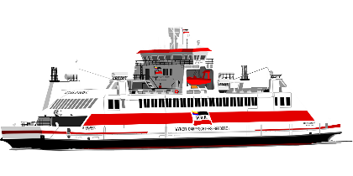
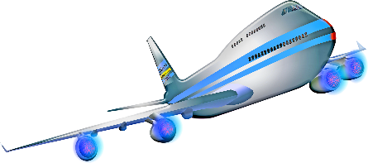
Partenaire A: questions
parler
Donne les réponses
à ton/ta partenaire:
Où ?
Quand ? | demain | le week-end prochain
Comment ?
Samedi ?
Dimanche ?
demain | à l’avenir
Notes:
Procedure:
1. Students ask and answer as per the information on their cards.

Slide 19
Partenaire B: questions
parler
Donne les réponses
à ton/ta partenaire:
Où ?
Quand ? | demain | à l’avenir
Comment ?
Samedi ?
Dimanche ?
demain | le week-end prochain
Notes:
Partner B prompt card.

Slide 20
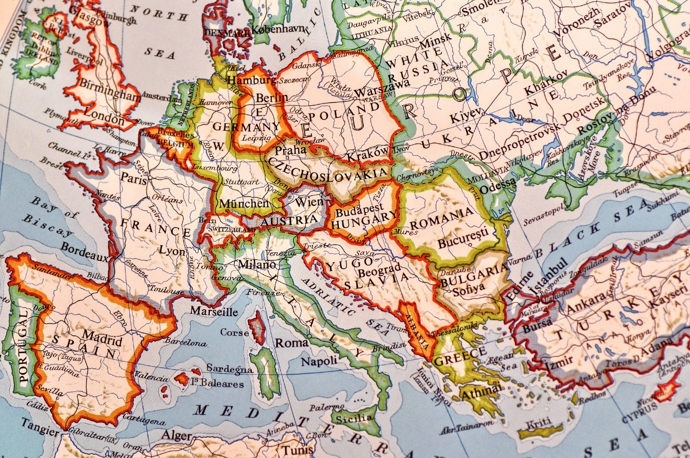
Des visites à l’étranger
lire / parler
Dis la phrase à ton/ta partenaire. Le/la partenaire traduit la phrase en anglais.
1) Àl’avenirellevaalleràAlgerenbateauavecLéa.
2) Ellesvontvisiterlesplagesdifférentes.
3) Ellesnevontpasallerauxmagasins.
4) LéavaalleràParisentrain.
5) L’amiedeLéavaallerauxÉtats-Unisenavion.
6) EllesnevontpasallerenAllemagne.
Notes:
Timing: 6 minutes
Aim: Segmentation of written text in the oral modality.
Procedure:
1. Students take it in turns to say the sentences to their partner, pausing between words.
2. The partner who is listening gives the translation in English.
3. Lead feedback using the next 6 slides in which every sentence is dealt with individually.

Slide 21
Des visites à l’étranger
lire / parler
1) Àl’avenirellevaalleràAlgerenbateauavecLéa.
In the future she is going to go to Algiers by boat with Léa.

Slide 22
Des visites à l’étranger
lire / parler
2)Ellesvontvisiterlesplages.
They are going to visit the beaches.

Slide 23
Des visites à l’étranger
lire / parler
3)Ellesnevontpasallerauxmagasins.
They are not going to go to the shops.

Slide 24
Des visites à l’étranger
lire / parler
4)LéavaalleràParisentrain.
Léa is going to go to Paris by train.

Slide 25
Des visites à l’étranger
lire / parler
5)L’amiedeLéavaallerauxÉtats-Unisenavion.
Léa’s friend is going to go to America by plane.

Slide 26
Des visites à l’étranger
lire / parler
6) EllesnevontpasallerenAllemagne.
They are not going to go to Germany.

Slide 27
Talking about what you can, will, must and want to do
Consolidation of a selection of Y7 grammar and vocabulary
SSCs [aim/im], [ain, in] before a vowel
SSCs [i], [ai] revisited
Y8 French
Term 2.2 - Week 5 - Lesson 48
Victoria Hobson / Natalie Finlayson
Artwork by: Chloé Motard
Date updated: 09/07/21
Notes:
Artwork by Chloé Motard. All additional pictures selected are available under a Creative Commons license, no attribution required.
Native speaker feedback provided by Sarah Brichory.
With thanks to Rachel Hawkes for her input on the lesson material.
Learning outcomes (lesson 2):
Introduction of SSC [aim/im], [ain/in] before a vowel
Revision of SSCs [i], [ai]
Consolidation of modal verbs; aller + infinitive (future intention); question formation, adverb placement and negation in two-verb structures; prepositions: uses of ‘en’, ‘à’ and ‘chez’ (to vs in)
Word frequency (1 is the most frequent word in French):
(Revisit 5/6) aimer [242], aller, allez, allons, va, vais, vas, vont [53], devoir, dois, doit [39], peut, peux, pouvoir [20], sais, sait, savoir [67], visiter [1378], en [7], aéroport [2113], Alger [n/a], Algérie [n/a], Allemagne [n/a], allemand [844], anglais [784], Angleterre [n/a], avenir [471], avion [1409], bateau [1287], café [1886], caisse [1881], cinéma [1623], Écosse [n/a], église [1782], États-Unis [n/a], étranger [305], français [251], France [n/a], hôtel [1774], jardin [2284], Londres [n/a], magasin [1736], parc [1240], Paris [n/a], pays [114], plage [2693], pont [1889], poste [489], samedi [1355], train [232], ville [260], visite [1072], différent [350], prochain [380], bientôt [1208], demain [871], à [4], avec [23], chez [206]
Source: Londsale, D., & Le Bras, Y. (2009). A Frequency Dictionary of French: Core vocabulary for learners London: Routledge.
The frequency rankings for words that occur in this PowerPoint which have been previously introduced in NCELP resources are given in the NCELP SOW and in the resources that first introduced and formally re-visited those words.
For any other words that occur incidentally in this PowerPoint, frequency rankings will be provided in the notes field wherever possible.

Slide 28
i
midi
Notes:
Timing: 1 minute
Aim: To consolidate SSC [i]
Procedure: 1. Present the letter(s) and say the [i] sound first, on its own. Students repeat it with you. 2. Bring up the word ”midi” on its own, say it, students repeat it, so that they have the opportunity to focus all of their attention on the connection between the written word and its sound.
3. A possible gesture for this would be to draw a circle representing a clock face with one hand, with the other arm and hand pointing straight up (representing the hands on 12) within the circle. 4. Roll back the animations and work through 1-3 again, but this time, dropping your voice completely to listen carefully to the students saying the [i] sound, pronouncing ”midi” and, if using, doing the gesture.
Word frequency (1 is the most frequent word in French):
midi [2483].
Source: Londsale, D., & Le Bras, Y. (2009). A Frequency Dictionary of French: Core vocabulary for learners London: Routledge.

Slide 29
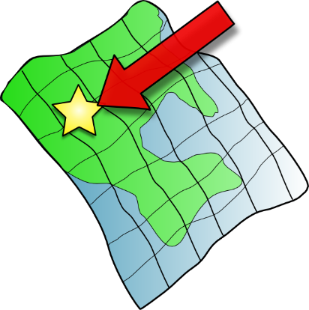
i
petit
lit
midi
ici
qui ?
il
?
Notes:
Timing: 1 minute
Aim: To consolidate SSC [i]
Procedure:
1. Introduce and elicit the pronunciation of the individual SSC [i] and then the source word again ‘midi’ (with gesture, if using). 2. Then present and elicit the pronunciation of the five cluster words.
The cluster words have been chosen for their high-frequency, from a range of word classes, with the SSC (where possible) positioned within a variety of syllables within the words (e.g. initial, 2nd, final etc.). Additionally, we have tried to use words that build cumulatively on previously taught SSCs (see the Phonics Teaching Sequence document) and do not include new SSCs. Where new SSCs are used, they are often consonants which have a similar symbol-sound correspondence in English.
Word frequency (1 is the most frequent word in French): midi [2483]; petit [138]; lit [1837] ici [167]; il[13]; qui [14]. Source: Londsale, D., & Le Bras, Y. (2009). A Frequency Dictionary of French: Core vocabulary for learners London: Routledge.

Slide 30
ai
vrai
Notes:
Timing: 1 minute
Aim: To consolidate SSC [ai]
Procedure: 1. Present the letter(s) and say the [ai] sound first, on its own. Students repeat it with you. 2. Bring up the word ”vrai” on its own, say it, students repeat it, so that they have the opportunity to focus all of their attention on the connection between the written word and its sound.
3. A possible gesture for this would be to mime a ‘tick’.
4. Roll back the animations and work through 1-3 again, but this time, dropping your voice completely to listen carefully to the students saying the [ai] sound, pronouncing ”vrai” and, if using, doing the gesture.
Word frequency (1 is the most frequent word in French):
vrai [292].
Source: Londsale, D., & Le Bras, Y. (2009). A Frequency Dictionary of French: Core vocabulary for learners London: Routledge.

Slide 31
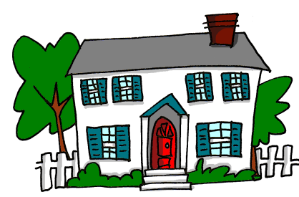
ai
maison
raison
[reason]
mauvais
vrai
faire
[bad]
semaine
[to do]
[week]
Notes:
Timing: 1 minute
Aim: To consolidate SSC [ai]
Procedure:
1. Introduce and elicit the pronunciation of the individual SSC [ai] and then the source word again ‘vrai’ (with gesture, if using). 2. Then present and elicit the pronunciation of the five cluster words.
The cluster words have been chosen for their high-frequency, from a range of word classes, with the SSC (where possible) positioned within a variety of syllables within the words (e.g. initial, 2nd, final etc.). Additionally, we have tried to use words that build cumulatively on previously taught SSCs (see the Phonics Teaching Sequence document) and do not include new SSCs. Where new SSCs are used, they are often consonants which have a similar symbol-sound correspondence in English.
Word frequency (1 is the most frequent word in French): maison [325]; raison [72] mauvais [274]; faire [25]; semaine [245]; vrai [292]. Source: Londsale, D., & Le Bras, Y. (2009). A Frequency Dictionary of French: Core vocabulary for learners London: Routledge.

Slide 32
[aim/im], [ain/in]
écouter / écrire
Normally, SSCs [aim/im] and [ain/in] are nasal vowels.
However, [aim/im] and [ain/in] sound different before a vowel.
Can you think of any examples in words you already know?
before a consonant: before a vowel:
important aimer
simple animal
prochain semaine
intéressant ordinateur
(important)
These sounds are nasal vowels [aim/im], [ain/in].
(to like)
These sounds are oral vowels [ai] / [i] + m / n.
(simple)
(animal)
(next)
(week)
(interesting)
(computer)
Notes:
Timing: 2 minutes
Aim: revising the spelling rules governing pronunciation changes in SSCs which are normally nasal vowels, and applying these to [aim/im] and [ain/in].
Procedure: 1. Cycle through the information on the slide using the animation sequence.

Slide 33
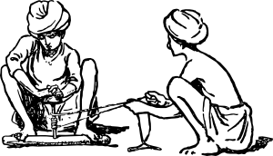
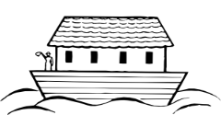
[nasal], [ai] ou [i] ?
lire / parler
 |  | [nasal] | [ai] + n | [i] + m/n
 | primitif [primitive]
 | intimider [to intimidate]
 | haine [hate]
j | crainte [fear]
 | timbre [to stamp]
 | prochainement [shortly, soon]
h | inondation [flood]
 | minimiser [to minimise]
 | capitaine [captain]
 | plaindre [to complain]
Lis les mots et décide si c’est une voyelle nasale ou une voyelle orale.
Puis, dis les mots !
1
2
3
4
5
6
nasal vowels
[aim/im], [ain/in]
7
8
oral vowels
[ai], [i]
9
10
Notes:
Timing: 5 minutes
Aim: applying awareness of the pronunciation rules governing SSCs [aim/ain], [ai] and [i] to the oral production of words containing these letter combinations.
Procedure
Student read the words and decide based on the presence of absence of a vowel after letter ‘m’ or ‘n’ whether a nasal is needed or not..
Click to check.
Now, students are challenged to pronounce the words correctly. Students should work in pairs and monitor each other for this.
Students try to say the words out loud. Teacher corrects.
Click the numbers to hear pronunciation
Transcript:
primitif
intimider
haine
crainte
timbre
prochainement
inondation
minimiser
capitaine
plaindre
Word frequency (1 is the most frequent word in French): primitif [3345], intimider [4777], haine [2277], crainte [1195], timbre [4138], prochainement [4417], inondation [4677], minimiser [4725], capitaine [2518], plaindre [1370]
Source: Londsale, D., & Le Bras, Y. (2009). A Frequency Dictionary of French: Core vocabulary for learners London: Routledge.
Word frequency of near-cognates used in task instructions (1 is the most frequent word in French): décider [165], voyelle [>5000], nasal [>5000], oral [4114]
Source: Londsale, D., & Le Bras, Y. (2009). A Frequency Dictionary of French: Core vocabulary for learners London: Routledge.

Slide 34
Vocabulaire
parler
airport
park
l’aéroport
beach
country
le parc
la plage
le pays
hotel
church
l’hôtel
America
bridge
l’église
les États-Unis
le pont
l’étranger
le magasin
abroad
shop
post office
la poste
le café
cafe
checkout
garden
le cinéma
la caisse
le jardin
cinema
Notes:
Timing: 1 minute
Aim: Spoken speeded recall of the nouns in this week’s revisited vocabulary set.
Procedure:
1. Click to highlight the word.
2. Click again to activate the slow reveal.
3. Students say out loud the word in French before the French word is fully revealed.
4. Optional: repeat with quicker animations (see next slide).

Slide 35
Vocabulaire
parler
airport
park
l’aéroport
beach
country
le parc
la plage
le pays
hotel
church
l’hôtel
America
bridge
l’église
les États-Unis
le pont
l’étranger
le magasin
abroad
shop
post office
la poste
le café
cafe
le cinéma
checkout
garden
cinema
la caisse
le jardin
Notes:
Optional activity (Further speeded recall)

Slide 36
‘Vouloir’ et ‘devoir’
grammaire
The verb ‘devoir’ = must, to have to
________________________________________
I
must, have to
Remember: devoir and vouloir are irregular verbs. The short forms have different endings from regular verbs.
je
dois
tu
dois
you
must, have to
il/elle
doit
he/she
must, has to
The verb ‘vouloir’ = to want (to)¦wanting (to)
________________________________________
Remember: all three forms of each verb sound the same.
je
veux
I
want (to)
tu
veux
you
want (to)
il/elle
veut
he/she
wants (to)
Notes:
Timing: 2 minutes
Aim: To recap the singular forms of the modal verbs vouloir and devoir.
Procedure:
1. Begin by eliciting the meaning of the infinitive devoir. Click to reveal the answer.
2. Click to bring up the full set of English forms.
3. Give students a minute in pairs to produce as many of the French forms as they can.
4. Take feedback from the class, revealing the French by clicking through the animations.
5. Repeat for vouloir.
6. Before moving on, remind students that the singular forms of these verbs sound the same.

Slide 37
Using modal verbs (devoir, vouloir)
grammaire
As you have learnt, pouvoir and vouloir are modal verbs.
Remember, modal verbs give more information about a second verb in a sentence.
Vouloir gives information about whether someone wants to do something:
Il veut visiter Londres. He wants to visit London.
Devoir gives information about whether someone has to do something:
Il doit visiter Londres. He must / has to visit London.
In two-verb sentences like these, the modal verb appears first, in short form.
The second verb is in long form (infinitive), and comes after the modal verb.
Notes:
Timing: 1 minute
Aim: To recap two-verb structures with modal verbs.
Procedure:
1. Click to bring up the explanation.

Slide 38
À Paris
lire
Julie et sa mère parlent de la visite en France. Elles parlent de qui ?
Remember: we can make two-verb sentences negative by adding ne…pas around the first verb, which is in short form.
1. Paris est une belle ville. Léa / tu dois visiter chaque pont.
2. Elle / je veux visiter les vieilles églises aussi.
Notice: the adverbs (other than time/place) can come after the short form but before the infinitive.
3. Léa / tu doit venir à l’aéroport.
4. Bien sûr ! Elle / je veut venir avec une amie.
5. Elle / tu ne dois pas sortir seule le soir.
6. Oui maman. Le soir, elle / je dois seulement sortir avec Léa.
7. Elle / tu veut venir chez nous aux États-Unis l’année prochaine ?
8. Oui, si possible. Elle / je veut venir chez nous pour pratiquer l’anglais.
Notes:
Timing: 5 minutes
Aim: To practise connecting the short form of modal verbs with the person (I, you, she) to whom they refer.
Procedure:
1. Students write numbers 1-8 in their books.
2. Students decide who is the subject of each sentence by looking at the form of the modal verb.
3. Whole-class correction. Ask: ‘numéro 1, c’est quelle personne ?’ Answers revealed on clicks. NB: numbering is horizontal (rather than vertical) in this instance to follow the turns in the conversation.
4. Oral translation of the dialogue. Students read the full French sentence aloud, then provide an English translation.
5. Click to bring up the grammar note on position of ne…pas and adverbs in two-verb structures.
6. Comprehension is practised on the following slide.
Word frequency of cognates used (1 is the most frequent word in French): pratiquer [1268]
Source: Londsale, D., & Le Bras, Y. (2009). A Frequency Dictionary of French: Core vocabulary for learners London: Routledge.

Slide 39
À Paris
écrire
Tu es Julie. Réponds aux questions en français. Ne regarde pas le texte!
Que dois-tu visiter?
Que veux-tu visiter?
Léa, que doit-elle faire?
Tu ne dois pas faire quoi le soir?
Léa, pourquoi veut-elle venir aux États-Unis?
Je dois visiter chaque pont.
Je veux visiter les (vieilles) églises.
Elle doit venir à l’aéroport.
Je ne dois pas sortir seule.
Elle veut pratiquer l’anglais.
Notes:
Timing: 5 minutes
Aim: Written production of modal verbs in full sentences. Reading comprehension.
Procedure:
1. Without referring back to the previous text, students write the answers to the questions in French, according to the dialogue they saw on the previous slide (with lower levels, it may be helpful to let students copy down the questions, and then display the previous slide to help them). Remind students that the pronoun needs to change in the answer.
2. Click to bring up suggested answers in French. (Accept correct alternatives)

Slide 40
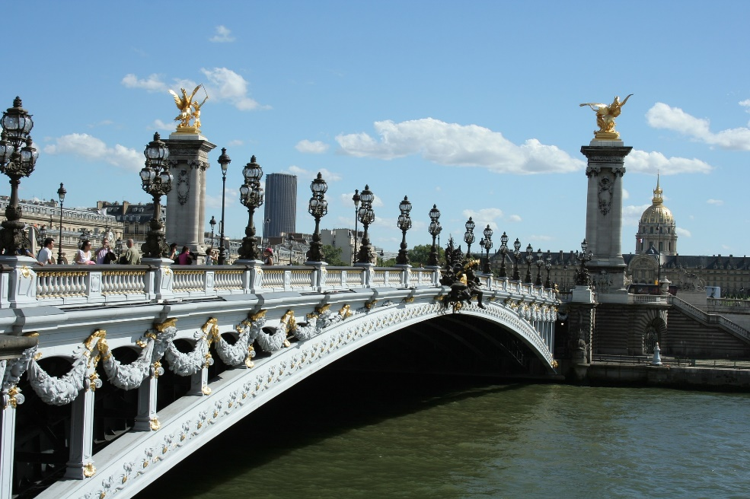
De beaux ponts à Paris
parler
Pont de Bir Hakeim
Pont Alexandre III
Pont des Arts
Pont Neuf
Notes:
Timing: 1 minute
Aim: To illustrate some of the beautiful bridges in Paris which were mentioned in the previous dialogue. Phonics practice.
Procedure:
1. Ask students to translate the title.
2. Explain that the photos show some of Paris’ beautiful bridges.
3. Ask students to consider in pairs the pronunciation of the name of each bridge. Explain the translation of Pont Neuf (new bridge).

Slide 41
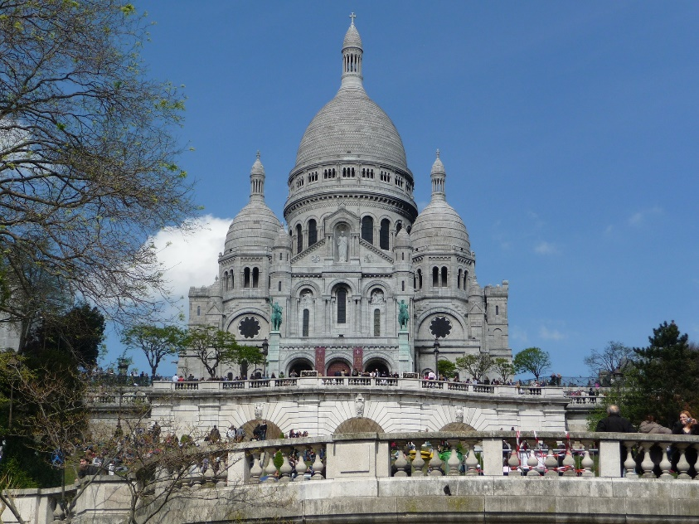
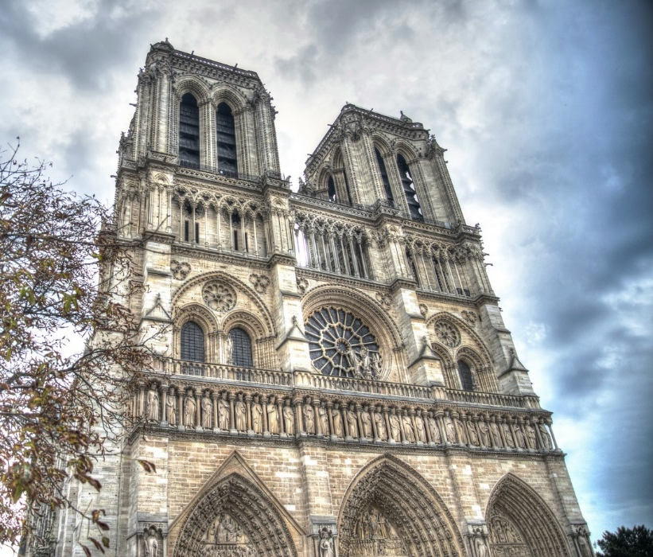
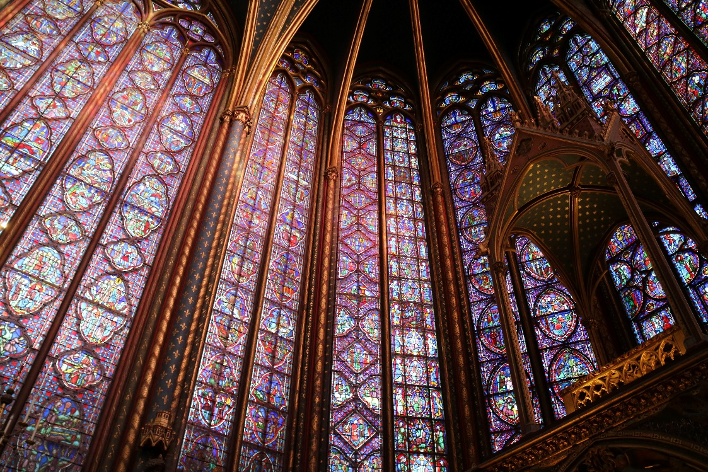
De belles églises à Paris
Sacré-Cœur
Notre-Dame de Paris
Sainte-Chapelle
Notes:
Timing: 1 minute
Aim: To illustrate some of the beautiful churches/cathedrals in Paris which were mentioned in the previous dialogue. SSC practice.
Procedure:
Ask students to translate the title.
Clarify that the photos show some of Paris’ beautiful churches/cathedrals.
Ask students to consider in pairs the pronunciation of the name of each church.

Slide 42
Saying ‘can’ in French
grammaire
As we have learned, there are two ways to say ‘can’ in French:
pouvoir (can/be able to) savoir (can/know how to)
Both verbs give more information about a second verb in a sentence.
When the second verb describes an activity which does not require specific skills or knowledge, pouvoir (can / be able to) is used:
Elle peut sortir le samedi. She can / is able to go out on Saturdays.
When the second verb describes an activity which requires specific skills or knowledge, savoir (can / know how to) is used:
Elle sait parler français. She can / knows how to speak French.
_______
_______
Notes:
Timing: 2 minutes
Aim: First language awareness-raising to recap the difference between the two meanings of ‘can’ in English (be able to / know how to). Revising cross-linguistic differences by mapping these concepts onto the two French verbs.
Procedure:
1. Click to bring up the explanation.

Slide 43
‘Pouvoir’ et ‘savoir’
grammaire
The verb ‘pouvoir’ = can / to be able to
________________________________________
je
peux
I
can, am able to
tu
peux
you
can, are able to
Remember: all three forms of each verb sound the same.
il/elle
peut
he/she
can, is able to
The verb ‘savoir’ = can / to know how (to)
________________________________________
je
sais
I
can, know how to
tu
sais
you
can, know how to
il/elle
sait
he/she
can, knows how to
Notes:
Timing: 1 minute
Aim: To recap the singular forms of the modal verbs pouvoir and savoir.
Procedure:
1. Begin by eliciting the meaning of the infinitive pouvoir. Click to reveal the answer.
2. Click to bring up the full set of English forms.
3. Give students a minute in pairs to produce as many of the singular forms as they can.
4. Take feedback from the class, revealing the French by clicking through the animations.
5. Repeat for savoir.
6. Before moving on, remind students that the singular forms of these verbs sound the same.

Slide 44
Position of adverbs [1/2]
grammaire
Notice: in English, the adverb can go in a variety of places in a sentence.
As you know, adverbs (other than time/place) come after verbs in short form:
Je vais souvent en Écosse.
This means that the adverb comes before the infinitive in two-verb structures.
Je dois seulement
sortir le soir avec Léa.
I must only go out with Léa in the evenings.
In a negative sentence, the ne…pas goes around the short form, before the adverb:
Tu ne peux pas encore visiter Alger.
You can’t visit Algiers again.
Notes:
Timing: 2 minutes
Aim: To explain the position of adverbs other than time/place in two-verb constructions.
Procedure:
1. Check students understand what an adverb is – i.e. a word used to describe a verb.
2. Click to bring up the explanation.

Slide 45
Position of adverbs [2/2]
grammaire
These are examples of adverbs you know. C’est quoi en anglais ?
enough
well
a lot
assez
bien
beaucoup
less
often
badly
moins
souvent
mal
quickly
better
soon
vite
mieux
bientôt
Notes:
Timing: 2 minutes
Aim: Written recognition of known adverbs (NB: for higher levels, a version of this activity which asks students to recall (rather than recognise) the adverbs can be found on the next slide.
Procedure:
1. At higher levels, you may wish to give students some time to write down as many French adverbs as they can in one minute before starting the activity. You can give one or two examples if they are unsure.
2. Give students a minute in pairs to produce the English for the adverbs.
3. Reveal the English by clicking on each adverb.

Slide 46
En français!
vocabulaire
C’est quoi en français ?
well
a lot
soon
bien
beaucoup
bientôt
enough
badly
better
assez
mal
mieux
less
often
quickly
moins
souvent
vite
Notes:
Timing: 2 minutes
Aim: Written or oral recall of known adverbs (NB: for lower levels, a version of this activity which asks students to recognise (rather than recall) the adverbs can be found on the previous slide.
Procedure:
1. At higher levels, you may wish to give students some time to write down as many French adverbs as they can in one minute before starting the activity. You can give one or two examples if they are unsure.
2. Give students a minute in pairs to give the French for the adverbs.
3. Reveal the French by clicking on each adverb.

Slide 47
Au parc avec des amis de Léa.
écouter / écrire
Des amis de Léa posent des questions à son amie américaine.
Écoute et coche les bonnes réponses. Écris les réponses en français.
 |  |  | ‘able to’ | ‘know how to’ | Réponse
 | Tu | Elle |  |  | Non,
 | Tu | Elle |  |  | Oui,
 | Tu | Elle |  |  | Oui,
 | Tu | Elle |  |  | Oui,
 | Tu | Elle |  |  | Non,
1
je ne sais pas bien parler français.
2
elle peut bientôt aller aux États-Unis.
3
elle sait bien faire les plats français.
4
je peux bientôt retourner en France.
5
elle ne peut pas souvent visiter les églises différentes.
Notes:
Timing: 6 minutes
See next slide for a differentiated version in which the end of the sentence is supplied.
Aim: Receptive and productive knowledge of singular forms of savoir and pouvoir. English translations of savoir and pouvoir. Written production of two-verb sentences with adverbs other than time/place.
Procedure:
1. Click the number trigger to play the audio.
2. Students listen and note both the subject of the verb and the correct translation in English.
3. Students then use this information to write the answer to the question in French, in affirmative or negative sentences as indicated.
4. Click to bring up the answers.
Transcript:
1) Sais-tu bien parler français ?
2) Peut-elle bientôt aller aux États-Unis ?
3) Sait-elle bien faire les plats français ?
4) Peux-tu bientôt retourner en France ?
5) Peut-elle souvent visiter les églises différentes ?
Word frequency of cognates used (1 is the most frequent word in French): américain [374]
Source: Londsale, D., & Le Bras, Y. (2009). A Frequency Dictionary of French: Core vocabulary for learners London: Routledge.

Slide 48
Au parc avec des amis de Léa.
écouter / écrire
Des amis de Léa posent des questions à son amie américaine.
Écoute et coche les bonnes réponses. Écris les réponses en français.
 |  |  | ‘able to’ | ‘know how to’ | Réponse
 | Tu | Elle |  |  | Non,
 | Tu | Elle |  |  | Oui,
 | Tu | Elle |  |  | Oui,
 | Tu | Elle |  |  | Oui,
 | Tu | Elle |  |  | Non,
1
je ne sais pas bien
parler français.
2
elle peut bientôt
aller aux États-Unis.
elle sait bien
3
faire les plats français.
je peux bientôt
4
retourner en France.
5
elle ne peut pas souvent
visiter les églises différentes.
Notes:
Timing: 6 minutes
Differentiated version of previous activity with the end of the sentence supplied. This allows students to focus solely on modals + adverb in negative and positive constructions.
Aim: Receptive and productive knowledge of singular forms of savoir and pouvoir. English translations of savoir and pouvoir. Written production of two-verb sentences with adverbs.
Procedure:
1. Click the number trigger to play the audio.
2. Students listen and note both the subject of the verb and the correct translation in English.
3. Students then use this information to write the first part of the answer to the question in French, in affirmative or negative sentences as indicated.
4. Click to bring up the answers.
Note: Teachers could consider further scaffolding this activity by providing visual support for verb and/or adverb definitions (by printing out the materials or allowing students access to their exercise books/vocabulary books).
Transcript:
1) Sais-tu bien parler français ?
2) Peut-elle bientôt aller aux États-Unis ?
3) Sait-elle bien faire les plats français ?
4) Peux-tu bientôt retourner en France ?
5) Peut-elle souvent visiter les églises différentes ?
Word frequency of cognates used (1 is the most frequent word in French): américain [374]
Source: Londsale, D., & Le Bras, Y. (2009). A Frequency Dictionary of French: Core vocabulary for learners London: Routledge.

Slide 49
Aux pays différents. [1/2]
Lis les textes. C’est un verbe ou deux ? Écris la terminaison du verbe.
lire / écrire
Elle doit souvent parler français.
6
Tu peux
encore visiter Londres.
__
Je visite souvent l’Allemagne.
4
1
__
__
She speaks
She has to speak
I visit
I want to visit
You visit
You can visit
Je parle bien anglais.
Il aime
beaucoup Alger.
7
2
__
__
He likes
He is going to like
I speak
I know how to speak
Elle veut bientôt visiter Paris.
5
__
Tu sais vite parler allemand.
Elle aime assez la visite en Écosse.
3
8
__
She visits
She wants to visit
__
You speak
You know how to speak
She likes
She must like
Notes:
Timing: 8 minutes for 2 slides
Aim: Written recognition of adverb positioning in single and two-verb structures. Form of the main verb (i.e. infinitive or short form) in single-verb and two-verb structures. Written production of forms of modal verbs. Written recall of adverbs in this week’s vocabulary revision set.
Procedure (part 1):
1. Students begin by reading the texts and using the position of the adverb to identify whether the sentence must be a two-verb structure or not. They tick the correct option.
2. Students use this information to conjugate the main verb accordingly (i.e. infinitive or je, tu, il/elle form).
3. Correct answers are revealed on a click.
4. Click on the orange underline trigger within each speech bubble to reveal the verb ending.
5. Move on to part 2 (see next slide).
Word frequency of cognates used (1 is the most frequent word in French): verbe [>5000], terminaison [>5000]
Source: Londsale, D., & Le Bras, Y. (2009). A Frequency Dictionary of French: Core vocabulary for learners London: Routledge.

Slide 50
Aux pays différents. [2/2]
Parle avec ton/ta partenaire.
C’est quoi la phrase complète en français ? Et en anglais ?
lire / parler
Elle doit souvent parler français.
She often has to speak French.
You can visit London again.
6
Tu peux
encore visiter Londres.
Je visite souvent l’Allemagne.
4
I often visit Germany.
1
She speaks
She has to speak
I visit
I want to visit
You visit
You can visit
I speak English well.
Je parle bien anglais.
He likes Algiers a lot.
7
Il aime
beaucoup Alger.
2
He likes
He is going to like
I speak
I know how to speak
She wants to visit Paris soon.
Elle veut bientôt visiter Paris.
5
Elle aime assez la visite en Écosse.
You know how to speak German quickly.
She quite likes the visit to Scotland.
Tu sais vite parler allemand.
8
3
She visits
She wants to visit
You speak
You know how to speak
She likes
She must like
Notes:
Aim: Written recognition of adverb positioning in single and two-verb structures. Form of the main verb (i.e. infinitive or short form) in single-verb and two-verb structures. Oral production of forms of modal verbs. Recall of adverbs in this week’s vocabulary revision set.
Procedure (part 2):
1. Students work in pairs, with immediate feedback given by the teacher.
2. Student A begins by saying the full sentence in French to their partner, using their previous answer and the English prompt to work out what the modal verb should be (if required).
3. The teacher clicks on the ‘world’ trigger to reveal the full sentence.
4. Student B then translates the sentence into English.
5. The teacher clicks on the number trigger within the French speech bubble to bring up the correct translation.
6. Partners swap roles.
Note: consider allowing students access to visual support (as before) of the verb and/or adverb definitions.
Word frequency of cognates used (1 is the most frequent word in French): complet [985]
Source: Londsale, D., & Le Bras, Y. (2009). A Frequency Dictionary of French: Core vocabulary for learners London: Routledge.

Slide 51
Gaming Grammar
Gaming Grammar
Relevant mini game(s):
Verbs (present): 1st person singular/plural (Verb agreement (present))
Verbs (present): 2nd person singular/plural (Verb agreement (present))
Verbs (present): 3rd person singular/plural (Verb agreement (present))
Questions: subject-verb inversion (Question formation)
Notes:
This slide links to Gaming Grammar login screen. The appropriate mission can then be selected from the menu page.
Students will progress through the game at their own rate; teachers should use the teacher interface to check progress. This will help to inform future lesson planning.

Slide 52
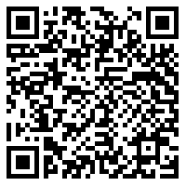
Devoirs
Vocabulary Learning Homework (Y8, Term 3.1, Week 1)
Audio file
Audio file QR code:
Student worksheet
Quizlet link
In addition, revisit: Year 8 Term 2.2 Week 1
Year 8 Term 1.2 Week 5
Notes:
The answer sheet for the 8.3.1.1 vocabulary learning homework is here: https://resources.ncelp.org/concern/resources/8c97kr14r?locale=en

