Slide 1
Talking about what, where and who you know
à and en with countries/states
SSCs [ai], [é]
Y9 French
Term 1.1 - Week 6 - Lesson 11
Amber Dudley / Catherine Morris / Natalie Finlayson
Artwork by: Chloé Motard
Date updated: 16/07/2021
Notes:
Artwork by Chloé Motard. All additional pictures selected are available under a Creative Commons license, no attribution required.
Native speaker feedback provided by Sarah Brichory.
With thanks to Rachel Hawkes and Emma Marsden for their input on the lesson material.
Learning outcomes (lesson 1):
Revision of SSCs [ai], [é]
Introduction of the use of preposition à with masculine countries
Revision of the use of preposition en with feminine countries.
Word frequency (1 is the most frequent word in French):
9.1.1.6 (introduce) connaître, connais [133], chanson [2142], chemin [859], endroit [650], gens [236], groupe [187], québécois [1970], canadien [611], Canada [n/a], Québec [n/a] 8.3.2.6 (revisit) bu [boire - 1879], eu [avoir - 8], pris [prendre - 43], accident [1227], bras [1253], jambe [2472], mal [277], maladie [793], petit-déjeuner [>5000], photo [1412], déjà² [58], pas encore [18/51], ensuite [265], avoir mal à + definite article, prendre + food/drink 8.3.1.4 (revisit) dépendre (de) [313], entendre [159], répondre (à) [200], annonce [1887], conversation [1747], espagnol² [1666], message [792], soleil [1713], temps² [65], espagnol¹ [1666], Espagne [n/a]
Source: Londsale, D., & Le Bras, Y. (2009). A Frequency Dictionary of French: Core vocabulary for Léarners London: Routledge.
The frequency rankings for words that occur in this PowerPoint which have been previously introduced in NCELP resources are given in the NCELP SOW and in the resources that first introduced and formally re-visited those words.
For any other words that occur incidentally in this PowerPoint, frequency rankings will be provided in the notes field wherever possible.

Slide 2
ai
vrai
Notes:
Timing: 1 minute
Aim: To consolidate SSC [ai]
Procedure: 1. Present the letter(s) and say the [ai] sound first, on its own. Students repeat it with you. 2. Bring up the word ”vrai” on its own, say it, students repeat it, so that they have the opportunity to focus all of their attention on the connection between the written word and its sound.
3. A possible gesture for this would be to mime a ‘tick’.
4. Roll back the animations and work through 1-3 again, but this time, dropping your voice completely to listen carefully to the students saying the [ai] sound, pronouncing ”vrai” and, if using, doing the gesture.
Word frequency (1 is the most frequent word in French):
vrai [292].
Source: Londsale, D., & Le Bras, Y. (2009). A Frequency Dictionary of French: Core vocabulary for learners London: Routledge.

Slide 3
é/-er/-ez
écrire
Notes:
Aim: To consolidate SSC [é]
Procedure: 1. Present the letter(s) and say the [é] sound first, on its own. Students repeat it with you. 2. Bring up the word ”écrire” on its own, say it, students repeat it, so that they have the opportunity to focus all of their attention on the connection between the written word and its sound.
3. A possible gesture for this would be to mime the act of writing (onto the palm of the other hand perhaps). 4. Roll back the animations and work through 1-3 again, but this time, dropping your voice completely to listen carefully to the students saying the [é] sound, pronouncing ”écrire” and, if using, doing the gesture.
Word frequency (1 is the most frequent word in French):
écrire [382] Source: Londsale, D., & Le Bras, Y. (2009). A Frequency Dictionary of French: Core vocabulary for learners London: Routledge.

Slide 4
SSCs: [ai] vs. [é]
When you make these sounds, notice how your lips are more relaxed in French than in English.
phonétique
The words below have a similar spelling and meaning in English and French.
This is because they are cognates.
Cognates are often pronounced differently in English and French.
In English, the letters in orange sound like the SSC [é]
English | French
In French, the letters in orange sound like the SSC [ai]
May
mai
e-mail
e-mail
mayonnaise
mayonnaise
Notes:
Timing: 3 minutes
Aim: To highlight the cross-linguistic differences between English and French pronunciations of SSC [ai].
Procedure:
1. Click to animate the explanation.
2. Students say the cognate words aloud in English and French. You can click on the words in orange to hear them read aloud in French by a native speaker.
3. Encourage students to compare the feel of their lips and mouth when saying the words in English and French. Because the French SSC [ai] is a more ‘lax’ vowel than the English SSC [ai], the lips and mouth should feel more relaxed when saying the French words.
Transcript:
mai, e-mail, mayonnaise
Word frequency of cognates used (1 is the most frequent word in French): e-mail [>5000], mayonnaise [>5000]
Source: Londsale, D., & Le Bras, Y. (2009). A Frequency Dictionary of French: Core vocabulary for learners London: Routledge.

Slide 5
Adjectifs : Quelle SSC ?
écouter / écrire
Écoute ces adjectifs. Tu entends [ai] ou [é] ? Remplis les blancs.
 | French | English | [ai] | [é]
 | frais | fresh
 | étonnant | surprising
 | clair | clear
 | spécial | special
 | faible | weak
 | pénible | annoying
 | parfait | perfect
 | étrange | strange
1
_
2
_
3
_
4
_
5
_
6
_
7
_
8
_
Notes:
Timing: 5 minutes
Aim: To distinguish aurally between SSCs [ai] and [é].
Procedure:
1. Click on the number button to listen to the word read aloud.
2. Students fill in the gap with the missing SSC.
3. Click to reveal the answers.
4. Students listen to and repeat the word.
Transcript:
frais
étonnant
clair
spécial
faible
pénible
parfait
étrange
Word frequency (1 is the most frequent word in French): frais [691], étonnant [1627], clair [335], spécial [726], faible [723], pénible [3690], parfait [1600], étrange [2159]
Source: Londsale, D., & Le Bras, Y. (2009). A Frequency Dictionary of French: Core vocabulary for learners London: Routledge.

Slide 6
Vocabulaire
écouter / lire
English | French
to be familiar with, know | connaître
Canada | le Canada
way, path | le chemin
song | la chanson
from Quebec (adj.) | québécois
people | les gens
place, spot | l’endroit
Quebec | le Québéc
group | le groupe
I am familiar with, I know | je connais
to know how to, know | savoir
Canadian (m) | canadien
Écoute, écris et répète les mots !
1
2
3
4
5
6
7
8
9
10
11
12
Notes:
Timing: 5 minutes
Aim: Recognition of this week’s new vocabulary in the oral and written modalities.
Procedure: 1. Click to hear the words in French. 2. Write down the meaning in English. 3. Click to reveal answers and transcriptions, one by one.
4. Click to cover the English.
5. Teacher now points at the French words in a random order.
6. Students say the English.
Transcript:
1. connaître
2. le Canada
3. le chemin
4. la chanson
5. québécois
6. les gens
7. l’endroit
8. le Québec
9. le groupe
10. je connais
11. savoir
12. canadien
Frequency of cognates used (1 is the most frequent word in French):
répéter [630] Source: Londsale, D., & Le Bras, Y. (2009). A Frequency Dictionary of French: Core vocabulary for learners London: Routledge.

Slide 7
Un Whatsapp à Amir
lire
Amir (mon cousin préféré)
With a capital letter, un Québécois is a noun meaning a person from Quebec.
On passe les vacances au Québec cette année ! Le Québec, c’est une province du Canada. Les gens parlent beaucoup de langues ici ! Par exemple, beaucoup de Québécois savent parler anglais et français !
Je connais déjà des chansons canadiennes. Arcade Fire, c’est mon groupe de rock préféré ! Et mon papa connaît un endroit où on peut écouter du rock. Il dit que c’est un café québécois . Mais il ne connaît pas le chemin !
Without an article, canadien is an adjective describing someone or something that comes from Canada.
Without an article, québécois is an adjective describing someone or something that comes from Quebec.
chemin
savent
Québec
canadiennes
groupe
québécois
gens
endroit
Canada
connais
Notes:
Timing: 6 minutes
Aim: Written recognition of this week’s new vocabulary in context.
Procedure:
1. Students read the text and fill in the blanks, using the words in orange at the bottom.
2. Click to reveal the answers.
3. Use call-outs to remind students about the multiple functions (i.e., nationality vs adjective) of words like québécois and canadien.
Word frequency of cognates (1 is the most frequent word in French):
cousin [3387]
Source: Londsale, D., & Le Bras, Y. (2009). A Frequency Dictionary of French: Core vocabulary for Léarners London: Routledge.

Slide 8
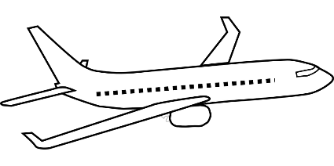
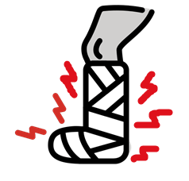
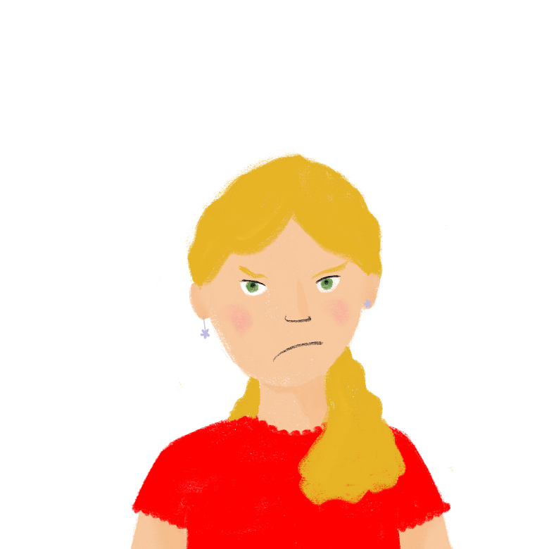
Dans l’avion
*le siege = seat
*grincheux = grumpy
écouter
C’est un voyage de 8 heures et les sièges* dans l’avion ne sont pas très confortables ! La famille devient grincheuse*. Ils ont mal où ?
1
Notes:
Timing: 5 minutes. This is slide 1/7.
Aim: Aural recognition of contracted forms of à + definite article; revisiting ‘avoir mal à + article + body part’; priming students for use of contracted forms of à + definite article + country in the new grammar introduced in the slide that follow.
Procedure:
1. Check students understand the task instructions. Invite them to guess the meaning of grincheux from the context, and their knowledge of the English noun grinch!
2. Remind students of the contracted forms of à + definite article.
3. Click on the number button to listen to hear a sentence with the noun missing.
4. Students listen and choose the correct body part based on the contracted form of à + definite article that they hear.
5. Click to reveal the correct answer. Click picture to hear the full sentence said aloud.
6. Repeat steps 2-4 for six more slides.
Transcript:
J’ai mal à la [jambe].
Frequency of cognates used (1 is the most frequent word in French):
confortable [3964] Source: Londsale, D., & Le Bras, Y. (2009). A Frequency Dictionary of French: Core vocabulary for learners London: Routledge.
Frequency of unknown words used (1 is the most frequent word in French): siège [1571], grincheux [>5000]
Source: Londsale, D., & Le Bras, Y. (2009). A Frequency Dictionary of French: Core vocabulary for learners London: Routledge.

Slide 9
Dans l’avion
écouter
2
Notes:
This is slide 2/7.
Transcript:
Romain, tu as mal aux [bras]?

Slide 10
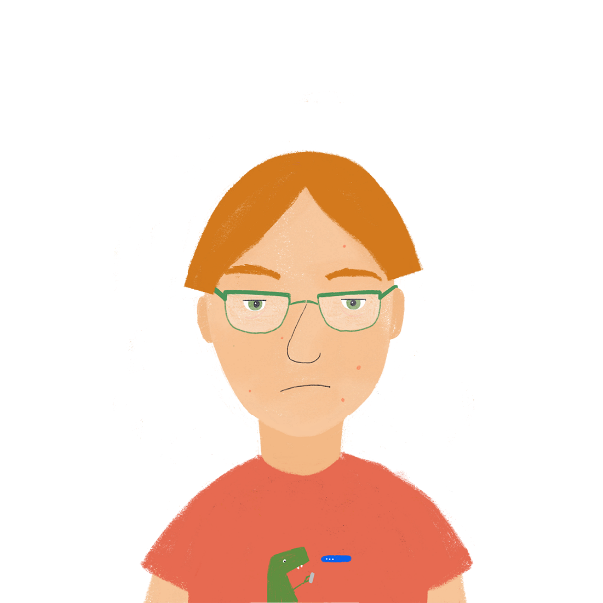
Dans l’avion
écouter
3
Notes:
This is slide 3/7.
Transcript:
Antoine a mal à la [tête].

Slide 11
Dans l’avion
écouter
4
Notes:
This is slide 4/7.
Transcript:
Léa a mal au [cœur].

Slide 12
Dans l’avion
écouter
5
Notes:
This is slide 5/7.
Transcript:
Nous avons mal aux [jambes].

Slide 13
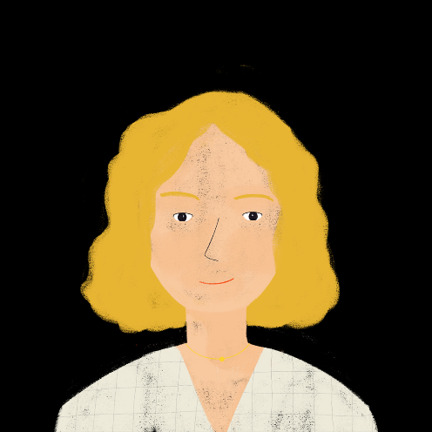
Dans l’avion
écouter
6
Notes:
This is slide 6/7.
Transcript:
Maman, papa, vous avez mal à la [tête]?

Slide 14
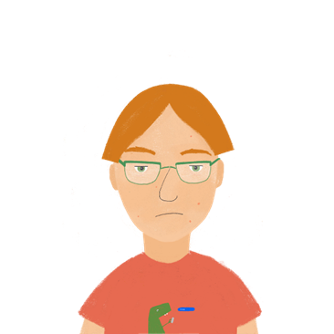
Dans l’avion
écouter
7
Notes:
This is slide 7/7.
Transcript:
Ils ont mal aux [bras].

Slide 15
Saying ‘to’ and ‘in’
grammaire
We use the preposition à to talk about going to or being in a town/city:
We use preposition en to talk about going to or being in a feminine country:
Country names ending in -e are normally feminine.
Je vais …
à Paris
to Paris
Tu es …
à Paris
in Paris
Elle va …
en France
to France
Ils sont…
en France
in France
Notes:
Timing: 2 minutes
Aim: To recap the use of à and en with place names (towns, cities and feminine countries); to introduce spelling rules governing gender of country names (-e = feminine).
Procedure:
1. Work through the information, drawing attention to the fact that the English translation of the preposition changes depending on the verb (‘to’ with verbs expressing movement, ‘in’ with verbs expressing location).
2. Click to bring up the hint about country names and gender. Ask students to recall the names of countries they have learned so far (la France, l’Angleterre, l’Écosse, l’Italie, l’Allemagne, l’Algérie, l’Espagne). Draw attention to the fact that these country names all end in –e and are all feminine. This prepares students for adding to this knowledge on the next slide.

Slide 16
Saying ‘to’ and ‘in’
grammaire
Country names ending in letters other than -e are masculine (e.g. le Canada).
We use au (à + le) to talk about going to or being in a masculine country:
Nous allons…
au Canada
to Canada
Je suis …
au Canada
in Canada
We also use au (à + le) to talk about going to or being in a masculine region:
Vous allez …
au Québec
to Quebec
Il est …
au Québec
in Quebec
Notes:
Timing: 2 minutes
Aim: To introduce the use of à + definite article with masculine countries and regions; to introduce spelling rules governing gender of country names (≠-e = masculine).

Slide 17
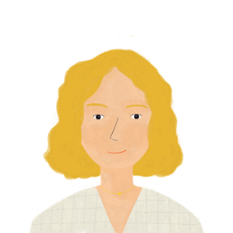
Qui va où ?
Remember! Most country names ending in –e are feminine.
lire
Les projets de mes amis
1. Abdel est en …
Australie. / Canada.
5. Pierre va en …
Norvège. / Costa Rica.
2. Sophie est en…
Portugal ? / Chine ?
6. Amir va au …
Portugal ? / Russie ?
3. Sophie est au …
Brésil. / Colombie.
7. Il va en …
Suisse. / Québec.
4. Pierre va au …
Inde ? / Japon ?
8. Ta prof est en …
Maroc ? / Thaïlande ?
Notes:
Timing: 8 minutes. This is slide 1/2.
Aim: Connecting au and en with masculine and feminine countries and translating them as ‘to’ or ‘in’ depending on the verb that precedes them.
Procedure:
1. Remind students of the spelling rules governing country gender. They will need to use their knowledge of this rule to complete the exercise as it contains the names of some countries they have not yet encountered in French.
2. Students read the sentences and decide which country name must complete them based on the preposition they see (en + countries ending in –e; au + others).
3. Click to reveal the answers. While giving feedback, ask students to use their SSC knowledge to read the names of the countries aloud. Check they know the English names of the countries which are written cognates.
4. Students translate the sentences. Focus students’ attention on whether en or au should be translated as ‘to’ or ’in’ based on the verb.
5. Suggested translations are provided on the following slide.
Word frequency of cognates (1 is the most frequent word in French):
Taxi [4235]; Australie [>5000]; Portugal [[>5000; Brésil [>5000]; Colombie [>5000]; Inde [>5000]; Japon [>5000]; Norvège [>5000]; Costa Rica [>5000]; Russie [>5000]; Maroc [>5000]; Thaïlande [>5000]
Source: Londsale, D., & Le Bras, Y. (2009). A Frequency Dictionary of French: Core vocabulary for Léarners London: Routledge.

Slide 18
Qui va où ?
Remember! Most country names ending in –e are feminine.
lire
Les projets de mes amis
1. Abdel is in Australia.
5. Pierre is going to Norway.
2. Is Sophie in China?
6. Is Amir going to Portugal?
3. Sophie is in Brazil.
7. He is going to Switzerland.
4. Is Pierre going to Japan?
8. Is your teacher in Thailand?
Notes:
This is slide 2/2.

Slide 19
La mère de Léa
Sur Twitter
*Rio de Janeiro = une ville brésilienne
écrire
Lis les messages et remplis les blancs. C’est ‘à’, ‘au’ ou ‘en’ ?
1. Sophie· Salut Léa ! Tu es à Paris ?
5. Sophie· Ah bon ? Je vais à Rio de Janeiro* demain avec maman.
__
__
2. Léa· Non ! Je suis au Canada.
6. Sophie· Mais papa est au Japon !
__
__
3. Léa· Nous allons au Québec !
7. Léa· Cool ! Et ton frère, est-il au Portugal en ce moment ?
__
__
4. Léa· Mais Élodie reste en France. Elle a une maladie.
8. Sophie· Oui, il voyage beaucoup ! Il va ensuite en Espagne.
__
__
Notes:
Timing: 5 minutes
Aim: Written production of à, au and en with place names (cities, masculine/feminine countries and regions).
Procedure:
1. Students read the sentences and choose à, au or en depending on the place name.
2. Click to reveal answers.

Slide 20
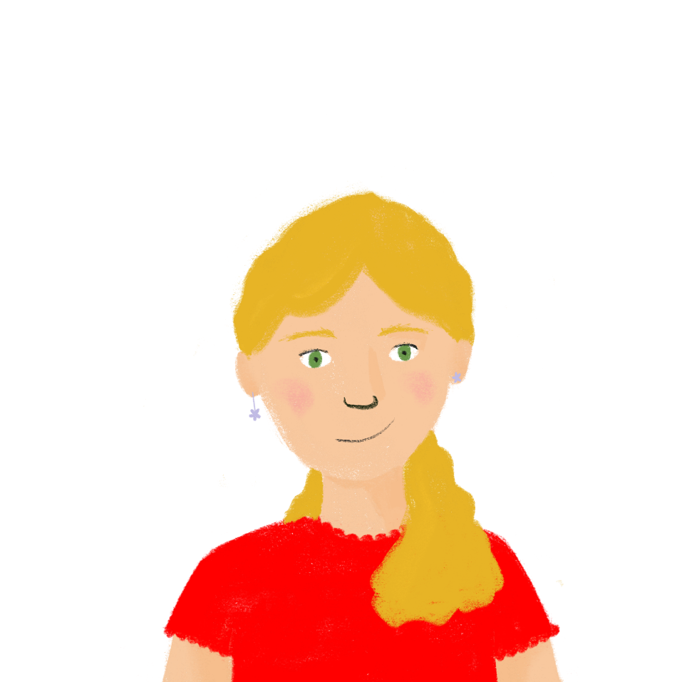
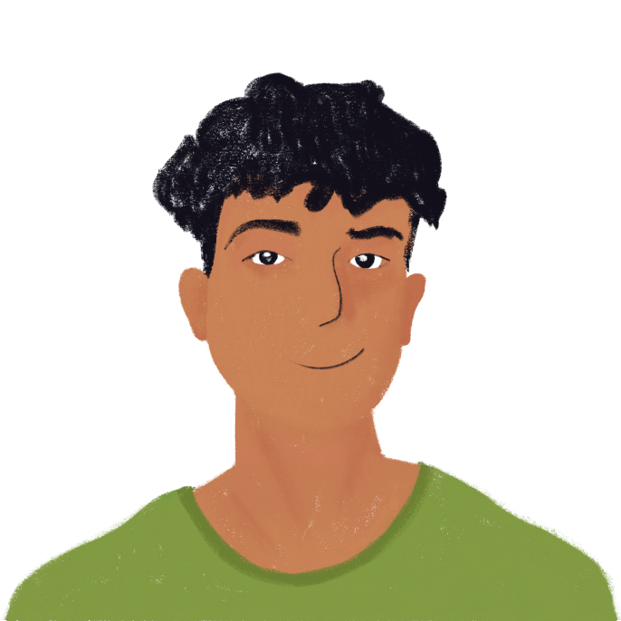
Je vais où ?
parler
J’aime bien le pain.
Vas-tu en Italie ?
Non ! Je veux visiter la Tour Eiffel.
Student A
Ah ! Tu vas en France !
Student B
Notes:
Timing: 8 minutes
Aim: Oral production of short sentences containing en with feminine countries and au with masculine ones; aural recognition of a range of vocabulary.
Procedure:
1. Print and distribute the role cards on slide 23-24 and display the picture board on slide 22.
2. Student A begins by reading the first clue for country A.
3. Student B guesses the name of a country that matches the description using the structure Vas-tu au/en…?. Remind students to focus on the use of au and en, and that they will need to look at the spelling of the country name to decide which to use.
4. If student B guesses correctly, student A moves on to the clues for country B. If student B guesses incorrectly, student A reads out the second clue for country A (and then the third if the country is still not guessed correctly). An example of such a dialogue is shown on this slide.
5. Repeat steps 2-4 for the remainder of countries on Student A’s card.
6. Students swap roles.
Word frequency of cognates (1 is the most frequent word in French):
pizza [>5000], Asie [>5000], sushi [>5000], Afrique [2289], éléphant [>5000], Amérique [>5000], Nord [1090], Europe [>5000], Amérique [>5000], carnaval [>5000], Asie [>5000], temple [3441], désert [2382]
Source: Londsale, D., & Le Bras, Y. (2009). A Frequency Dictionary of French: Core vocabulary for Léarners London: Routledge.

Slide 21
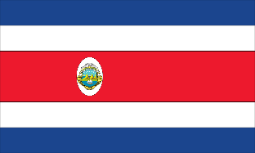
Je vais où ?
Remember! Most country names ending in –e are feminine.
parler
Norvège
Japon
Australie
Portugal
Brésil
France
Canada
Espagne
Italie
Chili
Chine
Maroc
Costa Rica
Afrique du Sud
Nigéria
Allemagne
Notes:
Picture Board

Slide 22
 | Country | Clues
A. | Italie | 1. J'aime l’Europe. 2. J'aime la pizza. 3. Je veux visiter Rome.
B. | Japon | 1. J'aime l’Asie. 2. J'aime le sushi. 3. Je veux visiter Tokyo.
C. | Afrique du Sud | 1. J'aime l’Afrique. 2. J'aime les éléphants. 3. Je veux visiter Cape Town.
D. | Canada | 1. J'aime l’Amérique du Nord. 2. J'aime la neige. 3. Je veux visiter le Québec.
 | Country | Clues
A. | Italie | 1. J'aime l’Europe. 2. J'aime la pizza. 3. Je veux visiter Rome.
B. | Japon | 1. J'aime l’Asie. 2. J'aime le sushi. 3. Je veux visiter Tokyo.
C. | Afrique du Sud | 1. J'aime l’Afrique. 2. J'aime les éléphants. 3. Je veux visiter Cape Town.
D. | Canada | 1. J'aime l’Amérique du Nord. 2. J'aime la neige. 3. Je veux visiter le Québec.
 | Country | Clues
A. | Italie | 1. J'aime l’Europe. 2. J'aime la pizza. 3. Je veux visiter Rome.
B. | Japon | 1. J'aime l’Asie. 2. J'aime le sushi. 3. Je veux visiter Tokyo.
C. | Afrique du Sud | 1. J'aime l’Afrique. 2. J'aime les éléphants. 3. Je veux visiter Cape Town.
D. | Canada | 1. J'aime l’Amérique du Nord. 2. J'aime la neige. 3. Je veux visiter le Québec.
 | Country | Clues
A. | Italie | 1. J'aime l’Europe. 2. J'aime la pizza. 3. Je veux visiter Rome.
B. | Japon | 1. J'aime l’Asie. 2. J'aime le sushi. 3. Je veux visiter Tokyo.
C. | Afrique du Sud | 1. J'aime l’Afrique. 2. J'aime les éléphants. 3. Je veux visiter Cape Town.
D. | Canada | 1. J'aime l’Amérique du Nord. 2. J'aime la neige. 3. Je veux visiter le Québec.
Notes:
Role Play Cards 1

Slide 23
 | Country | Clues
A. | Norvège | 1. J'aime l’Europe. 2. J'aime le poisson. 3. Je veux visiter Oslo.
B. | Brésil | 1. J'aime l’Amérique du Sud. 2. J'aime les carnavals. 3. Je veux visiter Rio de Janeiro.
C. | Chine | 1. J'aime l’Asie. 2. J'aime les temples. 3. Je veux visiter Shanghai.
D. | Maroc | 1. J'aime l’Afrique. 2. Je veux visiter le désert du Sahara. 3. Je veux visiter Marrakech.
 | Country | Clues
A. | Norvège | 1. J'aime l’Europe. 2. J'aime le poisson. 3. Je veux visiter Oslo.
B. | Brésil | 1. J'aime l’Amérique du Sud. 2. J'aime les carnavals. 3. Je veux visiter Rio de Janeiro.
C. | Chine | 1. J'aime l’Asie. 2. J'aime les temples. 3. Je veux visiter Shanghai.
D. | Maroc | 1. J'aime l’Afrique. 2. Je veux visiter le désert du Sahara. 3. Je veux visiter Marrakech.
 | Country | Clues
A. | Norvège | 1. J'aime l’Europe. 2. J'aime le poisson. 3. Je veux visiter Oslo.
B. | Brésil | 1. J'aime l’Amérique du Sud. 2. J'aime les carnavals. 3. Je veux visiter Rio de Janeiro.
C. | Chine | 1. J'aime l’Asie. 2. J'aime les temples. 3. Je veux visiter Shanghai.
D. | Maroc | 1. J'aime l’Afrique. 2. Je veux visiter le désert du Sahara. 3. Je veux visiter Marrakech.
 | Country | Clues
A. | Norvège | 1. J'aime l’Europe. 2. J'aime le poisson. 3. Je veux visiter Oslo.
B. | Brésil | 1. J'aime l’Amérique du Sud. 2. J'aime les carnavals. 3. Je veux visiter Rio de Janeiro.
C. | Chine | 1. J'aime l’Asie. 2. J'aime les temples. 3. Je veux visiter Shanghai.
D. | Maroc | 1. J'aime l’Afrique. 2. Je veux visiter le désert du Sahara. 3. Je veux visiter Marrakech.
Notes:
Role Play Cards 2

Slide 24
Talking about what, where and who you know
connaître (je, tu, il/elle)
SSCs [ai], [é]
Y9 French
Term 1.1 - Week 6 - Lesson 12
Amber Dudley / Catherine Morris / Natalie Finlayson
Artwork by: Chloé Motard
Date updated: 01/10/2021
Notes:
Artwork by Chloé Motard. All additional pictures selected are available under a Creative Commons license, no attribution required.
Native speaker feedback provided by Sarah Brichory.
With thanks to Rachel Hawkes and Emma Marsden for their input on the lesson material.
Learning outcomes (lesson 2):
Revision of SSCs [ai], [é]
Introduction of the verb connaître (je, tu, il/elle)
Word frequency (1 is the most frequent word in French):
9.1.1.6 (introduce) connaître, connais [133], chanson [2142], chemin [859], endroit [650], gens [236], groupe [187], québécois [1970], canadien [611], Canada [n/a], Québec [n/a] 8.3.2.6 (revisit) bu [boire - 1879], eu [avoir - 8], pris [prendre - 43], accident [1227], bras [1253], jambe [2472], mal [277], maladie [793], petit-déjeuner [>5000], photo [1412], déjà² [58], pas encore [18/51], ensuite [265], avoir mal à + definite article, prendre + food/drink 8.3.1.4 (revisit) dépendre (de) [313], entendre [159], répondre (à) [200], annonce [1887], conversation [1747], espagnol² [1666], message [792], soleil [1713], temps² [65], espagnol¹ [1666], Espagne [n/a]
Source: Londsale, D., & Le Bras, Y. (2009). A Frequency Dictionary of French: Core vocabulary for Léarners London: Routledge.
The frequency rankings for words that occur in this PowerPoint which have been previously introduced in NCELP resources are given in the NCELP SOW and in the resources that first introduced and formally re-visited those words.
For any other words that occur incidentally in this PowerPoint, frequency rankings will be provided in the notes field wherever possible.

Slide 25
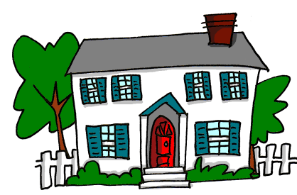
ai
maison
raison
[reason]
mauvais
vrai
faire
[bad]
semaine
[to do]
[week]
Notes:
Timing: 1 minute
Aim: To consolidate SSC [ai]
Procedure:
1. Introduce and elicit the pronunciation of the individual SSC [ai] and then the source word again ‘vrai’ (with gesture, if using). 2. Then present and elicit the pronunciation of the five cluster words.
The cluster words have been chosen for their high-frequency, from a range of word classes, with the SSC (where possible) positioned within a variety of syllables within the words (e.g. initial, 2nd, final etc.). Additionally, we have tried to use words that build cumulatively on previously taught SSCs (see the Phonics Teaching Sequence document) and do not include new SSCs. Where new SSCs are used, they are often consonants which have a similar symbol-sound correspondence in English.
Word frequency (1 is the most frequent word in French): maison [325]; raison [72] mauvais [274]; faire [25]; semaine [245]; vrai [292]. Source: Londsale, D., & Le Bras, Y. (2009). A Frequency Dictionary of French: Core vocabulary for learners London: Routledge.

Slide 26
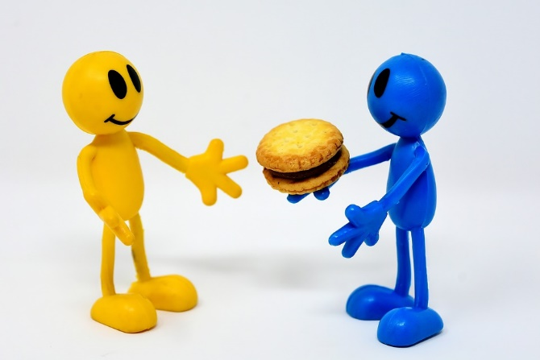
é/-er/-ez
bébé
donner
nez
parler
écrire
aller
[to go]
Notes:
Aim: To consolidate SSC [é]
Procedure:
1. Introduce and elicit the pronunciation of the individual SSC [é] and then the source word again ‘écrire’ (with gesture, if using). 2. Then present and elicit the pronunciation of the five cluster words.
The cluster words have been chosen for their high-frequency, from a range of word classes, with the SSC (where possible) positioned within a variety of syllables within the words (e.g. initial, 2nd, final etc.). Additionally, we have tried to use words that build cumulatively on previously taught SSCs (see the Phonics Teaching Sequence document) and do not include new SSCs. Where new SSCs are used, they are often consonants which have a similar symbol-sound correspondence in English.
Word frequency (1 is the most frequent word in French): écrire [382]; bébé [>5000]; aller [55] donner [46]; nez [2661]; parler [106]. Source: Londsale, D., & Le Bras, Y. (2009). A Frequency Dictionary of French: Core vocabulary for learners London: Routledge.

Slide 27
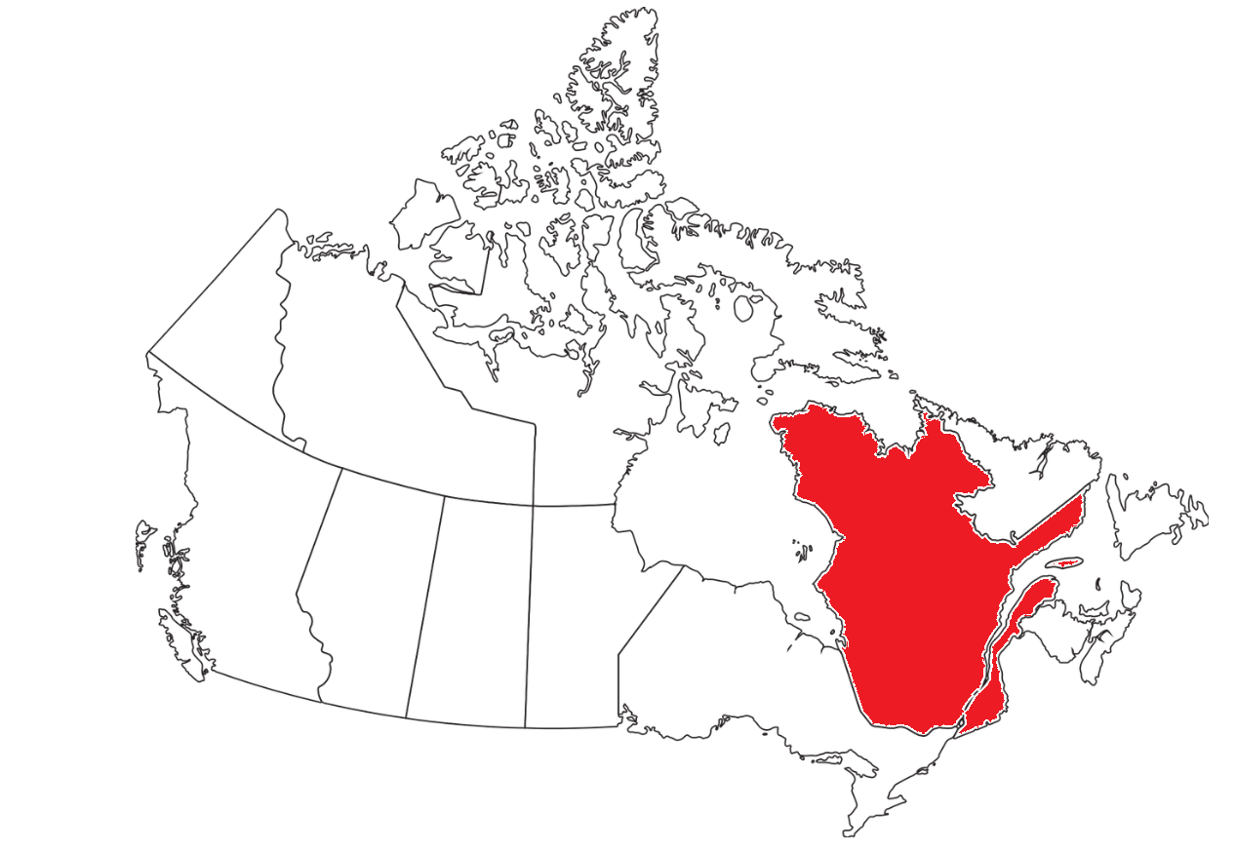
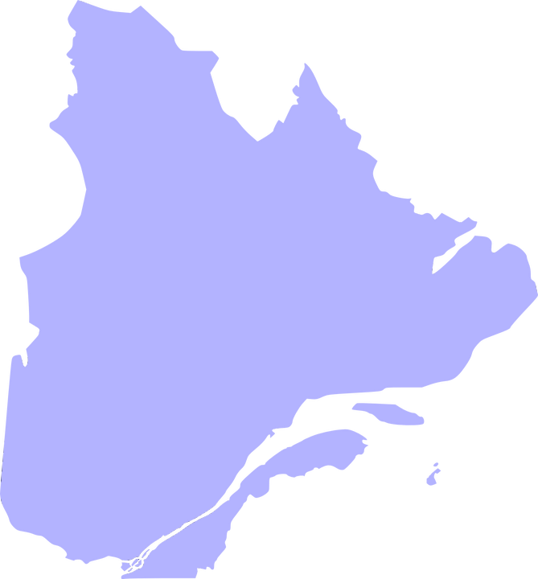
Villes du Québec
parler
Le Canada
Chapais
Cap-Santé
Lévis
Beaupré
QUEBEC
Bécancour
Mont-Saint-Hilaire
Léry
La Prairie
Baie-D’Urfé
Pointe-Claire
Notes:
Timing: 3 minutes
Aim: Oral production of place names containing SSCs [ai] and [é]; cultural awareness (situating Quebec in Canada).
Procedure:
1. Show students the maps of Canada and Quebec. Demonstrate the location of Quebec on the east coast. Explain to students that Quebec is the only Canadian province with French as its sole official language.
2. Each click brings up the missing a town/city name (top to bottom, left to right).
3. After each click, students try to say the name (focusing on SSCs [ai] and [é])
4. Click on the speech bubbles to hear the towns pronounced by a native speaker.
5. Students repeat .
Transcript:
Chapais
Lévis
Prévost
Léry
Baie-D’Urfé
Cap-Santé
Beaupré
Bécancour
Mont-Saint-Hilaire
La Prairie
Pointe-Claire

Slide 28
Trouve l’image !
parler
 | 1 | 2 | 3 | 4
A
B
C
D
Canadian (m)
from Quebec (f)
way,path
canadien
québécoise
le chemin
il connaît
he is familiar with, he knows
le Québec
l’endroit
canadienne
tu connais
Quebec
place, spot
Canadian (f)
you are familiar with, you know
le groupe
québécois
les gens (mpl)
savoir
group
from Quebec (adj.)
people
to know how to, know
connaître
la chanson
je connais
le Canada
to be familiar with, know
song
I am familiar with, I know
Canada
Notes:
Timing: 4 minutes
Aim: Oral retrieval of this week’s new vocabulary.
Procedure:
1. Students volunteer a letter/number combination relating to a square on the grid.
2. The whole class says the translation.
3. Click the blue box to reveal answer.
4. Click the yellow box to reveal part of the underlying image.
5. Students guess which revisited word is represented by the image as more is revealed.
Answer : italien, l’Italie

Slide 29
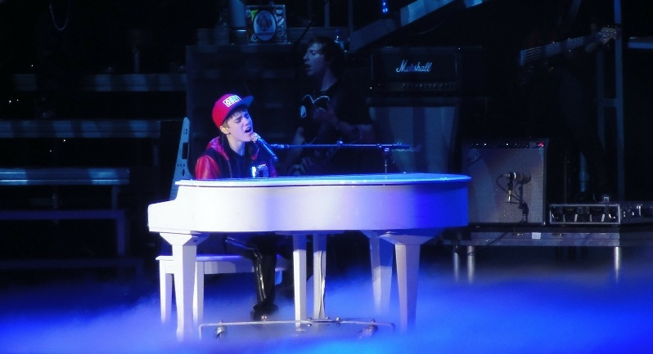
Un concert de Justin Bieber
écrire
Léa envoie un message Whatsapp à Sophie. Traduis les mots pour remplir les blancs.
J’ai déjà rencontré* beaucoup de gens au Québec ! Aujourd’hui j’ai bu un thé avec un groupe d’amis et demain on va à un concert ! Justin Bieber, c’est un chanteur canadien. J’adore ses chansons. Le concert est au Centre Bell à Montréal. Je sais que Montréal est une ville québécoise au Canada, mais je ne connais pas encore le chemin. Tu sais aller à cet endroit ?
people
Quebec
group
Canadian
songs
Quebec (adj).
Canada
am familiar with
way, path
know how to
place, spot
*rencontrer = to meet
Notes:
Timing: 5 minutes
Aim: Written production of this week’s new vocabulary.
Procedure:
1. Students complete the text with translations of the English words.
2. Click to reveal answers.
3. Oral translation of full text.
Word frequency of unknown words (1 is the most frequent word in French):
rencontrer [329]
Source: Londsale, D., & Le Bras, Y. (2009). A Frequency Dictionary of French: Core vocabulary for Léarners London: Routledge.
Word frequency of cognates (1 is the most frequent word in French):
concert [1697], centre [491]
Source: Londsale, D., & Le Bras, Y. (2009). A Frequency Dictionary of French: Core vocabulary for Léarners London: Routledge.

Slide 30
connaître
[to be familiar with, know]
connaît
[is familiar with, knows]
Notes:
Timing: 3 minutes for sequence of six verbs
Aim: To introduce the verb connaître more explicitly.
Procedure:
Bring up the word connaître on its own, say it, students repeat it, and remind them of the phonics. Draw attention to SSCs open [o], [ai] and [Sfe].
Try to elicit the meaning from the students. Students have had explicit teaching that the present tense in French communicates two different present tense meanings in English. This reinforces that learning. Emphasise the two meanings for the short form, reminding students that French only has one form and does not have a direct equivalent in the grammar for ‘is + ing’, the continuous form (as covered in previous weeks).
Bring up the picture, and, if using gestures, a possible gesture would be to tap your head.
Then bring up the English translations. Emphasise the two meanings for the infinitive.
Bring up the short form connaît, say it, students repeat it. Draw attention to SSCs open [o], [ai] and [SFC].
Try to elicit the meaning from the students. Emphasise the two meanings for the short form.
Transcript:
connaitre
connaît

Slide 31
connaître
[to be familiar with, know]
connaît
[is familiar with, knows]
Notes:
Cycle through the long and short form again.

Slide 32
connaît
[knows, is familiar with]
Elle connaît la chanson.
[She is familiar with / knows the song.]
Notes:
Introduce the short form in a sentence.

Slide 33
connaître
[to know, to be familiar with]
On doit connaître le chemin.
[We have to be familiar with / know the way.]
Notes:
Introduce the long form in a sentence.

Slide 34
connaît
[knows, is familiar with]
Elle connaît le groupe.
[She is familiar with / knows the group.]
Notes:
Cycle through the short form in context again.

Slide 35
connaître
[to know, to be familiar with]
Je veux connaître l’endroit.
[I want to be familiar with / know the place.]
Notes:
Cycle through the long form in context again.

Slide 36
Using the verb ‘savoir’
Le verbe ‘connaître’
grammaire
Here is the pattern of endings for the first, second and third person singular forms of connaître:
je connais
I am familiar with, know
All three singular forms sound the same (SFC!)
tu connais
you are familiar with, know
il connaît
he is familiar with, knows
These verb forms all sound the same!
The –s on the je and tu forms is a silent final consonant (SFC)
elle connaît
she is familiar with, knows
Notes:
Timing: 1 minute
Aim: To present the singular forms of the verb connaître.
Procedure:
1. Click through the explanation.

Slide 37
Le Québec, c’est comment ?
lire
Léa a beaucoup de questions! Elle parle à sa maman. De qui parlent-elles?
1. Est-ce que tu / papa connais bien le Québec ?
5. Très bien ! Tu / Papa connais un chanteur québécois ?
2. Non, mais je / papa connaît un bon restaurant québécois.
6. Oui ! Tu / Papa connais Céline Dion ?
3. Super ! Tu / Il connaît le chemin ?
7. Oui ! Et je / papa connais ses chansons aussi.
4. Non, mais je / il connaît l’endroit.
8. Cool! Je / Papa connaît un endroit où on peut écouter de la musique canadienne.
Notes:
Timing: 6 minutes
Aim: Written recognition of the short forms of connaître in context and connecting these with the person (I, you, he/she) to whom they refer.
Suggested procedure:
1. Students write numbers 1-8 in their books.
2. Students decide who is the subject of the sentence by looking at the form of connaître.
3. Whole-class correction. Ask: ‘numéro 1, quelle personne?’
4. Click to reveal answers.
5. Oral translation of the dialogue. Students read the full French sentence aloud and then provide an English gloss.
Word frequency of cognates (1 is the most frequent word in French):
restaurant [2336]
Source: Londsale, D., & Le Bras, Y. (2009). A Frequency Dictionary of French: Core vocabulary for Léarners London: Routledge.

Slide 38
Two words for ‘know’
vocabulaire
‘Connaître’ and ‘savoir’ both mean ‘to know’.
‘Connaître’ means knowing (being familiar with) a person, place or thing:
Je connais la chanson! I know the song!
Elle connaît Marie ? Does she know Marie?
‘Savoir’ means ‘can/know how to’ when used as a modal before another verb:
Elle sait faire l’exercice. She can / knows how to do the exercise.
‘Savoir’ means ’know’ when used alone, with a question word or with que (that):
Je ne sais pas ! I don’t know !
Il sait que c’est une bonne idée. He knows that it’s a good idea.
Tu sais où on peut manger ? Do you know where we can eat?
Notice there is no inversion after savoir + question word.
Notes:
Timing: 4 minutes. This is slide 1/2.
Aim: English language awareness-raising of the different meanings of the verb ‘know’; highlighting the cross-linguistic differences (separate verbs for these concepts in French).
Procedure:
1. Click to animate the explanation.
2. Click to bring up the bubble drawing attention to lack of question inversion after savoir + question word. At this stage, students only need to recognise that such sentences are formed with savoir rather than connaître. So far, students have learned that the subject and verb swap places after a question word. They will not be expected to produced sentences with savoir + question word + no inversion. This rule will be introduced formally in year 10.

Slide 39
‘Connaître’ ou ‘savoir’ ?
vocabulaire
If you want to say ‘know’ in French, ask yourself ….
Do I want to talk about knowing a person, place or thing?
yes
connaître
no
savoir
Notes:
This is slide 2/2.

Slide 40
‘Connaître’ ou ‘savoir’ ?
lire
Savoir means ‘to know how to’ when followed by a verb.
Il sait / connaît prendre une belle photo !
He knows how to take a nice photo !
Notes:
Timing: 5 minutes. This is slide 1/8.
Aim: Applying knowledge of the two French translations of the English verb ‘know’ (savoir/connaître) in reading; scaffolded English-French translation.
Procedure:
1. Students read the sentence and decide whether ‘know’ is translated with a form of savoir or a form of connaître, depending on context. Students should be encouraged to look at both the English translation (‘know how to’ = savoir; ‘know’ could be either) and the type of word which follows ‘know’ (noun phrase = connaître; verb, conjunction or question word = savoir) to inform their decision.
2. Click to reveal the answer along with an explanatory bubble.

Slide 41
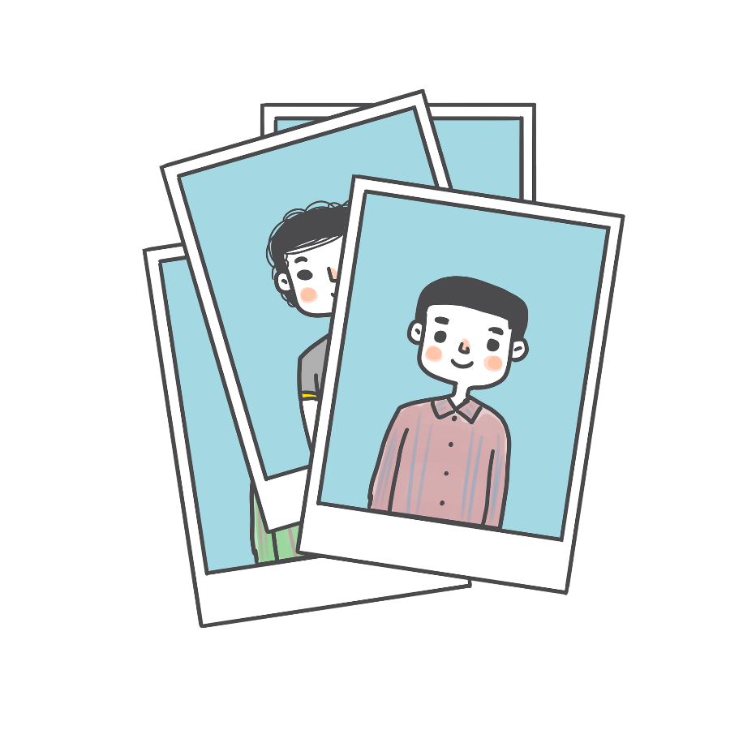
‘Connaître’ ou ‘savoir’ ?
lire
Connaître is used to talk about knowing a person, place or thing.
Tu sais / connais Marc ?
Do you know Marc?
Notes:
This is slide 2/8.

Slide 42
‘Connaître’ ou ‘savoir’ ?
lire
Savoir is used before ‘que’(that).
Je sais / connais que le soleil peut être dangereux !
I know that the sun can be dangerous!
Notes:
This is slide 3/8.

Slide 43
‘Connaître’ ou ‘savoir’ ?
lire
Savoir is used before a question word.
Tu sais / connais où il a pris son petit-déjeuner ?
Do you know where he had breakfast?
Notes:
This is slide 4/8.

Slide 44
‘Connaître’ ou ‘savoir’ ?
lire
Connaître is used to talk about knowing a person, place or thing.
Je sais / connais un petit café espagnol.
I know a little Spanish café.
Notes:
This is slide 5/8.

Slide 45
‘Connaître’ ou ‘savoir’ ?
lire
Savoir is used before ‘que’(that).
Tu sais / connais qu’il a eu un accident ?
Do you know that he’s had an accident?
Notes:
This is slide 6/8.

Slide 46
‘Connaître’ ou ‘savoir’ ?
lire
Connaître is used to talk about knowing a person, place or thing.
Elle sait / connaît beaucoup de gens en Espagne !
She knows lots of people in Spain.
Notes:
This is slide 7/8.

Slide 47
‘Connaître’ ou ‘savoir’ ?
lire
Connaître is used to talk about knowing a person, place or thing.
Tu sais / connais ce livre ? C’est très amusant !
Do you know this book? It’s very funny!
Notes:
This is slide 8/8.

Slide 48
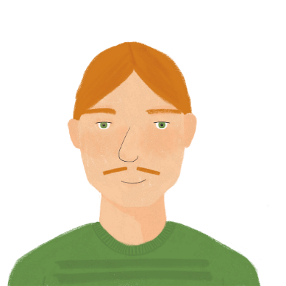
Romain parle du Québec
écouter
Romain parle du Québec avec Léa dans le taxi.
Écoute la conversation. C’est connais ou sais ?
 |  | connais/sais? | en anglais?
 |  | connais | Do you know Quebec?
 |  | sais | Mmm … I know that Quebec is in Canada.
 |  | sais | Do you know where we can eat pizza?
 |  | connais | Yes, I know an excellent restaurant.
 |  | connais | Do you know a place to drink tea?
 |  | connais | Yes, I know a nice café.
 |  | sais | Do you know that Céline Dion has made an announcement?
 |  | connais | No, but I know her songs …
1
R
2
R
3
R
4
R
5
R
6
R
7
R
8
R
Notes:
Timing: 8 minutes
Aim: Aural recognition to raise awareness of the cross-linguistic differences highlighted on the previous slides (one word for ‘know’ in English; two in French).
Procedure
1. Click on the number to hear the audio with the verb obscured.
2. Students listen to each sentence and decide whether the beep must cover connais or sais, using the words they hear directly after the beep to help them. As an extension activity, ask (more advanced) students to translate the sentence that they have just heard.
3. Click to the R button next to the number to hear the audio without the verb muted and click to reveal answers. Draw attention to the words directly after know in English to justify choices.
Transcript:
1. Tu [connais] le Québec ?
2. Mmm … je [sais] que le Québec est au Canada.
3. Tu [sais] où on peut manger une pizza ?
4. Oui, je [connais] un restaurant excellent.
5. Tu [connais] un endroit pour boire du thé ?
6. Oui, je [connais] un café sympa.
7. Tu [sais] que Céline Dion a fait une annonce ? Elle a une nouvelle chanson !
8. Non, mais je [connais] ses chansons … je préfère d'autres musiciens canadiens.
Word frequency of cognates (1 is the most frequent word in French):
restaurant [2336]; pizza [>5000]; taxi [4235]
Source: Londsale, D., & Le Bras, Y. (2009). A Frequency Dictionary of French: Core vocabulary for Léarners London: Routledge.

Slide 49
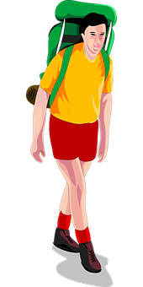
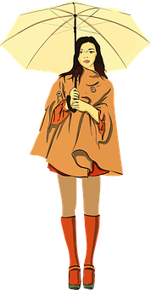
À l’hôtel
écouter / parler
Un touriste anglais arrive à l’hôtel. Il pose des questions en anglais, et une Canadienne répond en français. Il ne comprend pas ! Tu peux aider ?
1. Do you know where I can have breakfast?
2. Oui, je connais un bon café à côté de l’église.
1. Tu sais où je peux prendre le petit-déjeuner ?
2. Yes, I know a good café near the church.
1. ________
2.______________________________________________
touriste
(student A)
traducteur/-rice
(student B)
Canadienne (student C)
Notes:
Timing: 10 minutes. This is slide 1/5.
Aim: Aural comprehension and oral production of sentences containing connaître and savoir; scaffolded liaison interpreting.
Procedure:
1. Explain to students that they are going to work in groups of three and take turns to play the tourist, translator and local. Use this slide to model the task. Remind students to think about the translation of ‘know’, based on which words come after it. Note that only a partial translation of the French is required, so that students do not have to think about word order of questions after savoir. Click to reveal the suggested translations.
2. Distribute the rolecards on slide 56 and display slide 53.
3. Students A and C face the board. Student B turns away.
4. Student A reads the English sentence aloud.
5. Student B completes the French translation, using the partial translation on their rolecard to help them.
6. Student C reads the French sentence aloud.
7. Student B translates into English.
8. Student B turns back to face the board. Reveal suggested translations on clicks.
9. Display slide 54. Students swap roles. Repeat steps 3-8.
10. Display slide 55. Students swap roles again. Repeat steps 3-8.
Word frequency of unknown words used (1 is the most frequent word in French):
traducteur [>5000]
Source: Londsale, D., & Le Bras, Y. (2009). A Frequency Dictionary of French: Core vocabulary for Léarners London: Routledge.
Word frequency of cognates used (1 is the most frequent word in French):
touriste [2654], poser [218]
Source: Londsale, D., & Le Bras, Y. (2009). A Frequency Dictionary of French: Core vocabulary for Léarners London: Routledge.

Slide 50
À l’hôtel
écouter /parler
1. Do you know where the church is ?
2. Oui, je connais le chemin.
1. Tu sais où
est l’église ?
2. Yes, I know the way.
1. ________
2.______________________________
_____________
3. Do you know the history of the church ?
4. Non, mais je sais qu’elle est assez vieille.
3. Tu connais l’histoire de l’église ?
4. No, but I know that it’s quite old.
3.__________
4.______________________________
touriste
(student A)
traducteur/-rice
(student B)
Canadienne (student C)
Notes:
This is slide 2/5.

Slide 51
À l’hôtel
écouter /parler
2. Un peu. Je sais que c’est très grand.
1. Do you know the national park?
1. Tu connais le parc national?
2. A bit. I know that it’s very big.
1. _____________
2.______________________________
_____________
4. That depends. Do you know where there is a nice view?
3. Tu sais prendre des belles photos ?
4. Ça depend. Tu sais s’il y a une belle vue?
3. Do you know how to take nice photos?
3.______________________________
________
touriste
(student C)
traducteur/-rice
(student A)
Canadienne (student B)
Notes:
This is slide 3/5.

Slide 52
À l’hôtel
écouter /parler
1. Do you know how the weather is?
2. Oui. Je sais qu’il fait beau.
Tu sais quel temps il fait ?
2. Yes. I know that it’s nice.
1. __________
2.______________________________
_____________
3. Thank you. Do you know how to get to the park?
4. Oui, je connais un bus. Il va
au parc deux fois par jour.
3. Merci. Tu sais aller au parc?
4. Yes, I know a bus. It goes twice a day.
4.________________
_________________
____________
touriste
(student B)
traducteur/-rice
(student C)
Canadienne (student A)
Notes:
This is slide 4/5.

Slide 53
1. _____________
parc national?
1. ________ où
est l’église ?
1. __________ quel temps il fait ?
2.________________________________
2.________________________________
2.________________________________
3.________________________________
3.__________
l’histoire de l’église ?
3. Merci. ____________ aller au parc?
4. Ça dépend. ________ s’il y a une belle vue?
4.________________________________
4.________________
_________________
traducteur/-rice
(student A)
traducteur/-rice
(student B)
traducteur/-rice
(student C)
Notes:
ROLECARDS FOR PRINTING. This is slide 5/5.

Slide 54
Gaming Grammar
Gaming Grammar
Relevant mini game(s):
Verbs (present): 1st person singular/plural (Verb agreement (present))
Verbs (present): 2nd person singular/plural (Verb agreement (present))
Verbs (present): 3rd person singular/plural (Verb agreement (present))
Notes:
This slide links to Gaming Grammar login screen. The appropriate mission can then be selected from the menu page.
Students will progress through the game at their own rate; teachers should use the teacher interface to check progress. This will help to inform future lesson planning.

Slide 55
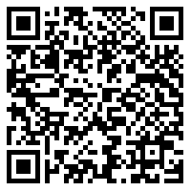
Devoirs
Vocabulary Learning Homework (Y9, Term 1.1, Week 7)
Audio file
Audio file QR code:
Student worksheet
Quizlet link
In addition, revisit: Year 8 Term 3.2 Week 7
Year 8 Term 3.1 Week 5
Notes:
Y9 T1.1 W7 vocabulary learning homework answers available at https://resources.ncelp.org/concern/resources/t435gf17c?locale=en

