Slide 1
Learning and teaching vocabulary
Some research underpinnings
“Without grammar, very little can be conveyed; without vocabulary, nothing can be conveyed”. (David Wilkins, 1972)

Slide 2

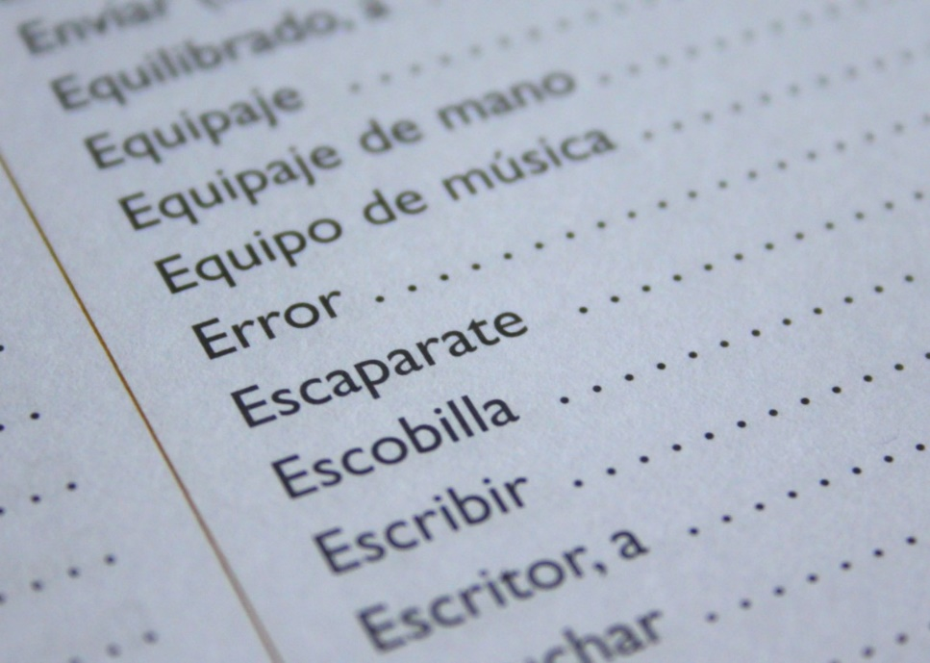
Session outline
Image: https://pxhere.com/en/photo/731038
Key questions:
What is it to ‘know’ a word?
Why is knowing words important? How many words do learners need to know?
Which words do learners need to know? (and how does this relate to current Schemes of Work and textbooks?)
How can learners best learn vocabulary? As teachers, how can we best promote vocabulary learning?
Robert Woore

Slide 3

What is it to ‘know’ a word?
Image: https://commons.wikimedia.org/wiki/File:Rodin%27s_The_Thinker.jpg
Robert Woore
Notes:
Rather than asking this in the abstract, suggest make it concrete. Choose a word (e.g. ‘fish’) and ask them to think of all the different things they know about it. Make a mind map on flipchart or whiteboard. For example: fish (noun), definition and examples of a fish, associated with parts of fish such as fins, gills, etc., also types of fish, e.g. salmon, trout. To fish is a verb with associated forms – fishing, fishes, fished; derived forms such as fishy and the register restrictions on this (it is informal); compounds such as fisherman, fishing rod, fishmonger; related form phishing (and this says something about our knowledge of SSC). And so on…

Slide 4
What is it to ‘know’ a word?
What is a word anyway?
How many words are there in the following text?
What issues does this exercise raise in terms of defining what a word is?
I asked the children to read a short text out loud to each other. I realized at once that this was a big ask! Several of the children are good readers, but others find reading difficult. The text was not easily readable for them. Before long, however, the children started to help each other out. Soon they had all read the text and had begun to tackle the comprehension questions.
Robert Woore
Notes:
First step in asking what it is to know a word = what is a word in the first place? This is to get people thinking about things like: types (48) versus tokens (67); lexemes (to read, reading, read (past)); word families (read, readable, reader); phrasal verbs (read out loud, help out – where ‘out’ does not have the same meaning as it would in isolation).

Slide 5
What is it to ‘know’ a word?
What is a word anyway?
Lemma
The ‘dictionary form’ – e.g. TO READ
Lexeme
The abstract unit of meaning which includes all the different forms of a given word – e.g. the inflected forms such as reads, reading, read (past)
Depends on the learner’s knowledge of inflectional morphology
Word family
“consists of a base word and all its derived and inflected forms that can be understood by a learner without having to learn each form separately” (Bauer & Nation, 1993:253) – e.g. reader, readable, unreadable
Depends on the learner’s knowledge of inflectional and derivational morphology
Robert Woore

Slide 6

What is it to ‘know’ a word?
Image: https://www.maxpixel.net/Koi-Carp-Happy-Fish-Goldfish-Fish-Cartoon-Fish-30837
Meaning
Orthography
Phonology
< fish >
/ f ɪ ʃ /
+ ‘receptive’ & ‘productive’ knowledge
Robert Woore
Notes:
These can be seen as the three most ‘basic’ components of word knowledge.
For each of these, the knowledge can be receptive / productive.

Slide 7
What is it to ‘know’ a word?
Breadth (size): how many words you know (irrespective of how well you know them or how much you know about them)
Depth: how well or how fully you know them; how much you know about them
(Anderson & Freebody, 1981)
Fluency: how readily you can access them in comprehension or production (Daller et al., 2007)
E.g. polysemes, pronunciation, spelling, grammar, register, associations, collocates…
Robert Woore
Notes:
Another way of looking at it. We are used to dealing in ‘breadth’ (size) i.e. how many words someone knows – but there is also depth and fluency. Fluency is particularly important for being able to produce and comprehend language rapidly. Eventually we want automaticity, allowing us to recognize and produce words without using up working memory capacity, thus freeing up resources for other aspects of communication.

Slide 8
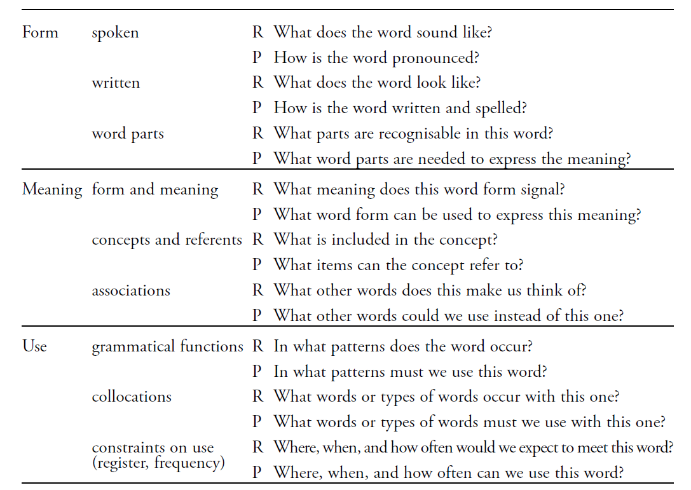
What is it to ‘know’ a word?
Nation, 2001:27
“The nearest thing we have to a definitive list of what it means to know a word”
(Milton, 2013:59)
Robert Woore
Notes:
Thinking more about depth and the different aspects of word knowledge.
This can be compared to the mind map made earlier (slide 3).

Slide 9
What is it to ‘know’ a word?
And finally – don’t forget formulaic sequences (chunks)
“a sequence, continuous or discontinuous, of words or other elements, which is, or appears to be, prefabricated: that is, stored and retrieved whole from memory at the time of use, rather than being subject to generation or analysis by the language grammar” (Wray 2002: 9)
Known to be very important in language use – aiding fluency
Sometimes ‘non-decomposable’: i.e. meaning is different from the sum of the individual parts
You must be joking
All’s well that ends well!
On the other hand
raining cats and dogs
How are you?
Robert Woore
Notes:
We won’t have much time to cover these but we just want to note that they are important in language use (both L1 and L2). Using formulaic sequences is likely to be a key factor in fluent language use – reduce processing time and burden. Therefore we should not forget these in our teaching!

Slide 10
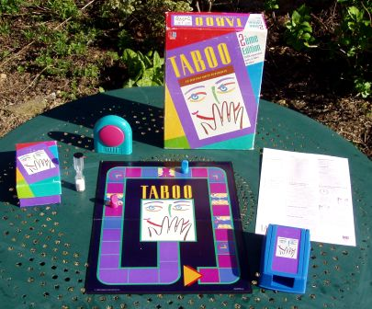
How many words do learners need to know?
Image: https://commons.wikimedia.org/wiki/File:Taboo_02.jpg
Vocabulary knowledge is not everything!
Communicative competence
Linguistic knowledge, e.g.
Vocabulary knowledge
Grammar knowledge
Self-regulated behaviour, e.g.
Communication strategies
…but it is vitally important!
Robert Woore
Notes:
Strategic competence – strategies can be used to compensate for gaps in vocabulary knowledge – as exemplified in games like Taboo and Articulate. BUT! Vocabulary knowledge is still crucially important. Recall the quotation on slide 1 (title slide) – i.e. without vocabulary nothing can be conveyed.

Slide 11

How many words do learners need to know?
Image: https://commons.wikimedia.org/wiki/File:Fabio_Capello_2012.jpg
If I need to speak about the economy, I can't speak. But when you speak about tactics, you don't use a lot of words. Maximum 100.
How many words do you think a learner needs to know?
Is vocab knowledge more important for some skills than others (listening, speaking, reading, writing)?
Robert Woore
Notes:
This is what Fabio Capello said in 2011 when England manager. This is intended as a light-hearted and provocative introduction to the questions that follow. Invite participants to reflect on these questions. Encourage them to come up with actual figures (e.g. x hundred or y thousand words). Of course it does depend what you want to do with the language (as Capello rightly notes here).

Slide 12

How many words do learners need to know?
Jim Milton (2013): ‘Measuring the contribution of vocabulary knowledge to proficiency in the four skills’
Significant correlation between vocabulary size and proficiency level
Vocabulary knowledge is a strong predictor of performance in all four skills – explaining up to about 50% of variance in performance
Breadth, depth and speed (automaticity) are all important
Generally speaking, the more words a learner knows, the more they are likely to know about them, and the better they are likely to perform, whatever the skill. (Milton, 2013: 71)
Robert Woore
Notes:
One answer to this question is: the more the better.
But the next slides have some figures suggested by Milton in relation to different proficiency levels / exams, both internationally and in the UK.

Slide 13
How many words do learners need to know?
Robert Woore

Slide 14
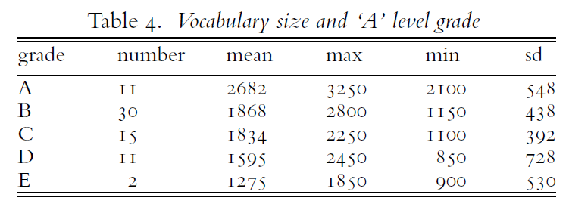
How many words do learners need to know?
Milton, J. (2006) ‘Language Lite? Learning French Vocabulary in School’. Journal of French Language Studies, 16: 187-205
Robert Woore
Notes:
Data gathered from one school only, and >10 years old. But this shows that for A Levels too, vocabulary size correlates with grade outcomes. (Note however that even a grade A at this level is associated with a rather lower vocabulary size than its supposed CEFR level equivalent, as per previous slide, which is one of Milton’s arguments in this article: “Learners approach GCSE after five years of study with fewer than 1000 words on average, and ‘A’ level with fewer than 2000 on average. These levels appear small in relation to the placement of these exams within the Common European Framework for languages.”, p. 202). Note also the range of vocabulary sizes at each grade level, and on previous slide. So, for a given vocabulary size, some people are more / less effective at making use of the language knowledge they have. Some of this will be exam technique of course but there is likely also the issue of strategic behaviour, to compensate for vocabulary gaps and help people make the most of the knowledge they have. Nonetheless, it is clear that vocabulary knowledge is very important for language performance – and in all four skills.

Slide 15
How many words do learners need to know?
Much research has looked at vocab size needed for reading comprehension
Findings converge to suggest that you need to know about 95% of words in a written text to comprehend it adequately. For ‘general academic’ texts, this equates to knowledge of about 4,000-5,000 word families.
For ‘optimal’ comprehension, the figures are 98% and 8,000 word families. However:
  You can compensate for gaps in knowledge using strategic behaviour, dictionaries, etc.;
  You get a lot of ‘bang for your buck’ with high frequency words!
  For comprehension of spoken language, less breadth of vocabulary is needed (though learners may find recognizing those words within the speech stream more of a challenge)
Robert Woore
Notes:
A look at reading comprehension in particular as this has been the focus of much research.
Some of these points are then illustrated in the graph on the next slide…

Slide 16
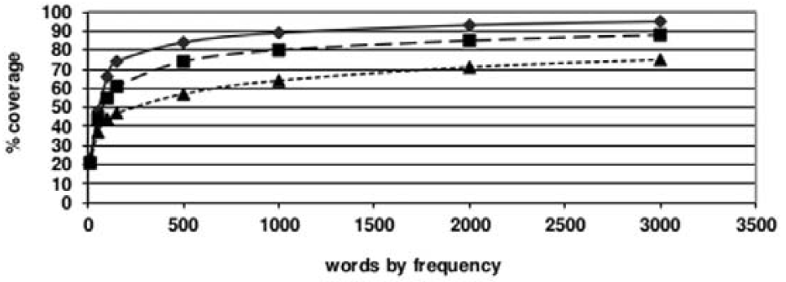
How many words do learners need to know?
Graph showing text coverage for written / spoken corpora in the BNC (Milton 2013:66)
General conversation
More formal speech – e.g. lectures
❐ Written language
Knowing less than 1000 words of a foreign language is probably insufficient for comprehension, even in spoken language, unless communication is of the most formulaic kind, such as greetings, and lacking in any specific or specialised content. (Milton, 2009:58)
Robert Woore
Notes:
Note that at 2,000 words (reference line), you get around 95% coverage of general conversation, likely to give adequate comprehension (but only 70% of written language – well below what is generally thought to be needed for adequate comprehension).
Note also the very steep slope of the curve early on – i.e. huge ‘bang for buck’ in terms of learning highest frequency words!
Also note Milton’s comment on a vocabulary size of <1000 words.

Slide 17
Summary so far
Vocabulary knowledge is crucial for performance in all four language skills
Breadth, depth and speed (fluency) of vocabulary knowledge are all important
  The more words you know, the better.
  The more you know about them, the better.
  The more quickly you can recognize and recall them, the better.
You get most ‘bang for your buck’ in learning high frequency words.
You won’t get very far with knowledge of < 1,000 words
You can get quite a long way with knowledge of ≥ 2,000 words
Strategic behaviour can help you compensate for gaps in vocabulary knowledge to some extent.
Robert Woore
Notes:
Could invite participants to come up with summary of any key points so far (they could do this in pairs and feed back). Then show this list. Or if preferred (or if short of time) just show this list summary so far.
Any comments / reflections?

Slide 18
Which words do learners need to know?
Limitations of current Schemes of Work
“Many language courses are organised around thematic topics, such as ‘free time activities’ (…) In such cases, the choice of vocabulary can be too specialised, teaching relatively rarely used words at the expense of common words which it is harder to plan for re-encountering later” (BR, p.9)
Häcker (2011): ‘Eleven pets and twenty ways to express one’s opinion: the vocabulary learners of German acquire at English secondary schools’
“Pupils do not learn enough words of a basic vocabulary, but learn many words that belong to a specialist vocabulary and restricted register. Even within the field of that specialist vocabulary … they do not learn enough to be able really to talk about a topic. Their vocabulary does not enable them to follow simple conversations or read texts in the target language”
Robert Woore
Notes:
Häcker (2011) and the PR in agreement on this point!

Slide 19

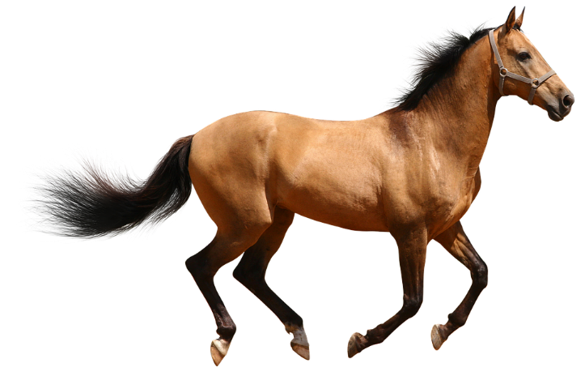




Which words do learners need to know?
Images: https://en.wikipedia.org/wiki/File:Adorable-animal-cat-20787.jpg; https://pixabay.com/no/photos/hest-brown-isolert-kj%C3%B8rer-2775949/; https://pixabay.com/no/photos/kanin-dyr-natur-av-%C3%B8rer-pet-2649157/; https://pixabay.com/no/photos/mus-gnager-rotte-3194768/; https://commons.wikimedia.org/wiki/File:Dog.in.sleep.jpg; https://pixabay.com/no/illustrations/slange-reptile-dyr-vintage-isolert-2082037/
“Pets”
A topic-based vocabulary list.
How frequent are these words in French?
How many are in the top 2,000 most frequent words?
3138
<4K
2220
<3K
5833
<6K
4328
<5K
1744
<2K
5547
<6K
Note
Pupils’ own interests are also important! (but may not be needed by all)
Lonsdale and Le Bras (2009) A Frequency dictionary for French.
Robert Woore
Notes:
Elicit participants’ views on frequency of these words. Therefore, how useful are these words across topics?

Slide 20
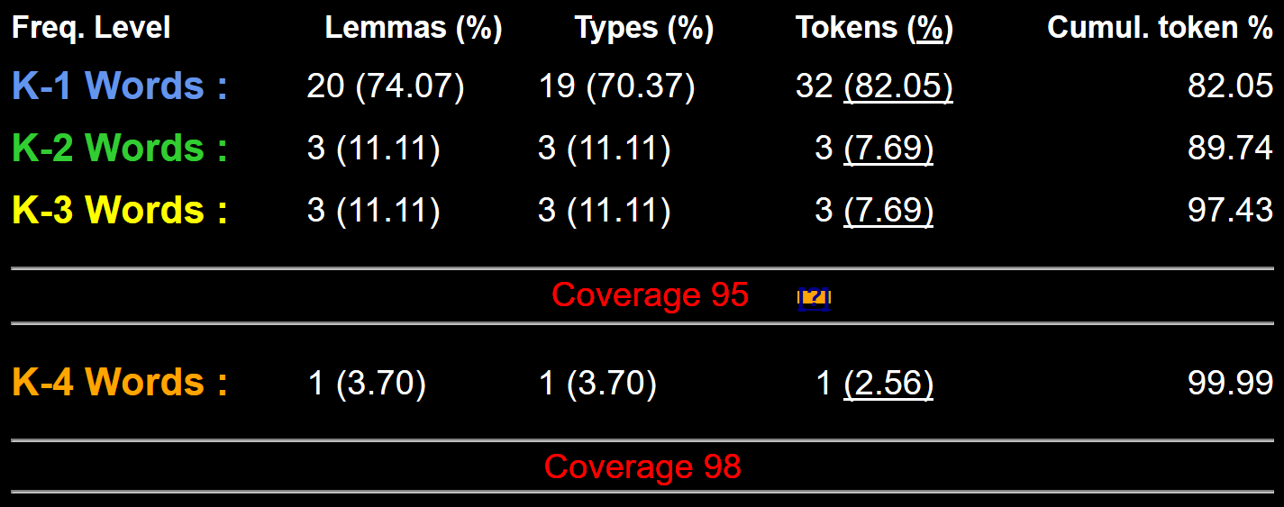
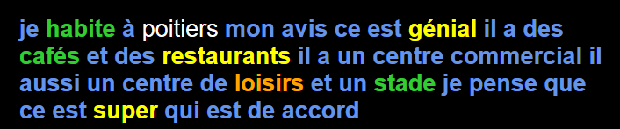
Which words do learners need to know?
Useful tool for ‘lexical profiling’ of texts: www.lextutor.ca/vp/comp/
J'habite à Poitiers. À mon avis, c'est génial. Il y a des cafés et des restaurants. Il y a un centre commercial. Il y aussi un centre de loisirs et un stade. Je pense que c'est super. Qui est d'accord ?
Robert Woore
Notes:
Recommend this as a way of checking lexical profile (i.e. frequency of words used) for texts used in class. Only available for French though, as far as I know.
Note the proper noun ‘Poitiers’ has been deleted before profiling.

Slide 21
Which words do learners need to know?
Other problems of topic-based vocabulary teaching
Predominance of nouns and adjectives → less attention to verbs (and therefore to sentence-building)
“In the early stages of a language course, particular attention should be paid to the planned building of pupils’ verb lexicon, focussing on the meaning of the stem or infinitive form of common verbs. A strong basic verb lexicon has been found to relate positively to pupils’ ability to effectively manipulate those verbs at later stages” (BR, p. 9)
Robert Woore
Notes:
Other problems of topic-based teaching beyond the ‘specialized vocabulary / low frequency’ issue…

Slide 22
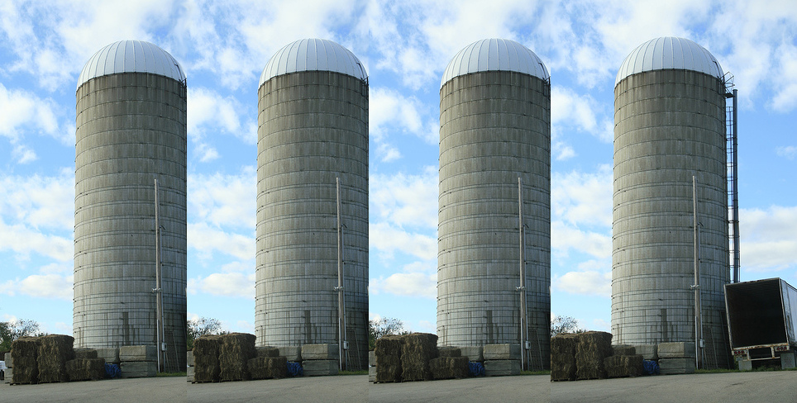
Which words do learners need to know?
Other problems of topic-based vocabulary teaching
Lexical sets – e.g. lists of nouns that fit a particular slot – reduces attention to pronoun and verb, because only the noun varies:
  Ich spiele gern… Fußball, Rugby, Tennis, Tischtennis, Korbball
Possibility of ‘lexical interference’ hampering learning
Vocabulary remains in topic-based ‘silos’ – pupils strongly associate words with a given topic, and find it hard to transfer them to new topics.
“Vocabulary listed under a particular theme should be considered transferable, as appropriate, to the other themes” (AQA Spanish GCSE specification, p. 21)
Image: ‘Silos’ by Do Searls, CC-BY-2.0, https://www.flickr.com/photos/docsearls/5500714140
Robert Woore
Notes:
too many words of the same word class that can just slot in to the same sentence formation
e.g. Ich spiele + lots of sports, Je porte + lots of clothes reduce the attention given to the verb and subject, as sentence formation is reduced to varying the noun (object) only.
In addition, there is some research that suggests that clustering words of the same word class together for learning can make them harder to learn, so it may be helpful to think in terms of learning a set of words with several different word classes but linked by a common theme. E.g. Tinkham, 1993.

Slide 23

How can learners best learn vocabulary?
Current methods and approaches to language teaching fail to consider how vocabulary should be systematically built into the curriculum. (Milton, 2013:73)
Need to consider:
Which words are being introduced and why?
How is vocab knowledge being consolidated through planned, spaced repetition?
Most vocabulary tasks focus their attention almost solely on introducing the meaning of new words. (Schmitt, 2008:343)
Different tasks are needed to:
Learn new words – initial form / meaning mapping (breadth)
Consolidating and extending word knowledge (depth)
Using words more quickly (automaticity / fluency)
Robert Woore
Notes:
…and how can we as teachers best support this?

Slide 24
How can learners best learn vocabulary?
Four (five?) learning ‘partners’ (Schmitt, 2008)
Teachers
Students
Materials writers
Researchers
Parents
+ technology (mobile phones, Memrise, etc.)
Given the magnitude of the lexical learning task, it is unlikely that it can be achieved without strong and active contributions from all four members of this learning partnership. (Schmitt, 2008:333)
Robert Woore

Slide 25
How can learners best learn vocabulary?
Initial form-meaning mapping
L1 translation can be efficient for this
This could be done at home, even in advance of a lesson (‘flipped learning’) and mediated by technology (e.g. Memrise, Quizlet)
Consolidating and extending word knowledge
Seeing and hearing words in context then becomes important to develop depth of knowledge (collocation, shades of meaning, etc.).
Building fluency
Multiple exposures and use are important to develop fluency – anywhere between 5 and 20 encounters with a word. (Nation, 2001:81)
Robert Woore
Notes:
A look at some of the different kinds of tasks that might be used for different stages of vocabulary learning / teaching.

Slide 26

How can learners best learn vocabulary?
Image: https://en.wikipedia.org/wiki/File:Recycling_symbol2.svg
Mastery through planned repetition
Systematic revisiting and recycling is crucial
This requires more planning and monitoring than a space-limited textbook course can display on its pages.
Spontaneous oral interaction in the target language and wider reading (beyond topics) ‘automatically’ recycle high frequency words
Recycling is necessary, and if it is neglected, many partially learned words will be forgotten, wasting all the effort already put into learning them ... Recycling has to be consciously built into vocabulary learning programs, and teachers must guard against presenting lexical items once and then forgetting about them, or else their students will likely do the same (Schmitt, 2008:343)
Robert Woore

Slide 27

How can learners best learn vocabulary?
Vocabulary knowledge develops incrementally
There are many different aspects of word knowledge: spoken form, written form & meaning; receptive and productive use; depth of knowledge (shades of meaning, collocations, etc.), fluency…
Multiple encounters are needed for knowledge of a word to develop
Using a word appropriately in a spoken or written sentence is a useful ‘rule of thumb’ for mastery (although development continues past this point).
A continuum of word knowledge
I recognize this word – I’ve seen it before
I can use this word accurately in spontaneous speech / writing
Image: pixabay.com/no/photos/trinn-trapp-klatring-1081909/
Robert Woore

Slide 28


How can learners best learn vocabulary?
Receptive versus productive knowledge
There is some evidence that receptive knowledge doesn’t automatically lead to productive knowledge.
Structured productive practice is helpful for improving production (Lee, 2003; Lee & Muncie, 2006).
Images: https://pixabay.com/no/illustrations/rex-t-rex-tyrannosaurus-rex-dino-163618/; https://pixabay.com/no/vectors/dinosaurer-dinosauria-gr%C3%B8nt-dyr-24743/
Robert Woore
Notes:
Lee, S. H. (2003). ESL learners’ vocabulary use in writing and the effects of explicit
vocabulary instruction. System, 31, 537–561.
Lee, S. H., & Muncie, J. (2006). From receptive to productive: Improving ESL learners’
use of vocabulary in a postreading composition task. TESOL Quarterly,
40(2), 295–320.

Slide 29
How can learners best learn vocabulary?
Factors which facilitate vocabulary learning: (Schmitt, 2008:339)
increased frequency of exposure;
increased attention focused on the lexical item;
increased noticing of the lexical item;
increased intention to learn the lexical item;
a requirement to learn the lexical item (by teacher, test, syllabus);
a need to learn/use the lexical item (for task or for a personal goal);
increased manipulation of the lexical item and its properties;
increased amount of time spent engaging with the lexical item;
Increased amount of interaction spent on the lexical item.
Robert Woore

Slide 30
How can learners best learn vocabulary?
In summary: (Schmitt, 2008)
Overall, it seems that virtually anything that leads to more exposure, attention, manipulation, or time spent on lexical items adds to their learning. In fact, even the process of being tested on lexical items appears to facilitate better retention. (p. 339)
The variety of factors which affect vocabulary learning means that there will never be one ‘best’ teaching methodology, but the meta-principle of maximizing sustained engagement with the lexical items which need to be learned appears to underlie all effective vocabulary learning. (p. 354)
Robert Woore

Slide 31
Summary of key points (1)
Vocabulary learning correlates strongly with performance in all four skills.
The more words a learner knows, the better!
High frequency words give more ‘bang for buck’ and can be used across contexts
Currently, learners appear to know (after five years’ secondary learning) far fewer words than is ideal.
Knowing ≥ 2000 words would be a much stronger basis for GCSE proficiency.
Vocabulary selection should balance frequency, GCSE specification, range and personal interest.
Verbs are crucial, and can be under-represented in text books.
Topic-based vocabulary lists, especially of the same word class, are not optimal.
Robert Woore

Slide 32
Summary of key points (2)
There is no ‘silver bullet’ for vocabulary learning / teaching
Word knowledge is multifaceted and develops incrementally
Errorless teaching techniques (when pupils are unambiguously told the meaning of a new word) are effective for initial form-meaning mapping
They should be followed by opportunities to use the new words in comprehension, and then productively.
Systematic repetition is crucial. The more times a pupil is required to recall a word, the more securely it will move into long term memory.
Genuine information gap activities are very helpful in assisting memorisation.
Careful, planned use of ICT can be effective.
Robert Woore

Slide 33
Approaches to teaching vocabulary
Questions for reflection
How effective are vocabulary teaching practices in your school currently?
How many words do pupils know?
How many high frequency words do pupils know?
Which words do pupils know?
In what ways might current practices be changed to develop pupils’ vocabulary knowledge more effectively?
Robert Woore

