Slide 1
French SSC teaching sequence
SFC (Silent final consonant)

Slide 2
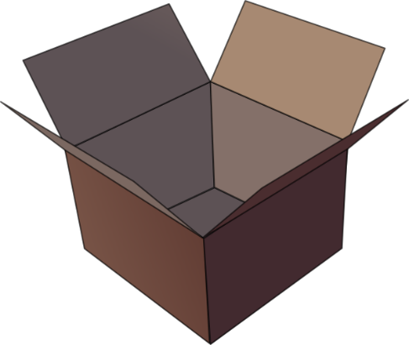
Silent final consonant
dans
X
Rachel Hawkes
Notes:
AUDIO x 2: on appearance of X and of the visual for ‘in’.
Explanation in English, if desired: Something that makes French sounds very different from English is that some consonants at the ends of words are silent. This means you don’t pronounce/sound them out at all. As in the word ‘dans’ in French. Say and repeat the word. Ensure pupils know the meaning (use usual routine for this – e.g. C’est quoi en anglais ‘dans’? ‘In’, oui, c’est ça. A possible gesture to accompany this SSC would be to hold ones finger to ones lips to indicate ‘Shhhh!’

Slide 3
Silence!
prix
petit
dans
X
mot
grand
mais
Rachel Hawkes
Notes:
Elicit pronunciation of ‘dans’ again before clicking to animate the ‘X’
Possible explanation, in English, if desired: Let’s see which other final consonants are silent in French. Lead class repetition of the five CLUSTER words.
Word frequency rankings (1 is the most common word in French): dans [11]; petit [138]; prix[310] mot [220]; grand [59]; mais [30] Source: Londsale, D., & Le Bras, Y. (2009). A Frequency Dictionary of French: Core vocabulary for learners London: Routledge.

Slide 4
petit
prix
grand
€15.95
mot
mais
Rachel Hawkes
Notes:
With this round of repetition, ensure that pupils are clear about the meaning of each of these high-frequency words. NB: pictures can, at best, only suggest meaning. Many high-frequency words less concrete than other words, and less easy to communicate unequivocally in pictures. Therefore, teachers should not shy away from giving the English meaning to students, to prevent any erroneous representations taking root in memory. With these words, however, it is expected that pupils will know several of them already. Lead class repetition of the five CLUSTER words.

Slide 5
… except for
c r f l
Be c a r e f u l with these!
Rachel Hawkes
Notes:
Some consonants work differently. CRFL are often pronounced.

Slide 6
60
petit
prix
Secondes
grand
mais
0
mot
DÉBUT
Rachel Hawkes
Notes:
Pairwork ‘tennis’ – pupils say the words alternately out loud with a partner, building up speed, over 1 minute’s intensive practice. They call in any order they like, pupils are not allowed to repeat the one they said in their last turn. Teacher can circulate to listen into their SSC knowledge. Click on Début to start a one minute timer on the screen.

Slide 7
60
petit
prix
Secondes
grand
mot
mais
0
DÉBUT
Rachel Hawkes
Notes:
Alphabetical read aloud Individually (but all at once) pupils read out the words but in alphabetical order. They keep going for one minute.
Teacher can circulate to listen into their SSC knowledge.

Slide 8
petit
prix
€15.95
grand
mot
mais
Rachel Hawkes
Notes:
Whole class: SFC, with the rest of the word obscured, allows the teacher to cue elicitation, the cue being the SFC plus the picture at this stage, which also acts as memorisation practice. Note that the final letter is still a different colour but the strikethrough has been removed.

