Slide 1
Phonics
SSC /r/
Y7 German
Term 2.2 - Week 3 - Lesson 43
Author name(s): Inge Alferink / Rachel Hawkes
Date updated: 26/04/20

Slide 2
Fonetik
a vs ä
a[long]
ä[long]
sagen
spät
a[short]
ä[short]
kalt
lächeln
a
1
eg__l
ä
2
st__ndig
zählen / zahlen
7
zählen / zahlen
ä
3
h__ngen
Wahlen / wählen
8
Wahlen / wählen
a
4
unbek__nnt
Geschäft / geschafft
9
Geschäft / geschafft
a
5
B__d
schätzen / schatzen
10
schätzen / schatzen
ä
6
N__he
Notes:
Phonics refresher - a vs ä
The contrast between a and ä is important for this week’s grammar point (strong verbs). Both sounds have been introduced already, we are simply revisiting them here.
Click on the SSCs and their example words (sagen / kalt / lächeln / spät) to play them and remind the students of the the sounds.
The first 6 words is a transcription (fill in the blank) task. The words are high-frequency, but haven’t yet been taught.
The second four are minimal pairs (some of these are rare).
The task is set up to do 1-6 first and correct those, and then complete 7-10.
Transcript
egal
ständig
hängen
unbekannt
Bad
Nähe
zählen /zahlen
Wahlen / wählen
Geschäft / geschafft
schätzen / schatzen

Slide 3
Fonetik
e vs i
e[long]
i[long]
geben
wir
e[short]
i[short]
denken
finden
gel__ngen
1
i
i
2
M__ttel
winden / wenden
7
winden / wenden
__ng
3
e
setzen / sitzen
8
setzen / sitzen
e
4
w__rfen
blecken / blicken
9
blecken / blicken
e
5
Z__lle
wirken / werken
10
wirken / werken
i
6
S__cht
Notes:
Phonics refresher - e vs i
The contrast between e and i is important for this week’s grammar point (strong verbs). Both sounds have been introduced already we are simply revisiting them here.
Click on the example words (denken / geben / finden / wir) to play them and remind the students of the the sounds.
The first 6 words a transcription (fill in the blank). The words are high frequency, but haven’t yet been taught.
The second four are minimal pairs (some of these are rare).
Transcript
gelingen
Mittel
eng
werfen
Zelle
Sicht
winden / wenden
setzen / sitzen
blecken / blicken
wirken / Werken

Slide 4
au
glauben
äu
Gebäude
genau
auf
Bäume
träumen
auch
häufig
Haus
Mäuse
Häuser
ausgehen
laufen
räumlich
äußern
läuft
Urlaub
brauchen
Käufer
nach Hause
Notes:
Phonics revision
The äu was only introduced last week. We’re revisiting it here, because it is relevant for this week’s grammar point (strong verbs and the stem change from au to äu)
This is a paired read aloud task. The students use different colours to play. Pupil A says one of the words/phrases and pupil B has 3 seconds to locate it and cross it off with their colour. If the pupil takes longer than 3 seconds pupil A can steal the point. Clearly, the classroom conditions need to be right with the individual class for friendly competition.
Alternatively, they can do it more slowly and carefully, scrutinising each other’s pronunciation. If one makes a mistake, then the other pupil corrects and crosses off in his/her colour.
Note: Not all of these words have been taught before, so there is the opportunity for some genuine decoding.

Slide 5
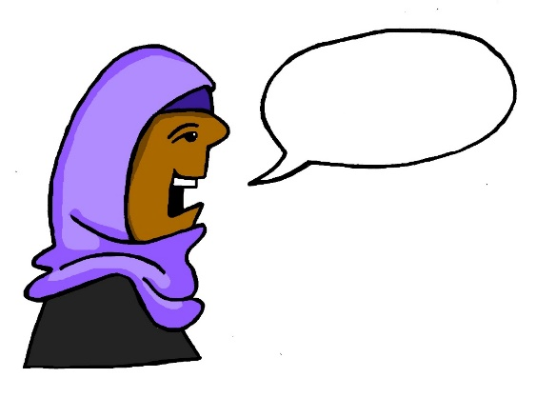
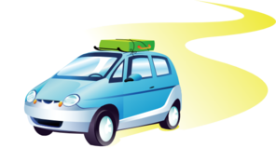
r
Regel
rot
reden
warum?
Beruf
Reise
Notes:
Introduce and elicit the pronunciation of the individual SSC ‘r’ and then the source word again (with gesture, if using). Then present and elicit the pronunciation of the five cluster words. The cluster words have been chosen for their high-frequency, from a range of word classes, with the SSC (where possible) positioned within a variety of syllables within the words(e.g. initial, 2nd, final etc..) and additionally, we have tried to use words that build cumulatively on previously taught SSCs (see the Phonics Teaching Sequence document) and do not include new SSCs. Where new SSCs are used, they are often consonants which have a similar symbol-sound correspondence in English.
Word frequency rankings (1 is the most common word in German): reden [356]; Regel [484] rot[381]; warum? [246]; Reise [786]; Beruf [477]. Source: Jones, R.L. & Tschirner, E. (2006). A frequency dictionary of German: core vocabulary for learners. Routledge

Slide 6
r
Regel
rot
reden
warum?
Beruf
Reise
Notes:
Without pictures to focus on the SSC alone.

Slide 7
r
Regel
rot
reden
warum?
Beruf
Reise
Notes:
Without sound to elicit the pronunciation.

Slide 8
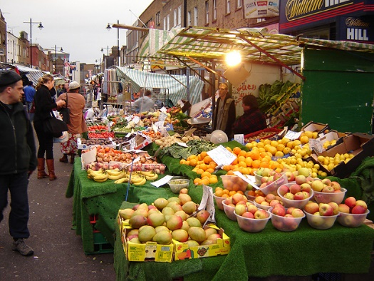
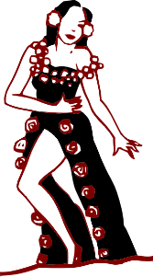
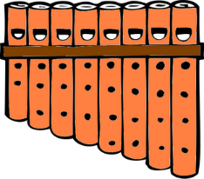
r
Markt
Morgen
Uhr
By Tarquin Binary - Own work, CC BY-SA 2.5
Kultur
Wort
dort
W O R T
Notes:
Introduce and elicit the pronunciation of the individual SSC ‘r’ and then the source word again (with gesture, if using). Then present and elicit the pronunciation of the five cluster words. The cluster words have been chosen for their high-frequency, from a range of word classes, with the SSC (where possible) positioned within a variety of syllables within the words(e.g. initial, 2nd, final etc..) and additionally, we have tried to use words that build cumulatively on previously taught SSCs (see the Phonics Teaching Sequence document) and do not include new SSCs. Where new SSCs are used, they are often consonants which have a similar symbol-sound correspondence in English.
Word frequency rankings (1 is the most common word in German): Uhr [349]; Markt [508] Morgen [311]; Kultur [593]; dort [104]; Wort [243]. Source: Jones, R.L. & Tschirner, E. (2006). A frequency dictionary of German: core vocabulary for learners. Routledge
By Tarquin Binary - Own work, CC BY-SA 2.5, https://commons.wikimedia.org/w/index.php?curid=406547

Slide 9
r
Markt
Morgen
Uhr
Kultur
Wort
dort
Notes:
Without pictures to focus on the SSC alone.

Slide 10
r
Markt
Morgen
Uhr
By Tarquin Binary - Own work, CC BY-SA 2.5
Kultur
Wort
dort
W O R T
Notes:
Without sound to elicit the pronunciation.

Slide 11
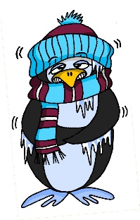
Phonics
Verhältnis
Fonetik
ä
haben
Mann
lächeln
kalt
fahren
klar
wählen
lang
Hälfte
Paar
spät
ändern
Klasse
zählen
danke
Nähe
Tag
ständig
a
Mädchen
erklären
Gast
ähnlich
sagen
Notes:
BONUS PHONICS ACTIVITY
Phonics – make you own tongue twister
Students (alone or in pairs) pick or teacher assigns one of the following sound pairs:
- a vs ä
e vs i
au vs äu
These sound contrasts are useful in the vowel changes in the verbs.
Students create three sentences using the source and cluster words for their sounds as well as (some) other words that have appeared in the scheme of work so far:
A sentence using as many instances of the first sound
A sentence using as many instances of the second sound
A sentence alternating the two sounds
This slide and the next two show source and cluster words for each pair. Students could use proper names as well (e.g. Max, Laura. Paul, Hilde, or Berlin, Wien etc.). Before starting students could do a short brainstorm to come up with more words that include the relevant sounds.

Slide 12
i
Fonetik
Leben
Kirche
Meer
sehen
wir
ihr
mehr
Ende
Familie
bitte
Hilfe
eng
Idee
finden
mit
besser
denken
privat
helfen
e
Linie
wissen
Bett
interessant
geben
Notes:
Make you own tongue twister e / i

Slide 13
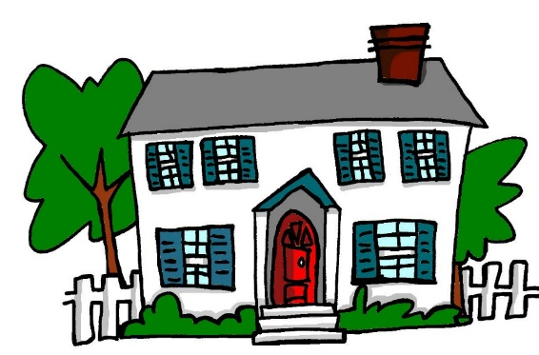
äu
au
Fonetik
Gebäude
genau
häufig
Bäume
auch
auf
Haus
träumen
glauben
Mäuse
ausgehen
Häuser
Notes:
Make you own tongue twister au / äu

