Slide 1
Grammar
present tense -ar verbs: 1st person plural
(-amos)
Y7 Spanish
Term 2.2 - Week 1
Author name(s): Ivan Luciano Avaca / Nick Avery
Date updated: 29/03/2020
Notes:
Learning outcomes
Introduction and practice of present tense –ar verbs in 1st person plural (-amos ending).
Frequency rankings of vocabulary introduced this week (1 is the most common word in Spanish):
trabajar [174]; buscar [179]; descansar [1749]; preparar [570]; comida [906]; animal [322]; pasar [68]; tiempo [80]; campo [342]; junto[s] [149]; solo [181]
Frequency rankings of vocabulary revisited this week (1 is the most common word in Spanish):
2.1.3 naturaleza [712]; árbol [748]; pájaro [1607]; río [496]; rojo [534]; amarillo [1381]; verde [812]; azul [811]; lugar [144]; sólo [95]
1.2.5 museo [1114]; banco [728]; teatro [605]; centro [316]; mercado [487]; tienda [1515]; plaza [806]; iglesia [437]; escuela [424]; ciudad [178]; entre [63]; el, la [1]; lejos [833]; cerca [1042]; respuesta [488]
Source of frequency rankings: Davies, M. & Davies, K. (2018). A frequency dictionary of Spanish: Core vocabulary for learners (2nd ed.). London: Routledge.

Slide 2
Talking about what you do with other people present tense -ar verbs: 1st person plural (-amos)
Remember that present tense –ar verbs change depending on who the verb refers to.
Compare
Llego tarde.
I arrive late.
Llegamos tarde.
We arrive late.
To mean ‘we’ with an –ar verb, remove –ar and add –amos to the stem.
compr-
compramos
we buy
habl-
hablamos
we speak
Notes:
The 1st person singular form is used for comparison with the new verb form (1st person plural). The 1st person singular form (-o ending) was introduced in term 1.1 week 7.

Slide 3
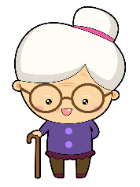
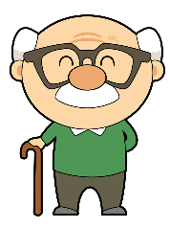
leer
José and his grandparents do quite different activities!
¿Quién habla, José (‘I’) o los abuelos (‘we’)?
Lee la frase, mira la imagen y marca el verbo correcto.
I
We
Trabajo
con un primo en el campo.
Trabajamos
¿Cómo se dice en inglés?
I work with a (male) cousin in the countryside.
Notes:
Students write the correct verb in their books (e.g. trabajo).
Note that the English pronoun is presented and circled for additional reinforcement of the agreement between the Spanish verb form and the 1st person singular or plural. Without the explicit English pronouns here, the pictures could otherwise be misinterpreted (e.g., as ‘he’ and ‘they’).
To keep the meaning of the lexical items in focus, and for additional reinforcement of the subject-verb agreement, elicit the English translation, too.

Slide 4
leer
José and his grandparents do quite different activities!
¿Quién habla, José (‘I’) o los abuelos (‘we’)?
Lee la frase, mira la imagen y marca el verbo correcto.
I
We
Compramos
comida barata en el mercado.
Compro
¿Cómo se dice en inglés?
We buy cheap food at the market.

Slide 5
leer
José and his grandparents do quite different activities!
¿Quién habla, José (‘I’) o los abuelos (‘we’)?
Lee la frase, mira la imagen y marca el verbo correcto.
I
We
Buscamos
animales pequeños.
Busco
¿Cómo se dice en inglés?
I look for small animals.

Slide 6
leer
José and his grandparents do quite different activities!
¿Quién habla, José (‘I’) o los abuelos (‘we’)?
Lee la frase, mira la imagen y marca el verbo correcto.
I
We
Miro
dibujos en una revista.
Miramos
¿Cómo se dice en inglés?
We look at drawings in a magazine.

Slide 7
leer
José and his grandparents do quite different activities!
¿Quién habla, José (‘I’) o los abuelos (‘we’)?
Lee la frase, mira la imagen y marca el verbo correcto.
I
We
No paso
tiempo en la ciudad antigua.
No pasamos
¿Cómo se dice en inglés?
I don’t spend time in the old city.

Slide 8
leer
José and his grandparents do quite different activities!
¿Quién habla, José (‘I’) o los abuelos (‘we’)?
Lee la frase, mira la imagen y marca el verbo correcto.
I
We
Estudiamos
arte.
Estudio
¿Cómo se dice en inglés?
I study art.

Slide 9
leer
José and his grandparents do quite different activities!
¿Quién habla, José (‘I’) o los abuelos (‘we’)?
Lee la frase, mira la imagen y marca el verbo correcto.
I
We
Preparo
una actividad para la familia.
Preparamos
¿Cómo se dice en inglés?
We prepare an activity for the family.

Slide 10
leer
José and his grandparents do quite different activities!
¿Quién habla, José (‘I’) o los abuelos (‘we’)?
Lee la frase, mira la imagen y marca el verbo correcto.
I
We
Descanso
en una plaza bonita y famosa.
Descansamos
¿Cómo se dice en inglés?
I rest in a pretty and famous square.

Slide 11
leer
Lee la frase y marca la imagen correcta.
¿Quién habla, solo José (‘I’) o José y otra persona (‘we’)?
1. | A | B | busco una revista.
y
2. | A Mi primo | B Mi primo y | no usamos teléfonos.
3. | A | B | paso tiempo en casa.
y
4. | A | B | C | preparamos la comida.
y
y
Notes:
OPTIONAL – extra grammar practice (reading)
This short activity provides extra practice of subject-verb agreement. Pupils need to identify the correct person (1st person singular or plural) by choosing the correct picture/word, this time.
Students can just write A or B in their books.

Slide 12
escuchar
Escucha.
Marca ‘I’ o ‘WE’.
Translate the sentence
Talks about ‘I’
Talks about ‘We’
1
No trabajamos.
We don’t work.
2
Preparo la comida.
I prepare the food.
3
Pasamos tiempo con animales.
We spend time with animals.
4
Hoy descansamos.
Today we rest.
5
Estudio en casa.
I study at home.
6
Hablamos inglés.
We speak English.
7
Buscamos un profesor de arte.
We look for an art teacher.
Notes:
Two part activity - In the first part, pupils listen to the Spanish sentence. They choose between ´I´ or ´WE´. In the second part, pupils either work by themselves or in pairs, listening again to the same sentences and translating them.
Transcript:
No trabajamos.
Preparo la comida.
Pasamos tiempo con animales.
Hoy descansamos.
Estudio en casa.
Hablamos inglés.
Buscamos un profesor de arte.
Words revisited in this activity:
hoy[167]; estudiar[281]; casa[106]; hablar[90]; comprar[361], bicicleta[3684]
Source of frequency rankings: Davies, M. & Davies, K. (2018). A frequency dictionary of Spanish: Core vocabulary for learners (2nd ed.). London: Routledge.

Slide 13
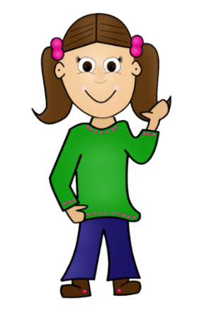
Las actividades de José con la familia
José does a lot of activities. He also does some of them with members of his family. Can you identify which he does alone and which he does with a member of his family?
Notes:
See slide 33 help slide for a quick recap of words that will be used in the activity

Slide 14
hablar/escuchar
En parejas
Persona A: eres José.
Say what you do
alone
with others in your family.
Remember to use the right verb ending:
–o to talk about ‘I’.
–amos to talk about ‘we’.
Persona B: Escucha.
¿Es José (solo) o José y otra persona (juntos)?
Escribe el verbo en la columna correcta en inglés).

Slide 15
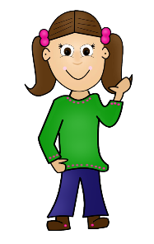
Un ejemplo
Persona A (habla)
Preparamos la comida
prepare the food
Persona B (escucha y escribe)
Solo (alone) | Juntos (together)
Prepare the food
Notes:
Students can just copy the grid into their books (with 3 rows below each header).

Slide 16
rest in the house
study art
look for a shirt
work in the countryside
spend time in the city
walk
Notes:
Student A prompt cards - Do not display during the activity

Slide 17
study English
look at the horses
walk
use a bicycle
talk to a cousin
prepare the food
Notes:
Student B prompt cards - Do not display during the activity

Slide 18
Respuestas
Persona A
Solo (alone) | Juntos (together)
study English
look at the horses
walk
use a bicycle
talk to a cousin
prepare the food
Respuestas Persona B
Solo (alone) | Juntos (together)
rest in the house
study art
look for a shirt
walk
work in the countryside
spend time in the city
Notes:
Answer grids These can be used to go through feedback with students

Slide 19
¿Necesitas ayuda?
rest
study
look for
walk
descansar
estudiar
buscar
caminar
work
spend
talk
look at
pasar
hablar
mirar
trabajar
use
prepare
usar
preparar
Notes:
This help slide can be used to do a quick recap of the meaning of the verbs and of the 1st person plural. Click once on any box to reveal the Spanish translation. The boxes can be clicked in any order.

Slide 20
Grammar [2]
present tense -ar verbs: 1st person plural
(-amos)
Y7 Spanish
Term 2.2 - Week 1
Author name(s): Ivan Luciano Avaca / Nick Avery
Date updated: 29/03/2020

Slide 21
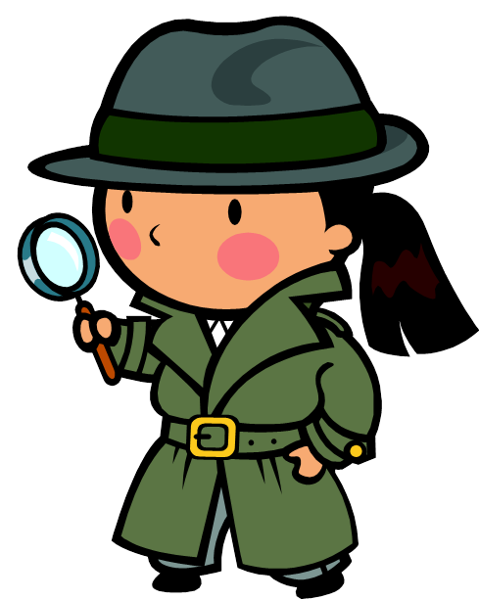
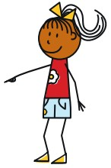
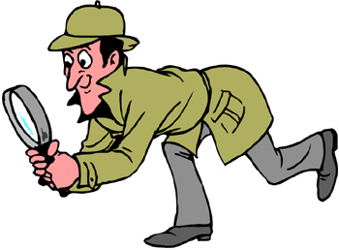
Remember that verb endings change depending on who the verb refers to.
S/he looks for the school.
We look for the school.
I look for the school.
Busco la escuela.
Buscamos la escuela.
Busca la escuela.
Notes:
Optional – a quick recap of the meanings of the 3 –ar verb endings that will appear in the next activity. All have been previously taught.

Slide 22
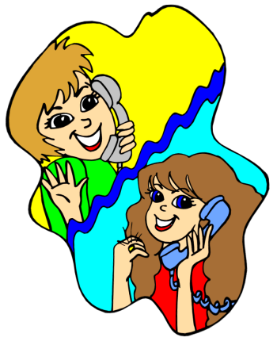
¿Un perro normal?
Quelly habla con Fiona, una amiga, por telefono…
¡Es pequeño, fuerte y muy feo!
¿Cómo es el perro de Vanessa?
Notes:
This slide presents the context for the full text presented on slide 49. The full text is Fiona’s reply to the question.
Picture credit : http://clipart-library.com/
Vocabulary revisited on this slide:
¿cómo es? [cómo-151]; pequeño [202]; perro [888]; fuerte [435]; muy [435]
Source: Davies, M. & Davies, K. (2018). A Frequency Dictionary of Spanish: Core vocabulary for learners (2nd ed.) London: Routledge.

Slide 23
¿Es el perro de Vanessa?
Notes:
Picture credit : https://pixabay.com/fr/
Teachers could use this slide to ask the students to say if they think this is the dog or not. Ask yes-no questions such as ¿Es grande o pequeño?’, ‘¿Es guapo o feo?’, ‘¿Es fuerte?’. (It’s a small dog, but not strong and not very ugly, so probably not!) This could also be done in pairs.

Slide 24
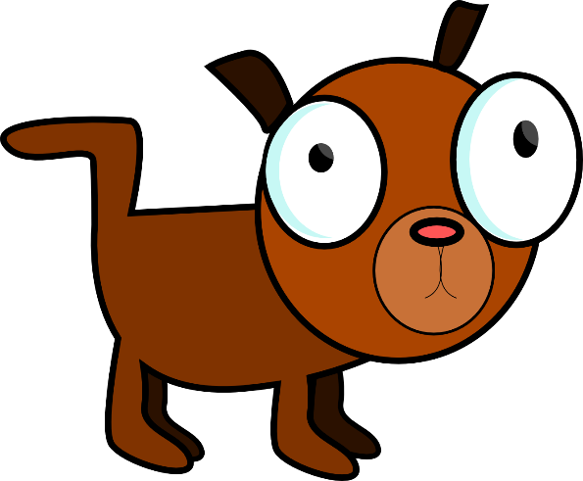
leer
El perro de Vanessa es fuerte y bastante feo, pero no es malo. Pasa mucho tiempo con el abuelo y la abuela de Vanessa cerca de una plaza artística. Escucha música en la iglesia antigua de un pueblo rico y famoso. Luego, el perro busca un lugar tranquilo con los abuelos. Vanessa y yo estudiamos juntas en la escuela. Pasamos tiempo en la tarde en el pueblo famoso. Usamos un teléfono caro y hablamos con los abuelos de Vanessa. En la noche, bailamos y caminamos mucho. Compramos unos zapatos baratos y una camisa con muchos colores para el perro. ¡El perro de Vanessa es muy guapo!
Notes:
Picture credit: http://clipart-library.com/
Reading task for grammar awareness raising – students read the text and identify how many examples of the verbs refer to ‘we’ and how many to ‘s/he’.
Answer: 7 x 1st person plural (estudiamos, pasamos, usamos, hablamos, bailamos, caminamos, compramos) 6 x 3st person singular (es, es, pasa, escucha, busca, es).
Alternatively, students can first listen to the gapped text on the next slide and complete the gaps (which include examples of these grammar features, and other vocabulary items revisited this week), before going on to complete the activity on slide 51.

Slide 25
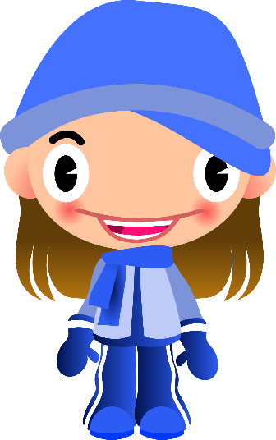
escuchar
El perro de Vanessa , pero no es malo. _______________________ con el abuelo y la abuela de Vanessa cerca de una plaza artística. en la iglesia antigua de un pueblo rico y famoso. Luego, el perro tranquilo con los abuelos. Vanessa y yo en la escuela. Pasamos tiempo en la tarde en el pueblo famoso.
caro y hablamos con los abuelos de Vanessa. En la noche, y . Compramos unos zapatos baratos y una camisa con muchos colores para el perro. ¡El perro de Vanessa es muy guapo!
Notes:
Picture credit: http://clipart-library.com/
Task: Some words are missing from the original text. Ask the students to listen and write the missing words. Missing words include: - examples of 1st person plural –amos and 3rd person singular –a
It could be useful to quickly remind the students of the adjective agreement in Spanish.
This activity could be done individually or in pairs.

Slide 26
leer
Translate each sentence in English next to ‘S/he’ or ‘We’.
pasa mucho tiempo
usamos un teléfono
estudiamos juntas
busca un lugar
escucha buena música
es fuerte y bastante feo
bailamos
caminamos mucho
spends a lot of time
S/he |  | We
S/he |  | We
S/he |  | We
S/he |  | We
use a phone
looks for a place
study together
listens to good music
dance
is strong and quite ugly
walk a lot
Notes:
The 8 text fragments contain 4 x examples of the 1st person plural and 3rd person singular, respectively.
Students need to identify which ones correspond to the ‘s/he’ and ‘we’ sentence starters and then translate the sentences.

Slide 27
hablar
Sadly, Quelly has some difficulty hearing what Fiona is saying on the phone. Can you help her find the missing words ?
strong
quite
bad
El perro de Vanessa es y feo, pero no es .
grandfather
grandmother
Pasa mucho tiempo con el y la v de Vanessa
cerca de una plaza .
artistic
old, ancient
good
Escucha música en la iglesia de un pueblo
y .
rich
famous
Notes:
This final activity allows for productive practice of the revisited vocabulary this week. It can be done as paired read-aloud, where students have to recall and say the Spanish translations of the English words as they read.
It may be useful to remind students of the need for gender agreement on most of the adjectives.
Revisited 1 (2.1 week 2)
perro [888]; abuelo [4796]; abuela [717]; bastante [308]; artístico [1402]; fuerte [435]
Revisited 2 (1.2 week 4)
bueno [98]; malo [368]; famoso [997]; feo [2373]; rico [398]; caro [2179]; antiguo [446]

