Slide 1
Examples
Examples
production
(Freer) production tasks eliciting personal response

Slide 2
Quelles sont vos émotions?
Les émotions
parler
Je suis…
heureux (-euse)
calme
content(e)
indifférent(e)
triste
fâché(e)
intéressé(e)
Notes:
7.1.1.3
Timing: 2 minutes
Aim: To encourage further engagement with the text by asking students for their emotional response after they have finished reading the poem.
Procedure:
Use the French prompt to ask students how they feel.
Ask students to report back on how their partner feels (il est/elle est…)
Word frequency (1 is the most frequent word in French):
hereux(-euse) [764]; calme [1731]; content(e) [1841]; indifférent(e) [4151]; triste [1843]; fâché(e) [4413]; intéressé(e) [559].
Source: Londsale, D., & Le Bras, Y. (2009). A Frequency Dictionary of French: Core vocabulary for learners London: Routledge.

Slide 3
Écris un poème!
écrire
Now create your own poem!
Try to re-use the colours in the poem with ‘comme’
Remember to use un/une/le/la correctly
Notes:
7.1.2.1 Timing: 10 minutes
Aim: To practise correct use of the article according to intended meaning within a creative written production task.
Procedure:
1. Tell student their task is to research and writing their own poem.
2. Allow use of dictionaries for this, especially as they may want to include words that haven’t yet been taught.
3. Offer students feedback on their use of articles
Note:
This task can be given with or without the concrete/abstract nouns focus on the previous slide. Even without an explicit focus on the previous slide, it's possible that students will mix/match concrete and abstract e.g. Rouge comme l’amour
Bleu comme une voiture

Slide 4
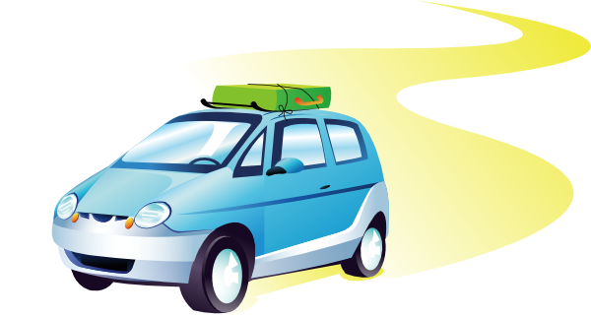
Écris en français
écrire
Now use the pictures below to write 8 sentences in FRENCH to describe what normally happens on a holiday.
Notes:
7.1.2.2
Timing: 6 minutes
Aim: to practise written production of first person singular of ‘faire’ along with this week’s target vocabulary.
Procedure:
Students write sentences using the first person singular form of ‘faire’ in response to the pictures, in order to narrate an imaginary day on holiday.
For an additional challenge, students could then be asked to do this using the second person singular form – i.e. writing about what ‘you’ do – or the third person singular form – i.e. writing about what s/he does.
Make it clear to students that they are writing in the present tense, i.e. saying what happens normally (Note: we will cover the present continuous in a later week, I am doing, I am playing).
Remind learners that the weather expressions are always used impersonally – i.e. with ‘il’.

Slide 5
Vocabulaire
parler
Discuss your favourite things with your partner.
Here are some example questions to get you started.
Tu as un livre préféré ?
Tu as un professeur préféré ou une professeure préférée ?
Tu as une couleur préférée ?
Tu as un chanteur préféré ou une chanteuse préférée ?
Tu as un film préféré ?
Les réponses :
Non / oui, c’est … Comment ça s'écrit ?
Notes:
7.1.2.5
Timing: 8 minutes
Aim: Students use cues on slide to ask and answer questions about their favourite things.
Procedure:
1. Allow up to 3 minutes’ preparation time. The questions suggested use known vocabulary and are designed to elicit answers that take the form of names or titles. However, at advanced levels, students could be encouraged to use dictionaries to ask about other things (animals, food, sports …)
2. Students use cues on slide to ask and answer questions about their favourite things. Draw attention to the fact that the masculine and feminine forms of préféré are identical in the oral form.
3. Encourage students to use Comment ça s'écrit ? to request clarification and spell answers. Students should be encouraged not to respond with non more than once!

Slide 6
Answering others: je and nous
écrire
Write an answer to each question below. You can choose what other vocabulary to use!
 | Question | Réponse
1 | Vous travaillez à l’école ?
2 | Vous demandez la raison ?
3 | Tu trouves la solution ?
4 | Tu marches dehors ?
5 | Tu portes un uniforme ?
6 | Vous restez à la maison ?
7 | Tu prépares le déjeuner ?
Notes:
7.1.2.7
Timing: 5 minutes
Aim: to practice choosing the correct verb form in response to questions asked in second person singular and second person plural, thereby combining learning from 7.1.2.5 (‘je’/’nous’ forms of –ER verbs in the present tense).
Procedure:
Students write an answer to each question.
Students’ creativity can be encouraged here by advising them to review previously learnt vocabulary from across the series of lessons with –ER verbs and, if appropriate, to consult a dictionary to search for any new vocabulary items needed.

Slide 7
Vous faites quoi ?
parler / écrire
Now write two sentences about what your friend does - use ‘he’ or ‘she’ and write two sentences about what you think your teachers do – use ‘they’ (it doesn’t have to be true!).
E.G.
L’amie
Les professeurs
Elle écoute le chanteur.
Ils préparent le déjeuner.
Elle étudie l’histoire.
Ils chantent avec la radio.
Say your sentences to your partner who will translate them into English.
Notes:
7.1.2.6
Timing: 5 minutes
Aim: to practise creative written production at sentence level of regular –er verbs in third person singular and plural.
Procedure:
Students write (then say) two sentences describing what one friend does (it doesn't have to be true!) 'use she or he';
They then write (then say) two sentences that you think all your teachers do - use 'they'.
Note: this exercise offers an opportunity to try to get students to write and say something creative, producing their own language to express their own meanings (rather than translations as previously practised in this sequence).

Slide 8
Le week-end
Le week-end
parler / écrire
Travaille avec un(e) partenaire. Parlez avec trois groupes différentes. Qui fait quoi le week-end? Écrivez trois phrases.
Sophie et Michel, vous faites quoi le week-end?
Nous faisons le ménage, nous faisons les devoirs et nous faisons une fête.
e.g. Sophie et Michael font le ménage. Ils font les devoirs. Ils font une fête aussi.
Notes:
7.2.1.4
Timing: 10 minutes
Aim: Spoken and written production of all three new forms of faire learned this week.
Procedure:
1. In preparation for the exercise, teacher should work through the example here, drawing attention to question formation with quoi.
2. Students write an example sentence in the third person plural using the information given. Teacher to remind students that names of two or more people (e.g. Sophie et Michel here) also require the third person plural form.
3. Teacher reveals the answer, and practises pronunciation.
4. Working in pairs, students choose three activities from the previous slide that they will do at the weekend, and prepare sentences with nous.
5. Students then ask three other pairs, using the vous form, about their weekend plans.
6. Students write sentences in the third person plural describing what their classmates are doing at the weekend.
7. Teacher to elicit examples from the class, by choosing a pair and asking e.g. Sophie et Michael font quoi le week-end? The next slide provides a blank template for the teacher to gather class responses.

Slide 9
Fais une interview
Fais une interview !
parler
Fais des questions avec qui ou quoi. Donne des réponses comme Léa et Amir.
Exemple 1 :
A : C’est qui ta personne préférée ?
B : Ma personne préférée est Sophie.
A : C’est quoi la raison ?
B : Elle est une personne ouverte.
 |  | qui / quoi ? | raison ?
A | personne
Remember to make the adjective agree if needed!
Sophie
ouverte
 |  | qui / quoi ? | raison ?
B | personne | Sophie | ouverte
Exemple 2 :
B : C’est quoi ton animal préféré ?
A : Mon animal préféré est le chien.
B : C’est quoi la raison ?
A : C’est un animal sage.
 |  | qui / quoi ? | raison ?
B | animal
le chien
sage
 |  | qui / quoi ? | raison ?
A | animal | le chien | sage
Notes:
7.2.1.5
In-class version (NB: a self-study version of this activity can be found on slides 25-27)
Timing: 10 minutes
Aim: consolidate the lesson’s work on agreement with possessive and other adjectives, whilst providing additional practise in adjective placement.
Procedure:
Print a rolecard (slides 22-23) for each student, working in pairs as A and B.
Partner A has Amir’s answers and Partner B has Léa’s answers – they ask questions in turn, following the examples provided, to complete the information about their partner.
To extend the activity, students complete the tables with their own answers and ask questions about each other.
Word frequency (1 is the most frequent word in French):
footballeur [>5000] and rappeur [>5000], interview [3186]
Source: Londsale, D., & Le Bras, Y. (2009). A Frequency Dictionary of French: Core vocabulary for learners London: Routledge.

Slide 10
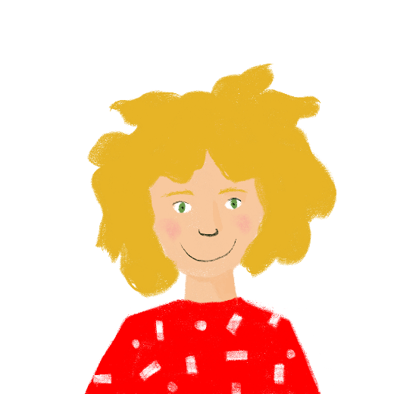
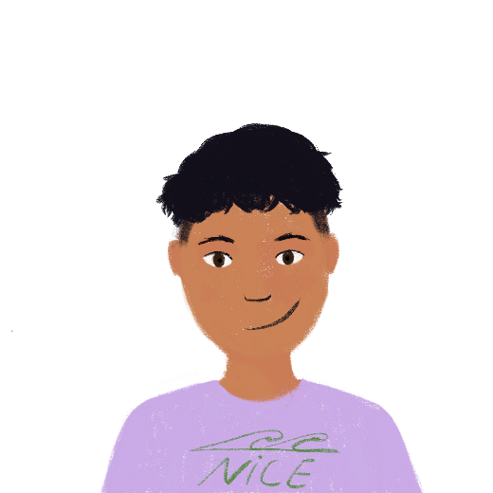
Fais une interview
Fais une interview !
Partenaire A
parler
Fais un interview
 |  | qui / quoi ? | raison ?
 | chanteuse
 | actrice
 | magasin
 | numéro
1
2
3
4
 |  | qui / quoi ? | raison ?
 | footballeur | Kylian Mbappé | français
 | rappeur | Sofiane | rapide
 | livre | Kiffe kiffe demain | excellent
 | film | Moi, César | amusant
C’est qui ta chanteuse préférée ?
C’est quoi la raison ?
5
6
7
8
Notes:
Role card A

Slide 11
Fais une interview
Fais une interview !
Partenaire B
parler
Fais un interview
C’est qui ton footballeur préféré ?
C’est quoi la raison ?
 |  | qui / quoi ? | raison ?
 | chanteuse | Suzane | intelligent
 | actrice | Audrey Tautou | sympa
 | magasin | Zara | moderne
 | numéro | 7 | intéressant
1
2
3
4
 |  | qui / quoi ? | raison ?
 | footballeur
 | rappeur
 | livre
 | film
5
6
7
8
Notes:
Role card B

Slide 12
Écris en français !
Écris en français !
écrire
Questions
Write 3 different questions in French for your partner, using the words below:
où – comment – quand - à l’étranger – aux magasins – au collège - à la maison
E.g. Tu vas aux magasins quand ?
1.
E.g. Tu vas à la maison comment ?
E.g. Tu vas où ?
2.
E.g. How do you go (get) home?
E.g. Where are you going?
E.g. When do you go to the shops?
3.
Réponses
Answer in French (in full sentences) the 3 questions which your partner has prepared for you!
Here are some other words you may find useful:
souvent – rarement – chaque semaine – aujourd’hui – le week-end
E.g. Je vais aux magasins chaque semaine.
1.
E.g. Je vais à la maison en vélo.
E.g. Je vais au collège.
2.
E.g. I go (get) home by bike.
E.g. I go to the shops every week.
E.g. I am going to school.
3.
Notes:
7.2.2.2
Optional extension activity.
Timing: 5 minutes
Aim: Written production of questions with où ?, comment ? and quand ? and answers with aux/à l’ and adverbs of frequency/time.
Procedure:
Teachers could choose to add a speaking element to this activity for higher ability pupils. After preparing the questions, students take turns to ask each other the questions. The student listening has to say their response in a full sentence, striving for grammatical accuracy. Partner A would write down partner B’s response in English on their sheet. A back translation task could follow whereby the sentence in English is translated back into French by the listener.
Students will need to be reminded of the position of the adverbs: rarement/souvent after the verb; le week-end / aujourd’hui / chaque semaine at the end of the sentence.
This also offers the teacher the chance to remind students of the two different translations into English of the present tense: I go / am going; you go/are going.

Slide 13
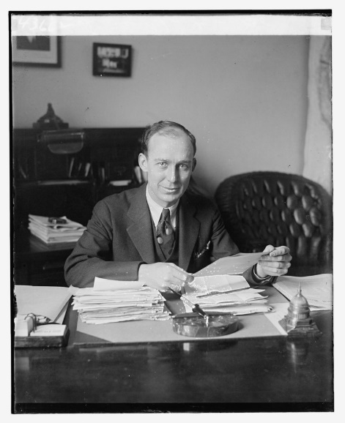
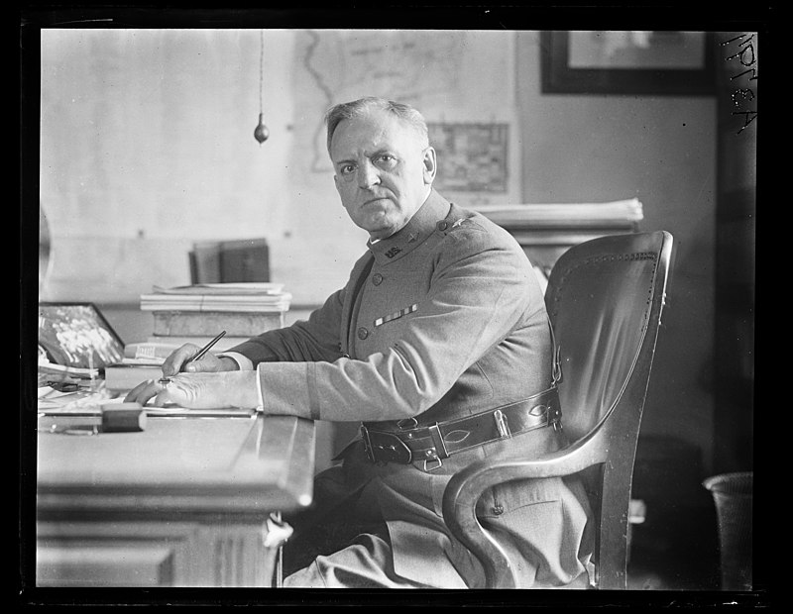
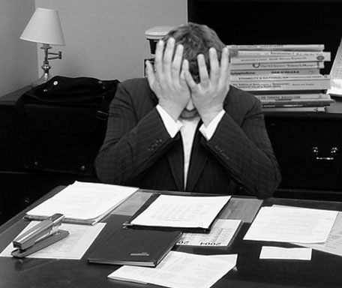
Le père et la mère
parler
Choisis une image pour représenter le père. Il est comment ?
a)
b)
c)
Le père est…
triste sympa indifférent strict affectueux heureux autoritaire
Et la mère ? Elle est comment ?
Notes:
7.2.2.3
Timing: 2 minutes
Aim: To express opinions in French based on interpretation of the text.
Procedure:
1. Students choose an image to represent the father and justify their choice.
2. Students describe the mother.
3. No right or wrong answer for either.
Word frequency of cognates used (1 is the most frequent word in French): image [659], représenter [293], indifférent [4151], affectueux [>5000], autoritaire [4661].
Source: Londsale, D., & Le Bras, Y. (2009). A Frequency Dictionary of French: Core vocabulary for learners London: Routledge.
Attribution:
Unidentified man by National Photo Company Collection is in the public domain
Frustrated man at a desk by LaurMG. is licensed under CC BY-SA 3.0
Military man at desk by Library of Congress, Prints & Photographs Division, photograph by Harris & Ewing, LCCN2016891032

Slide 14
À ton tour !
parler
Lis le poème à haute voix. Fais attention à la répétition - exprime la monotonie, la routine et l’indifférence !
ou
Choisis une ou deux lignes que tu trouves importantes. Fais une présentation mémorisée et creative, avec un(e) partenaire ou en groupe.
Notes:
7.2.2.3
Timing: 10 minutes
Aim: Class read-aloud of the poem.
Procedure: Offer a choice of activities if possible:
1. Give students the opportunity to read the poem aloud (à haute voix will need to be explained in the instructions), either a line each at a time, or a verse each at a time. Encourage them to read expressively, thinking about the meaning and trying to convey the sense of monotony.
2. Ask them to choose the section of the poem that they think is most important and to memorise it so that they can perform it.
Word frequency of cognates used (1 is the most frequent word in French): haut [264], voix [414], répétition [2804], exprimer [466], monotonie [>5000], routine [4120], indifférence [4176], choisir [226], ligne [342], présentation [1723], mémorisé [>5000], créatif [>5000], groupe [187]
Source: Londsale, D., & Le Bras, Y. (2009). A Frequency Dictionary of French: Core vocabulary for learners London: Routledge.

Slide 15
Écris en français !
Écris en français !
écrire
Use a dictionary to look up any words you don’t know!
Réponds aux questions.
Combien de matières étudies-tu au collège?
Quelle matière aimes-tu ?
Pourquoi aimes-tu ça ?
Aimes-tu le professeur / la professeure ?
Comment est-il ? / Comment est-elle ?
Lis les réponses de Léa.
J’étudie douze matières au collège.
J’aime le français.
Parce que je trouve ça intéressant. J’aime lire et écrire.
Oui !
La professeure est sympa et intelligente.
Notes:
7.3.1.3
Optional additional HW task
This writing activity practises a selection of the question words as well as the school subject vocabulary. Students can use a dictionary to help express personal responses which contain unknown vocabulary.

Slide 16
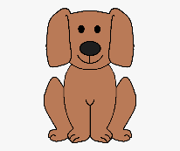
Parle en français !
Parle en français !
parler
Parle avec un partenaire. Fais des questions et donne des réponses.
Questions: combien ? quel(le) ? | Réponses:
A
Exemple
A: Combien de chiens as-tu ?
B: J’ai deux chiens.
A: Quel chien demandes-tu ?
B: Je demande un chien sage.
Je ne demande pas de chien calme.
un chien (demander)
Questions: combien ? quel(le) ? | Réponses:
B
sage
calme
Notes:
7.3.1.5
In-class version (NB: a self-study version of this activity can be found on the next slide)
Timing: 8 minutes
Aim: Consolidation of the week’s work on negation, whilst revising the question words combien and quel(le).
Procedure:
1. Print one set of role cards for each pair (the cards may be found on the portal alongside this resource).
2. Partner A first asks a question about the noun on their role cards using combien and avoir, Partner B answers first with number + noun.
3. Partner A then asks a question about the noun and verb on their role cards using quel(le). Partner B chooses an option and answers in the affirmative with indefinite article + noun + adjective, and makes negative sentences with the remaining options.
4. The partners swap roles after each turn.
Word frequency (1 is the most frequent word in French): pizza [>5000], margherita [>5000], pepperoni [>5000], végane [>5000], podcast [>5000], classique [1845], orange [3912].
Source: Londsale, D., & Le Bras, Y. (2009). A Frequency Dictionary of French: Core vocabulary for learners London: Routledge.

Slide 17
Écris en français !
écrire
Écris en français !
Write some sentences contrasting your town/village with your ideal town/village. You could start as follows:
Dans mon village (idéal) / ma ville (idéale), il y a ...
Use the vocabulary from this sequence, and the dictionary to look up other places to mention.
Make longer sentences using these conjunctions (linking words):
et and comme like
mais but aussi also
ou or
Notes:
7.3.1.6
OPTIONAL EXTRA (could be set for homework)
Timing: 10 minutes
Aim: Free written production exercises bringing together all new vocabulary and grammar structures covered this week.
Procedure:
Students are now challenged to write some sentences of their own, contrasting their town/village with their ideal town/village (note that the conditional tense is not introduced at this stage), following the model of the sentences in this resource sequence.
Word frequency of cognates used in task instructions (1 is the most frequent word in French): idéal [1429]
Source: Londsale, D., & Le Bras, Y. (2009). A Frequency Dictionary of French: Core vocabulary for learners London: Routledge.

Slide 18
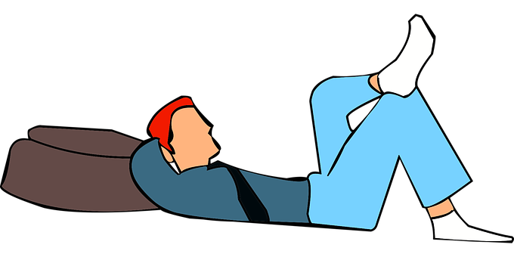
Tu vas faire quoi samedi?
Tu vas faire quoi samedi ?
écouter / écrire
Write five sentences about what you are going to do on Saturday!
Use the short form of aller with the infinitive to say what you are going to do.
You could start as follows:
Samedi, je vais aller en ville ...
Then, exchange sentences with your partner!
What are they doing on Saturday? Écris en français!
Notes:
7.3.2.3
Timing: 8 minutes
Aim: Free written production (with dictionary look up) to bring together the vocabulary and grammar covered in lesson 1.
Procedure:
Students write five sentences about what they are going to do on Saturday
If time permits, the partner should write down the sentences and translate them.

Slide 19
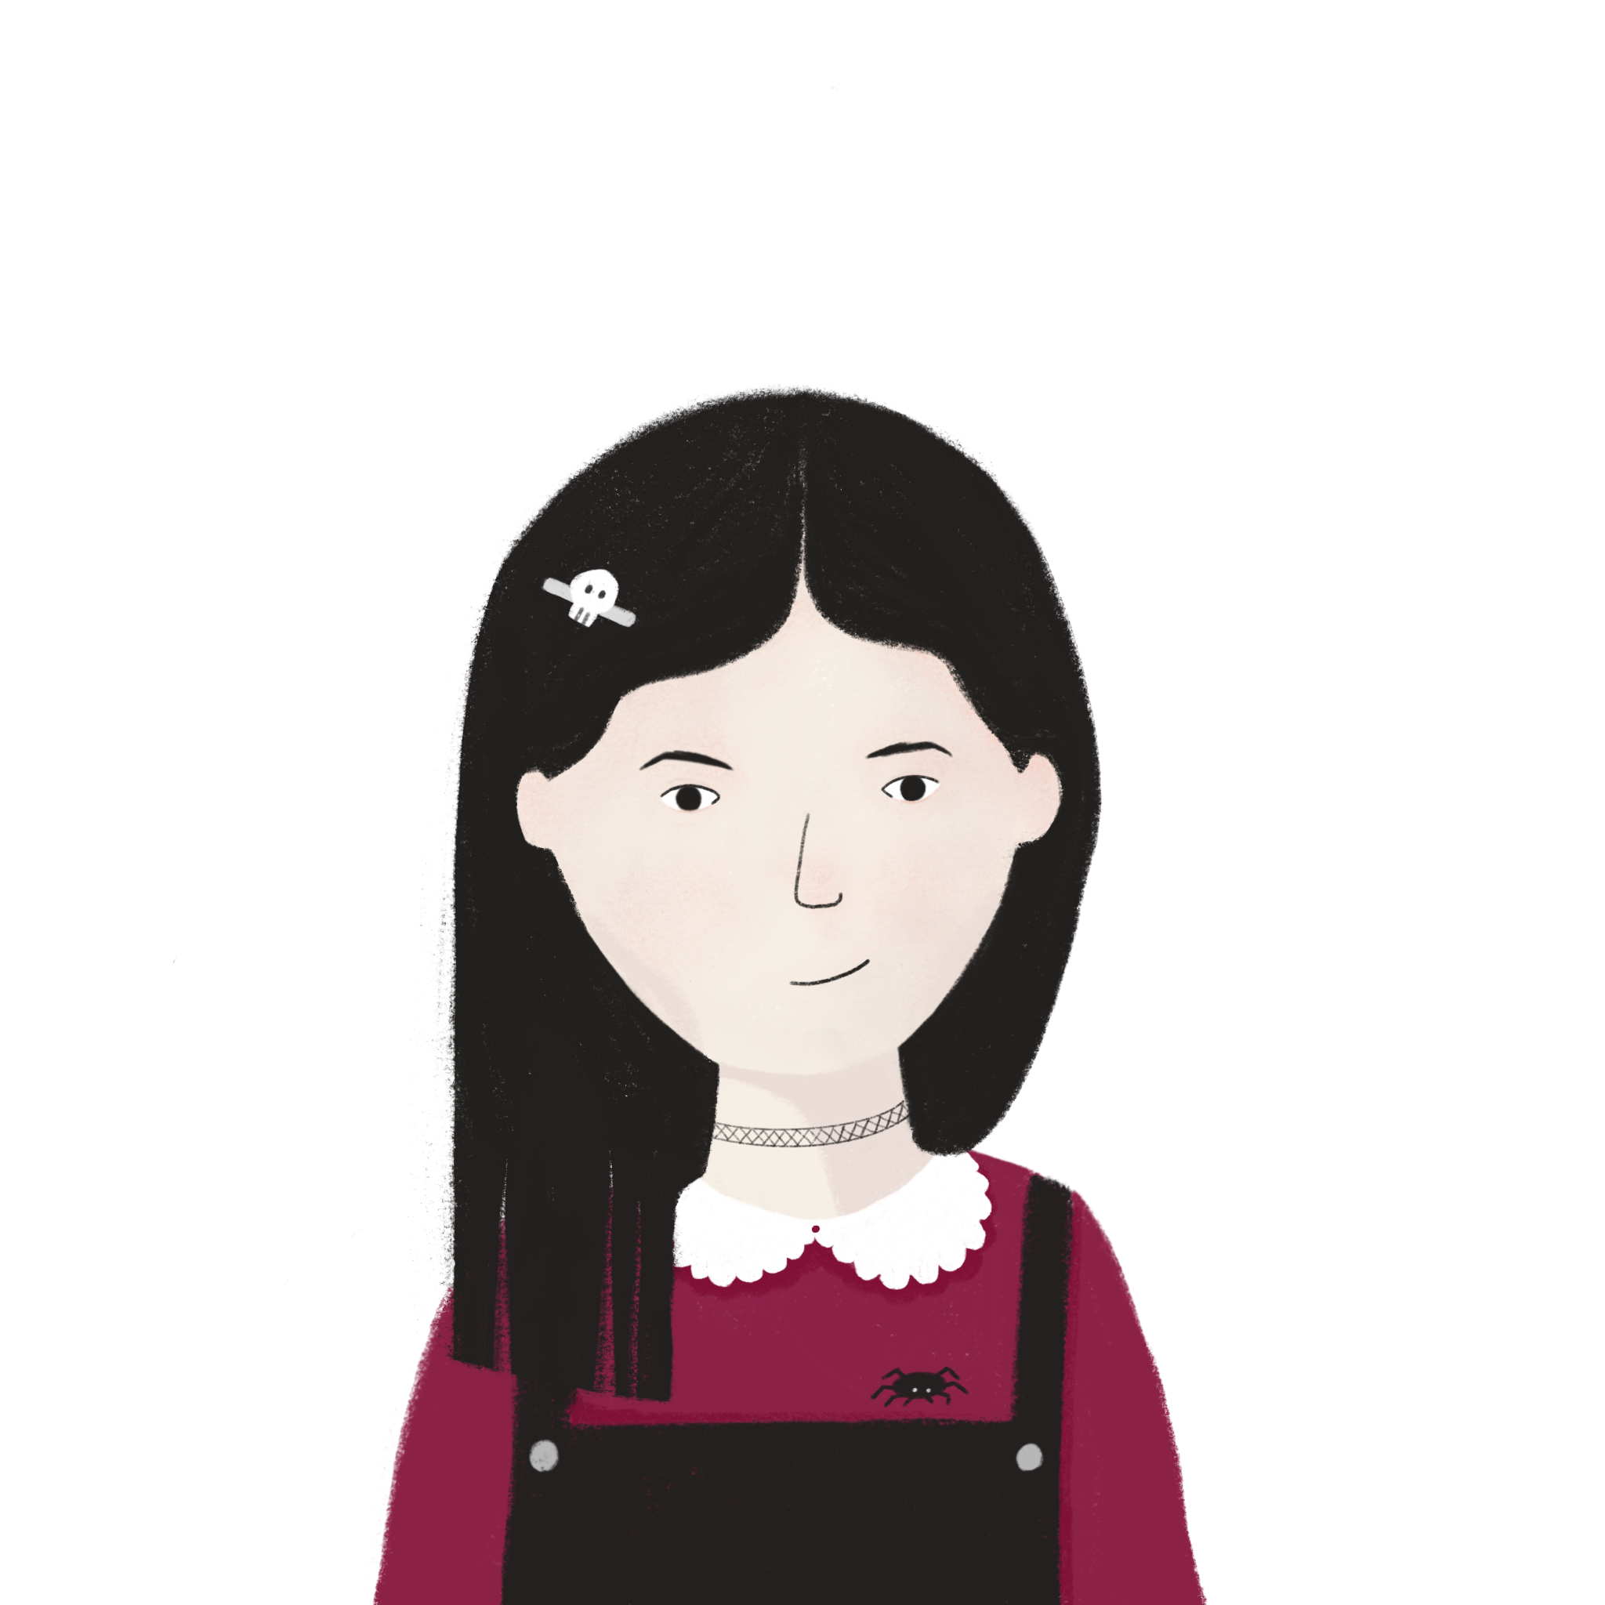
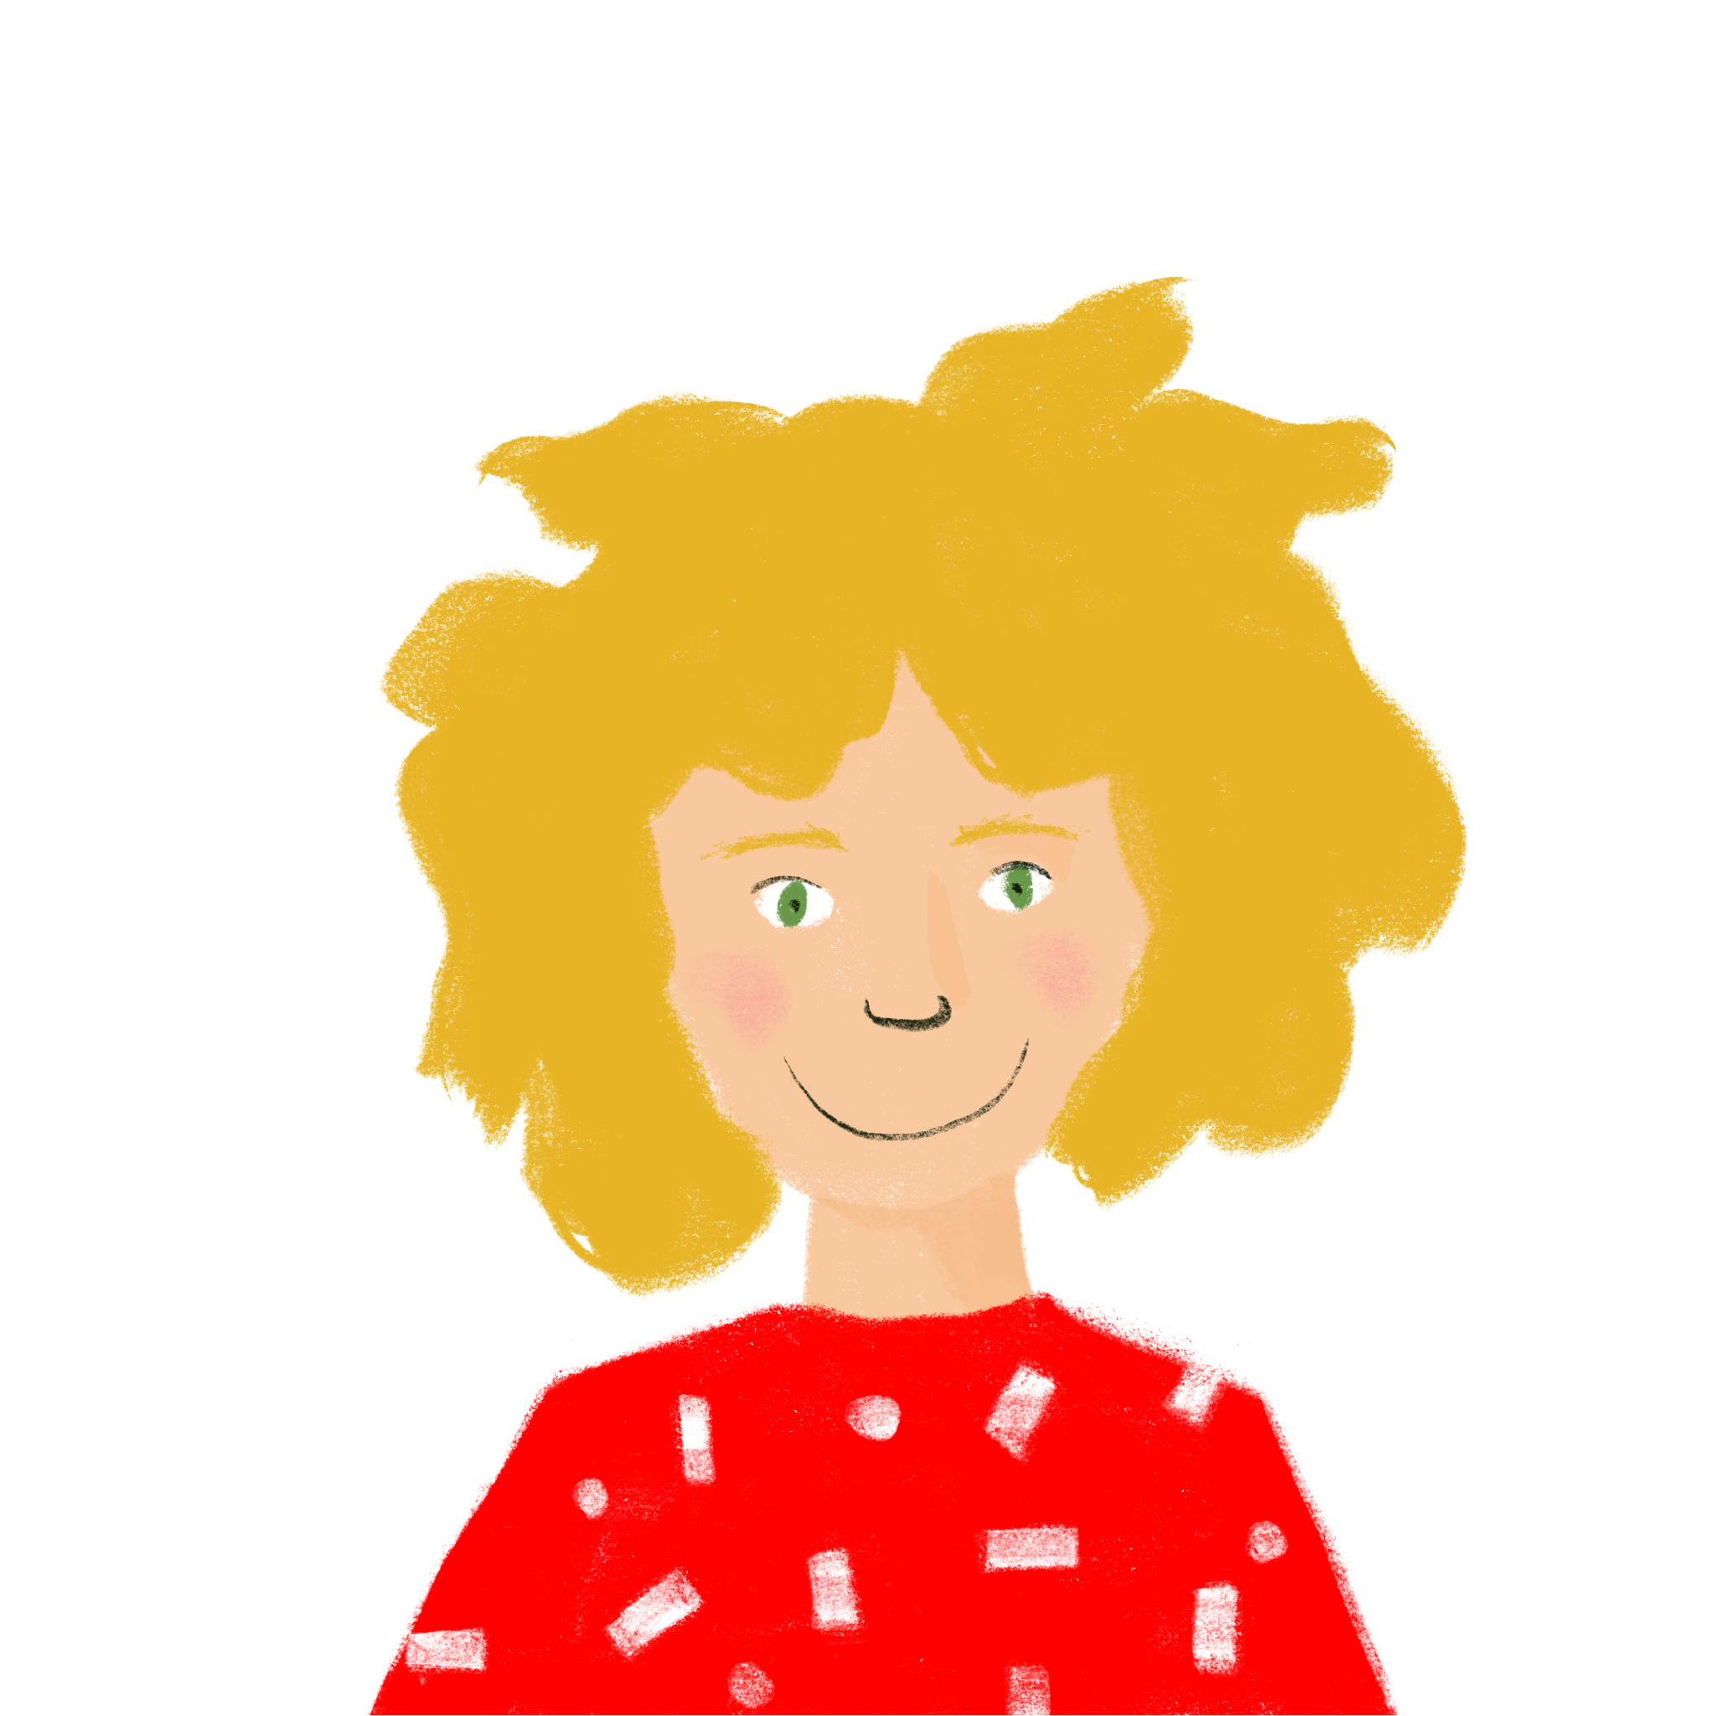
Aujourd’hui ou le week-end?
parler / écrire
Et vous? Que faites-vous aujourd’hui? Qu’allez-vous faire le week-end? Travaillez en paires !
Et tes amis? Que font-ils aujourd’hui? Que vont-ils faire le week-end? Parlez et écrivez les activités dans les colonnes correctes !
nous
aujourd’hui | demain
1. Nous faisons les devoirs. 2. 3. | 1. Nous allons faire une promenade. 2. 3.
ils/elles
aujourd’hui | demain
1. Ils … 2. 3. | 1. Ils vont … 2. 3.
Notes:
7.3.2.4
Timing: 10 minutes
Aim: To practice oral production and comprehension of personalised statements about the present and the future
Procedure
Students sketch out a table following the model on the slide, and work in pairs to write three present tense sentences about what they did today, and three sentences with future intention about what they are doing at the weekend. Teacher circulates and corrects.
Click to reveal the second set of task instructions. Students sketch out a second table following the model.
Working with another pair, students take it in turns to read the six statements they have written in a random order. To ensure the order is random, teachers can distribute the role cards on slide 30, which tell students the order in which to read their statements. The listening pair notes down the activities in the appropriate column. Students must not say the words demain or aujourd’hui! Remind them that the verb form tells us whether events are happening today or tomorrow.
Students check with the other Groupe to ensure they have written the words in the correct columns.
Students turn their notes into full sentences with ils/elles.
Teacher can elicit some oral answers from stronger pairs by asking e.g. ‘Que font Andrew et Louise aujourd’hui? Que vont faire Sarah et Richard le week-end?’

Slide 20
Aujourd’hui ou le week-end?
parler / écrire
Groupe 1
demain 1
demain 2
aujourd’hui 1
demain 3
aujourd’hui 2
aujourd’hui 3
Groupe 1
demain 1
demain 2
aujourd’hui 1
demain 3
aujourd’hui 2
aujourd’hui 3
Groupe 1
demain 1
demain 2
aujourd’hui 1
demain 3
aujourd’hui 2
aujourd’hui 3
Groupe 1
demain 1
demain 2
aujourd’hui 1
demain 3
aujourd’hui 2
aujourd’hui 3
Groupe 1
demain 1
demain 2
aujourd’hui 1
demain 3
aujourd’hui 2
aujourd’hui 3
Groupe 1
demain 1
demain 2
aujourd’hui 1
demain 3
aujourd’hui 2
aujourd’hui 3
Groupe 2
demain 1
aujourd’hui 1
aujourd’hui 2
demain 2
demain 3
aujourd’hui 3
Groupe 2
demain 1
aujourd’hui 1
aujourd’hui 2
demain 2
demain 3
aujourd’hui 3
Groupe 2
demain 1
aujourd’hui 1
aujourd’hui 2
demain 2
demain 3
aujourd’hui 3
Groupe 2
demain 1
aujourd’hui 1
aujourd’hui 2
demain 2
demain 3
aujourd’hui 3
Groupe 2
demain 1
aujourd’hui 1
aujourd’hui 2
demain 2
demain 3
aujourd’hui 3
Groupe 2
demain 1
aujourd’hui 1
aujourd’hui 2
demain 2
demain 3
aujourd’hui 3
Notes:
Role cards to accompany the activity on slide 28.

Slide 21
Les idées de vacances
parler / écrire
Tu veux faire quoi ? Que dois-tu faire ? Écris cinq phrases avec vouloir et devoir.
Example (je)
Paris
1. Je dois voyager en avion à Paris.
2. Je veux visiter les vieilles églises.
devoir
Mes phrases
1. Je … 2. 3.
4. 5.
vouloir
Parle avec un(e) partenaire. Que veut-il/elle fait ? Il/elle doit faire quoi ? Écris cinq phrases.
Example (il/elle)
1. Il veut aller à la plage.
2. Elle doit faire les devoirs dans le train.
vouloir
Mon/ma partenaire
1. Elle … 2. 3.
4. 5.
devoir
Notes:
7.3.2.5
NB an alternative spoken activity for home-learning can be found on slide 36.
Timing: 10 minutes
Aim: Semi-structured writing exercise to practise independent production of structures with modal verbs vouloir and devoir and prepositions.
Procedure:
1. Students use the pictures on the storyboard to practise writing example sentences with modal verbs in the first person.
2. Students then write five additional sentences of their own using devoir and vouloir to say what they want and have to do during the holidays.
3. Click to bring up the second task instruction.
4. Students use the pictures on the storyboard to practise writing example sentences with modal verbs in the third person.
5. Students exchange their je sentences orally with a partner, taking notes on what their partner has said.
6. Students then write five sentences in the third person to convey what their partner wants and has to do.

