Slide 1
Vowels
German vowels can be short or long.
Vowels are short when followed by more than one consonant, e.g., Mann, Gast.
Vowels are long when:
there is a double vowel, e.g. Paar,
or when followed by the letter ‘h’, e.g., fahren,
or by a single consonant, e.g., sagen.
NB: German final ‘e’is not silent, but very short, e.g. danke, Klasse.
Notes:
Note: It is important to give this explanation, but in the same way as with explicit grammar explanation, it is the practice that counts most. The idea here is not to write out the explanation, but to put it into practice with the phonics source words, and then relate the long and short ‘a’ sounds to two new nouns, ‘die Tafel’ and ‘die Flasche’.

Slide 2
e
[e:]
geben
Steve Clarke / Rachel Hawkes
Notes:
Introduce and elicit the pronunciation of the individual SSC ‘e’ and then present and practise the pronunciation of the source word ‘geben’.
A possible gesture for this would be to mime offering an imaginary present to someone, with both hands.

Slide 3
e
[ɛ]
denken
Steve Clarke / Rachel Hawkes
Notes:
Introduce and elicit the pronunciation of the individual SSC ‘e’ and then present and practise the pronunciation of the source word ‘denken’.
A possible gesture for this would be to put your index finger to your temple and look thoughful!

Slide 4
e
mehr
Leben
geben
sehen
Idee
Meer
Rachel Hawkes
Notes:
Introduce and elicit the pronunciation of the individual SSC ‘e’ and then the source word again (with gesture, if using). Then present and elicit the pronunciation of the five cluster words. The cluster words have been chosen for their high-frequency, from a range of word classes, with the SSC (where possible) positioned within a variety of syllables within the words(e.g. initial, 2nd, final etc..) and additionally, we have tried to use words that build cumulatively on previously taught SSCs (see the Phonics Teaching Sequence document) and do not include new SSCs. Where new SSCs are used, they are often consonants which have a similar symbol-sound correspondence in English.
Word frequency rankings (1 is the most common word in German): geben [57]; mehr [58] Leben [220]; sehen [81]; Meer [977]; Idee [641]. Source: Jones, R.L. & Tschirner, E. (2006). A frequency dictionary of German: core vocabulary for learners. Routledge

Slide 5
e
mehr
Leben
geben
sehen
Idee
Meer
Rachel Hawkes
Notes:
Without pictures to focus on the SSC.

Slide 6
e
mehr
Leben
geben
sehen
Idee
Meer
Rachel Hawkes
Notes:
Without audio or pictures for students to produce.

Slide 7
e
Leben
60
sehen
Meer
Sekunden
mehr
geben
Idee
0
Anfang

Slide 8
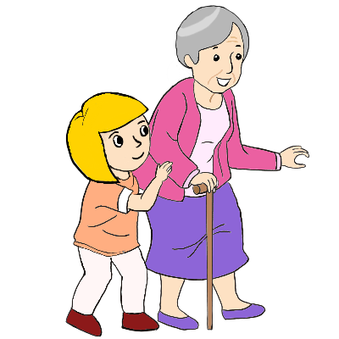
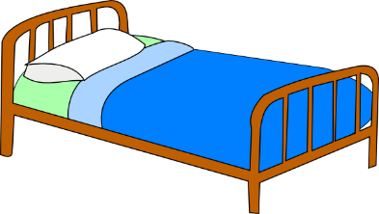
e
besser
Ende
denken
helfen
eng
Bett
Rachel Hawkes
Notes:
Introduce and elicit the pronunciation of the individual SSC ‘e’ and then the source word again (with gesture, if using). Then present and elicit the pronunciation of the five cluster words. The cluster words have been chosen for their high-frequency, from a range of word classes, with the SSC (where possible) positioned within a variety of syllables within the words(e.g. initial, 2nd, final etc..) and additionally, we have tried to use words that build cumulatively on previously taught SSCs (see the Phonics Teaching Sequence document) and do not include new SSCs. Where new SSCs are used, they are often consonants which have a similar symbol-sound correspondence in English.
Word frequency rankings (1 is the most common word in German): denken [124]; besser [231] Ende [204]; helfen [406]; Bett [654]; eng [591]. Source: Jones, R.L. & Tschirner, E. (2006). A frequency dictionary of German: core vocabulary for learners. Routledge

Slide 9
e
besser
Ende
denken
helfen
eng
Bett
Rachel Hawkes
Notes:
Without pictures to focus on the SSC.

Slide 10
e
besser
Ende
denken
helfen
eng
Bett
Rachel Hawkes
Notes:
Without audio or pictures for students to produce.

Slide 11
Lang oder kurz?
 | geben | denken
1
2
3
4
Notes:
Hör die Wörter an. Ist die E wie ‘geben’ (lang) oder wie ‘denken’ (kurz)?
Leben
Bett
besser
Ende
Lang oder kurz? (long or short) - listening task to identify if the vowel is long or short.

Slide 12
Antworten
 | geben | denken
1
2
3
4
Leben
Bett
besser
Ende
Notes:
Antworten
Leben
Bett
besser
Ende

Slide 13
Lang oder kurz?
 | lang | kurz
A
1
2
3
E
4
5
6
Notes:
Hör die Wörter an. Ist die A oder E lang oder kurz?
Idee
eng
Paar
danke
Gast
sehen
Lang oder kurz? (long or short) - listening task to identify if the vowel is long or short, but this time with the vowels mixed. Depending on the level of ability the previous exercise could be skipped.

Slide 14
Lang oder kurz?
 | lang | kurz
1
2
3
4
5
6
Idee
eng
Paar
danke
Gast
sehen
Notes:
Antworten
Idee
eng
Paar
danke
Gast
sehen
Lang oder kurz? (long or short) - listening task to identify if the vowel is long or short, but this time with the vowels mixed. Depending on the level of ability the previous exercise could be skipped.

