Slide 1
Identität
Namibia
Year 10 Term 1.1 Week 6 Lesson 3
Charlotte Moss / Janine Turner
Artwork: Steve Clarke
Date updated: 8/02/2023
Notes:
Artwork by Steve Clarke. All additional pictures selected are available under a Creative Commons license, no attribution required. Native-speaker teacher feedback provided by Stephanie Cross.
Learning outcomes
Introduce: Simple past weak and strong plural (H)
Introduce: Perfect tense irregular past participles
Revisit: Perfect tense weak verbs (+HABEN) with meaning 'did' and 'have done’
Revisit: Simple past (HABEN, SEIN, es gab) as single verb option for past Revisit: Simple past weak verbs (singular) (H); simple past strong verbs (singular) (H);
Phonics: SSC: long and short [a]|[o] [u] [link to grammar: simple past (H), past participles] hard and soft [ch] [link to grammar: simple past, plural rule 7]
New vocabulary: (aux)…gedacht [128] (aux)…genannt [191] (aux)…getan [123] (aux)…gewusst [78] (aux)…gezogen [193] hattest [6] warst [4] Afrika [2010] Kanzler [1983] Land2 [134] Situation [423] meiner Meinung nach [n/a] brachte (H) [163] dachte (H) [128] entschied (H) [414] lag (H) [107] ließ (H) [83] saß (H) [231] zog (H) [193] wusste (H) [78] Integration (H) [1282] gerecht (H) [2080]
Revisited vocabulary: beantworten [1865] bedeuten [398] Aktion1 [1838] Artikel [1378] Bedeutung [484] Gespräch [517] Reihe [738] Satz [432] Sinn [380] Unterschied [632] anders [303] betonen (H) [782] bilden1 (H) [315] klingen (H) [700] merken (H) [566] unterrichten (H) [3188] Ausdruck (H) [970] Begriff1 (H) [569] Übung (H) [1434] deutlich (H) [302] international (H) [426] verschieden (H) [254]
Thematic revisited vocabulary: (aux)…gebracht [163] bringen [163] glauben1 [156] heißen [126] lachen [444] lernen [288] tun1 [123] wohnen [560] ziehen [193] Baum [1013] Blick [306] Feld [834] Herr1 [154] Land1 [134] Mutter [218] Ort [341] Religion [1976] Sohn [596] Tochter [694] ganz1 [69] gleich1 [141] aß (H) [323] begann (H) [251] ging (H) [66] kam (H) [62] mischen (H) [2160] Angriff (H) [1489] Sorge (H) [888]
Revisited function words: hatte, hatten, hattet, war, waren, wart, es gab
Source: Jones, R.L & Tschirner, E. (2019). A frequency dictionary of German: Core vocabulary for learners. London: Routledge.
The frequency rankings for words that occur in this PowerPoint which have been previously introduced in NCELP resources are given in the NCELP SOW and in the resources that first introduced and formally re-visited those words.
For any other words that occur incidentally in this PowerPoint, frequency rankings will be provided in the notes field wherever possible.

Slide 2
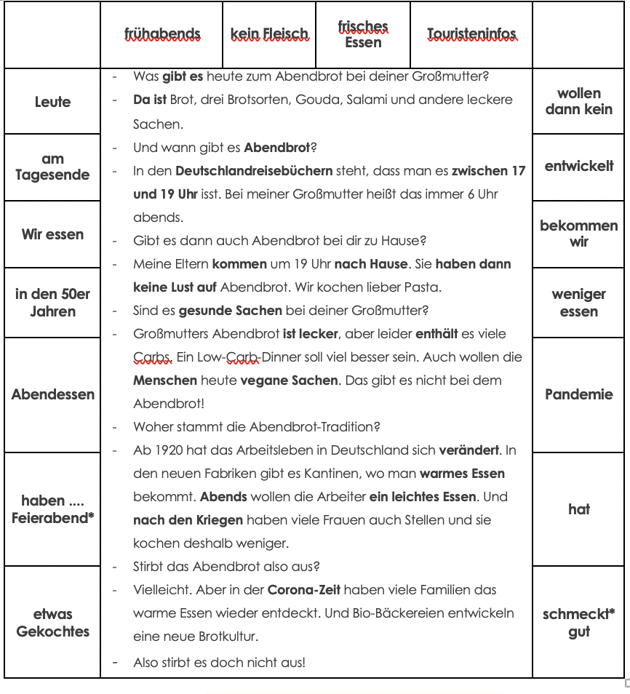
Hausaufgaben
Recap 10.1.1.5 homework
Notes:
Timing: 5 – 20 minutes Note: Lesson 3 in every week has less directed time to allow teachers the opportunity to adapt (consolidate and/or extend) the learning for their students.
Aim: to allow the opportunity for following up on homework from the previous week. Procedure: Teachers to use the time as appropriate to their students for whole class homework review.

Slide 3
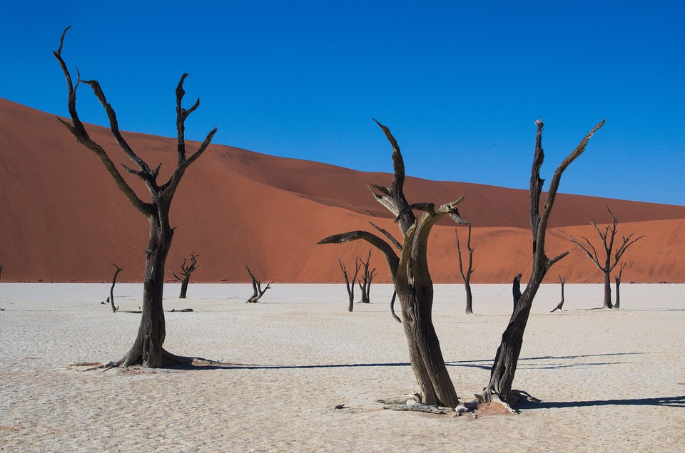
Vokabeln
lesen
Wie heißt das auf Englisch? Was ist auf dem Foto?
 | 1 | 2 | 3
A
B
C
D
to believe
aß
mischen
glauben
ate
to mix, blend
Mr
die Religion
son
der Herr
religion
der Sohn
field
daughter
same
das Feld
die Tochter
gleich
tun
to live
tree
to do
wohnen
der Baum
Notes:
F+H
Timing: 5 minutes
Aim: to recognize thematic vocabulary at word level.
Note: the two squares in grey are higher only vocabulary. In a foundation only class, the teacher could click to reveal the picture underneath these two squares before starting the exercise.
Procedure:
1. Students volunteer a letter/number combination relating to a square on the grid.
2. The whole class say the English translation in chorus.
3. Click the yellow box to reveal answer.
4. If the majority of the class says the correct answer, click the pale yellow box to reveal part of the underlying image.
5. Students guess what the image represents as more is revealed.
6. Ask students what they know about Namibia.
Answer: Deadvlei in Namibia

Slide 4
Namibia
Phonetik
Lies den Text deinem Partner/deiner Partnerin vor.
*Franzose – French person | verursachen – to cause | töten – to kill
The phrase einen Platz in der Sonne was first used by Bernhard von Bülow in a Reichstag debate on colonial policy in 1897. He stated that Germany demanded its “place in the sun”. The phrase has become synonymous with Germany’s striving for colonial power in the period before the First World War.
1900 hatten die Franzosen* und die Engländer schon viel Macht in Afrika
und Deutschland wollte auch einen Platz in der Sonne haben.
Deutschland hat Namibia kolonisiert und deshalb sprechen einige hier
noch Deutsch. Die Deutschen haben ihre Kultur nach Afrika gebracht
und deshalb kann man sie in dem Land von Namibia noch wahrnehmen.
Die Kolonisierung hat große Probleme für die Menschen in Afrika verursacht*. Im Osten von Namibia haben die Deutschen den Namibiern Tiere und Gebäude weggenommen. Deutsche haben 80000 Herera und Nama getötet*. Jetzt denken Wissenschaftler sehr schlecht über die deutsche Kolonialzeit.
Notes:
See below for links to further information about colonialism in Germany.
F+H
Timing: 8 minutes
Aim: to practise recognition of long and short [a] [o] [u].
Procedure:
Students work in pairs using handouts. Student A reads the first paragraph to their partner, who circles any examples of short a o and u and underlines any examples of long a o and u that they hear. Students then swap roles.
Click to hear a native speaker read aloud the text. Students double check their answers.
Click to reveal answers.
Click to reveal a callout which explains einen Platz in der Sonne.
Click to hide the callout and then students discuss in English what they have learned about the colonial history of Namibia.
Transcript:
1900 hatten die Franzosen* und die Engländer schon viel Macht in Afrika und Deutschland wollte auch einen Platz in der Sonne haben.
Deutschland hat Namibia kolonisiert und deshalb sprechen einige hier noch Deutsch. Die Deutschen haben ihre Kultur nach Afrika gebracht
und deshalb kann man sie in dem Land von Namibia noch wahrnehmen.
Die Kolonisierung hat große Probleme für die Menschen in Afrika verursacht. Im Osten von Namibia haben die Deutschen den Namibiern Tiere und Gebäude weggenommen. Deutsche haben 80000 Herera und Nama getötet. Jetzt denken viele Wissenschaftler sehr schlecht über die deutsche Kolonialzeit.
Word frequency of unknown words (1 is the most frequent word in German): Franzose [2349] verursachen [1767] töten [1134] Source: Jones, R.L. & Tschirner, E. (2019). A frequency dictionary of German: core vocabulary for learners. Routledge
Further information about Germany‘s colonial past can be found here: Deutsche Kolonien – Klexikon – das Kinderlexikon (zum.de)
Deutsche Kolonien • Deutscher Kolonialismus in Afrika · [mit Video] (studyflix.de)
Kolonialismus / Kolonien | Politik für Kinder, einfach erklärt - HanisauLand.de
Nirgendwo in Afrika ≣ 2001 ≣ Trailer - YouTube

Slide 5
Warum spricht man Deutsch in Namibia?
lesen
Namibia liegt in Südwestafrika. Warum spricht man dort Deutsch? Die Antwort findet man in der Geschichte. 1880 gab es Interesse an Sub-Sahara-Afrika von Großbritannien, denn Afrika hatte Gold. Aber von 1884 bis 1915 war Namibia eine deutsche Kolonie, denn der Kanzler Bismarck wollte sie für seinen Reich. Die Deutschen haben ihre Sprache mitgebracht. Eine Sprache aus der Kolonialzeit hat natürlich auch immer eine negative Seite, weil Sprache auch Macht heißt. Auch heute sprechen noch 20.000 Personen in Namibia Deutsch. Es ist eine von den elf Nationalsprachen in Namibia. Dieses Deutsch ist aber anders als das Deutsch, das man in Deutschland spricht: es hat sich anders entwickelt. In der Kolonialzeit gab es deutsche Namen für die Städte, Dörfer und Straßen. Viele heißen heute noch so, besonders im Süden. Es gibt sogar auch noch eine deutsche Zeitung.
Richtig oder Falsch?
1) Deutschland war das einzige Land, das eine Kolonie in Afrika wollte. F
2) Großbritannien wollte in Südafrika reich werden. R
3) Fast dreißig Jahre war Namibia eine deutsche Kolonie. R
4) In der deutschen Kolonie Namibia hat man wenig Deutsch gesprochen. F
6) Heute ist Deutsch keine Nationalsprache in Namibia. F
7) 1900 waren die Stadtnamen in Namibia deutsche Namen. R
Notes:
F+H
Timing: 8 minutes
Aim: to practise comprehension of a longer test; to revise the perfect tense.
Procedure:
1. Students read the text about Namibia.
2. They read the statements and decide whether they are true or false.
3. Click to reveal answers.

Slide 6
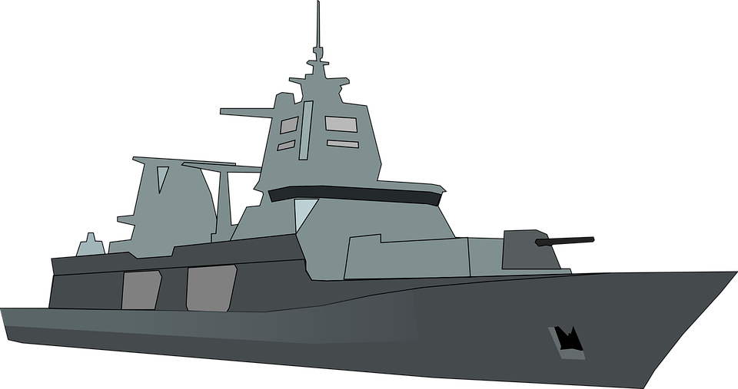
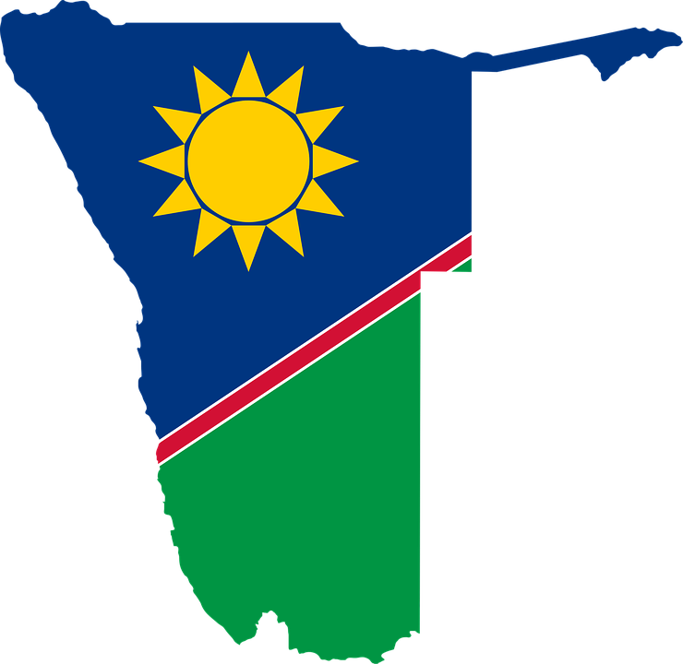
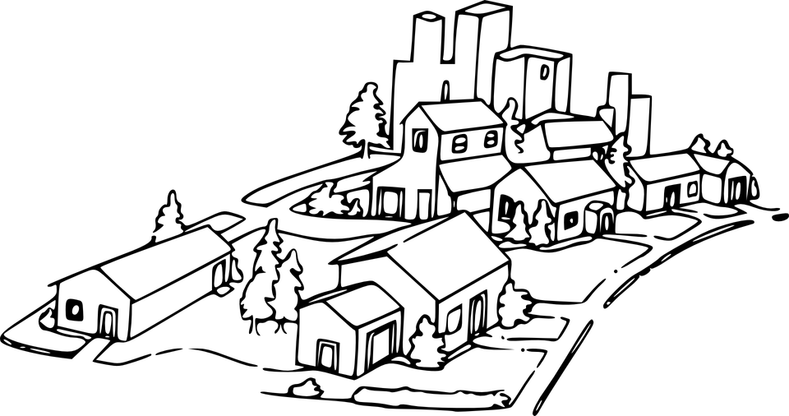
Namibia
Using the information you have just learned, and the pictures and text boxes below as prompts, write five sentences about colonialism in Namibia.
schreiben
Some useful words
die Kolonie – colony
kolonial – colonial
das Gold – gold
1884 - 1915
3
2
1
1
3
denken, nennen, tun, wissen, ziehen, haben, sein, bringen
Land, Afrika, Kanzler, Situation, Ort, Aktion
gerecht, Angriff, Sorge
denken, entscheiden, lassen, legen, ziehen, bringen, beginnen, gehen, kommen
Notes:
F+H
Timing: 10 minutes
Aim: to bring together this week’s main grammar (perfect/imperfect tenses) and vocabulary in a writing task.
Procedure:
1. Students write five sentences about colonialism in Namibia.
2. Foundation students should write their sentences in the perfect tense. Higher students should use the imperfect.
3. Students must use the minimum number of words from each box at the bottom of the slide. Foundation students look at the numbers in the yellow circles (i.e., 3 from box 1 and 2 from box 2) and Higher students look at the numbers in the grey circles (i.e., 1 from the 2nd gold box, 1 from the first grey box, and 3 from the 2nd grey box).
Word frequency of unknown words (1 is the most frequent word in German): Kolonie [>5000] kolonial [>5000] Gold [2413] Source: Jones, R.L. & Tschirner, E. (2019). A frequency dictionary of German: core vocabulary for learners. Routledge

Slide 7
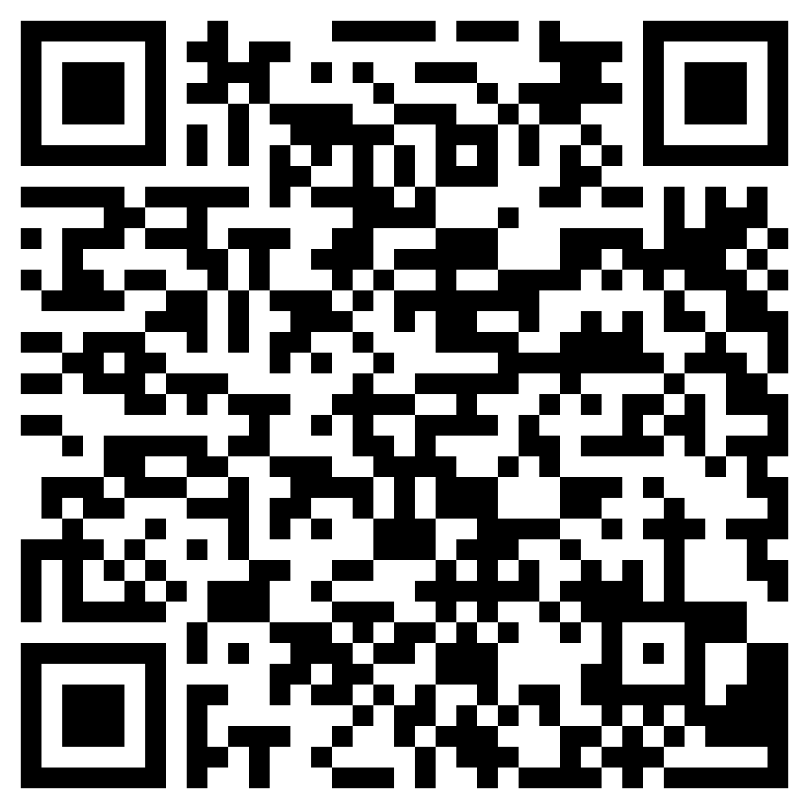
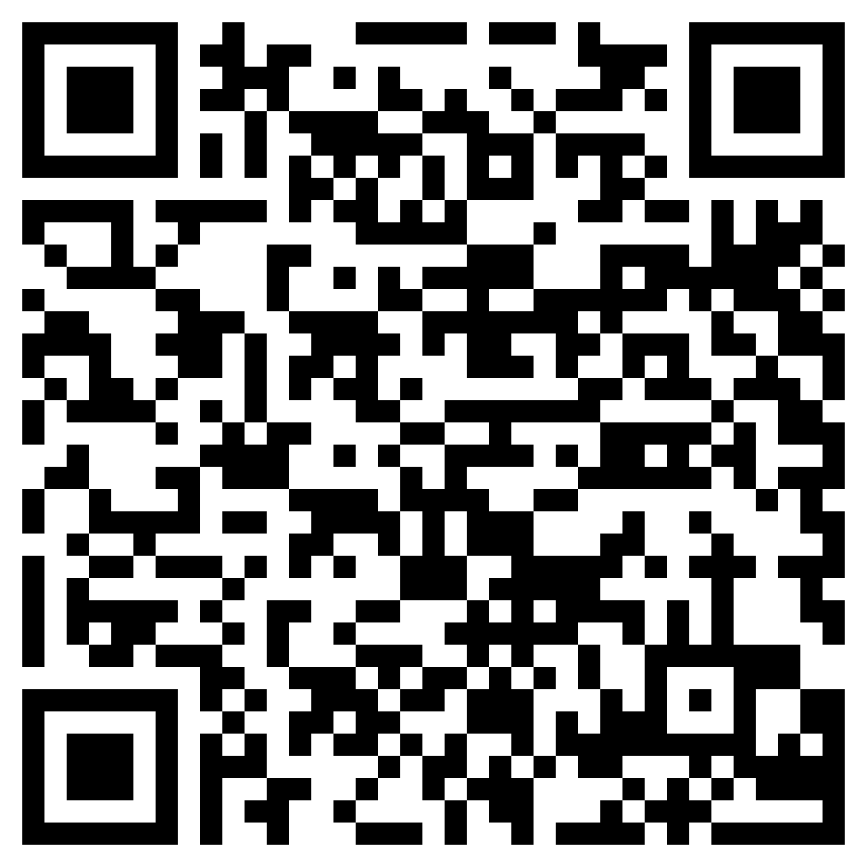
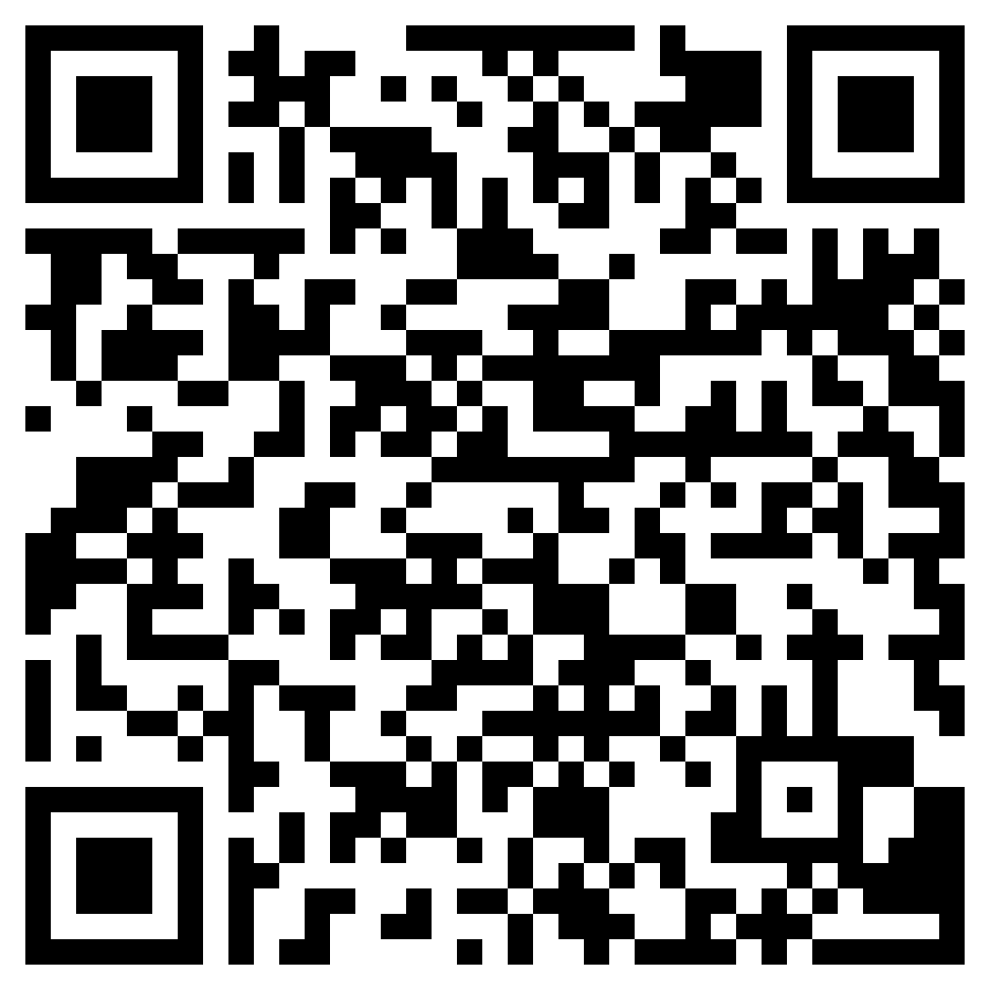
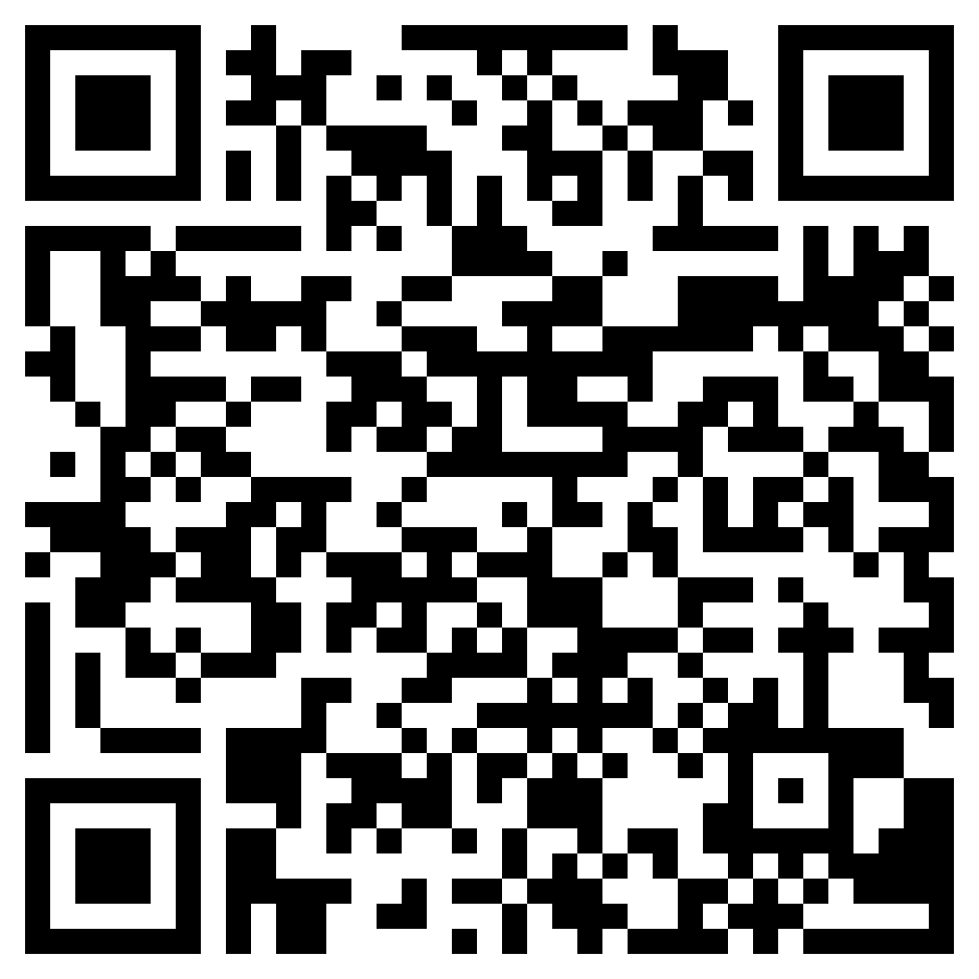
Hausaufgaben
10.1.1.7 new vocabulary
Foundation
Higher
10.1.1.7 revisited vocabulary
Foundation
Higher
Notes:
Timing: 2 minutes Aim: to remind students of the vocabulary they are learning and revisiting as pre-learning for next week. Procedure: 1. Display the slide. Explain the tasks. 2. Post this slide or its information for students, using the usual school system for this.
Notes: A regular feature of the scheme of work (as for KS3) is that students spend time learning the vocabulary for the following week’s lessons. This can be done using any platform. We provide the words on Quizlet. Most lists are also available (free to all schools, not just subscribers) on LanguageNut. Teachers may of course create their own versions of vocabulary learning activities in any of the different platforms available. At KS4, there are several sets for learning/revisiting: 1. The new vocabulary for the following week. 2. The revisited thematic vocabulary (from KS3 SOW) assigned to the week. 3. The systematic revisiting (at +3 and +9 weekly intervals) of new vocabulary.
In the KS4 SOW every word from the GCSE vocabulary list has been tracked to ensure that: 1. New words are introduced, revisited twice at intervals during the course, and once again during the final 9-week revision phase. 2. KS3 revisited thematic vocabulary is revisited twice during the course, and once again during the final 9-week revision phase. 3. KS3 function words (listed as R(equired) on Annex E of the GCSE Subject Content are all revisited multiple times (Column D on the KS4 SOW) and the revisits are also tracked on the KS4 Vocabulary tracker.
We anticipate that students will spend on average 2 hours on homework per week at KS4. As a general rule, one hour would be assigned to vocabulary learning (and ideally this time will be spread across the week). The aim at KS3 was to establish a ‘little and often’ approach to vocabulary learning, using an app to facilitate this. This learning habit will hopefully continue into KS4. The 2nd hour will generally include additional reading, listening, speaking tasks. Teachers will be best placed to decide whether to include extended writing tasks for homework. However, given the availability of online translation tools and the strong temptation to use them, such tasks might best be undertaken in class, where teachers can replicate the conditions for written language production that will apply for students at GCSE.

