Slide 1
Identität
Syrer in Deutschland
Year 10 Term 1.1 Week 6 Lesson 1
Charlotte Moss / Janine Turner
Artwork: Steve Clarke
Date updated: 15/2/2023
Notes:
Artwork by Steve Clarke. All additional pictures selected are available under a Creative Commons license, no attribution required. Native-speaker teacher feedback provided by Stephanie Cross.
Learning outcomes
Introduce: Simple past weak and strong plural (H)
Introduce: Perfect tense irregular past participles
Revisit: Perfect tense weak verbs (+HABEN) with meaning 'did' and 'have done’
Revisit: Simple past (HABEN, SEIN, es gab) as single verb option for past Revisit: Simple past weak verbs (singular) (H); simple past strong verbs (singular) (H);
Phonics: SSC: long and short [a]|[o] [u] [link to grammar: simple past (H), past participles] hard and soft [ch] [link to grammar: simple past, plural rule 7]
New vocabulary: (aux)…gedacht [128] (aux)…genannt [191] (aux)…getan [123] (aux)…gewusst [78] (aux)…gezogen [193] hattest [6] warst [4] Afrika [2010] Kanzler [1983] Land2 [134] Situation [423] meiner Meinung nach [n/a] brachte (H) [163] dachte (H) [128] entschied (H) [414] lag (H) [107] ließ (H) [83] saß (H) [231] zog (H) [193] wusste (H) [78] Integration (H) [1282] gerecht (H) [2080]
Revisited vocabulary: beantworten [1865] bedeuten [398] Aktion1 [1838] Artikel [1378] Bedeutung [484] Gespräch [517] Reihe [738] Satz [432] Sinn [380] Unterschied [632] anders [303] betonen (H) [782] bilden1 (H) [315] klingen (H) [700] merken (H) [566] unterrichten (H) [3188] Ausdruck (H) [970] Begriff1 (H) [569] Übung (H) [1434] deutlich (H) [302] international (H) [426] verschieden (H) [254]
Thematic revisited vocabulary: (aux)…gebracht [163] bringen [163] glauben1 [156] heißen [126] lachen [444] lernen [288] tun1 [123] wohnen [560] ziehen [193] Baum [1013] Blick [306] Feld [834] Herr1 [154] Land1 [134] Mutter [218] Ort [341] Religion [1976] Sohn [596] Tochter [694] ganz1 [69] gleich1 [141] aß (H) [323] begann (H) [251] ging (H) [66] kam (H) [62] mischen (H) [2160] Angriff (H) [1489] Sorge (H) [888]
Revisited function words: hatte, hatten, hattet, war, waren, wart, es gab
Source: Jones, R.L & Tschirner, E. (2019). A frequency dictionary of German: Core vocabulary for learners. London: Routledge.
The frequency rankings for words that occur in this PowerPoint which have been previously introduced in NCELP resources are given in the NCELP SOW and in the resources that first introduced and formally re-visited those words.
For any other words that occur incidentally in this PowerPoint, frequency rankings will be provided in the notes field wherever possible.

Slide 2
Vokabeln
Wolfgang und Mia machen einen Online-Escape-Room. Hör zu. Welches Wort ist richtig? Welches Wort ist das? Was ist das Thema für diese Stunde?
SUCCESS!
SYRER (in Deutschland)
 | 1 | 2 | 3 | 4
 | Punkt | Situation | warnen | Liste
 | erwarten | Hobby | Yoga | immer
 | zahlen | Reise | Blick | Eintritt
 | Berg | ohne | Küste | Essen
 | Abend | Angst | Rede | besonders
A
S
B
Y
C
R
D
E
E
R
Notes:
F+H
Timing: 6 minutes Aim: to revisit some of this week’s vocabulary items. Procedure: 1. Click on the action buttons to hear the definitions.
2. Students decide which word is the correct answer
3. The first letter of each answer will spell out the secret word.
4. Click to reveal the answers (the secret word) along the door.
5. When all the correct answers have been revealed, the door will open, revealing a picture of Syria.
6. Ask students whether they know anything about Syria or why a lot of Syrians came to Germany.
Transcript:
Du warst letzte Woche in der gleichen [Situation].
Hattest du wieder [Yoga]?
Die Kanzler [Reise] nach Afrika war kurz.
Meiner Meinung nach ist das [Essen] auf dem Land frisch und lecker.
Freie und gerechte [Rede] ist wichtig für die Integration.

Slide 3
Irregular Past Participles
hören
As you know, the past participles of some verbs do not follow a pattern. Listen to the following past participles. What is their infinitive version?
denken
1
nennen
2
3
tun
4
wissen
5
ziehen
6
bringen
Notes:
F+H Timing: 5 minutes Aim: to practise irregular past participles and their infinitives. Procedure:
1. Click on the audio buttons to hear a past participle. All participles in this exercise are in this week’s vocabulary, so students should already be familiar with their meanings.
2. Students listen to the participle and note the infinitive on the right it refers to.
3. Click to reveal answers.
Transcript: 1. getan
2. gebracht
3. gedacht
4. gezogen
5. gewusst
6. genannt

Slide 4
Imperfect tense vocab
hören
As you know, the stems of some verbs in the imperfect tense are irregular. Listen to the following verbs. What is their infinitive version?
1
brachte
ziehen
2
wusste
denken
3
ließ
entscheiden
4
lag
wissen
5
dachte
sitzen
6
zog
bringen
7
saß
liegen
8
entschied
lassen
Notes:
Higher Timing: 5 minutes Aim: to practise irregular imperfect verbs and their infinitives. Procedure:
1. Click on the audio buttons to hear a verb. All verbs in this exercise are in this week’s vocabulary, so students should already be familiar with their meanings.
2. Students listen to the verb and note the corresponding infinitive on the right.
3. Click to reveal answers.
Transcript: 1. brachte
2. wusste
3. ließ
4. lag
5. dachte
6. zog
7. saß
8. entschied

Slide 5
Irregular Past Participles
übersetzen
Wie heißt das auf Englisch?
getan
did
gezogen
pulled, moved
gebracht
brought
gewusst
knew
gedacht
thought
genannt
named
Notes:
Foundation
Timing: 5 minutes
Aim: to revise some of this week’s vocabulary.
. getan
2. gebracht
3. gedacht
4. gezogen
5. gewusst
6. genannt
Note: In mixed-tier classes this activity can be used as a handout for foundation students while higher students complete the vocab exercise on the previous slide.
Procedure:
Students translate the past participles into German.
Click to reveal answers.

Slide 6
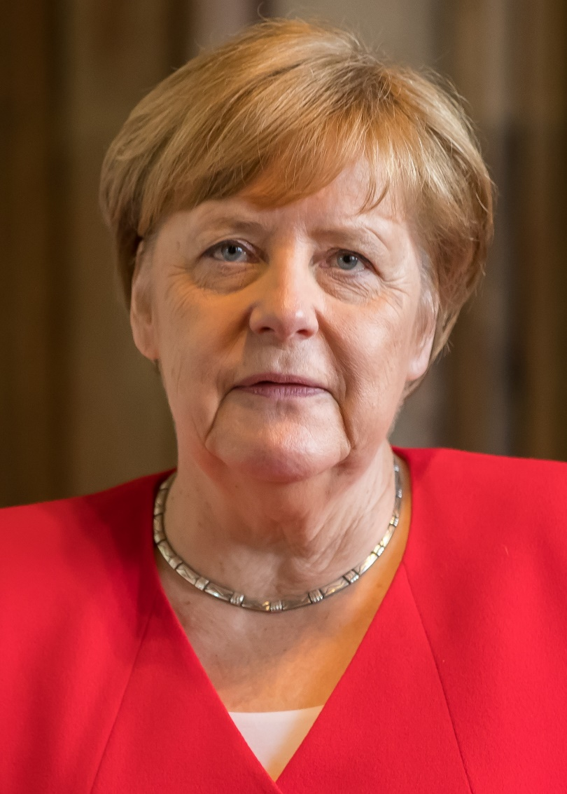
Syrer* in Deutschland
*Syrer – Syrians
Flüchtlinge – refugees
lesen/sprechen/hören
In den letzten Jahren haben viele Menschen Syrien verlassen. Damals war Angela Merkel Kanzlerin von Deutschland.
Sie wollte den Flüchtlingen* helfen, also hat sie 2015 sie nach Deutschland eingeladen. „Wir schaffen das!”, hat sie gesagt und gedacht. Und ihre Idee war gerecht! Viele Menschen haben Deutschland erreicht. Die Situation war nicht immer einfach, aber man hat es geschafft.
Notes:
F+H Timing: 8 minutes (2 slides) Aim: to practise listening to and speaking soft and hard [ch]. Procedure:
Students read the first paragraph of each slide to themselves for background knowledge.
Students work in pairs. Student B turns away from the board. Click to revel the yellow box. Student A reads the text to student B, paying particular attention to their pronunciation of the words in bold. Student B notes down any words they hear that contain [ch] and whether it is soft or hard. Student B then turns back to face the board to check their answers.
Click the gold text box to hear the text pronounced.
Click to reveal the following slide. Students repeat steps one and two, but swap roles for step two.
Angela Merkel: By © Raimond Spekking / CC BY-SA 4.0 (via Wikimedia Commons), CC BY-SA 4.0, https://commons.wikimedia.org/w/index.php?curid=96378820
Word frequency of unknown words (1 is the most frequent word in German): Syrer [4860] Flüchtling [410] Source: Jones, R.L. & Tschirner, E. (2019). A frequency dictionary of German: core vocabulary for learners. Routledge

Slide 7
Syrer in Deutschland
*Syrer – Syrians
gespalten – divided
lesen/sprechen/hören
Heute leben rund 800.000 Syrer in Deutschland. Yasmin Merei ist eine von ihnen. Vor dem Krieg hat sie in Homs gewohnt. 2015 ist sie nach Berlin gereist. Zuerst hat sie versucht, Berlin nicht zu mögen. Homs war ihre Heimat, nicht Berlin. Jetzt hat sie gelernt, Berlin zu mögen, aber sie fühlt sich gespalten*.
Ach, das war nicht einfach! In Berlin spürt sie ihre Nationalität nicht mehr. Wie viele Syrer hat sie Gefahr, auch Angriffe, erlebt. Aber in Berlin hat sie in Sicherheit gelebt. Yasmin meint: „Heute lebe ich in Berlin. Emotional lebe ich immer noch in Syrien.“
Notes:
[2/2]
Word frequency of unknown words (1 is the most frequent word in German): Syrer [4860] gespalten [>5000] Source: Jones, R.L. & Tschirner, E. (2019). A frequency dictionary of German: core vocabulary for learners. Routledge

Slide 8
Perfect tense translations
Remember! Use the German perfect tense for actions completed in the past.
Here, the time phrase prompts us to use the ‘have done’ translation.
English translates it in two ways:
I did (emphasises the completion of a past action)
I have done (emphasises the ongoing effect of a past action)
In den letzten Jahren haben viele Menschen Syrien verlassen.
In the last (few) years many people have left Syria.
The time phrase (in 2015) emphasises the completion and prompts us to use the ‘did’ (simple past).
2015 Angela Merkel hat sie nach Deutschland eingeladen.
In 2015 Angela Merkel invited them to Germany.
If there is no time phrase, use the translation that best fits the context.
Notes:
F+H Timing: 4 minutes
Aim: to quickly recap the two English translations of the German perfect tense. Procedure:
Students read the quick reminder.
Ask students to suggest translations for the two German sentences, chorally.
Click to reveal the answers and callouts explaining why each translation has been used.

Slide 9
Syrer in Deutschland
lesen
Lies die Sätze noch einmal. Ist es ‘did’ oder ‘have done’ auf Englisch?
Aber in Berlin hat sie immer in Sicherheit gelebt.
Jetzt hat sie gelernt, Berlin zu mögen.
2015 ist sie nach Berlin gereist.
Zuerst hat sie versucht, Berlin nicht zu mögen.
Vor dem Krieg hat sie in Homs gewohnt.
„Wir schaffen das!”, hat sie gesagt und gedacht.
Wie viele Syrer hat sie Gefahr, auch Angriffe, erlebt.
have done
did
Notes:
F+H Timing: 10 minutes
Aim: to practise the two English translations of the German perfect tense. Procedure:
Click to reveal the first sentence. Students chorally translate the sentence to English and then decide whether they have translated the sentence as ‘did’ or ‘have done’.
Click to reveal the answer.
Click to reveal the next sentence and repeat steps one and two.
Note: We begin with the sentences that have adverbial time phrases that strongly suggest the correct English tense. The final three sentences have no time indicator, and students need prompting to consider / refer back to the context for a ‘best fit’. Without a time phrase, either translation is usually possible:
1. Wie viele Syrer hat sie Gefahr, auch Angriffe, erlebt. (Like many Syrians, she (has) experienced danger, even/also attacks). The choice here depends on whether we choose to emphasise that this happened but is completely over (simple past) or whether it is still something that has an ongoing effect on her life (present perfect). 2. Aber in Berlin hat sie immer in Sicherheit gelebt. (But in Berlin she (has) always lived in safety). If this were the biography of someone who had either since died or moved to a different city now, then we would prefer the simple past here, but given that she is still living in Berlin now, we prefer the present perfect. 3. Wir schaffen das!, hat sie gesagt and gedacht. (Even without a time phrase here, the fact that it is an utterance – we’ll do this! – suggests that it was said once and thought once, so we prefer the simple past here. However, in a different context, and the addition of ‘immer’ it would be possible to translate it ‘’We’ll do this!” she has always said and thought.

Slide 10
Firas Alshater
lesen / schreiben
*Syrier – Syrian |Flüchtling – refugee | Gefängnis – prison
Firas Alshater ist Syrier. Lies seine Geschichte und schreib die richtigen Verben auf.
Firas Alshater lebt in Berlin, wo er Filme macht. Firas ist Syrier* und junge Deutsche lieben ihn. Firas macht Youtube-Comedy durch die Augen von einem politischen Flüchtling*.
In seiner Heimatstadt, Damaskus, hat Firas einige Jahre lang Theater studiert, dann hat er sein eigenes Filmunternehmen entwickelt. Firas hat gedacht: er kann seine politischen Meinungen durch Film aussprechen. Er hat zum Beispiel den Diktator Baschar al-Assad gefilmt. Firas hat gewusst, wie gefährlich das war. Die Folge? Firas musste einige Monate im Gefängnis* verbringen. Seine Familie hat oft seine Freiheit gekauft. Bis 2013. Dann hat ein Projekt ihn nach Deutschland gezogen.
1._______
2._______
3._______
4._______
5._____
6.______
7._______
8. ______
lieben
studieren
kaufen
denken
ziehen
machen
leben
wissen
Notes:
F+H Timing: 10 minutes
Aim: to practise vocabulary, irregular past participles, the perfect tense with haben, and to contrast the perfect tense with the present tense. Procedure:
Explain the task. Firas Alshater is a Syrian who has made a career out of his national identity in Germany.
Students must use the infinitives at the bottom of the slide to fill in the gaps in the text. They will need to conjugate the verbs either in the present tense or the perfect tense, depending on the presence of an auxiliary in the sentence. They will need to use their knowledge of vocabulary to decide where each verb should go.
Click to reveal the answers.
Note: The following slide is a continuation of this exercise and would make a good homework task.
Word frequency of unknown words (1 is the most frequent word in German): Flüchtling [410] Syrier [>5000] Gefängnis [2523] Source: Jones, R.L. & Tschirner, E. (2019). A frequency dictionary of German: core vocabulary for learners. Routledge

Slide 11
Firas Alshater
lesen / schreiben
*Flüchtling – refugee | vertrauen – to trust | umarmen – to hug
Firas Alshater is a Syrian who has made a career out of his national identity in Germany. Read his story and fill in the gaps using the verbs at the bottom.
Firas Youtube-Comedy ˵Zukar” stellt die Frage: Wann beginnt die Integration? Letzte Woche hat er sich mit geschlossen Augen an den Alexanderplatz gestellt. Ein Meter vor ihm hat er geschrieben: Ich bin Flüchtling*. Ich vertraue* dir. Vertraust* du mir? Umarme* mich! Auf den ersten Blick hat man sich sehr unsicher gefühlt. Aber bald umarmt* man ihn.
Durch Firas Augen schaut die ganze Welt Deutschland an. Die Deutschen sind ein freundliches Volk. Sie brauchen nur ein bisschen Zeit.
1._____
2._____
3._____.
4.__________
5._____
6._____.
7._____
8._______
sein
fühlen
schreiben
brauchen
stellen x2
beginnen
schauen
Notes:
SUGGESTED HOMEWORK TASK
Word frequency of unknown words (1 is the most frequent word in German): Flüchtling [410] vertrauen [1122] umarmen [3807] Source: Jones, R.L. & Tschirner, E. (2019). A frequency dictionary of German: core vocabulary for learners. Routledge

Slide 12
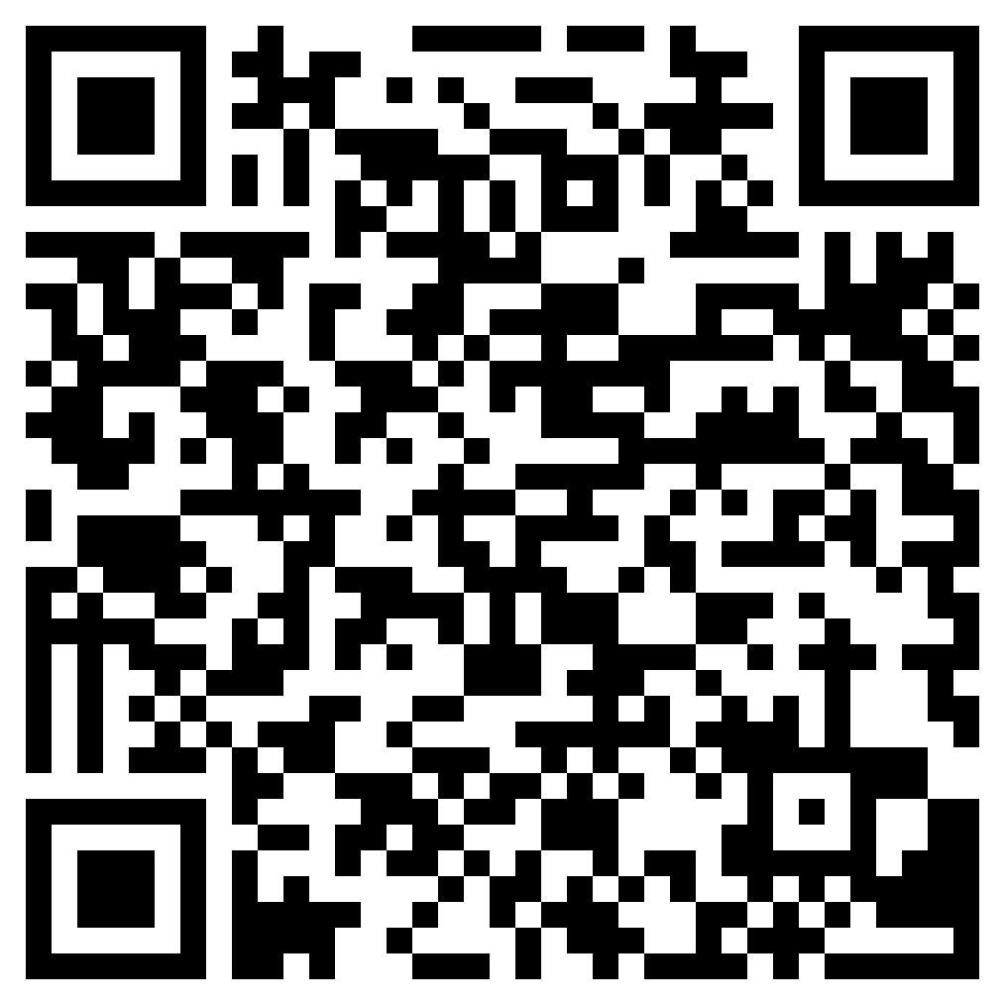
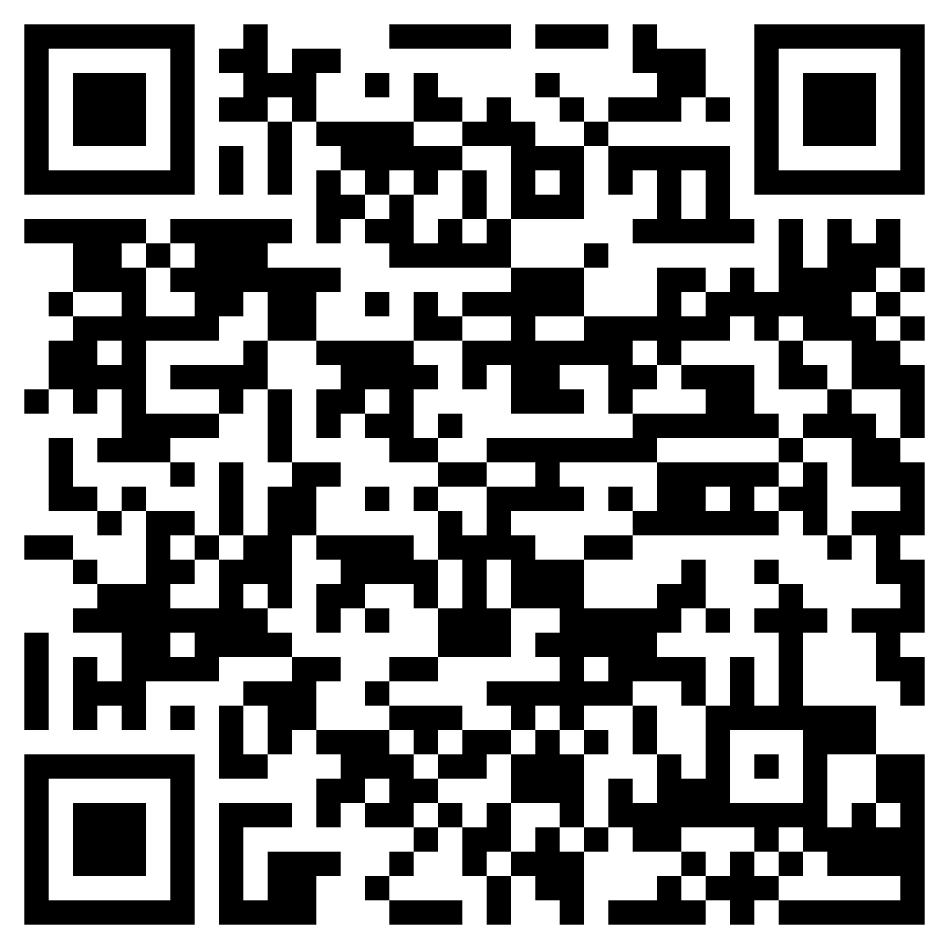
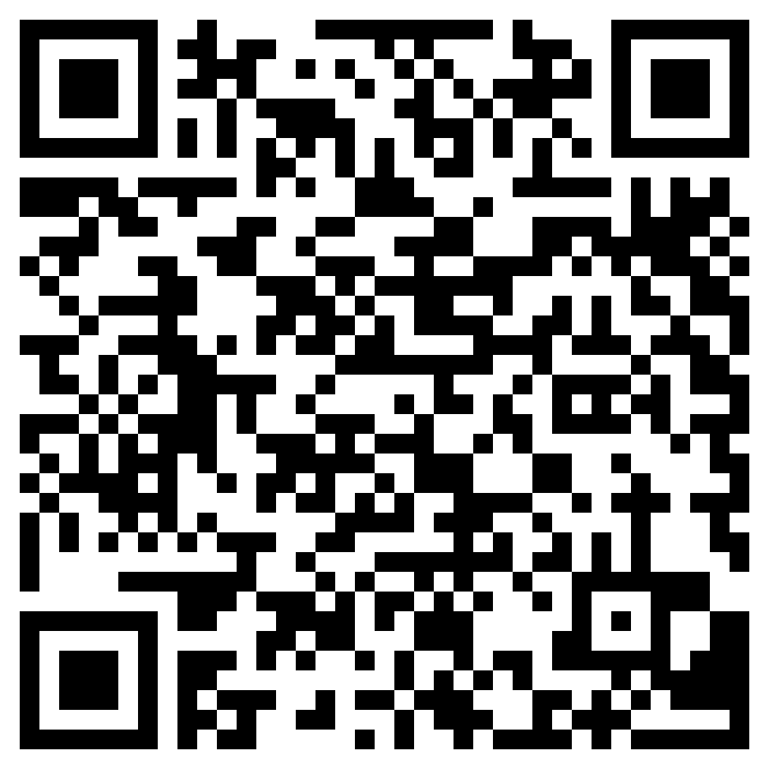
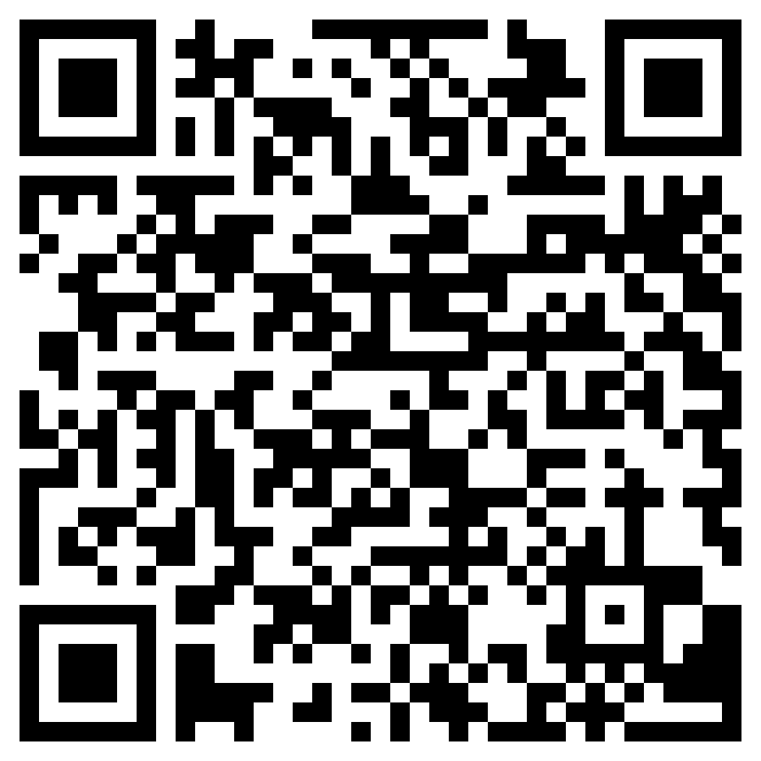
Hausaufgaben
10.1.1.6 new vocabulary
Foundation
Higher
Revisited vocabulary
Foundation
Higher
Notes:
Timing: 2 minutes Aim: to remind students of the vocabulary they are learning and revisiting this week. Procedure: 1. Display the slide. Explain the tasks. 2. Post this slide or its information for students, using the usual school system for this.
Notes: A regular feature of the scheme of work (as for KS3) is that students spend time learning the vocabulary for the following week’s lessons. This can be done using any platform. We provide the words on Quizlet. Most lists are also available (free to all schools, not just subscribers) on LanguageNut. Teachers may of course create their own versions of vocabulary learning activities in any of the different platforms available. At KS4, there are several sets for learning/revisiting: 1. The new vocabulary for the following week. 2. The revisited thematic vocabulary (from KS3 SOW) assigned to the week. 3. The systematic revisiting (at +3 and +9 weekly intervals) of new vocabulary.
In the KS4 SOW every word from the GCSE vocabulary list has been tracked to ensure that: 1. New words are introduced, revisited twice at intervals during the course, and once again during the final 9-week revision phase. 2. KS3 revisited thematic vocabulary is revisited twice during the course, and once again during the final 9-week revision phase. 3. KS3 function words (listed as R(equired) on Annex E of the GCSE Subject Content are all revisited multiple times (Column D on the KS4 SOW) and the revisits are also tracked on the KS4 Vocabulary tracker.
We anticipate that students will spend on average 2 hours on homework per week at KS4. As a general rule, one hour would be assigned to vocabulary learning (and ideally this time will be spread across the week). The aim at KS3 was to establish a ‘little and often’ approach to vocabulary learning, using an app to facilitate this. This learning habit will hopefully continue into KS4. The 2nd hour will generally include additional reading, listening, speaking tasks. Teachers will be best placed to decide whether to include extended writing tasks for homework. However, given the availability of online translation tools and the strong temptation to use them, such tasks might best be undertaken in class, where teachers can replicate the conditions for written language production that will apply for students at GCSE.

