Slide 1
Describing future plans
Using ‘para’ + infinitive
SSCs [cue], [cua], [cui] [revisited]
Y8 Spanish
Term 1.2 - Week 5 - Lesson 23
Victoria Hobson / Nick Avery / Jack Peacock Artwork: Mark Davies
Date updated: 08/07/21
Notes:
Artwork by Mark Davies. All additional pictures selected are available under a Creative Commons license, no attribution required.
Learning outcomes (lesson 1):
Consolidation of SSCs [cue], [cua], [cui]
Introduction of para + infinitive
Consolidation of ir a + infinitive (singular persons)
Word frequency (1 is the most frequent word in Spanish):
8.1.2.6 (introduce) vocab set: van [ir-33]; país [109]; café [961]; costa [896]; para² [16]; tomar² [133]; presentar [235]; enseñar [610]; el tema [240]; pronto [376]; próximo [466]; paseo [2126]; compra [1162]; tapa [3645]; copa [1514]
8 1.2.2 (revisit) salir [114]; subir [410]; perder [195]; recoger [828]; partido [302]; el fútbol [1471]; entrada [767]; billete [292]; pues¹ [73]; fin [182]; semana [301]; inglés² [583]; jugador [1019]; (a) pie [365]
8 1.1.4 (revisit) vender [528]; entender [229]; creer (en) [83]; esconder [1130]; poner [91]; noticia [859]; periodista [1235]; entrevista [1653]; página [598]; sobre¹ [62]; que [3] realidad [260]; sociedad [353]
Source: Davies, M. & Davies, K. (2018). A frequency dictionary of Spanish: Core vocabulary for learners (2nd ed.). Routledge: London
The frequency rankings for words that occur in this PowerPoint which have been previously introduced in NCELP resources are given in the NCELP SOW and in the resources that first introduced and formally re-visited those words.
For any other words that occur incidentally in this PowerPoint, frequency rankings will be provided in the notes field wherever possible.

Slide 2
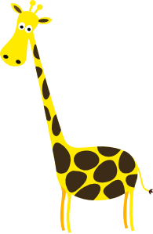
CU + vowel [revisited]
hablar
Remember, the vowel [u] merges with another vowel to make a single syllable. This is called a ________ vowel.
weak
Words with ‘cu’ + vowel follow this pattern.
cuerpo
escuela
cuello
to look after
50
cuidar
cuatro
cincuenta
cuadro
cuarenta
40
consecuencia
[consequence]
Notes:
Timing: 3 minutes
Aim: to recap weak vowels and apply this understanding to a sound-spelling correspondence that was taught in Year 7: [cu] + vowel
Procedure:
Bring up the explanation and elicit the missing word from students (weak vowels were taught in 8.1.1.3).
Bring up the example words. Some of these were already taught as phonics and/or vocabulary words in Year 7. Others (cuello, cuarenta, cincuenta, consecuencia) are new and included to broaden the range of practice words. All words are within the 2000 most frequent in Spanish. Pronunciation of the word each word modelled by a native speaker.

Slide 3
CU + vowel [revisited]
escuchar / escribir
Escucha y escribe la palabra en español.
 | Palabra en español
 | Palabra en español
escuela
cuello
1
5
cuidar
cuadro
2
6
cuarenta
consecuencia
3
7
cuerpo
cincuenta
4
8
Notes:
Timing: 3 minutes
Aim: to consolidate understanding of the SSC [cu+vowel]
Procedure:
Students listen to the word and write it in Spanish.
At the end of the listening activity, give students a minute in pairs to translate the words to reinforce meanings in English.
Transcript:
escuela
cuidar
cuarenta
cuerpo
cuello
cuadro
consecuencia
cincuenta

Slide 4
Vocabulario
hablar
5
Segundos
[about]
[to believe, believing]
[news item]
la noticia
creer
sobre
0
INICIO
Notes:
Timing: 1 minute for the next five slides
Aim: to practise productive (oral) recall of three words within a given time. This is slide 1/5.
Procedure:
1. Say all three words before five seconds elapse.
2. Click to reveal answers.
3. Repeat if additional practice needed.
Vocabulary from revisited sets:
8.1.1.4: noticia [859]; creer [83]; sobre¹ [62]

Slide 5
Vocabulario
hablar
5
Segundos
[to put, putting]
[page]
[society]
poner
la página
la sociedad
0
INICIO
Notes:
This is slide 2/5.
Vocabulary from revisited sets:
8.1.1.4: poner [91]; página [598]; sociedad [353]

Slide 6
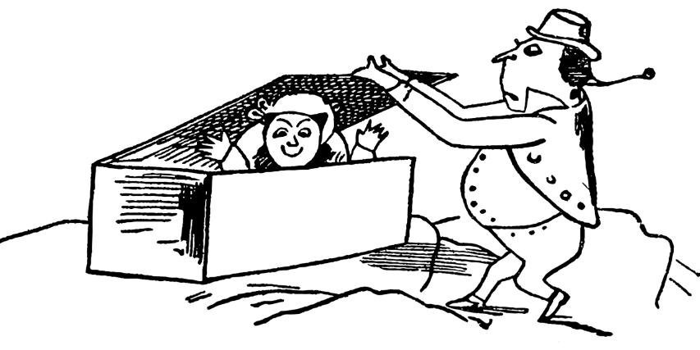
Vocabulario
hablar
5
[that]
Segundos
[to hide, hiding]
esconder
el/la periodista
que
0
INICIO
Notes:
This is slide 3/5.
Vocabulary from revisited sets:
8.1.1.4: esconder [1130]; que [3]; periodista [1235]

Slide 7
Vocabulario
hablar
5
[to sell]
[reality]
Segundos
[interview]
vender
la entrevista
la realidad
0
INICIO
Notes:
This is slide 4/5.
Vocabulary from revisited sets:
8.1.1.4: vender [528]; entrevista [1653]; realidad [260]

Slide 8
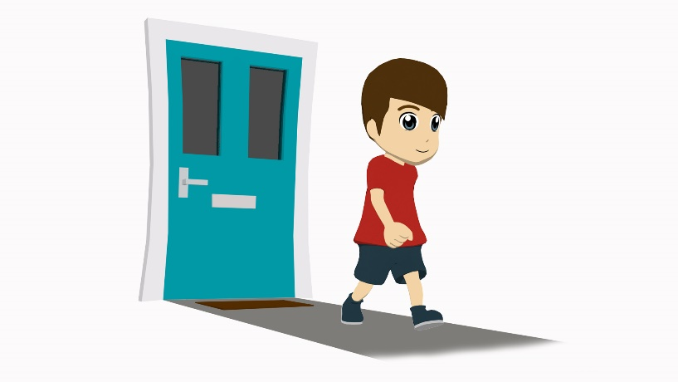
Vocabulario
hablar
5
Segundos
[to understand, understanding]
[to go out]
[to go up]
entender
salir
subir
0
INICIO
Notes:
This is slide 5/5.
Vocabulary from revisited sets:
8.1.1.4: entender [229];
8.1.2.2: salir [114]; subir [410]

Slide 9
Vocabulario
hablar
 | Word | English meaning
1 | van | they go, are going
2 | el país | country
3 | el café | coffee
4 | la costa | coast
5 | para | for, in order to
6 | tomar | to take, to drink
7 | presentar | to present, presenting
8 | el tema | topic, issue
9 | pronto | soon
10 | próximo, próxima | next
Notice how tema ends in –a but is a masculine noun.
Próximo is commonly used before the noun
(e.g. la próxima clase).
Notes:
Timing: 2-4 minutes
Aim: to embed word knowledge of this week’s vocabulary set.
Procedure 1. Pupils either work by themselves or in pairs, reading out the words and studying their English meaning (1 minute). 2. Then the English meanings are removed and they try to recall them, looking at the Spanish (1 minute). 3. Then the Spanish meanings are removed and they to recall them, looking at the English (1 minute) 4. Further rounds of learning can be facilitated by one pupil turning away from the board, and his/her partner asking him/her the meanings. This activity can work from L2 → L1 or L1 → L2.
Note:
paseo [2126]; compra [1162]; tapa [3645]; copa [1514] are to be introduced in lesson 2
According to an analysis of the Corpus del Español (the same corpus used for A frequency dictionary of Spanish: Core vocabulary for learners), ‘próximo’ was found to be used both prenominally and postnominally. However, it was one of the 10 adjectives that most commonly preceded nouns, and we therefore emphasise its prenominal position in the callout above. http://spanishlinguist.us/tag/before-or-after-noun/

Slide 10
IR [revisited]
gramática
Remember, to mean ‘to the’, use use ‘a la’ for singular feminine nouns and ‘al’ for singular masculine nouns..
voy
I go, am going = _____
you go, are going = _____
s/he or it goes, is going = _____
vas
va
To talk about what someone is going to do (future plans), use part of the verb ‘ir’ + a + infinitive:
Voy
a
tomar
un café.
=
I am going to drink a coffee.
Vas
a
ir
You are going to go to the cinema.
al cine.
=
Va
a
ir
a la costa.
=
S/he is going to go to the coast.
Notes:
Timing: 2 minutes
Aim:
To recap previously learnt singular persons of the verb ‘ir’.
To recap ir + a + infinitive to talk about future plans.
To recap al vs. a la for ‘to the’.
Procedure:
Read through the slide, eliciting the Spanish and translations. These include some of the language introduced on the last slide (tomar, costa) for further reinforcement.

Slide 11
Talking about intentions Using ‘para’ + infinitive
gramática
You have already learnt one meaning of the word ‘para’:
El regalo es para mi madre.
=
The present is for my mum.
‘Para’ can also mean ‘in order to’.
We often leave out the words ‘in order’ in spoken English.
Voy a ir al parque para ver un partido de fútbol.
I am going to go to the park (in order) to watch a football match.
Vas a viajar a la costa para comprar un barco.
You are going to travel to the coast (in order) to buy a boat.
When used in this way, ‘para’ is always followed by an infinitive.
Notes:
Timing: 1 minute
Aim:
To recap the previously learnt meaning of ‘para’ as ‘for’.
To introduce the second meaning of ‘para + infinitive’ as ‘in order to’.
Procedure:
Read through the slide, eliciting the translations of the example sentences.

Slide 12
Talking about intentions Using ‘para’ + infinitive
gramática
Lee las frases. ¿Qué significa ‘para’ en cada frase (‘for’ or ‘in order to’)?
Elige la opción correcta y escribe quién es.
 |  | ‘for’ | ‘in order to’ | ¿Quién? (I, you, s/he)
1. | Va al centro para tomar un café rico.
2. | Vas a ir a otro país para enseñar inglés.
3. | Pues, voy a comprar una casa para mi abuelo muy pronto.
4. | ¿Vas a recoger los billetes para el viaje a la costa?
5. | ¿Cuándo va a buscar las entradas para el partido de fútbol?
6. | Voy a leer la entrevista para entender la realidad.
s/he
you
I
you
s/he
I
Notes:
Timing: 6 minutes
Aim: to consolidate understanding of the verb ‘ir’ in singular persons and the meanings of ‘para’ (written modality).
Procedure:
Students read the sentences and decide if ‘para’ will be translated as ‘for’ or ‘in order to’.
The teacher could also check understanding of who the verb refers to in items 1,2,3, 4 and 6 (‘I’, ‘you’ or ‘s/he’).
Vocabulary from revisited sets:
8.1.2.2 pues [73]; recoger [828]; billete [292]; partido [302]; fúbol [1471]
8.1.1.4 entender [229]; realidad [260]

Slide 13
escuchar
Dos amigos hablan de sus planes para la próxima semana. Escucha y escribe ‘I’, ‘you’ o ‘s/he’. Luego, escribe la traducción de ‘para’ y completa la frase.
escuchar
 | I | you | s/he
for | in order to | ¿Cómo termina la frase?
1
for the journey/trip
(in order) to see a football match
2
3
for the interview
4
(in order) to look for work
(in order) to rest on the beach
5
6
for the holidays
(in order) to practise the language
7
8
for a party
Notes:
Timing: 8 min
Aim: to consolidate understanding of the verb ‘ir’ in singular persons and the meanings of ‘para’ (oral modality).
Procedure:
Students listen to each sentence and identify the correct form of the verb ‘ir’
Students listen again and decide if ‘para’ means ‘for’ or ‘in order to’, depending on whether it is followed by an infinitive or not, and the rest of the sentence.
Note: Some students may be able to complete both parts as they go.
Transcript:
1. Voy a comprar billetes para el viaje.
2. Vas a ir a Madrid para ver un partido de fútbol.
3. Voy a recoger una camisa limpia para la entrevista.
4. Va a ir a otro país para buscar trabajo.
5. Voy a viajar a la costa para descansar en la playa.
6. Va a comprar ropa nueva para las vacaciones.
7. Vas a presentar unos temas en inglés para practicar el idioma.
8. Va al centro para una fiesta.
Vocabulary from revisited sets:
8.1.1.2 billete [292]; fin [182]; semana [301]; partido [302]; fútbol [1471]; recoger [828]
8.1.1.4 entrevista [1653]

Slide 14
Los planes de verano
escribir, hablar y escuchar
Ejemplo
Persona A: Mira la carta y habla. Si necesitas, puedes escribir la segunda parte de la frase antes de hablar.
You are going to visit France
Vas a visitar Francia para ver las montañas.
(in order) to see the mountains
para ver las montañas
………………………
Persona B: Escucha y completa la tabla.
 | ¿Quién? |  |  | ‘for’ | ‘in order to’ | Completa la frase en inglés
1. | I | you | s/he
(in order) to see the mountains
Notes:
Timing: 12 minutes (2 minutes explanation, 10 minutes activity)
Aim:
to practise producing and understanding sentences with ‘IR’ + infinitive in singular persons
to practise constructing sentences with ‘para’ and to understand its two translations into English.
Procedure:
The teacher can use this slide to show students a worked example of the activity.
Upon distributing the prompt cards, students are given a couple of minutes to consider what they will say. They can use reference material (i.e. looking book in their exercise books or using their vocabulary books) to help them with this first step before they begin the pair work properly. Since the task already requires production of ‘IR’ + infinitive in singular persons, students could write the second part of the sentence in Spanish before speaking. However, writing the full sentence out before speaking is to be avoided as this would mean that no retrieval of language is needed in oral production. As always, there is a judgement for teachers to make here about the desirable level of difficulty. Some groups can (and should) be encouraged to complete the tasks only using English prompts; others will benefit from a degree of scaffolding.

Slide 15
Los planes de verano
escribir, hablar y escuchar
Persona A
I am going to go to the centre
She is going to buy the tickets
(in order) to drink a coffee
for the journey/trip
………………………
………………………
You are going to pick up a shirt
I am going to travel to the coast
She is going to look for a present
for the holidays
(in order) to rest on the beach
for a friend
………………………
………………………
………………………
Notes:
Student A speaking prompts – Do not display in class.

Slide 16
Los planes de verano
escribir, hablar y escuchar
Persona B
You are going to go to another country
I am going to present some topics
(in order) to teach English
for the activities in class
………………………
………………………
You are going to visit Valencia
She is going to buy some tickets
I am going to go to Italy soon
(in order) to see a football match
for a concert
(in order) to discover the coast
………………………
………………………
………………………
Notes:
Student A speaking prompts – Do not display in class.

Slide 17
Los planes de verano
escribir, hablar y escuchar
Escucha las frases de tu compañero/a.
Completa la tabla.
 | ¿Quién? |  |  | ‘for’ | ‘in order to’ | Completa la frase en inglés
1. | ‘I’ | ‘you’ | ‘s/he’
2. | ‘I’ | ‘you’ | ‘s/he’
3. | ‘I’ | ‘you’ | ‘s/he’
4. | ‘I’ | ‘you’ | ‘s/he’
5. | ‘I’ | ‘you’ | ‘s/he’
Notes:
Blank student answer grid.
This can be left displayed on the board while the activity is taking place rather than printing this out. Students write the answers in their books.

Slide 18
Respuestas
escribir, hablar y escuchar
Persona A
¿Quién?
 |  |  |  | ‘for’ | ‘in order to’ | Completa la frase en inglés
1. | ‘I’ | ‘you’ | ‘s/he’
2. | ‘I’ | ‘you’ | ‘s/he’
3. | ‘I’ | ‘you’ | ‘s/he’
4. | ‘I’ | ‘you’ | ‘s/he’
5. | ‘I’ | ‘you’ | ‘s/he’
(in order) to teach English
for the activities in class
(in order) to see a football match
for a concert
(in order) to discover the coast
Persona B
¿Quién?
 |  |  |  | ‘for’ | ‘in order to’ | Completa la frase en inglés
1. | ‘I’ | ‘you’ | ‘s/he’
2. | ‘I’ | ‘you’ | ‘s/he’
3. | ‘I’ | ‘you’ | ‘s/he’
4. | ‘I’ | ‘you’ | ‘s/he’
5. | ‘I’ | ‘you’ | ‘s/he’
(in order) to drink a coffee
for the journey/trip
for the holidays
(in order) to rest on the beach
for a friend
Notes:
Timing: 2 minutes
Aim: to clarify the answers to bring the activity to a close
Procedure:
1. take feedback from students, revealing the answers on a mouse click to clarify students’ understanding and responses.

Slide 19
leer
Lee las frases. Marca las opciones correctas y escibe en
inglés la razón en cada frase.
¿Para qué?
 |  |  |  | ¿Quién?
1. | Voy a ir al | playa campo | para descansar. | I / you / s/he
2. | Vas a ir al | museo plaza | para quedar con una amiga. | I / you / s/he
3. | Va a ir a la | isla extranjero | para aprender el idioma. | I / you / s/he
4. | Voy a ir a la | centro capital | para visitar los museos. | I / you / s/he
5. | Vas a ir a la | casa de un amigo cine | para ver una película. | I / you / s/he
6. | Voy a ir al | extranjero universidad | para enseñar inglés. | I / you / s/he
7. | Va a ir al | parque escuela | para ver un partido de fútbol. | I / you / s/he
8. | Vas a ir a la | colegio escuela | para usar un ordenador. | I / you / s/he
(in order) to relax.
(in order) to meet up with a friend.
(in order) to learn the language.
(in order) to visit the museums.
(in order) to watch a film.
(in order) to teach English.
(in order) to watch a football match.
(in order) to use a computer.
Notes:
Timing: 10 minutes
Aim:
To consolidate ‘al’ vs. ‘a la’ for ‘to the’.
To consolidate previously learnt singular persons of the verb ‘ir’.
To practise translations into English of the newly learnt ‘para’ + infinitive.
Procedure:
1. Students read the sentences and choose between the masculine or feminine noun, to match ‘al’ or ‘a la’.
2. Students identify the subject of the verb: I, you or s/he
3. Students translate the final part of the sentence into English.
Note: teachers might consider using this activity ahead of the production activity

Slide 20
Describing future plans [2]
Using ‘para’ + infinitive
‘IR’ in 3rd person plural (van)
Y8 Spanish
Term 1.2 - Week 5 - Lesson 24
Victoria Hobson / Nick Avery / Rachel Hawkes Artwork: Mark Davies
Date updated: 08/07/21
Notes:
Artwork by Mark Davies. All additional pictures selected are available under a Creative Commons license, no attribution required.
Learning outcomes (lesson 2):
Consolidation of SSCs [cue], [cua], [cui]
Introduction of van a + infinitive
Introduction of ‘ir de + noun’ expressions
Word frequency (1 is the most frequent word in Spanish):
8.1.2.6 (introduce) vocab set: van [ir-33]; país [109]; café [961]; costa [896]; para² [16]; tomar² [133]; presentar [235]; enseñar [610]; el tema [240]; pronto [376]; próximo [466]; paseo [2126]; compra [1162]; tapa [3645]; copa [1514]
8 1.2.2 (revisit) salir [114]; subir [410]; perder [195]; recoger [828]; partido [302]; el fútbol [1471]; entrada [767]; billete [292]; pues¹ [73]; fin [182]; semana [301]; inglés² [583]; jugador [1019]; (a) pie [365]
8 1.1.4 (revisit) vender [528]; entender [229]; creer (en) [83]; esconder [1130]; poner [91]; noticia [859]; periodista [1235]; entrevista [1653]; página [598]; sobre¹ [62]; que [3] realidad [260]; sociedad [353]
Source: Davies, M. & Davies, K. (2018). A frequency dictionary of Spanish: Core vocabulary for learners (2nd ed.). Routledge: London
The frequency rankings for words that occur in this PowerPoint which have been previously introduced in NCELP resources are given in the NCELP SOW and in the resources that first introduced and formally re-visited those words.
For any other words that occur incidentally in this PowerPoint, frequency rankings will be provided in the notes field wherever possible.

Slide 21
Fonética
hablar
La pronunciación de [que] y [cue] parece ser similar, pero en realidad no es así! La pronunciación de [qui] y [cui] también es diferente. ¿Puedes pronunciar bien las frases?
1. ¿Cuántos cuadros hay en la escuela? ¿Quince, cuarenta o cincuenta?
2. Cuatro equipos tranquilos quedan en el parque cerca de la escuela.
3. ¿Por qué quieres cuidar el cuello? Yo no cuido mi cuerpo.
4. ¿Quién cree que las consecuencias de no cuidar el cuerpo son buenas?
5. ¿Usas la palabra ‘cuidado’ con mucha frecuencia?
Notes:
Tongue twisters
Timing: 5 minutes
Aim: to revisit SSC [cu] + vowel (cua/cue/cui) and build students’ confidence in oral production.
Revisited SSCs include [cu] + vowel, [que] and [qui].
Procedure:
Ask students to read these sentences aloud in pairs. Ask them to focus especially on pronouncing the bold words.
Elicit meanings of the sentences in English to check comprehension.

Slide 22
Vocabulario
el partido
la semana
el fútbol
pues
el fin de semana
el/la jugador/a
el billete
salir
el pie
recoger
perder
la entrada
subir
el inglés
escribir
el fin
A
B
C
D
E
[English, English person (m)]
[to lose, losing]
[foot]
[week]
[match]
F
G
H
I
J
[ticket (for a venue)]
[to go out, going out]
[football (sport)]
[player (m)]
[well…]
K
L
M
N
O
[to pick up, collect]
[ticket (for transport)]
[to go up, going up]
[end]
[weekend]
Notes:
Timing: 8 minutes
Aim: to revise in productive mode/written modality the 8.1.2.2 revisited vocabulary, this time within a limited time frame.
This activity builds on receptive practice of a number of these vocabulary items in lesson 1 and leads into the final oral production activity.
Procedure:
1. Write A-O in books.
2. Click / press enter to flash an English prompt (e.g. foot). It will disappear after 5 seconds. Note that the pictures do not appear in alphabetical order to increase the challenge.
3. Write down the Spanish translation before the English disappears.
4. Click to reveal the Spanish and click to have it disappear before revealing the next.
Notes:
This activity could also be done in oral production with a higher-proficiency group.
Vocabulary from revisited sets:
8.1.2.2 salir [114]; subir [410]; perder [195]; recoger [828]; partido [302]; el fútbol [1471]; entrada [767]; billete [292]; pues¹ [73]; fin [182]; semana [301]; inglés² [583]; jugador [1019]; pie [365]

Slide 23
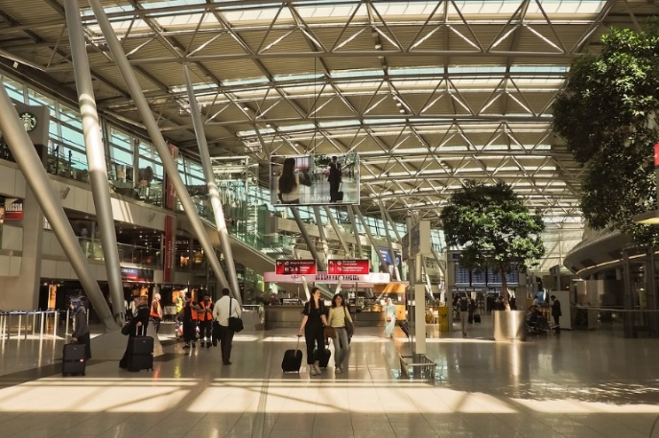
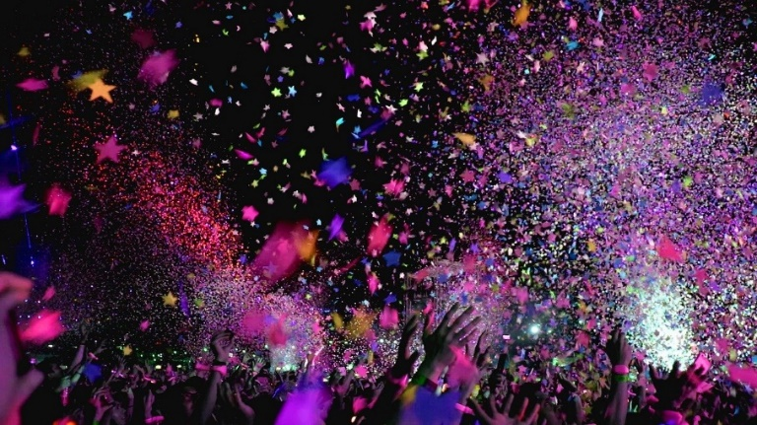
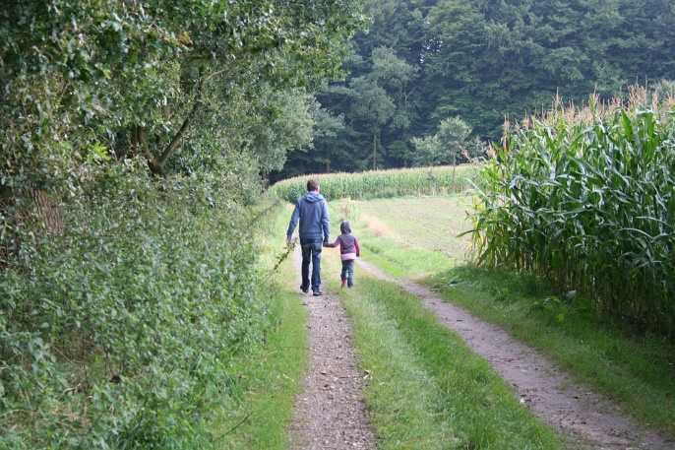
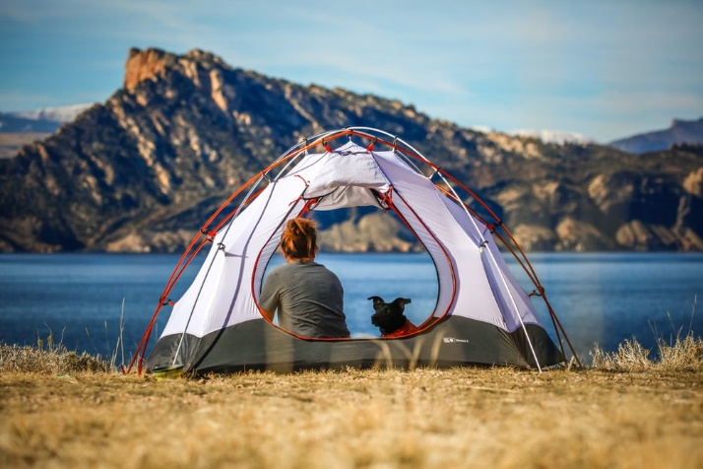
Saying what you go and do Expressions with ‘ir de’ + noun
vocabulario
to go on holiday
to go partying
ir de vacaciones
ir de fiesta
to go for an outing
to go camping
ir de paseo
ir de camping
Notes:
Timing: 2 minutes
Aim: to embed word knowledge of the ‘ir + noun’ expressions from this week’s vocab set
Procedure:
1. Introduce the picture with the word, asking students to listen and repeat.
2. Solicit English translations from students.
Note: ‘ir de camping’ is included as a further example, drawing on a cognate.

Slide 24
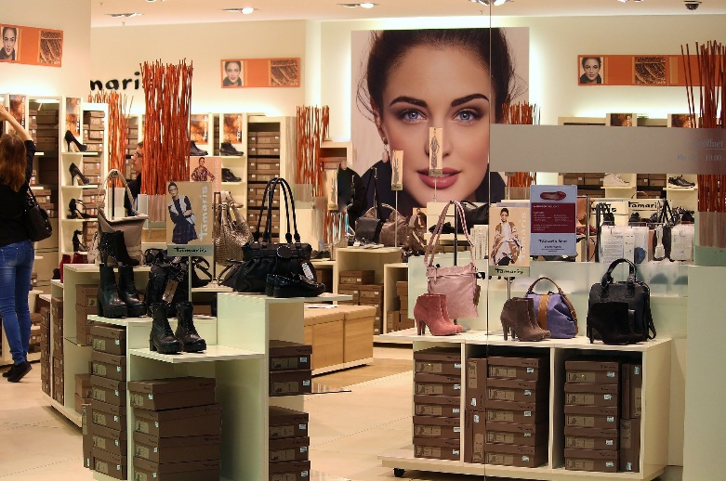
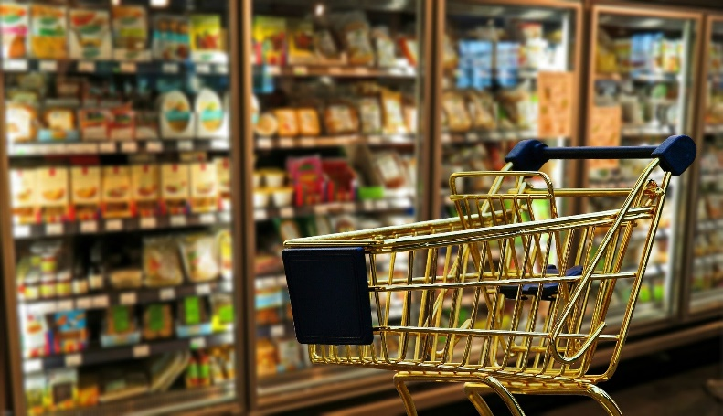
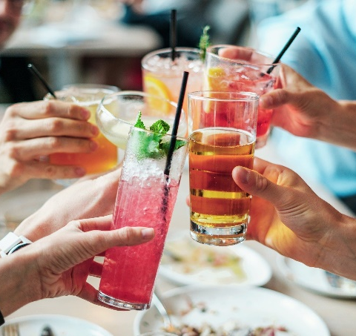
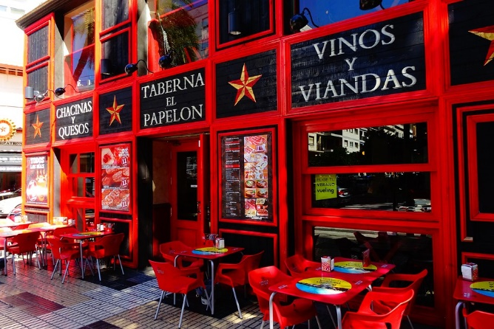
Saying what you go and do Expressions with ‘ir de’ + noun
vocabulario
to go shopping
to go shopping (e.g. to browse, window-shop)
ir de compras
ir de tiendas
Una ‘copa’ puede ser una bebida o puede ser un vaso.
to go for drinks
to go for tapas
ir de copas
ir de tapas
Notes:
Timing: 2 minutes
Aim: to embed word knowledge of the ‘ir + noun’ expressions from this week’s vocab set
Procedure:
1. Introduce the picture with the word, asking students to listen and repeat.
2. Solicit English translations from students.
Notes: directly following this there is an explanatory slide on what ‘tapas’ are. Spanish also uses the phrase ‘hacer la compra’ for grocery shopping. This will be taught later.

Slide 25
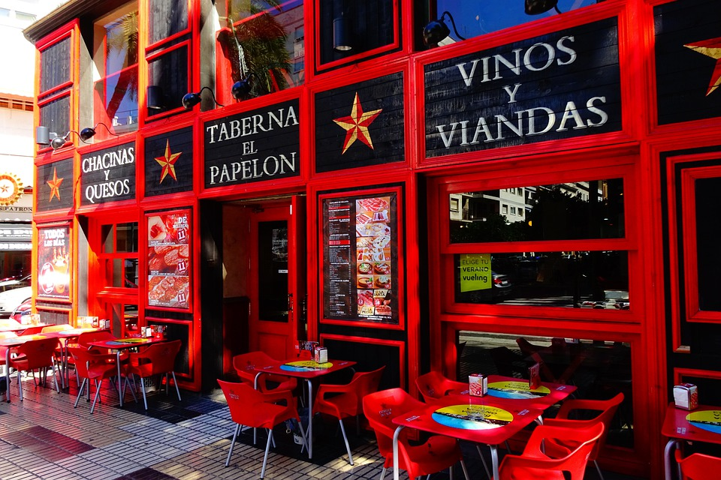
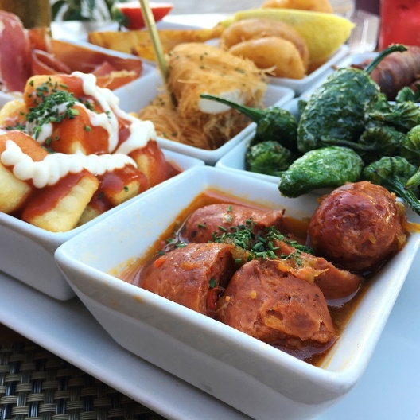
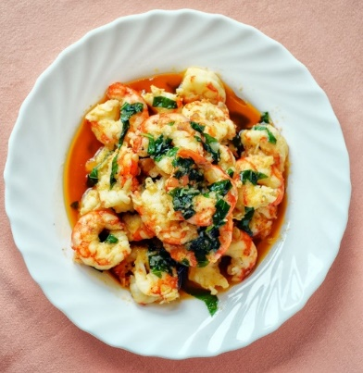
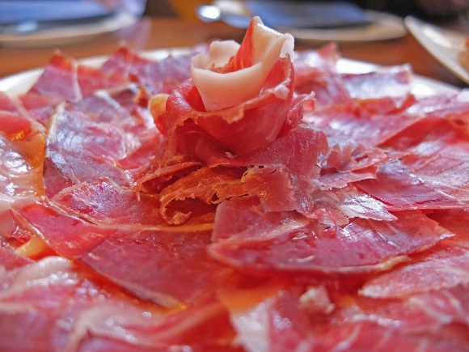
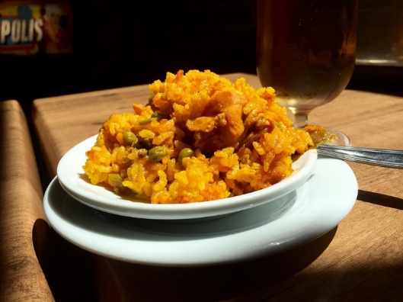
Tapas
‘Tapas’ are small plates of food, such as olives, meatballs, prawns, cured meats and cheeses. These are very popular as an evening snack in bars (the Spanish often have dinner at 9 or 10pm!).
The word ‘tapa’ translates as ‘cover’ or ‘lid’. There are different theories about why it is called this. Some think that tapas were originally served on top of a glass of wine as a way to keep out dust or insects!
Notes:
Timing: 2 minutes
Aim: to explain to students what ‘tapas’ are.
Procedure:
1. Click to bring up the explanation

Slide 26
Vocabulario
hablar
ir de paseo
Notes:
Timing: 2 minutes for the next seven slides
Aim: to promote recall of the expressions ‘ir de’ +noun
Procedure:
1. click to slowly reveal the image on square at a time
2. students give the Spanish for the image

Slide 27
Vocabulario
hablar
ir de compras

Slide 28
Vocabulario
hablar
ir de tapas

Slide 29
Vocabulario
hablar
ir de fiesta

Slide 30
Vocabulario
hablar
ir de vacaciones

Slide 31
Vocabulario
hablar
ir de copas

Slide 32
Vocabulario
hablar
ir de tiendas

Slide 33
Saying where people go ‘IR’ in 1st and 3rd person plural
gramática
vamos
We go, are going = _____________
They go, are going = _____________
van
Notes:
Timing: 1 minute
Aim:
to recap the previously learnt first person plural of the verb ‘ir’
to introduce third person plural
Procedure:
Read through the slide.

Slide 34
vamos
[we go | are going]
van
[they go |are going]
Notes:
Timing: 3 minutes for sequence of six verbs
Procedure
Bring up the 1st person plural, students repeat it, and remind them of the phonics. Draw attention to the SSC [v]
Try to elicit the meaning from the students.
Then bring up the English translations.
Bring up the 3rd person plural say it, students repeat it. Draw attention to the SSC [v]
Try to elicit the meaning from the students.

Slide 35
vamos
[we go | are going]
van
[they go |are going]
Notes:
Cycle through both forms again.

Slide 36
vamos
[we go | are going]
Vamos a ir de compras.
[We are going to go shopping.]
Notes:
Introduce the first person plural in a sentence with future meaning.

Slide 37
van
[they go | are going]
Van a ir de paseo.
[They are going to go for a stroll / outing.]
Notes:
Introduce the third person plural in a sentence with future meaning.

Slide 38
vamos
[we go | are going]
Vamos
_______ a ir de compras.
[We are going to go shopping.]
Notes:
Cycle through the first person plural in context again.

Slide 39
van
[they go | are going]
Van
_____ a ir de paseo.
[They are going to go for a stroll / outing.]
Notes:
Cycle through the third person plural in context again.

Slide 40
Los planes de la familia López para el próximo fin de semana
leer
Daniel y Lucia hablan de los planes de la familia. Lee las frases y escribe quién hace la actividad. Escribe también la actividad en inglés.
 |  | ‘We’ | ‘They’ | Actividad en inglés
1. | Por la tarde van a ir de copas.
2. | El sábado van a ir de tiendas .
3. | Quizás vamos a ir de fiesta.
4. | También van a ir de tapas.
5. | Vamos a ir de paseo después de comer.
6. | El dómingo van a ir de compras.
7. | Vamos a ir de vacaciones muy pronto.
8. | No vamos a ir de camping.
to go for drinks
to go shopping (for fun)
to go partying
to go for tapas
to go for a stroll / outing
to go shopping (e.g. groceries)
to go on holiday
to go camping
Notes:
Timing: 7 minutes
Aim: to consolidate understanding of ‘ir’ (in 1st and 3rd person plural) and of the newly learnt expressions: ‘ir de’ + noun (written modality).
Procedure:
1. Students read the sentences and decide the subject of the verb (we/they).
2. Students write the activity in English (e.g. to go for tapas)

Slide 41
Using ‘para’ in different contexts
gramática
The money is for the tickets.
=
El dinero es para los billetes.
They are going to go to the school in order to present the topic/issue to the students.
Van a ir a la escuela para presentar el tema a los estudiantes.
=
Notes:
Timing: 1 minute
Aim: to recap learnt translations of ‘para’ in context. To revisit several vocabulary items introduced in lesson 1 (presentar, tema, enseñar).
Procedure:
1. Bring up the English and elicit the Spanish from students.

Slide 42
escuchar
Escucha las frases.
İAmamos el fútbol!
Escribe ‘we’ o ‘they’.
También escribe la traducción correcta de
‘para’ y completa la frase en inglés.
 | We | They
For | In order to
Completa la frase (en inglés)
in order to see the football match
in order to go for tapas
for the bus journey
in order to pick up the tickets
for an exclusive interview with the players
in order to go partying afterwards
for other activities
for the next match
1
2
3
4
5
6
7
8
Notes:
Timing: 8 min
Aim: to consolidate understanding of verb ‘ir’ (in first and third person plural) and the two meanings of ‘para’ (oral modality). To also consolidate receptive understanding of several ‘ir de + noun’ expressions.
Procedure:
Students listen to each sentence and decide if the verb is referring to ‘we’ or ‘they’
They listen again and decide if ‘para’ means ‘for’ or ‘in order to’ depending on whether it is followed by an infinitive or not.
This time, students also write the sentence ending in English, including ‘for’ / ‘(in order) to’
Transcript:
El próximo fin de semana vamos a viajar a la costa para ver el partido de fútbol.
Pues, creo que van a llegar temprano para ir de tapas antes del partido.
Primero, vamos a buscar billetes baratos para el viaje en autobús.
Luego, van a ir a la tienda para recoger las entradas.
También vamos a comprar entradas para una entrevista exclusiva con los jugadores.
Van a llevar dinero para ir de fiesta después.
No van a ir de tiendas; no tienen tiempo para otras actividades.
¡Vamos a ir a otro país muy pronto para el próximo partido!
Note: ‘amar’ was a year 7 phonics word. Students may need a reminder of its meaning.
Vocabulary from revisited sets: 8.1.2.2: recoger [828]; partido [302]; fútbol [1471]; entrada [767]; billete [292]; pues¹ [73]; fin [182]; semana [301]; jugador [1019]
8.1.1.4: creer [83]; entrevista [1653]; sobre¹ [62]; que [3]

Slide 43
escribir
1. | They are going to visit Barcelona (in order) to go for tapas with some friends.
2. | We are going to go to another country for the next match. We are not going to lose!
3. | My parents are going to go for drinks (in order) to celebrate the news.
4. | He is going to do an interview (in order) to speak about some important issues.
5. | I am going to buy a ticket for the interview with the football players.
6. | Next weekend you are going to go shopping (for fun).
7. | She is going to go on holiday to the coast (in order) to rest. She isn’t going to teach!
8 | I am going to buy tickets for the bus soon. First, I need to drink a coffee!
Van a visitar Barcelona para ir de tapas con unos amigos.
Vamos a ir a otro país para el próximo partido. İNo vamos a perder!
Mis padres van a ir de copas para celebrar las noticias.
Va a hacer una entrevista para hablar sobre unos temas importantes.
Voy a comprar una entrada para la entrevista con los jugadores de fútbol.
El próximo fin de semana, vas a ir de tiendas.
Va a ir de vacaciones a la costa para descansar. ¡No va a enseñar!
Voy a comprar billetes para el autobús pronto. Primero, ¡necesito tomar/beber un café!
Notes:
Timing: 10 minutes
Aim: to bring together in written production the five forms of ‘ir’ practised across the two lessons, the two uses of ‘para’ and the ‘ir de + noun’ expressions.
Procedure:
1. Students translate the sentences into Spanish
Note: ‘celebrar’ was used as a phonics practice word in year 7. It is a near-cognate, though students may need to be reminded of it before the activity.

Slide 44
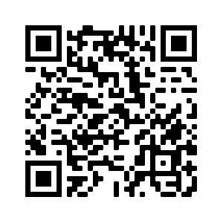
Deberes
Vocabulary Learning Homework (Term 1.2, Week 6)
Quizlet link: Y8 Term 1.2 Week 6
Quizlet QR code:
In addition, revisit: Y8 Term 1.2 Week 3
Y8 Term 1.1 Week 5

