Slide 1
German SSC (symbol-sound correspondences)
Source Words
Date updated: 21/11/19

Slide 2
Vowels
German vowels can be short or long.
Vowels are short when followed by more than one consonant, e.g., Mann, Gast.
Vowels are long when:
there is a double vowel, e.g. Paar,
or when followed by the letter ‘h’, e.g., fahren,
or by a single consonant, e.g., sagen.
NB: German final ‘e’is not silent, but very short, e.g. danke, Klasse.
Steve Clarke / Rachel Hawkes
Notes:
Note: It is important to give this explanation, but in the same way as with explicit grammar explanation, it is the practice that counts most.

Slide 3
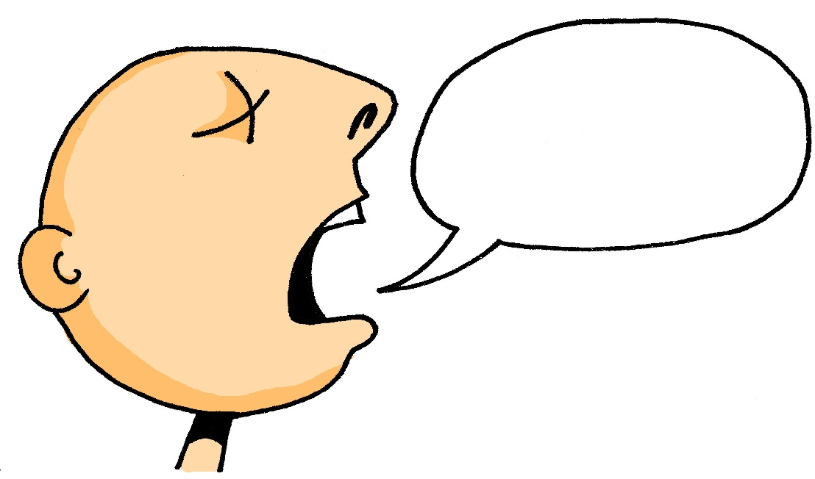
a
[a:]
sagen
Steve Clarke / Rachel Hawkes
Notes:
Introduce and elicit the pronunciation of the individual SSC ‘a’ and then present and practise the pronunciation of the source word ‘sagan’.
A possible gesture for this would be to mime speech coming out of your mouth, opening your mouth and drawing your hand away quickly away from you.

Slide 4
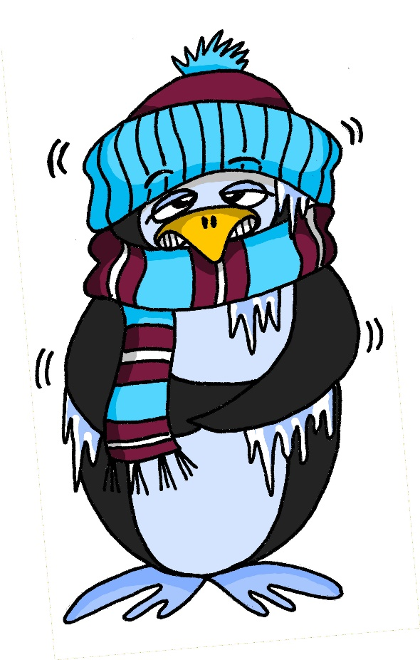
a
[a]
kalt
Steve Clarke / Rachel Hawkes
Notes:
Introduce and elicit the pronunciation of the individual SSC ‘a’ and then present and practise the pronunciation of the source word ‘kalt’.
A possible gesture for this would be to mime a shiver, crossing your arms in front of your body.

Slide 5
e
[e:]
geben
Steve Clarke / Rachel Hawkes
Notes:
Introduce and elicit the pronunciation of the individual SSC ‘e’ and then present and practise the pronunciation of the source word ‘geben’.
A possible gesture for this would be to mime offering an imaginary present to someone, with both hands.

Slide 6
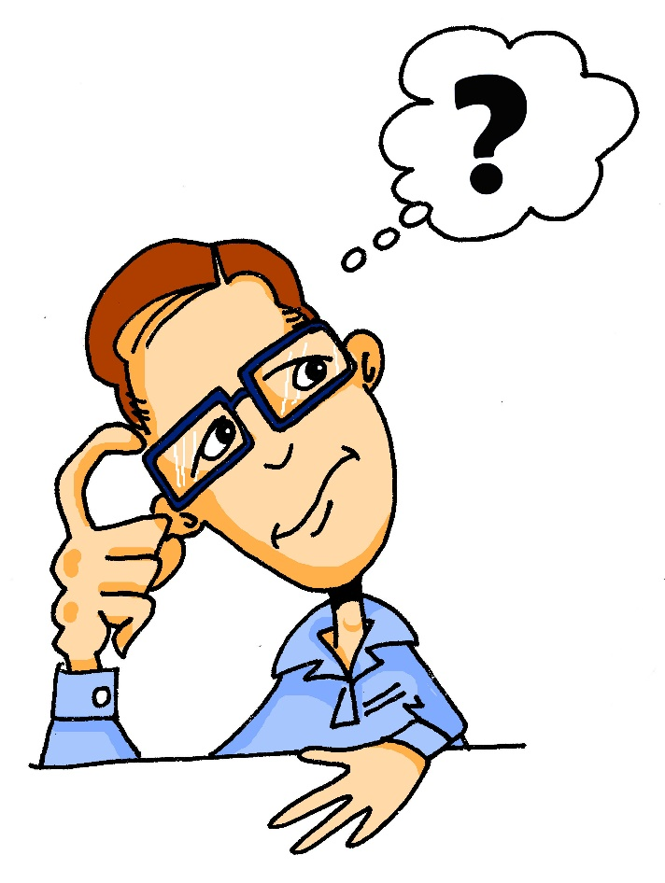
e
[ɛ]
denken
Steve Clarke / Rachel Hawkes
Notes:
Introduce and elicit the pronunciation of the individual SSC ‘e’ and then present and practise the pronunciation of the source word ‘denken’.
A possible gesture for this would be to put your index finger to your temple and look thoughful!

Slide 7
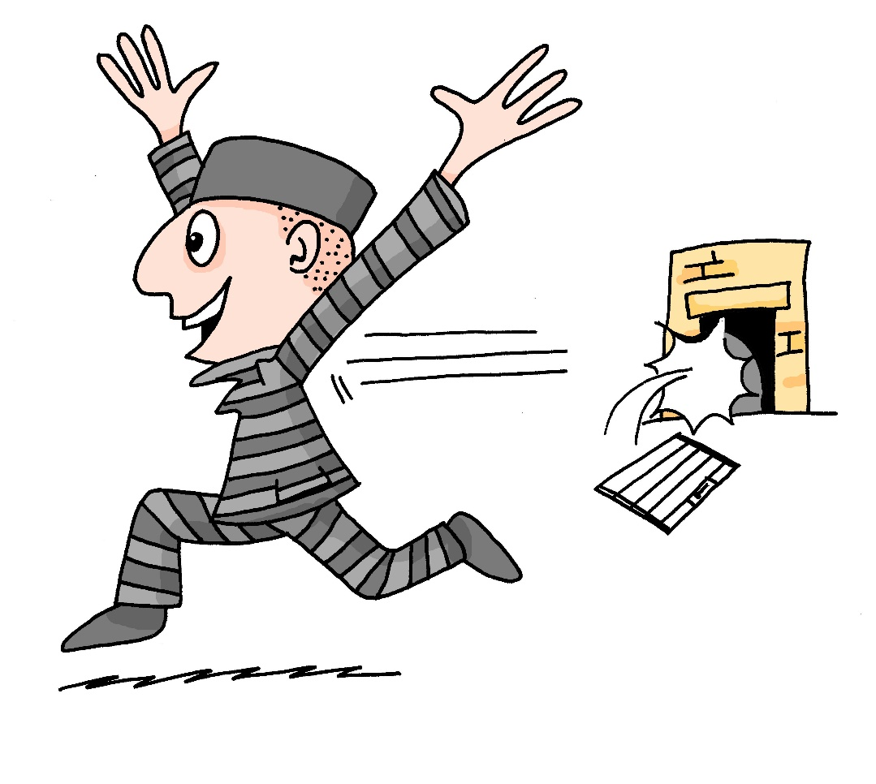
ei
frei
Steve Clarke / Rachel Hawkes
Notes:
Introduce and elicit the pronunciation of the individual SSC ‘ei’ and then present and practise the pronunciation of the source word ‘frei’.
A possible gesture for this would be stretch both arms up in the air (pointing outwards slightly to make a Y shape with your body), and smile!

Slide 8
Nouns
All German nouns start with a capital letter, wherever they are in the sentence.
For example: Der Mann ist kalt.
Which nouns do this in English?
Proper nouns, e.g. London, September, Monday.
Steve Clarke / Rachel Hawkes

Slide 9
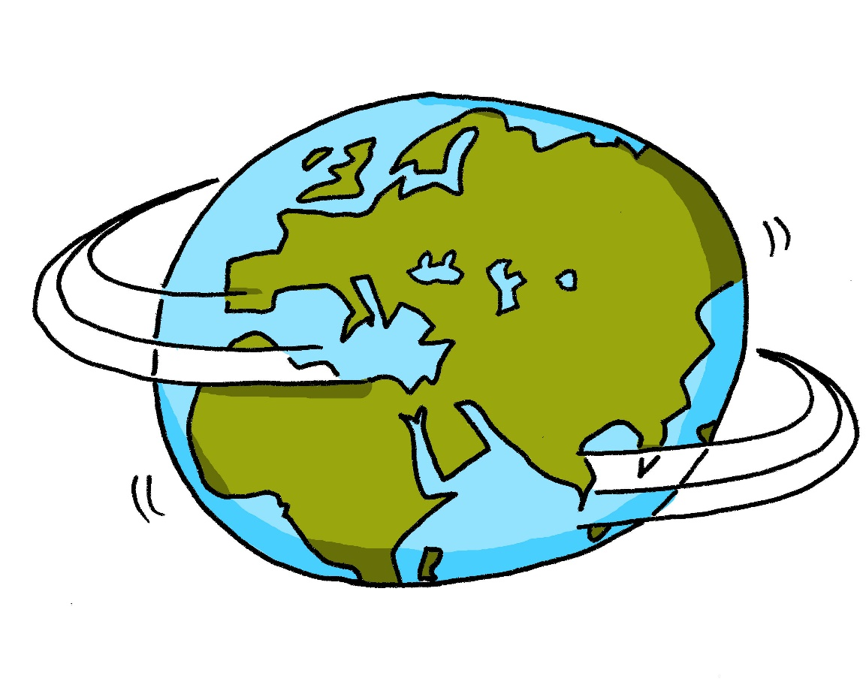
w
Welt
Steve Clarke / Rachel Hawkes
Notes:
Introduce and elicit the pronunciation of the individual SSC ‘w’ and then present and practise the pronunciation of the source word ‘welt’.
A possible gesture for this would be to start with your hands above your head and draw them down, out and then back into the body, tracing the shape of the world.

Slide 10
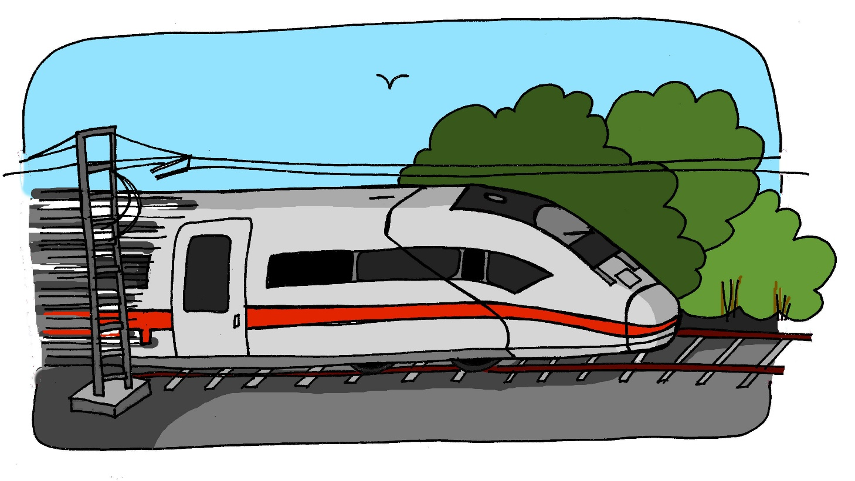
z
Zug
Steve Clarke / Rachel Hawkes
Notes:
Introduce and elicit the pronunciation of the individual SSC ‘z’ and then present and practise the pronunciation of the source word ‘zug’.
A possible gesture for this would be to mime wheels, holding your hands at your sides, elbows bent, forearms facing forwards in a right angle, and draw small circles with them, in the air (to denote the wheels of a train going round).

Slide 11
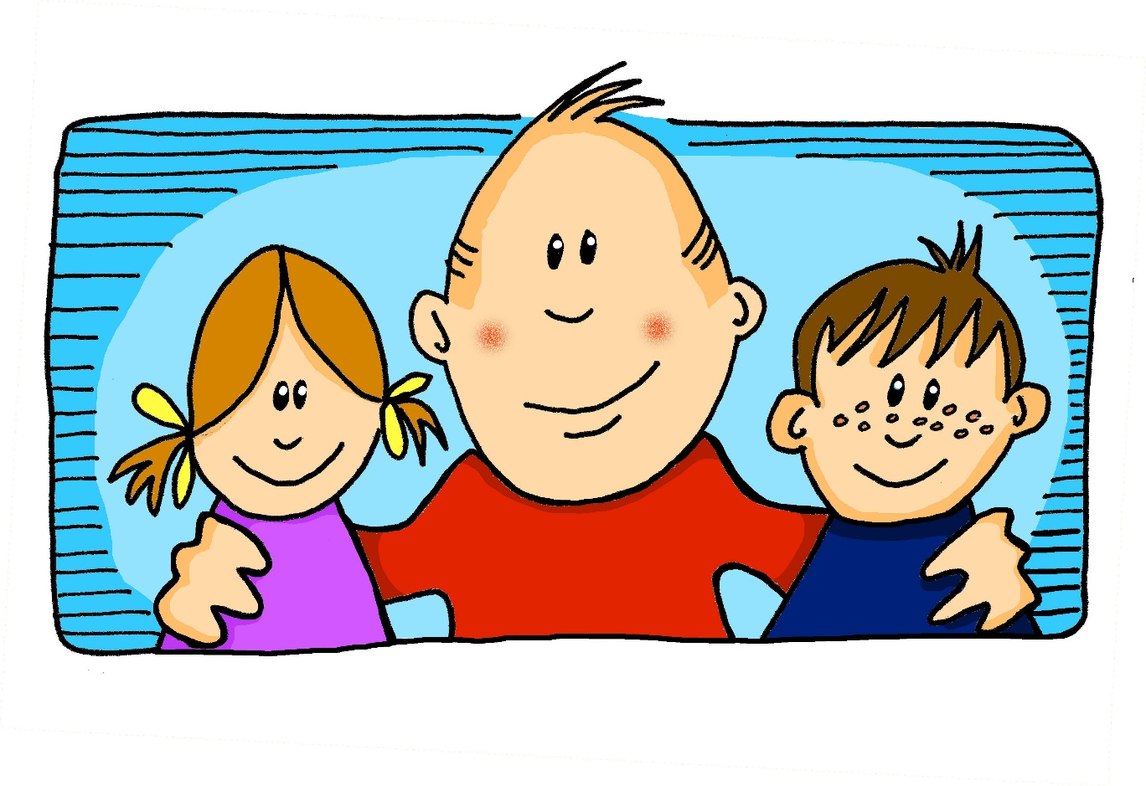
i
[i:]
wir
Steve Clarke / Rachel Hawkes
Notes:
Introduce and elicit the pronunciation of the individual SSC ‘i’ and then present and practise the pronunciation of the source word ‘wir’.
A possible gesture for this would be to mime putting your arms around two people, one on either side.

Slide 12
i
[ɪ]
finden
Steve Clarke / Rachel Hawkes
Notes:
Introduce and elicit the pronunciation of the individual SSC ‘i’ and then present and practise the pronunciation of the source word ‘finden’.
A possible gesture for this would be to mime looking by holding a magnifying glass in your left hand, and pointing to what you’ve found with your right hand.

Slide 13
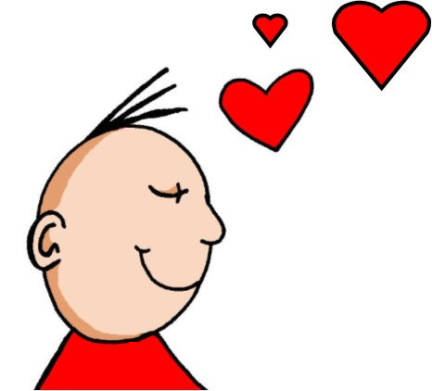
ie
Liebe
Steve Clarke / Rachel Hawkes
Notes:
Introduce and elicit the pronunciation of the individual SSC ‘ie’ and then present and practise the pronunciation of the source word ‘liebe’.
A possible gesture for this would be to fold both hands over your heart, and smile!

Slide 14
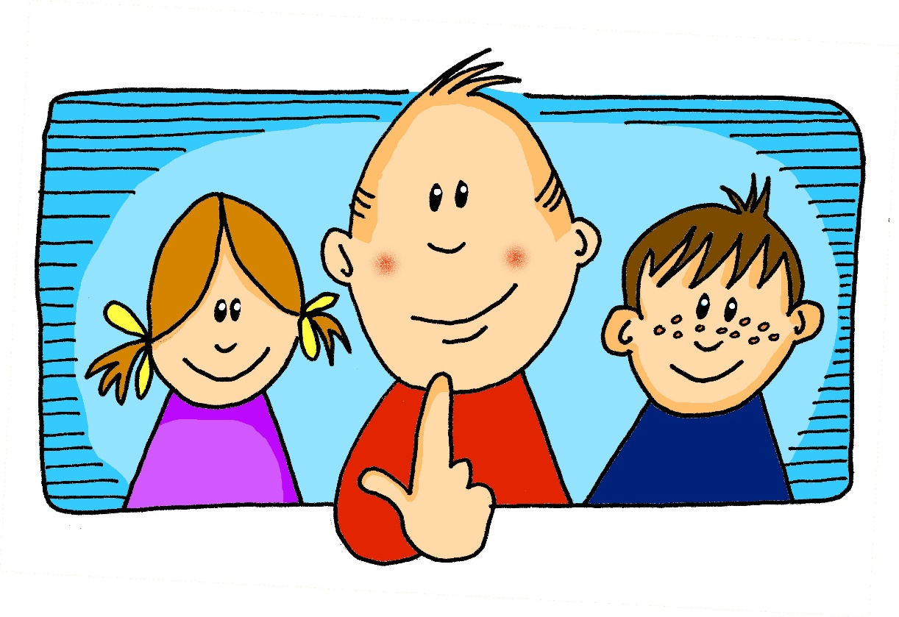
ch
[ç]
ich
Steve Clarke / Rachel Hawkes
Notes:
Introduce and elicit the pronunciation of the individual SSC ‘ch’ and then present and practise the pronunciation of the source word ‘ich’.
A possible gesture for this would be to do an exaggerated gesture of pointing to yourself.

Slide 15
ch
[x]
Buch
Steve Clarke / Rachel Hawkes
Notes:
Introduce and elicit the pronunciation of the individual SSC ‘ch’ and then present and practise the pronunciation of the source word ‘buch’.
A possible gesture for this would mime opening the pages of a book with both hands.

Slide 16
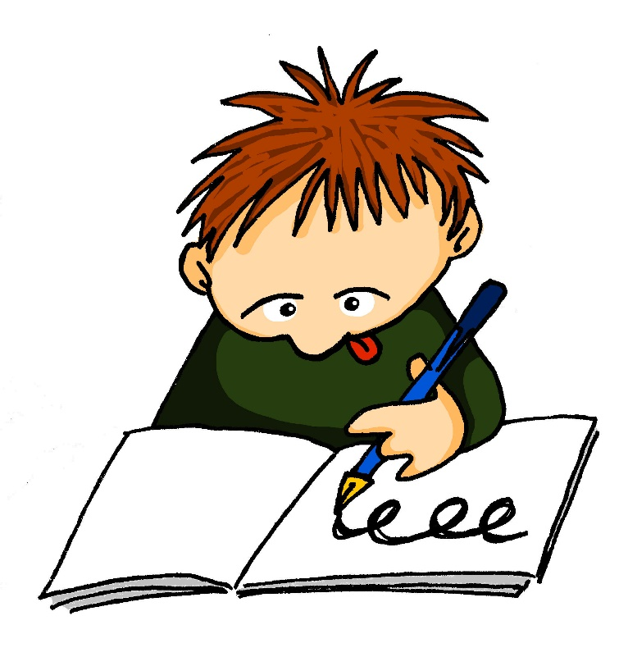
sch
schreiben
Steve Clarke / Rachel Hawkes
Notes:
Introduce and elicit the pronunciation of the individual SSC ‘sch’ and then present and practise the pronunciation of the source word ‘schreiben’.
A possible gesture for this would be to mime writing.

Slide 17
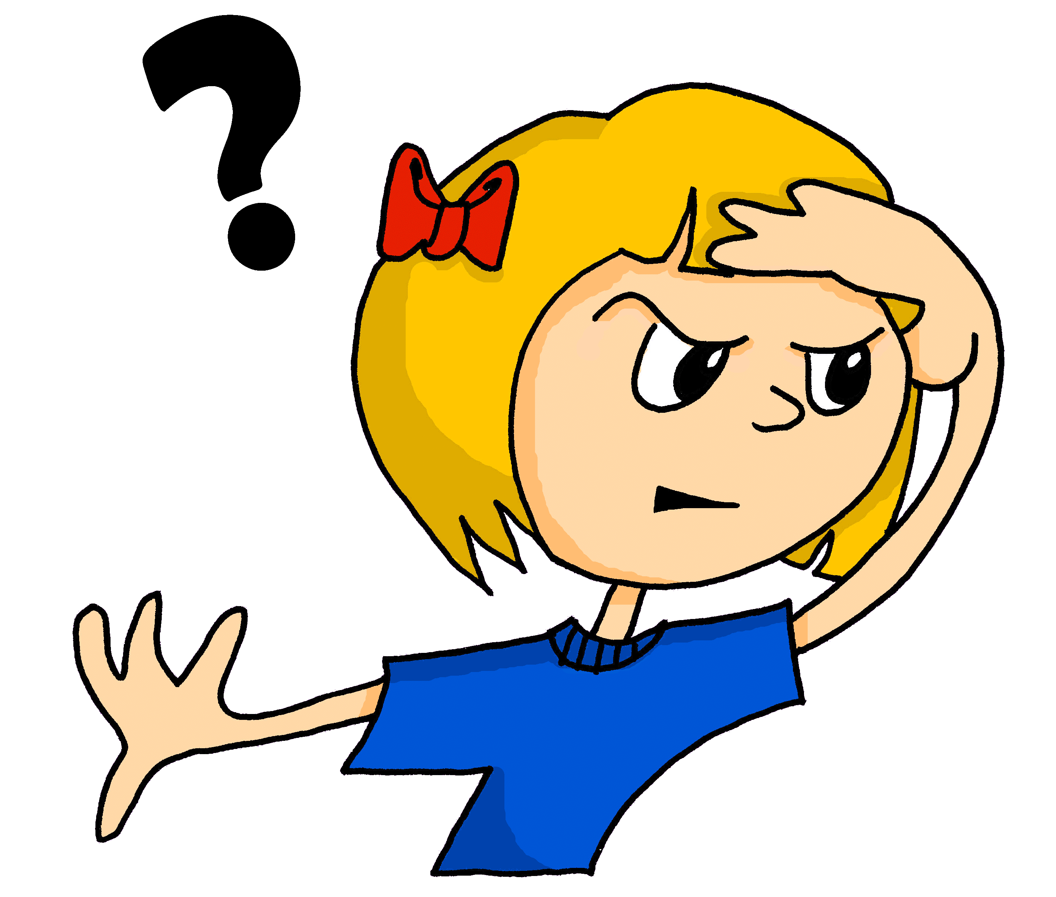
o
[o:]
wo?
Steve Clarke / Rachel Hawkes
Notes:
Introduce and elicit the pronunciation of the individual SSC ‘o’ and then present and practise the pronunciation of the source word ‘wo?’.

Slide 18
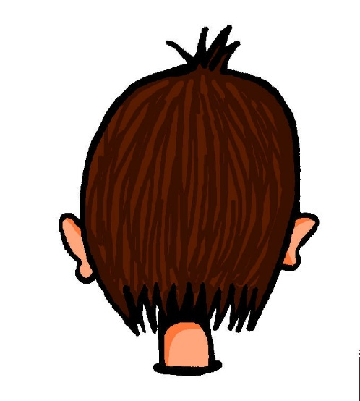
o
[ɔ]
Kopf
Steve Clarke / Rachel Hawkes
Notes:
Introduce and elicit the pronunciation of the individual SSC ‘o’ and then present and practise the pronunciation of the source word ‘Kopf’.

Slide 19
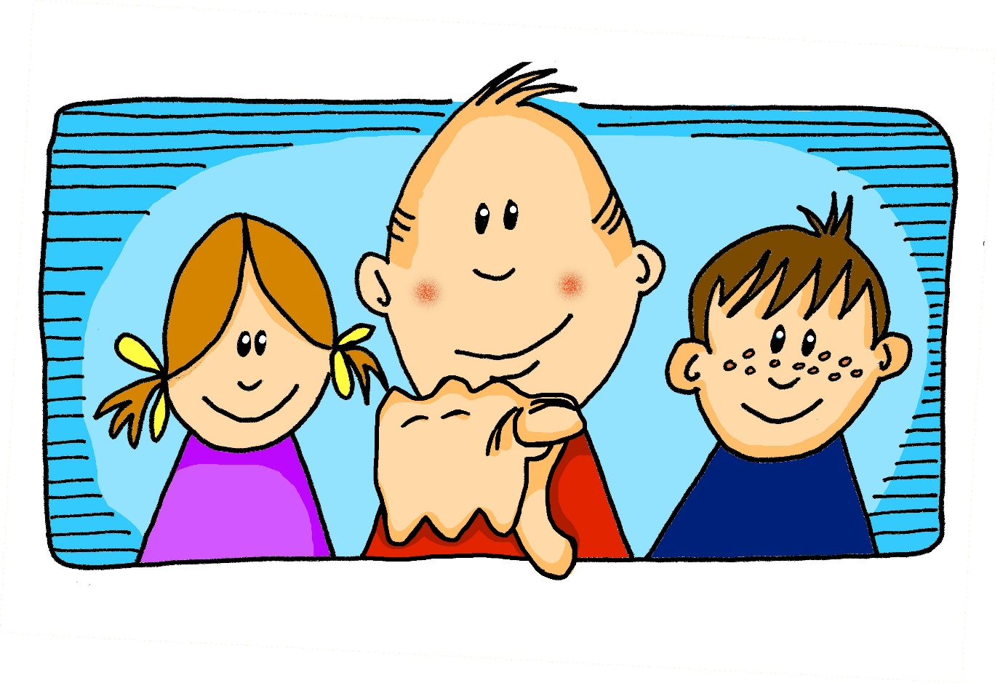
u
[u:]
du
Steve Clarke / Rachel Hawkes
Notes:
Introduce and elicit the pronunciation of the individual SSC ‘u’ and then present and practise the pronunciation of the source word ‘du’.
A possible gesture for this would be to point out directly in front of you.

Slide 20
u
[ʊ]
Punkt
Steve Clarke / Rachel Hawkes
Notes:
Introduce and elicit the pronunciation of the individual SSC ‘u’ and then present and practise the pronunciation of the source word ‘punkt’.
A possible gesture for this would be to mime putting a full stop with your index finger in the air (point away from yourself, with a quick jabbing motion).

Slide 21
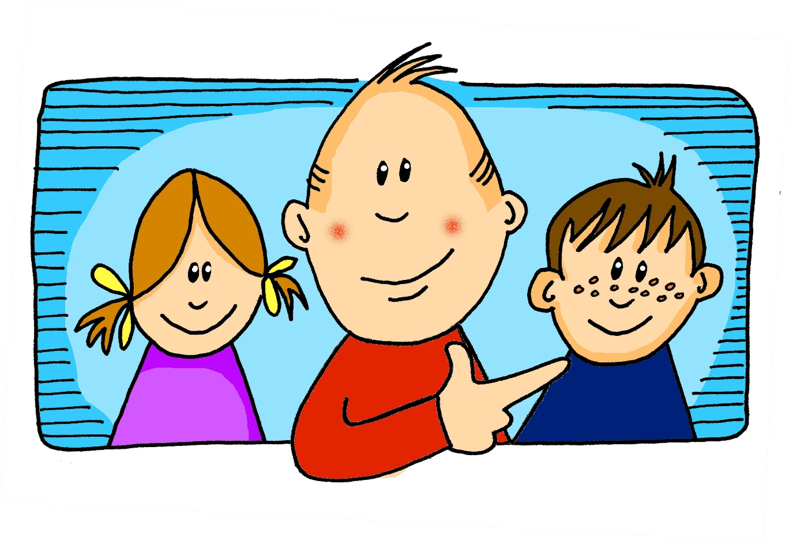
er
er
Steve Clarke / Rachel Hawkes
Notes:
Introduce and elicit the pronunciation of the individual SSC ‘er’ and then present and practise the pronunciation of the source word ‘er’.
A possible gesture for this would be to point to an imaginary ‘he’, using your index finger, thumb point upwards (to make the gesture more exaggerated), as per the image.

Slide 22
er
wieder
Steve Clarke / Rachel Hawkes
Notes:
Introduce and elicit the pronunciation of the individual SSC ‘er’ and then present and practise the pronunciation of the source word ‘wieder’.
A possible gesture for this would be to roll your hands over in the air, clockwise. Your hands are in front of your body.

Slide 23
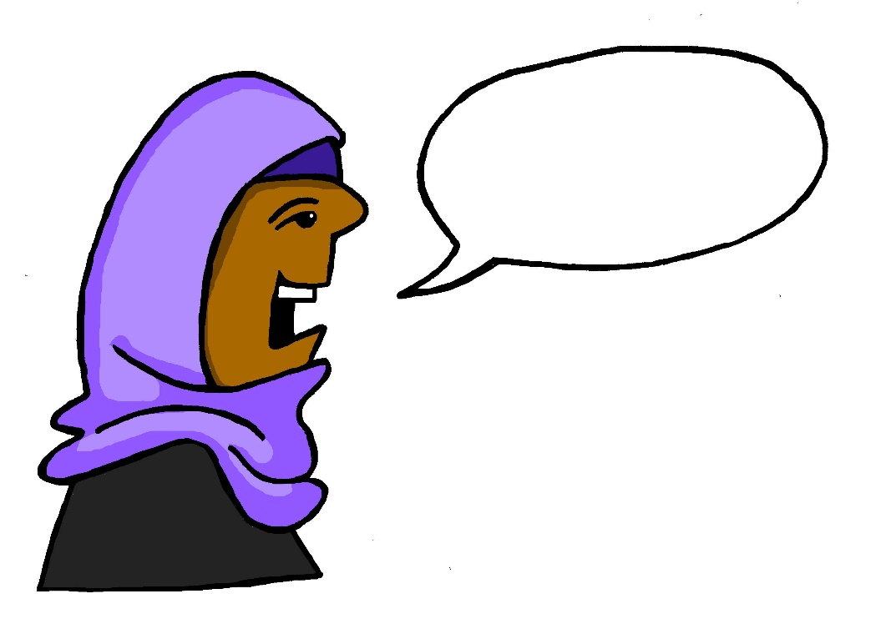
r
reden
Steve Clarke / Rachel Hawkes
Notes:
Introduce and elicit the pronunciation of the individual SSC ‘r’ and then present and practise the pronunciation of the source word ‘reden’.
A possible gesture for this would be to mime talking between your right hand and your left hand.

Slide 24
r
Uhr
Steve Clarke / Rachel Hawkes
Notes:
Introduce and elicit the pronunciation of the individual SSC ‘r’ and then present and practise the pronunciation of the source word ‘uhr’.
A possible gesture for this would be to look at your left wrist and tap your imaginary watch twice, to emphasise the two distinct sounds you hear – Uh-r.

Slide 25
v
vor
Steve Clarke / Rachel Hawkes
Notes:
Introduce and elicit the pronunciation of the individual SSC ‘v’ and then present and practise the pronunciation of the source word ‘vor’.
A possible gesture for this would be to hold your hands, left in front of right, in front of your body, palms facing inward. Quickly move the right hand over the top of the left, as you say ‘vor’, to mime ‘in front’.

Slide 26
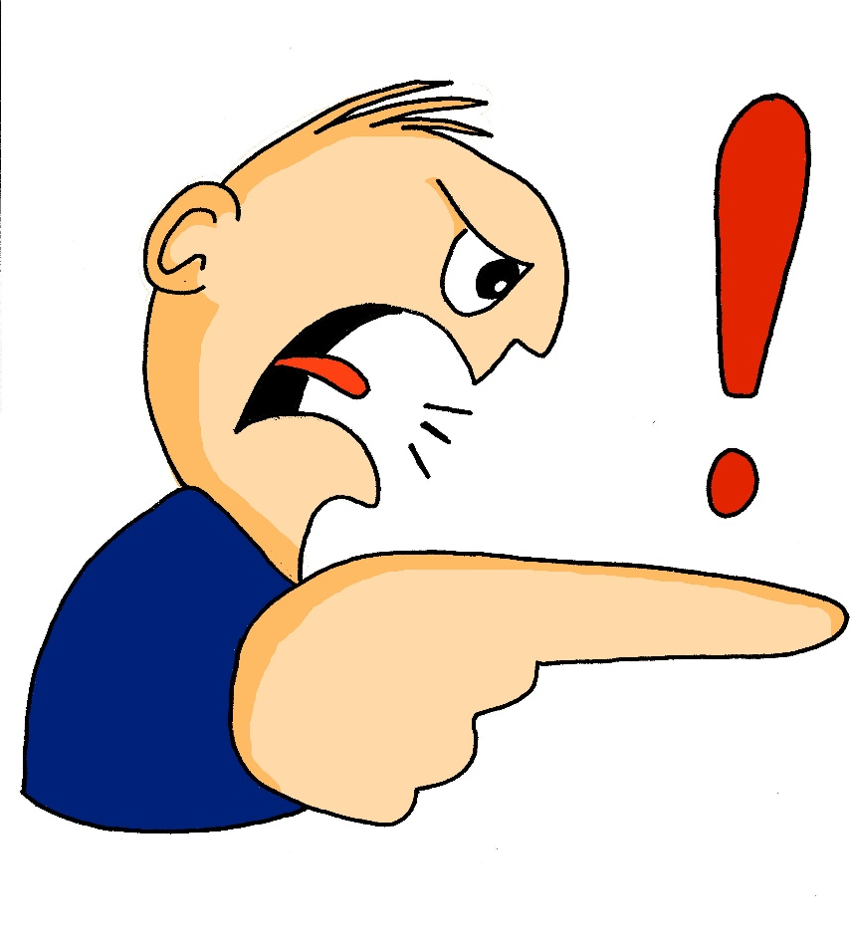
s
sollen
Steve Clarke / Rachel Hawkes
Notes:
Introduce and elicit the pronunciation of the individual SSC ‘s’ and then present and practise the pronunciation of the source word ‘sollen’.
A possible gesture for this would be to mime telling someone what s/he should do, by wagging your finger, and looking serious.

Slide 27
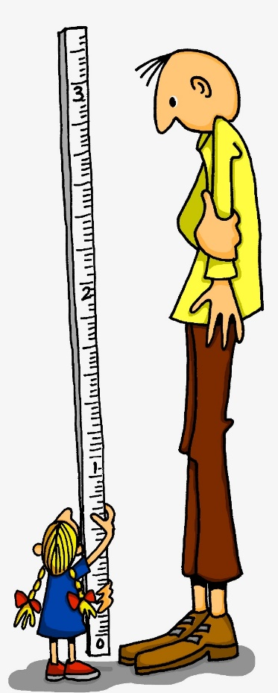
ß
groß
Steve Clarke / Rachel Hawkes
Notes:
Introduce and elicit the pronunciation of the individual SSC ‘ß’ and then present and practise the pronunciation of the source word ‘groß’.
A possible gesture for this would be to stretch your hand up high above your head, forming your hand into a right angle to indicate that you are measuring something/one very tall.

Slide 28
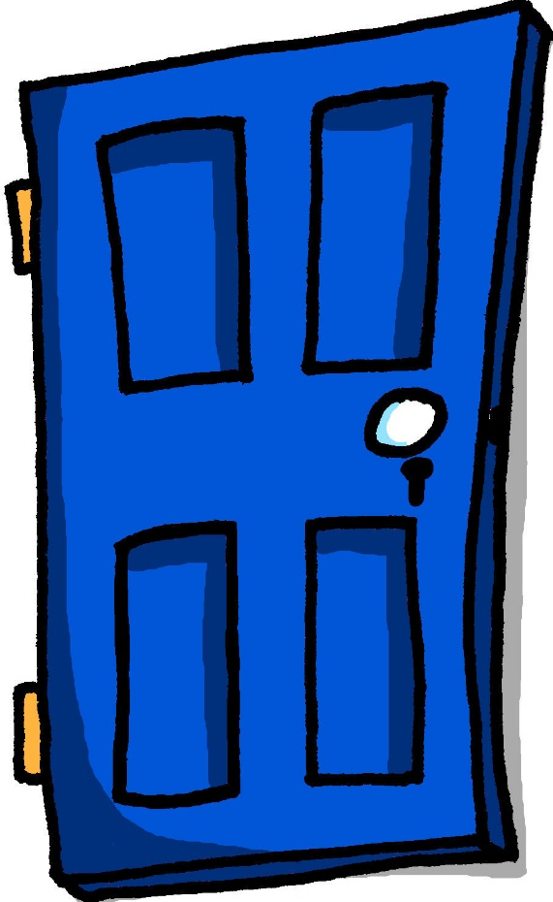
ü
[y:]
Tür
Steve Clarke / Rachel Hawkes
Notes:
Introduce and elicit the pronunciation of the individual SSC ‘ü’ and then present and practise the pronunciation of the source word ‘Tür’.
A possible gesture for this would be to hold both hands touching in front of your body, palms facing inward, thumbs to the ceiling. Then, with the right hand, mime a door opening by drawing it away from the left so that it finishes at a right angle, like a fully open door.

Slide 29
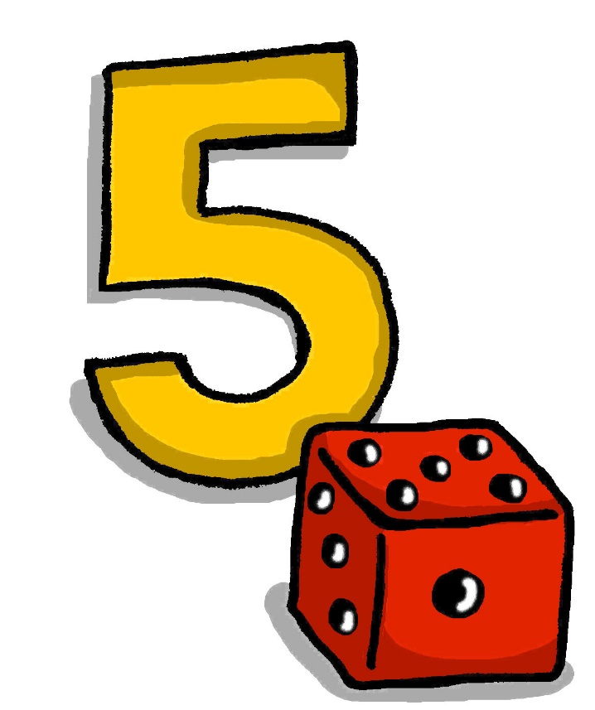
ü
[Y]
fünf
Steve Clarke / Rachel Hawkes
Notes:
Introduce and elicit the pronunciation of the individual SSC ‘ü’ and then present and practise the pronunciation of the source word ‘fünf’.
A possible gesture for this would be to hold up your right hand, five digits spread apart.

Slide 30
ö
[ø:]
schön
Steve Clarke / Rachel Hawkes
Notes:
Introduce and elicit the pronunciation of the individual SSC ‘ö’ and then present and practise the pronunciation of the source word ‘schön’.
A possible gesture for this would be to mime an exaggerated exclamation of seeing / receiving something beautiful. As you say ‘schön’ with an appropriate sigh, bring your hands to the rest on your cheeks, and smile!

Slide 31
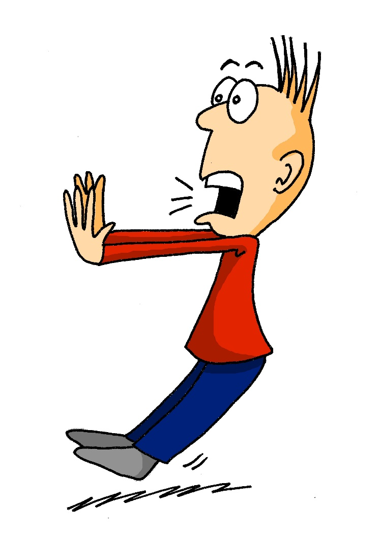
ö
[ø]
plötzlich
Steve Clarke / Rachel Hawkes
Notes:
Introduce and elicit the pronunciation of the individual SSC ‘ö’ and then present and practise the pronunciation of the source word ‘plötzlich’.
A possible gesture for this would be to mime a sudden shock that makes you jump backwards. Put your hands up and look shocked, as in the picture.

Slide 32
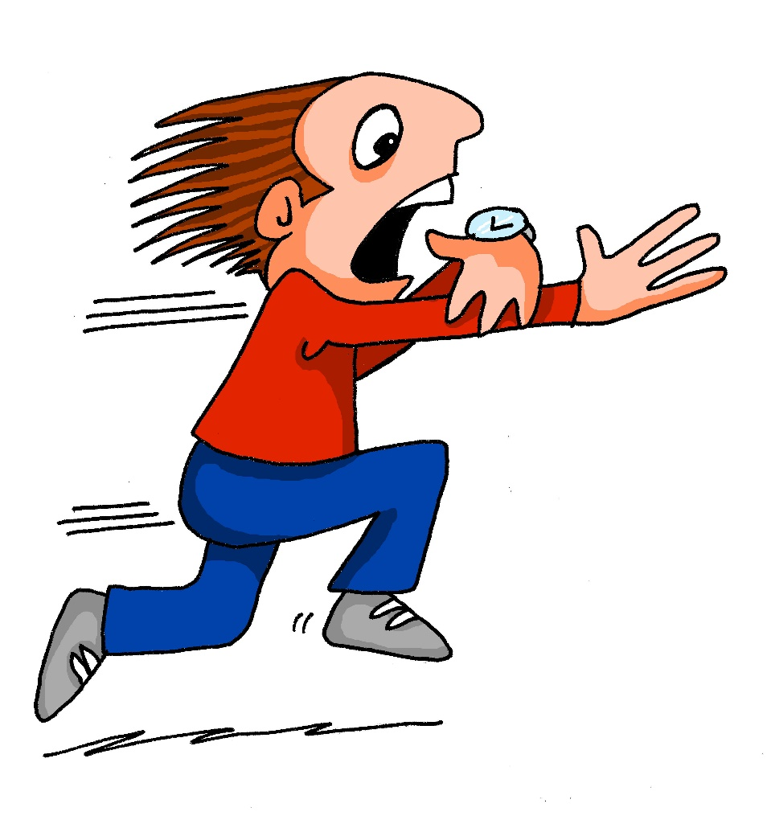
ä
[ɛ:]
spät
Steve Clarke / Rachel Hawkes
Notes:
Introduce and elicit the pronunciation of the individual SSC ‘ä’ and then present and practise the pronunciation of the source word ‘spät’.
A possible gesture for this would be to bring your left arm up to mime suddenly looking at your watch.

Slide 33
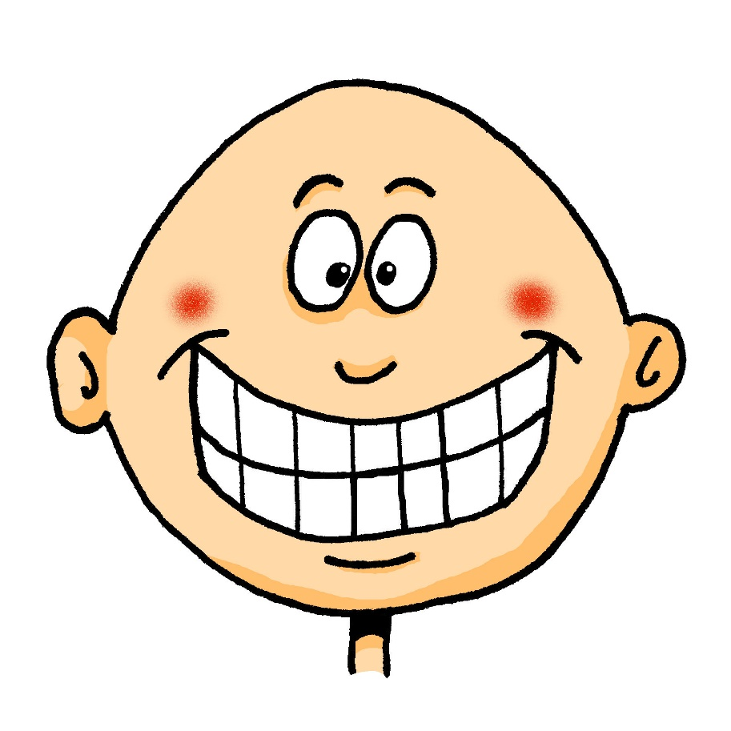
ä
[ɛ]
lächeln
Steve Clarke / Rachel Hawkes
Notes:
Introduce and elicit the pronunciation of the individual SSC ‘ä’ and then present and practise the pronunciation of the source word ‘lächeln’.
A possible gesture for this would be to trace a broad smile on your own face, drawing your index fingers away from the middle of your mouth to the outer edges.

Slide 34
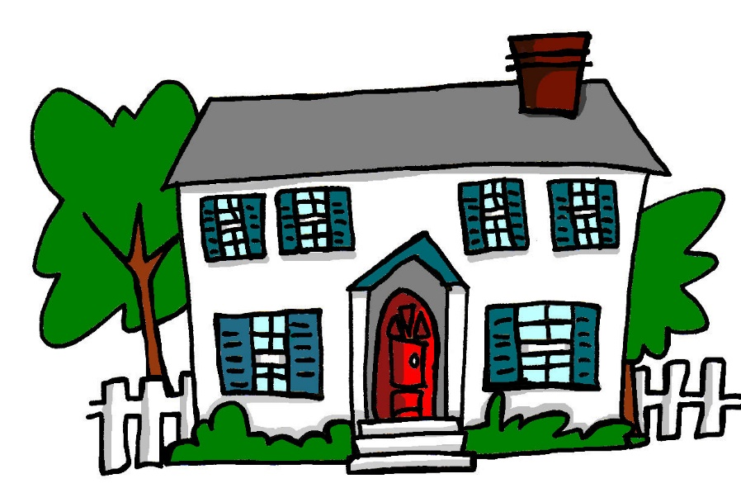
au
Haus
Steve Clarke / Rachel Hawkes
Notes:
Introduce and elicit the pronunciation of the individual SSC ‘au’ and then present and practise the pronunciation of the source word ‘Haus’.
A possible gesture for this would be to form a roof shape by touching your fingertips together, in front of you.

Slide 35
eu
Deutschland
Steve Clarke / Rachel Hawkes
Notes:
Introduce and elicit the pronunciation of the individual SSC ‘eu’ and then present and practise the pronunciation of the source word ‘Deutschland’.
A possible gesture for this would be to act as though you are addressing Germany, saying ‘Oy! Deutschland!’ and jabbing your finger into the air (joyfully) twice, once on ‘Oy!’ and once on the first syllable of Deutschland.

Slide 36
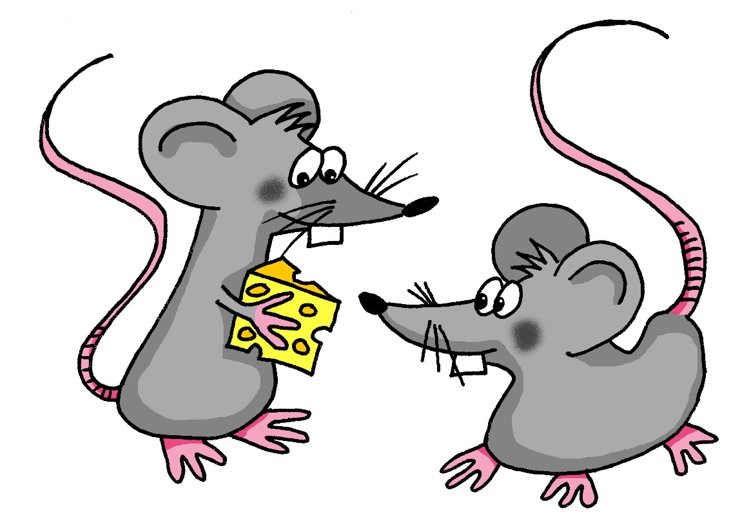
äu
Mäuse
Steve Clarke / Rachel Hawkes
Notes:
Introduce and elicit the pronunciation of the individual SSC ‘äu’ and then present and practise the pronunciation of the source word ‘Mäuse’.
A possible gesture for this would be to mime whiskers, holding your fingers up to the side of your mouth.

Slide 37
-d
und
Steve Clarke / Rachel Hawkes
Notes:
Introduce and elicit the pronunciation of the individual SSC ‘-d’ and then present and practise the pronunciation of the source word ‘und’.
A possible gesture for this would be to make an exaggerated plus sign with your index fingers, holding them up in front of you.

Slide 38
-ig
richtig
Steve Clarke / Rachel Hawkes
Notes:
Introduce and elicit the pronunciation of the individual SSC ‘-ig’ and then present and practise the pronunciation of the source word ‘richtig’.
A possible gesture for this would be to mime ‘correct’ by tracing a tick in the air with the index finger on your right hand.

Slide 39
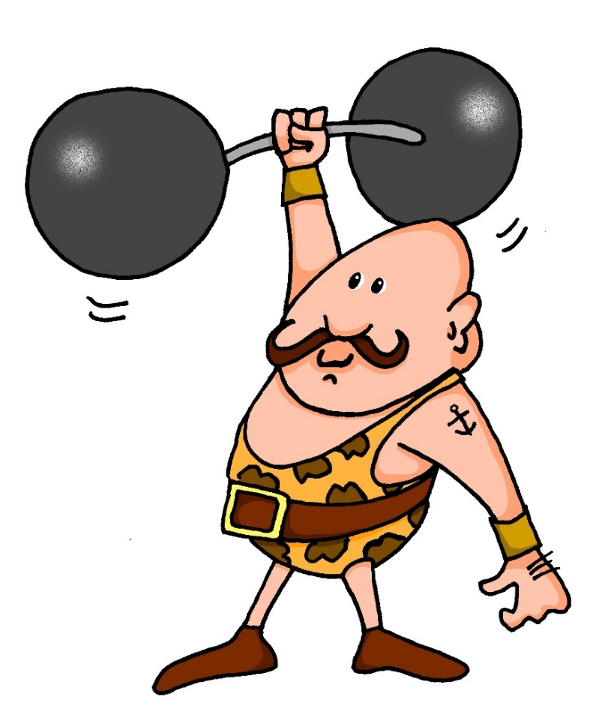
st-
stark
Steve Clarke / Rachel Hawkes
Notes:
Introduce and elicit the pronunciation of the individual SSC ‘st-’ and then present and practise the pronunciation of the source word ‘stark’.
A possible gesture for this would be to mime lifting dumbells by clenching your fists and raising them above your head.

Slide 40
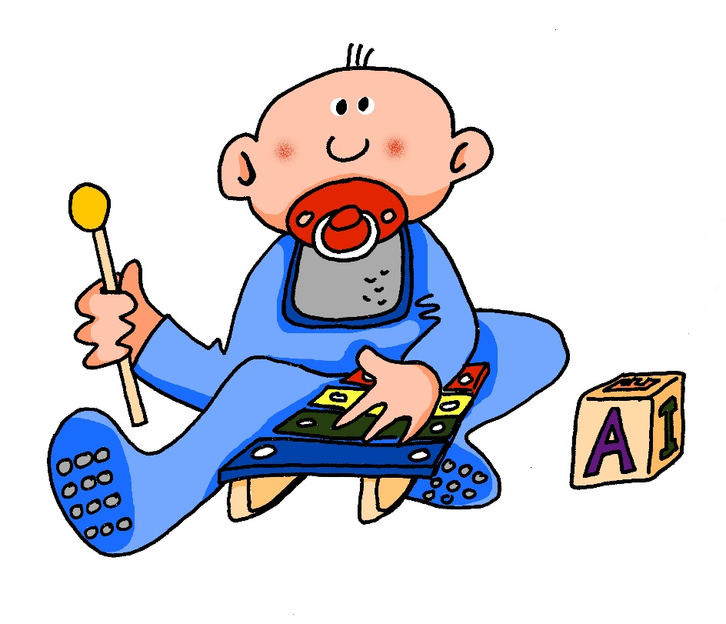
sp-
spielen
Steve Clarke / Rachel Hawkes
Notes:
Introduce and elicit the pronunciation of the individual SSC ‘sp-’ and then present and practise the pronunciation of the source word ‘spielen’.
A possible gesture for this would be to mime playing a xylophone.

Slide 41
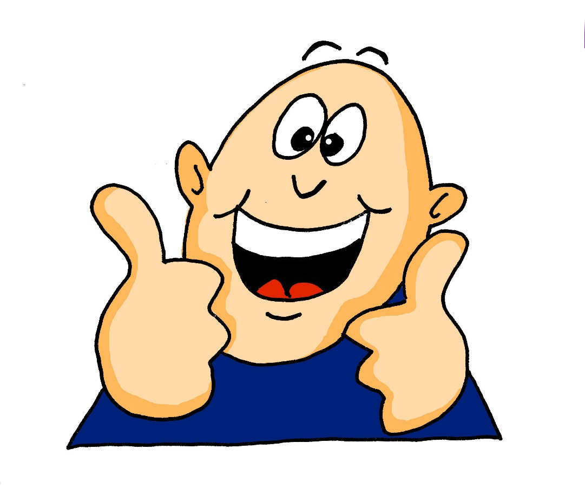
j
ja
Steve Clarke / Rachel Hawkes
Notes:
Introduce and elicit the pronunciation of the individual SSC ‘j’ and then present and practise the pronunciation of the source word ‘ja’.
A possible gesture for this would be to mime yes by nodding your head quickly twice, as you say ‘ja’

Slide 42
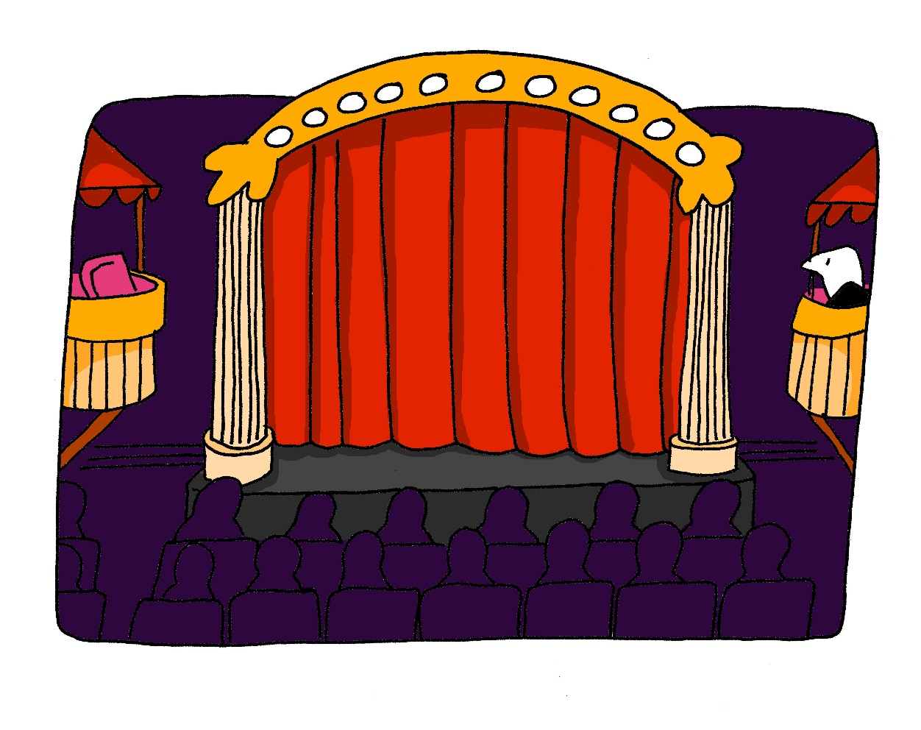
th
Theater
Steve Clarke / Rachel Hawkes
Notes:
Introduce and elicit the pronunciation of the individual SSC ‘th’ and then present and practise the pronunciation of the source word ‘Theater’.
A possible gesture for this would be to mime the opening of a theatre’s curtains, by drawing your hands away from each other quickly, in front of your body. This is very much like the gesture for ‘play’ in charades.

